Slide 1
Observability of quarks and gluons orbital angular momentum distributions
Simonetta Liuti
University of Virginia
EIC
Jefferson Laboratory
August 13th15th, 2014

Slide 2
How will a future EIC lead us to understand the missing components of the proton’s spin in QCD?
Definitions of observables
Measurements
Implications
What observables can be identified, what set of measurements will uniquely settle this question?
?

Slide 3
Definitions: Helicity amplitudes
Helicity basis
?
Transversity basis

Slide 4
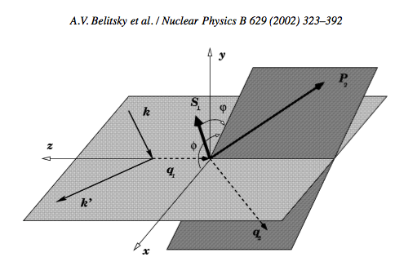
Measurements
lepton plane
hadron plane

Slide 5
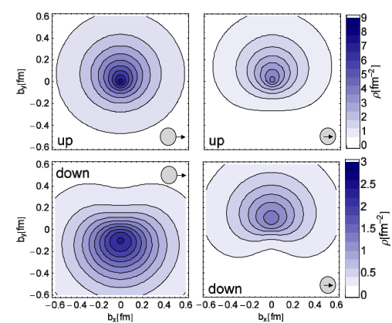
Physical implications: Correlation between transverse displacement and
transverse spin (M. Burkardt)
E
k_{T}
The net b corresponds to net k_{T} in the opposite direction (attractive color force due to FSI)
Gockeler M et al. (QCDSF) 2007 PRL 98
Notes:
Insert A_UT quote Hagler

Slide 6
Model dependent extractions of J_{u} and J_{d}
O. Gonzalez Hernandez et al., Phys. Rev. C88, 065206; arXiv:1206.1876

Slide 7
We got a lot of insight this way: can we learn from this success story and apply it to OAM?

Slide 8
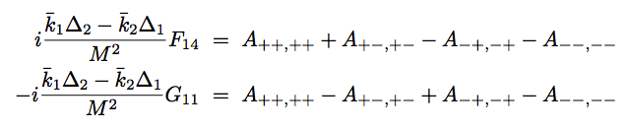
Definition of Observables ?
GTMDs: a new structure appears
(Meissner, Metz , Schlegel (2009))
F₁₄
UL correlation
Twist 3
(Polyakov et al., (2000), Hatta Yoshida (2012))
G₂
UL correlation
G₂
~
G₂
contains one bad component

Slide 9
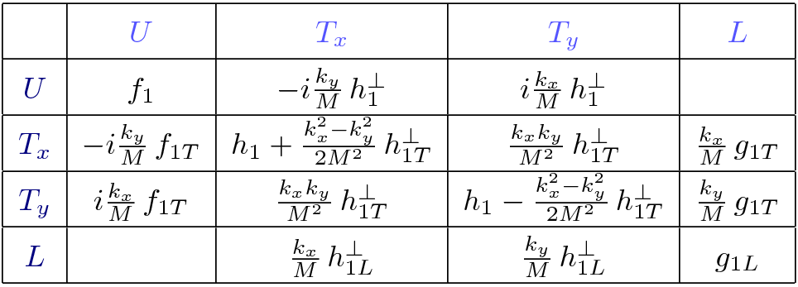
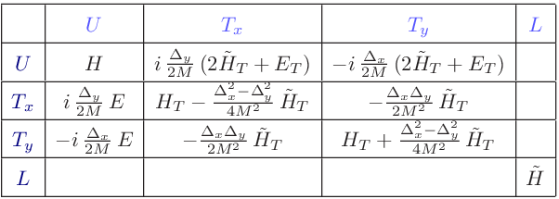
But Parity predicts a lack of a UL correlation at twist 2
arXiv:1310.5157
TMDs
GPDs
The amps will cancel unless they are imaginary:
A_{+ +, + +} = A*_{- -,-} ₋ ; A_{+ - , + -} = A*_{- +,} ₋ ₊
But this cannot be, as seen from CM system - at leading order - these will be real – all in the same plane, so there can be no relative phase between helicity amps.
Different from E where the phase is a consequence of helicity flip and off-forward spinor rotation

Slide 10
Measurements
To measure F₁₄ one has to be in a frame where the reaction cannot be viewed as a two-body quark-proton scattering
In the CoM the amplitudes are imaginary UL connection does not exist
The way to accomplish this is to define two planes
  Off forward SIDIS
  Twist three measurements
φ_{Δ}
φ_{k}

Slide 11

… “off-forward SIDIS” allows us to introduce additional degrees of freedom:
π₁
π₂
k,λ
k’,λ’
H,E
p,Λ
p’,Λ’
⬇

Slide 12

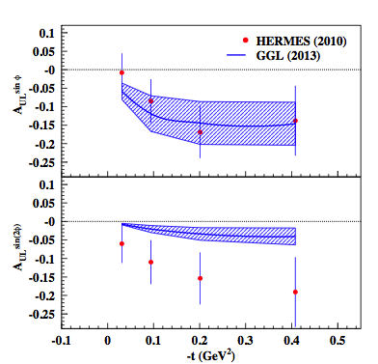
Twist 3 from DVCS on a longitudinally polarized target
sin 2φ term is tw 3!
WW, small ξ

Slide 13

≠F₁₄!

Slide 14
Implications: knowing th helicities configuration allows us to interpret OAM in the proton
u quark
d quark
ρ₂
b_{y}
b_{x}

Slide 15
OAM can exist in the transverse (orthogonal) direction!
x
b
k_{z}
L
z
y
This is the physical meaning of G₂

Slide 16
I am indebted to
Harut Avakian
Aurore Courtoy
Michael Engelhardt
Gary Goldstein
Osvaldo Gonzalez Hernandez
Andrey Kim
Silvia Pisano
Abha Rajan

