Slide 1
What We Might Learn with a Lumi During PREX
Review some Qweak luminosity monitor experience; look forward to PREX and MOLLER
Qweak downstream luminosity monitor
  Similar geometry, kinematics to PREX
  Details of design that gives linear behavior at high photocathode currents
  Prospects for PREX
Qweak upstream luminosity monitor
  Brief review of Qweak beamline background issue
Possible location and purposes of upstream luminosity monitors for PREX

Slide 2
Kent’s Thoughts on Lumis from Intro Talk
Comment: For PREX we presumably hope the main PREX detectors are independent of what is going on in the lumis; but it is probably a good precaution to deploy them in places where Qweak saw non-zero asymmetries

Slide 3
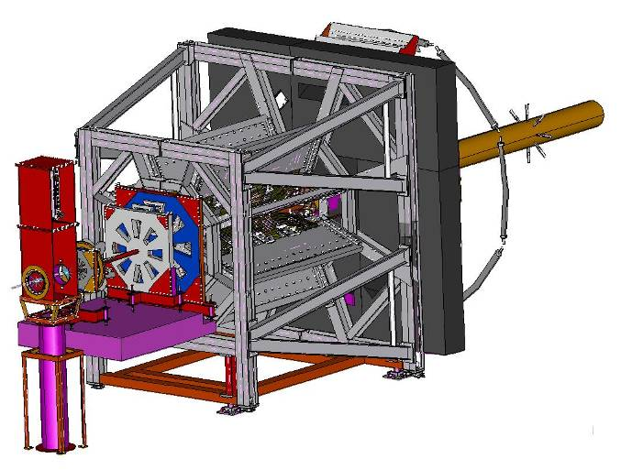
Qweak Downstream Luminosity Monitor Location
8 quartz Cerenkov detectors, symmetrically arranged
Θ_{lab} ~ 0.5º ~ 17 meters downstream of target
Mounted in “cups” on 2 foot diameter “sewer” beampipe
Lumi “cup” –
inner edge penetrated to within ~ 13 cm from beam centerline

Slide 4
Qweak Downstream Luminosity Monitor Rates
Observed rate (per detector) at 180 μA on 35 cm LH₂ target ~ 150 GHz (based on scaling from event mode running)
About equal mix of Mollers (e-e) and Motts (e-p) at ~ 1 GeV
Simulation indicated ~ 30% of signal was due to photons/electrons from showering in LH₂ target
Notes:
The 150 GHz observed rate was based on event mode running with high gain bases at ~ 1 nA beam current. That was also how we measured the photoelectron yield per event that is used in later slides.

Slide 5
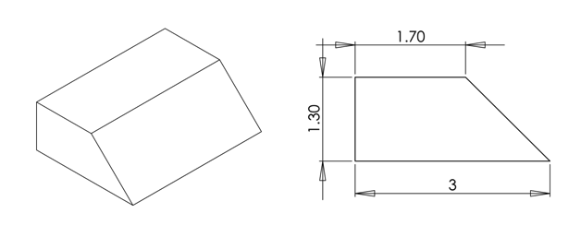
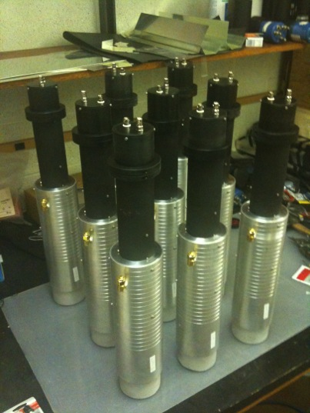
Qweak Downstream Luminosity Monitor Construction
4 cm x 3 cm x 1.3 cm Spectrosil 2000 quartz; 2 cm Pb pre-radiator in front of each
35 cm long Alanod Miro-Silver 27 “air” lightguides (continuously flushed with N₂ gas to eliminate corrosive build-up from moist air)
2 inch Hamamatsu R375 quartz window phototube
Spectrosil quartz block schematics
Notes:
We added the lead pre-radiator to eliminate low energy background (like we did for main detector), but I have not gone back to look at the data to decide how critical that was.
The flushing with N2 worked well. After the running was done, both the upstream and downstream lumis showed no evidence of the white powder build-up that Riad saw with the HAPPEX downstream lumis.

Slide 6
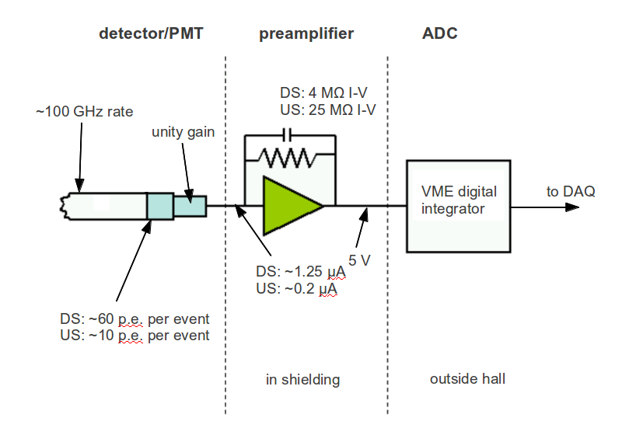
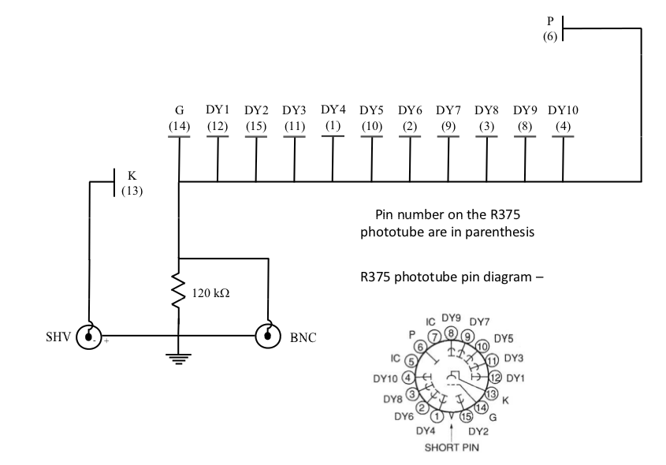
Qweak DSLumi Readout Scheme
Hamamatsu R375 phototube operated in “vacuum photodiode mode” – unity gain voltage divider (also could swap in high gain (10⁶) base for low current event mode running)
TRIUMF low-noise I-to-V preamplifier
TRIUMF sampling-integrating ADC (“VQWK” modules)
Typical photocathode current under operating (180 μA on 35 cm LH₂) conditions ~ 1.25 μA
Unity gain voltage divider schematic
Lumi monitor readout scheme
Notes:
We swapped in high gain bases to use during our low current (~ 50 pA – 1 nA) event mode running for tracking.
The lower right figure shows the typical rates and photocathode currents for the both the downstream and upstream luminosity monitors. The upstream luminosity monitors didn’t have any lead pre-radiator on them.

Slide 7
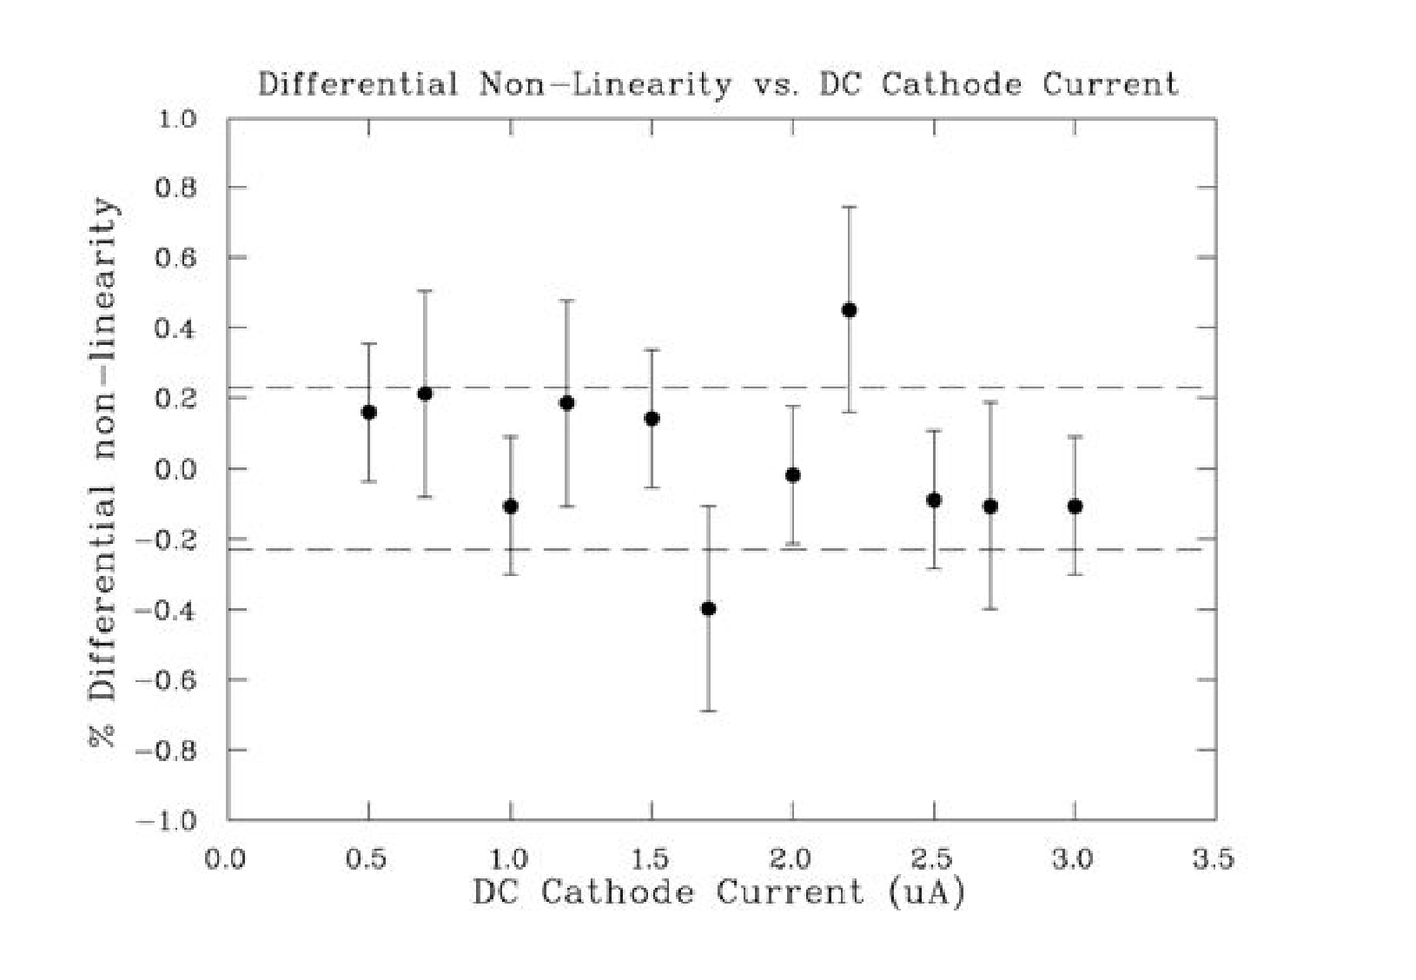
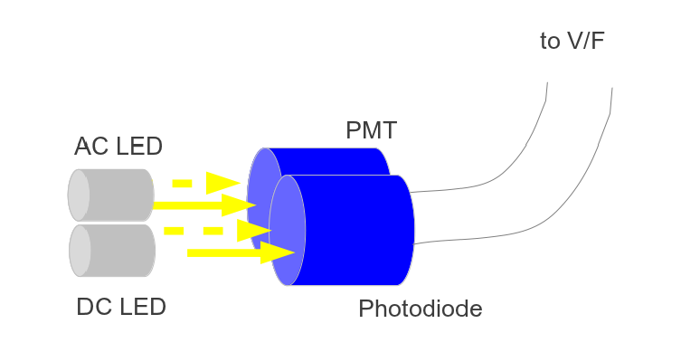
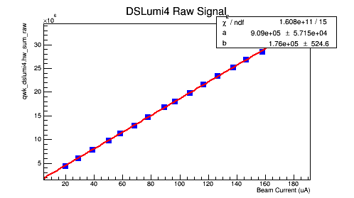
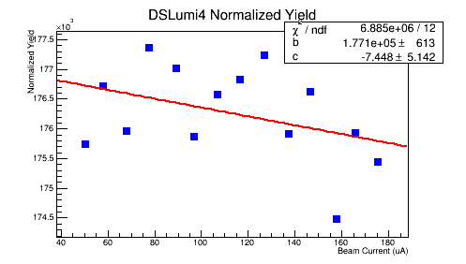
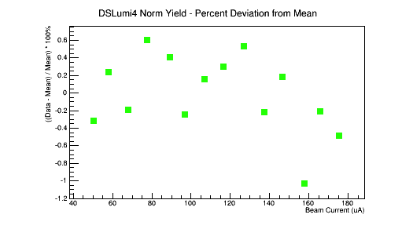
Qweak DSLumi – Linearity Behavior
Non-linearity was less than 1% in bench tests and with beam.
2 LED Bench Test with Hamamatsu R2046 Vacuum Photodiode as reference
Non-linearity < 0.2% over 0.5 – 3.0 μA cathode current range
With beam on 35 cm LH₂ target, normalized yield did not vary more than 0.8% from 40 – 180 μA
Notes:
The bench test used a true 3 inch vacuum photodiode like np-dgamma uses (borrowed from Des Ramsey at TRIUMF). We assumed it was very linear and used it to normalize out fluctuations in the LEDs. But we obtained similar results even when we didn’t do that; it was mainly just to get Carlini off our back.
The three plots from left to right are for one of the eight downstream lumis, all versus beam current. They show raw signal (arbitrary units), normalized yield, and fractional stability of normalized yield in %.

Slide 8
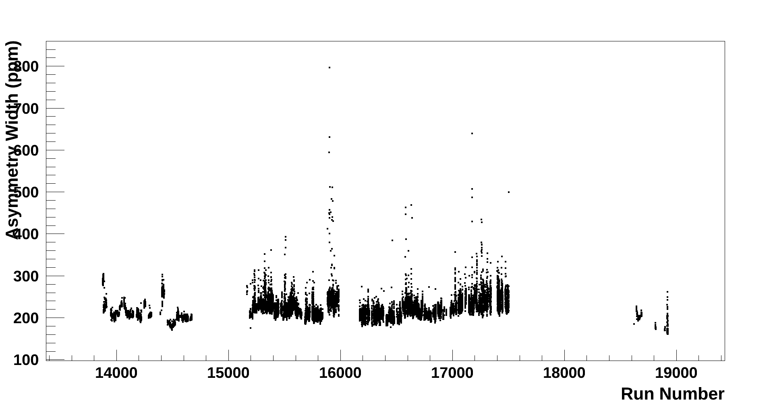
Qweak DSLumi – Random Fluctuation Width
After regression, the combined asymmetry width of all eight downstream lumis was ~ 200 ppm typically (for 250 Hz quartets)
Known noise sources couldn’t account for this width
  Target ~ 53 ppm
  BCM ~ 60 ppm
  Electronic noise ~ 13 ppm
  Expected statistical width ~ 18 ppm
  Need to properly estimate contribution of beam position monitor resolution to this list
Asymmetry width (for 250 Hz quartets) for sum of all 8 DSlumis
Notes:
This plot shows the downstream lumi asymmetry width over about 6 months of running. Usually it was about 200 ppm (compared to main detector width of ~ 235 ppm), but there were some excursions due to bad beam conditions.
In our noise budget above, I need to go back and do a careful estimate with the known position slopes and beam position monitor resolutions; when I have done that before, I couldn’t come up with big enough numbers to account for the full 200 ppm

Slide 9
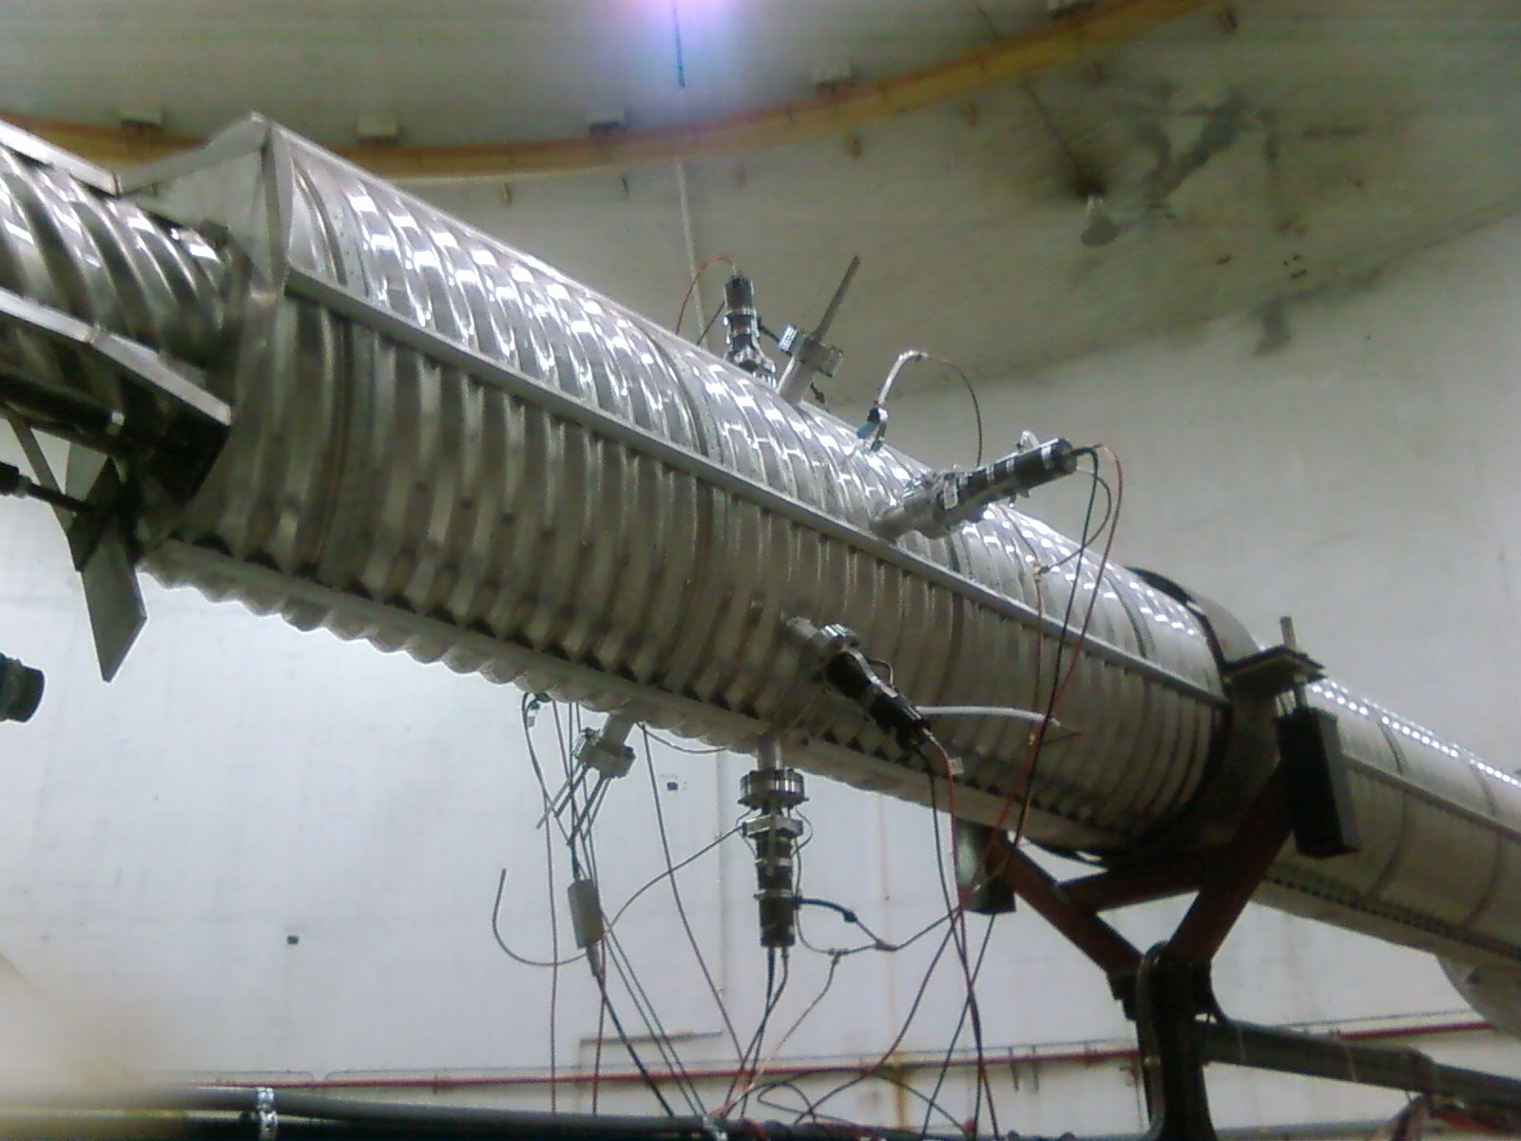
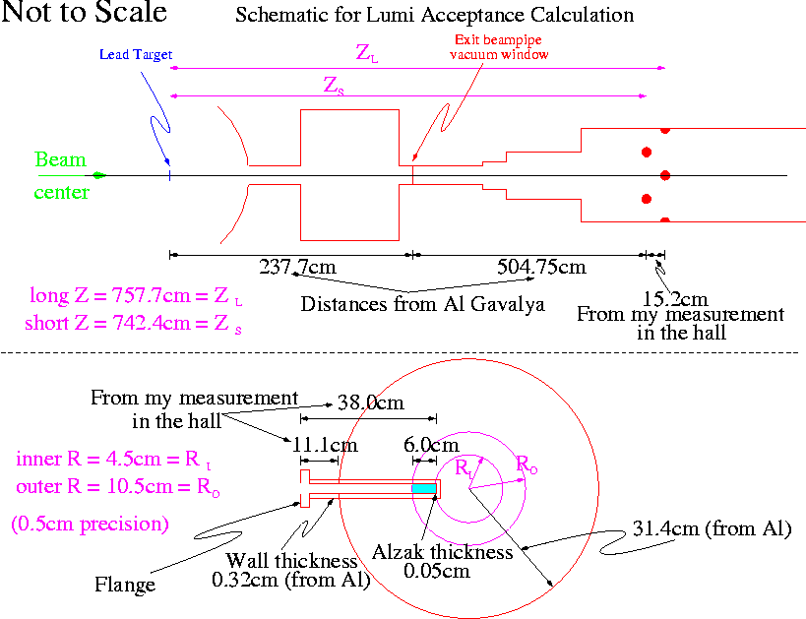
Downstream Lumis for PREX
Handwaving calculation: 0.5 degrees, 10% of azimuth, Pb form factor: factor of 250 or so above 1 GHz rate in main acceptance i.e. similar to Qweak rates within a factor of 2 to 3

Slide 10
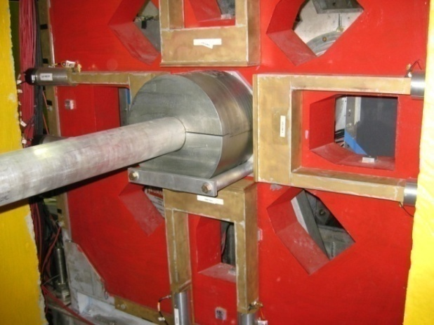
Qweak Upstream Luminosity Monitor Location
4 quartz Cerenkov detectors, symmetrically arranged
Θ_{lab} ~ 5.0º ~ 2.67 meters downstream of target
Mounted to front face of “primary” (second of three) collimator
1st Collimator is oversized relative to 2nd, so these monitors catch the “spillover” at small radius

Slide 11
Qweak Upstream Luminosity Monitor Rates
Observed rate (per detector) at 180 μA on 35 cm LH₂ target ~ 110 GHz (based on scaling from event mode running)
Signal predominantly ~120 MeV Mollers (e-e)

Slide 12
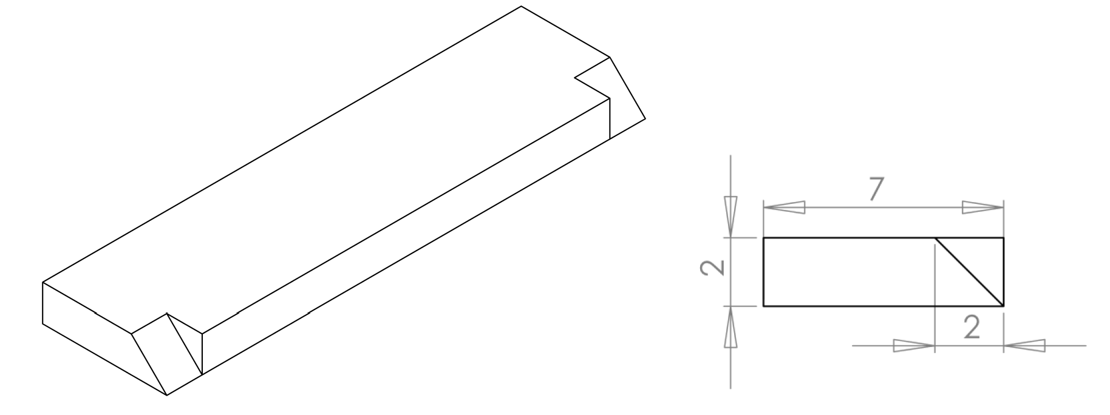
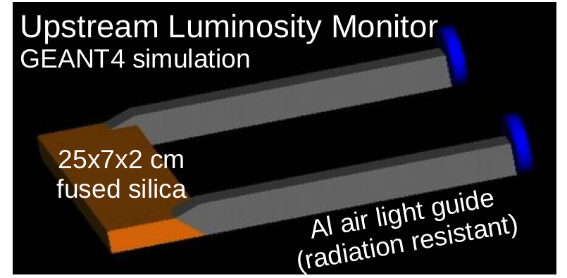
Qweak Upstream Luminosity Monitor Construction
25 cm x 7 cm x 2 cm Spectrosil 2000 quartz (no Pb pre-radiator)
Two 35 cm long Alanod Miro-Silver 27 “air” lightguides per detector(continuously flushed with N₂ gas to eliminate corrosive build-up from moist air)
2 inch Hamamatsu R375 quartz window phototube (2 per detector)
Readout same as downstream lumis
Spectrosil quartz block schematics

Slide 13
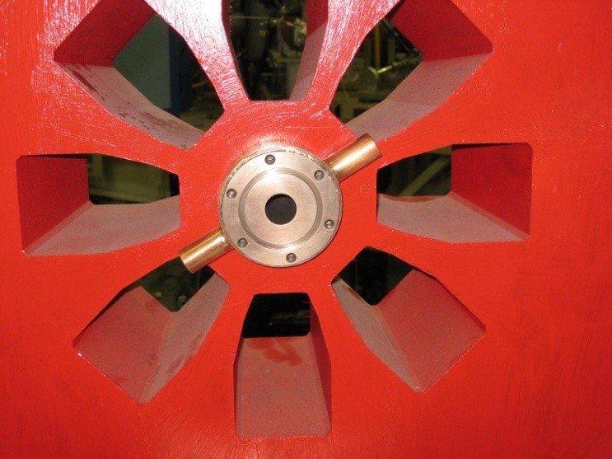
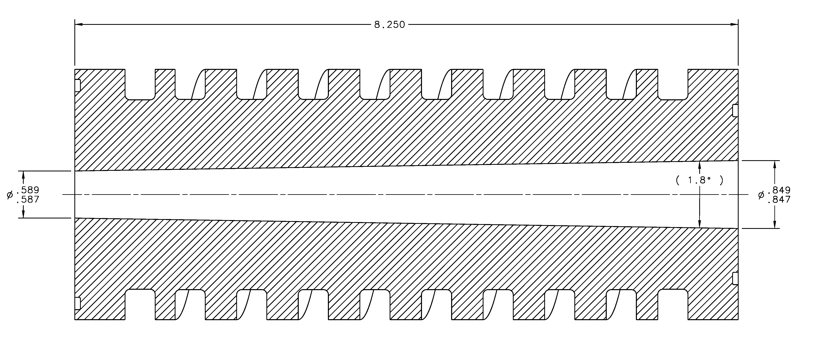
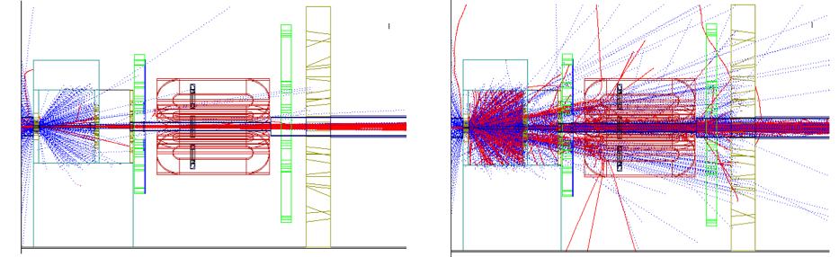
Qweak Tungsten Beamline Collimator
  Small aperture tungsten-copper collimator placed in center of collimator 1 to block small angle scattered particles from interacting with the downstream beampipe
  (~ 1.6 kW power deposit expected and measured) – catches electrons in ~ 0.8 – 4.0º range
Simulation with “plug”
Simulation without “plug”
  Simulation indicated the “plug” keeps scattered beam from interacting in downstream beampipe.
Notes:
This “tungsten” collimator seems very similar to PREX in terms of the scattered electrons collected, proximity to the target, and total power depost.

Slide 14
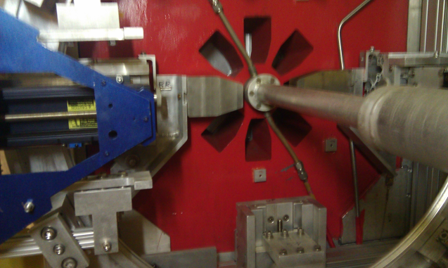
Qweak Tungsten Octant Blocker
  Two 5.1 cm thick tungsten blocks could be inserted manually into the Octant 1 and 5 holes of Collimator 1: eliminates direct scattered events from the target and measures scattering flux from tungsten collimator, beampipe, etc.
Diffuse backgrounds directly demonstrated with measurements
Fraction of signal left in a main detector when blocked with tungsten blocker
~ 0.19 ± 0.06% (it is believed that the is mostly neutrals)
For upstream lumis, ~ 50% of the signal remained when a tungsten octant blocker was inserted
→ Upstream lumis were very sensitive to interactions in the tungsten plug (which was about 1.5 meters upstream of it)

Slide 15
Qweak Beamline Background Experience
  One of the corrections made to the asymmetry by Qweak in its published paper (Phys. Rev. Lett. 111, 141803 (2013)) on 4% of the data was for scattered events that originated in the beamline and tungsten beam collimator.
  The upstream lumis and various “diffuse” background detectors in the focal plane observed large asymmetries (as did the main detectors when the main signal was blocked with the tungsten blockers)
  Correction was done using the measured correlation between the main detector and Uslumi/background detectors
  PREX has a very similar “tungsten plug” geometry to Qweak, similar beam energy (~ 1 GeV), but “different” accelerator and lower beam current
  PREX main detector is much better isolated from the “tungsten plug” than the Qweak main detector in its more open geometry
Qweak
Asymmetries in ppm

Slide 16
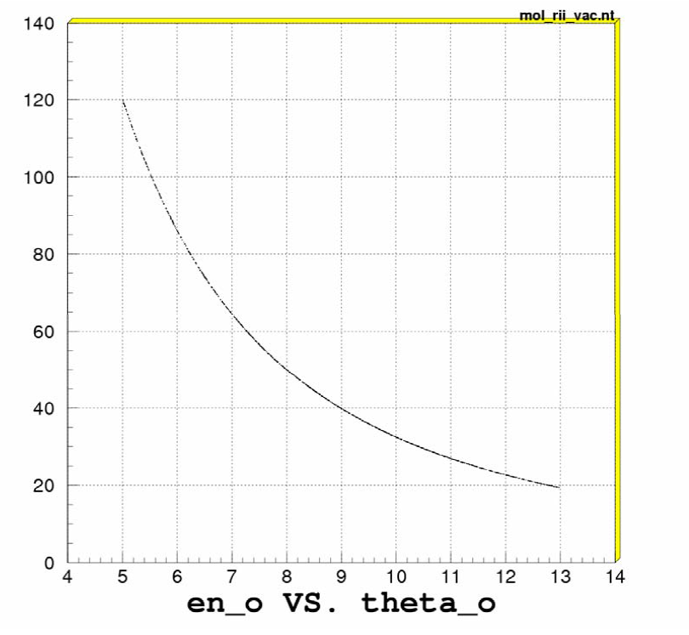
Upstream lumi thoughts for PREX
  Upstream lumis could be deployed in PREX for two reasons
    Monitor signal and potential asymmetries from tungsten plug
    “Catch” some of the large ~ 120 MeV (at 5 degrees) Moller flux for a potentially small counting statistics error
  Study the correlations between upstream and downstream luminosity monitors; compare to what was observed during Qweak
  Show that PREX main detector signal is immune to any non-zero asymmetries at the lumi locations by a hopefully small or non-existent correlation between them
  Use the lumi monitors to understand further the nature of the large “halo” asymmetries via further injector studies of the kind done during the latter stages of Qweak
Scattered Moller (e-e) electron energy (MeV) vs. lab scattering angle (degrees)

Slide 17
Potential PREX Upstream Lumi Locations
Initial idea: 2 sets of upstream lumis
Sensitive to “tungsten plug”; skinny quartz radiator (“finger)at inner and outer edges of transport channel;
probably out of Moller flux, but
sensitive to tungsten plug events;
4 detectors total
Sensitive to large Moller flux that is swept somewhere (simulation will say where) inside the septum magnet
2 detectors total

Slide 18
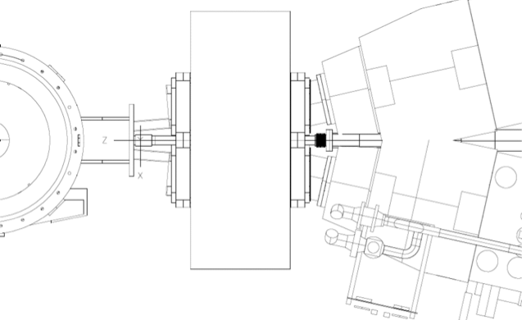
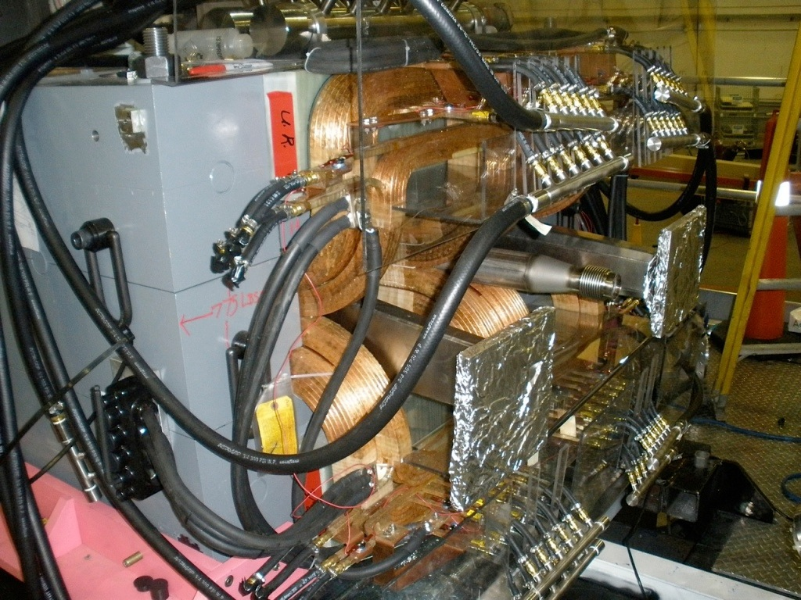
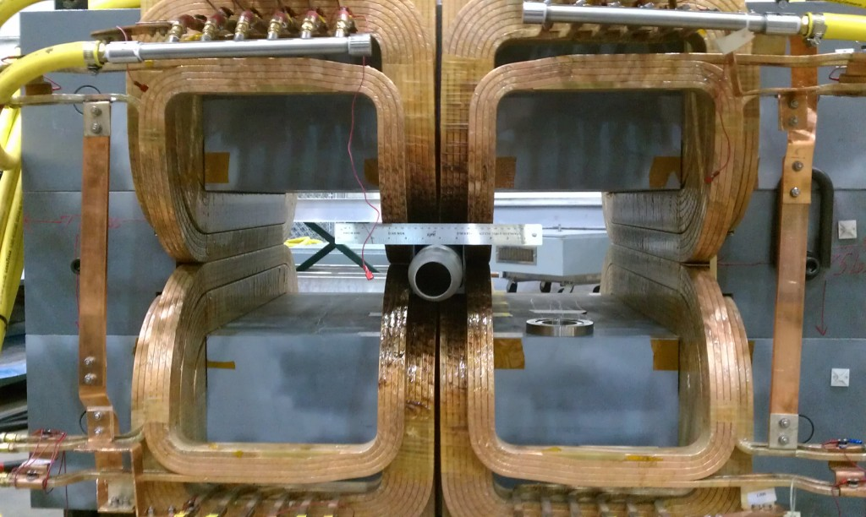
Potential PREX Upstream Lumi Locations
“Tungsten plug” sensitive
Upstream face of septum magnet
4 detectors total
“Moller scatters” sensitive
At location of scattered Moller envelope in septum magnet
2 detectors total
Perhaps fit in small gap between coils and vacuum box?

Slide 19
Conclusions
Downstream lumis: Qweak “unity gain” phototube configuration and TRIUMF style preamplifier may give the desired linearity at the anticipated photocathode currents
  Qweak integrating mode teststand still exists in EEL 126 if a test linearity bench test is desired
Upstream lumis: First look indicates two possible interesting places to locate upstream lumis:
  Front face of septum magnet to detect shower products from the tungsten plug
  Inside the septum magnet to detect the large ~ 120 MeV scattered Moller flux from the target
All of the above would require some simulation to further refine the ideas

