Slide 1
The light-front energy-momentum tensor
[C.L., arXiv:1502.06656]
Based on :
Cédric Lorcé
SLAC & IFPA Liège
May 26th 2015, JLab, Newport News, Virginia, USA

Slide 2
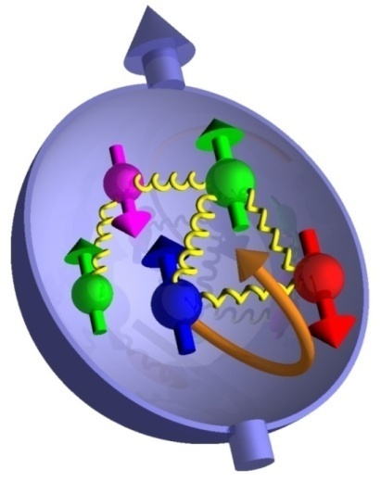
Outline
Energy-momentum tensors
General parametrization
Relations to parton distributions
Conclusions
Bonus !

Slide 3
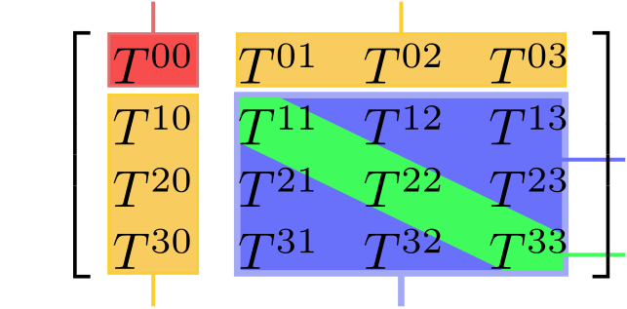
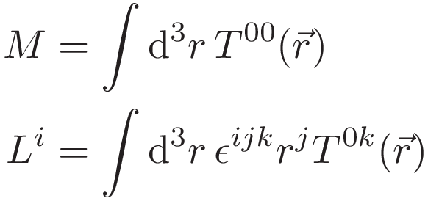
Energy-momentum tensor
A lot of interesting physics is contained in the EMT
[Polyakov, Shuvaev (2002)]
[Polyakov (2003)]
[Goeke et al. (2007)]
[Cebulla et al. (2007)]
Energy density
Momentum density
Shear stress
Normal stress (pressure)
Energy flux
Momentum flux
E.g.

Slide 4
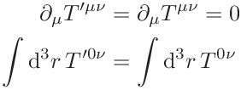
Energy-momentum tensor
Canonical EMT
[Jaffe, Manohar (1990)]
Gauge transformation
Superpotential
Freedom of the EM distribution
satisfies
Total EM is gauge invariant and conserved

Slide 5
Energy-momentum tensor
Ji EMT
QCD EOM
Gauge invariant
[Ji (1997)]
Belinfante-Rosenfeld EMT
QCD identity
Gauge invariant
and symmetric

Slide 6
Gauge invariance vs locality
System
Gauge A
Gauge B
GI
Local
« Factorized » system
GIE
GIE
Non-local
Simple
Complicated
[C.L. (2013-14)]

Slide 7
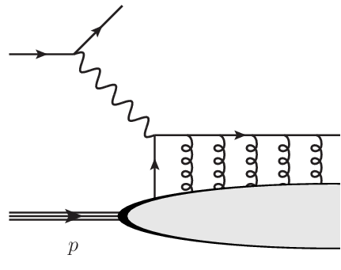
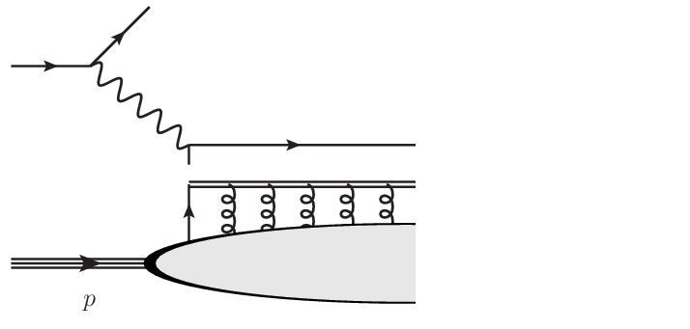
Gauge invariance vs locality
System
« Factorized » system
Wilson line
~ background field
Local
Non-local
Chen et al. approach (special case of background field method)
Background
Dynamical
[Chen et al. (2008-09)]
[Wakamatsu (2010-11)]
[C.L. (2013-14)]

Slide 8
Energy-momentum tensor
Gauge-invariant canonical EMT
Gauge-invariant kinetic EMT
[Wakamatsu (2010-11)]
[C.L. (2013-14)]
[Leader, C.L. (2014)]

Slide 9
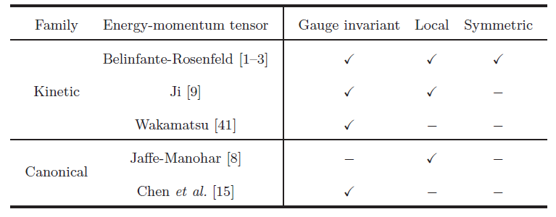
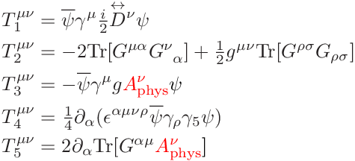
Energy-momentum tensor
A convenient gauge-invariant basis
Kinetic
Canonical
[C.L. (2015)]

Slide 10
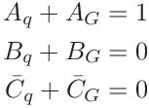
Matrix elements
Belinfante-Rosenfeld EMT
[Ji (1997)]
Ji EMT
[Bakker et al. (2004)]
Angular momentum relations
Kinetic version !
[Ji (1997)]
[Shore, White (2000)]

Slide 11
Matrix elements
Light-front EMT
Angular momentum relations
Kinetic and canonical versions !
[C.L. (2015)]

Slide 12
Link with vector GPDs
Twist 2
Twist 3
Twist 4
Similar to Ji’s sum rule !
[C.L. (2015)]

Slide 13
Link with axial-vector FFs
Consistent with spin sum rule
[Shore, White (2000)]

Slide 14
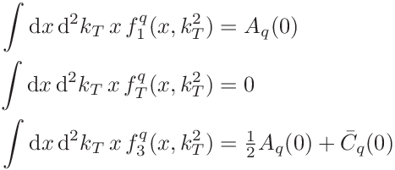
Link with vector TMDs
Twist 2
Twist 3
Twist 4
Twist 2
Twist 3
Twist 4
[C.L. (2015)]

Slide 15
Sum rules
Transverse momentum conservation
[Burkardt (2004)]
Vanishing net transverse momentum flux
[C.L. (2015)]

Slide 16
Conclusions
Definition of EMT density is not unique
General parametrization involves 32 scalar functions
9 of them are directly related to 2-parton GPDs and TMDs
Simpler derivation of Burkardt sum rule + new sum rules for higher-twist TMDs

Slide 17
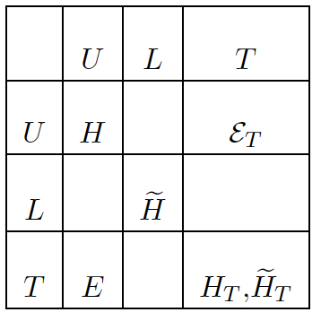
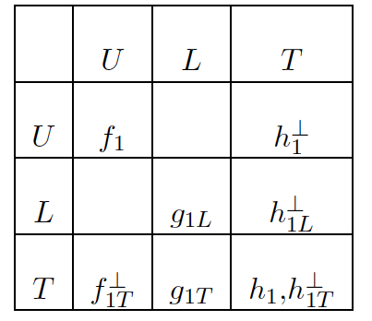
Bonus : AM correlations
Wigner distribution
[C.L., Pasquini (in preparation)]
GPDs
TMDs

Slide 18
Backup slides

Slide 19
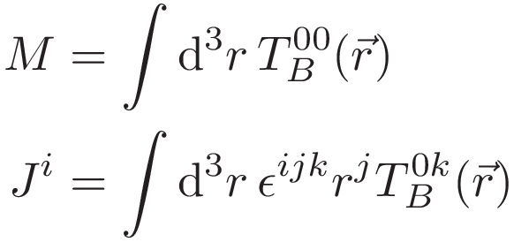
Energy-momentum tensor
In presence of spin density
Belinfante « improvement »
Spin density gradient
Four-momentum circulation
In rest frame
No « spin » contribution !

Slide 20
Link with GPDs
« Trick »
Local
Non-local
GPD operator
Twist-2
[Ji (1997)]
Twist-3
[Penttinen et al. (2000)]
[Kiptily, Polyakov (2004)]
[Hatta, Yoshida (2012)]

