Slide 1

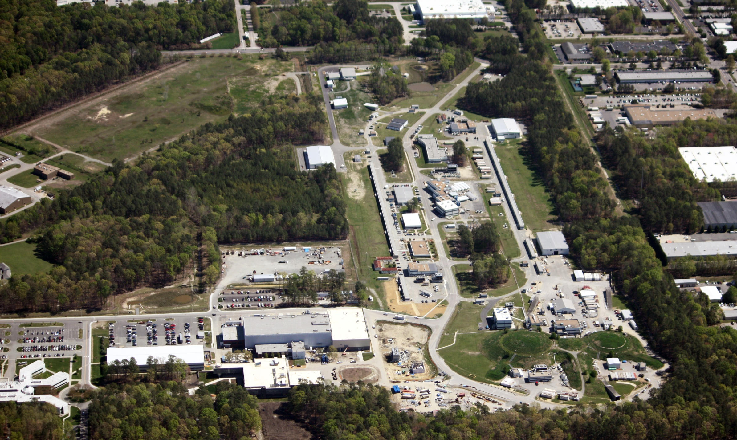
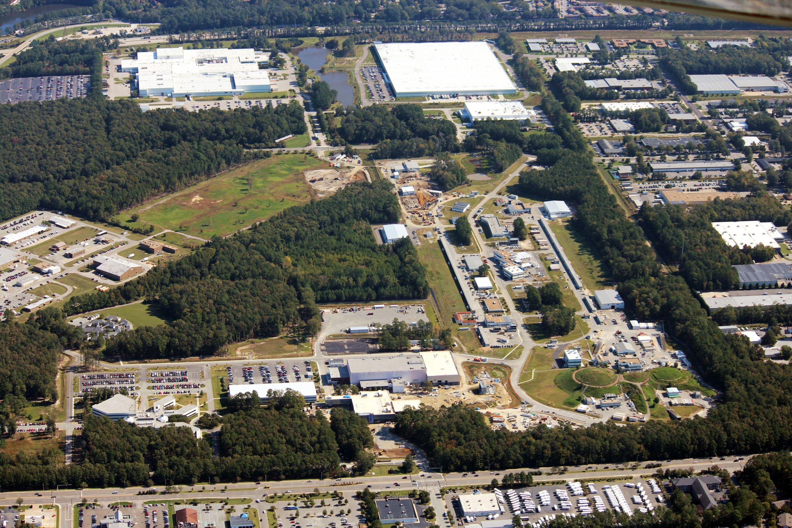
Jefferson Lab
Nuclear Science Program
R. D. McKeown
QCD Evolution
May 26, 2015

Slide 2
Outline
JLab context in Nuclear Physics
12 GeV CEBAF
- Upgrade status
- Science Program:
Phenomenology
Techniques (theory+exp)
Standard model tests
Future new capability: MEIC
Outlook
New
Discovery
Potential
Notes:
Like to give an overview of Jefferson Lab.
I can’t get going without saying something of the current status of the lab.
The dominant part of the talk will concern our 12 GeV Upgrade Project, the physics and the project status.
However, the technology which enables our nuclear physics and its enhancement also provides opportunities in the future
Photon Science
Accelerator Driven Systems
Nuclear Physics
Conclude

Slide 3


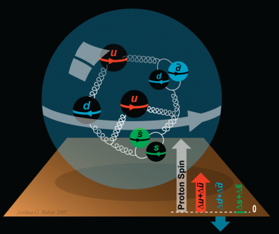
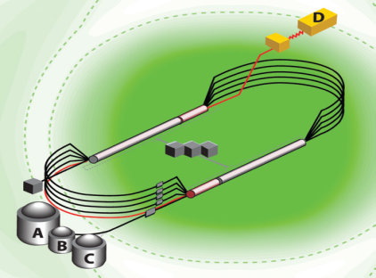
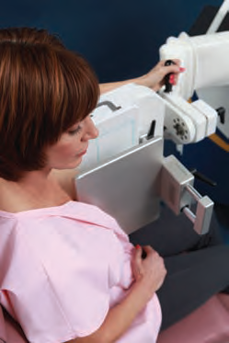
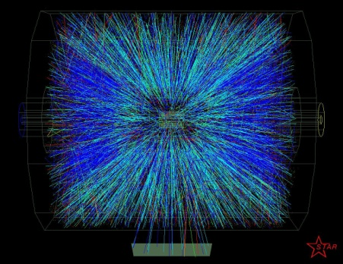


A Laboratory for Nuclear Science
Structure of Hadrons
Nuclear Structure
Fundamental
Forces & Symmetries
Accelerator S&T
Medical Imaging
Hadrons from Quarks
Theory and Computation
Quark Confinement

Slide 4
JLab: 21st Century Science Questions
What is the role of gluonic excitations in the spectroscopy of light mesons? Can these excitations elucidate the origin of quark confinement?
Where is the missing spin in the nucleon? Is there a significant contribution from valence quark orbital angular momentum?
Can we reveal a novel landscape of nucleon substructure through measurements of new multidimensional distribution functions?
What is the relation between short-range N-N correlations , the partonic structure of nuclei, and the nature of the nuclear force?
Can we discover evidence for physics beyond the standard model of particle physics?

Slide 5
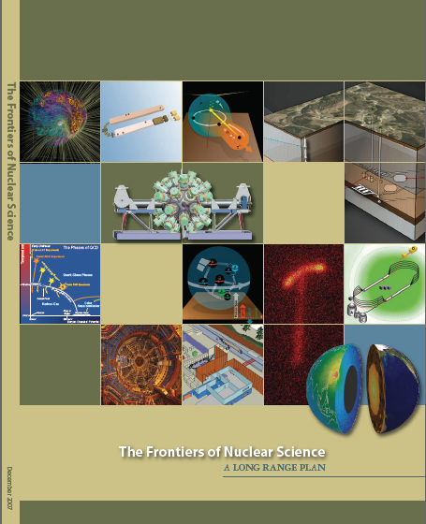
12 GeV Upgrade Project
Upgrade is designed to build on existing facility: vast majority of accelerator and experimental equipment have continued use
New Hall
Upgrade arc magnets
and supplies
Add 5 cryomodules
20 cryomodules
CHL upgrade
Maintain capability to deliver lower pass beam energies: 2.2, 4.4, 6.6….
Add arc
20 cryomodules
The completion of the
12 GeV Upgrade of CEBAF was ranked the highest priority in the 2007 NSAC Long Range Plan.
Add 5 cryomodules
Scope of the project includes:
Doubling the accelerator beam energy
New experimental Hall and beamline
Upgrades to existing Experimental Halls
$338M DOE project (FY09-17)
Currently ~91% complete
Beam Commissioning in progress
Enhanced capabilities
in existing Halls

Slide 6
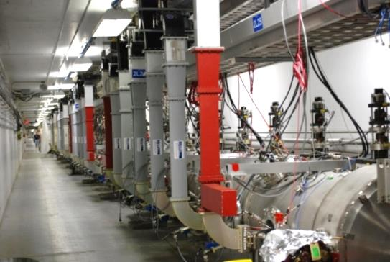
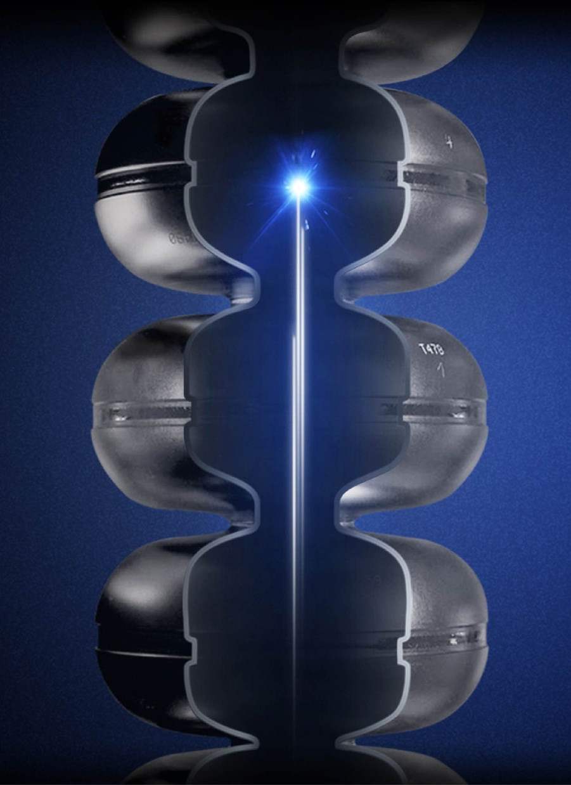
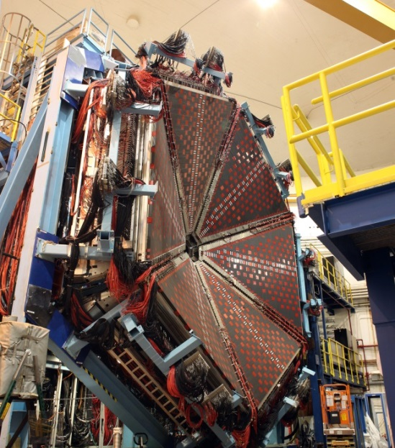
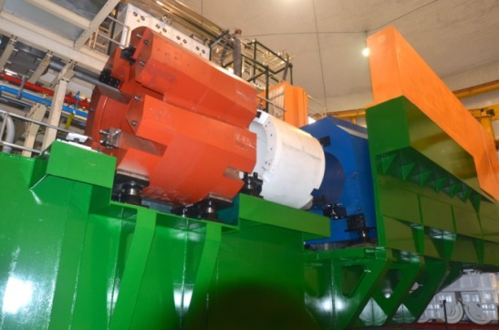
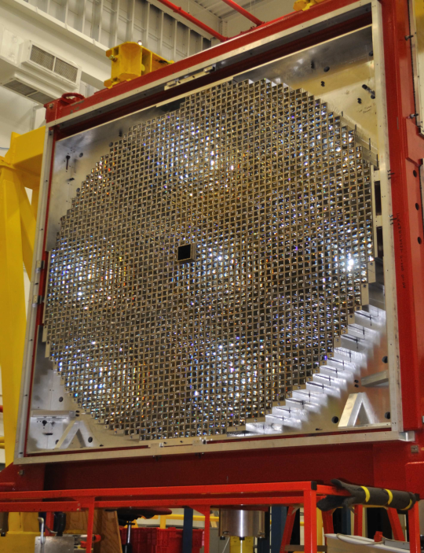
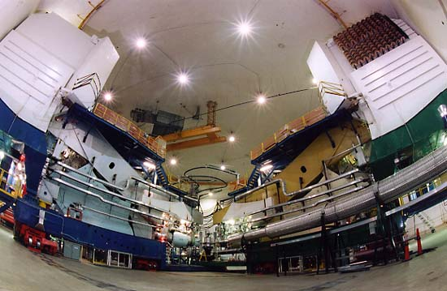
JLab12: Nuclear Physics for the Future
Notes:
I have not yet got comfortable with this one???? But maybe

Slide 7
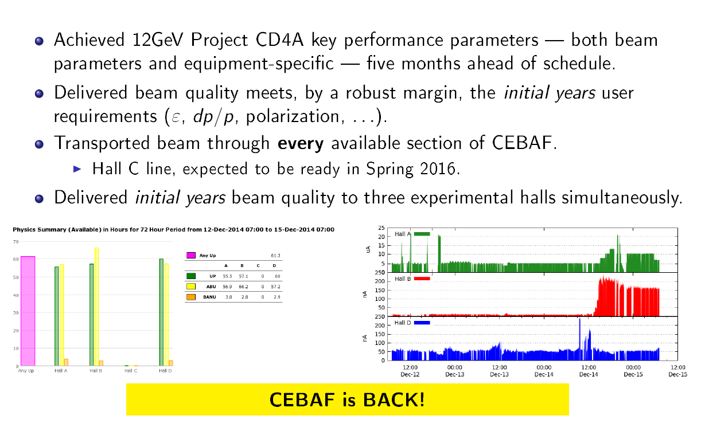
CEBAF Commissioning
Hall A
Dec. 2014:
Hall B
Current
Hall D
Feb. 2015: restore 5 pass beam
Mar. 2015: commission new RF separator system in pass 5
Demonstrate 5 pass beam to D and A
Beam to Hall A, B, D for commissioning/physics

Slide 8
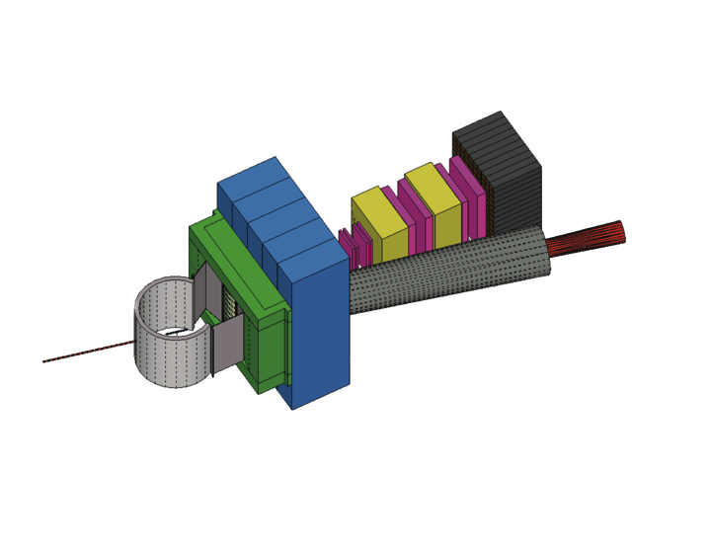
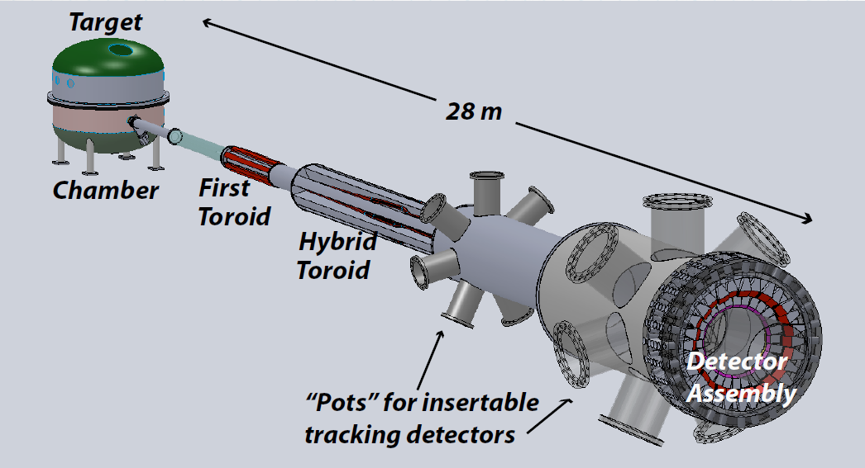

Additional Experimental Equipment
Super BigBite Spectrometer
(FY13-17 construction)
- High Q² form factors
- SIDIS
MOLLER experiment
(MIE – FY17-19?)
  - Standard Model Test
  - Successful Science Review
SoLID
- SIDIS and PVDIS
- Chinese collaboration
- CLEO Solenoid

Slide 9
12 GeV Approved Experiments by Physics Topics
Topic | Hall A | Hall B | Hall C | Hall D | Other | Total
The Hadron spectra as probes of QCD (GlueX and heavy baryon and meson spectroscopy) |  | 1 |  | 3 |  | 4
The transverse structure of the hadrons (Elastic and transition Form Factors) | 5 | 3 | 2 | 1 |  | 11
The longitudinal structure of the hadrons (Unpolarized and polarized parton distribution functions) | 2 | 3 | 6 |  |  | 11
The 3D structure of the hadrons (Generalized Parton Distributions and Transverse Momentum Distributions) | 5 | 9 | 7 |  |  | 21
Hadrons and cold nuclear matter (Medium modification of the nucleons, quark hadronization, N-N correlations, hypernuclear spectroscopy, few-body experiments) | 6 | 3 | 7 |  | 1 | 17
Low-energy tests of the Standard Model and Fundamental Symmetries | 3 | 1 |  | 1 | 1 | 6
TOTAL | 21 | 20 | 22 | 5 | 2 | 70
A Decade of Experiments

Slide 10
12 GeV Approved Experiments by PAC Days
Topic | Hall A | Hall B | Hall C | Hall D | Other | Total
The Hadron spectra as probes of QCD (GlueX and heavy baryon and meson spectroscopy) |  | 119 |  | 540 |  | 695
The transverse structure of the hadrons (Elastic and transition Form Factors) | 145.5 | 85 | 102 | 25 |  | 357.5
The longitudinal structure of the hadrons (Unpolarized and polarized parton distribution functions) | 65 | 230 | 165 |  |  | 460
The 3D structure of the hadrons (Generalized Parton Distributions and Transverse Momentum Distributions) | 409 | 872 | 212 |  |  | 1493
Hadrons and cold nuclear matter (Medium modification of the nucleons, quark hadronization, N-N correlations, hypernuclear spectroscopy, few-body experiments) | 180 | 175 | 201 |  | 14 | 570
Low-energy tests of the Standard Model and Fundamental Symmetries | 547 | 205 |  | 79 | 60 | 891
TOTAL | 1346.5 | 1686 | 680 | 644 | 74 | 4430.5

Slide 11
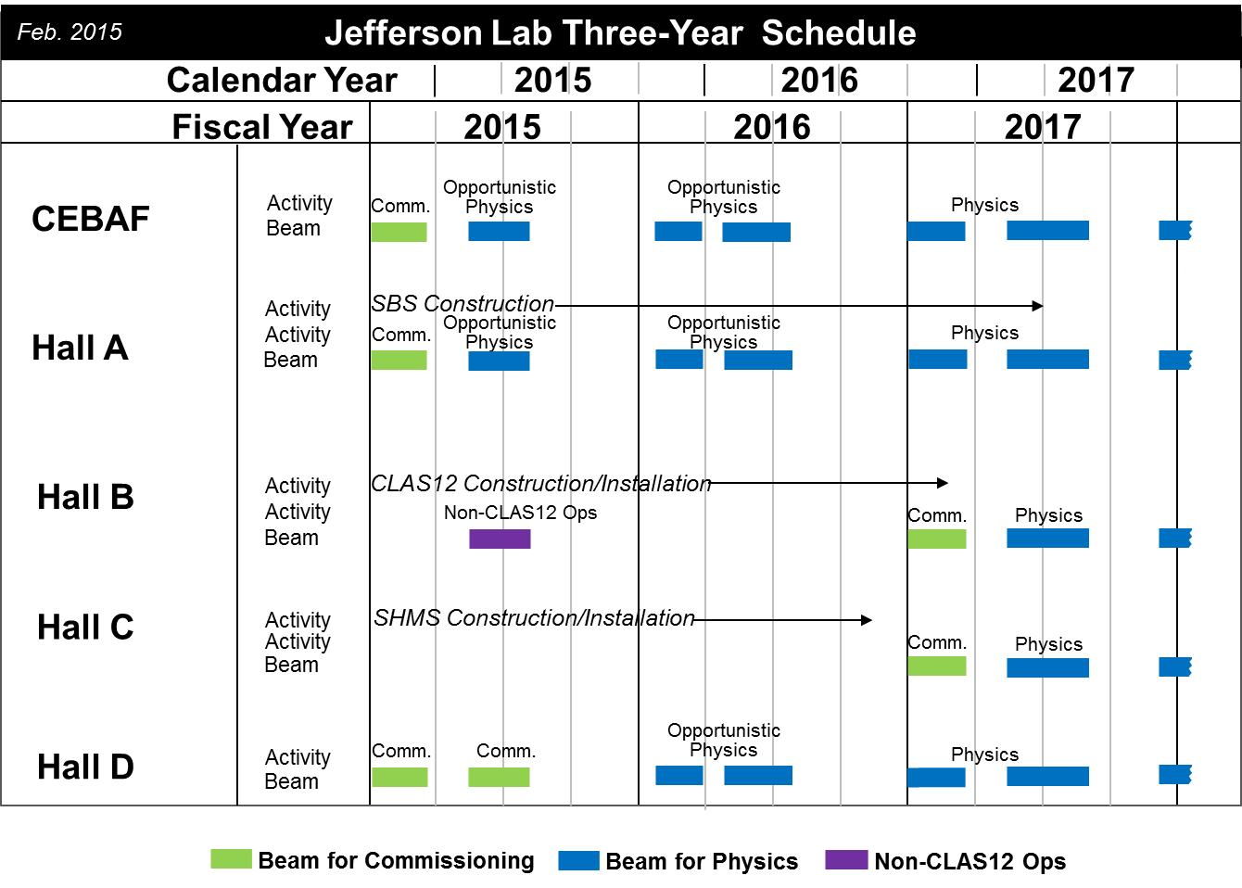
Jefferson Lab 3 Year Schedule

Slide 12
Quantum Numbers of Hybrid Mesons
Excited
Gluon Field
Quarks
Hybrid Meson
like
Exotic
like
Gluonic excitation (and parallel quark spins) lead to exotic J^{PC}

Slide 13
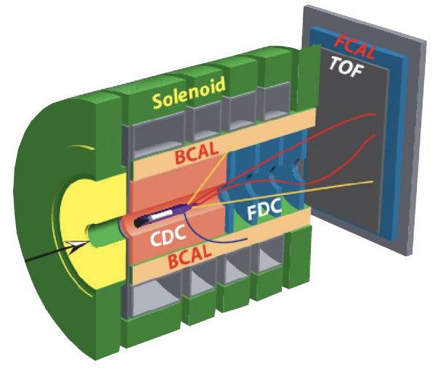

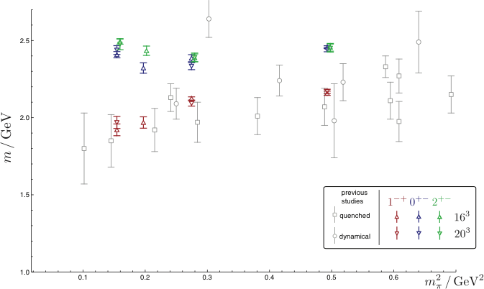

Isovector Meson Spectrum
Hall D@JLab
States with Exotic Quantum Numbers
2
+-
0
+-
1
-+
Dudek et al.

Slide 14
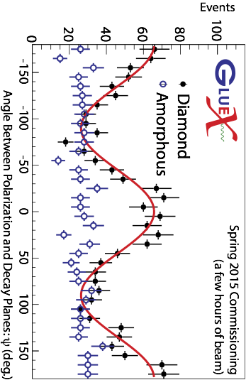

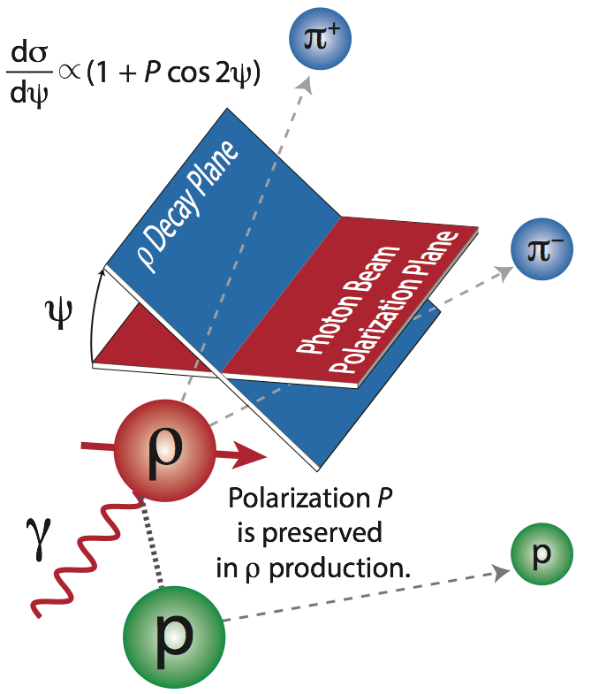
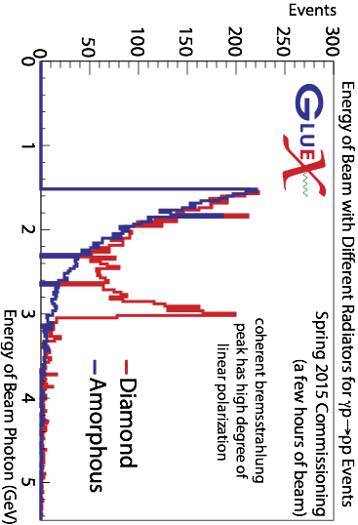
Polarized ρ Production with the Hall D Photon Beam

Slide 15
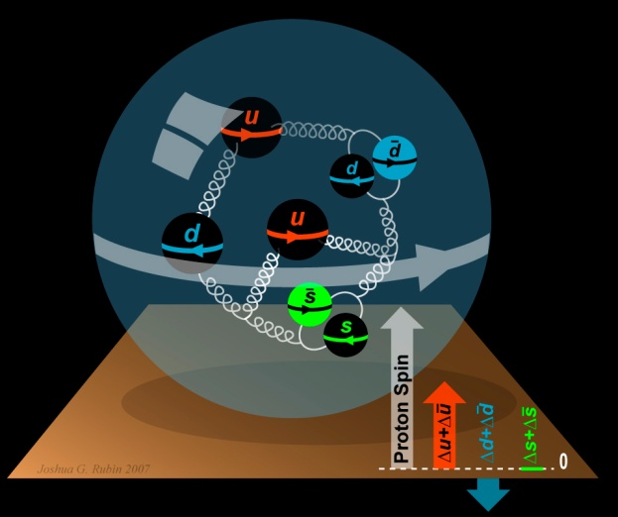
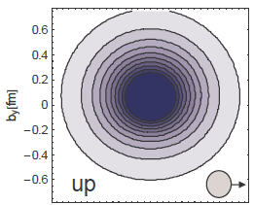
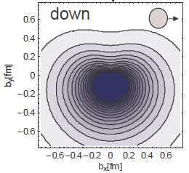
The Incomplete Nucleon: Spin Puzzle
1
1
ΔΣ
+
L_{q}
+
J_{g}
=
2
2
[X. Ji, 1997]
DIS → ΔΣ ≅ 0.25
RHIC + DIS → ΔG~0.2
→ L_{q}

Slide 16
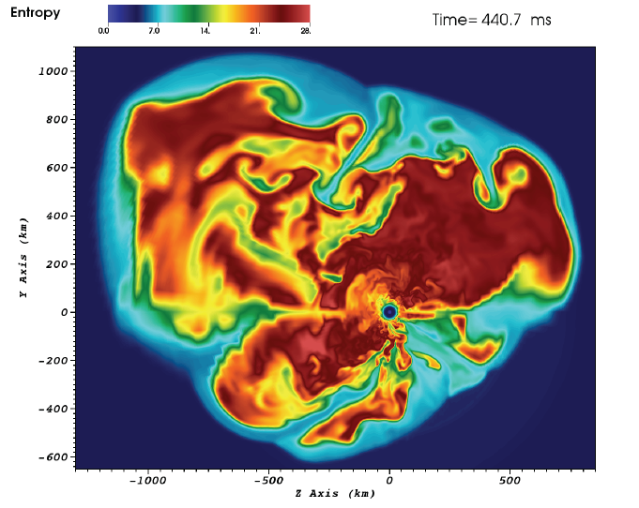
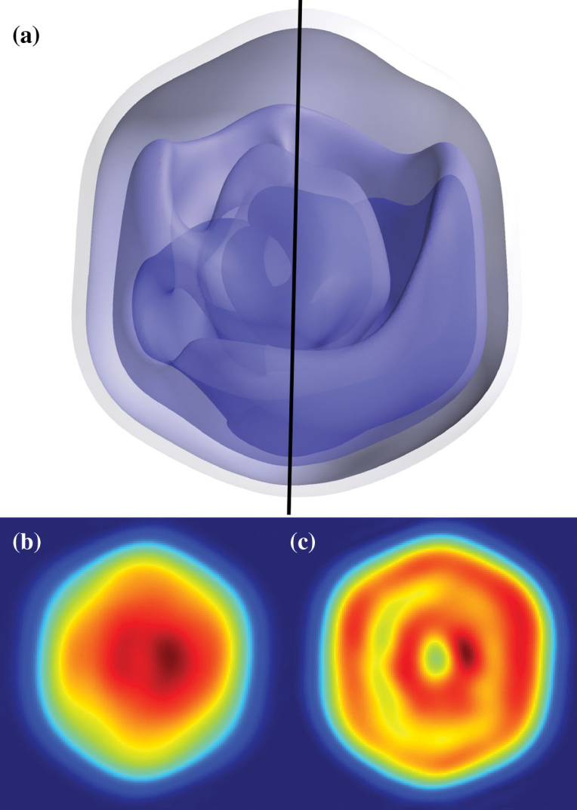
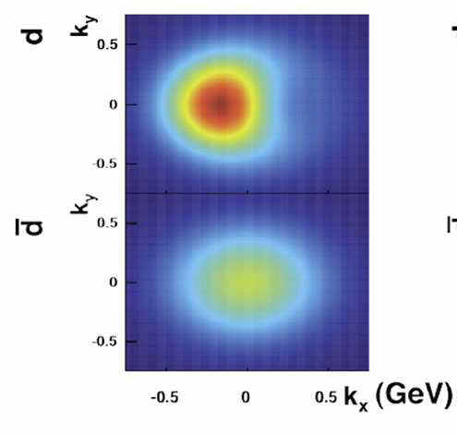
3D Science
3D simulation of
15M supernova
(ORNL)
Predicted down
quark transverse
momentum distribution
for a polarized proton
(accessible at JLab12)
Mimivirus imaged at LCLS
(SLAC)

Slide 17

New Paradigm for Nucleon Structure
5D
TMDs
– Confined motion in a nucleon
(semi-inclusive DIS)
GPDs
– Spatial imaging
(exclusive DIS)
Requires
− High luminosity
− Polarized beams and targets
3D
Major new capability with JLab12

Slide 18
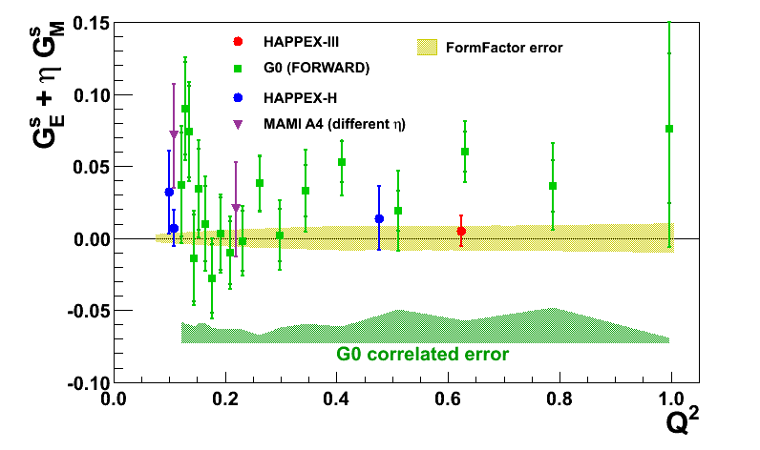
Parity Violation at JLab
Nucleon Strangeness Form Factors (complete)
- HAPPEX (Hall A)
- G0 (Hall C)
Neutron Skin
- PREX
- CREX
Precision Tests of Standard Model
- Qweak (Under analysis)
- MOLLER
- SoLID

Slide 19
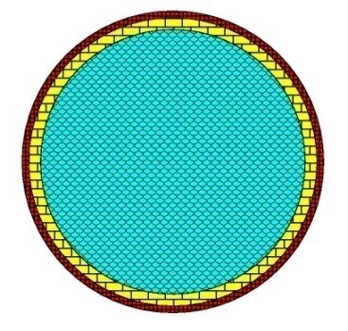
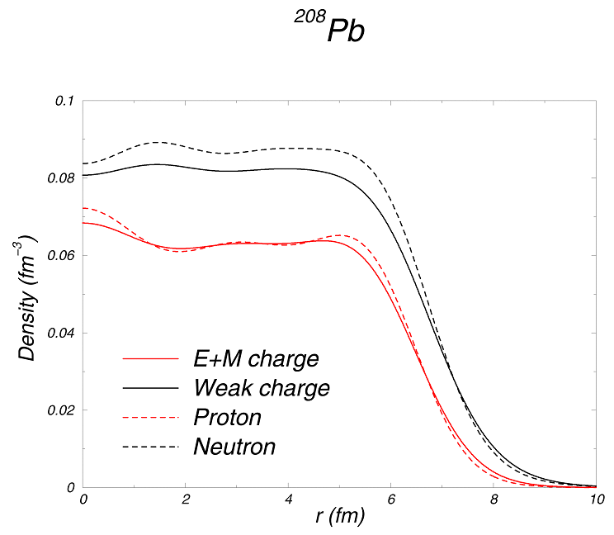
Measuring the Neutron “Skin” in the Pb Nucleus
Q_{w}^{p} =(1 – 4 sin² θ_{W})
Q_{W}^{n} = -1
Weak interaction selects neutrons
Parity violating electron scattering
Sensitive to neutron distribution
Neutron Star
Lead Nucleus
10 km
10 fm
skin
crust
Applications: Nuclear Physics, Neutron Stars,
Atomic Parity, Heavy Ion Collisions

Slide 20
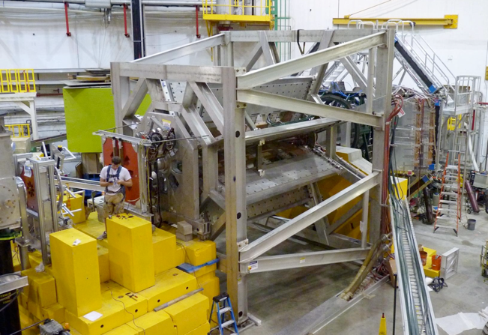
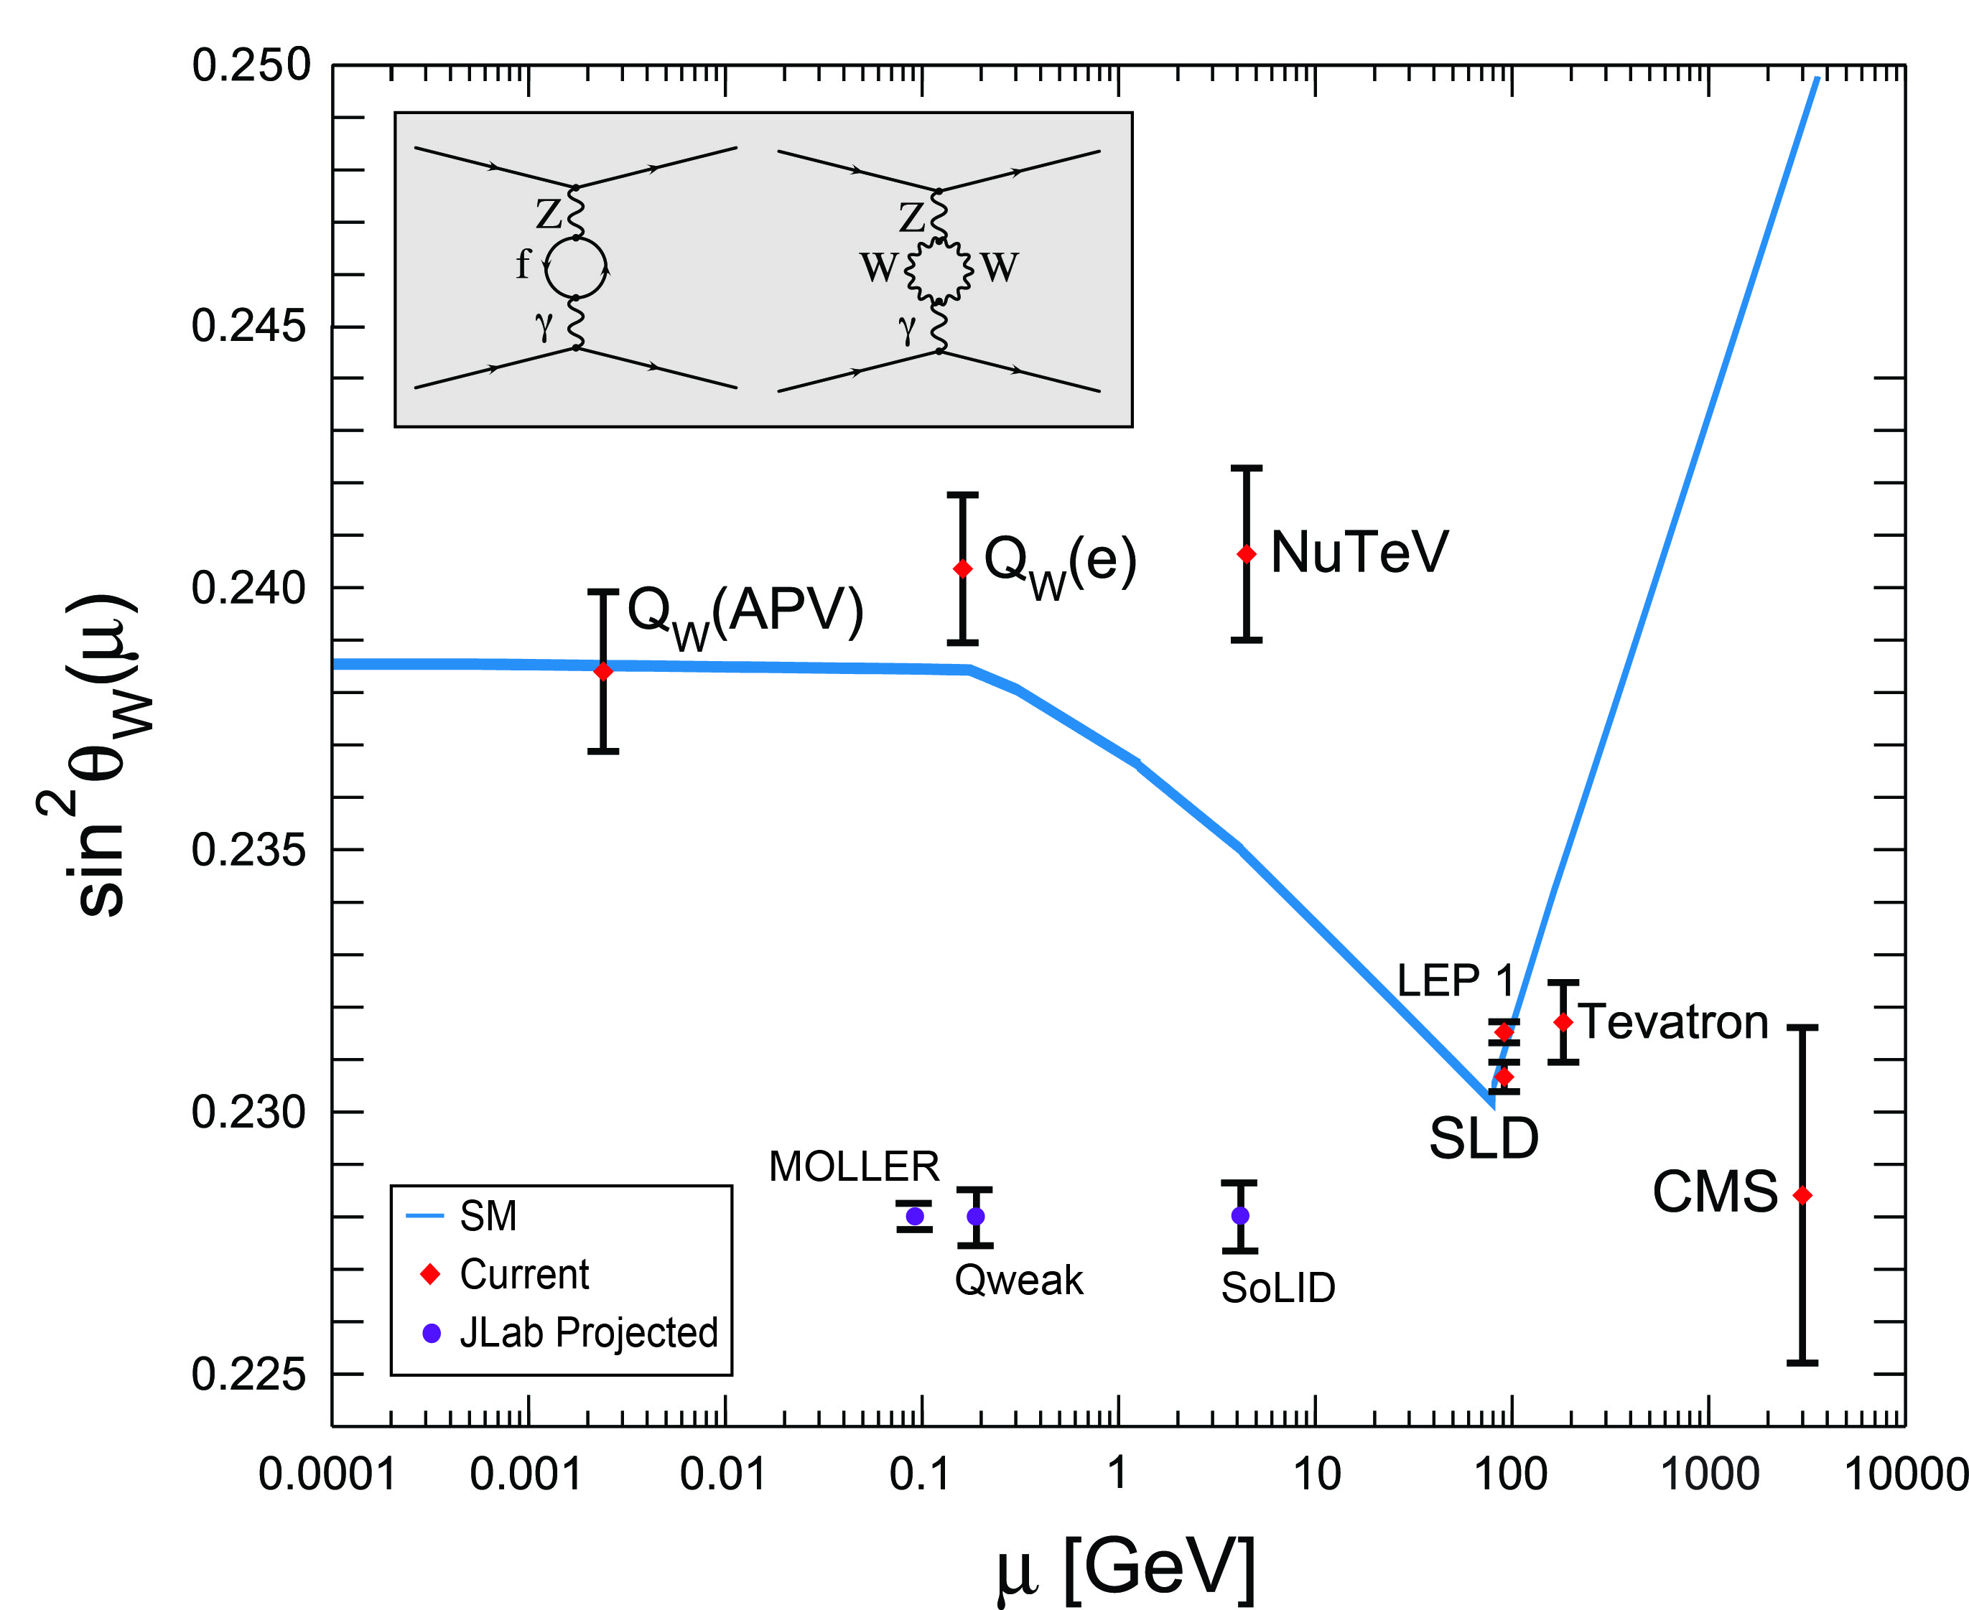
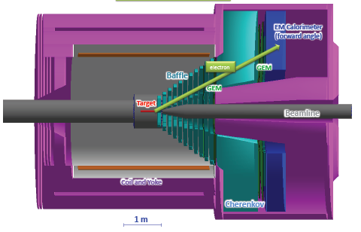
Projected Results

Slide 21
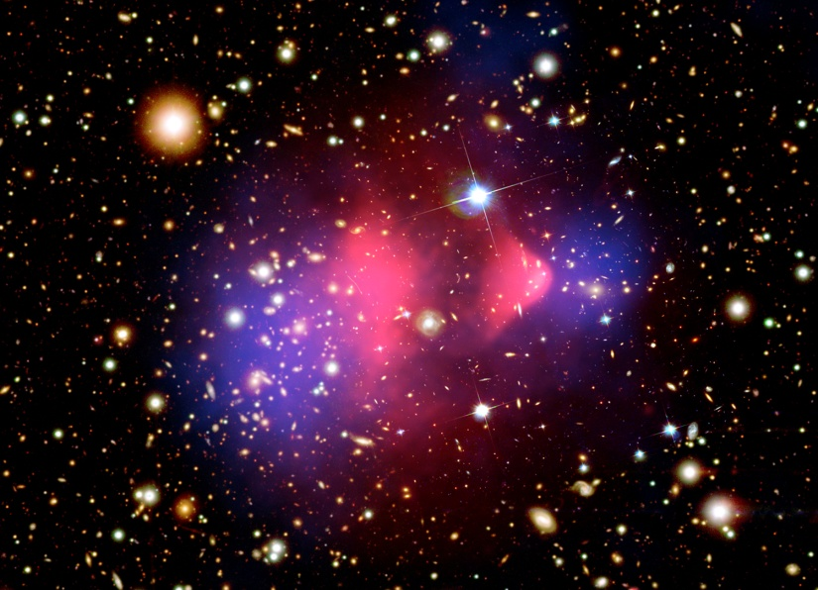
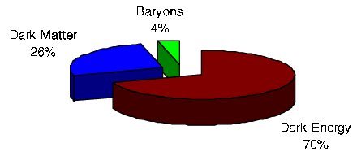
Cosmology and Dark Matter
Dark sector is new physics, beyond the standard model
Many direct searches for dark matter interacting with
sensitive detectors (hints, no established signal yet…)
Controversial evidence for
excess astrophysical positrons…

Slide 22
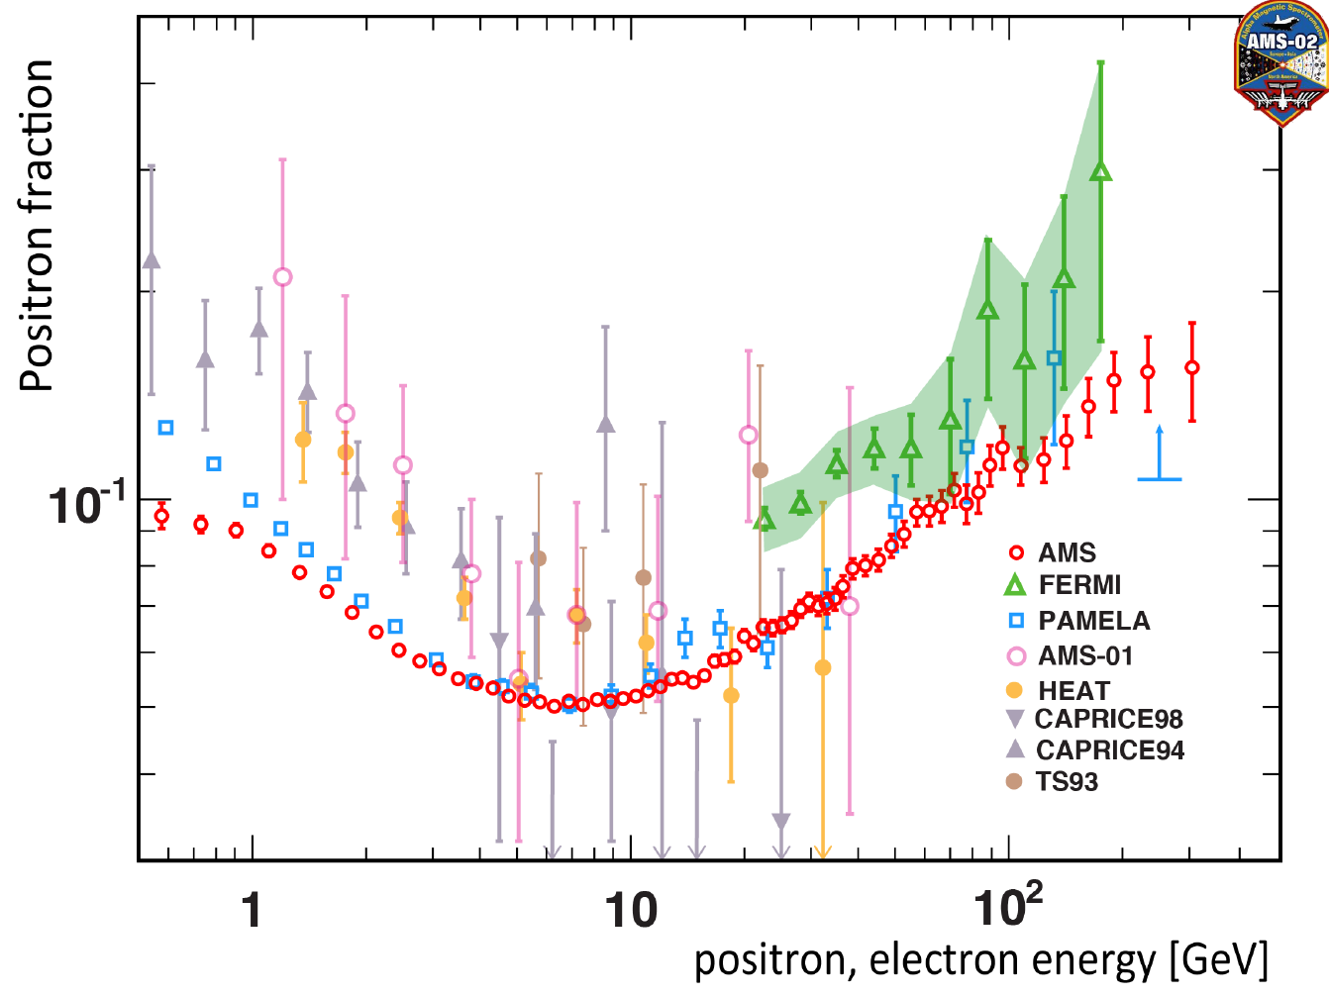
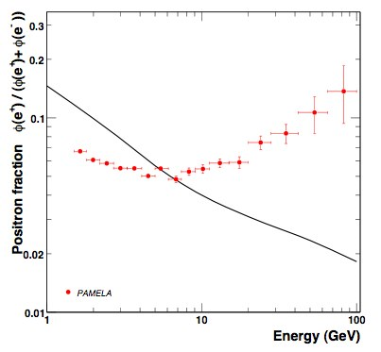
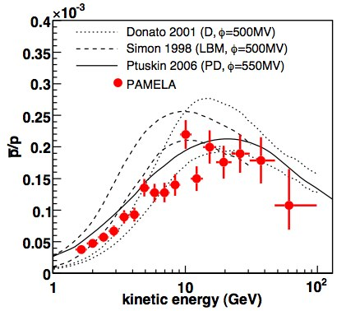
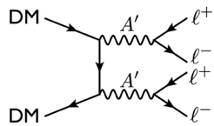
PAMELA Data on Cosmic Radiation
Surprising rise in e⁺ fraction
But not p
Could indicate low mass A’ (M_{A’} < 1 GeV )
Or local astrophysical origin??

Slide 23
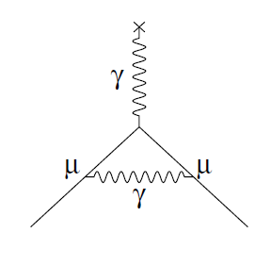
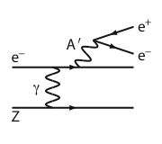
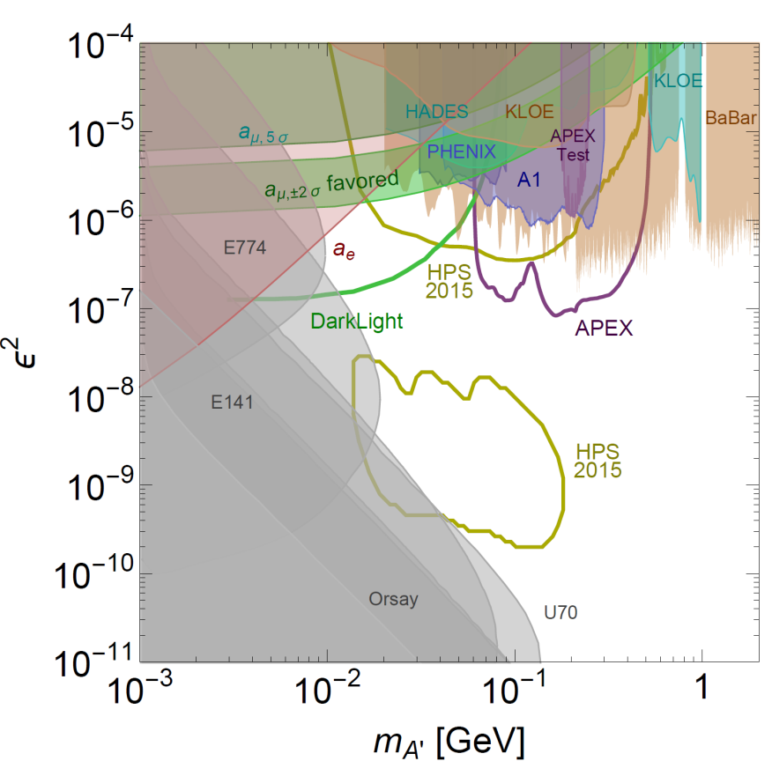
New Opportunity: Search for A’ at Jefferson Lab
BNL “g-2” expt: Δa_{μ}(expt-thy) = (295±88) x 10⁻¹¹ (3.4 σ)
No evidence for SUSY at LHC (yet)
Another solution: A’, a massive neutral vector boson
- Also useful for dark matter models
3 Jefferson Lab proposals:
APEX test run (Hall A) – published
PRL 107, 191804 (2011)
HPS (Hall B) –initial FY15 run completed
DarkLight (FEL) – NSF-MRI funds

Slide 24
12 GeV JLab – The Potential
Opportunity to discover and study new exotic mesons to elucidate the mechanism of confinement.
Opportunity to discover and study new exotic mesons to elucidate the mechanism of confinement.
Open a new landscape of nucleon tomography, with potential to identify the missing angular momentum.
Establish the quantitative foundation for the short-distance behavior in nuclei, underpinning the development of precision nuclear structure studies.
Provide stringent new tests of the standard model and extensions, complementing the information obtained at LHC.
Establish a firm basis for higher energy studies with a future
Electron Ion Collider

Slide 25
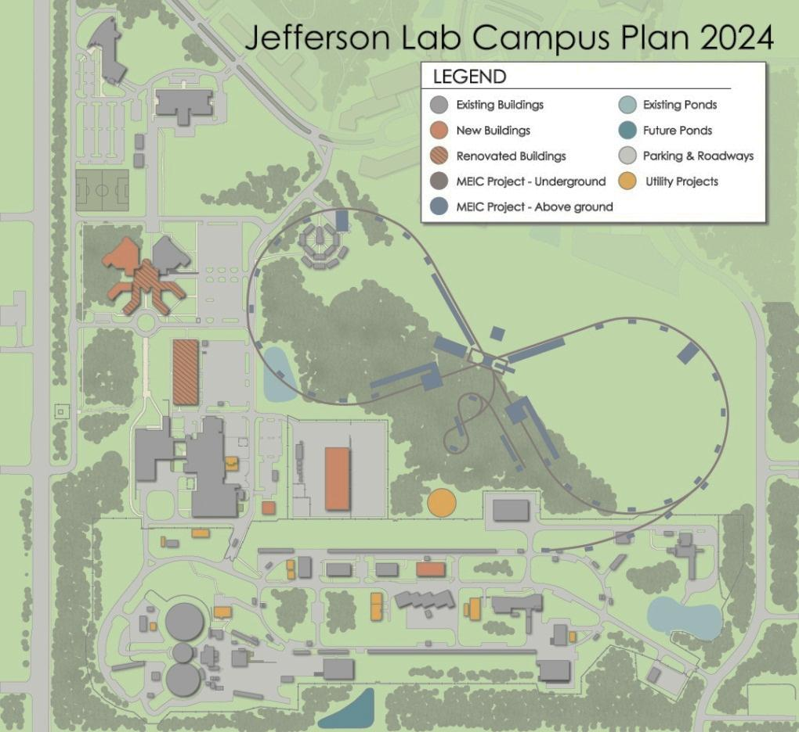
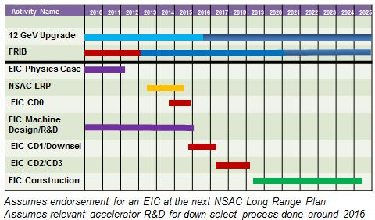
Jefferson Lab Future: MEIC
JLab MEIC Figure 8 Concept
Initial configuration:
  3-10 GeV on 20-100 GeV ep/eA collider
  Optimized for high ion beam polarization:
    polarized deuterons
  Luminosity:
    up to few x 10³⁴ e-nucleons cm⁻² s⁻¹
    Low technical risk
    Upgradable to higher energies
    250 GeV protons + 20 GeV electrons
    Flexible timeframe for Construction
    consistent w/running 12 GeV CEBAF
    Thorough cost estimate completed
      presented to NSAC EIC Review
    Cost effective operations
     Fulfills White Paper Requirements

Slide 26
Jefferson Lab: Today and Tomorrow
The Jefferson Lab electron accelerator is a unique world-leading facility for nuclear physics research
12 GeV upgrade ensures at least a decade of excellent opportunities for discovery
– New vistas in QCD
– Growing program Beyond the Standard Model
– Additional equipment: SBS, MOLLER, SoLID
EIC moving forward:
– Strong science case, much builds on JLab 12 GeV program
– MEIC design well developed – time scale following 12 GeV program is “natural”
– Expecting NSAC recommendation

