Slide 1
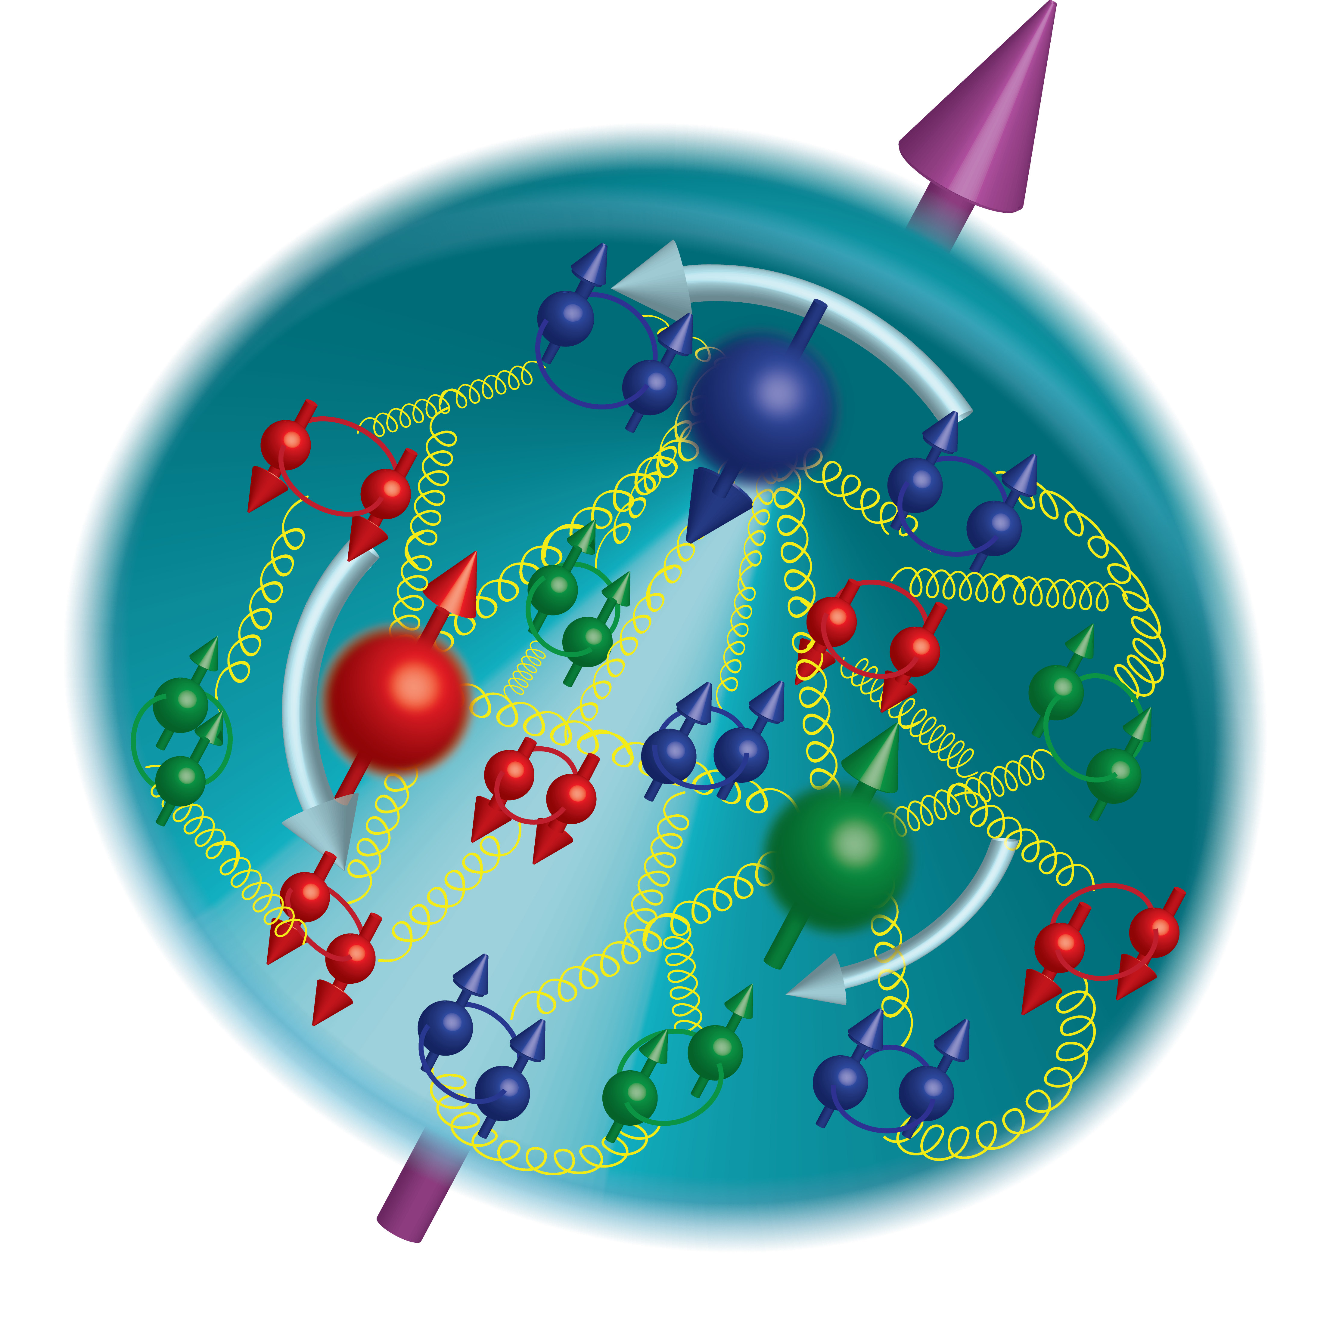
Nucleon g₂ Structure Function at Large x: Probing Color Forces
Zein-Eddine Meziani
Temple University
Outline:
Introduction
Quark-gluon correlations and color forces
JLab d2n and SANE experiments
Experimental results
Summary
On behalf of the d2n and the SANE collaborations

Slide 2
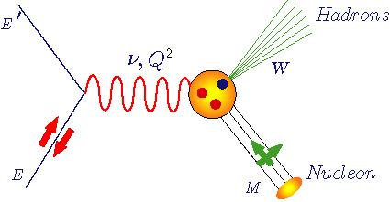
Inclusive Deep Inelastic Scattering: 1-D View
Unpolarized structure functions F₁(x,Q²) and F₂(x,Q²)
Polarized structure functions
g₁(x,Q²) (parton model interpretation)
g₂(x,Q²) (quark-gluon correlations)
U
Q² :Four-momentum transfer
x : Bjorken variable
: Energy transfer
M : Nucleon mass
W : Final state hadrons mass
L
T

Slide 3
Moments of spin structure functions
Gerasimov-Drell-Hearn
Sum Rule
I_{GDH} (0)
Generalized
GDH Integral
I_{GDH} (Q² )
Bjorken
Sum Rule
Γ₁^{p-n}
Burkhardt-Cottingham
sum rule
Γ₂ (Q²)
Spin
Polarizabilities
γ₀(Q²),δ_{LT} (Q² )
Higher twists & color
forces/polarizabilities
d₂(Q²) , f₂ (Q²)
0
1
10
∞
Lattice QCD
Q²
pQCD
MODELS
DSE
AdS/CFT

Slide 4
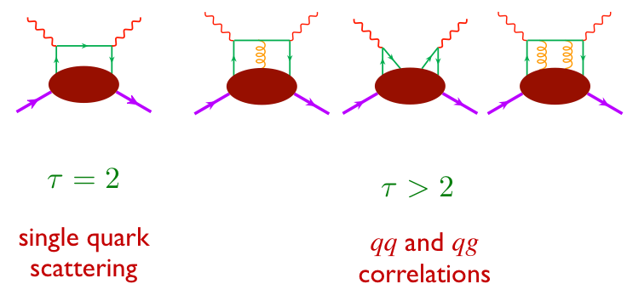
Moments of Structure Functions: Probing Color Forces

Slide 5
Moment of spin structure function g₁

Slide 6
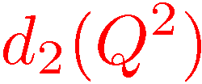
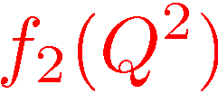
Moments of Structure Functions (continued)
target mass correction term
dynamical twist-3 matrix element
dynamical twist-4 matrix element

Slide 7
g₂ and quark-gluon correlations
Twist -2
Twist -3
a twist-2 term (Wandzura & Wilczek, 1977):
a twist-3 term with a suppressed twist-2 piece (Cortes, Pire & Ralston, 1992):
Transversity
q-g correlations

Slide 8
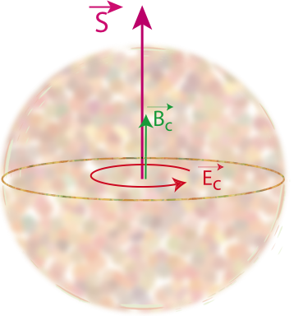
“Color Polarizabilities”
X.Ji 95, E. Stein et al. 95

Slide 9
Lorentz Color Force (M. Burkardt)
M. Burkardt, Phys. Rev. D 88, 114502 (2013) and Nucl. Phys. A 735, 185 (2004).

Slide 10
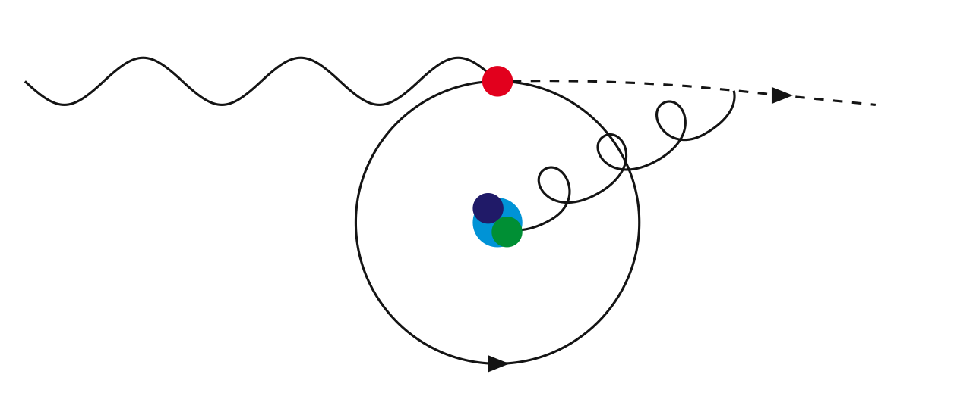
Average Color Lorentz Force (M. Burkardt)

Slide 11
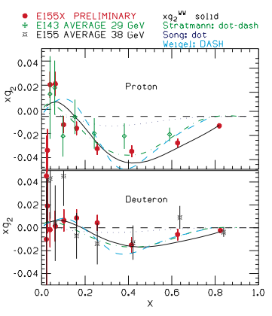
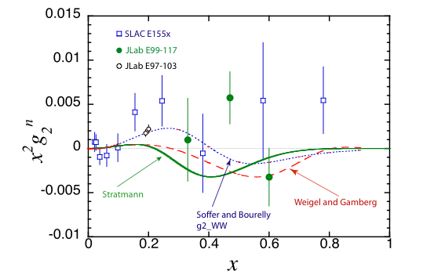
Earlier nucleon world results of g₂
Neutron
SLAC E155x (proton and deuteron)
JLab E99-117(helium-3), A₁^{n} in DIS
Jlab E97-103 (helium 3) Q² dependence below 1 GeV²
SLAC E155x (proton and deuteron)
Recent work on g₂: V. Braun et al. Phys. Rev. D83 (2011) 094023

Slide 12
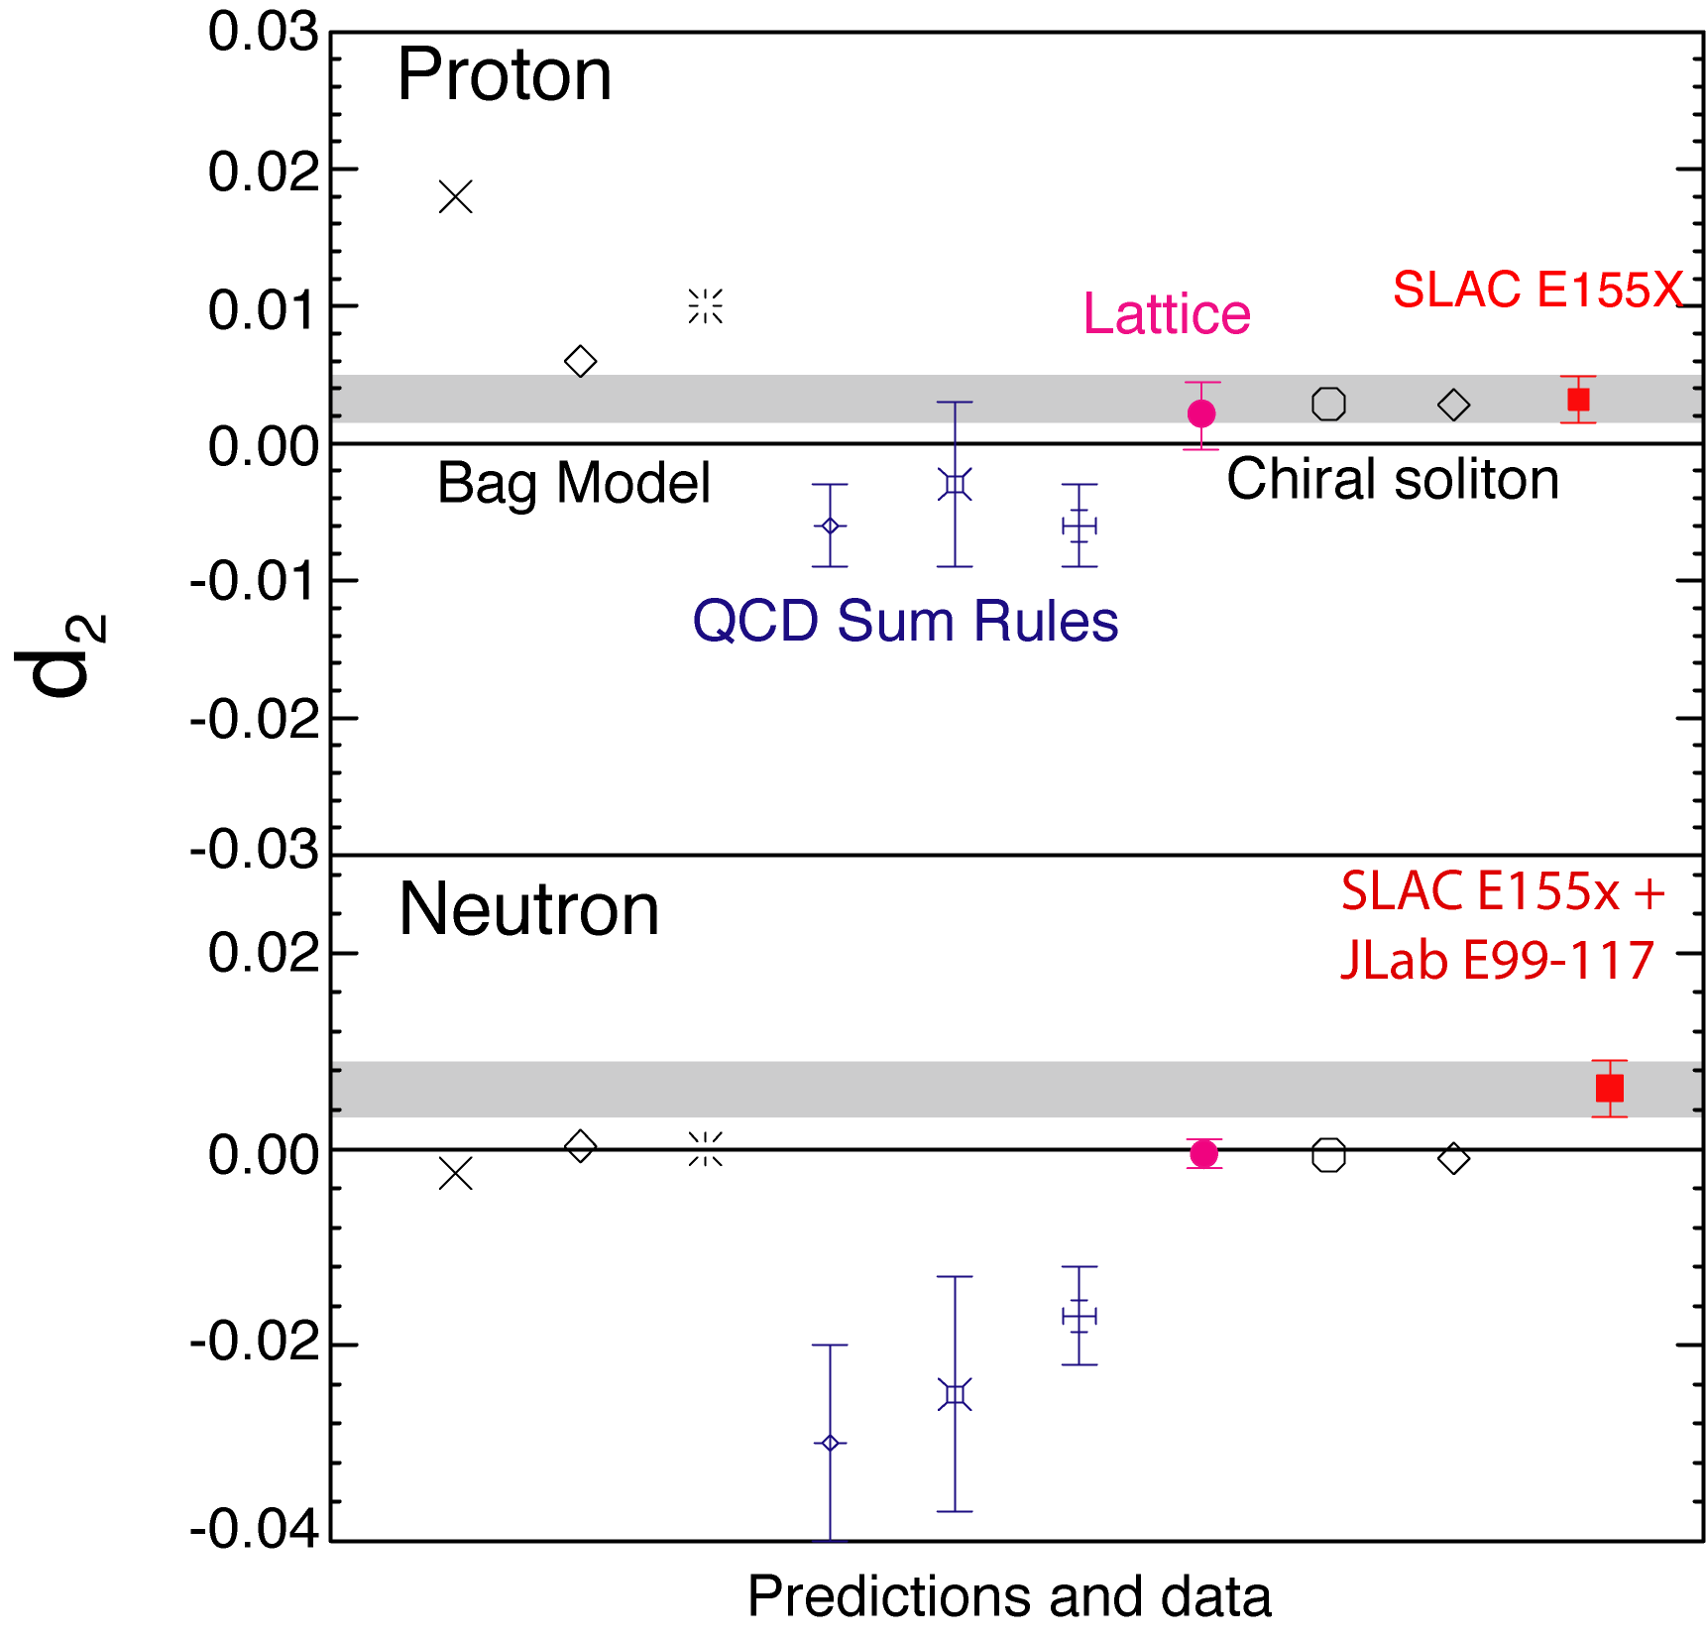
Models and Lattice evaluations of d₂
Quark Bag Models
M.Stratmann, Z.Phys.C60,763(1993).
X.Song, Phys.Rev.D54,1955(1996).
X.Ji and P.Unrau, Phys.Lett.B333,228(1994).
Chiral Soliton Model
H.Weigel and L.Gamberg,
Nucl. Phys. A680, 48 (2000).
M.Wakamatsu, Phys. Lett. B487,118(2000).
Lattice QCD
M.Gockeler et al., Phys.Rev.D72:054507,(2005)

Slide 13
Two Jefferson lab experiments dedicated to measure the g₂ structure function
Hall A d₂^{n} and Hall C SANE
experiments
Neutron and Proton
Spokespeople:
B. Sawatzky, S. Choi, X. Jiang and Z.-E.M
Students:
D. Flay, D. Parno, M. Posik
and the Hall A collaboration
Spokespeople:
O. Rondon, S. Choi, M. Jones and Z.-E. M
Students:
W. Armstrong, H. Kang, A. Liyanage, J. Maxwell,
J. Mulholland
and the Hall C collaboration
Posik, Flay, Parno et al.,
Phys.Rev.Lett. 113 (2014) 2, 022002
Phys.Lett. B744 (2015) 309-314
Analysis close to completion:
Preliminary results

Slide 14
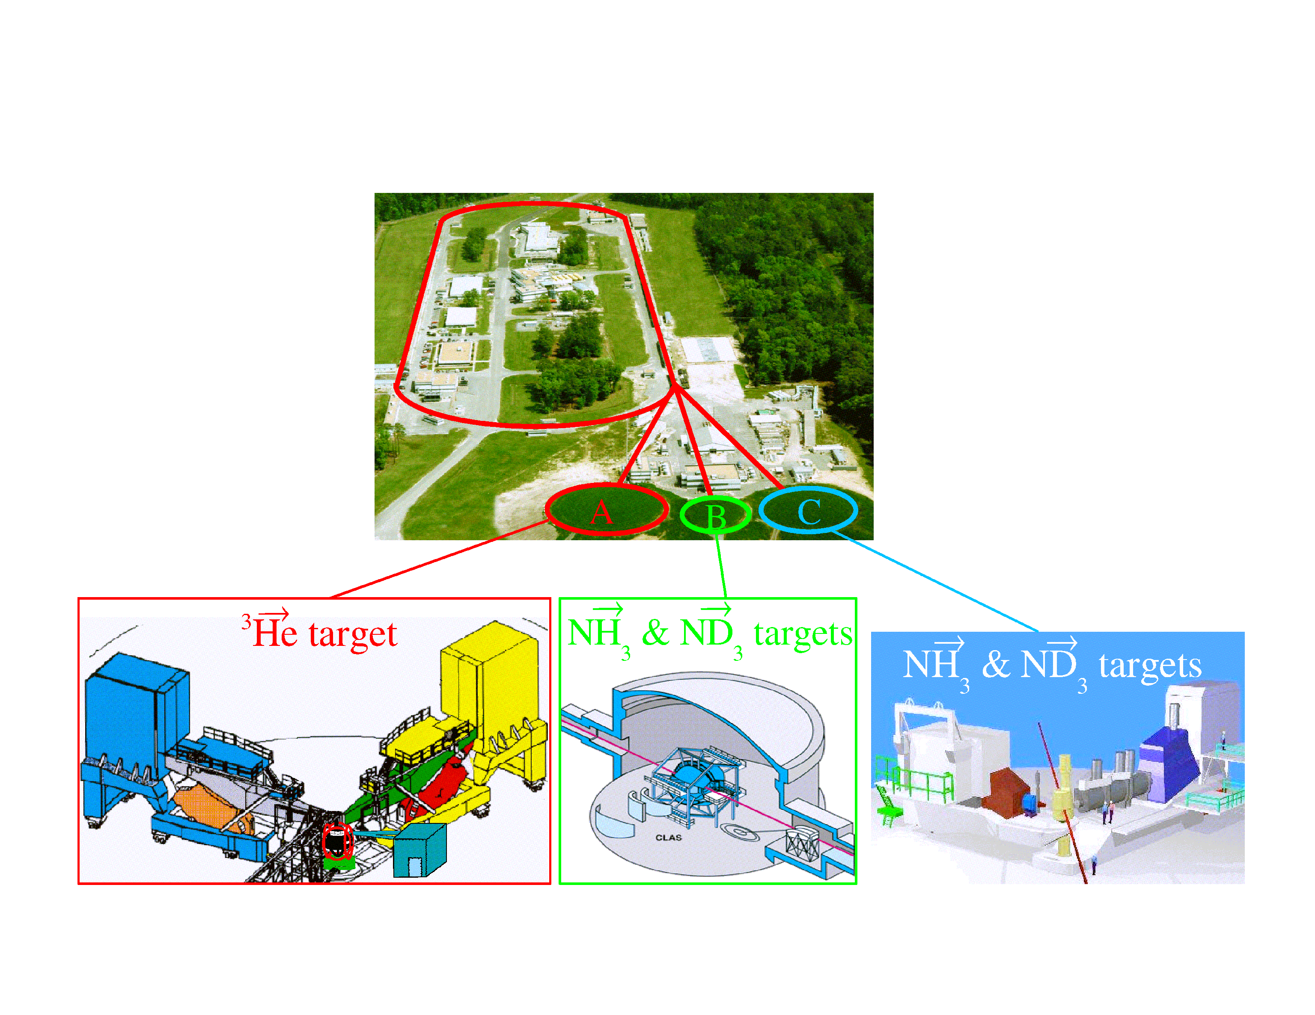
Jefferson Lab Polarized DIS experiments at 6 GeV
6 GeV pol. e beam
Pol=85%, 100μA
HallA: two HRS’ Hall B:CLAS Hall C: HMS+SOS
Luminosity~10³⁶ (cm⁻² s⁻¹ )
Luminosity up to 10³⁵ (cm⁻² s⁻¹ )

Slide 15
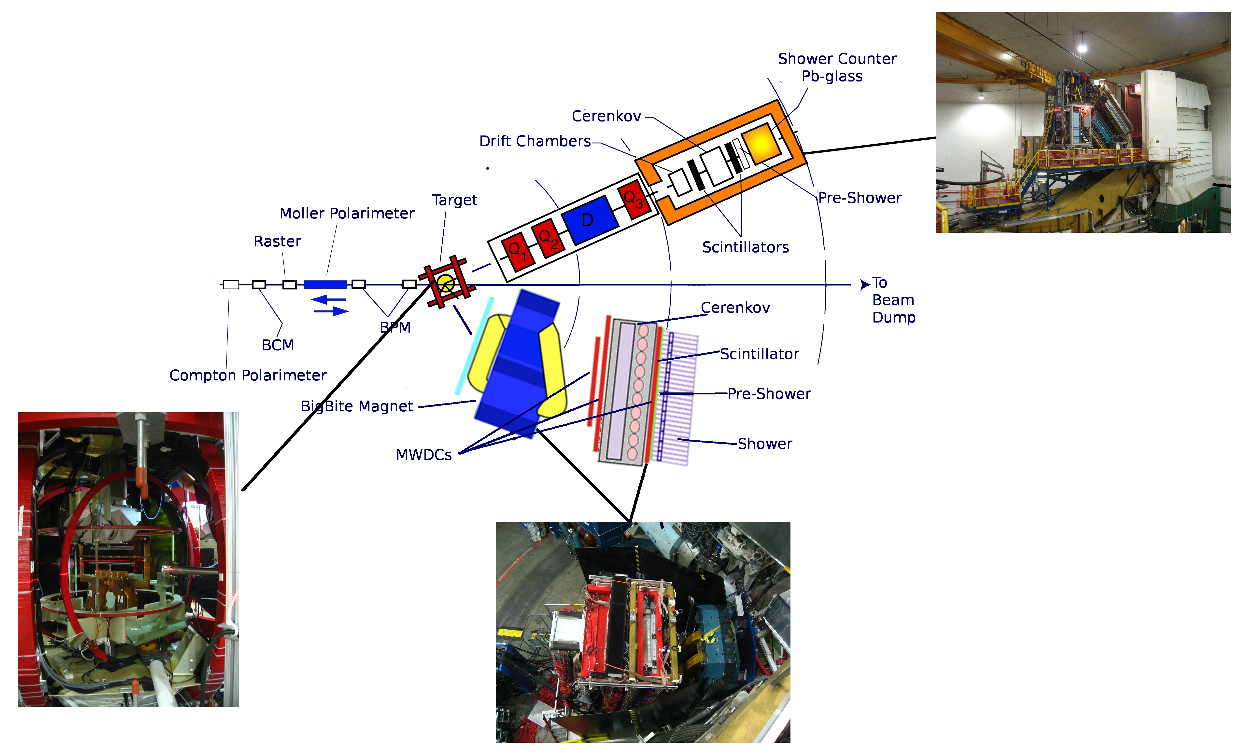
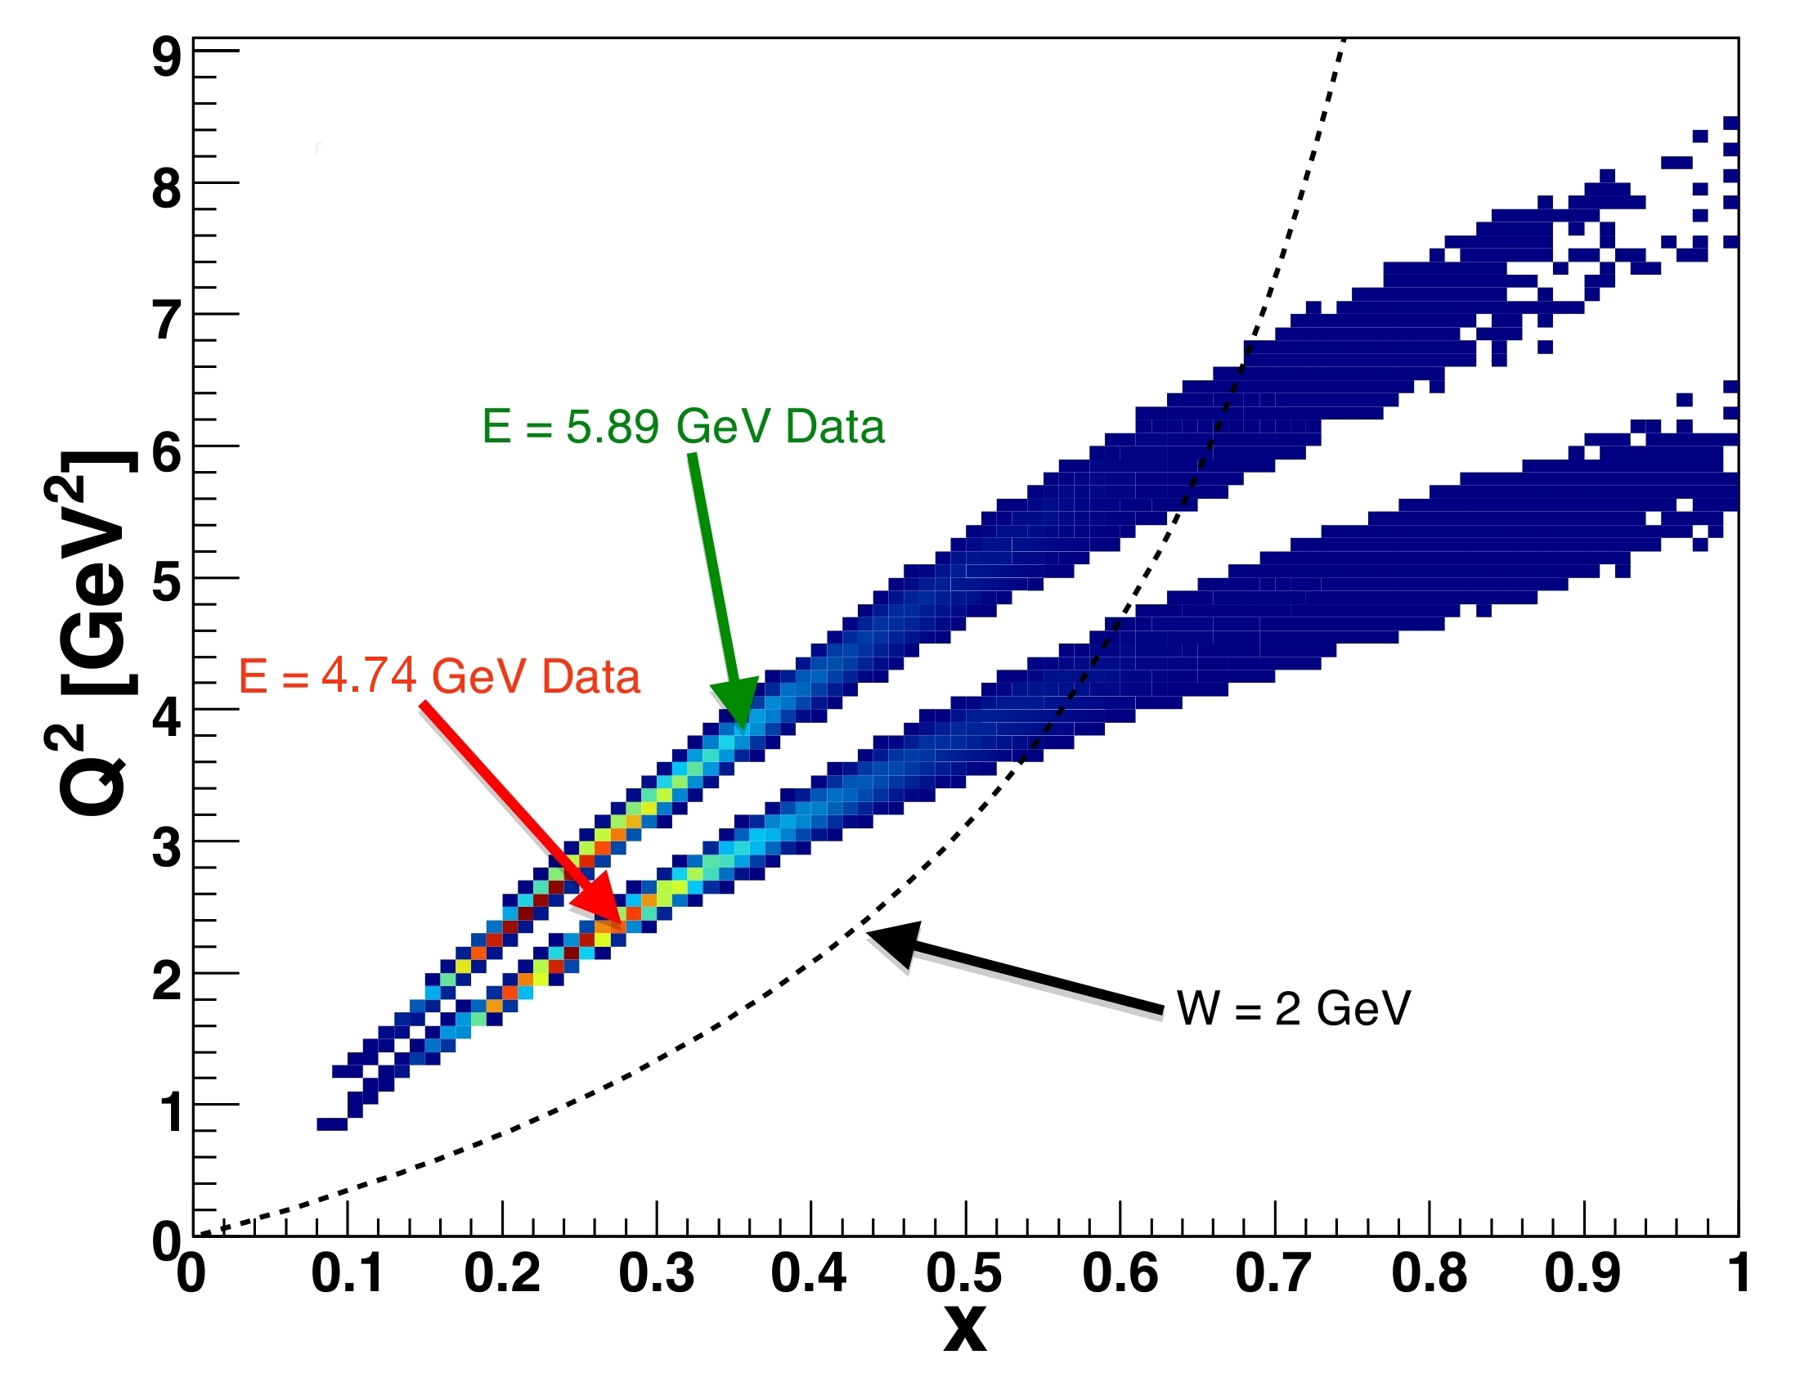
The JLab E06-014 (d₂^{n}) Experiment
Polarized electron beam: E=4.74, 5.89 GeV, polarization ~ 71%
Polarized ³He target ~ 50%
HRS used for absolute cross section measurements at 45⁰
Bigbite used for asymmetries measurements at 45⁰

Slide 16
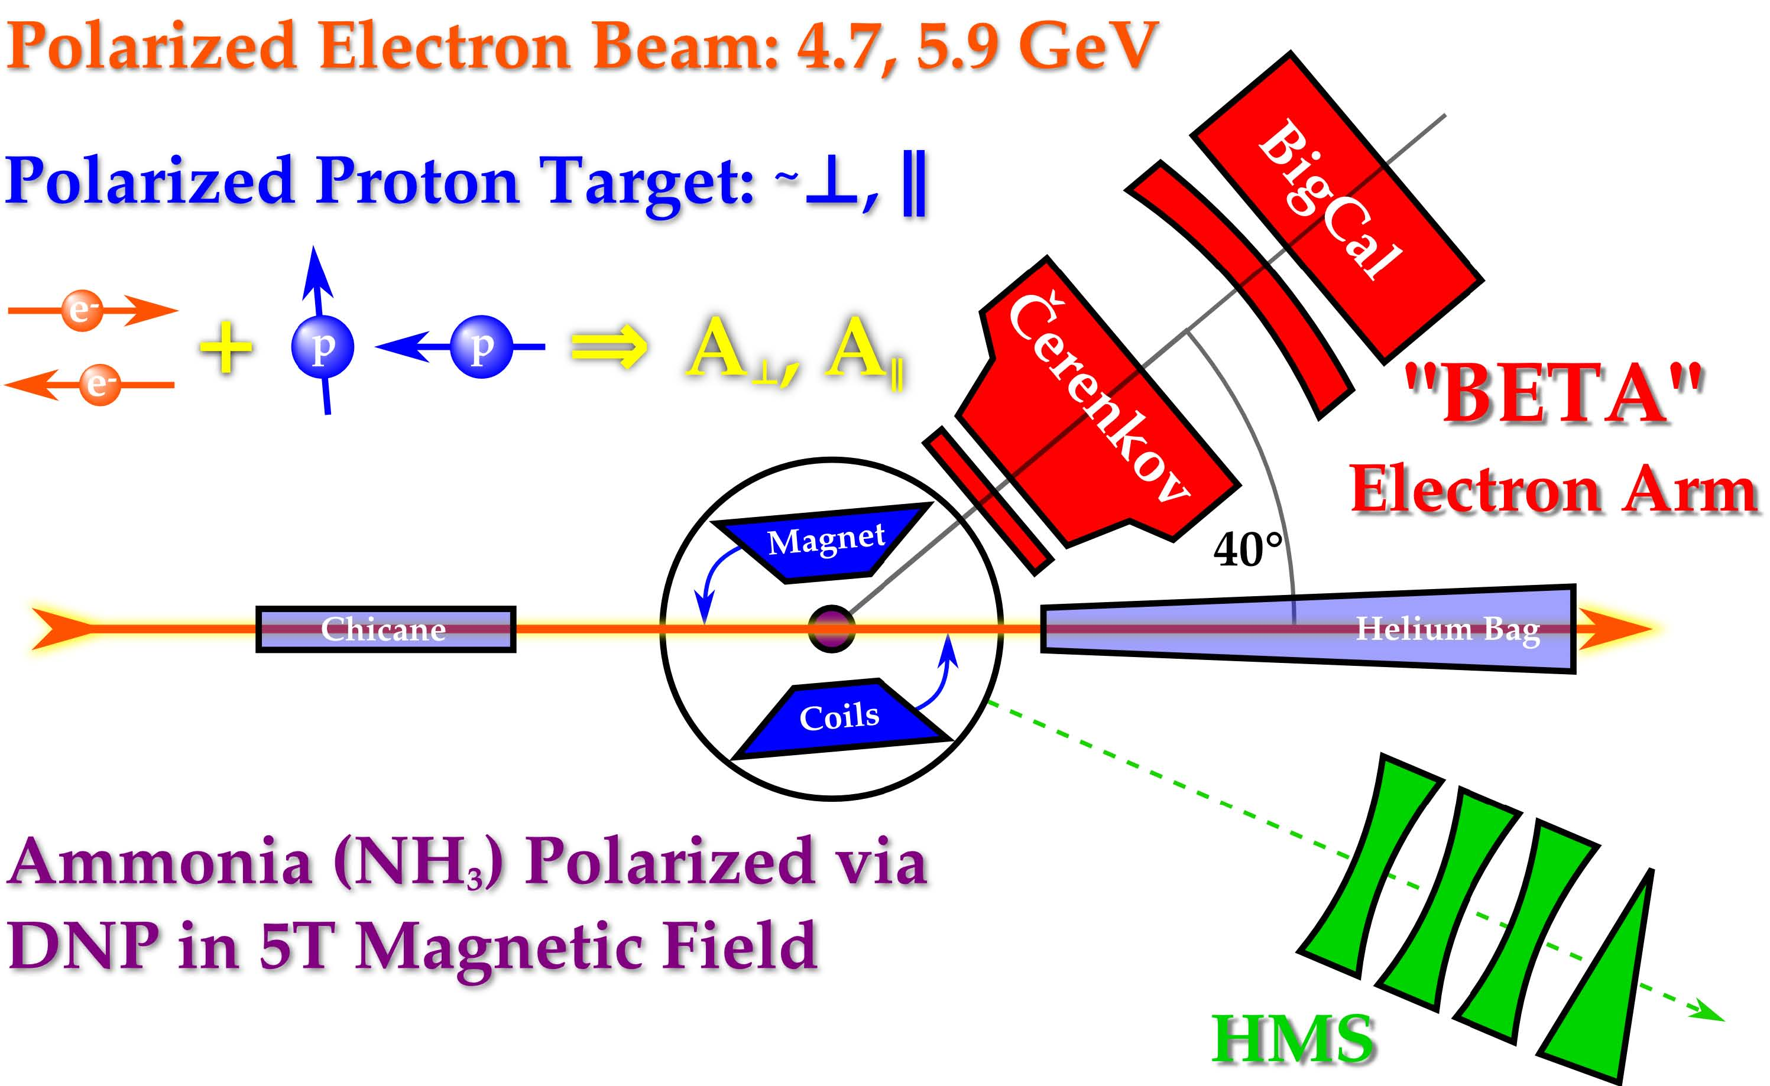
Spin Asymmetries of the Nucleon Experiment (SANE)

Slide 17
³He g₂ structure function
M. Posik, D. Flay, D. Parno et al.
Phys.Rev.Lett. 113 (2014) 2, 022002
V. Braun et al. Nucl. Phys. B603 (2001) 69-124

Slide 18
³He g₂ structure function

Slide 19
d₂^{n} results compared to calculations

Slide 20
Proton g₂ spin structure function (SANE)
Beta proton data
DIS and Resonance data
g2^{WW} curves using g₁ at Q² = 4 GeV²
E’> 0.6 GeV
More data at Q² = 1.6 GeV²
(W. Armstrong)

Slide 21
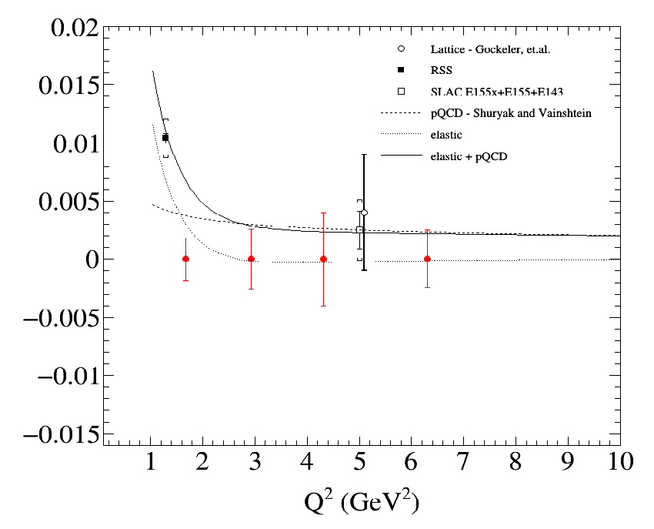
Proton d₂ compared to calculations
Nachtmann moments are needed to get twist-3 free of target mass corrections
Preliminary
Stat errors only
(W. Armstrong)

Slide 22
Flavor separated color forces
Will finalize the SANE proton results …

Slide 23
Summary
The neutron was measured with precision and found consistent with Lattice and in contrast with previous results.
The proton d₂ is measured with reasonable precision and found to be consistent with Lattice QCD calculations and consistent with the SLAC data around 5 GeV². The results need to be finalized.
Using the proton and neutron data a preliminary flavor decomposition of the color forces is carried out.
This program will be pursued at JLab 11 GeV for higher precision and greater Q² and x coverage.

