Slide 1
Welcome
Stuart Henderson
May 22, 2017

Slide 2
QCD Evolution and Jefferson Lab Program
Welcome, we’re very pleased to host this meeting!
Understanding QCD and hadron structure is one of the key missions of the Jefferson Lab scientific program
JLab 12 GeV Upgrade is nearly complete, already producing data and exciting new physics results
To get the best physics results from JLab12 data needs strong theory support, new ideas and tools, and strong coupling between theory and experiment
Jlab 12 GeV will be critically important for preparing the physics program at the future EIC

Slide 3
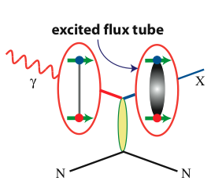
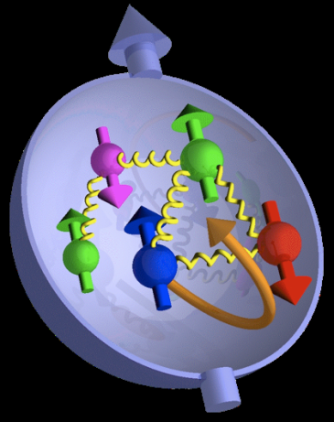

Jefferson Lab @ 12 GeV Science Questions
excited gluon field
What is the role of gluonic excitations in the spectroscopy of light mesons?
Where is the missing spin in the nucleon?
Role of orbital angular momentum?
Can we reveal a novel landscape of nucleon substructure through 3D imaging at the femtometer scale?
Can we discover evidence for physics
beyond the standard model
of particle physics?

Slide 4
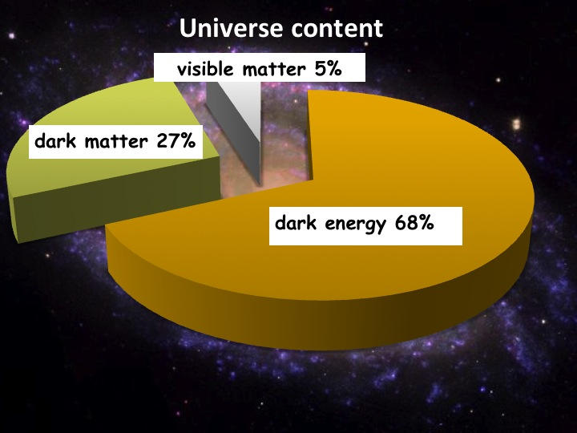
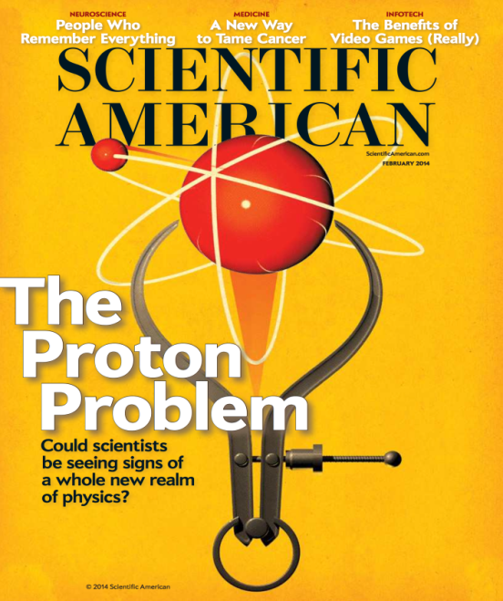
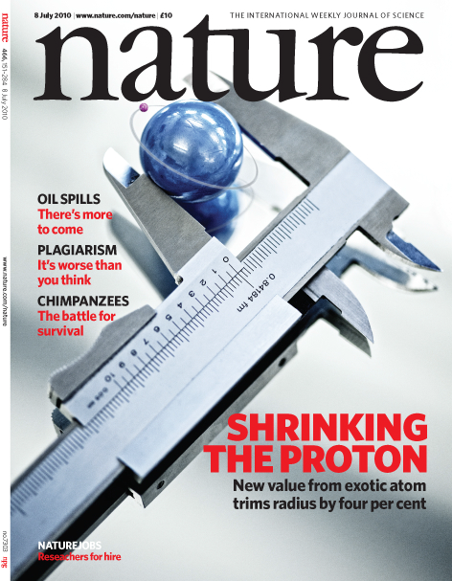
12 GeV Science Era has Begun!
Quark confinement: Hall D (GlueX) started physics operations
  Engineering Run Complete: Basis for > dozen papers at APS DNP Fall 2016 Meeting
  First 12 GeV era publication: 24 April, 2017!
  First physics run: 50 Billion events in Spring 2017
Nucleon Structure(I): Hall A in physics operations
  GMp experiment completed in Fall 2016
  First phase of DVCS experiment completed
Nuclear Structure: First experiment completed
  Argon Spectral Function experiment completed in Hall A in Spring 2017
Fundamental Symmetries: Hall B Heavy Photon Search
  First results of 2015 engineering run presented
Nucleon Structure (II): Hall B Proton Radius (PRad)
  Experiment run and completed Summer 2016
Starting to exploit the Upgrade for Physics

Slide 5
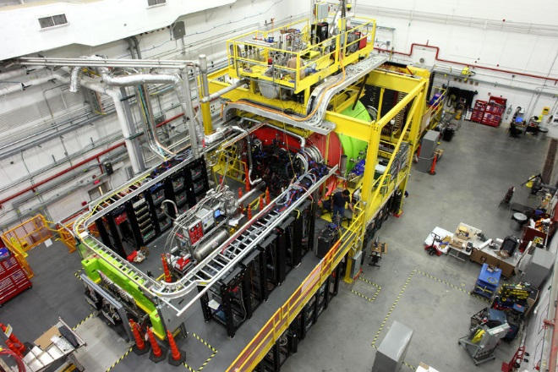
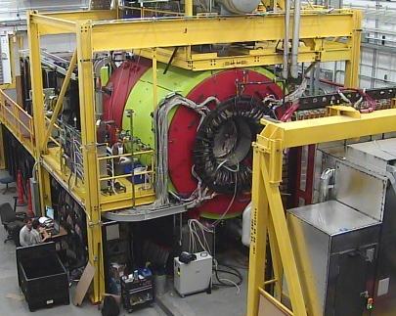
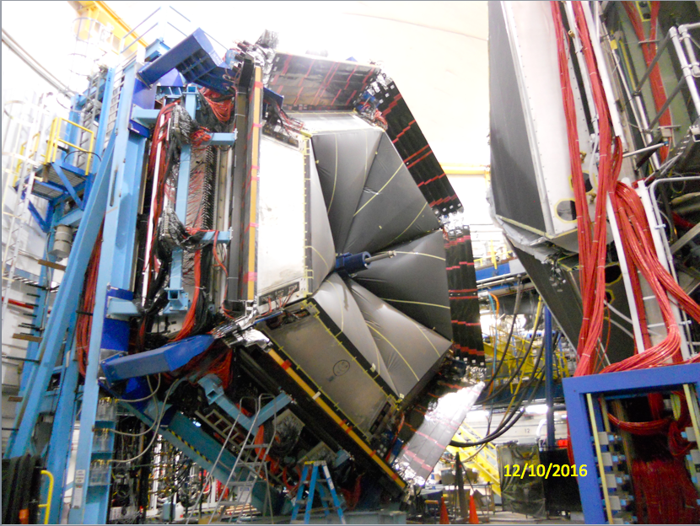
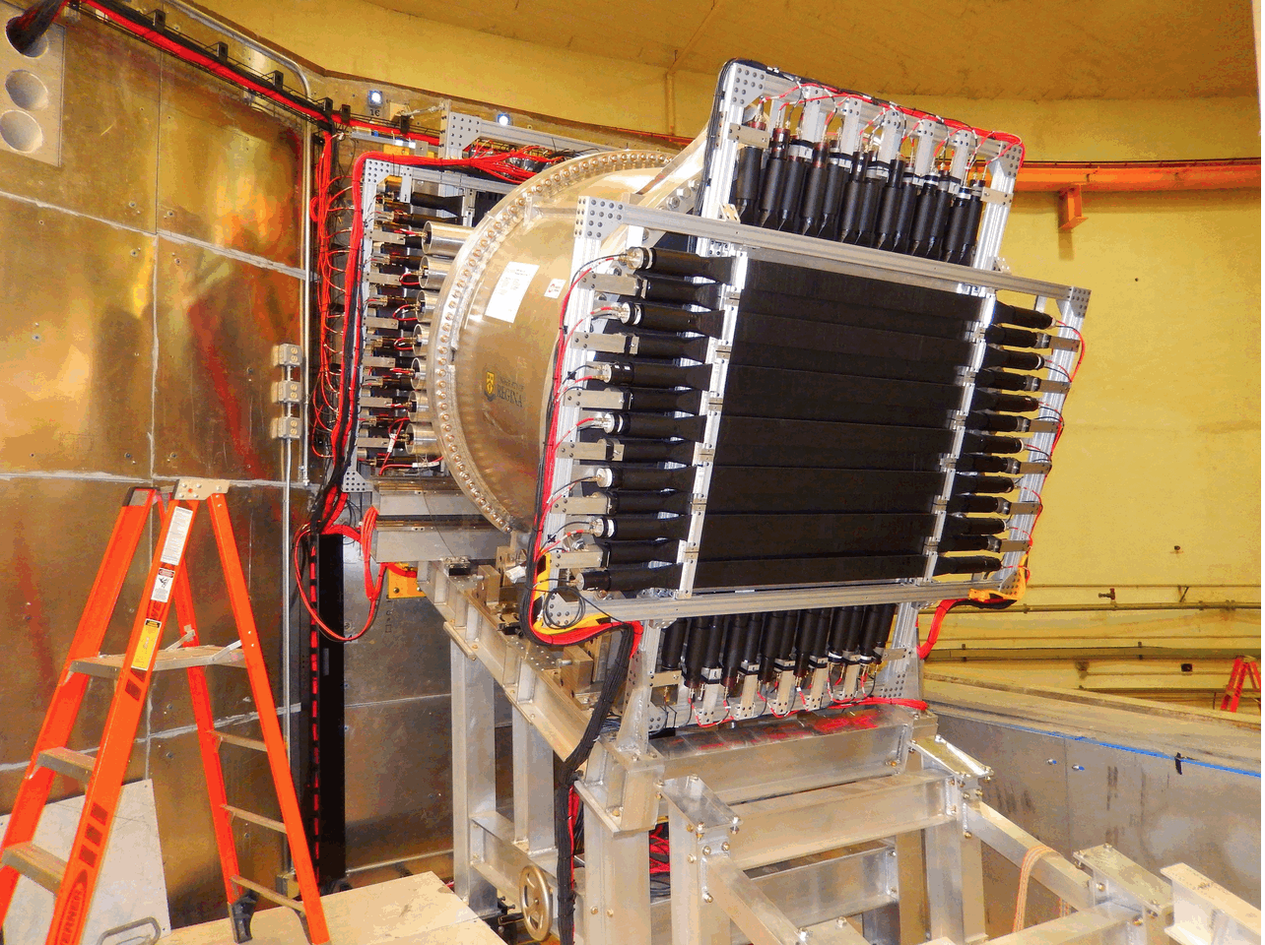
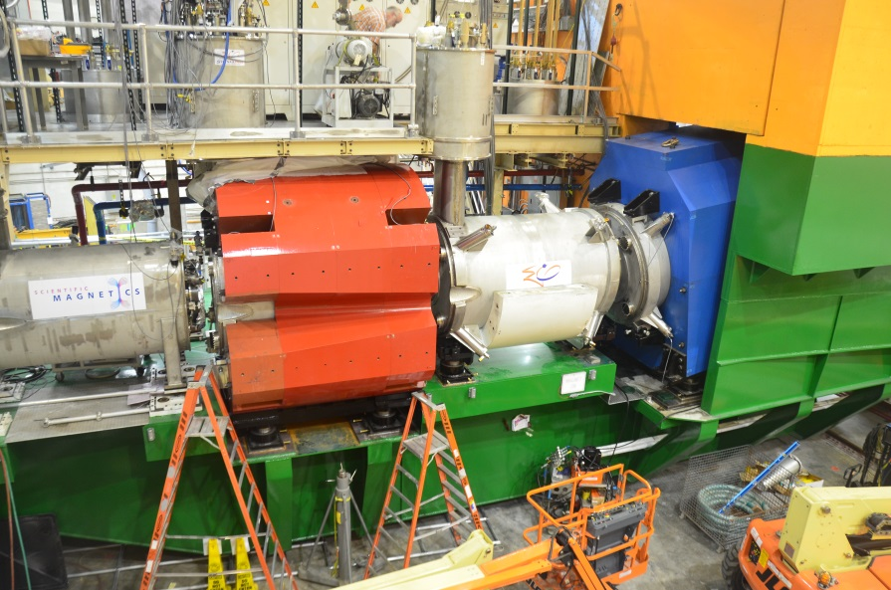
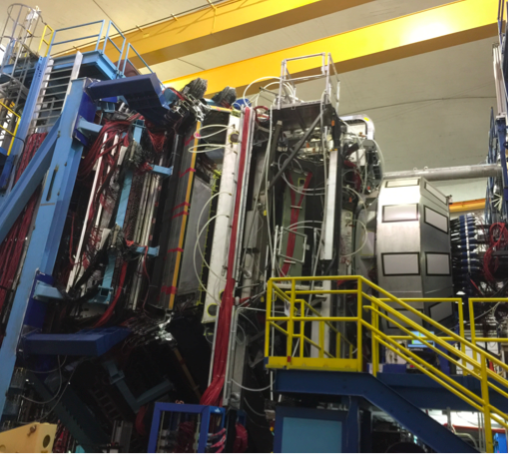
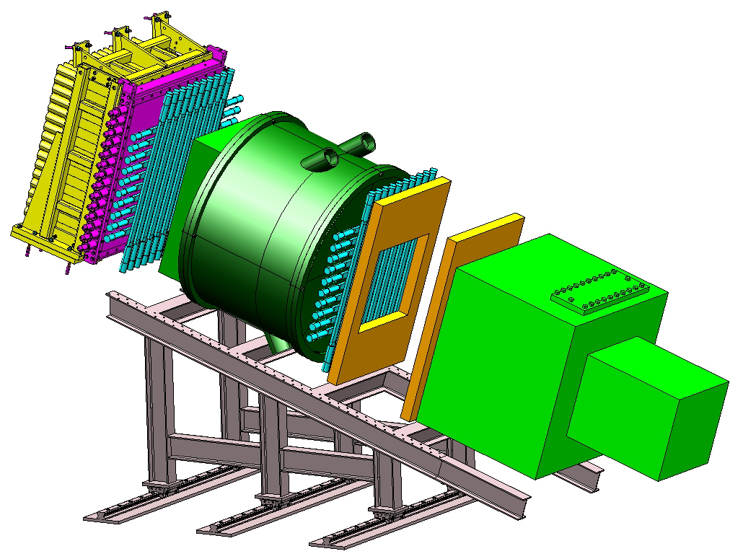
12 GeV Upgrade Project
Project 99.7% Complete (through March)
All Key Performance Parameters Achieved
All CD-4B Scope complete (with exception of Hall B Solenoid delivery/install/commission)

Slide 6
Finally…
The series of QCD evolution workshops has been very helpful for Jefferson Lab’s scientific programs.
Jefferson lab has been and will continue to be very supportive of this workshop and its efforts
Welcome!

