Slide 1
TMD EFFECTS IN SIDIS @ COMPASS

Slide 2
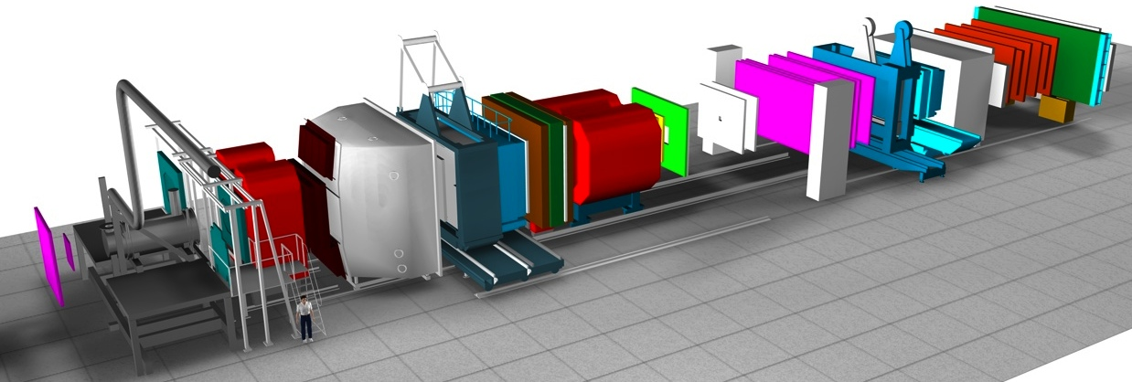
Space resolution
Target
region
Large
Angle
Spectrometer
Small
Angle
Spectrometer
SM2
SM1
10 µ 100µ 200µ 500µ 1 mm
Space resolution is function of the distance to the target

Slide 3
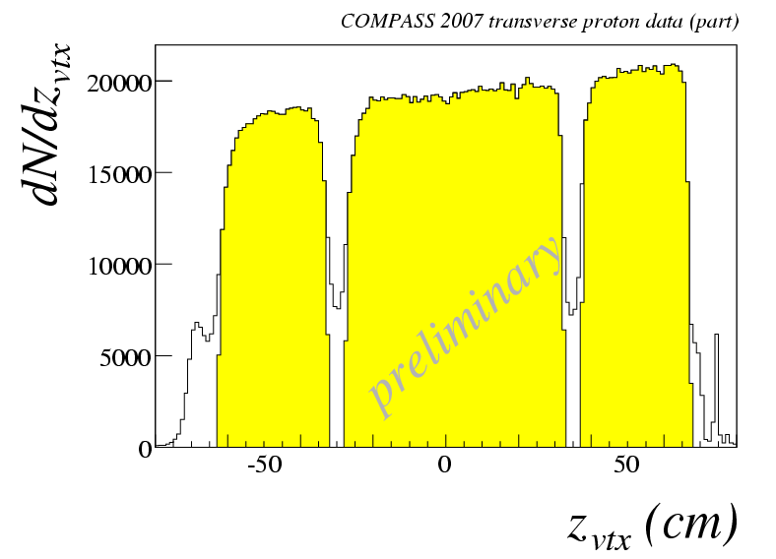
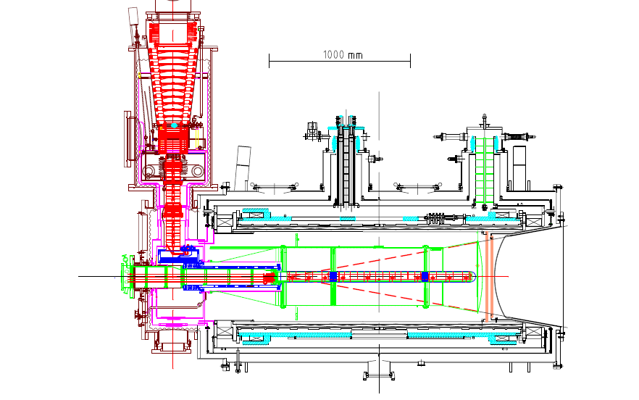
the polarized target system (>2005)
³He – ⁴He dilution refrigerator (T~50mK)
solenoid 2.5T
dipole magnet 0.6T
acceptance > ± 180 mrad
3 target cells
30, 60, and 30 cm long
μ
opposite polarisation
d (⁶LiD) p (NH₃)
polarization 50% 90%
dilution factor 40% 16%
no evidence for relevant
nuclear effects (160 GeV)

Slide 4
COMPASS data taking
muon beam | deuteron (⁶LiD) PT | 2002 2003 2004 | 80% L/20% T target polarisation
 |  | 2006 | L target polarisation
 | proton (NH₃) PT | 2007 | 50% L /50% T target polarisation
Hadron | LH target | 2008 2009
muon beam | proton (NH₃) PT | 2010 | T target polarisation
 |  | 2011 | L target polarisation
Hadron | Ni target | 2012 | Primakoff
muon beam | LH2 target | 2012 | Pilot DVCS & unpol. SIDIS
Hadron | Proton (NH3) DT PT | 2014 2015 2018 | Pilot DY run DY run 2° year of DY run
muon beam | LH2 target | 2016 2017 | DVCS & unpol. SIDIS

Slide 5
Measurements with the target transversely polarized:
Year | Obs
2005 | $$A_{Siv, d}^{h}, A_{Col, d}^{h}$$ | First ⁶LiD data
2006 | $$A_{Siv, d}^{h}, A_{Col, d}^{h}$$ | Full ⁶LiD statistics
2009 | $$A_{Siv, d}^{π^{±},{ K}^{±}, K_{s}^{0}}, A_{Col, d}^{π^{±},{ K}^{±}, K_{s}^{0}}$$ | Full ⁶LiD statistics
2010 | $$A_{Siv, p}^{h}, A_{Col, p}^{h}$$ | 2007 NH₃ data
2012 | $$A_{UT,d}^{sinφ_{RS}},A_{UT,p}^{sinφ_{RS}}$$ | $$\text{Full} \text{6}\text{LiD}$$
2012 | $$A_{Siv, p}^{h}, A_{Col, p}^{h}$$ | $$\text{Full} \text{NH}\text{3}\text{statistics}$$
2012 | $A_{UT,d}^{sin\left(φ_{ρ}−φ_{S}\right)}$, $A_{UT,p }^{sin\left(φ_{ρ}−φ_{S}\right)}$ | Exclusive${ ρ}^{0}$
2013 | $$A_{UT,d}^{\left(φ_{ρ},φ_{S}\right)}\text{, }A_{UT,p }^{\left(φ_{ρ},φ_{S}\right)}$$ | Exclusive${ ρ}^{0}$, all asyms.
2014 | $$A_{UT,d}^{sinφ_{RS}},A_{UT,p}^{sinφ_{RS}}$$ | $\text{Full} \text{6}\text{LiD}$and NH₃
2014 | $$A_{Siv, d}^{π^{±},{ K}^{±}, K_{s}^{0}}, A_{Col, d}^{π^{±},{ K}^{±}, K_{s}^{0}}$$ | Full NH₃ statistics
2015 | Interplay $A_{UT,p}^{sinφ_{RS}}$ vs $A_{Col, p}^{h}$ | Full NH₃ statistics
2016 | $A_{Siv, p}^{h}$ binned in $Q^{2}$ to be in DY range | Full NH₃ statistics
Year | Obs
2013 | $${{dn}^{h}}/{\left({dN}^{μ}dz dp_{T}^{2}\right)}$$ | 2004, full
2014 | $A_{UU,d}^{\cos{φ_{h}}},A_{UU,d}^{\cos{{2φ}_{h}}}$, $A_{LU,d}^{\sin{φ_{h}}}$ | 2004, part
2016 | ${{dn}^{π}}/{\left({dN}^{μ}dz\right)}$, ${{dn}^{K}}/{\left({dN}^{μ}dz\right)}$ | 2006, full
2016 | $${{dn}^{h}}/{\left({dN}^{μ}dz dp_{T}^{2}\right)}$$ | 2006, full

Slide 6
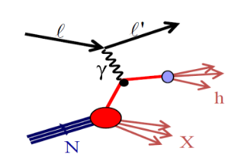
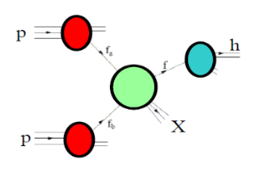
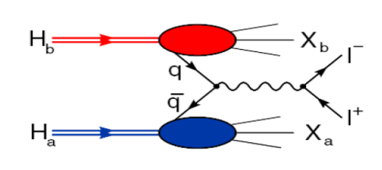
Accessing TMD PDFs and FFs
SIDIS off polarized p, d, n targets
hard polarised pp scattering
polarised Drell-Yan
$e^{+}e^{−}→h_{1}h_{2}$
HERMES
COMPASS
JLab
future: eN colliders
$$σ^{ℓp→ℓ^{′}hX}\sim f_{q,p}\left(x,k_{⊥}^{2} \right)⊗σ^{ℓq→q}⊗D_{1q}^{h}(z,p_{⊥}^{2})$$
RHIC
COMPASS
RHIC
FNAL
future: FAIR, JPark, NICA
$$σ^{hp→ℓℓ}\sim {\overline{f}}_{q,h}\left(x_{1},k_{⊥}^{2}\right)⊗f_{q,p}\left(x_{2},k_{⊥}^{2}\right)⊗{\hat{σ}}^{\overline{q}q→μμ}\left(\hat{s}\right)$$
BaBar
Belle
Bes III
$$σ^{e^{+}e^{−}→h_{1}h_{2}}\sim {\hat{σ}}^{ℓℓ→\overline{q}q}\left(\hat{s}\right)⊗D_{q}^{h_{1}}\left(z_{1},p_{⊥}^{2}\right)⊗D_{q}^{h_{2}}\left(z_{2},p_{⊥}^{2}\right)$$

Slide 7
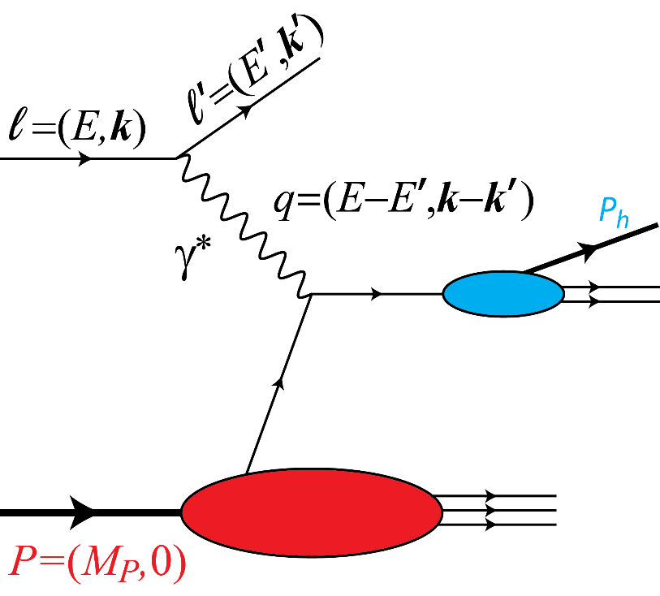
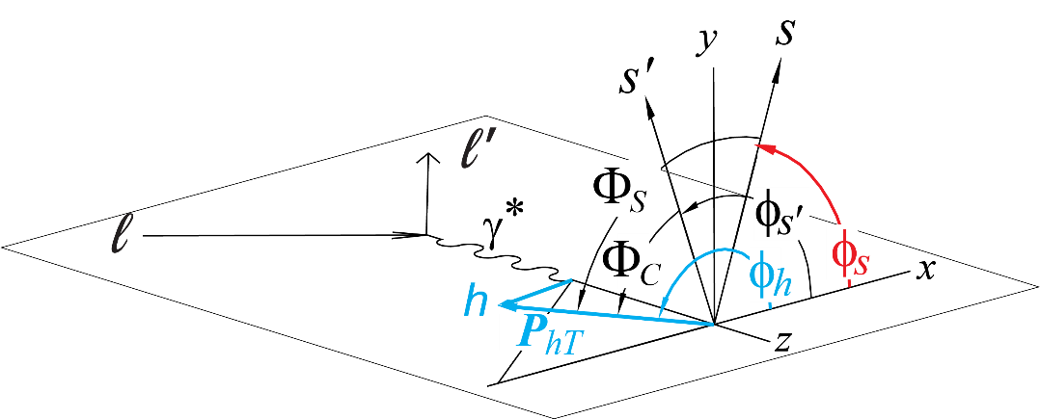
SIDIS Measurements
hard interaction of a lepton with a nucleon via virtual photon exchange
$$Q^{2}=−q^{2}$$
$$x=\frac{Q^{2}}{2P∙q}=\frac{Q^{2}}{2M_{p}ν}$$
$$y=\frac{P∙q}{P∙ℓ}=\frac{E−E′}{E}$$
$$W^{2}={\left(P+q\right)}^{2}=M_{P}^{2}−Q^{2}+2M_{p}ν$$
$$z=\frac{P∙P_{h}}{P∙q}=\frac{E_{h}}{ν}$$
$$σ^{ℓP→ℓhX }∝\sum_{q}{f_{q}\left(x,k_{⊥}^{2};Q^{2} \right)⊗σ^{ℓq→q}⊗D_{1q}^{h}(z,p_{⊥}^{2};Q^{2})}$$

Slide 8
Kinematic coverage
Notes:
8
\

Slide 9
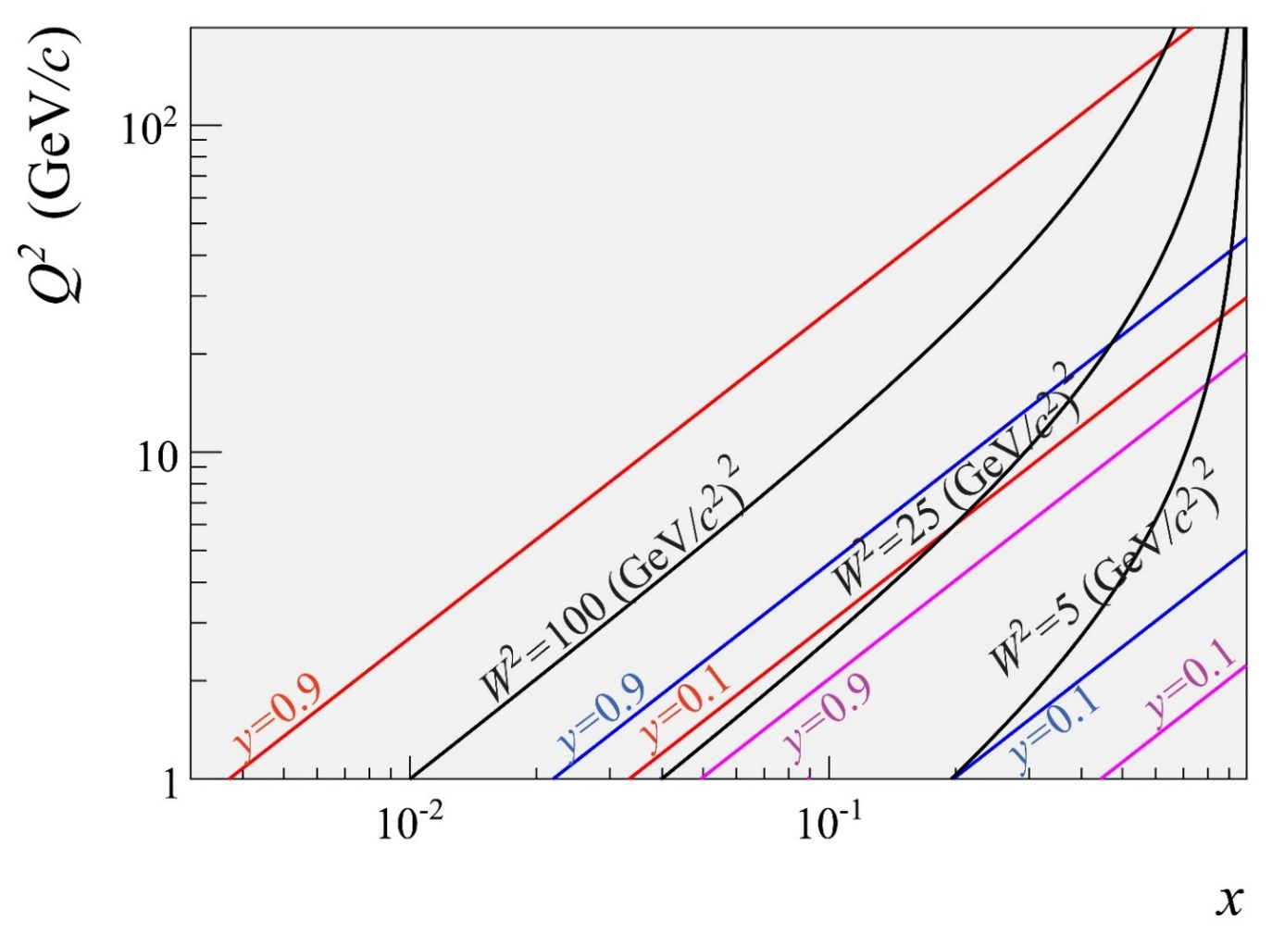
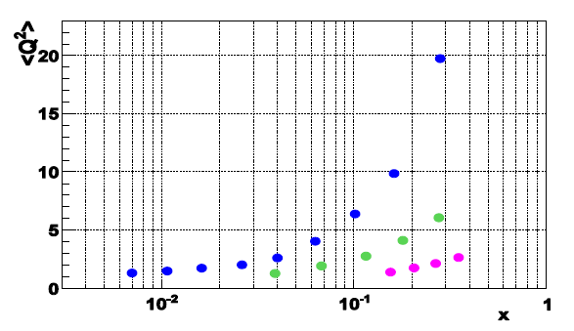
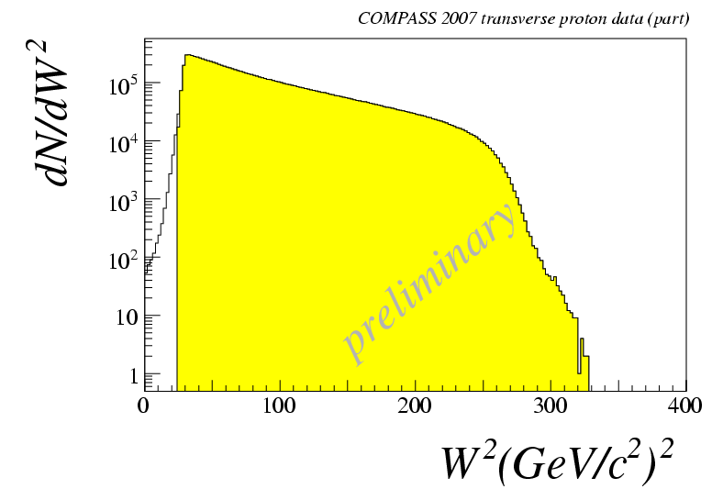
Kinematic coverage
COMPASS
HERMES
JLAB12
Notes:
9
\

Slide 10
SIDIS access to TMDs
$$σ^{ℓp→ℓ^{′}hX}\sim f_{q,p}\left(x,k_{⊥}^{2} \right)⊗σ^{ℓq→q}⊗D_{1q}^{h}(z,p_{⊥}^{2})$$
TMDs
FFs
Nucleon polarization
Hadron polarization
 | U | T | L
U | $$f_{1}$$ | $$f_{1T}^{⊥}$$
T | $$h_{1}^{⊥}$$ | $$h_{1}, h_{1T}^{⊥}$$ | $$h_{1L}^{⊥}$$
L |  | $$g_{1T}$$ | $$g_{1L}$$
 | U | T | L
U | $$D_{1}$$ | $${ D}_{1T}^{⊥}$$
T | $$H_{1}^{⊥}$$ | $H_{1}^{}, { H}_{1T}^{⊥}$ | $${ H}_{1T}^{⊥}$$
L |  | $${ G}_{1T}^{}$$ | $$G_{1L}$$
Parton polarization
Parton polarization
T odd
chiral odd
Factorisation (Collins & Soper, Ji, Ma, Yuan,
Qiu & Vogelsang, Collins & Metz...)

Slide 11
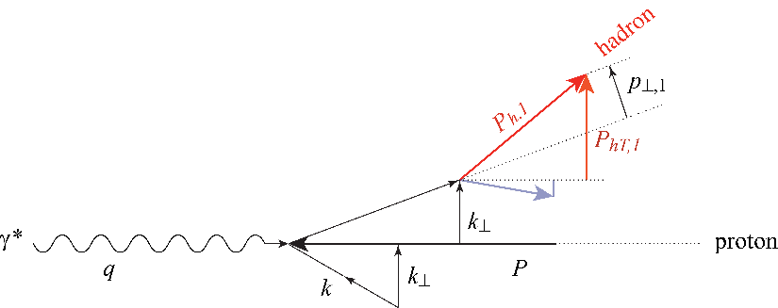
Importance of unpolarised SIDIS
The cross-section dependence from $P_{hT}$ results from:
intrinsic $k_{⊥}$ of the quarks
$p_{⊥}$ generated in the quark fragmentation
A Gaussian ansatz for $k_{⊥}$ and $p_{⊥}$ leads to
$\left\langle P_{hT}^{2}\right\rangle =z^{2}\left\langle k_{⊥}^{2}\right\rangle +\left\langle p_{⊥}^{2}\right\rangle$
The azimuthal modulations in the unpolarised cross sections comes from:
Intrinsic $k_{⊥}$ of the quarks
The Boer-Mulders PDF
Difficult measurements were one has to correct for the apparatus acceptance
COMPASS and HERMES have
results on ${}_{}^{6}{LiD} \left(\sim d\right)$ and $d$ and on p (Hermes only)
No COMPASS measurements on $p$ since on $NH_{3} \left(\sim p\right)$ nuclear effects may be important
$⇒$COMPASS-II, measurements on LH₂ in parallel with DVCS

Slide 12
Unpolarised Azimuthal Modulation
The full cross section for the unpolarised case is written as:
$$\frac{dσ}{dx dy dz dP_{hT}^{2} dφ_{h} dψ}=\left[\frac{α^{2}}{xyQ^{2}}\frac{y^{2}}{2\left(1−ε\right)}\left(1+\frac{γ^{2}}{2x}\right)\right]\left(F_{UU,T}+εF_{UU,L}\right)\left\{1+\cos{φ_{h}}\sqrt{2ε\left(1+ε\right)}A_{UU}^{\cos{φ_{h}}}+\cos{2φ_{h}A_{UU}^{\cos{{2φ}_{h}}}}\right\}$$
Bacchetta, Diehl, Goeke, Metz, Mulders and Schlegel JHEP 0702:093 (2007)
$$ε=\frac{1−y−\frac{1}{4}y^{2}γ^{2}}{1−y+\frac{1}{2}y^{2}+\frac{1}{4}y^{2}γ^{2}} and γ=\frac{2xM}{Q}$$
$$A_{UU}^{x}\left(x, z,dP_{hT}^{2}, Q^{2}\right)=\frac{F_{UU}^{x}}{F_{UU,T}+εF_{UU,L}}$$
$F_{UU}=C\left[f_{1}D_{1}\right]=x\sum_{q}{e_{q}^{2}}\int{d{\vec{p}}_{⊥}d{\vec{k}}_{⊥}}δ^{2}\left(z{\vec{k}}_{⊥}+{\vec{p}}_{⊥}−{\vec{P}}_{hT}\right)f_{1}^{q}\left(x,k_{⊥}^{2},Q^{2}\right)D_{1, q}^{h}\left(z,p_{⊥}^{2},Q^{2}\right)$=

Slide 13
Unpolarised Azimuthal Modulation
When looking at the content of the structure functions/modulations in terms of TMD PDFs for the $\cos{φ_{h}}$ and $\cos{{2φ}_{h}}$ we can write:
In the $\cos{{2φ}_{h}}$ Cahn effects enters only at twist4
$$F_{UU}^{\cos{φ_{h}}}=−\frac{2M}{Q}C\left[\frac{\hat{h}∙{\vec{k}}_{⊥}}{M}f_{1}D_{1}−\frac{p_{⊥}k_{⊥}}{M}\frac{{\vec{P}}_{hT}−z\left(\hat{h}∙{\vec{k}}_{⊥}\right)}{zM_{h}M}h_{1}^{⊥}H_{1}^{⊥}\right]+twists>3$$
$$F_{UU}^{\cos{{2φ}_{h}}}=C\left[\frac{\left(\hat{h}∙{\vec{k}}_{⊥}\right)\left(\hat{h}∙{\vec{p}}_{⊥}\right)−{\vec{p}}_{⊥}∙{\vec{k}}_{⊥}}{MM_{h}}h_{1}^{⊥}H_{1}^{⊥}\right]+twists>3$$
$$F_{Cahn}^{\cos{{2φ}_{h}}}≈\frac{2}{Q^{2}}C\left[\left\{2{\left(\hat{h}∙{\vec{k}}_{⊥}\right)}^{2}−k_{⊥}^{2}\right\}f_{1}D_{1}\right]$$

Slide 14
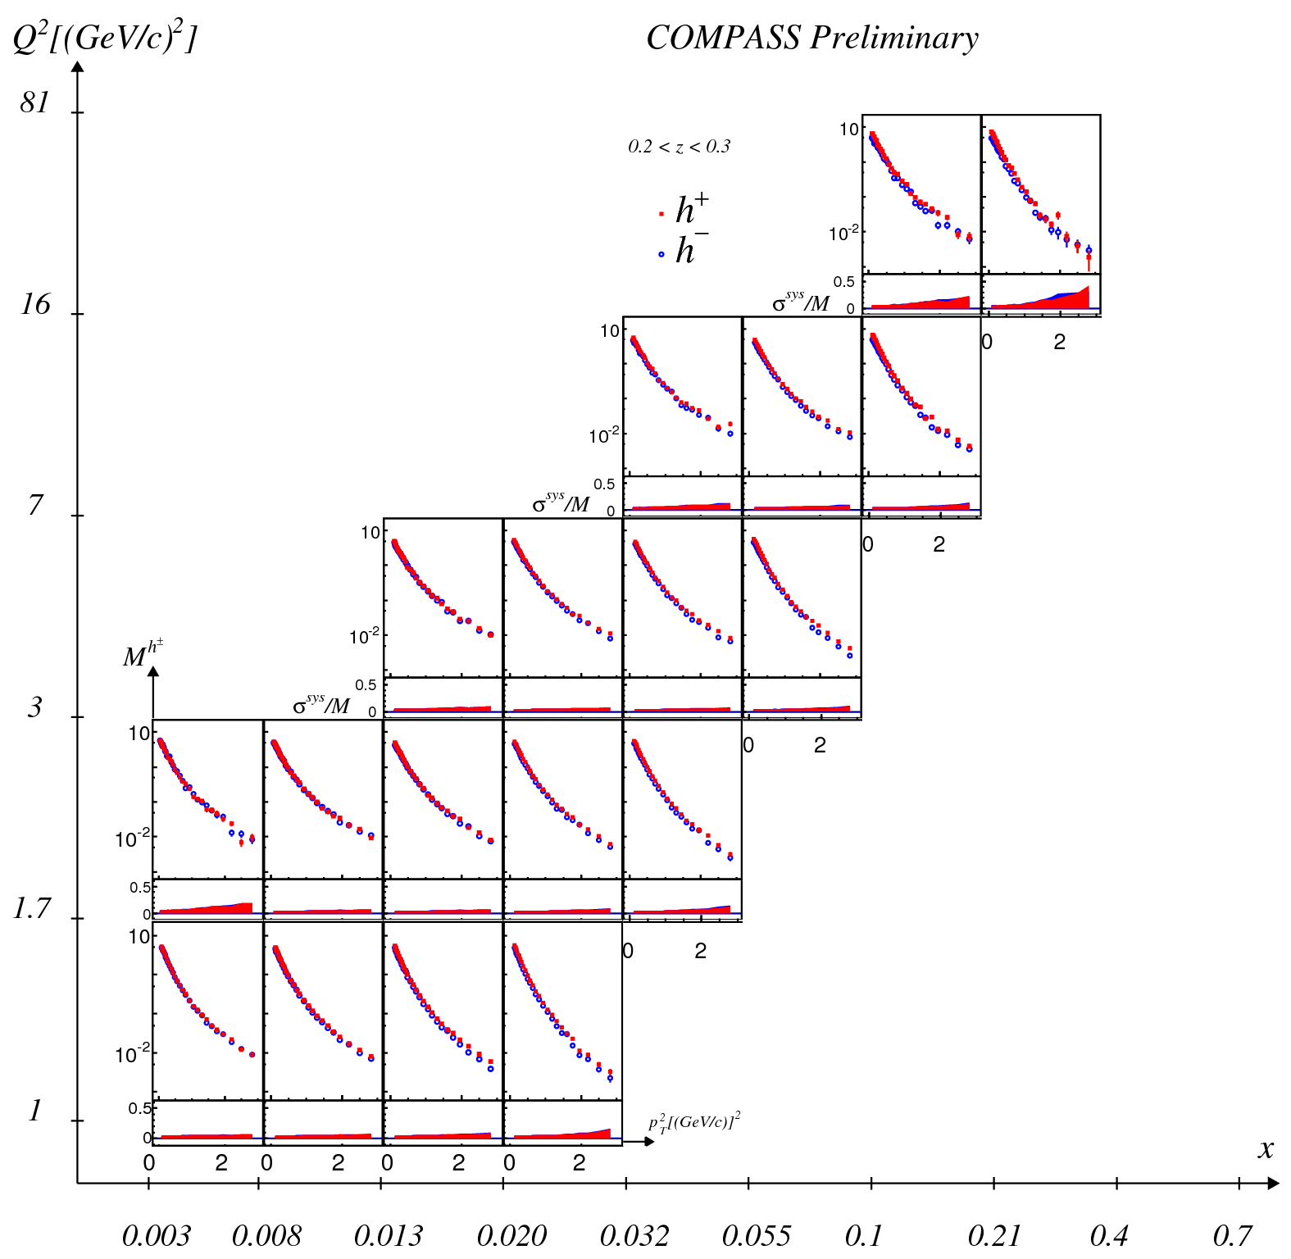
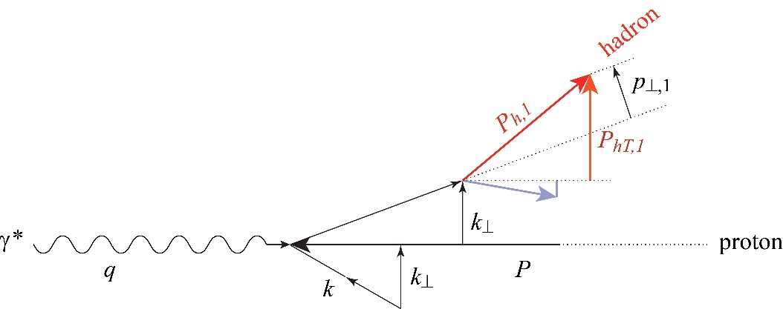
Importance of unpolarised SIDIS
$$F_{UU}^{h}\left(x, z, P_{hT}^{2}; Q^{2}\right)=x\sum_{q}{e_{q}^{2}\int{d^{2}{\vec{k}}_{⊥}d^{2}{\vec{p}}_{⊥}δ\left({\vec{p}}_{⊥}−z{\vec{k}}_{⊥}−{\vec{P}}_{hT}\right) f_{1}^{q}\left(x, k_{⊥}^{2};Q^{2}\right)D_{1q}^{h}\left(z,p_{⊥}^{2};Q^{2}\right)}}$$
$$M^{h}\left(x,z, P_{hT}^{2};Q^{2}\right)=\frac{d^{5}σ^{h}/dxdQ^{2}dzd^{2}{\vec{p}}_{T}}{d^{2}σ^{DIS}/dxdQ^{2}}\sim \frac{F_{UU}^{h}\left(x, z, P_{hT}^{2}; Q^{2}\right)}{F_{UU,T}+εF_{UU,L}}$$

Slide 15
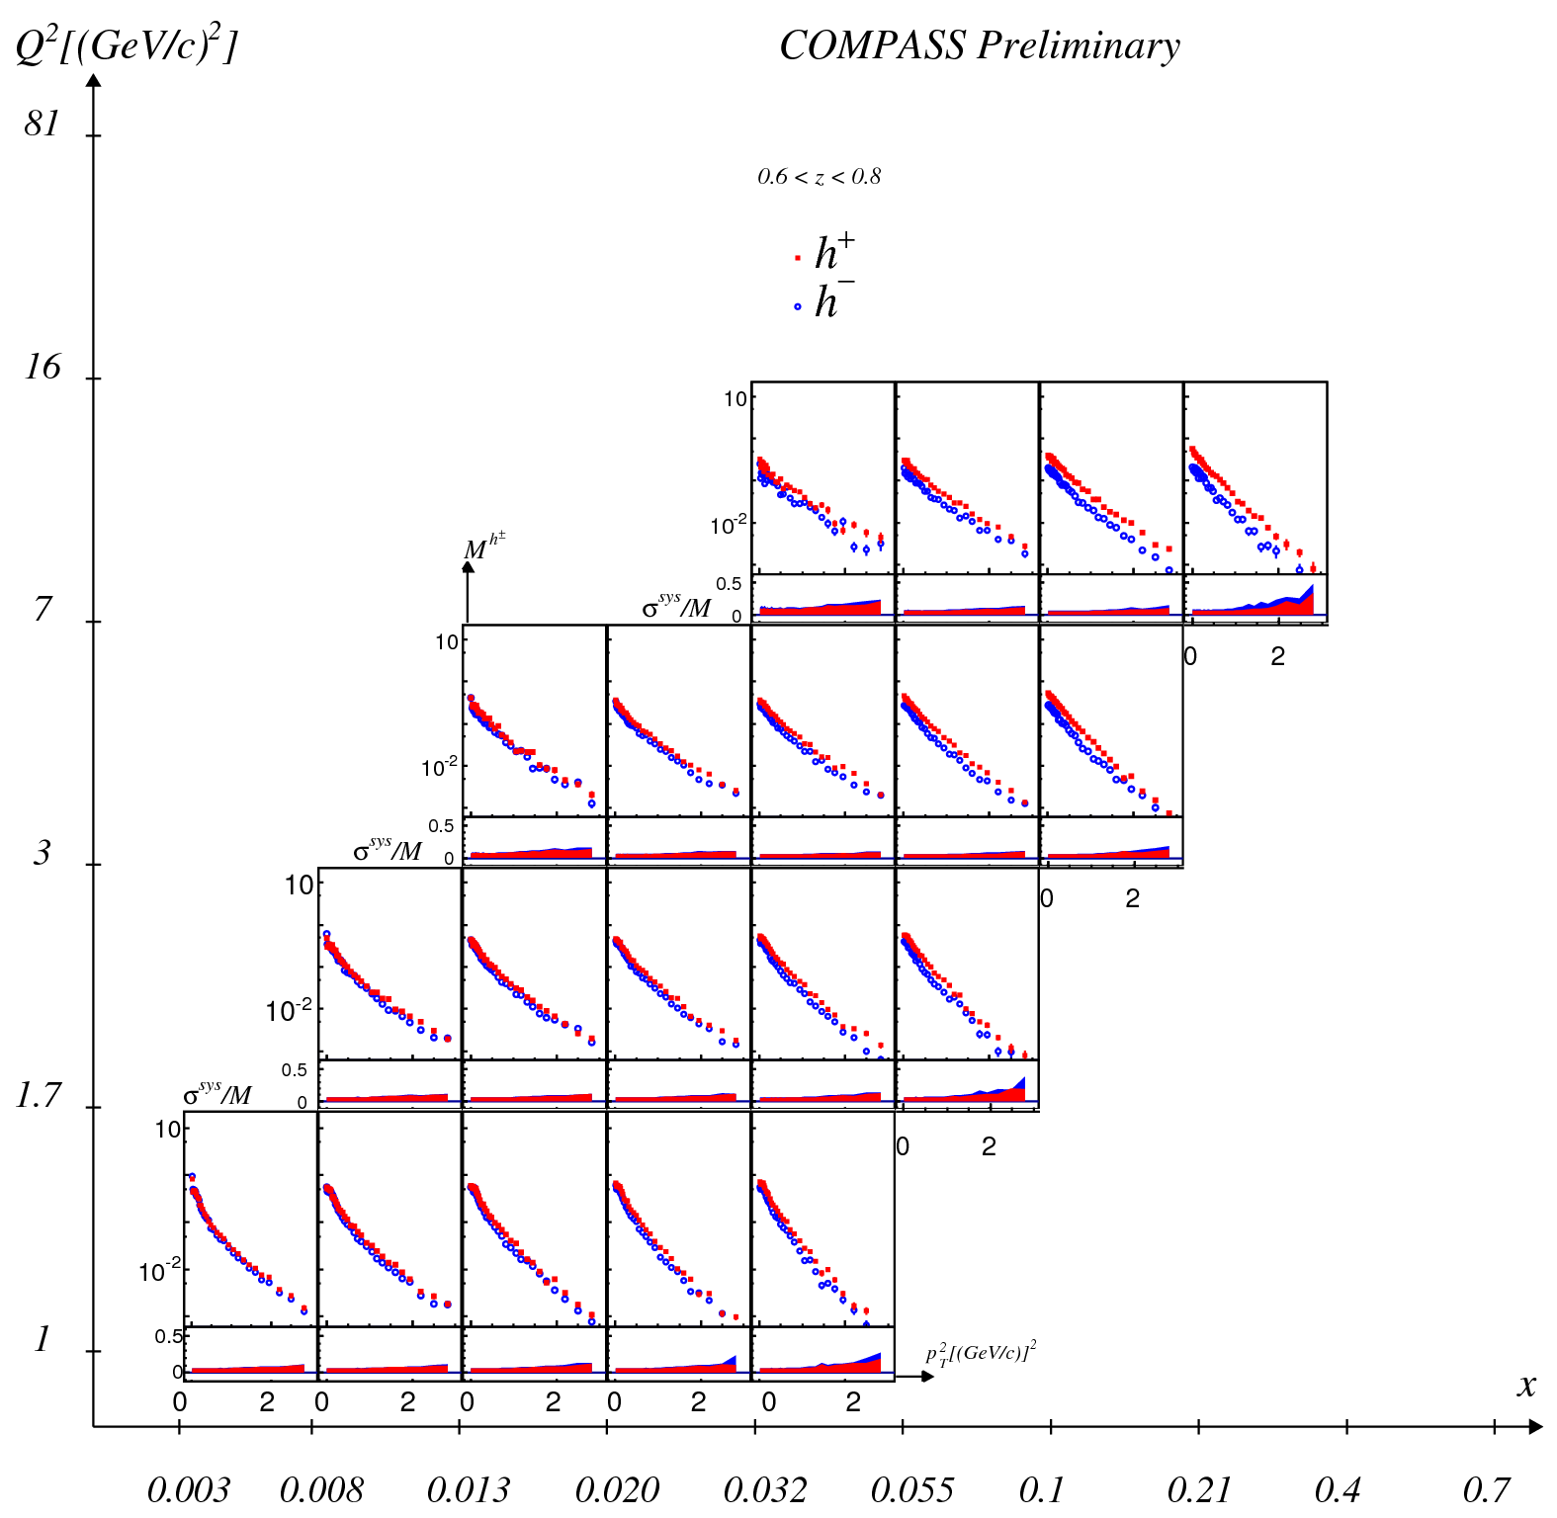
Importance of unpolarised SIDIS

Slide 16
Boer-Mulders in $\cos{2φ}$
$$F_{UU}^{\cos{2φ}}\left(x, z, P_{hT}^{2}; Q^{2}\right)=−x\sum_{q}{e_{q}^{2}\int{d^{2}{\vec{k}}_{⊥}d^{2}{\vec{p}}_{⊥}\frac{2\left(\hat{h}∙{\vec{k}}_{⊥}\right)\left(\hat{h}∙{\vec{k}}_{⊥}\right)−{\vec{k}}_{⊥}∙{\vec{p}}_{⊥}}{Mm_{h}} h_{1}^{⊥,q}\left(x, k_{⊥}^{2};Q^{2}\right)H_{1q}^{⊥}\left(z,p_{⊥}^{2};Q^{2}\right)}}$$

Slide 17
Boer-Mulders in $\cos{2φ}$ and in $\cos{φ}$

Slide 18
Sivers Asymmetry
Sivers: correlates nucleon spin & quark transverse momentum k_{T} /T-ODD: at LO for $μp^{↑}→μXh^{±}$
$A_{Siv}\left(x,z\right)=\frac{F_{UT}^{sinΦ_{Siv}}(x,z) }{F_{UU}(x,z)}= \frac{\sum_{q}{e_{q}^{2}xf_{1T}^{⊥q}\left(x,{ k}_{⊥}^{2}\right)⨂D_{1q}^{h}(z, p_{⊥}^{2})}}{\sum_{q}{e_{q}^{2}xf_{1}^{q}\left(x, k_{⊥}^{2}\right)⨂D_{1q}^{h}(z, p_{⊥}^{2})}}$
To evaluate it we need to solve the convolutions (i.e. make hypothesis on the transverse momenta dependences of the TMDs)
Gaussian ansatz: $f_{1T}^{⊥q}\left(x\right)\frac{e^{−k_{⊥}^{2}/{\left\langle k_{⊥}^{2}\right\rangle }_{S}}}{π{\left\langle k_{⊥}^{2}\right\rangle }_{S}} D_{1q}^{h}\left(z\right)\frac{e^{−p_{⊥}^{2}/\left\langle p_{⊥}^{2}\right\rangle }}{π\left\langle p_{⊥}^{2}\right\rangle }$
Leading to:$A_{Siv,G}\left(x,z\right)=\frac{\sqrt{π}M}{\sqrt{{z^{2}\left\langle k_{T}^{2}\right\rangle }_{S}+\left\langle p_{T}^{2}\right\rangle }}\frac{\sum_{q}{e_{q}^{2} xf_{1T}^{⊥\left(1\right)q}\left(x\right)zD_{1q}^{h}\left(z\right)}}{\sum_{q}{e_{q}^{2}{xf}_{1}^{q}\left(x\right)D_{1q}^{h}}\left(z\right)}$ with $f_{1T}^{⊥\left(1\right)q}(x)=\int{d^{2}{\vec{k}}_{T}}\frac{k_{T}^{2}}{2M^{2}}f_{1T}^{⊥q}(x,k_{T}^{2})$

Slide 19
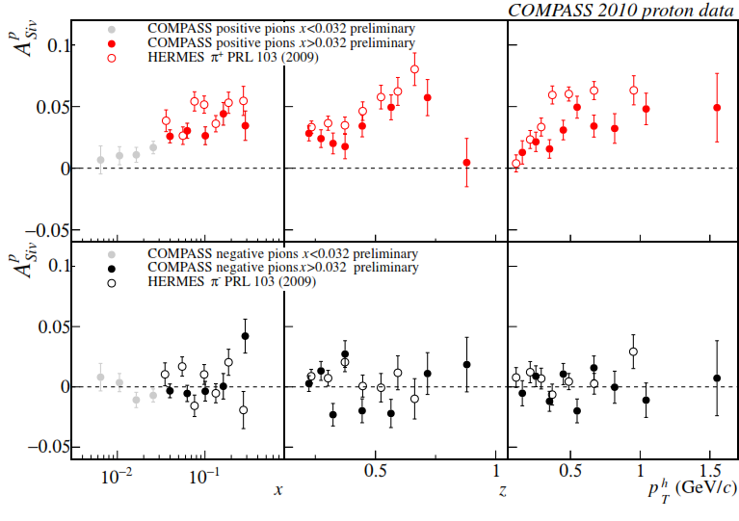
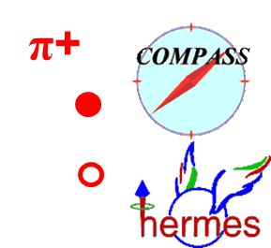
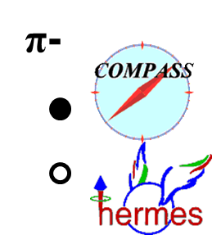
Sivers asymmetry on p
charged pions (and kaons), HERMES and COMPASS

Slide 20
The weighted Sivers asymmetry
If we weight the spin dependent part of the cross-section
$$F_{UT}^{sinΦ_{Siv}}\left(x,z\right){=Σ}_{q}e_{q}^{2}\int{d^{2}{\vec{P}}_{T}P_{T}F_{q}(x,z,P_{T}^{2})}$$
with $w=P_{T}/zM$, i.e.
$$F_{UT}^{sinΦ_{Siv}, w}\left(x,z\right){=Σ}_{q}e_{q}^{2}\int{d^{2}{\vec{P}}_{T}{\frac{P_{T}^{2}}{zM}F}_{q}(x,z,P_{T}^{2})}{=2 Σ}_{q}e_{q}^{2}xf_{1T}^{⊥\left(1\right)q}(x)D_{1q}^{h}(z)$$
and $F_{q}\left(x,z,P_{T}^{2}\right)=\int{d^{2}{\vec{k}}_{T}}\int{d^{2}{\vec{p}}_{T} δ^{2}\left({\vec{P}}_{T}−z{\vec{k}}_{T}−{\vec{p}}_{T}\right)\frac{{\vec{P}}_{T}⋅{\vec{k}}_{T}}{MP_{T}^{2}}}xf_{1T}^{⊥q}{\left({x,k}_{T}^{2}\right) D}_{1q}^{}({z,p}_{T}^{2})$
we have no longer a convolution but a product of two integrals and we can write
$$A_{Siv}^{w}\left(x,z\right)=\frac{F_{UT}^{sinΦ_{Siv},w}\left(x,z\right)}{F_{UU}\left(x,z\right)}=2\frac{\sum_{q}{e_{q}^{2}xf_{1T}^{⊥\left(1\right)q}\left(x\right)D_{1q}^{h}}(z)}{\sum_{q}{e_{q}^{2}xf_{1}^{q}(x)D_{1q}^{h}(z)}}$$
with $f_{1T}^{⊥\left(1\right)q}(x)=\int{d^{2}{\vec{k}}_{T}}\frac{k_{T}^{2}}{2M^{2}}f_{1T}^{⊥q}(x,k_{T}^{2})$

Slide 21
The weighted Sivers asymmetry
In one dimension: for $x$
$$A_{Siv}^{w}\left(x\right)=2\frac{\sum_{q}{e_{q}^{2}xf_{1T}^{⊥\left(1\right)q}(x)\int{D_{1q}^{h}(z)dz}}}{\sum_{q}{e_{q}^{2}xf_{1}^{q}(x)\int{D_{1q}^{h}(z)dz}}}$$
and for $z$
$$A_{Siv}^{w}(z)=2\frac{\sum_{q}{e_{q}^{2}D_{1q}^{h}}(z)\int{C\left(x\right)xf_{1T}^{⊥\left(1\right)q}\left(x\right)dx}}{\sum_{q}{e_{q}^{2}D_{1q}^{h}(z)\int{C\left(x\right)xf_{1}^{q}\left(x\right)dx}}}$$
with $C\left(x\right)=\int_{Ω_{y}}{dy\frac{1−y+{y^{2}}/2}{x^{2}y^{2}}}$
Note that assuming u-dominance at large $x$ for positive hadrons:
$$A_{Siv}^{w,h^{+}}\left(x\right) ≅ 2\frac{f_{1T}^{⊥\left(1\right)u}\left(x\right)}{f_{1}^{u}\left(x\right)} and A_{Siv}^{w,h^{+}}(z)=2\frac{\int{C\left(x\right)xf_{1T}^{⊥\left(1\right)u}\left(x\right)dx}}{\int{C\left(x\right)xf_{1}^{u}\left(x\right)dx}}$$

Slide 22
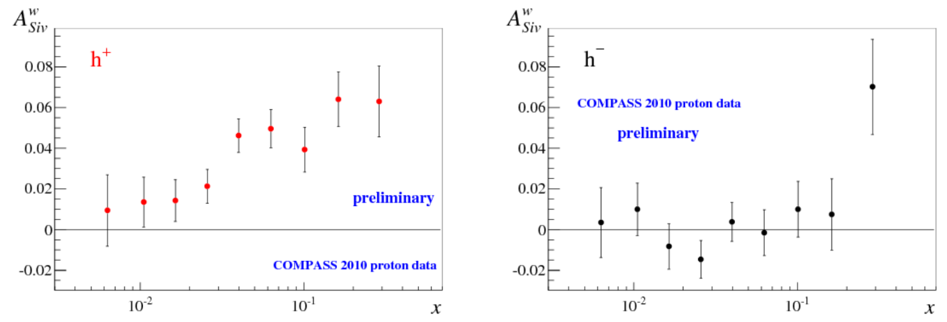
The weighted Sivers asymmetry
$$A_{Siv}^{w}\left(x\right)=2\frac{\sum_{q}{e_{q}^{2}xf_{1T}^{⊥\left(1\right)q}(x)\int{D_{1q}^{h}(z)dz}}}{\sum_{q}{e_{q}^{2}xf_{1}^{q}(x)\int{D_{1q}^{h}(z)dz}}}$$
standard cuts z>0.2
$$w=P_{T}/zM$$
$$\sim 2\frac{f_{1T}^{⊥\left(1\right)u}(x)}{f_{1}^{u}(x)}$$
both $f_{1T}^{⊥\left(1\right)u}$ and $f_{1T}^{⊥\left(1\right)d}$ contribute

Slide 23
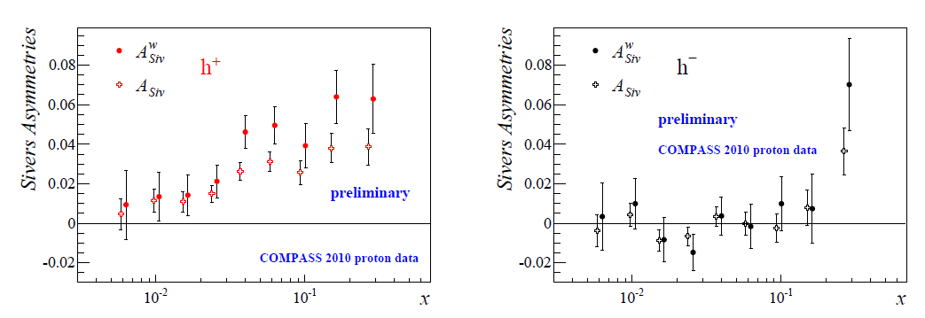
The weighted Sivers asymmetry
$$A_{Siv}^{w}\left(x\right)=2\frac{\sum_{q}{e_{q}^{2}xf_{1T}^{⊥\left(1\right)q}(x)\int{D_{1q}^{h}(z)dz}}}{\sum_{q}{e_{q}^{2}xf_{1}^{q}(x)\int{D_{1q}^{h}(z)dz}}}$$
standard cuts z>0.2
$$w=P_{T}/zM$$

Slide 24
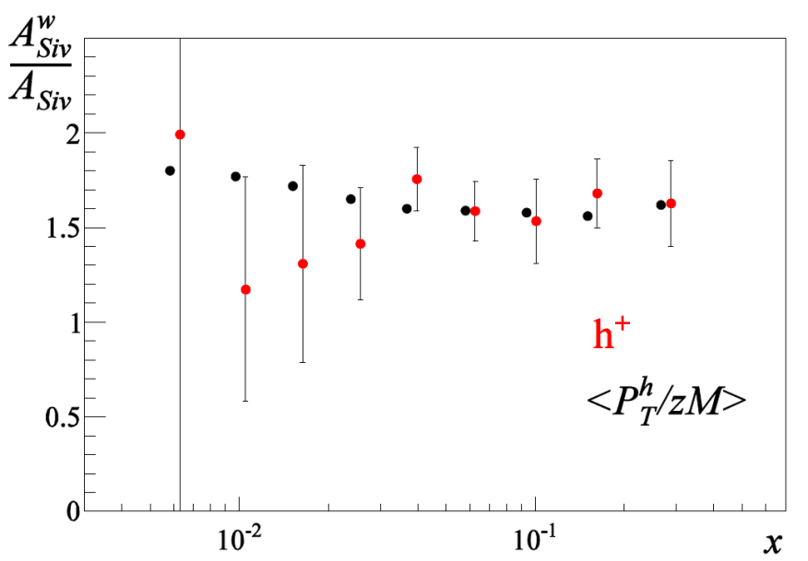
The weighted Sivers asymmetry
$$A_{Siv}^{w}\left(x\right)=2\frac{\sum_{q}{e_{q}^{2}xf_{1T}^{⊥\left(1\right)q}(x)\int{D_{1q}^{h}(z)dz}}}{\sum_{q}{e_{q}^{2}xf_{1}^{q}(x)\int{D_{1q}^{h}(z)dz}}}$$
standard cuts z>0.2
$$w=P_{T}/zM$$
The ratio between weighted and unweighted Sivers asymmetries follows the average of $\left\langle \frac{P_{hT}}{zM}\right\rangle$ of the unpolarised sample

Slide 25
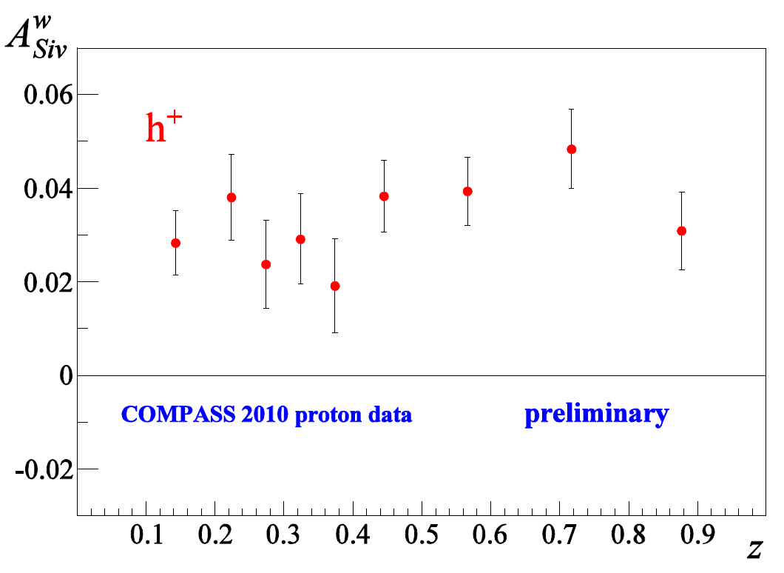
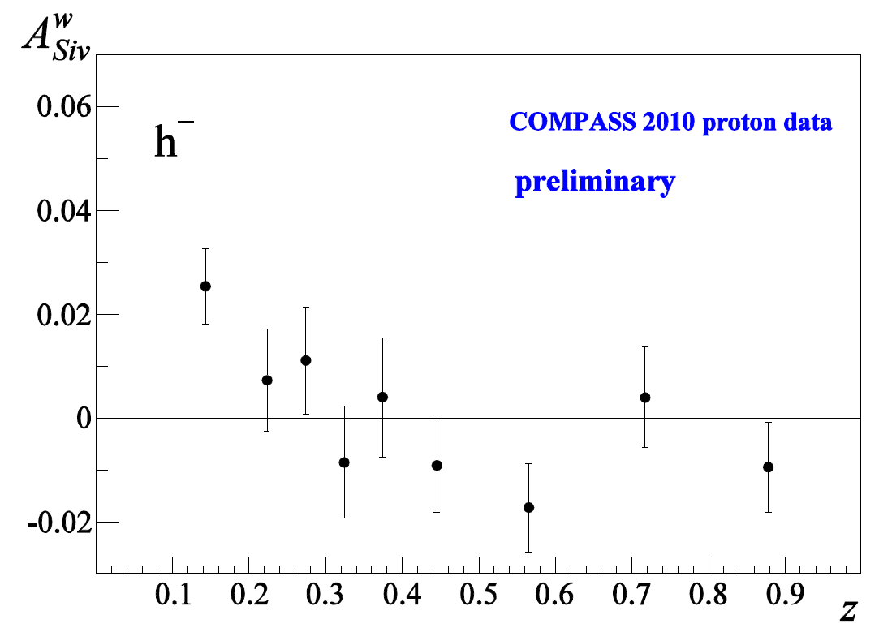
The weighted Sivers asymmetry
weight $w=P_{T}/zM$ $A_{Siv}^{w}(z)$ $0.1<z<1.0$
$$2\frac{\int{C\left(x\right)xf_{1T}^{⊥\left(1\right)u}\left(x\right)dx}}{\int{C\left(x\right)xf_{1}^{u}\left(x\right)dx}}$$

Slide 26
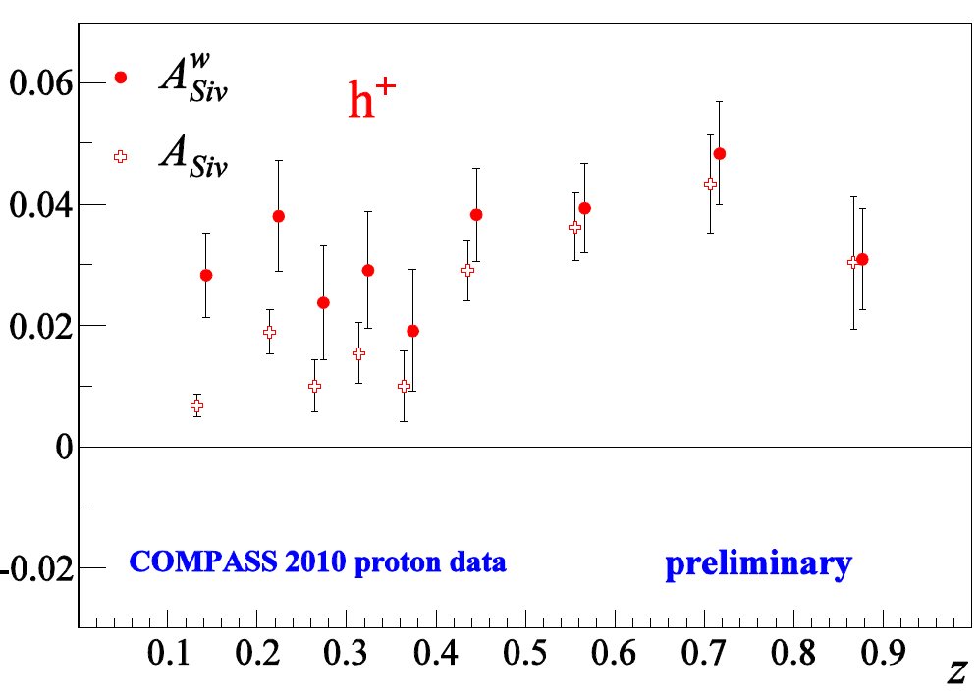
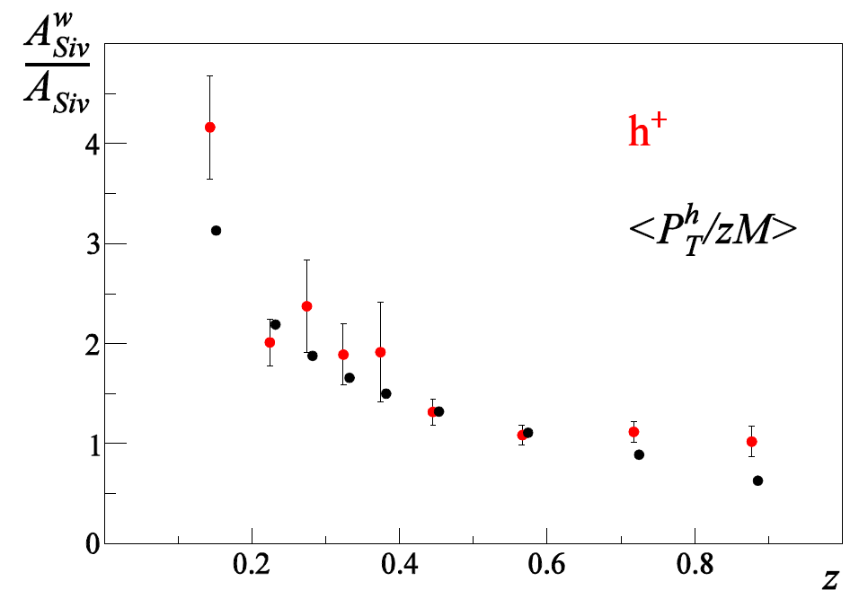
The weighted Sivers asymmetry
weight $w=P_{T}/zM$ $A_{Siv}^{w}(z)$ $0.1<z<1.0$
The ratio between weighted and unweighted Sivers asymmetries follows the average of $\left\langle \frac{P_{hT}}{zM}\right\rangle$ of the unpolarised sample

Slide 27
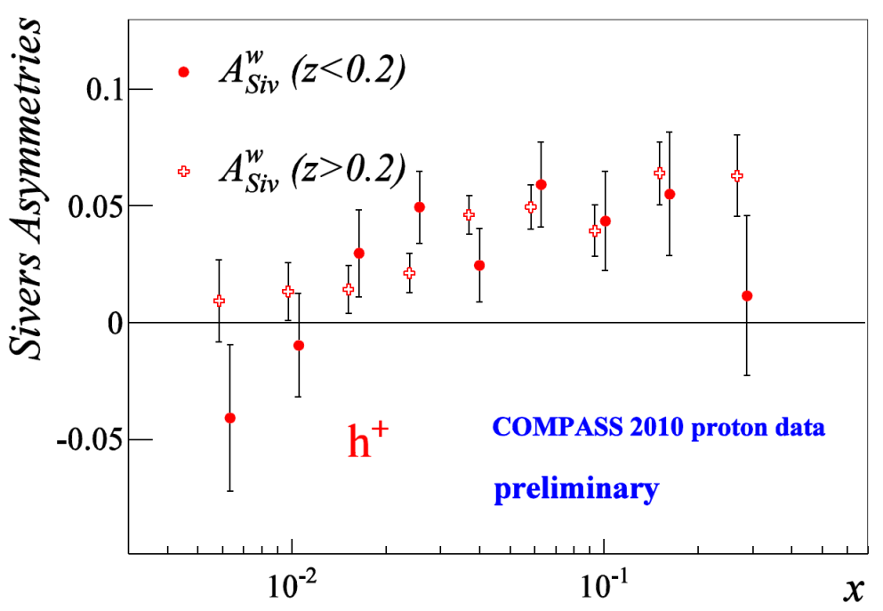
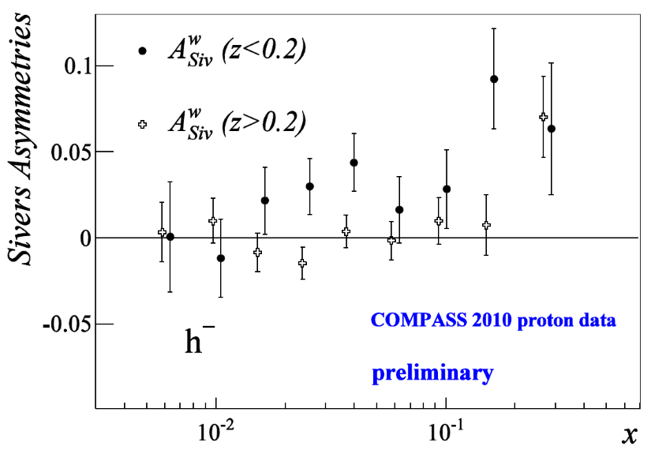
The weighted Sivers asymmetry
weight $w=P_{T}/zM$ $A_{Siv}^{w}(z)$ $0.1<z<1.0$
For $0.1<z<0.2$ the asymmetries for $h^{+ }and { h}^{− }$show the same behavior

Slide 28
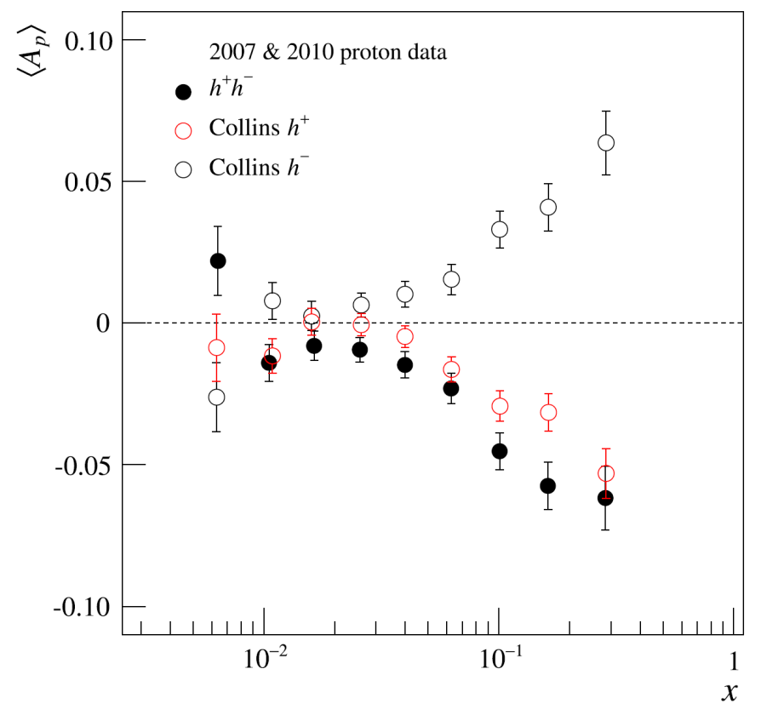
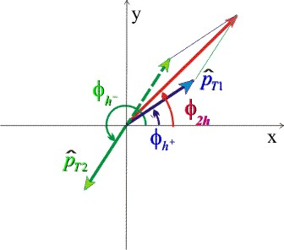
Interplay among dihadron and single hadron asymmetries
Collins asymmetry for h+ and for h- “mirror symmetry”
dihadron asymmetry only somewhat larger than h+ Collins
hints for a common origin
of the Collins FF and DiFF
Como 2013, DSpin2013, PLB736 (2014) 124
further study: look at
the $∆φ=φ_{1}−φ_{2}$
dependence of the asymmetries
one of the COMPASS studies on final state hadron correlations

Slide 29
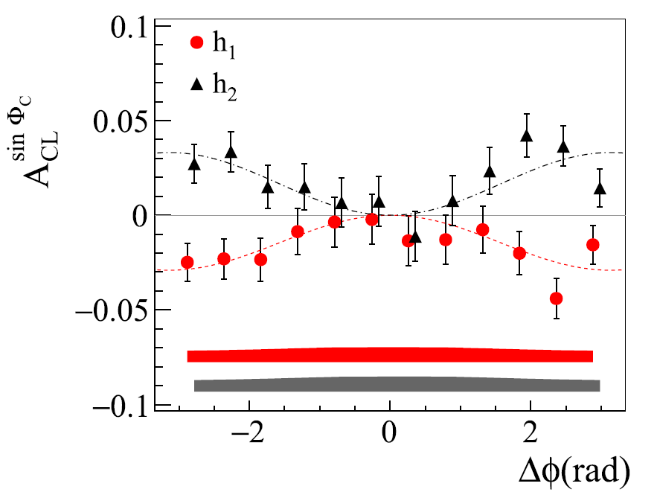
Interplay among dihadron and single hadron asymmetries
PLB 753 (2016) 406
$$A_{CL1}^{\sin{Φ_{C}}}=a_{1}+ a_{2}cos{∆φ}$$
analitically
$$A_{CL2}^{\sin{Φ_{C}}}=a_{2}+ a_{1}cos{∆φ}$$
agreement with data if
mirror symmetry
$$a_{1}=− a_{2}=a$$
$$h^{+}$$
$$h^{−}$$
$$A_{CL 2h}^{\sin{Φ_{2h,S}}}=a \sqrt{2\left(1−\cos{∆φ}\right)}$$
ratio of the $Δφ$integrated 2h and 1h asymmetries: 4/π
slightly larger than h⁺

Slide 30
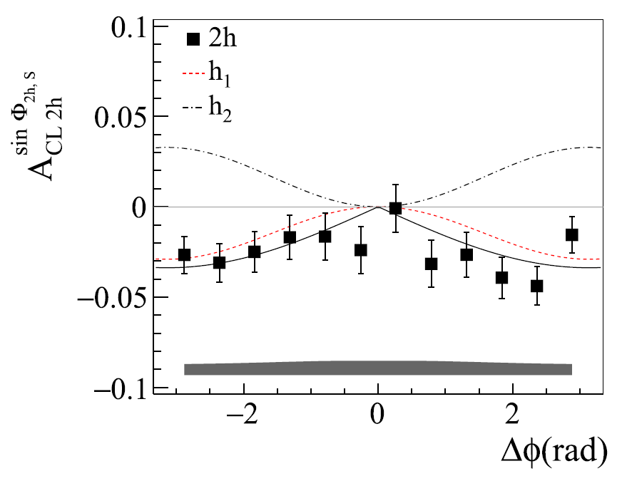
Interplay among dihadron and single hadron asymmetries
PLB 753 (2016) 406
$$A_{CL1}^{\sin{Φ_{C}}}=a_{1}+ a_{2}cos{∆φ}$$
analitically
$$A_{CL2}^{\sin{Φ_{C}}}=a_{2}+ a_{1}cos{∆φ}$$
agreement with data if
mirror symmetry
$$a_{1}=− a_{2}=a$$
$$h^{+}$$
$$h^{−}$$
$$A_{CL 2h}^{\sin{Φ_{2h,S}}}=a \sqrt{2\left(1−\cos{∆φ}\right)}$$
agreement with data
a very simple relationships among the asymmetries in the “2h sample”
they are driven by the same elementary
mechanism.
ratio of the $Δφ$integrated 2h and 1h asymmetries: 4/π
slightly larger than h⁺

Slide 31
From Collins asymmetries to transversity
Following Physical Review D 91, 014034 (2015), in the valence region
$$\begin{matrix}xh_{1}^{u}=\frac{1}{5}\frac{1}{{\tilde{a}}_{P}^{h}\left(1−\tilde{α}\right)}\left[\left(xf_{p}^{+}A_{p}^{+}−xf_{p}^{−}A_{p}^{−}\right)+\frac{1}{3}\left(xf_{d}^{+}A_{d}^{+}−xf_{d}^{−}A_{d}^{−}\right)\right] \\ \\ xh_{1}^{d}=\frac{1}{5}\frac{1}{{\tilde{a}}_{P}^{h}\left(1−\tilde{α}\right)}\left[\frac{4}{3}\left(xf_{d}^{+}A_{d}^{+}−xf_{d}^{−}A_{d}^{−}\right)−\left(xf_{p}^{+}A_{p}^{+}−xf_{p}^{−}A_{p}^{−}\right)\right]\end{matrix}$$
With ${\tilde{a}}_{P}^{h}$ and $\tilde{α}$ constants

Slide 32
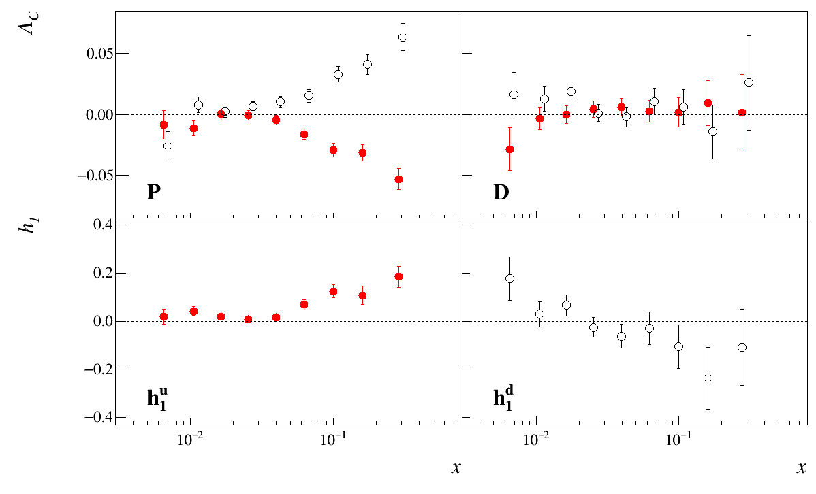
New deuteron data
Benchmark: extraction from Collins asymmetries

Slide 33
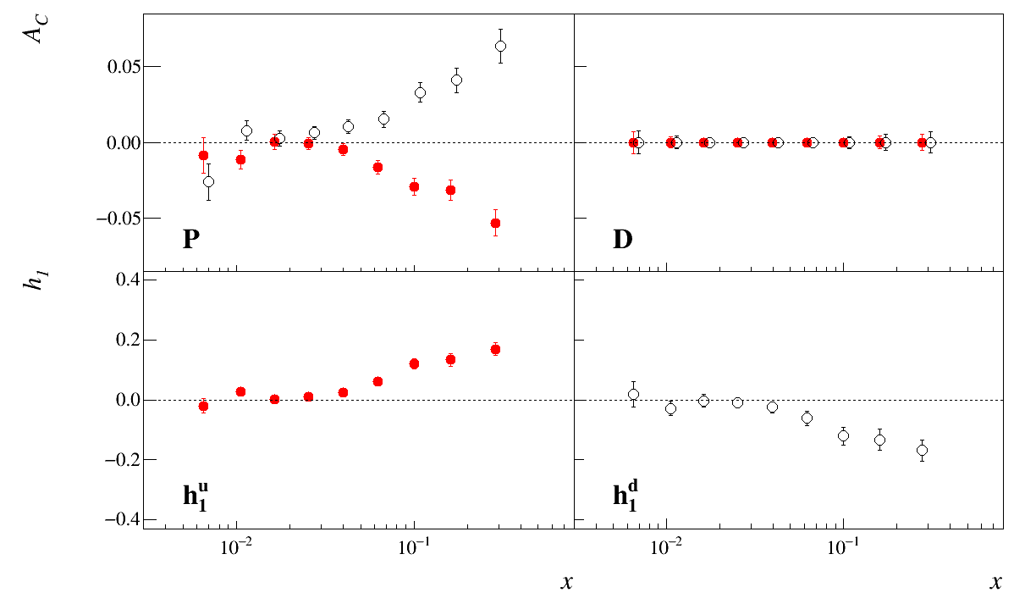
New deuteron data
1 full year (same as 2010). We also gain from $\frac{f_{p}P_{pT}}{f_{D}P_{DT}}=\frac{0.155×0.8}{0.40×0.5}=0.6$
THIS IS A KEY MEASUREMENT THAT WILL IMPACT OUR KNOWLEDGE,

Slide 34
Conclusions
The study of TMDs has entered the phase of multidimensional analysis
An important step in this direction is the large sample of precise unpolarised data, both as multiplicities and as azimuthal modulations
In the next years more of such data will be available both from COMPASS and from JLab12
One year of deuteron data (something that COMPASS can do after 2020) will strongly impact our knowledge of $h_{1}^{d}$!
Waiting for the EIC to extend the accessible phase space, the description of such data is a mandatory task for the theory of TMDs

Slide 35
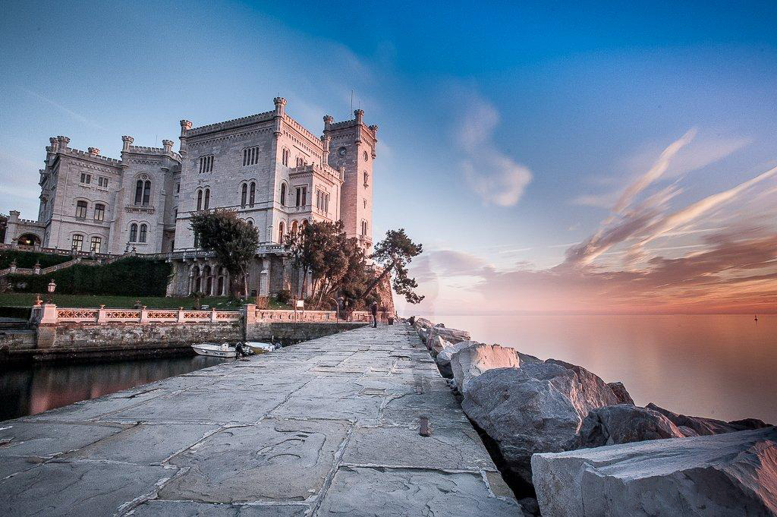
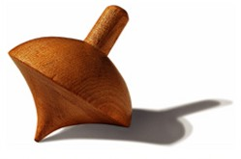
Thank you and see you all in Trieste for the EICUG meeting (July 18-22, 2017) eicug2017.ts.infn.it

Slide 36
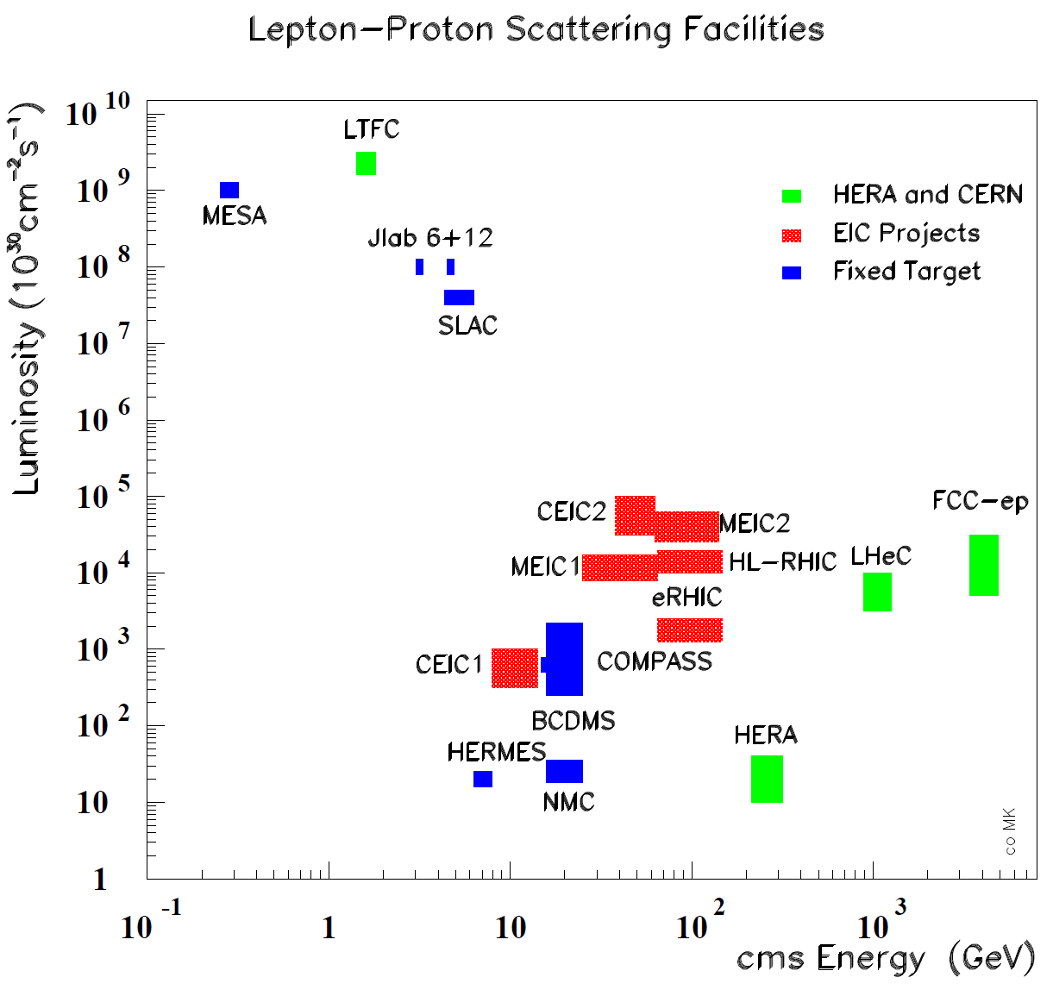
The CM Energy vs Luminosity Landscape
CEIC1 = Chinese version
of Electron-Ion Collider
(“A dilution-free mini-COMPASS”)
MEIC1 = EIC@Jlab
eRHIC = EIC@BNL
LHeC = ep/eA collider @ CERN
CEIC2
MEIC2
HL-eRHIC
FCC-he
}

Slide 37
SIDIS Experiments
SIDIS Experiment must:
Have large acceptances on all the relevant variables $x, Q^{2}, z, P_{hT}, φ$
Use different targets (p, d, n) and identify hadrons to allow flavor separation
Be ad different energies for to cover PDFs from the valence region down to small-$x$
Large luminosity to allow multidimensional results needed by the complexity of TMDs
The polarized lepton-nucleon collider will be a mandatory tool to reach the level of ordinary PDF

