Slide 1

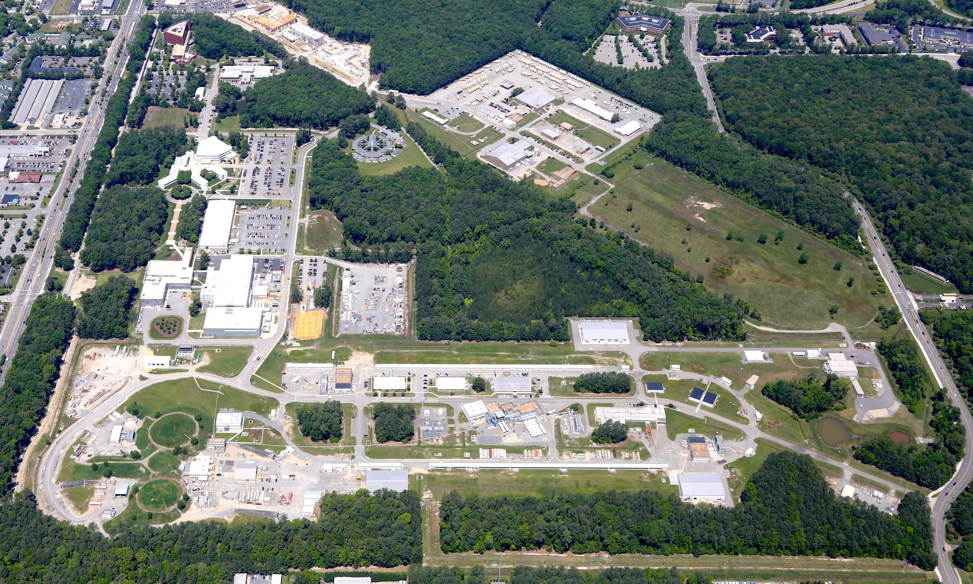
Jefferson Lab Science Opportunities at 12 GeV
R. D. McKeown
May 23, 2017

Slide 2
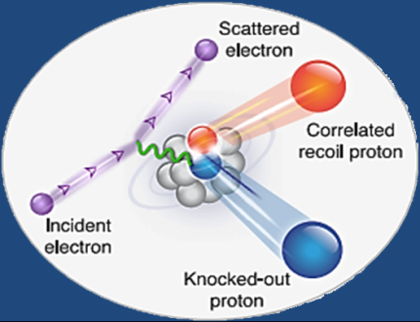
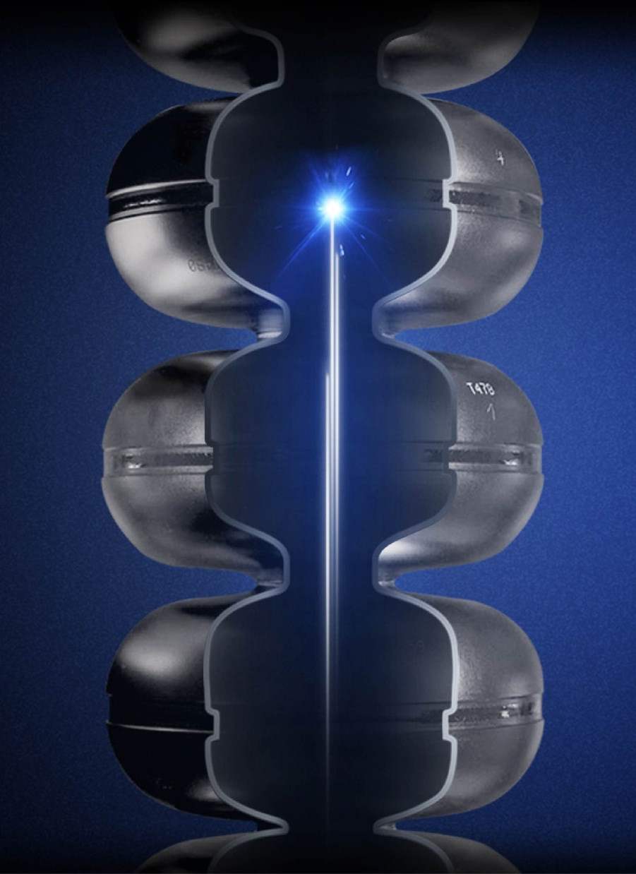
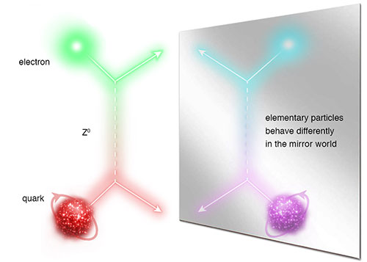
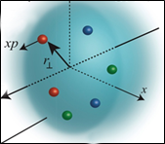
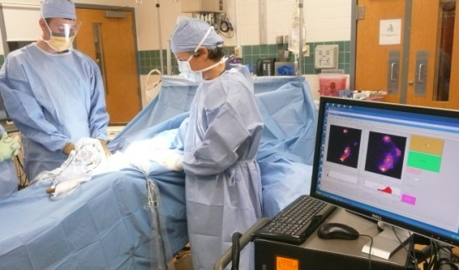
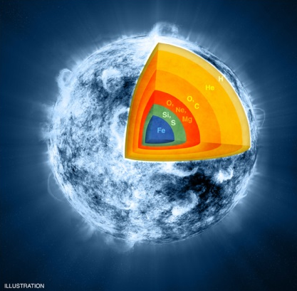
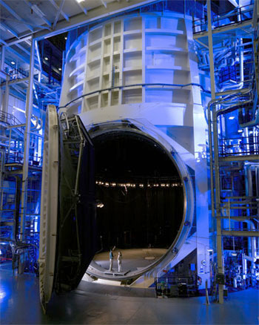
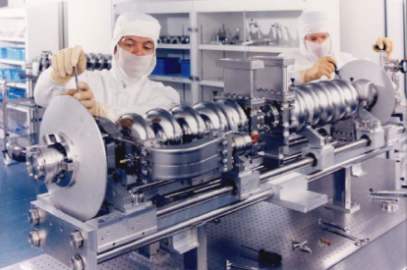

JLab: A Laboratory for Nuclear Science
Z⁰
Nuclear Structure
Fundamental
Forces & Symmetries
Structure of Hadrons
Medical Imaging
Nuclear Astrophysics
Accelerator S&T
Cryogenics
Theory & Computation

Slide 3
Outline
Upgrade status
12 GeV Research Program
Recent highlights
Future EIC

Slide 4
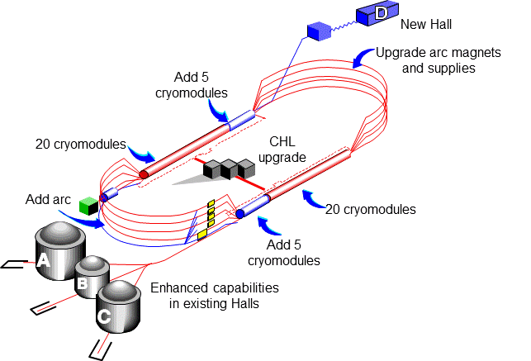

12 GeV CEBAF Upgrade
Completion of the 12 GeV CEBAF Upgrade was ranked the highest priority in the 2007 NSAC Long Range Plan.
Project (99.7% complete):
Doubling the accelerator beam energy – DONE
Civil construction including utilities – DONE
New experimental Hall D and beam line – DONE
Upgrade to Experimental Hall C – DONE
Upgrade to Experimental Hall B – 99%
  Solenoid magnet only remaining scope
Total Project Cost = $338M
Estimate to Complete = $1.2M

Slide 5
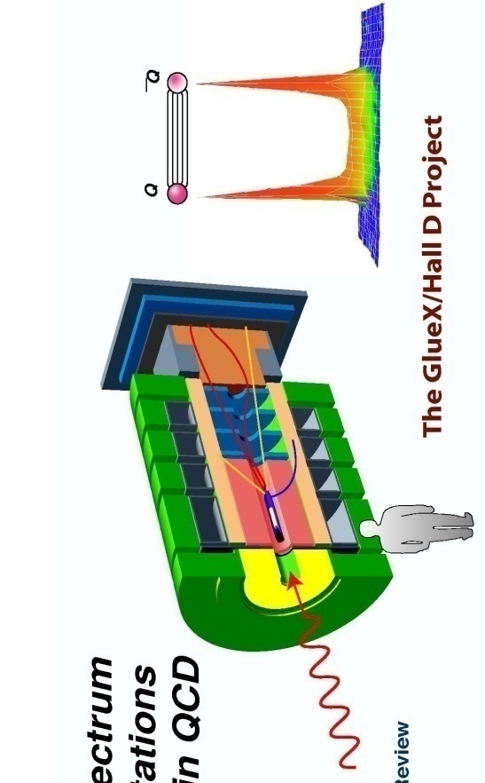
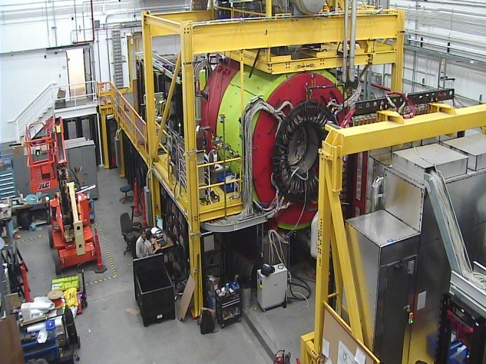
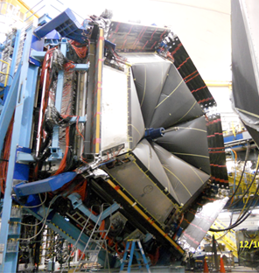
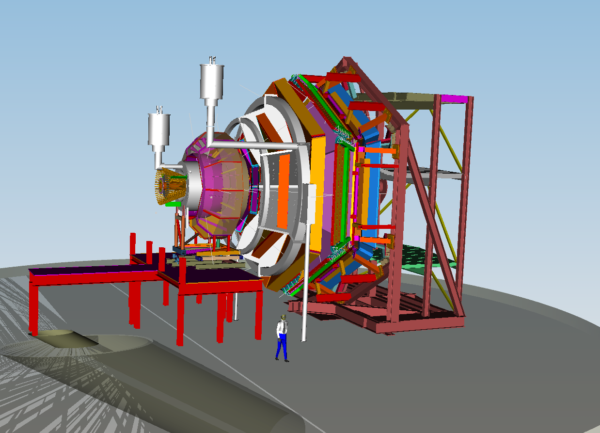
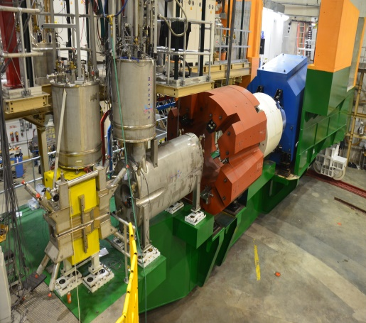
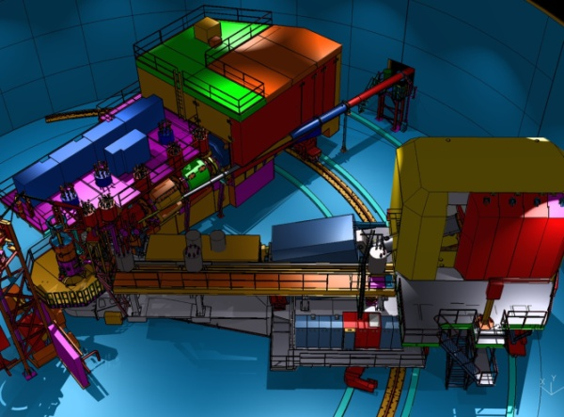
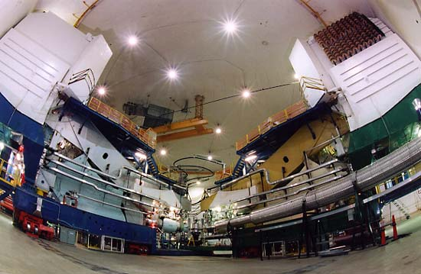

12 GeV Scientific Capabilities
Hall D – exploring origin of confinement by studying
exotic mesons
Hall B – understanding nucleon structure via generalized parton distributions and transverse momentum distributions
Hall C – precision determination of valence quark properties
in nucleons and nuclei
Hall A – short range correlations,
form factors, hyper-nuclear physics,
future new experiments (e.g., SoLID and MOLLER)
Notes:
5
Note BSM not included in project

Slide 6
12 GeV Project: University Detector Work
Hall | University | Activity | Status
B | Idaho State U | Drift Chamber | Complete
B | Old Dominion U | Drift Chamber | Complete
B | U South Carolina | TOF Counters | Complete
B | Moscow State U (RU) | SVT Testing | Complete
C | Michigan State U | HB Magnet | Complete
C | U Virginia | Noble Gas Cerenkov | Complete
D | U Athens (GR) | Monitoring BCAL, FCAL | Complete
D | Carnegie Mellon U | Central Drift Chamber | Complete
D | Catholic U | Tagger Hodoscope | Complete
D | U Connecticut | Tagger Microscope | Complete
D | Florida Internat'l U | Start Counter | Complete
D | Florida State U | TOF Counters | Complete
D | Indiana U | Forward Calorimeter | Complete
D | U Regina (CA) | Barrel Calorimeter | Complete
D | U Santa Maria (CH) | SiPM, Lightguides for BCAL | Complete
B, C, D | U Massachusetts | Electronics Testing | Complete
NSF-MRI funded (Hall B):
PCAL Detector
Long. Polarized Target
NSF-MRI funded (Hall C):
Drift Chambers
Trigger Hodoscopes
Aerogel
Internat’l contributions
for detectors beyond
base equipment.

Slide 7
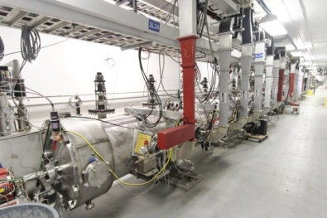
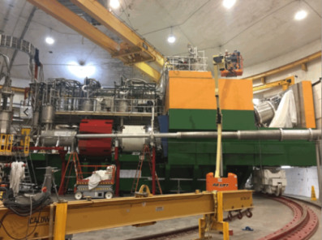
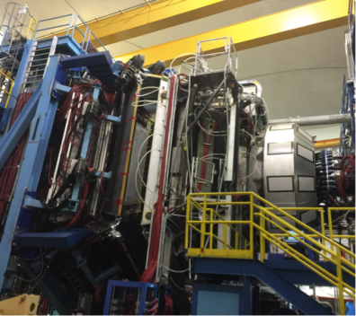
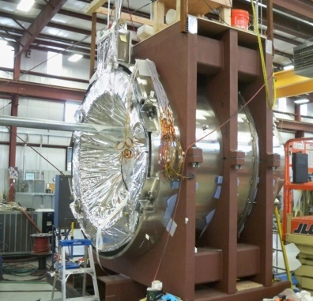
12 GeV Upgrade – Path to Completion
Accelerator
  Full 12 GeV energy achieved
  Full luminosity demonstrated
  Simultaneous multi-hall beam delivery achieved
Hall C – Key Performance Parameter demonstrated
  SHMS installed, commissioned with beam
  March 2017
Hall B – Key Performance Parameter demonstrated
  CLAS12 installed, commissioned with beam
  February 2017
Remaining Scope = Solenoid Magnet for Hall B
  Final phase of assembly at vendor, ETI
  May delivery to Jefferson Lab
  Installation and commissioning through August
Project Completion September 2017

Slide 8
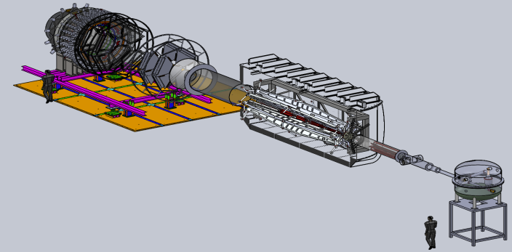
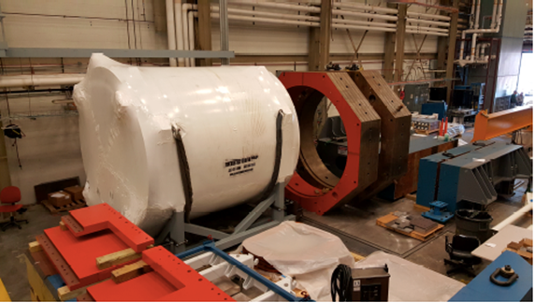

Future Projects
MOLLER experiment
(Possible MIE – FY19-23)
– CD-0 approved
(project paused due to budget uncertainty)
– Standard Model Test
– DOE science review (September 2014) – strong endorsement
– Director’s review held December 15-16, 2016
Technical, cost & schedule
SoLID
– SIDIS and PVDIS
– CLEO Solenoid 
– International collaboration
– Director’s review (Feb. 2015)
 new pre-CDR almost complete

Slide 9
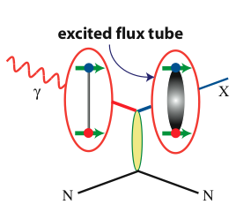
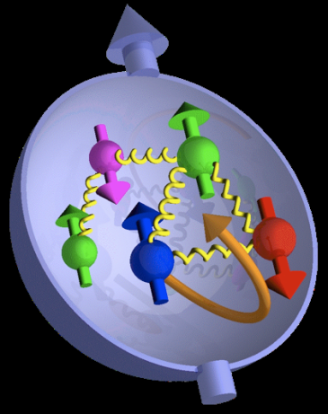

Jefferson Lab @ 12 GeV Science Questions
excited gluon field
What is the role of gluonic excitations in the spectroscopy of light mesons?
Where is the missing spin in the nucleon?
Role of orbital angular momentum?
Can we reveal a novel landscape of nucleon substructure through 3D imaging at the femtometer scale?
Can we discover evidence for physics
beyond the standard model
of particle physics?

Slide 10
12 GeV Approved Experiments by Physics Topics
Topic | Hall A | Hall B | Hall C | Hall D | Other | Total
Hadron spectra as probes of QCD | 0 | 3 | 1 | 3 | 0 | 7
Transverse structure of the hadrons | 5 | 4 | 3 | 1 | 0 | 13
Longitudinal structure of the hadrons | 2 | 3 | 6 | 0 | 0 | 11
3D structure of the hadrons | 5 | 9 | 7 | 0 | 0 | 21
Hadrons and cold nuclear matter | 7 | 3 | 7 | 0 | 1 | 18
Low-energy tests of the Standard Model and Fundamental Symmetries | 3 | 1 | 0 | 1 | 1 | 6
Total | 22 | 23 | 24 | 5 | 2 | 76
Total Experiments Completed | 2.5 | 1.1 | 0 | 0.4 | 0 | 4.0
Total Experiments Remaining | 19.5 | 22 | 24 | 4.6 | 2 | 72.0
A Decade of Experiments

Slide 11
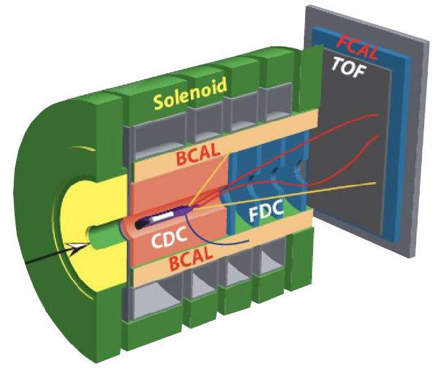

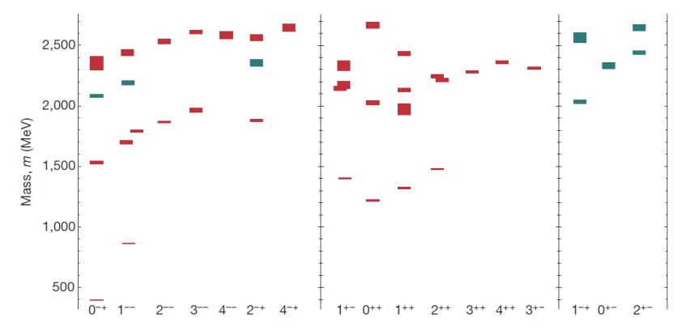

Gluonic Excitations and the Mechanism for Confinement
Excited Glue
Hall D@JLab
States with Exotic Quantum Numbers
Searching for the rules that govern hadron construction
M. R. Sheperd, J. J. Dudek, R. E. Mitchell

Slide 12
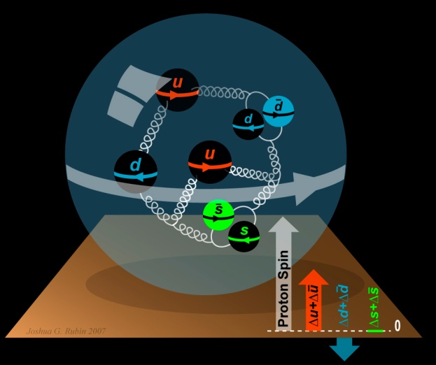
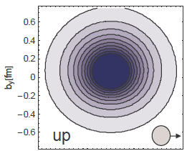
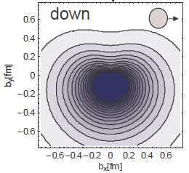
The Incomplete Nucleon: Spin Puzzle
1
1
ΔΣ
+
L_{q}
+
J_{g}
=
2
2
[X. Ji, 1997]
DIS → ΔΣ ≅ 0.25
RHIC + DIS → ΔG~0.2
→ L_{q}

Slide 13

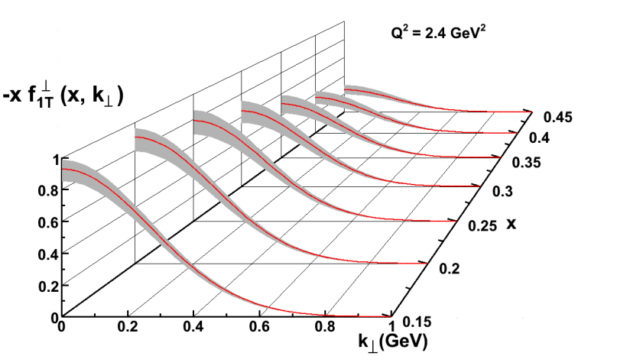
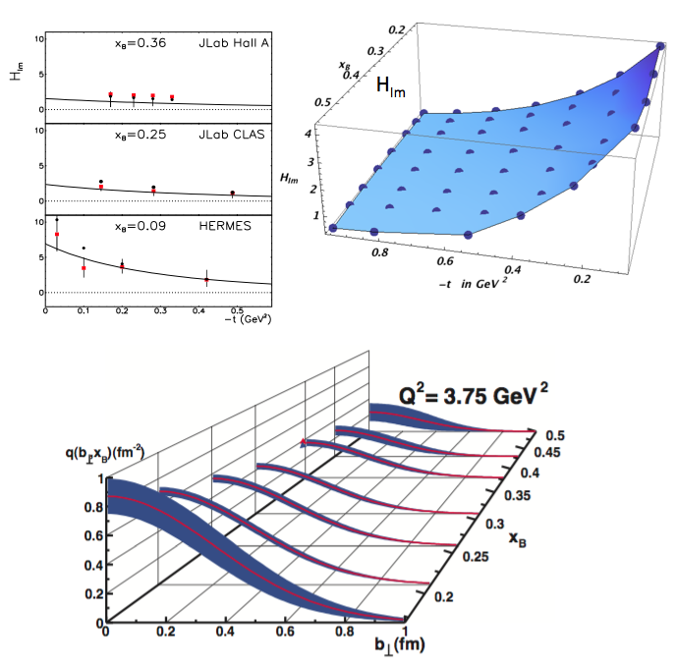
Imaging the Nucleon
5D
Transverse Momentum Dist. (TMD)
– Confined motion in a nucleon
(semi-inclusive DIS)
Generalized Parton Dist. (GPD)
– Spatial imaging
(exclusive DIS)
Requires
– High luminosity
– Polarized beams and targets
– Sophisticated detector systems
3D
Major new capability with JLab @ 12 GeV

Slide 14
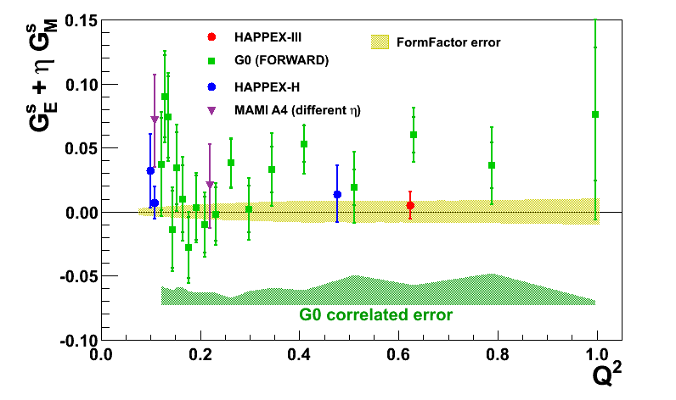
Parity Violation at JLab
Nucleon Strangeness Form Factors (complete)
  HAPPEX (Hall A)
  G0 (Hall C)
Neutron Skin
  PREX
  CREX
Precision Tests of Standard Model
  Qweak (Under analysis)
  MOLLER
  SoLID

Slide 15
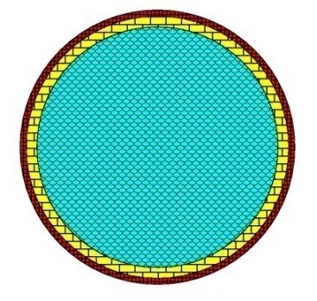
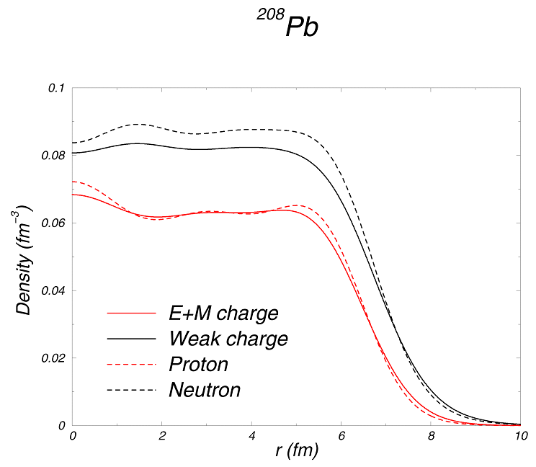
Measuring the Neutron “Skin” in the Pb Nucleus
Q_{w}^{p} =(1 – 4 sin² θ_{W})
Q_{W}^{n} = -1
Weak interaction selects neutrons
Parity violating electron scattering
Sensitive to neutron distribution
Neutron Star
Lead Nucleus
10 km
10 fm
skin
crust
Applications: Nuclear Physics, Neutron Stars,
Atomic Parity, Heavy Ion Collisions

Slide 16
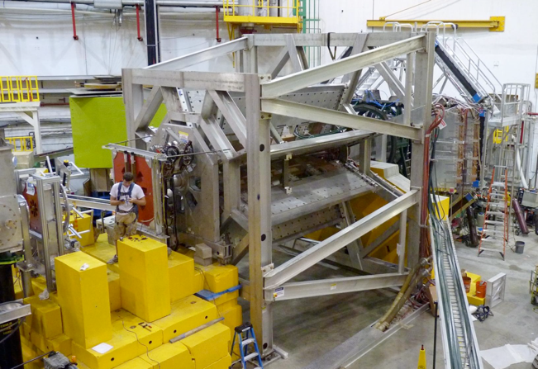
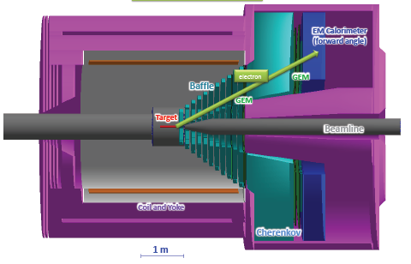
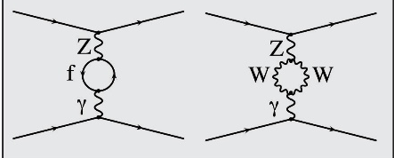
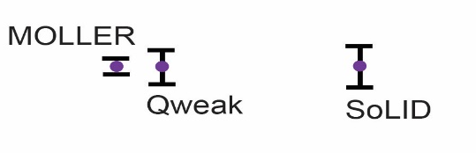

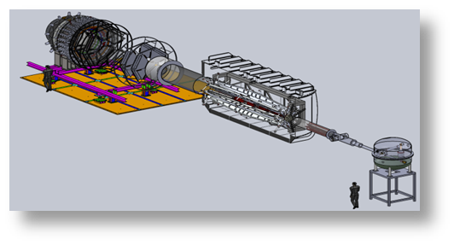
Testing the Standard Model at JLab
Standard Model
JLab
Data
Projected
JLab data:
(from PDG 2014)

Slide 17
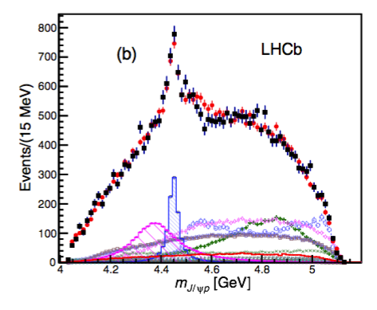
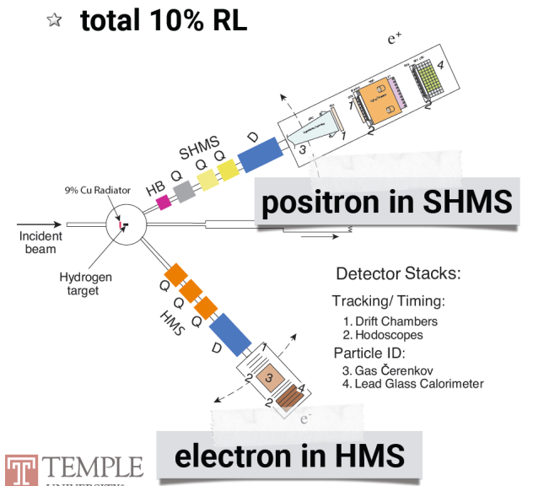
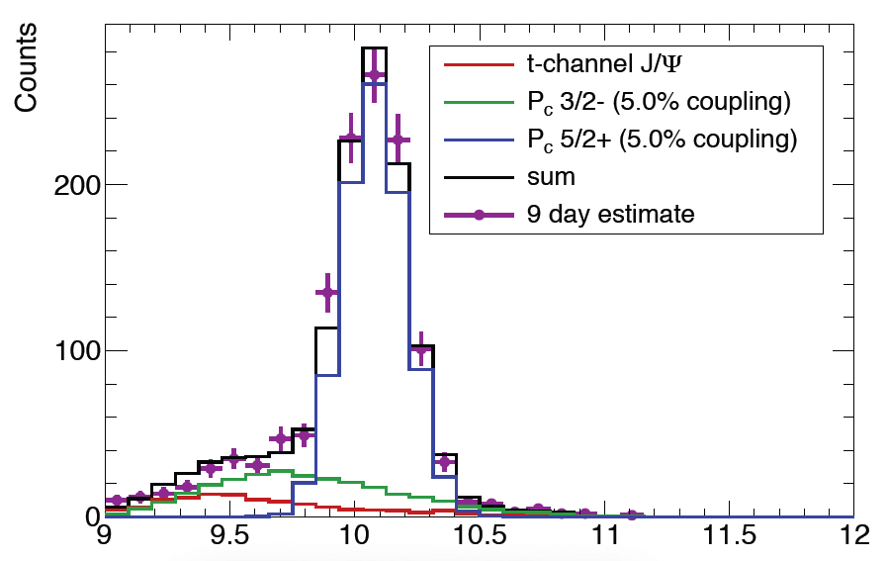

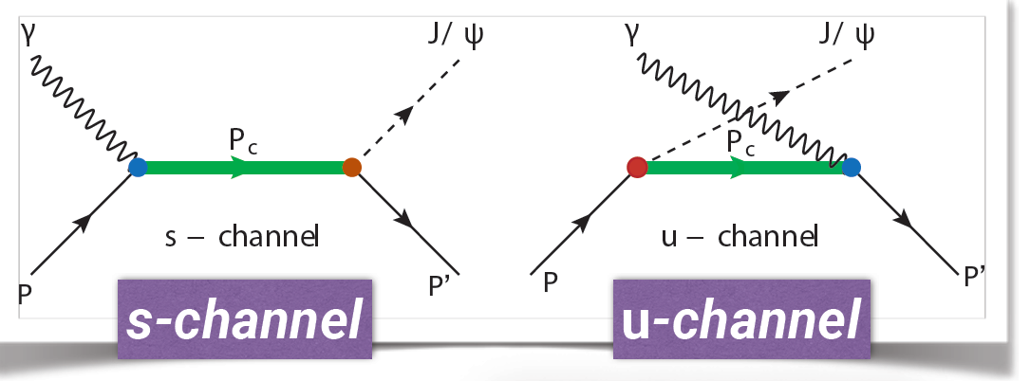
Charmonium Pentaquark
JLab E12-16-007
LHCb
2 Pc states needed to
describe results:
narrow: Pc(4450)
wide: Pc(4380)

Slide 18
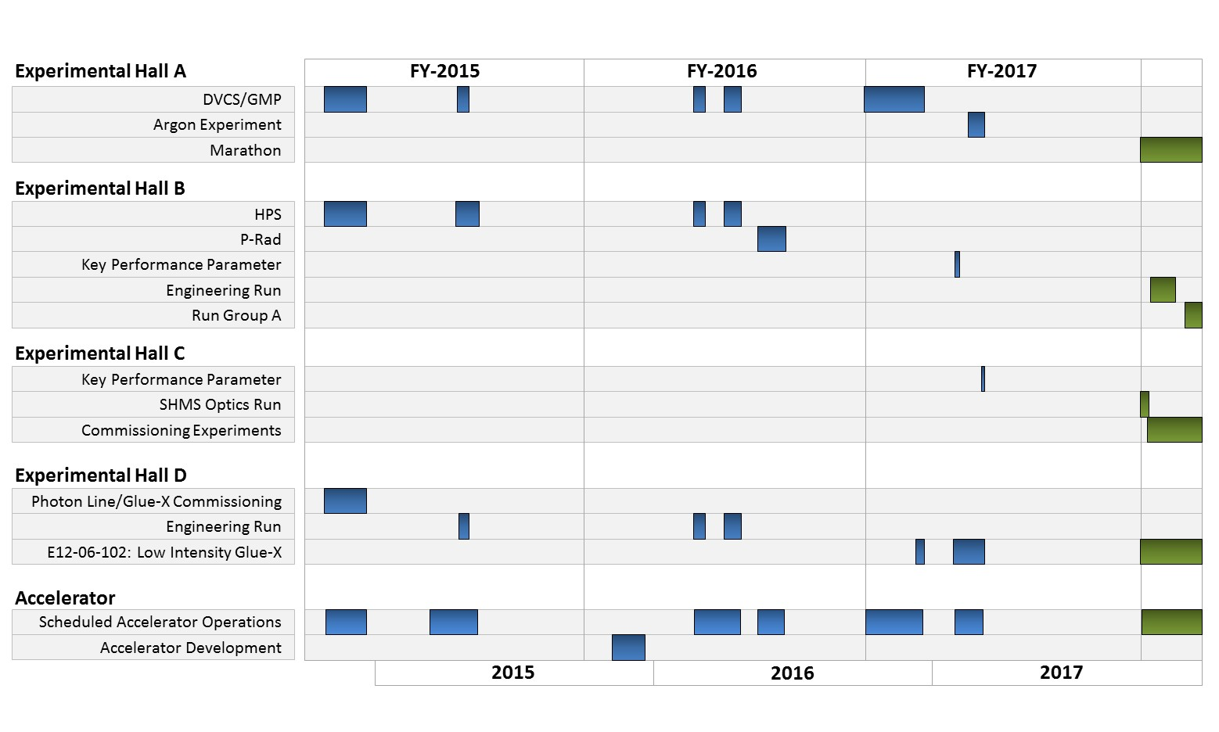
CEBAF Program FY15-17

Slide 19

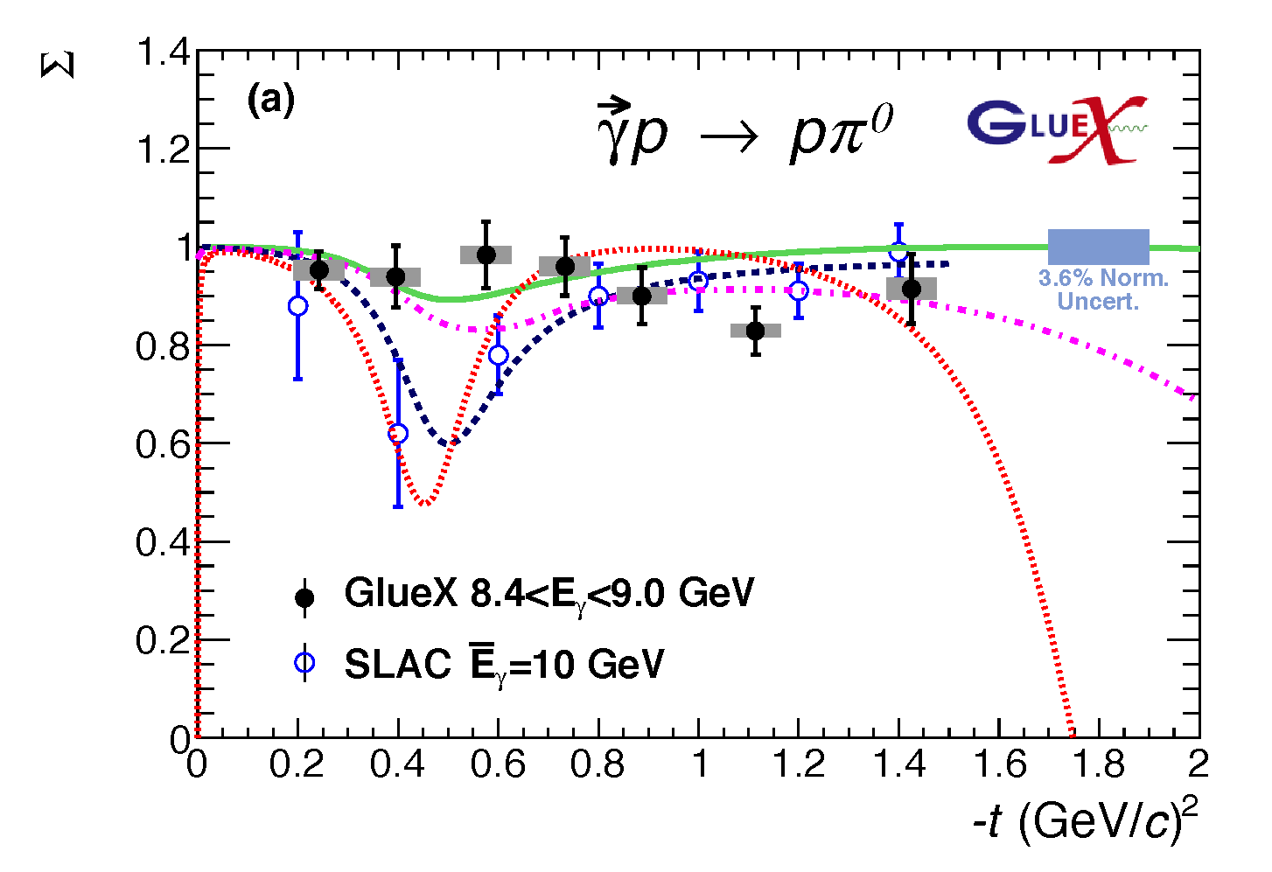

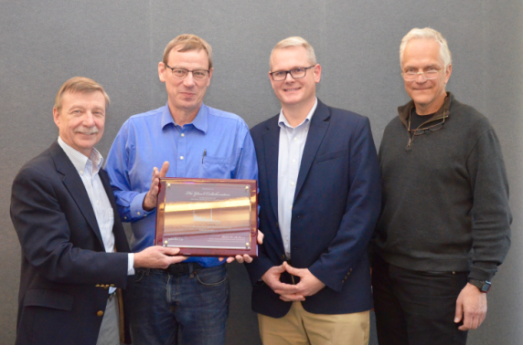
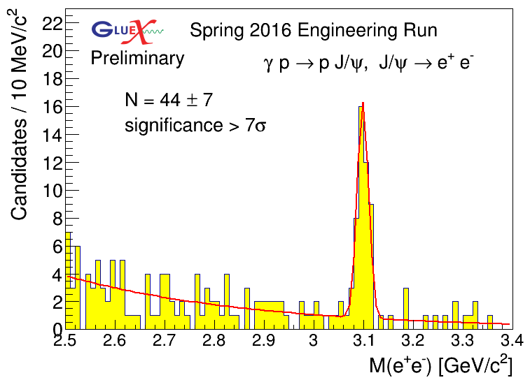
First Published Results from 12 GeV CEBAF
The first experimental results, from data collected in the GlueX engineering run, have been published in Phys. Rev. C.
The new GlueX results show:
• For neutral pions, the reaction mechanism is dominated by pure vector coupling.
• The first data for beam asymmetry for η production >3 GeV.
• The GlueX experiment in Hall D can produce timely results.
Σ
GlueX will search for hybrid mesons, particles in which the strong gluonic field contributes directly to their properties. From the spectrum of these particles, we can learn about the gluonic field in QCD.
Bonus:
First observation of charmonium at JLab!

Slide 20

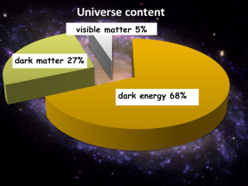
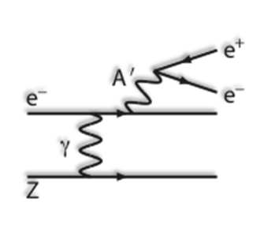
Heavy Photon Search – First Results
NP-HEP Collaboration
2015 Engineering Run
1.7 PAC days @ 1.05 GeV
2 GeV data taken in 2016,
under analysis
1 mm gap between Si
tracker detectors for
passage of electron beam
Future Program: more HPS, APEX, DarkLIGHT

Slide 21



PRad
PRad: new experiment to
address proton radius @ JLab
NSF MRI: H₂ gas target
DOE GEM tracking detectors
Successful run in summer 2016
statistical errors are ~0.4%
Systematic uncertainty
1 GeV data will extend to Q²~2x10⁻⁴ GeV²

Slide 22



From CEBAF at 12 GeV to EIC
Decade of Experiments Approved
First 12 GeV Science
Experiments Complete!
Electron Ion Collider
The Next QCD Frontier
2015 NSAC Long Range Plan
Strong support for TJNAF program
Confinement
Hadron Structure
Nuclear Structure and Astrophysics
Fundamental Symmetries
Role of Gluons in Nucleon and Nuclear Structure
22

Slide 23




EIC at Jefferson Lab
JLab EIC Figure 8 Concept
    High Polarization
    High Luminosity
    Low technical risk
    Flexible timeframe for construction
    consistent w/running 12 GeV CEBAF
    Cost effective operations
    Fulfills White Paper Requirements
Collaboration with SLAC, LBNL, ANL, BNL
Site evaluation (Virginia funds)
10³⁵
LHC
User group organizing (charter, meetings)
NAS study underway
DOE-NP accelerator R&D program
(FY17-18)
(
10³⁴
10³³

Slide 24






Jefferson Lab: Today and Tomorrow
The Jefferson Lab electron accelerator is a unique world-leading facility for hadron and nuclear physics research
12 GeV upgrade ensures at least a decade of excellent opportunities for discovery
– New vistas in QCD
– Growing program Beyond the Standard Model
– Additional equipment: MOLLER, SoLID,
plus smaller projects
EIC moving forward:
– Strong science case, much builds on JLab 12 GeV program
– JLEIC design well developed – time scale following 12 GeV program is “natural”
– NSAC 2015 Long Range Plan recommendation

