Slide 1
NLO Calculations of Jets and Heavy Flavor in Heavy Ion Collisions
Ivan Vitev
QCD Evolution 2017
May 2017, Jefferson Lab, Newport News, VA

Slide 2


Outline of the talk
Introduction and motivation
Framework of soft collinear effective theory with Glauber gluons. Splitting functions
Semi-inclusive jet cross sections in SCET / jet radius resummation.
Consistent calculation of jet cross sections at NLO in heavy ion reactions
Open heavy flavor calculations at NLO
Conclusions
Thanks to the organizers for the opportunity
Collaboration with : Y.-T. Chien, Z.-B. Kang, G. Ovanesyan, F. Ringer, M. Sievert, H. Xing, S. Yoshida …

Slide 3
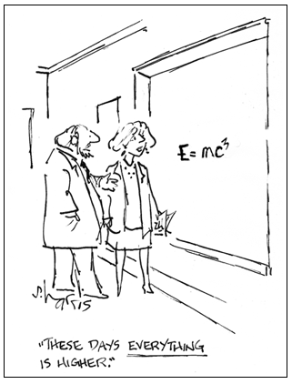
Introduction & Motivation

Slide 4
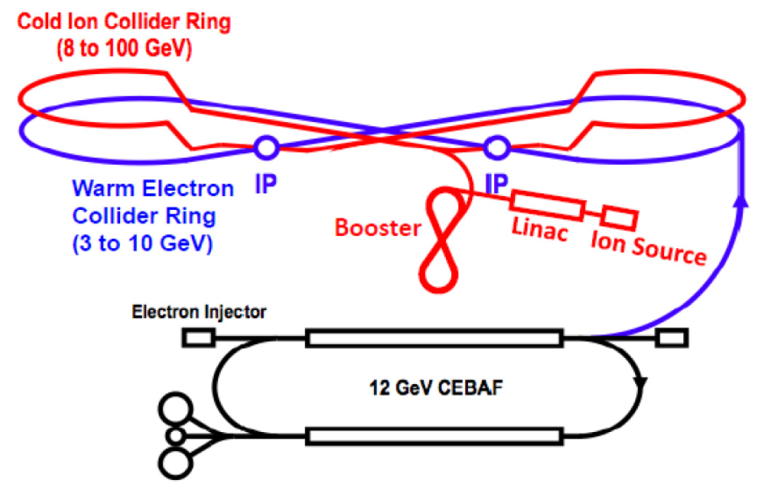
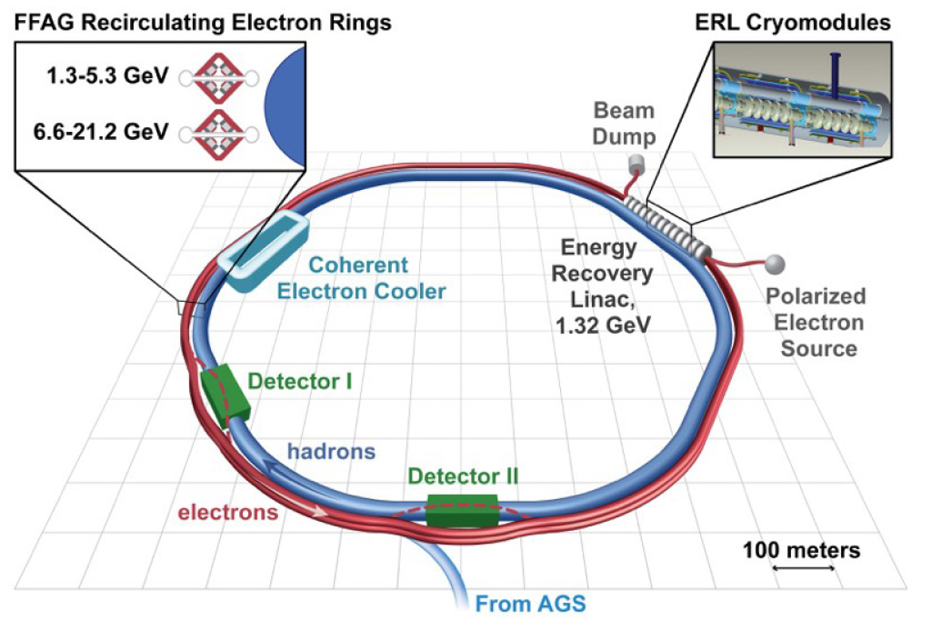
Jets and Heavy Flavor from HIC to EIC
JLab design
Study spin phenomena, the structure of nucleons and nuclei, small-x physics
Set of imp0rtant complementary physics questions: transport properties of large nuclei, heavy flavor proves of gluon densities, even more traditionally studied nuclear transparency (or lack there off)
BNL design
Various CM energies possible. Does allow certain reach for jets and HF
NSAC long range plan (2015)

Slide 5
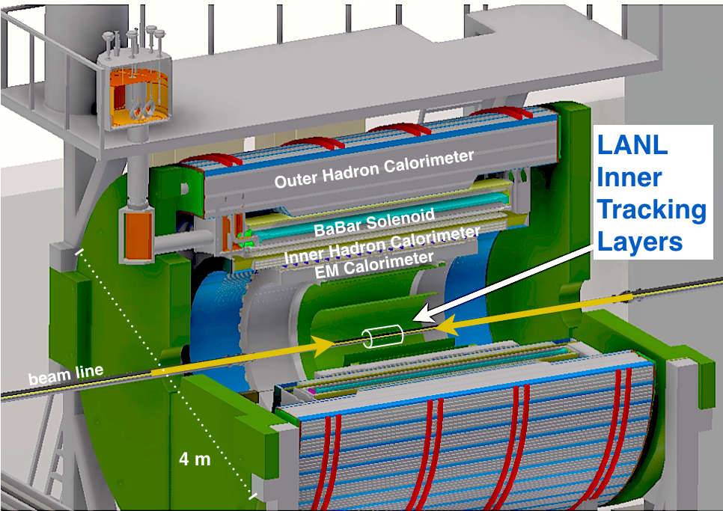
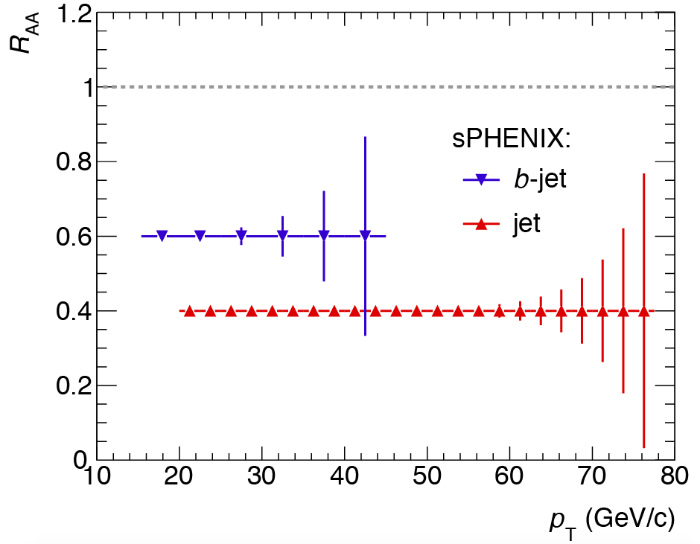
Current and Near Future Facilities
A lot of existing expertise on jets and heavy flavor – pQCD / SCET
New results on jets and heavy flavor in p+A and A+A collisions, p_{T}, rapidity, centrality
Good accuracy data on inclusive jets and jet substructure, open heavy flavor and quarkonia / correlations with them
Proposed new program (sPHENIX) till 2025 will study jets and heavy flavor
e.g. Talk by Petriello, today’s sessions
e.g. Talk by Lansberg
1 equals no QGP suppression
sPHENIX proposal (2014-2016)

Slide 6

Framework

Slide 7
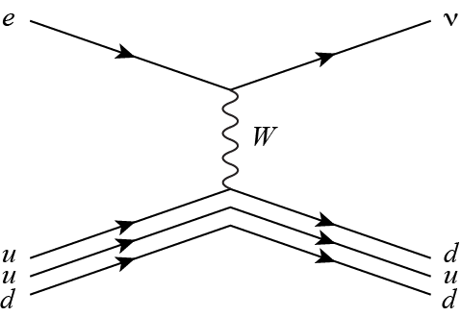
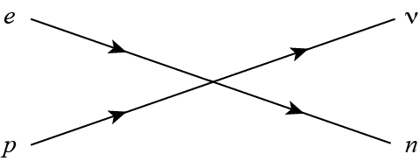
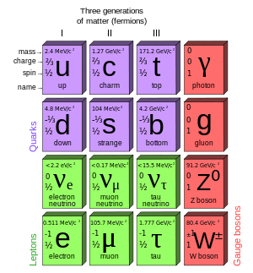
EFTs (Effective Field Theories)
The first, probably best known, effective theory is the Fermi interaction
E
Full
Theory
DOF in FT
Q
DOF in EFT
Effective Theory
Effective theories are ubiquitous. The Standard Model is likely a low energy EFT of a theory at a higher scale
Particularly well suited to QCD, and nuclear physics: χPT, HQET, NRQCD, …
C. Bauer et al. (2001)
Collinear quarks, antiquarks
Collinear gluons, soft gluons
SCET
D. Pirol et al. (2004)
E

Slide 8
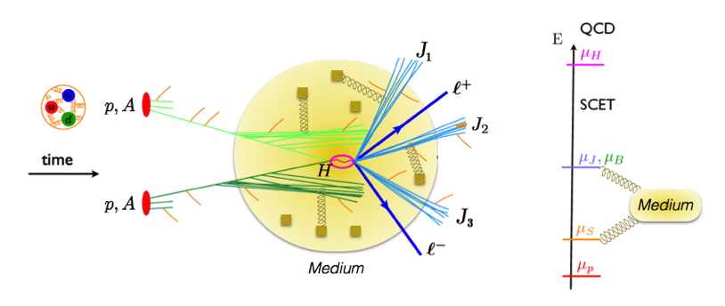
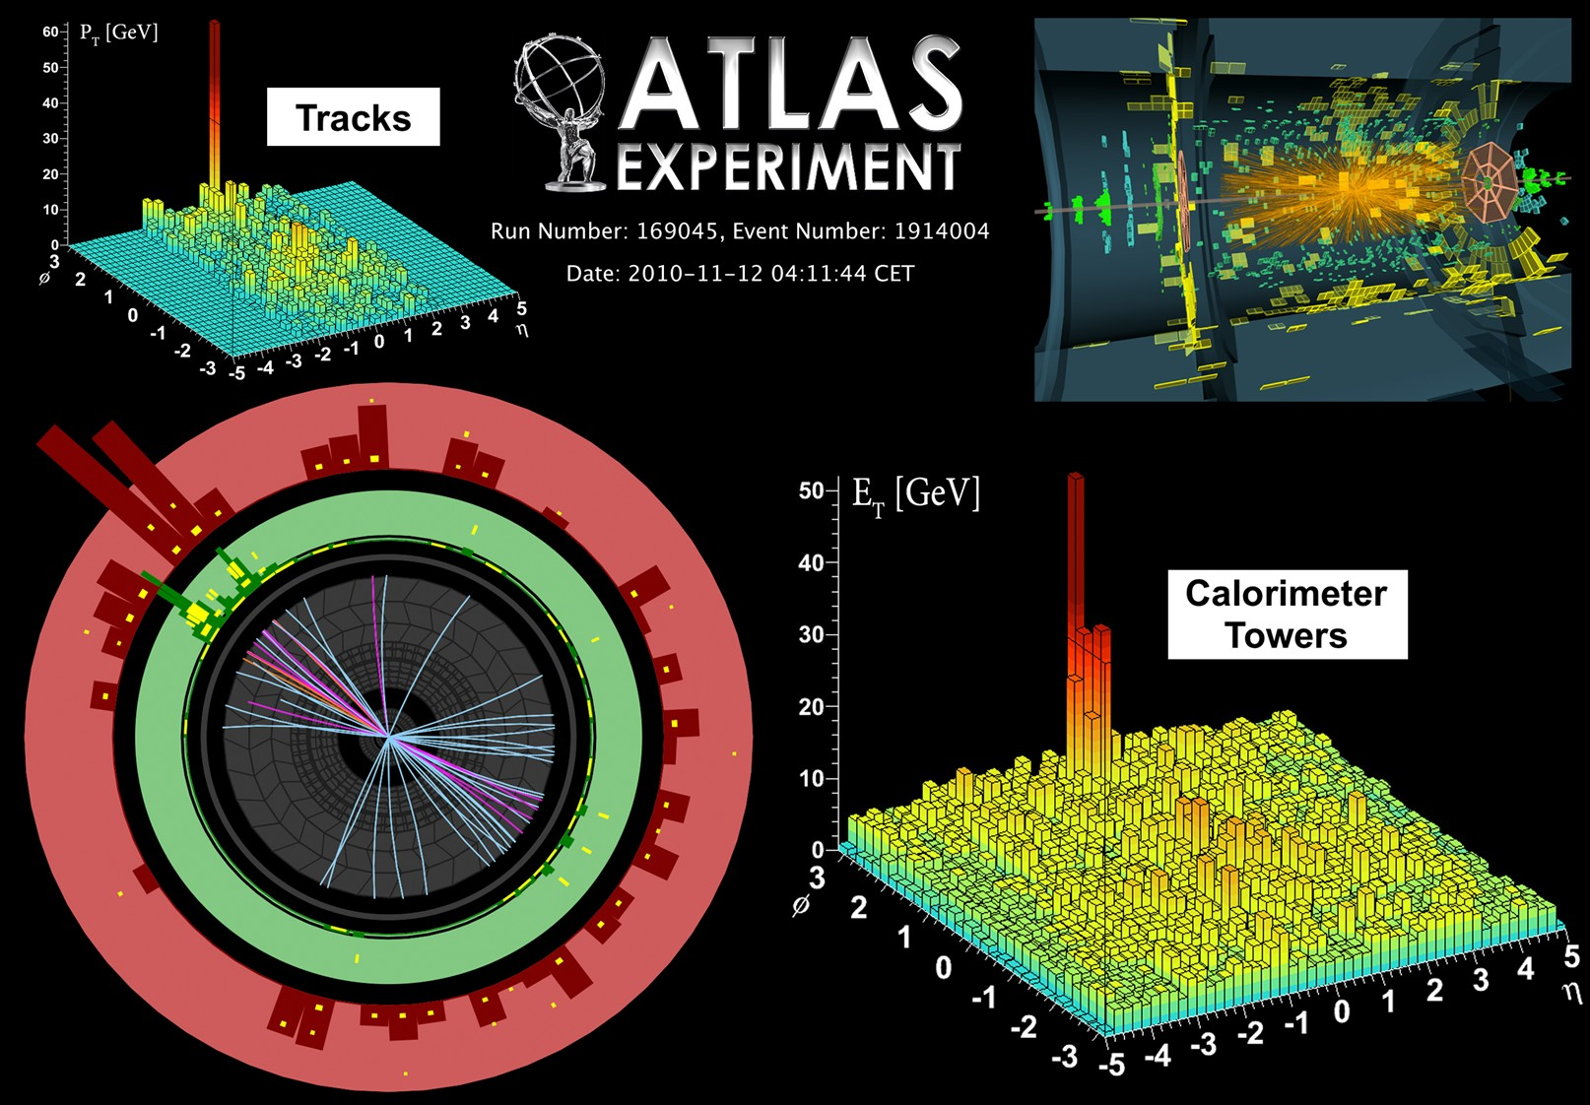

The HIC picture for hard probes
QCD in the medium remains a multi-scale problem
Ovanesyan et al. (2011)
Aad et al. (2010)
Factorization, with modified J (jet), B (beam), S (soft) functions

Slide 9
The splitting kernels
What is missing in the SCET Lagrangian is the interaction between the jet and the medium
Background field approach
A. Idilbi et al. (2008)
G. Ovanesyan et al. (2011)
Operator formulation for forward scattering / BFKL physics
I. Rothstein et al. (2016)
Splitting functions are related to beam (B) and jet (J) functions in SCET
W. Waalewjin. (2014)
Gribov et al. (1972)
G. Altarelli et al. (1977)
Y. Dokshitzer (1977)

Slide 10


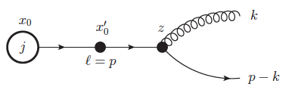

Heavy quarks in the vacuum and the medium
SCET_{M,G} – for massive quarks with Glauber gluon interactions
Feynman rules depend on the scaling of m. The key choice is m/p⁺ ~λ
I. Rothstein (2003)
A. Leibovich et al. (2003)
With the field scaling in the covariant gauge for the Glauber field there is no room for interplay with mass in the LO Lagrangian
Result: SCET_{M,G} =SCET_{M} ✕ SCET_{G}
x
1 - x
You see the dead cone effects
You also see that it depends on the process – it not simply x²m² everywhere: x²m², (1-x)²m², m²
Dokshitzer et al. (2001)
The process is not written Q to gQ
F. Ringer et al . (2016)

Slide 11
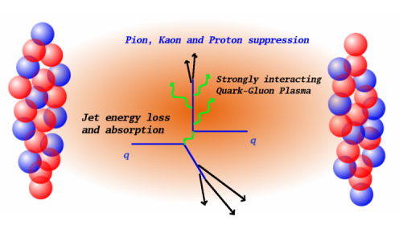
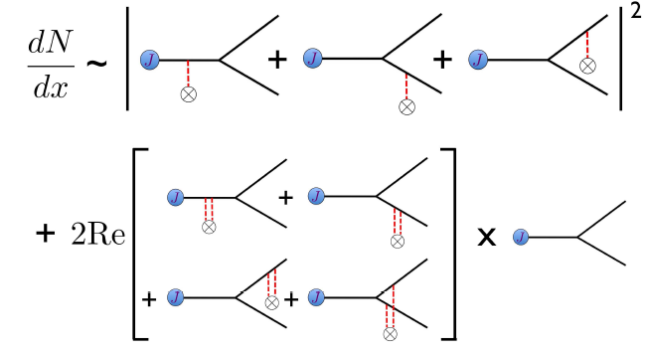

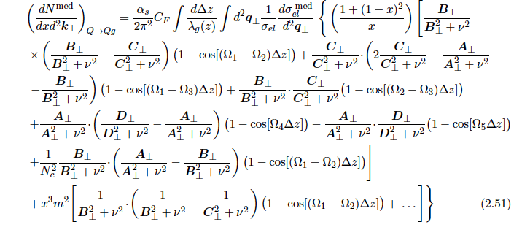
Heavy quarks splitting functions in the medium
New physics – many-body quantum coherence effects
F. Ringer et al . (2016)
Full massive in-medium splitting functions now available
Can be evaluated numerically

Slide 12
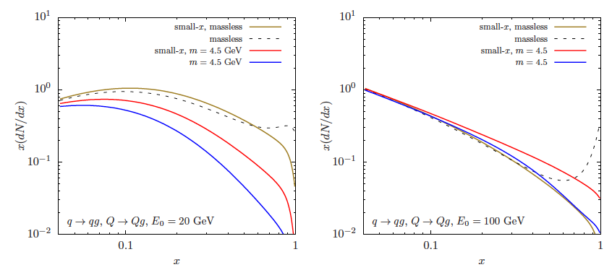
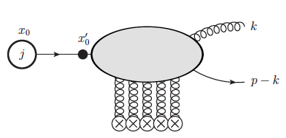

Various limits and crosschecks
In the soft gluon emission (x ➔0) energy loss limit only the diagonal splittings survive (Q to Qg) – check against e-loss calculations
By taking the massless limit we cross checked the result against massless splitting functions
Massless vs mass
M. Djordjevic et al . (2003)
Full vs e-loss
G. Ovanessyan et al . (2012)
There is a limitation to the calculation to first order in opacity. Higher order correlations lead to smoother 2D (x,kT) distributions
Calculation can be done using light cone wavefunctions. Checked for light quarks.
M. Sievert et al . in prep

Slide 13
Semi-Inclusive Jet Calculations HI via SCET_{(G)}

Slide 14
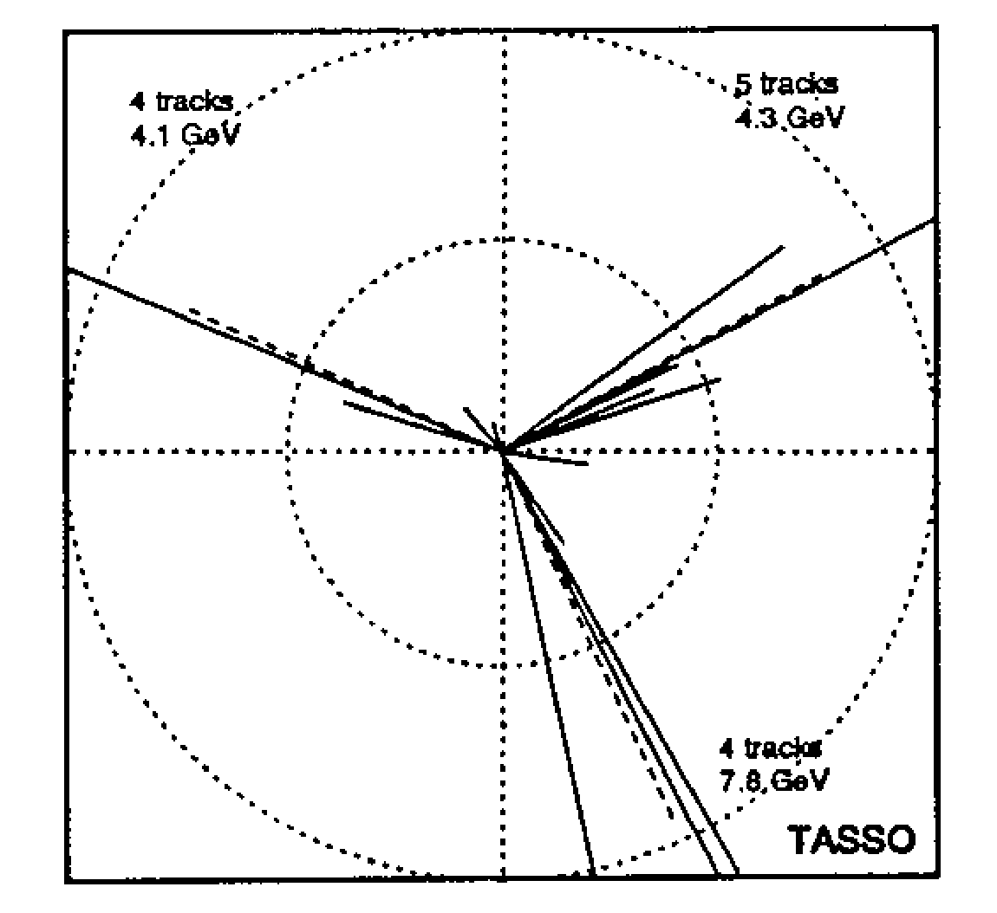


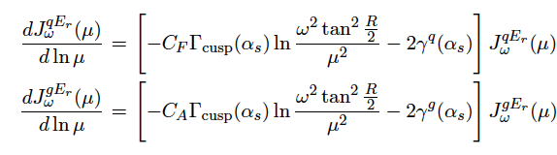
Exclusive approach to jets in SCET
Motivated by early e+ e- annihilation, SCET assumes that all energy goes into a well defined number of jets
Factorized expression
Nomenclature: H – hard function, S – soft function, B- beam function, J – jet function
TASSO (1979)
PETRA at DESY
12 GeV < CM energy < 47 GeV
The exclusive view of a process in SCET summarized as
Evolution of jet energy function

Slide 15
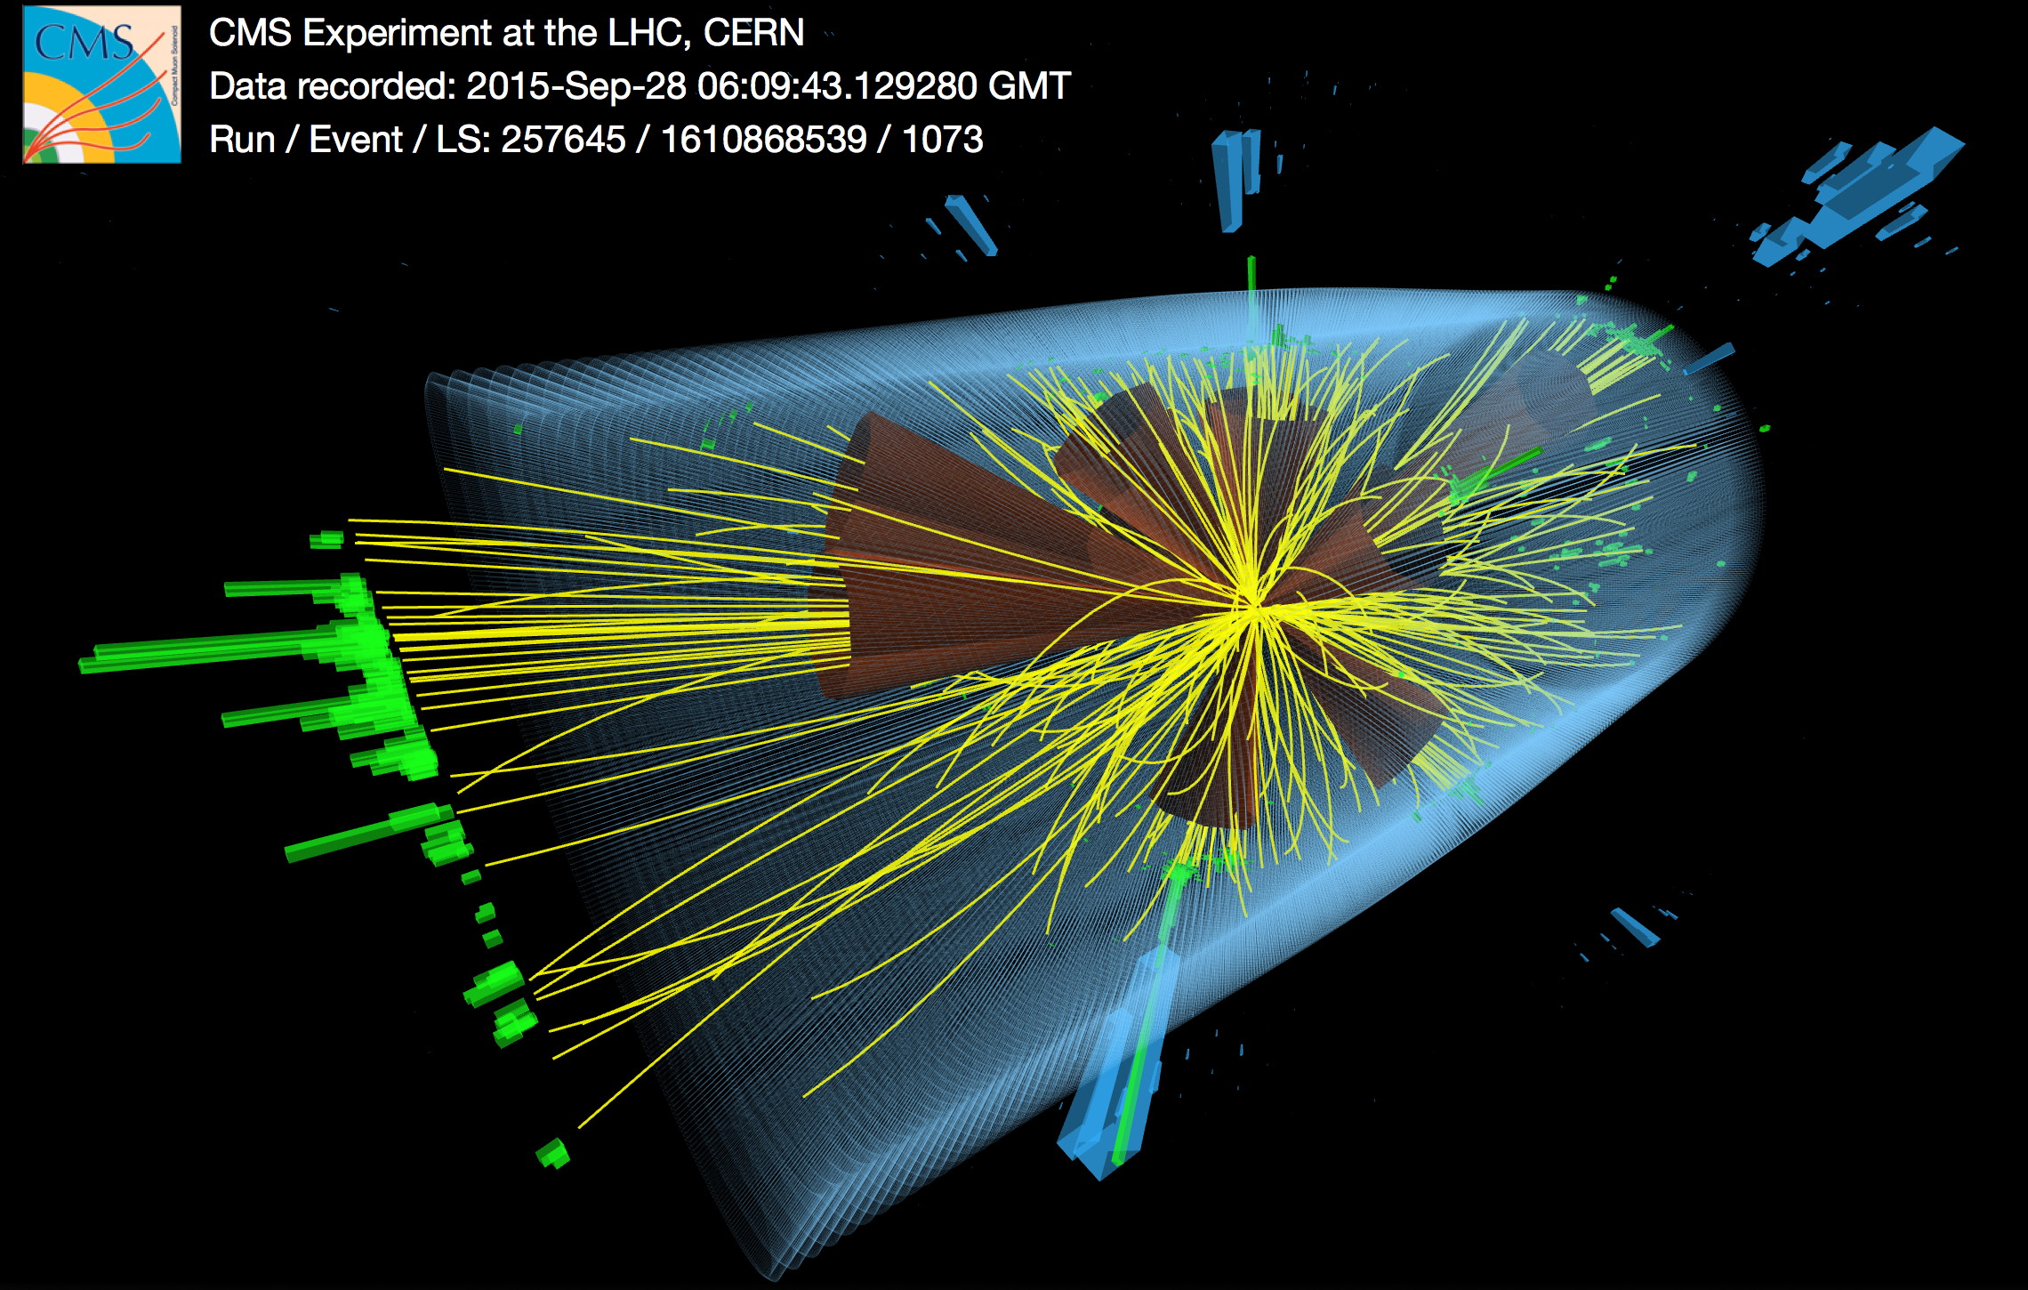

Why may we need inclusive SCET approach?
CERN energies 0.9 TeV < CM energy < 13 TeV
It is certainly not the case in hadronic collisions (and even more energetic e+ e-) that all the energy goes into jets and beams.
Conjectured that a different type of evolution may hold, namely DGLAP evolution
Dasgupta et al. (2014)
CMS (2015)
Experiments measure for example
Kang et al. (2016)
Iidlbi et al. (2016)
Chul et al. (2016)
Allow for the jet to capture only a fraction of the parton shower energy z=ω_{J}/ω
Typically no effort to determine what X is
Semi-inclusive jet function

Slide 16

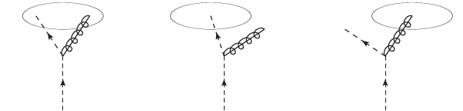

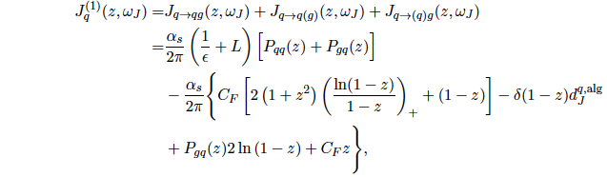
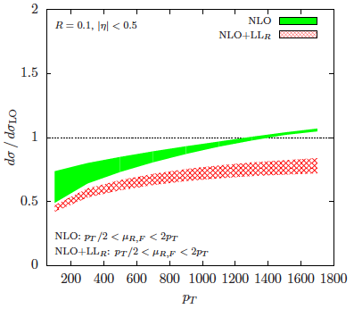
Semi-inclusive jet function in SCET
At tree level
All double poles (1/ε²) and double logarithms (L²) and cross cancel. Single logarithms survive
At one loop order
F. Ringer et al. (2015)
We can perform LL_{R} resummation. Have generalized to NLL_{R}
Fixes the unphysical scale dependence of NLO jet
Resummation can have up to 30% effect for small R

Slide 17
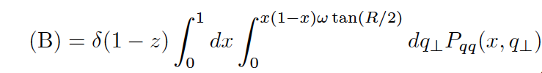

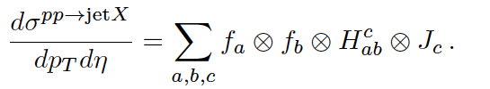


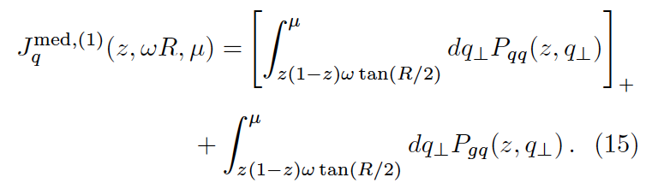
Evaluating the in-medium jet function
Can we formulate the evaluation of the jet function in a way suitable for numerical implementation
Z. Kang et al. (2017)
Sum
rules
Can be combined.
NB has to be understood in the sense of convolution
Stable in numerical implementation
Similarly for gluon jets

Slide 18

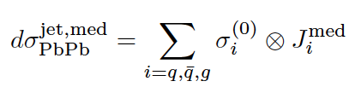
Results for HI jets at NLO
In the medium it is strictly NLO
No multiple splittings, no collisional energy loss (to be revisited)
Possibilities: better evaluation of the splitting functions, collisional energy loss, larger jet-medium coupling, …
One possibility is cold nuclear matter effects in the initial state (p+A)
200
200
600
p_{T} [GeV]

Slide 19
Centrality dependence of jet suppression
Central
Peripheral
Consistent within error bars. But then any small separation ordering will be
c.f. Y.T. Chien et al. (2015)
Nuclei are macroscopic objects. One can define centrality of the collision: Changes the size, temperture of the medium
Central
Peripheral
The centrality dependence appears to be well captured

Slide 20
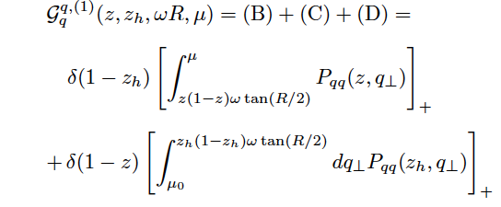
Modification of Fragmentation Functions
A wide variety of jet substructure observable measurements are available: jet shapes, jet fragmentation functions, jet splitting functions
CNM-no effect (like on all other substructure
observables)
Out of cone contribution – this is quenching –more quark jets
In cone contribution – enhance the soft particle, reduce hard
Still in the process of assessing the sensitivity, centrality dependence, etc
Y.-T. Chien et al . (2016)

Slide 21

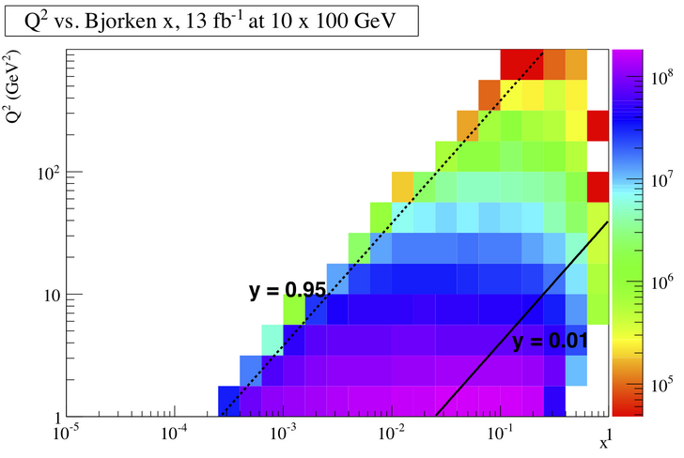
Semi-inclusive hadron modification at the EIC
NLO calculation
F. Ringer et al. (2017)
Kinematics
CM energy =60 GeV
0.01 < y < 0.95, 0.3 < x_{B} < 0.9
W>3 GeV
Observe the lepton
Still find that quarks gives the dominant contribution
Considerable suppression at large z. Enhancement at low z.
In the LRP claimed to hold for heavy flavor. Find it is true for light flavor at much smaller z

Slide 22
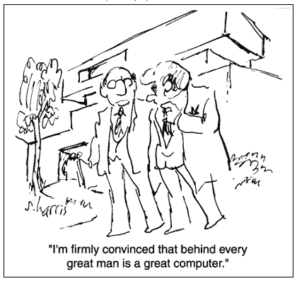
Heavy Flavor in HI

Slide 23
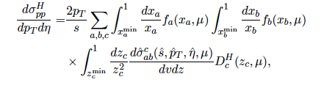
ZMVFS open heavy flavor at NLO
Typically assumed that only c to D, b to B fragment perturbatively
Perform an NLO calculation
B. Jager et al . (2002)
~50% gluon contribution
Kneesch et al . (2008)
Kniehl et al . (2008)
When p_{T} > m_{c}, m_{b}
Factorization, non-perturbative physics is long distance

Slide 24
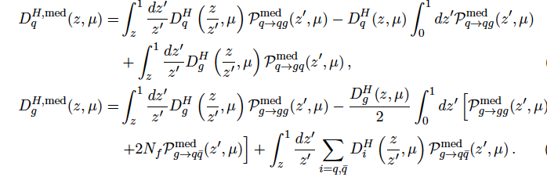

Cross section calculation in the QCD medium
Medium contribution
For numerical implementation one can rewrite these expression in the + prescription and finds that the correction is negative
Can lead to larger cross section suppression at smaller p_{T}

Slide 25
Uncertainty and data comparison
Includes both production mechanism and e-loss vs NLO
The pure scale uncertainty largely cancels in the ratio
At low PT the ucertainties can grow to 30% D and 50+% B
For D mesons works reasonably well. Below 10 GeV room for some additional effects: collisional energy loss, dissociation

Slide 26
Conclusions
Effective theories of QCD have enabled important conceptual and breakthroughs in our understanding of strong interactions and very significant improvement in the accuracy of the theoretical predictions
SCET_{G} - an effective theory for jet propagation in matter constructed. In medium splitting functions derived for massless and massive partons to first order in opacity. Ongoing work using lightcone wavefunction techniques to improve results beyond this order
Only recently were semi-inclusive jet functions introduced and computed to one loop. Extended to more differential measurements. Allowed to understand jet R resummation to NLL_{R.} Appear to have immediate relevance to the small radius jet measurements at LHC
Performed a consistent NLO calculation of jet production in SCET_{G} (an effective theory for jet propagation in matter). Allows us now to also look at jet substructure. Found that at high p_{T} only part of the suppression can be explained. CNM or collisional energy loss of the shower.
Recently extended to heavy flavor and NLO calculations

Slide 27


Many observables to access jet substructure have emerged in SCET
Groomed jet distribution using “soft drop”
A. Larkoski et al . (2014)
p_{T2}
r_{g} = ΔR₁₂
p_{T1}
z_{g =}
QGP size ~ 10fm
The great utility of these new distributions:
Definition eliminates soft and collinear divergences to the observable
probe the early time dynamics / splitting
Typical situation: E=200 GeV, r_{g} = 0.1
Branching time < 2 fm for z_{g} studied
Y. T. Chien et al . (2016)

Slide 28


Accessing the hardest branching in HIC – longitudinal modification
Calculating the soft dropped distribution with β=0
Medium
Vacuum
P(z_{g})
NB: data is preliminary, being reanalyzed, pints can change
z_{g}

Slide 29
Centrality and p_{T} dependence
(Collisional) energy loss of individual branches does not help
P(z_{g})
Evolution in pT is slowish theoretically . Experimental data fluctuates more but beware of error bars
z_{g}
P(z_{g})
Centrality dependence as expected – reduced effect for peripheral collisions
Y.T Chien et al . (2016)
z_{g}

Slide 30

Modification of the angular distribution of hardest branchings
Flexibility in selecting angular separation r_{g}
Found that inermediate values r_{g} = 0.2 give the strongest p_{T} dependence. Though not nearly as strong as preliminary data
P(r_{g})
New observable proposed – measures the typical splitting angle modification in HIC
Y.-T. Chien et al . (2016)
r_{g}

Slide 31

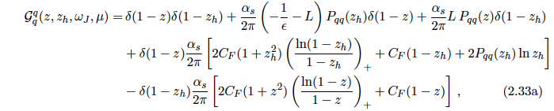
Semi-inclusive fragmenting jet function
Generalize the definition to jet and a hadron, sequences of fractions
Z. Kang et al . (2016)
Derive to one loop the SIFJF
Agrees with data within uncertainties.
However the central values can deviate by 20% and small z even 40%
Can be used to constrain FFs

Slide 32
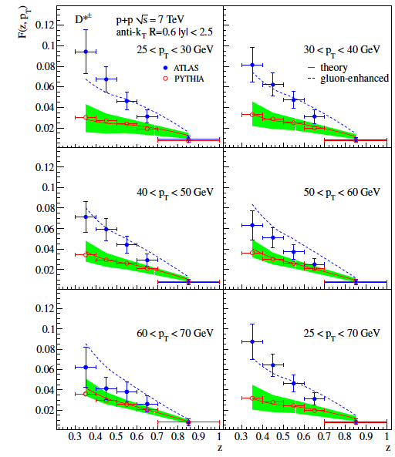
Implications for heavy flavor modification
A very large contribution of gluon FF to heavy flavor ~50%
The important implication of this will affect the nuclear modification factor
Y.T. Chien et al . (2015)

Slide 33
Combined uncertainty
Includes both production mechanism and e-loss vs NLO
The pure scale uncertainty largely cancels in the ratio
At high pT there is at least 20% combined uncertainty. Did not increase much since gluon fragmenatation in H is softer and offsets the difference between quark-gluon enegry loss.
At low PT th eucertainties can grow to 30% D and 50+% B.

Slide 34
Suppression of open heavy flavor in the medium
For D mesons works reasonably well. Below 10 GeV room for some additional effects: collisional energy loss, dissociation
Z. Kang et al . (2016)
B mesons there is improvement but not sufficient. Even more room for other nuclear effects
Nice to extend the approach to include collisional energy losses

Slide 35

Medium-modified jet shapes at NLL
One can evaluate the jet energy functions from the splitting functions
Measurement operator – tells us how the above configurations contribute energy to J (jet function)
First quantitative pQCD/SCET description of jet shapes in HI

Slide 36
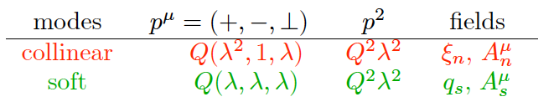
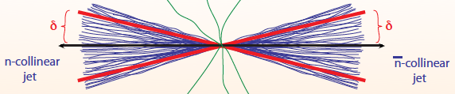
SCET formulation
Modes in SCET
C. Bauer et al. (2001)
D. Pirol et al. (2004)
Collinear quarks, antiquarks
Collinear gluons, soft gluons
Soft quarks are eliminated through the equations of motion
SCET _{II}
D. Neill et al. (2012)
Other formulations, e.g. SCET_{I} and ultrasoft particles
Especially suited for jet physics
E

Slide 37





Renormalization and evolution of the SIJF
Renormalization matrix to one-loop order
Absorb the remaining 1/ε divergence
Anomalous dimensions
Standard single logarithmic time-like DGLAP evolution
The semi-inclusive jet function is evolved in Melin space

Slide 38
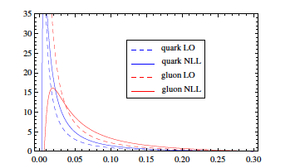
Numerical NLL results in p+p collisions
We can study the algorithm dependence of the jet shapes (anti)k_{T} vs cone.
Significant improvement over fixed order calculation
Works reasonably well, but there can be room for improvement. Different evolution?
NLL cone
NLL anti-k_{T}
LO
arXiv:1405.4293
CMS data R=0.3
Just to show that
the fixed order is
divergent

Slide 39
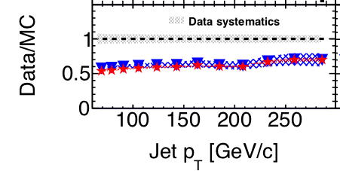
Recent applications to inclusive jet production
Is it relevant?
CMS appears to see a difference difference between data and NLO calculations
Resummation can explain large part of the discrepancy between data and NLO calculations
F. Ringer et al. (2017)
F. Ringer et al. (2017)

