Slide 1
HIAF EIC@China Project
Jian-ping Chen, JLab, USA and Xurong Chen, IMP, China
QCD Frontier2013, Virginia, Oct. 21-22, 2013
Introduction
EIC@HIAF Project
1st stage: 3 GeV (pol. e) X 12 GeV (pol. p), L=4x10³²
Energy: Between JLab12 and EIC@US
Time: likely significantly earlier than US EIC
What are the Unique Opportunities for EIC@HIAF
Spin-Flavor Structure (sea quark polarization)
3-d Structure of the Nucleon (GPDs,TMDs)
π/K Structure Functions
Hadronization/EMC/SRC

Slide 2
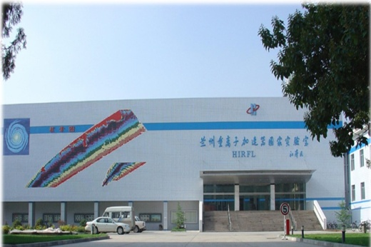
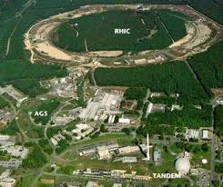
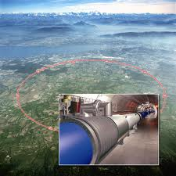
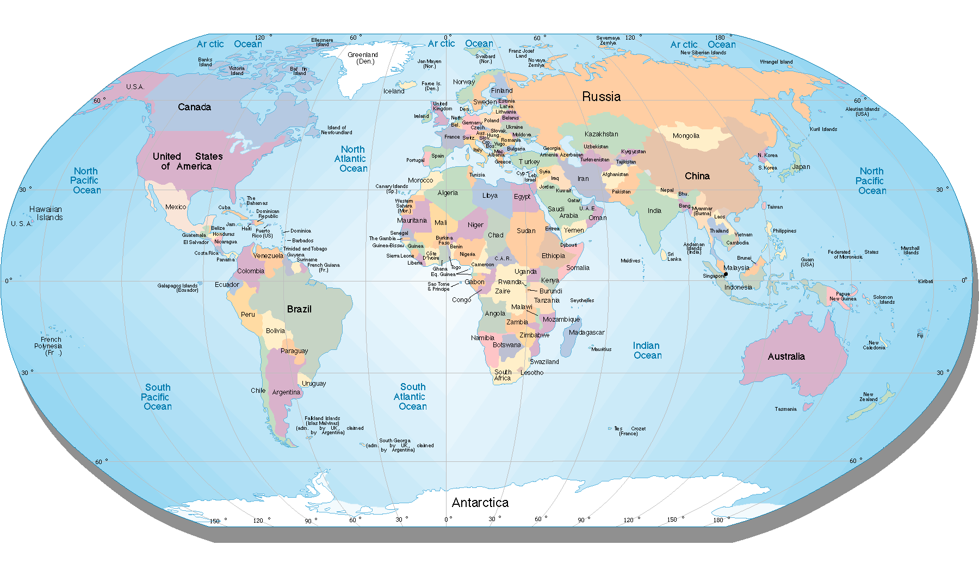
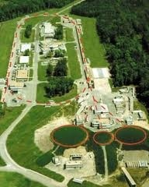
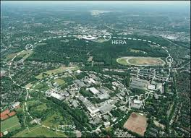
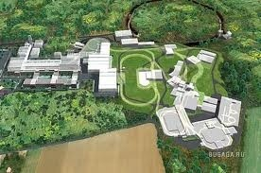
Electron Ion Colliders on the World Map
EIC@HIAF
LHC ➔ LHeC
RHIC ➔ eRHIC
CEBAF ➔ MEIC/EIC
HERA
FAIR ➔ ENC

Slide 3
Introduction
IMP, HIAF and EIC@HIAF

Slide 4
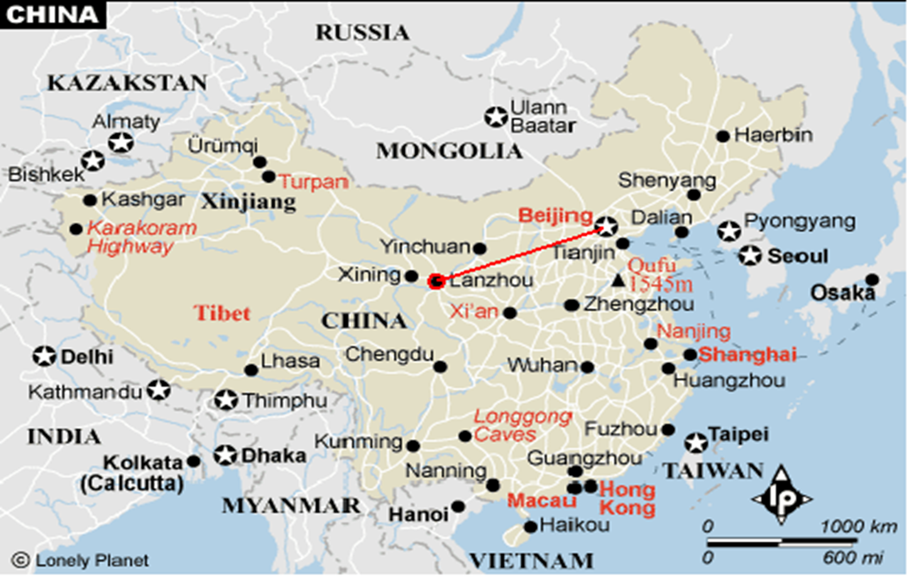
HEP-NP Major Research Facilities in China
Institute of High Energy Physics (IHEP), CAS, Beijing
Beijing Electron-Positron Collider / BES
Daya Bay, …
Institute of Modern Physics, CAS, Lanzhou
Heavy-Ion Research Facility in Lanzhou-Cooler Storage Ring (HIRFL- CSR)

Slide 5
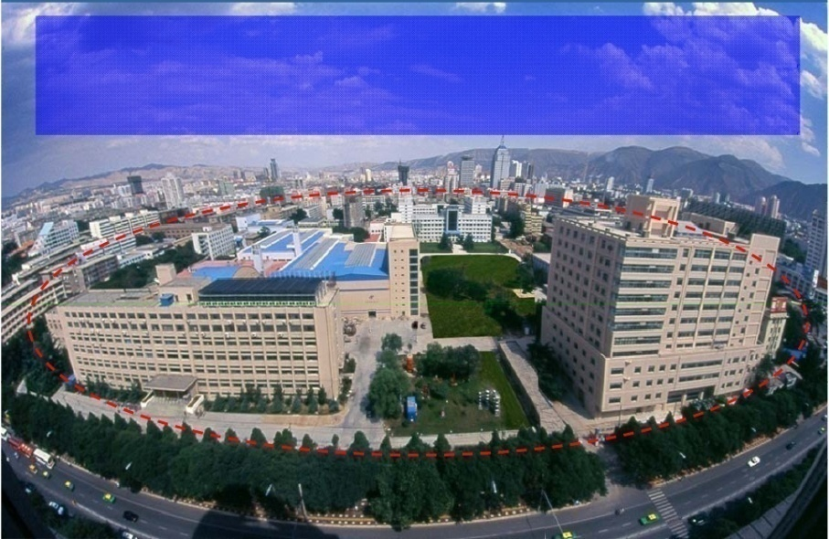
Institute of Modern Physics (IMP)
1957: The institute of Modern Physics(IMP) was founded .
It is affiliated with the Chinese Academy of Sciences (CAS)
1991: Heavy Ion Research Facility in Lanzhou (HIRFL).
2007: Cooler Storage Ring (HIRFL-CSR)
  ~2 GeV for p, ~1 GeV/u for heavy ion up to U.
  Main focus: basic research in heavy ion physics and related interdisciplinary science
  Research center for low-to-intermediate energy physics in China.
  800 scientists and engineers
2011-2013 New Proposal: High Intensity Heavy Ion Accelerator Facility (HIAF)

Slide 6


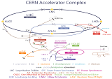

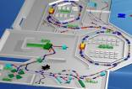
立项背景：加速器
能区MeV/u~TeV/u运行与在建的~30台
FRIB
6亿美元
RIBF
直线加速器
回旋加速器
最高流强
对撞机
同步＋环
同步＋环
LHC
FAIR
11.9亿欧元
CSR
2.9亿人民币
最高能量
最高功率
亚洲领先
发展趋势 | 高能量 | 对撞机 | 宇宙起源、质量来源、QCD检验、新物理…
 | 高流强 | 直 线 | 宇宙演化、元素和原子核存在极限、奇异核结构…
 | 高功率 | 储存环 | 高能量密度物质、新物态、重离子驱动惯性聚变…
为了提升我国重离子科学研究国际竞争力,提出建造新一代加速器装置

Slide 7
(Physics Today, May) China prepares to spend billions on science & technology
12th five-year plan: Mid- to long-term projects ranked by priority
1. Ocean-floor scientific survey network
2. High-energy synchrotron test facility
3. Accelerator-driven subcritical reactor research facility
4. Synergetic Extreme Condition User Facility
5. High-flux heavy ion accelerator
6. High-efficiency, low-carbon gas turbine testing facility
7. Large High Altitude Air Shower Observatory
8. Future network experimental facility
9. Outer-space environment simulating facility
10. Translational medicine research facility
11. China Antarctic Observatory
12. Precision gravity measurement research facility
13. Large-scale low-speed wind tunnel
14. Shanghai Synchrotron Radiation Facility Phase-II Beamline Project
15. Model animal phenotype and heredity research facility
16. Earth system digital simulator

Slide 8
HIAF → EIC@ HIAF?
Initial goals fro HIAF:
1) rare isotope
2) high-energy-density matter
3) applications …
New: add collision physics
1) EIC
2) Ion-Ion Collider
3) Ion-Ion Merging
Discussions, 2012- 2013: inputs from international communities
→ EIC emerged as the highest priority among the new goals
1st stage: 3 GeV (pol. e) x 12 GeV (pol. p), L= 4x10³²
Time: significantly before US EIC (5-10 years)
2nd Int. Conf. on “QCD and Hadron Physics”, March, 2013, Lanzhou
http://qcd2013.csp.escience.cn/
Symposium on EIC @ China, July, 2013, Weihai, organized by CPS-HEP
strong support for EIC@HIAF

Slide 9

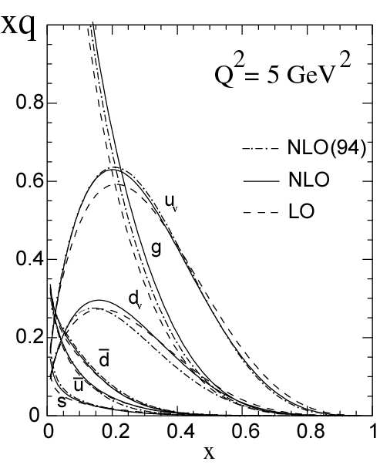
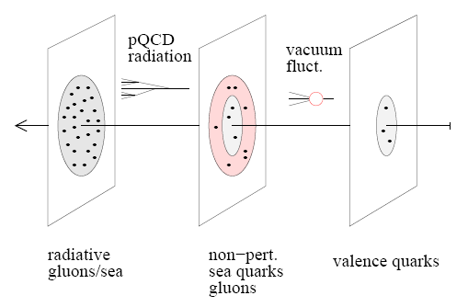
The Landscape of EIC
An EIC aims to study gluon dominated matter
and sea quark component.
With 12 GeV we study mostly the valence quark component
EIC@HIAF
mEIC
EIC
12 GeV

Slide 10
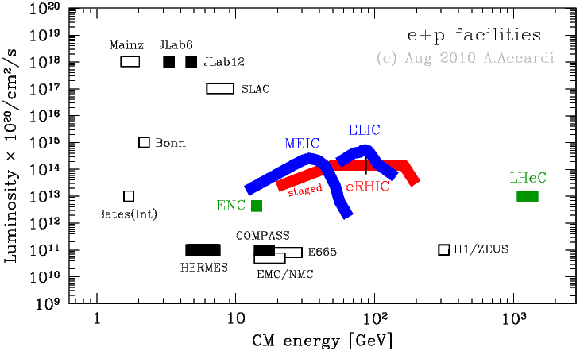
Lepton-Nucleon Facilities
HIAF: e(3GeV) +p(12GeV), both polarized, L(max)=4*10³²cm²/s
JLAB12
HIAF

Slide 11
Figure of Merit
Figure-of Merit for double polarization experiments
FOM=L * P_{e}² * P_{N}² * D²
L=Luminosity, P=Polarization, D=Dilution
FOM Comparison of EIC@HIAF (1) with COMPASS (2)
HIAF: L=4*10³², D=1
COMPASS: L=10³², D=0.13 (NH₃ target)
Unpolarized:
FOM(1)/FOM(2) = L(1)/L(2) ~ 4
Polarized:
FOM(1)/FOM(2) = L(1)/L(2) * [D(1)² /D(2)²] ~ 200

Slide 12
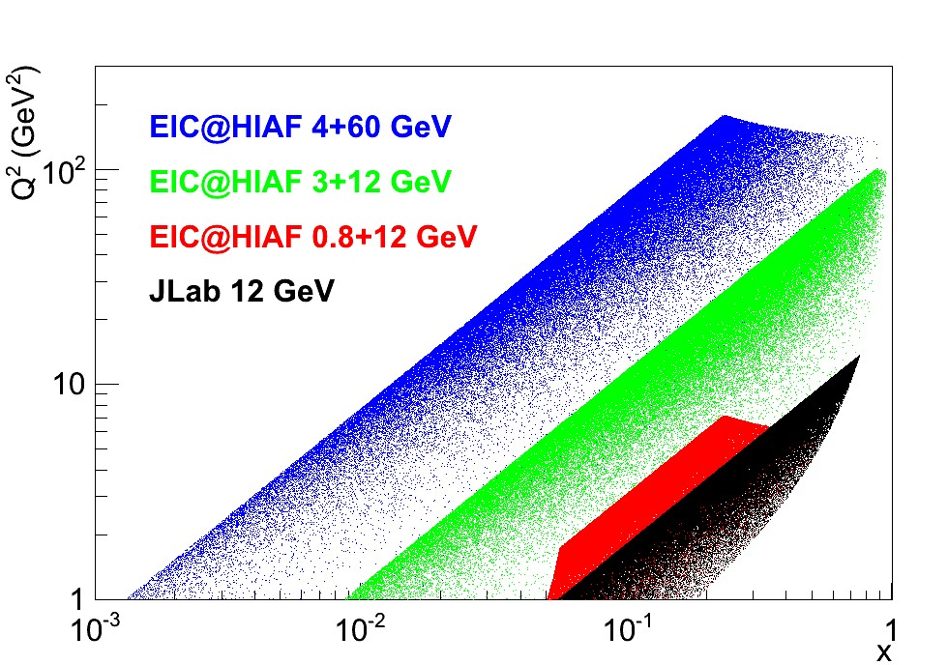
EIC@HIAF Kinematic Coverage Comparison with JLab 12 GeV
e(3GeV) +p(12GeV), both polarized, L(max)=4*10³²cm²/s
EIC@HIAF:
study sea quarks (x > 0.01)
deep exclusive scattering at Q² > 5-10
higher Q² in valance region
range in Q² allows some study gluons
plot courtesy of Xurong Chen

Slide 13
Science Case (I): Spin-Flavor
Δs and other polarized sea quark distributions

Slide 14
Spin-Flavor Study at EIC@HIAF
Unique opportunity for Δs
JLab12 GeV energy not high enough to have clean Δs measurements
EIC@HIAF, combination of energy and luminosity：
By semi-inclusive DIS, in particular, for Kaons , will help to identify strange quark helicity

Slide 15
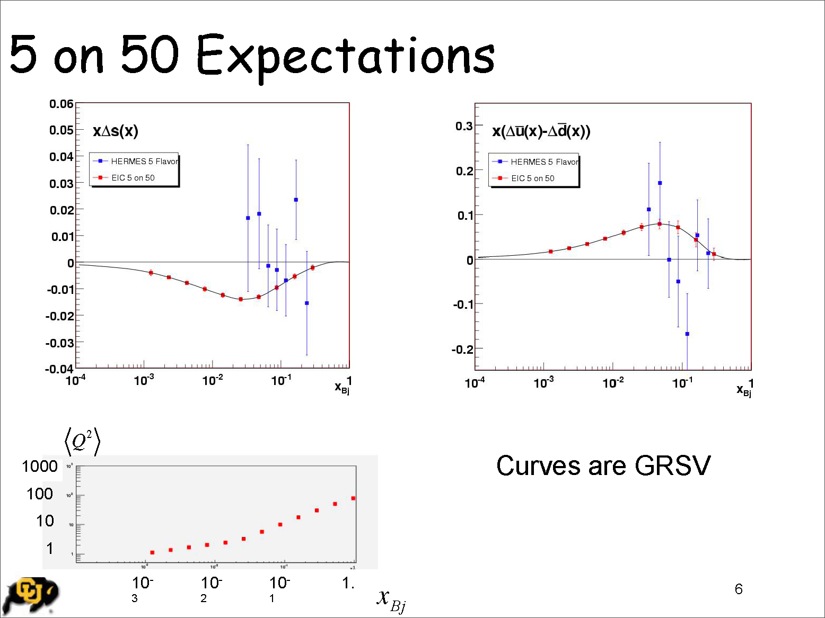
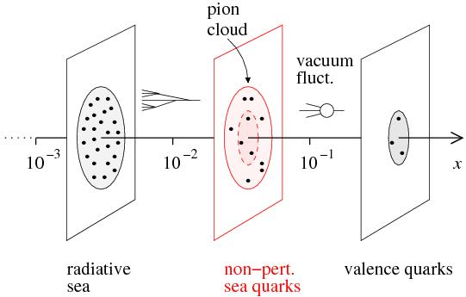
Sea Quark Polarization
}
Kinney, Seele
EIC@HIAF
Spin-Flavor Decomposition of the Light Quark Sea
100 days, L =10³³, s = 1000
Access requires s ~ 100-1000 (and good luminosity)
A simulation with parameters of EIC@HIAF is being performed by Xiaodong Jiang (Los Alamos)

Slide 16
Spin-Flavor Study at EIC@HIAF
Unique opportunity for Δs
energy reach current fragmentation region for Kaon tagging in SIDIS
Significant improvement for Δu_bar, Δd_bar from SIDIS
combination of energy and luminosity
Increase in Q² range/precision for g₁ (and g₂)
constraint on Δg.

Slide 17
Science Case (II): 3-d Structure, GPDs
DVCS and Deep-exclusive Light Mesons Production

Slide 18
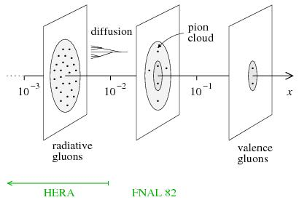

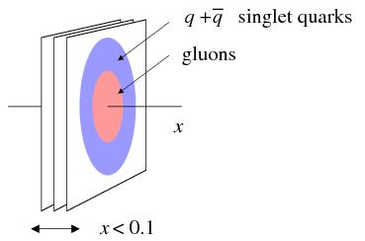
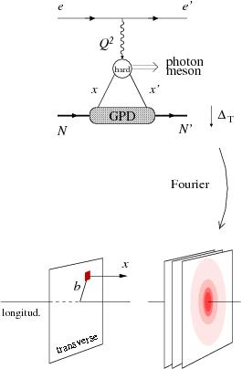
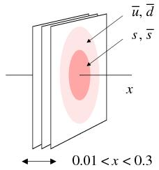
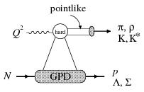
Detailed differential images from nucleon’s partonic structure
EIC: Gluon size from J/Ψ and φ electroproduction (Q² > 10 GeV²)
t
[Transverse distribution derived directly from t dependence]
Hints from HERA:
Area (q + q) > Area (g)
Dynamical models predict difference:
pion cloud, constituent quark picture
-
Weiss, Hyde, Horn
EIC: singlet quark size from deeply virtual compton scattering
Fazio
t
Q² > 10 GeV²
for factorization
Statistics hungry
at high Q²!
EIC: strange and non-strange (sea) quark size from π and K production
Horn

Slide 19
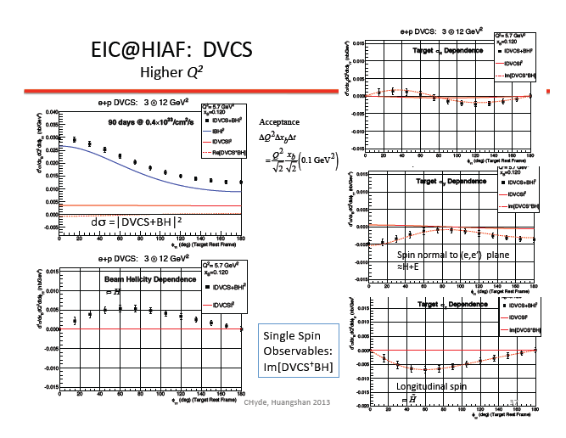
Charles Hyde (ODU)

Slide 20
GPD Study at EIC@HIAF
Unique opportunity for DVMP (pion/Kaon)
flavor decomposition needs DVMP
energy reach Q² > 5-10 GeV², scaling region for exclusive light meson production
(JLab12 energy not high enough to have clean meson deep exclusive process)
Significant increase in range for DVCS
combination of energy and luminosity
Other opportunities: vector meson, heavy flavors?

Slide 21
Science Case (III): 3-d Structure, TMDs,
Precision multi-d mapping of SSA in SIDIS

Slide 22
The TMD simulation: Projections for SIDIS Asymmetry π⁺
EIC@HIAF reach high precision similar to SoLID at lower x, higher Q2 region
Hiayan Gao (Duke)
Green (Blue) Points: SoLID projections for polarized NH3 (³He/n) target
Luminosity: 10³⁵ (10³⁶) (1/cm²/s); Time: 120 (90) days
Black points: EIC@HIAF projections for 3 GeV e and 12 GeV p
Luminosity: 4 x 10³² /cm²/s; Time: 200 days

Slide 23
TMD Study at EIC@HIAF
Unique opportunity for TMD in “sea quark” region
reach x ~ 0.01
Significant increase in Q² range for valence region
energy reach Q² ~40 GeV² at x ~ 0.4
Significant increase in P_{T} range
reach >1 GeV (TMD/co-linear overlap region)

Slide 24
Science Case (IV): π/K Structure
π/Κ Parton Distribution Function in Valence Quark Region

Slide 25
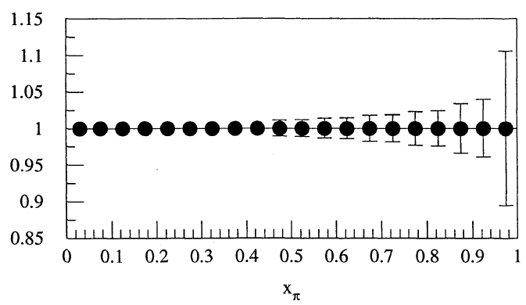
High-impact large-x measurements
Simulated errors for DIS events using 5 GeV electron beam on a 25 GeV proton beam with luminosity
10³²cm⁻²s⁻¹ and 10⁶s running.
Pion PDF on the
valence-quark domain
  What is the pointwise structure
  of Goldstone modes: massless
  bound-states of very massive
  constituents?
  Currently, a single reanalysis of
  an old experiment agrees with
  one (DSE) prediction
  Simulations at EIC-kinematics exist:
  Holt & Reimer AIP Conf.Proc. 588 (2001) 234-239
Kaon PDF on the valence-quark domain
  Critical complement to pion: x=1 measures strength of DCSB
  Need simulations @ EIC-kinematics: kaon structure function [p(e,e’Λ)]

Slide 26
π structure simulation for EIC@HIAF
Paul Reimei
(Argonne)
EIC@HIAF projections for 3 GeV e and 12 GeV p
Luminosity: 5 x 10³² /cm²/s; Time:10⁶ seconds

Slide 27
Physics Programs at EIC@HIAF
Opportunity to bring Chinese hadron physics to the forefront in the world
Nucleon spin-flavor structure (polarized sea, Δs)
3-d Structure: GPDs (Deep-Virtual Meson Production, pion/Kaon)
TMD in “sea quark” region
and significant increase in Q² / P_{T} range for valence region
Pion/Kaon structure functions in the high-x (valence) region
e-A to study hadronization
EMC-SRC in e-A
……
Whitepaper on EIC@China is being worked on
http://snst-hu.lzu.edu.cn/wiki/index.php/Eic

Slide 28
HIAF Facility
Design, Schedule, R&D, Site

Slide 29
HIAF Layout
超导直线加速器、同步加速器和储存环组合的技术路线
Notes:
29
29

Slide 30
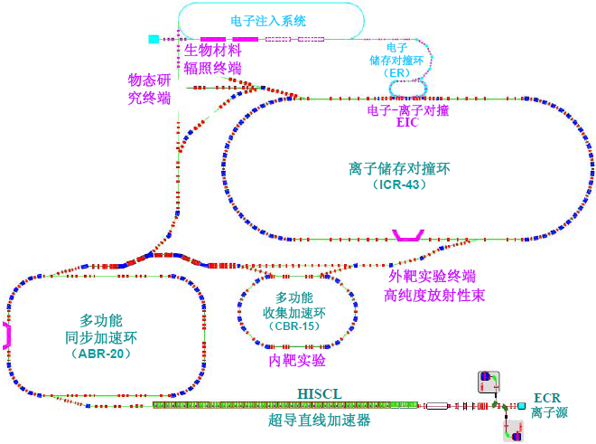
HIAF Facility
Characteristics and Advantages
Machine | Ion | Energy | Intensity
ECR Source | U³⁴⁺ | 14 keV/u | 0.05 pmA
LIS Source | U³⁴⁺ | 14 keV/u | 0.2 pmA
HISCL | U³⁴⁺ | 25 MeV/u | 0.03~0.15 pmA
ABR | U³⁴⁺ | 0.50 GeV/u | 0.6~2.4×10¹¹ ppp
 | p | 6.5 GeV/u | 1.0×10¹² ppp
ICR | U³⁴⁺ | 1.1 GeV/u | 0.2~1.0×10¹² ppp
 | p | 12.0 GeV/u | 5.0×10¹² ppp
ECR | e | 3.0-4.0 GeV/u | 7.5×10¹³ ppp
储存环＋脉冲强流 短寿命核质量测量
高功率、强聚焦短脉冲 高能量密度物质
high-energy、double pol、high Lumi ENC
    Nucleon Structure
Characteristics
脉冲强流重离子束
高功率短脉冲束团
极化质子和电子束
宽能量范围离子束
高品质放射性束流

Slide 31
HIAF Schedule
2013年1月-2013年8月 项目建议书准备 (proposal preparation)
2013年1月-2013年7月 选址评估 (site selection)
2013年8月-2014年7月 可行性研究报告（1.0年） (feasibility report)
2014年8月-2014年12月 初步设计报告（0.5年） (Preliminary DR)
2015年1月-2015年6月 开工报告（0.5年） (Technical Report)
2015年6月-2019年10月 项目建设、部分试运行（4.5年）(Construction)
2019年11月-2021年4月 完成建设、投入运行（1.5年） (Commission)
2021年10月 竣工验收 (Completion)

Slide 32
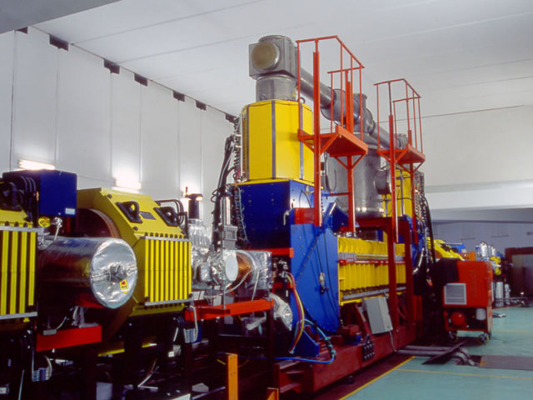
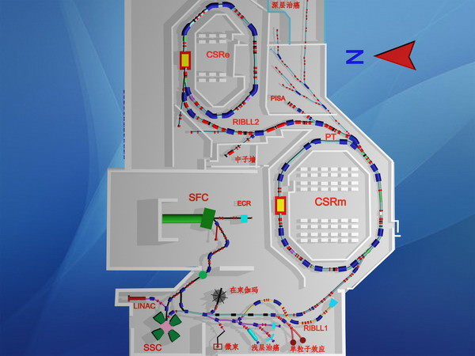
R&D Activity: JLab-IMP collaboration
Proposed Cooling Experiments at IMP
DC cooler
Idea: pulse the beam from the existing thermionic gun using the grid (Hongwei Zhao)
Non-invasive experiment to a user facility
Proposed experiments
Demonstrate cooling of a DC ion beam by a bunched electron cooling (Hutton)
Demonstrate a new phenomena: longitudinal bunching of a bunched electron cooling (Hutton)
(Next phase) Demonstrate cooling of bunched ion beams by a bunched electron beam (need an RF cavity for bunching the ion beams)
Two storage rings for Heavy ion coasting beam

Slide 33
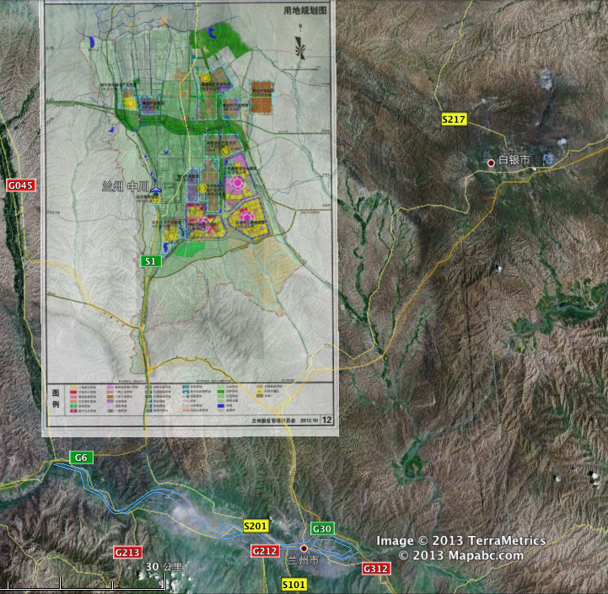
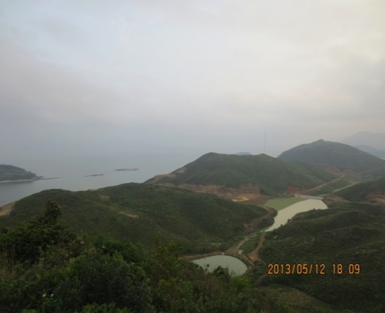

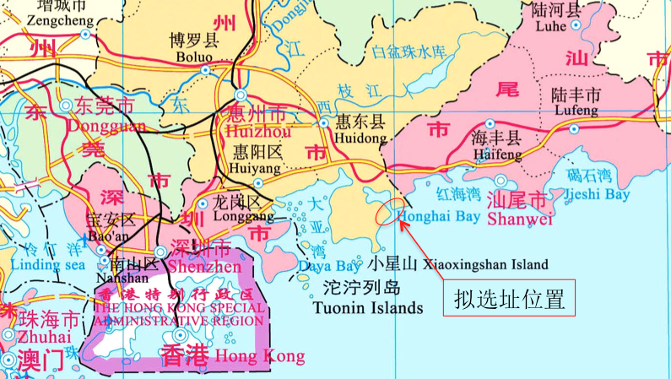
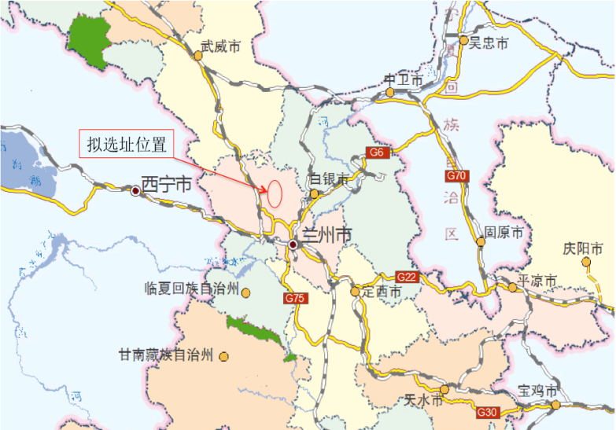
Site Selection
1. Huizhou, Guangdong
2. New Lanzhou District

Slide 34
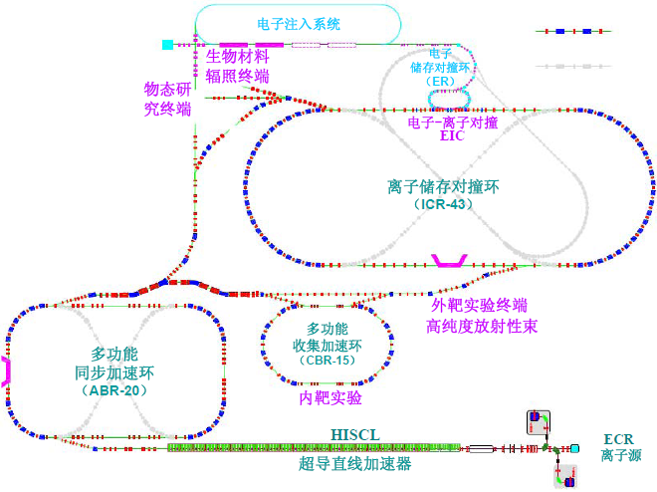
Future Upgrade
能量及强度升级
EIC升级（亮度、能量）
β束？
HEDP面向ICF点火？
应用研究
空间辐射环境模拟
材料研究
中子照相（GeV单能中子束）

Slide 35
Summary
HIAF and EIC@HIAF facility
Examples of Possible “Golden Experiments”
Nucleon spin-flavor structure (polarizd sea, Δs)
3-d structure: GPDs (DVMP) and DVCS
3-d structure: TMDs (sea, range in Q², P_{T})
Meson (pion/Kaon) structure function at high-x
Hadronization/EMC/SRC
EIC@HIAF opens up a new window to study/understand nucleon
structure, especially the sea
  Forefront of hadron physics
  Exciting new opportunities

