Slide 1
Valence-quark parton distributions
Craig Roberts, Physics Division

Slide 2
Collaborators: 2013-Present
Students, Postdocs, Profs.
S. HERNÁNDEZ (U Michoácan) ;
Jing CHEN (Peking U.)
Bo-Lin LI (Nanjing U.)
Ya LU (Nanjing U.)
Khépani RAYA (U Michoácan);
Chien-Yeah SENG (UM-Amherst) ;
Kun-lun WANG (PKU);
Chen CHEN (IFT, São Paulo);
Zhu-Fang CUI (Nanjing U.) ;
J. Javier COBOS-MARTINEZ (U Michoácan);
Minghui DING (Nankai U.) ;
Fei GAO (Peking U.) ;
L. Xiomara Gutiérrez-Guerrero (Sonora U.);
Cédric MEZRAG (ANL) ;
Mario PITSCHMANN (Vienna);
Si-xue QIN (ANL, U. Frankfurt am Main, PKU);
Eduardo ROJAS (Antioquia U.)
Jorge SEGOVIA (TU-Munich);
Chao SHI (ANL)
Shu-Sheng XU (Nanjing U.)
Adnan Bashir (U Michoácan);
Daniele Binosi (ECT*)
Stan Brodsky (SLAC);
Lei Chang (Nankai U. ) ;
Ian Cloët (ANL) ;
Bruno El-Bennich (São Paulo);
Roy Holt (ANL);
Tanja Horn (Catholic U. America)
Yu-xin Liu (PKU);
Hervé Moutarde (CEA, Saclay) ;
Joannis Papavassiliou (U.Valencia)
M. Ali Paracha (NUST, Islamabad)
Alfredo Raya (U Michoácan);
Jose Rodriguez Qintero (U. Huelva) ;
Franck Sabatié (CEA, Saclay);
Sebastian Schmidt (IAS-FZJ & JARA);
Peter Tandy (KSU);
Tony Thomas (U.Adelaide) ;
Shaolong WAN (USTC) ;
Hong-Shi ZONG (Nanjing U)

Slide 3
Hadron Structure

Slide 4
Hadron Structure Why?
Classical QCD … non-Abelian local gauge theory
Remove the mass … there’s no scale left
There is no dynamics in a scale-invariant theory; only kinematics … the theory looks the same at all length-scales … there can be no clumps of anything … hence bound-states are impossible.
Our Universe can’t exist
Higgs boson doesn’t solve this problem … normal matter is constituted from light-quarks … the mass of protons and neutrons, the kernels of all visible matter, are 100-times larger than anything the Higgs can produce
Where did it all begin?
… becomes … Where did it all come from?

Slide 5
Overarching Science Challenge for the coming decade
Discover meaning of confinement, its relationship to DCSB – the Origin of Visible Mass – and the connection between them

Slide 6
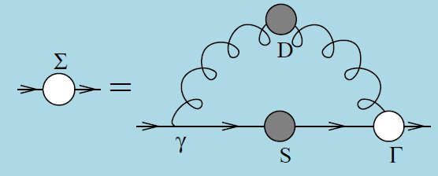
DCSB Paradigm

Slide 7
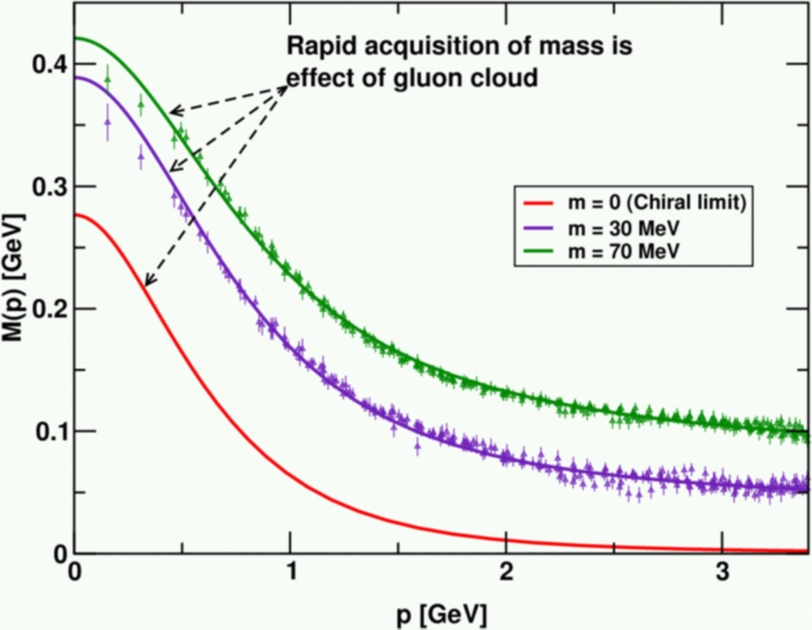
DCSB
Dynamical chiral symmetry breaking (DCSB) is
a crucial emergent phenomenon in QCD
Expressed in hadron wave functions not in vacuum condensates
Contemporary theory indicates that it is responsible for more than 98% of the visible mass in the Universe; namely, given that classical massless-QCD is a conformally invariant theory, then DCSB is the origin of mass from nothing.
Dynamical, not spontaneous
Add nothing to QCD ,
No Higgs field, nothing!
Effect achieved purely
through quark+gluon
dynamics.

Slide 8
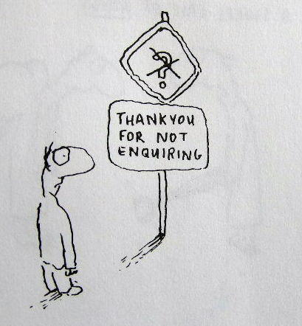
Enigma of Mass

Slide 9
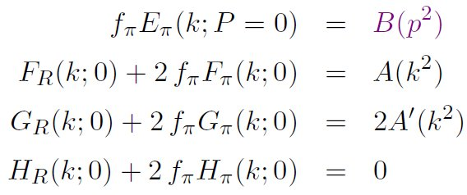
Pion’s Goldberger -Treiman relation
Maris, Roberts and Tandy
nucl-th/9707003, Phys.Lett. B420 (1998) 267-273
Pion’s Bethe-Salpeter amplitude
Solution of the Bethe-Salpeter equation
Dressed-quark propagator
Axial-vector Ward-Takahashi identity entails
B(k²)
Owing to DCSB
& Exact in
Chiral QCD
Miracle: two body problem solved, almost completely, once solution of one body problem is known

Slide 10
The most fundamental expression of Goldstone’s Theorem and DCSB in SM
Rudimentary version of this relation is apparent in Nambu’s Nobel Prize work
Model independent
Gauge independent
Scheme independent
f_{π} E_{π}(p²) = B(p²)

Slide 11
Pion exists if, and only if, mass is dynamically generated
Rudimentary version of this relation is apparent in Nambu’s Nobel Prize work
Model independent
Gauge independent
Scheme independent
f_{π} E_{π}(p²)⇔ B(p²)

Slide 12
This is why m_{π}=0 in the absence of a Higgs mechanism
Rudimentary version of this relation is apparent in Nambu’s Nobel Prize work
Model independent
Gauge independent
Scheme independent
f_{π} E_{π}(p²)⇔ B(p²)

Slide 13
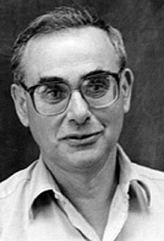
Enigma of mass
f_{π} E_{π}(p²) = B(p²)
This algebraic identity is why QCD’s pion is massless in the chiral limit
The quark level Goldberger-Treiman relation shows that DCSB has a very deep and far reaching impact on physics within the strong interaction sector of the Standard Model; viz.,
Goldstone's theorem is fundamentally an expression of equivalence between the one-body problem and the two-body problem in the pseudoscalar channel.
This emphasises that Goldstone's theorem has a pointwise expression in QCD
Hence, pion properties are an almost direct measure of
the dressed-quark mass function.
Thus, enigmatically, the properties of the massless pion
are the cleanest expression of the mechanism that is
responsible for almost all the visible mass in the universe.

Slide 14
Gluons, too, have a gap equation
Non-perturbative comparison of QCD effective charges, A.C. Aguilar, D. Binosi, J. Papavassiliou and
J. Rodriguez-Quintero, Phys. Rev. D80 (2009) 085018
Pinch-technique + background field method … reordering of diagrammatic summations in the self-energy – Π_{μν} – ensures that subclusters are individually transverse and gluon-loop and ghost-loop contributions are separately transverse
STIs → WGTIs
Enables systematic analysis and evaluation of truncations and straightforward comparison of results with those of lQCD

Slide 15
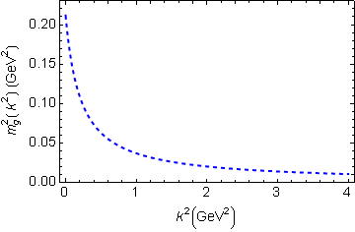
In QCD: Gluons also become massive!
Bridging a gap between continuum-QCD and ab initio predictions of hadron observables, D. Binosi, L. Chang, J.Papavassiliou, C.D. Roberts, arXiv:1412.4782 [nucl-th], Phys. Lett. B742 (2015) 183-188
Running gluon mass
Gluons are cannibals – a particle species whose members become massive by eating each other!
Gluon mass-squared function
Power-law suppressed in ultraviolet, so invisible in perturbation theory
5%
Interaction model for the gap equation, S.-x.Qin, L.Chang, Y-x.Liu, C.D.Roberts and D. J. Wilson, arXiv:1108.0603 [nucl-th], Phys. Rev. C 84 (2011) 042202(R) [5 pages]

Slide 16
Massive Gauge Bosons!
Gauge boson cannibalism
… a new physics frontier … within the Standard Model
Asymptotic freedom means
… ultraviolet behaviour of QCD is controllable
Dynamically generated masses for gluons and quarks means that QCD dynamically generates its own infrared cutoffs
Gluons and quarks with
wavelength λ > 2/mass ≈ 1 fm
decouple from the dynamics … Confinement?!
How does that affect observables?
It will have an impact in
any continuum study
Must play a role in gluon PDFs, and saturation ...
In fact, perhaps it’s a harbinger of gluon saturation?

Slide 17
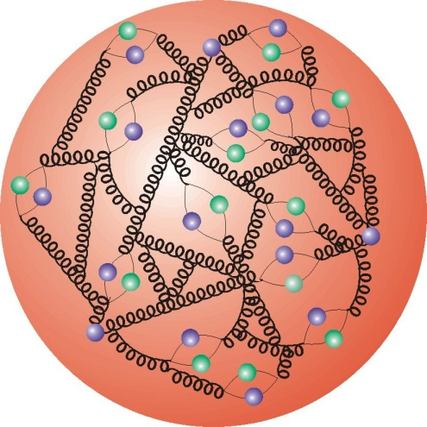
Parton structure of hadrons
Valence quarks

Slide 18
Parton Structure of Hadrons
Valence-quark structure of hadrons
Definitive of a hadron.
After all, it’s how we distinguish a proton from a neutron
Expresses charge; flavour; baryon number; and other Poincaré-invariant macroscopic quantum numbers
Via evolution, determines background at LHC
Foreseeable future will bring precision experimental study of (far) valence region, and theoretical computation of distribution functions and distribution amplitudes
Can’t rely on assumption of leading-twist, leading-order dominance
Computation of distributions is critical
Without it, no amount of data will reveal anything about the theory underlying the phenomena of strong interaction physics

Slide 19
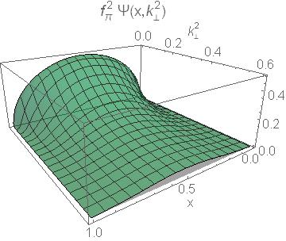
Pion’s Wave Function

Slide 20
Pion’s valence-quark Distribution Amplitude
Imaging dynamical chiral symmetry breaking: pion wave function on the light front, Lei Chang, et al., arXiv:1301.0324 [nucl-th], Phys. Rev. Lett. 110 (2013) 132001 (2013) [5 pages].
Since 2012, methods were developed that enable direct computation of the pion’s light-front wave function
φ_{π}(x) = twist-two parton distribution amplitude = projection of the pion’s Poincaré-covariant wave-function onto the light-front
Results have been obtained with rainbow-ladder DSE kernel, simplest symmetry preserving form; and the best DCSB-improved kernel that is currently available.
x^{α} (1-x)^{α}, with α≈0.5

Slide 21
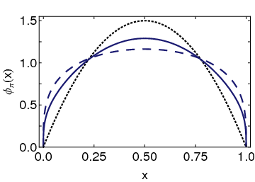
Pion’s valence-quark Distribution Amplitude
Imaging dynamical chiral symmetry breaking: pion wave function on the light front, Lei Chang, et al., arXiv:1301.0324 [nucl-th], Phys. Rev. Lett. 110 (2013) 132001 (2013) [5 pages].
Continuum-QCD prediction:
marked broadening of φ_{π}(x), which owes to DCSB
Conformal QCD
DB
RL
Real-world PDAs are squat and fat

Slide 22
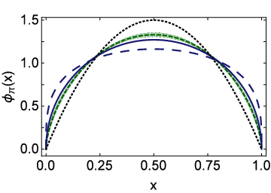
Lattice & Pion’s valence-quark PDA
Flavour symmetry breaking in the kaon parton distribution amplitude, Chao Shi, Lei Chang, Craig D. Roberts, Sebastian M. Schmidt, Peter C. Tandy and Hong-Shi Zong, arXiv:1406:3353 [nucl-th], Phys. Lett. B 738 (2014) pp. 512–518
Isolated dotted curve = conformal QCD
Green curve & band = result inferred from the single pion moment computed in lattice-QCD
Blue solid curve = DSE prediction obtained with DB kernel
DSE & lQCD predictions are practically indistinguishable
lattice
DSE

Slide 23
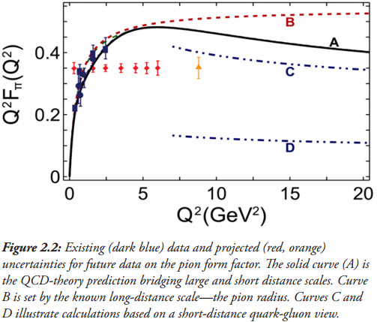
Pion’s electromagnetic form factor
Pion electromagnetic form factor at spacelike momenta L. Chang, I. C. Cloët, C. D. Roberts, S. M. Schmidt and P. C. Tandy, arXiv:1307.0026 [nucl-th], Phys. Rev. Lett. 111, 141802 (2013)
A: Internally-consistent DSE prediction
Curve-A is parameter-free prediction
Broadening has enormous impact on understanding F_{π}(Q²)
C: Hard-scattering formula with broad PDA

Slide 24
Pion’s electromagnetic form factor
Pion electromagnetic form factor at spacelike momenta L. Chang, I. C. Cloët, C. D. Roberts, S. M. Schmidt and P. C. Tandy, arXiv:1307.0026 [nucl-th], Phys. Rev. Lett. 111, 141802 (2013)
A: Internally-consistent DSE prediction
Curve-A is parameter-free prediction
Broadening has enormous impact on understanding F_{π}(Q²)
Appears that JLab12 is within reach of first verification of a QCD hard-scattering formula
C: Hard-scattering formula with broad PDA

Slide 25
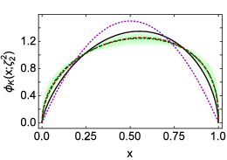
Lattice & kaon’s valence-quark PDA
Flavour symmetry breaking in the kaon parton distribution amplitude, Chao Shi, Lei Chang, Craig D. Roberts, Sebastian M. Schmidt, Peter C. Tandy and Hong-Shi Zong, arXiv:1406:3353 [nucl-th], Phys. Lett. B 738 (2014) pp. 512–518
Isolated dotted curve = conformal QCD
Green curve & band = result inferred from the single pion moment computed in lattice-QCD
Black solid and red dashed curves = band of DSE predictions
Agreement between DSE & lQCD predictions, within errors
Lattice
DSE

Slide 26
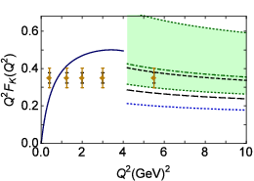
Kaon’s electromagnetic form factor
The pion: an enigma within the Standard Model
Tanja Horn, Craig D. Roberts: arXiv:1602.04016 [nucl-th]
Solid blue curve = Maris-Tandy prediction
Hard-scattering formula
Short- and long-dashed curves = DSE prediction for PDA yields result within this area
Green band = broad, skewed lQCD PDA
Skewing is not the issue: 12%-15%, DSE- and lattice-QCD agree
It’s extent of the broadening that generates the uncertainty
JLab 12 has potential to settle the issue … Meantime, extend F_{π}(Q²) analysis on entire spacelike domain → F_{K}(Q²)
lattice
DSE

Slide 27
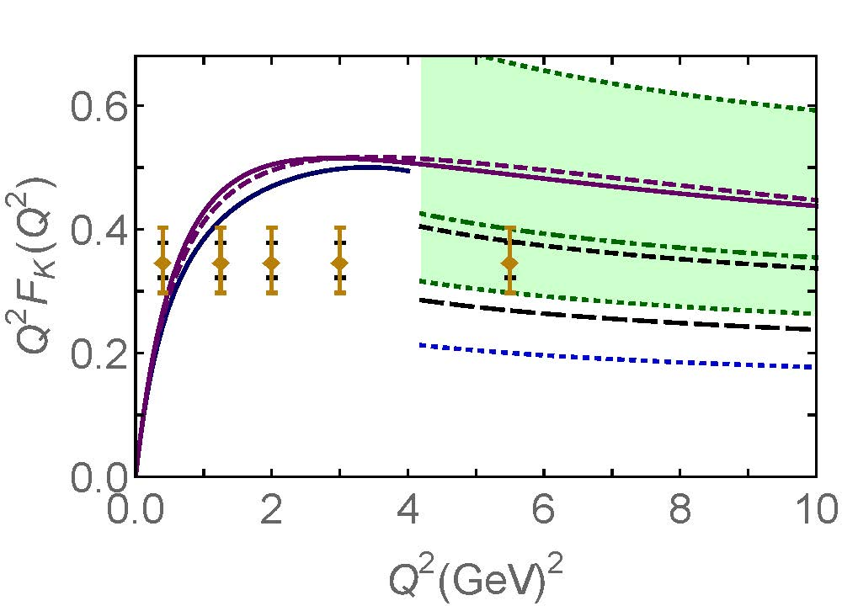
Kaon’s electromagnetic form factor
Kaon elastic form factor at all spacelike momenta, Fei Gao et al.
Solid blue curve = Maris-Tandy prediction
Hard-scattering formula
Short- and long-dashed curves = DSE prediction for PDA yields result within this area
Green band = broad, skewed lQCD PDA
Skewing is not the issue: 12%-15%, DSE- and lattice-QCD agree
It’s extent of the broadening that generates the uncertainty
JLab 12 has potential to settle the issue … Meantime, extend F_{π}(Q²) analysis on entire spacelike domain → F_{K}(Q²)
lattice
DSE

Slide 28
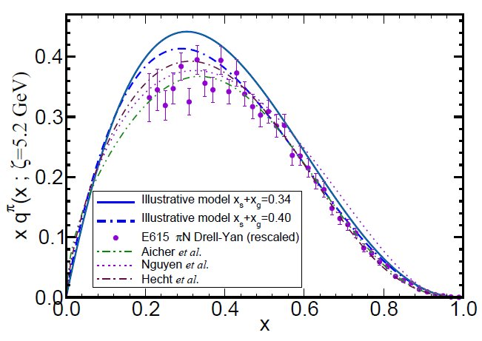
π & K Valence-quark Distribution Functions

Slide 29
π & K PDFs
Experimental data on π & K PDFs obtained in mesonic Drell-Yan scattering from nucleons in heavy nuclei; but it’s old: 1980-1989
Newer data would be welcome:
persistent doubts about the Bjorken-x ≃1 behaviour of the pion’s valence-quark PDF
single modest-quality measurement of u^{K}(x)/u^{π}(x) cannot be considered definitive.
Approved experiment, using tagged DIS at JLab 12, should contribute to a resolution of pion question; and a similar technique might also serve for the kaon.
Furthermore:
new mesonic Drell-Yan measurements at modern facilities could yield valuable information on π and K PDFs,
as could two-jet experiments at the large hadron collider;
and an EIC would be capable of providing access to π and K PDFs through measurements of forward nucleon structure functions.
Gribov-Lipatov reciprocity (crossing symmetry) entails connection between PDFs and fragmentation functions on z ≃ 1 (z ≥ 0.75)
D_{H/q}(z) ≈ z q^{H}(z)
Reliable information on meson fragmentation functions is critical if the worldwide programme aimed at determing TMDs is to be successful

Slide 30
Pion’s Valence-Quark Distribution Function
Hadron PDAs are not directly measurable; but experiments place constraints on their Mellin moments
One of the earliest predictions of the QCD parton model (1974,1975):
q^{π}(x) ∼ (1-x)²
Owing to the validity of factorisation in QCD,
q^{π}(x) is directly measurable in πN Drell-Yan experiments
E615 @ FNAL (Conway:1989fs): leading-order analysis of πN Drell-Yan
q^{π}(x) ∼ (1-x)¹
Apparent disagreement with QCD.
Nevertheless used to produce “modern” PDF fits

Slide 31
E615 Controversy
q^{π}(x) ∼ (1-x)¹
Numerous “explanations”
Nambu – Jona-Lasinio model, translationally invariant regularisaion
q^{π}(x) ∼ (1-x)⁰,
which becomes “1” after evolving from a low resolution scale
NJL models with a hard cutoff & also some duality arguments:
q^{π}(x) ∼ (1-x)¹
Relativistic constituent quark models:
q^{π}(x) ∼ (1-x)^{0…2}
depending on the form
of model wave function
Instanton-based models
q^{π}(x) ∼ (1-x)^{1…2}
Any power you might like in models possessing no traceable connection with QCD.
What can be learnt from this?
Is QCD threatened?

Slide 32
Valence-quark PDFs within mesons
Basic features of the pion valence-quark distribution function,
Lei Chang, Cédric Mezrag, Hervé Moutarde, Craig D. Roberts, Jose Rodríguez-Quintero and Peter C. Tandy,
arXiv:1406:5450 [nucl-th], Phys. Lett. B 737 (2014)pp. 23–29
Valence-quark distribution functions in the kaon and pion,
Chen Chen, Lei Chang, Craig D. Roberts, Shaolong Wan and Hong-Shi Zong, arXiv:1602.01502 [nucl-th], Phys. Rev. D93 (2016) 074021/1-11
Compute PDFs from imaginary part of virtual-photon – pion forward Compton scattering amplitude:
γ π → γ π
Handbag diagram is insufficient. Doesn’t even preserve global symmetries. Exists a class of leading-twist corrections that remedies this defect ⇒
Similar expressions for u_{V}^{K}(x), s_{V}^{K}(x)
Projection onto light-front
Partial derivative wrt relative momentum

Slide 33
Valence-quark PDFs within mesons
Formulae guarantee that valence-quark PDFs satisfy, independent of model details:
Ensure, too, that at an hadronic scale ζ_{H} ≈ 0.5 GeV
q_{V}^{M}(x ≃ 1) ∝ (1-x)^{2n}
in any theory with (1/k²)^{n} vector-boson exchange interaction

Slide 34
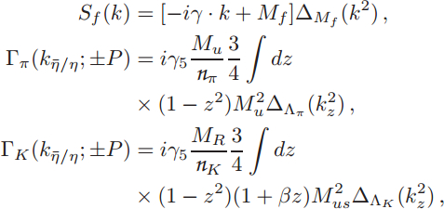
Valence-quark PDFs within mesons
Algebraic analysis
Δ_{f}(k²)=1/[k²+M_{f}²]
M_{R}=M_{us}²/[M_{u}+M_{s}]
M_{us}² = M_{u} M_{s}
M_{u} , M_{s} = dressed-quark mass-scales: M_{u}=0.4GeV and M_{s}=1.2M_{u} from most sophisticated DSE analyses
β = 1 is kaon asymmetry gauge, fixed to reproduce best DSE result for first moment of kaon PDA
Λ_{π,K} = widths of meson Bethe-Salpeter amplitudes: chosen to ensure f_{π,K} reproduce empirical values
Could use sophisticated DSE input, like Tandy et al. arXiv:1102.2448 [nucl-th]; but, as demonstrated in arXiv:1602.01502 [nucl-th], nothing material is gained
Predictions of algebraic framework are indistinguishable and provide additional, novel insights

Slide 35
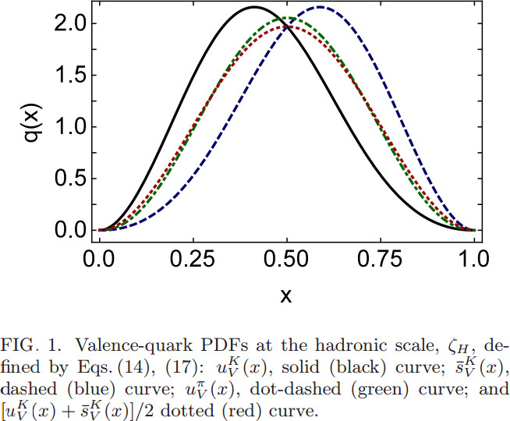
Valence-quark PDFs within mesons
arXiv:1602.01502 [nucl-th]
Pointwise results obtained via reconstruction from (arbitrarily many) computed PDF moments
Peak in kaon PDFs shifted 17% away from x=½,
i.e. scale of flavour symmetry breaking is set by DCSB (M_{s}/M_{u}=1.2), here as in all other nonperturbative quantities
[u_{V}^{K}(x)+s_{V}^{K}(x)]/2 must be symmetric, owing to momentum sum rule.
Similar but not identical to u_{V}^{π}(x)
u_{K}(x)
s_{K}^{bar}(x)

Slide 36
Valence-quark PDFs within mesons
x=1 values of ratios of PDFs are invariant under DGLAP evolution
Consequently, they’re a scale invariant discriminator between competing pictures of hadron structure
On the other hand
Owes to inexorable growth in both mesons’ gluon and sea-quark content driven by pQCD splitting mechanisms.
Analogous to the convergence of all meson PDAs to conformal form as Λ_{QCD}/ζ → 0

Slide 37
Building realistic distributions
In order to sensibly evolve PDFs, one must include sea and glue content at hadronic scale, ζ_{H}
Pion distribution at ζ_{H}
DSE prediction, following from analysis of leptonic decay: π contains 5% sea
Assume GRV analysis of πN Drell-Yan is reliable, then 30% of π momentum carried by glue
Adopting standard PDF parametrisations, this additional information is sufficient to completely fix realistic u_{π}(x; ζ_{H}) = valence + sea + glue
Kaon distribution at ζ_{H}
Owing to heavier mass of intermediate states that can introduce sea-quarks, safe to assume sea-quark content of kaon is effectively zero
Treat momentum fraction carried by glue as a parameter to be used in understanding u^{K}(x)/u^{π}(x)
… owing to heavier mass of s-quark, expect 〈x〉_{g}^{K} < 〈x〉_{g}^{π}; but how much less?

Slide 38
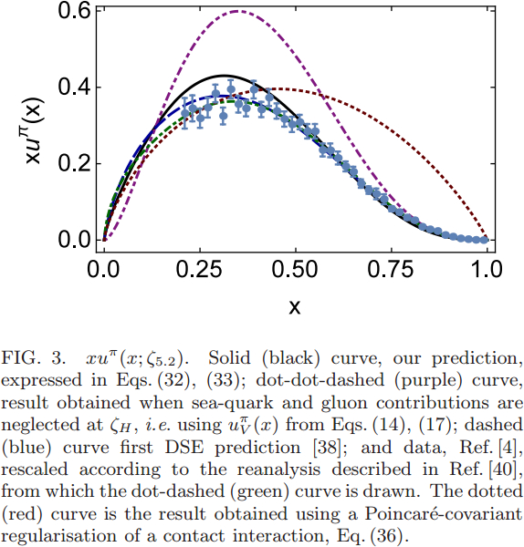
Pion PDF
Purple dot-dot-dash = prediction at ζ_{H}
Data = modern reappraisal of E615: NLO analysis plus soft-gluon resummation (ASV)
Solid black curve, prediction evolved to ζ=5.2GeV, the scale associated with the experiments
Blue dashed curve = first DSE prediction, in 2000 (ζ=5.2GeV)
Dotted red curve = result obtained with momentum-independent gluon exchange (contact interaction, ζ=5.2GeV)
CI: (1-x)^{1.0±0.1}
ζ=5.2GeV
Data and DSE: (1-x)^{3.0±0.1}

Slide 39
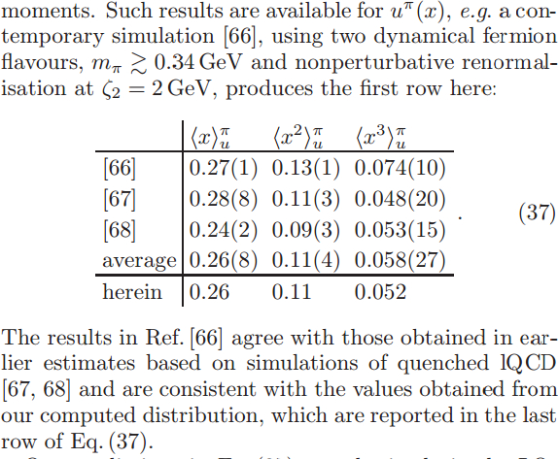
Pion: DSE comparison with lattice moments
All lattice studies agree with each other, within errors
DSE and lattice agree, within errors; and DSE at level of 4% with lattice-average
[66]: Brommel et al. (2007)
[67]: Best et al. (1997)
[68]: Detmold et al. (2003)
On light-front, just 52% of the pion’s momentum is carried by valence-quarks at ζ₂ = 2GeV, down from 65% at ζ_{H}= 0.51GeV

Slide 40
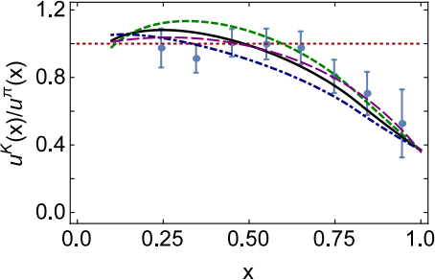
Gluon content of kaon
〈x〉_{g}^{K}(ζ_{H}) = 0.05 ± 0.05
⇒ Valence quarks carry 95% of kaon’s momentum at ζ_{H}
Evolved to ζ₂
Valence-quarks carry ⅔ of kaon’s light-front momentum
0%
10%
1st DSE analysis (Tandy et al., fully numerical DSE solutions)
At a given scale, far less glue in kaon than in pion:
heavier quarks radiate less readily than lighter quarks
heavier quarks radiate softer gluons than do lighter quarks
Landau-Pomeranchuk effect: softer gluons have longer wavelength and multiple scatterings are suppressed by interference.
Momentum conservation communicates these effects to the kaon's u-quark.

Slide 41
π & K PDFs
Dressed-quark basis and symmetry-preserving (beyond-handbag) expressions used to analyse π & K valence-quark PDFs … guarantee that at hadronic scale
q_{V}(x;ζ_{H}) ∝ (1-x)² on x ≃ 1
Flavour-dependence of DCSB modulates the strength of SU(3)-flavour symmetry breaking in meson PDFs, as it does in every other nonperturbative quantity
At ζ_{H}:
valence dressed-quarks carry roughly two-thirds of pion’s light-front momentum, with the bulk of the remainder carried by glue … sea-quarks carry roughly 5%
contrast, valence dressed-quarks carry approximately 95% of the kaon’s light-front momentum, with the remainder lying in the gluon distribution … sea-quarks carry ≃ 0 %
heavier s-quarks radiate soft gluons less readily than lighter quarks and momentum conservation subsequently constrains gluons associated with the kaon’s u-quark

Slide 42
π & K PDFs
Evolving distributions to scale characteristic of meson-nucleon Drell-Yan experiments, ζ=5.2 GeV
extant data reproduced
x ≃ 1: q(x) ∝ (1-x)³
ratio u^{K}(x)/u^{π}(x) explained by vastly different gluon content of π & K
Distributions evolved the distributions to ζ₂ = 2 GeV, which is typically used in numerical simulations of lattice-regularised QCD:
Valence-quarks carry roughly half the pion’s light-front momentum but two-thirds of the kaon’s momentum.
Next steps
Do not anticipate any improvement over these results using continuum methods in QCD
Can lattice say anything novel? (As yet, nothing from lattice on kaon PDF)
Empirical verification of the predictions is essential (equivalent to verifying hard-scattering formulae)
Extend analysis to GPDs, TMDs and Fragmentation Functions

Slide 43
Baryon Structure

Slide 44
Baryon Structure
Poincaré covariant Faddeev equation sums all possible exchanges and interactions that can take place between three dressed-quarks
Confinement and DCSB are readily expressed
Prediction: strong diquark correlations exist within baryons as a dynamical consequence of DCSB in QCD
The same mechanism that produces an almost massless pion from two dynamically-massive quarks forces a strong correlation between two quarks in colour-antitriplet channels within a baryon
Diquark correlations are not pointlike
Typically, r₀₊ ~ r_{π} & r₁₊ ~ r_{ρ} (actually 10% larger)
They have soft form factors

Slide 45
Baryon Structure
Poincaré covariant Faddeev equation sums all possible exchanges and interactions that can take place between three dressed-quarks
Confinement and DCSB are readily expressed
Prediction: strong diquark correlations exist within baryons as a dynamical consequence of DCSB in QCD
The same mechanism that produces an almost massless pion from two dynamically-massive quarks forces a strong correlation between two quarks in colour-antitriplet channels within a baryon
Diquark correlations are not pointlike
Typically, r₀₊ ~ r_{π} & r₁₊ ~ r_{ρ} (actually 10% larger)
They have soft form factors
Nucleon wave function can be calculated … prediction of nucleon properties is possible

Slide 46
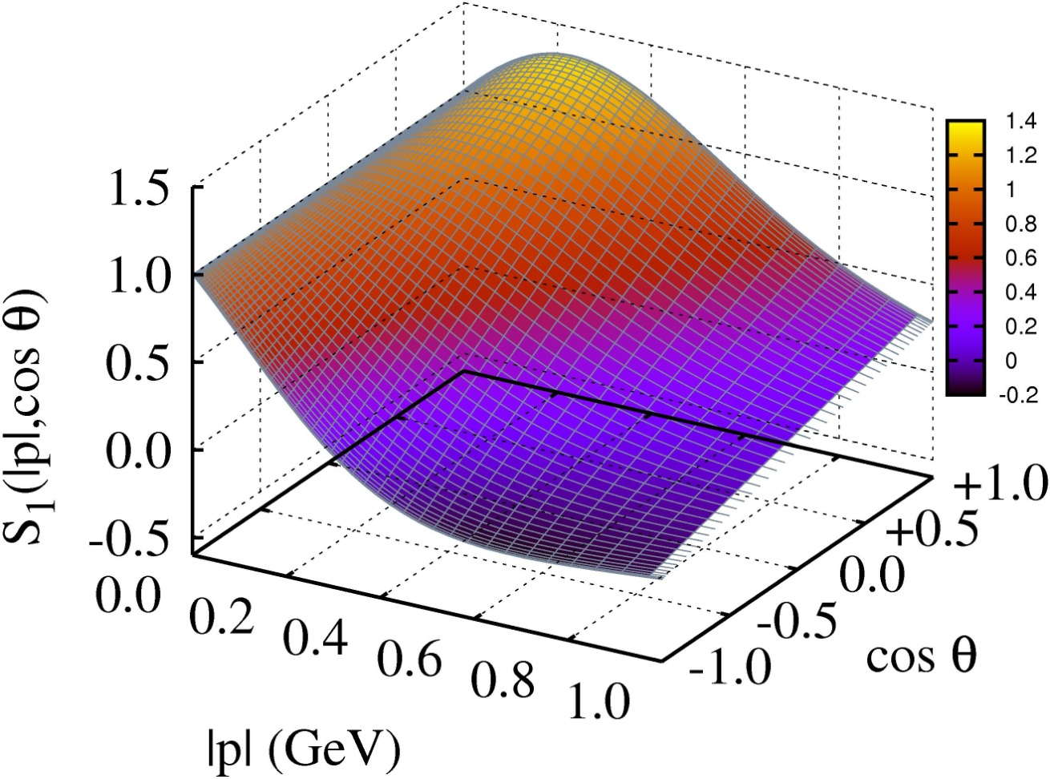
Proton Faddeev Amplitude
Understanding the nucleon as a Borromean bound-state,
J. Segovia, C.D. Roberts, S.M. Schmidt,
arXiv: 1506.05112 [nucl-th], Phys.Lett. B 750 (2015) pp. 100-106
Eight terms in Faddeev amplitude
Plot the dominant scalar-diquark component: S₁(|p|, cos θ)
Realistic solution of Faddeev equation
Strong variation with both arguments
Peaks at
|p|≈ m_{N}/6, cos θ ≈ +1
⇒ k_{q} ≈ P/2, k_{qq} ≈ P/2
i.e., natural rel-momentum = 0
cos θ = -1, maximum at |p|= 0,
⇒ k_{q} ≈ P/3, k_{qq} ≈ (2/3)P
Support concentrated in
forward direction:
cos θ >0 ; i.e. k ∥ P
Simple interactions & truncations fail to capture sophisticated profile of nucleon’s Faddeev wave function

Slide 47
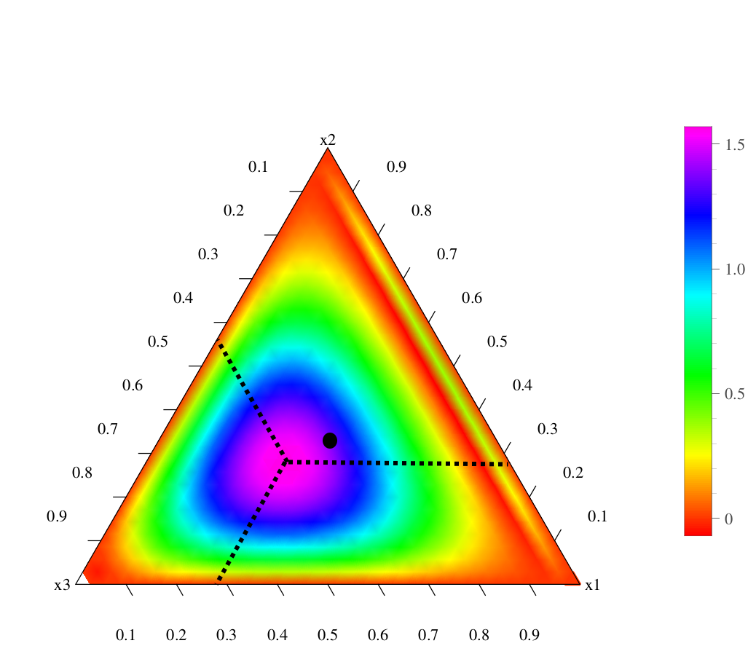
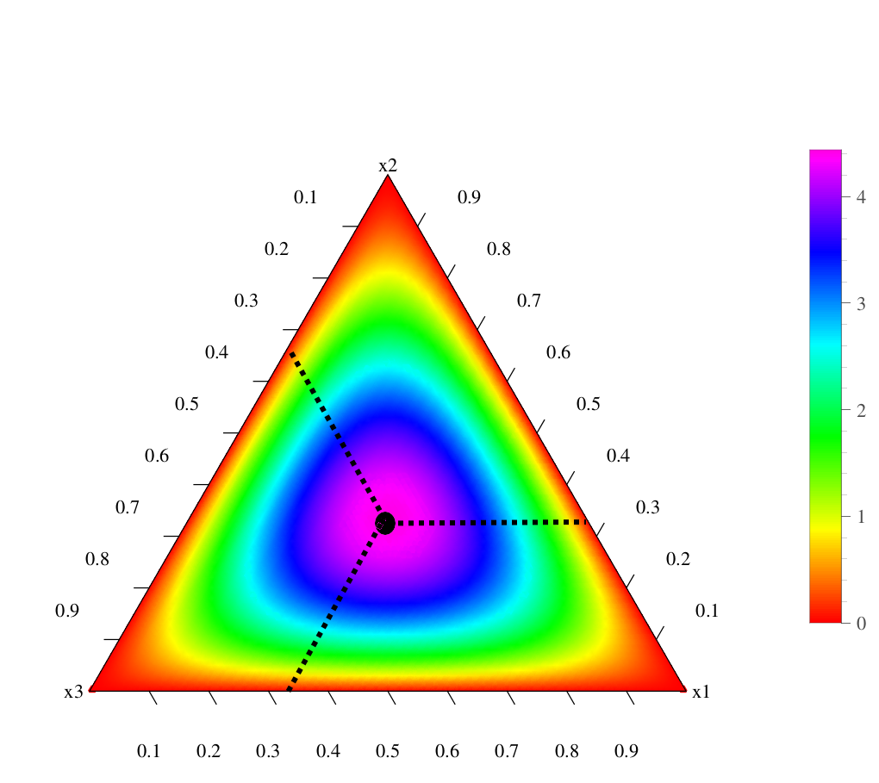
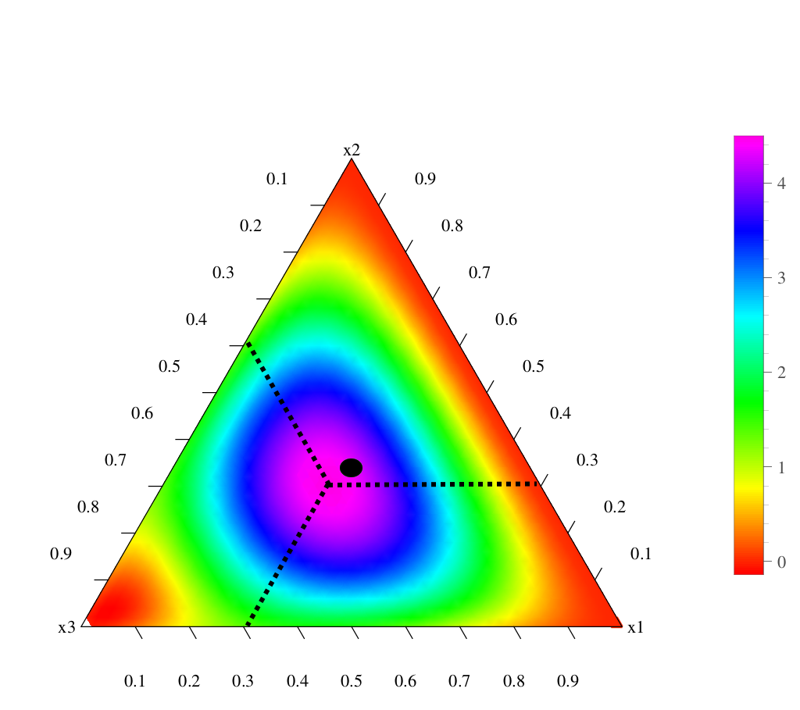
Nucleon Parton Distribution Amplitudes
Cédric Mezrag, et al. ANL
Computations underway. First results available.
Diquark clustering skews the distribution toward the dressed-quark bystander, which therefore carries more of the proton’s light-front momentum
qq correlation: weaker ↔ stronger
conformal limit:
120 x₁x₂x₃
〈x_{i}〉=⅓ … peak of the distribution

Slide 48
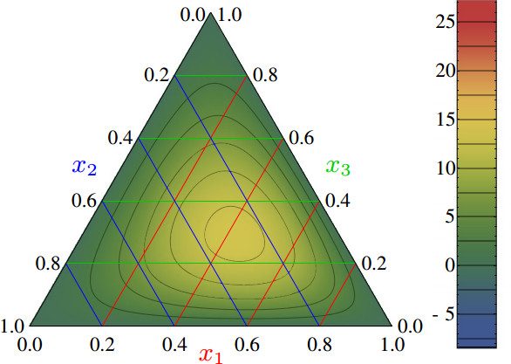
Nucleon PDAs & lQCD
Light-cone distribution amplitudes of the nucleon and negative parity nucleon resonances from lattice QCD
V. M. Braun et al., Phys. Rev. D 89 (2014) 094511
Light-cone distribution amplitudes of the baryon octet
G. S. Bali et al. JHEP 1602 (2016) 070
First lattice results for n=0, 1 moments of the leading twist PDA of the nucleon are available
Used to constrain strength (a₁₁) of the leading-order term in a conformal expansion of the nucleon’s PDA:
Φ(x₁,x₂,x₃)
= 120 x₁ x₂ x₃ [ 1 + a₁₁ P₁₁(x₁,x₂,x₃) + … ]
Shift in location of central peak is consistent with existence of diquark correlations within the nucleon
Notes:
The calculation is done using Nf = 2 + 1 flavors of dynamical (clover) fermions on lattices of different volumes and pion masses down to 222 MeV. Significant SU(3) flavor symmetry violation effects in the shape of the distribution amplitudes are observed.

Slide 49
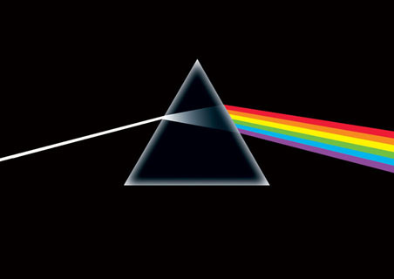
Far valence domain x≃1

Slide 50
Far valence domain x≃1
Nucleon spin structure at very high-x Craig D. Roberts, Roy J. Holt and Sebastian M. Schmidt arXiv:1308.1236 [nucl-th], Phys. Lett. B 727 (2013) pp. 249–254
Endpoint of the far valence domain: x ≃ 1, is especially significant
All familiar PDFs vanish at x=1; but ratios of any two need not
Under DGLAP evolution, the value of such a ratio is invariant.
Thus, e.g.,
lim_{x→1} d_{v}(x)/u_{v}(x)
is unambiguous, scale invariant, nonperturbative feature of QCD.
∴ keen discriminator between frameworks
that claim to explain nucleon structure.
Furthermore, Bjorken-x=1 corresponds strictly to the situation in which the invariant mass of the hadronic final state is precisely that of the target; viz., elastic scattering.
∴ Structure functions inferred experimentally on x≃1
are determined theoretically by target's elastic form factors.

Slide 51
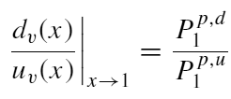
Neutron Structure Function at high-x
I.C. Cloët, C.D. Roberts, et al.
arXiv:0812.0416 [nucl-th], Few Body Syst. 46 (2009) 1-36
D. J. Wilson, I. C. Cloët, L. Chang and C. D. Roberts
arXiv:1112.2212 [nucl-th], Phys. Rev. C85 (2012) 025205 [21 pages]
Valence-quark distributions at x=1
Fixed point under DGLAP evolution
Strong discriminator between theories
Algebraic formula
P₁^{p,s} = contribution to the proton's charge arising from diagrams with a scalar diquark component in both the initial and final state
P₁^{p,a} = kindred axial-vector diquark contribution
P₁^{p,m} = contribution to the proton's charge arising from diagrams with a different diquark component in the initial and final state.
Measures relative strength of axial-vector/scalar diquarks in proton

Slide 52
Neutron Structure Function at high-x
I.C. Cloët, C.D. Roberts, et al.
arXiv:0812.0416 [nucl-th], Few Body Syst. 46 (2009) 1-36
D. J. Wilson, I. C. Cloët, L. Chang and C. D. Roberts
arXiv:1112.2212 [nucl-th], Phys. Rev. C85 (2012) 025205 [21 pages]
x>0.9
d/u=1/2
SU(6) symmetry
Deep inelastic scattering
– the Nobel-prize winning
quark-discovery experiments
Reviews:
S. Brodsky et al.
NP B441 (1995)
W. Melnitchouk & A.W.Thomas
PL B377 (1996) 11
N. Isgur, PRD 59 (1999)
R.J. Holt & C.D. Roberts
RMP (2010)
d/u=0.29
DSE: “realistic”
pQCD, uncorrelated Ψ
DSE: “contact”
d/u=0.14
0⁺ qq only, d/u=0
Melnitchouk, Accardi et al.
Phys.Rev. D84 (2011) 117501
Melnitchouk, Arrington et al.
Phys.Rev.Lett. 108 (2012) 252001
Distribution of neutron’s
momentum amongst quarks
on the valence-quark domain
Notes:
(48)

Slide 53
Neutron Structure Function at high-x
I.C. Cloët, C.D. Roberts, et al.
arXiv:0812.0416 [nucl-th], Few Body Syst. 46 (2009) 1-36
D. J. Wilson, I. C. Cloët, L. Chang and C. D. Roberts
arXiv:1112.2212 [nucl-th], Phys. Rev. C85 (2012) 025205 [21 pages]
NB.
d/u|_{x=1}= 0 means there are no truly valence d-quarks
in the proton!
JLab12 can solve this enigma
x>0.9
d/u=1/2
SU(6) symmetry
Deep inelastic scattering
– the Nobel-prize winning
quark-discovery experiments
Reviews:
S. Brodsky et al.
NP B441 (1995)
W. Melnitchouk & A.W.Thomas
PL B377 (1996) 11
N. Isgur, PRD 59 (1999)
R.J. Holt & C.D. Roberts
RMP (2010)
d/u=0.29
DSE: “realistic”
pQCD, uncorrelated Ψ
DSE: “contact”
d/u=0.14
0⁺ qq only, d/u=0
Melnitchouk, Accardi et al.
Phys.Rev. D84 (2011) 117501
Melnitchouk, Arrington et al.
Phys.Rev.Lett. 108 (2012) 252001
Distribution of neutron’s
momentum amongst quarks
on the valence-quark domain
Notes:
(48)

Slide 54
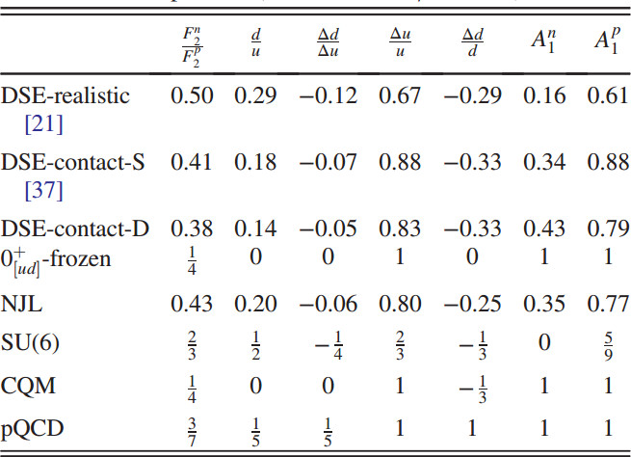
Quark helicity at large Bjorken-x
Nucleon spin structure at very high-x Craig D. Roberts, Roy J. Holt and Sebastian M. Schmidt arXiv:1308.1236 [nucl-th], Phys. Lett. B 727 (2013) pp. 249–254
Contact-interaction Faddeev equation and, inter alia, proton tensor charges, Shu-Sheng Xu et al., arXiv:1509.03311 [nucl-th], Phys. Rev. D 92 (2015) 114034/1-21
Correlations
between dressed-quarks within the proton
have an enormous impact on nucleon spin structure

Slide 55
Quark helicity at large Bjorken-x
Existing data cannot distinguish between modern pictures of nucleon structure
Empirical results for nucleon longitudinal spin asymmetries on x ≃ 1 promise to add greatly to our capacity for discriminating between contemporary pictures of nucleon structure.

Slide 56
TMDs
Eight leading-twist TMDs
Three of these are nonzero in the collinear limit

Slide 57
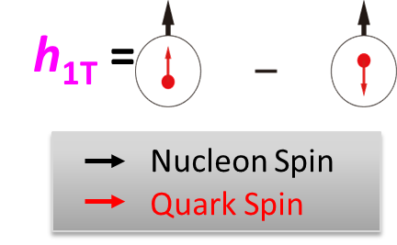
TMDs … Transversity … Tensor Charge
Direction of motion
Intrinsic, defining property of the nucleon
… just as significant as axial-charge
No gluon transversity distribution
Value of tensor charge places constraints on some extensions of the Standard Model <PRD85 (2012) 054512>
Current knowledge of transversity:
SIDIS @HERMES, COMPASS, JLab
Future SIDIS at JLab (SoLId), EIC, …

Slide 58
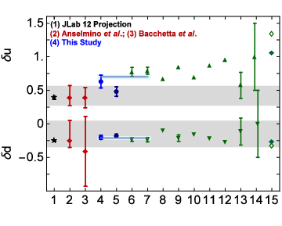
TMDs … Transversity … Tensor Charge
Direction of motion
Contact-interaction Faddeev equation and, inter alia, proton tensor charges
Shu-Sheng Xu et al., arXiv:1509.03311 [nucl-th], Phys. Rev. D 92 (2015) 114034/1-21
Presence of diquark correlations in the proton wave function suppresses δu by ⅓-½ cf. SU(6) quark model prediction
Axial-vector correlation is crucial, e.g.: δd is only measurably nonzero because the proton wave function contains axial-vector correlations; and axial-vector suppresses δu
lattice
models
DSE
Data fits
δu = 0.70 ± 0.03
δd = − 0.21 ± 0.01

Slide 59
Baryons & their Resonances
Nucleon and Δ elastic and transition form factors Jorge Segovia et al., arXiv:1408.2919 [nucl-th],
Few Body Syst. 55 (2014) pp. 1185-1222 [on-line]
Completing the picture of the Roper resonance Jorge Segovia et al. arXiv:1504.04386 [nucl-th],
Phys. Rev. Lett. 115 (2015) 171801
Critical issues:
is there an environment sensitivity of DCSB and the dressed-quark mass function?
are quark-quark correlations an essential element in the structure of all baryons?
Properties of nucleons alone can’t answer such questions
Detailed knowledge of resonances and their electroproduction is necessary
Existing feedback between experiment and theory indicates that there is no environment sensitivity for the nucleon, ∆-baryon and Roper resonance:
DCSB in these systems is expressed in ways that can readily be predicted once its manifestation is understood in the pion, and this includes the generation of diquark correlations with the same character in each of these baryons.

Slide 60
Epilogue

Slide 61
Epilogue
Thankyou!
Conformal anomaly ... gluons & quarks acquire momentum-dependent masses, values large in the infrared m_{g} ∝ 500 MeV & M_{q} ∝ 350 MeV … underlies DCSB, origin of mass: many observable consequences
Sound predictions for π & K PDAs and PDFs … empirical validation crucial
PDAs relevant for analysis of DVMP
framework exists for computation of related meson GPDs and TMDs
Nucleon PDAs … programme underway; PDFs … large-x, theoretically “easy” but x-dependence harder … programme underway
Sound computation of PDAs and PDFs are necessary precursor to reliable computation of GPDs and TMDs
How universal is M(p²)? How robust are diquark correlations?
Electroproduction of baryon resonances is one excellent way to tackle questions such as these …
Nucleon → Nucleon … Nucleon → Δ ... Nucleon → Roper … understood with no environment sensitivity
meson cloud does not alter level ordering in baryon spectrum
Computation will reveal verifiable signals in observables

