Slide 1
Radiative corrections in SIDIS from COMPASS
Andrea Bressan

Slide 2
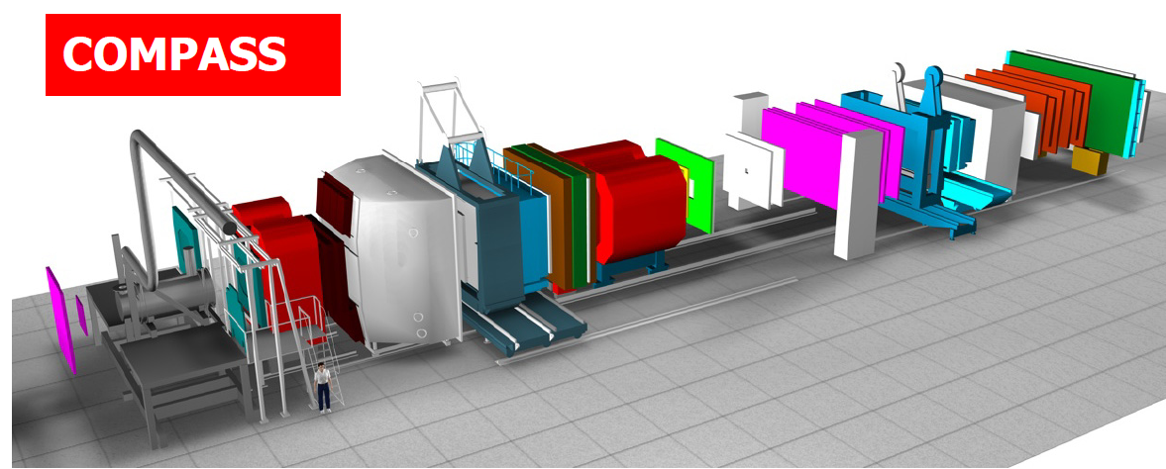
COMPASS-I
high energy beam
large angular acceptance
broad kinematical range
two stages spectrometer
  Large Angle Spectrometer (SM1)
  Small Angle Spectrometer (SM2)
SM2
MuonWall
E/HCAL
SM1
RICH
MuonWall
Target
E/HCAL
variety of tracking detectors to cope with different particle flux from θ = 0 to θ ≈ 200 mrad
Notes:
2

Slide 3
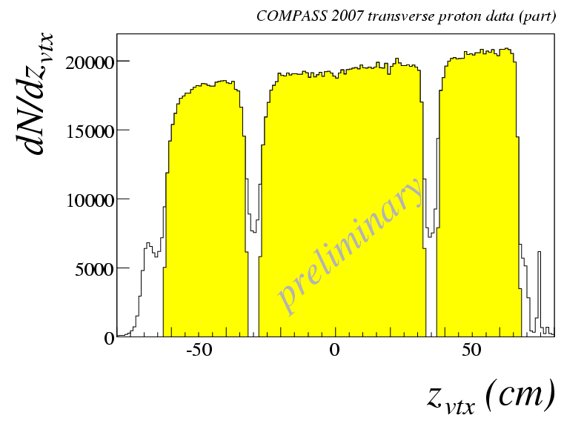
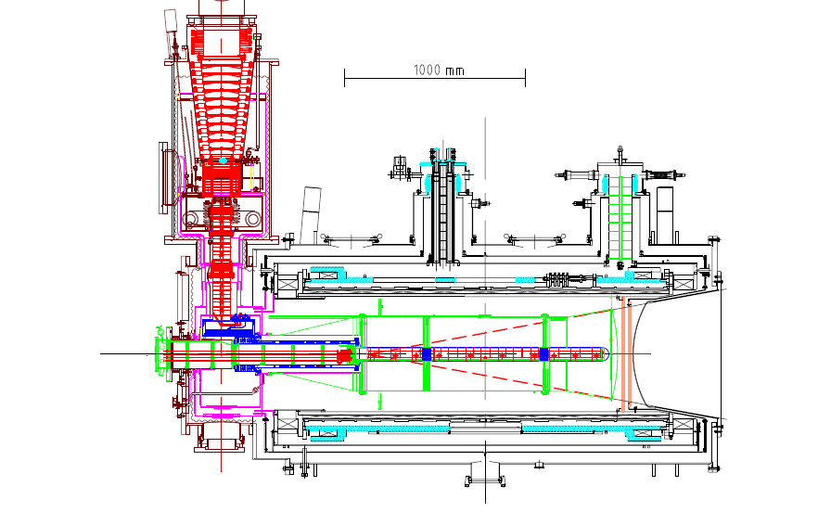
the polarized target system
³He – ⁴He dilution refrigerator (T~50mK)
solenoid 2.5T
dipole magnet 0.6T
acceptance > ± 180 mrad
3 target cells
30, 60, and 30 cm long
μ
opposite polarisation
d (⁶LiD) p (NH₃)
polarization 50% 90%
dilution factor 40% 16%
no evidence for relevant
nuclear effects (160 GeV)

Slide 4
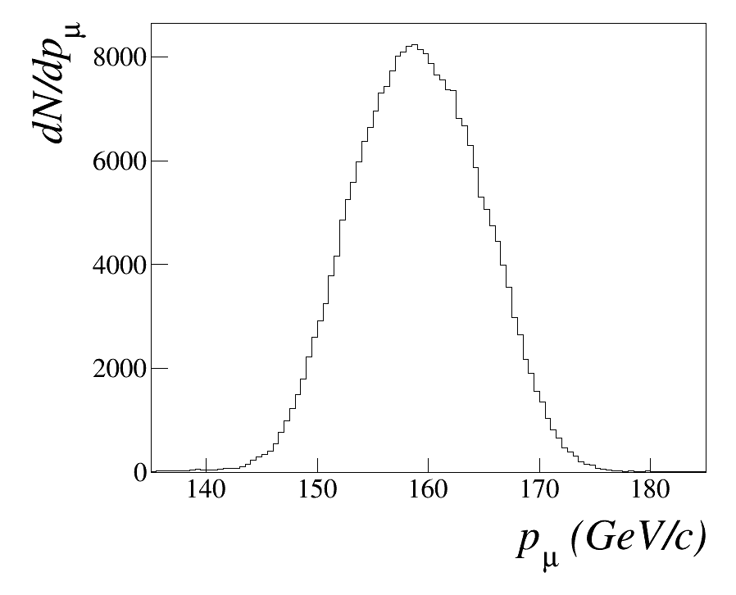
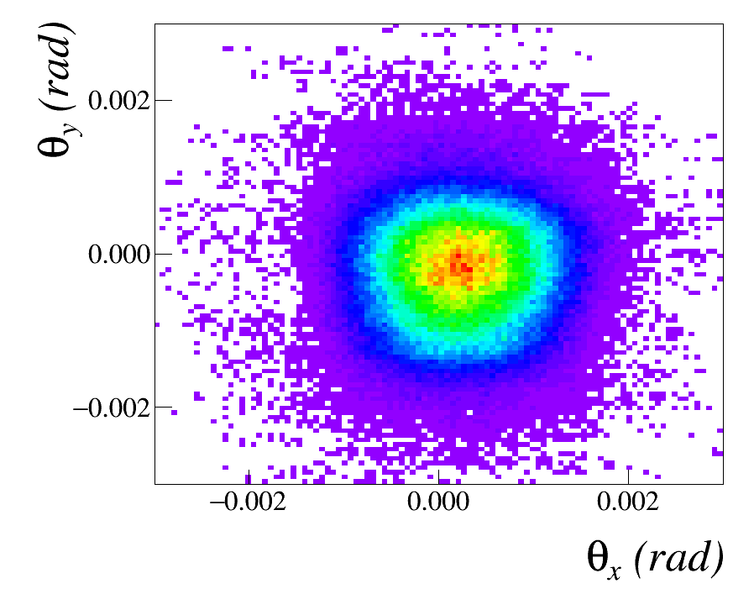
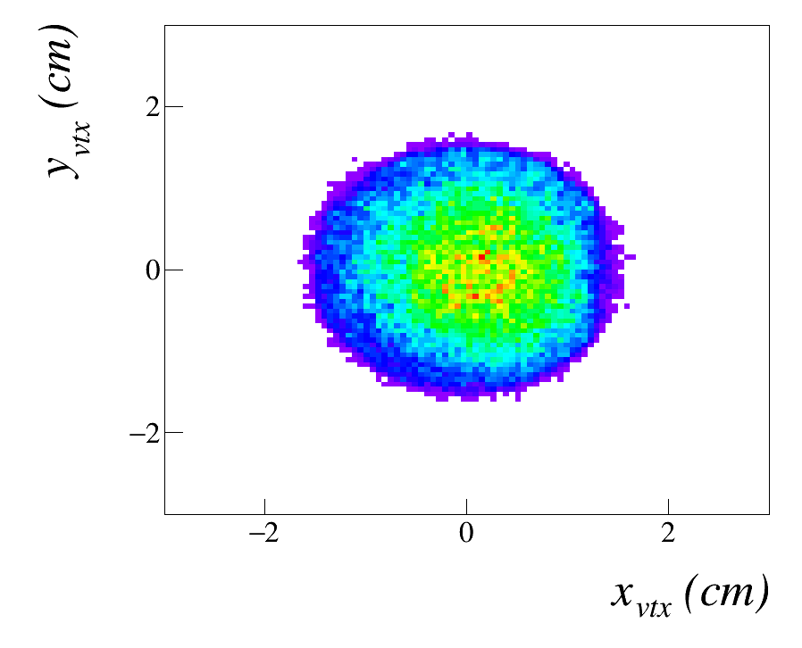

COMPASS Muon Beam
We mainly used 160 GeV$/c$ $μ^{+}$.
The momentum and direction of each $μ^{+}$ is measured.

Slide 5

CORRECTIONS IN COMPASS SIDIS
TERAD (A. Akhundov, D. Bardin, L. Kalinovskaya and T. Riemann, Fortschr. Phys. 44 (1996) 373). Used for the tables of radiative corrections and in the calculation of the dilution factors. Analitical calculation; not a generator.
HAPRAD (I. Akushevich et al, Eur.Phys.J.C10:681-687) used by Andrei Afanasev to calcultate f.i. effects in the $\cos{φ}$ and $\cos{2φ}$ modulation Analitical calculation; not a generator.
RADGEN (I.Akushevich, H.Boettcher, D.Ryckbosch, arXiv:hep-ph/9906408) called from Lepto or Pythia. Generates hard photons and gives true virtual photon 4-momentum

Slide 6
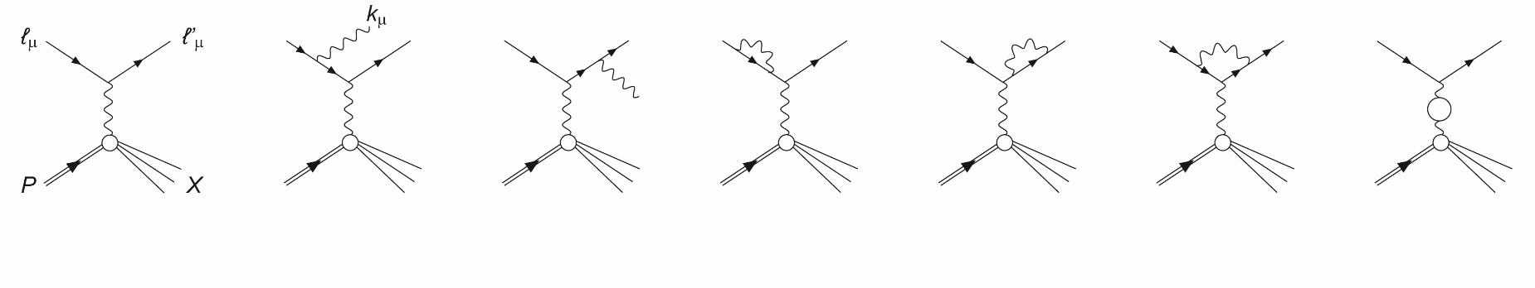
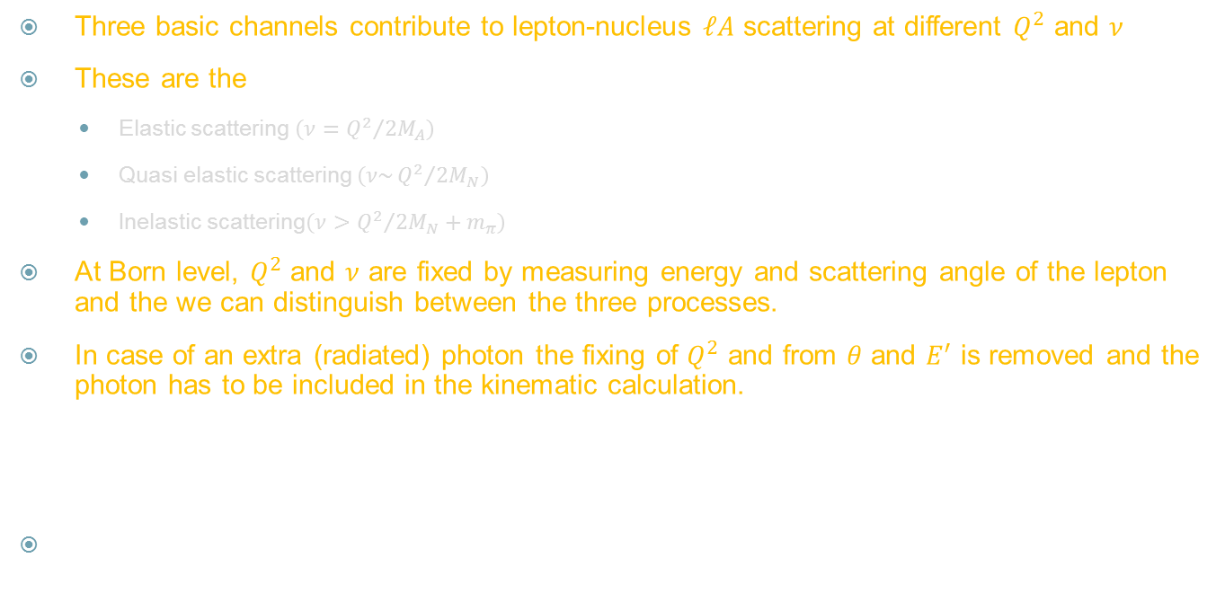
RADIATIVE CORRECTIONS
Three basic channels contribute to lepton-nucleus $ℓA$ scattering at different $Q^{2}$ and $ν$
These are the
  Elastic scattering $\left(ν={Q^{2}}/{2M_{A}}\right)$
  Quasi elastic scattering $\left(ν\sim {Q^{2}}/{2M_{N}}\right)$
  Inelastic scattering$\left(ν>{Q^{2}}/{2M_{N}}+m_{π}\right)$
At Born level, $Q^{2}$ and $ν$ are fixed by measuring energy and scattering angle of the lepton and the we can distinguish between the three processes.
In case of an extra (radiated) photon the fixing of $Q^{2}$ and from $θ$ and $E^{′}$ is removed and the photon has to be included in the kinematic calculation.

Slide 7
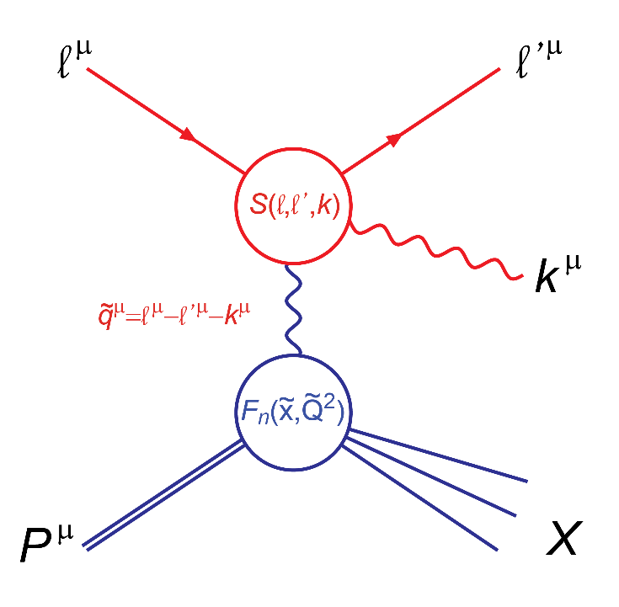
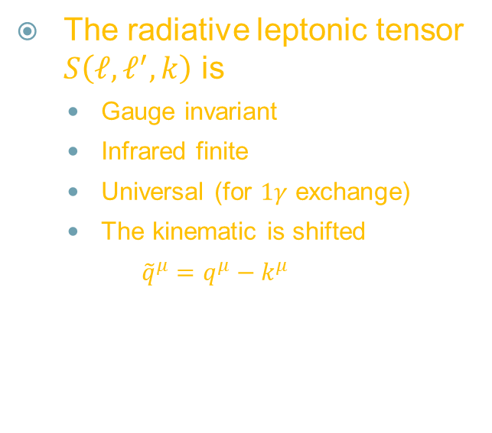
RADIATIVE CORRECTIONS
The radiative leptonic tensor $S\left(ℓ, ℓ^{′},k\right)$ is
  Gauge invariant
  Infrared finite
  Universal (for $1γ$ exchange)
  The kinematic is shifted
  $${\tilde{q}}^{μ}=q^{μ}−k^{μ}$$

Slide 8
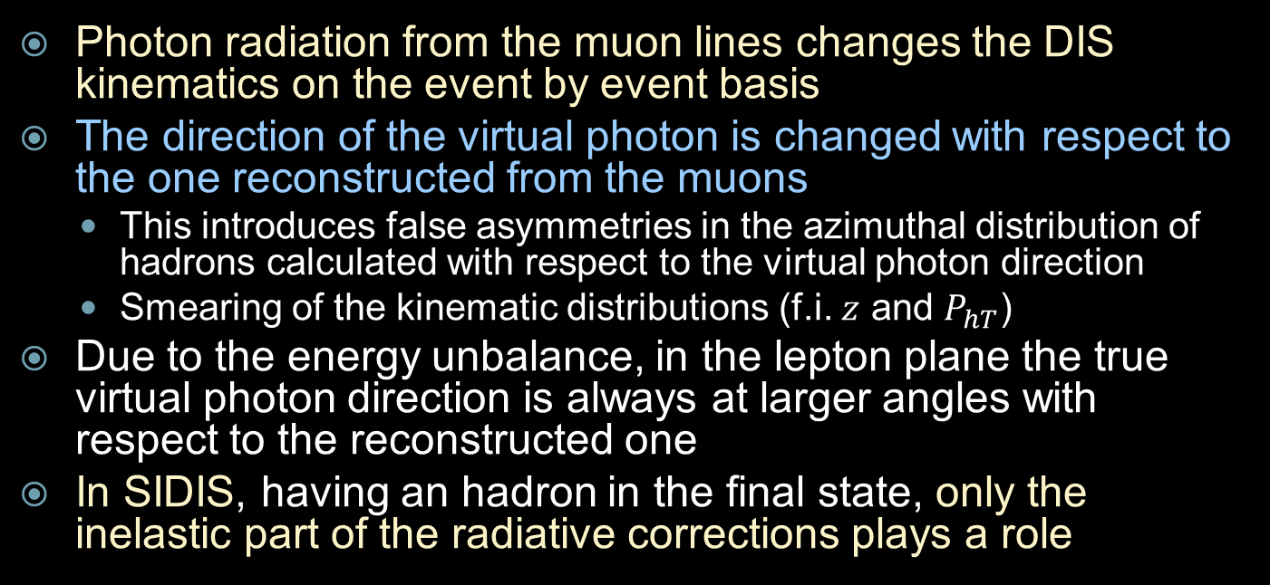
The problem for SIDIS
Photon radiation from the muon lines changes the DIS kinematics on the event by event basis
The direction of the virtual photon is changed with respect to the one reconstructed from the muons
  This introduces false asymmetries in the azimuthal distribution of hadrons calculated with respect to the virtual photon direction
  Smearing of the kinematic distributions (f.i. $z$ and $P_{hT}$)
Due to the energy unbalance, in the lepton plane the true virtual photon direction is always at larger angles with respect to the reconstructed one
In SIDIS, having an hadron in the final state, only the inelastic part of the radiative corrections plays a role

Slide 9
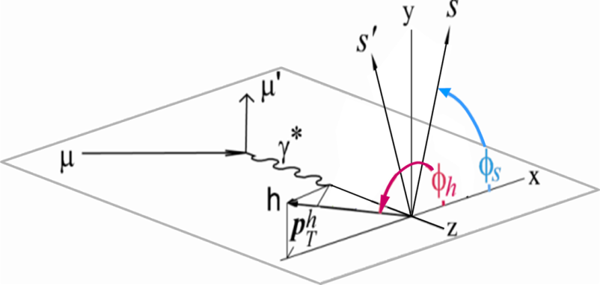
Azimuthal asymmetries in SIDIS

Slide 10
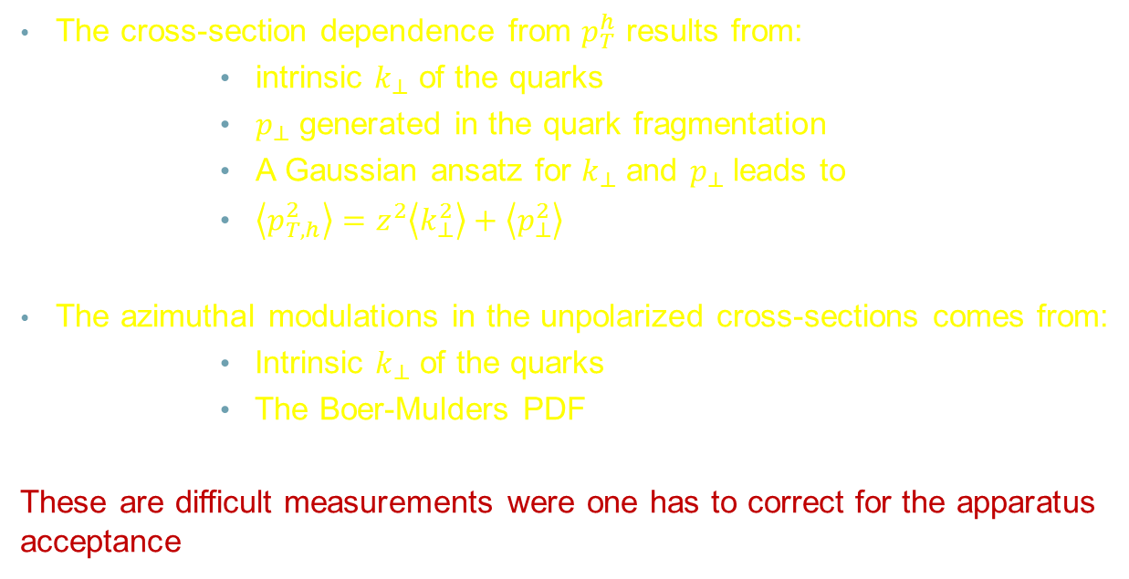
Importance of unpolarized SIDIS for TMDs
The cross-section dependence from $p_{T}^{h}$ results from:
  intrinsic $k_{⊥}$ of the quarks
  $p_{⊥}$ generated in the quark fragmentation
  A Gaussian ansatz for $k_{⊥}$ and $p_{⊥}$ leads to
  $\left\langle p_{T,h}^{2}\right\rangle =z^{2}\left\langle k_{⊥}^{2}\right\rangle +\left\langle p_{⊥}^{2}\right\rangle$
The azimuthal modulations in the unpolarized cross-sections comes from:
  Intrinsic $k_{⊥}$ of the quarks
  The Boer-Mulders PDF
These are difficult measurements were one has to correct for the apparatus acceptance

Slide 11
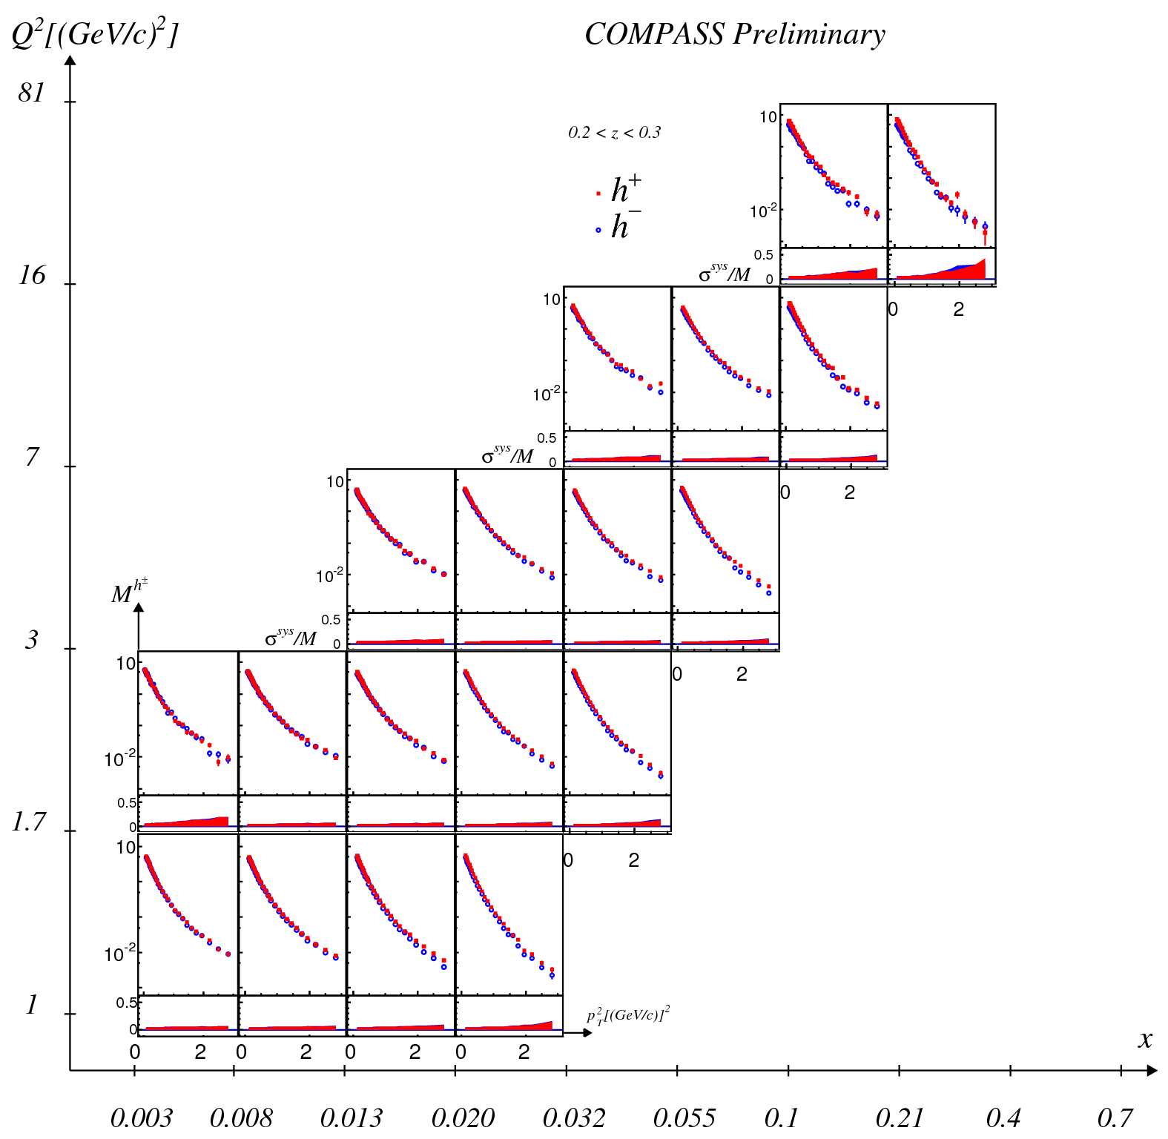
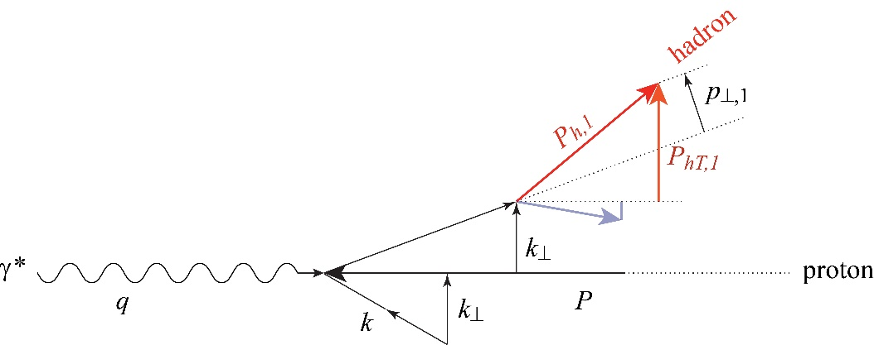
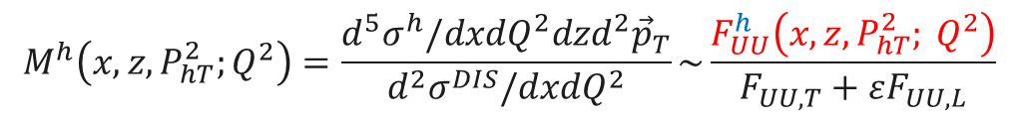
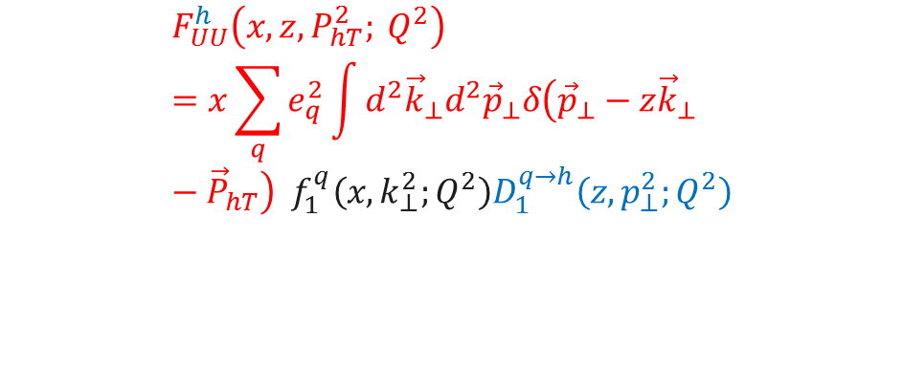
Unpolarized SIDIS
$$F_{UU}^{h}\left(x, z, P_{hT}^{2}; Q^{2}\right)=x\sum_{q}{e_{q}^{2}\int{d^{2}{\vec{k}}_{⊥}d^{2}{\vec{p}}_{⊥}δ\left({\vec{p}}_{⊥}−z{\vec{k}}_{⊥}−{\vec{P}}_{hT}\right) f_{1}^{q}\left(x, k_{⊥}^{2};Q^{2}\right)D_{1}^{q→h}\left(z,p_{⊥}^{2};Q^{2}\right)}}$$
$$M^{h}\left(x,z, P_{hT}^{2};Q^{2}\right)=\frac{d^{5}σ^{h}/dxdQ^{2}dzd^{2}{\vec{p}}_{T}}{d^{2}σ^{DIS}/dxdQ^{2}}\sim \frac{F_{UU}^{h}\left(x, z, P_{hT}^{2}; Q^{2}\right)}{F_{UU,T}+εF_{UU,L}}$$

Slide 12
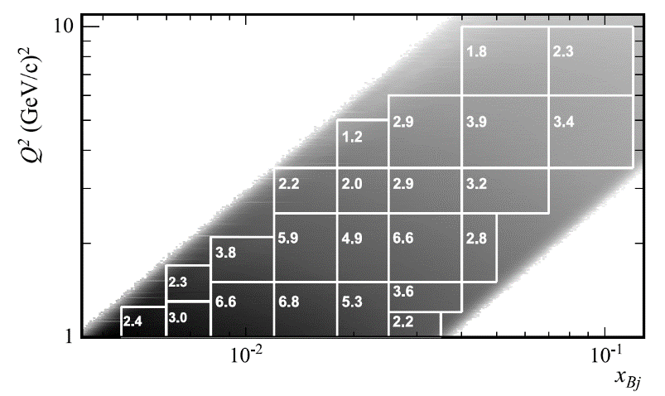
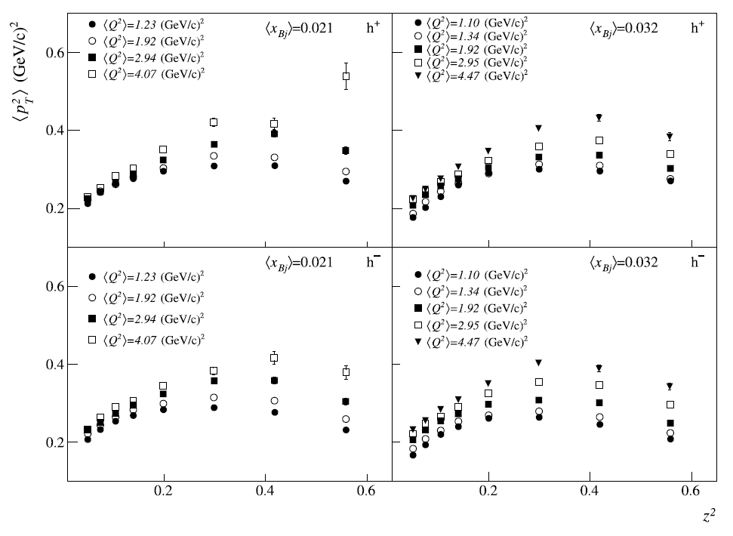
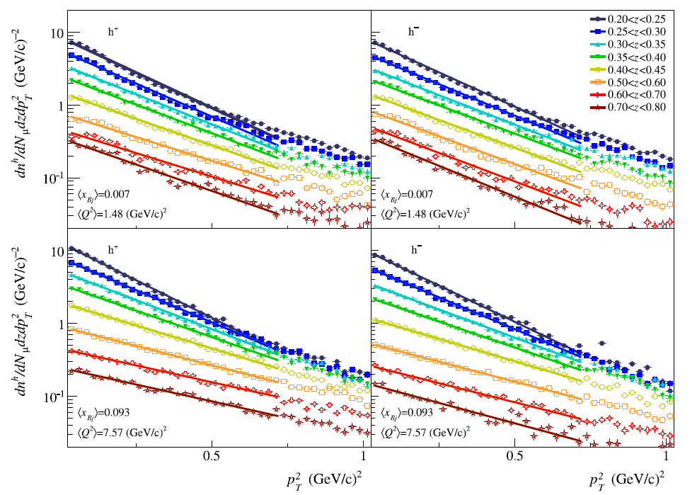

X-section dep. from $p_{T}^{h}$

Slide 13

$\cos{φ}$ modulation
$$A_{UU}^{\cos{φ}}\left(x, z, P_{hT}^{2}; Q^{2}\right)∝\frac{1}{Q}\sum_{q}{e_{q}^{2}}\left[f_{1}^{q}⨂D_{1}^{q→h}−h_{1}^{⊥,q}⨂H_{1}^{⊥,q→h}\right]$$

Slide 14

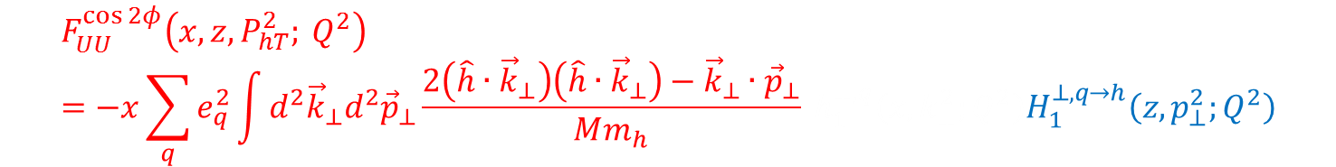
Boer-Mulders in $\cos{2φ}$
$$F_{UU}^{\cos{2φ}}\left(x, z, P_{hT}^{2}; Q^{2}\right)=−x\sum_{q}{e_{q}^{2}\int{d^{2}{\vec{k}}_{⊥}d^{2}{\vec{p}}_{⊥}\frac{2\left(\hat{h}∙{\vec{k}}_{⊥}\right)\left(\hat{h}∙{\vec{k}}_{⊥}\right)−{\vec{k}}_{⊥}∙{\vec{p}}_{⊥}}{Mm_{h}} h_{1}^{⊥,q}\left(x, k_{⊥}^{2};Q^{2}\right)H_{1}^{⊥,q→h}\left(z,p_{⊥}^{2};Q^{2}\right)}}$$

Slide 15
Boer-Mulders and Cahn effects

Slide 16

RADGEN
In RADGEN $E_{min}^{γ}$ defines the minimum energy needed to reconstruct the radiated photon by the experimental setup:
$$σ_{obs}=δ_{R}\left(E_{min}^{γ}\right)\left(1+δ_{vertex}+δ_{vacum}+δ_{i.r}\right)σ_{1γ}+$$
$$σ_{add}\left(E_{min}^{γ}\right)+σ_{el}+σ_{q}+σ_{in}\left(E_{min}^{γ}\right)$$
Then a term $σ_{add}\left(E_{min}^{γ}\right)$ is used to take into account the approximation that the photon energy is considered to be small $\left(E_{γ}<E, E′\right)$ for $E_{γ}<E_{min}^{γ}$

Slide 17

RADGEN+LEPTO
Radgen changes the virtual photon, therefore the procedure is the following
  First use Lepto to generate $x$ and $y$ of the event (i.e. fix $E′$ and $θ$ of the lepton) but not the hadronisation
  Call Radgen with the incoming lepton energy and the virtual photon $q_{μ}^{∗}$
  Obtain in output the true $q_{μ, true}^{∗}$ and the possible radiated photon $k^{μ}$
  Call Lepto to generate the hadronisation if ${\left(q_{μ, true}^{∗}+P\right)}^{2}>4 {\left({GeV}/c\right)}^{2}$
  A toy MC for hadron and muon propagation trough the experimental setup is used to check acceptance effects already at generator level

Slide 18
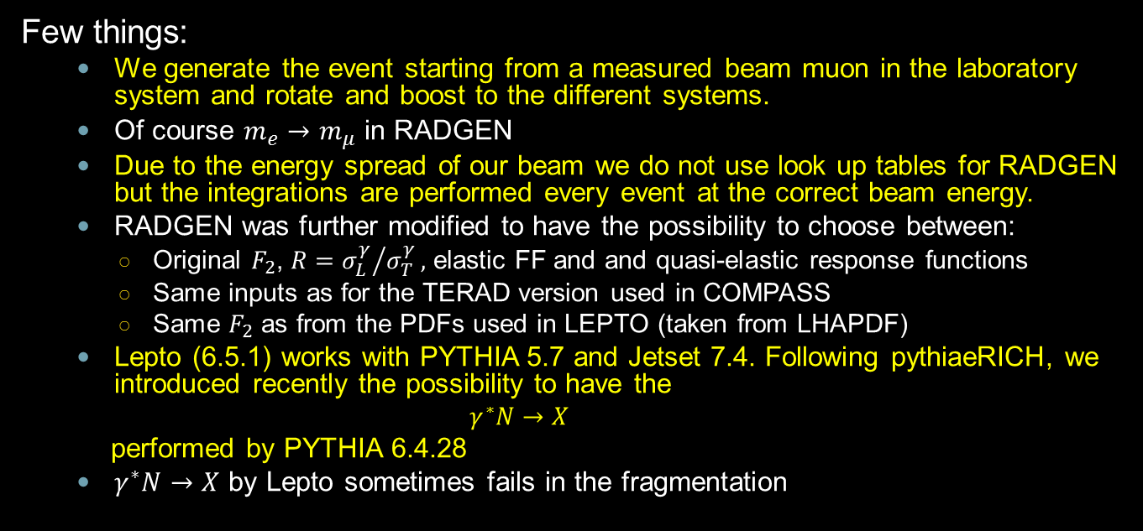
How RADGEN+LEPTO works
Few things:
  We generate the event starting from a measured beam muon in the laboratory system and rotate and boost to the different systems.
  Of course $m_{e}→m_{μ}$ in RADGEN
  Due to the energy spread of our beam we do not use look up tables for RADGEN but the integrations are performed every event at the correct beam energy.
  RADGEN was further modified to have the possibility to choose between:
    Original $F_{2}$, $R={σ_{L}^{γ}}/{σ_{T}^{γ}},$ elastic FF and and quasi-elastic response functions
    Same inputs as for the TERAD version used in COMPASS
    Same $F_{2}$ as from the PDFs used in LEPTO (taken from LHAPDF)
  Lepto (6.5.1) works with PYTHIA 5.7 and Jetset 7.4. Following pythiaeRICH, we introduced recently the possibility to have the
    $$γ^{∗}N→X$$
  performed by PYTHIA 6.4.28
  $γ^{∗}N→X$ by Lepto sometimes fails in the fragmentation

Slide 19
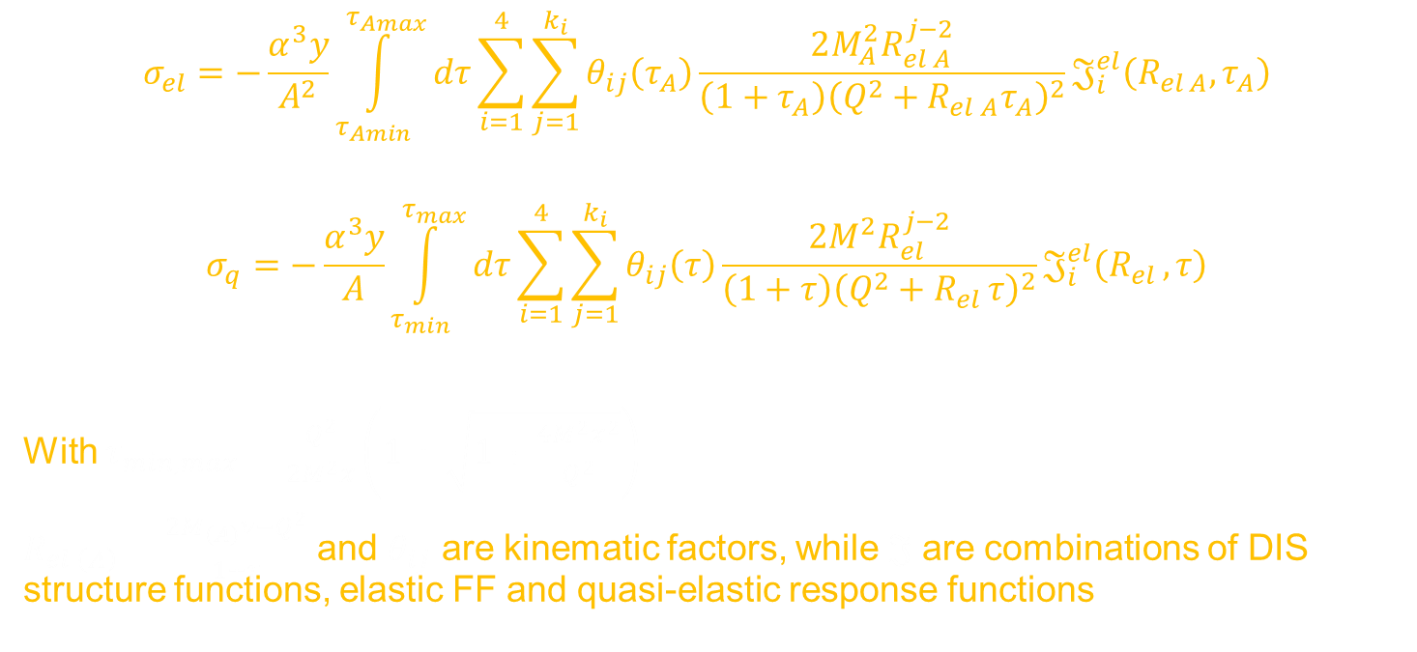
X SECTIONS of RADGEN
$$σ_{el}=−\frac{α^{3}y}{A^{2}}\int_{τ_{Amin}}^{τ_{Amax}}{dτ}\sum_{i=1}^{4}{\sum_{j=1}^{k_{i}}{θ_{ij}\left(τ_{A}\right)\frac{2M_{A}^{2}R_{el A}^{j−2}}{{\left(1+τ_{A}\right)\left(Q^{2}+R_{el A}τ_{A}\right)}^{2}}𝔍_{i}^{el}\left(R_{el A},τ_{A}\right)}}$$
$$σ_{q}=−\frac{α^{3}y}{A}\int_{τ_{min}}^{τ_{max}}{dτ}\sum_{i=1}^{4}{\sum_{j=1}^{k_{i}}{θ_{ij}\left(τ\right)\frac{2M^{2}R_{el }^{j−2}}{{\left(1+τ\right)\left(Q^{2}+R_{el }τ\right)}^{2}}𝔍_{i}^{el}\left(R_{el },τ\right)}}$$
With $τ_{min, max}=\frac{Q^{2}}{2M^{2}x}\left(1±\sqrt{1+\frac{4M^{2}x^{2}}{Q^{2}}}\right)$
$R_{el \left(A\right)}=\frac{2M_{\left(A\right)}ν−Q^{2}}{1+τ}$ and $θ_{ij}$ are kinematic factors, while $𝔍$ are combinations of DIS structure functions, elastic FF and quasi-elastic response functions
Notes:
In, max

Slide 20
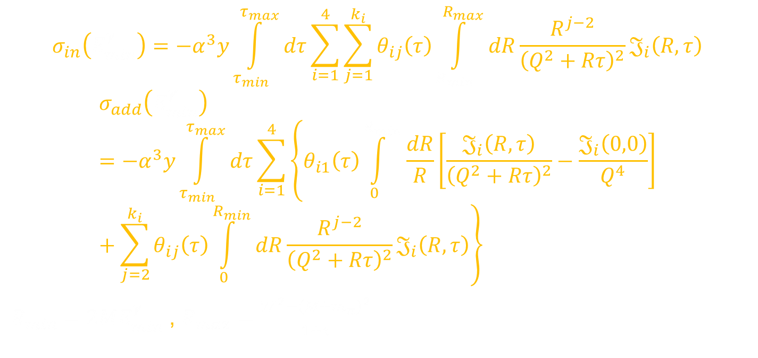
X SECTIONS of RADGEN
$$σ_{in}\left(E_{min}^{γ}\right)=−α^{3}y\int_{τ_{min}}^{τ_{max}}{dτ}\sum_{i=1}^{4}{\sum_{j=1}^{k_{i}}{θ_{ij}\left(τ\right)\int_{R_{min}}^{R_{max}}{dR\frac{R^{j−2}}{{\left(Q^{2}+Rτ\right)}^{2}}𝔍_{i}\left(R,τ\right)}}}$$
$$σ_{add}\left(E_{min}^{γ}\right)=−α^{3}y\int_{τ_{min}}^{τ_{max}}{dτ}\sum_{i=1}^{4}{\left\{θ_{i1}\left(τ\right)\int_{0}^{R_{min}}{\frac{dR}{R}\left[\frac{𝔍_{i}\left(R,τ\right)}{{\left(Q^{2}+Rτ\right)}^{2}}−\frac{𝔍_{i}\left(0,0\right)}{Q^{4}}\right]}+\sum_{j=2}^{k_{i}}{θ_{ij}\left(τ\right)\int_{0}^{R_{min}}{dR\frac{R^{j−2}}{{\left(Q^{2}+Rτ\right)}^{2}}𝔍_{i}\left(R,τ\right)}}\right\}}$$
$R_{min}=2ME_{min}^{γ}$ , $R_{max}=\frac{W^{2}−{\left(M+m_{π}\right)}^{2}}{1+τ}$

Slide 21


A problem with $σ_{in}$
$$σ_{in}=\int_{M_{p}+m_{p}}^{W}{dm_{h}}σ_{in}\left(m_{h}, θ_{max}\right)$$
If we have detected/generated in the setup $\sqrt{{\left(\sum{p_{hi}}\right)}^{2}}$, should not start from there the integral?

Slide 22

Corrections for azimuthal asym.s:
For each bin in $x, z$or $P_{hT}$ used for the analysis we fitted the azimuthal distribution of the ratio
$$\frac{{N\left(φ\right)}_{Lepto+RADGEN}}{{N\left(φ\right)}_{Lepto}}$$
with the following function
$$f\left(φ\right)=a\left(1+p_{1}\cos{φ}+p_{2}\cos{2φ}+…\right)$$

Slide 23
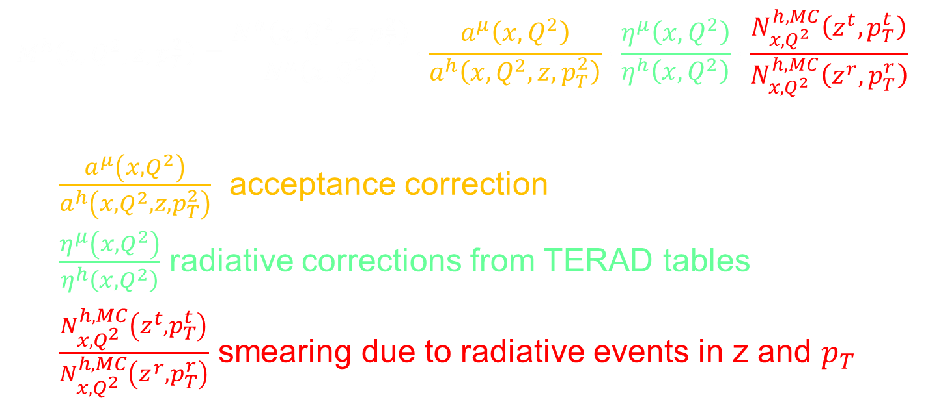
Corrections for Multiplicities:
$$M^{h}\left(x, Q^{2},z, p_{T}^{2}\right)=\frac{N^{h}\left(x, Q^{2},z, p_{T}^{2}\right)}{N^{μ}\left(x, Q^{2}\right)}∙\frac{a^{μ}\left(x, Q^{2}\right)}{a^{h}\left(x, Q^{2},z, p_{T}^{2}\right)}∙\frac{η^{μ}\left(x, Q^{2}\right)}{η^{h}\left(x, Q^{2}\right)}∙\frac{N_{x, Q^{2}}^{h,MC}\left(z^{t},p_{T}^{t}\right)}{N_{x, Q^{2}}^{h,MC}\left(z^{r},p_{T}^{r}\right)}$$
$\frac{a^{μ}\left(x, Q^{2}\right)}{a^{h}\left(x, Q^{2},z, p_{T}^{2}\right)}$ acceptance correction
$\frac{η^{μ}\left(x, Q^{2}\right)}{η^{h}\left(x, Q^{2}\right)}$ radiative corrections from TERAD tables
$\frac{N_{x, Q^{2}}^{h,MC}\left(z^{t},p_{T}^{t}\right)}{N_{x, Q^{2}}^{h,MC}\left(z^{r},p_{T}^{r}\right)}$ smearing due to radiative events in z and $p_{T}$

Slide 24
Some kinematic distribution for events with radiation
All shown at generator level

Slide 25
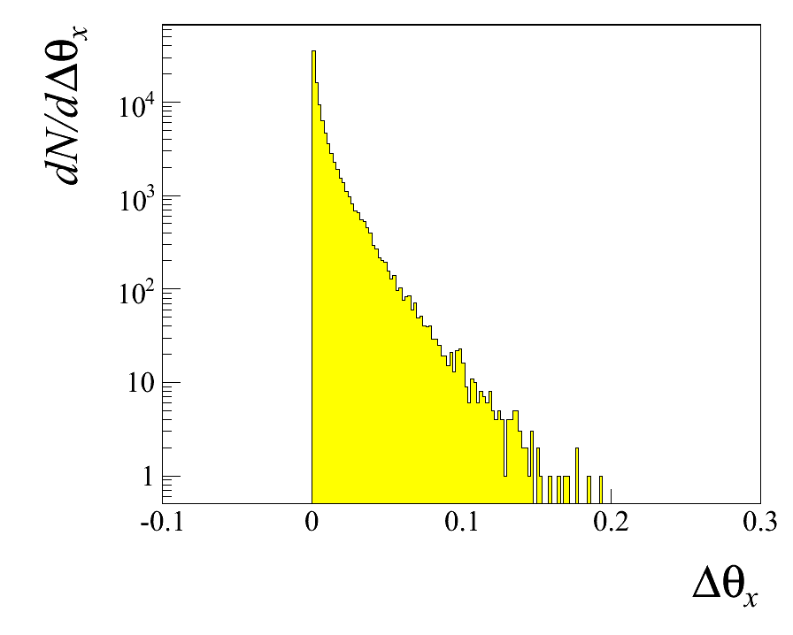
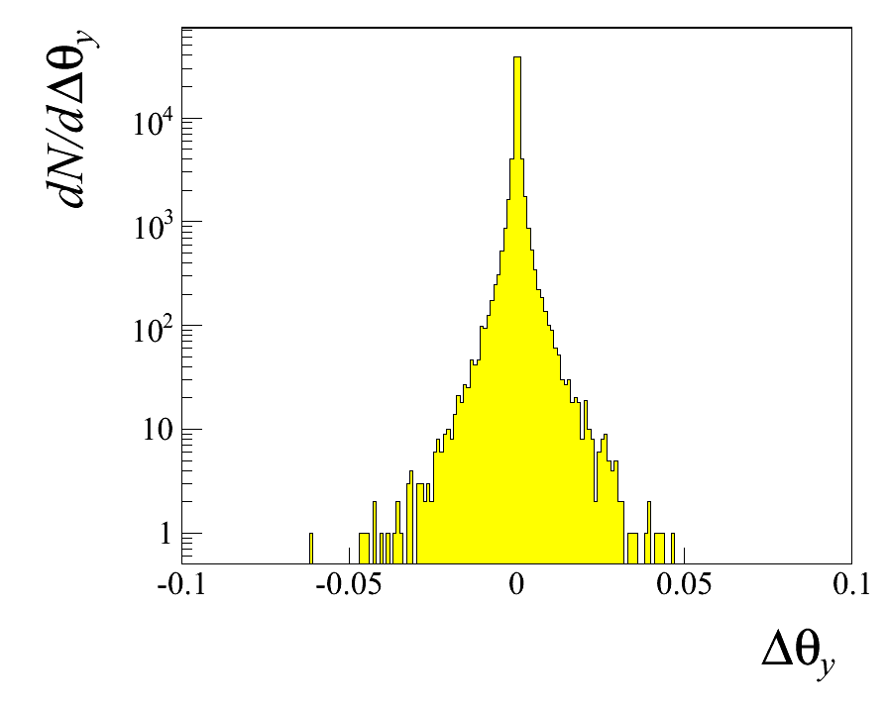
Virtual photon Δ’s (Θ_{true}-Θ_{m})
XZ is the lepton scattering plane
YZ is the off-lepton scattering plane

Slide 26
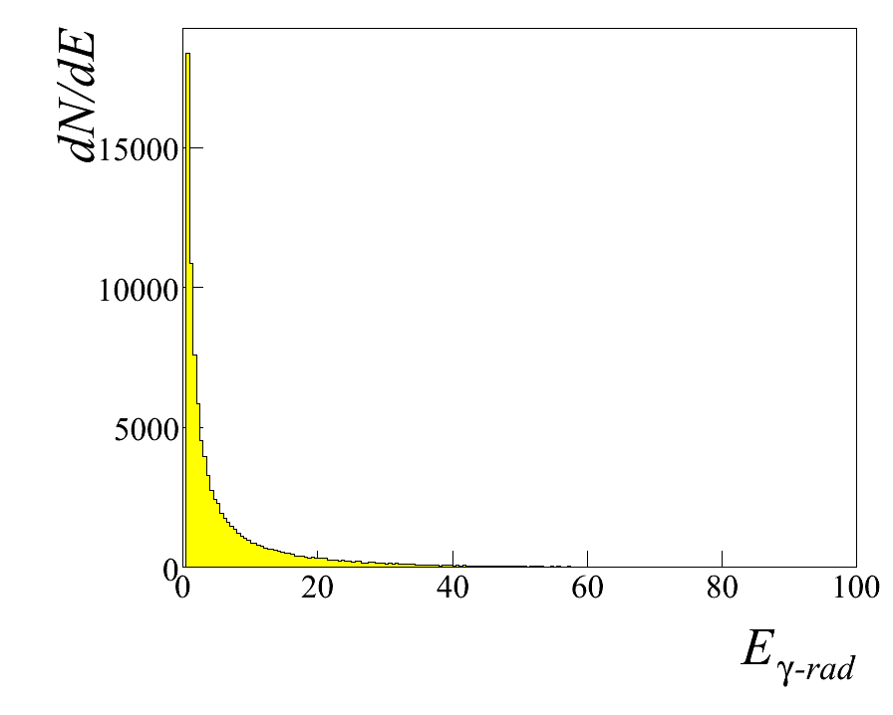
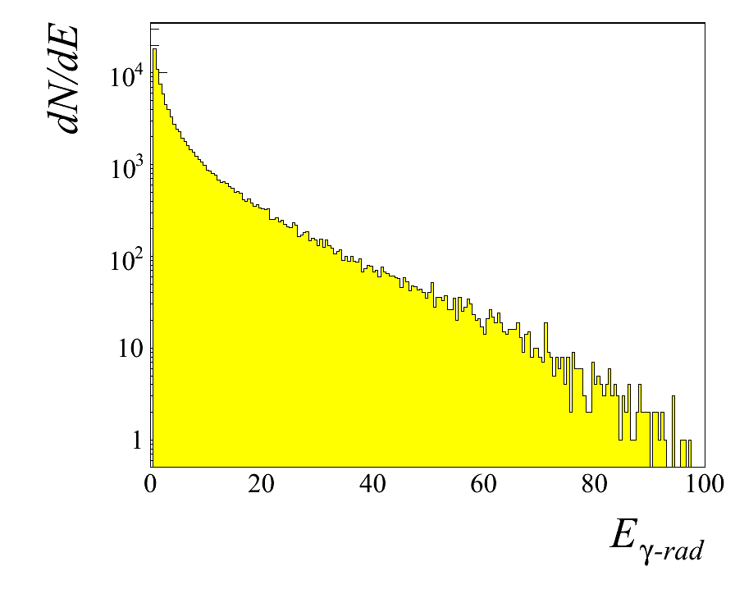
Radiated Photon: Energy

Slide 27
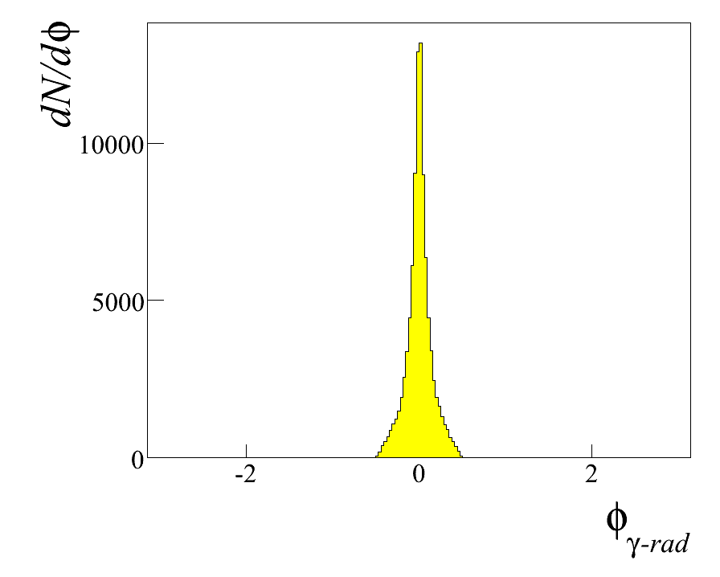
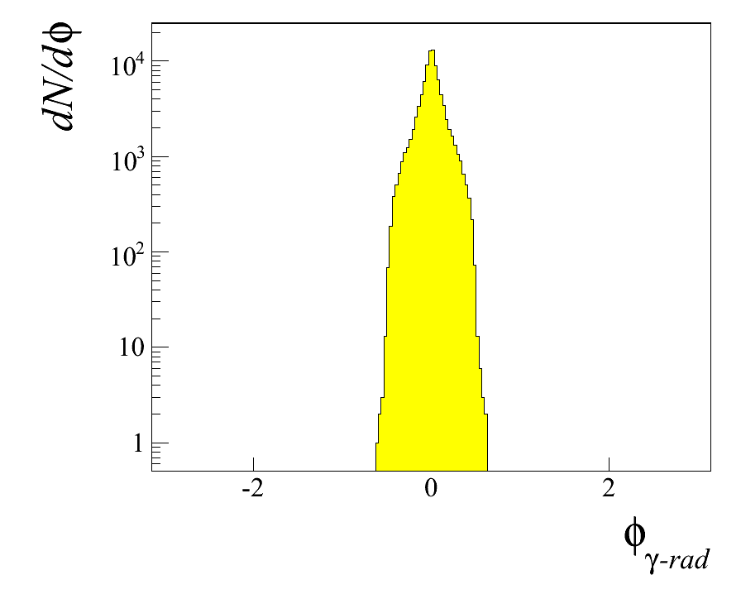
Radiated Photon: Azimuthal angle in GNS

Slide 28
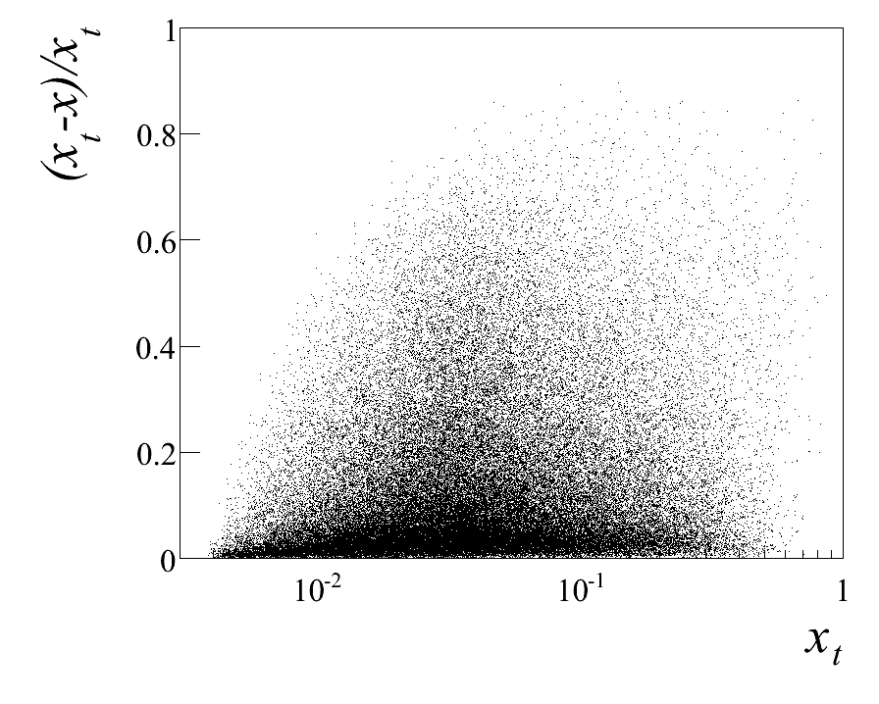
Bjorken-x

Slide 29
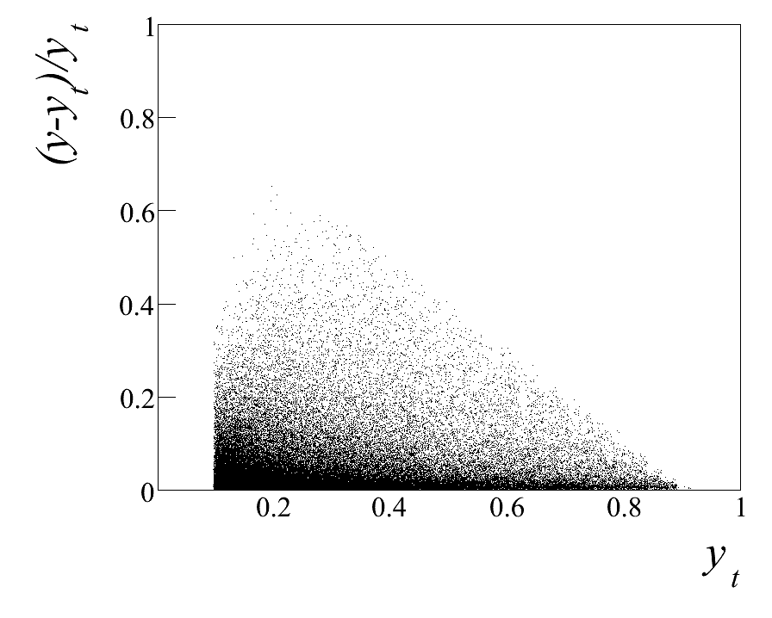
y

Slide 30
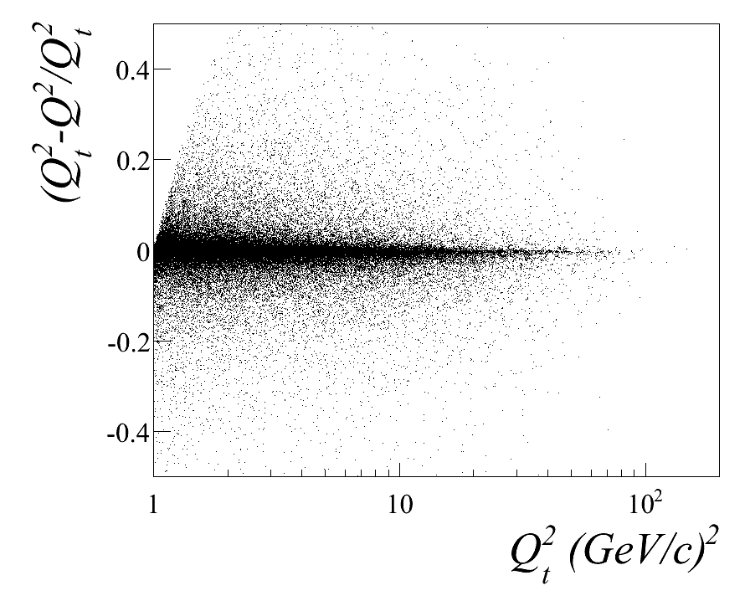
Q²

Slide 31
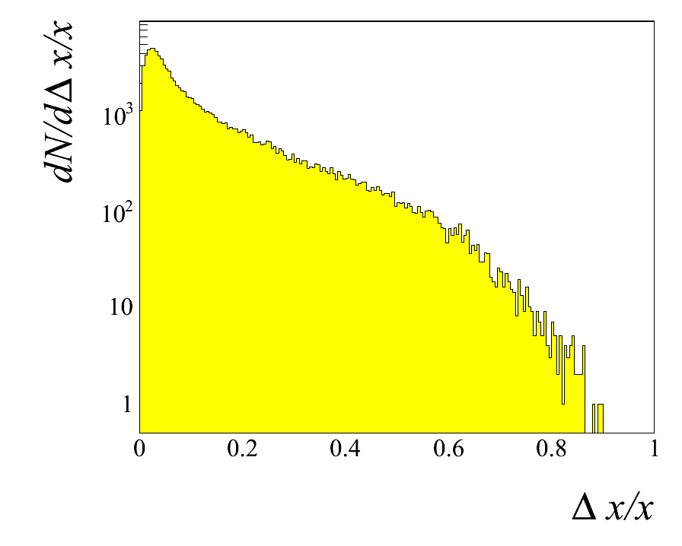
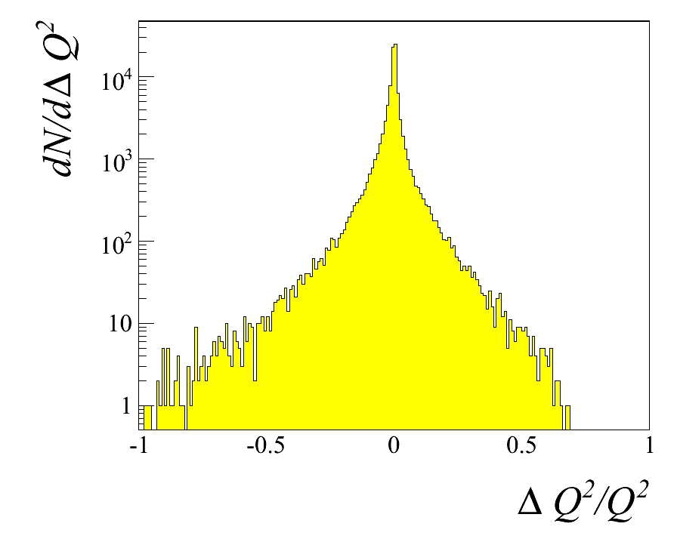
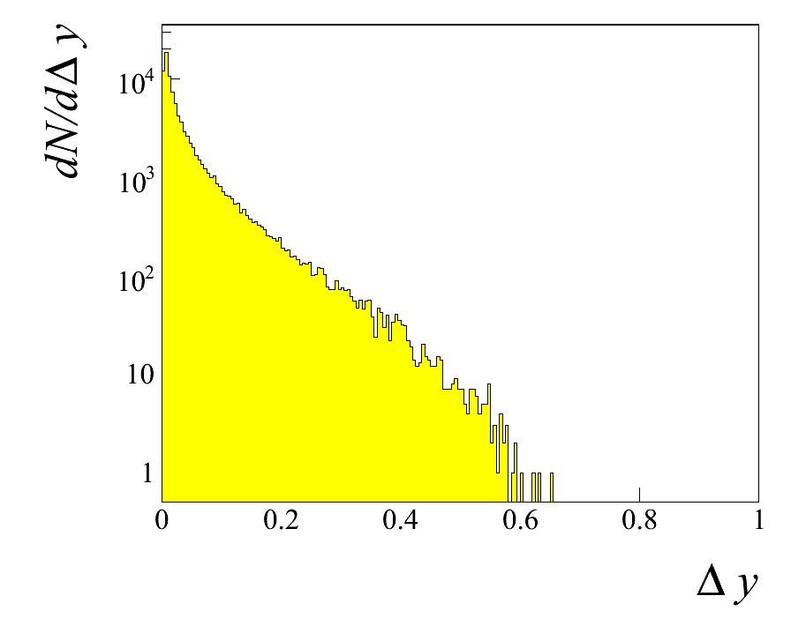
Projections:

Slide 32
HAPRAD for COMPASS:
Muons at 160 GeV, sample kinematics
σ_{exp}/σ_{Born} for E=160GeV, x_{Bj}=0.01 GeV, y=0.2, z=0.4
p_{T,} GeV/c | 1.0 | 1.5 | 2.0
σ_{exp}/σ_{Born} | +0.4%(muons) -8%(electrons) | +0.7%(muons) -6.8%(electrons) | +0.8%(muons) -6.8%(electrons)
Use power-like p_{T}-dependence. Choice of p_{T}-dependence
may affect the calculated value of rad.correction

Slide 33
Rad Corrections for COMPASS (HAPRAD)
NB: rad-correction depends on z and p_{T}

Slide 34

Conclusions
We are studying smearing effects from RC events in COMPASS by using RADGEN.
Presently effects are small (i.e. smaller than the systematic errors our present measurements).
Something is nevertheless missing: only the inclusive cross-sections are integrated in RADGEN. Not SIDIS
We would also need to take into account the experimentally detected final state, i.e. the detected invariant mass of the ${γ }^{∗}N$ system, in or we will overestimate $σ_{in}$.

Slide 35
END

