Slide 1

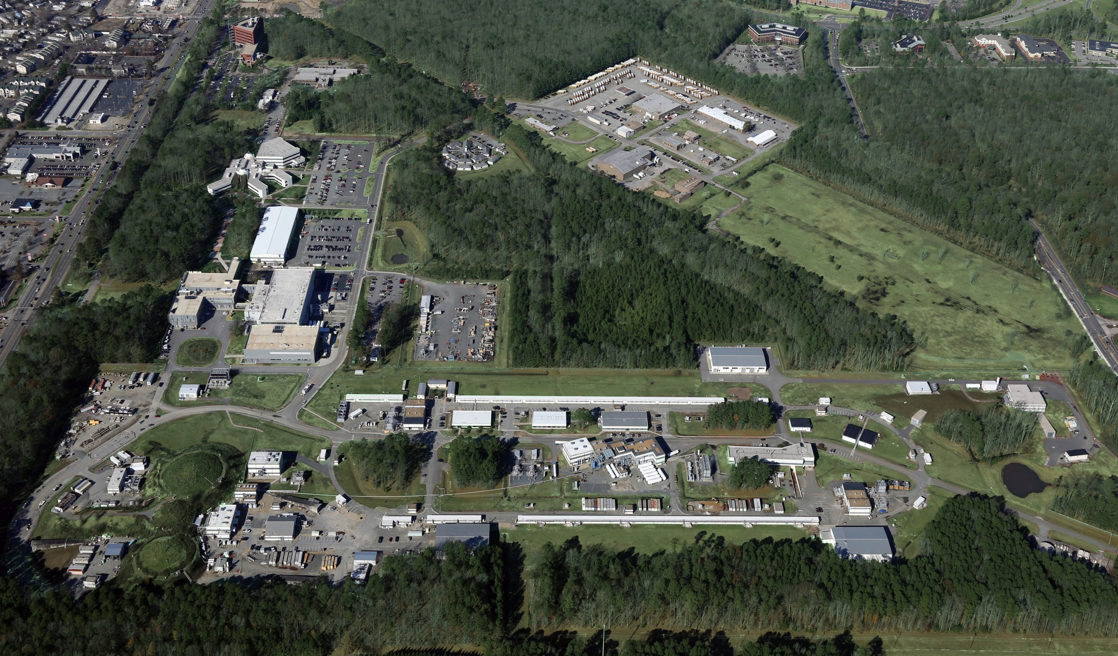
GPD Program at Jefferson Lab
Latifa Elouadrhiri
May 17, 2016

Slide 2
Generalized Parton Distributions
(Quantum phase-space quark distribution in the nucleon)
Polarized DVCS directly probes GPDs
Integrate over momentum space
Sensitivity to GPD
~
Generalized Parton Distributions (GPD) H, H, E, E
UP
LP
TP
H, H, E
~
~
Nucleon polarization
~
H, H, E
3D nucleon imaging in transverse coordinate and longitudinal momentum space
E, H

Slide 3
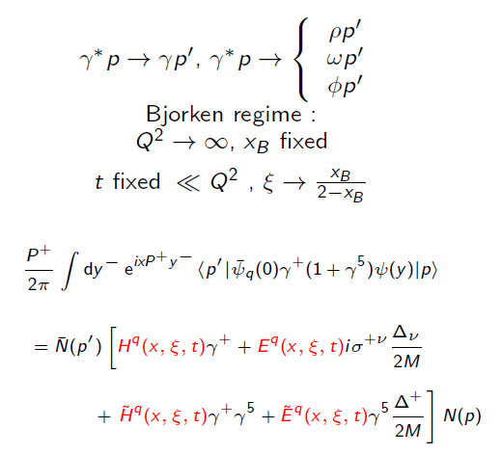
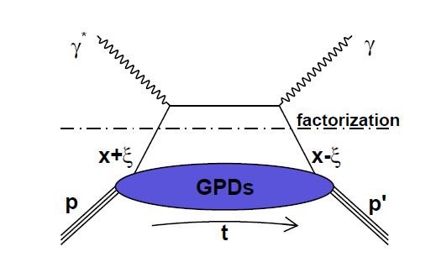
Deep Virtual Compton Scattering (DVCS)
and Generalized Parton Distributions
x: average fraction of quark
longitudinal momentum
:fraction of longitudinal
momentum transfer
H, E, H, E : Generalized Parton Distributions (GPDs)
3-D Imaging conjointly in transverse impact parameter and longitudinal momentum

Slide 4
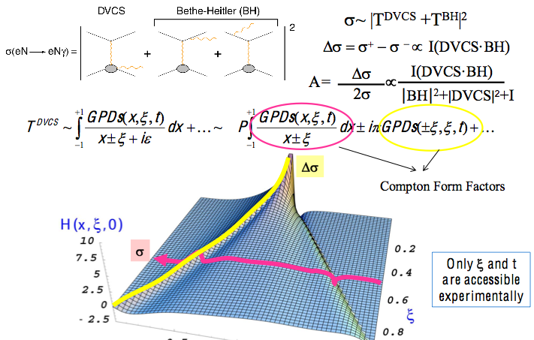
Accessing GPDs through DVCS

Slide 5
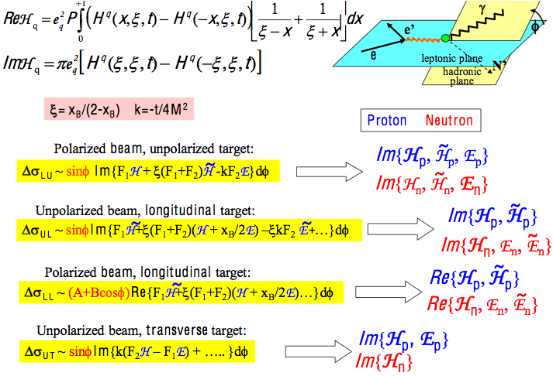
Sensitivity to GPDs Spin Observables

Slide 6
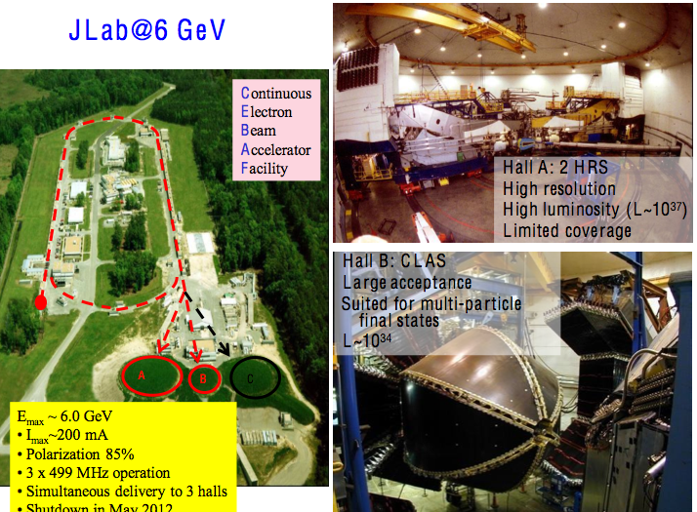

Slide 7
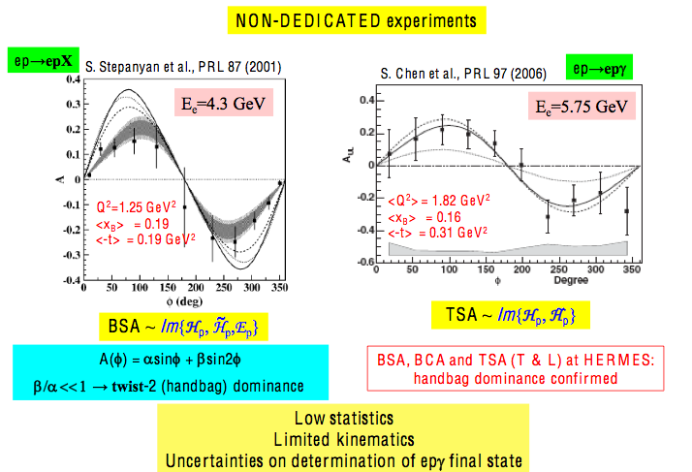
DVCS @ CLAS the first pioneering Results

Slide 8
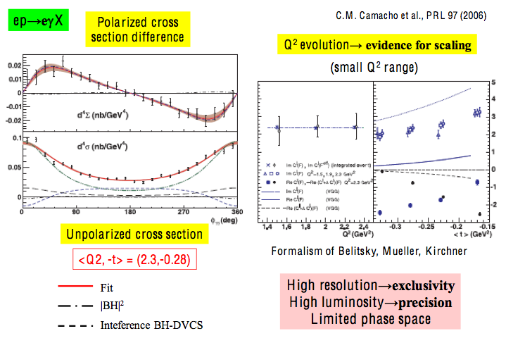
Hall A (JLab) first dedicated SVCS experiment

Slide 9
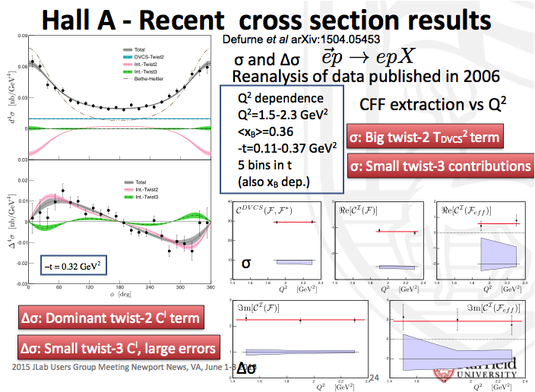

Slide 10
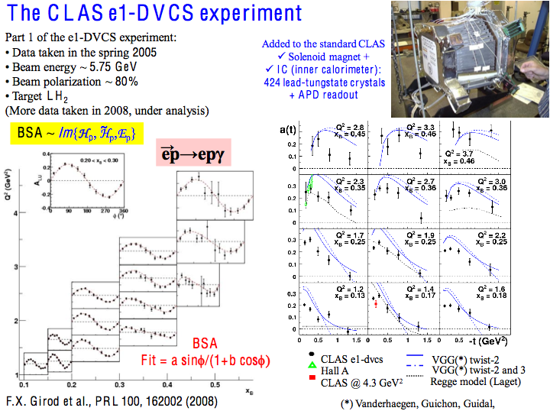

Slide 11
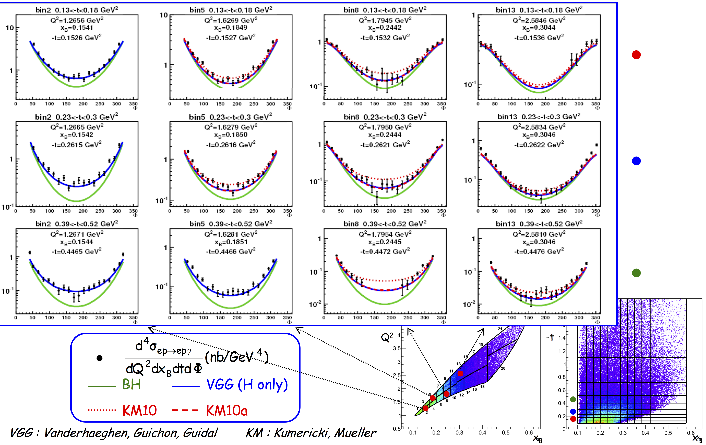
DVCS Unpolarized Cross-Sections

Slide 12


DVCS Longitundinal Target

Slide 13
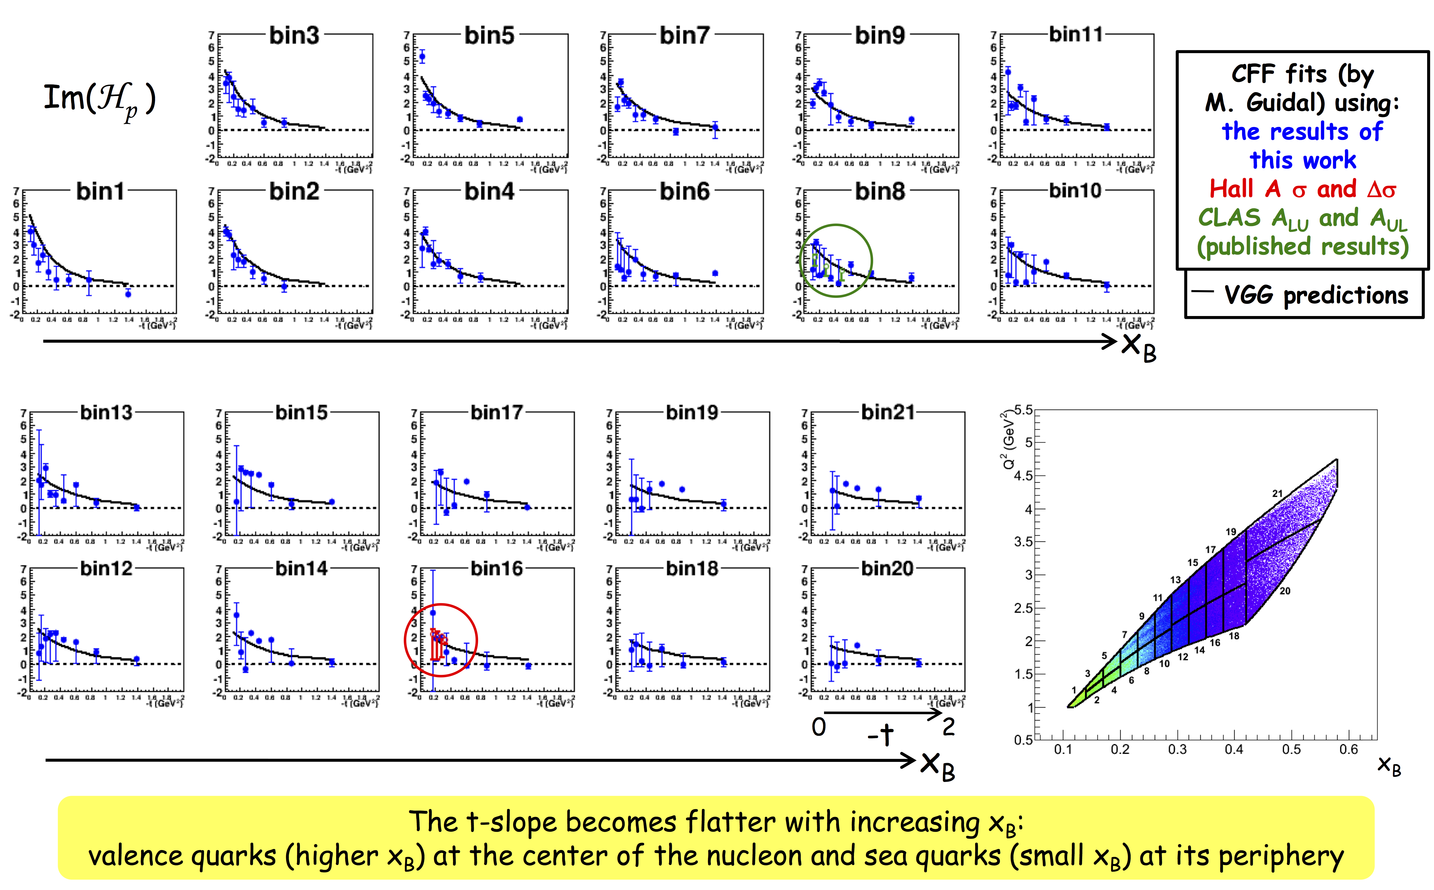
Compton Form Factor H(x,x,t)

Slide 14
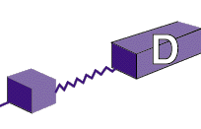
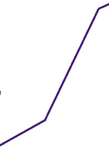
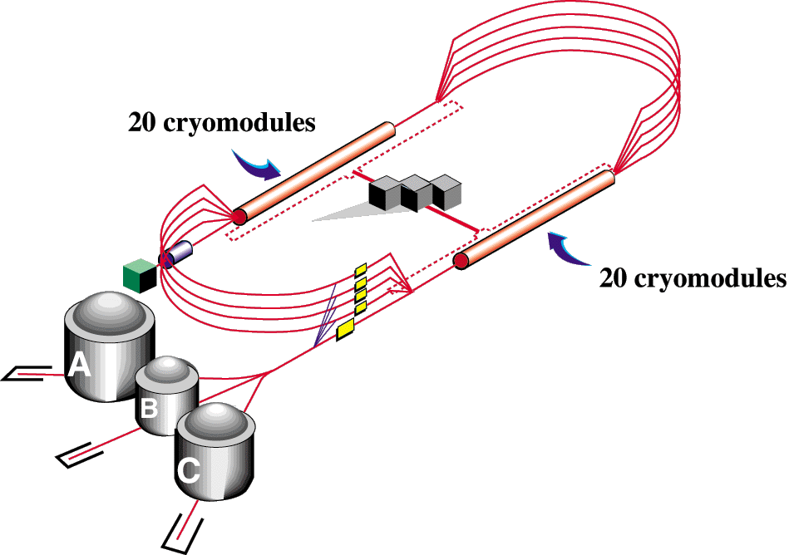
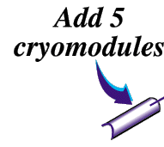

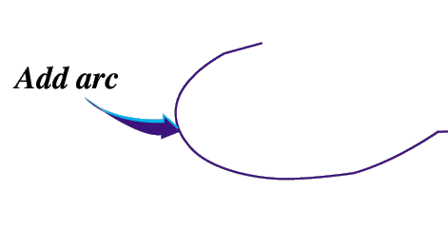

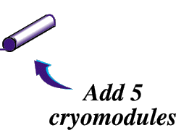
The CEBAF 6/12 GeV Energy Upgrade
Add new hall
CHL-2
Enhance equipment in existing halls

Slide 15
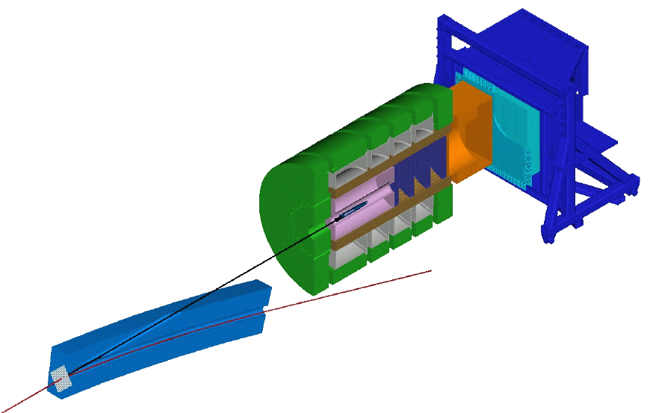
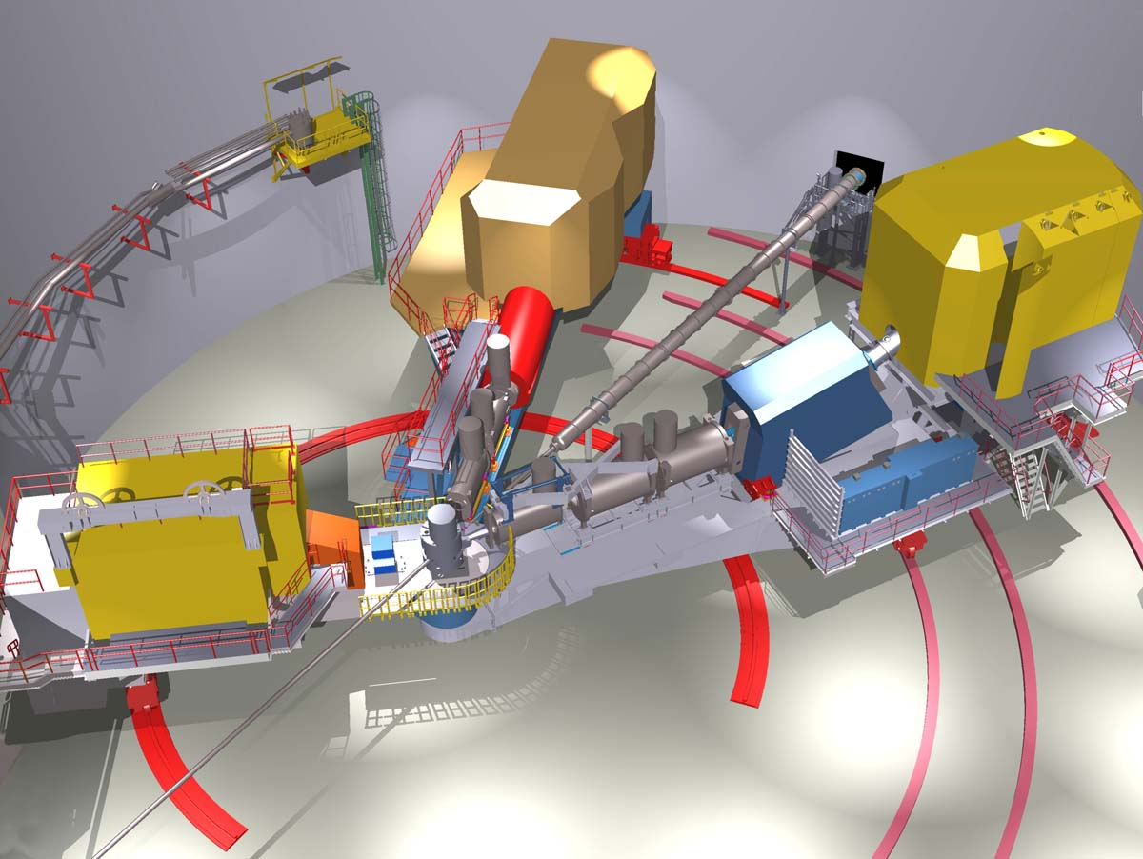
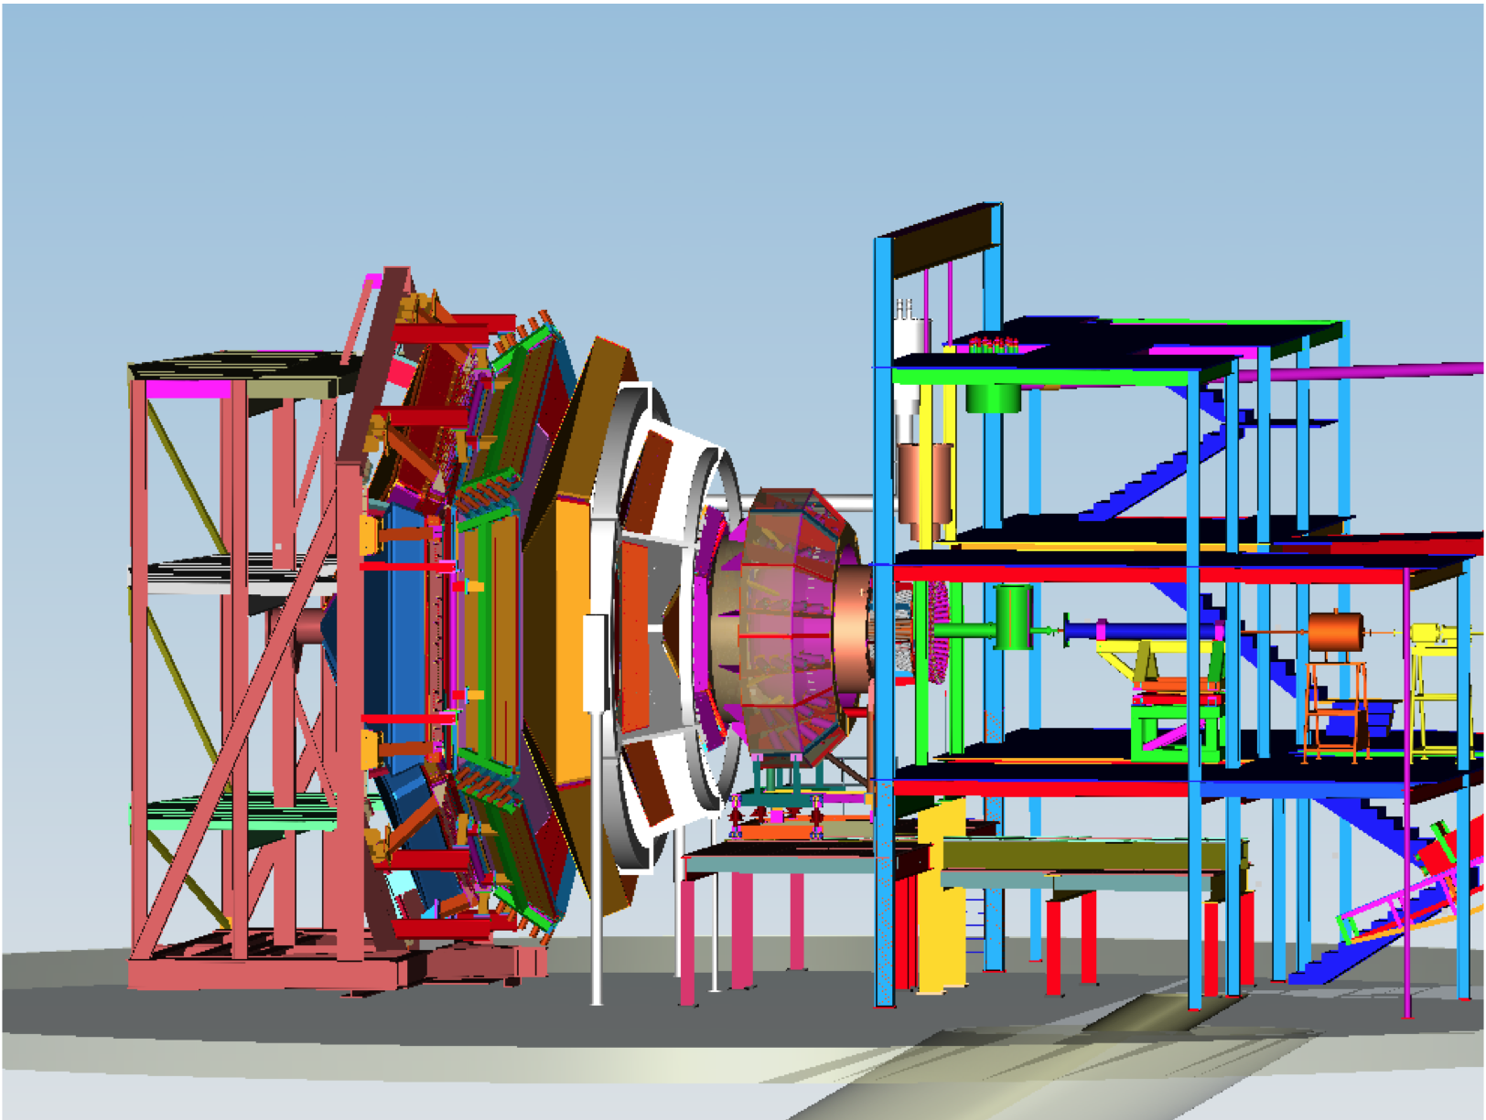
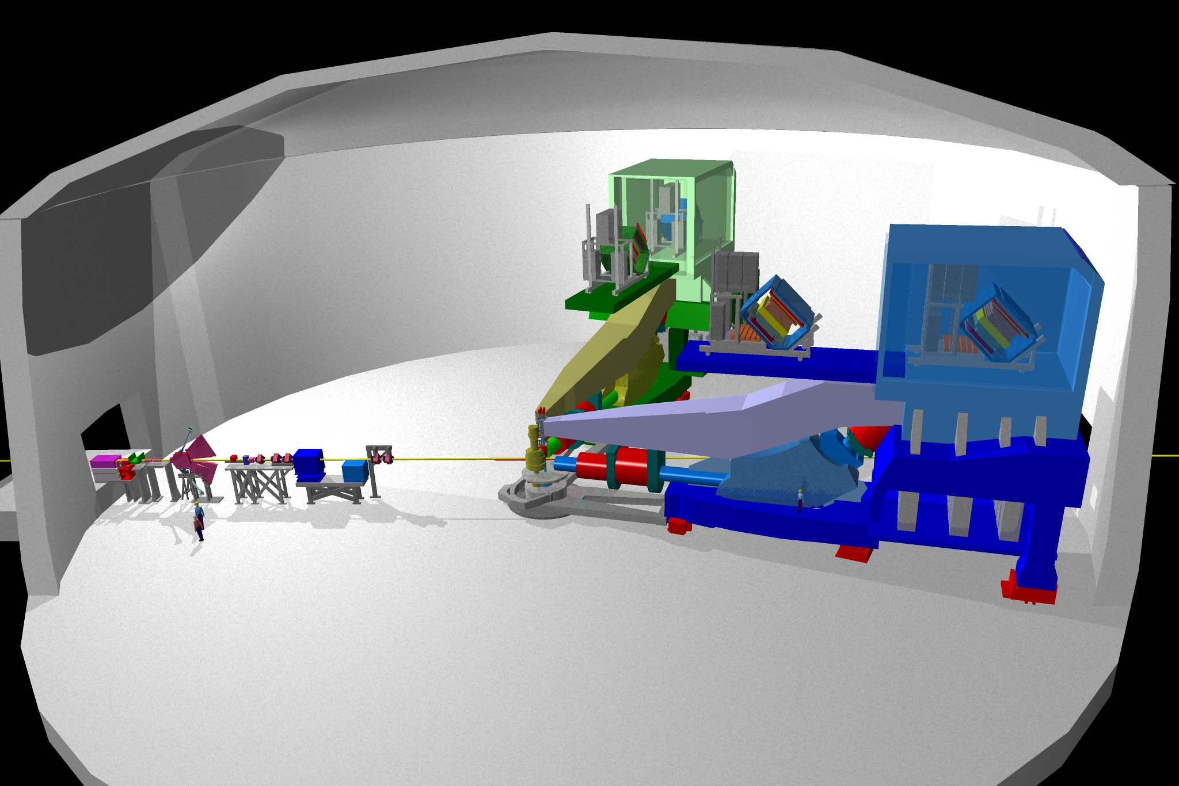
New Capabilities in Halls A, B, & C, and a New Hall D
D
C
9 GeV tagged polarized photons and a 4π hermetic detector
Super High Momentum Spectrometer (SHMS) at high luminosity and forward angles
B
A
High Resolution Spectrometer (HRS) Pair, and specialized large installation experiments + SBS (+ proposals for Moller & SOLID )
CLAS12 high luminosity, large acceptance + RICH + user provided equipment
Notes:
A new Hall will be constructed to house the GlueX detector, that will conduct a search for excited mesons with gluonic components, and the existing Halls will be upgraded with new equipment as well. Hall C will have an additional super high momentum spectrometer. Hall A will retain the existing spectrometers and provide space for new specialized equipment to address a variety of physics topics. Hall B will house the CLAS12 detector which is the focus of this of workshop. At 12 GeV JLab will be ideal for precision studies at large Bjorken x.

Slide 16
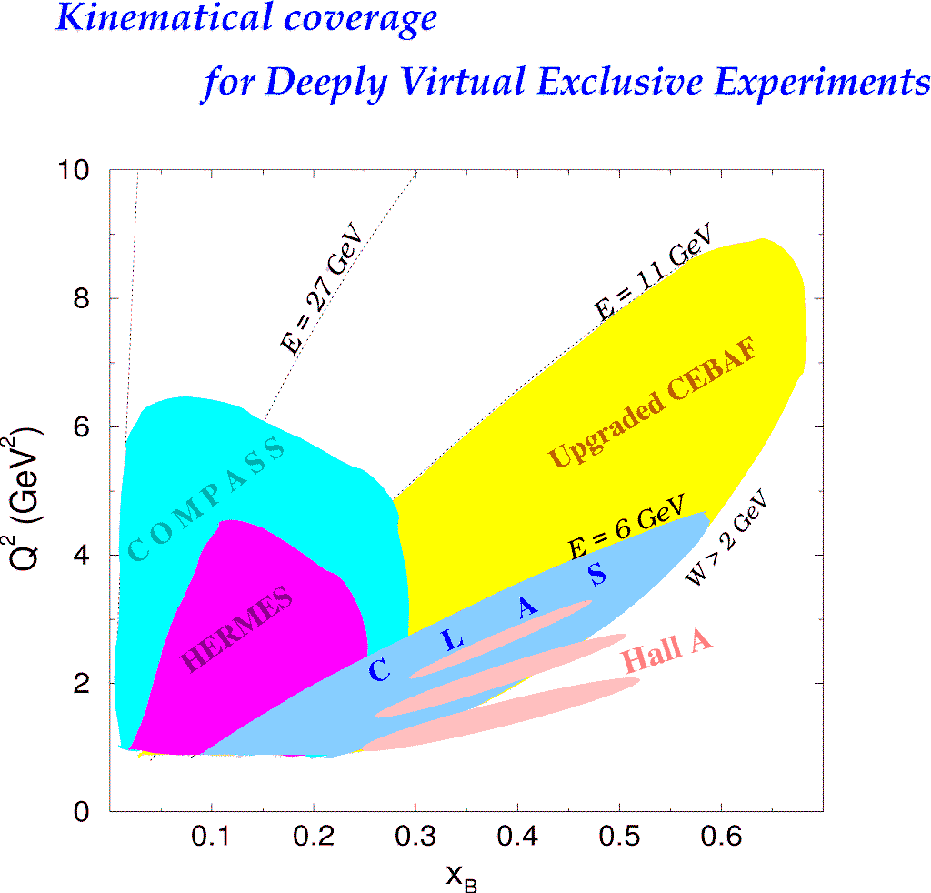
DVCS Experiments Worldwide
H1, ZEUS
Study of high x_{B} domain
requires high luminosity
H1, ZEUS
27 GeV
11 GeV
200 GeV
11 GeV
JLab Upgrade
JLab @ 12 GeV
COMPASS
W = 2 GeV
HERMES
The 12 GeV Upgrade is well matched to studies in the valence quark regime.
0.7
Notes:
The kinematics range that can be covered in exclusive processes with high precision data is shown with this yellow area. This will be the only accelerator where rhe valence quark regime can be fully covered with high precision data. other existing machines, even at much higher energies can not cover this regime due to the much lower luminosity at HERA or COMPASS.
My own personal view is that several experiments, in some of which I participated, eg EMC and E665, but also HERA, the physics, especially at high x was limited by the lack of luminosity.
Jefferson Lab has luminosity, also good spin control in both beam and targets.
So high x is (still) there for the taking and given 12 GeV, it is accessible kinematically.

Slide 17
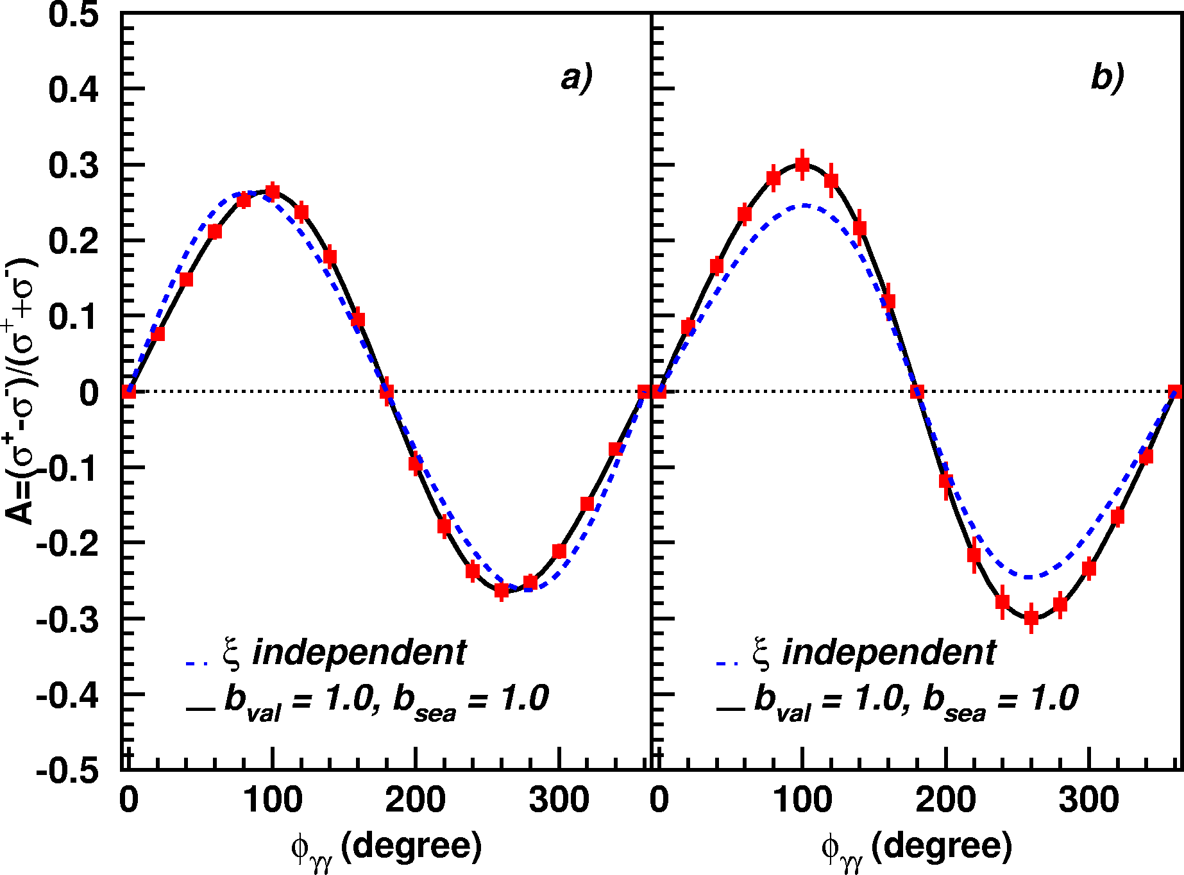
A_{LU} projections for JLab@12GeV
~
ep --> epγ
Δσ_{LU} ~ sinφ {F₁H + ξ(F₁+F₂)H +kF₂E}dφ
A_{LU}
E12-06-114
E12-06-119

Slide 18
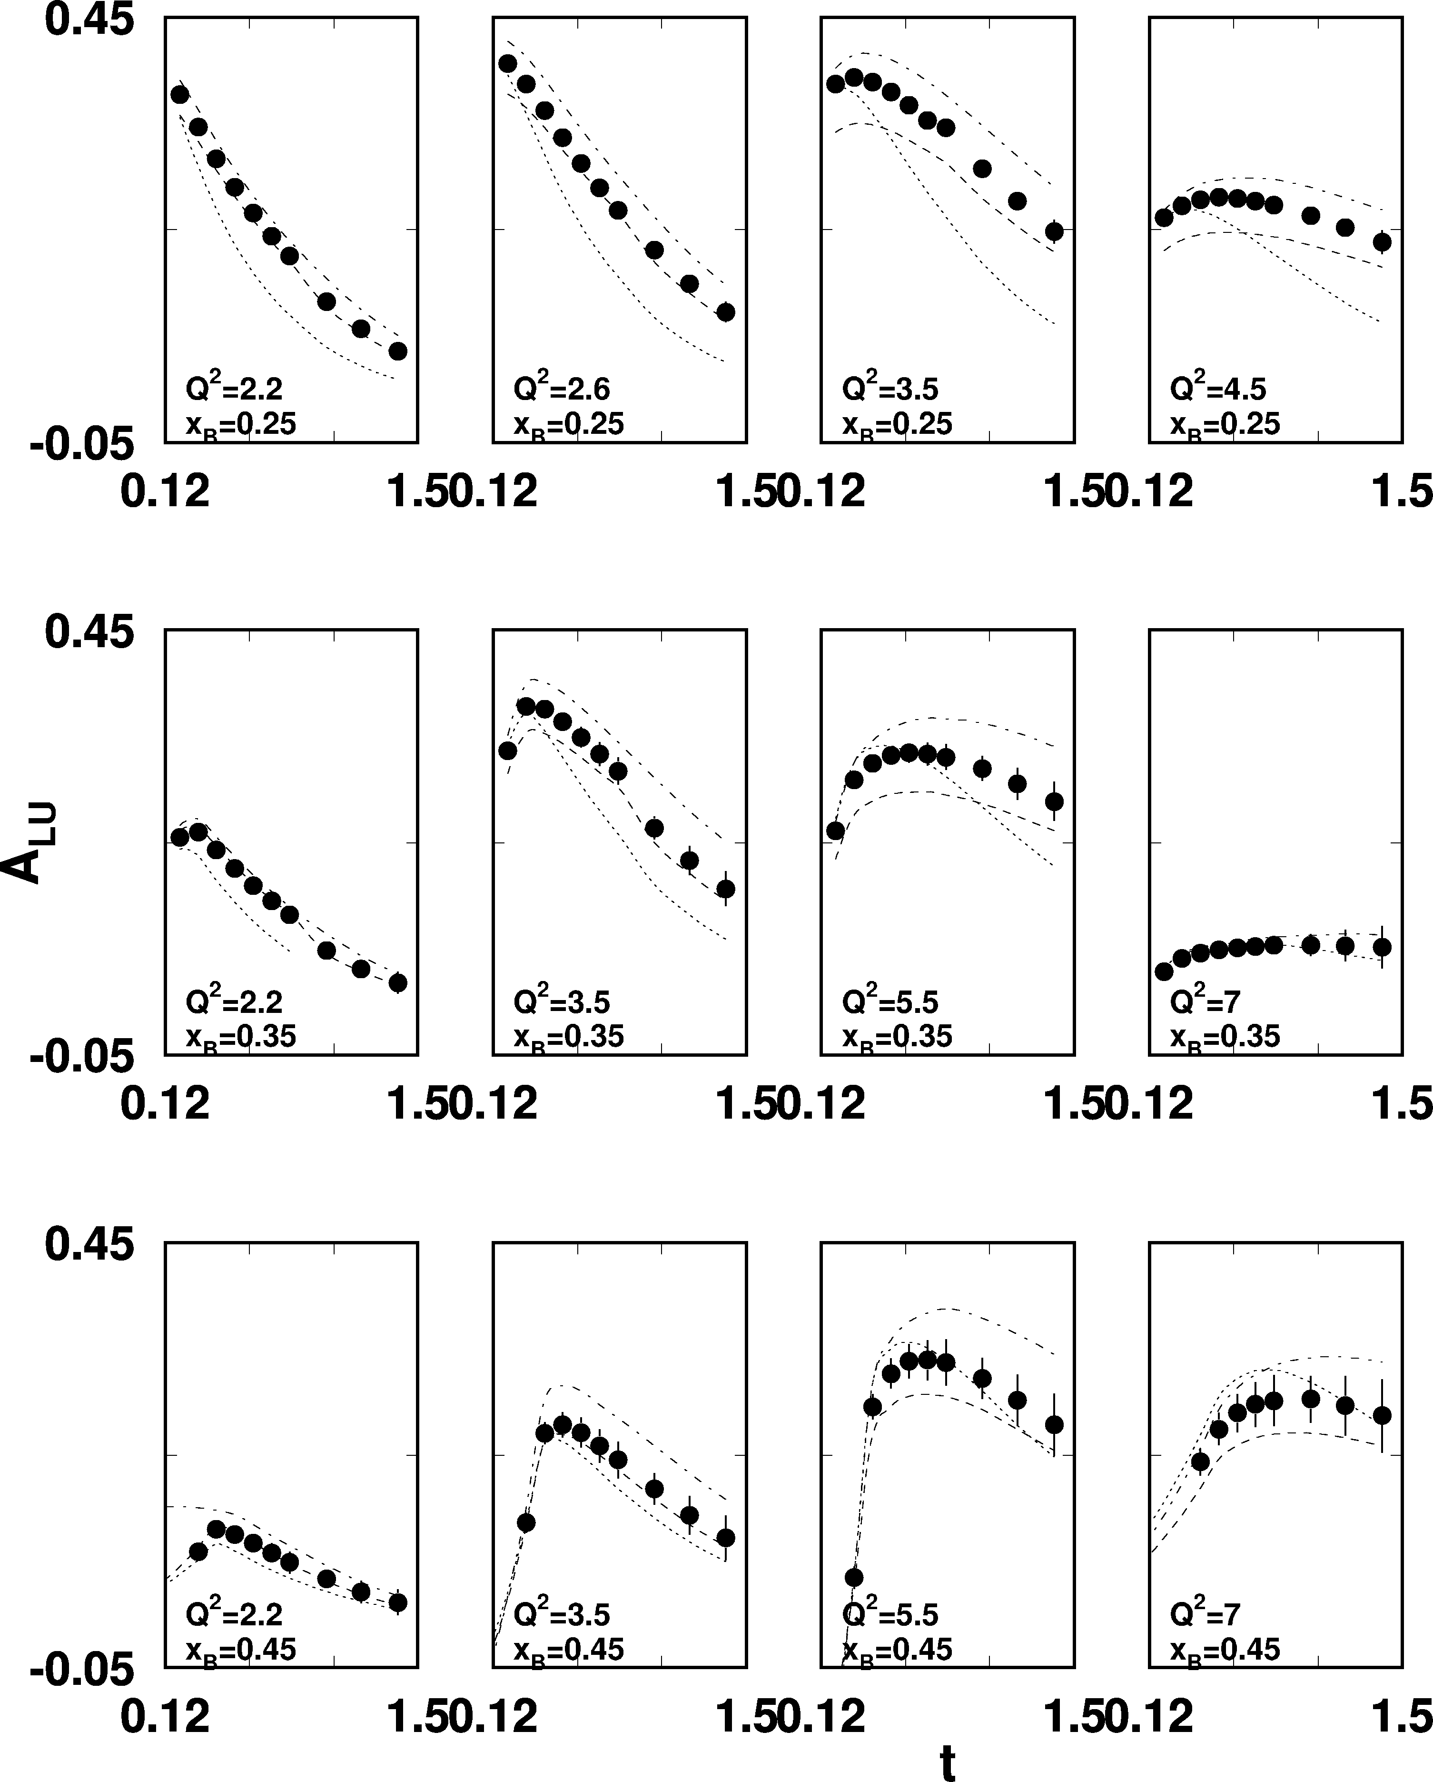
A_{LU} projections for protons
e p epγ
~
Δσ_{LU} ~ sinφ {F₁H + ξ(F₁+F₂)H +kF₂E}dφ
E_{e}=11GeV
sinφ
, GeV²

Slide 19
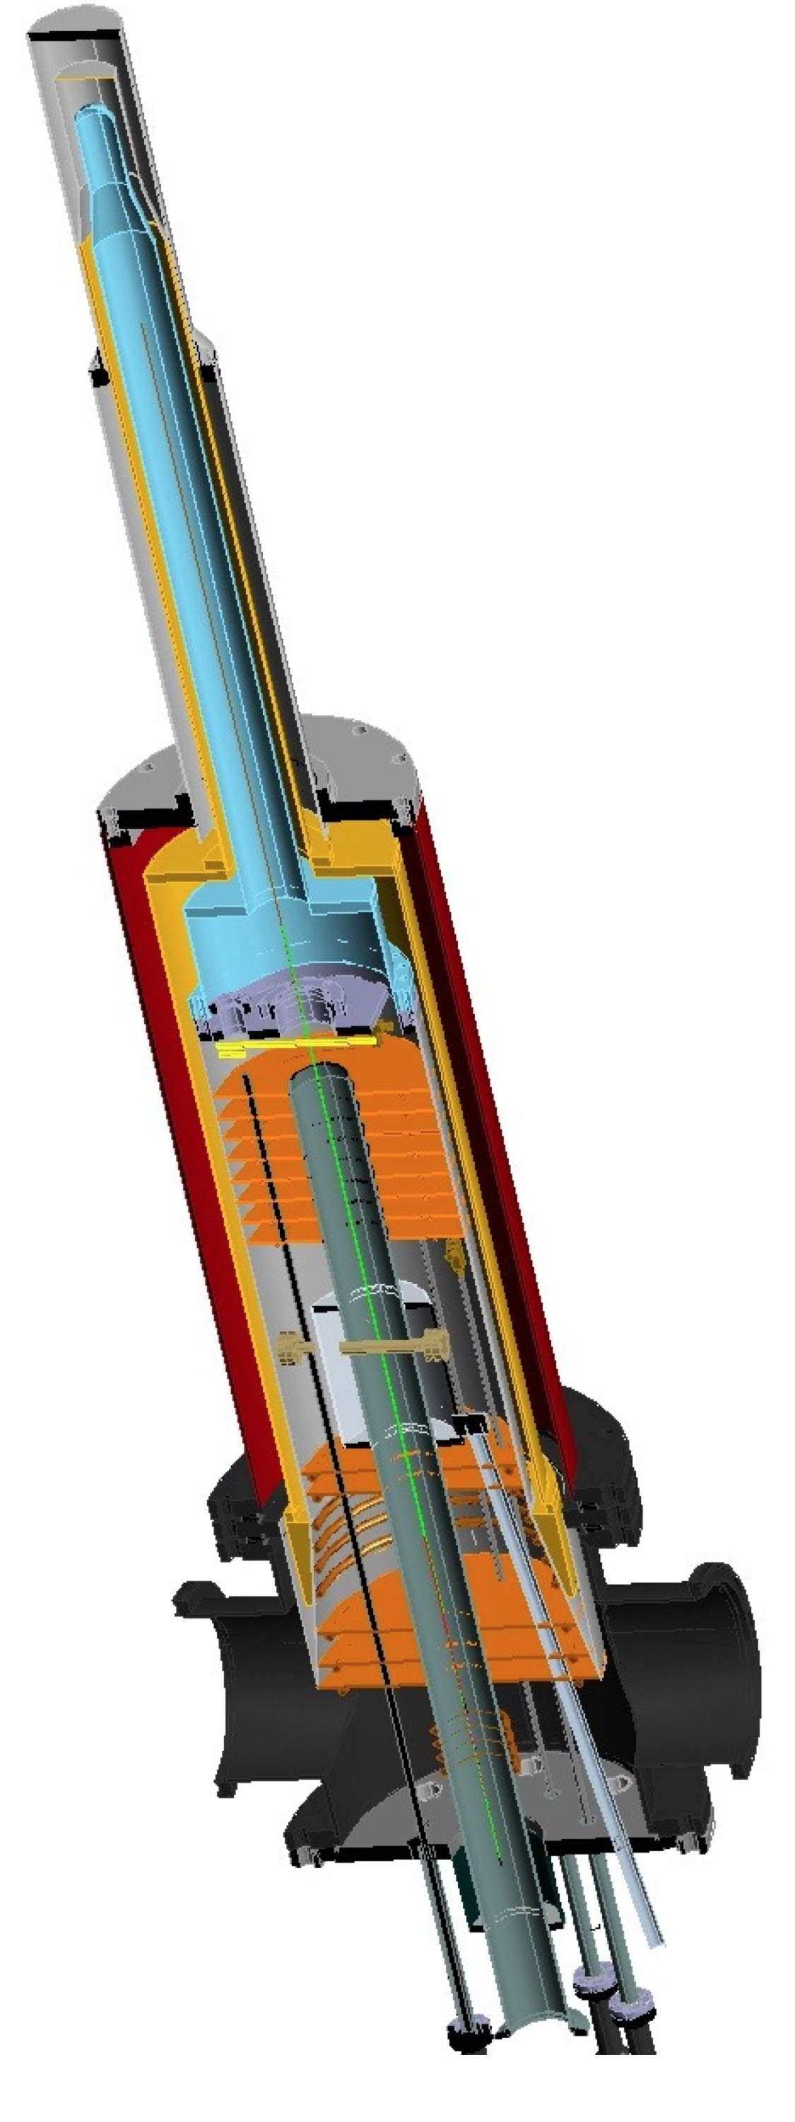
A_{UL} projections for protons
e p epγ
~
Δσ_{UL} ~ sinφ {F₁H+ξ(F₁+F₂)(H +ξ/(1+ξ)E)}dφ
~
Dynamically polarized target NH₃, ND₃
L = 1x10³⁵ cm⁻²s⁻¹
T = 2000 hrs
ΔQ² = 1GeV²
Δx = 0.05
A_{UL}
E12-06-119

Slide 20
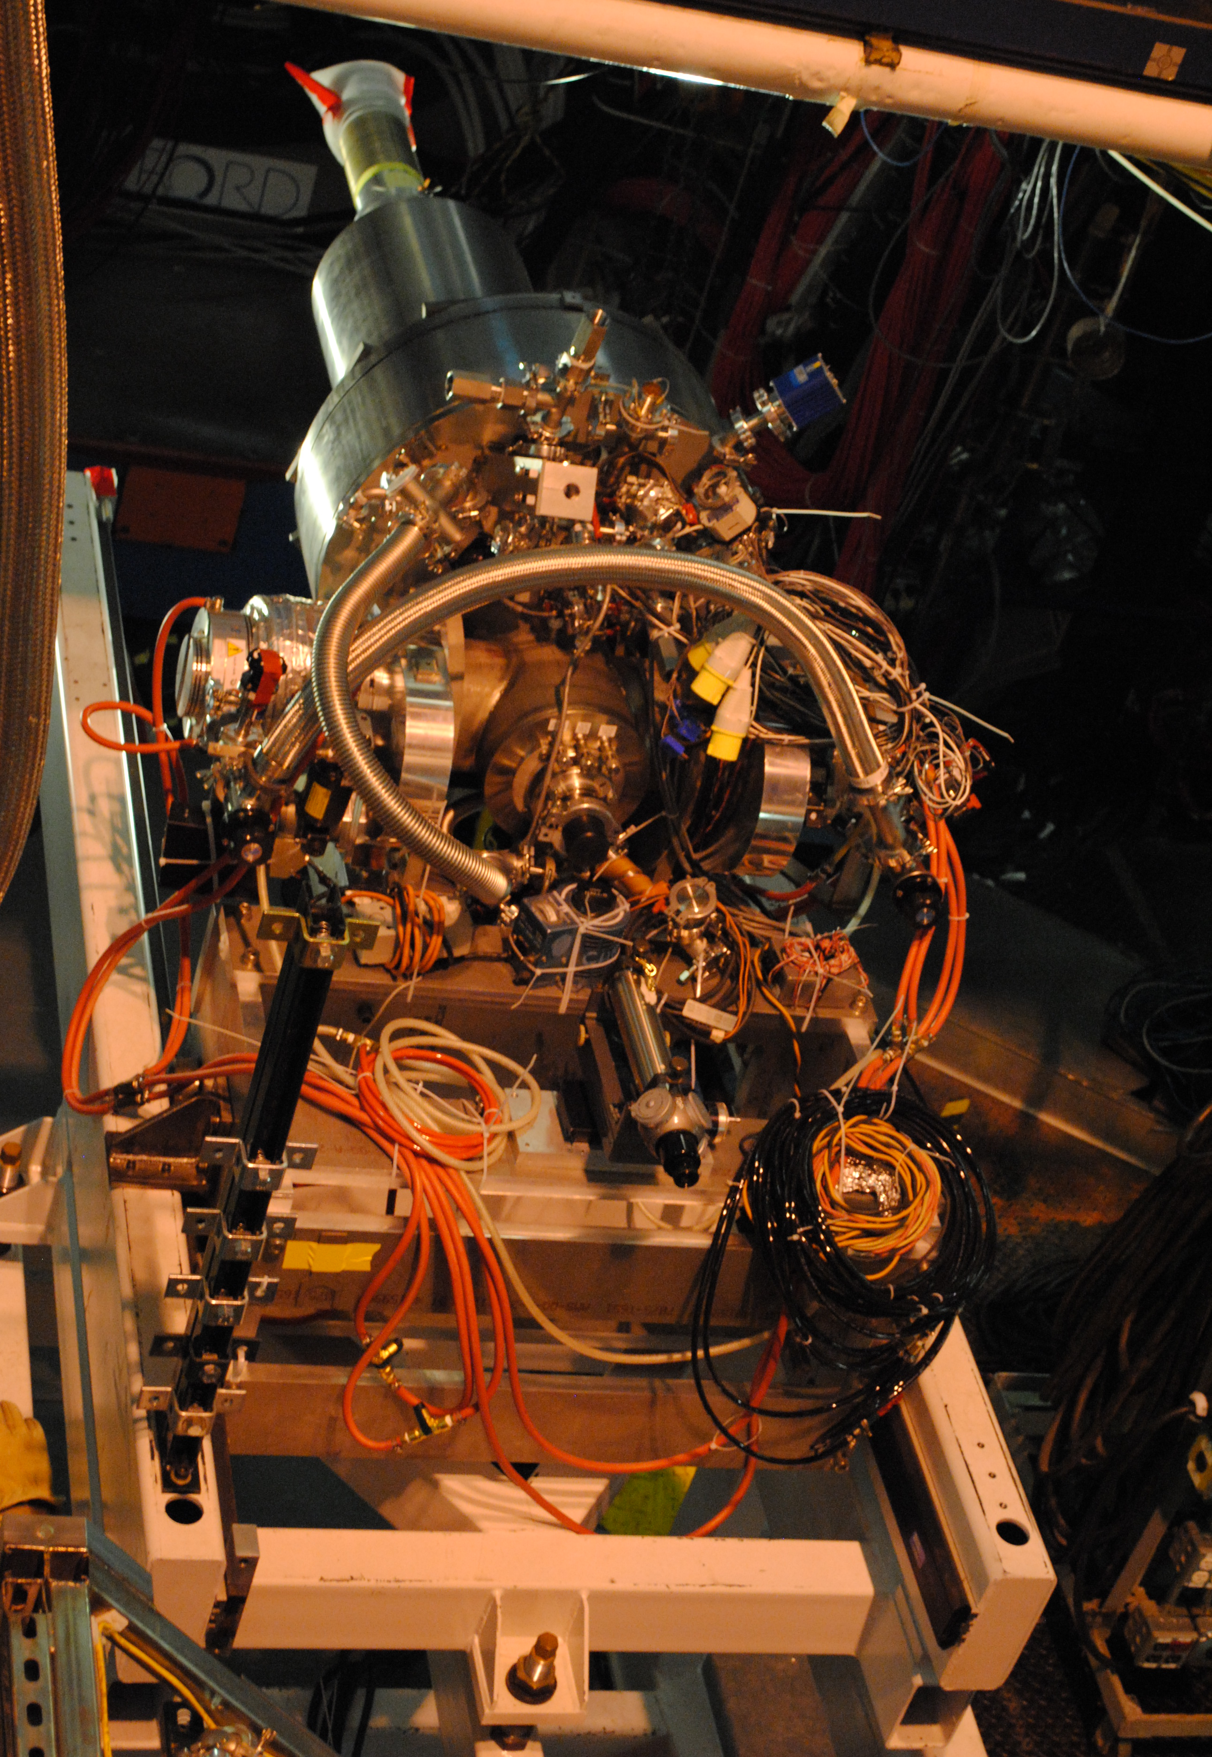
A_{UT} projections for 12GeV
ep epγ
Δσ_{UT} ~ cosφsin(φ_{s}-φ){k(F₂H – F₁E)}dφ
polarized HD
P_{p}=0.60
Dilution = 0.8
C12-12-010
cosφ
x=0.25,
Q²=2 GeV² t=-0.55 GeV²
A_{UT} and A_{LT} are sensitive to the u and d-quark helicity content of the proton spin

Slide 21
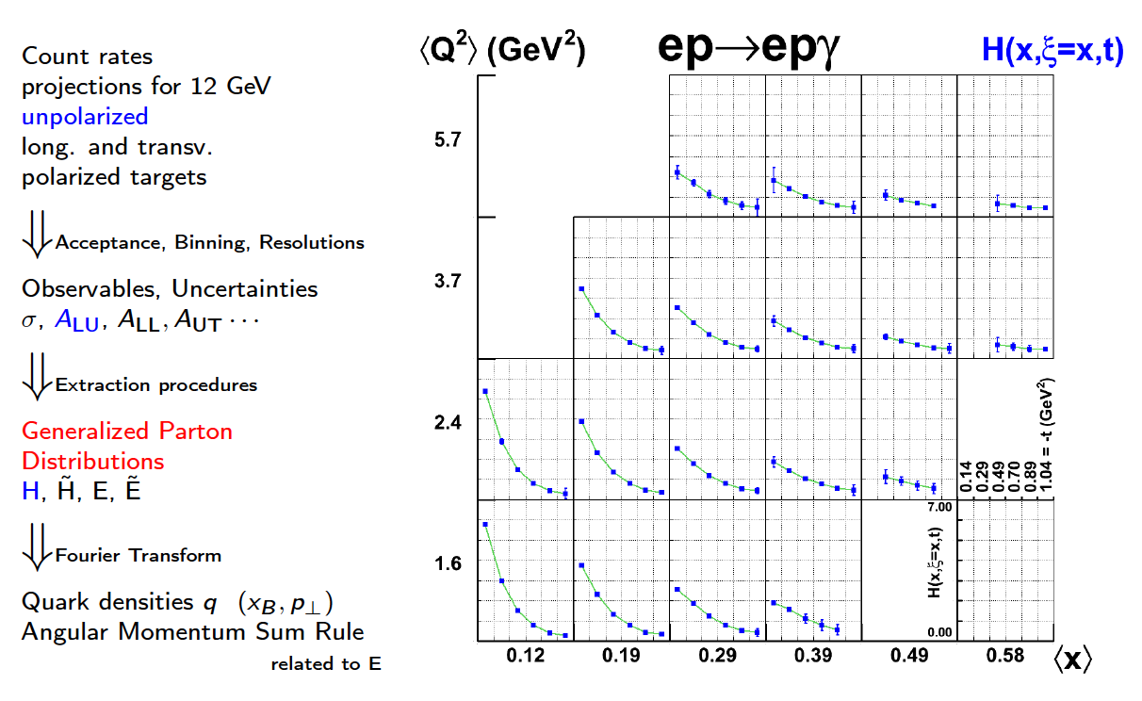
Projections for H with CLAS12

Slide 22
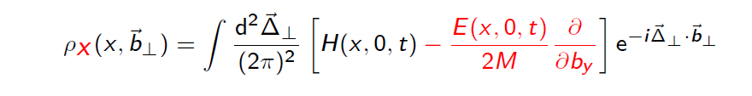
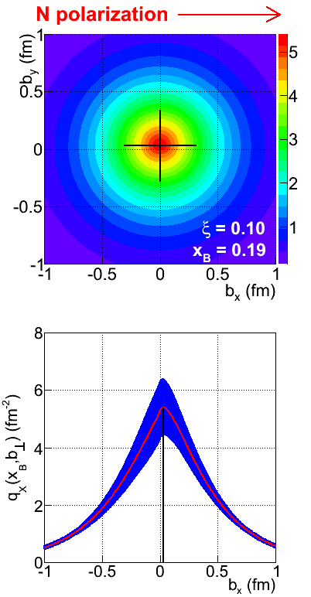
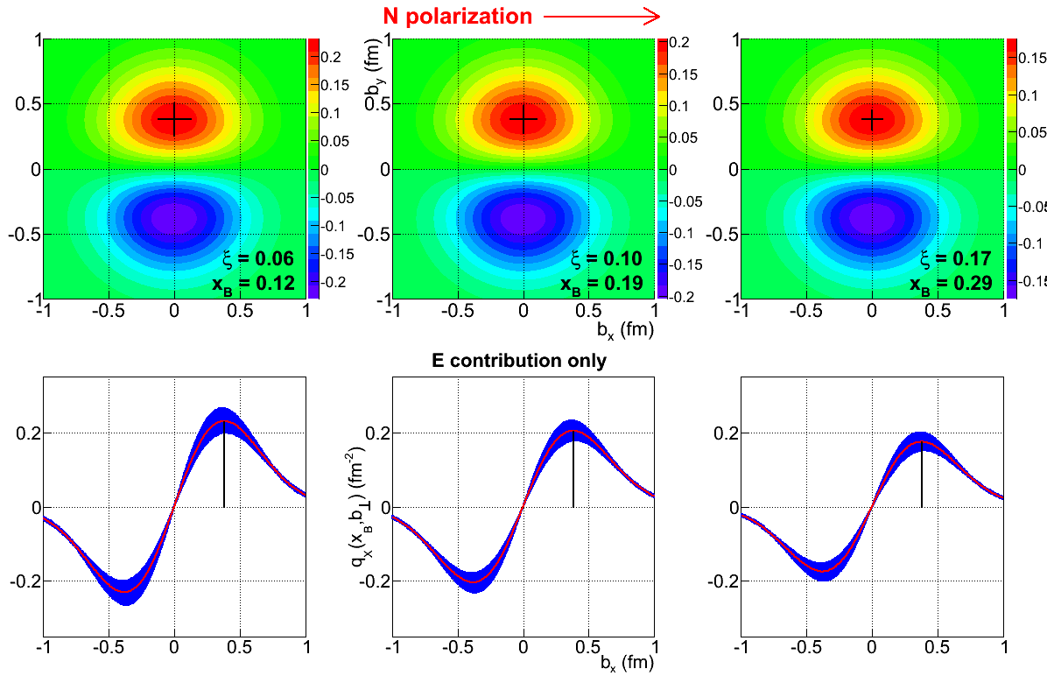
Projected quark densities in impact parameter
Fourier transform of GPDs give access to the quark densities distribution in impact parameter space.
GPD E probes the u- and d-quark separation in impact parameter space. Transversely polarized proton shows flavor dipole.
Contribution of H+E
Contribution of E

Slide 23
Accessing GPDs through DVCS

Slide 24
DDVCS with CLAS12 in Hall-B – Proposal in preparation
Two main challenges in DDVCS measurements:
cross section is two to three orders of magnitude smaller than the DVCS cross section
decay leptons of the outgoing virtual photon must be distinguishable from the incoming-scattered lepton
Both challenges can be solved with by studying di-muon electroproduciton,
CLAS12 FD will be blocked with heavy shielding/absorber from electromagnetic and hadronic backgrounds to be able to run at luminosities ~10³⁷ cm⁻² s⁻¹, and will be used as muon detector
Scattered electrons will be detected in a compact PbWO₄ calorimeter that is part of the shielding
Electron calorimeter and shield/absorber
30º
Location of HTCC mirrors
30º
7º
500
W shield
S
7º
5º
17
PbWO₄
13
200
500
PbWO₄ modules with APD readout - ~ 1500 modules

Slide 25
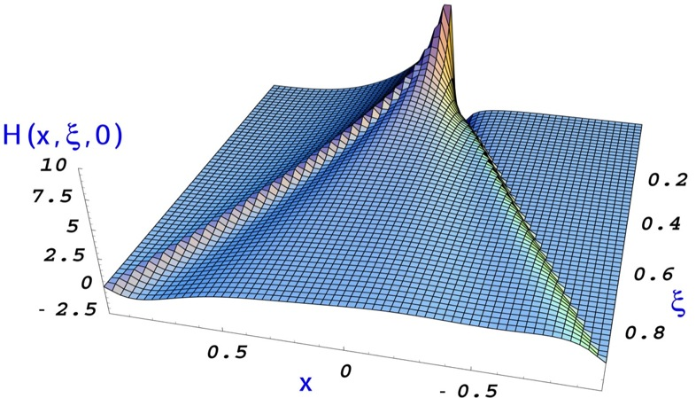
Expected results on beam spin of DDVCS asymmetry
The beam spin asymmetry (BSA) in DDVCS is proportional to the imaginary part the, i.e. in a concise notation:
DVCS BSA (Im, x=ξ)
DVCS Cross sections |Re|²
This allows the mapping of GPDs along each of the three axis ( , ξ and t) independently
Prediction of the “handbag” formalism is the sign change of BSA in transitioning from “space-like dominated” to “time-like dominated” regime
DDVCS ( )
BSA for 100 days of running with CLAS12 at luminosity of 10³⁷ cm⁻² s⁻¹
Electron kinematics:
Space-like dominance
Time-like dominance
BSA
Transferred momentum squared:
From Boer, Paremuzyan

Slide 26
Complete separation of deeply virtual photon and π0 electroproduction observables of unpolarized protons
With E_{beam}= 6.6 GeV, 8.8 GeV, 11 GeV
Hall A experiment data taking underway
Hall B proposal being developed for submission to the next PAC

Slide 27
Motivation
To use the beam energy dependence of the BH and DVCS amplitudes to isolate the BH·DVCS interference term from the pure DVCS2 contribution (as a function of Q2):
  Extraction of different combinations of GPDs
  Additional test of DVCS scaling
To measure response functions of the deep virtual π0 channel, in particular dσL and dσT by a Rosenbluth separation (as a function of Q2):
  valuable complementary (flavor) information on GPDs
Complementary measurements in Hall A and Hall B
  Hall A taking data
  Hall B preparing proposal for next PAC

Slide 28
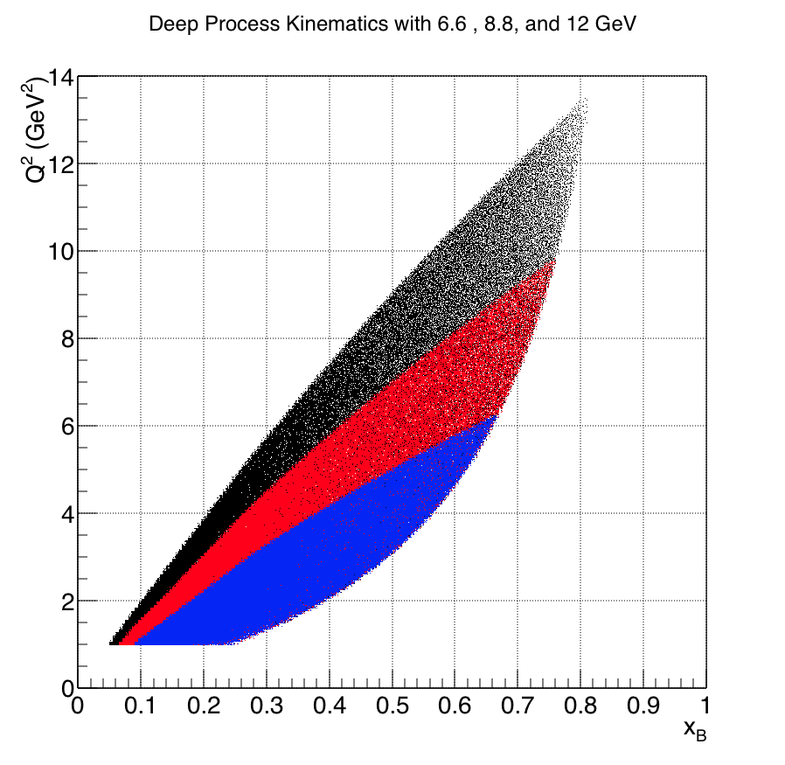
DVCS with CLAS12 at various beam energies
Increase and optimize kinematical coverage with 6.6, 8.8, and 11 GeV
“Rosenbluth” type separation between DVCS /Bethe-Heitler interference term and DVCS square term
Clean extraction of Imagininary and Real parts of Compton Form Factors
Use dispersion relations to access the elusive D-term and open physics reach of exclusive processes beyong Imaging in the transverse plane

Slide 29
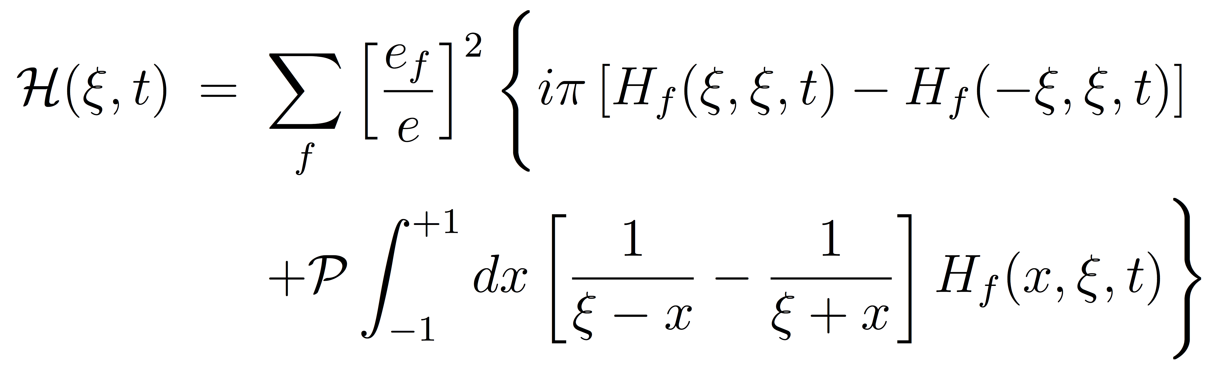
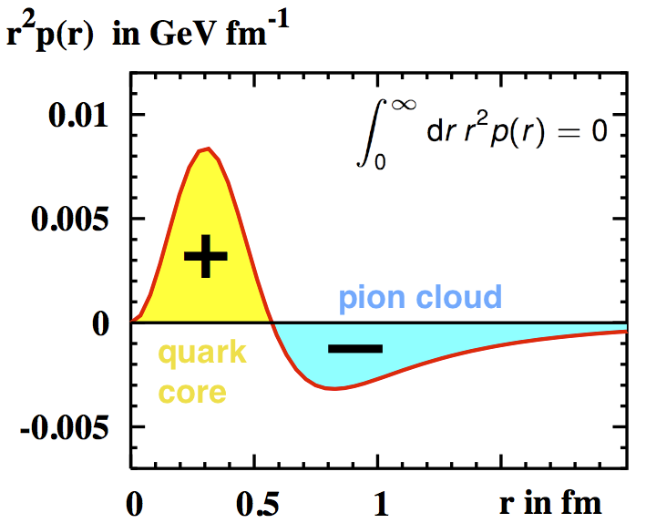
DVCS with CLAS12 at various beam energies
Imaginary Part of CFF
Real Part of CFF
The D-term is the least known part of the conventional GPD H
t-dependence of the D-term encodes the form factor associated with the distributions of forces on partons inside hadrons
May shed light on the mechanism of confinement

Slide 30
Extraction and Validation Framework
The main goal is to develop a framework for extraction and validation of 3 D PDFs from experimental measurements of hard exclusive and semi-inclusive production of photons and mesons through:
  Developing multidimensional MC-simulation
  Implementing self consistent QED radiative corrections in the cross sections for a complete set of structure functions needed for the extraction framework and MC simulations
  Developing capabilities, within the extraction and validation framework, to provide persistence and data visualization tools
  Robust strategy to propagate and control uncertainties to the extracted 3D PDFs
The analysis framework to be used in 2 ways: from measured observables to 3D PDFs, and from models of 3D PDFs to predictions of observables.

Slide 31
Analysis Framework
Data (contains N events with 4 vectors of reconstructed particles, N~1B)
MC (contains M events with 4 vectors of generated and reconstructed particles, M~10-100N)
acceptance
Define x-sections/normalized counts
Microscopic bins (counts in λ,Λ,x,y,[z,P_{T}][t], φ) defining detector acceptance, efficiency and material on path of leptons
Counts in microscopic bins in λ,Λ,x,y, [z,P_{T}][t],φ, corrected for detector acceptance and efficiency
GPD/TMD extraction framework
Fundamentals
SFs, evolution
Perform radiative corrections and fits
GPD/TMD extraction
Multiplicities and azimuthal moments in macroscopic bins in x,y, [z,P_{T}][t], corrected for Radiative Corrections
GPD/TMD library

Slide 32
Analysis framework
Data (contains N events with 4 vectors of reconstructed particles, N~1B)
MC (contains M events with 4 vectors of generated and reconstructed particles, M~10-100N)
acceptance
Define x-sections/normalized counts
Elementary bins (counts in λ,Λ,x,y,[z,P_{T}][t], φ) defining detector acceptance, efficiency and material on path of leptons
Counts in elementary bins in λ,Λ,x,y, [z,P_{T}][t],φ, corrected for detector acceptance and efficiency
GPD/TMD extraction framework
Fundamentals
SFs, evolution,RC
Pros:
Only pure (no theory based assumptions) experimental data will serve as input for extraction framework
Elementary (limited by resolution) bins would allow also “event based” analysis (unbinned, Bessel,…)
Cons:
Require 10-100 times more computing power
GPD/TMD extraction
GPD/TMD library

Slide 33
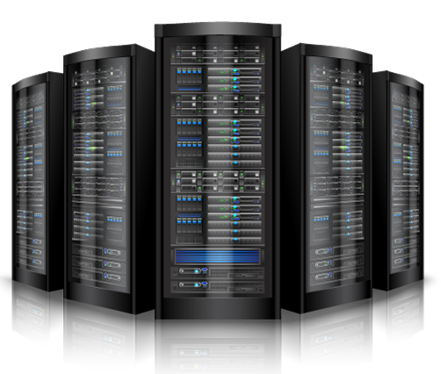
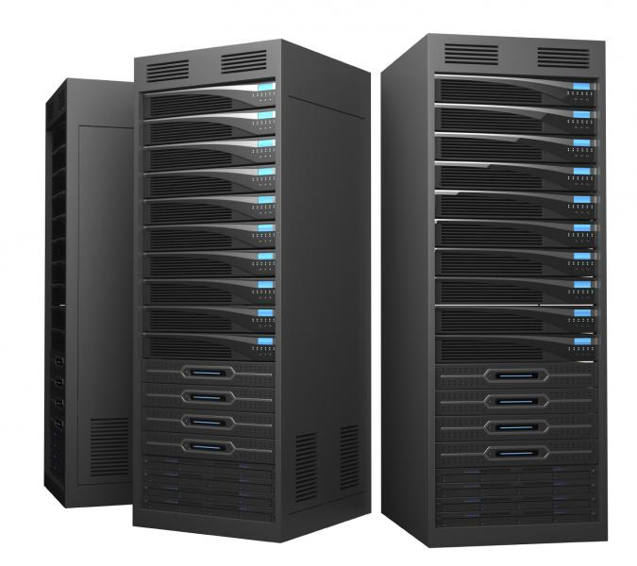
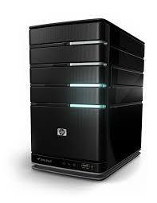
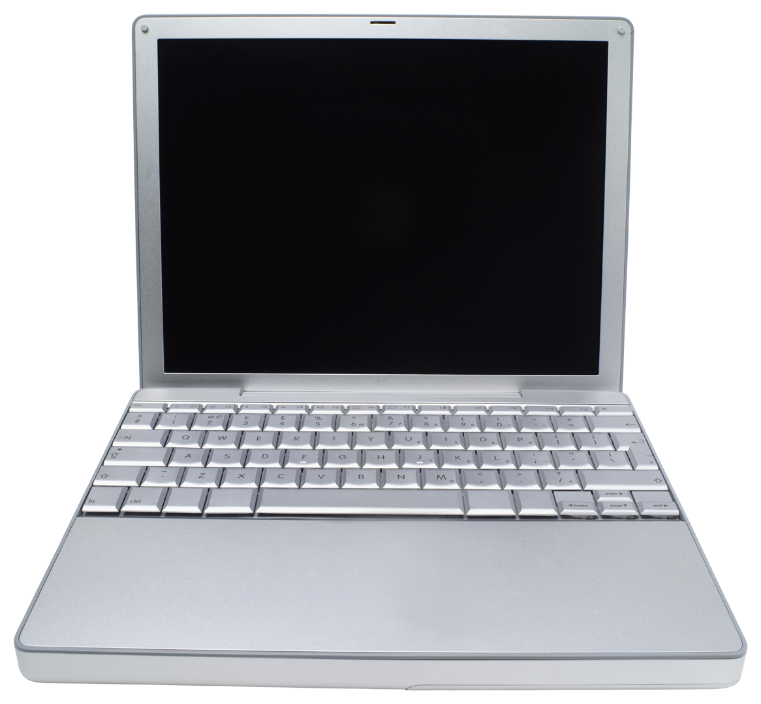
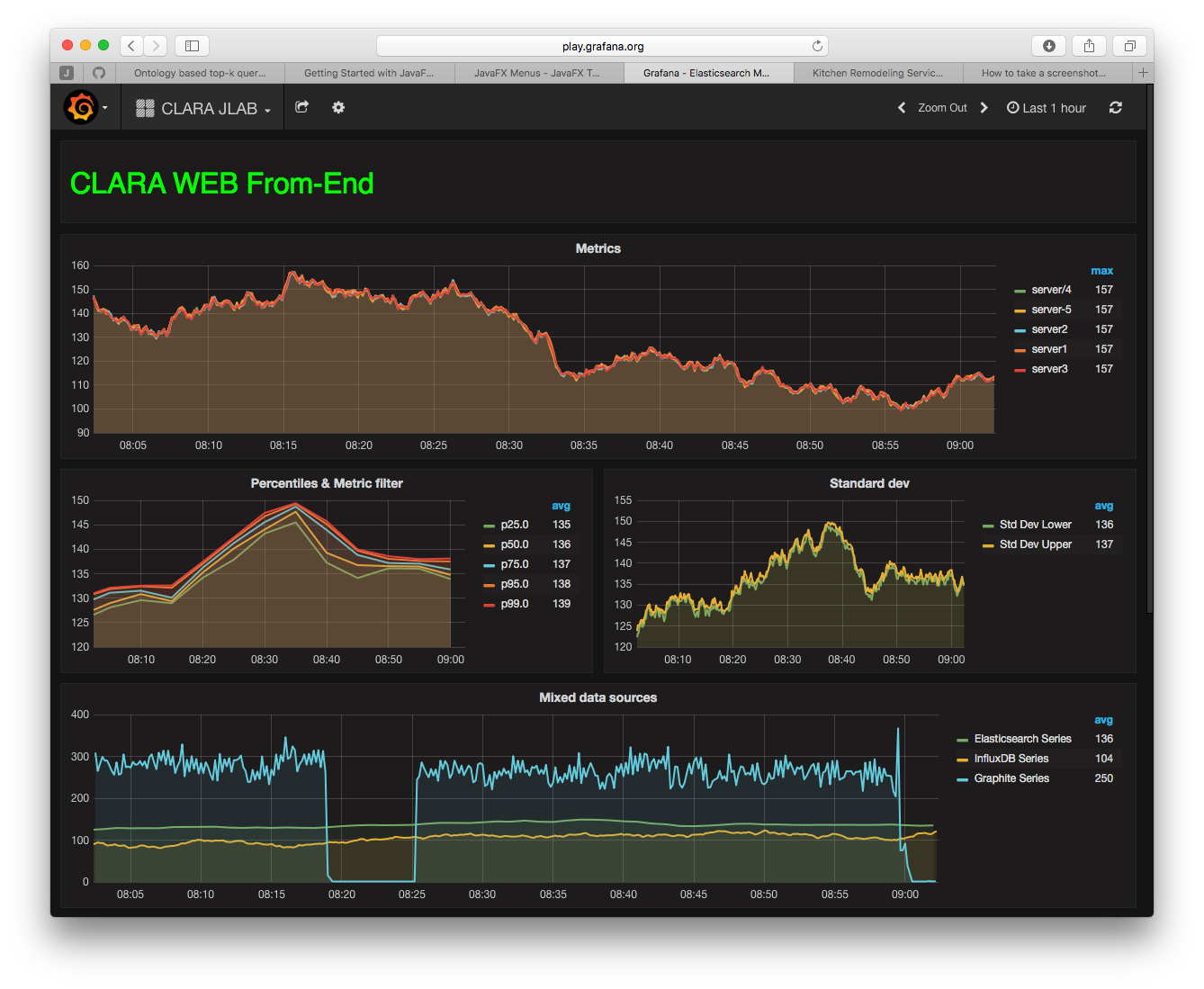
CLARA Distributed Data Processing and Provisioning System
JLAB
LHC
Possible Framework
Data Center 1 (e.g. JLAB)
Service Bus
Data Bus
Data Center 1
Distributed Client Layer
Data Bus 1 (e.g. raw data)
BNL
Data Bus N (e.g. GPD data grid)
Data Bus 1
Service Bus (CLARA services)
Data Bus N
Data communications
Service Bus
CLARA
Front-End
Data Center 2
CLARA
Front-End
Data Center 2
CLARA FE hosts:
Meta-data Database
Data Server
Application Server
Web Server (JNLP support)
Data Visualization Server
Application Design, Service upgrade
Data Center N
CLARA Cloud
Data Center N

Slide 34
Summary
Precision studies of DVCS in polarization measurements give access to GPDs and enables quark spatial imaging, and relate to the quark spin distribution and orbital angular momentum.
Precise measurements of SIDIS give access to TMDs and quark momentum tomography, and relate to the quark orbital angular momentum.
Unprecedented data quality with CEBAF 6 GeV and 12 GeV
Need Robust Framework for 3D PDFs extraction and Validation Framework

Slide 35
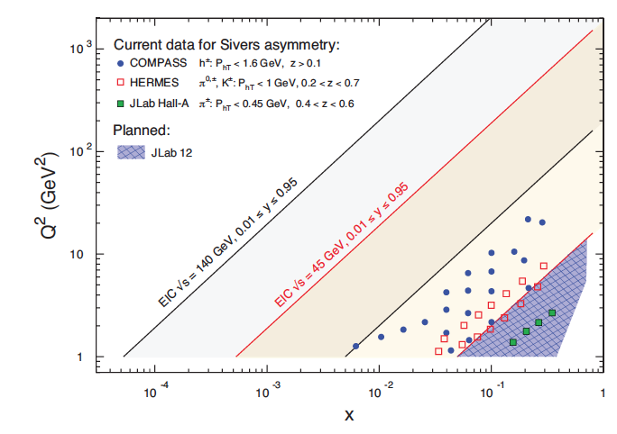
Nucleon 3D imaging (EIC)
(See next talk)
Kinematic coverage in x and Q² for electron machines.

