Slide 1

The green revolution.
How energy usage is shaping future accelerators
G. Ciovati
Perspectives on Superconducting RF
Jefferson Lab May 19th 2014

Slide 2

Outline
Climate change
Energy production
Accelerator Driven Systems
Carbon-neutral accelerator facilities: ESS
  Cavities
  RF power
  Cryogenics
Improving the efficiencies of SRF Accelerators

Slide 3
IPCC 5th Assessment Report
The Intergovernmental Panel on Climate Change (IPCC) is the international body for assessing the science related to climate change
The IPCC works by assessing published literature. It does not conduct its own scientific research
IPCC Assessment Reports cover the full scientific, technical and socio-economic assessment of climate change.
Source: http://www.ipcc.ch/report/ar5/

Slide 4
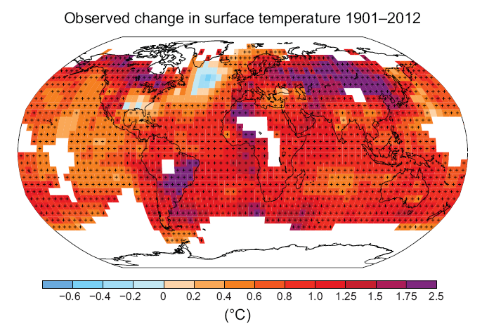
Observed changes in the climate system
“Warming of the climate system is unequivocal, and since the 1950s, many of the observed changes are unprecedented over decades to millennia. The atmosphere and ocean have warmed, the amounts of snow and ice have diminished, sea level has risen, and the concentrations of greenhouse gases have increased”
Source: IPCC, 2013: Summary for Policymakers. In: Climate Change 2013: The Physical Science Basis. Contribution of Working Group I to the Fifth Assessment Report of the IPCC [Stocker, T.F., D. Qin, G.-K. Plattner, M. Tignor, S.K. Allen, J. Boschung, A. Nauels, Y. Xia, V. Bex and P.M. Midgley (eds.)]. Cambridge University Press, Cambridge, United Kingdom and New York, NY, USA.

Slide 5
Understanding the Climate System and its Recent Changes
“Human influence on the climate system is clear. This is evident from the increasing greenhouse gas concentrations in the atmosphere, positive radiative forcing, observed warming, and understanding of the climate system “

Slide 6
Consequences
“Continued emissions of greenhouse gases will cause further warming and changes in all components of the climate system. Limiting climate change will require substantial and sustained reductions of greenhouse gas emissions. “
By the end of 21st century, over most land areas:
Warmer and/or more frequent hot days and nights: virtually certain (>99%)
Increased frequency and intensity of heat waves: very likely (>90%)
Increase in the frequency, intensity, and/or amount of heavy precipitation: very likely
Increases in intensity and/or duration of drought: likely (>66%)
Increases in intense tropical cyclone activity: More likely than not (>50%) in the Western North Pacific and North Atlantic
Increased incidence and/or magnitude of extreme high sea level : very likely

Slide 7
International Energy Outlook 2013
Annual publication from U.S. Energy Information Administration (www.eia.gov)
Key findings:
With world GDP rising by 3.6 percent per year, world energy use will grow by 56 percent between 2010 and 2040. Half of the increase is attributed to China and India.
Renewable energy and nuclear power are the world’s fastest-growing energy sources, each increasing by 2.5 percent per year; however, fossil fuels continue to supply almost 80 percent of world energy use through 2040.
Given current policies and regulations, worldwide energy-related carbon dioxide emissions are projected to increase 46 percent by 2040, reaching 45 billion metric tons in 2040.

Slide 8
Electricity generation and CO₂ emissions
Source: EIA, International Energy Outlook 2013

Slide 9
Accelerator-driven subcritical systems
Neutrons necessary to establish a fission chain reaction are knocked out of a spallation target by high-energy protons from an accelerator
  Nuclear-waste transmutation
  Electricity generation from thorium, uranium or spent nuclear fuel
R&D on ADS are ongoing mostly in China, India and Europe

Slide 10
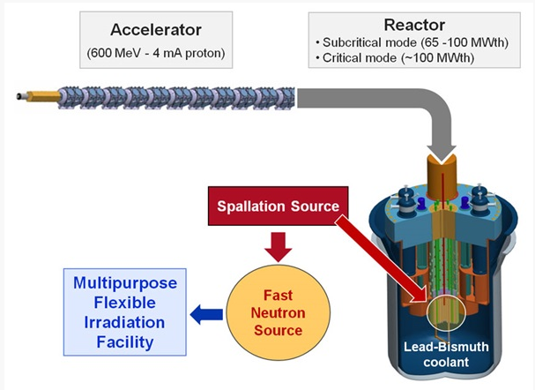
MYRRHA Project
Construction: 2017-21, commissioning 2022-24, full power operation in 2025
SRF, CW, proton Linac

Slide 11
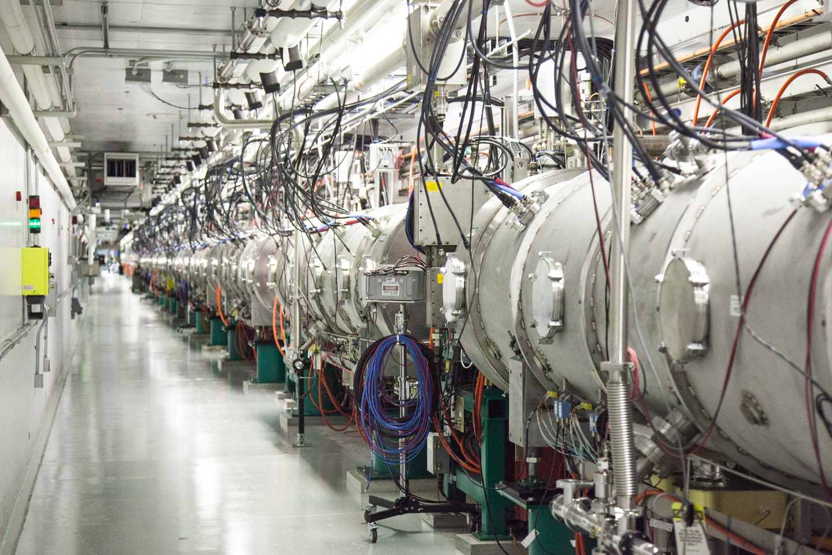
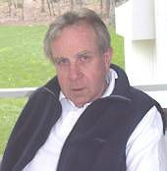
The first SRF proton Linac…
SNS at Oak Ridge: 1 GeV, 26 mA pulsed accelerator, operational since 2002
Superconducting section built at Jefferson Lab
SRF cavities R&D effort led by…

Slide 12

Workshops on ADS
International Workshops on Accelerator-Driven Sub-Critical Systems & Thorium Utilization since 2010:
http://www.phys.vt.edu/~kimballton/gem-star/workshop/index.shtml
http://www.ivsnet.org/ADS/ADS2011
3rd workshop to be held in Richmond, Virginia, Oct. 14-17 2014 http://www.adsthu.org

Slide 13
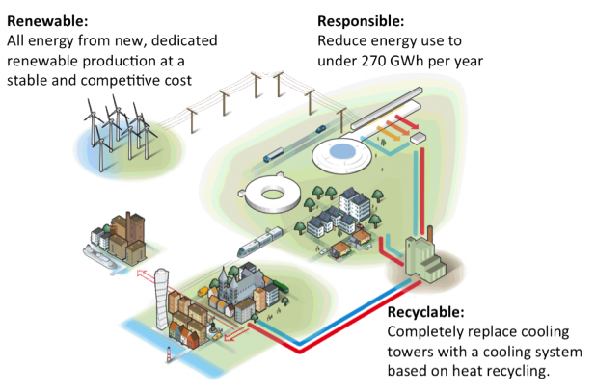
The world’s first carbon-neutral accelerator facility
2 GeV, 5 MW pulsed SRF proton Linac for the European Spallation Source
Scheduled for operation at 1 MW in 2019, 5 MW in 2025
Source: http://europeanspallationsource.se/

Slide 14
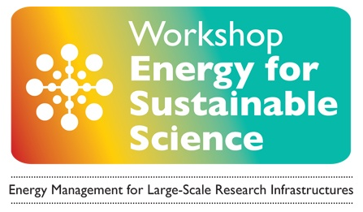
Energy for sustainable science workshops
identify the challenges and best practice in respect of energy efficiency and optimization, solutions and implementation
review the challenges represented by potential future technical solutions
1st Workshop: Oct. 13-14, 2011 in Lund Sweden (http://europeanspallationsource.se/energyworkshop)
2nd Workshop: Oct. 23-25, 2013 at CERN (https://indico.cern.ch/event/245432/other-view?view=standard)

Slide 15
Improving efficiency
Progress towards increasing efficiency in SRF accelerators:
  ↑ efficiency of cryogenic plants (“Ganni cycle”)
  ↑ efficiency of RF sources
  ↑ efficiency of SRF cavities (high Q₀ by doping)

Slide 16
Improved Helium refrigerator systems efficiency
He refrigeration systems are usually designed for one maximum capacity operating point.
Many systems are operated continuously at maximum capacity unnecessarily by wasting capacity with throttling valves, adding load with heaters and/or bypassing capacity
The majority of system losses occur in the compressor system inefficiencies
A process cycle which can support system loads from ~50% to ~100% of the maximum capacity while maintaining the highest possible efficiency was patented by Rao Ganni in 2008 (Floating pressure process – Ganni cycle)
The Ganni cycle provides up to 20% increase in efficiency for 4.5 K refrigeration or liquefaction and a 15% increase for 2 K refrigeration over traditional cycle design efficiencies
Source: R. Ganni, presentation at Jlab, Feb. 22nd 2011

Slide 17
Floating pressure process
Gas management valves establish how to respond to a given load
The compressor and expander establish an essentially constant pressure ratio and system Carnot efficiency

Slide 18
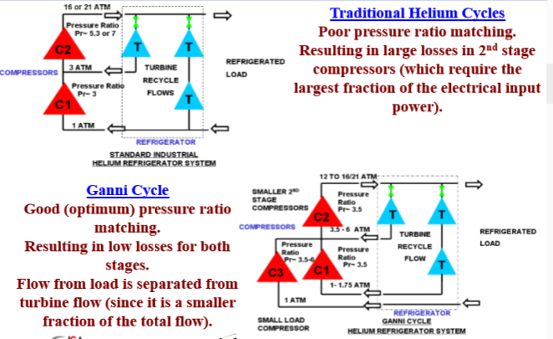
Ganni Cycle

Slide 19
RF Sources Efficiency
Development of MW-class IOT for ESS (704 MHz)
  smaller than a klystron
  High efficiency at operation point
  Cost typically does not scale strongly with output power
  Low power consumption in standby or for reduced output power
  No need to pulse HV for pulsed operation
M. Jensen, 2nd Workshop on Energy for Sustainable Science, CERN, Oct. 23-25th 2013
Development of high-power injection-locked Magnetrons for SRF cavities (JLab, FNAL, Muons, Inc.)
  Higher efficiency than klystrons and IOT
  Lower cost
A. C. Dexter et al., Phys. Rev. ST-AB 14, 032001 (2011)
G. Kazakevich et al., http://arxiv.org/abs/1402.6249

Slide 20
Efficiency of SRF cavities
History of high-Q at 2 K and low RF field in L-band cavities
ILC, at134 mT
CEBAF Upgrade, at 70 mT
CEBAF at 26 mT
Q₀(2 K) typically degrades to 1-2×10¹⁰ above ~20 MV/m

Slide 21
↑ Efficiency SRF cavities
Heat treatment study of ingot Nb cavities in custom built furnace led to the achievement of Q₀(2 K)>3x10¹⁰ at 1.5 GHz and 20 MV/m gradients
P. Dhakal et al., Phys. Rev. ST-AB 16, 042001 (2013)

Slide 22
↑ Efficiency SRF cavities
Heat treatment of Nb cavities in N₂ atmosphere followed by “light” EP led to the achievement of Q₀(2 K)>3x10¹⁰ at 1.3 GHz and 20 MV/m gradients
A. Grassellino et al., Supercond. Sci. Technol. 26, 102001 (2013)

Slide 23
Conclusions
Climate change will have a significant negative impact on human society by the end of the century
Global greenhouse gas emissions are projected to increase by ~50% by 2040
ADS are being considered to reduce our society’s dependence on fossil fuels
Improving efficiency is an obvious way to lower emissions and new solutions are being developed and applied to SRF accelerators
Thanks to Peter Kneisel for his career-long contribution to SRF which allowed this technology to become widely used in present and future accelerators for fundamental and applied science.

