Slide 1
What's left to understand about SRF?
Hasan Padamsee
Cornell University
(soon to be…Fermilab)

Slide 2
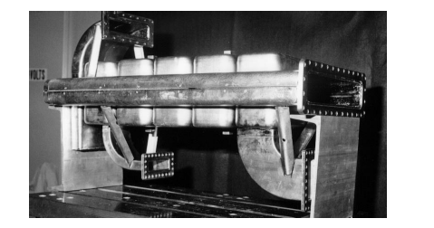
First, Some Remarks about Peter
I had two occasions to work with Peter,
One short in 1978
And one long between 1981 – 1987
At Cornell Peter worked on Muffin-Tin Cavities for high energy synchrotrons

Slide 3
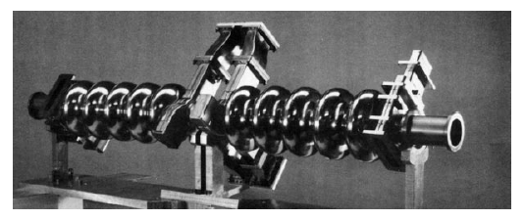
And Elliptical Cavities
For Storage Rings
  Peter invented elliptical cavities at Karlsruhe
Later adopted as the basis for CEBAF
  Performance 5 – 8 MV/m

Slide 4
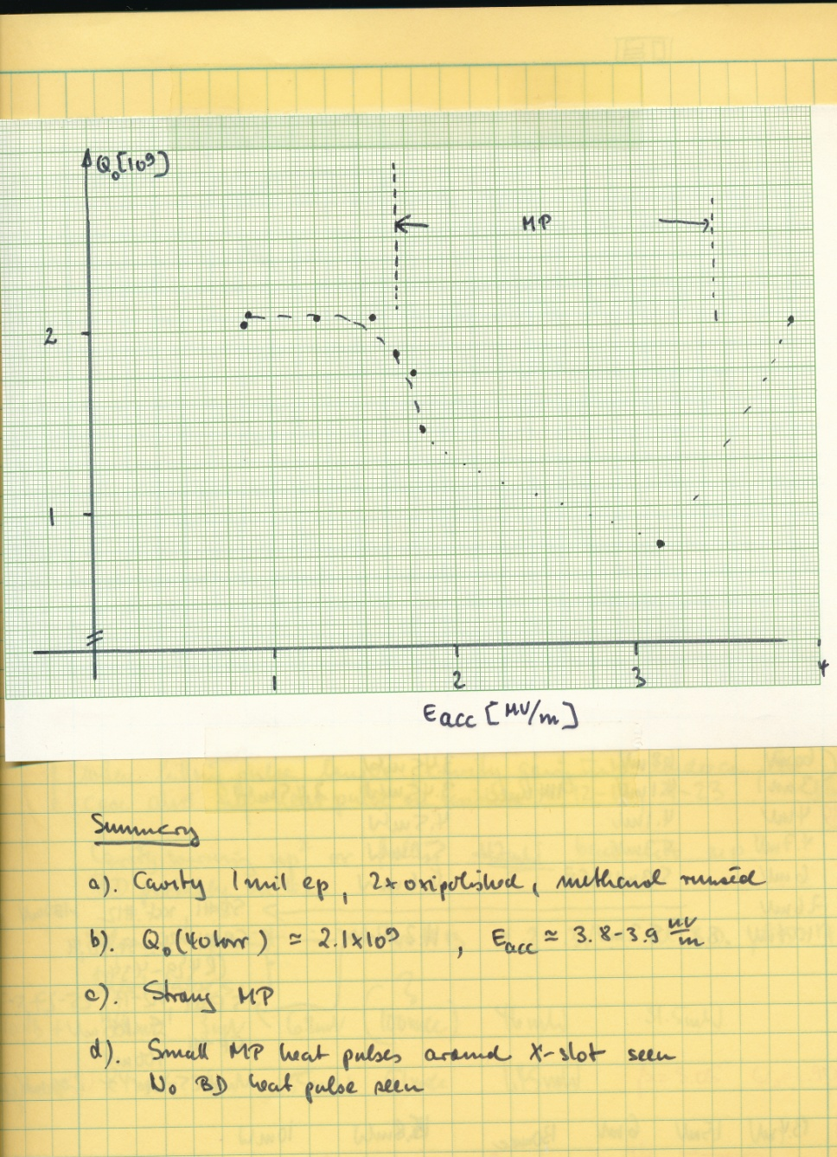
A Page from the Past (1982) :
Peter’s Logbook
At the time, Muffin-Tin cavities showed very colorful behavior!
  Multipacting, thermal breakdown, field emission.
Peter played a MAJOR role in understanding and solving all such problems

Slide 5
Peter’s Impact
Throughout his career Peter always pushed hard –
To help advance the field
Both for basic understanding and for projects
He has consistently been a driving force
Asking the tough questions, breaking barriers, opening new pathways.

Slide 6
So, What Remains To Be Understood?
Has Peter left us anything to work on?
Much work has been done to understand the topics I will cover
Many explanations have been put forward.
So I cannot say categorically that these phenomena are “not understood”
  Because many believe they understand some of this stuff
But is the understanding universally accepted?
Mostly NOT
That is why I pick these topics, as
“remain to be understood”
My apologies if I don’t show all the possible “explanations” put forward, just some.

Slide 7
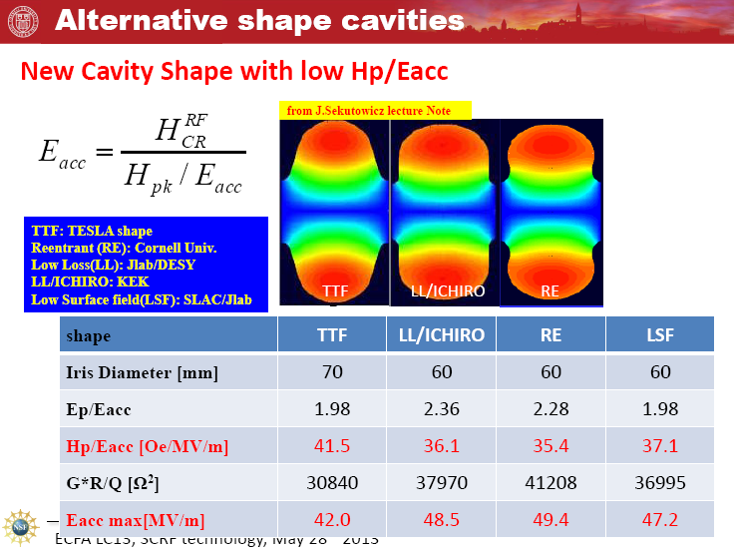
1) Why can’t we get to 50 MV/m in
Multicell cavities of the “winning” shapes ?
Peter promoted the Low Loss shape with Jacek
Is it all just practical problems?
  Or Project distractions?
Is there something fundamental?
Single cell cavities perform fantastic!

Slide 8
Hpk > 190 mT
E_{pk} > 120 MV/m

Slide 9
Best Single Cell: Cornell/Rongli
58 MV/M !!
H_{pk} > 200 mT
E_{pk} > 130 MV/m

Slide 10
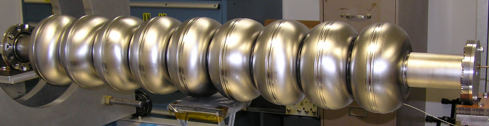
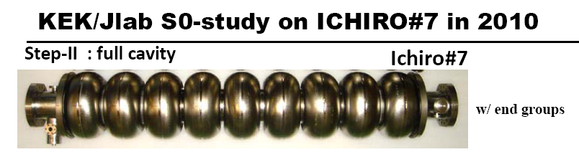
Cornell Re-Entrant 9-cell # 1
Advanced Shape Multi-Cell Cavities

Slide 11
Guiding Philosophy for Shapes:
Lower Hpk even if you have to raise Epk
Was that a mistake?

Slide 12
So Field Emission X-rays Swamp Performance

Slide 13
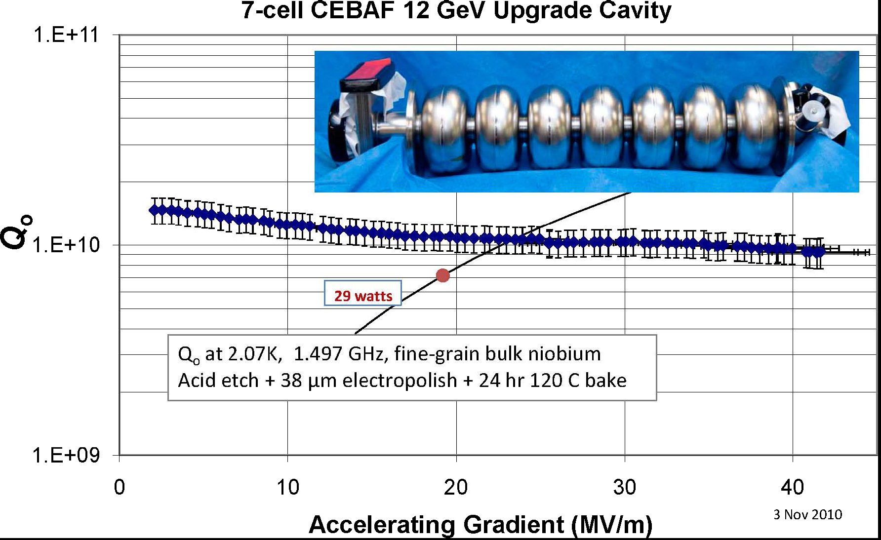
42 MV/m Demonstrated With

Slide 14
How to get rid of Field Emission?
Peter demonstrated this powerful weapon against Field Emission!
HPR at 100 bar
Is HPR at 100 bar good enough to get rid of FE above Epk > 100 MV/m?
OR
Should we get serious about other FE reduction methods, like snow cleaning?

Slide 15


2) Is Hc1relevant to good rf performance?
What is Hc1 for 120 C Baked Nb?
Baking decreases electron-mean-free-path
So λ increases, ξ decreases
=> κ increases
Hc1 goes down from 180 mT to about 100 mT
Best cavities show high Q to Hpk > 190 mT
=> Hc1 is not relevant to rf performance (high Q)

Slide 16



Muon Spin Resonance Penetration Depth Measurements (Fermilab)
Effect of 120 C Baking
EP 120 um + BCP 10 um finish EP 120 um
~15 nm - no
EP 120 um + 120C bake
screening
Nitrogen treatment
1.0
mfp ~ 2 nm at the surface,
increasing deeper
120 C Bake
Kappa increases from
1.5 to about 3
Hc1 goes down
To about 100 mT
0.5
mfp~40 nm
mfp > 400 nm
0.0
Ba = 25 mT
0 20 40 60 80
Average depth (nm)
Fit by Gaussian model for the field at the muon site – approximate, qualitative comparison

Slide 17
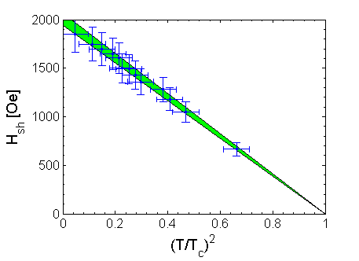
Fundamental RF Critical Field Measurement
N. Valles Cornell
Hrf-crit >> Hc1
Hrf-crit ~ Hsh
Hc1 (T)
Eacc (max) = 2000/35.4 = 61 MV/m !!

Slide 18
3) What is/are the causes of low-field, medium field and high field Q-slopes…
Are they related?

Slide 19
A Promising Model
Several possible answers have been proposed
  Apologies if I don’t pick your favorite one
But the basic question is still unanswered - to everyone’s satisfaction
A promising model is that Medium and High Field Q-slopes arise from a “mild” form of the H-Q-Disease
Nb-H islands form but are Superconducting due to their proximity with Nb

Slide 20
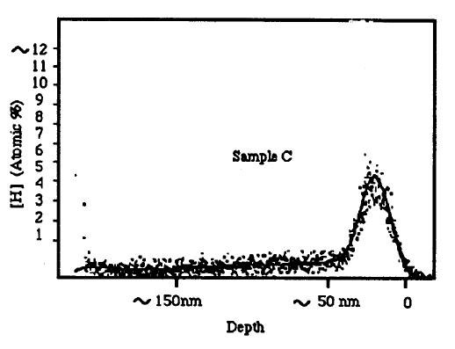
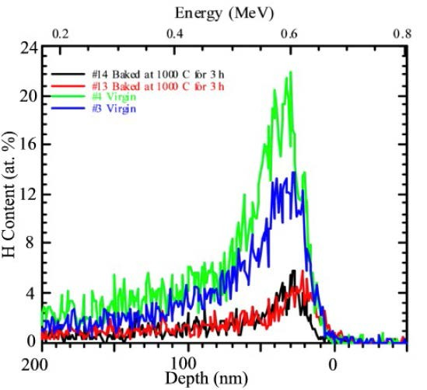


1) H Always gets into Nb
2) H is Enriched at the surface
Neither standard 800C degassing
nor “fast” cooldown make Nb completely free of H
C. Antoine et al, SRF’01
Near-surface H-rich layer is still there after standard H degassing treatments

Slide 21
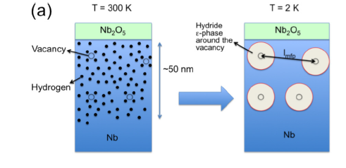

Near surface H forms Nb-H on cool-down
Electron Mean free path is large
BCS Q is based on long mean free path
Cool down

Slide 22
High and Medium Field Q-Slopes
RF Losses of SC islands increase with increasing rf field (proximity effect gets weaker)
  Medium Field Q-slope
Largest island becomes normal at the onset field
  High field Q-slope starts
Smaller islands remain SC but increase losses with field
  Continued Medium field Q-slope

Slide 23













120 C Baking Effect
Vacancies trap H, Prevent Nb-H formation
Effect of 120C baking
Oxide
Oxide
~50 nm
Free interstitial hydrogen
120C
baking
T= 300K T= 300K
A. Romanenko, C. J. Edwardson, P. G. Coleman, P. J. Simpson, Appl. Phys. Lett. 102, 232601 (2013)

Slide 24







Effect of 120C baking
Cool down of 120C baked niobium Oxide Oxide
Hydrogen trapped
Only small hydrides can form
Small Hyrdides remain SC to high field
No HFQS
MFQS still present due to deteroioration of proximity effect with rf field
T= 300K T= 2K

Slide 25
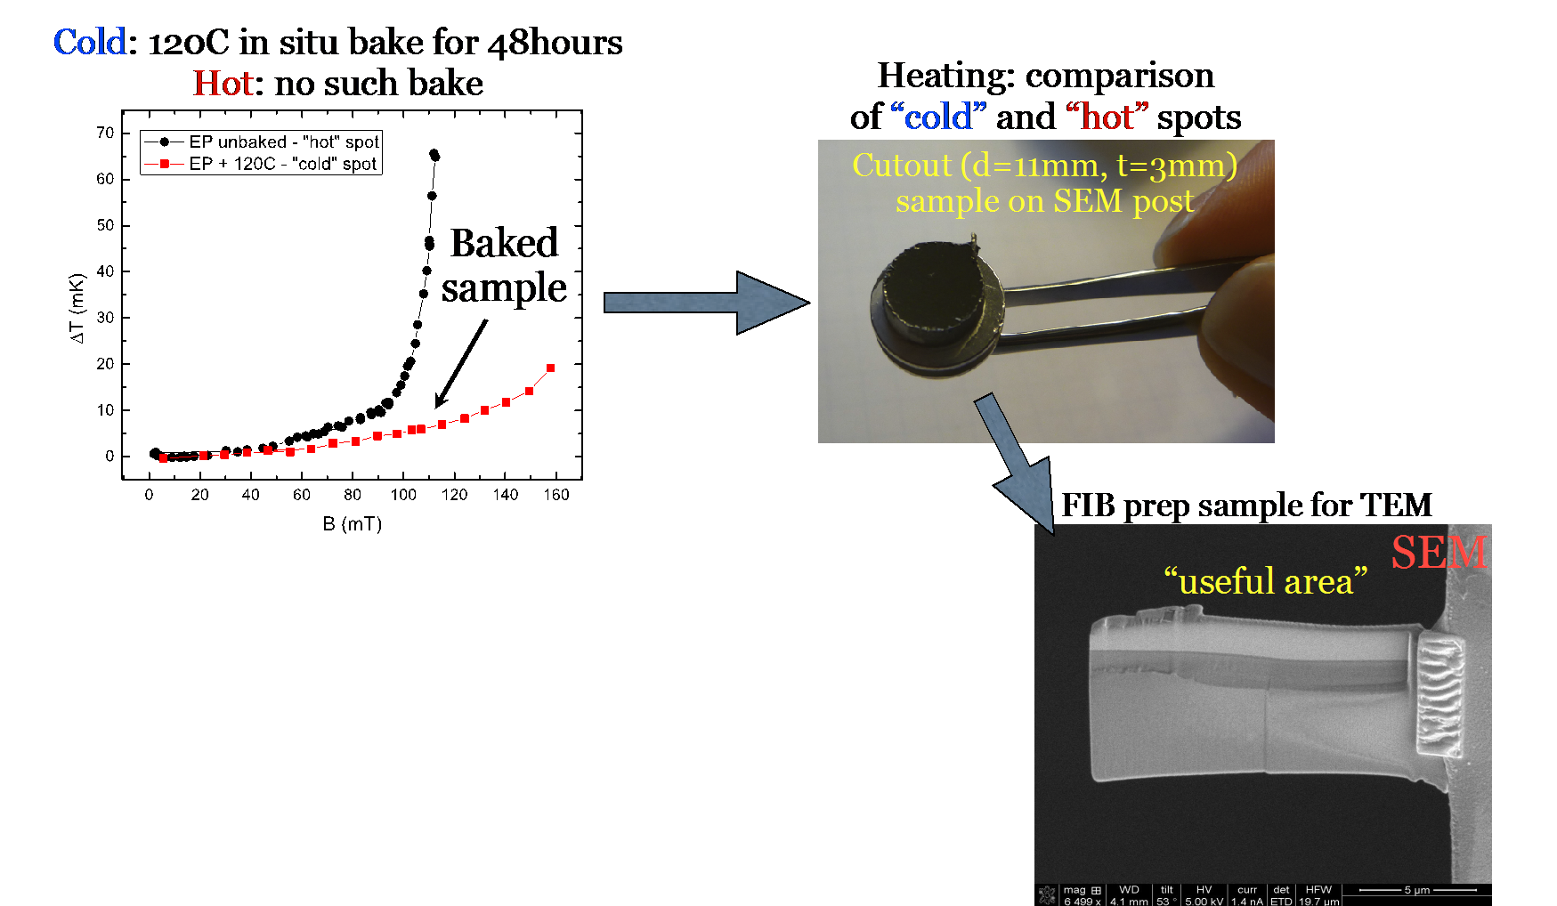
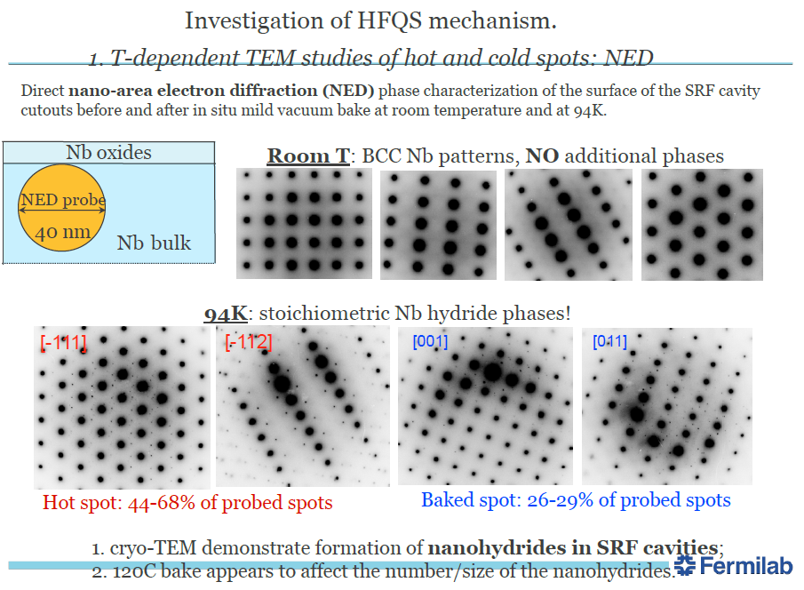
120 C Bake Inhibits Nb-H formation
Romanenko (SRF 13)
Substantial reduction of Hydride formation after 120 C Bake

Slide 26
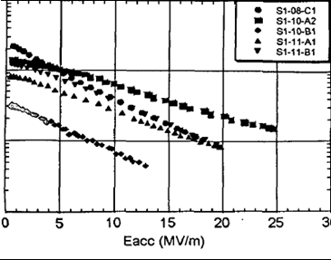

4) What is the cause of the Q-slope for Nb-Cu?
How can we get rid of that nasty Q-slope?
  Bulk Niobium:
      grains ∅>~ 100 µm to mms, good crystallographic quality
  Niobium ~1-5 µm/Copper :
      ∅ <~ 100 nm, many crystallographic defects, grain boundaries…
      good low field performances (thermal configuration and cost)
  It is changing !!!: New emerging thin films techniques
Typical sputtered Nb cavities
1.5 GHz
Typical bulk Nb cavity
1.3 GHz

Slide 27
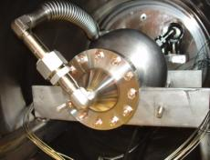
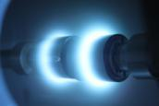
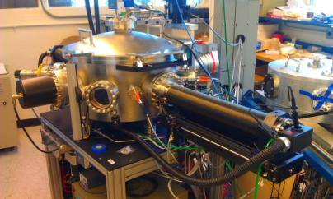
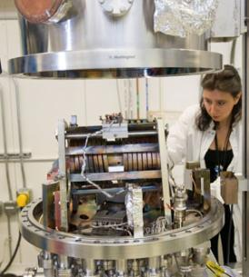
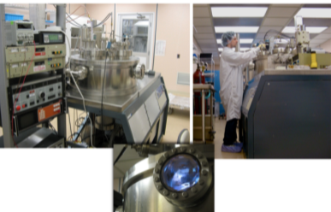
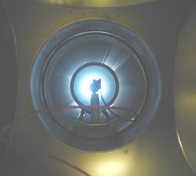
5) Will the new coating methods of high energy deposition get rid of that nasty Q-slope???? Jlab and others
Cavity ALD at ANL
High-impulse deposition at LBNL
Film deposition at JLab
CED at AASC, 1st coated Nb-Cu cavity in hand, 2012

Slide 28
6) What is the correct BCS prediction for Rs vs Hrf?
Gurevich predicts Non-linear BCS
Q should go down at high rf fields
    Δ(v_{s}) = Δ − p_{f} |v_{s}|=> decreased gap =>
    R_{s} = R_{s0}(1+C(Δ/T)²(H₀/H_{c})²)
Xiao predicts Q should go up!
Surprise - Q increase found!

Slide 29
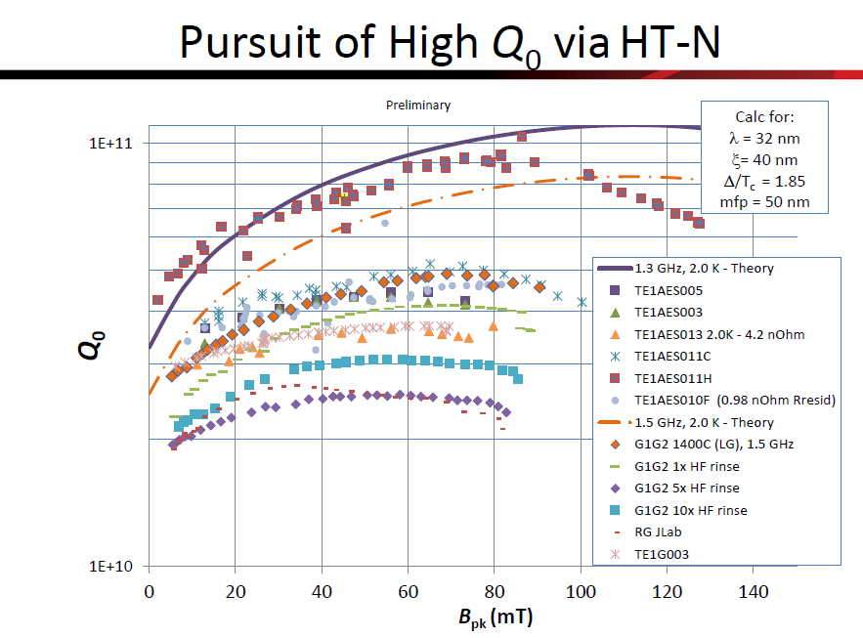

Slide 30
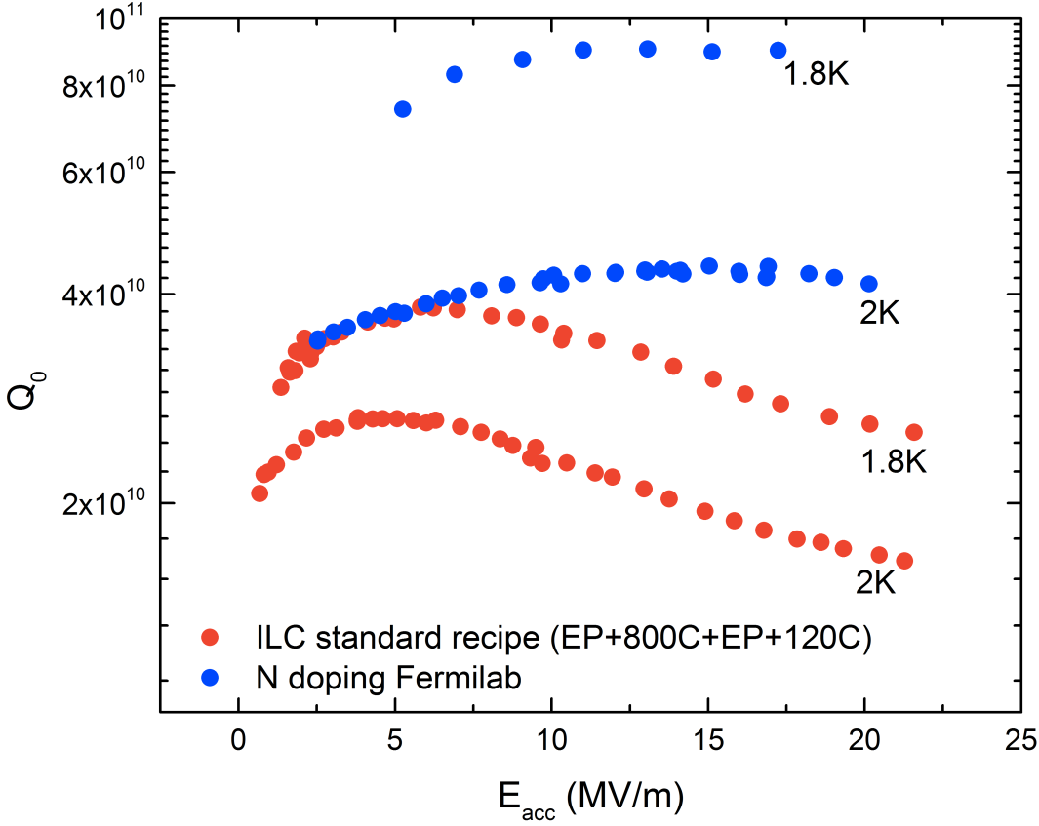
N and Ar Doping

Slide 31
7. What is the cause of the Q-improvement with HT followed by
N-doping, Ar-doping, Ti-doping?
Clue: There is a thin layer (μm) of Nb below oxide layer that has the magical high Q properties
Material removal in excess of the ideal amount destroys the “good layer”.
What is the magic?
N, Ti, or Ar Interstitials???

Slide 32
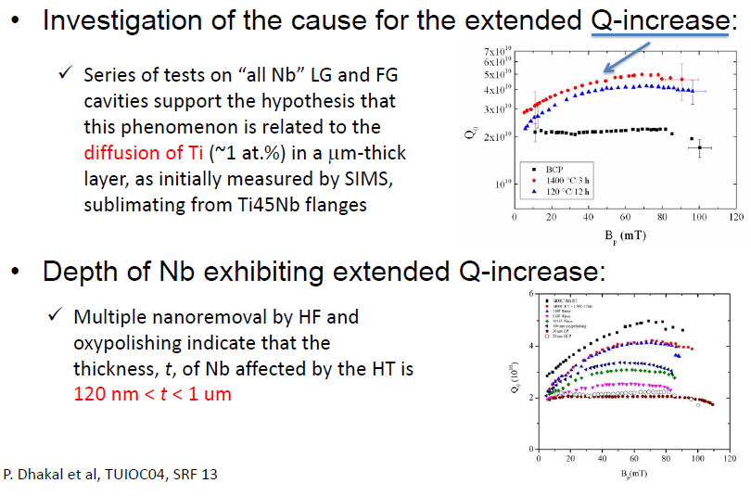
l

Slide 33
Possible Model for N-Doping Effect
Ideal BCS Nb Behavior
a la Xiao
Onset of Medium Field Q-Slope
Due to Smaller Nb-H islands (Romanenko)
N-doping inhibits formation of all Nb-H
Bringing Nb to ideal behavior

Slide 34
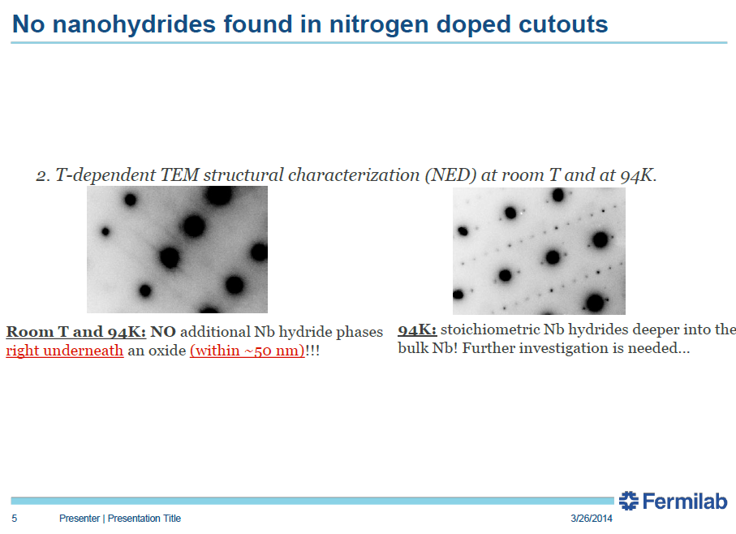
Romanenko (Fermilab)
Reported at TTC
No Nb-H found to 50 nm below oxide layer
Interstitials present here prevents formation of small Nb-H
Nb-H phase found only below 50 nm
Not enough intertitials present down here to prevent formation of Nb-H?

Slide 35
8. Is there any material out there which can reach higher gradients than Nb?
What is the potential for HiTc?

Slide 36



Generalities about HiT_{c} Materials
Attraction: Higher T_{c} means potential for higher H_{c}
Concerns: Hi T_{c} means smaller coherence length and thus greater sensitivity to small defects
Also watch the energy gap, some new materials have small gaps, ∆ which means lower Q for a given temp
Also may have difficult phase diagram and difficult mechanical properties…….

Slide 37
My Ranking
HTS (candidates in order of increasing attraction)
  YBaCuO - Reject- Has nodes in energy gap
  => Q will be low
  MgB2 – Questionable advantages
    Two energy gaps, lower gap is less than Nb3Sn gap, so surface resistance will be higher
    Hc ranges from 0.26 – 0.6 (Nb, Hc = 0.2, Nb3Sn Hc = 0.4)
  Pnictides – very new (e.g. LaOFeAs) & ceramic like
    Tc best 50 K, some evidence for S-wave gap ∆~ 8mev (Nb3Sn, ∆= 3.3mev) Could lead to high Q
  Sorry to be so pessimistic, but facts are facts
Only Nb3Sn shows encouraging results

Slide 38
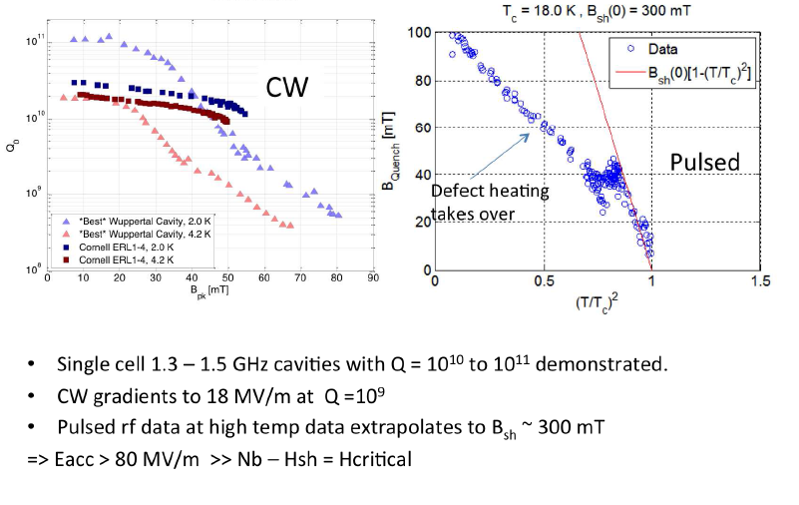
Hail Nb₃Sn!

Slide 39
To Conclude
With all these unanswered questions
Peter, do you still really want to retire?
Take it from a professional retiree
What did I miss the most when I retired?
So…..I wish you the best
Find something else to be passionate about
as you always have been about SRF

