Slide 1
Industrialization of SRF:
How the European XFEL is revolutionizing the industrial base for SRF production
Michael Peiniger
RI Research Instruments GmbH
Friedrich-Ebert-Str. 1
51429 Bergisch Gladbach
Germany

Slide 2
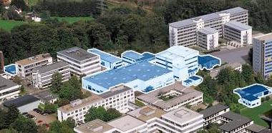
RI Research Instruments GmbH
Development, production and sales of rf accelerator components and systems and special manufacturing projects
Former activity of Interatom/Siemens (80‘s to mid 90‘s) and ACCEL Instruments (mid 90‘s to 2009, since 2007 daughter company of Varian Medical Systems), since 2009 majority owned by Bruker Corp.
More than 3000 Person Years of accumulated KnowHow and about 0,4 Bio € of business volume since 1985
About 150 Employees, 30% Engineering & Project Management, 60% Manufacturing
RI Research Instruments GmbH in the
Technologiepark Bergisch Gladbach
51% of shares by Bruker EST, Inc.
RI management holding a significant equity stake of the company
Worldwide acknowledged as an advanced technology engineering and manufacturing specialist

Slide 3
Technologies, „Products“ and Markets
Quality Management certified according to DIN EN ISO 9001:2008, KTA
Technologies
RF, Accelerator, Electromagn
Superconductivity
Cryogenics, Vacuum
Precision Manufacturing
Surface Treatment , Coating
Metal Joining
System Integration
Integrated System Control
Projects / Products
Linear Accelerators
Accelerator Modules
RF Cavities, Couplers
Particle Sources
Beamlines and Diagnostics
Special Manufacturing Projects
Markets
Big Science
Medical/ Particle Therapy
Energy/ Nuclear (incl. Fusion,
ADS, Transmutation)
Advanced Technology Industry
(incl. Inspection, Life
Science)
project management - physics layout - engineering - manufacturing – assembly – testing – service

Slide 4
World map of customers and partners
AU
Chalmers
Germany:
DESY
FZ Jülich
HZB (BESSY)
HZDR
Uni Frankfurt
Uni Dortmund
Uni Wuppertal
Uni Mainz
TU München
TU Darmstadt
HMI
MPI
GSI
PTB
Uni Bonn KIT
Daresbury
MaxLab Lund
Budker
CLS
RAL
RUN
Diamond
JU
TRIUMF
WMU
Soleil
Fermi Lab
GANIL
CNRS
CEA
PSI
MSU
CERN
ANL
Cornell
ESRF
ENEA
KAERI
JAERI
LBL
Stanford
BNL
CELLS
TAC
Beijing
KEK
SLAC
LANL
JLAB
IMP
PAL
RIKEN
ORNL
SOREQ
SSRF
NSRRC
NUS
SIRIUS
NECSA
ASP

Slide 5
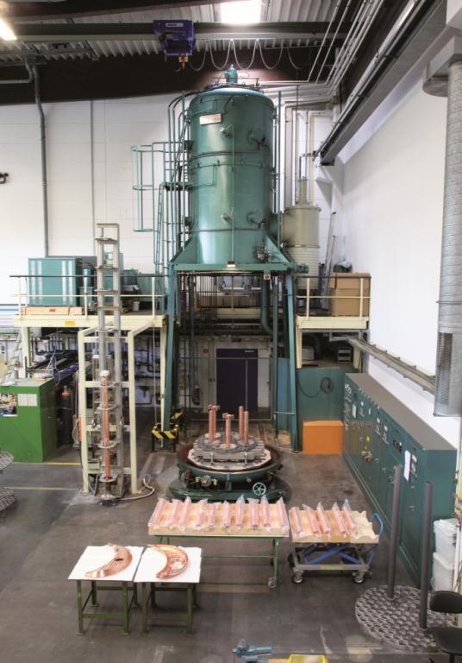
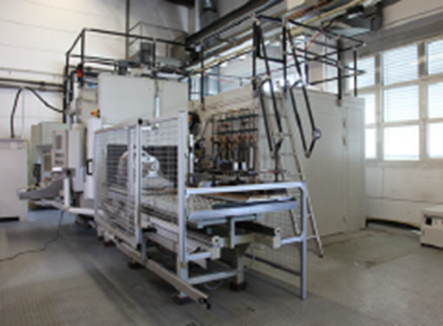
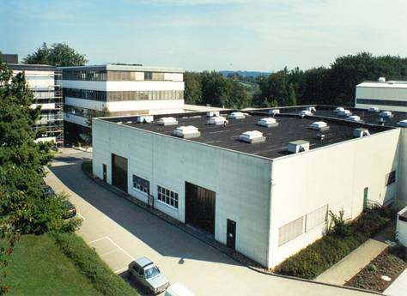
RI‘s specialized manufacturing technologies
Manufacturing technologies:
Turning (CNC)
5 axis milling (CNC)
Metal working
Surface technology (cleaning, etching, coating)
Joining technology (EB, TIG, vacuum brazing)
Heat treatment
Assembly (partly in cleanroom) and testing
RF, vacuum, cryogenic
Quality Control
Electron Beam Welder (1/2)
Brazing Furnace (1/2)
Manufacturing
Premises

Slide 6
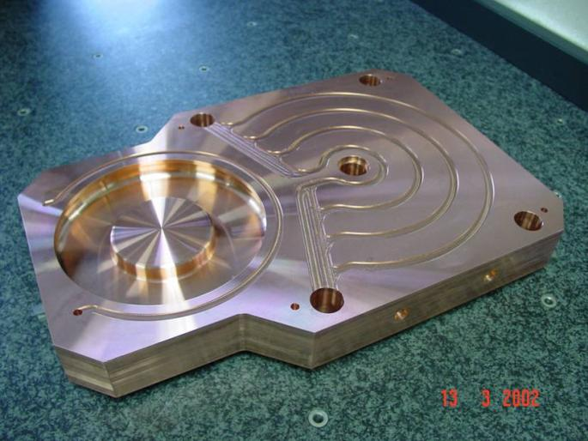
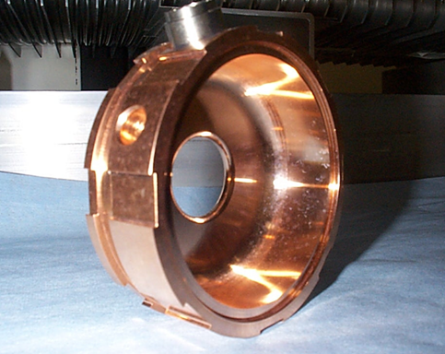
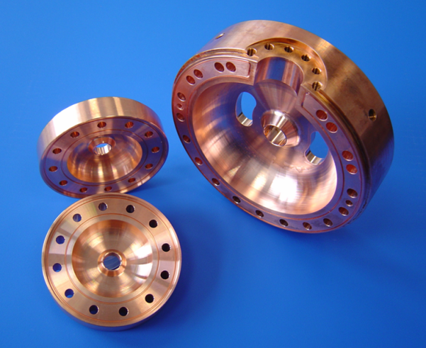
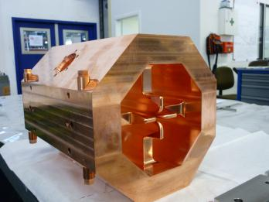
Normal conducting cavity production
800 MHz (SNS), CCL structures
S-Band
2,998 GHz
2,856GHz
C-Band (4,8 GHz)
Notes:
4 short + 1 long pulse generators on one board
easy switching between short and long pulse mode
each short pulse will be triggered individually (by standard digital delay generator)
e.g. Stanford Research 4 Channel digital delay generator (60ps jitter)
easy variation of delay between pulses
long pulse will be chopped (352 MHz)
optical connection of all trigger signals
to high voltage platform
transformer only for heater and electrical power
only semiconductor technology
very good experience concerning lifetime
no cooling required
no pressed air

Slide 7
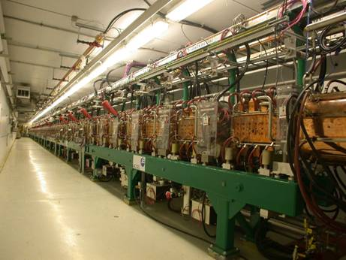
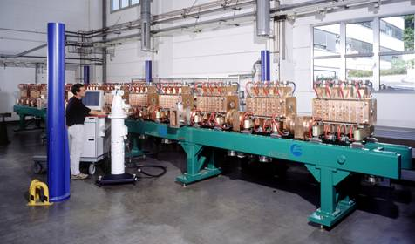
CCL Modules for SNS in Oak Ridge/USA
Normal conducting RF sections
CCL Linac at SNS
Complete CCL-Module during RF Test at RI
We manufactured, assembled, aligned and rf tuned 4 CCL Modules as a Special Equipment Supplier
(Co-operation with LANL)

Slide 8
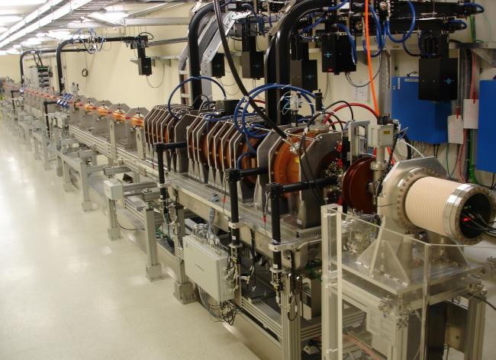
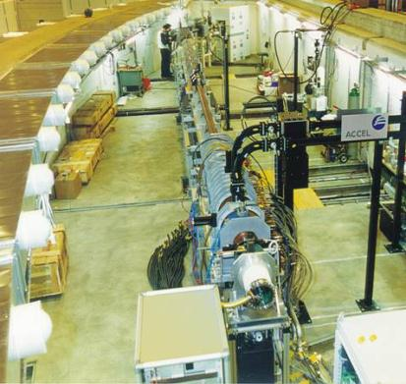
Electron injection linacs for synchrotron light sources
SLS/PSI, CH 100 MeV
DLS, UK 100 MeV
ASP, Australia 100 MeV
PTB, Germany 0,5-50 MeV
Taiwan Light Source 150 MeV
Uni Nijmegen 15 MeV
NSLS-II
(Brookhaven Natl Lab) 200 MeV
New Taiwan Light Source 150 MeV Linac
Swiss Light Source
100 MeV Linac

Slide 9
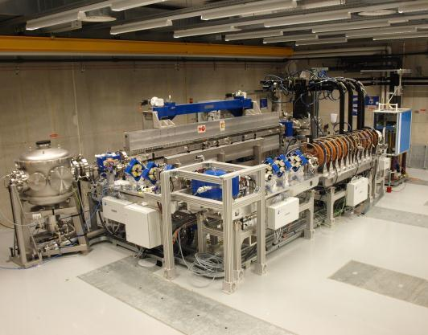
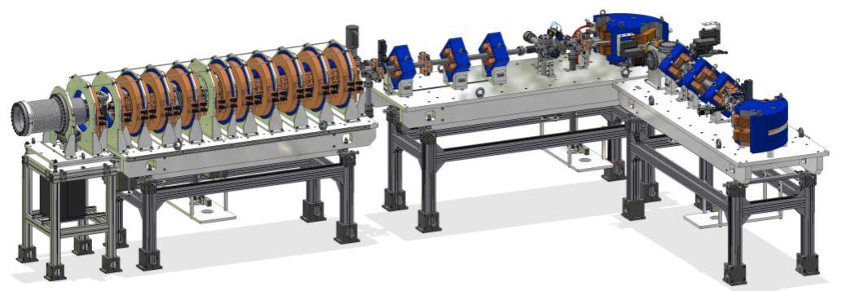
Electron injection linacs for special applications (FEL driver)
Project | Energy | Pulse structure / repetition rate | Charge | Emittance (1σ) / energy spread (rms)
FLARE IR-FEL driver Netherland | Range 10 MeV – 15 MeV | Multi bunch 10 µs, 333 ps bunch spacing / 10 Hz | > 0.2 nC per bunch, 6000 nC per macro pulse | ε_{n} < 50 π·mm·mrad / σ_{E}/E < 0.3 %
The 10-15 MeV Electron Linac drives an infrared FEL (FLARE)

Slide 10
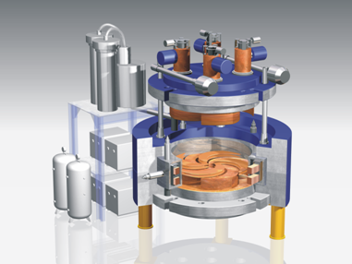
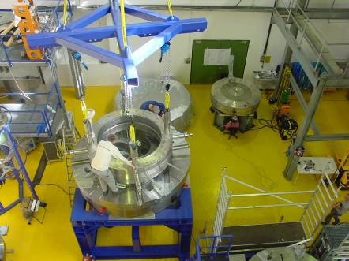
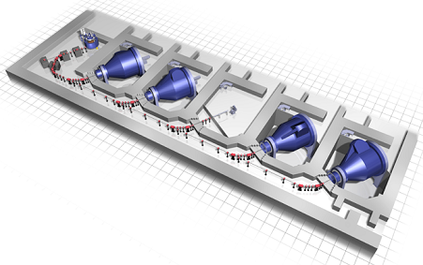
Superconducting 250 MeV Cyclotron for Paul Scherrer Institute (PSI) and RPTC, Munich
Varian Proton Therapy Systems
Gantry Rooms
Eye Treatment Room
S.C. cyclotron
Beam Transfer Line

Slide 11
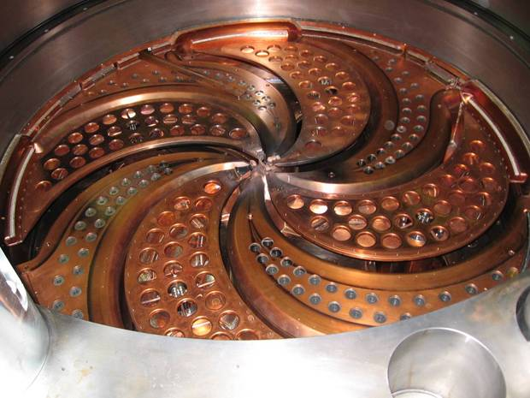
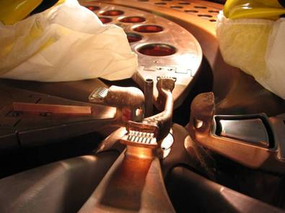
Components and subsystems of a
250 MeV Cyclotron for Varian Medical Systems
Liner, Dee‘s and inner region

Slide 12
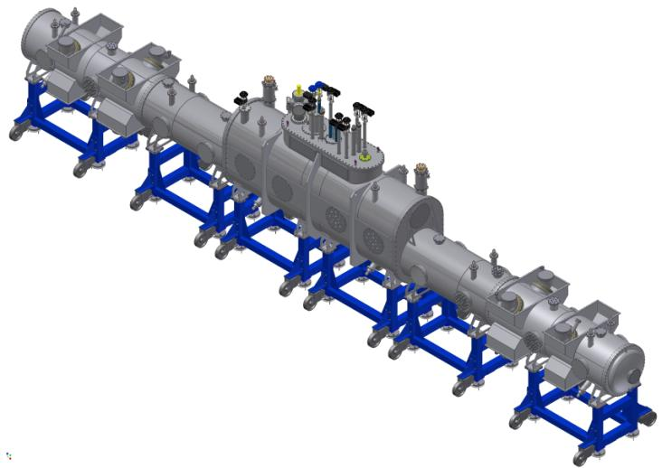
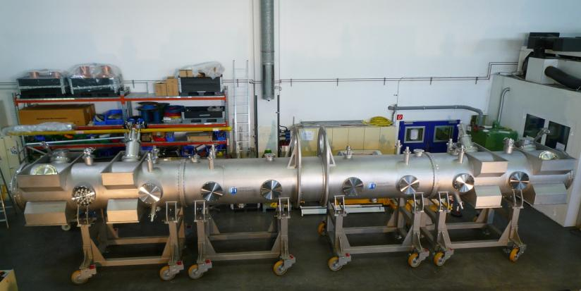
Special Manufacturing – WGTS for KIT
We manufactured, assembled, tested and shipped the demonstrator of the WGTS (windowless gaseous
tritium source), a key component for the KATRIN (Karlsruhe Tritium Neutrino) Experiment
Technologies: Cryogenics, Alignment, Welding, Assembly, Leak Testing, QA, Documentation (Tritium
Laboratory Instructions)
Demonstrator returned from successful acceptance testing from KIT last year. Now preparation of WGTS
assembly and manufacturing of subcomponents at RI. Final assembly of WGTS to start in autumn 2013
Final WGTS: 25 tons, 16 m long, 5 m high, 2 m width
Cryogens used for WGTS: Liquid Neon, Liquid Argon, Liquid Nitrogen, Liquid Helium and gaseous Helium
Demonstrator after testing at KIT Final WGTS

Slide 13
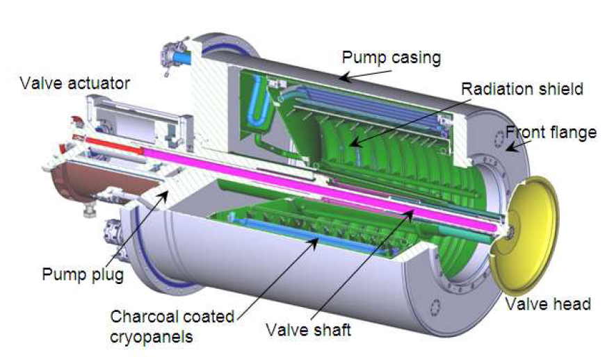
Consortium of RI and Alsyom to build Pre-Production Cryopump for ITER
contract received in October 2012
Pump size: Diameter 1,5 m x 3 m long
8 more pumps needed later for operation of ITER

Slide 14
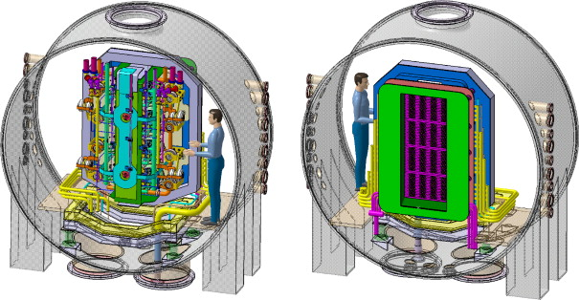
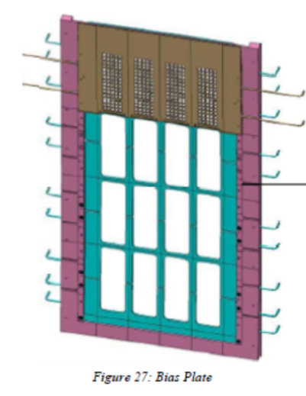
Manufacturing of grids for PVATePla
(DNB Source for ITER)
Scope of RI – Galvano T team:
① 2 pcs prototype grids
② 4 pcs Extraction grids
③ 4 pcs Plasma grids
  5 pcs BIAS Plates
④ 4 pcs grounding grids
  4 pcs soft iron plates
We are now in the status of ordering the copper material for the series and have defined an R&D program for a prototype of the grid.
The prototype study should investigate the connection of the water piping system, the milling accuracy achievable and the electroplating process.

Slide 15

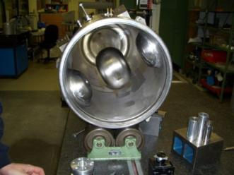
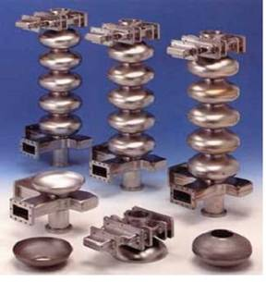
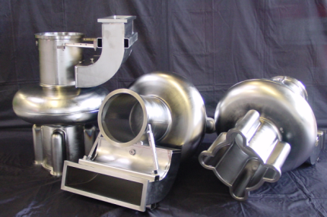
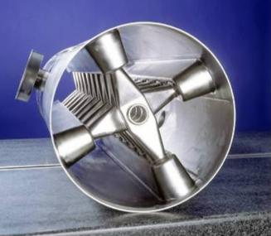
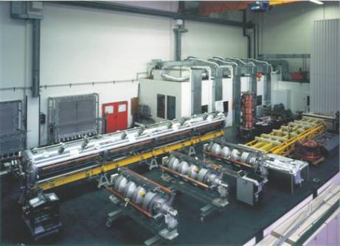
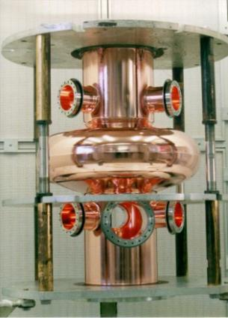
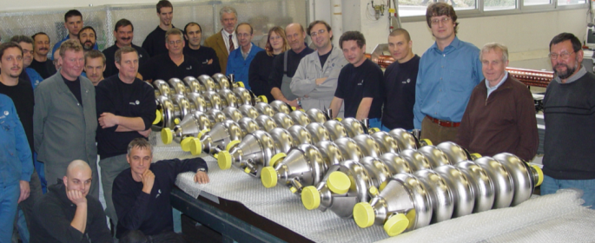
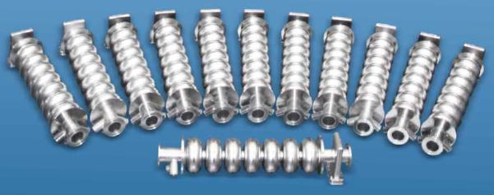
Superconducting cavity production
1200 SRF cavities produced so far, 40 SRF cavities/year in average over the last 25 years (Siemens, ACCEL, RI). RI is the world leader in SRF cavity manufacturing

Slide 16
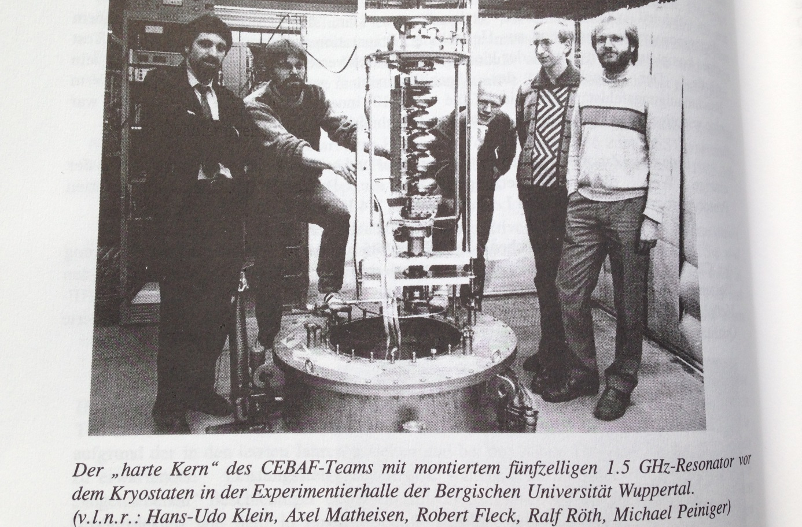
Vertical testing of a CEBAF cavity (1986)

Slide 17
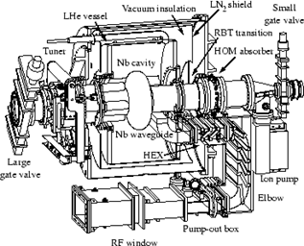
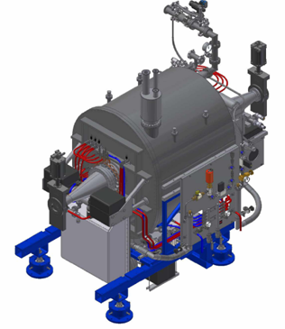
500 MHz SRF accelerator modules
Technology transfer from Cornell University, USA
2000: 2 SRF modules for NSRRC, Taiwan
2000: 2 SRF modules for CORNELL, USA
2000: 2 SRF modules for CLS, Canada
2003: 3 SRF modules for DLS, Great Britain
2005: 3 SRF modules for SSRF, PR China
2010: 3 SRF modules for PAL, Korea
2012: 1 SRF module for DLS Great Britain
Cavity production
Cavity surface preparation
Cavity vertical test
Coupler production
Coupler conditioning
Ferrite style HOM loads
Module assembly,
Installation on customer site
Commissioning, performance guarantee on cavity voltage and Q
Valve boxes and transfer lines lines
SRF Electronics
Interlock and data acquisition system

Slide 18
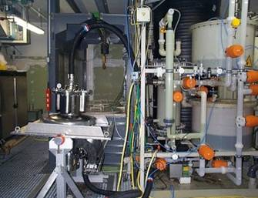
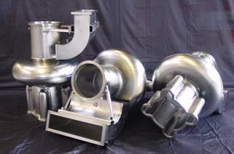
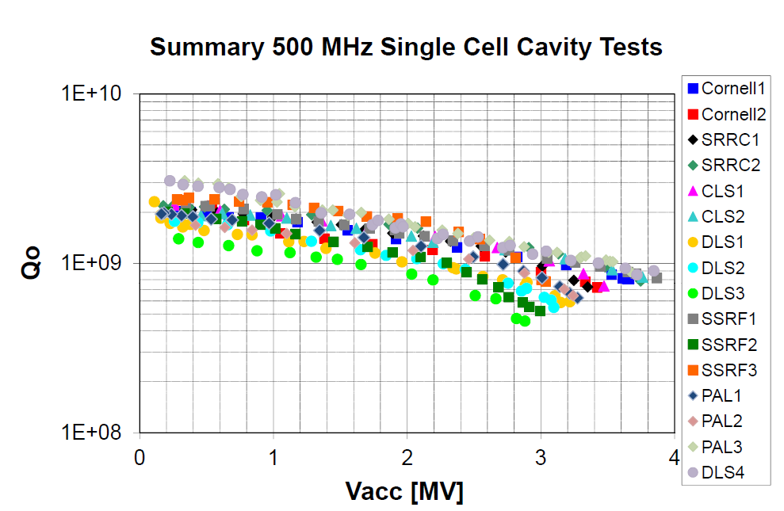
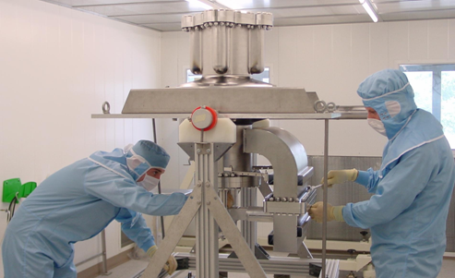
Cavity preparation and test
3 MV corresponds to 10 MV/m, cavities tested at 4,5 K

Slide 19
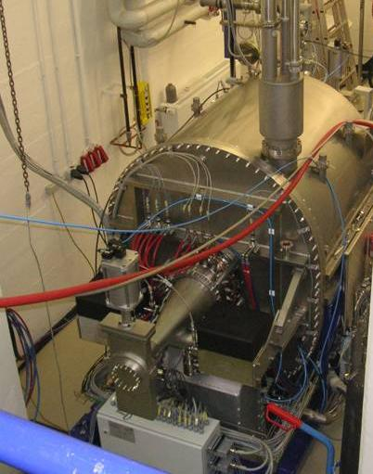
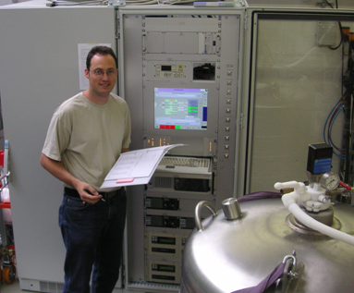
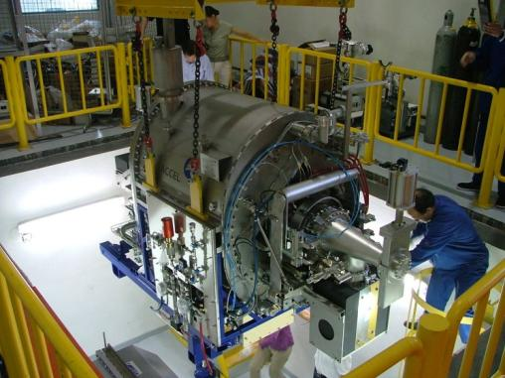
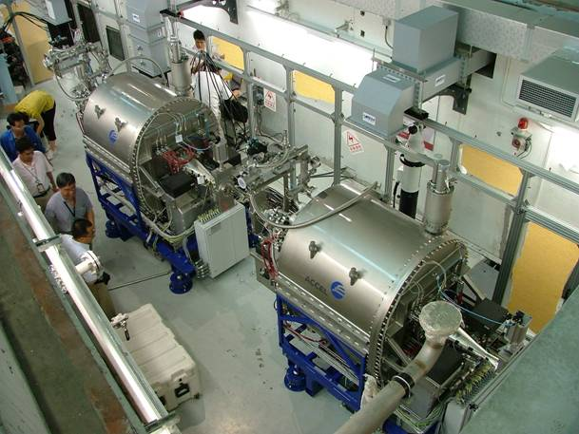
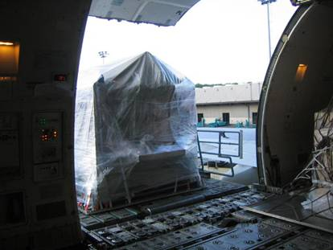
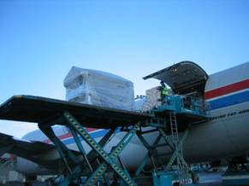
Factory testing, shipping, installation

Slide 20
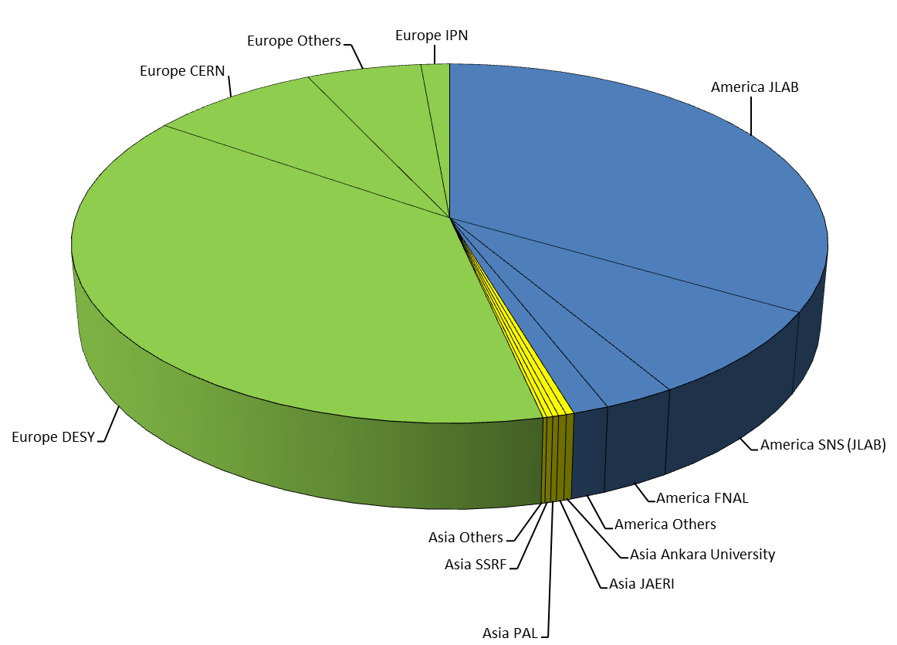
Regional distribution of # cavities and modules
Between 1985 and 2015 some 1350 srf cavities and modules are supplied by RI (former activity of ACCEL, Siemens/Interatom)

Slide 21
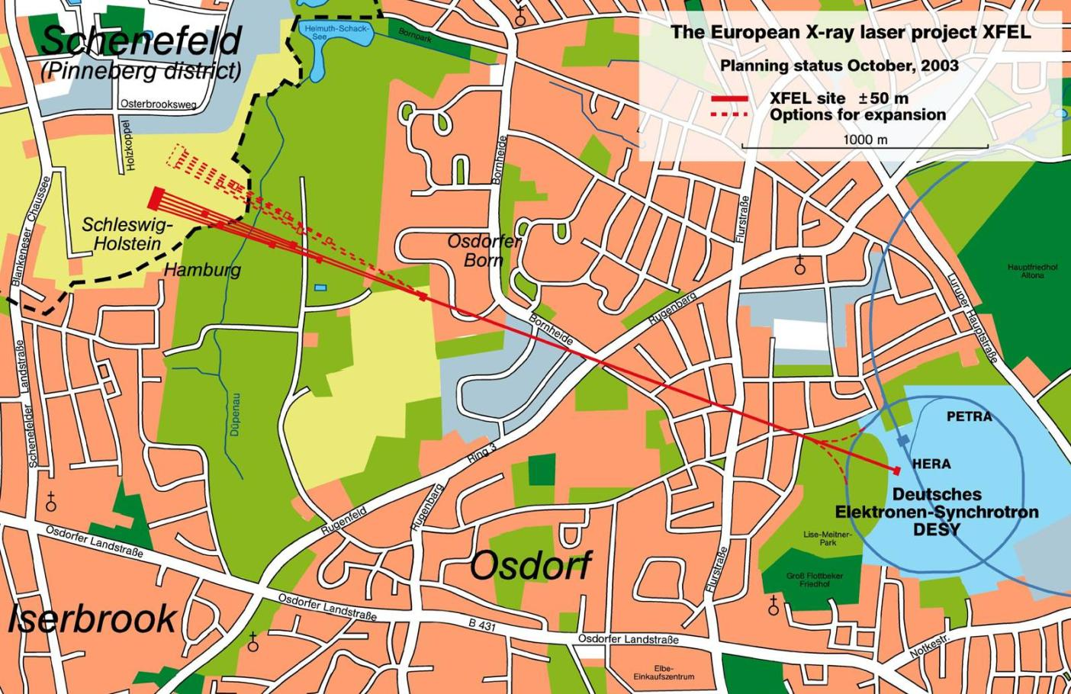
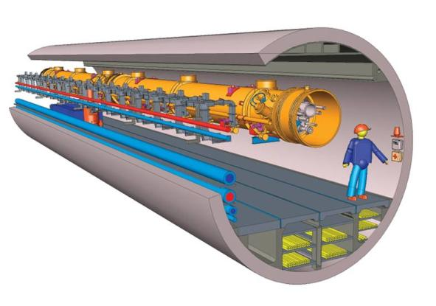
European XFEL Superconducting Linac
3.4km
key components of linac:
800 superconducting RF cavities, 800 RF couplers

Slide 22
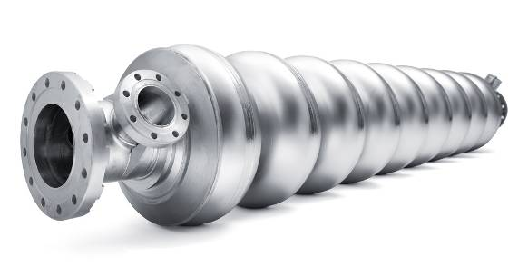
XFEL cavity production project
Order for 300 cavities received from DESY in September 2010
Order for additional 120 cavities received in March 2013
Niobium and
helium vessel supplied by DESY
RI scope:
Mechanical manufacturing of cavity, respecting the pressure vessel code
Complete Surface preparation and helium vessel welding
Shipping to DESY under vacuum and “ready for cold RF test”
Extensive documentation and QA is crucial and will ensure that cavities are manufactured and treated according to detailed DESY specification. No performance guarantee.
DESY:
Cavities will be cold RF tested at DESY (vertical test) with helium vessel already welded
After successful test, DESY will ship the cavities under vacuum to CEA for module assembly

Slide 23
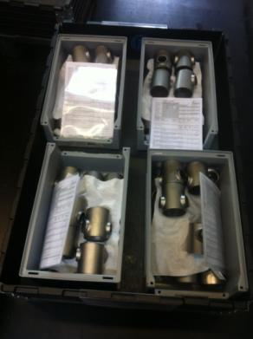








XFEL cavity manufacturing impressions
End tubes,
HOM couplers
Metrological inspection of dumbbells
Dumbbells and stiffening rings, welded dumbbells

Slide 24




XFEL cavities / subcomponents
We are now producing 16 cavities / month

Slide 25

RI infrastructure for XFEL
Electropolishing plant for XFEL cavities

Slide 26


RI infrastructure for XFEL
800 C annealing furnace for hydrogen degassing, hydrogen enters the niobium during the electropolishing process

Slide 27


RI infrastructure for XFEL
Cleaning of outer and inners surface of cavity prior entering ISO4 clean room

Slide 28


RI infrastructure for XFEL
Work in ISO4 clean room

Slide 29

RI infrastructure for XFEL
High pressure DI water rinsing station in ISO4 clean room
The cavity is being rinsed in total 4 times during the surface preparation process
Water pressure: 100 bar
Total rinsing time: about 30 hours per cavity

Slide 30

RI infrastructure for XFEL
Assembly and leak checking in ISO4 clean room,
A new 160 m² ISO 4 clean room was installed for the XFEL production

Slide 31

XFEL cavity project status
Prototype Phase and built up of infrastructure finished
RI Infrastructure qualified by reference cavities, fields up to 33 MV/m reached with reference cavities
First series production cavity delivered in May 2013
Series cavities tested up to 43 MV/m. Q₀ above 10¹⁰ up to 35 MV/m, all well above specification of 23 MV/m with Q₀ > 10¹⁰
now delivering about 16 cavities per months
Average gradient of about 70 tested cavities is above 32 MV/m
Project should be finished in summer 2015 where the last of the 420 cavities should be delivered

Slide 32

Accelerating field of XFEL cavities delivered in chronological order

Slide 33

Estimated RI cavity and module business volume between 1985 and 2015 ca. 150 M€

Slide 34
Dear Peter, the story and success of RI‘s business in SRF technology over three decades goes in parallel to our extremely fruitful and trustful cooperation with you in person.
Thank you very much
Michael Pekeler, Stefan Bauer, Hanspeter Vogel,
Michael Peiniger

