Slide 1


SRF photo-injectors
Cool sources keeping us busy
J. Sekutowicz
May 19th, 2014

Slide 2
Outline
Introduction
  History and goals
  Applications
  Two approaches
R&D programs
    Cavities for SRF injector
    Cathodes
Final remarks

Slide 3
  Introduction a. History and goals
Milestones in history of NC and SC photoinjectors
Date Milestones
1985 First photoinjector at Los Alamos , R. Sheffield et al.
First FEL driven by photoinjector at Stanford
1988 First proposal for SRF photoinjector by H. Piel
1991 First photocathode in a sc cavity at Wuppertal, A. Michalke
1993 UV FEL driven by photoinjector at Los Alamos
...............................
2013 First IR FEL driven by photoinjector J. Teichert, et al., HZDR
3 years
22 years
???? UV- or X-FEL driven by SRF photoinjector ?

Slide 4
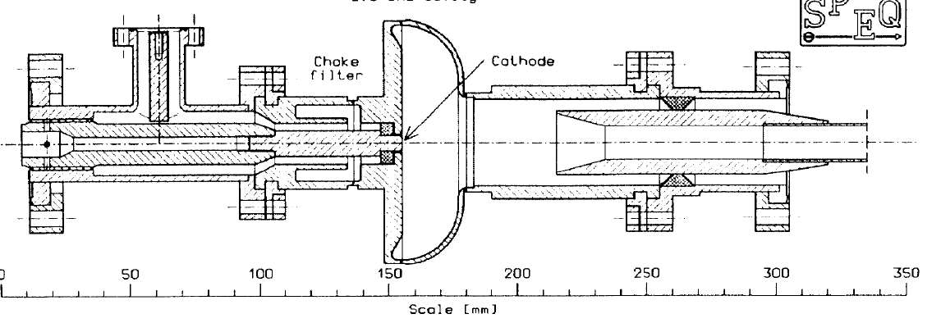
  Introduction a. History and goals
Result of the first photocathode in a sc cavity experiment was published in 1992 at EPAC by H. Piel and A. Michalke.
Eacc = 1.5 MV/m, Qo 1.5E7 and electron current of 0.5µA.
Important step but expectations nowadays are far from this result.

Slide 5
  Introduction a. History and goals
SRF photoinjectors have unique potential to generate
high brightness electron beams at high duty factor
q/bunch
~ 1nC
low ɛ_{n}
₊
≤ 1mm·mrad
high DF
₊
-> 100%
Courtesy A. Arnold
SRF photoinjectors seem to be the best choice for this spec

Slide 6
  Introduction b. Applications
Potential application of SRF injectors in accelerators
Parameters of SRF injectors* for future applications
Facility | I_{beam} [mA] | q [nC] | Ɛ_{n} [µm] | f_{rep} [MHz] | E_{cath} [MV/m]
ELBE at HZDR (operation at low q) | 0.5 | 1 | ≤ 1 | 0.5 | 30
E- XFEL upgraded to cw/lp mode | 0.2 | 1 | ≤ 1 | 0.2 | 50+
FLASH upgraded to cw/lp mode | 0.2 | 1 | ≤ 1 | 0.2 | 50+
ERL BERLinPro at HZB | 100 | 0.077 | ≤ 1 | 1300 | ≥ 10+
ERL at BNL | 500 | 0.7 | ≤ 1.4 | 704 | 30
WiERL | 1 | 0.2 | ≤ 0.9 | 5 | 45
*I will not discuss DC-SRF hybrids (like Cornell or PKU designs).

Slide 7
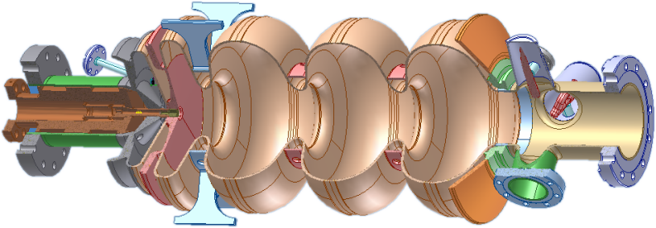
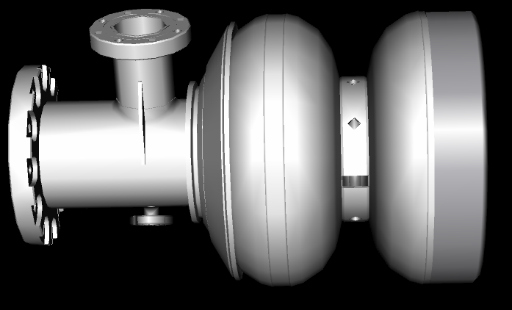
  Introduction c. Two approaches
Two approaches to SRF photo-injector design
sc-cavity & nc-cathode
I_{beam} up to 500 mA
sc-cavity & sc-cathode
I_{beam} ~ 1 mA
Pros: QE of nc cathodes is high.
Pros: There is no load lock system. Integration of sc-cathode with sc-cavity is less challenging.
Cons: Load lock system makes integration of nc-cathode with sc-cavity very challenging.
Cons: QE of metallic sc-cathode is low.

Slide 8
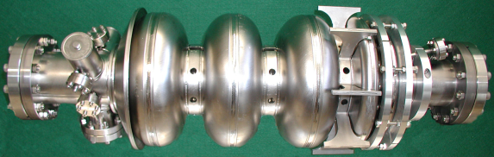
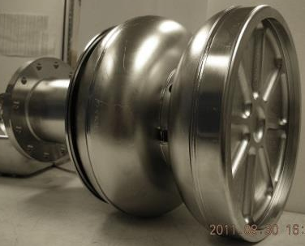
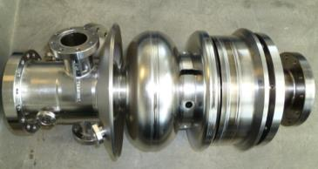
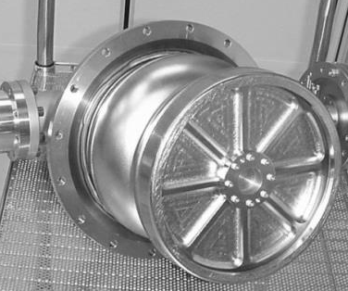
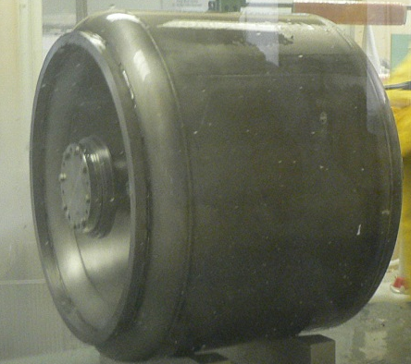
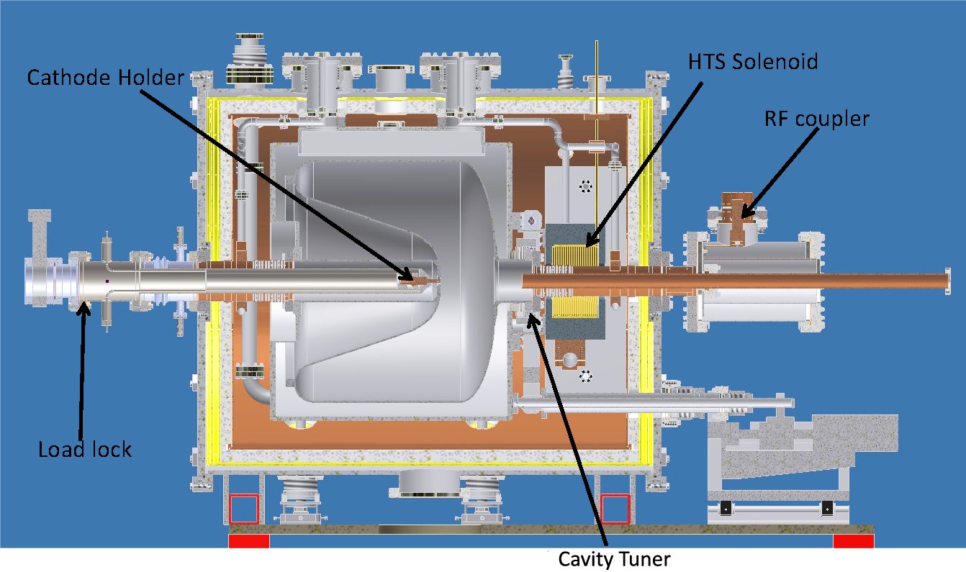
  Introduction c. Two approaches
Two approaches to SRF photo-injector design, cont.
sc-cavity & nc-cathode
I_{beam} up to 500 mA
sc-cavity & sc-cathode
I_{beam} ~ 1 mA
HZDR
1.3GHz
JLab/DESY, 1.3GHz
before Febr. 2012
HZB
1.3GHz
JLab/DESY, 1.3GHz
after Febr. 2012
Plug option
Univ. Wisconsin
200 MHz

Slide 9
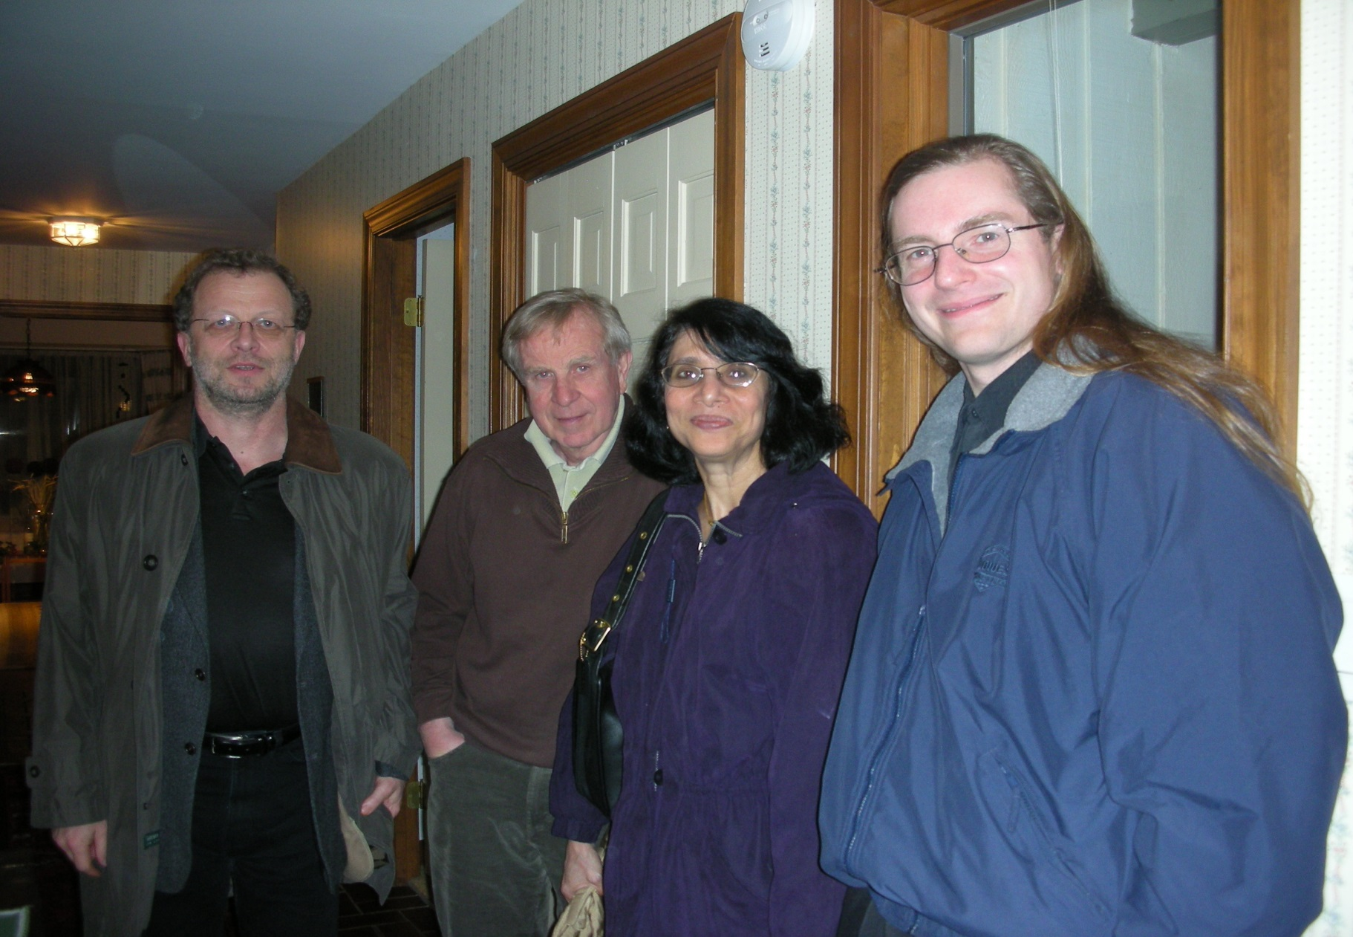
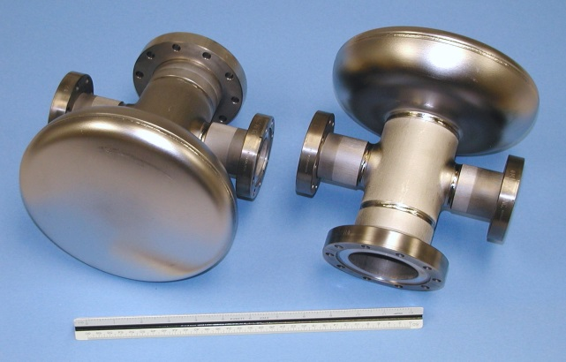
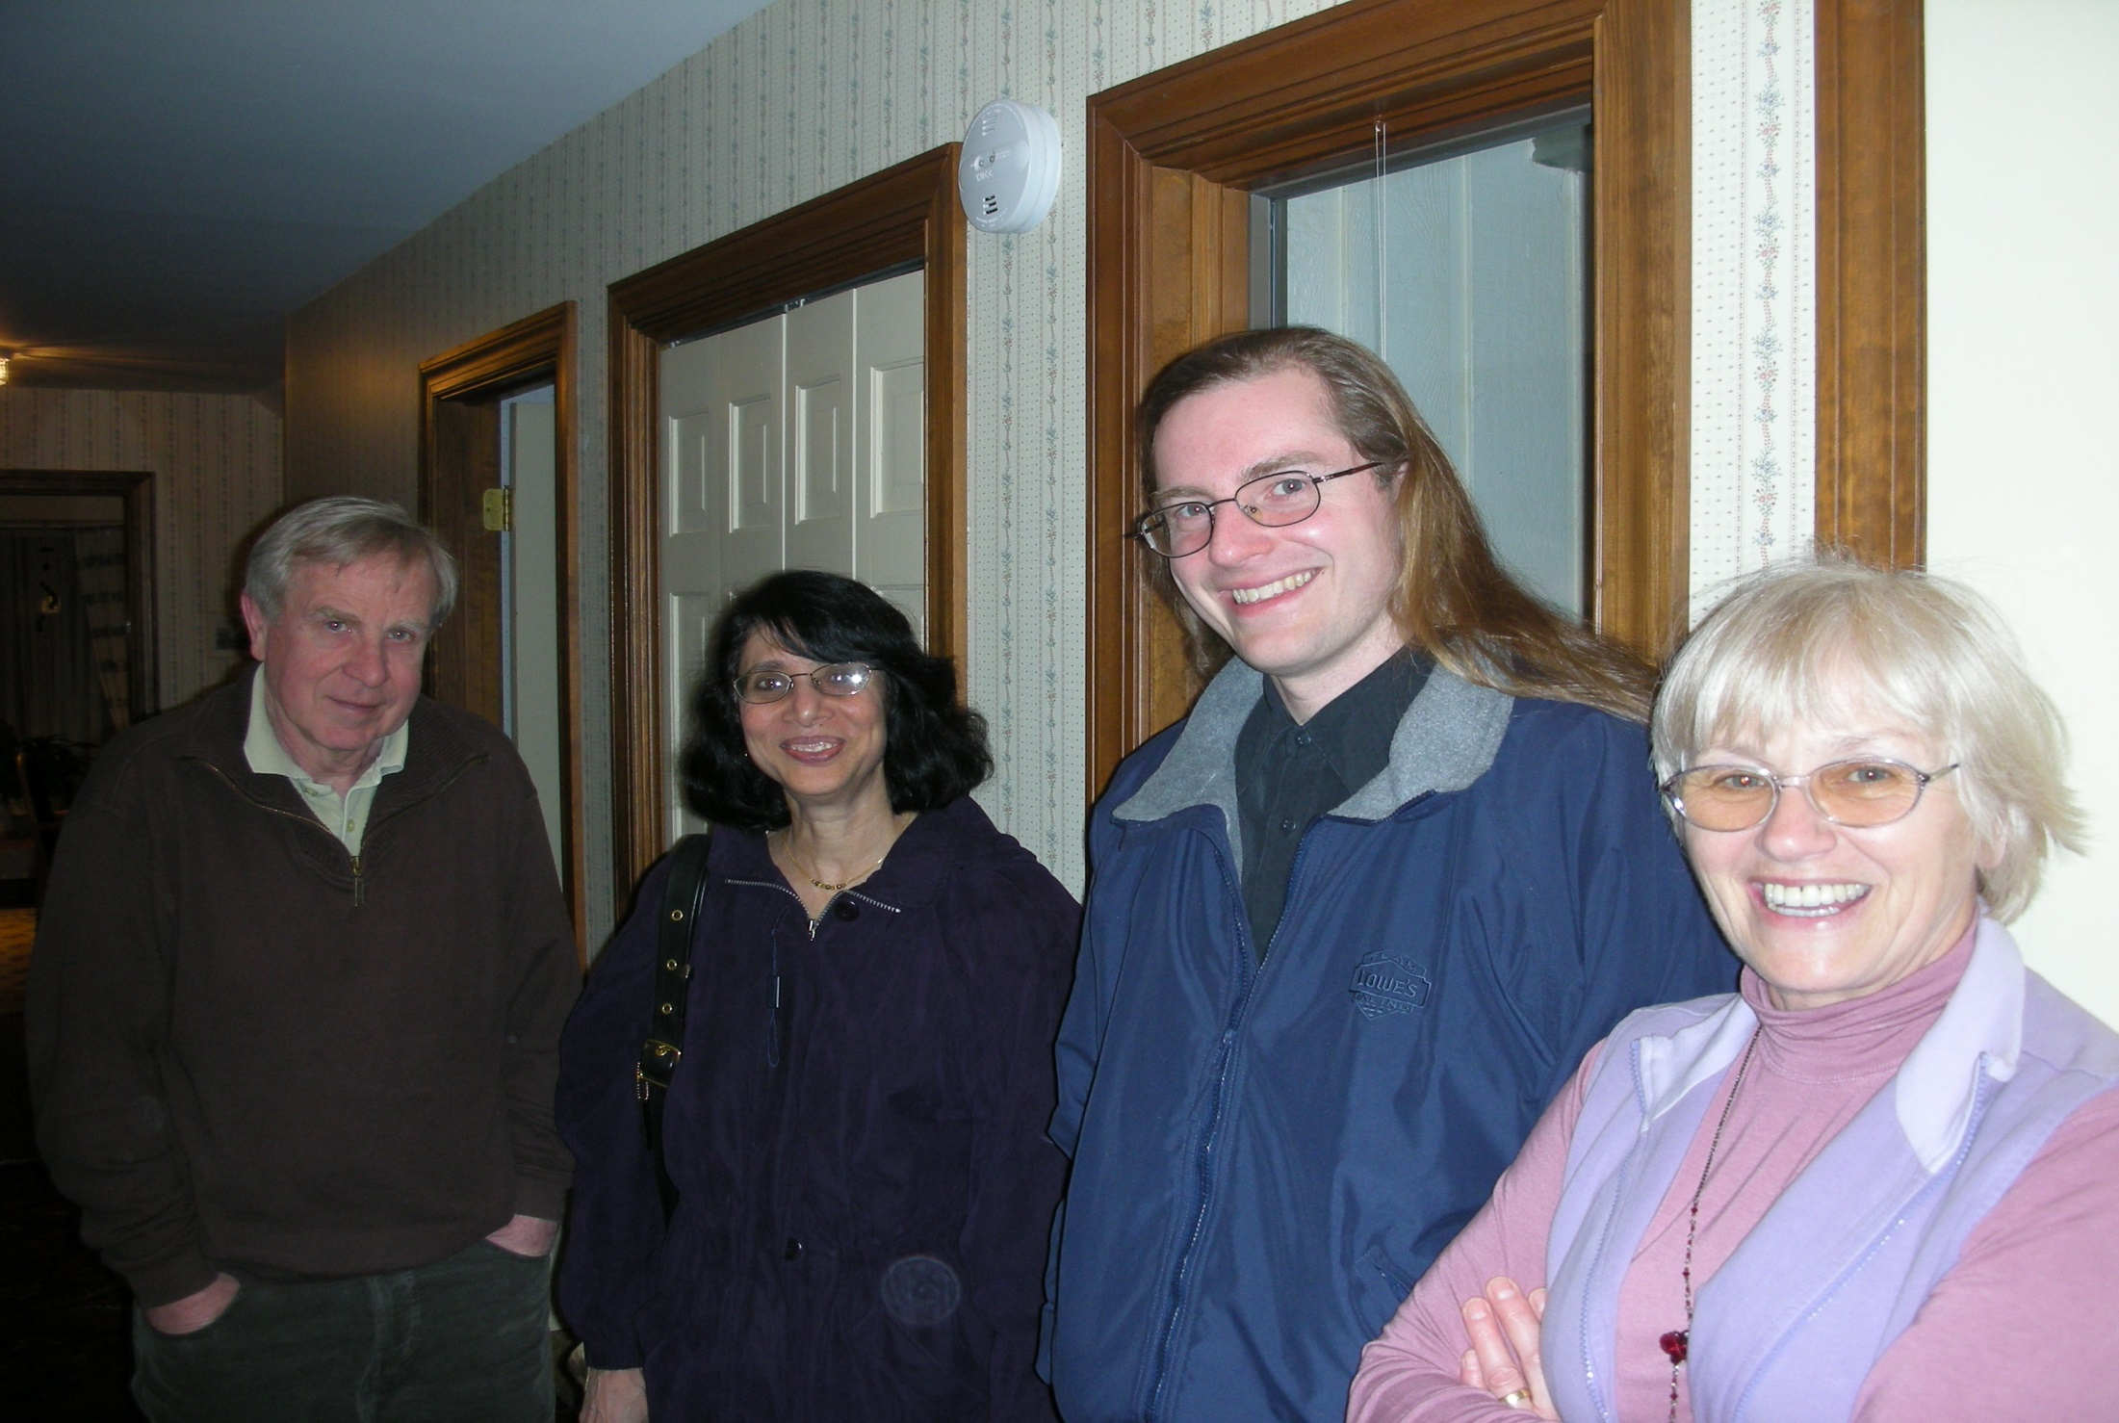
  Introduction c. Two approaches
sc-cavity & sc-cathode = all superconducting photo-injector
The story began in 2002 with these two at BNL
John Smedley
Triveni Rao
Cathode was the back wall made of Nb
QE = 10⁻⁵ @ λ =260 nm and 48 MV/m
P_{laser} = 0.5W, spot 6 mm², no quench!

Slide 10

  Introduction c. Two approaches
The result showed that for 1nC & f_{rep}. of ~200 kHz, one will need UV laser with power of 93 W on the cathode. Quenching guaranteed!!!
In 2004 we began to look for a better sc-cathode:

Slide 11
  Introduction c. Two approaches
and the first choice was Pb cathode (Tc=7.2K)
190 nm
200 nm
193 nm
210 nm
213 nm
QE
220 nm
Courtesy T. Rao & J. Smedley
230 nm
240 nm
248 nm
Eɣ [eV]
For this QE laser P will drop from 93 W to 2.6 W !!!

Slide 12
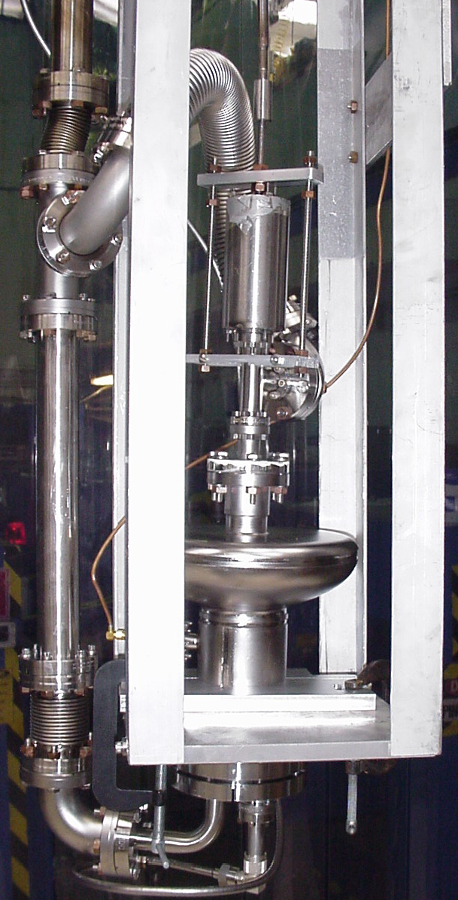
  Introduction c. Two approaches
Back wall with stiffening slab,
no plug
Back wall with plug
Smooth back wall option (JS)
Plug option (PK)

Slide 13
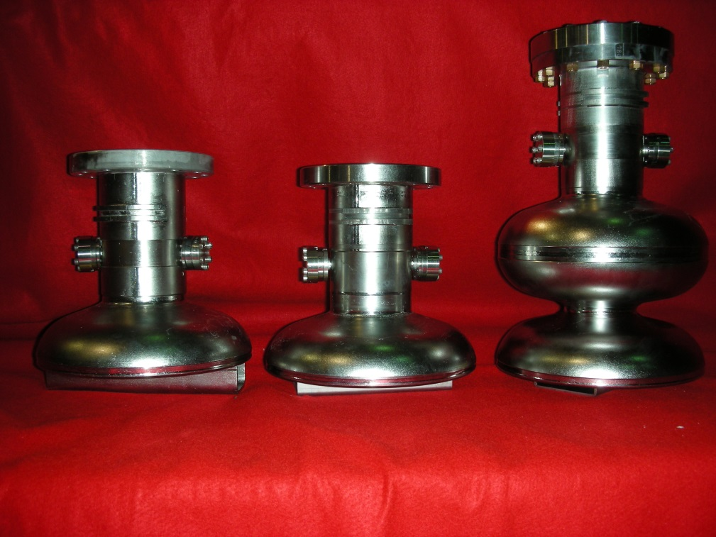
  Introduction c. Two approaches
After several tests we decided to proceed with no-plug option. We build a number of cavities, both 0.5 and 1.6-cell. All cavities were tested before the coating (baseline test).
Courtesy P. Kneisel

Slide 14
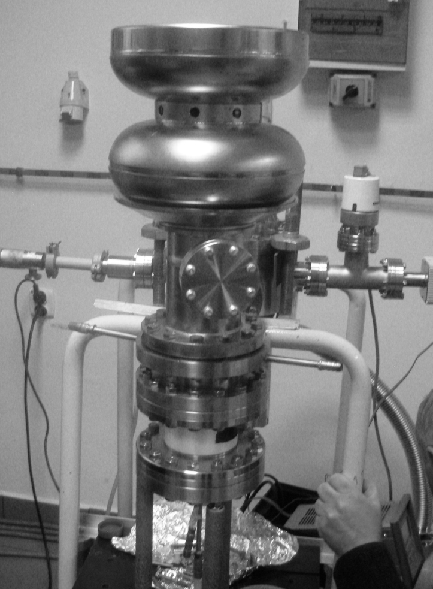
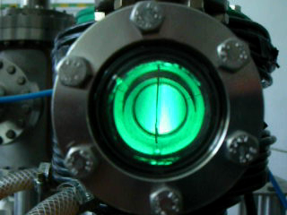
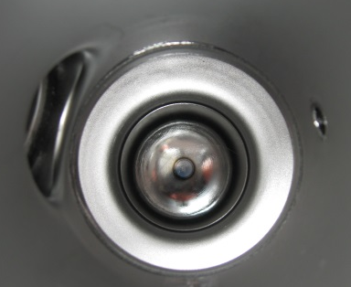
  Introduction c. Two approaches
Pb coating took place at NCBJ in Świerk:
FPC port
Pickup port
Pb spot on the back wall
Arc-deposition setup

Slide 15
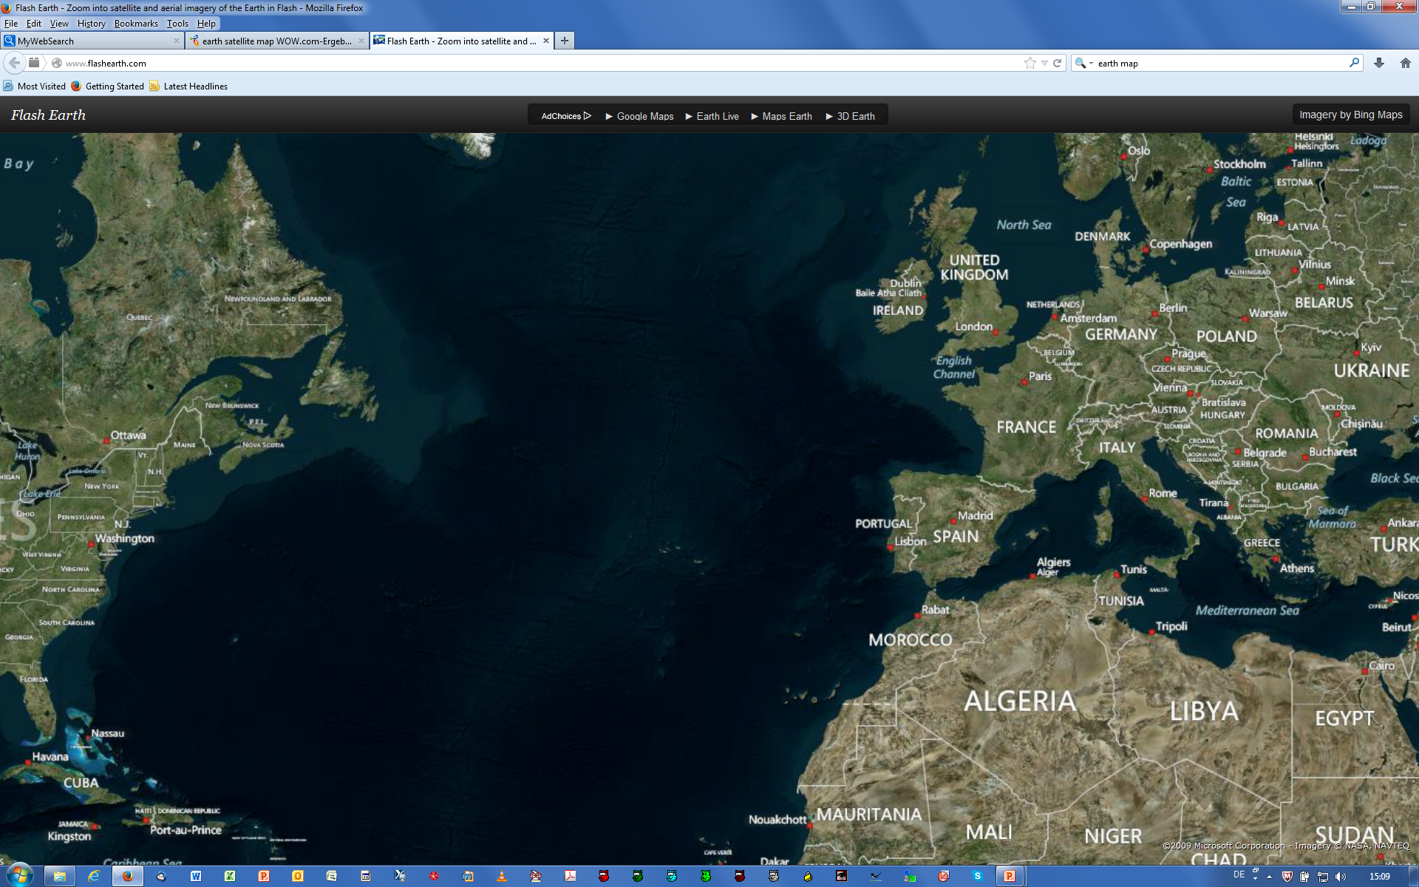
  Introduction c. Two approaches
The route to coat the back wall was long:
JLab->DESY->Świerk->DESY->JLab = 11000 miles
and it took a lot of time, especially when we wrote down in the shipment documents “gun cavity”.

Slide 16
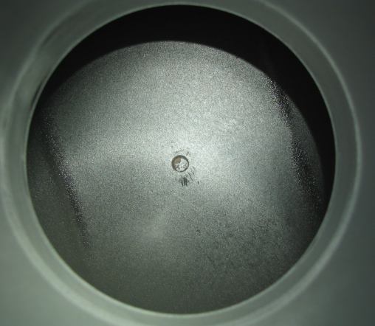
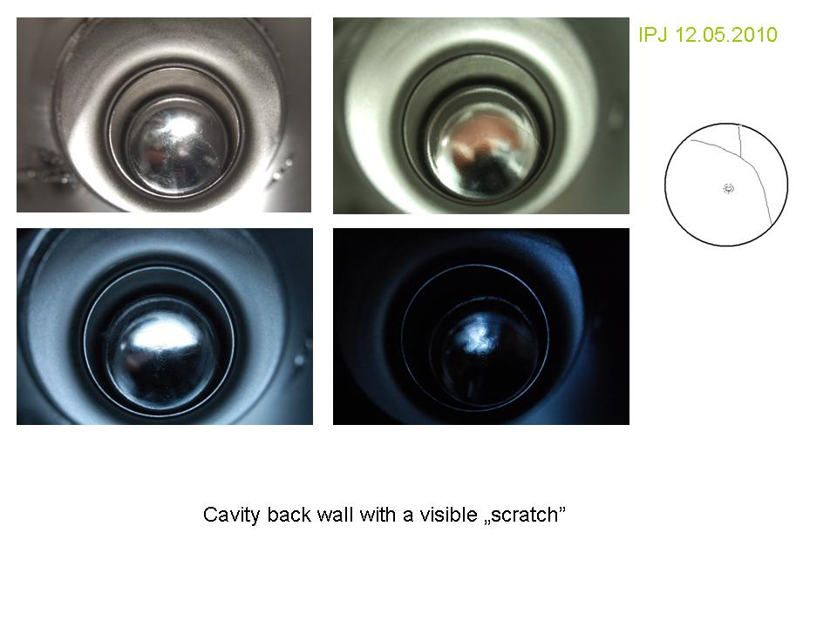
  Introduction c. Two approaches
Back at JLab: preparing for the vertical test we used mask to protect coating from the BCP acids. For HP rinsing (no jets directly on the Pb-spot) the mask had to be disassembled.
In most cases, after the preparation
Pb spot was partially damaged
…or totally removed
In February 2012, we decided to proceed with plug even though the first results for plug version were not very encouraging.

Slide 17

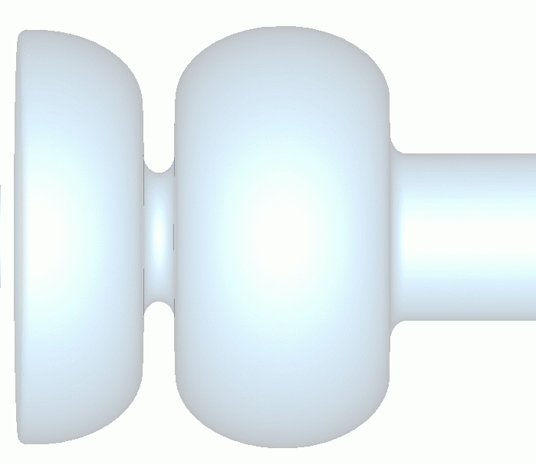
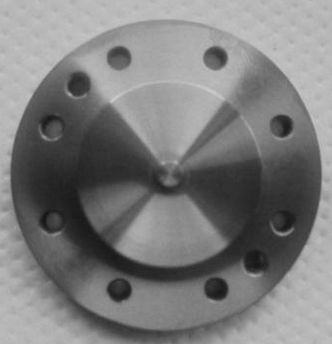
  Introduction c. Two approaches
Present design of the SRF-injector cavity with sc-cathode.
Cathode
Plug
Plug
1.6 cells
Pros:
Pb-coated plug is assembled after BCP and HP rinsing.
Preparation of the substrate and coating is technically simpler.
Shipment is easier.
Cons:
Cooling of the cathode requires more attention.
Plug, if improper installed, may cause leaks.

Slide 18
  Introduction c. Two approaches
Present design of the SRF-injector cavity with sc-cathode, cont.

Slide 19
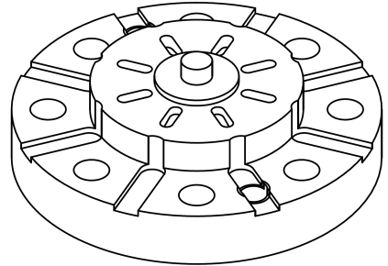
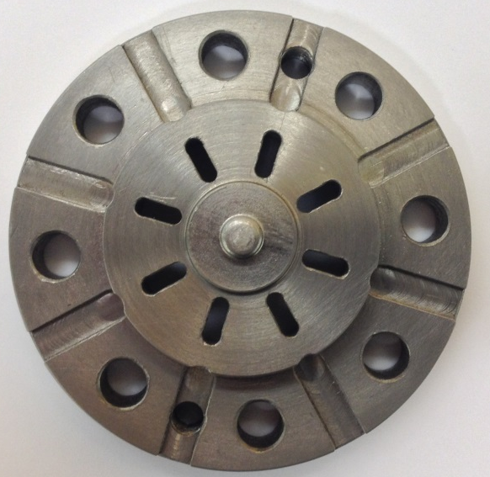
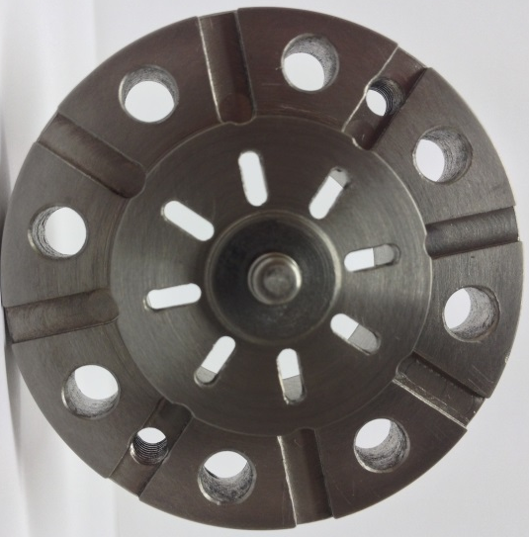
  Introduction c. Two approaches
We could not reassemble Jlab good results neither at HZB nor at DESY
Maximum Eacc was 24 MV/m only and Qo was low.
QE (test at HZB) was by factor of 4 lower than for Pb-samples.
Recent improvements.
Better cooling of the cathode plug with additional channels for LHe.
Cathode post
Sealing
surface
Helium channels

Slide 20
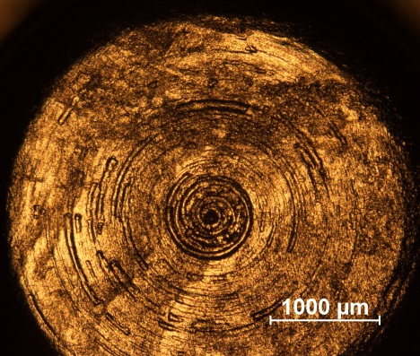
  Introduction c. Two approaches
Recent improvements, cont.
Plug tested at HZB was rough and coating showed many large droplets
Present Pb coating is better as compared to the coating on tested plug
Before Pb coating
Roughness < 0.5µm
After Pb coating
droplets ø < 20µm
and height of few µm

Slide 21
  Introduction c. Two approaches
sc-cavity & nc-cathode
HZDR 1.3GHz, 3.5-cell is the most advanced SRF source, driving ELBE
Significant progress

Slide 22
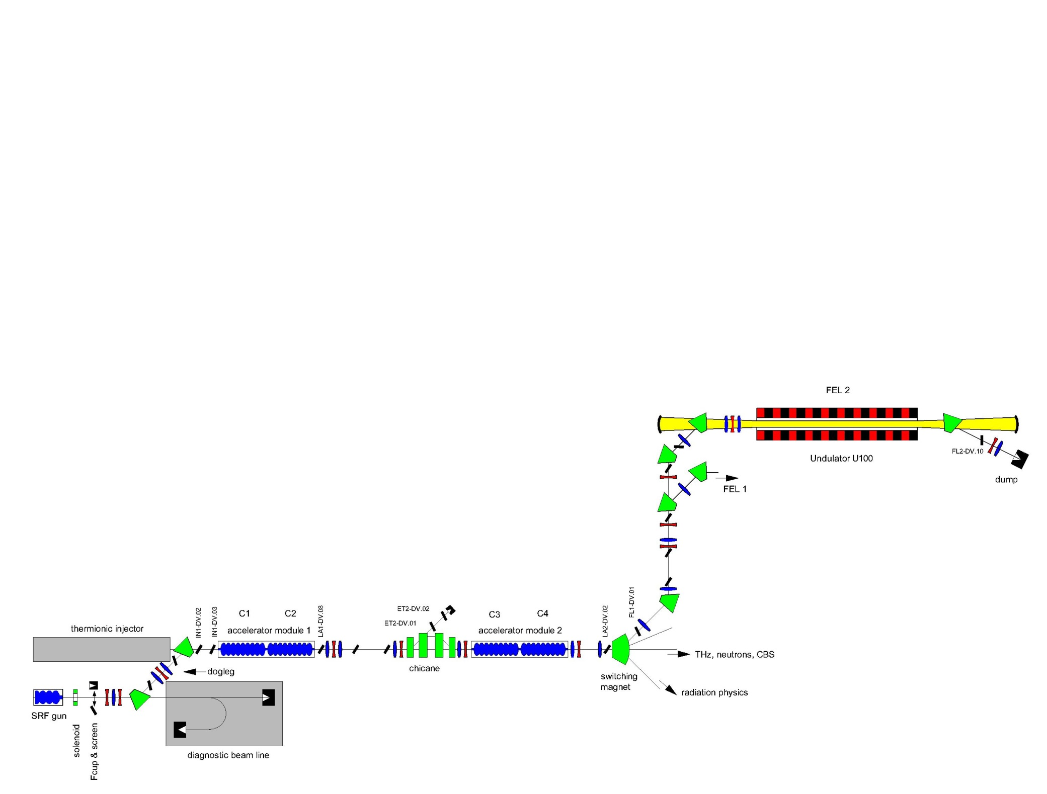
  Introduction c. Two approaches
HZDR lasing with Gun 1
E_{kin} at gun exit | 3.3 MeV
Micro pulse repetition rate | 13 MHz
Macro pulse repetition rate / length | 1.25 Hz / 2 ms
Beam energy at FEL | 27.9 MeV
Bunch charge / beam current | 20 pC / 260 µA
RMS bunch length | 1.6 ps
Normal. RMS emittance | 1 mm mrad
ELBE infrared FEL (20 – 250 µm)
April 11, 2013!
before
first lasing
optimized
Courtesy A. Arnold
Congratulations!!!!

Slide 23
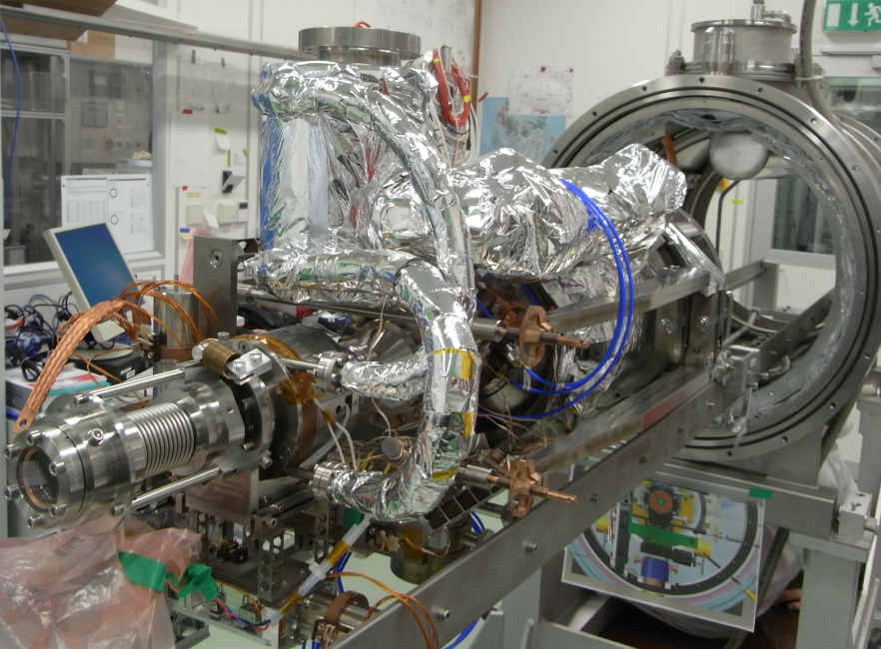
  Introduction c. Two approaches
Gun 2 is now being assembled and prepared for testing.
Courtesy A. Arnold
We are waiting for good news from Rossendorf.

Slide 24
  Introduction c. Two approaches
HZB: 1.5-cell, 1.3GHz
Courtesy A. Neumann
Cavity is still at JLab for testing and further improvement of the performance ( mainly to remove the multipacting barriers).

Slide 25
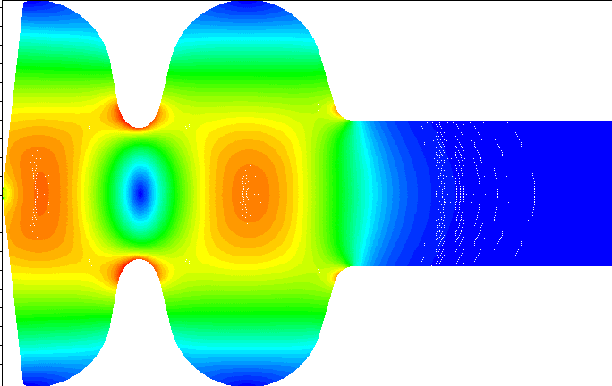
  2. R&D programs a. Cavities for SRF injector
Shape of the back wall for all sc injector (we follow studies of Rama Calaga at BNL):
α
E_{cath}
Solenoid
B
l_{cs}
1 m
Fixed parameters for investigation ɛ_{x} vs. α
Parameter | Unit | Value
Bunch charge, Q | nC | 1
τ | ps | 20
E_{cath} | MV/m | 60
B | T | 0.25
Cath.-to-solen. dist., l_{cs} | m | 0.41
8° seems to be optimal.

Slide 26
  2. R&D programs b. Cathodes
Alternative emitter to Pb could be cesiated p-GaN (support by BNL and NCBJ)
Pros: High QE at 4-th harmonic for thin coatings of ≥ 30 nm.
Cons: GaN after cesiation must be transported and assembled in an inert gas.
QE measured in April, 2014 at SVT company. Deposition on Nb, QE at 300K.

Slide 27
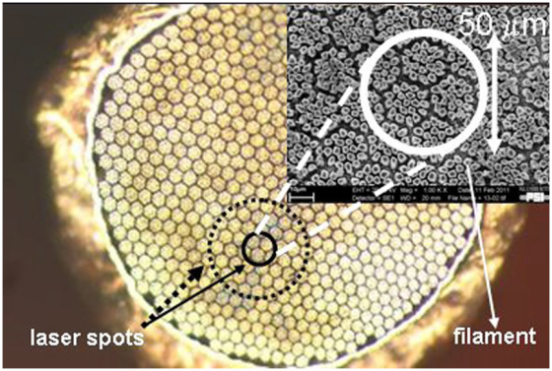
  2. R&D programs b. Cathodes
GaN is not a superconductor but if coating is thinner than 40nm it should behave like a superconductor (proximity effect).
Next steps:
Coating of Nb-plug with 30 nm GaN (no Cs) and vertical test to prove proximity effect in the sc gun cavity
QE test at 70K of 30nm GaN on Nb.
The third choice is Nb₃Sn multifilament (4µm) wires as emitters. We follow here PSI approach, in collaboration with BNL and NCBJ. Unlike PSI we want to take advantage of the fact that Nb₃Sn is an excellent superconductor and use it in sc cavity. This R&D program is at very early stage.
Measured max. QE=1% @ 266nm
A. Anghel et al.

Slide 28
  3. Final Remarks
1. Technical remark
LCLS showed in 2009 that SASE process takes place with 20 pC !
The nominal charge of LCLS II bunches will be ≤ 300 pC.
Assuming:
QE = 2·10⁻⁴@260nm
(half of QE measured for Pb)
q/bunch
₊
300 pc
f_{rept.}
₊
200 kHZ
the required laser power will be 1.4 W@260nm (7µJ/pulse).
Technical remark
The list of type 2 superconductors is rather long, more than 140
are listed. Is there really no good photo-emitter among them?

Slide 29
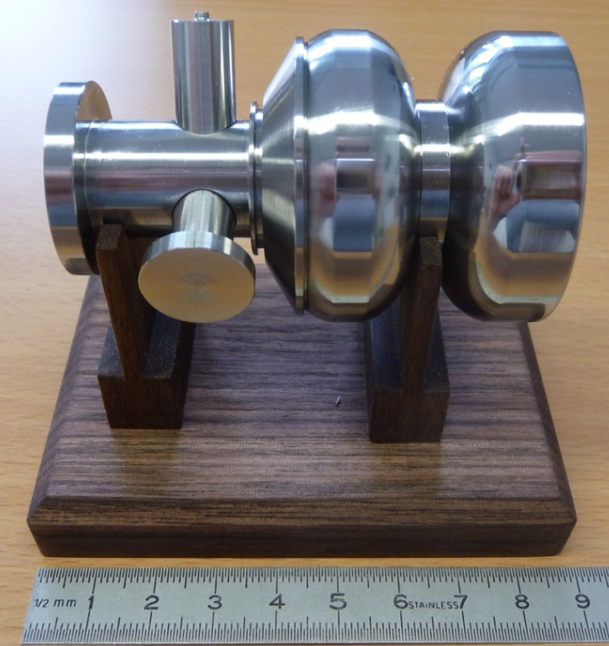
  3. Final Remarks
Dear Peter,
the DESY SRF group thanks you for your contribution to our SRF programs and projects based on the SRF technology.
We built for you a “mini-gun”, just in case you will need one.
Thanks and enjoy the family life in Denver.

Slide 30
Acknowledgements
I want to express my gratitude to all Colleagues contributing to the experiments and R&D program on sc-cathodes:
DESY: R. Bandelmann, D. Klinke, D. Kostin, A. Matheisen, W.-D. Möller, D. Reschke, M. Schmoekel, X. Singer, W. Singer, N. Steinhau-Kuehl
HZB: T. Kamps, O. Kugeler, A. Neuman
NCBJ: M. Barlach, J. Lorkiewicz, R. Nietubyc,
JLab: G. Ciovati, P. Kneisel
BNL: T. Rao, J. Smedley
HZDR: A. Arnold, J. Teichert
Thank you for your attention

Slide 31
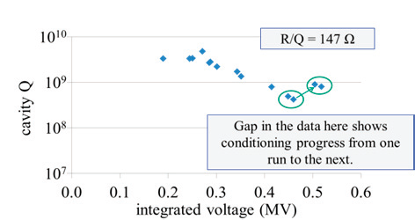
  Backup WiFEL Wisconsin
Test 2012, fall
Ecath = 5 MV/m
Parameter Calc Value Units
Temperature 4.2 K
Cavity Frequency 199.6 MHz
Unloaded Q (Q0), Nominal 3 x 10⁹
Surface electric field, Pk /Ec_{ath} 53 /40 MV/m
Integrated Electric Field 3.96 MeV
Dynamic heat loss at EPK 39.2 Watts
Static Heat Loss at 4.2K 7.5 Watts

Slide 32
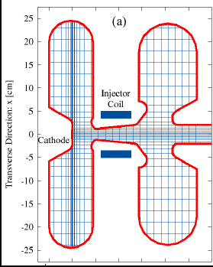
  Backup Boeing (status 2008)
At 25% duty factor, the Boeing gun delivered 32 mA, the highest average current for any electron injectors. The measured rms emittance was:
5-10 microns for bunch charge between 1 and 10 nC.
At duty factor between 1% and 25%,
the average photocathode lifetime was 2.3 hours.
The Boeing 433-MHz re-entrant RF injector cavity design.

