Slide 1
Development of superconducting sensor arrays at NIST
Joel Ullom
Group Leader, Quantum Sensors
NIST
joel.ullom@nist.gov

Slide 2
Why care? Diverse applications
millimeter and submillimeter bolometers for astronomical imaging
single optical and near-IR photon sensors for quantum information
x-ray sensors for materials analysis and astronomy
γ-ray sensors for nuclear materials analysis
bolometers
calorimeters
also: dark matter searches, electrons, alpha particles, neutrino mass, …

Slide 3
Review
Low temperatures (typically sub-Kelvin) suppress thermal noise, allowing performance of thermal sensors to surpass more common semiconducting sensors
Not all low temperatures sensors use superconductivity, but most do
Superconductors are extremely useful in sensor circuits:
  as thermometers
  as small gap sensor materials (Δ ~ 1 meV vs 1 eV for Si)
  for SQUID ammeters
  to make interconnections with high κ_{electrical}/κ_{thermal}
  for low specific heats
  …
High T_{c} superconductors are unlikely to be helpful

Slide 4
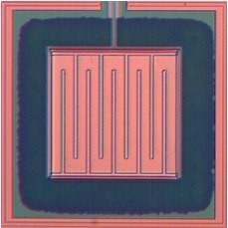
Transition-Edge Sensor (TES) bolometer
P
thin-film thermometer
TES micrograph
0.06
resistance (Ω)
current
0.00
SiN
95.8
96
96.2
temperature (mK)

Slide 5
Transition-Edge Sensor (TES) calorimeter
thin-film thermometer
TES micrograph
0.06
resistance (Ω)
current
0.00
SiN
95.8
96
96.2
temperature (mK)

Slide 6
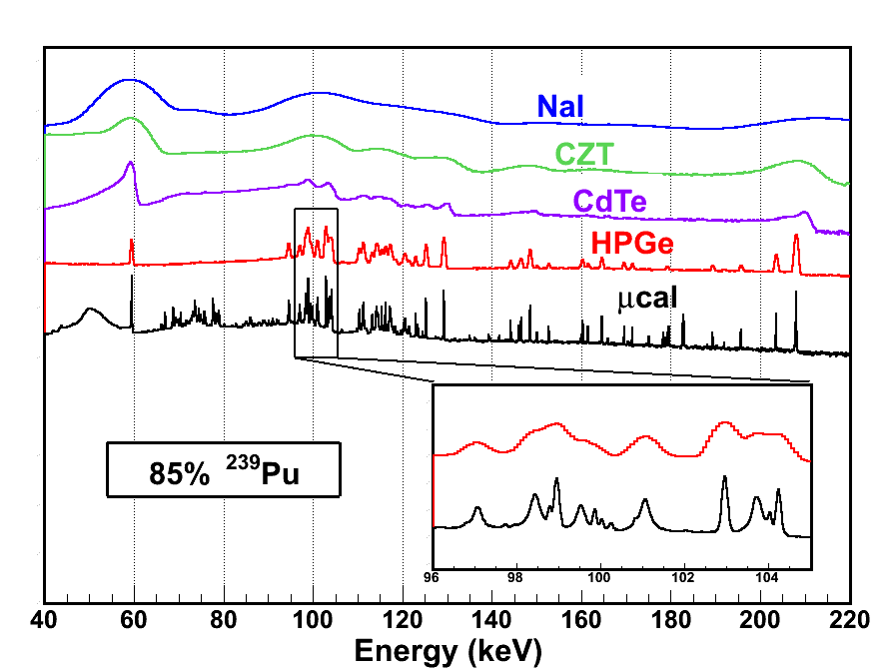
Why care?
Superconducting sensors can provide a unique combination of energy sensitivity and efficiency
energy-dispersive
gamma-ray
detectors
TES
²³⁹Pu
²⁴⁰Pu

Slide 7
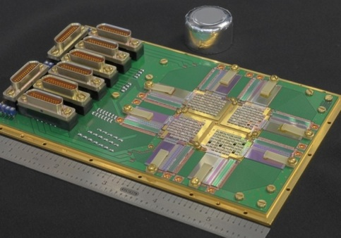
Compare to existing EDS technologies
Performance metrics for TES calorimeters are attractive
NIST-Los Alamos gamma-ray spectrometer
Performance limits
from stat mech
detector types
 | sup. | semi.
6 keV (x-ray) | 1.1 eV | 120 eV
100 keV (γ-ray) | 4.6 eV | 400 eV
5 MeV (α) | 33 eV | 8 keV
256 sensors, time-division SQUID multiplexing
5.76 cm² active area, ~35% efficiency at 100 keV
E_{sat}
calculated limits are far better than Si or Ge

Slide 8
Compare to existing EDS technologies
Performance metrics for TES calorimeters are attractive
NIST-Los Alamos gamma-ray spectrometer
Performance limits
from stat mech
detector types
 | sup. | semi.
6 keV (x-ray) | 1.6 eV | 120 eV
100 keV (γ-ray) | 22 eV | 400 eV
5 MeV (α) | 700 eV | 8 keV
256 sensors, time-division SQUID multiplexing
5.76 cm² active area, ~35% efficiency at 100 keV
E_{sat}
achieved values still much better than Si or Ge

Slide 9
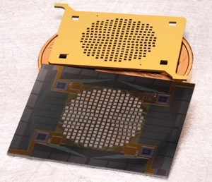
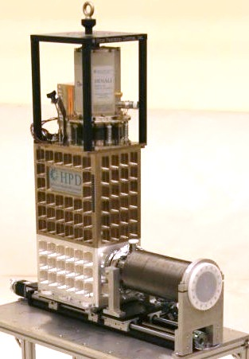
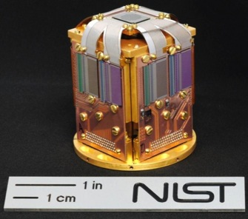
What makes up a superconducting spectrometer?
sensors and collimator
cryogen-free 50 mK platform
1 m
readout circuitry

Slide 10
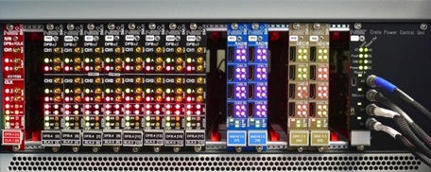
What makes up a superconducting spectrometer?
sensors and collimator
cryogen-free 50 mK platform
digital feedback electronics
CLK DFB RA16 QDC power
1 m
and software, lots and lots of software …
^{Technology overview:}
Bennett and Ullom, Supercond. Sci. Technol. 28 (2015) 084003
readout circuitry

Slide 11
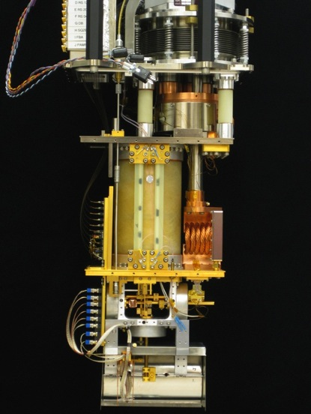
Recent: no liquid cryogens to reach 100 mK
Simple, robust cryogenics enable dissemination of cryogenic sensors
Designed & commercialized pulse tube-cooled adiabatic demagnetization refrigerator compatible with up to 256 pixels
Several 10’s of units sold worldwide
Taking steps towards next-generation refrigerators compatible with kilopixel arrays
1 m

Slide 12
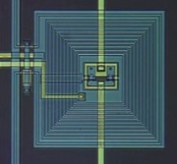
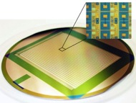

Core technology: SQUID readout
SQUIDS = versatile, low noise current amplifiers that provide useful signal gain between superconducting sensors and conventional electronics
TES bias circuit
SQUID current amplifier
T, R, and I change
0.2 mm
V
I
NIST SQUIDS fabricated into superconducting integrated circuits for readout of sensor arrays
32:1 and 1,312:32 multiplexer circuits for TDM or Φ-CDM
SQUIDs enable multiplexed readout: combining the signals from multiple sensors into a smaller number of amplifier chains
  time-division multiplexing
  code-division multiplexing
  frequency-division multiplexing
20 mm
75 mm
(Stiehl, APL 2012)

Slide 13
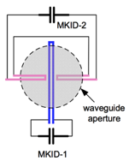
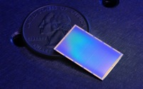
Microwave Kinetic Inductance Detectors (MKIDs)
an alternative sensor with a distinctive readout
a quarter-wave resonator
pair breaking in superconducting microresonator changes its microwave properties
figs from P. Day, Nature, 2003
￼
naturally compatible with GHz frequency division multiplexing
pixel layout
test setup
UCSB 10,000 sensor optical array (R ~ 10)
NIST dual-polarization submm MKIDs for BLAST-TNG balloon mission

Slide 14
Applications - too many to cover all
Polarization in the CMB
Submillimeter astronomical imaging
Dark matter detection
Submillimeter terrestrial imaging
Single near-optical photon counting for quantum information
Synchrotron X-ray science
Industrial X-ray materials analysis
Time-resolved X-ray absorption spectroscopy
X-ray astronomy
Nuclear materials analysis
Neutrino mass measurement
NIST is active in all these areas

Slide 15
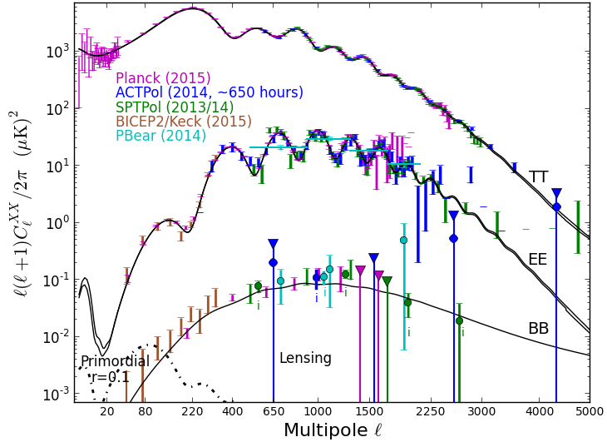
Application area: transforming cosmology into a precision science
Polarization in the CMB
angular power spectrum of Cosmic Microwave Background (CMB)
Polarization in the CMB
Submillimeter astronomical imaging
Dark matter detection
Submillimeter terrestrial imaging
Single near-optical photon counting for quantum information
Synchrotron X-ray science
Industrial X-ray materials analysis
Time-resolved X-ray absorption spectroscopy
X-ray astronomy
Nuclear materials analysis
Neutrino mass measurement
IF detected, primordial B modes are a signature of gravity waves and an inflationary epoch in the early universe

Slide 16
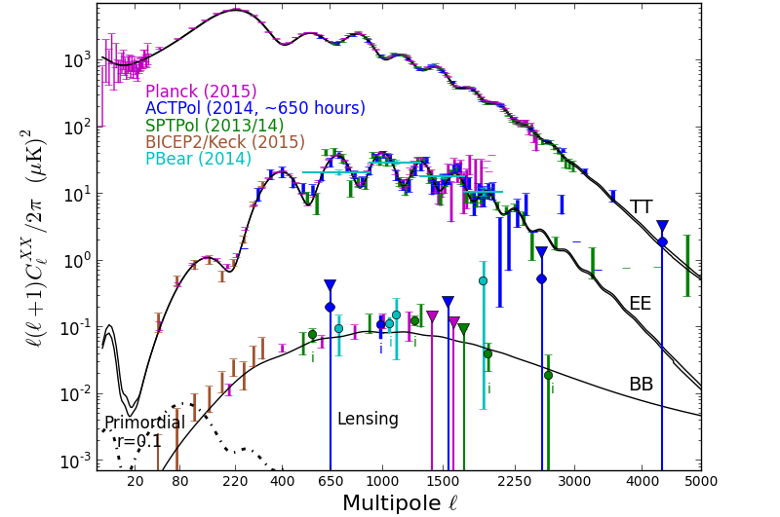
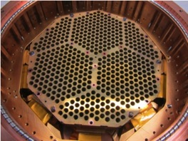
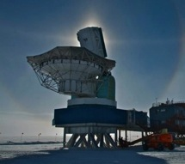

NIST plays an important role
Atacama Cosmology
Telescope Polarimeter
(1of 3 arrays)
South Pole Telescope Polarimeter

Slide 17
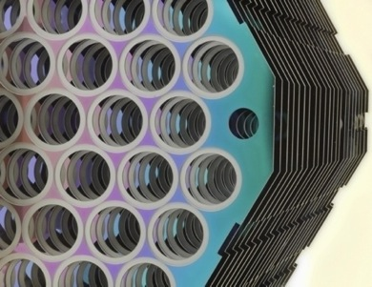
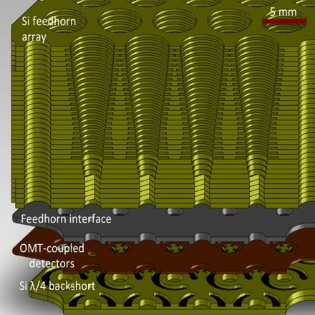
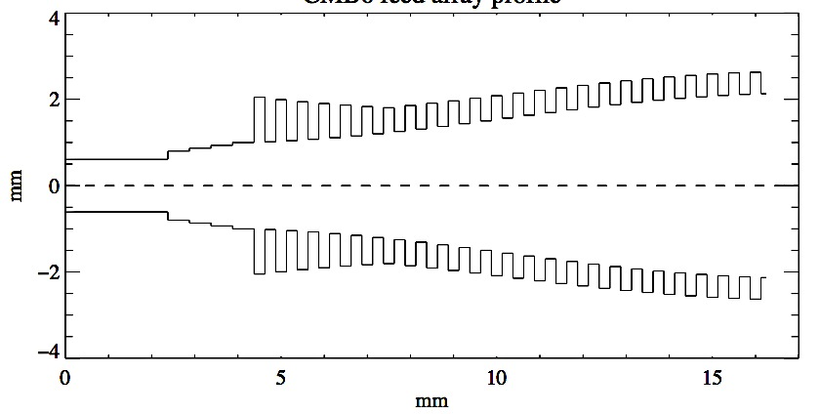
NIST technology: micromachined feedhorn arrays
corrugation profile
Hubmayr et al. JLTP 2012

Slide 18
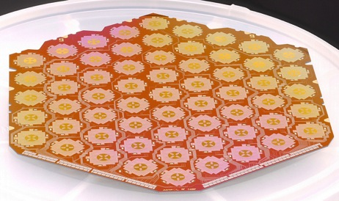
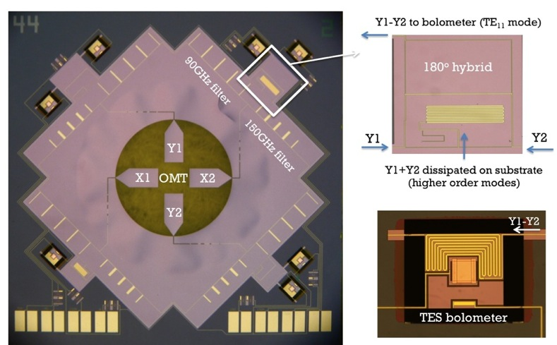
NIST technology: multichroic, polarization-sensitive detector arrays
7mm
McMahon et al. JLTP (2011)
Four TES per spatial pixel: two frequency bands, X/Y polarization per band

Slide 19
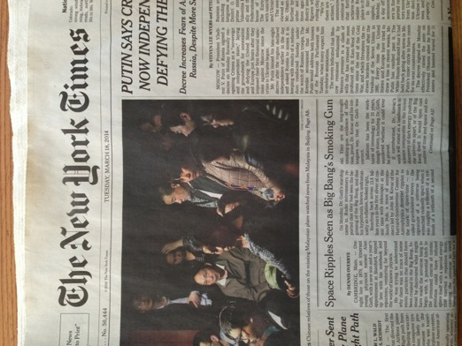
Millimeter-wave polarimetry: status and prospects
NIST parts in almost all instruments in the field
high profile science
first deployed multichroic array
currently working on large new instrument: AdvancedACT
  migration to 150 mm wafers
  lower loss dielectrics
  more frequency bands
also, starting work on SPIDER balloon payload
also, starting work on planning for LITEbird satellite
future of field is bright
press after announcement of BICEP2 results, but since shown NOT to be primordial B modes

Slide 20
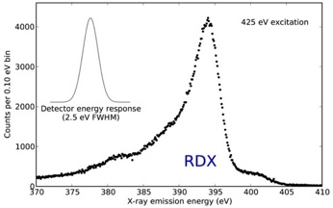
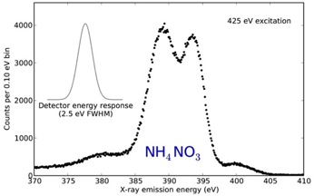




Application example: synchrotron science
Polarization in the CMB
Submillimeter astronomical imaging
Dark matter detection
Submillimeter terrestrial imaging
Single near-optical photon counting for quantum information
Synchrotron X-ray science
Industrial X-ray materials analysis
Time-resolved X-ray absorption spectroscopy
X-ray astronomy
Nuclear materials analysis
Neutrino mass measurement
there are many different synchrotron measurements. Superconducting sensors are useless for most.
but, there are applications in photon-in, photon-out spectroscopy when outgoing photons are scarce
X-ray emission spectroscopy (XES): energy of fluoresced photons provides elemental, structural, and electronic information. The last two require very good (eV-scale) energy resolution.
high collecting efficiency lets you look at trace samples, radiation-sensitive samples, and dynamic effects
also, absorption spectroscopy and x-ray scattering
Synchrotron X-ray science
NIST x-ray microcalorimeter spectra of two explosive compounds

Slide 21
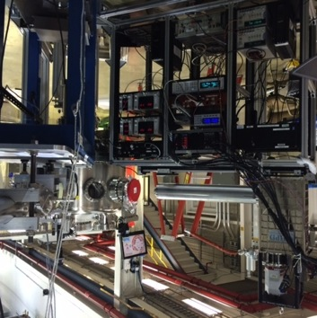
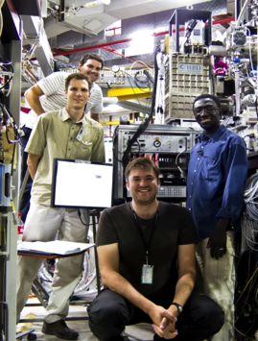
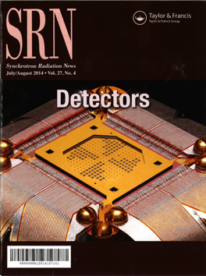
Material science at large facilities
NIST spectrometer at the NSLS
Ullom et al cover article in Aug. 2014 Synchrotron Radiation News
NIST spectrometer at the APS
also, system under construction for SSRL, delivery in ~ January 2016

Slide 22
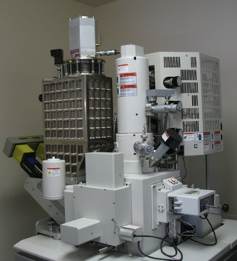
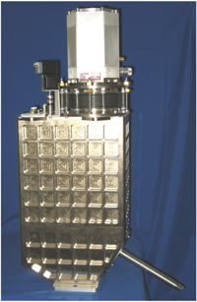

Application example – industrial X-ray analysis
Polarization in the CMB
Submillimeter astronomical imaging
Dark matter detection
Submillimeter terrestrial imaging
Single near-optical photon counting for quantum information
Synchrotron X-ray science
Industrial X-ray materials analysis
Time-resolved X-ray absorption spectroscopy
X-ray astronomy
Nuclear materials analysis
Neutrino mass measurement
Electron beam-induced X-ray fluorescence is a ubiquitous tool for determining elemental composition on SEMs and TEMs
Silicon drift detectors (SDDs) provide high rates, large area, but ~ 120 eV FWHM resolution
Wavelength dispersive detectors are evolving. Modern units provide high rates, medium effective area, but complicated efficiency curve and ~ 10 eV resolution
TES arrays can provide medium rates, small effective area, but simple efficiency curve and < 3 eV resolution
Industrial X-ray materials analysis
Cryogen-free
spectrometer with 16 TES X-ray array –
STAR Cryoelectronics

Slide 23
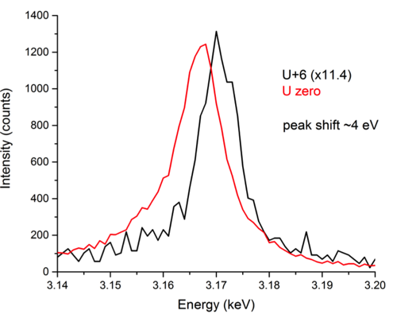
Chemical shift detection with commercial spectrometer
Polarization in the CMB
Submillimeter astronomical imaging
Dark matter detection
Submillimeter terrestrial imaging
Single near-optical photon counting for quantum information
Synchrotron X-ray science
Industrial X-ray materials analysis
Time-resolved X-ray absorption spectroscopy
X-ray astronomy
Nuclear materials analysis
Neutrino mass measurement
Los Alamos/STAR Cryo
uranium chemical shifts on commercial SEM-TES instrument
several STAR spectrometers sold and installed at customer facilities
Industrial X-ray materials analysis

Slide 24
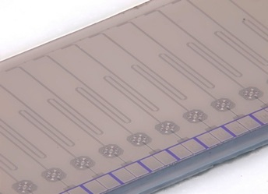
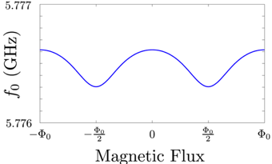
Looking to the future: how to reach arrays of 10⁶ elements?
Single microwave amplifiers can provide GHz of readout bandwidth
1. superconducting resonators as detectors:
Microwave Kinetic Inductance Detectors (MKIDs)
2. resonators with RF-SQUIDS and TESs
ν₁, ν₂, ν₃
stimulus changes power at ν₁ that reaches amplifier
input flux shifts GHz resonance frequency
shared feedline
resonators
RF-SQUIDs
1 mm
Likely path for next-generation instruments

Slide 25
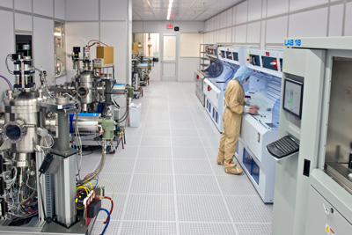
NIST Boulder Microfabrication Facility
Precision Imaging Facility:
Aberration corrected TEM
Dual beam focused ion beam mill/scanning electron microscope
Helium ion microscope
Local electrode atom probe
Boulder Micro-fabrication Facility:
60% of site research passes through
18,900 sqft class 100 cleanroom
Full lithography suite (ASML 0.35 µm stepper, reticle pattern generator)
GaN and GaAs two chamber MBE
15 deposition tools
13 dry etch tools
8 tube furnace bank
10 nm resolution EBL (future)
18,900 sq. ft. state-of-the-art class 100 clean room
Opened in 2012
$20-$25M of tools, $30M of infrastructure

Slide 26
Conclusions
Cryogenic detectors provide a unique combination of energy sensitivity and collecting ability.
There are already applications where cryogenic detectors are “required” and anticipated performance improvements will make new applications accessible in the future.
The tools to fabricate and cool cryogenic sensors are well established but their cost and complexity should be acknowledged.
The development of microwave readout techniques is an active area of effort. These techniques are a likely path to arrays of 10⁶ sensors. Today’s arrays contain 10²-10⁴ sensors.
NIST is active in most areas of cryogenic sensor technology. But, we are also interested in new projects and new collaborators.
Thanks!
joel.ullom@nist.gov

