Slide 1
ESnet Overview
Jason Zurawski – zurawski@es.net
Science Engagement Engineer, ESnet
Lawrence Berkeley National Laboratory
Future Trends in Nuclear Physics Computing
March 18th 2016

Slide 2
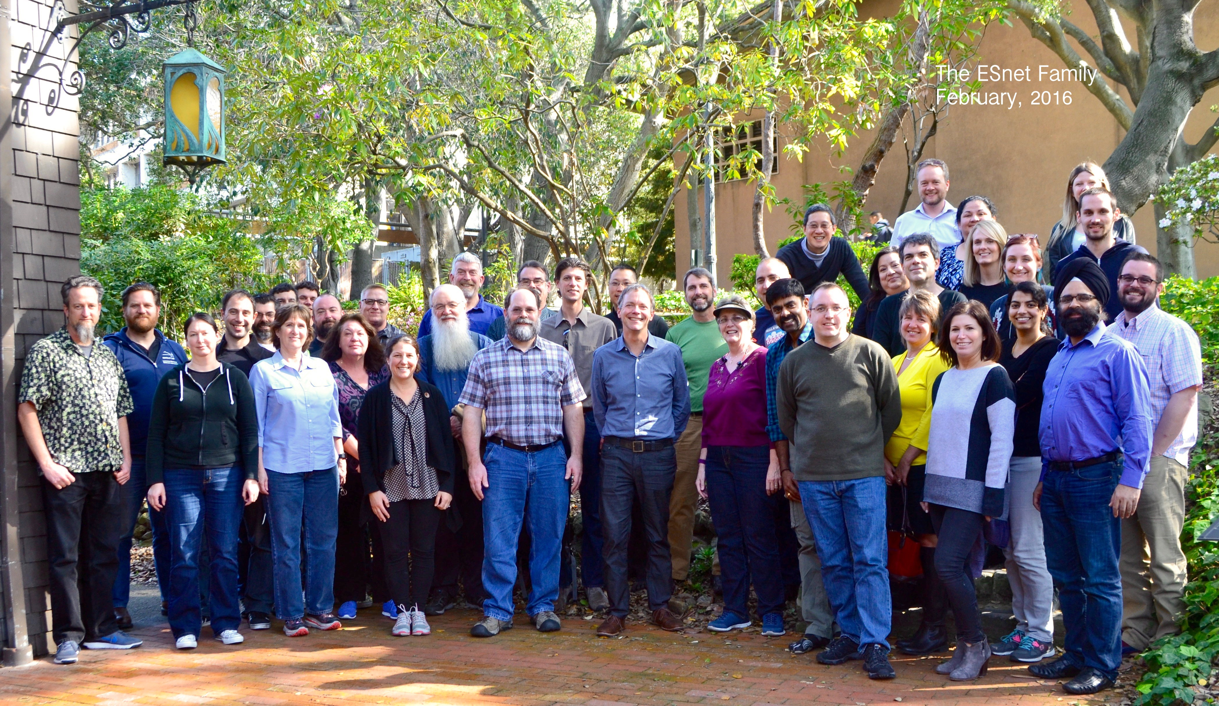

Slide 3
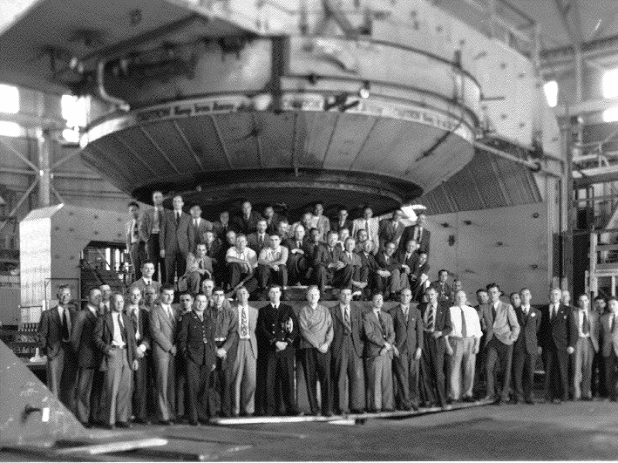

Slide 4
ESnet Background
ESnet is a special-purpose mission network, funded by the US Congress to support scientific goals of the Department of Energy.
We see networking as a means to an end: scientific productivity.
We aim to create a world in which discovery is unconstrained by geography.

Slide 5
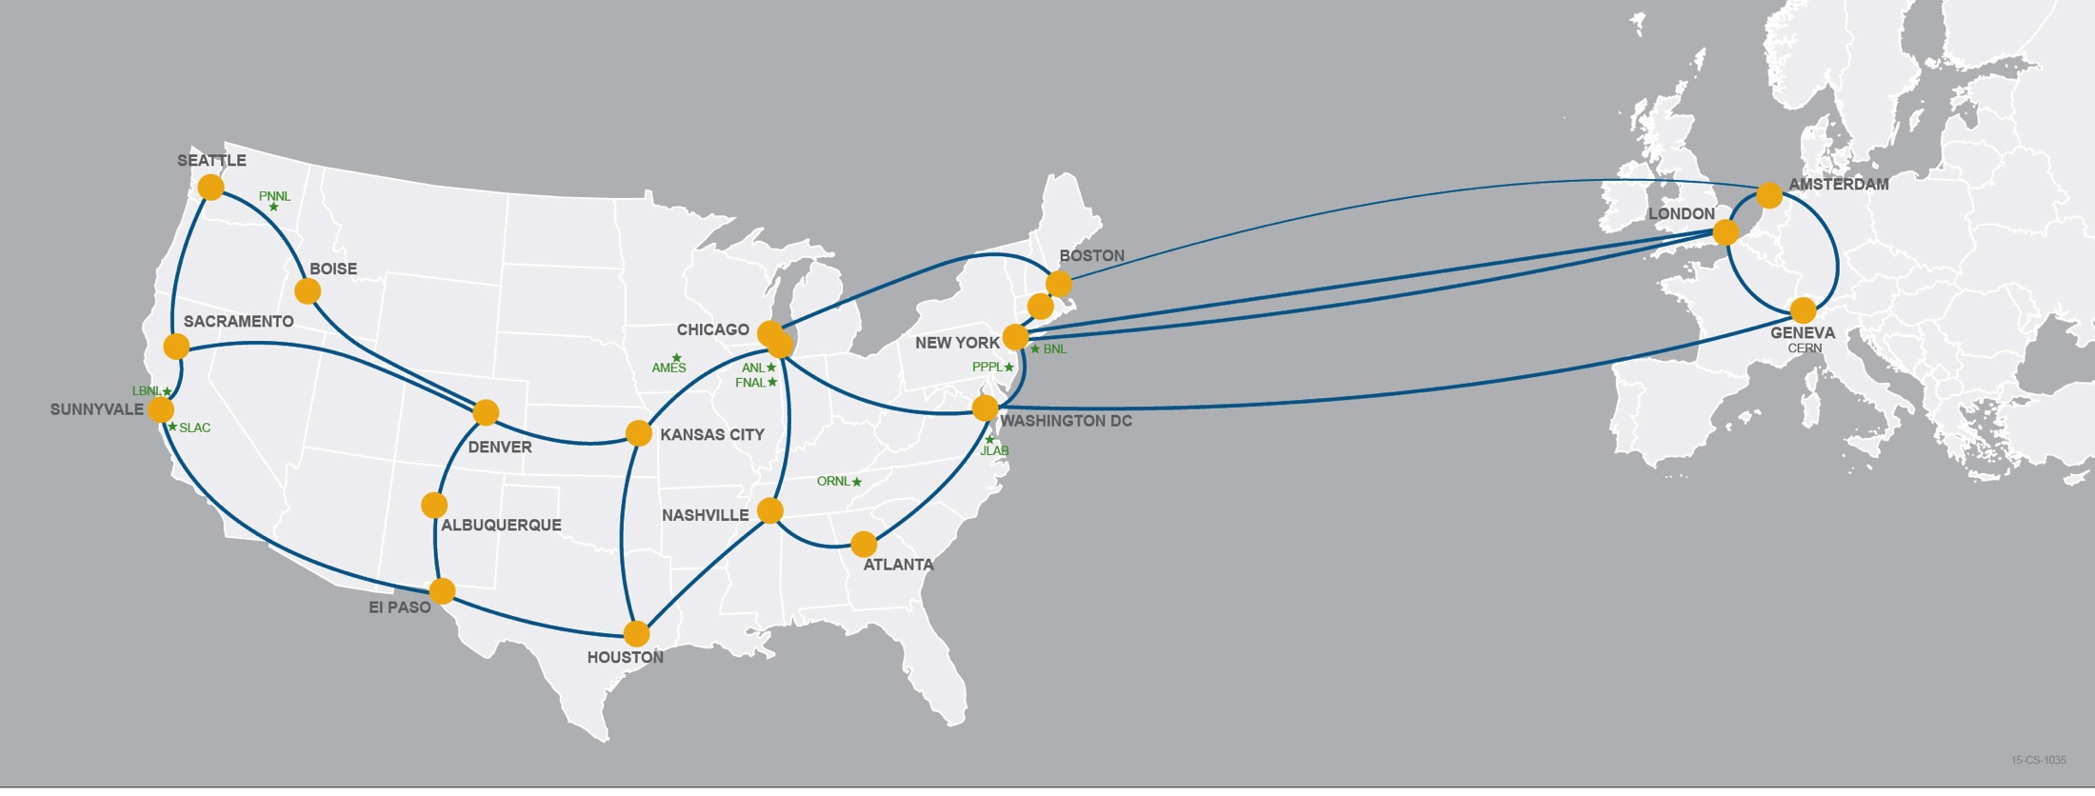
This is not an ISP.

Slide 6
It’s a DOE user facility designed to overcome the constraints of geography.
We do this by offering unique capabilities and optimizing the facility for data acquisition, data placement, data sharing, data mobility.

Slide 7
340Gbps extension.
Why?
25% of ESnet traffic
Immediate driver: more capacity for LHC Run 2. But the extension supports all DOE missions, reducing barriers to European collaborators / instruments. Note AUP change.

Slide 8
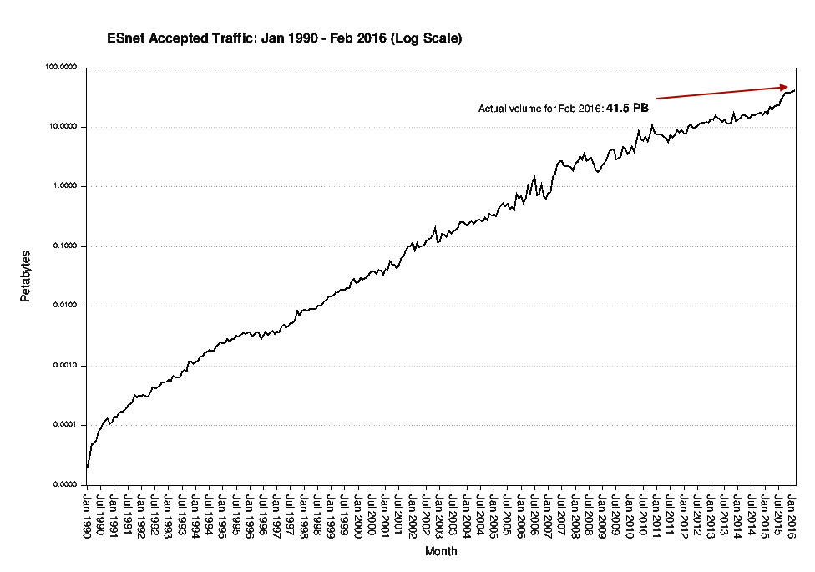

Slide 9
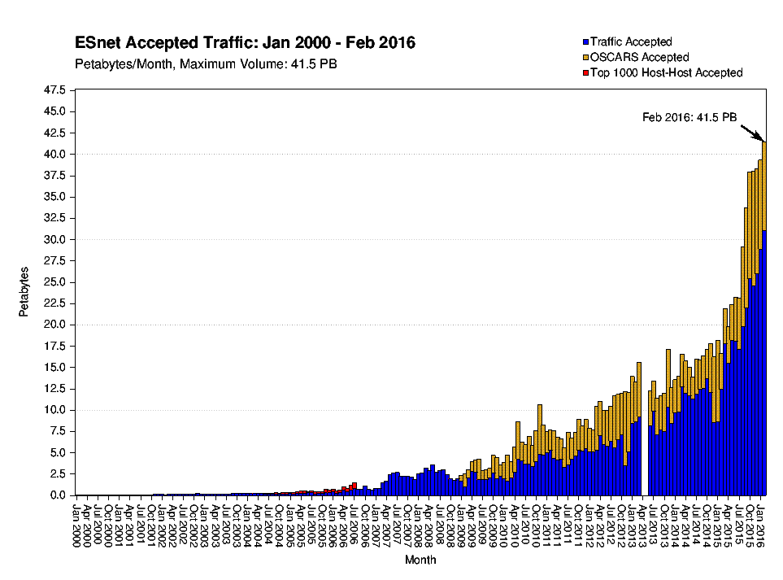

Slide 10
ESnet Strategy (in addition to world-class operations…)
Discovery is unconstrained by geography.
2. Provide information and tools for optimal network use.
vision:
goals:
3. Pioneer architectures, protocols, applications.
1. Improve networking practices globally.

Slide 11
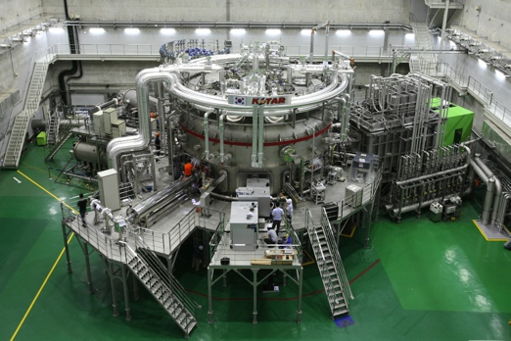
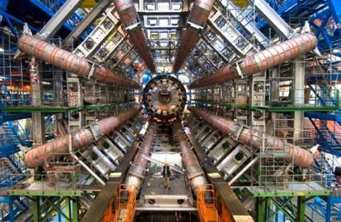
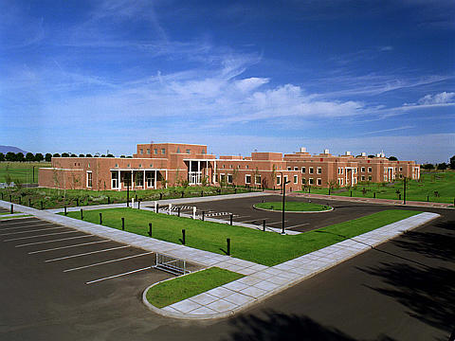
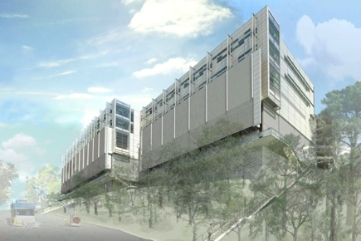
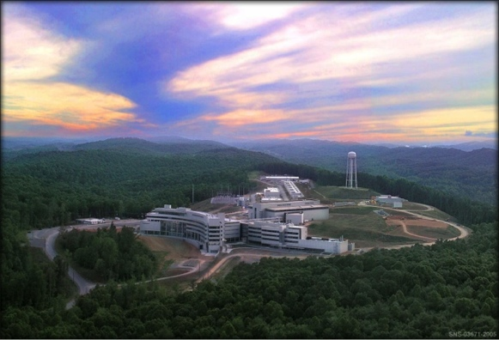
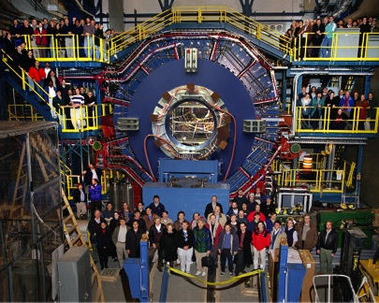
Network as Infrastructure Instrument
Connectivity is the first step – usability must follow

Slide 12
80% of ESnet traffic originates or terminates outside the DOE complex.
ESnet’s success is necessary but not sufficient for DOE, because networks share fate. SC invests nearly $1B/year in university research: campus networks matter.

Slide 13
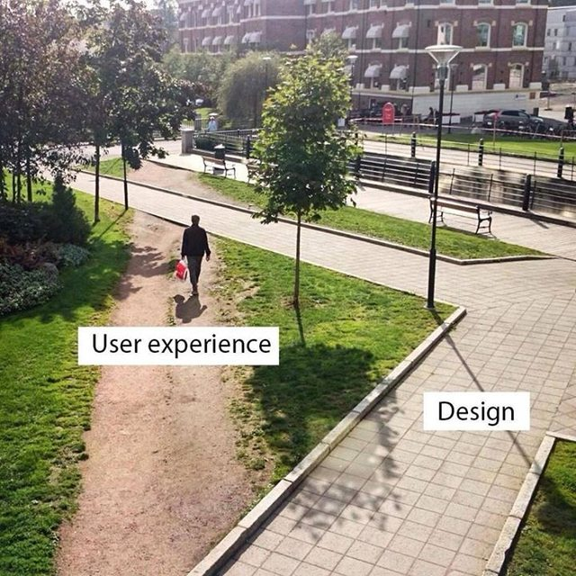
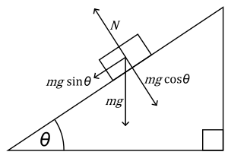
The Science DMZ in 1 Slide
Consists of four key components, all required:
“Friction free” network path
Highly capable network devices (wire-speed, deep queues)
Virtual circuit connectivity option
Security policy and enforcement specific to science workflows
Located at or near site perimeter if possible
Dedicated, high-performance Data Transfer Nodes (DTNs)
Hardware, operating system, libraries all optimized for transfer
Includes optimized data transfer tools such as Globus Online and GridFTP
Performance measurement/test node
perfSONAR
Engagement with end users
Details at http://fasterdata.es.net/science-dmz/
© 2013 Wikipedia
Notes:
Single slide summary

Slide 14
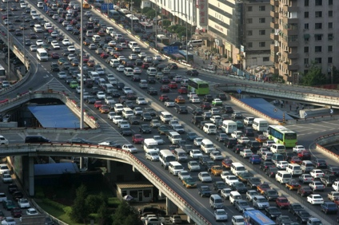
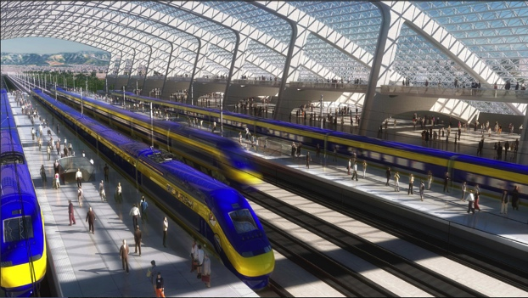
Science DMZ now recognized as a global best practice.
NSF is investing $60M to promote adoption by US universities (among other CI goals). Fourth funding round underway.
>120 universities in the US have deployed this DOE architecture.
In addition: USDA, NIH – with NASA, NOAA investigating.
Australian, Canadian universities following suit.

Slide 15
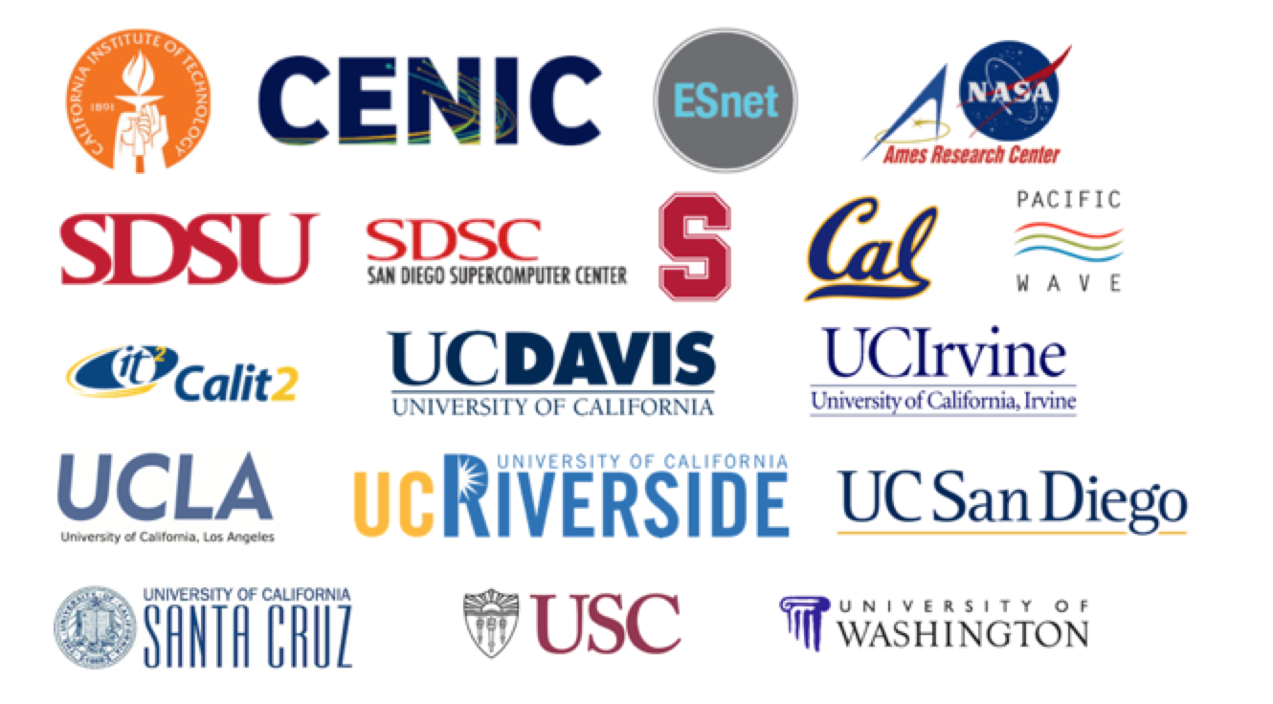
What’s next? Evolution of Science DMZ as a regional cyberinfrastructure platform.
Recent announcement of Pacific Research Platform initiative:
first large-scale effort to coordinate and integrate Science DMZs
participation by all major California R&E institutions, CENIC, ESnet
announced March 6: http://cenic.org/news/item/high-performance-big-science-pacific-research-platform-debuts-at-cenic

Slide 16
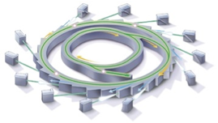
Superfacility instances multiply.
By 2025, DOE light sources will be transformed by high-resolution detectors, advanced mathematical analysis techniques, robotics, software automation, programmable networks.
Integration of experimental and computational facilities in real time, using programmable networks.
Detectors capable of generating terabit data streams.
Computational tools for analysis, data reduction, feature extraction in situ, using advanced algorithms and specialized hardware.
Data management and sharing, with federated identity management and flexible access control.
Increased scientific throughput from robotics and automation software.
Post-processing: reconstruction, inter-comparison, simulation, visualization.

Slide 17
Superfacility Vision: : A network of connected facilities, software and expertise to enable new modes of discovery
Extreme Data Science Facility (XDSF)
MS-DESI
ALS
JGI
APS
LCLS
Other data-producing sources
LHC
ESnet
New Math
High performance Software
Novel compute/data platforms
Program-mable network
Data mgmt. and sharing
Real-time analysis
Notes:
DOE should have a facility dedicated to …

Slide 18
Superfacility Prototype and Use Case : Process of science transformed
Real-time analysis of ‘slot-die’ technique for printing organic photovoltaics, using ALS + NERSC (SPOT Suite for reduction, remeshing, analysis) + OLCF (HipGISAXS running on Titan w/ 8000 GPUs).
1
2
http://www.es.net/news-and-publications/esnet-news/2015/esnet-paves-way-for-hpc-superfacility-real-time-beamline-experiments/
Results presented at March 2015 meeting of American Physical Society by Alex Hexemer.
Additional DOE contributions: GLOBUS (ANL), CAMERA (Berkeley Lab)

Slide 19
engage@es.net
Jason Zurawski – zurawski@es.net
Science Engagement Engineer, ESnet
Lawrence Berkeley National Laboratory
Future Trends in Nuclear Physics Computing
March 18th 2016

