Slide 1
Jefferson Lab Strategic Plan
Bob McKeown
User Meeting June 8, 2011

Slide 2
Charge from Lab Director
Jefferson Lab Strategic Plan
The goal is to produce a concise document, perhaps not more than 20 pages, which would start with a vision statement and a set of goals for the laboratory as a whole and would then delve deeper into what we do, developing visions, goals, and outcomes at multiple levels. The intent is that we engage our owners, both the science and operations components of the lab, the laboratory leadership more broadly, the staff, and the user community, essentially all of our stakeholders, in the process.

Slide 3
Jefferson Laboratory Strategic Plan
Strategic Plan
Decisions, planning
LDRD
DOE
SC Annual Lab Plan
JSA (contractor assurance, risk registry, …)

Slide 4
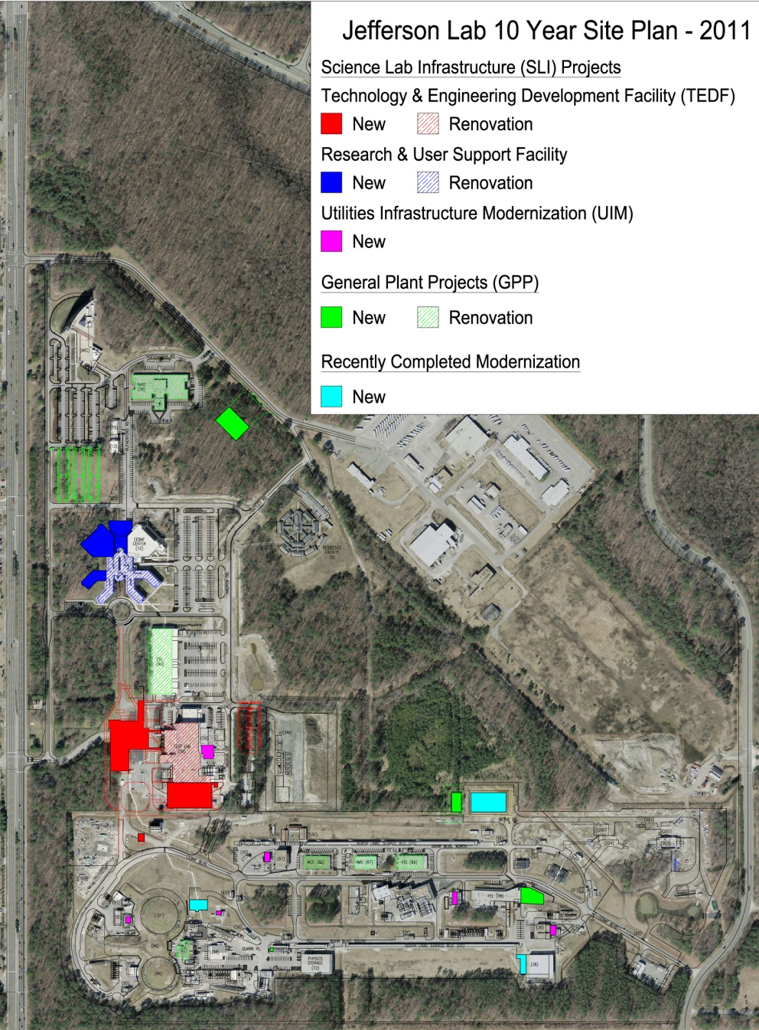
Mission Readiness: The Ten Year Modernization Plan
Facilities – New and Renovated
Research and Development
TEDF (SLI)
Staff & User Support
Research & User Support Facility (SLI)
Experimental Staging, Assembly and Operational Support
Experimental Staging Facility (GPP-ARRA)
End Station Refrigeration (GPP-ARRA)
Magnet Test Facility (GPP-ARRA)
Shipping & Receiving (GPP)
Parking and roads (GPP-ARRA)
Utilities (SLI/GPP)
Electrical distribution and reliability (SLI)
Process cooling to support accelerator operations and scientific computing (SLI)
Cryogenics to support SRF R&D and Experimental Halls (GPP)
Communications Upgrades to ensure current and future mission success (SLI)

Slide 5
Mission Statement
From Jlab website:
“Jefferson Lab's mission is to provide forefront scientific facilities, opportunities, and leadership essential for discovering the fundamental nature of nuclear matter, to partner with industry to apply its advanced technology, and to serve the nation and its communities through education and public outreach, all with uncompromising excellence in environment, health and safety.”

Slide 6
Jefferson Lab At-A-Glance
Created to build and Operate the Continuous Electron Beam Accelerator Facility (CEBAF), world-unique user facility for Nuclear Physics: Mission is to gain a deeper understanding of the structure of matter Through advances in fundamental research in nuclear physics Through advances in photon science and related research In operation since 1995 1,356 Active Users 172 Completed Experiments to date; 4 remaining in 6 GeV program Produces ~1/3 of US PhDs in Nuclear Physics (419 PhDs granted, 204 more in progress) Managed for DOE by Jefferson Science Associates, LLC (JSA) Human Capital: 763 FTEs (at 3/15/11) 23 Joint faculty, 25 Post docs, 14 Undergraduate; 30 Graduate students K-12 Science Education program serves as national model Site is 169 Acres, and includes: 79 Buildings & Trailers; 704K SF Replacement Plant Value: $317M
FY 2010:
Total Lab Operating Costs: $135M
Non-DOE Costs: $6M

Slide 7
Jefferson Lab Core Capabilities
Nuclear Physics Jefferson Lab is the world’s leading facility for exploring the fundamental nature of confined states of quarks and gluons, including the nucleons that comprise the mass of the visible universe, using continuous beams of high energy, polarized electrons. Accelerator Science State-of-the-art superconducting, high current, continuous wave, multi pass linacs, including energy recovering linear accelerators. Jefferson Lab leads the world in integrated operating experience of superconducting linear accelerators. Applied Nuclear Science and Technology The application of key technologies in accelerator, photon, and detector science enabled the development of advanced instruments and research tools, particularly, the high-power Free Electron Laser (FEL) using novel Energy Recovery Linac (ERL) technology. Large-Scale User Facilities The expertise in building CEBAF has led to the design of an upgrade that doubles the energy and will provide a unique facility that will enable continuing world leading nuclear physics research for several decades to come.

Slide 8
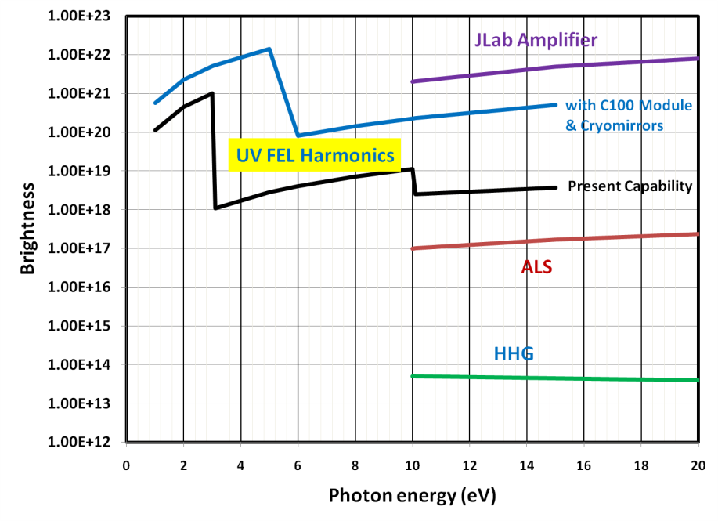
Core Capability Proposal Photon Science
Beamline Brightness
New VUV FEL facility implemented 100W at 300nm in fundamental  100mW (3rd harmonic) @ 10eV (100nm) Photon beam transport lines completed Unique science capability in the world - complements and enhances present BES program Pilot science program in FY11 Commonwealth of Virginia funds Director’s review Three experiments: Trace Kr detection (Argonne) Photoemission spectroscopy (Brookhaven) Combustion dynamics (Sandia) New core capabilities associated with VUV FEL facility (request denied) Chemical and Molecular Science Condensed Matter Physics and Materials Science Organize photon science user community in the Southeast Establish extended scientific team with demonstrated expertise Reconsider assignment of core capability?

Slide 9
Strategy for the Future: Major Scientific Initiatives
Overview
Nuclear Physics: 12 GeV Upgrade Project Experimental Nuclear Physics Program Theoretical and Computational Nuclear Physics Program Electron Ion Collider Photon Science and Next Generation Light Sources Superconducting RF Technology Note: Laboratory Directed Research and Development (LDRD) program is in preparation

Slide 10
Strategy for the Future – Major Initiative Nuclear Physics - 12 GeV Upgrade Project
Exciting new scientific opportunities – continue world leadership
CEBAF: premier facility for exploration of the fundamental nature of confined states of quarks and gluons 12 GeV Upgrade: Highest priority in the 2007 NSAC Long Range Plan Currently under construction (~50% complete); will be commissioned in 2013-2015 The Vision for the program: Upgrade to both the CEBAF accelerator and the associated experimental facilities, enable breakthrough programs to be launched in three key areas: Mechanism of quark confinement is one of the major gaps in our understanding of QCD 3-D imaging of the quark structure of the proton, the neutron, and atomic nuclei Search for new physics beyond the Standard Model of nuclear and particle physics

Slide 11
Strategy for the Future – Major Initiative Nuclear Physics – Experimental Program
CEBAF in the 21st Century
Outstanding physics utilizing the capabilities of the present CEBAF and experimental equipment during the year remaining before the final Upgrade shutdown. Once the 12 GeV Upgrade Project is completed, we envisage a program of experimental measurements for in excess of ten years. The Vision for the program: Enables the national scientific strategy of understanding the structure of matter Enables completion of 8 of the13 Office of Science milestones for hadronic physics Aims for excellence and pre-eminence in a number of key areas of nuclear physics: Confinement and its manifestation in hadronic states with exotic quantum numbers Structure of hadrons Structure of nuclei Standard Model tests via high precision at low energy

Slide 12
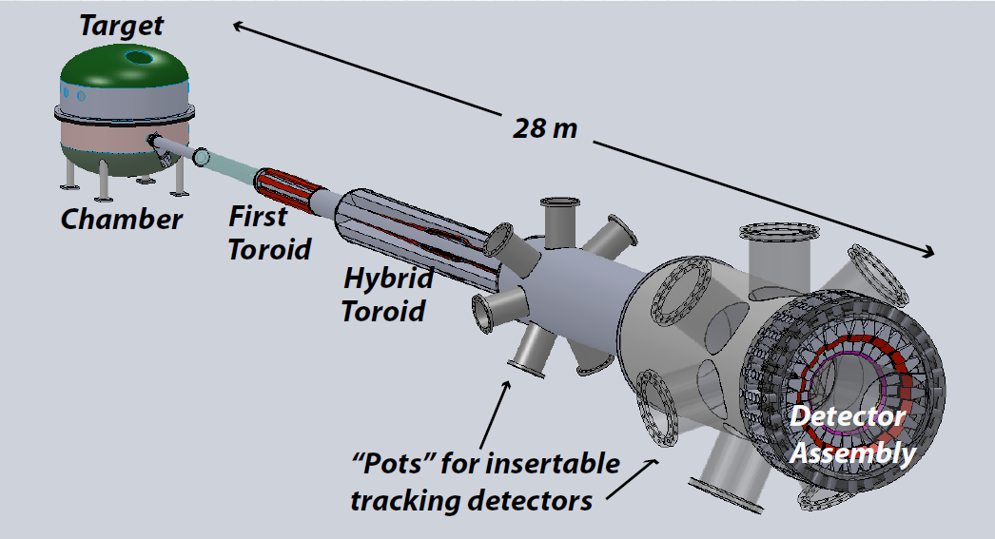
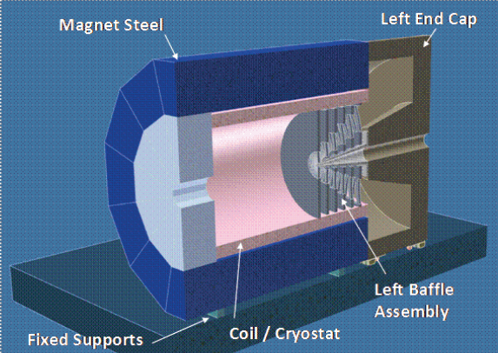
Strategy for the Future – Major Initiative Nuclear Physics – Experimental Program
CEBAF in the 21st Century
Required Resources: 12 GeV operations: Operation of the facility for 35 weeks per year Simultaneous experiments in three of the four halls on average 30% increase in scientific through-put MIE funding for SBS, MOLLER and SoLID to enable exceptional new opportunities Need for significant increase in funding

Slide 13
Strategy for the Future – Major Initiative Nuclear Physics – Theoretical and Computational Program
A Premier Center for Nuclear Theory
Jefferson Lab will continue to provide world leadership in nuclear theory, including the continued engagement and collaboration between experimentalists and theorists at Jefferson Lab, US universities and the wider hadron physics community. The Vision for the program: World-class program in nuclear theory focused on hadronic physics Addresses 2 of the 13 Office of Science milestones for hadronic physics Creation of a Physics Analysis Center, to draw on world theoretical expertise in developing the appropriate theoretical tools and computational framework required for detailed analyses of quarks and gluons in nuclei: The facilitation of pooling of world expertise in scattering and reaction theory, with well documented underpinning formalisms. The training of a generation of theoretical and experimental graduate students and postdocs to carry out such analyses. The promotion of a culture change within both experimental and theoretical communities of working together with common methodologies and the sharing of data, a forum for communicating this expertise with regular workshops/graduate schools and meetings in the US, Europe and Asia, focused in the short term on Jefferson Lab, on Jülich and GSI, and on Beijing, leadership of such an umbrella effort for both baryon and meson spectroscopy, and with extensions to eventually understanding the internal dynamics of hadrons.

Slide 14
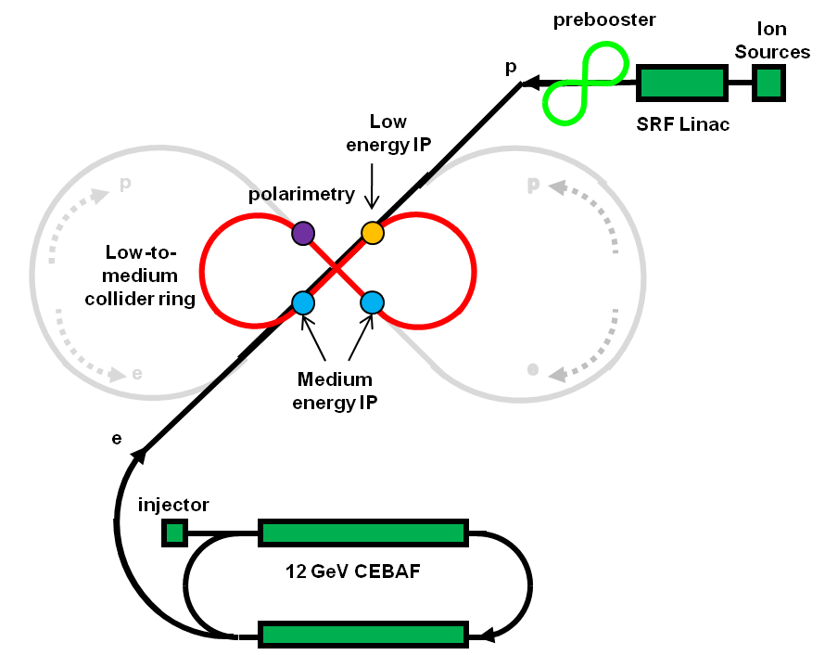
Strategy for the Future – Major Initiative Electron Ion Collider (EIC)
Imaging the Quark/Gluon Sea
Developing the concept and the physics case and initial design of a future EIC is essential for the future evolution of experimental nuclear physics in the US and in the world. According to the 2007 NSAC Long Range Plan, “An Electron-Ion Collider (EIC) with polarized beams has been embraced by the U.S. nuclear science community as embodying the vision for reaching the next QCD frontier.”
The Vision for the program:
Major physics goals
Discover the collective effects of gluons in nuclei
Map the spin and spatial structure of quarks and gluons in nucleons
Electroweak nuclear physics beyond CEBAF at 12 GeV
Jefferson Lab and users: major role in the development of
the physics case for the EIC  Luminosity > 10³⁴(cm²-s)⁻¹
Jefferson Lab developing “MEIC” design
CEBAF as injector
Center-of-mass energy of 20-65 GeV
L ~1x10³⁴ cm⁻²s⁻¹
Novel “figure 8” design  optimize spin performance
Light ions (¹H, ²H, and ³He) and heavier nuclei (such as ¹²C, ⁴⁰Ca, and ¹⁹⁷Au)

Slide 15
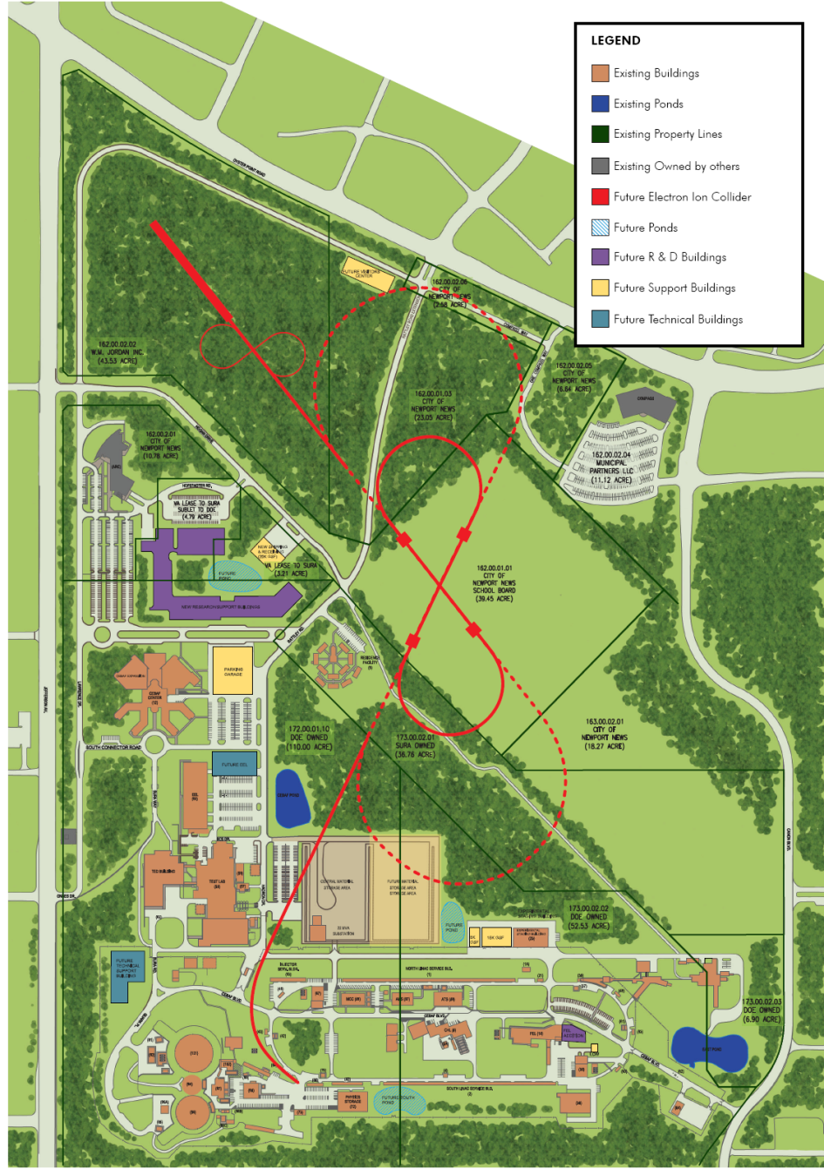
Electron Ion Collider on Jefferson Lab Site

Slide 16
EIC Realization Imagined
Activity Name | 2010 | 2011 | 2012 | 2013 | 2014 | 2015 | 2016 | 2017 | 2018 | 2019 | 2020 | 2021 | 2022 | 2023 | 2024 | 2025
12 GeV Upgrade
FRIB
EIC Physics Case
NSAC LRP
EIC CD0
EIC Machine Design/R&D
EIC CD1/Downsel
EIC CD2/CD3
EIC Construction

Slide 17
EIC Summary
Logical next step beyond 12 GeV
High risk
- technically challenging
- competition from BNL
- NSAC approval
- funding?
Contingency plan?

Slide 18
Strategy for the Future – Major Initiative Superconducting RF Technology
World leading center for accelerator technology
Jefferson Lab’s Institute for Superconducting Radio Frequency Science and Technology has fabricated and/or processed a wider variety of multi-cell SRF cavities than anyone else, some 714 of them, comprising 27 distinct cavity types, both CW and pulsed, as well as countless single-cell test cavities. The Lab’s Free-Electron Laser (FEL) Division is tightly coupled to the institute. The goal is world leadership in each Core Capability. The focus is high-current, CW, superconducting, multi-pass linacs, explicitly including ERLs. The Vision for the program: Jefferson Lab will continue to develop, improve upon and put its expertise and capabilities in world-leading SRF technology to the service of the whole Office of Science as a recognized center of expertise The continued development directed towards specific future applications will enable the Laboratory to position itself to make major contributions to new projects in the US and around the world (FRIB, ANL-APS, SNS-PUP, Project X, NGLS, ESS, MYRRHA) Jefferson Lab would develop and make its capability, expertise and capacity in SRF technology available to address societal needs beyond basic science

Slide 19
Strategy for the Future - Major Initiative Photon Science and Next Generation Light Sources
Building on SRF and ERL Technology
The Vision for the program: Jefferson Lab has a strong program in FELs based on ERLs Science program with VUV photons in the 10 eV range and above, for chemical and molecular dynamics and condensed matter studies as supported by BES Photon science at Jefferson Lab is envisioned to proceed in several stages: Establishing world-class user research program utilizing VUV photon system (already operating) Upgrade present facility, expanding the photon energy into the soft x-ray region (JLAMP) Next generation light source producing CW beams up to the hard x-ray regime Required Resources: Operations costs of the existing VUV User facility less than $10M per year to support a substantial set of user experiments JLAMP construction is estimated at ~$100M. Operations cost would be approximately $18M per year. Extensions to 550 eV photon energy would cost a total of around $250M and could be reached in a phased approach A next generation light source might be expected to cost $1B to $1.5B for a green field site. It is anticipated that substantial savings would accrue from existing JLab infrastructure and the low costs in Virginia Ongoing R&D for BES is anticipated to be at the level of ~$3.5M/year and the work for others for the DOD – ONR is expected to continue at the current level of ~$4M/year Local university involvement

Slide 20
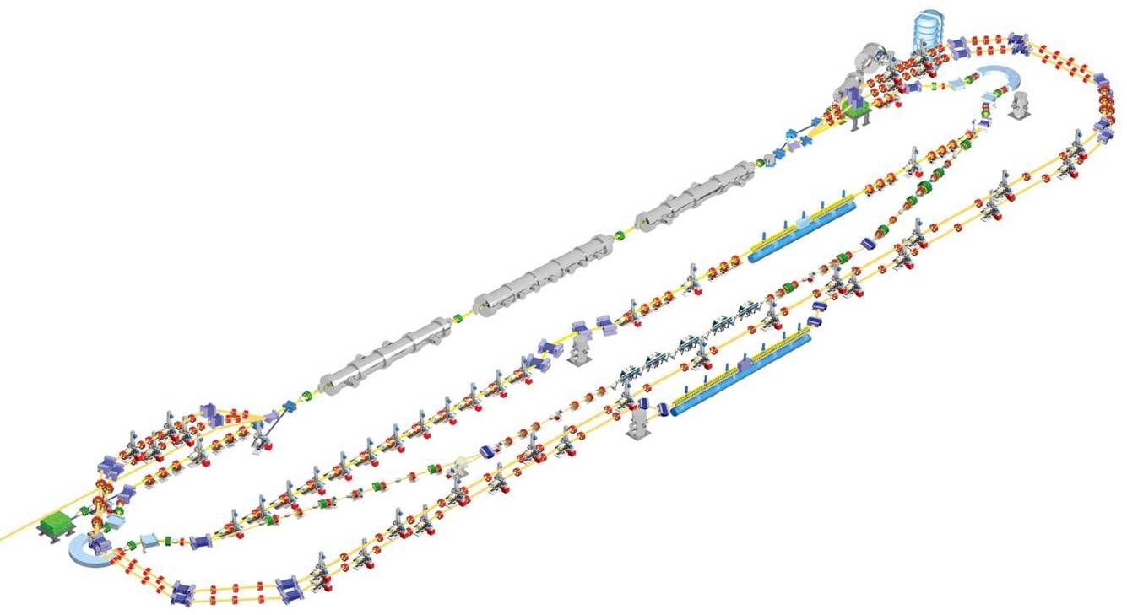
JLAMP Upgrade: 4th Generation Light Source
Upgrade three cryomodules to new C100 (12 GeV Project) design with >100 MeV/module
Add two recirculations up in energy and two down in energy recovery
~$100M upgrade

Slide 21
Projected JLAMP Performance
NGLS
JLAMP
XFEL
JLAB-UV FEL
JLAMP harm
LCLS
4th Gen
UV harm
FLASH
JLAB-THz
Infrared FELs
3rd Gen
2nd Gen

Slide 22
A Vision for Photon Science at Jefferson Lab
Ultraviolet Laser
(10 eV*)
Build User Community
For Photon Science
Upgrade
JLAMP
(500 eV*)
VUV Science
Program
Develop New Facility
Proposal
“Next Generation
Light Source”
(2000 eV X-rays)
* =3rd Harmonic

Slide 23
US-DOE Light Sources
Typically ~$100M/year operations

Slide 24
Light Source Summary
UV Laser operational
- Build science community
- Conduct scientific program
- Upgrade to JLAMP (~$100M)?
Next Generation Light Source Facility
- DOE to issue CD0 “Mission Need” soon
- Jlab may develop a competitive proposal
 $1M/year
<2 years
>$2M/year

Slide 25
What is LDRD?
Lab Directed Research and Development
Within the overall context of maintaining the vitality of the laboratories, the specific purpose of the LDRD program is to provide the DOE laboratories with the opportunity and flexibility to undertake overhead-funded research and development activities to:
(1) pursue new and innovative scientific and technological ideas;
(2) enhance the scientific and technological vitality of the institution;
(3) manage strategic direction; and
(4) develop and retain new workforce capabilities.
(See http://www.mbe.doe.gov/cf1-2/ldrd.htm)

Slide 26
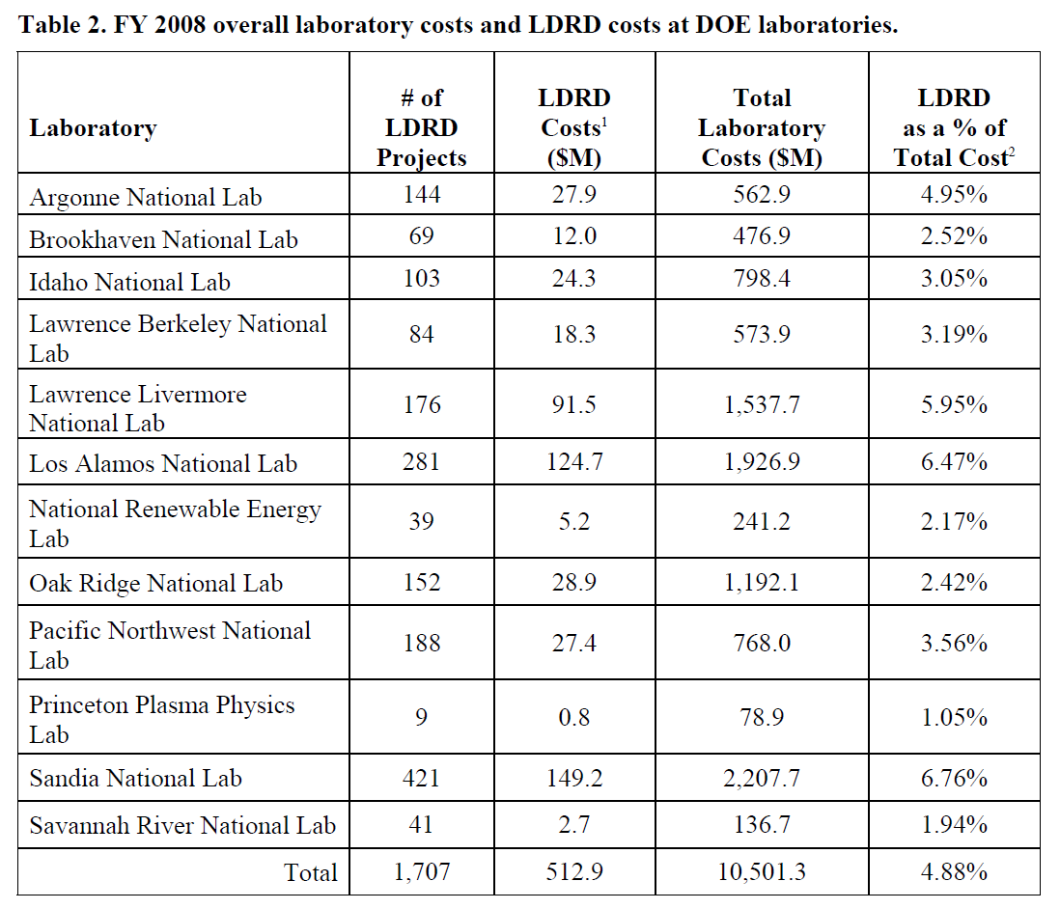
LDRD survey

Slide 27
Summary
Strategic Plan development is getting started
May need to initially address photon science
A comprehensive plan is the goal: < 1 year
Need input from many stakeholders – including users
I am interested in your views and ideas

Slide 28
BACKUPS

