Slide 1
COMPASS
1/ Recent results. 2/ Near future.
Stephane Platchkov
Institut de Recherche sur les lois Fondamentales de l’Univers
CEA/IRFU, Saclay, France
2011 JLAB Users Group Meeting
Newport News, June 6 – 8, 2011

Slide 2

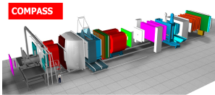
The COMPASS experiment at CERN
Jura mountains
Geneva lake
LHC
SPS
N
CERN

Slide 3
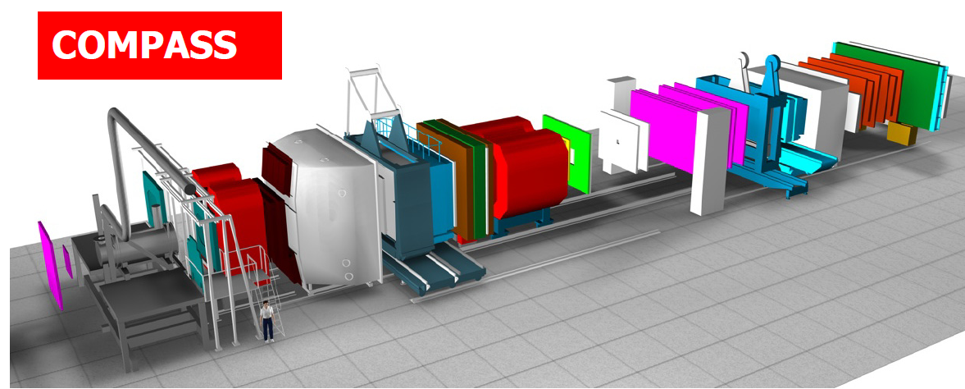
COMPASS experimental set-up
50 m
beam
Various beams: polarized µ⁺/µ⁻ (P_{µ}=80%), p, π⁺, π⁻, e⁻
High beam energy: 100-200 GeV
Large acceptance, Particle identification detectors
Low intensity beam – good luminosity thanks to a large polarized target
High amount of collected data - > 1000 TB/y

Slide 4
COMPASS : An experiment to study QCD
Nucleon spin structure studies – muon beam
  Parton distributions, Transversity, Momentum-dependent distributions
  Data taking:
    2002 – 2004, 2006 : Polarized deuteron target (⁶LiD)
    2007, 2010, 2011 : Polarized proton target (NH₃)
      Selected results in this talk
Structure and spectroscopy studies – hadron beams (π, (K), p)
  Hybrid mesons, Gluonic excitations, Polarizabilities
  Data taking:
    2004 : Test run : 2 weeks pion beam with a ²⁰⁸Pb target
    2008, 2009 : Various solid and liquid targets, from H₂ to ²⁰⁸Pb
      One example

Slide 5
Recent results

Slide 6
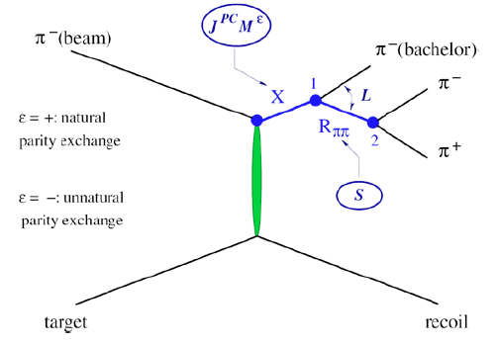
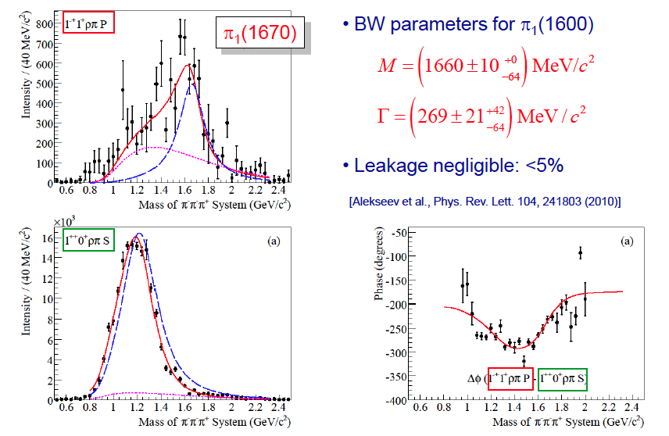
Observation of a 1⁻⁺ exotic wave (4 days of data)
New data is coming:
Many channels: ρπ, ηπ, η’π, f₁π…
Detection of both charged and neutral modes
Different A targets: ²⁰⁸Pb, ⁵⁸Ni, p
  A number of new results (data from 2008, 2009) to be presented at Hadron 2011, June 13-17 in Munich, Germany.

Slide 7
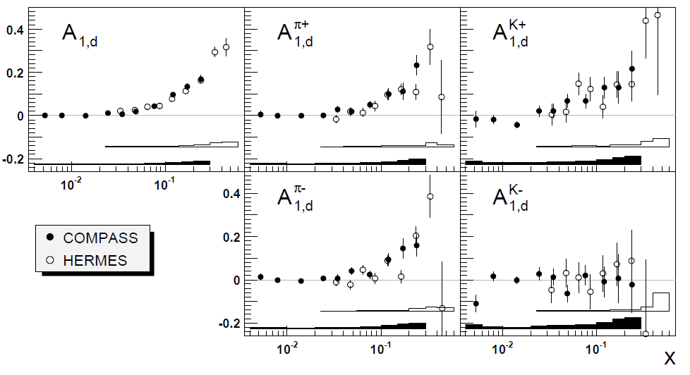
COMPASS: SIDIS asymmetries - deuteron
Deuteron data: 2002 – 2004, 2006
Both pions and kaons are identified

Slide 8
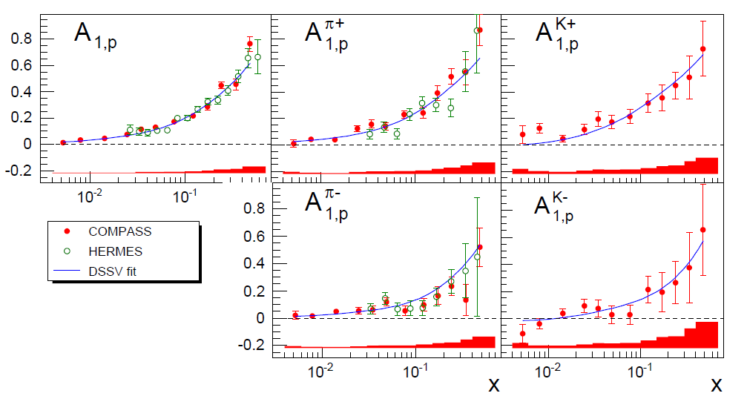
COMPASS: SIDIS asymmetries - proton
Proton data: 2007 (Phys. Lett. B693, 2010.)
COMPASS preliminary
Leading Order (LO) fit of the 10 asymmetries (2x5)
Determine 6 flavor separated PDFs :

Slide 9
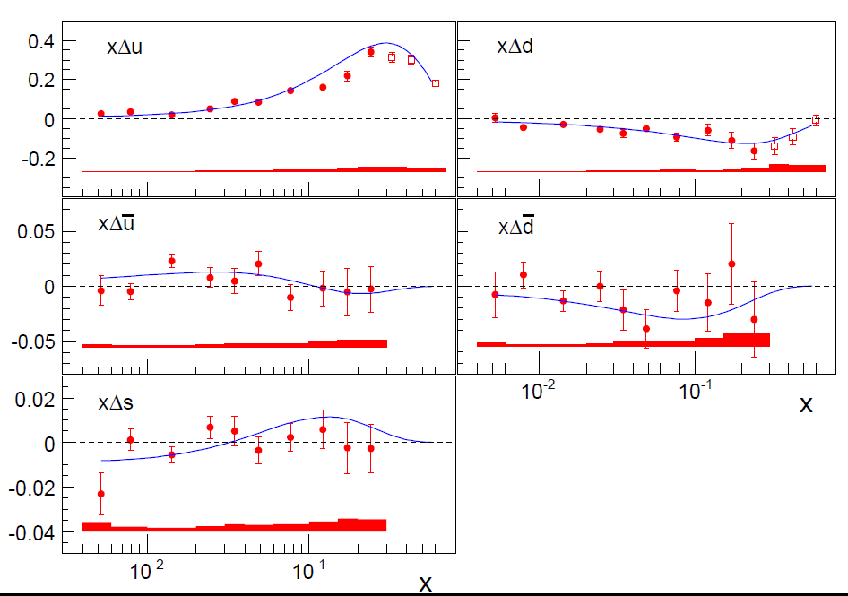
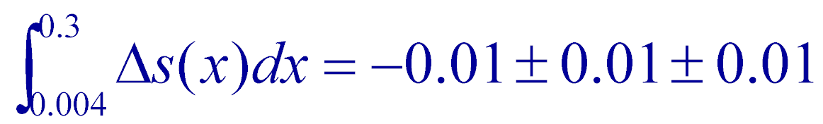
Compass results for Δu(x), Δd(x), Δs(x)
COMPASS Phys. Lett. B693, 2010.
DSSV, Phys. Rev. D80, 2009
Δs: Truncated first moment:

Slide 10
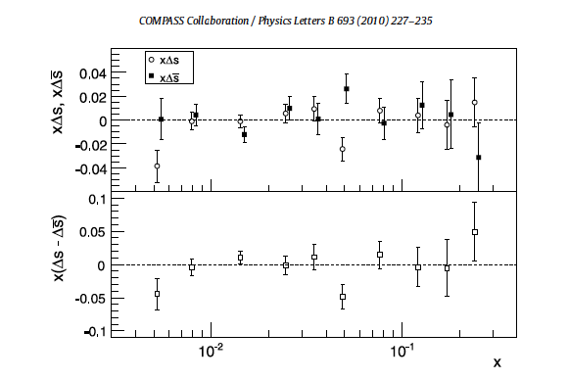
Check the assumption Δs = Δs (a 6 flavors fit)
xΔs and xΔs
x(Δs – Δs)
Both strange and anti-strange distributions are compatible with 0

Slide 11
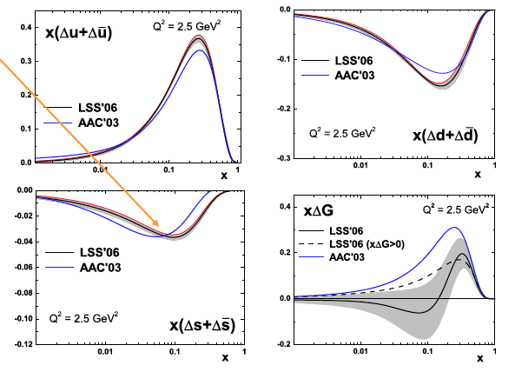
Fits to inclusive data (ONLY) : find negative Δs
Δs<0
First moment of Δs: ≈ -0.08±0.01

Slide 12
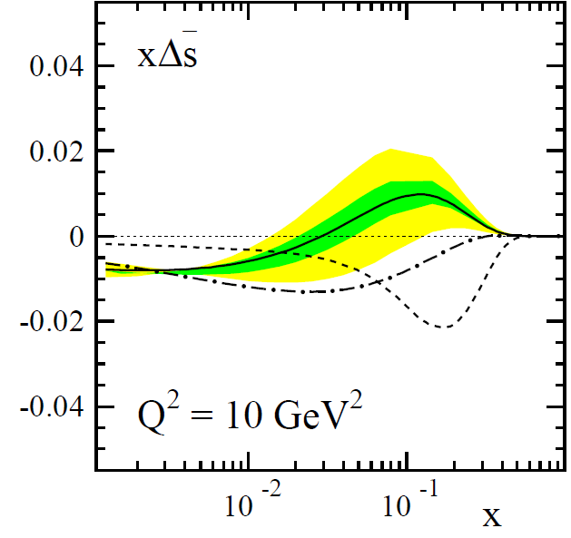
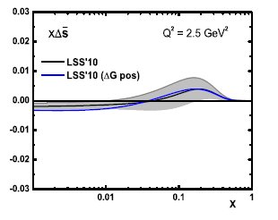
ΔS and Global analysis of DIS, SIDIS, pp data
From De Florian, Sassot, Stratman, Vogelsang, PRL 101, 2008
constrained by SIDIS
constrained by SU(3): 3F-D
DIS+SIDIS combined fit, 2010
GRSV
DNS
Leader, Sidorov, Stamenov 2010
      Global fits are compatible with both DIS and SIDIS
      The shape of Δs(x) at low x remains unknown

Slide 13
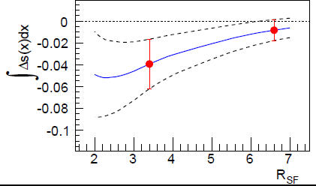
Δs: dependence on the Fragmentation Functions
COMPASS preliminary, hep-ex/1007.4061
DSS: De Florian, Sassot, Stratman, Phys. Rev. D75, 2007
EMC: EMC collaboration, Arneodo et al, Nucl. Phys. B321, 1989
  First moments: FF from DSS = -0.01±0.01±0.01
FF from EMC = -0.04±0.03±0.01
The value of the Δs first moment depends on the FF used
  Measurements of kaon and pion multiplicities are mandatory
  New COMPASS results will be shown next week in Munich

Slide 14
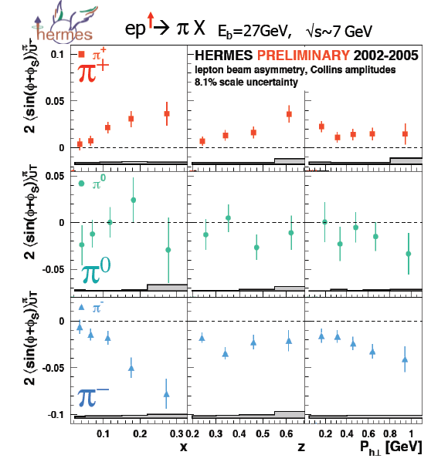
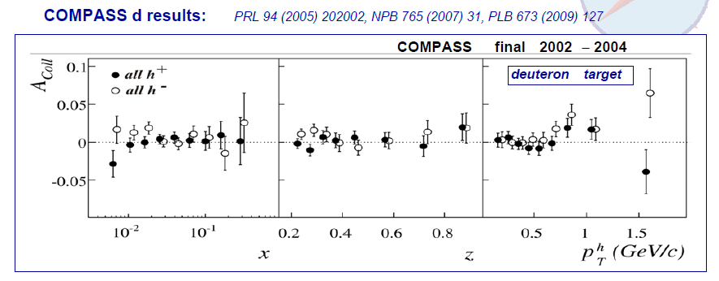
Collins asymmetry: COMPASS (d) vs HERMES (p)
Clear signal in the proton
PROTON
No signal in the deuteron
DEUTERON
Interpreted as a cancellation between u and d contributions

Slide 15

Collins asymmetry: COMPASS (p), identified hadrons
Collins FF -> measured at
π⁺⁻
K⁺⁻
Dependence on x for both positive and negative hadrons
Opposite sign for positive and negative hadrons

Slide 16
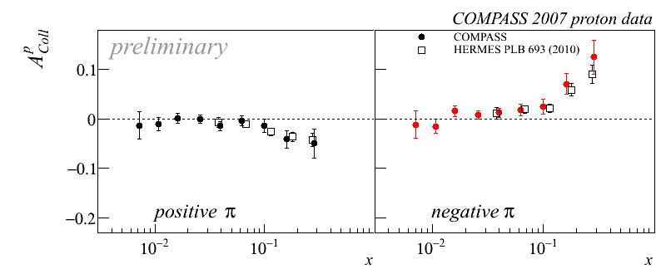
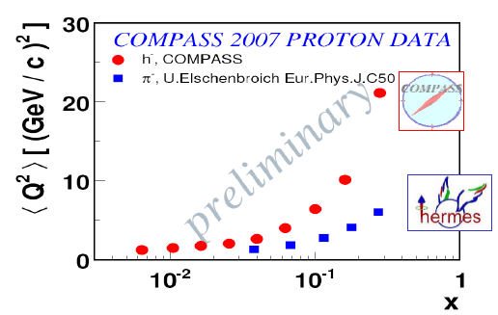
Collins asymmetry: Compass vs Hermes
π⁺
π⁻
Q² dependence
Compass and Hermes: nice agreement
Collins effect sizeable for large x
Very weak or null Q²-dependence

Slide 17
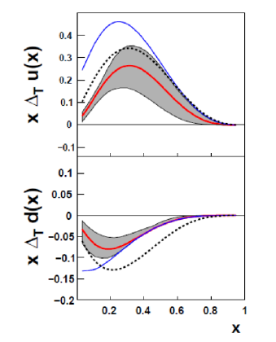


Transversity: global fit (without COMPASS proton)
Fit includes:
  COMPASS (deuteron)
  HERMES (proton)
  BELLE (Collins FF)
  (e⁺e⁻ →π⁺π⁻X)
Calculations also from:
Cloet, Bentz and Thomas PLB659 (2008)
Bacchetta, Conti, Radici, PRD78 (2008)
Anselmino et al., (2009)
Anselmino et al., Phys. Rev. D75, 2007

Slide 18
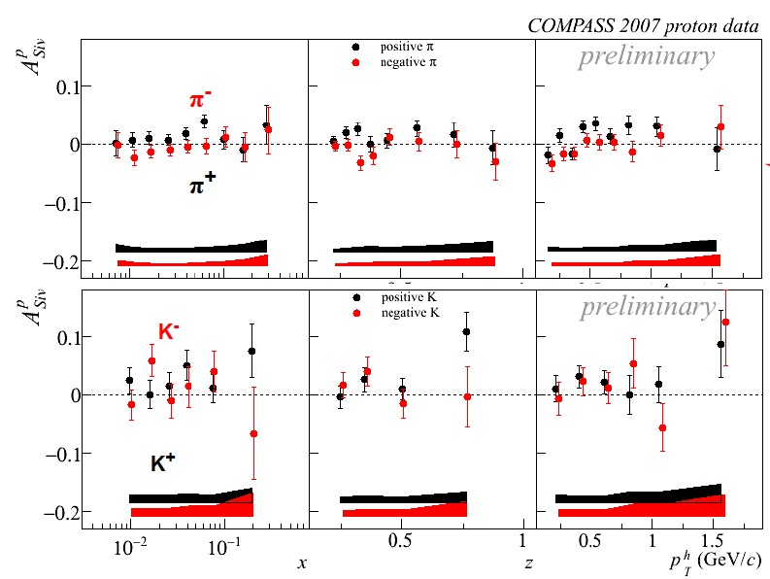
Sivers asymmetry: identified hadrons
Positive hadrons: slightly positive signal
Negative hadrons: the asymmetry is compatible with zero

Slide 19
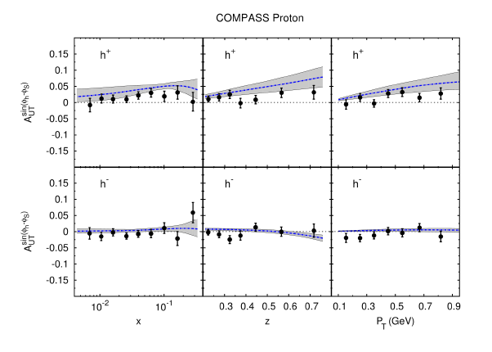
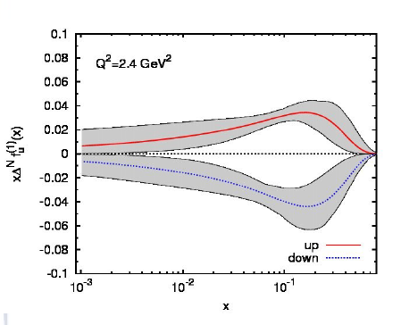
Sivers: COMPASS data vs fit (Anselmino et al.)
Anselmino et al., Eur.Phys.J.A39 (2009)89
Update in S. Mellis, DIS 2011.
Updated fit with the latest HERMES and COMPASS data (Mellis, 2011)
Opposite transverse momentum for u and d quarks
Additional results in Arnold et al., arXiv: 0805.2137 (2008).

Slide 20
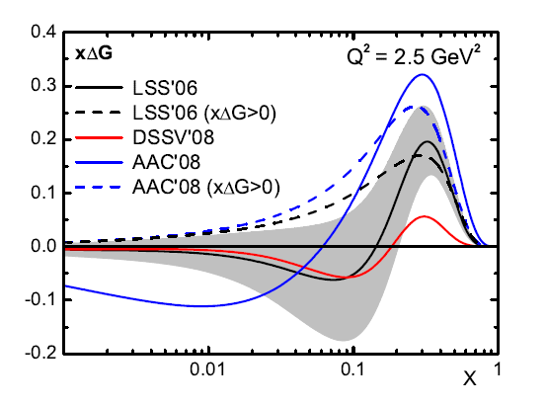
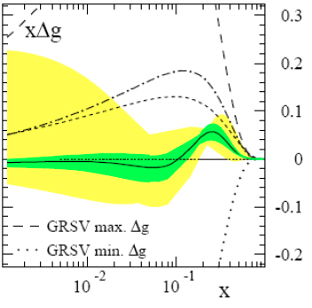
Accessing ΔG: QCD fits to world data (DIS, SIDIS)
From Leader, Spin-2008
From DSSV, PRL 101, 2008
      Shape of ΔG(x)?
      Needed are dedicated measurements of ΔG(x)
LSS-06 : Phys. Rev. D73, 2006
AAC’06 : Phys. Rev. D74, 2006
DSSV-08: Phys. Rev. Lett. 101, 2008
ΔG(x) may be: positive, negative, or sign-changing!

Slide 21
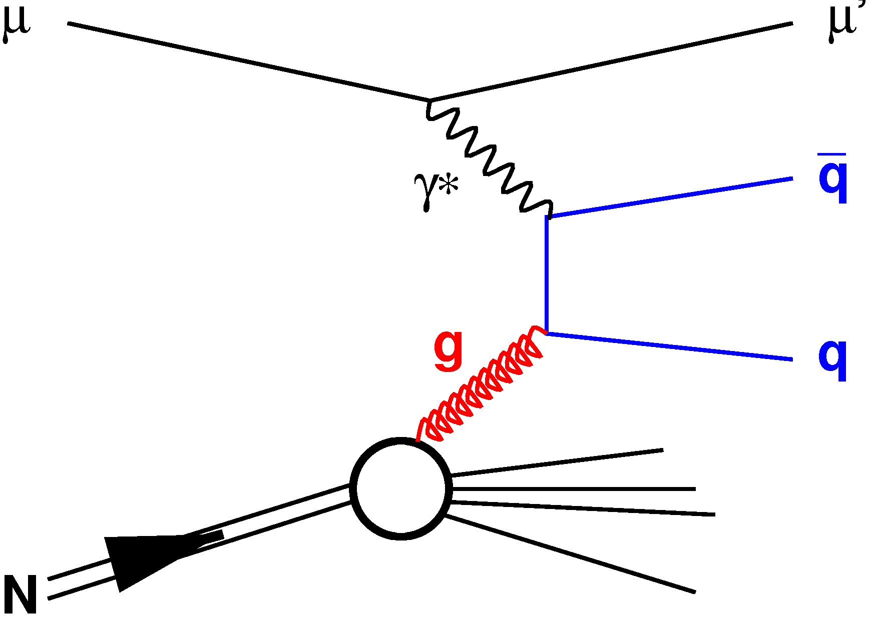
Accessing ΔG: Photon-Gluon Fusion (2 methods)
High-p_{T} hadron pairs (q=u, d, s)
  Physical background
  Rely on MC estimates
  2 cases: Q²>1 (GeV/c)² Q²<1 (GeV/c)²
Open Charm production (q=c)
  Detect D° → K⁻p⁺ and D*→D°π⁺
  Clean channels (no u, d, s quarks)
  Low statistics
COMPASS data:
  hi-p_{T}, Q²>1 : 3 points, data from 2002-2007
  Hi-p_{T}, Q²<1 : 1 point, data from 2002-2004
  Open charm: 1 point, data from 2002-2007
Photon-Gluon Fusion
5 ΔG/G points

Slide 22
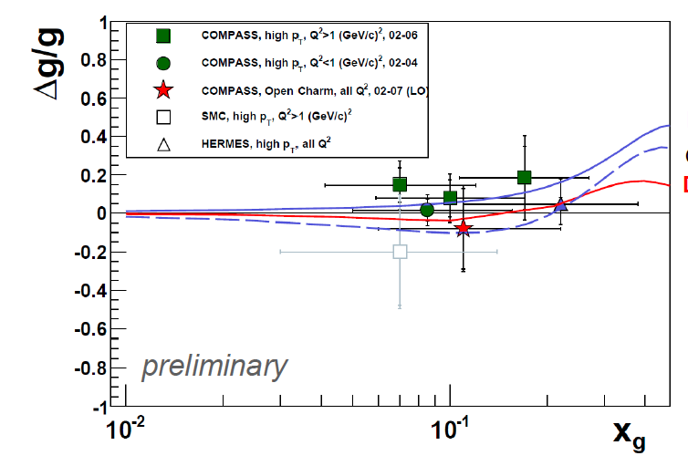
Accessing ΔG: summary of measurements
LSS ’10
DSSV ‘08
Measurements are compatible with 0 – large values of ΔG seem excluded
But: Sign of ΔG is yet ambiguous
The shape of ΔG(x) is still unknown, data constrain a limited region
The contribution of ΔG to the nucleon spin is not determined

Slide 23
COMPASS – 2

Slide 24
COMPASS-2: the near future
COMPASS-2 is a new experiment
  Recommended by the CERN SPSC: Sept. 29, 2010.
  Approved by the CERN Research Board: Dec. 1, 2010.
COMPASS-2 physics – 4 main topics
  DVCS and DVMP : Study GPDs, “nucleon tomography”
  Unpolarized SIDIS : Fragmentation Functions, s-PDFs, TMDs
  Drell-Yan : Universality of TMDs
  Primakoff scattering : Polarizabilities of π and K
Data taking
  2012, SPS/LHC shutdown, 2014, 2015, 2016

Slide 25
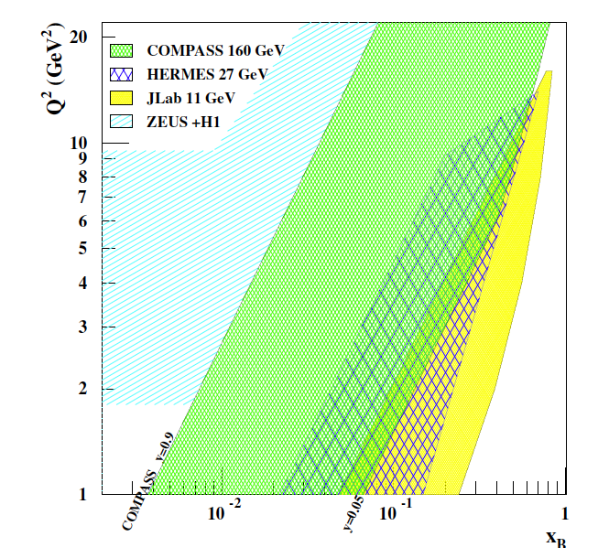
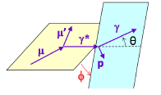
DVCS – COMPASS kinematical coverage
Beams
  100 – 190 GeV
  Polarization: ~80%
  Both μ⁺ and μ⁻ beams
x-Q² region: ≈ 0.01 – 0.1
  Between HERA – Jlab/Hermes
Detect both outgoing photon and recoiling proton

Slide 26
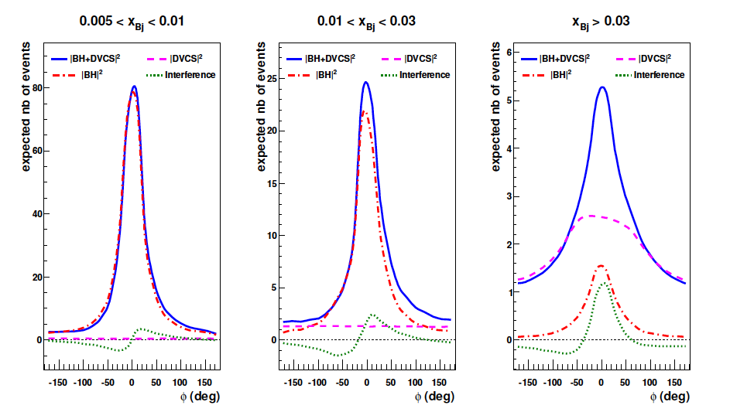
DVCS – the COMPASS x_{B} regions - similation
Relative amplitude dramatically changes as a function of x

Slide 27
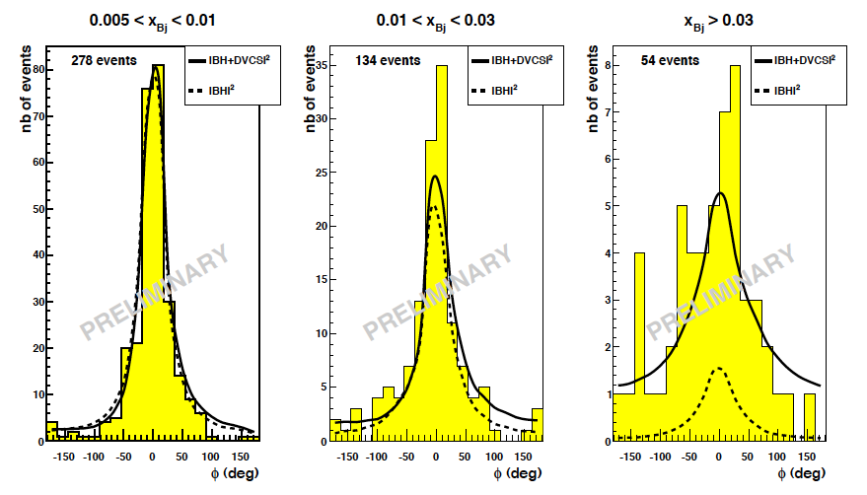
DVCS – the COMPASS x_{B} regions – REAL DATA
278
134
54
DVCS
BH
Clear sign for a DVCS signal
Test runs in 2008/2009 – 40 cm long H₂ target

Slide 28

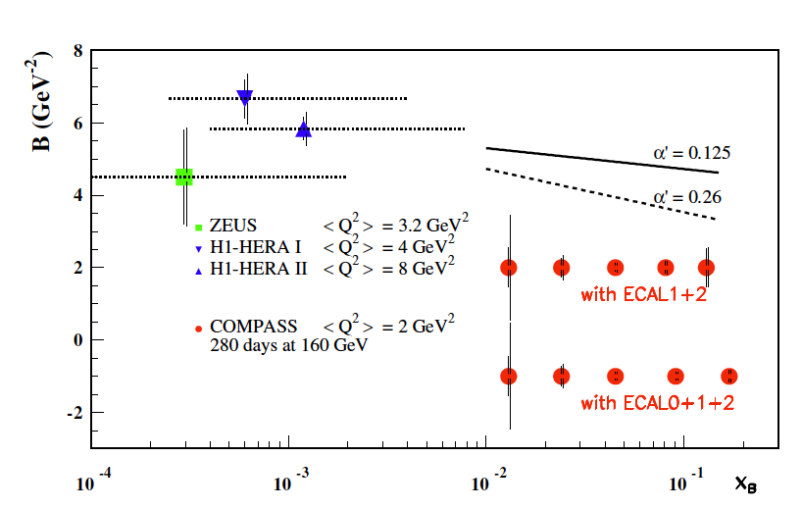
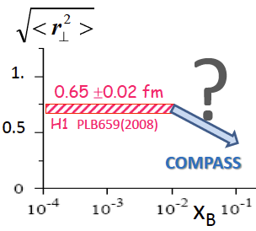
DVCS – SUM of μ⁺ and μ⁻ cross sections
2 x 5 months of data, LH₂ target
Extract the transverse size of the nucleon as a function of x_{B}

Slide 29
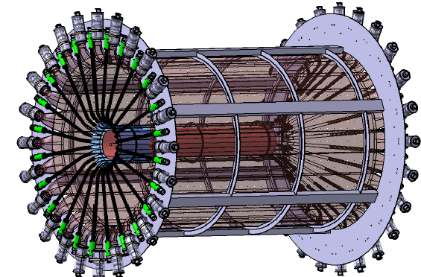
DVCS – main new equipment
ECAL1
ECAL2
50 m
New electromagnetic calorimeter, ECAL0
Liquid hydrogen target, 2.5 m long
Proton Time-Of-Flight detector, 4.0 m long

Slide 30

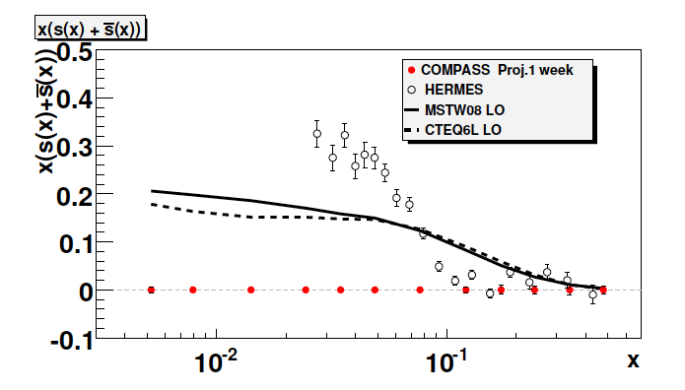
Semi-inclusive DIS (in parallel with DVCS)
Features
  Pure hydrogen target
  High-performance particle identification for π⁺,π⁻,π⁰,K⁺,K⁻,K⁰ etc…
Measurements of:
  Multiplicities
    Input to global FF analysis
  Strange quark PDF
    down to x=0.004
1 week of beam
2.5 m liquid H₂ target

Slide 31
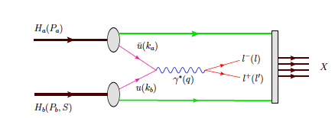

Polarized Drell-Yan measurements
COMPASS
  190 GeV pion beam
  Transversely polarized NH₃ target
  Spectrometer ready for muon detection
  SIDIS :
  DY:
    Dominated by u/u annihilation
Access to TMDs, complementary to SIDIS
  Universality of TMDs
  Test of factorization: opposite sign expected:

Slide 32
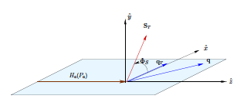
DY cross section expansion
Expansion in LO quark parton model
  polarized target nucleon
  Access 4 TMDs:
    Sivers, Boer-Mulders, Pretzelosity, Transversity
  Convolution with the pion f₁ or BM distributions
Access 4 TMDs – asymmetry modulation:
Arnold, Metz and Schlegel, Phys. Rev. D79:034005, 2009.
Siv
BM
Pr
Tr

Slide 33
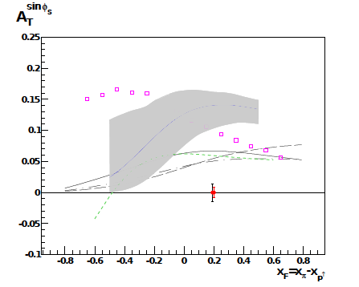
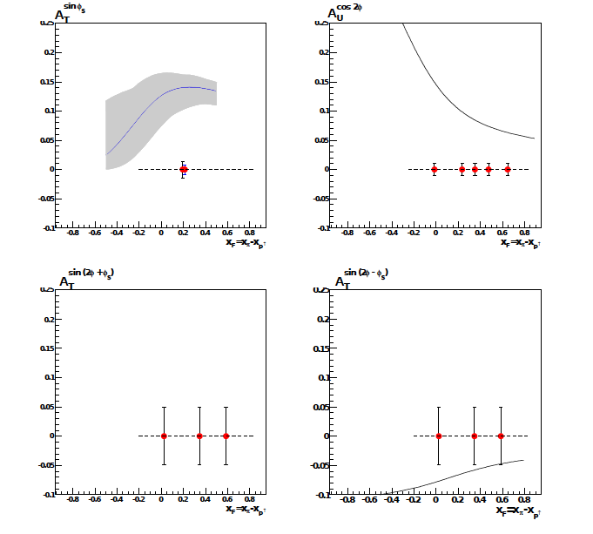
Polarized Drell-Yan – expected results
2 x 5 months of data taking
6.10⁸ pions/spill
1.1 m NH₃ target
Mass: 4<M_{μμ}<9 GeV
Sivers
Boer-Mulders
DY beam test in 2008
Pretzelosity
Transversity

Slide 34
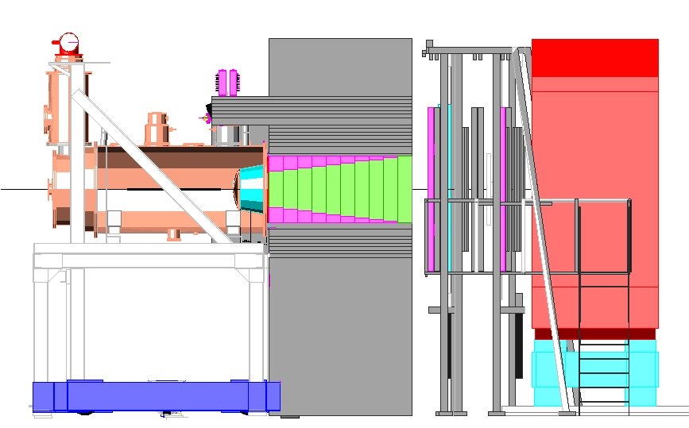
Drell-Yan preparation
Upgrade of the spectrometer
New beam telescope (Sci-Fi)
Thick hadron absorber/beam dump
Vertex detector
Displacement of the target

Slide 35
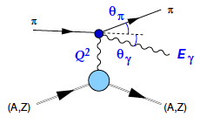
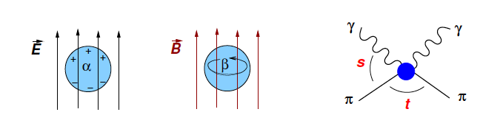
Primakoff scattering – test of ChPT
Primakoff, PR 81 (1951) : use the Coulomb field of a nucleus as a photon target
Electromagnetic polarizability
  from the deviation from point-like particle
Present status
  Theory : α_{π}−β_{π} = 5.7±1 (10⁻⁴fm³)
  Available data: between 4 and 14

Slide 36
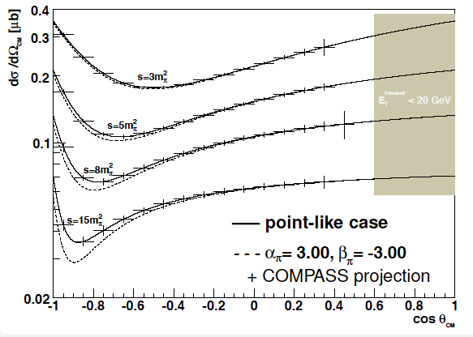
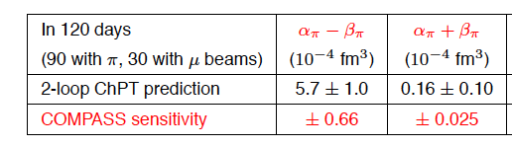
Primakoff scattering – test of ChPT
COMPASS features
  Energy: 190 GeV
  High-I pion beam
  Muon beam = ref.
  For’d anlgles: (α_{π}+β_{π})
  Backward angles (α_{π}−β_{π})

Slide 37
COMPASS is a major QCD laboratory
Recent achievements
  New proton data with both L and T polarized target
  New results on ΔG/G, g₁(x), flavor-sep. PDFs, Collins, Sivers, TMDs
  New hadron spectroscopy results -> next week in Munich
Present times – improve statistics on p by x2 to x3
  2010 run : transversely polarized NH₃ target
  2011 run : longitudinally polarized NH₃ target -> improved statistics on the proton to come
COMPASS near future :
  COMPASS 2 proposal was accepted
  Physics programs (DVCS, Drell-Yan, Primakoff): in preparation, data taking in 2012, 2014-2016

Slide 38
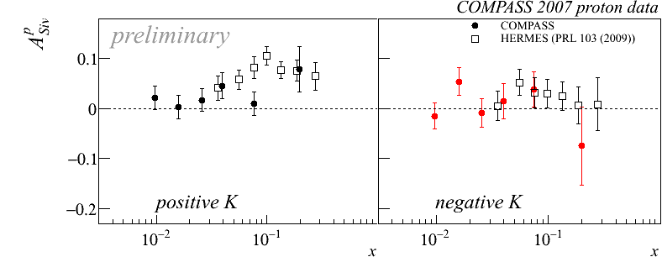
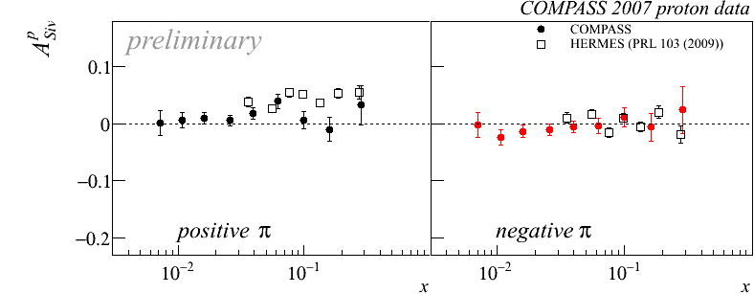
Sivers: COMPASS vs Hermes
Overall good agreement, differences for π+
Additional COMPASS data (x3) from our 2010 run: to come
Non-zero asymmetries: could indicate a non-zero orbital momentum

Slide 39
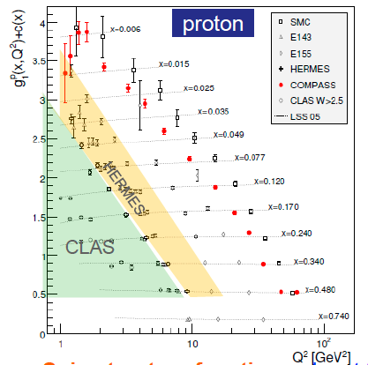
Accessing ΔG: QCD fits to world data
NLO QCD fit to world DIS data
  From: DIS: Many groups …. since about 15 years
  (access all parton distributions)
Recent achievements: global fits - include SIDIS and pp data:
  DIS+SIDIS+pp: DSSV, PRL101, 2008. DIS+SIDIS: LSS, arXiv 10125033.

