Slide 1
12 GeV CEBAF INJECTOR
Reza Kazimi
Users Group Annual Meeting
June 4, 2012

Slide 2
12 GeV Injector
What we are working on:
45MeV to 123MeV final energy
200 kV Gun
2-Wien Spin Flipper
SRF Capture inside the new booster
3-Wien
Polarized Positrons

Slide 3
12 GeV Injector
Motivation
Make CEBAF work
Parity Violation experiments are more demanding
More efficient use of polarization
Expand the physics capability
What we are working on:
45MeV to 123MeV final energy
200 kV Gun
2-Wien Spin Flipper
SRF Capture inside the new booster
3-Wien
Polarized Positrons

Slide 4
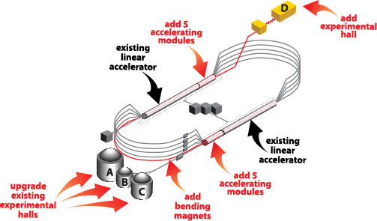
12 GeV CEBAF Upgrade

Slide 5
12 GeV CEBAF Upgrade
Injector
11.25% of
Linac Energy

Slide 6
West Recombiner

Slide 7
Parity Quality Beams at CEBAF
1.158
1.158

Slide 8
Beam quality and Injector
In CEBAF many of critical beam parameters are set in the injector and some remain unchanged through the accelerator. Therefore, the injector plays a significant role in setting the final beam qualities such as bunch structure, energy spread, current stability, etc.
Parity quality is achieved when the two helicity states are created and treated similarly particularly in the injector’s low energy region. Also, if the symmetry is maintained, the beam motion can be damped through the initial acceleration in the injector, further reducing the position asymmetry.

Slide 9
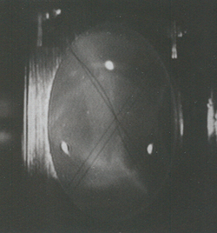
Brief description of the CEBAF Injector
Polarized Electron Source
(130 kV)
Synchronous Injection
SRF Acceleration
(<65 MeV)
B
5 MeV Mott
Polarimeter
Synchrotron
Light Monitor
C
A
Chopper
Cryounit
Cryomodules
Apertures
Buncher
Capture
Gun#2
Bunchlength
Injection Chicane
V-Wien Filter
H-Wien Filter
FC#1
Cavity
FC#2
PreBuncher
Spin Solenoids
Gun#3
100/500 keV Mott
Polarimeter
45 MeV Dump/
Spectrometer
Electron Spin Manipulation
Bunching & Acceleration
500 keV
SRF Acceleration
(<10 MeV)
Injection
Chicane

Slide 10
Chopper Operation

Slide 11
Breaking down the problem
The CEBAF Injector Upgrade
Acceleration
Space Charge
5 MeV Dump
Synchrotron Light Monitor
Chopper
Cryounit
Cryomodules
Apertures
Buncher
Capture
Gun#2
Bunchlength
Injection Chicane
PCup
FC#1
Cavity
FC#2
Prebuncher
Gun#3
V-Wien Filter
H-Wien Filter
500 keV Dump
45 MeV Dump/Spectrometer
Bunching Process

Slide 12
The CEBAF Injector Upgrade
Increase Gun Voltage from
130 kV to 200 kV
Lowers the space charge effect and reduces difference between high and low bunch charge.
5 MeV Dump
Chopper
Superconducting
Booster
Apertures
Cryo-modules
Buncher
Capture
Gun#2
Injection Chicane
Faraday Cup
Prebuncher
Faraday Cup
Faraday Cup
V-Wien Filter
H-Wien Filter
Gun#3
500 keV Dump
Spectrometer/Beam Dump

Slide 13
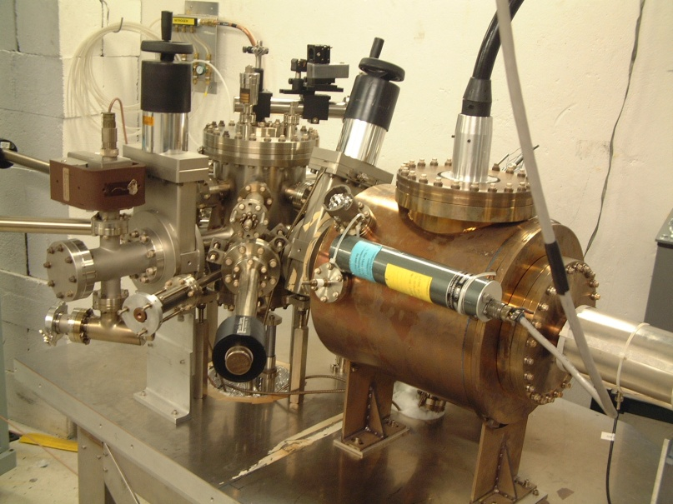
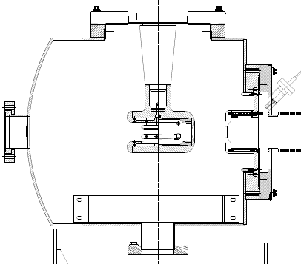
The CEBAF 200kV Inverted Gun
New design
Higher voltage = better beam quality.

Slide 14
The CEBAF Injector Upgrade
Increase Gun Voltage from
130 kV to 200 kV
Lowers the space charge effect and reduces difference between high and low bunch charge.
5 MeV Dump
Chopper
Superconducting
Booster
Apertures
Cryo-modules
Buncher
Capture
Gun#2
Injection Chicane
Faraday Cup
Prebuncher
Faraday Cup
Faraday Cup
V-Wien Filter
H-Wien Filter
Gun#3
500 keV Dump
Spectrometer/Beam Dump
Upgrade the Wien Filters for higher energy beam
Enables electron spin setting and 180 deg spin flip as required by Parity Quality experiments

Slide 15
The CEBAF Injector Upgrade
Increase Gun Voltage from
130 kV to 200 kV
Lowers the space charge effect and reduces difference between high and low bunch charge.
5 MeV Dump
Chopper
Superconducting
Booster
Apertures
Cryo-modules
Buncher
Capture
Gun#2
Injection Chicane
Faraday Cup
Prebuncher
Faraday Cup
Faraday Cup
V-Wien Filter
H-Wien Filter
Gun#3
500 keV Dump
Spectrometer/Beam Dump
Upgrade the Wien Filters for higher energy beam
Enables electron spin setting and 180 deg spin flip as required by Parity Quality experiments
Integrate Capture into the Booster
Accommodates higher energy beam, simplifies beam setup, and increases reliability

Slide 16
The CEBAF Injector Upgrade
New Booster with new SRF design
Eliminates the x/y coupling and improves and simplifies the Parity Quality beam setup.
Increase Gun Voltage from
130 kV to 200 kV
Lowers the space charge effect and reduces difference between high and low bunch charge.
5 MeV Dump
Chopper
Superconducting
Booster
Apertures
Cryo-modules
Buncher
Capture
Gun#2
Injection Chicane
Faraday Cup
Prebuncher
Faraday Cup
Faraday Cup
V-Wien Filter
H-Wien Filter
Gun#3
500 keV Dump
Spectrometer/Beam Dump
Upgrade the Wien Filters
Enables 180 deg electron spin flip as required by Parity Quality experiments
Integrate Capture into the Booster
Accommodates higher energy beam, simplifies beam setup, and increases reliability

Slide 17
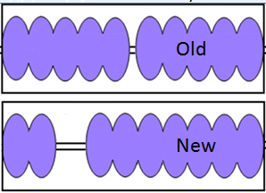
Modeling the New Booster
Beam brightness is reduced at the higher gun voltage due to the β mismatch at the start of the capture (a beta-graded cavity). Different booster designs considered in an injector without a capture cavity:
5+5 Existing booster, two 5-cell cavities
1+7, 1-cell cavity and standard CEBAF 7-cell cavity
1+1+7
2+5
2+7
7+7
5+5
2+7

Slide 18
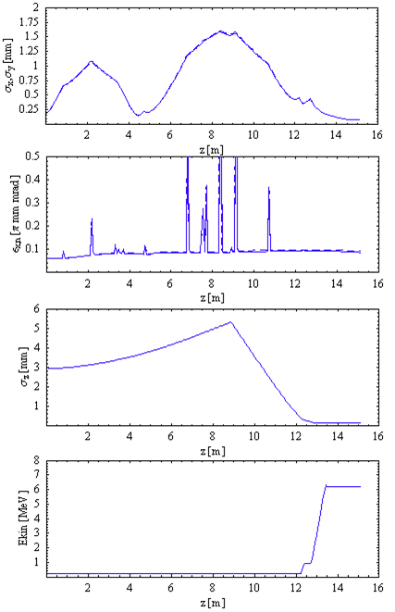
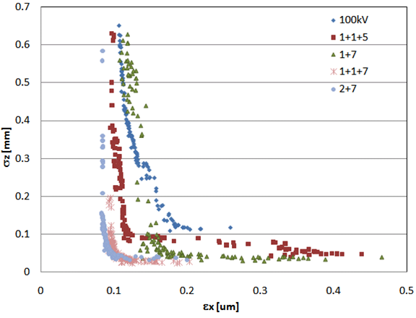
Modeling the New Booster
Evolutionary genetic algorithm optimization using an ASTRA model

Slide 19
Bunch Length for Different Currents

Slide 20
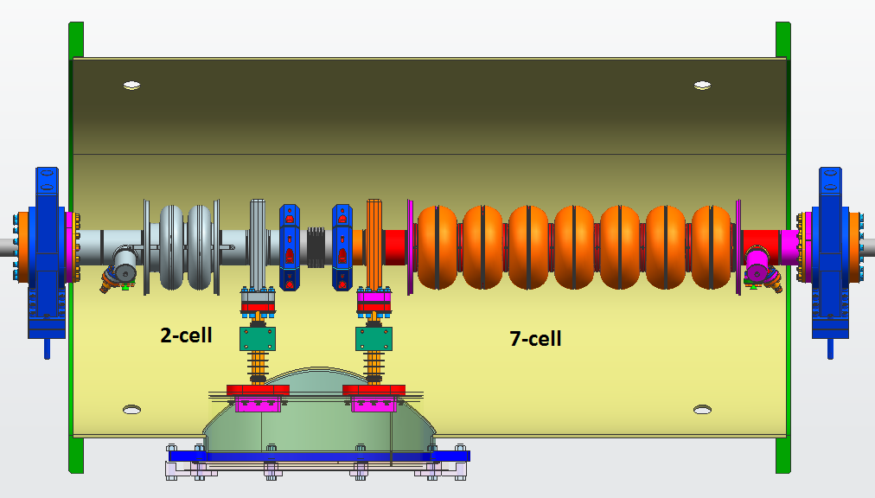
New booster with 2 cell + 7 cell cavities
Significantly reduced rf kick and x/y coupling and easier operation

Slide 22
The CEBAF Injector Upgrade
Increase Gun Voltage from
130 kV to 200 kV
Lowers the space charge effect and reduces difference between high and low bunch charge.
New Booster with new SRF design
Eliminates the x/y coupling and improves and simplifies the Parity Quality beam setup.
Upgrade the Cryo-modules to increase the injector energy from 45 MeV to 123 MeV
To achieve the 12 GeV injector energy requirement
5 MeV Dump
Chopper
Superconducting
Booster
Apertures
Cryo-modules
Buncher
Capture
Gun#2
Injection Chicane
Faraday Cup
Prebuncher
Faraday Cup
Faraday Cup
V-Wien Filter
H-Wien Filter
Gun#3
500 keV Dump
Spectrometer/Beam Dump
Upgrade the Wien Filters
Enables 180 deg electron spin flip as required by Parity Quality experiments
Integrate Capture into the Booster
Accommodates higher energy beam, simplifies beam setup, and increases reliability

Slide 23
Upgrade of the Accelerating modules
C25
R100
Up to 30 MeV + Up to 100 MeV

Slide 24
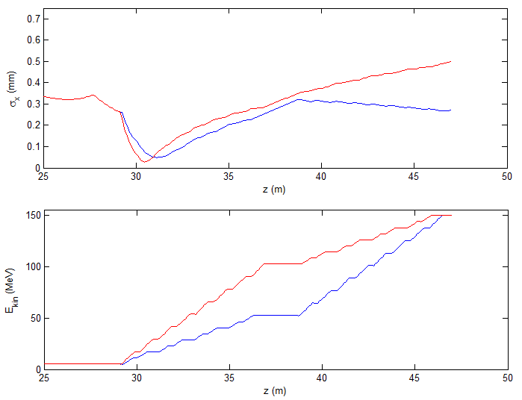
Order of Modules
Horizontal rms beam size (top) and beam energy (bottom) along the two modules. Red curve is high gradient module first. Blue curve is low gradient first.

Slide 25
Next Topic:
3 Wien System

Slide 26
Spin Precession at CEBAF
3 Wien system
Spin rotation through a Bend
spin precession = [(g-2) / 2m_{e}]E θ Where g=2.002319
= E θ/440.7 E is in MeV
The spin difference between the injector and the experimental hall is the sum of all the spin precessions through all the bends in the accelerator
At certain final energies, the electron spins at different halls become parallel otherwise they are not.
At present we use a single Wien filter to rotate the spin angle of all three halls. Their relative spin angles difference remain unchanged.

Slide 27
Past Scheduling Issue Example
3 Wien system
For example, Qweak energy was reduced 2 MeV in October 2011 to improve the polarization for hall A on passes 2-5. With C at P²=1 Hall B has P²=1 on passes 2 and 4 and P²=0 on passes 3 and 5. HD-Ice wanted polarization on pass 3 as well, but ….
Pass | P² 549 MeV/linac |  | P² 548 MeV/linac |  | Independent Wiens P²
 | Hall A | Hall B | Hall A | Hall B | A,B,C
2 | .870 |  | .884 | .981 | 100
3 | .869 |  | .902 | .002 | 100
4 | .909 |  | .957 | .983 | 100
5 | .969 |  | 1.00 | .145 | 100

Slide 28
Future12 GeV Issues
3 Wien system
Energy which gives full polarization at fifth pass to A/B/C simultaneously is 1047 MeV/linac, or 11.635 GeV to D. The figure of merit for GlueX is about 0.6 at this energy vs 12.1 GeV per R. Jones. The hall D eta factory proposers give 0.9.
@12.1 GeV | Energy (GeV) | P² Optimize A | P² Opt A&B | P² Optimize B | Independent Wiens P²
Hall A | 11.0 | 100 | 89 | 61 | 100
Hall B | 11.0 | 61 | 89 | 100 | 100
Hall C | 11.0 | 5 | 28 | 61 | 100
Hall D | 12.1
P is “percent alignment” of polarizations.
Polarization is P times Cathode polarization (88%)

Slide 29
Future12 GeV Issues
3 Wien system
Energy which gives full polarization at fifth pass to A/B/C simultaneously is 1047 MeV/linac, or 11.635 GeV to D. The figure of merit for GlueX is about 0.6 at this energy vs 12.1 GeV per R. Jones. The hall D eta factory proposers give 0.9.
For those experiments which require high but not fully longitudinal polarization, there exist combinations of three halls in the linac energy range 1050-1095 which provide ~95% of cathode polarization to two or three of A/B/C at various passes.
If there’s an experiment running which requires full longitudinal polarization, e.g. parity, near 11 GeV the problem becomes harder and the other halls may be down in the range of 80% of cathode.

Slide 30
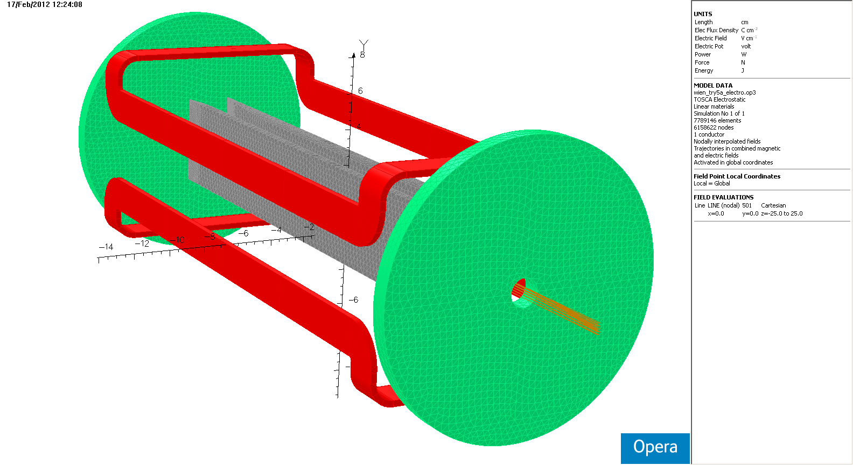
Present Wien Internals
3 Wien system
B(y)
E(x)
38 cm
16 cm

Slide 31
Just an Idea
3 Wien system
Have a Wien filter for each beam to provide full longitudinal polarization for every hall.
In the injector the only place that the three beams are separated, is between the chopper cavities.
If one could build three independent small Wien filters around the separated beams, then one could set the spin angle for each beam separately.
The chopper Wiens provide ±90 degree spin rotation. The spin flipper system remains unchanged.

Slide 32
3 Wien system
2.6 cm

Slide 33
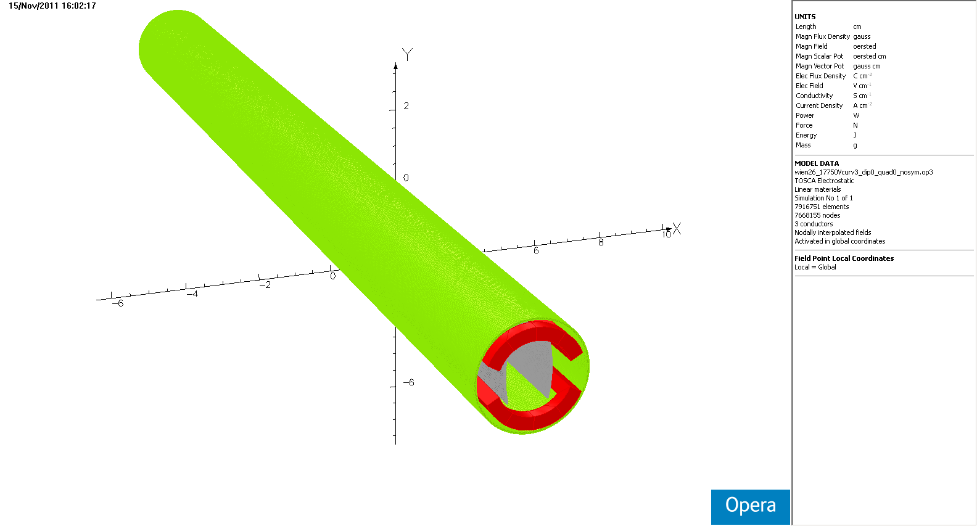
single Wien model
3 Wien system
30 cm

Slide 34
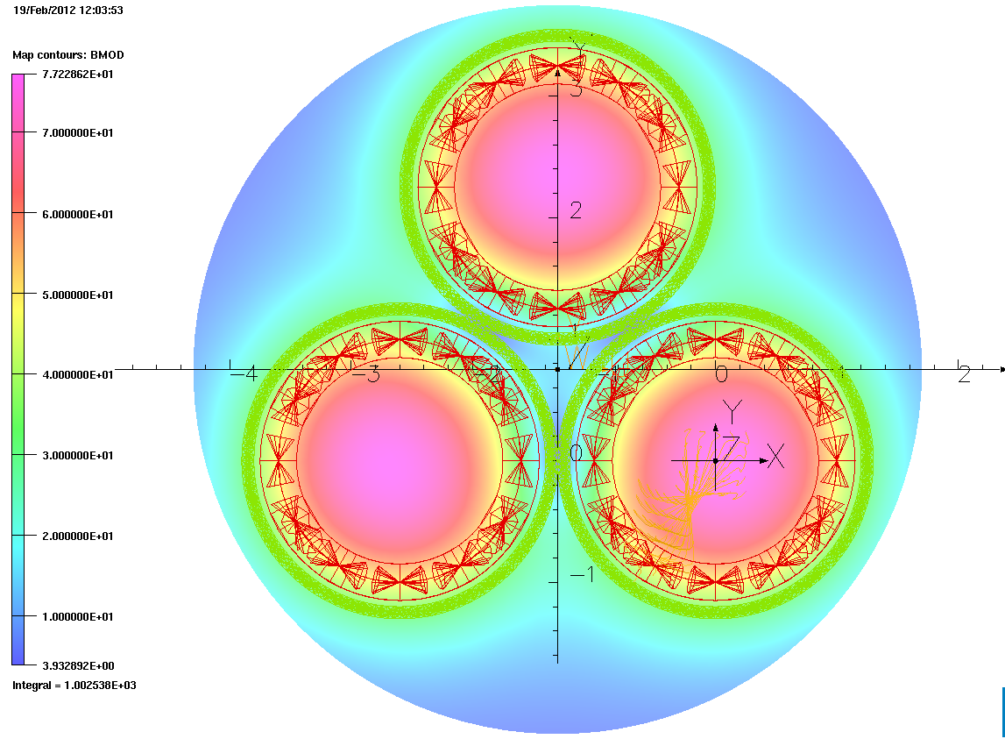
Three Wiens Z+ end view
3 Wien system
b
B
c
A
C
A

Slide 35
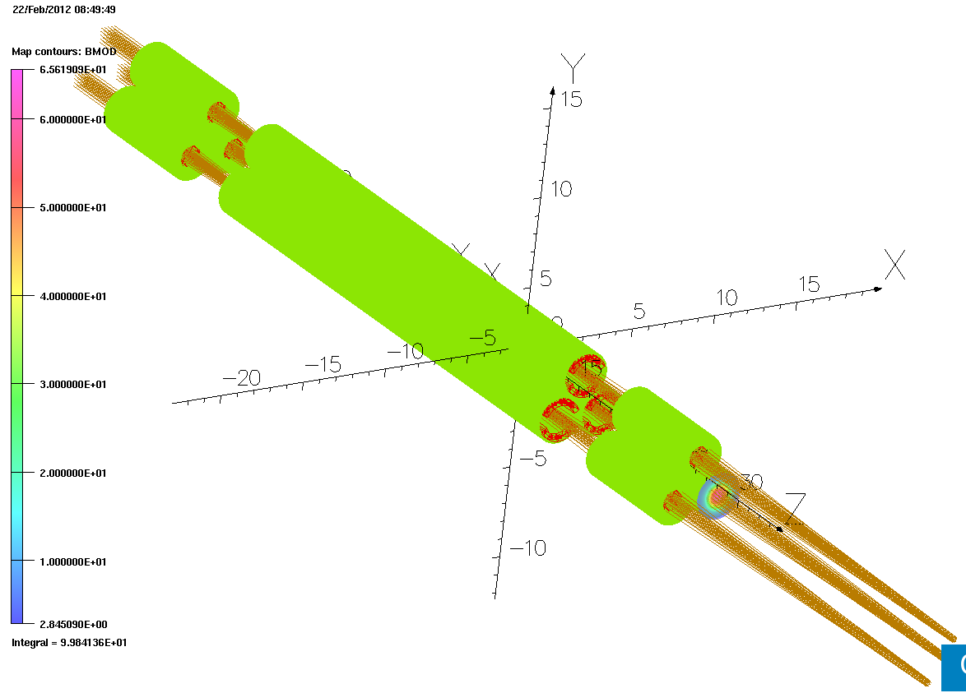
Chopped beam through the model
Full 6mm radial by 24 degree theta extent for A and C beams. Full radial extent by 12 degree theta for B beam. All the rays remain within the bunches.
IT’S POSSIBLE!

Slide 36
Next Topic:
PEPPO

Slide 37
PEPPo Experiment
PEPPo, Polarized Electrons for Polarized Positrons,
is an experiment in progress at the CEBAF Injector
Polarized Bremsstrahlung and pair production
Demonstrate producing polarized e⁺ from polarized e⁻ beam
Characterize low-energy (<10 MeV) polarized pair creation
E.G. Bessonov, A.A. Mikhailichenko, EPAC (1996) A.P. Potylitsin, NIM A398 (1997) 395

Slide 38
The CEBAF Injector Upgrade
5 MeV Dump
Chopper
Superconducting
Booster
Apertures
Cryo-modules
Buncher
Capture
Gun#2
Injection Chicane
Faraday Cup
Prebuncher
Faraday Cup
V-Wien Filter
H-Wien Filter
Gun#3
500 keV Dump
PEPPO line
Spectrometer/Beam Dump

Slide 39
PEPPo Proof-of-Principle Concept
Step 1: Polarization from e- to e+
Step 2: Collect positrons
P_{e-}
S₁
e⁻
D
T₁
S₂
P_{t}
e⁺
D
T₂
Calorimeter
Step 3: Measure e+ polarization
PEPPo will measure polarization transfer from electrons to positrons in 2-8 MeV energy range
S&T Review May 9-11, 2012

Slide 40
Conclusions
We are upgrading injector energy to meet CEBAF requirement.
Parity Violation experiments are more demanding and require upgrading some of the existing injector components and beam dynamics.
More efficient use of polarization can be achieved if a practical independent spin manipulation scheme is found.
A proof-of-principle experiment for producing polarized positron at CEBAF is in progress that could eventually expand the physics capability.

Slide 41
Thank You!

Slide 43
Conclusions
The CEBAF Injector will not only increase its energy to meet the 12 GeV requirements, but also is planned to get upgrades to other systems in order to meet the future demands for parity quality beams.
During the long shutdown we plan to continue our beam dynamic modeling to further improve our setup parameters.
A model for independent spin settings in the halls was presented but it is by no means the only option. For example combining three independent beam lines each having their own gun and Wien could be another option. It depends on how much improvement we will get to the schedule and time saved for running at highest polarization possible.
The proof-of-principle PEPPO experiment is in progress and we hope to get better understanding for having positrons at CEBAF.

Slide 44
Grew support beginning ~2009 JPOS Workshop
A. Adeyemi, P. Aguilera, H. Areti, M. Baylac, G. Bosson, A. Camsonne,
L. Cardman, S. Covrig, C. Cuevas, O. Dadoun, J. Dumas, E. Fanchini,
T. Forest, E. Forman, A. Freyberger, S. Golge, J. Grames, P. Guèye,
C. Hyde, R. Kazimi, Y. Kim, J.-F. Muraz, M. Marton, M. Poelker, S. Setiniyaz,
J.-S. Réal, R. Suleiman, A. Variola, E. Voutier, Y. Wang
(Growing) Collaboration…
In-Kind Support…
External Funding…

Slide 45
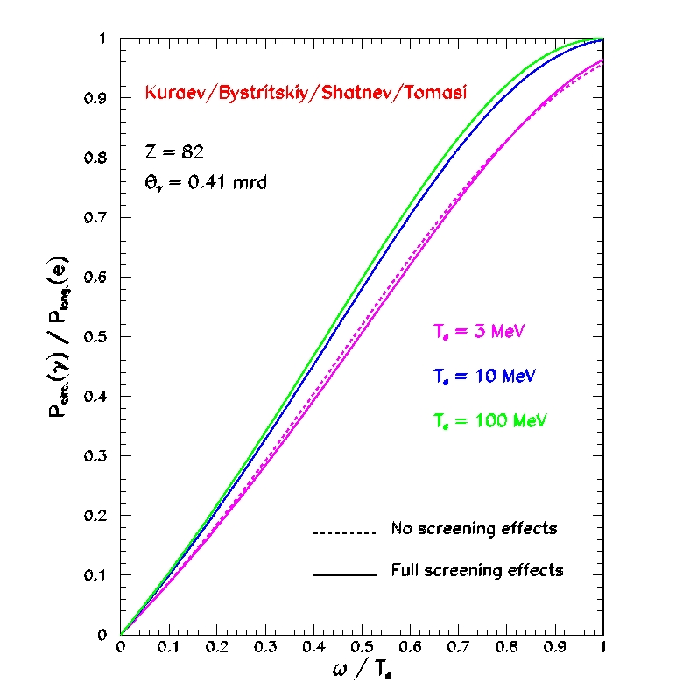
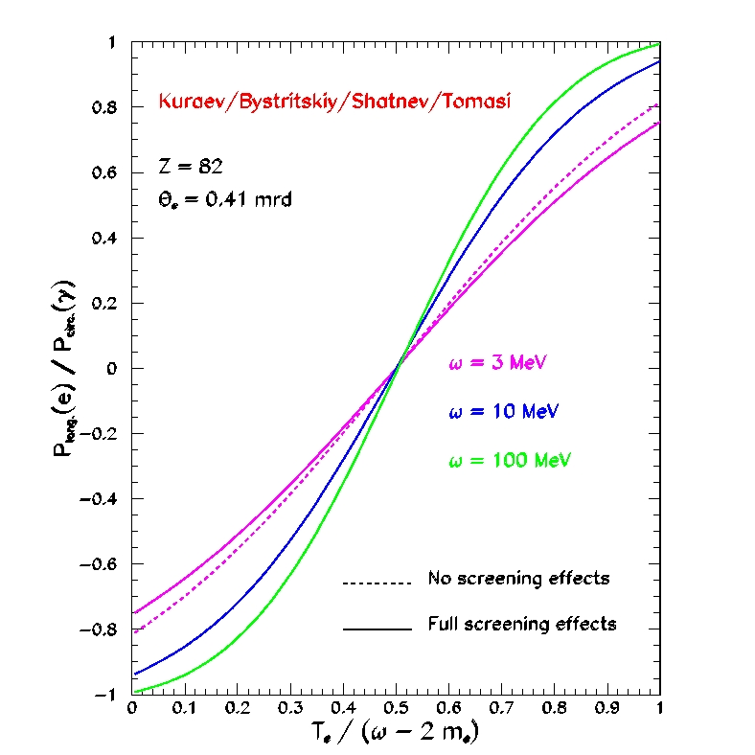
Polarized bremmstrahlung & pair creation
Half-centry-old result of Olsen & Maximon (1959) revisited (2010) to address unphysical result of polarized pair creation at low energy <10MeV.
E.A. Kuraev, Y.M. Bystritskiy, M. Shatnev, E. Tomasi-Gustafsson, PRC 81 (2010) 055208
BREMSSTRAHLUNG
PAIR CREATION

Slide 46
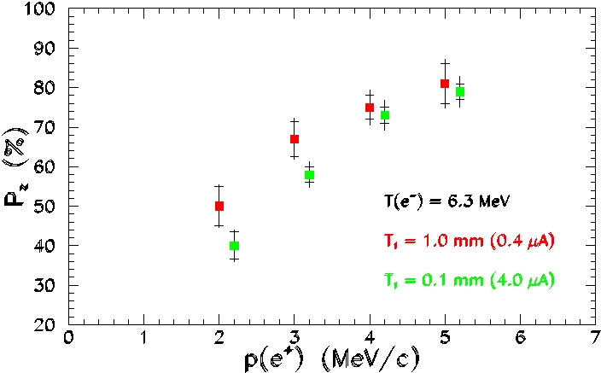
Polarized Electrons for Polarized Positrons
Projected Data
Positron momentum distribution and polarization will be measured during the run period from May 25 through June 29.
S&T Review May 9-11, 2012

Slide 47
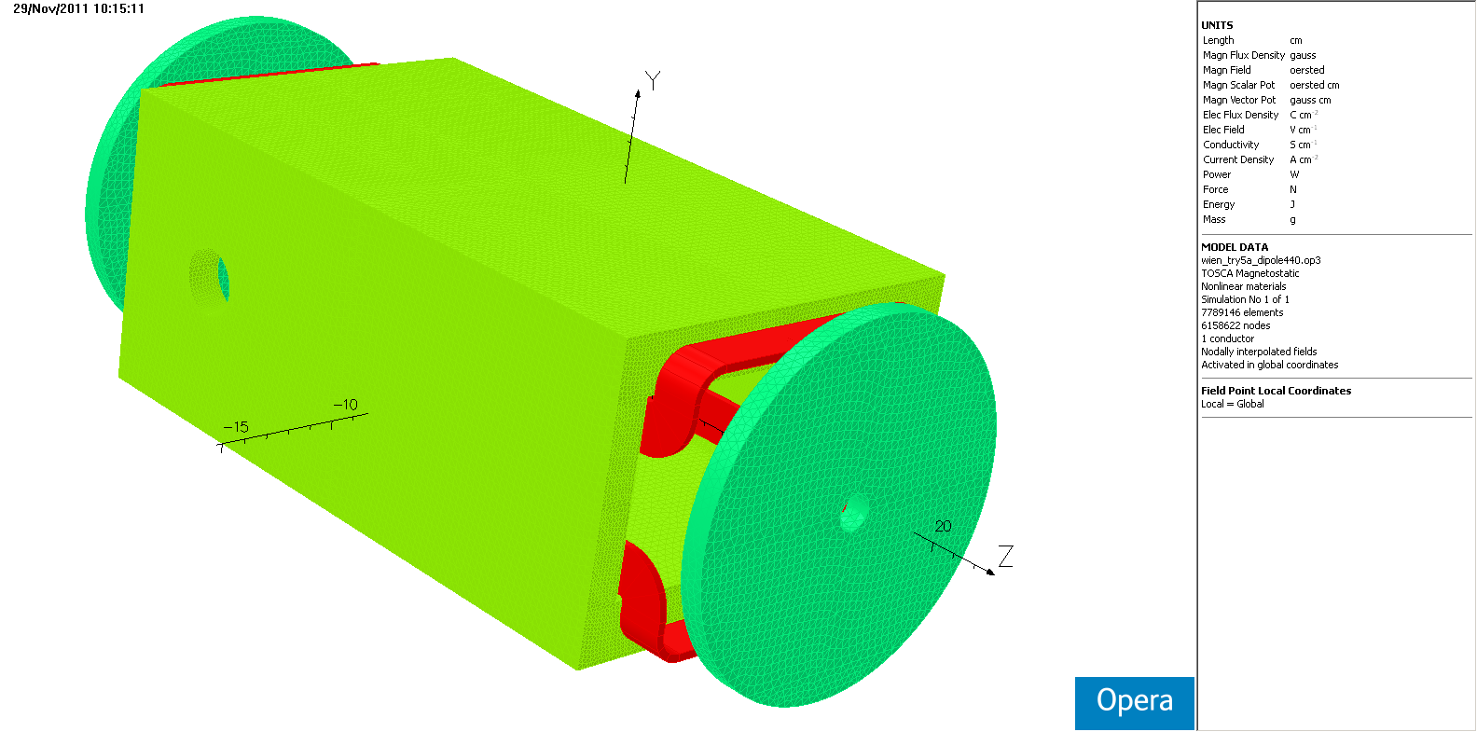
Present Wien
3 Wien system
B(y)
hole for HV
E(x)
Steel box with 5.375” inside width, 3.125” inside height. Nickel disk at each end to reduce field Z extent.

Slide 49
Basics of new Wiens
Three osculating 26mm circles have their centers on a 30mm circle.
There’s a stock metric steel tube size 26mm OD, 1mm wall – perfect for shielding one Wien from the next.
E-field limit suggested 4 MV/m
200 keV beam, 90 degree precession capability needed
For those values and sharp edged fields 30 cm long, BdL=3600 G-cm and E=2.5 MV/m.
Since E field and B field don’t fall off the same way in Z, the electrode length has to be adjusted to minimize steering.

Slide 50
End fields
Electrode length was adjusted to match magnetic field fall-off.
Magnetic shield length was varied in a failed attempt to adjust the B field end profile.
Final electrode 14.8 cm half-length.
Final steel tube 15cm half-length.
x axis cm from center
y axis V/cm or 208*G

Slide 51
Electrode curvature
I explored electrodes as arcs of circles, keeping 1cm spacing on mid-plane. 3.05 cm chosen

Slide 52
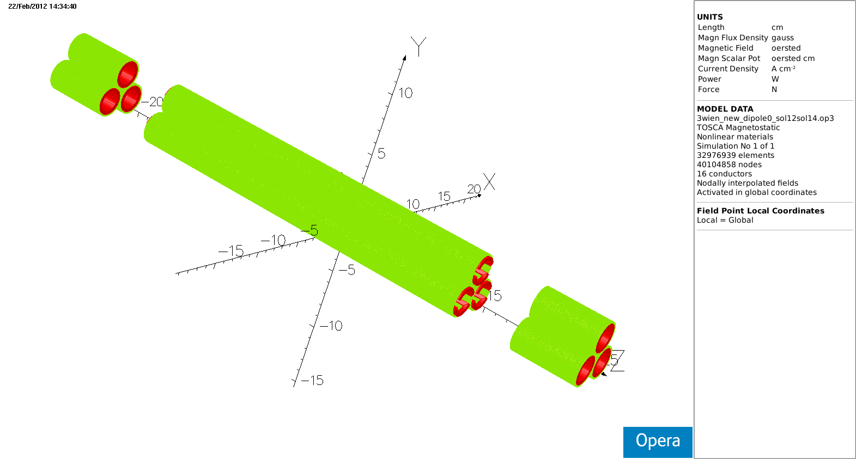
Three Wien filters on 30mm circle

Slide 56
3 Wien System
Spin rotation through a Bend
spin precession= [(g-2) / 2m_{e}]E θ
Where g=2.002319
The spin difference between the injector and the experimental hall is the sum of all the spin precessions through all the bends in the accelerator
At certain final energies, the electron spin at the halls become parallel otherwise they are not.
A Wien filter for each beam provides full longitudinal polarization for every hall.

Slide 57
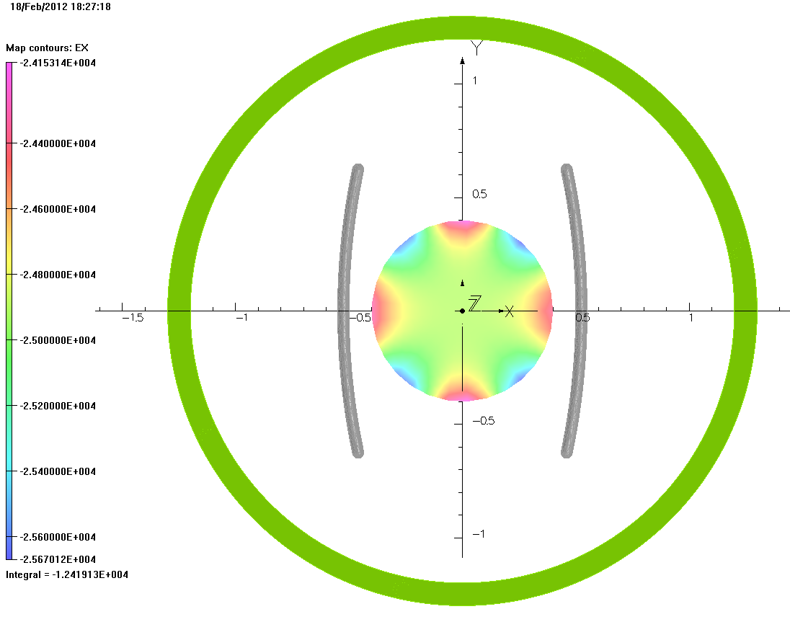
E field in midplane of Wien
3 Wien system
8mm circle
-24912+-760 V/cm

Slide 58
Scheduling Issue Example
3 Wien system
Energy which gives full polarization at fifth pass to A/B/C simultaneously is 1047 MeV/linac, or 11.635 GeV to D. The figure of merit for GlueX is about 0.6 at this energy vs 12.1 GeV per R. Jones. The hall D eta factory proposers give 0.7.
For those experiments which require high but not fully longitudinal polarization, there exist combinations of three halls in the linac energy range 1050-1095 which provide ~95% of cathode polarization to two or three of A/B/C at various passes. 1080/linac isn’t bad for two existing halls and drops hall D only 110 MeV, to 12.0 GeV.
If there’s an experiment running which requires full longitudinal polarization, e.g. parity, near 11 GeV the other halls are down in the range of 80% of cathode, 60% longitudinal polarization.
Worst case ~1.4m of beam line will be needed for the triple Wien. Of this, 40cm would be made available by removal of the capture cavity. The additional 100cm would be obtained by moving the new quarter cryomodule downstream. Longer U-tubes would be needed. Girders downstream of the quarter would have to be relocated. A temporary FODO lattice would be installed in the 1.4m upstream of the quarter until the triple Wien is implemented.

Slide 59
Motivation
3 Wien system
Energy which gives full polarization at fifth pass to A/B/C simultaneously is 1047 MeV/linac, or 11.635 GeV to D. The figure of merit for GlueX is about 0.6 at this energy vs 12.1 GeV per R. Jones. The hall D eta factory proposers give 0.7.
For those experiments which require high but not fully longitudinal polarization, there exist combinations of three halls in the linac energy range 1050-1095 which provide ~95% of cathode polarization to two or three of A/B/C at various passes. 1080/linac isn’t bad for two existing halls and drops hall D only 110 MeV, to 12.0 GeV.
If there’s an experiment running which requires full longitudinal polarization, e.g. parity, near 11 GeV the other halls are down in the range of 80% of cathode, 60% longitudinal polarization.
Worst case ~1.4m of beam line will be needed for the triple Wien. Of this, 40cm would be made available by removal of the capture cavity. The additional 100cm would be obtained by moving the new quarter cryomodule downstream. Longer U-tubes would be needed. Girders downstream of the quarter would have to be relocated. A temporary FODO lattice would be installed in the 1.4m upstream of the quarter until the triple Wien is implemented.

Slide 60
Parity Quality Beam

Slide 61
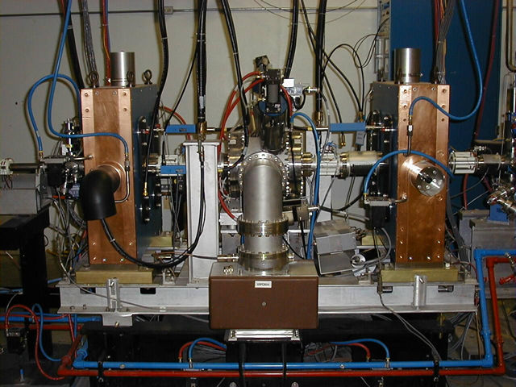
Chopping System (As Installed)

Slide 62
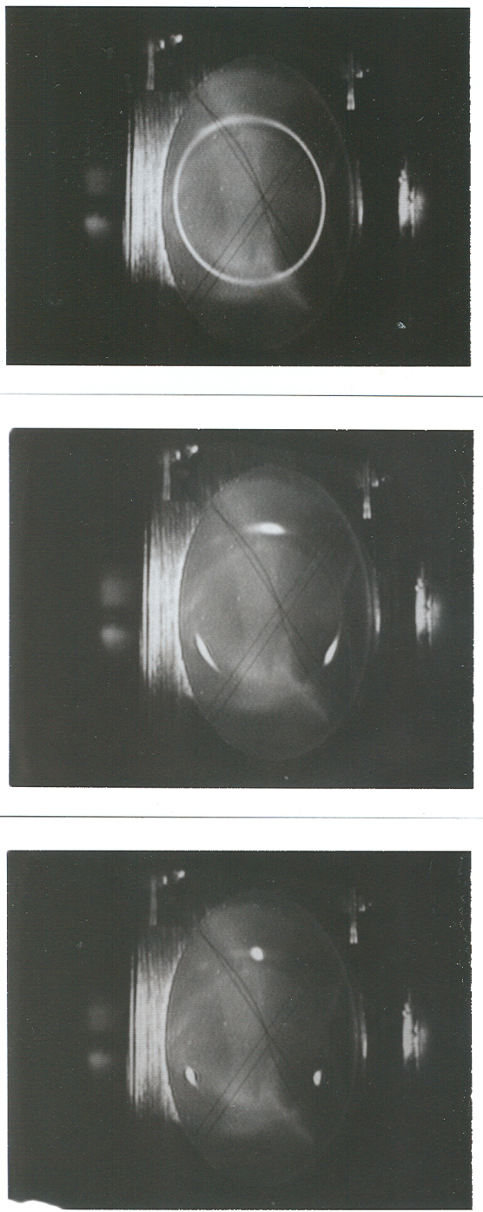
Synchronous Photoinjection
A B C A B C….
Beam Current
111ps
1497 MHz

Slide 63
Continuous Electron Beam Accelerator Facility:
0.6 GeV linac
(20 cryomodules)
1497 MHz
67 MeV injector
(2 1/4 cryomodules)
1497 MHz
Gain switched
A
B
C
RF separators
diode lasers
499 MHz
499 MHz,
Δφ
= 120°
B
A
B
Pockels cell
A
C
C
Gun
Double sided
septum

Slide 64
Chopper Operation Animation
3 cm
B
C
A
Beam
Beam
Beam
Beam
Beam
Beam
Beam
Beam
Beam
Beam
Beam
Beam
Beam
Beam
Beam
Beam
Beam
Beam
Beam
Beam
Beam
Beam
Beam
Chopper #1 RF Cavity (499 MHz)
Lens
Master Slit
Lens
Chopper #2 RF Cavity (499 MHz)
130 cm

