Slide 1
National Science Foundation
NP Program
Kyungseon Joo
Program Director (IPA)
for Nuclear Physics
JLab Users Meeting
June 4 - 6, 2012

Slide 2
Nuclear Physics at NSF
NP Experiment
Structure
Heavy Ions
Symmetries
Hadrons and QCD
Astrophysics (Notre Dame, FSU)
NP Theory
Frontier Center (Joint Institute for Nuclear Astrophysics)
NSCL
FY2011 total: $48.5M

Slide 3
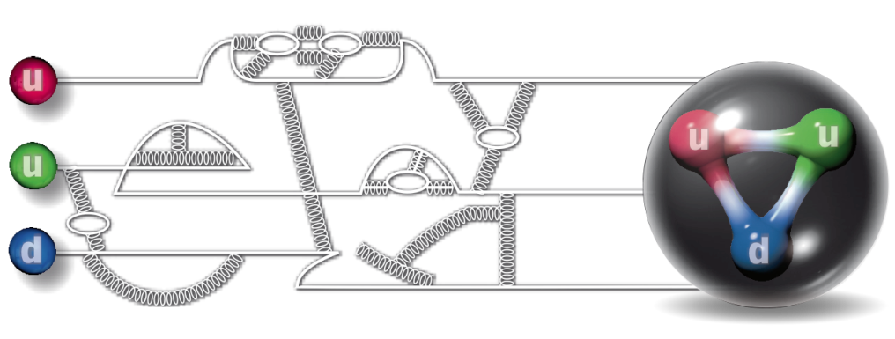
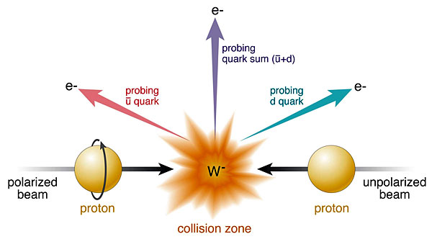
Cold QCD
confinement, hadron structure (JLAB)
MRI and investigator awards
spin (RHIC)
MRI and investigator awards

Slide 4
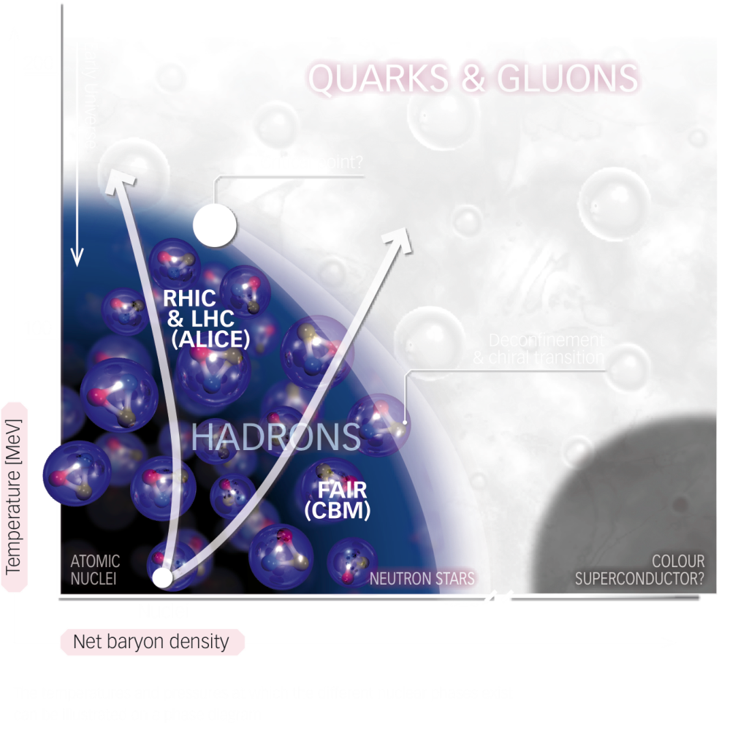
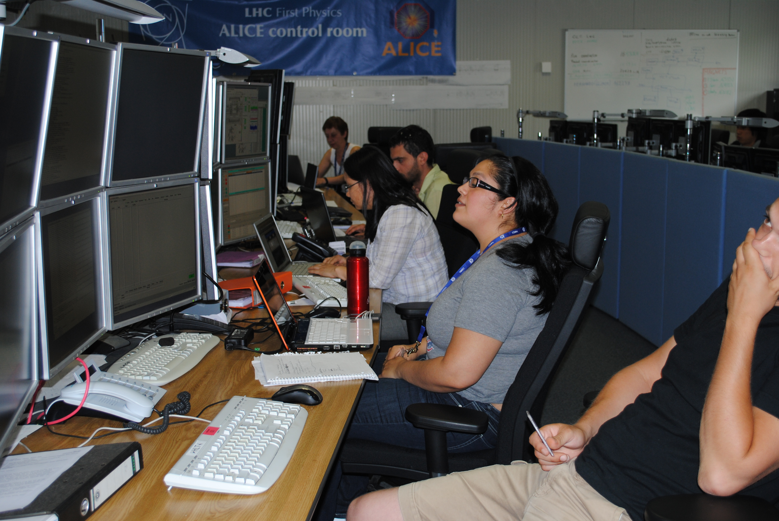
Hot QCD
investigator awards at RHIC, LHC
summer student experience

Slide 5
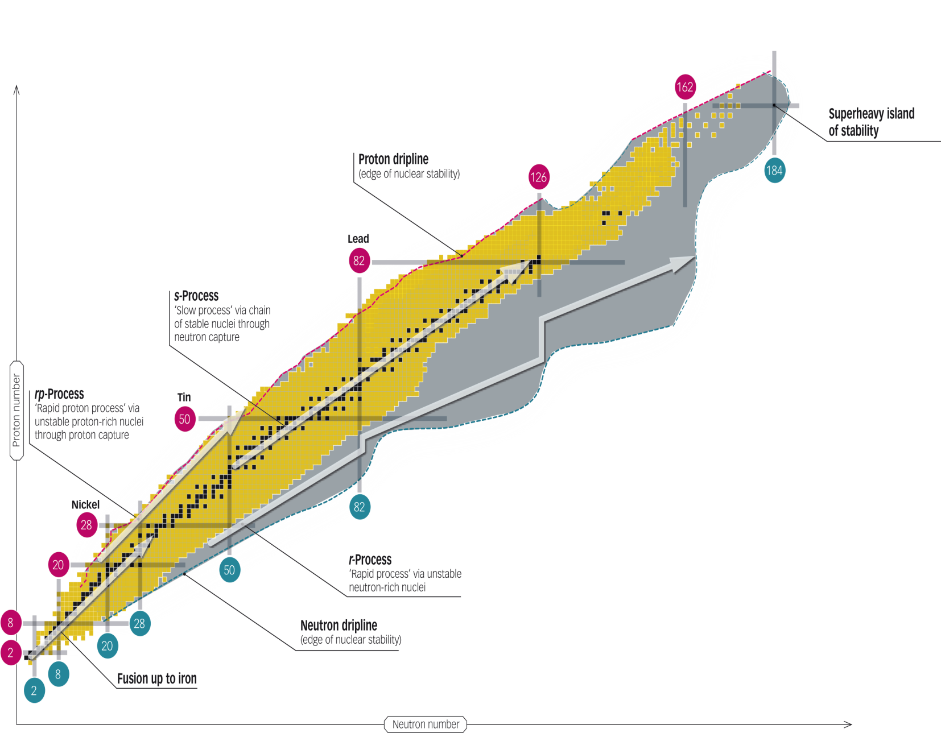
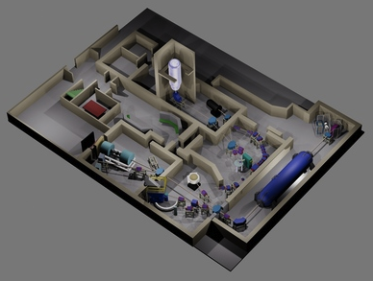
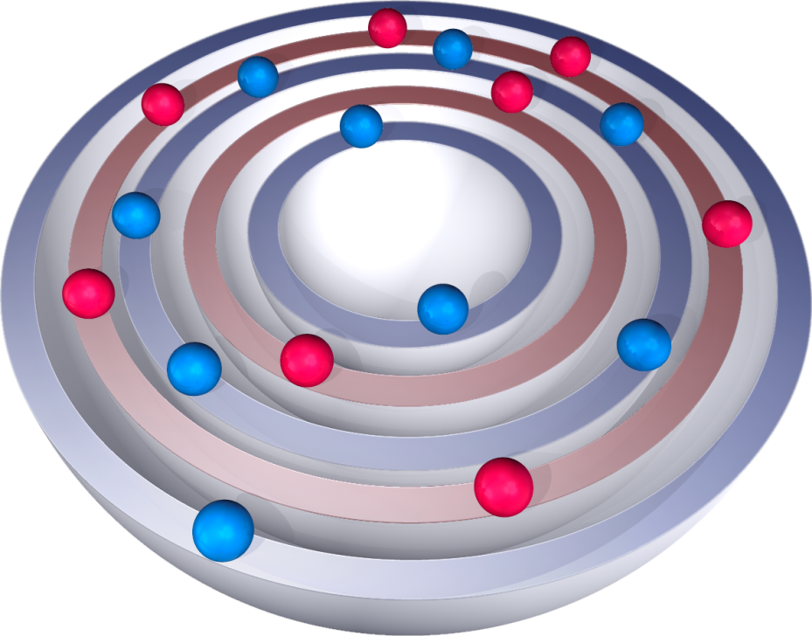
Nuclear Structure
understanding structure (theory)
nuclei far from stability
nuclei in extreme states
NSF MRI:
new accelerator at Notre Dame
Rutgers, UT: ¹³²Sn

Slide 6
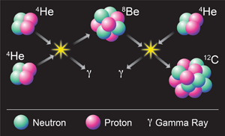
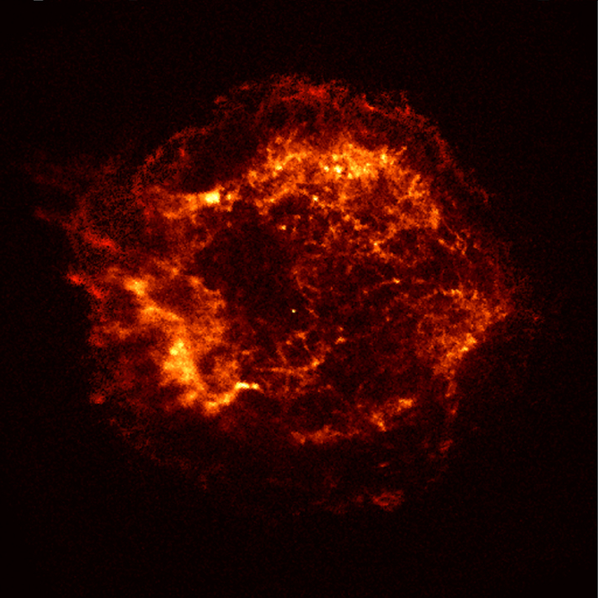
Nuclear Astrophysics
nuclear processes in stellar formation, energy generation, novae, supernovae

Slide 7
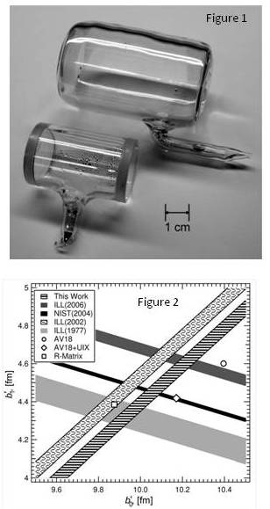
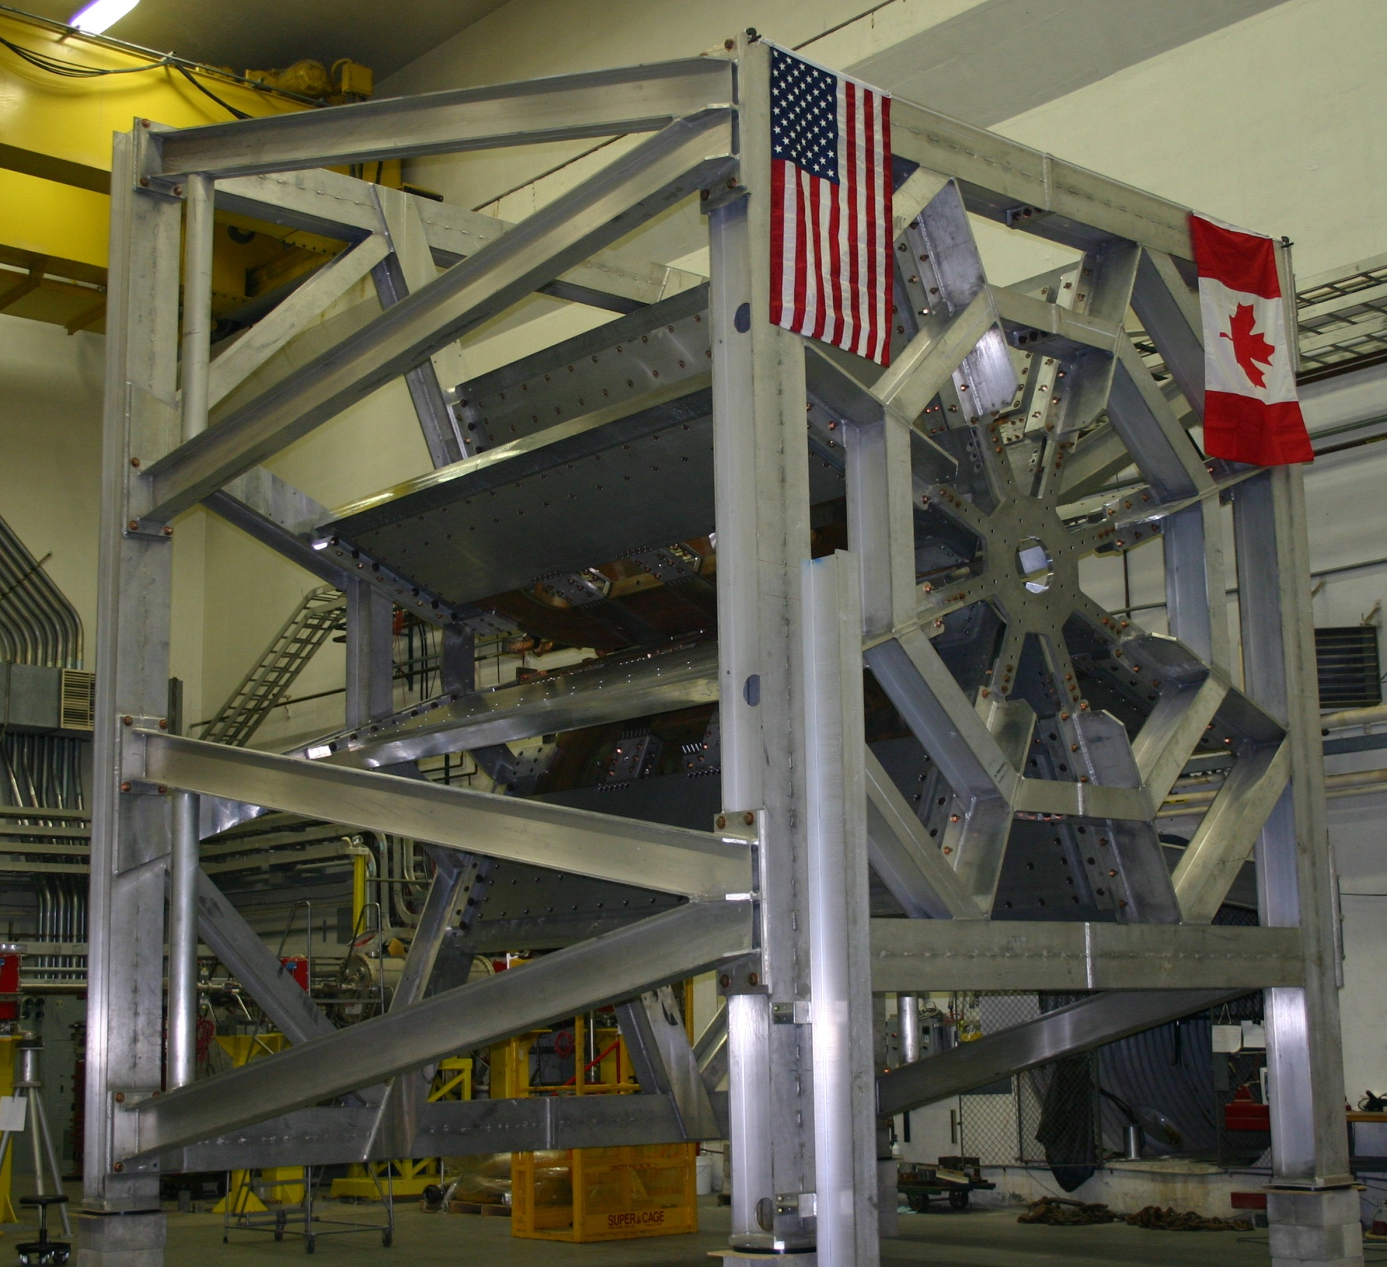
Nuclear Precision Measurements
Qweak at JLAB
proton weak charge
NSF (MRI), DOE, NSERC, VA
neutron interferometry
n-A scattering lengths
tests of EFT

Slide 8
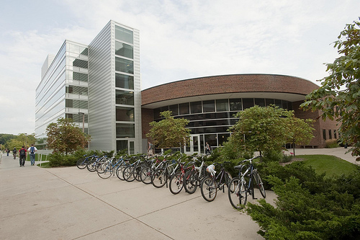
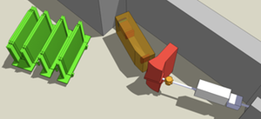
Operation of the NSCL
Flagship facility for rare isotope research and education at Michigan State U.
310 employees, incl. 120 students, 30 faculty
700 users, 10% US PhDs in nuclear physics
Experiments in nuclear physics and nuclear astrophysics
Focus: Nuclei Emit Paired-up Neutrons

Slide 9
FY2012 Status
NSF appropriation: R&RA up 2.8%
NP and most other division programs down 3.5% from FY2011 (down 3% from FY2010)
NSCL flat from FY2011 level
continue managing ARRA funding impact from FY2009

Slide 10
Decision Process: Path to NP
Research & Related Activities: NSF Director allocates to directorates (base + initiatives)
MPS Directorate: MPS AD allocates to divisions (base + initiatives)
Physics Division: Division Director allocates to
facilities
programs

Slide 11
Decision Process: Inside NP
Program has several account numbers, but funds are commingled (freedom to move funds between accounts.
Most decisions are proposal driven via merit review:
intellectual merit
broader impacts
Strong weight given to advice from individual reviewers plus panel prioritization.
Mitigating factors:
new/seasoned investigators
program balance

Slide 12
NP Program Breakdowns: Funding
FY | hadrons & light nuclei | nuclear structure & heavy ion physics | precision measurements | theory | total investigator program | NSCL
2011 | $5,348,862 | $6,485,244 | $5,335,879 | $3,719,188 | $20,889,173 | $21,500,000
FY2009 includes ARRA funds
nuclear structure 2/3, heavy ions 1/3
Nuclear astrophysics: $2M
FY | total investigator program | NSCL
2012 | 3.5% down | $21,500,000
2011 | $20,899,173 | $21,500,500
2010 | $22,670,993 | $21,000,000
2009 | $33,168,833 | $22,500,000
2008 | $21,101,151 | $19,250,000

Slide 13
FY2013 R&RA Budget Request
R&RA Funding
(Dollars in Millions)
 |  |  |  | Change over
 | FY 2011 | FY 2012 | FY 2013 | FY 2012 Estimate
 | Actual | Estimate | Request | Amount | Percent
Biological Sciences | $712.27 | $712.38 | $733.86 | $21.48 | 3.0%
Computer & Information Science & Engineering | 636.06 | 653.59 | 709.72 | 56.13 | 8.6%
Engineering | 763.33 | 826.17 | 876.33 | 50.16 | 6.1%
Geosciences | 885.32 | 885.27 | 906.44 | 21.17 | 2.4%
Mathematical & Physical Sciences | 1,312.42 | 1,308.94 | 1,345.18 | 36.24 | 2.8%
Social, Behavioral & Economic Sciences | 247.33 | 254.25 | 259.55 | 5.30 | 2.1%
Office of Cyberinfrastructure | 300.75 | 211.64 | 218.27 | 6.63 | 3.1%
Office of International Science & Engineering | 49.03 | 49.85 | 51.28 | 1.43 | 2.9%
Office of Polar Programs¹ | 440.70 | 435.87 | 449.74 | 13.87 | 3.2%
Integrative Activities | 259.60 | 349.59 | 431.52 | 81.93 | 23.4%
U.S. Arctic Research Commission | 1.58 | 1.45 | 1.39 | -0.06 | -4.1%
Total, R&RA | $5,608.38 | $5,689.00 | $5,983.28 | $294.28 | 5.2%
Totals may not add due to rounding.

Slide 14
FY2013 MPS Budget Request
MPS Funding
(Dollars in Millions)
 | FY 2011 Actual | FY 2012 Estimate | FY 2013 Request | Change Over FY 2012 Estimate
 |  |  |  | Amount | Percent
Division of Astronomical Sciences (AST) | $236.78 | $234.55 | $244.55 | $10.00 | 4.3%
Division of Chemistry (CHE) | 233.55 | 234.06 | 243.85 | 9.79 | 4.2%
Division of Materials Research (DMR) | 294.91 | 294.55 | 302.63 | 8.08 | 2.7%
Division of Mathematical Sciences (DMS) | 239.79 | 237.77 | 245.00 | 7.23 | 3.0%
Division of Physics (PHY) | 280.34 | 277.37 | 280.08 | 2.71 | 1.0%
Office of Multidisciplinary Activities (OMA) | 27.06 | 30.64 | 29.07 | -1.57 | -5.1%
Total, MPS | $1,312.42 | $1,308.94 | $1,345.18 | $36.24 | 2.8%

Slide 15
Additional Funding
Domestic Nuclear Detection Office (DNDO)
FY2012 process canceled (no DHS funds)
Major Research Instrumentation (MRI)
deadline passed
proposals under review
Petascale Computing Resource Allocations (PRA)
testbed access to petascale code development
FY2012 deadline: June 30, 2012

Slide 16
People
NSF Director: Subra Suresh
NSF Deputy Director: Cora Marrett
MPS Assistant Director: Ed Seidel
Physics Division Director: Joe Dehmer
Nuclear Physics:
Brad Keister (expt and theory)
Kyungseon Joo (and astro, underground)

