Slide 1

DVCS in Hall A: early 12 GeV experiment
J. Roche (Ohio University)
Our collaboration is ready (and eager) to start taking data this fall.
The DVCS reaction is a clean probe of the Generalized Parton Distributions. This reaction is studied with a simple, well understood apparatus in Hall A.
The Hall A DVCS experiments are an essential part of the comprehensive GPD program with the 12 GeV CEBAF beam .
UG meeting, June 14

Slide 2
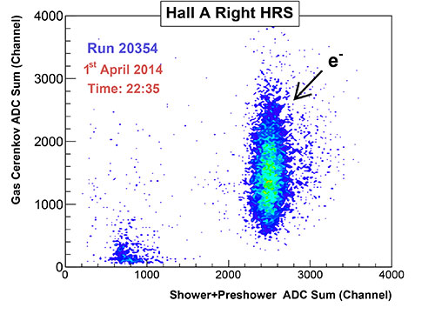
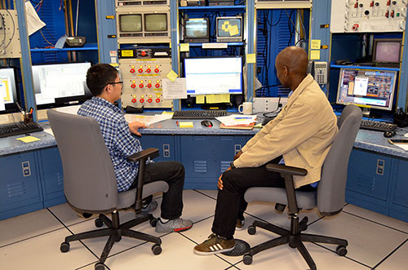
Why us first??
We are ready to go
  Running in 12 GeV-commissioned Hall A
  Using the same dedicated apparatus as
  during our last experiment (2010)
  but for a new trigger module.
E12-06-114 is a high impact experiment (as rated by PAC41)
Grad students Longwu Ou & Mongi Dlamini and
30+ other scientists
and
on the other side, many MCC scientists
CNRS/France
3 graduate students and two senior scientists have relocated from France and Ohio
to take these data.

Slide 3
Generalized Parton Distributions
DIS
Elastic
In the Bjorken regime:
Factorization theorems separate the hard from the soft reaction,
GPDs correlate longitudinal momentum with transverse position of the partons,
DVCS or Deep Meson production give access to the GPDs.
Experimentally, one measures Compton form factors (CFF: integration over the quark loop)

Slide 4
Measuring Deeply Virtual Compton Scattering
GPD
DVCS
When absolute cross sections cannot be measured

Slide 5
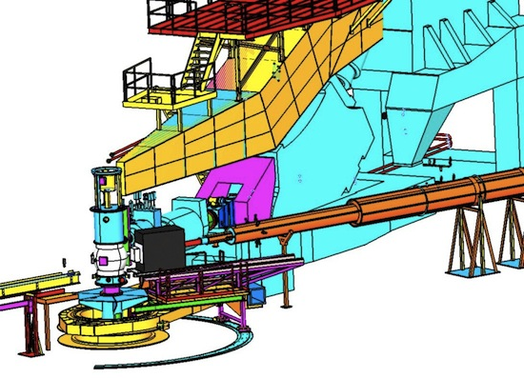
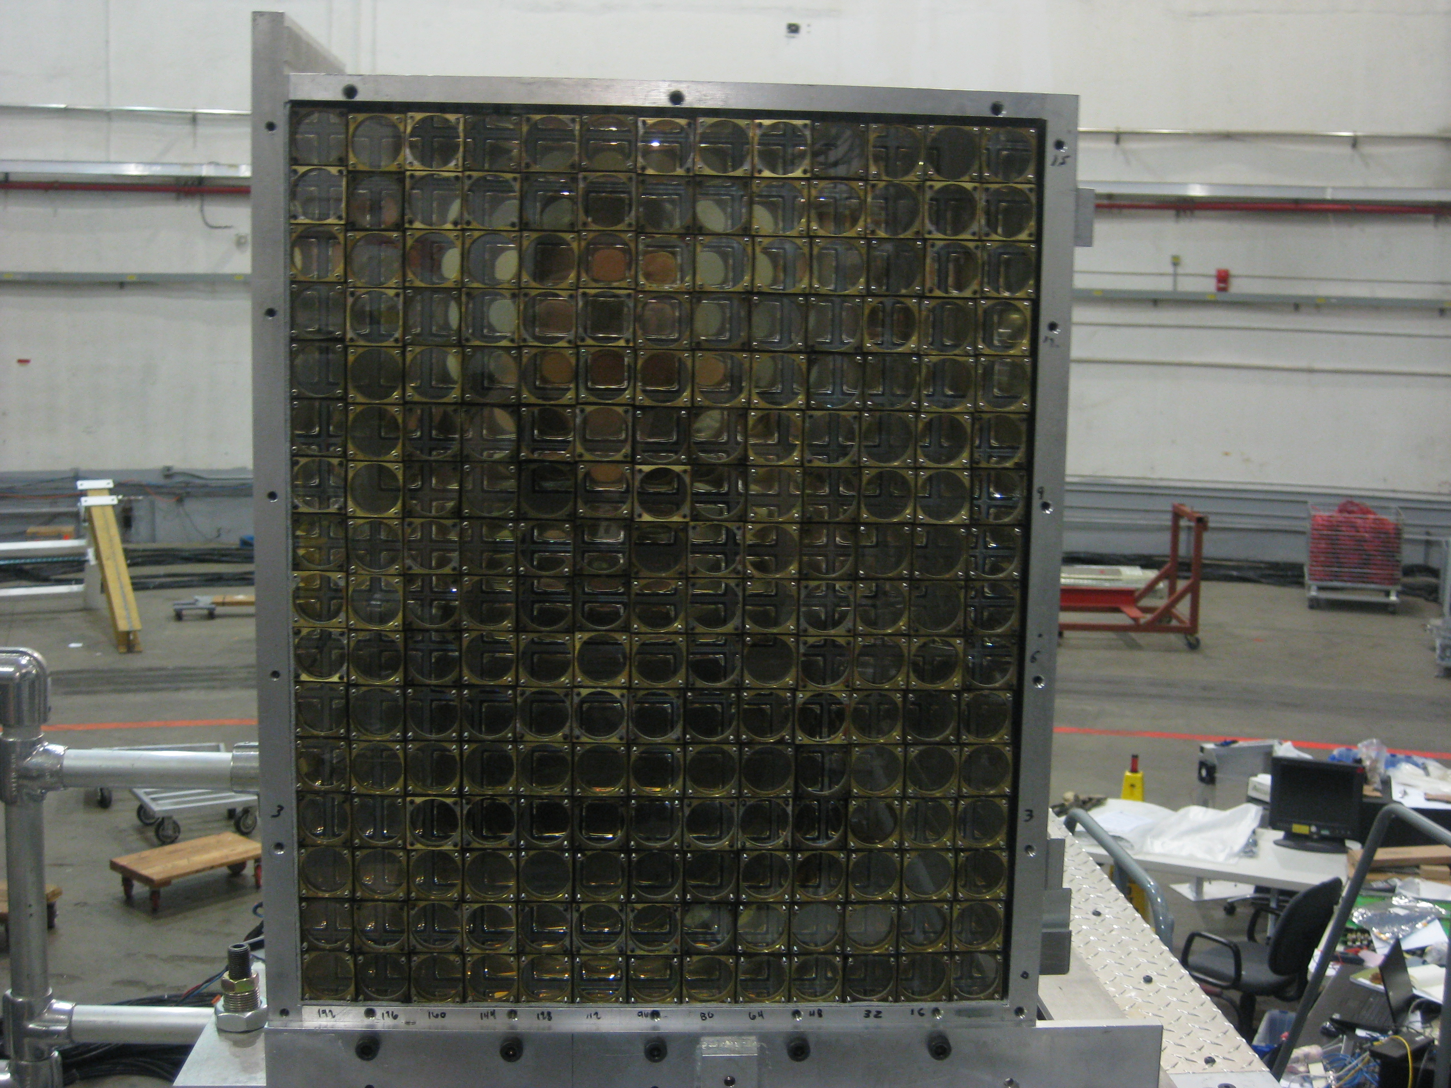
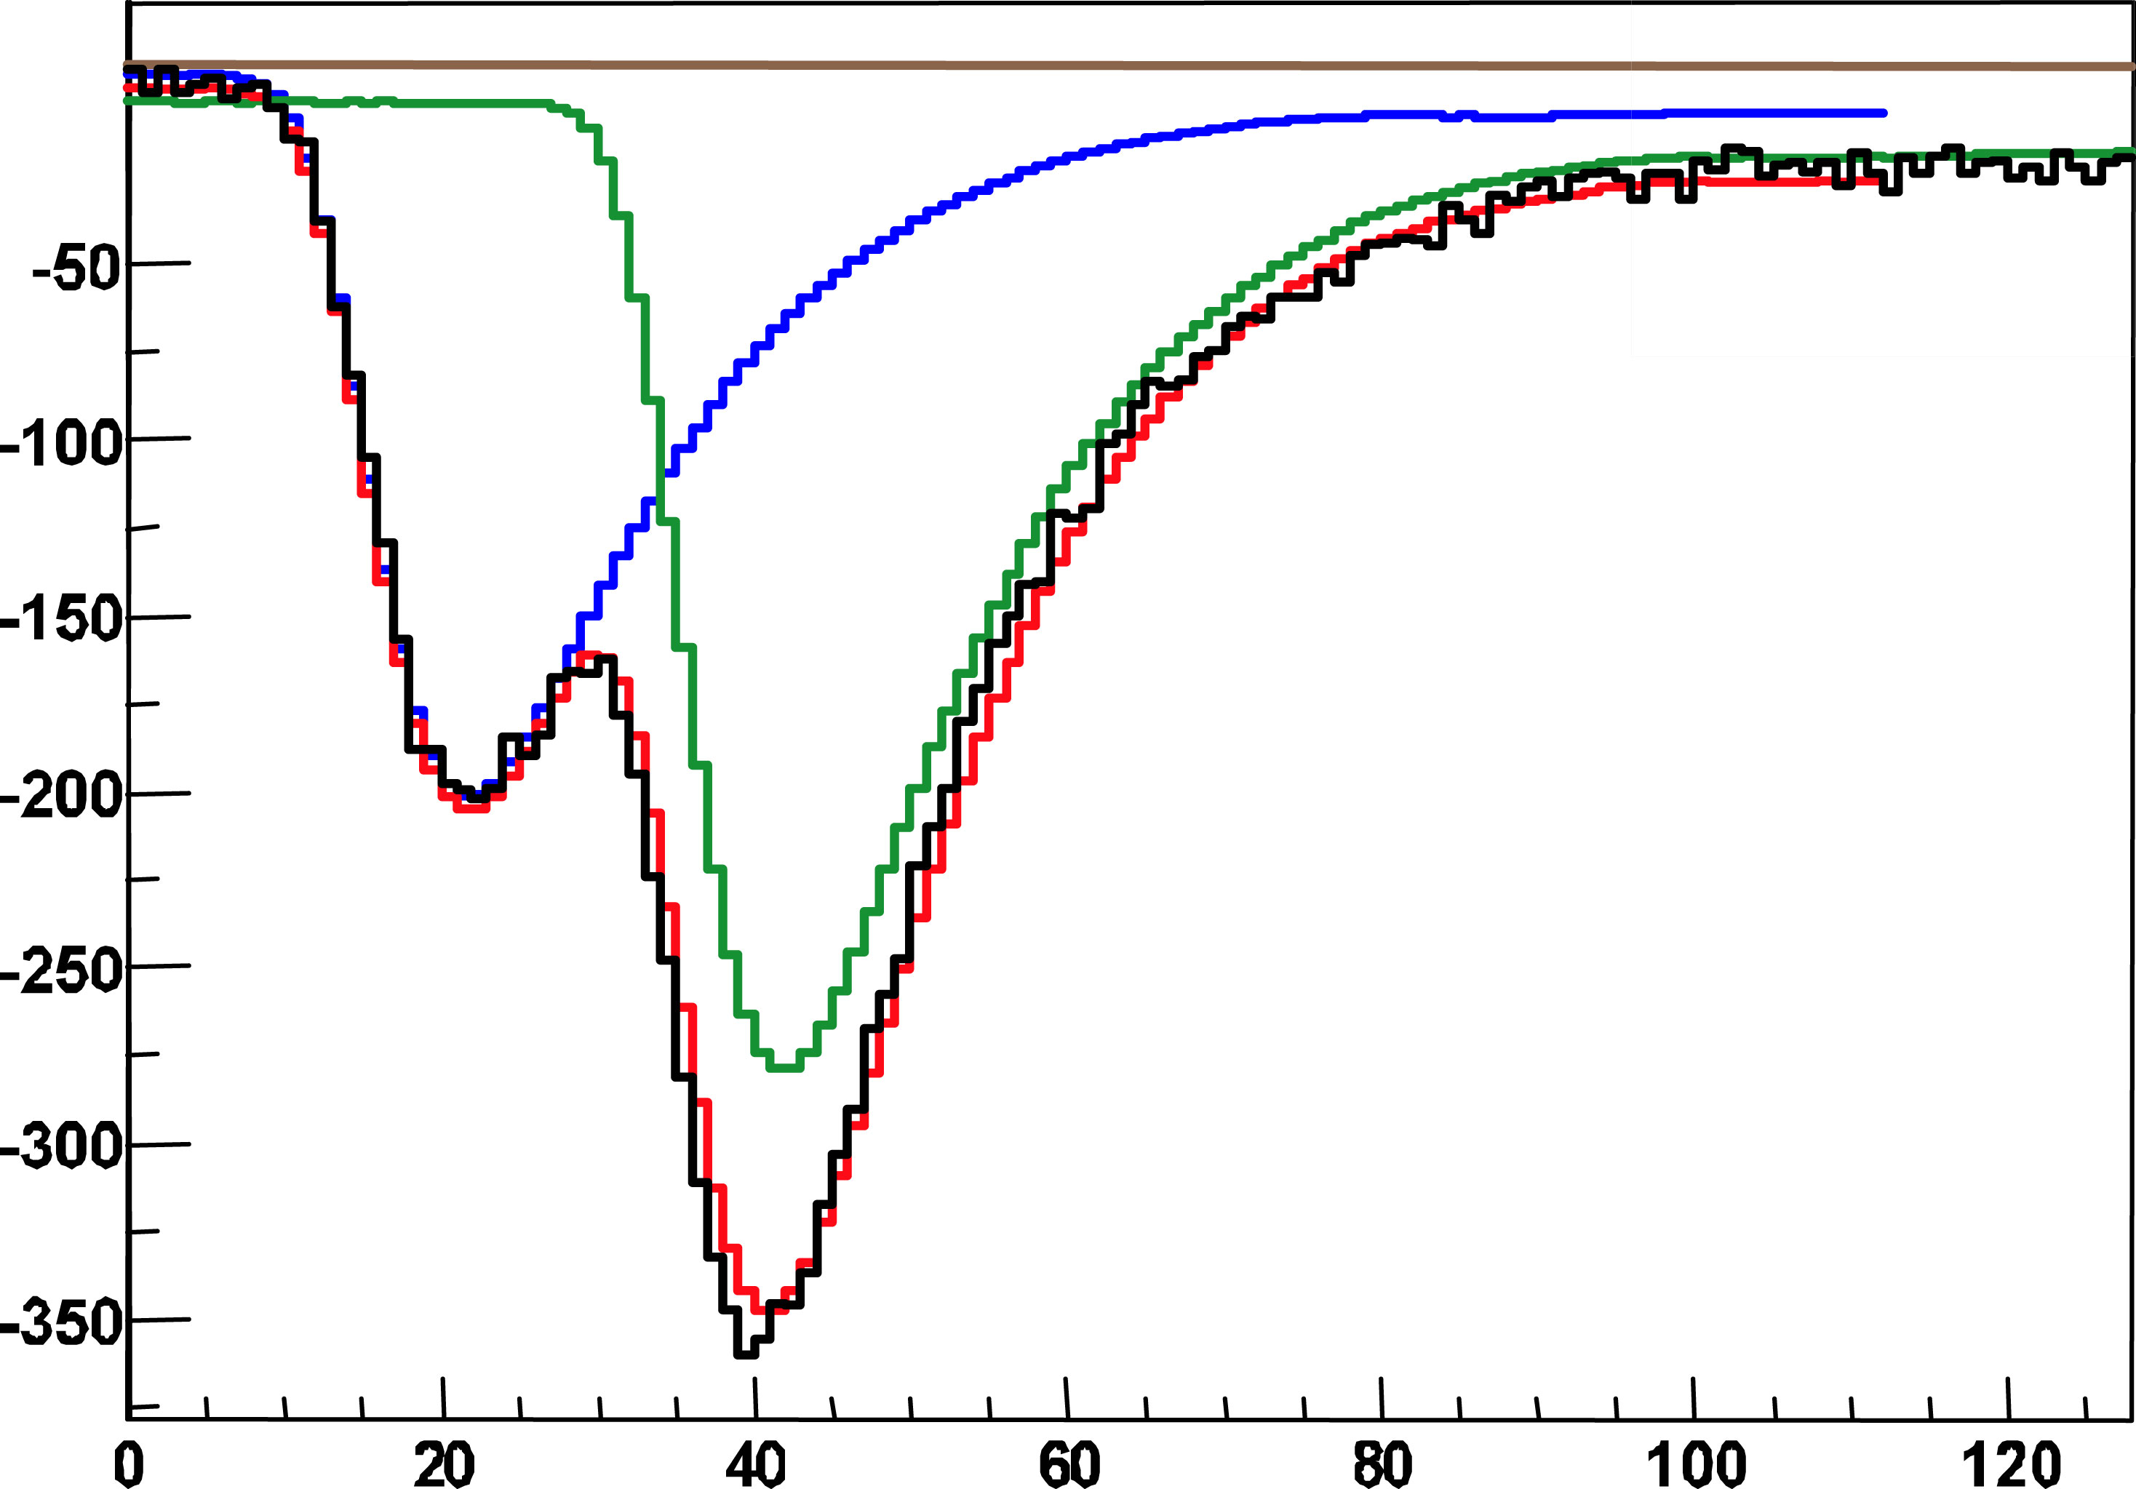
Dedicated apparatus for cross-section measurement
208 PbF2 blocks
Luminosity of ~5. 10³⁷ Hz/cm²
1 GHz digitizer
t (ns)

Slide 6
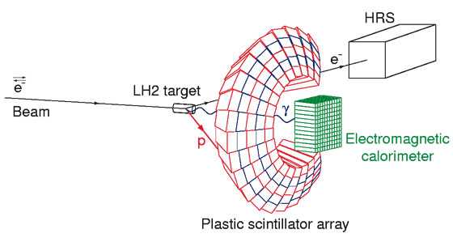
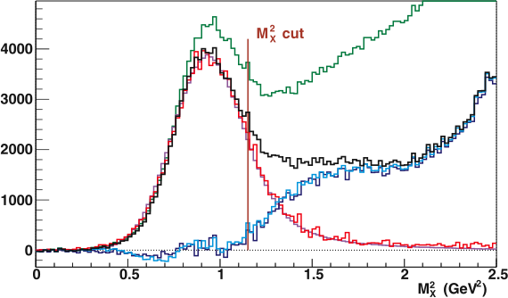
Exclusivity
2005 apparatus
(2005 data)
H(e,e’γ)X
HRS+calorimeter
X can be
p : ep -> epγ
γp : ep -> epπ⁰, π⁰->γγ
Νπ: ep -> eNγπ
…
H(e,e’γ)X - H(e,e’γγ’)X'
H(e,e’γp)
HRS+calorimeter + proton array
H(e,e’γ)Nπ
Good resolution : no need for the proton array => solid angle easy to compute
Remaining π contamination 1.7%

Slide 7
Proton experiment PRL 97: 262002 (2006)
x=0.36, Q²=2.3 GeV² t=-0.28 GeV²
Q² independence =>
Twist-2 dominance
BH², DVCS² and BH-DVCS interference
all contribute to the total cross-section.
Also results on:
Neutron: PRL 99: 242501 (2007)
π⁰ electro-production: PRC 83 (2011) 025201

Slide 8
Second generation experiments (data taken in 2010)
Goal:
To separate the BH.DVCS interference contribution from the DVCS² contribution,
  And L/T separation of the deeply virtual π⁰ production,
  Also DVCS² on the neutron.
Motivated by the first generation result
Rosenbluth type separation
(nb/Gev⁴)
 | Kin 1 |  | Kin 2 |  | Kin3
Q² (GeV²) | 1.5 |  | 1.75 |  | 2.0
X _{b} | 0.36 |  | 0.36 |  | 0.36
E_{beam} (GeV) | 3.36 | 5.55 | 4.45 | 5.55 | 4.45 | 5.55
Status of the analysis (close to publication).
Beamline, HRS, Calorimeter calibrations completed
In depth effort to reproduce DIS cross-sections based on HRS data only (+/- 4%)
New GEANT4 code for acceptance estimation
Detailed analysis of systematic effect on π⁰ subtraction, missing mass cuts, …

Slide 9
Extracting Compton form factor from the data
Status:
Independent cross-check completed
Rosenbluth-type fits in progress
  (add a C^{DVCS} term)
Black dot: data / Red histogram: MC fit
Slide from C. Desnault

Slide 10
Third generation experiment (JLab 12 GeV era)
The strengths of our method
Accurate cross-sections
  -High luminosity 10³⁸ cm⁻²s⁻¹
  -Well understood acceptance
High angular resolution
  Small bins necessary to capture the rapidly varying Bethe-Heitler cross-section
Equal statistic in each bin (even at high Q²)
Goals for E12-06-114 (100 PAC days):
To measure precise absolute cross-sections (3-5% stat and 4% sys uncertainties),
To test the scaling of the DVCS amplitudes, and
To separate the Re and Im part of the DVCS amplitudes.
Our equipment is ready to take data at the highest energy possible,
we will be able to run as soon as the CEBAF beam is available.

Slide 11
Beam time approved (days)
Total: 88+12 (curing)=100 days
August 2011

Slide 13
DVCS with High Resolution Spectrometers: Hall A and C
E00-110: Deeply Virtual Compton Scattering at 6 GeV.
E03-106: Deeply Virtual Compton Scattering on the neutron.
Spokepersons: P. Bertinª, C. Hyde^{b}, R. Ransome^{c} , F. Sabatié^{d} and E. Voutierª
E07-007: Complete separation of Deeply Virtual Photon and π⁰ electroproduction observable of unpolarized proton.
E08-025: Measurement of the DVCS cross-section off the neutron.
Spokespersons: A. Camsonne^{e,} C. Hyde^{b}, M. Mazouz^{g}, C. Munoz-Camachoª, J. Roche^{f} .
E12-06-114: Measurements of the Electron-helicity Dependent Cross sections of the DVCS with CEBAF at 12 GeV.
Spokespersons: A. Camsonne^{e,} C. Hyde^{b}, C. Munoz-Camachoª, J. Roche^{f} .
E12-13-010: Exclusive Deeply Virtual Compton and Neutral Pion Cross-section measurements in Hall C.
Spokespersons: T. Horn^{h}, C. Hyde^{b}, C. Munoz-Camachoª, R. Paremuzyanª, J. Roche^{f} .
ªCNRS ^{b}ODU ^{c}Rutgers ^{d}CEA ^{e}Jlab ^{f}Ohio U ^{g}U of Monastir ^{h} Catholic U. of A.
Complementary to the Hall B program:
H, D unpolarized, and
H longitudinally and transversely polarized.

Slide 14
Moving to Hall C and joining the NPS collaboration
Hall A settings
Goals: Extend the kinematic coverage
To test scaling
To separate the DVCS² from the interference
PAC40 approved us for 53 PAC days with A rating.
We have submitted a NSF/MRI proposal in January
to build the NPS calorimeter.

Slide 15
DVCS in Hall A: early 12 GeV experiment
Our collaboration is ready (and eager) to start taking data this fall.
The DVCS reaction is a clean probe of the Generalized Parton Distributions. This reaction is studied with a simple, well understood apparatus in Hall A.
The Hall A DVCS experiments are an essential part of the comprehensive GPD program with the 12 GeV CEBAF beam .
CNRS/France: C. Desnault, M. Magne, C. Munoz-Camacho,
ODU: S.L. Allison, C. Hyde, K. Park,
Ohio U.: M. Dlamini, N. Israel, P. King, J. Roche,
Catholic U of A. : M. Carmignotto, I. Sapkota, T. Horn,
CEA/France: M. Defurne, F. Sabatié,
JLab: A. Camsonne,
the Hall A collaboration and the Hall A/C physics staff.
grad. student postdoc

Slide 16
Back up slides

Slide 17
From GPDs to observables
The full DVCS amplitude (ep->epγ) is
The hadronic tensor is
The Compton form factors (CFF) are defined by the integration over the quark loop
In practice, one exploits the azimuthal modulation of the DVCS
(and its interference)

Slide 18
Sensitivities to GPDs
Slide from M. Vanderhaeghen

Slide 19
Neutron experiment PRL 99: 242501 (2007)
Ji’s sum rule on the fraction of the proton spin carried by quarks:
!! Model dependent result !!
Q²=1.9 GeV², x=0.36
VGG model with various parameters defining
the GPD E (-> different values of J_{u} and J_{d})
Hermes:
Unpolarized beam, transversly polarized proton target
Ji, PRL 78:610 (97) VGG, Phys Rev D 60: 094017 (99) Lattice, PRL 92:042002 (04) Hermes, Eur Phys J C46:729 (06)

Slide 20
GPD fitters, eg: Moutarde, Phys Rev D 79:094021(2009)
Goal: extract each CFF from the data.
Uses a more complete parametrization of the BH-DVCS interference
Assumes a functional form for the x, Q², ξ and t variation of the GPD (dual model)
Assumes only H contributes
Uses Hall A cross-sections and Hall B beam spin asymmetries
Other fits: Guidal (arXiv:1003.0307, arXiv:0807.2355), Kumericki+Mueller (Hermes data, arXiv:0904.0458)

Slide 23
Improved dedicated equipment: expanded calorimeter and ancillary electronics
Expanded calorimeter (from 132 to 208 blocks)
- less radiation damage than previously (selection of blocks and better shielding)
1 GHz sampling electronic (ARS) with better transfer speed
- used VME320 protocol (16 times faster) and buffering of the FIFO
New coincidence trigger module
- reduces data rate by selecting clusters above a threshold in the calorimeter
- ran successfully during the last 8 days of the experiment

Slide 24
Dedicated apparatus for cross-section measurement in Hall A/Jlab (2005 experiment)
100-channel scintillator array
1 GHz digitizer
Luminosity of 4 10³⁷ Hz/cm²
132 block PbF2 calorimeter
t (ns)

Slide 25
Proton experiment PRL 97: 262002 (2006)
x=0.36, Q²=2.3 GeV² t=-0.28 GeV²
Twist-2: dominant contribution
BH², DVCS² and BH-DVCS interference
all contribute to the total cross-section.
Also results on:
Neutron: PRL 99: 242501 (2007)
π⁰ electro-production: PRC 83 (2011) 025201

Slide 26
Second generation: Online Data quality

