Slide 1


« Dark photon » searches at Jefferson Lab
APEX (Hall A)
HPS (Hall B)
DarkLight (FEL)
Michel Garçon JLab Users Group Annual Workshop, June 2014

Slide 2
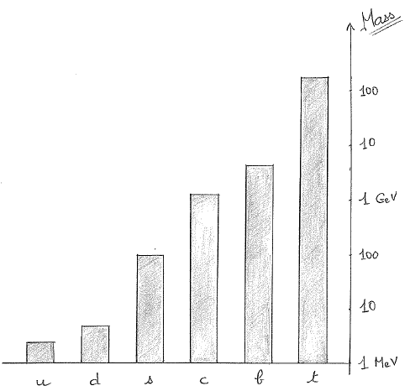
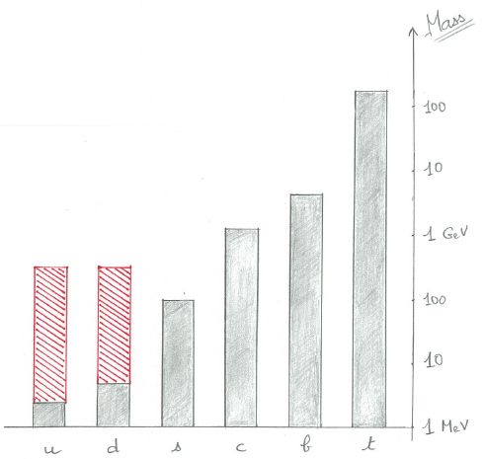
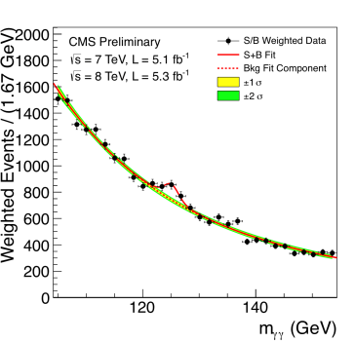
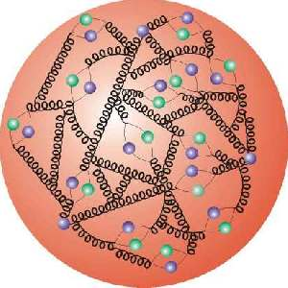
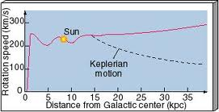
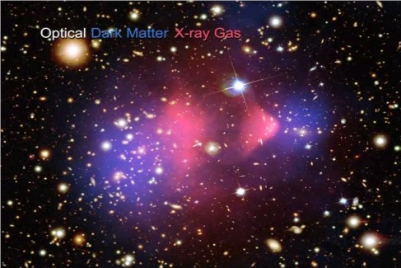
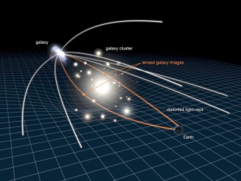
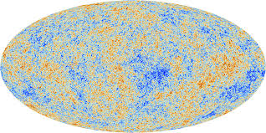
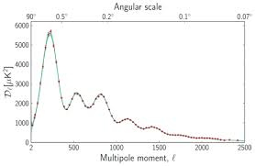
Interaction of quarks with Higgs
generates their mass
(couplings = SM parameters)
Higgs thus generates
~1% of the mass
of the visible universe
QCD generates
the other 99%
Galactic rotation curves,
colliding galaxy clusters,
BBN & structure formation
constitute evidence
for ~5 times more
non-luminous, non-absorbing (dark) matter
ΛCDM SM
From t^{re} fluctuations in the cosmic microwave background, infer ~2.5 times more energy content in the universe:
dark energy

Slide 3

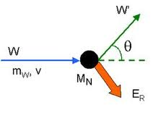
Dark Matter ?
Fritz Zwicky
While the cosmological « concordance model » can still be challenged
(for a discussion ΛCDM vs MOND, see e.g. Stacy McGaugh, arXiv:1404.7525),
it is very successfull and DM is one of its essential components.
Cosmology does not give a clue for the nature of DM
(apart from being « cold », non-baryonic, non electromagnetically interacting, non-participant in the primordial nucleosynthesis).
Particle physicists favor WIMPs
(with a trend to look for less massive particles)
and very light axions
(see Particle Data Group).

Slide 4
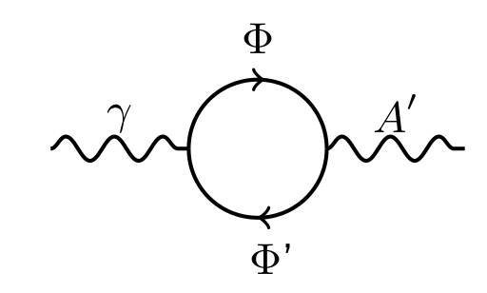
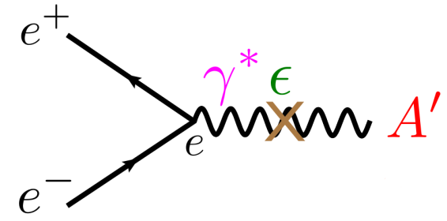
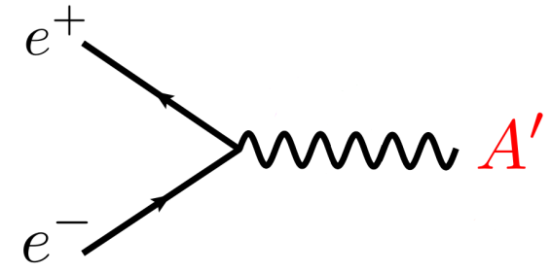
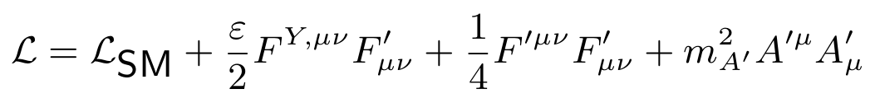
A dark sector with a new interaction ?
If DM exists, then it is natural to think it is subject to new (dark) forces.
Several theories beyond the Standard Model incorporate new, em-like, interactions. A dark/heavy photon (denoted γ’, A’ or U) could be the mediator of such a new U(1) interaction.
Through (theory dependent) loop interactions, an effective term in the Lagrangian generates a kinetic mixing between dark and ordinary photons.
In this way, dark photons can couple to electrons.

Slide 5
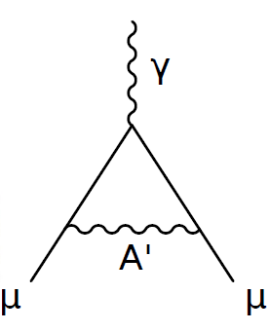
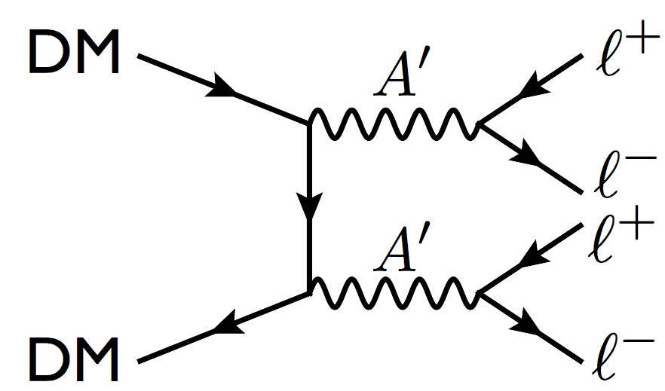
Why searching for a dark photon ?
« Natural » theoretical extension of SM
Muon anomalous magnetic moment « anomaly »:
would 2σ discrepancy in g-2 measurement
be due to additional contributions such as ?
Excess of high energy electrons and positrons
in cosmic rays due to
dark matter annihilation?
(but no excess of antiprotons → m_{A’} < 2 GeV ?)

Slide 6
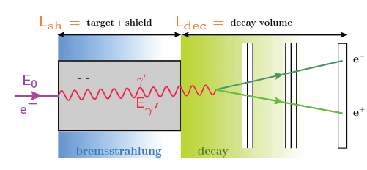
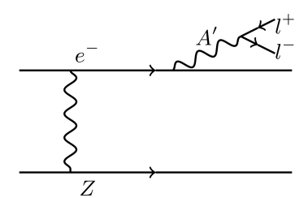
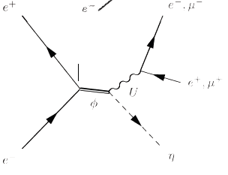
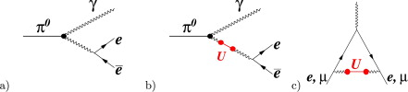
A’ production and detection
A’ radiated by electron in Bremstrahlung-like process and decaying in e⁺e⁻.
Beam-dump experiments
Dedicated experiments: MAMI, JLab
Collider experiments (KLOE, BaBar)
Hadron beams and
π⁰/η → e⁺e⁻γ decays
COSY/WASA, GSI/HADES

Slide 7
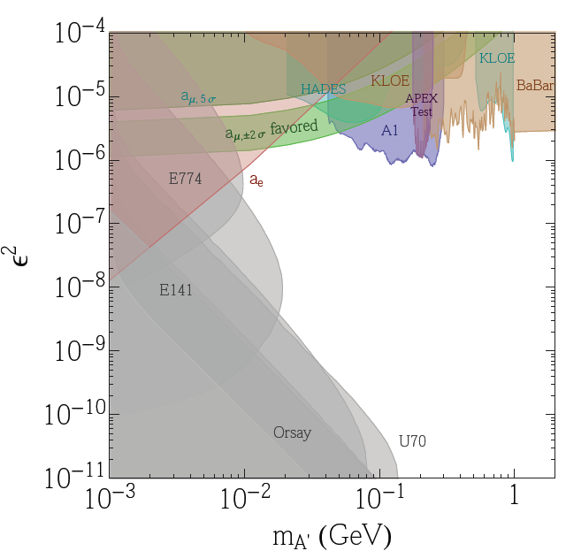
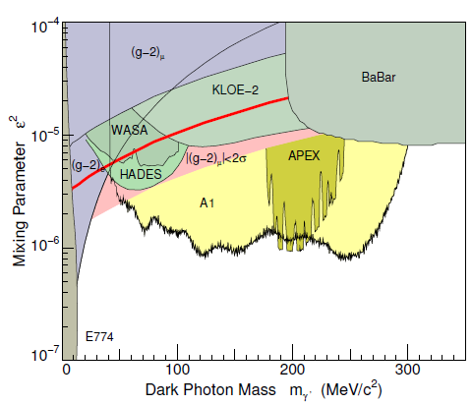
Published results
Rouven Essig
2σ exclusion plot
in γ-A’ mixing parameter
vs A’ mass
(visible decays):
Latest results from MAMI/A1 arXiv:1404.5502
(2m_{e})
(2m_{p})

Slide 8
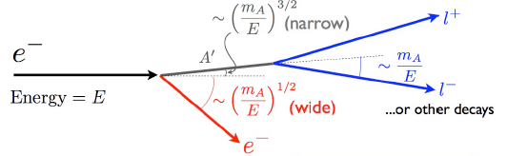
A’ radiation and decay
Like photon Bremstrahlung, production enhanced by high Z target, but suppressed by ~ (εm_{e}/m_{A’})²
Emitted mostly at beam energy (E_{A’} ≈ E)
and at small angles
Important QED background (except for displaced decay vertex)
Bjorken et al., PRD 80 (2009) 075018

Slide 9
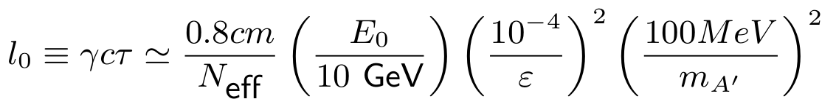
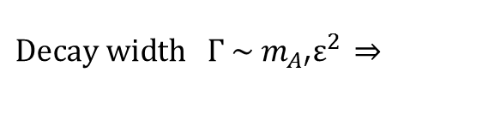
A’ decay length
$Decay width Γ \sim m_{A′}ε^{2} \overset{⇒}{}$
100 µm
1 cm
100 µm
Decay length at 6.6 GeV
1 m
1 cm
1 m

Slide 10
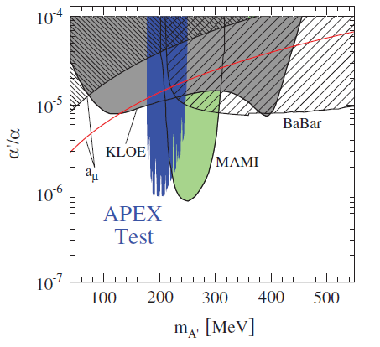
A’ experiment (APEX)
APEX
After successfull test run and first publication:
Abrahamyan et al., PRL 107 (2011) 191804

Slide 11
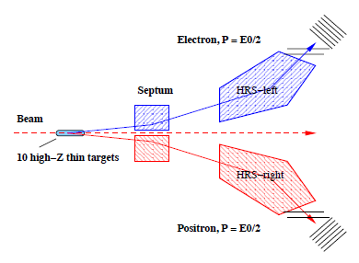
A’ experiment (APEX)
APEX
Spectrometer central momentum at E₀/2 + septum magnet forward angle coverage maximizes signal acceptance
VDC operation and track reconstruction at 5 MHz
(75 kHz/wire)
SciFi detectors for optimized optics calibration
Selective coincidence trigger with π⁺ rejection
Multi-foil target minimizes multiple scattering and increases mass coverage per beam energy
Hall A, E12-10-009, R. Essig, P. Schuster, N. Toro & B. Wojtsekhowski spokespersons

Slide 12
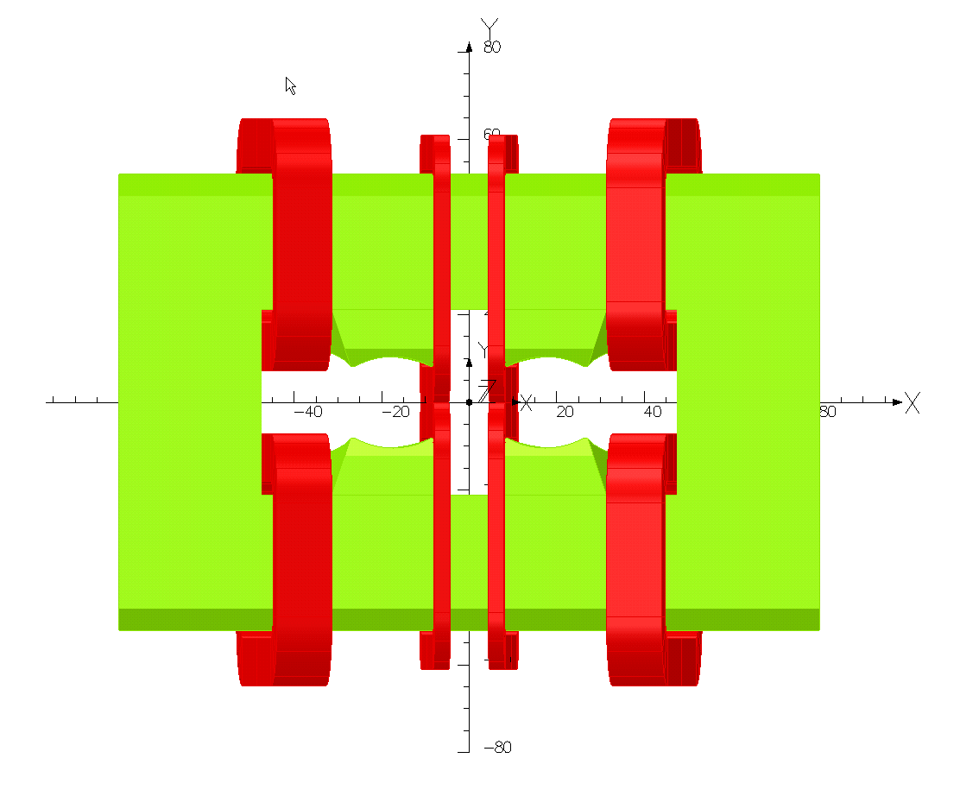
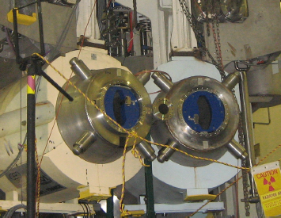
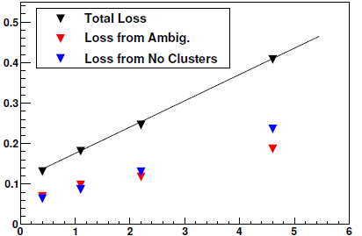
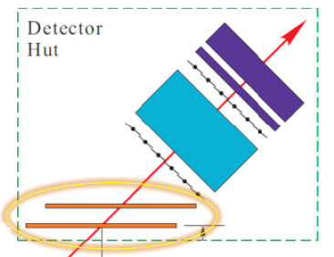
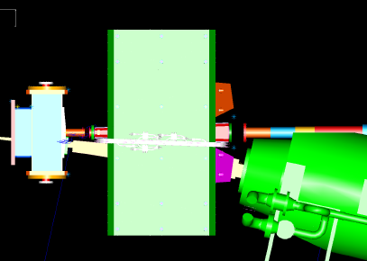
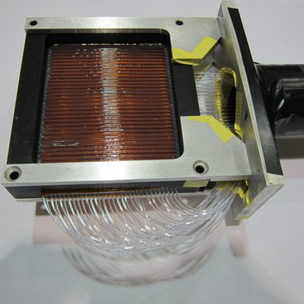
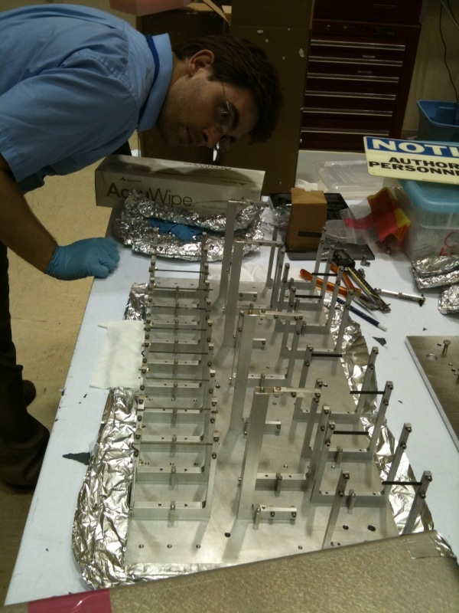
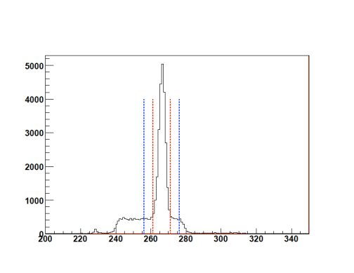
APEX
Track losses vs rate (MHz)
+ septum → +/- 5°
HRS quads → +/- 12.5°
Scintillating Fiber Detector
Targets
Concidence window 10 ns
(20 ns online)

Slide 13
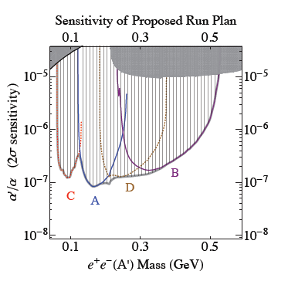
APEX run plan and expected sensitivity
APEX
(α’/α = ε²)
A/B/C/D : 2.2/4.4/1.1/3.3 GeV
41 days
Ready early 2015, awaiting scheduling

Slide 14

Heavy Photon Search (HPS)
After successfull test run
for validation of background and trigger rates
NIM paper to be submitted very soon

Slide 15
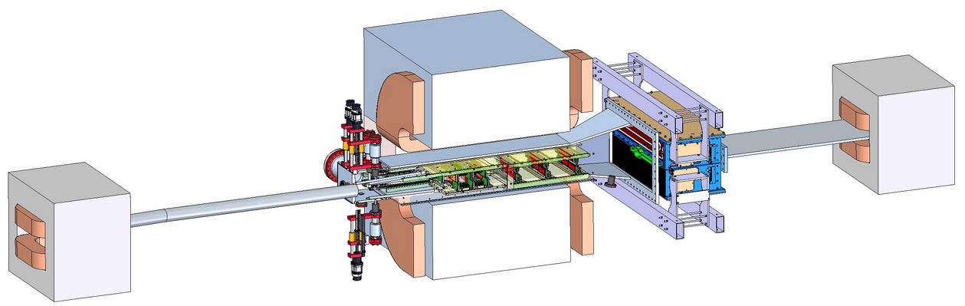
Heavy Photon Search (HPS)
Analyzing Magnet
Chicane Magnet
Chicane Magnet
SVT
PbWO₄ ECal
W Target
Hall B, E12-11-006, M. Holltrop, J. Jaros & S. Stepanyan spokespersons

Slide 16
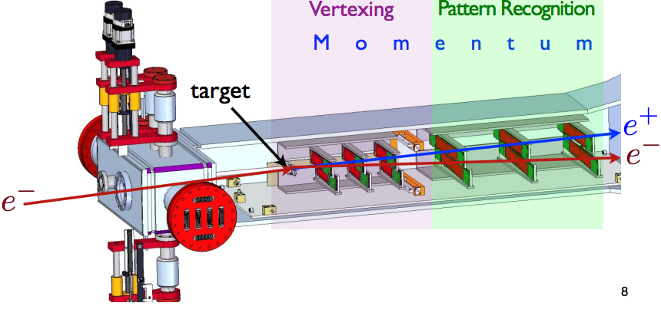
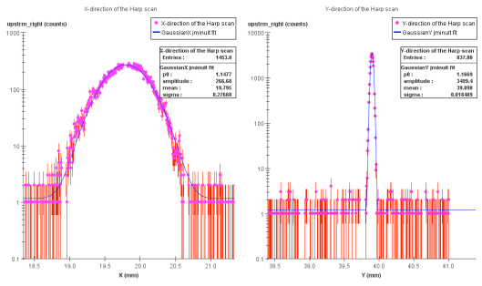
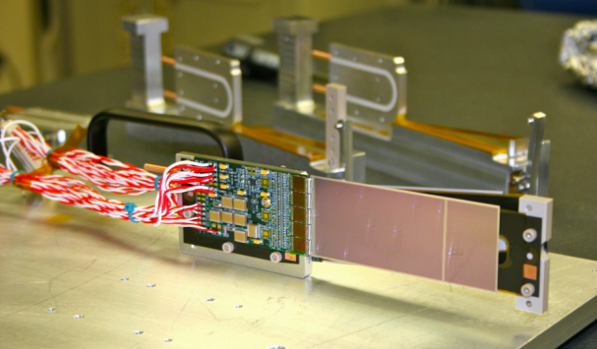
HPS - SVT
Beam 270 x 20 µm
Sensors 0.5 mm from beam !
First 3 planes σ_{x} = 60 µm for vertexing (σ_{z} = 1-5 mm)
Planes 4-6: σ_{x} = 180 µm
to complete momentum determination
Continuous read-out at 40 MHz

Slide 17
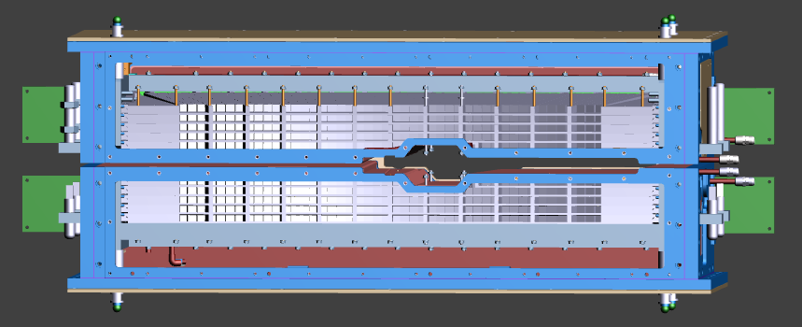
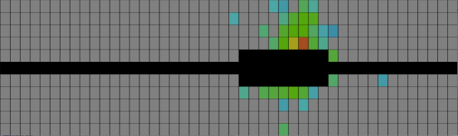
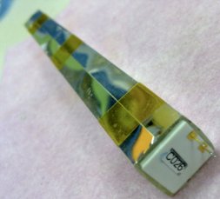
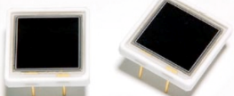
HPS - ECal
e⁺
e⁻
(background)
Provides trigger and other energy measurement
Refurbished/upgraded from CLAS/IC
- 442 lead tungstate crystals
- new 10 mm x 10 mm APDs
- lower noise (~ 5 MeV FWHM) preamplifiers
- new light-monitoring (LED)

Slide 18
HPS - Triggers
1 cluster trigger
elastically scattered electrons, prescaled by zones (for calibration)
2 cluster triggers
- A’: 2 clusters in opposite quadrants,
with energy conditions (~ 40 kHz)
- π⁰ → γ γ: invariant mass calculated online (for calibration)
- ….
3 cluster trigger
π⁰ → e⁺e⁻γ Dalitz decay (for cross-checks)

Slide 19
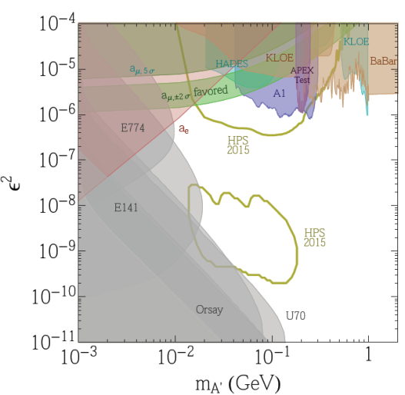
HPS run plan and expected sensitivity
Installation in Hall B in September & October
Run during CLAS12 installation in 2015: 25 days
(commissioning + 1.1 GeV + 2.2 GeV)
+ 14 days at 4.4 GeV
(to be scheduled)

Slide 20

DarkLight
Goals:
Measure the exclusive process e⁻p → e⁻pe⁺e⁻ (below pion threshold) and search for resonance in the e⁺e⁻ invariant mass spectrum
Cover the lower mass range 10-90 MeV at and below the (g-2)_{µ} band
Potential search for invisible decay through ep missing mass and photon veto detector
Experiment:
Kinematics different from APEX and HPS: m_{A’}/E₀ not small, lighter target
Very high intensity ERL beam (10 mA, 100 MeV) on low pressure H₂ target
Detect all four particles in the final state
FEL/ERL, E12-11-008, P. Fisher contact person

Slide 21
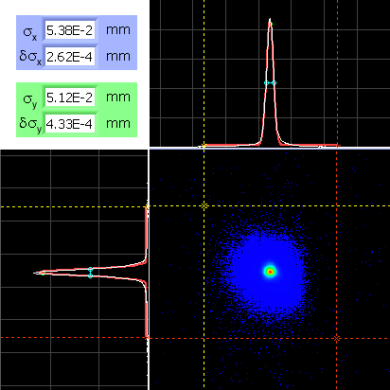
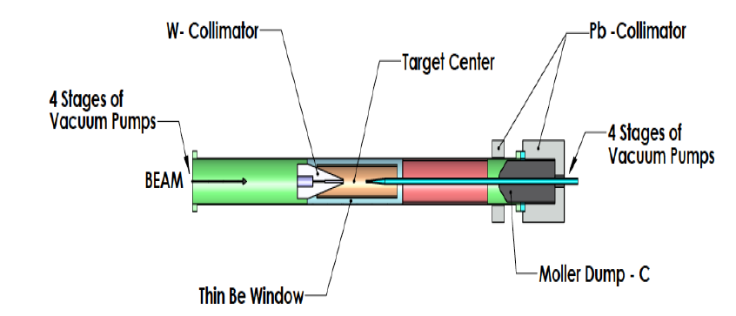
DarkLight
Beam test in July 2012 demonstrated that the ERL ½ MW, stable, beam
can be transmitted through a 2-mm diameter, 13-cm long, aperture
with ppm losses and acceptable backgrounds.
PRL 111, 164801 (2013), NIM A729, 69 (2013), NIM A729, 233 (2013)
This validates the concept of low-pressure (a few torr) target
with differential pumping
Dipole Magnet
Beam e⁻
Electromagnetic Calorimeter
Silicon Vertex Tracker

Slide 22
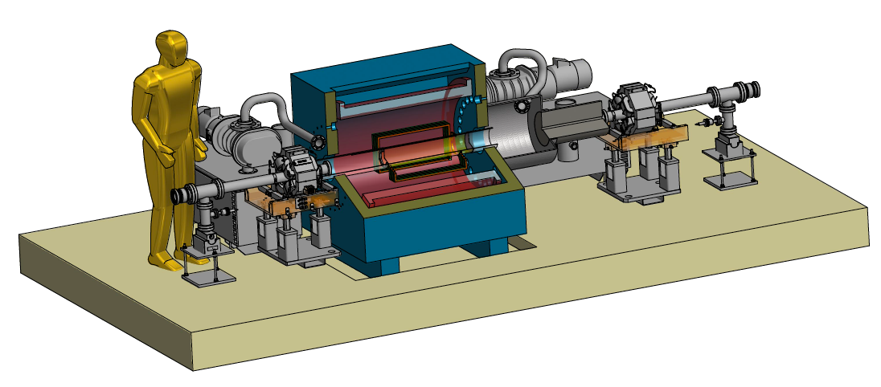
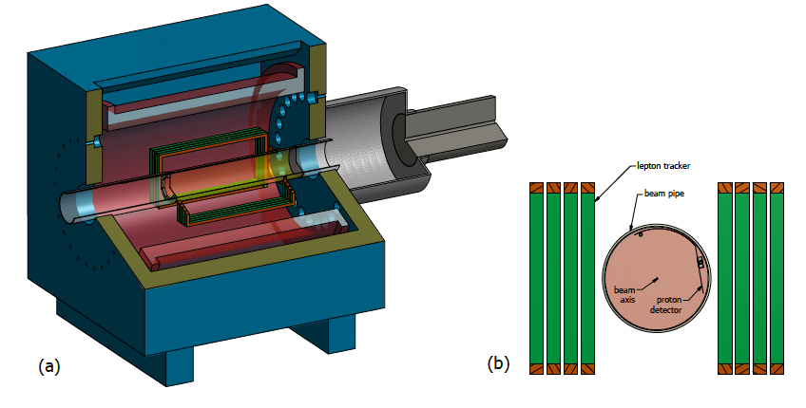
DarkLight proposed phase 1
Goals:
Carry out accelerator studies,
Perform precise measurements of QED processes,
Obtain a first significant physics result (for A’ mass between 30 and 70 MeV).
by implementing the target concept and using a reduced detection
- two-arm planar GEM lepton tracker,
- one third of the proton detector (Si),
- no photon detector.
MRI proposal (2014), R. Milner PI

Slide 23
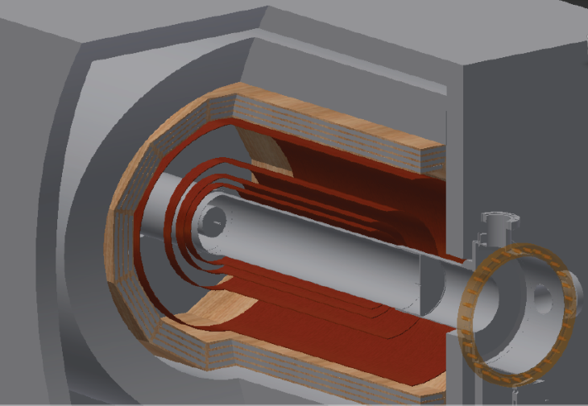



DarkLight Lepton Tracker
single electron
P_{T}=20 MeV/c
Jan Balewski
4 cylindrical layers (10/12/16/26 cm radii) with strips read-out
(close to CLAS12/MVT design)
Singles rate at 10 cm radius (Hz/cm²) = f(z)
Extensive background studies:
L = 6 10³⁵ cm⁻²s⁻¹, rate up to 50 kHz/cm² in layer 1,
mostly from backscattering and secondaries
from ep elastic in downstream material
(target exit straw + magnets)

Slide 24

DarkLight plan and expected sensitivity
(If MRI approved,) build phase 1 in one year
and perform measurement in second half of 2015.
(α’= αε²)
(In all cases,) write TDR for full experiment by this summer
and aim at data taking in 2017-2018.
Dipole Magnet
Beam e⁻
Electromagnetic Calorimeter
Silicon Vertex Tracker

Slide 25

Resolutions
Bump hunt on large background requires excellent invariant mass resolution
Sensitivity ~ Signal/sqrt(Background) ~ A’ acceptance/sqrt(Resolution)
$$M^{2}=2E_{+}E_{−}(1−\cos{Θ)}$$
Resolutions depend on kinematics and are dominated by multiple scattering.
For illustration, indicative numbers:
 | E₀ (GeV) | M (MeV) | Θ (rd) | σ_{p}/p | σ_{θ} (mrad) | σ_{M}/M | σ_{M} (MeV)
APEX | 2.26 | .2 | 0.18 | 10⁻⁴ | 0.35 | 0.5% | 1.
HPS | 2.2 | .11 | 0.1 | 2.8% | 1. | 2.4% | 2.7
DarkLight | 0.1 | .028 | 1. | 5% | 40 | 4.7% | 1.3

Slide 26
Main experimental challenges
APEX
APEX
- Background reduction at trigger level
- Tracking efficiency at high rates
HPS
- Background reduction at trigger level
- Operation of Si tracker very close to beam
- Beam stability
- Identify (and cure) sources of beam induced background
DarkLight
  - MW beam, background reduction
  - Low-pressure gas target configuration
  - Si proton detector + Fast, efficient and thin lepton tracker
  - Data read-out and acquisition

Slide 27
Main strong points
APEX
APEX – 2-arm spectrometer
- Sensitivity to higher A’ masses (up to 550 MeV)
- Readiness early 2015
HPS – forward vertexing/tracking
- Readiness fall 2014
- Sensitivity to significantly lower A’ couplings through displaced vertex
DarkLight full final state measurements
  - Sensitivity to lower A’ masses (down to 15-20 MeV)
  - Exclusive reaction implies potentially cleaner signal
  - Sensitivity to invisible decays

Slide 28
Other A’/DM searches at JLab ?
Hall D beam dump experiment sensitive to invisible decays:
BDX Letter of Intent submitted to PAC42
(M. Battaglieri contact person)

Slide 29

Dark photon searches
JLab in a unique position to probe theory beyond the Standard Model
with potentially high relevance to the nature of dark matter

