Slide 1
Upgraded Injector Test Facility
JLab Annual User’s Group Meeting
Matt Poelker
June 20-22, 2016

Slide 2
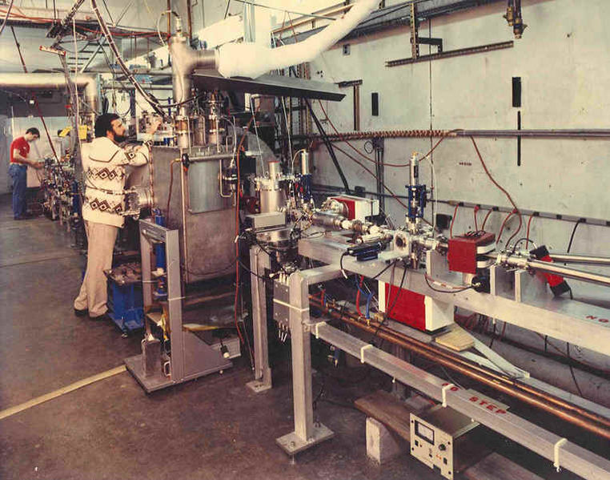
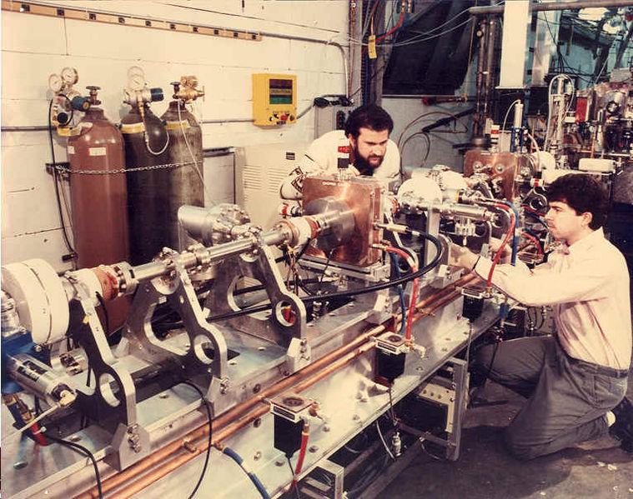
Injector Test Cave at Building 58
thermionic gun,
three-beam rf-chopper ¼ cryomodule
First tests of CEBAF injector

Slide 3
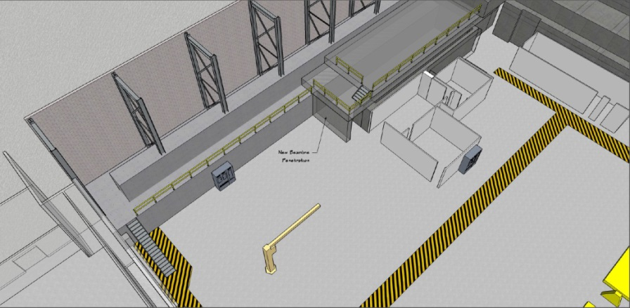
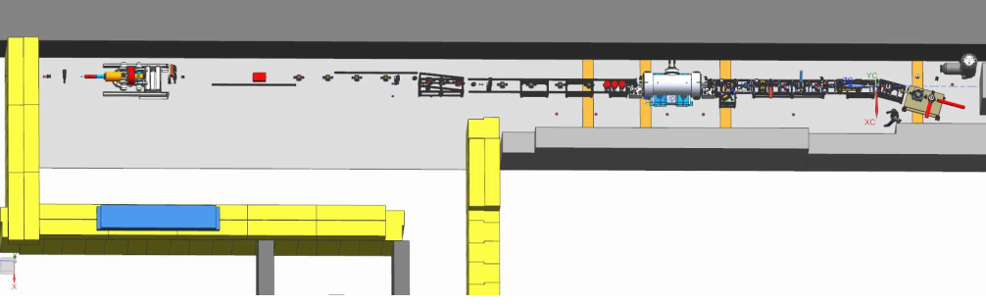
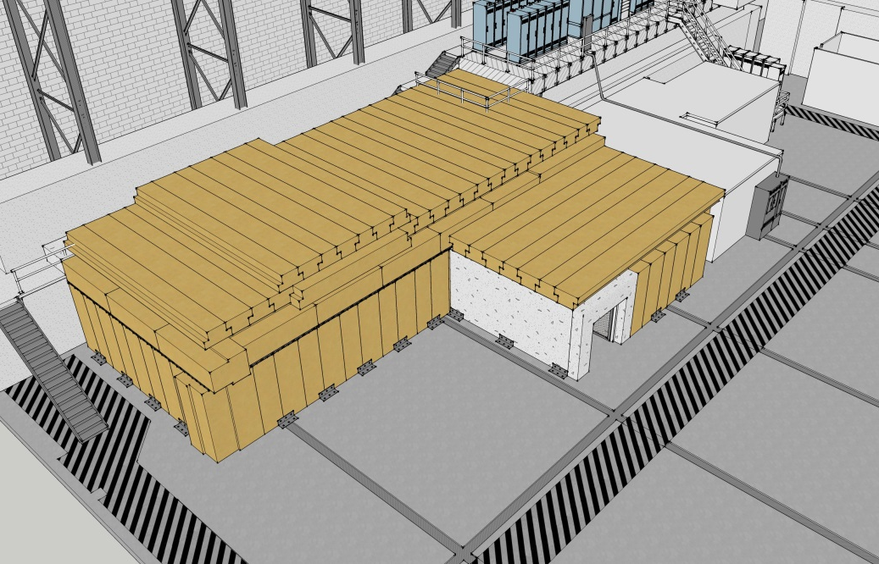
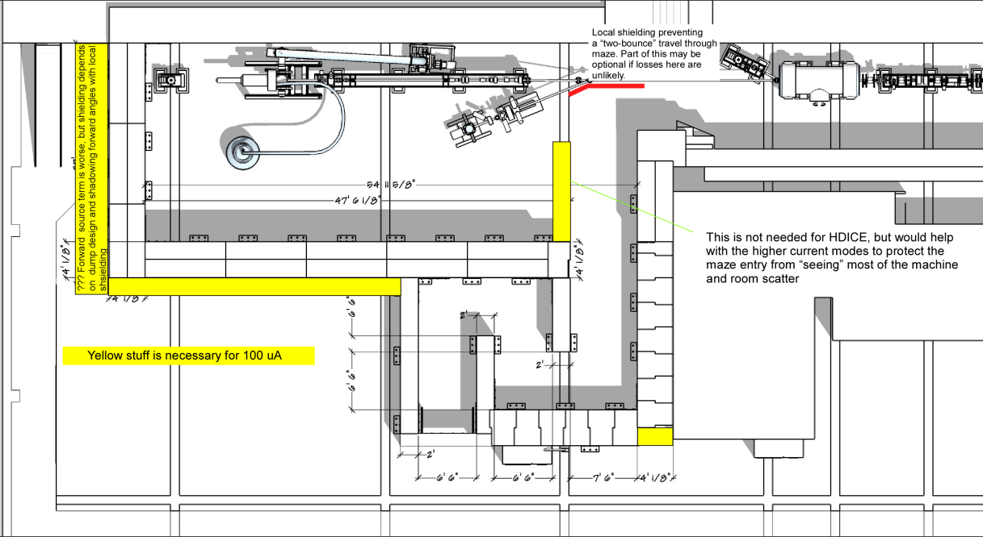
Upgraded Injector Test Facility….Compact 10 MeV Accelerator
old injector test cave
What we started with…
UITF as imagined

Slide 4
Upgraded Injector Test Facility
keV region
450 kV, 3mA
225 kV, 32 mA
MeV region
Up to 10 MeV, 100 nA
Desire 100 uA at 42” beam height

Slide 5
UITF: what will it do? who will use it?
Commission HDIce with electron beam
Tests with MeV beam more challenging than tests with GeV beam
Commission key components of Injector Upgrade: new ¼ CM, 200kV gun, 200kV Wien
High current polarized gun tests at keV energy
Commission new hardware for CEBAF: nA stripline BPMs, low noise BCM for parity violation experiment, magnetron vs klystron, etc.,
Polarized positron source, fast kicker for EIC, Bubble Chamber experiments, MeV parity violation experiments, Thin-film SRF cavity R&D, etc.,

Slide 6
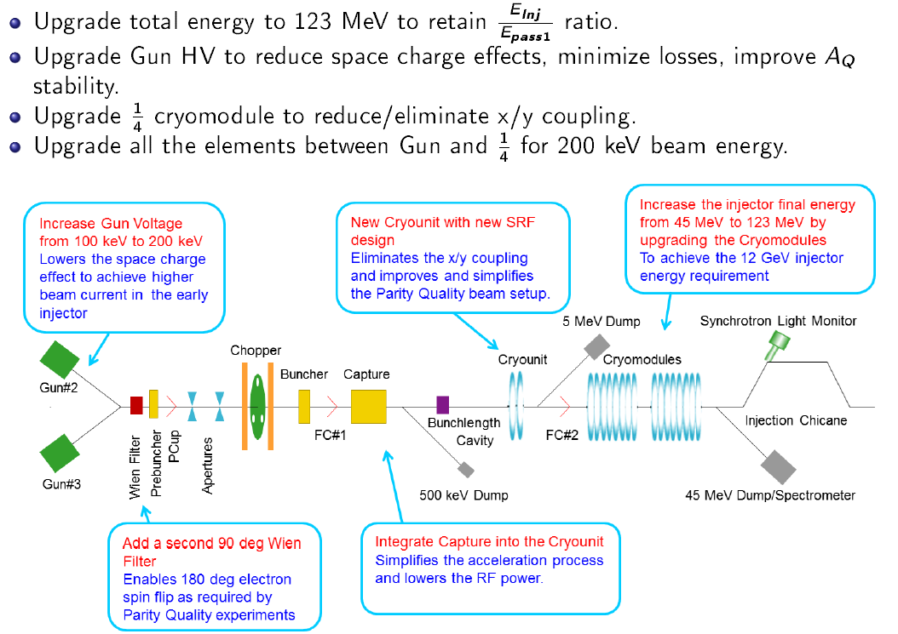
CEBAF Injector Upgrade

Slide 7
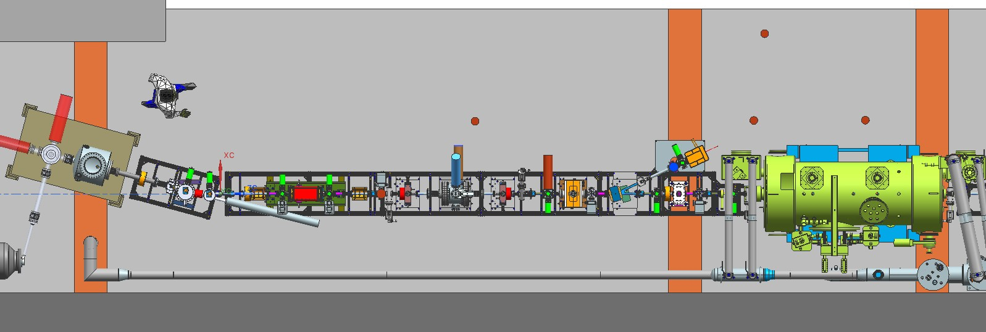
chopper
buncher
New inverted-insulator polarized photogun
Wien filter
Connection to LHe supply
New ¼ cryomodule

Slide 8
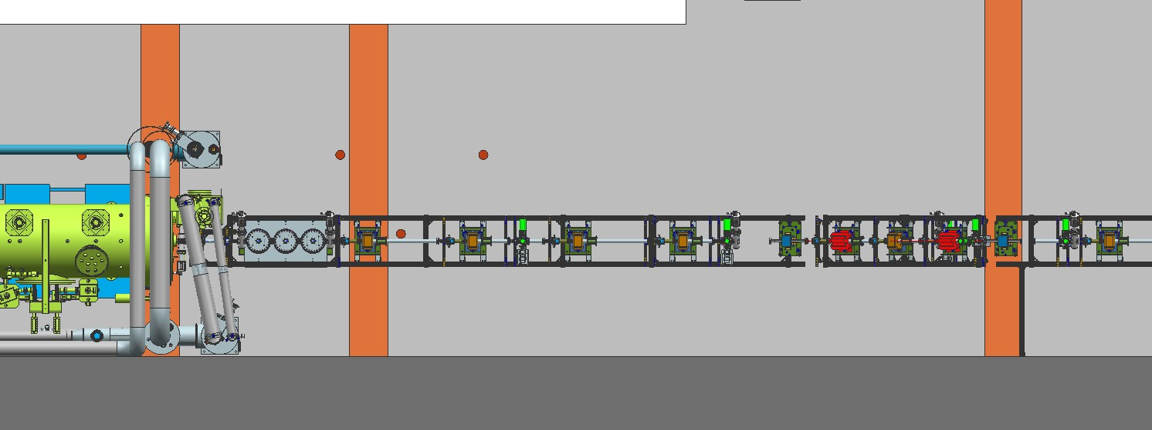
BLM locations
Fixed Dump
PSS BCM
Insertable Faraday Cup
want to deliver 100uA to cup or dump

Slide 9
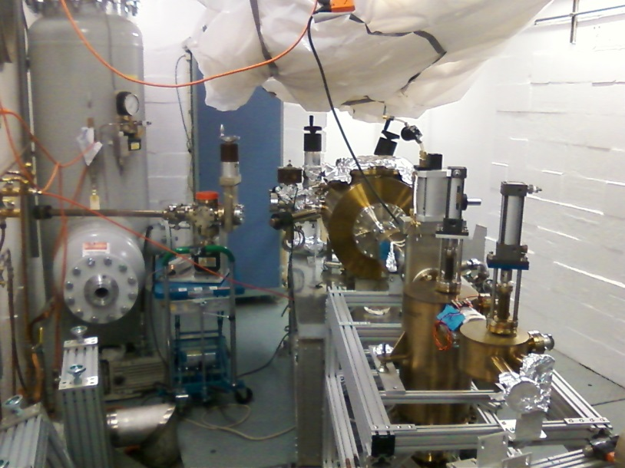
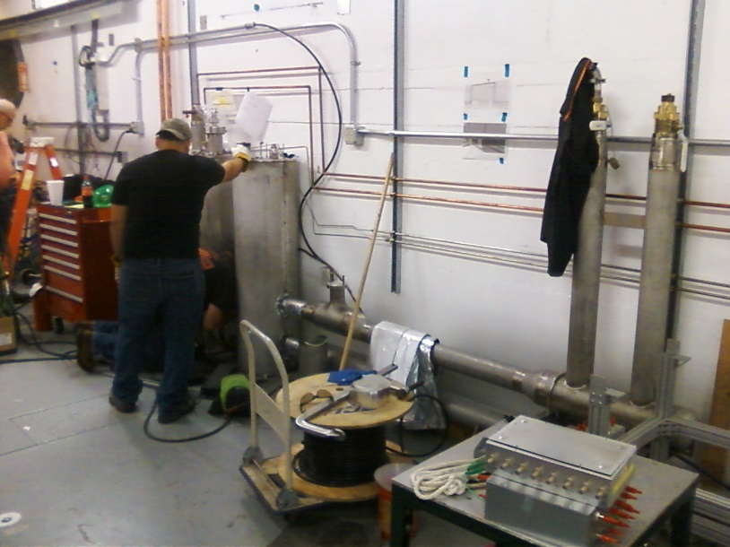
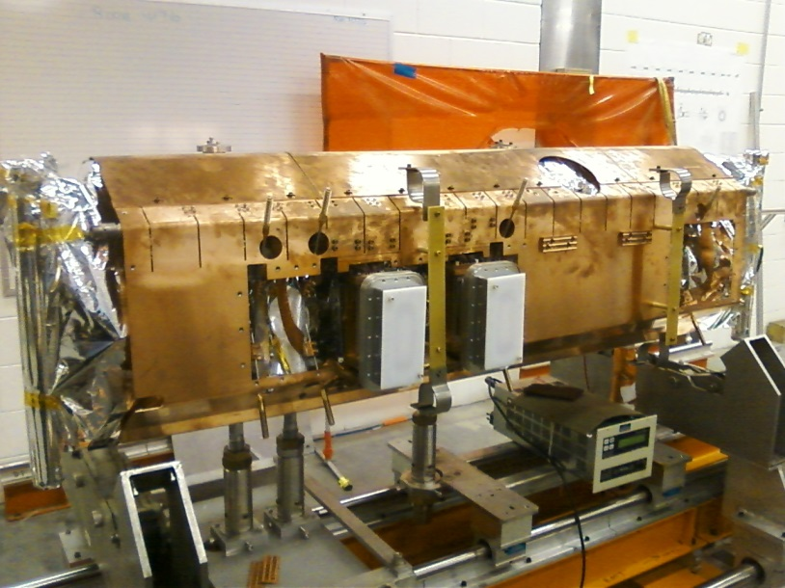
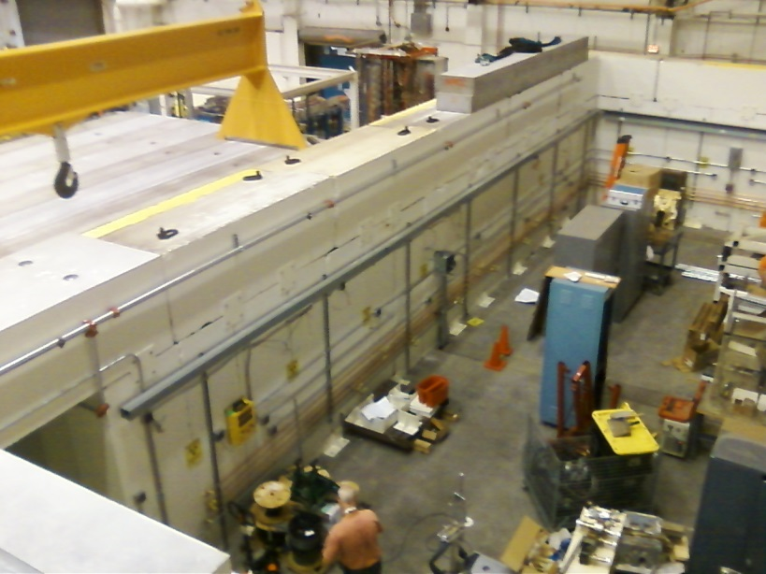
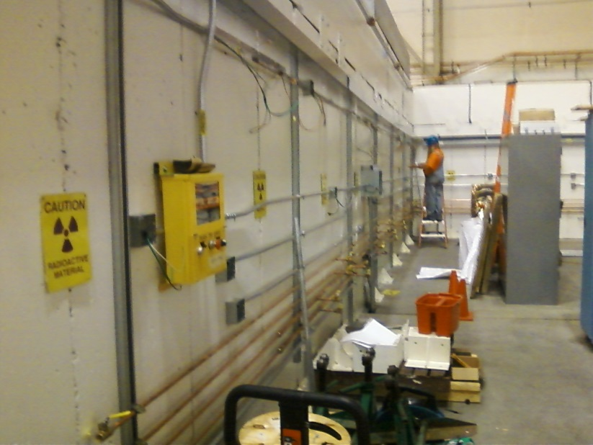
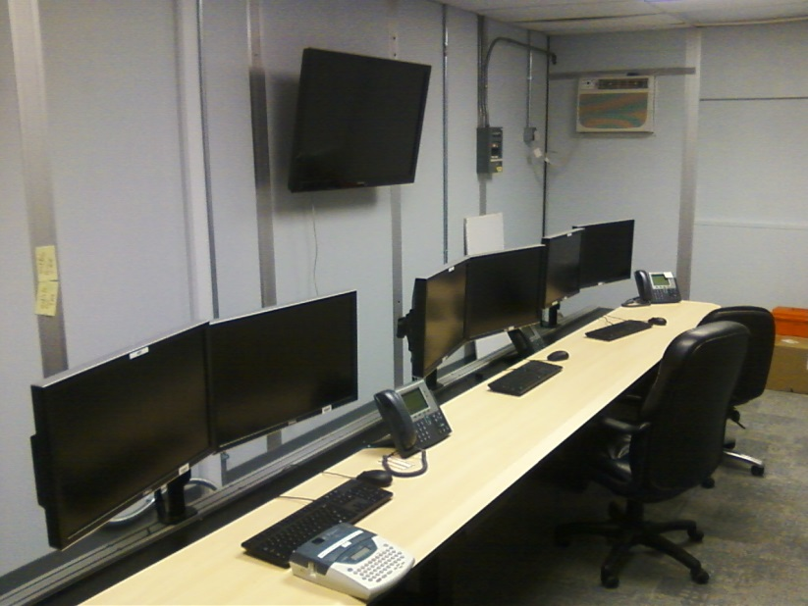
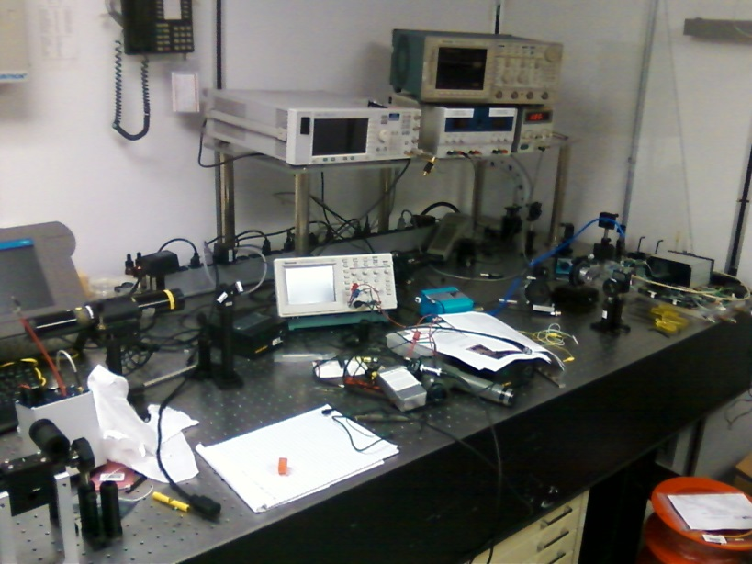
UITF Status Today

Slide 10
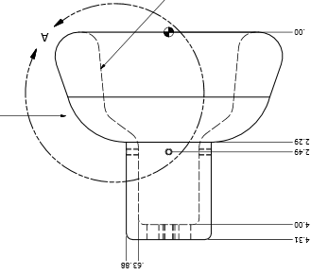
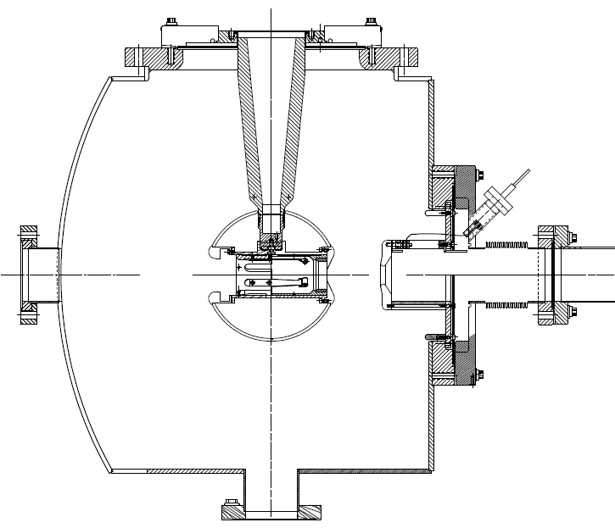
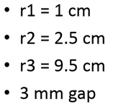
Inverted Insulator Photogun
No exposed high voltage

Slide 11
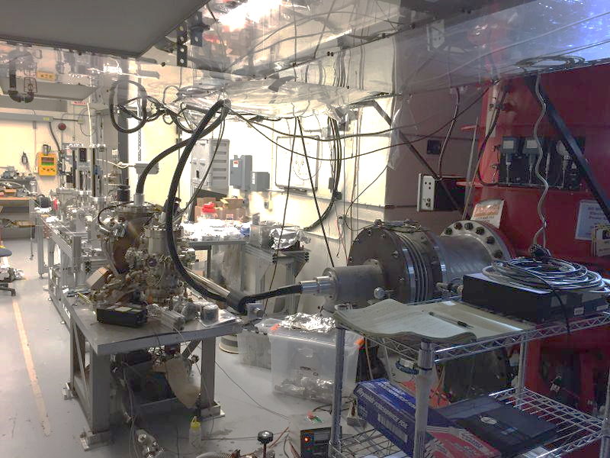
Gun and Beamline at LERF GTS
Now making beam at 275kV

Slide 12
Conclusion
Hope to be making MeV polarized beam at UITF during Fall of 2016
HDIce beam tests early 2017
After that? Your ideas are welcome, we want to help you conduct your research and enhance the scientific output of JLab

Slide 13
Status Reviews
UITF Accelerator Review: beamline design reviewed by Ops/CASA/SRF, March 18, 2016, “Will it work?” review
Geoff Krafft, Mike Spata, Reza Kazimi, Arne Freyberger, Todd Satogata, Fay Hannon
Yes, it will work
Internal Safety Review, May 10, 2016
Personnel safety, including radiation protection. Assessment will be sent to the Safety Configuration Management Board (SCMB)
Conduct of Operations Review, July 2016
Commissioning and Operations plans
Accelerator Readiness Review, August 2016
Documentation in place, systems ready and checked out, staff trained
Experimental Readiness Review, Nov/Dec 2016

