Slide 1
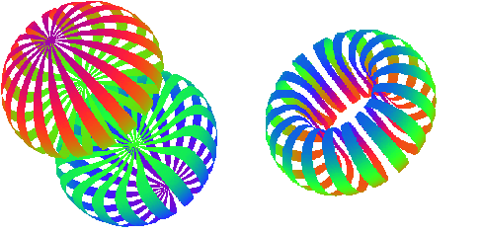


Probing Short-Range Interactions with a Tensor Polarized Target
Elena Long
Users Group Meeting
Jefferson Lab
June 21st, 2016
go.aps.org/lgbtphysics

Slide 2



















































Slide 3

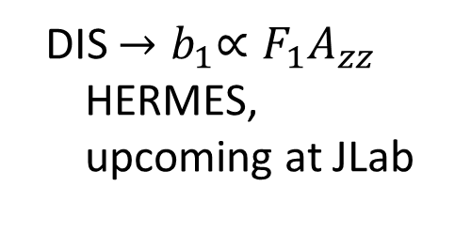

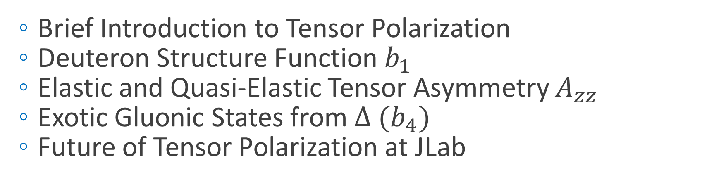

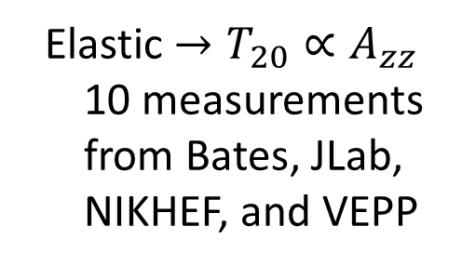
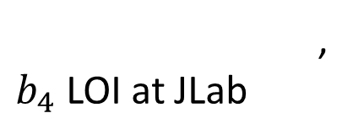
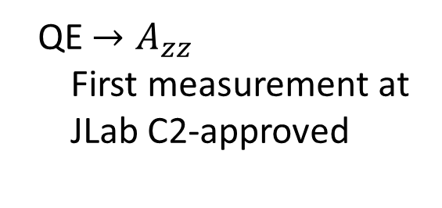

Today’s Discussion
  Brief Introduction to Tensor Polarization
  Deuteron Structure Function $b_{1}$
  Elastic and Quasi-Elastic Tensor Asymmetry $A_{zz}$
  Exotic Gluonic States from $∆ {(b}_{4})$
  Future of Tensor Polarization at JLab
  QE ${→A}_{zz}$
  First measurement at JLab C2-approved
  Elastic $→T_{20}∝A_{zz}$
  10 measurements from Bates, JLab, NIKHEF, and VEPP
  DIS ${→b}_{1}∝F_{1}A_{zz}$
  HERMES, upcoming at JLab
,
$b_{4}$ LOI at JLab
$$<0.5$$
$$0.8−1.8$$
$$2$$
$$x$$

Slide 4
A Brief Introduction to Tensor Polarization

Slide 5
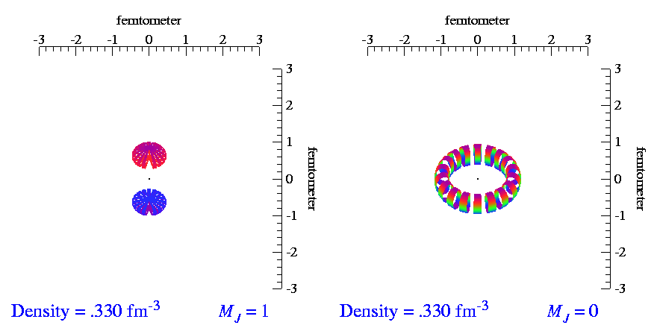
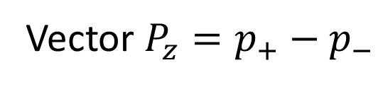
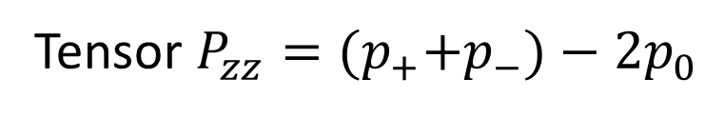
Tensor Polarization
For tensor polarization, need spin-1 particles
Spin-1
System
Spin-½
System
Development of a high luminosity, high tensor polarized target has promise as a novel probe of nuclear physics
m = +1
$${(p}_{+}+p_{−})=1, { p}_{0}=0, { P}_{zz}=+1$$
m = +½
$$\left(p_{+}+p_{−}\right)=2/3,{ p}_{0}=1/3, { P}_{zz}=0$$
m = 0
m = -½
$${(p}_{+}+p_{−})=0.5, { p}_{0}=0.5, { P}_{zz}=−1$$
m = -1
$${(p}_{+}+p_{−})=0, { p}_{0}=1, { P}_{zz}=−2$$
Vector $P_{z}=p_{+}−p_{−}$
Tensor $P_{zz}={(p}_{+}+p_{−})−2p_{0}$
-
( + )-2
Animations by SC Pieper, et al, http://www.phy.anl.gov/theory/movie-run.html

Slide 6
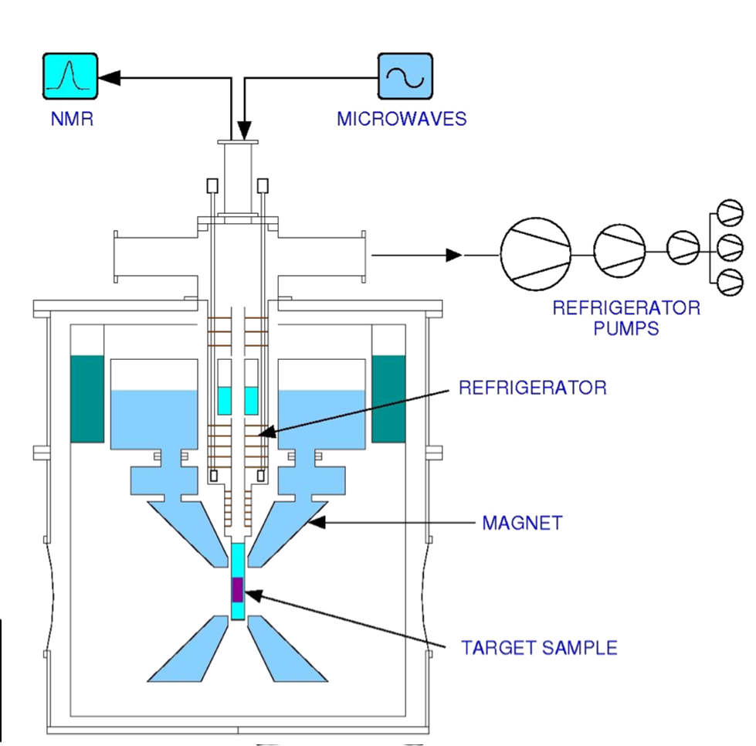
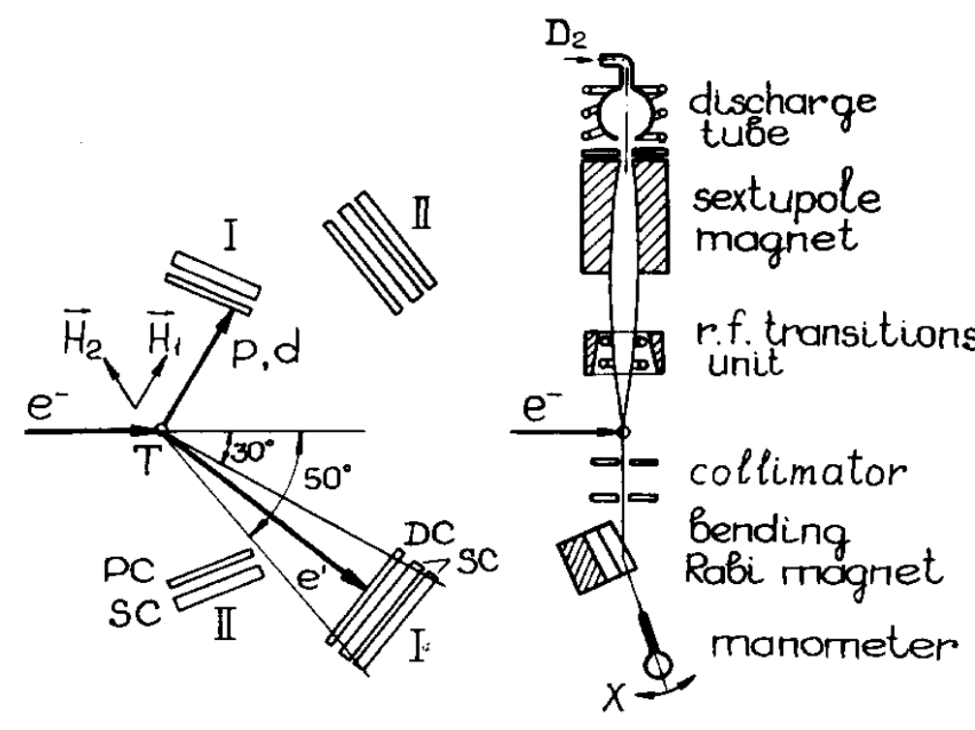
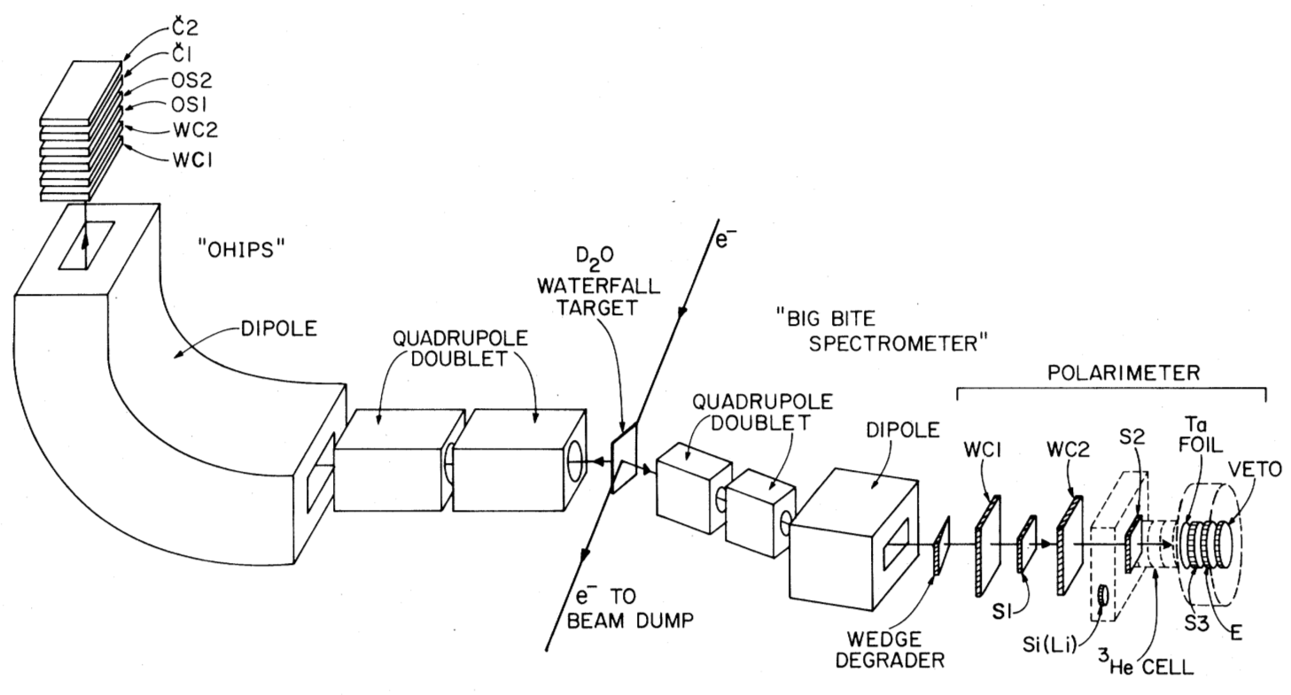
Tensor Polarization Techniques
  Unpolarized Target + Polarimeter
    D₂O waterfall^{[1]}
    Liquid D₂^{[2]}
    Medium-high luminosity, no polarization enhancement
  Gas Jet/Storage Cell Target^{[3]}
    Low luminosity, very high tensor polarization
  Solid Polarized DNP Target^{[4]}
    High luminosity, polarization enhancement, large dilution at high x
^{[1]} ME Schulze, et al, PRL 52 597 (1984)
^{[2]} D Abbot, et al, PRL 84 5053 (2000)
^{[3]} AV Evstugneev, et al, NIM A 238 12 (1985)
^{[4]} B Boden, et al, Z. Phys. C 49 175 (1991)

Slide 7
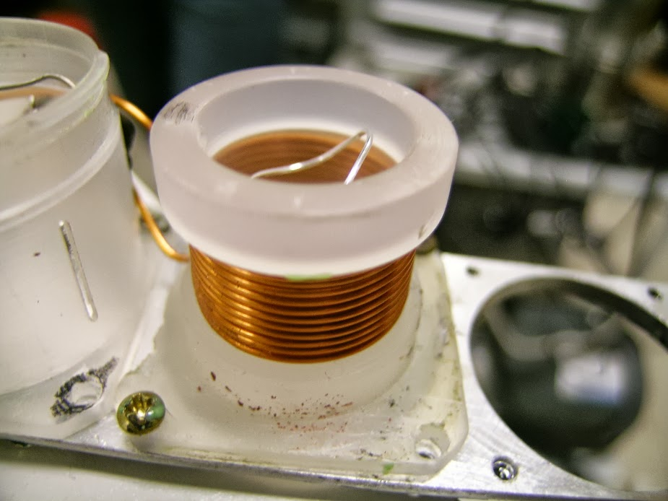
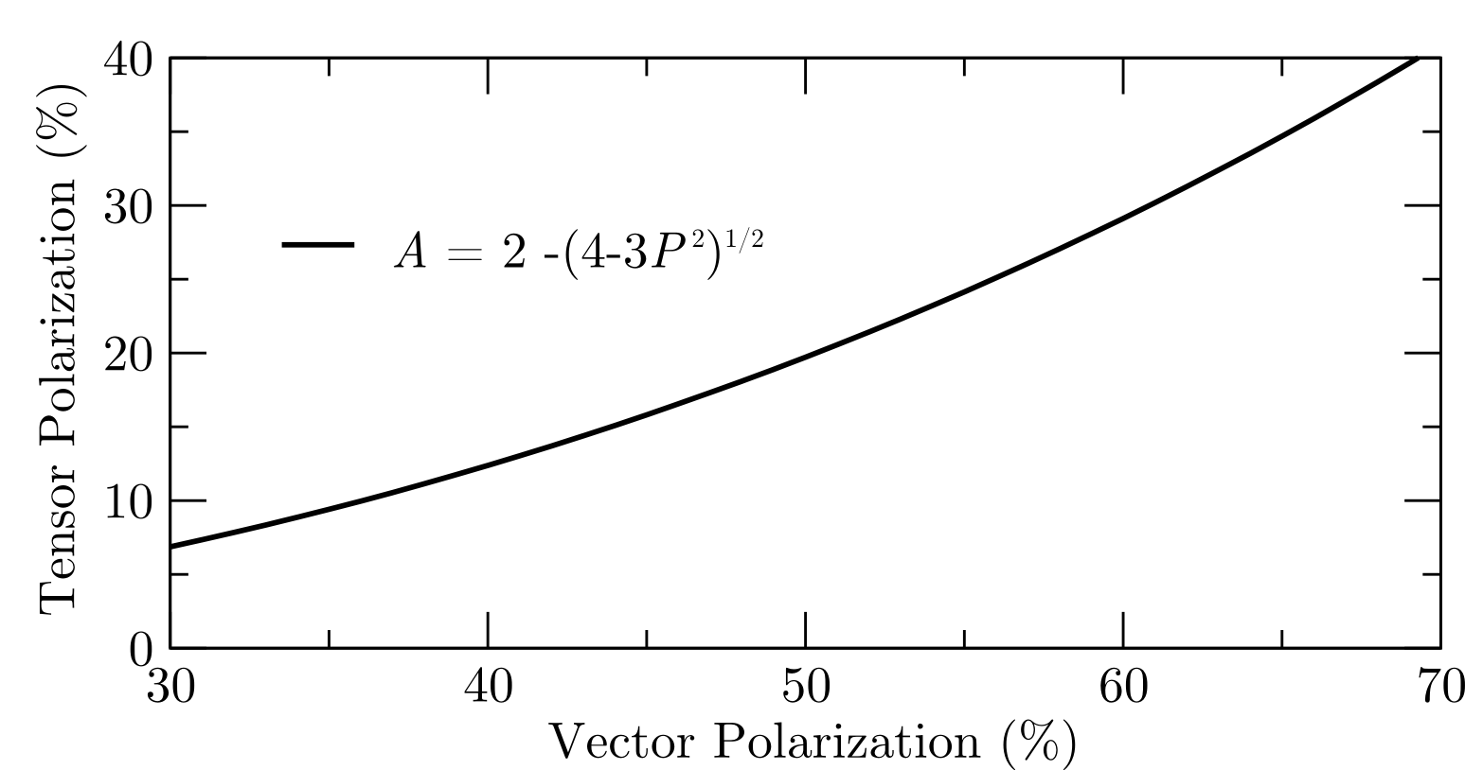


Tensor Structure Function, $b_{1}$
  Dynamic Nuclear Polarization of ND₃
  Approved experiments for $P_{zz} \sim 30\%$
  5 Tesla at 1 K
“Brute Force” Tensor Polarization

Slide 8
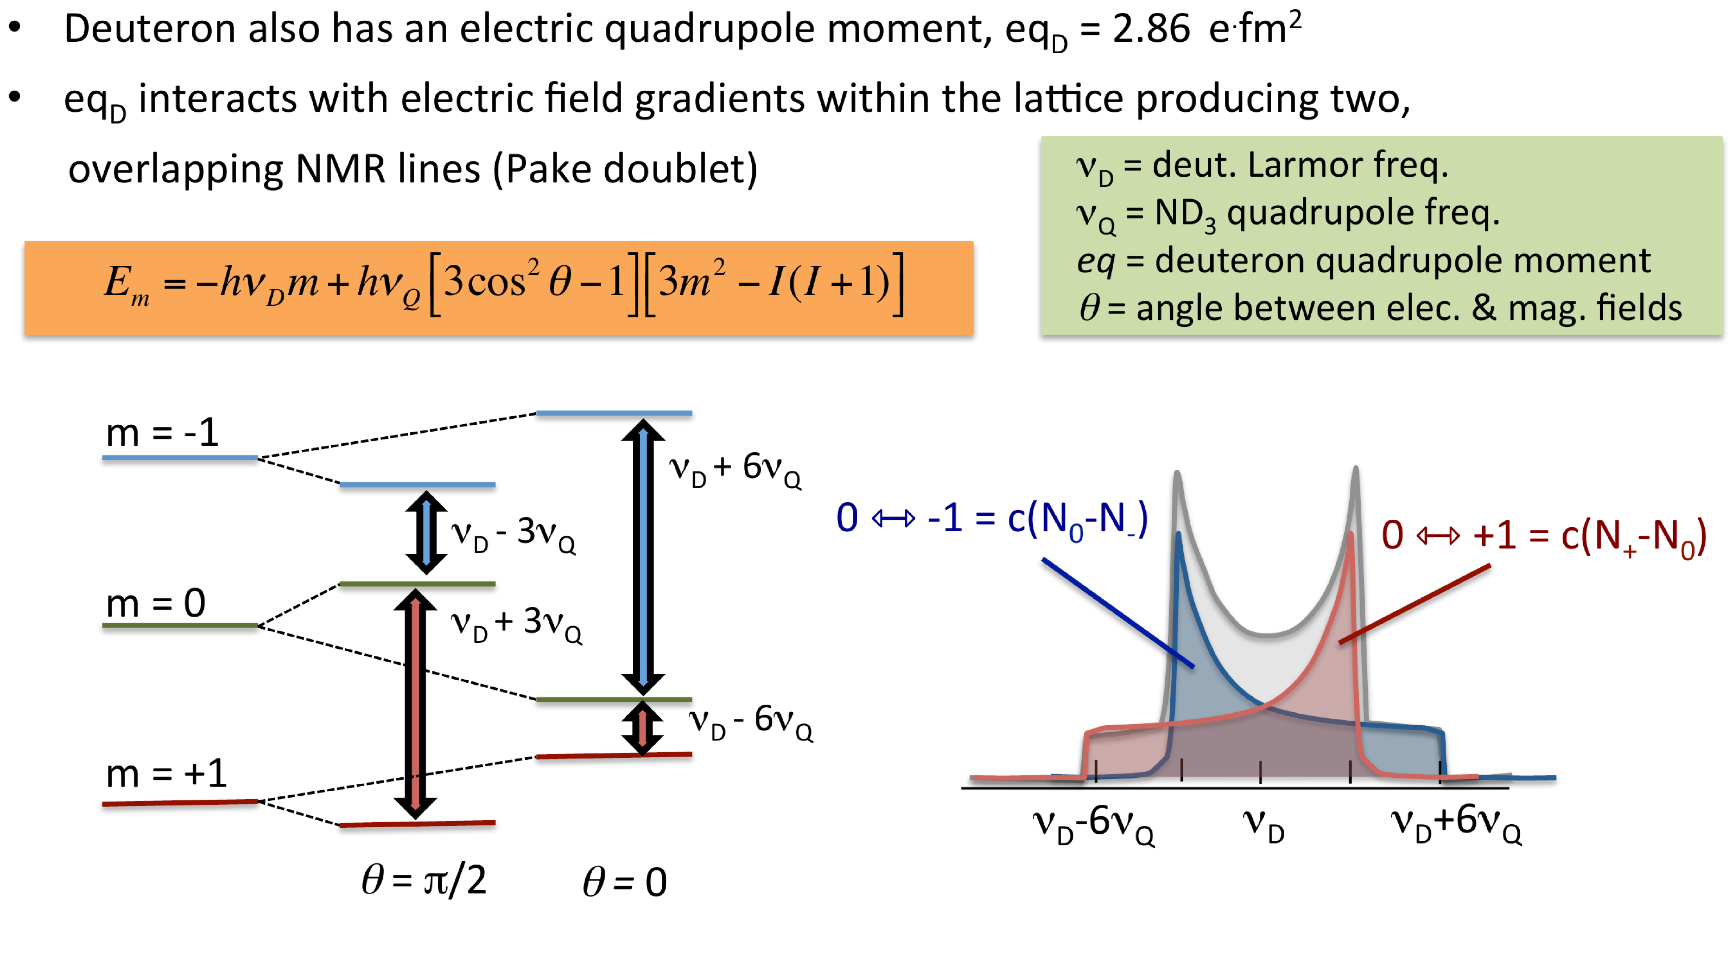
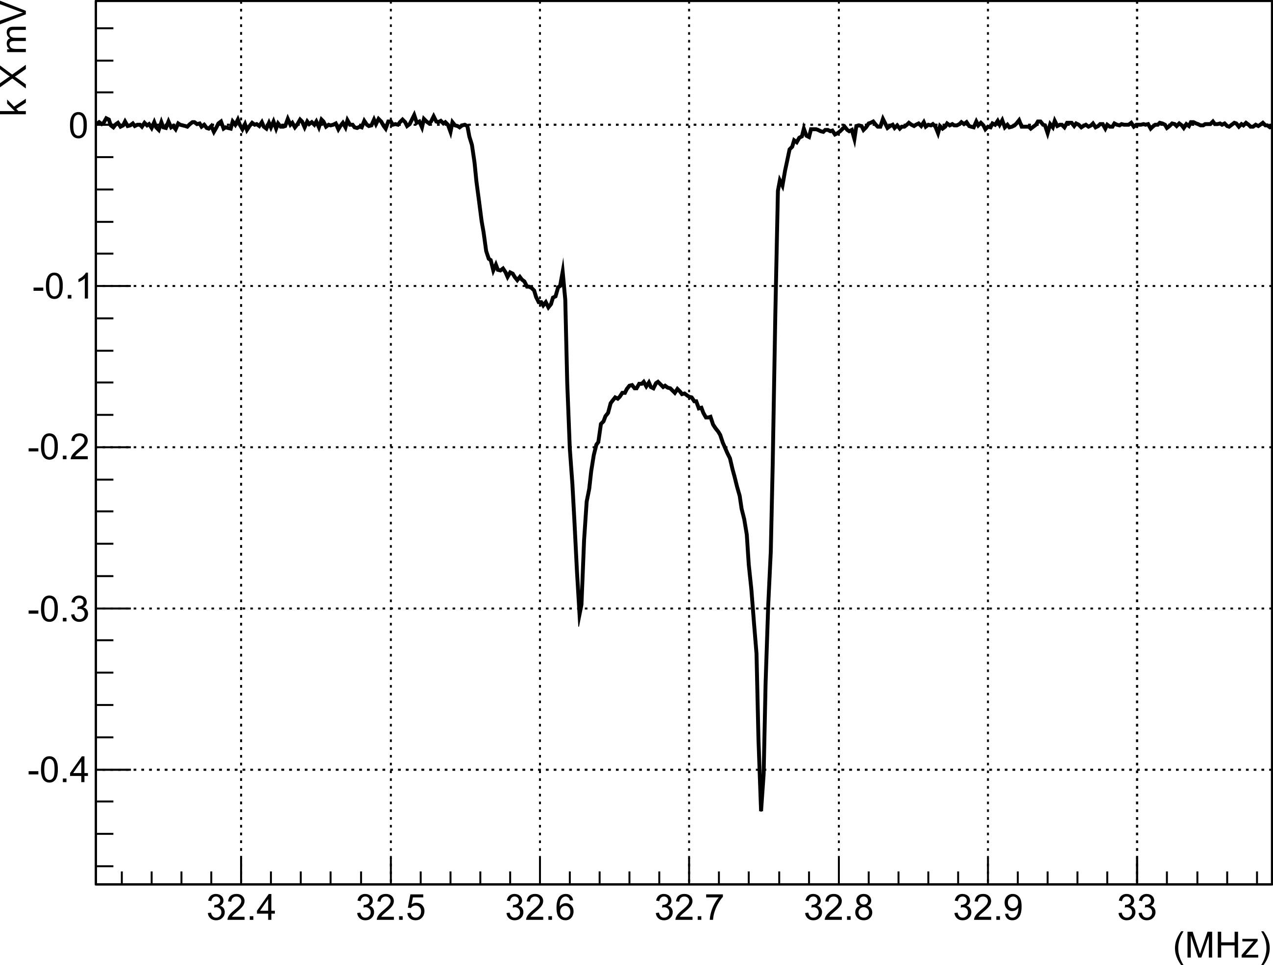



Tensor Structure Function, $b_{1}$
“Hole Burning” Tensor Enhancement
32.4
32.5
32.6
32.7
32.8
32.9
MHz
-0.4
-0.3
-0.2
-0.1
  Techniques in R&D:
    1) Selective Semi-Saturation
    2) Time Dependence of Sample
    Rotation
    3) Material Crystallization
    4) Alternative Materials
$k∙$ mV
0.0
$$υ_{D}−3υ_{D}$$
$$υ_{D}+3υ_{D}$$
D Keller, HiX Workshop (2014)
UVA Tensor Enhancement on Butanol (2014)

Slide 9
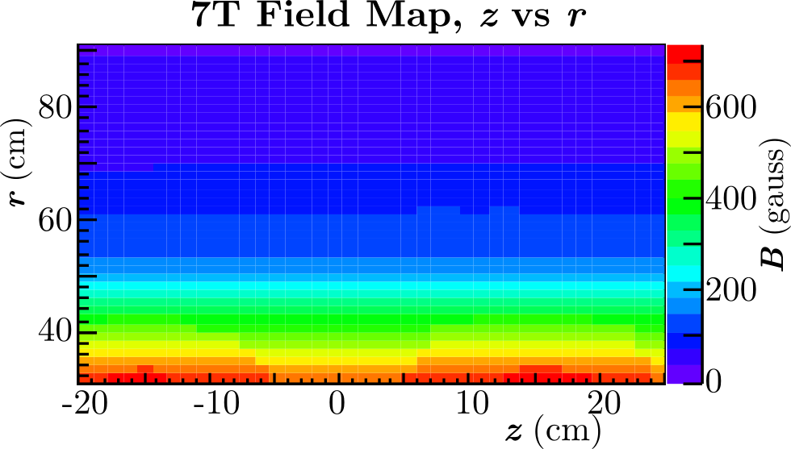
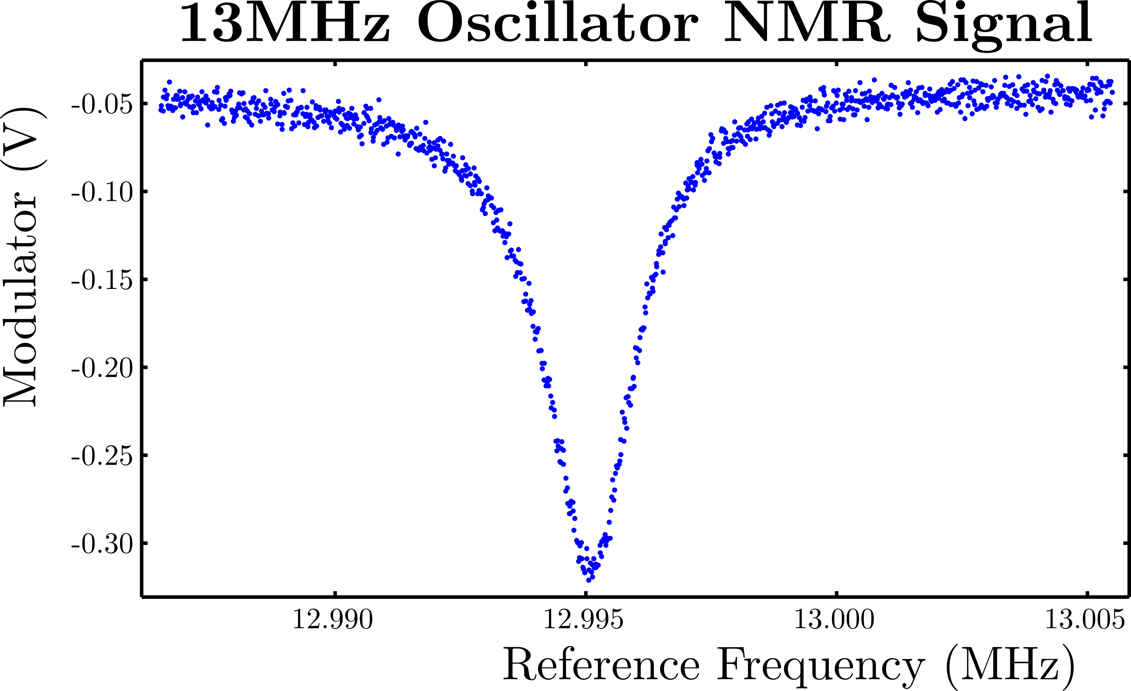

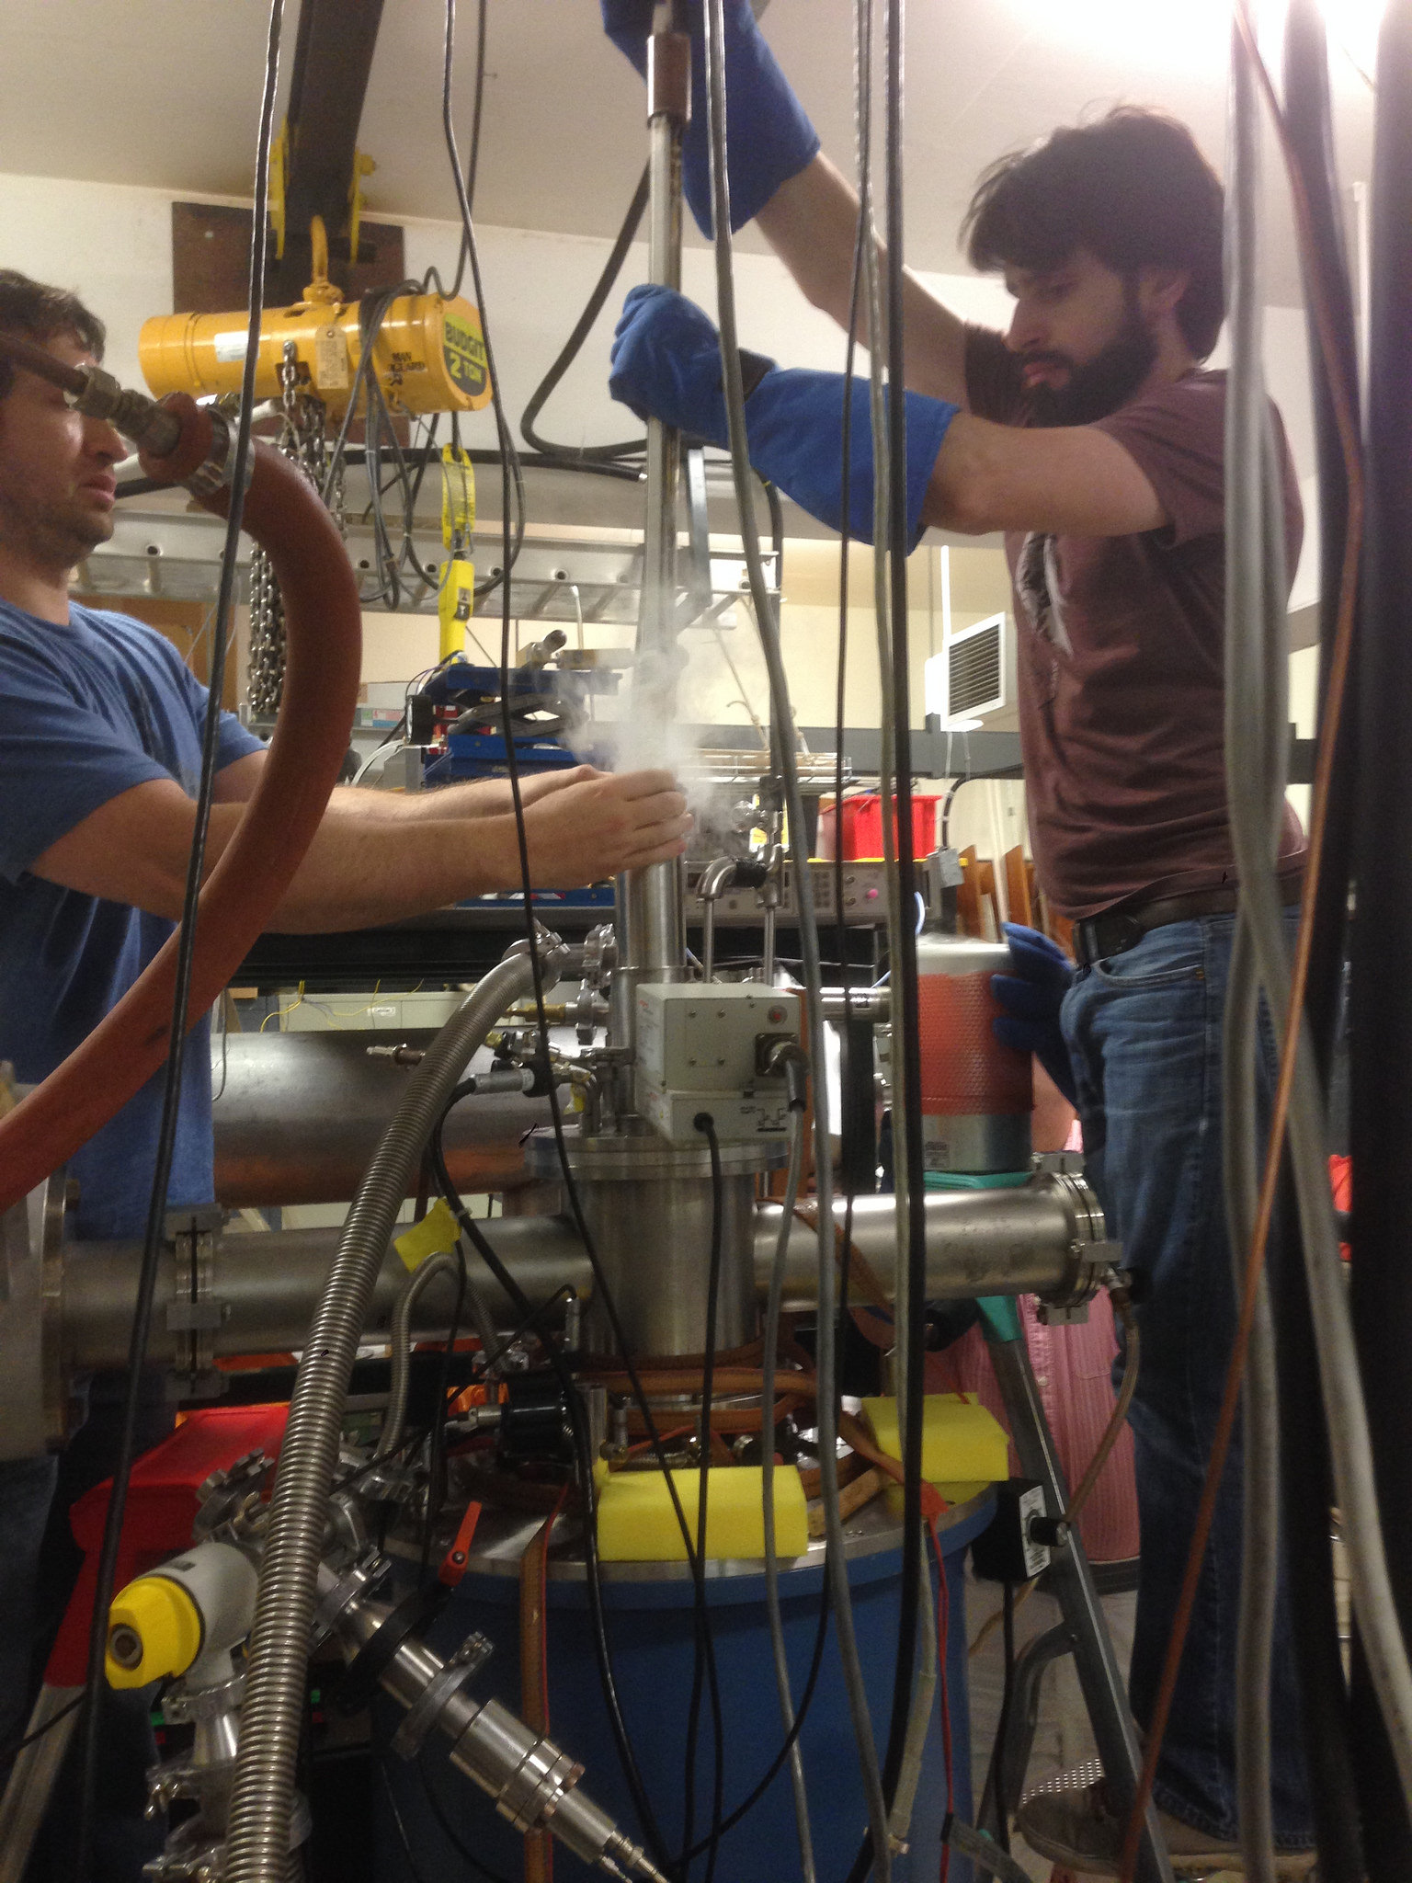
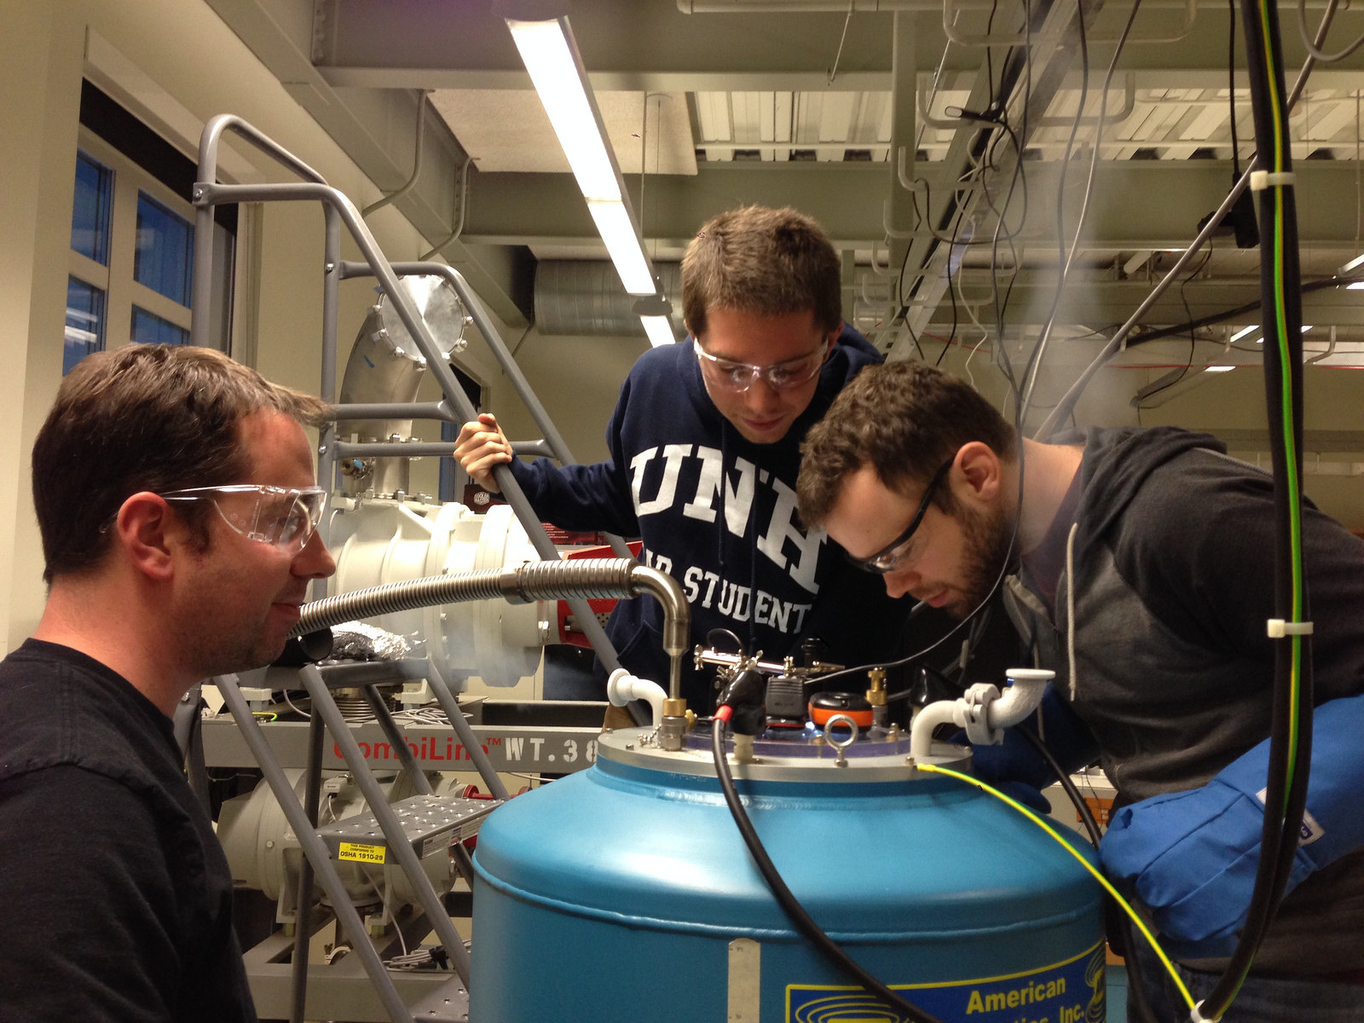
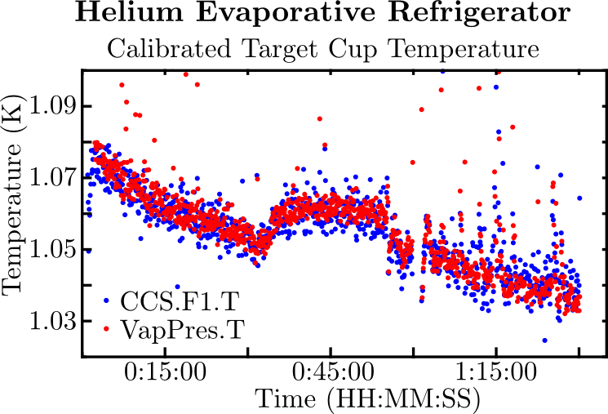
Target Status Update
  Results from UVA are promising, preliminary Pzz=30% on butanol recently achieved with full analysis in progress
  UNH target lab is nearing complete, successfully tested magnet, NMR, horizontal He fridge
D Keller, PoS(PSTP 2013) 010
D Keller, HiX Workshop (2014)
D Keller, J.Phys.:Conf.Ser. 543, 012015 (2014)
UVA Tensor Enhancement on Butanol (2014)

Slide 10
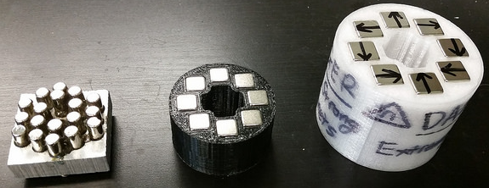
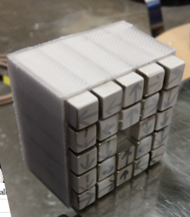
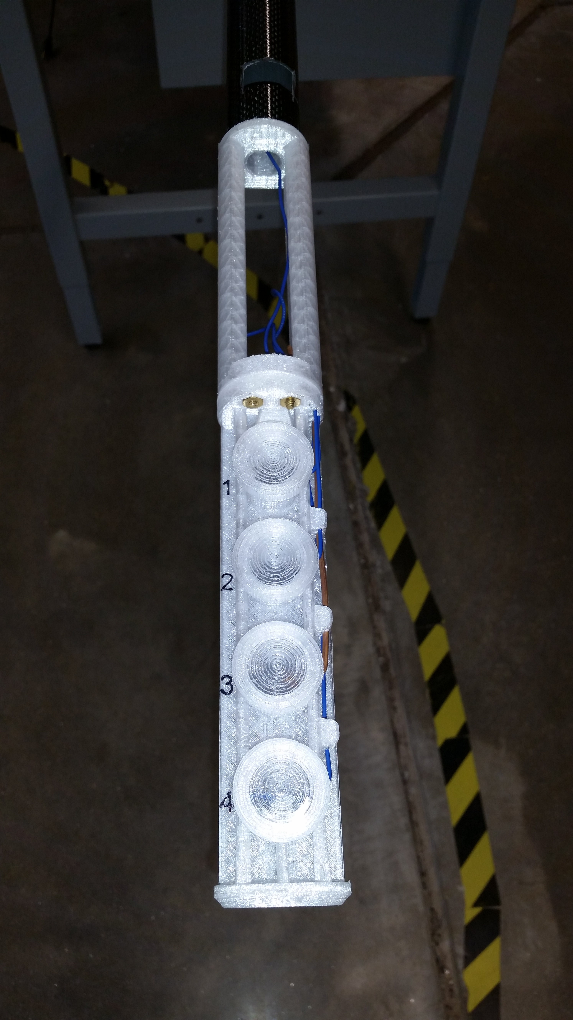
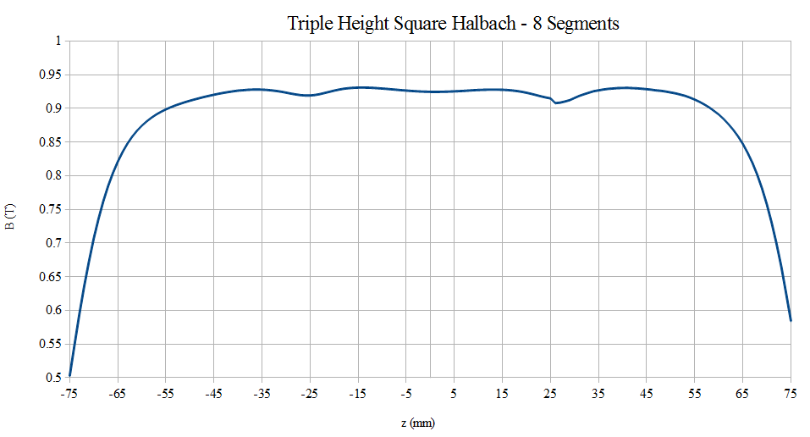
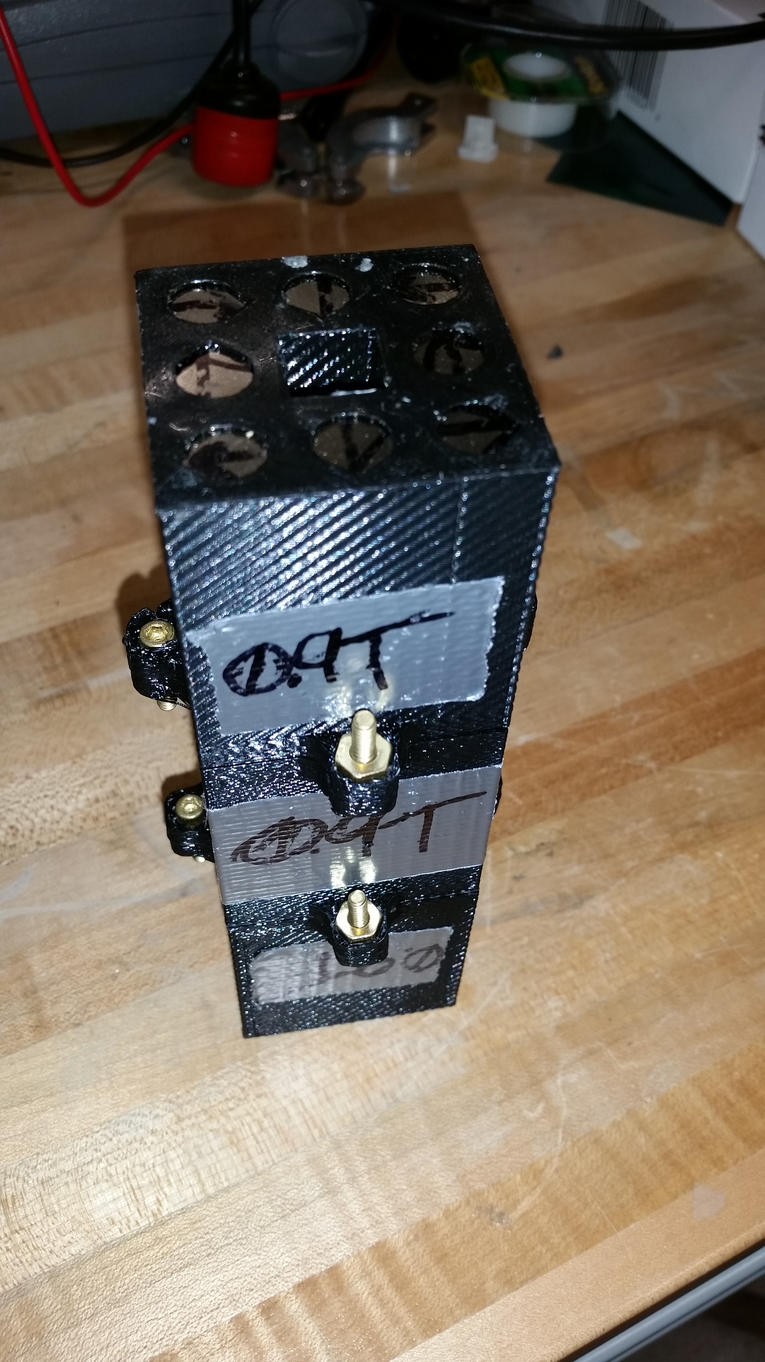
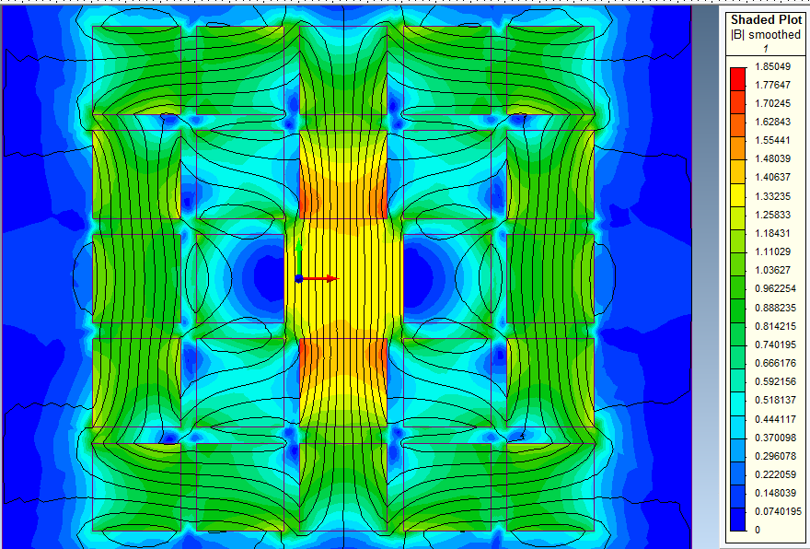
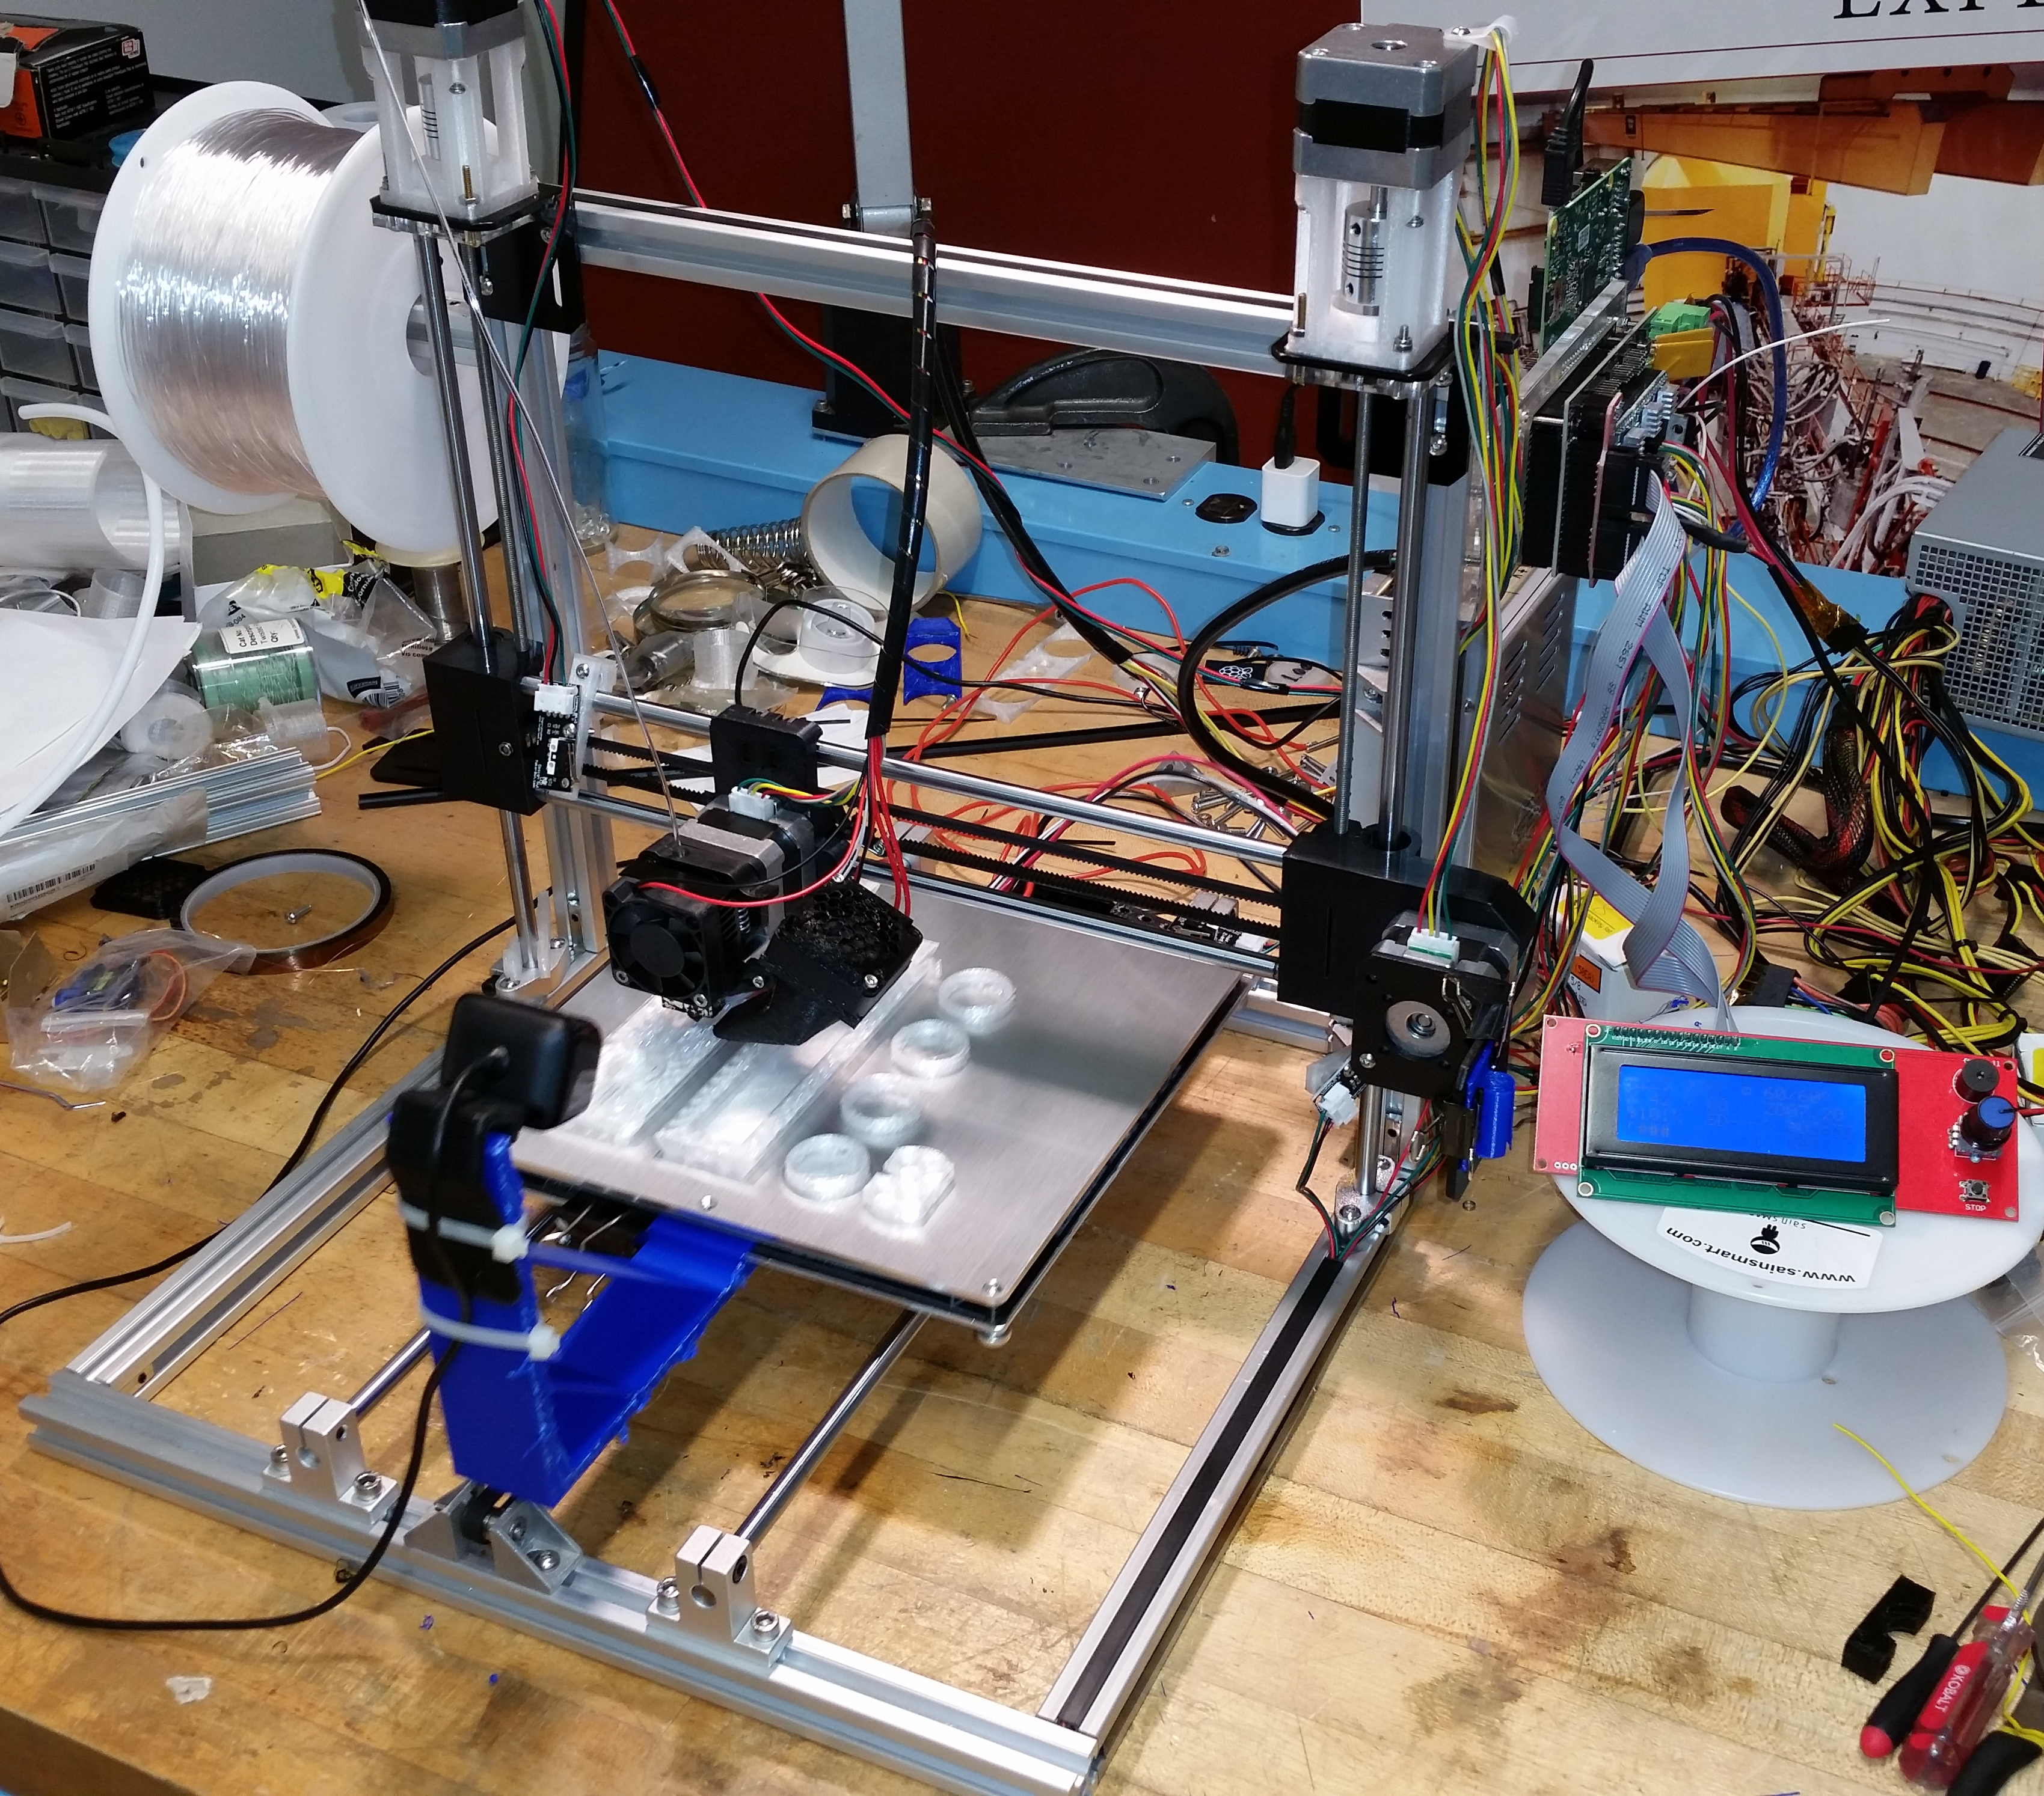
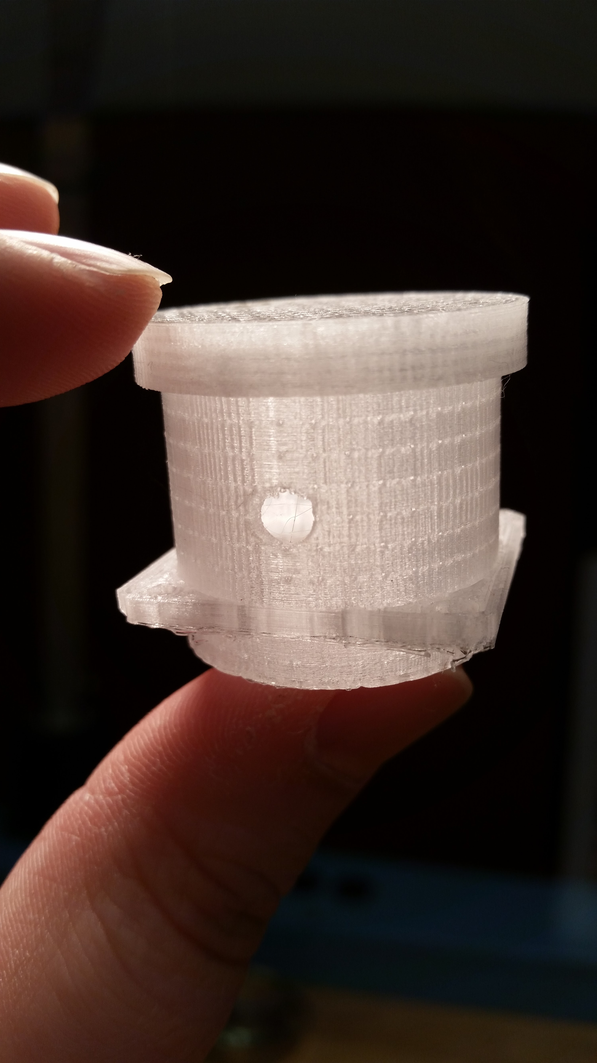
Target Status Update: UNH Side Projects
  NMR testing with room-temp Halbach Magnet
    Up to 1.2T and 1.5cm of <10⁻⁴ uniformity
  3D printed target sticks and cups
    Design to object in a few hours
    Heavily customized dual-head Prusa i3
    Will be capable of printing FEP and Kel-F, along with traditional materials
    Fine resolution, able to make r<0.15mm holes
X Zhang et al, COMSOL Users Conference Proceedings (2015)

Slide 11
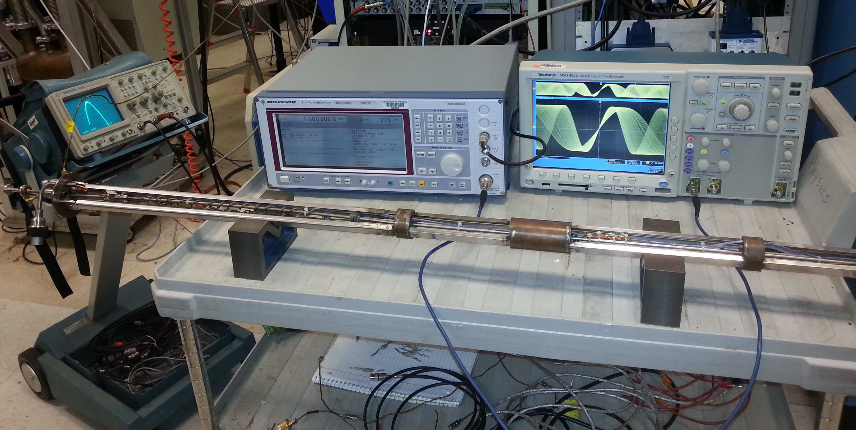
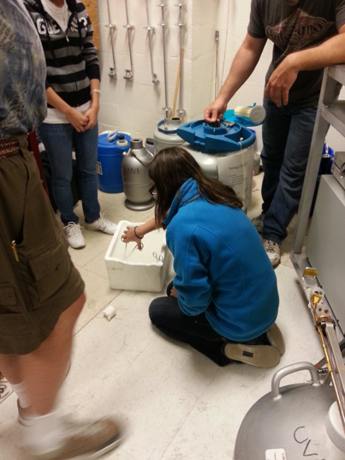
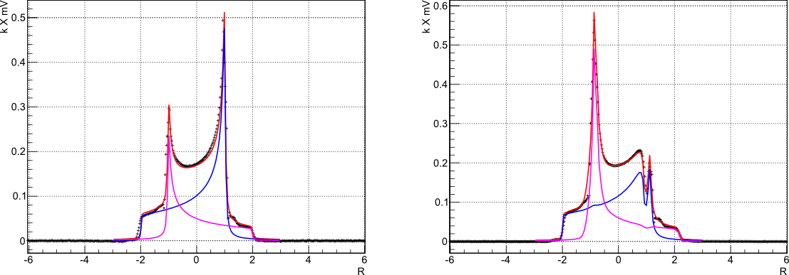

Target Status Update
D Keller, PoS(PSTP 2013) 010
D Keller, HiX Workshop (2014)
D Keller, J.Phys.:Conf.Ser. 543, 012015 (2014)
UVA Tensor Enhancement on Butanol (2014)
Progress made on measuring $P_{zz}$ through NMR line-shape analysis
Solid-state NMR $P_{zz}$ can be confirmed with elastic scattering ($T_{20}$)

Slide 12
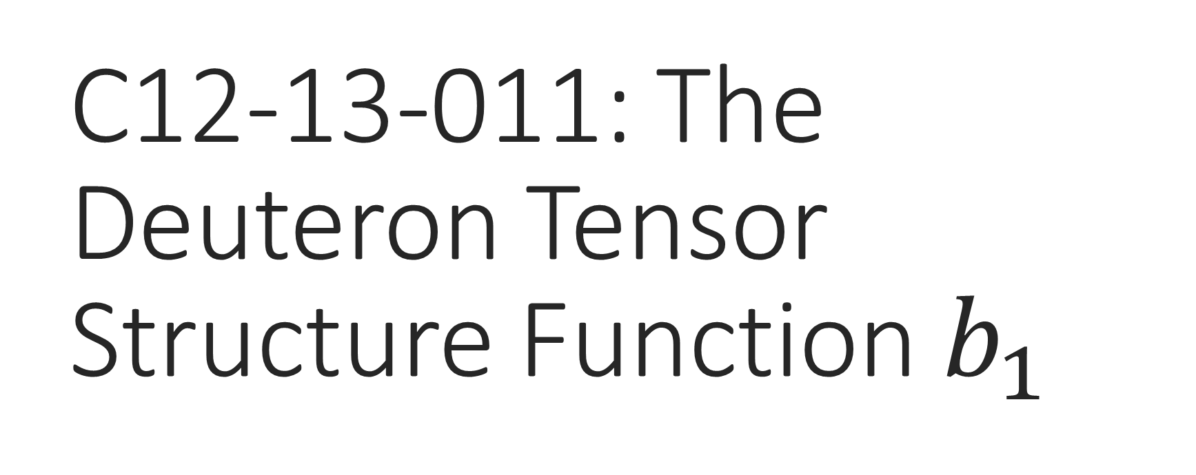
C12-13-011: The Deuteron Tensor Structure Function $b_{1}$
Spokespeople:
K. Slifer*, O.R. Aramayo, J.P. Chen, N. Kalatarians, D. Keller, E. Long, P. Solvignon
C1-Approved, A- Physics Rating

Slide 13
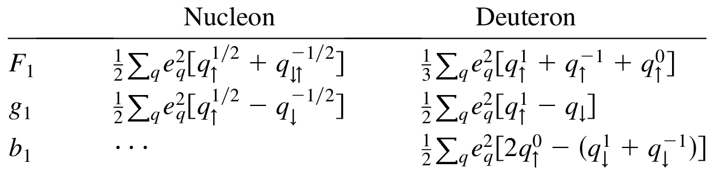



Structure Functions
$$W_{μν}=−{αF}_{1}+{βF}_{2}$$
Scattering on Unpolarized Targets
$$+iγg_{1}+iδg_{2}$$
Scattering on Vector Polarized Targets
$$−εb_{1}+ζb_{2}+ηb_{3}+κb_{4}$$
Scattering on Tensor-Polarized Targets
P Hoodbhoy et al, Nucl. Phys. B312, 571 (1989)
A Airapetian, et al, PRL 95 242001 (2005)

Slide 14
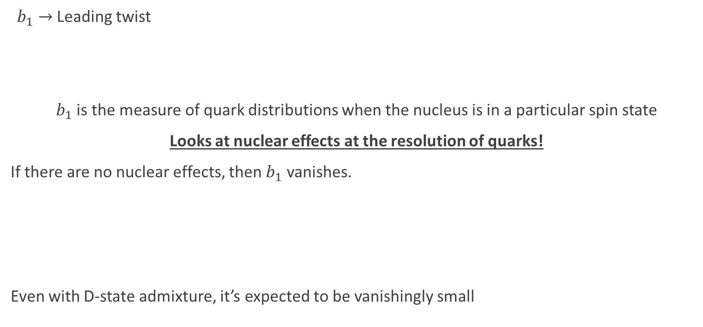

Tensor Structure Function, $b_{1}$
$b_{1}→$ Leading twist
$b_{1}$ is the measure of quark distributions when the nucleus is in a particular spin state
Looks at nuclear effects at the resolution of quarks!
If there are no nuclear effects, then $b_{1}$ vanishes.
Even with D-state admixture, it’s expected to be vanishingly small
Deuteron
=
n
+
p
$$b_{1}=0$$
Khan & Hoodbhoy, PRC 44 1219 (1991)
Umnikov, Phys. Lett. B 391 177 (1997)

Slide 15
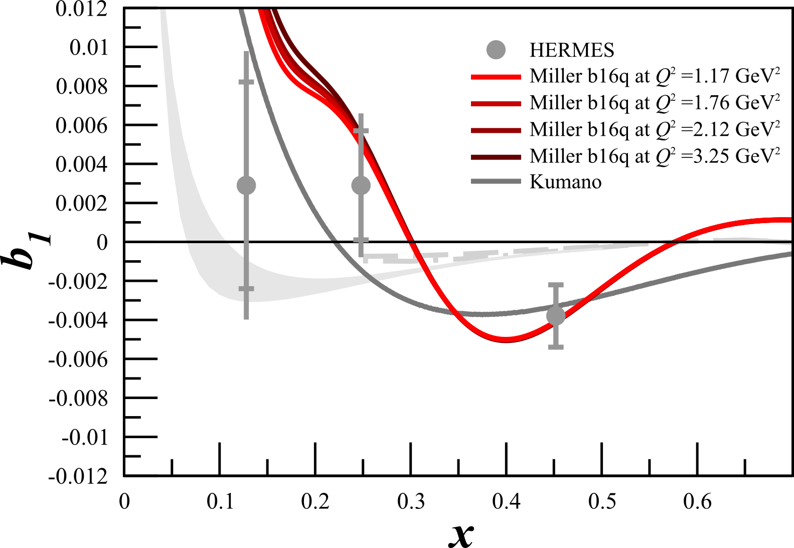
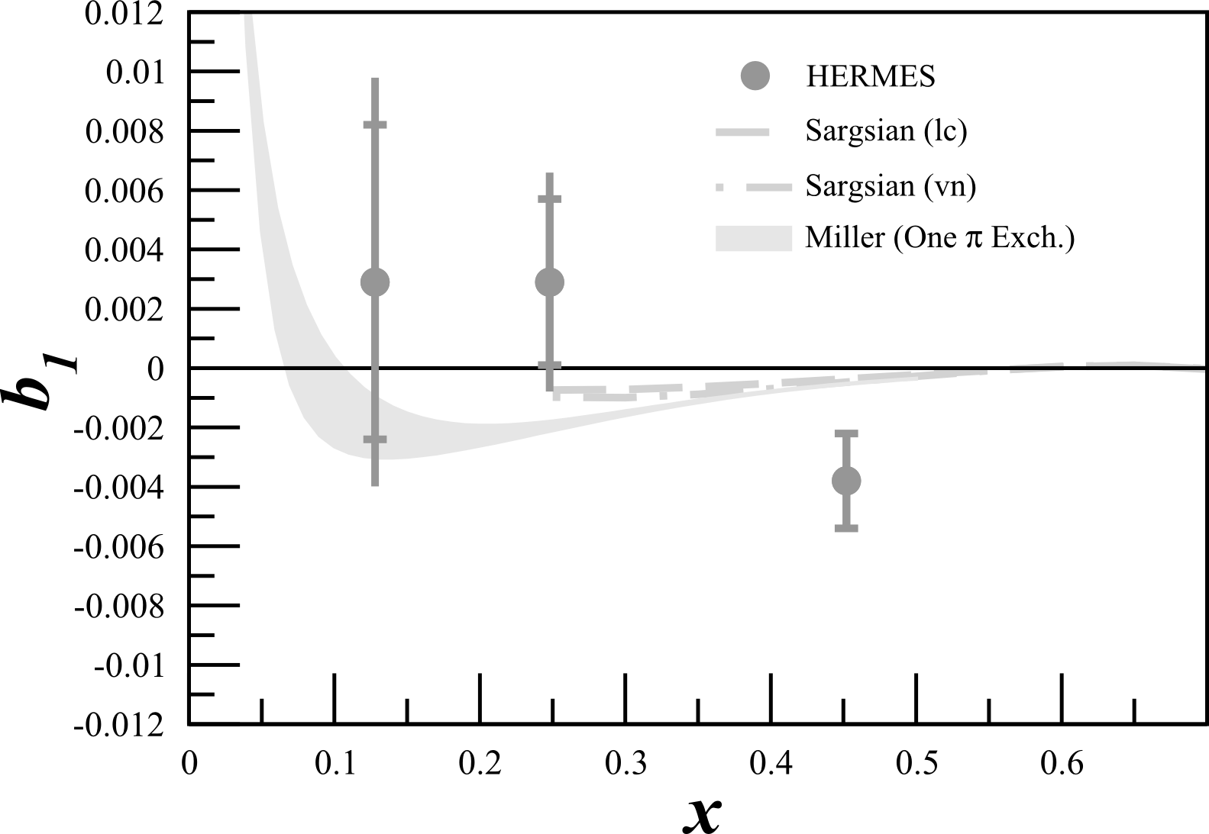
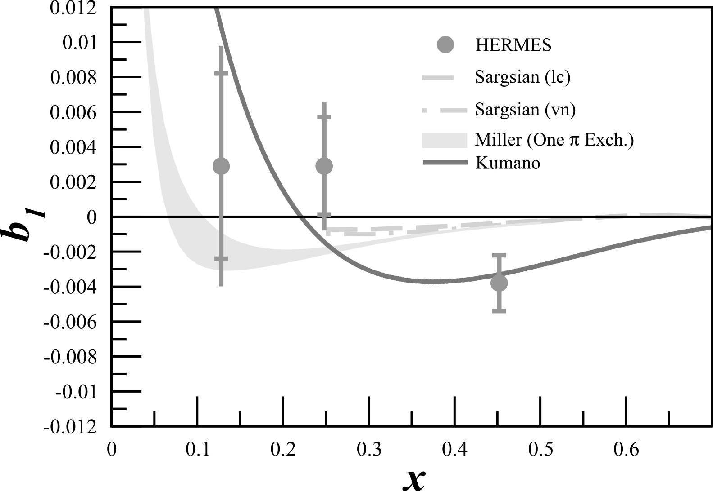
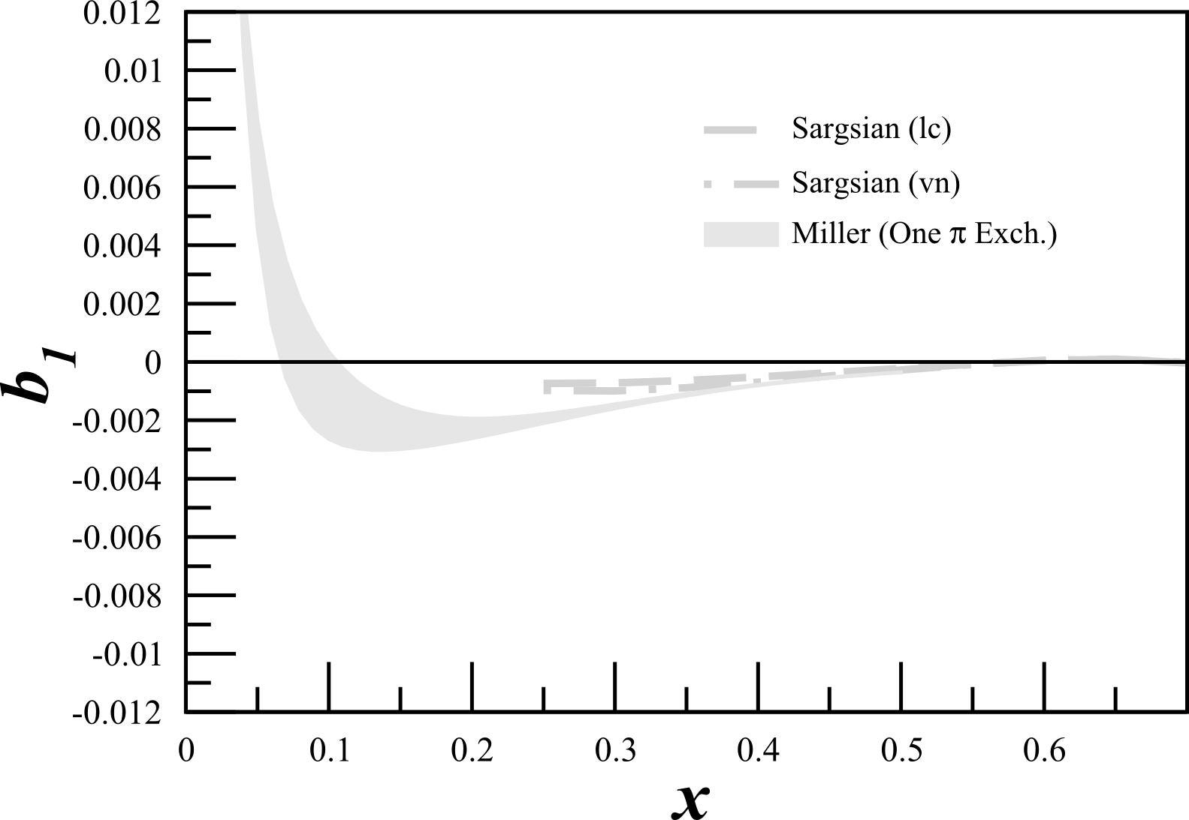
Tensor Structure Function, $b_{1}$
All conventional models predict small or vanishing values of b₁ in contrast with the HERMES data
All conventional models predict small or vanishing values of b₁ in contrast with the HERMES data
Any measurement of a b₁<0 indicates exotic physics
K Slifer et al, JLab E12-13-011

Slide 16
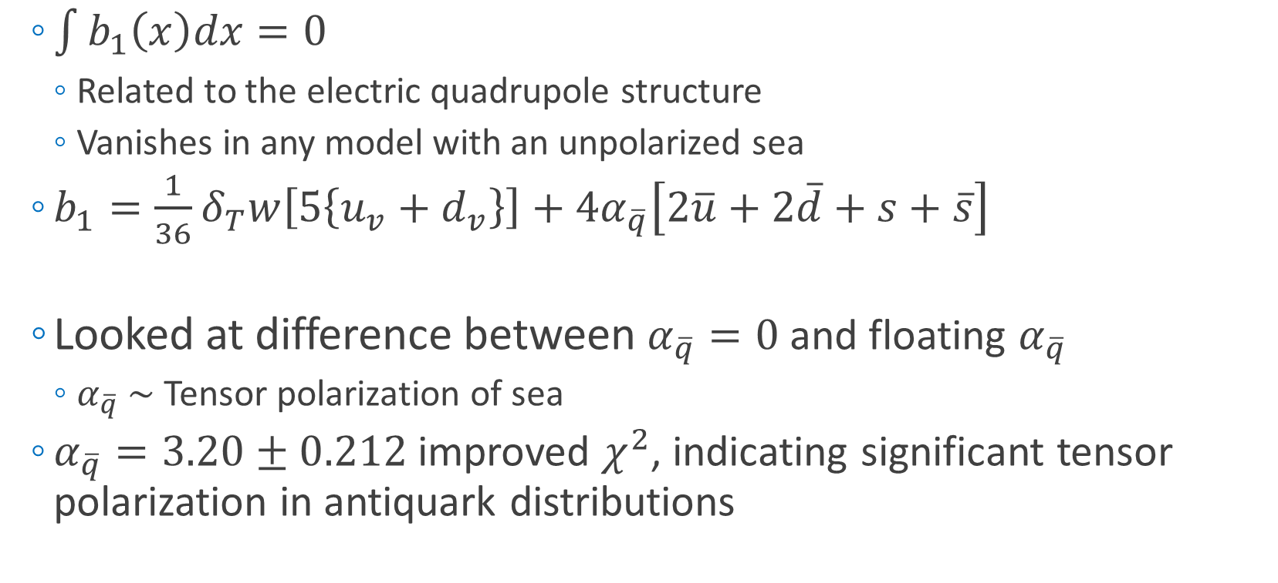
Close-Kumano Sum Rule
  $\int{b_{1}\left(x\right)dx=0}$
    Related to the electric quadrupole structure
    Vanishes in any model with an unpolarized sea
  $b_{1}=\frac{1}{36}δ_{T}w\left[5\left\{u_{v}+d_{v}\right\}\right]+4α_{\overline{q}}\left[2\overline{u}+2\overline{d}+s+\overline{s}\right]$
  Looked at difference between $α_{\overline{q}}=0$ and floating $α_{\overline{q}}$
    $α_{\overline{q}} \sim$ Tensor polarization of sea
  $α_{\overline{q}}=3.20±0.212$ improved $χ^{2}$, indicating significant tensor polarization in antiquark distributions
Quarks
Sea Strange and Anti-Quarks
S Kumano, PRD 82 017501 (2010)

Slide 17
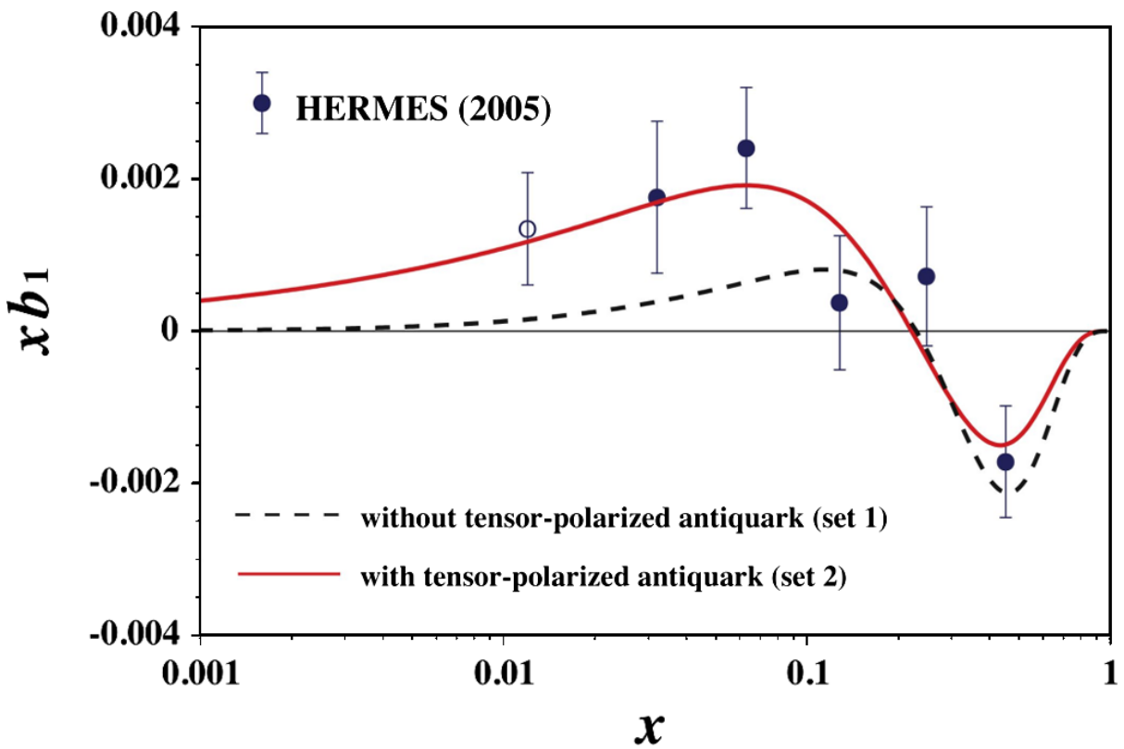


Close-Kumano Sum Rule
$$χ^{2}/dof=1.57$$
$$χ^{2}/dof=2.83$$
S Kumano, PRD 82 017501 (2010)

Slide 18
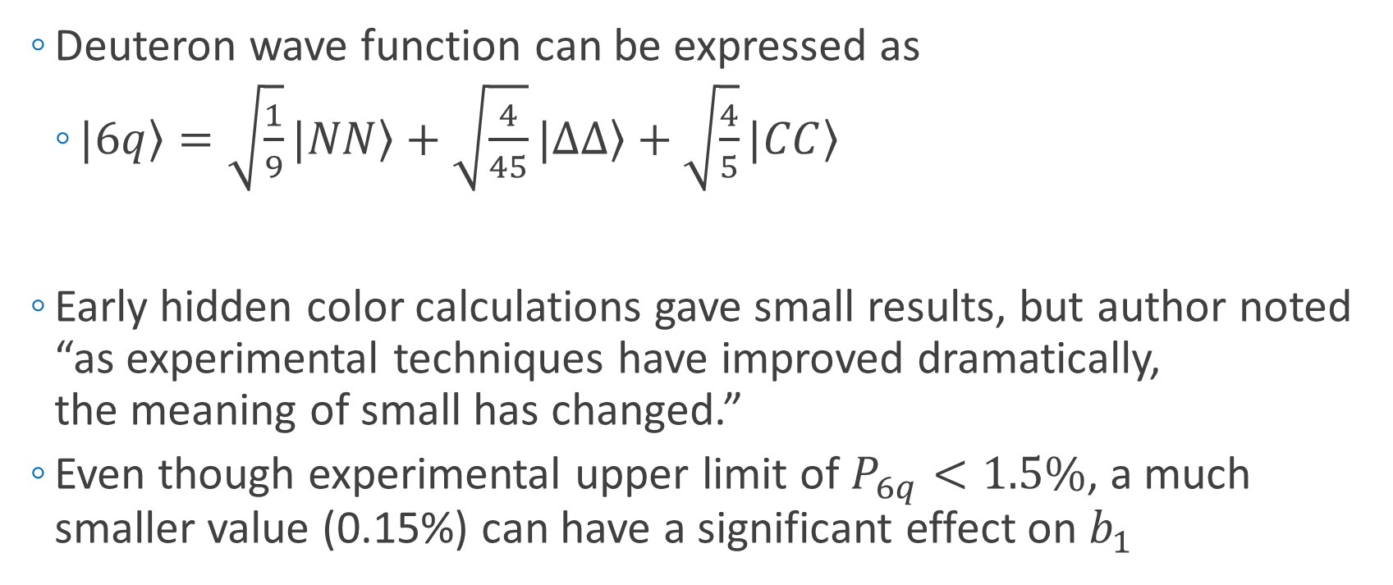
6-Quark, Hidden Color
  Deuteron wave function can be expressed as
    $\left.|6q\right\rangle =\sqrt{\frac{1}{9}}\left.|NN\right\rangle +\sqrt{\frac{4}{45}}\left.|∆∆\right\rangle +\sqrt{\frac{4}{5}}\left.|CC\right\rangle$
  Early hidden color calculations gave small results, but author noted “as experimental techniques have improved dramatically,
  the meaning of small has changed.”
  Even though experimental upper limit of $P_{6q}<1.5\%$, a much smaller value (0.15%) can have a significant effect on $b_{1}$
Nucleon-
Nucleon
Delta-Delta
Hidden Color
Probability of Hidden-Color Effects
G Miller, PRC 89 045203 (2014)

Slide 19
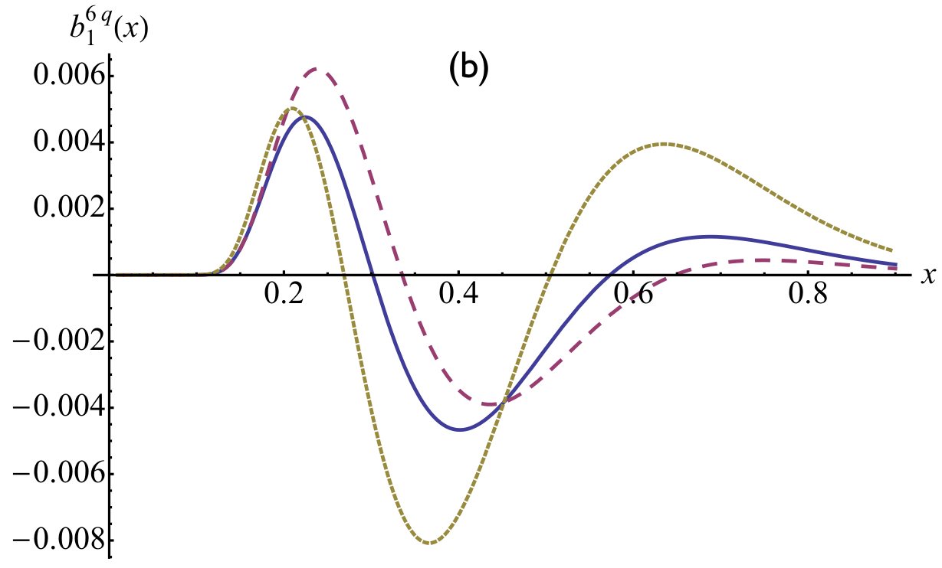
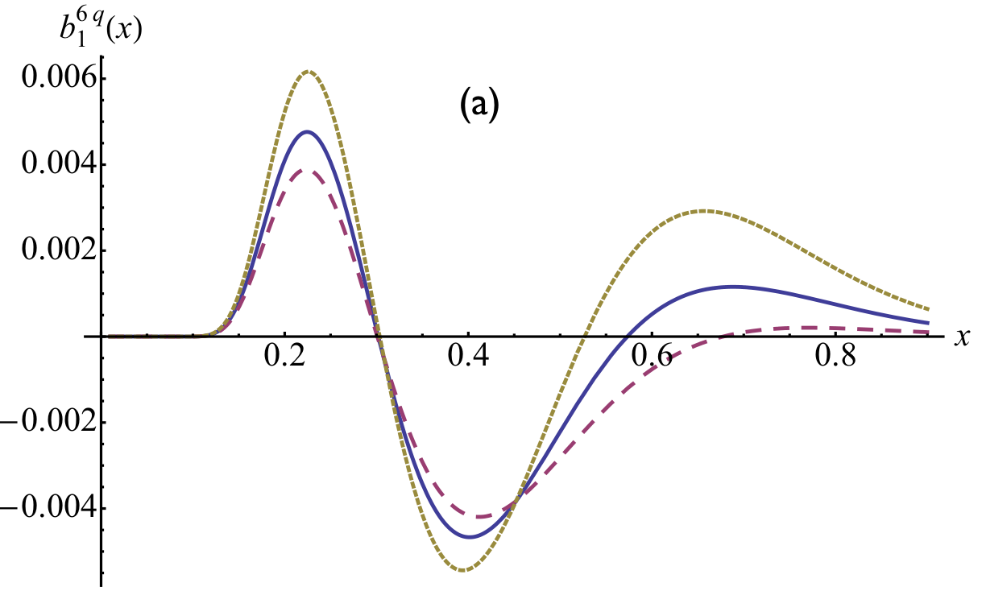

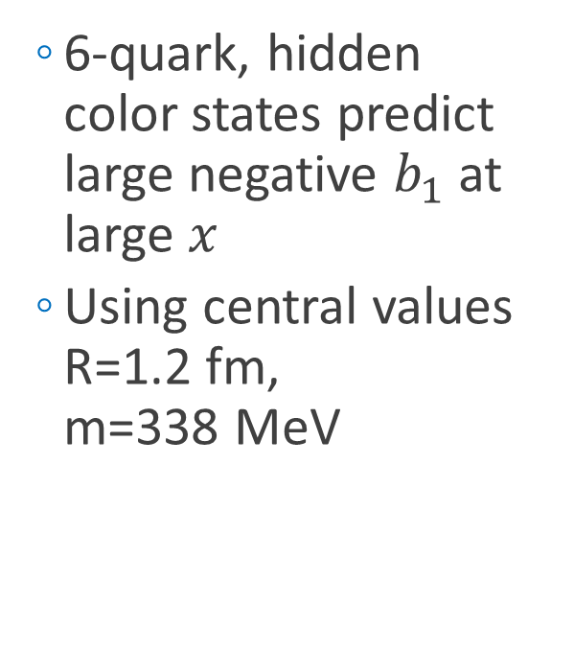

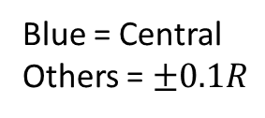
6-Quark, Hidden Color
  6-quark, hidden color states predict large negative $b_{1}$ at large $x$
  Using central values R=1.2 fm,
  m=338 MeV
Blue = Central
Others = $±0.1M$
Blue = Central
Others = $±0.1R$
G Miller, PRC 89 045203 (2014)

Slide 20



6-Quark, Hidden Color
  First theory to reproduce anomalous HERMES result
  $b_{1}^{π}+b_{1}^{6q}$predictions made for upcoming JLab $b_{1}$ measurement
G Miller, PRC 89 045203 (2014)

Slide 21



$b_{1}$ Kinematics
SHMS
SHMS
Slow
Raster
Faraday
Cup
Lumi
Unpolarized
Beam
Fast
Raster
Polarized
Target
HMS
  Jefferson Lab’s Hall C
  Unpolarized beam, tensor polarized target (longitudinal alignment)
Det. | $$x$$ | $$Q^{2}$$ (GeV²) | $$W$$ (GeV) | $$E_{e′}$$ (GeV) | $$θ_{e′}$$ (deg) | Rate (kHz) | Time (Day)
SHMS | 0.15 | 1.21 | 2.78 | 6.70 | 7.4 | 1.66 | 6
SHMS | 0.30 | 2.00 | 2.36 | 7.45 | 9.0 | 0.79 | 9
SHMS | 0.45 | 2.58 | 2.0 | 7.96 | 9.9 | 0.38 | 15
HMS | 0.55 | 3.81 | 2.0 | 7.31 | 12.5 | 0.11 | 30

Slide 22


Tensor Structure Function, $b_{1}$
Measuring $b_{1}$ will give insight into:
Close-Kumano sum rule^{[1]}
6-quark hidden color^{[2]}
OAM and spin crisis^{[3]}
Pionic effects^{[2,4]}
Polarized sea quarks^{[4]}
Approved JLab Experiment C12-13-011
Spokespersons: K. Slifer, E. Long, D. Keller, P. Solvignon, J.P. Chen, O.R. Aramayo, N. Kalantarians
^{[1]} FE Close, S Kumano, Phys. Rev. D42, 2377 (1990)
^{[2]} G Miller, Phys. Rev. C89, 045203 (2014)
^{[3]} SK Taneja et al, Phys. Rev. D86, 036008 (2012)
^{[4]} S Kumano, Phys. Rev. D82, 017501 (2010)

Slide 23


PR12-15-005: Quasi-Elastic and Elastic Deuteron Tensor Asymmetry $A_{zz}$
Spokespeople:
E. Long*, K. Slifer, P. Solvignon, D. Day, D. Keller,
D. Higinbotham
C2-Approved
“What can you get with A_{zz} at x>1?”

Slide 24



Deuteron Wavefunction
Is the deuteron wavefunction hard or soft?
  AV18 is an example of a moderate-hard WF
  CDBonn is an example of a soft WF
Unpolarized deuterons need to be probed at $k>400 MeV$ to distinguish between hard and soft WFs
  Not practical
Currently no unambiguous experimental evidence for which is more valid
Tensor polarization enhances the D-state, allowing hard and soft WFs to be distinguished at lower momenta
N. Fomin, et al, PRL 108, 092502 (2012)

Slide 25






Deuteron Wavefunction
  Unpolarized
  Vector Polarized
First calculated in the ‘70s, $A_{zz}$ can be used in to discriminate between hard and soft wavefunctions
$A_{zz}=\frac{2}{fP_{zz}}\left(\frac{σ_{p}−σ_{u}}{σ_{u}}\right)$
In the impulse approximation, $A_{zz}$ is directly related to the S- and D-states
Modern calculations indicate a large separation of hard and soft WFs begins just above the quasi-elastic peak at $x>1.3$
AV18
~1%
~60%
~1%
CDBonn
H. Zhu, Ph. D Thesis. (2000)
H. Arenhovel
L.L. Frankfurt, M.I. Strikman, Phys. Rept. 76 215 (1981)
M. Sargsian

Slide 26



Relativistic NN Bound System
Relativistic calculations needed to understand underlying physics in short-range correlations at high momenta
Light Cone (LC) and Virtual Nucleon (VN) calculations are often used
Large momenta ($>500 MeV/c$) needed to discriminate with unpolarized deuterons
With tensor polarized $A_{zz}$ significant difference at much lower momenta ($>300 MeV/c$) and $x>1.1$
Light
Cone
Virtual
Nucleon
M Sargsian, Tensor Spin Observables Workshop (2014)

Slide 27



Elastic $T_{20}$ - Calibration & Measurement
Simultaneous measurement of the elastic tensor analyzing power $T_{20}$
At low $Q^{2}$,
  $T_{20}$ well known
  $P_{zz}$ can be extracted from $T_{20}$
  Completely independent $P_{zz}$ measurement from NMR line-shape $P_{zz}$
$T_{20}$ in the largest and highest $Q^{2}$ range ever done in a single experiment
  Import cross-check of Hall C high $Q^{2}$ data

Slide 28



Kinematics
SHMS
Longitudinally
Polarized
Target
SHMS
Slow
Raster
Faraday
Cup
Unpolarized
Beam
Lumi
Fast
Raster
HMS
  Hall C with HMS & SHMS
  Identical equipment and technique as $b_{1}$ (E12-13-011)

Slide 29







Discriminating Power
Relativistic Model Discrimination >6σ
Wave Function Discrimination up to >4σ
- LC_{AV18} =
Solid = Quasi-elastic
Open = Elastic
E Long, et al, Upcoming PAC44 Prposal

Slide 30




$A_{zz}$ for $Q^{2}>1 {GeV}^{2}$ with $P_{zz}=30\%$
$$Q^{2}=1.5 {GeV}^{2}$$
$$Q^{2}=1.8 {GeV}^{2}$$
$$Q^{2}=2.9 {GeV}^{2}$$
Solid = Quasi-elastic
Open = Elastic
E Long, et al, Upcoming PAC44 Prposal

Slide 31




$A_{zz}$ for $Q^{2}<1 {GeV}^{2}$ with $P_{zz}=30\%$
$$Q^{2}=0.2 {GeV}^{2}$$
$$Q^{2}=0.3 {GeV}^{2}$$
$$Q^{2}=0.7 {GeV}^{2}$$
Solid = Quasi-elastic
Open = Elastic
E Long, et al, Upcoming PAC44 Prposal

Slide 32



First Measurement of Quasi-Elastic $A_{zz}$
^{[2]} L Frankfurt, M Strikman, Phys. Rept. 160, 235
^{[3]} J Arrington et al, Prog. Part. Nucl. Phys. 67, 898 (2012)
Bonus: $T_{20}$ for largest $Q^{2}$ range in a single experiment, region of systematic discrepancy, highest $Q^{2}$ measured
^{[4]} Sargsian, Strikman, J. Phys.: Conf. Ser. 543, 012099 (2014)
^{[5]} W Cosyn, M Sargsian, arXiv:1407.1653
Sensitive to effects that are very difficult to measure with unpolarized or vector polarized deuterons
Huge 10-100% asymmetry
  Measuring $A_{zz}$ over a range in $x$ and $Q^{2}$ provides insight to
  Hard/Soft Wavefunctions ^{[2]}
    Nature of NN Forces, SRCs & pn dominance ^{[3]}
  Relativistic NN Dynamics ^{[4]}
  On-Shell/Off-Shell FSI Effects ^{[5]}
Decades of theoretical interest that we can only now probe with a high-luminosity tensor-polarized target
Importance ranges from understanding short-range correlations to the equations of state of neutron stars
^{[1]} E. Long, et al, Upcoming PAC44 Proposal

Slide 33
LOI12-14-001: Search for Exotic Gluonic States in the Nucleus
Authors:
J. Maxwell*, W. Detmold, R. Jaffe, R. Milner, D. Crabb, D. Day, D. Keller, O.A. Rondon, M. Jones, C. Keith, J. Pierce

Slide 34



Tensor Structure Function, $b_{4}$ (or $∆$)
Hadronic double helicity flip structure function, $Δ\left(x,Q^{2}\right)=b_{4}$
Unpolarized beam on transversely-aligned target
Insensitive to bound nucleons or pions
Any non-zero value indicates exotic gluonic components
New lattice QCD result for first moment of ∆(x, Q2) in a φ meson is preliminary, but very promising (arXiv:1606.04505)
Encouraged for full proposal submission, updated LOI submitted
R Jaffe, A Manohar, Phys. Lett. B 223,218 (1989)
J. Maxwell, et al, JLab LOI-14-001

Slide 35




The Future of Tensor Polarization
J. Phys.: Conf. Ser. 543 011001-012015 (2014)
http://iopscience.iop.org/1742-6596/543/1
Growing tensor program:
  DIS $b_{1}$ already approved (C12-13-011)
  QE and Elastic $A_{zz}$ C2-approved (PR12-15-005)
  Exotic gluon states through $∆$ (LOI12-14-001)
Physics accessible with a tensor polarized target:
    Orbital Angular Momentum
    & Spin Crisis
    Gravitomagnetic Form Factors
    Pionic Effects
    Polarized Sea Quarks
    Tensor polarized antiquarks
    Linking traditional nuclear physics and quark-gluon picture
    Final State Interactions
    Gluonic Effects
    New tensor structure functions → $b_{2}$, $b_{3}$
    Tensor DVCS → Test sum rules, new helicity term
    Tensor Drell-Yan → 60 new structure functions
    …and more!

Slide 36


JLab12 Tensor Program (So far…)
1.2 1.3 1.4 1.5 1.6 1.7 1.8 1.9 2.0 2.1

Slide 37
Thank you

Slide 39
Backup Slides

Slide 40


6-Quark, Hidden Color
  Pionic effects alone would violate Close-Kumano Sum Rule $\int{b_{1}\left(x\right)dx=0}$
G Miller, PRC 89 045203 (2014)

Slide 41

Summary
“The measurement proposed here arises from a well-developed context, presents a clear objective, and enjoys strong theory support. It would further explore the nature of short-range pn correlations in nuclei, the discovery of which has been one of the most important results of the JLab 6 GeV nuclear program.”
-JLab PAC42 & PAC43 Theory TACs
(C. Weiss, R. Schiavilla, J.W. Van Orden)
E. Long, et al, JLab PR12-15-005
Sargsian, Strikman, J. Phys.: Conf. Ser. 543, 012099 (2014)

Slide 42

Deuteron
Simplest composite nuclear system
However, understanding of deuteron at short distances remains unsatisfying
  A well-constrained theoretical model is necessary for understanding tensor interactions underlying short-range correlations and pn-dominance
Short-range deuteron structure can be probed using choice in kinematics ($x>1$) and by enhancing the D-state through tensor polarization
  This proposal uses a combination of both techniques
J Forest, et al, PRC 54 646 (1996)

Slide 43

Final State Interactions
To determine nucleonic components of the deuteron WF, FSI must be understood
Minimum and maximum effects from FSI have been calculated by W. Cosyn
Even with FSI, large discrepancy based on WF input
AV18
CDBonn

Slide 44


DIS Tensor Observables
  HERMES $b_{1}$ -- First tensor structure function measurement
Q² (GeV/c)²
x
A Airapetian, et al, PRL 95 242001 (2005)

Slide 45




$A_{zz}$ for $Q^{2}<1 {GeV}^{2}$ with $P_{zz}=30\%$
$$Q^{2}=0.7 {GeV}^{2}$$
$$Q^{2}=0.3 {GeV}^{2}$$
$$Q^{2}=0.2 {GeV}^{2}$$
Solid = Quasi-elastic
Open = Elastic
* More calculation coming soon…

Slide 46


Systematics
More than 10x less sensitive to systematics than $b_{1}$

Slide 47

Overhead

Slide 48

Challenges and Opportunities
  Tensor polarized target in development with dedication from multiple labs
  Stray SHMS fields will have negligible effect on target
  Data recoverable in rare event of target material shifting
  Very large $A_{zz}$ asymmetry (10-120%)
  Identical equipment and technique as $b_{1}$
  More than an order of magnitude less dependent on systematics than $b_{1}$
    Perfect testing ground for fully understanding and controlling systematics

Slide 49

Theoretical Interest
“A measurement of Azz will provide important information on whether the deuteron wavefunction is hard or soft, as well as on relativistic effects. These are important for the progress of our understanding of the short-range dynamics of nuclear interactions, which have relevance ranging from short-range correlations in nuclei to the equations of state of neutron stars.” - M. Sargsian
“$A_{zz}$ is a unique method to measure the ratio of S- and D-waves in the deuteron at short distances and hence test the spin structure of short-range correlations. It is also the most sensitive observable to test different approaches to the description of relativistic dynamics.” – M. Strikman
“What interests me most in this proposal is that it can teach us about the nature of the nucleon-nucleon force at short distances and with an observable sensitive to non-nucleonic contributions there is also room for surprising results. Additionally, on the theory side, this measurement would also provide an incentive for additional calculations and studies on top of the testing of various existing models, which is always a good thing.”
-W. Cosyn
“Previous low $Q^{2}$ measurements seemed to indicate that the asymmetries are far less sensitive to reaction mechanisms than the cross sections; so while the new calculations are not yet available, it is clear that the asymmetries will produce unique constraints on our understanding of the deuteron.”
- W. Van Orden
“This proposal really challenges theorists to better understand the meaning of nuclear wave functions in a situation that demands a relativistic treatment. I plan on working to understand this reaction during the upcoming summer.” - G. A. Miller

Slide 50

Tensor Structure Function, $b_{1}$
Measured by ratio method
$$=−\frac{3}{2}F_{1}A_{zz}$$

Slide 51

OAM and Angular Momentum Sum Rule
  Deuteron angular momentum dominated by the GPD $H$
    $J_{q}=\frac{1}{2}\int{dxxH_{2}^{q}(x,0,0)}$
    DVCS ${(A}_{UT})$ on tensor-polarized deuterons would be an ideal observable to test this sum rule
  Sum rule can calculate normal nuclear effects with high precision,
  giving $H_{2}≈H+E$
  Any measured deviation might shed light on elusive gluon angular momentum components
  Measurement of $b_{1}=H_{5}(x,0,0)$ will provide necessary information for assumptions in the above sum rule and relates to gravitomagnetic form factors
    $\int{dxxH_{5}\left(x,ξ,t\right)=−\frac{t}{8M_{D}^{2}}𝒢_{6}\left(t\right)+\frac{1}{2}𝒢_{7}(t)}$
SK Taneja, et al, PRD 86 036008 (2012)

Slide 52


Quasi-Elastic $A_{zz}$
Encouraged for full submission by PAC42
“The measurement proposed here arises from a well-developed context, presents a clear objective, and enjoys strong theory support. It would further explore the nature of short-range pn correlations in nuclei, the discovery of which has been one of the most important results of the JLab 6 GeV nuclear program.”
-JLab PAC42 Theory Advisory Committee
E. Long, et al, JLab LOI12-14-002
Sargsian, Strikman, J. Phys.: Conf. Ser. 543, 012099 (2014)

Slide 53

Elastic Tensor Observables
VEPP-3 Internal gas 1.65-4.26 $T_{20}, T_{21}$ 6 2003
Bates Internal gas 0.42-0.89 $T_{20}, T_{21}$ 9 2011
R Gilman, F Gross, J. Phys. G 28 R37 (2002)

Slide 54

Frankfurt and Strikman Light Cone Calculations
  $A_{zz}=\left(3\frac{\frac{1}{2}k_{⊥}^{2}−k_{z}^{2}}{k^{2}}\right)\frac{\frac{1}{2}w^{2}\left(k\right)−u\left(k\right)w(k)\sqrt{2}}{u^{2}\left(k\right)+w^{2}(k)}$
    $u(k)$ is the momentum-dependent S state
    $w(k)$ is the momentum-dependent D state
  Recent study indicates dependence on choice of NN potential
L.L. Frankfurt, M.I. Strikman, Phys. Rept. 76 (1981) 215

Slide 55


Connection to
Short Range Correlations
Short range correlations caused by tensor force – why not probe it through tensor polarization?
N. Fomin et al., Phys. Rev. Lett. 108 (2012) 092505
L.L. Frankfurt et al., Int. J. Mod. Phys. A23 (2008) 2991-3055

Slide 56

Connection to
Short Range Correlations
Short range correlations caused by tensor force – why not probe it through tensor polarization?
L.L. Frankfurt et al., Int. J. Mod. Phys. A23 (2008) 2991-3055

Slide 57


Tensor Polarization Measurement
Vector optimize with microwaves
Fit peaks with convolution
Tensor optimize with RF
Measure change in peaks using Riemann Sum segments
Ratio of instantaneous
to initial NMR signal area
Percentage of initial peak
shifted any time
(from reduced side)
Available tensor
enhancement

Slide 58
Brute Force Tensor Polarization
When vector polarizing deuterium, some amount of tensor polarization occurs
Higher vector polarization → Higher tensor polarization

Slide 59


Systematics Estimate for $A_{zz}$

Slide 60

Interest from Theorists
M. Strikman and M. Sargsian have already been involved in providing $A_{zz}$ calculations
“This is an important measurement. Accessing the large x region will provide insights on the partonic structure of the D-wave dominated deuteron tensor structure function, $b_{1}$. This process should be calculated more thoroughly.” – S. Liuti
“This measurement was a highlighted need early at Jlab. A new measurement at higher $Q^{2}$ would be very interesting. In principle such could test my model. I could calculate the influence of my 6-quark configurations on elastic scattering.” – G. Miller
“I hope to do some calculations soon and could easily do them for the kinematics in your proposal.” – W. Cosyn
W. Van Orden has agreed to look into tensor polarization observables at low $Q^{2}$ using a variety of NN potentials

Slide 61




Rates for D(e,e’)X
Assumptions:
$$P_{zz}=30\%$$
$$p_{f}=65\%$$
$$z_{tgt}=3 cm$$
P.E. Bosted, V. Mamyan, arXiv:1203.2262
M. Sargsian, Private Communication
N. Fomin, et al., Phys. Rev. Lett. 108 (2012) 092502
N. Fomin, et al., Phys. Rev. Lett. 105 (2010) 212502
$R_{Pol}=𝒜\left[ℒ_{He}σ_{He}^{u}+ℒ_{N}σ_{N}^{u}+ℒ_{D}σ_{D}^{u}\left(1+\frac{1}{2}P_{zz}A_{zz}\right)\right]$
$R_{Unpol}=𝒜\left[ℒ_{He}σ_{He}^{u}+ℒ_{N}σ_{N}^{u}+ℒ_{D}σ_{D}^{u}\right]$
$N=Rt$
$A_{zz}=\frac{2}{f_{dil}P_{zz}}\left(\frac{N_{Pol}}{N_{Unpol}}−1\right)$
$δA_{zz}^{stat}=\frac{2}{f_{dil}P_{zz}}\sqrt{{\left(\frac{1}{N_{Unpol}}\sqrt{N_{Pol}}\right)}^{2}+{\left(\frac{N_{Pol}}{N_{Unpol}^{2}}\sqrt{N_{Unpol}}\right)}^{2}}$
  Used combination of P. Bosted and M. Sargsian code to calculate unpolarized cross sections
Compared with data similar to Azz range
  $E_{0}=5.766 GeV$
  $E′=4.8 GeV$
  $θ_{e′}={18.0}^{∘}$
E. Long, Technical Note, JLAB-TN-13-029

Slide 62


Dilution Factor
“…the background from interaction with nuclei increases as $α(x)$ increases. For example, for a D¹²C target the ratio of the cross sections $σ_{A}$ for A=¹²C and A=D is of the order of 40 for $x\sim 1.3$ and increases with $x$.”
- L.L. Frankfurt, M.I. Strikman,
Phys. Rept. 160 (1988) 235
$f_{dil}=\frac{ℒ_{D}σ_{D}}{ℒ_{N}σ_{N}+ℒ_{He}σ_{He}+ℒ_{D}σ_{D}+\sum{ℒ_{A}σ_{A}}}$
With the 12 GeV upgrade and the new SHMS, this measurement becomes possible even with the low dilution factor at high $x$

Slide 63
Target Development in Progress
  UVa Target Lab has successfully polarized deuterated butanol in April
  UNH Target Lab is ramping up, first cool-down in January, successfully reached 7T
Courtesy of D. Keller

Slide 64


Experimental Details
  D(e,e’)X with 90nA beam current
  Same equipment as C1-approved $b_{1}$ (E12-13-011) experiment

Slide 65






Elastic Tensor Observables
$$Q=7 {fm}^{−1}→Q^{2}=1.9{ GeV}^{2}$$
$$A=G_{C}^{2}+\frac{2}{3}ηG_{M}^{2}+\frac{8}{9}η^{2}G_{Q}^{2}$$
$$B=\frac{4}{3}η(1+η)G_{M}^{2}$$
$$T_{20}=−\frac{{\frac{8}{9}η^{2}G}_{C}^{2}+\frac{8}{3}ηG_{C}G_{Q}}{\sqrt{2}\left[A+Btan2\left(\frac{θ}{2}\right)\right]}+$$
$$\frac{\frac{2}{3}ηG_{M}^{2}\left[\frac{1}{2}+\left(1+η\right)tan2{(θ/2)}\right]}{\sqrt{2}\left[A+Btan2\left(\frac{θ}{2}\right)\right]}$$
RJ Holt, R Gilman, Rep. Prog. Phys. 75 086301 (2012)

Slide 66


Elastic Tensor Observables
0.20
0.39
0.59
0.79
0.99
1.18
Q (GeV)
RJ Holt, R Gilman, Rep. Prog. Phys. 75 086301 (2012)
C Zhang, et al, PRL 107 252501 (2011)

Slide 67




Quasi-Elastic $A_{zz}$
  Repeat same experiment, only look at $A_{zz}$ in the quasi-elastic region
    DIS ${→b}_{1}∝F_{1}A_{zz}$; QE ${→A}_{zz}$; Elastic $→T_{20}∝A_{zz}$
  Can give insight to short range deuteron structure
AV18
Light
Cone
AV18
Virtual
Nucleon
cdBonn
  $$A_{zz}∝\frac{\frac{1}{2}w^{2}−uw\sqrt{2}}{u^{2}+w^{2}}$$
cdBonn
M Sargsian, M Strikman, J. Phys.: Conf. Ser. 543, 012099 (2014)
R Gilman, F Gross, J. Phys. G 28 R37 (2002)
$$x$$
L. Frankfurt, M. Strikman, Phys. Rept. 160 235 (1988)

Slide 68




Quasi-Elastic $A_{zz}$ Experimental Set-Up
  Hall C
  Identical equipment as $b_{1}$ (E12-13-011)
  (Mostly??)
SHMS
SHMS
Polarized
Target
???
???
???
???
???
???
???
???
???
???
???
???
???
???
???
???
???
???
???
???
Slow
Raster
Faraday
Cup
Unpolarized
Beam
Lumi
Fast
Raster
?
?
?
LAD?
HMS
?
?
?
L. Frankfurt, M. Strikman, Phys. Rept. 160 235 (1988)

Slide 69



Kinematics
A
B
{
C
$I=90 nA$
$ℒ_{D}=1.3×{10}^{35} {cm}^{−1}s^{−1}$
1.5 (GeV/c)²
0.7
0.3
E. Long, et al, JLab LOI12-14-002

Slide 70



Quasi-Elastic $A_{zz}$
E. Long, et al, JLab LOI12-14-002

Slide 71

Quasi-Elastic $A_{zz}$
  Very large asymmetry
  Identical equipment as $b_{1}$ (?? + tagging??), less dependent on systematics
  Direct access to the tensor component of the deuteron, which is necessary to understand SRC
  Potential for parasitic $T_{20}$ measurement
    Can also be used to calibrate target polarization at low $Q^{2}$
E. Long, et al, JLab LOI12-14-002
RJ Holt, R Gilman, Rep. Prog. Phys. 75 086301 (2012)

Slide 72


Quasi-Elastic $A_{zz}$
First measurement of quasi-elastic $A_{zz}$ will give insight into:
SRCs & pn dominance^{[3]}
Differentiate light cone and VN models^{[1,2]}
Better understanding of deuteron wf^{[4]}
Final state interaction models^{[5]}
^{[1]} E. Long, et al, JLab LOI12-14-002
^{[2]} Sargsian, Strikman, J. Phys.: Conf. Ser. 543, 012099 (2014)
^{[4]} L Frankfurt, M Strikman, Phys. Rept. 160, 235
^{[5]} W Cosyn, M Sargsian, arXiv:1407.1653
^{[3]} J Arrington et al, Prog. Part. Nucl. Phys. 67, 898 (2012)

Slide 73
Quasi-Elastic $A_{zz}$
Encouraged for full submission by PAC42
“The measurement proposed here arises from a well-developed context, presents a clear objective, and enjoys strong theory support. It would further explore the nature of short-range pn correlations in nuclei, the discovery of which has been one of the most important results of the JLab 6 GeV nuclear program.”
-JLab PAC42 Theory Advisory Committee
E. Long, et al, JLab LOI12-14-002
Sargsian, Strikman, J. Phys.: Conf. Ser. 543, 012099 (2014)

