Slide 1
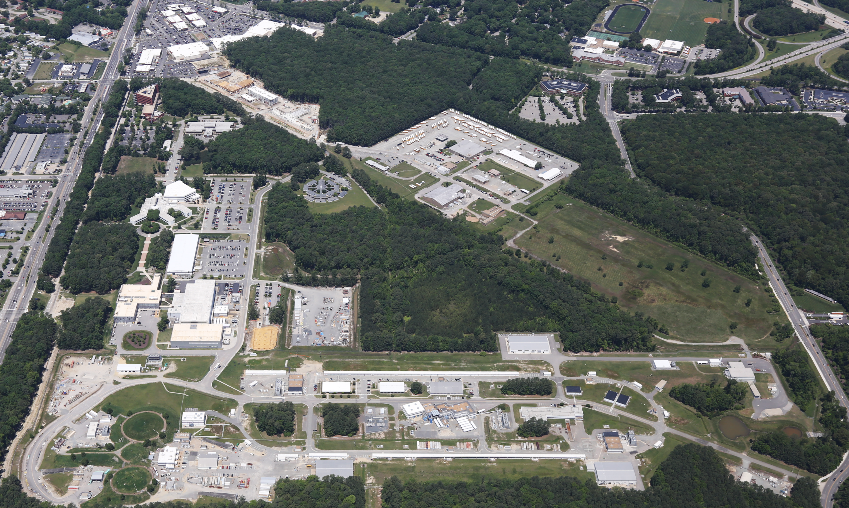
Jefferson Lab Status
Hugh Montgomery
Jefferson Lab Users Meeting, June 21, 2016

Slide 2
Outline
Laboratory Highlights
12 GeV CEBAF Upgrade Project
Funding and Operations
Director’s Perspective
Something extra

Slide 3
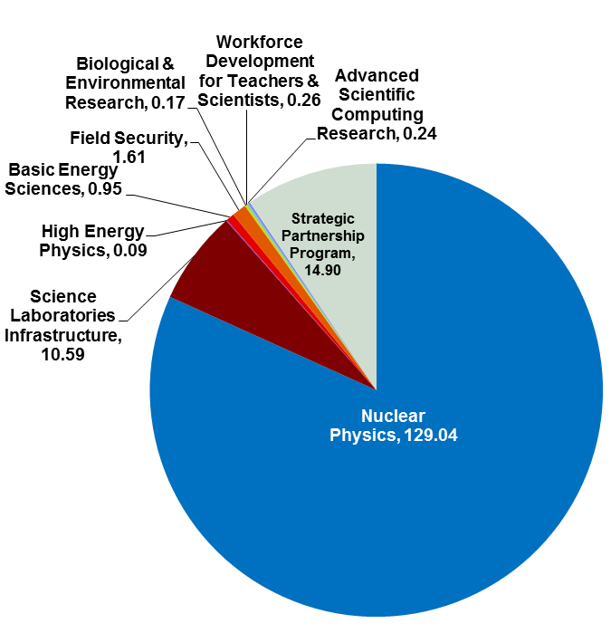
Jefferson Lab At-A-Glance
Created to build and Operate the Continuous Electron Beam Accelerator Facility (CEBAF), world-unique user facility for Nuclear Physics: Mission is to gain a deeper understanding of the structure of matter Through advances in fundamental research in nuclear physics Through advances in accelerator science and technology CEBAF In operation since 1995 1,510 Active Users 178 Completed Experiments to date; 70 have been approved for the future 12 GeV program Produces ~1/3 of US PhDs in Nuclear Physics (531 PhDs granted, 195 more in progress) Managed for DOE by Jefferson Science Associates, LLC (JSA) Human Capital: 686 FTEs 24 Joint faculty; 21 Post docs; 7 Undergraduate, 37 Graduate students K-12 Science Education program serves as national model Site is 169 Acres, and includes: 70 Buildings & Trailers; 876K SF Replacement Plant Value: $397M
FY 2015:
Total Lab Operating Costs: $157.8M
Total DOE NP Costs: $129.0M
SPP and DOE non-NP Costs: $ 28.8M

Slide 4
Jefferson Lab Safety History
1.5 Million + Hours Worked without Recordable Injury (October 2014 – January 2016)
Recent events serve as reminders to report injuries in a timely fashion, stay focused on situational awareness, and when conditions change, pause and re-evaluate

Slide 5
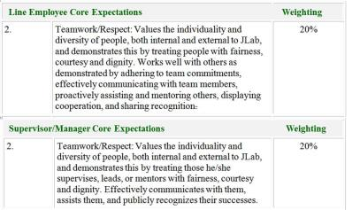
Integrated D&I Management
JLab Diversity logo created by D&I Council
D&I Council partnering with HR to co-facilitate D&I Training
Diversity awareness is now an element of Core Expectations in our staff annual evaluations

Slide 6
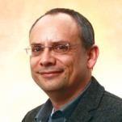
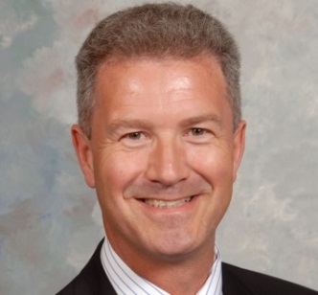
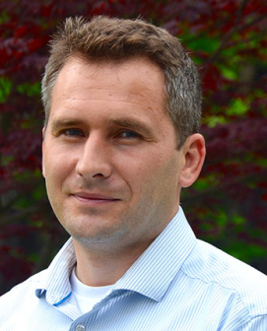
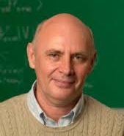
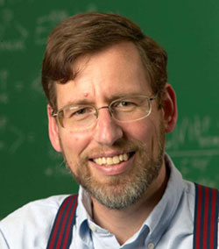
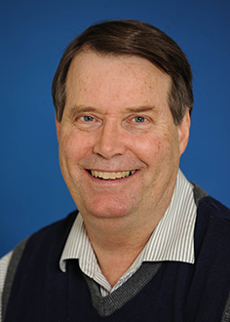
Accolades and Kudos!
APS Fellowships:
Kostas Orginos (Jefferson Lab & College of W&M)
Xiaochao Zheng (University of Virginia)
Peter Blunden
(Univ. of Manitoba)
Eli Piasetzky
(Tel Aviv University)
Matt Poelker
(Jefferson Lab)
2016 Breakthrough
Prize in Fundamental Physics
2016 Outstanding Faculty Award
DOE
Early Career Award
SESAPS 2015
Jesse W. Beams
Research Prize
George B. Pegram Award
APS DNP
Mentoring Award
Robert McKeown
(Jefferson Lab
Deputy Director
for Science)
Patricia Solvignon
(Bridge faculty/Univ.
New Hampshire)
Grigory Eremeev
(Jefferson Lab
Staff Scientist)
Anatoly Radyushkin
(Jefferson Lab & ODU)
Lawrence Weinstein (Old Dominion Univ.)
Dirk Walecka
(Jefferson Lab
Emeritus/W&M)
Charles Hyde
(Old Dominion Univ.)

Slide 7
Personnel News
Electron Ion Collider Physics Leadership
Rik Yoshida (ex ZEUS, ATLAS, ANL) joined Jefferson Lab as leader of our EIC Physics Group
Head of Theory
Position was advertised
Co-chairs Joe Carlson, LANL & Bob McKeown, Jefferson Lab
Members Charlotte Elster (Ohio U.), Franz Gross (Jefferson Lab emeritus), Frithjof Karsch (Bielefeld U. & BNL), Krishna Rajagopal (MIT), and Feng Yuan (LBNL)
Search is well advanced
I would like to recognize the contributions that Mike Pennington has given to the Lab and User Community and to our physics during his tenure at Jefferson Lab.
Celebratory Workshop on Thursday and Friday this week

Slide 8
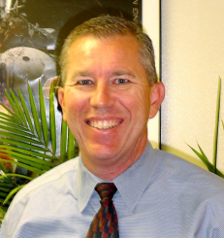
Leadership Enhancement
New Chief Operating Officer
Michael Maier, formerly PAE Vice President for Space System Operations, has accepted the position of COO effective May 2, 2016.
Chief Planning Officer
Allison Lung, 12 GeV Upgrade Deputy Project Manager, has accepted the positon of Chief Planning Officer effective May 2, 2016 → a new position generated as a result of the recruitment process to strengthen the directorate and facilitate Jefferson Lab expansion.
Both DOE Approved Key Contractual Positions

Slide 9
Jefferson Lab Organization
Effective 5/2/16
JSA Board of Directors
Chair
JSA Finance & Audit Committee
Accelerator Science
Advisory Comm.
Nuclear Physics
Program Adv. Comm.
Director
H. Montgomery
Internal Audit
Deputy Director
Science & Tech
R. McKeown
University Relations
Chief Planning
Officer
A. Lung
Chief Operating
Officer
M. Maier
Laboratory
Planning
Laboratory
Programs
Laboratory
Operations

Slide 10
Lab Directed Research and Development (LDRD)
JLab’s LDRD program is now well into its third year
Five of the six projects begun in FY14 or FY15 have been completed and the results have made a substantive contribution to future science at the laboratory
The FY16 program includes
The sixth project, which started in FY15 (Enhancing Simulation Capability for Electron Cooling in MEIC Project – He Zhang) was approved for completion in FY16
Two new projects that were chosen from among the eight proposals received for FY16 and are now in progress:
Generation and Characterization of Magnetized Bunched Electron Beam from DC Photogun for MEIC Cooler (Matt Poelker, Riad Suleiman)
Nuclear Gluons with Charm at EIC (Christian Weiss)
The FY16 budget for the three projects now underway totals $644,954 (<1% of our DOE funding)
A total of eight proposals have been received for FY17 (including continuation of two of the FY16 projects); evaluation is now underway
The LDRD program continues to play an important role in preparing for the future of the laboratory and in recognizing quality young staff; we are following its evolution with deep interest

Slide 11
Accelerator Advisory Committee
Charter
The Jefferson Lab Accelerator Advisory Committee is asked to look at activities related to CEBAF Operations, the Jefferson Lab EIC proposal, and accelerator-related R&D. There are three primary topics for review and discussion:
1. CEBAF Operations
2. Jefferson Lab EIC
3. Accelerator-related R&D
Committee
Chair: Norbert Holtkamp (SLAC, Chair)
Oliver Bruning (CERN)
Wolfram Fischer (BNL)
Richard Milner (MIT)
Yoshishige Yamasaki (MSU-FRIB)
Eric Prebys (FNAL)
Marion White (ANL)

Slide 12
Jefferson Lab Technology: Theory & Computation
Provide world-leading theoretical support for the experimental program:
Phenomenological support across broad scientific agenda
Lattice QCD as method to unambiguously establish predictions of QCD vs. experiment:
Capability computing allocations at supercomputer centers
10 years experience operating/managing local capacity computing facility for LQCD users
Dedicated LQCD computing project at JLab
Current LQCD SciDAC project ends in mid-FY17
Exascale 2025 project: DOE initiative to build/deploy exascale machine by 2025-2027
Led by ASCR and NNSA
For NP, computing is increasingly important for theory, experiment, and accelerators
At this stage, software application developments are emphasized
~12 application areas selected for R&D using FY16 funds
LQCD advanced
A coherent ONP approach would be desirable
Jefferson Lab in strong position to make unique contributions
Computation Collaboration
Advanced Discussions with Old Dominion University

Slide 13
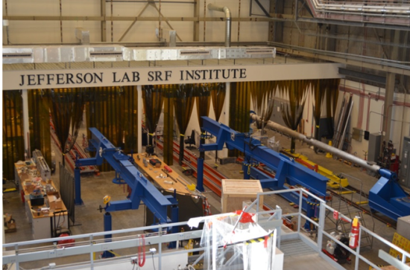
Accelerator Technology
Maintain and enhance world leadership in SRF, polarized e- source, ERL, and cryogenic technology: Partner in SRF-based accelerator construction projects
 | FRIB | LCLS-II
Description | New user facility at MSU for rare isotope studies | 4 GeV superconducting linac in existing SLAC tunnel
Collaboration | MSU, State of Michigan, DOE-SC; Jefferson Lab | ANL, Cornell, FNAL, LBNL, SLAC, Jefferson Lab
JLab Scope | Cryogenics system: design, procurement, fabrication, integration. Cryomodule: engineering & design finalization. | Cryoplant: design & acquisition. Cryomodule & cavities for half of linac. Q₀ R&D, LLRF, machine physics.
Status | 2K Coldbox Compressors contract awarded. 4K plant in fabrication. Beta 0.041 design complete. Beta 0.29 design well underway. | SRF cavity contracts placed. Prototype cryomodule assembly in progress. CD-2/3 Approve Construction Start – Spring 2016.
Notes:
BMcK updated 05Feb; Added photo (tf);
AL edits 06Feb

Slide 14
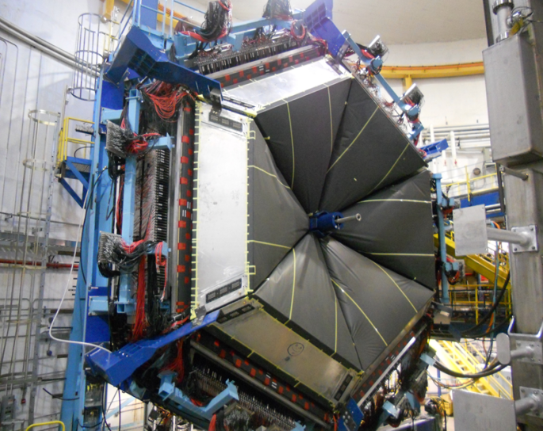
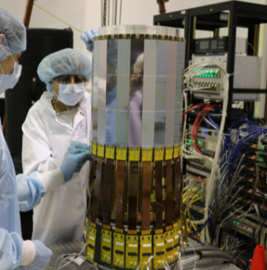
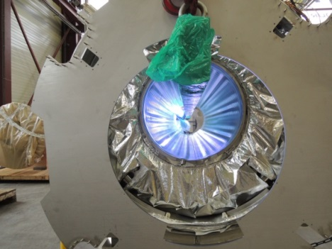
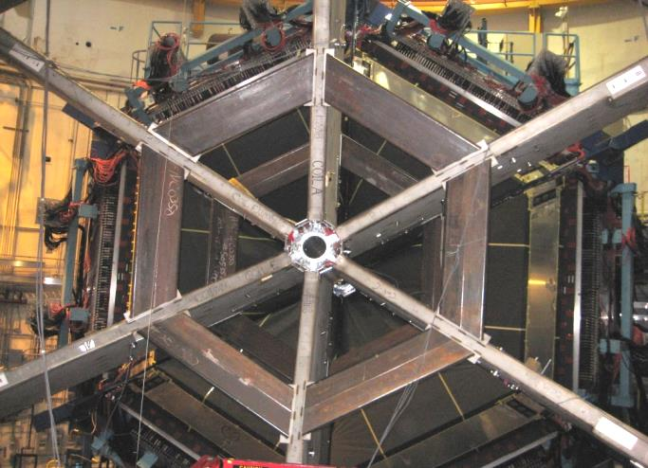
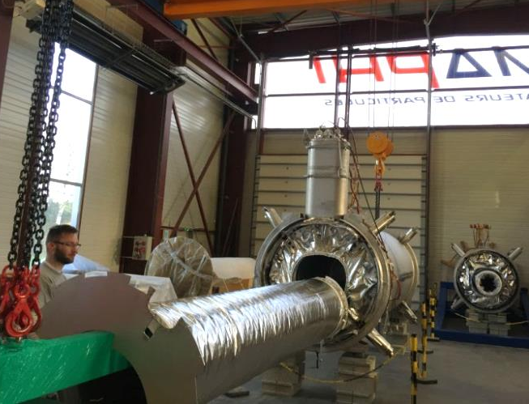
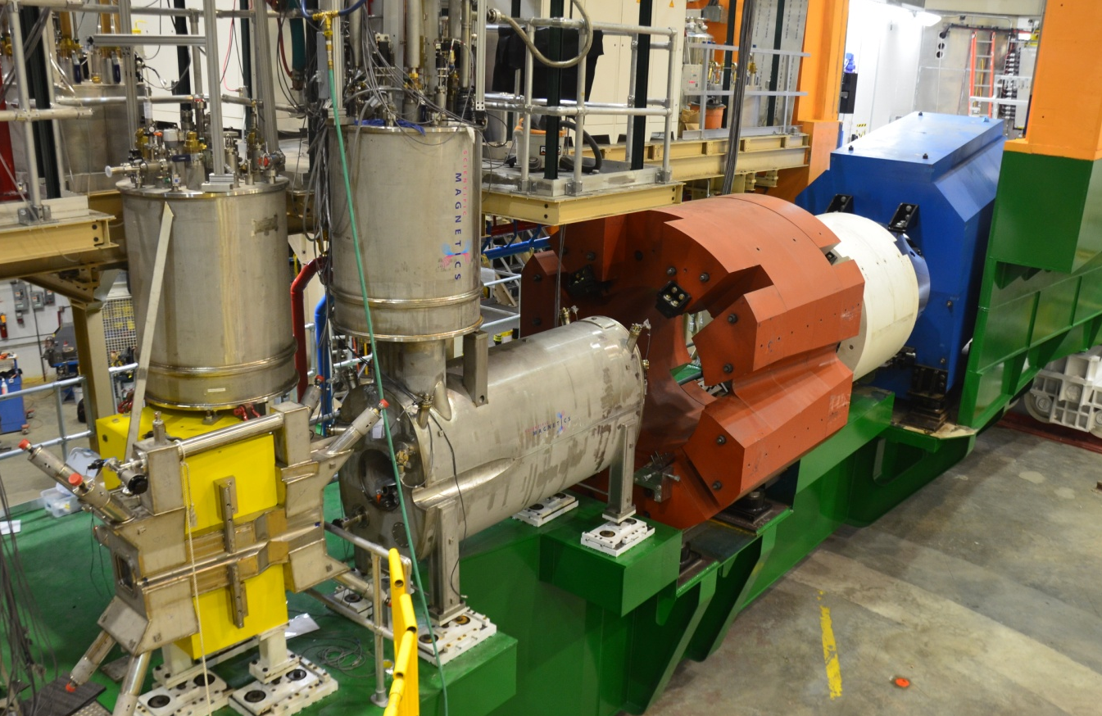
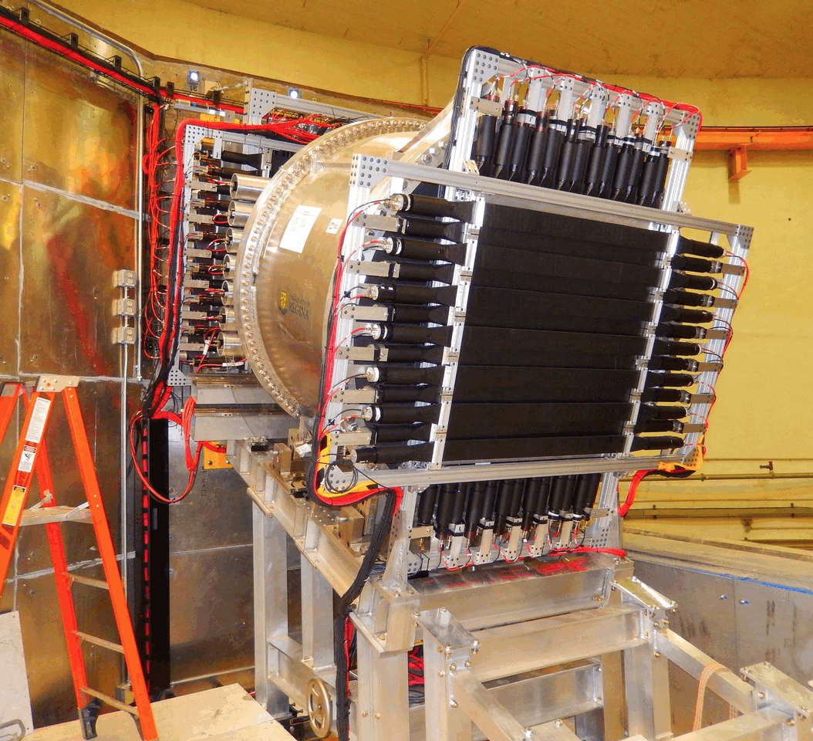
12 GeV Upgrade Project
TPC = $338M
ETC = ~$9M
Project Scope (~98% complete):
Doubling the accelerator beam energy – DONE
New experimental Hall D and beam line – DONE
Civil construction including utilities – DONE
Upgrades to Experimental Halls B & C – ~94%
Halls B & C Detectors – DONE

Slide 15
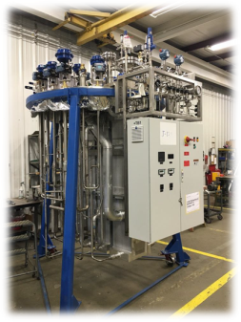
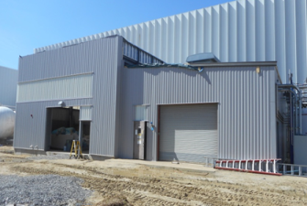
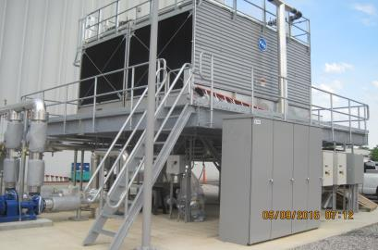
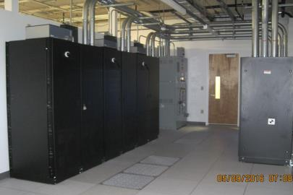
Utilities Infrastructure Modernization
Successful Annual review
Overall Progress → 82% complete
CTF Building / Equipment – 60% complete
Communications – Substantially Complete
Computer Center Cooling & Power – 87% Complete
CTF Cooling Tower – 85% Complete

Slide 16
Critical Vulnerabilities & Spares
Cryoplant is 20+ years old
We had one serious failure (CC4 compressor)
Attempting repair
Technology is irreplaceable, CEBAF, SNS impact
Draft plan, $4M, $10M, (modern Cold Box and compressors in discussions with ONP
Spares Program
eg Klystrons
Gradient Maintenance Program
C50 program → (C75) Cryomodule refurbishment
Multi Million dollar program broached in Office of Nuclear Physics
Budget Briefing

Slide 17
Budget: FY16; FY17 Discussion
Omnibus FY16: JLab allocation is $1.5M below Pres. budget.
Keep 16 weeks running; Retain staff
Delay some activities, accelerator spares  increased risk, little margin
FY2017
Pres. Budget release Feb. 9: NP at $636M, an increase of $18M (3%)
Major increases in isotope program ($8M) and RHIC/BNL ($7.5M)
JLab ops up $5.5M but insufficient for full operation
Senate mark: $636M
Language for FRIB construction and RHIC ops
House Mark: $620M
Language for FRIB construction, RHIC and CEBAF ops

Slide 18
JLab Operations Budget ONP Briefing
During FY01-FY12, CEBAF ops averaged 34.5 weeks/year (best year FY05 at 42 weeks)
For 12 GeV era we estimate “optimal” operations at
37 weeks per year
FY17 Pres. Budget includes JLab ops at $104M
- would fund 23 weeks (+ 3 weeks from 12 GeV project)
FY18+ at cost of living implies 23 weeks/year running
(62% of optimal)
We propose FY18+ at 30 weeks/year (81%), will require ~$6M increase in operations budget.

Slide 19
CEBAF Three-Year Schedule
Feb 2016
Calendar Year
2016
2017
2018
Fiscal Year
2016
2017
2018
Accelerator
Activity
Opportunistic
Physics
Physics
Physics
Beam
Activity
SBS Construction
Hall A
Activity
Opportunistic
Physics
Physics
Physics
Beam
CLAS12 Construction/Installation
Hall B
Activity
Activity
Non-CLAS12 Ops*
Physics
Physics
Beam
Hall C
Activity
SHMS Construction/Installation
Activity
Comm.
Physics
Physics
Beam
Opportunistic
Physics
Physics
Physics
Hall D
Activity
Beam
* Potential PRad Summer 2016 run
Beam for Commissioning
Beam for Physics
Non-CLAS12 Ops

Slide 20
Spring/Summer 2016
Hall A
DVCS
Substantial data in Q² scans
GMp
~1% statistics at Q²~5, 12 GeV²
Hall B
Heavy Photon Search (test run)
Detector worked well, silicon operated at 0.5 mm from beam
Recorded ~77% of targeted 2.1 GeV data  publishable results
Single Hall Low Energy Run, PRAD run successful
Hall C
(Tune) Beam Test Successful
Hall D
GlueX (commissioning)
Magnet refrigeration reconfigured
Stable operation for most of run at 1200 amps
Stable operation for ~6 days at 1345 amps
Detector and Data Acquisition worked well
 publishable results
Low Energy Recirculator Facility
DARKLIGHT Test run

Slide 21
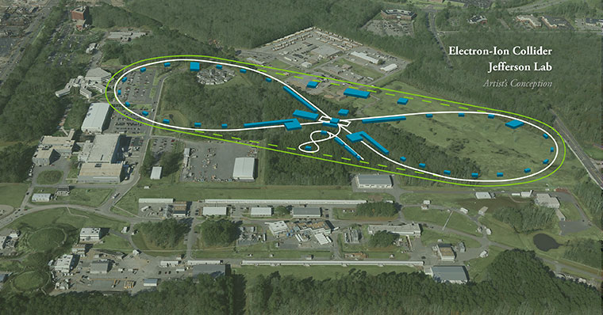
Electron Ion Collider at Jefferson Lab
JLab EIC Figure 8 Concept
Initial configuration:
3-10 GeV on 20-100 GeV ep/eA collider
Optimized for high ion beam polarization:
polarized deuterons
Luminosity:
up to few x 10³⁴ e-nucleons cm⁻² s⁻¹
Low technical risk
Upgradable to higher energies
250 GeV protons + 20 GeV electrons
Flexible timeframe for Construction
consistent w/running 12 GeV CEBAF
Thorough cost estimate completed
presented to NSAC EIC Review
Cost effective operations
Fulfills White Paper Requirements
Current Activities
Site evaluation (VA funds)
Accelerator, detector R&D (DOE and VA funds)
Design optimization (examine alternatives)
Cost reduction
Long Range Plan impact on Electron Ion Collider
Users Organization/Meetings
National Academy Study
Enhanced explicit EIC Accelerator R&D
Increased interest in collaboration with Jefferson Lab

Slide 22
Commonwealth of Virginia Funding
Special Request $4.2M in the FY15 - FY16 biennium to help improve Virginia’s competitive position for the Electron Ion Collider:
$3.7M in FY16 to complete the site studies
$0.25M in FY16 to attract a leading scientist to Virginia
Included in the Commonwealth of Virginia Budget
Request FY17-18 biennium
$2.4M for Accel. R&D with aim to further reduce technical risk has thus far been retained in the Commonwealth Budget.

Slide 23
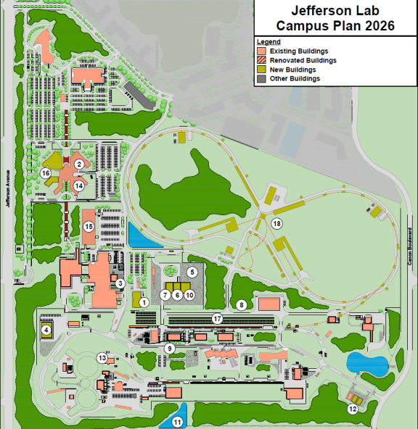
Jefferson Lab 2026 Campus Plan
PROJECTS
ESH&Q Building
Core Computing Sustainability
Cryogenics Equipment Upgrade
Physics Technical Support Building
Central Materials Storage Area Expansion
Shipping & Receiving Building
Facilities Operations Building
Water Reuse Capture & Tank
Lab Road Improvements
Property Storage Building
Site Storm Water Management
Accelerator Storage Building
Cryogenics Infrastructure Modernization
CEBAF Center Renovation: Wings A, B, C
EEL Modernization
CEBAF Center Office Expansion
UESC
Jefferson Lab Electron Ion Collider (JLEIC)

Slide 24
Director’s Perspective
Emphases
Core Nuclear Physics
Finish the upgrade project, safely, on time, and within budget.
Full-time operations. Operations budgets continue to be a concern here.
Reliability and Risk Mitigation
Advance new NP projects beyond the upgrade
Develop Jefferson Lab EIC design:
Technical Designs, Collaboration, (Land now secured)
Technology Collaborations
Large projects, like FRIB and LCLS-II, within context of NP – management is key
Computational Physics
LERF Initiatives, 1st Tests for Nuclear Physics Operations
Management/Personnel
Operations Functions are vital to the functioning of the lab
New Appointments
Recent Engagements
Top Down Cyber Security – Multi Factor Access
Ethics program improvements
Diversity & Inclusion (Integrated Diversity and Inclusion Management)
Jefferson Lab continues to be an exciting place…

Slide 25
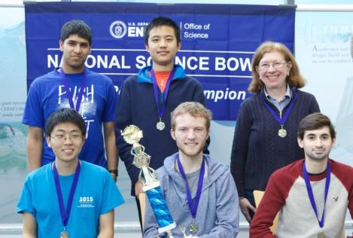
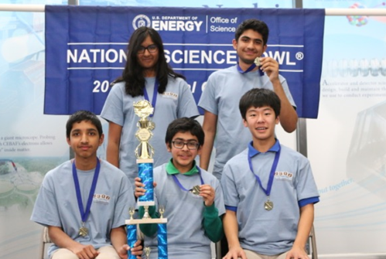
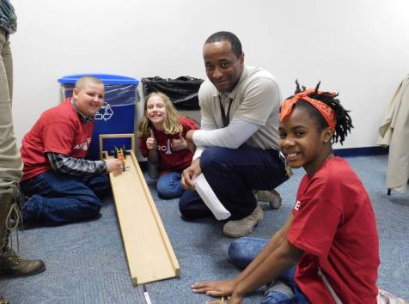
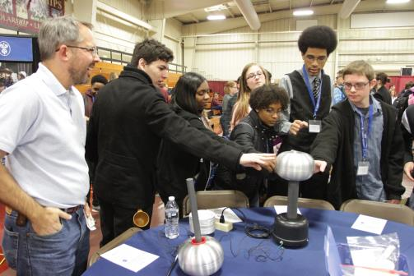
Science Education
Virginia Regional High School Science Bowl
Virginia Regional Middle School Science Bowl
My Brother’s Keeper Initiative
Engineering Career Day with Newport News Shipyard

Slide 26
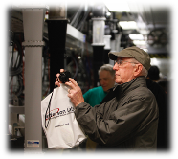
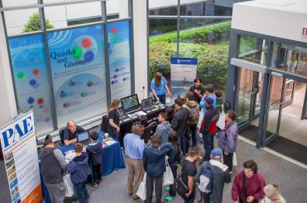
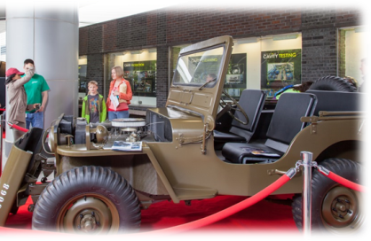
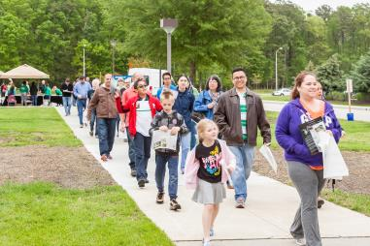
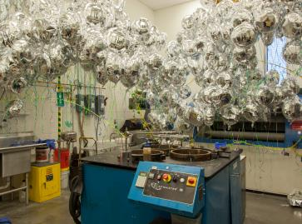
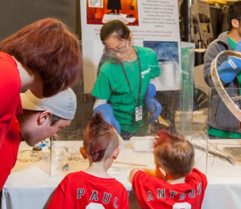
JLab Open House – April 30, 2016
…~12,000 visitors agree!

