Slide 1
Perspectives from DOE NP
JLAB User Meeting
June 19, 2017

Slide 2
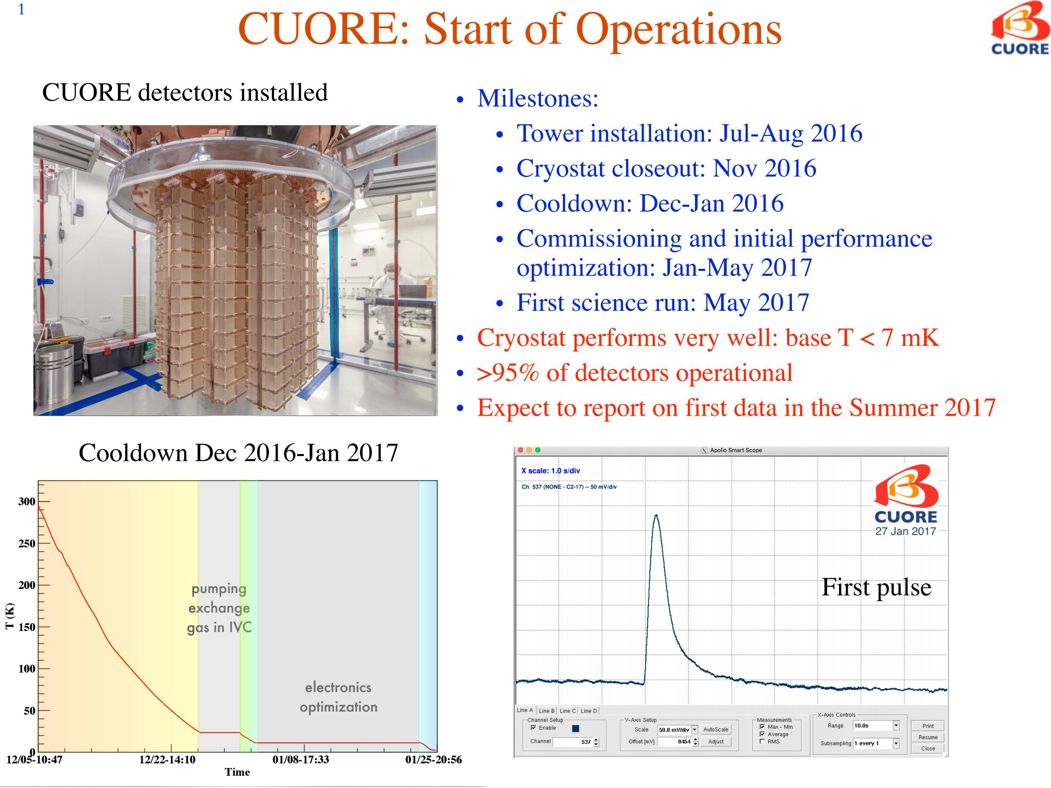
Science News

Slide 3
Additional Science News
From: "Clayton, Steven" <sclayton@lanl.gov>
Subject: New neutron lifetime result from UCNtau
Date: May 30, 2017 at 12:59:15 PM MDT
Hello,
Over Memorial Day weekend, the UCNtau collaboration unblinded results from the 2016-17 and 2015-16 LANSCE run cycles at a collaboration meeting, and prepared a first physics result for the experiment with uncertainty approximately equal to the previous most precise neutron lifetime measurement, and that is the first sub-1-second-precision neutron lifetime measurement that did not require a systematic correction large compared to its stated uncertainty…. We are working on rapid publication of this result…We also unblinded the 2015-16 data set and found agreement with the 2016-17 result, giving us confidence in both results considering the widely varying run conditions of numerous data subsets.
In addition, we have a publication that was just released today about the experimental method: "A new method for measuring the neutron lifetime using an in situ neutron detector," 30 May 2017, in Review of Scientific Instruments (Vol.88, Issue 5). It may be accessed via the link below:
http://scitation.aip.org/content/aip/journal/rsi/88/5/10.1063/1.4983578

Slide 4
One Important Take-Away
Delivering exciting discoveries, important scientific knowledge and technological advances is what we do.
We need to stay focused and continue to deliver these outcomes for the nation

Slide 5
Budget News

Slide 6
NP FY 2018 President’s Request
(Dollars in thousands)
 | FY 2016 Enacted Approp. |  | FY 2016 Current w/SBIR-STTRª |  | FY 2017 Enacted Approp. |  | FY 2018 President's Request |  | FY 2018 Request vs. FY 2016 Current w/SBIR-STTRª
Medium Energy Nuclear Physics
Research | 37,802 |  | 34,411 |  | 36,585 |  | 25,316 |  | -9,095 | -26.4%
Operations (TJNAF) | 98,670 |  | 99,672 |  | 99,168 |  | 88,598 |  | -11,074 | -11.1%
SBIR/STTR and Other | 19,321 |  | 18,457 |  | 21,546 |  | 16,253 |  | -2,204 | -11.9%
Total, Medium Energy Nuclear Physics | 155,793 |  | 152,540 |  | 157,299 |  | 130,167 |  | -22,373 | -14.7%
Heavy Ion Nuclear Physics
Research | 35,822 |  | 36,036 |  | 37,369 |  | 20,943 |  | -15,093 | -41.9%
Operations (RHIC) | 172,088 |  | 172,088 |  | 174,538 |  | 164,738 |  | -7,350 | -4.3%
Total, Heavy Ion Nuclear Physics | 207,910 |  | 208,124 |  | 211,907 |  | 185,681 |  | -22,443 | -10.8%
Low Energy Nuclear Physics
Research | 51,383 |  | 54,263 |  | 55,717 |  | 33,033 |  | -21,230 | -39.1%
GRETA | … |  | … |  | 676 |  | 200 |  | +200 | ...
Operations | 27,402 |  | 27,402 |  | 23,499 |  | 19,222 |  | -8,180 | -29.9%
Total, Low Energy Nuclear Physics | 78,785 |  | 81,665 |  | 79,892 |  | 52,455 |  | -29,210 | -35.8%
Nuclear Theory
Theory Research | 38,033 |  | 37,616 |  | 36,475 |  | 27,749 |  | -9,867 | -26.2%
Nuclear Data Activities | 7,742 |  | 8,022 |  | 7,572 |  | 5,537 |  | -2,485 | -31.0%
Total, Nuclear Theory | 45,775 |  | 45,638 |  | 44,047 |  | 33,286 |  | -12,352 | -27.1%
Isotope Development and Production for Research and Applications
Research | 6,033 |  | 6,329 |  | 9,829 |  | 5,307 |  | -1,022 | -16.1%
Operations | 15,304 |  | 15,304 |  | 16,526 |  | 14,304 |  | -1,000 | -6.5%
Stable Isotope Production Facility (SIPF) | … |  | … |  | 2,500 |  | 1,500 |  | +1,500 | ...
Total, Isotope Production and Applications | 21,337 |  | 21,633 |  | 28,855 |  | 21,111 |  | -522 | -2.4%
Subtotal, Nuclear Physics | 509,600 |  | 509,600 |  | 522,000 |  | 422,700 |  | -86,900 | -17.1%
Construction
14-SC-50 Facility for Rare Isotope Beams, MSU | 100,000 |  | 100,000 |  | 100,000 |  | 80,000 |  | -20,000 | -20.0%
06-SC-01 12 GeV CEBAF Upgrade, TJNAF | 7,500 |  | 7,500 |  | … |  | … |  | -7,500 | -100.0%
Total, Construction | 107,500 |  | 107,500 |  | 100,000 |  | 80,000 |  | -27,500 | -25.6%
Total, Nuclear Physics | 617,100 |  | 617,100 |  | 622,000 |  | 502,700 |  | -114,400 | -18.5%
ªThe FY 2016 Enacted column printed in the FY 2018 Congressional Budget Justification (President’s Request) includes SBIR/STTR funding in the program lines
and reflects programmatic updates through the end of the fiscal year.

Slide 7

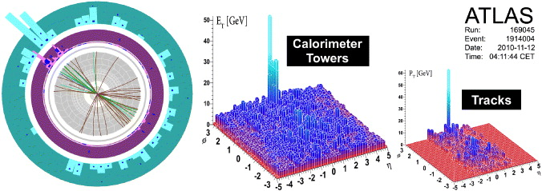
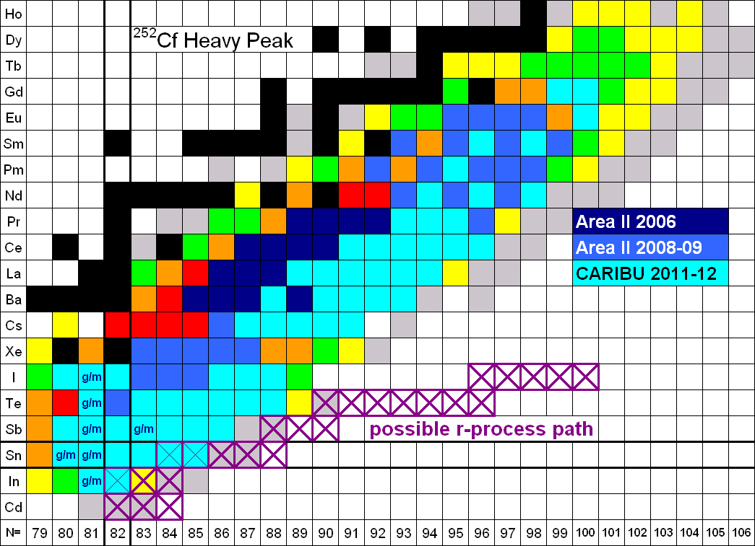
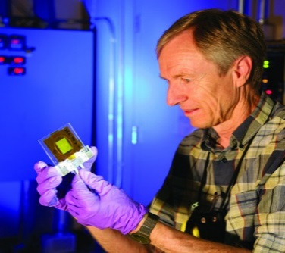
The FY 2018 Request for Nuclear Physics
      Decreased funding for research focuses resources on the most critical areas of nuclear science research
      Operations at RHIC are supported for 10 weeks in FY 2018. Beam time in FY 2018 is combined with planned operation in FY 2019 to explore the properties of the quark gluon plasma first discovered there and to enable studies of spin physics
The 12 GeV CEBAF Upgrade, completed in FY 2017, begins its scientific program with a 10 weeks run, promising new discoveries and an improved understanding of quark confinement.
Operations at ATLAS are supported, continuing to provide high-quality beams of all the stable elements up to uranium as well as selected beams of short-lived nuclei.
Construction continues on the Facility for Rare Isotope Beams following a rebaseline of the project reflecting reduced construction funding in FY 2018. The Gamma-Ray Energy Tracking Array (GRETA) MIE is continued to exploit the scientific potential of FRIB.
Fabrication continues on the Stable Isotope Production Facility (SIPF) to produce enriched stable isotopes, a capability not available in the U.S. for almost 20 years.

Slide 8
FY 2018 Reductions to Research
Targeted Cuts to
  RHIC Spin Program
  LHC Heavy Ion Program
  The MIT Research and Engineering Center
  New ECA awards in FY 2018
A general reduction of 24.5% across all research lines

Slide 9
FY2018 Impacts
Impacts of FY 2018 President’s Request for Nuclear Physics by Sub-program as described in President’s Request narrative
Lab and University Research Reduced ~ 35% from FY17 Enacted to FY18 PR
Reductions in Force at national laboratories: ~ 200 FTEs
Reductions in Force at universities: ~ 500-600 scientists
No new Early Career Awards in FY 2018

Slide 10
FY 2018 Impacts
Medium Energy:
Continuous Electron Beam Facility (Scientific User Facility) operates at 10 weeks (28.7% utilization)
No CEBAF capital equipment, accelerator improvement project, facility accelerator R&D or general purpose plant funding provided to Jlab
Up to 100 FTE reduction-in-force at Jlab
No initiation of the Moller MIE, which received Critical Decision 0 approval in 12/16.
No medium energy experimental program at FNAL
No RHIC Spin Program
No MIT Research and Engineering Center (University Center of Excellence)
Remaining research reduced 24.5%

Slide 11
FY2018 Impacts
Heavy Ion Program:
No U.S. participation in LHC Heavy Ion Program; M&O common funds and computing commitments cancelled; No ALICE Barrel Tracking Upgrade
Relativistic Heavy Ion Collider (Scientific User Facility) operations at 10 weeks (66.7% utilization); run is combined for a single run to span the FY18/FY19 boundary
No capital equipment, accelerator improvement project, facility accelerator R&D funding provided to RHIC
Up to 100 FTE reduction in force at RHIC
No initiation of sPHENIX MIE, which received Critical Decision approval in September 2016
All Heavy Ion National Laboratory Research efforts are reduced by 24.5%

Slide 12
FY 2018 Impacts
Nuclear Structure and Astrophysics and Fundamental Symmetries:
Argonne Tandem Linac Accelerator Facility (Scientific User Facility) at 23 weeks at 5 days/week (39.7% utilization).
No capital equipment, accelerator improvement project funding provided to ATLAS.
FRIB construction profile reduced; FRIB operations funding not initiated in 2018.
GRETA MIE, initiated in FY 2017, pursued at reduced pace.
No SECAR instrumentation effort for FRIB
Operations of 88 inch cyclotron at LBNL paused
Operations of TAMU and Duke HIGS facilities (both University Centers of Excellence) paused; reductions in force possible; no equipment funding provided
No Next Generation Neutrinoless Double Beta Decay R&D
No nEDM R&D
All other Low Energy University and Laboratory research efforts are reduced by 24.5%.

Slide 13
FY2018 Impacts
Theory, Nuclear Data, Scidac
No participation in NP/HEP LQCD project effort
Research reduced by 24.5%
DOE Isotope Program:
Research reduced by 24.5%
Mission readiness of isotope production facilities reduced
Stable Isotope Production Facility Major Item of Equipment, initiated in FY2017, is pursued at a slower pace.

Slide 14
One feature of the FY 2017 enacted appropriation is that all research lines were put at the level of the FY 2017 President’s Budget Request
Since the overall bottom-line was less than the FY2017 PBR, other lines had to be reduced accordingly

Slide 15
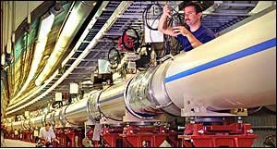
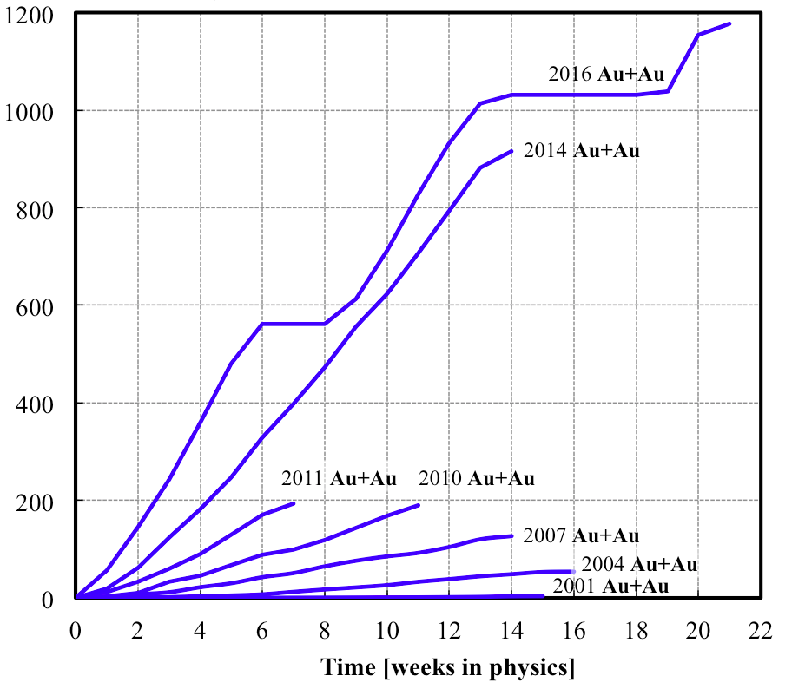
RHIC Machine Performance Continues to Set New Records
In FY 2018, RHIC operates for 10 weeks. Beam time in FY 2018 is combined with planned operation in FY 2019 to improved operational efficiency.
The FY 2018 request supports data taking to confirm the explanation of never-before-seen phenomena in quark gluon plasma formation and preparations to search for a critical point between the phases of nuclear matter.
Au + Au runs
2014
2016
Higher luminosity in Run 16 than in all other RHIC runs combined
Integrated nucleon-pair luminosity L_{NN} [pb⁻¹]
Integrated luminosity L [pb⁻¹]
Consistently high facility availability ( ~ 85%)
No other facility worldwide, existing or planned, rivals RHIC in science reach and versatility as a heavy ion collider. It is the only polarized proton collider in the world.

Slide 16
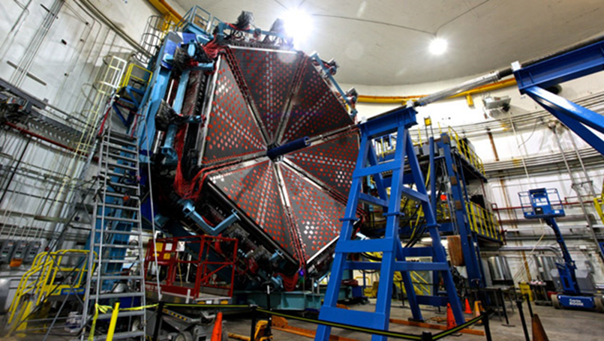
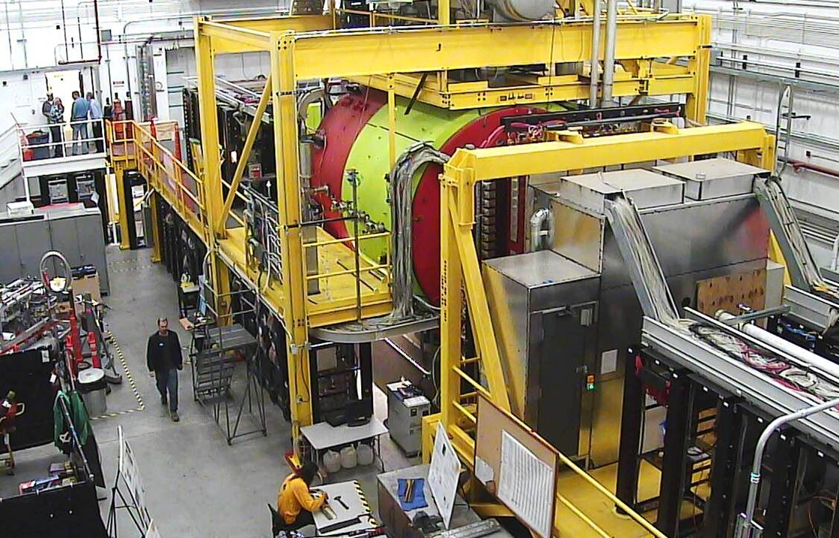
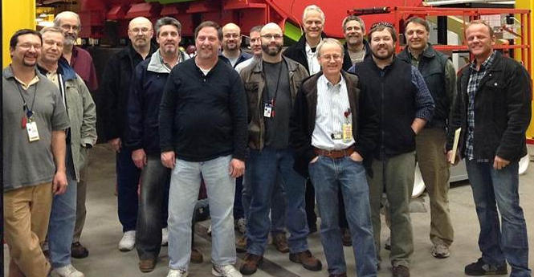
Continuous Electron Beam Accelerator Facility
CEBAF operates for 10 weeks in FY 2018
12 GeV CEBAF Upgrade Science Program is initiated:
The CEBAF science program restarts its first science data taking operations following the completion of the 12 GeV Upgrade.
While concurrent operation of the 4 experimental halls is constrained by resources, sequential data taking in the four experimental halls, including the recently constructed Hall D, gets underway.
Hall B Time of Flight Detector
With the completed 12 GeV CEBAF Upgrade, researchers begin experiments to:
Search for exotic new quark-anti-quark particles to advance our understanding of the strong force.
Find evidence of new physics from sensitive searches for violations of nature’s fundamental symmetries.
Gain a microscopic understanding of the internal structure of the proton, including the origin of its spin, and how this structure is modified when the proton is inside a nucleus. begin
Hall D Solenoidal Spectrometer

Slide 17
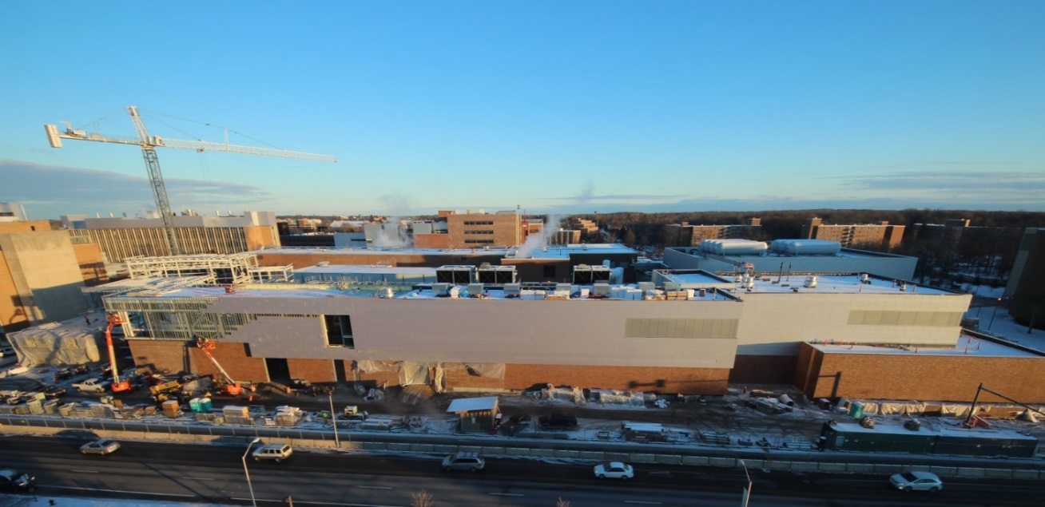
Facility for Rare Isotope Beams is > 77% Complete
FRIB will increase the number of isotopes with known properties from ~2,000 observed over the last century to ~5,000 and will provide world-leading capabilities for research on:
Nuclear Structure
  The limits of existence for nuclei
  Nuclei that have neutron skins
  Synthesis of super heavy elements
Nuclear Astrophysics
  The origin of the heavy elements and explosive nucleo-synthesis
  Composition of neutron star crusts
Fundamental Symmetries
  Tests of fundamental symmetries,
  Atomic EDMs, Weak Charge
  This research will provide the basis for a predictive model of nuclei and how they interact.
FRIB is rebaselined in FY2018 to reflect reduced construction funding
The FY2018 Request supports:
Completing work on the fabrication and assembly of the cryogenics plant and distribution system.
Remaining major procurements; fabrication, assembly and installation of technical systems including cryo-modules and experimental systems.
Completing the commissioning of the FRIB ion source, and beginning the commissioning of the linear accelerator (linac) system.

Slide 18
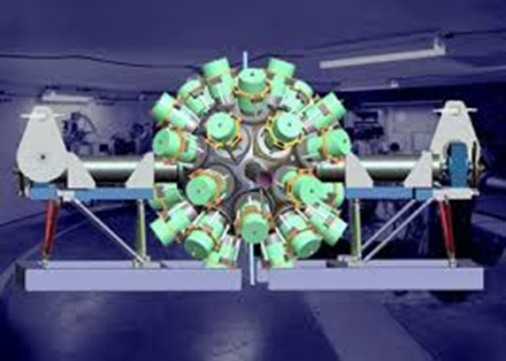
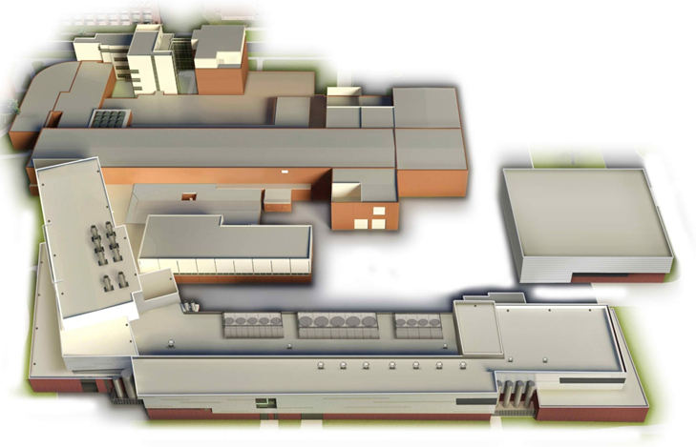
Gamma-Ray Energy Tracking Array (GRETA)
The FY 2018 Request continues the Gamma Ray Energy Tracking Array (GRETA) Major Item of Equipment (MIE) initiated in FY 2017, a premiere gamma-ray tracking device that will exploit the new capabilities of FRIB.
GRETA was identified by NSAC as an instrument that will “revolutionize gamma-ray spectroscopy and provide sensitivity improvements of several orders of magnitude.”
GRETA will advance the rare-isotope science at FRIB and investigate reactions of importance for nuclear structure and nuclear astrophysics.
FY 2018 Request: $0.2M
Est. Total Project Cost: $52M-$67M
The estimated cost and schedule will be re-evaluated in the context of funds available in the FY 2018 budget

Slide 19
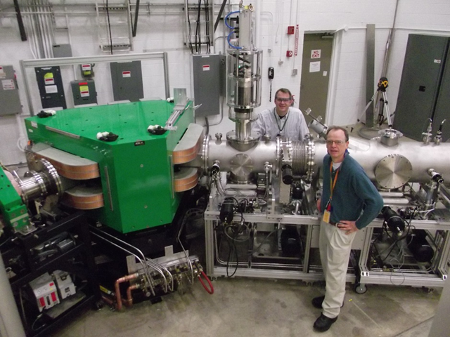
Stable Isotope Production Facility (SIPF)
The FY 2018 Request initiates the Stable Isotope Production Facility (SIPF) MIE, which restores domestic capability lacking since 1998:
  Renewed enrichment capability that will benefit nuclear and physical sciences, industrial manufacturing, homeland security, and medicine.
  Nurtured U.S. expertise in centrifuge technology and isotope enrichment, useful for a variety of peaceful-use activities.
  Capability to address U.S. needs for high priority isotopes needed for research, feedstock material for Mo-99 production, and more.
  Removes U.S. dependence on off-shore suppliers of of enriched stable isotopes
Stable Isotope Pilot Production Facility at ORNL
  Responds to the Persistent Recommendation of the Nuclear Science Advisory Committee for Isotopes (NSACI)
    2009 Recommendation: “Construct and operate an electromagnetic isotope separator facility for stable and long-lived radioactive isotopes.”
    2015 Long Range Plan: “We recommend completion and the establishment of effective, full intensity operations of the stable isotope separation capability at ORNL.”

Slide 20

The 2015 Long Range Plan for Nuclear Science
Recommendations:
Capitalize on investments made to maintain U.S. leadership in nuclear science.
Develop and deploy a U.S.-led ton-scale neutrino-less double beta decay experiment.
Construct a high-energy high-luminosity polarized electron-ion collider (EIC) as the highest priority for new construction following the completion of FRIB.
Increase investment in small-scale and mid-scale projects and initiatives that enable forefront research at universities and laboratories.
The FY 2018 Request supports progress in important aspects of the 2015 LRP Vision

Slide 21
Things to Bear in Mind
Budget discussions that NP engages in must be factual only without commentary.
There are no scenarios which avoid significant impacts to all current NP supported operations and research
The decisions made are owned by the AD and issues should be directed to him.
An attempt was made to preserve “core” areas of NP’s mission and the tools which enable them, even though they are also impacted.
Both the Executive and the Legislative branches must agree on whatever the FY18 budget will be. The answer may not be known for a while and it will be challenging to try to remain prepared for the full range of possibilities. An attempt was made to take that into account.
At the requested budget level there will be significant RIFs and that is unavoidable. The size of these reductions can be different FTE-wise at Labs and universities because of the differing cost of doing business at the two types of institutions and method of operations.
At FY 2018 request level it will not be possible to continue to execute on the full scope of the 2015 Long Range Plan
21

Slide 22
Other DOE NP News Items
Selections have been made for proposals submitted in response to the 0νββ R&D FOA released August 29,2016
The recommendations of the Jones panel are being folded into planning for accelerator R&D related to a possible Electron-Ion Collider
A new lab-only FOA has been published by the Interagency Working Group established on Nuclear Data to assess the possibility of some additional investment in targeted experiments with great leverage for enhancing nuclear data
FRIB Theory alliance continues to progress
12 GeV upgrade and FRIB construction continue to be on track
A Statement of Mission has been established for the MIT Research and Engineering center
The 2017 ECA process is progressing
Selections in progress for SciDAQ4
Quantum Information Science is a new SC-wide focus

Slide 23
Next Formal Step on the EIC Science Case is Continuing
THE NATIONAL ACADEMIES OF SCIENCES, ENGINEERING, AND MEDICINE
Division on Engineering and Physical Science
Board on Physics and Astronomy
U.S.-Based Electron Ion Collider Science Assessment
Summary
The National Academies of Sciences, Engineering, and Medicine (“National Academies”) will form a committee to carry out a thorough, independent assessment of the scientific justification for a U.S. domestic electron ion collider facility. In preparing its report, the committee will address the role that such a facility would play in the future of nuclear science, considering the field broadly, but placing emphasis on its potential scientific impact on quantum chromodynamics. The need for such an accelerator will be addressed in the context of international efforts in this area. Support for the 18-month project in the amount of $540,000 is requested from the Department of Energy.
“U.S.-Based Electron Ion Collider Science Assessment” is now getting underway. The Chair will be Gordon Baym. The rest of the committee, including a co-chair, will be appointed in the next couple of weeks. The first meeting is being planned for January, 2017

Slide 24
The Outlook Today
The U.S. has unquestioned world leadership in experimental QCD research. CEBAF and RHIC are both unique and at the “top of their game” with compelling “must-do” science in progress or about to start. Long term, the future of QCD science is pointing to the need for an electron-ion collider.
There is a wealth of science opportunity near term at ATLAS, and longer term at FRIB which will be world leading. NP is beginning to position the low energy experimental community to take full advantage of FRIB. The Theory Alliance (and support for theory in general) is also crucial.
A very high priority for the NP community is U.S. leadership in the science of neutrino-less double beta decay.
A specific challenge will be ensuring essential R&D for candidate technologies is completed in the next 2-3 years prior to a down-select for a ton-scale experiment
Research and production efforts to meet the Nation’s need for isotopes in short supply are being strengthened; re-establishing U.S. capability for stable isotopes will be a major advance and will help address community concerns in this area documented in the 2009 and 2015 NSACI Strategic Plans

Slide 25
The Outlook Three Months From Today
The U.S. has unquestioned world leadership in experimental QCD research. CEBAF and RHIC are both unique and at the “top of their game” with compelling “must-do” science in progress or about to start. Long term, the future of QCD science is pointing to the need for an electron-ion collider.
There is a wealth of science opportunity near term at ATLAS, and longer term at FRIB which will be world leading. NP is beginning to position the low energy experimental community to take full advantage of FRIB. The Theory Alliance (and support for theory in general) is also crucial.
A very high priority for the NP community is U.S. leadership in the science of neutrino-less double beta decay.
A specific challenge will be ensuring essential R&D for candidate technologies is completed in the next 2-3 years prior to a down-select for a ton-scale experiment
Research and production efforts to meet the Nation’s need for isotopes in short supply are being strengthened; re-establishing U.S. capability for stable isotopes will be a major advance and will help address community concerns in this area documented in the 2009 and 2015 NSACI Strategic Plans

Slide 26
It’s a process informed by information gathering

Slide 27

A Long Tradition of Partnership and Stewardship
There has been a long tradition in Nuclear Science of effective partnership between the community and the agencies in charting compelling scientific visions for the future of nuclear science.
Key factors:
Informed scientific knowledge as the basis for recommendations and next steps
Mutual respect among scientific sub-disciplines
Commitment to the greater good of nuclear science as a discipline
Meticulously level playing field leading to respect for process and outcomes
Deep appreciation for the wisdom of Ben Franklin

