Slide 1


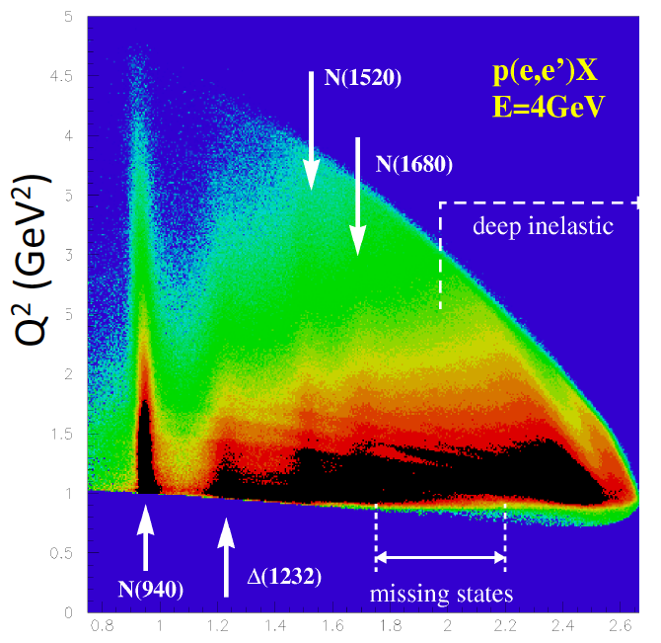
N* Spectrum and Structure
and Search for Hybrid Baryons
Annalisa D’Angelo
University of Rome Tor Vergata & INFN Rome Tor Vergata
Rome - Italy
Outline:
Establishing N* states
Identifying the effective degrees of freedom
Search for hybrid Baryons
Outlook & conclusions
W (GeV)

Slide 2
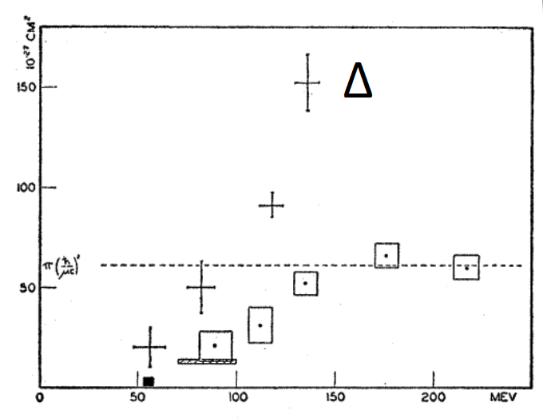
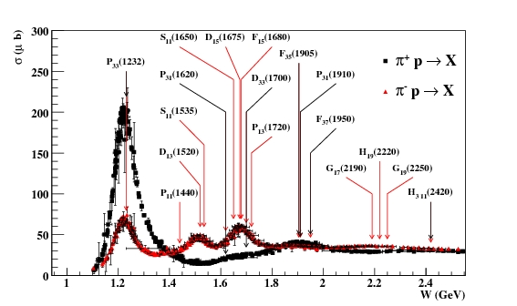

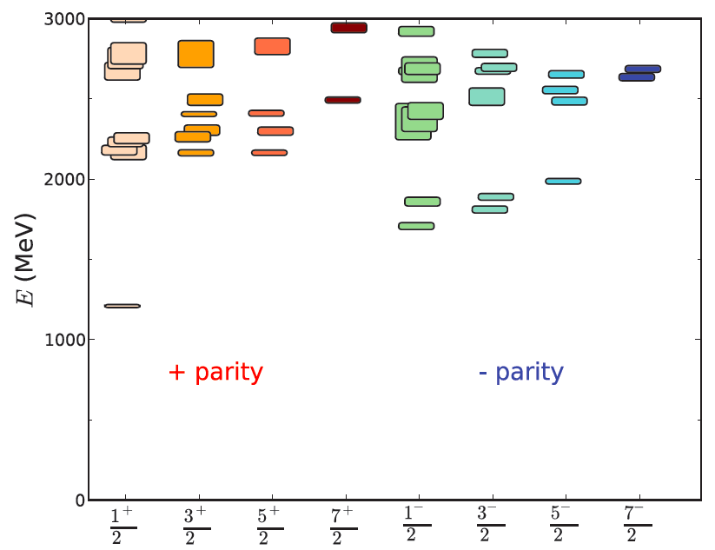
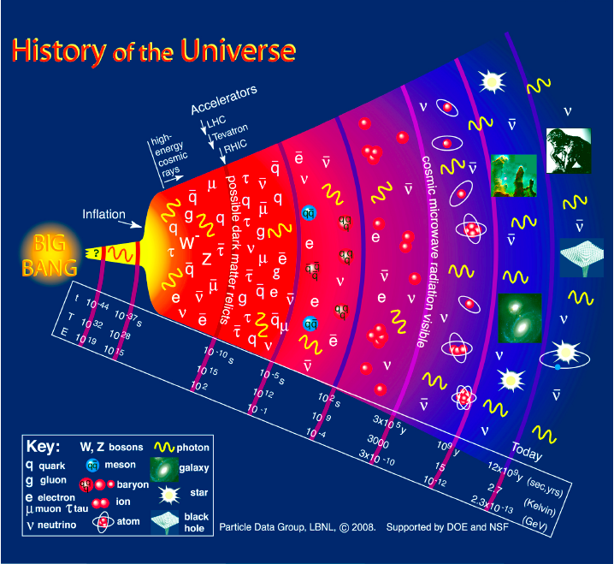
Historical Markers
1952: First glimpse of the Δ(1232) in πp scattering shows internal structure of the proton.
1964: Baryon resonances essential in establishing the quark model and the color degrees of freedom.
1989: Broad effort to address the missing baryon puzzle.
2010: First successful attempt to predict the nucleon spectrum in LQCD.
2015: Understanding of the baryon spectrum is needed to quantify the transition from QGP to the confined phase in the early universe.

Slide 3
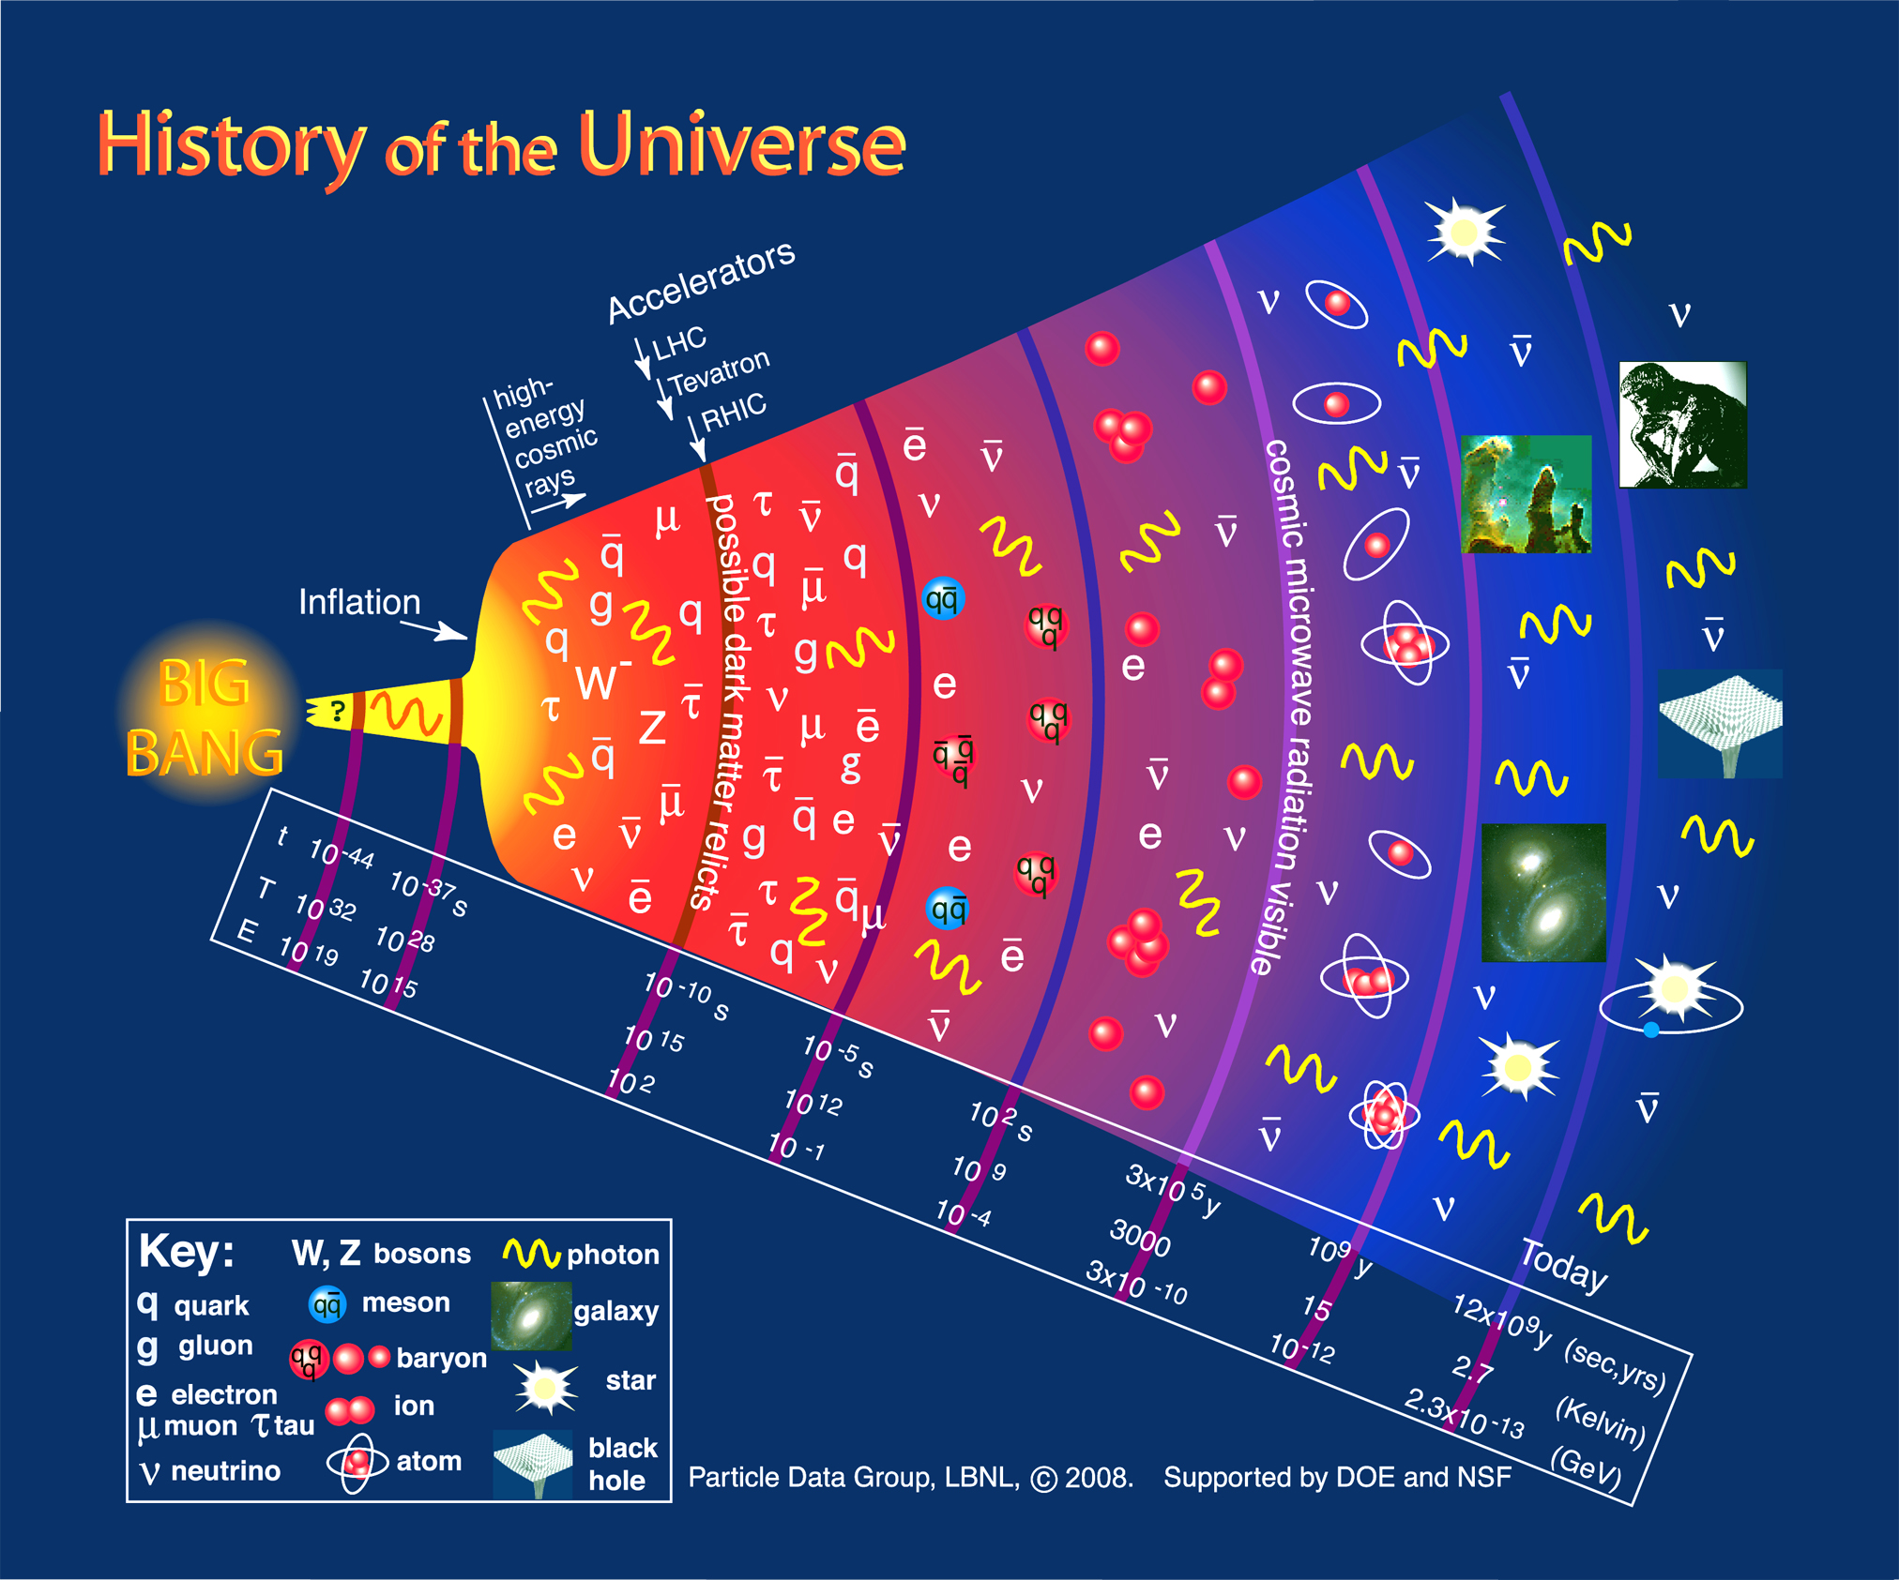
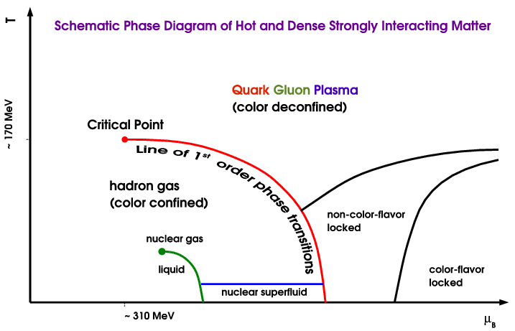
N* in the History of the Universe
CEBAF
ELSA
Mami
Quark Gluon Plasma
(color deconfined)
N*
Hadron Gas
(color confined)
N*
Dramatic events occur in the microsecond old Universe.
The transition from the QGP to the baryon phase is dominated by excited baryons.
A quantitative description requires more states than found to date => missing baryons.
During the transition the quarks acquire dynamical mass and the confinement of color occurs.

Slide 4
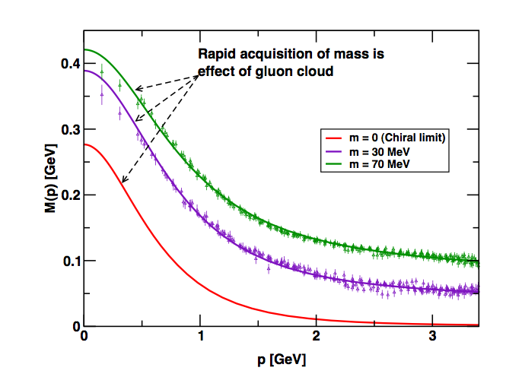
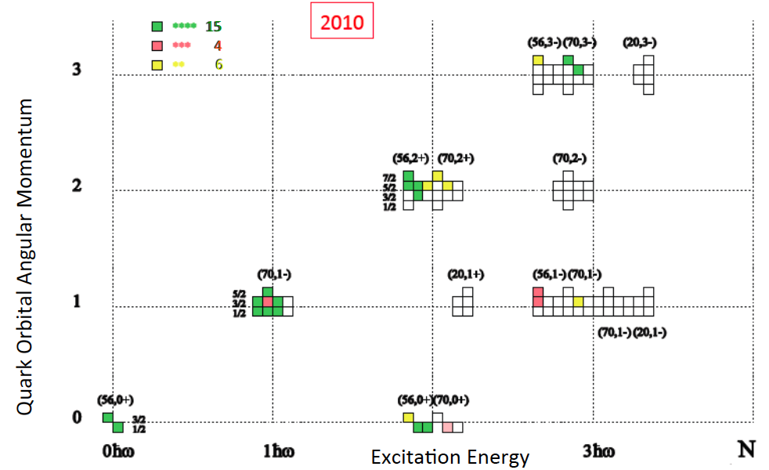
Constituent quark models and SU(6)xO(3)
Courtesy: D. Menze
numerical simulations
of unquenched lattice QCD
(Bowman et al.)
SU(6)xO(3)
Dyson-Swinger equation
(Bhagwat et al.)
Missing Baryons
Current-quarks of perturbative QCD evolve into constituent quarks at low momentum.
Connection between constituent and current quarks.
QCD-inspired Constituent Quark models: states classified by isospin, parity and spin within each oscillator band. Many projected q³ states are still missing or uncertain.

Slide 5
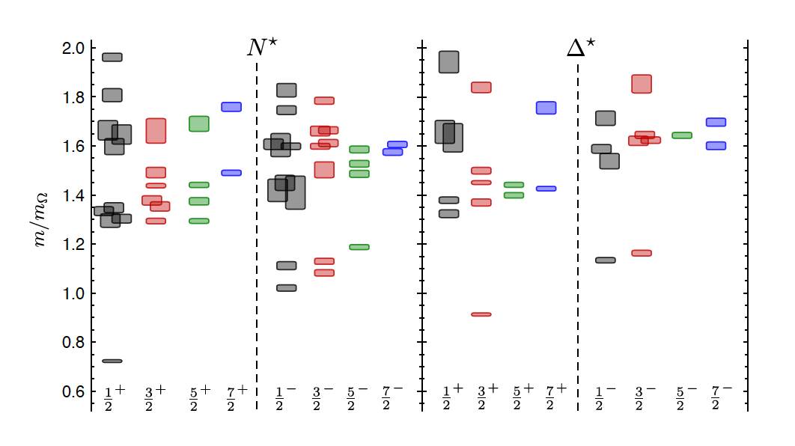
LQCD N* & Δ Spectra
Exhibit the SU(6)×O(3)-symmetry features
Counting of levels consistent with non-rel. quark model
Striking similarity with quark model
No parity doubling
4
5
3
1
2
3
2
1
1
1
2
2
1
Δ(1232)
N(938)
Problems are not solved!
Robert G. Edwards, Jozef J. Dudek, David G. Richards, Stephen J. Wallace
Phys.Rev. D84 (2011) 074508

Slide 6
What Do We Want to Learn ?
Understand the effective degrees of freedom underlying the N* spectrum and the forces.
Baryon-meson
system
A vigorous experimental program is worldwide underway with the aim to:
search for undiscovered states in meson photoproduction at CLAS, CBELSA, GRAAL, MAMI, LEPS
confirm or dismiss weaker candidates (*, **, ***)
characterize the N* and Δ spectrum systematics.
Measure the strength of resonance excitations versus distance scale in meson electro-production at JLab, to reveal the underlying degrees of freedom in the Q² evolution of the transition amplitudes.

Slide 7
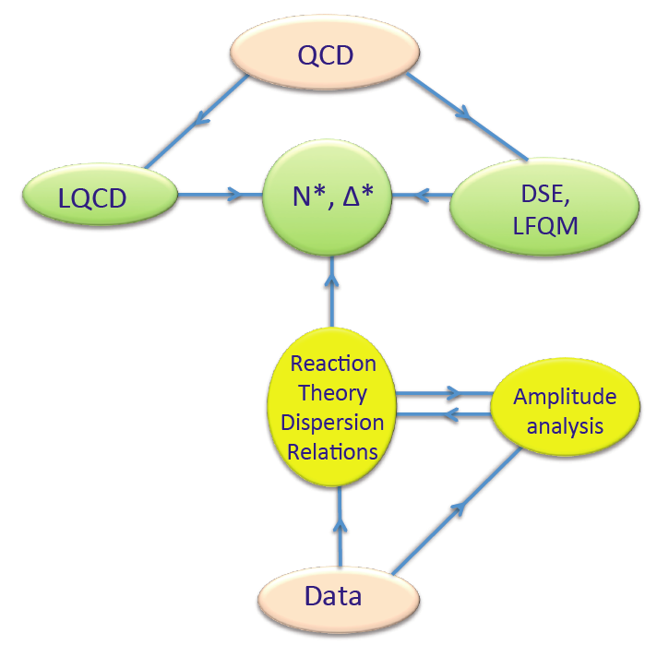
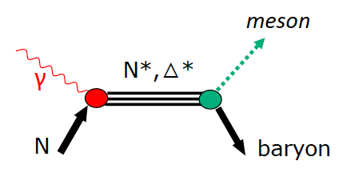
Establishing the N* and Δ Spectrum
Experimental requirements:
Precision measurements of photo-induced processes in wide kinematics, e.g.
γp→πN, ηp, KY, .., γn→πN, K⁰Y⁰, ..
More complex reactions, e.g. γp → ωp, pφ, ππp, ηπN, K*Y, .. may be sensitive to high mass states through direct transition to ground state or through cascade decays
Polarization observables are essential
Engaging theoretical groups
Extract s-channel resonances
Hadronic
production
Electromagnetic
production
&

Slide 8
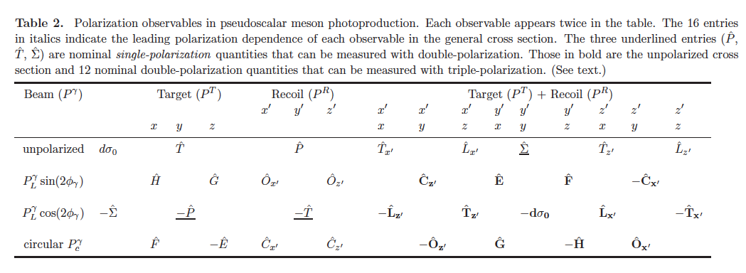
Polarization Observables: Complete Experiment
The holy grail of baryon resonance analysis
Process described by 4 complex, parity conserving amplitudes
8 well-chosen measurements are needed to determine amplitude.
Up to 16 observables measured directly
3 inferred from double polarization observables
13 inferred from triple polarization observables
Λ weak decay has large analyzing power
A. Sandorfi, S. Hoblit, H. Kamano, T.-S.H. Lee, J.Phys. 38 (2011) 053001

Slide 9
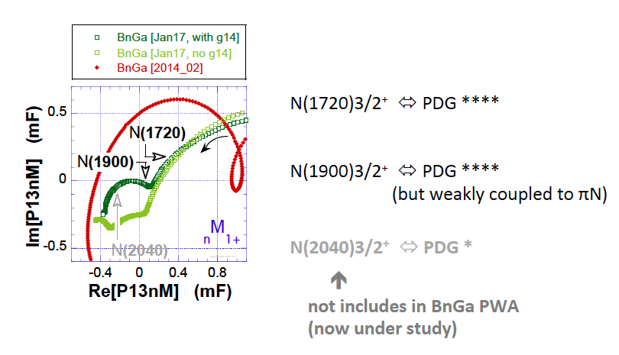
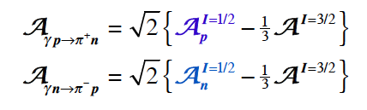

Establishing the N* and Δ Spectrum
Beam-Target Helicity Asymmetry E for
γ + n π⁻ + p
Nπ,ΚΛ, Nππ
γNN*
Proton data determine
neutron data are necessary to identify I=1/2 amplitudes
Phys. Rev Lett. 118, 242002 (2017)

Slide 10
Evidence for New N* in KY Final State
State N(mass)J^{P} | PDG pre 2010 | PDG 2016 | KΛ | KΣ | Nγ
N(1710)1/2⁺ | *** | **** | **** | ** | ****
N(1880)1/2⁺ |  | ** | ** |  | **
N(1895)1/2⁻ |  | ** | ** | * | **
N(1900)3/2⁺ | ** | *** | *** | ** | ***
N(1875)3/2⁻ |  | *** | *** | ** | ***
N(2150)3/2⁻ |  | ** | ** |  | **
N(2000)5/2⁺ | * | ** | ** | * | **
N(2060)5/2⁻ |  | ** |  | ** | **
Naming scheme has changed:
L _{2I} _{2J} (E) J^{P}(E)
Naïve quark-di-quark models are ruled out
Study these states in electroproduction and extend to higher masses
Notes:
This slides shows a summary of the results in this analysis. The green column shows the rating by the PDG. The two columns show the importance of the strangeness channel in this results.

Slide 11
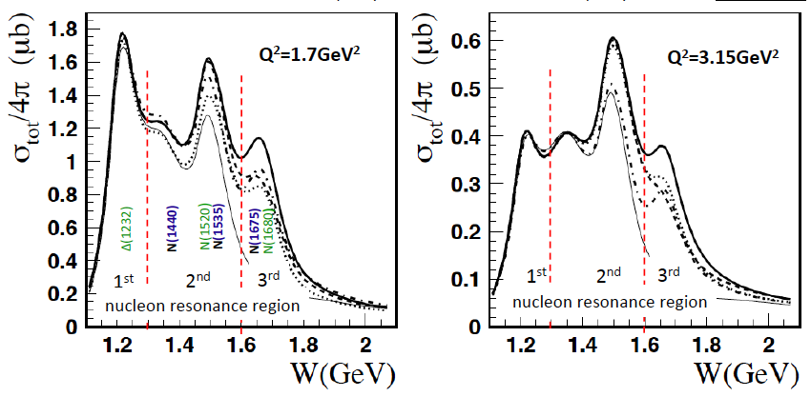
Total cross section at W < 2.1 GeV
γ* + p π⁺ + n
Data: K. Park et al. PRC 77 (2008) 015208; K. Park et al. PRC 91 (2015) 045203
Analysis with UIM & fixed-t DR; Recent review: I. Aznauryan, V. Burkert, Prog. Part. Nucl. Phys. 67 (2012) 1.

Slide 12
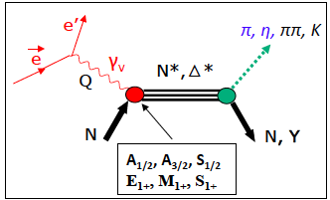
Electroexcitation of N*/Δ resonances
Central question in hadron physics:
what are the relevant degrees of freedom at varying distance scale?
[56,2⁺]
2
N(1680)5/2⁺
N(1720)3/2⁺
Probe resonance strength vs photon virtuality Q
L_{3q}
[70,1⁻]
N(1675)5/2⁻
N(1520)3/2⁻
N(1535)1/2⁻
1
[56,0⁺]
0
Δ(1232)3/2⁺
N(940)
N(1710)1/2⁺
N(1440)1/2⁺
[70,0⁺]
0
1
N [ħω]
2

Slide 13
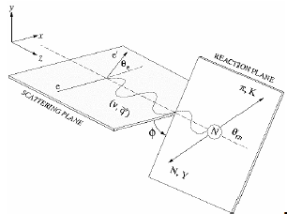
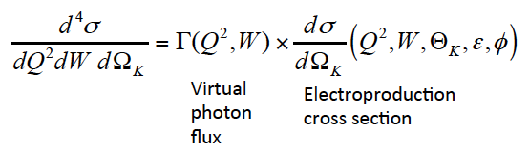
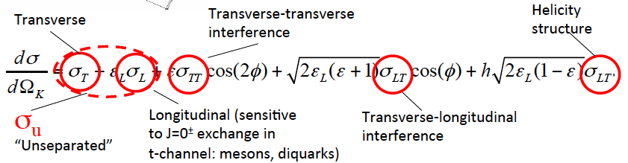
Electroexcitation kinematics
Measured σ are decomposed using UIM or fixed-t DR to extract N* & Δ helicity amplitudes.

Slide 14
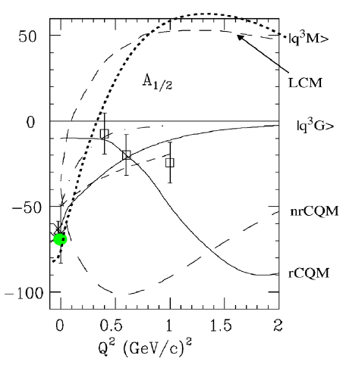
Electrocouplings of the ‘Roper’ in 2002
N(1440)1/2⁺
In 2002 Roper amplitude A_{1/2} measurements were more consistent with hybrid state
but data were limited with large uncertainties.
Lowest mass hybrid baryon should be J^{P} =1/2⁺ (same as Roper)

Slide 15
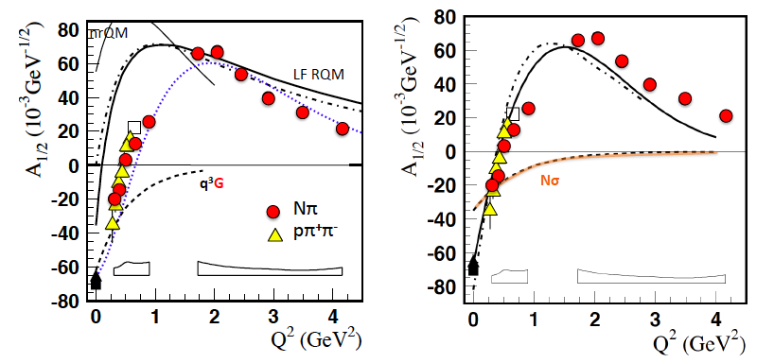
Electrocouplings of the ‘Roper’ in 2012
I. Aznauryan et al. (CLAS), PRC 80, 055203 (2009)
V. Mokeev et al. (CLAS), PRC 86, 035203 (2012)
N(1440)1/2⁺
L. Tiator et al., Chin Phys C33, (2009) 1069 (MAID fit)
I. Aznauryan et a.l. PRC 76, (2007) 025212
Z.P. Li et al. PRD 46, (1992) 70
I. T. Obukhovsky et a.l. PRD 84, (2011) 014004

Slide 16
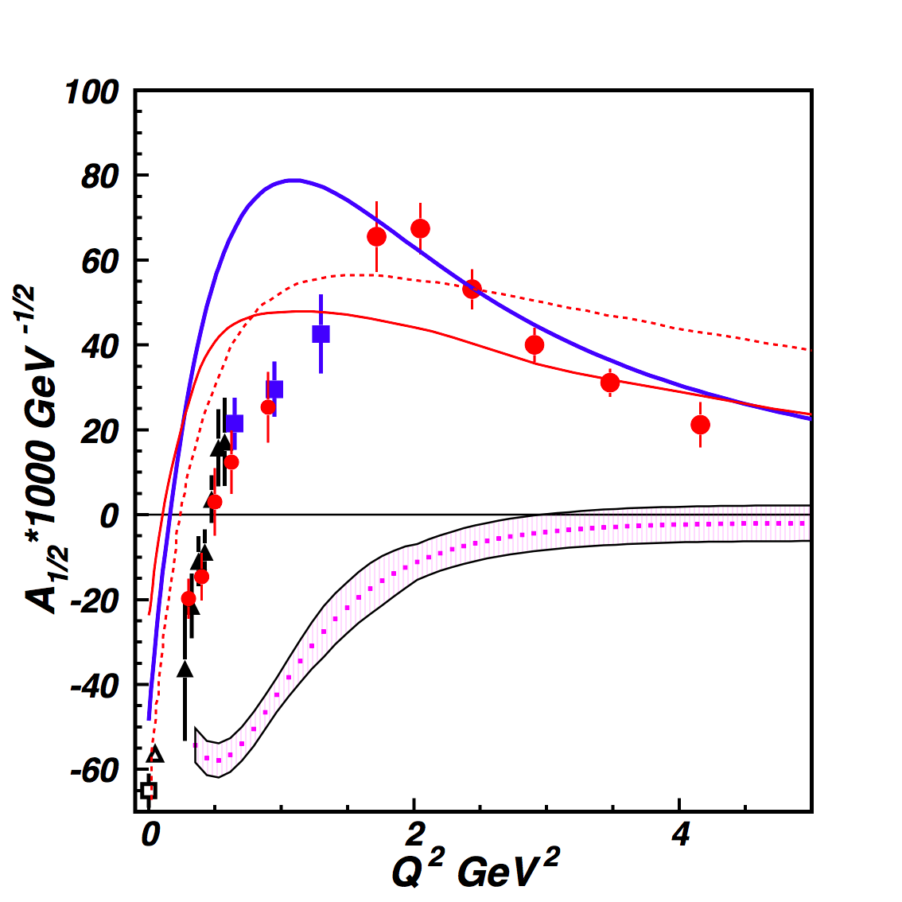
Electrocouplings of the ‘Roper’ in 2016
Nπ loops to model MB cloud: running quark mass in LF RQM.
I. G. Aznauryan, V.D. Burkert PR C 85 (2012) 055202.
Nσ loops to model MB cloud in LF RQM: frozen constituent quark mass in LF RQM .
I. T. Obukhovsky et al. PRD 89, (2014) 0140032.
Quark-core contributions from DSE/QCD
J. Segovia et al. PRL 115 (2015) 171801.
Meson Baryon cloud inferred from CLAS data as the difference between data and the quark-core evaluation in DSE/QCD.
V. Mokeev et al., PR C 93 (2016) 025206.
N(1440)1/2⁺

Slide 17
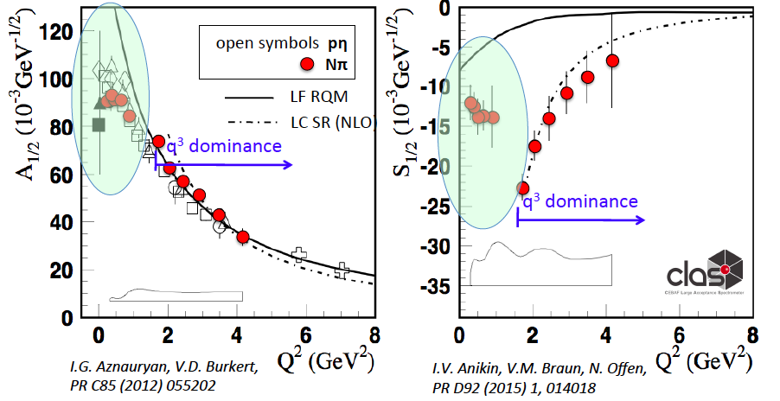
MB Contribution to electro-excitation of N(1535)1/2⁻
Meson-baryon cloud may account for discrepancies at low Q².

Slide 18
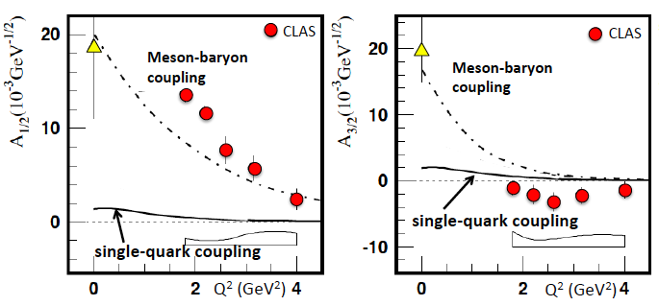
MB Contribution to electro-excitation of N(1675)5/2⁻
Measures the meson-baryon contribution to the γ* p N(1675)5/2⁻ directly.
Can be verified on γ* n N(1675)5/2⁻ which is not suppressed

Slide 19
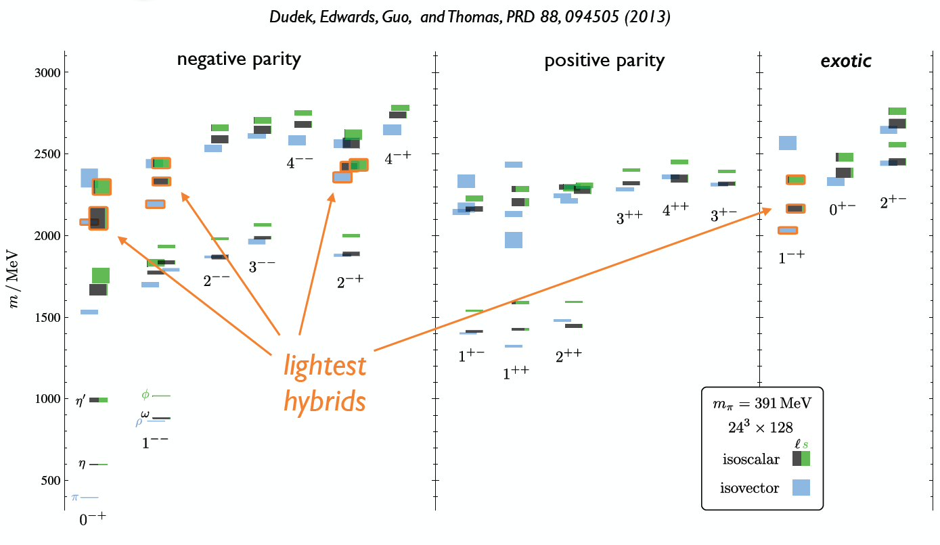
Hybrid Hadrons: Hadrons with Explicit Gluonic Degrees of Freedom
Hybrid hadrons with dominant gluonic contributions are predicted to exist by QCD.
Hybrid mesons

Slide 20
Hybrid Baryons: Baryons with Explicit Gluonic Degrees of Freedom
Hybrid hadrons with dominant gluonic contributions are predicted to exist by QCD.
Experimentally:
Hybrid mesons |qqg> states may have exotic quantum numbers J^{PC} not available to pure |qq> states 0⁺⁻ , 1⁻⁺, 2⁺⁻, ….GlueX, MesonEx, COMPASS, PANDA ….
Hybrid baryons |qqqg> have the same quantum numbers J^{P} as |qqq>
electroproduction with CLAS12 (Hall B).
Theoretical predictions:
        MIT bag model - T. Barnes and F. Close, Phys. Lett. 123B, 89 (1983).
        QCD Sum Rule - L. Kisslinger and Z. Li, Phys. Rev. D 51, R5986 (1995).
        Flux Tube model - S. Capstick and P. R. Page, Phys. Rev. C 66, 065204 (2002).
        LQCD - J.J. Dudek and R.G. Edwards, PRD85, 054016 (2012).

Slide 21
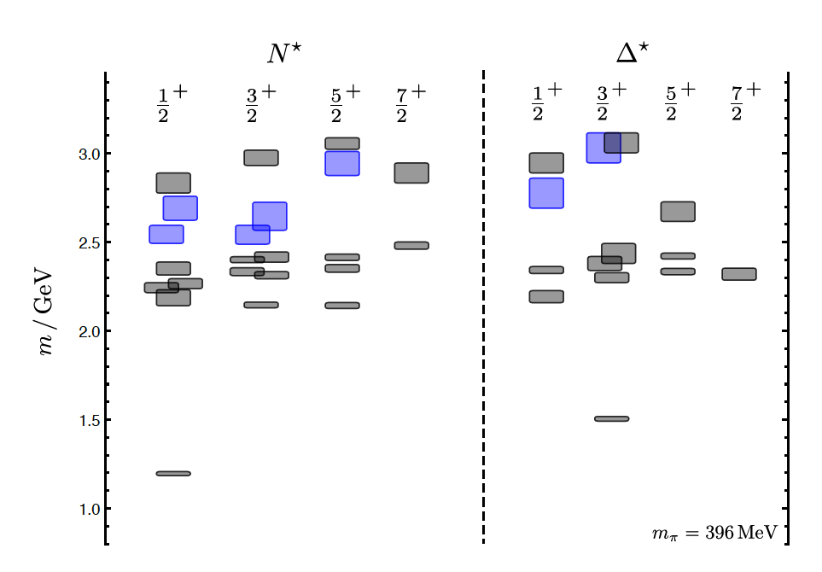
Hybrid Baryons in LQCD
J.J. Dudek and R.G. Edwards, PRD85, 054016 (2012)
regular states
clustered
in mass
hybrid states
LQCD
1.3GeV
The nucleon mass is shifted ~300 MeV to higher masses
N
Hybrid states have same J^{P} values as qqq baryons. How to identify them?
Overpopulation of N 1/2⁺ and N 3/2⁺ states compared to QM projections. ?
A_{1/2} (A_{3/2}) and S_{1/2} show different Q² evolution. Can we do it?

Slide 22
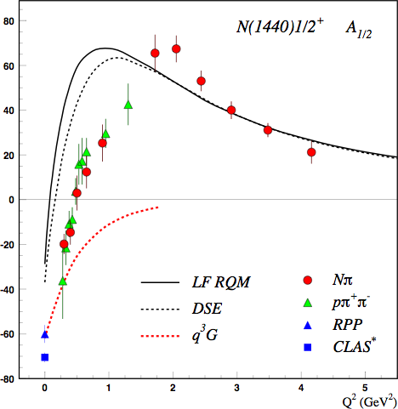
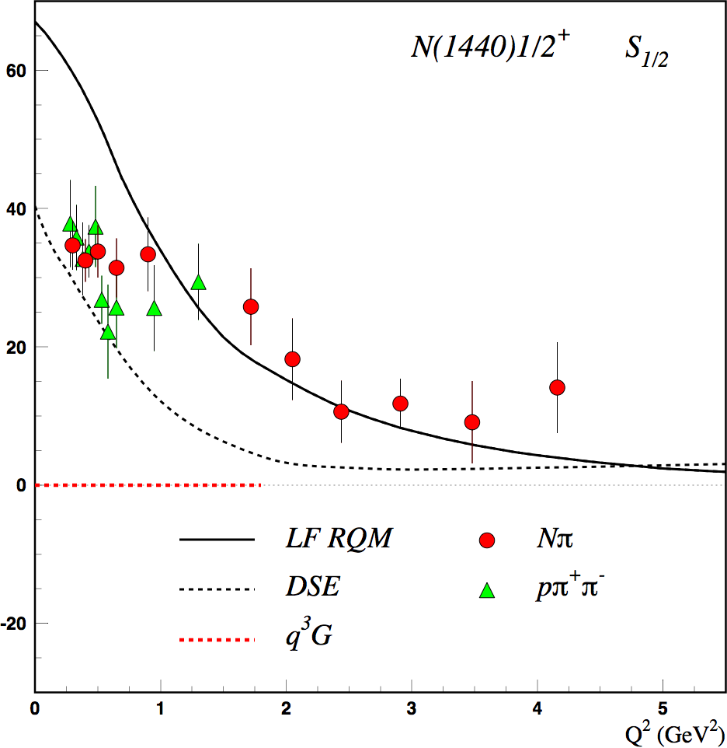
Separating q³g from q³ States?
Precise CLAS results on electrocouplings clarified nature of the Roper
q³
q³
q³g
q³g
q³
A_{1/2} and S_{1/2} amplitudes at high Q² indicate 1st radial q³ excitation
Significant meson-baryon coupling at small Q²
For hybrid “Roper”, A_{1/2}(Q²) drops off faster with Q² and S_{1/2}(Q²) ~ 0.

Slide 23
Hybrid Baryon Signatures
Based on available knowledge, the signatures for hybrid baryons consist of:
• Extra resonances with J^{p}=1/2⁺ and J^{p}=3/2⁺, with masses > 1.8 GeV and decays into Nππ or KY final states.
•A drop of the transverse helicity amplitudes A_{1/2}(Q²) and A_{3/2}(Q²) faster than for ordinary three quark states, because of extra glue-component in valence structure.
•A suppressed longitudinal amplitude S_{1/2}(Q²) in comparison with transverse electro-excitation amplitude (J^{P}=1/2⁺).
We focused on:
e p e p π⁺ π⁻
e p e K⁺Λ, e K⁺Σ⁰
The study will include other single meson channels.

Slide 24

Equipment
CLAS12
Hall B
Forward Detector (FD)
  - TORUS magnet
  HT Cherenkov Counter
  Drift chamber system
  LT Cherenkov Counter
  Forward TOF System
  Pre-shower calorimeter
  E.M. calorimeter
Central Detector (CD)
  SOLENOID magnet
  Silicon Vertex Tracker
  Central Time-of-Flight
Beamline
  Cryo Target
  Moller polarimeter
  - Shielding
  Photon Tagger
Upgrade to the baseline
- Central Neutron Detector
  MicroMegas
  Forward Tagger
  RICH detector
  Polarized target
MM
CND
FT
RICH

Slide 25
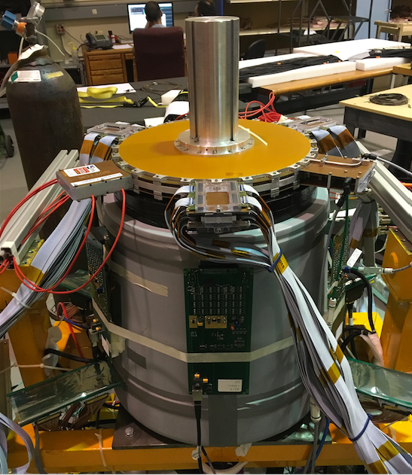
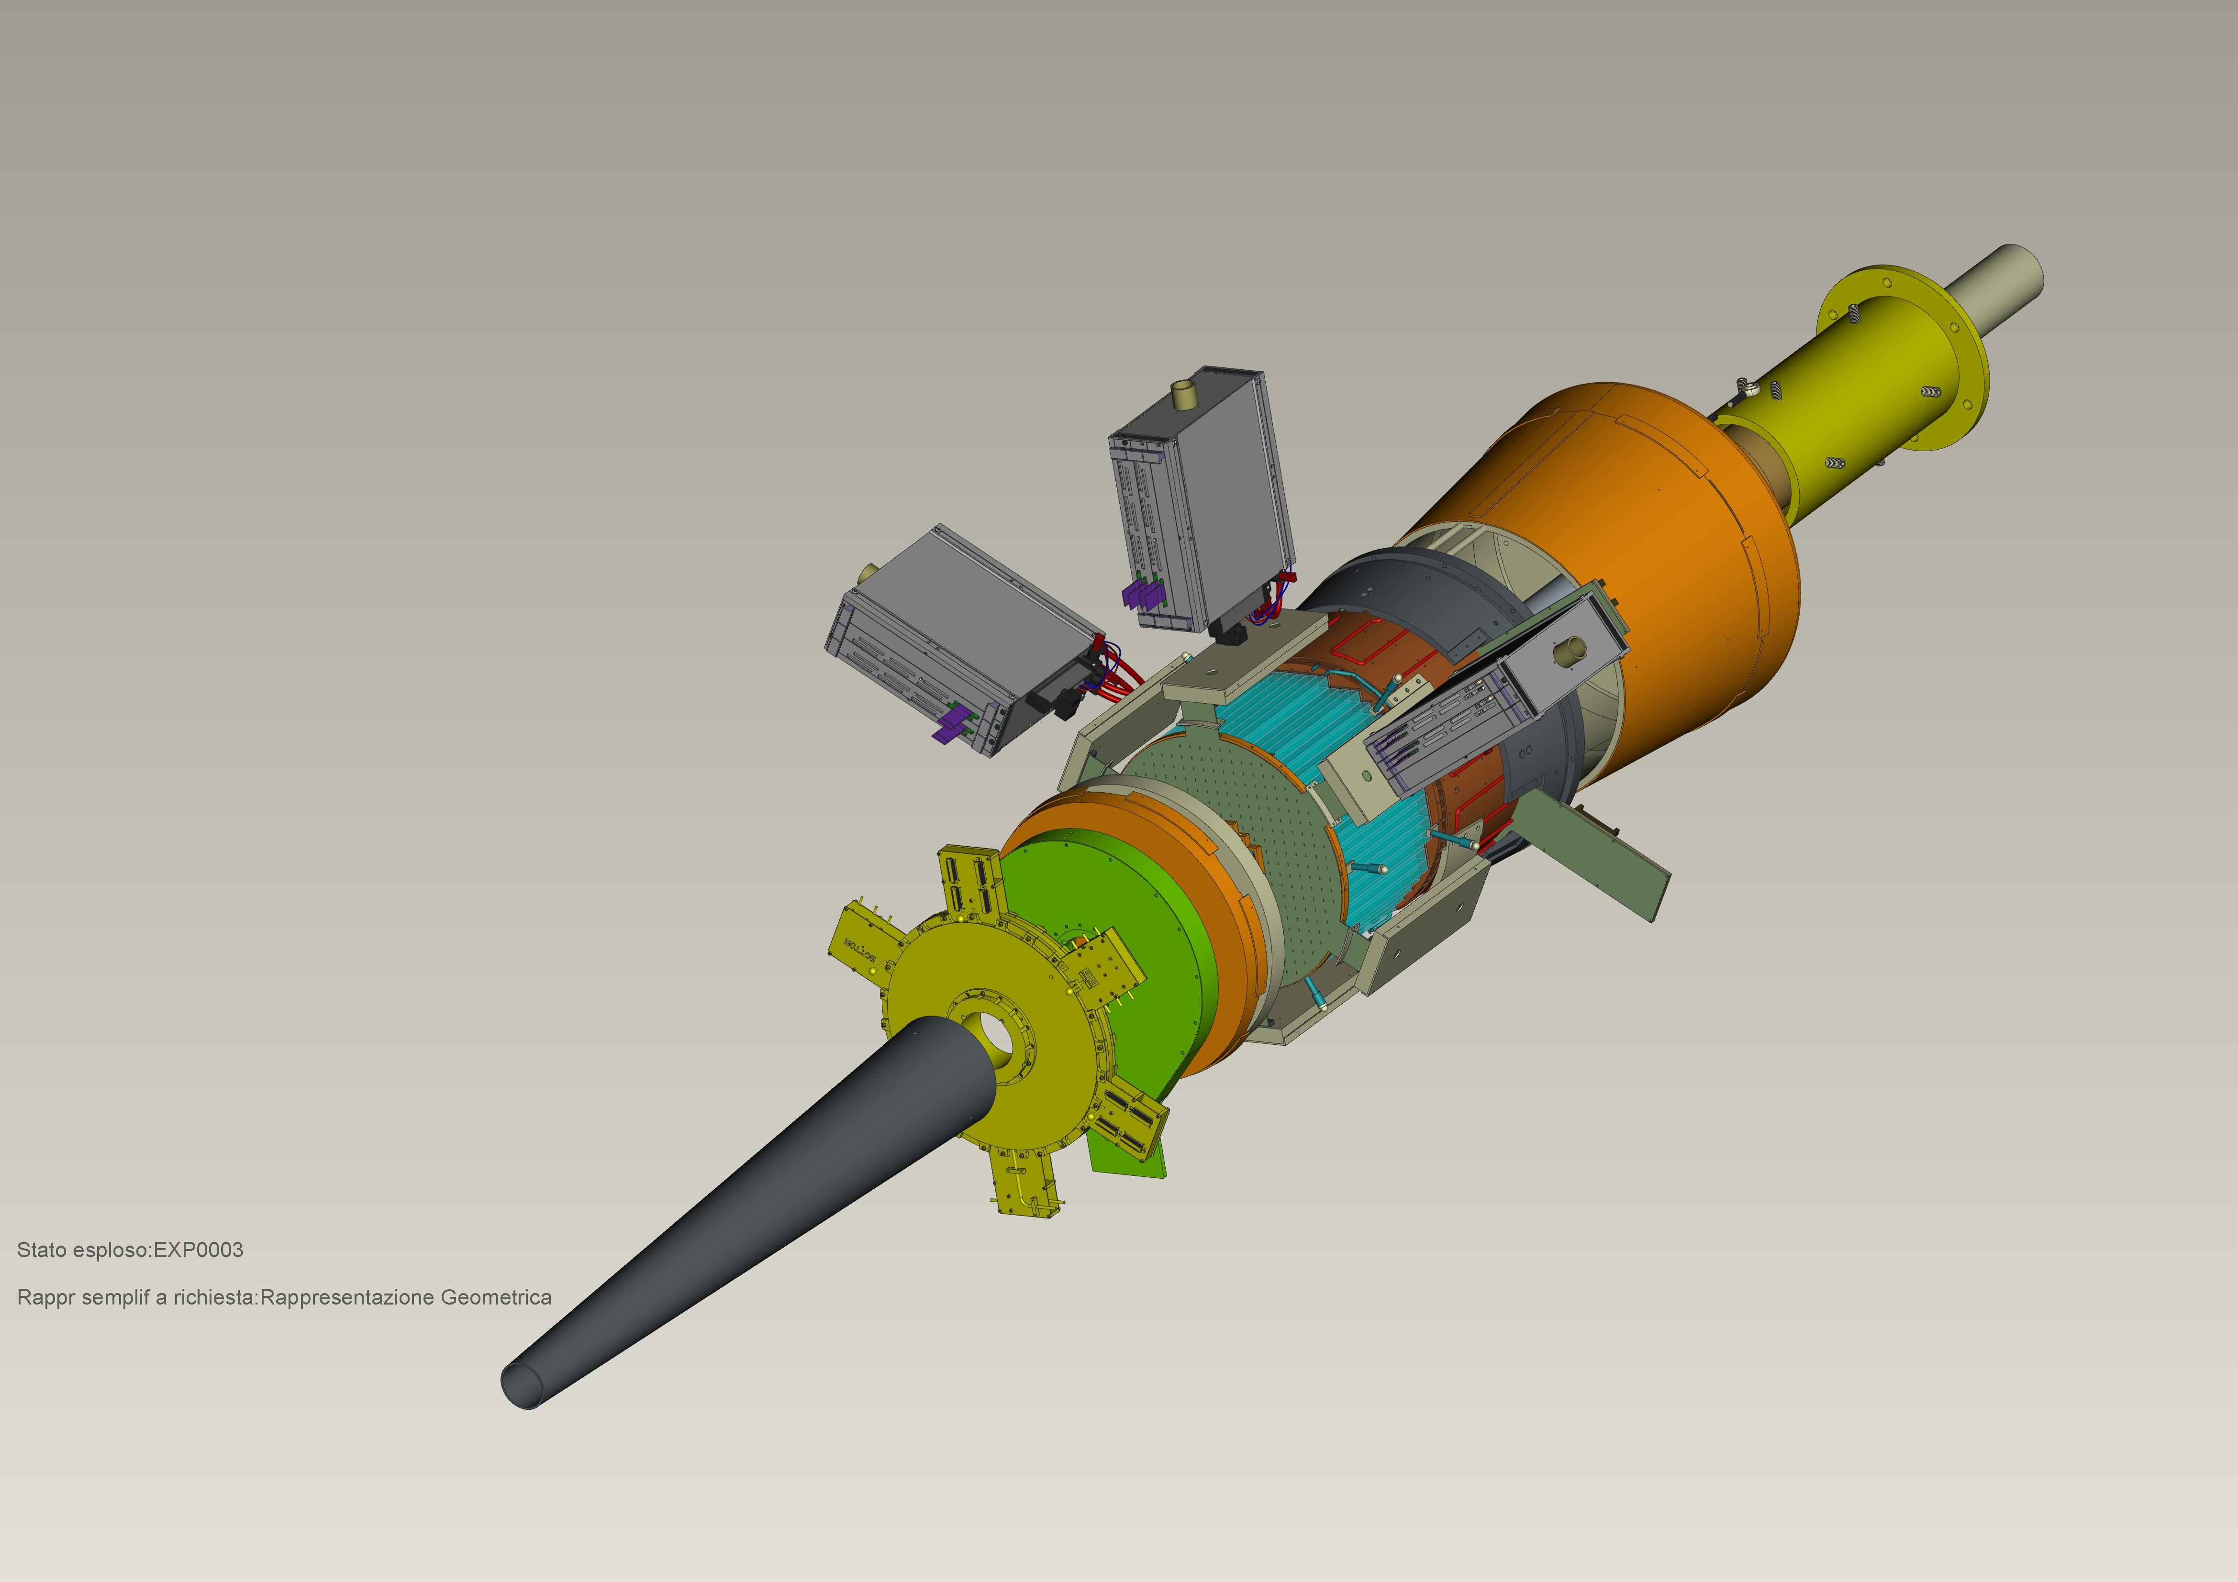
Forward Tagger
CLAS12
Hall B
FT designed to detect electrons and photons at small angles
FT-Cal: calorimeter to measure electron energy/momentum
  FT-Hodo: scintillation hodoscope to veto photons & backsplash
FT-Trk: micro-mega detector to measure electron angles, polarization plane
calorimeter
tracker
hodoscope

Slide 26
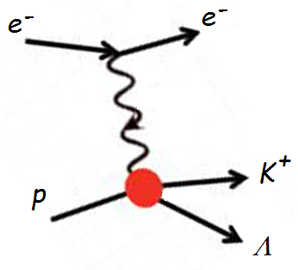
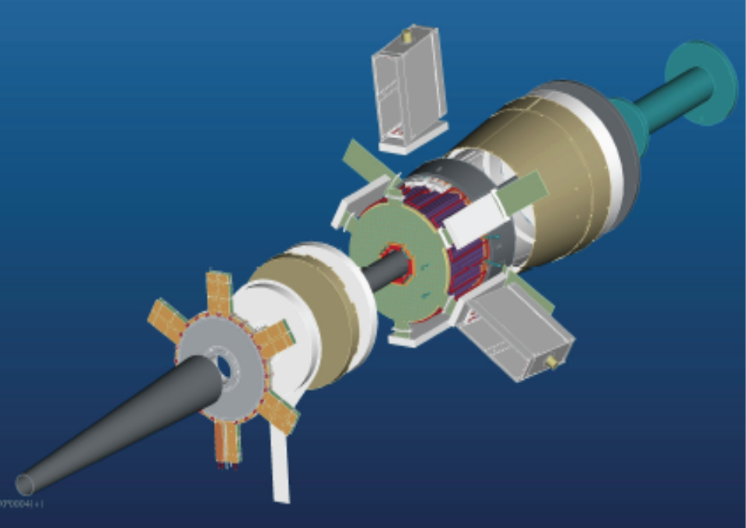
The Experiment
ϑ > 6°
ϑ > 6°
CLAS12
p
π⁺
π⁻
Scattered electrons will be detected:
in the Forward Tagger for angles from 2.5° to 4.5°
in the Forward Detector of CLAS12 for scattering angles greater than about 6°
Charged hadrons will be measured in the full range from 6° to 130°
FT allows to probe the crucial Q² range where hybrid baryons may be identified due to their fast dropping A_{1/2}(Q²) amplitude and the suppression of the scalar S_{1/2}(Q²) amplitude.
W < 3 GeV Q² range of interest: 0.05 - 2 GeV²

Slide 27
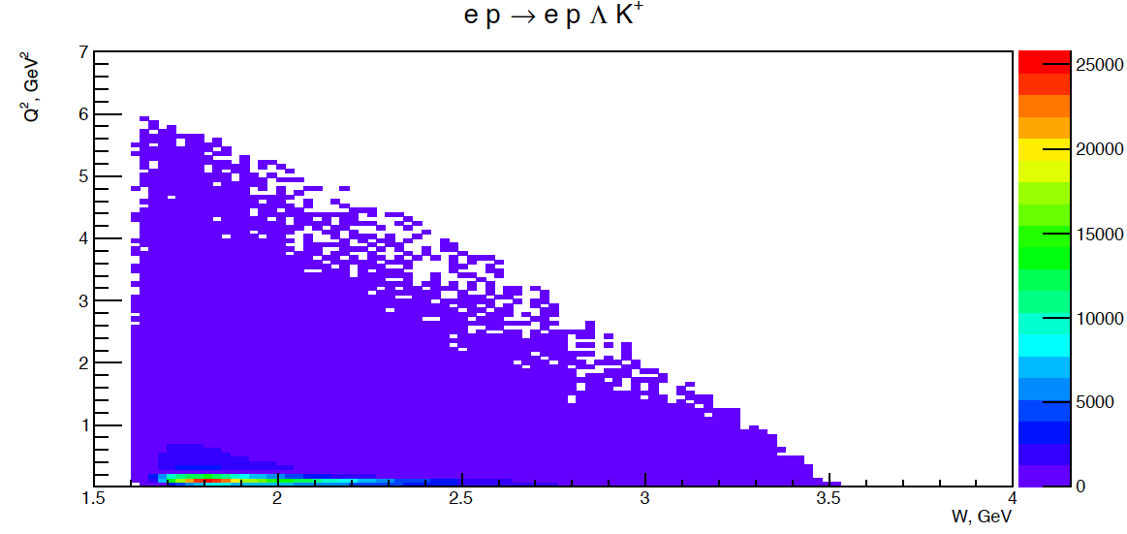
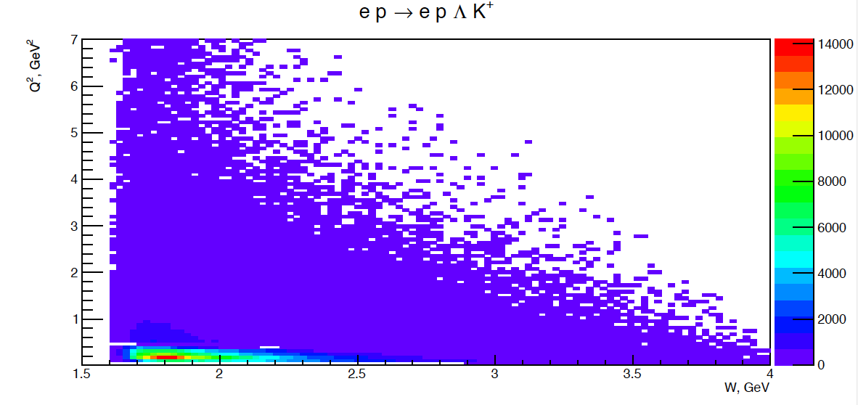
Kinematical Coverage: Full Q² Range
Q² vs W
ep e K⁺Λ
e p e K⁺Λ
Ee =6.6 GeV
I = - 3375 A
Ee =6.6 GeV
I = - 3375 A
Ee =6.6 GeV
I = - 3375 A
Q² ≥ 0.05 GeV²
ep e K⁺Λ
Q² as low as 0.05 GeV² may be reached
e p e K⁺Λ
Ee =8.8 GeV
I = - 3375 A
Ee =8.8 GeV
I = - 3375 A
Ee =8.8 GeV
I = - 3375 A
Complementary Q² ranges using different E_{e}
Ee = 8.8 GeV provides enough statistics for 2.5 < W < 3 GeV

Slide 28
Quasi – Data Analysis
A hypothetical hybrid baryon contribution added at the amplitude level to the best presently available model RPR-2011:
M_{R} = 2.2 GeV Γ_{R}=0.25 GeV J^{P} = 1/2 ⁺ (J^{P} = 3/2 ⁺)
The reaction cross section has been calculated with and without the hybrid baryon resonance contribution to determine:
Minimum beam time needed to obtain statistical uncertainty for cross sections comparable with CLAS photoproduction data.
      100 days of beam time (50 days at 6.6 GeV & 50 days at 8.8 GeV)
The Legendre moments of the unseparated and polarization interference components of the cross section.
    Search for distinctive structures due to the added resonance.
The statistical sensitivity to hybrid baryons electrocouplings.
      Minimum electrocoupling values with 100 days of beam time.
The capability of extracting the added resonance parameters from expected data.
      Blind analysis of quasi-data.

Slide 29
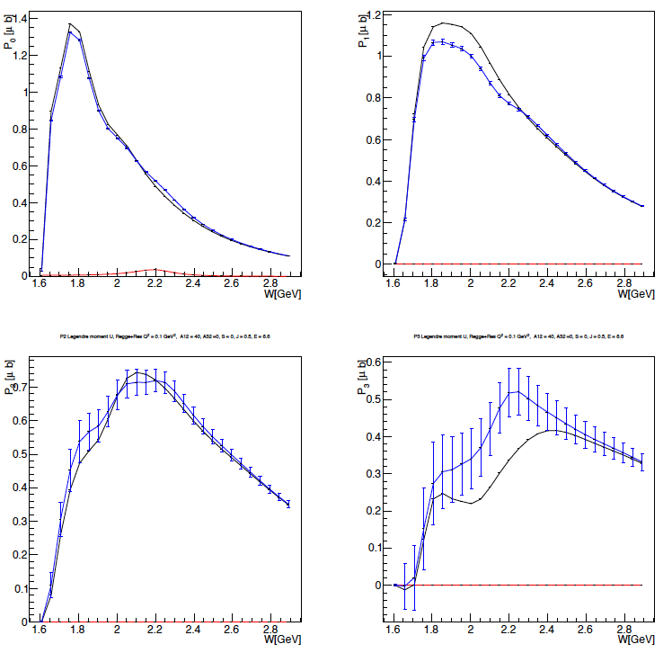
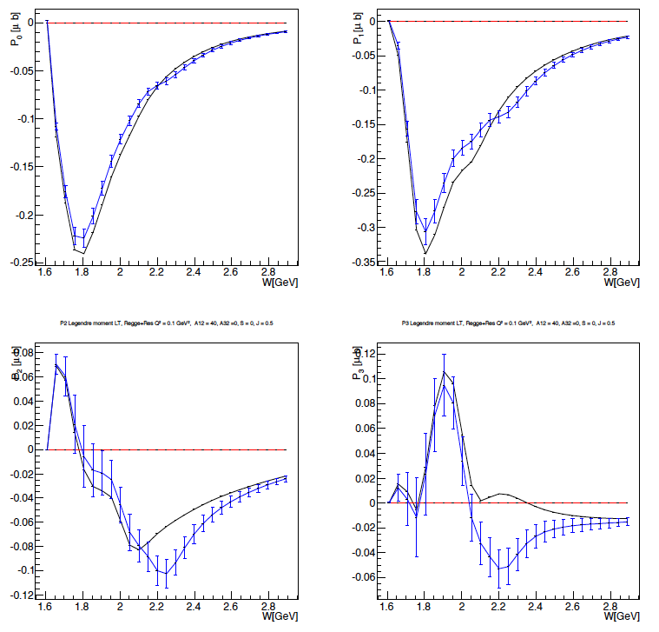
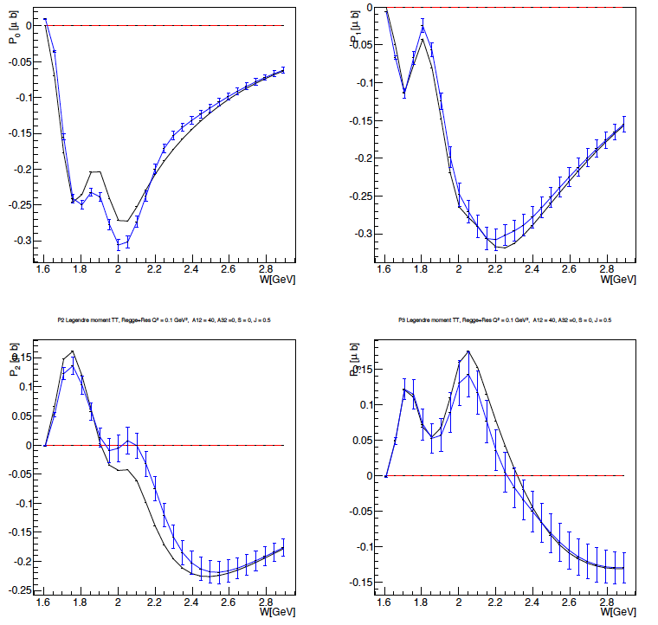
Extraction of Legendre Moments
e p e K⁺Λ
First Legendre Moments
Black curves RPR 2011 model
Blue points RPR 2011 + Resonance
σ_{U}
σ_{LT}
σ_{TT}
P1
P1
P0
P1
P0
P0
P3
P3
P2
P3
P2
P2
J = ½ Regge + Res. Q² = 1 GeV² M_{res} = 2.2 GeV A_{1/2} = 0.04 GeV^{-1/2} S_{1/2} = 0
Significant structures appear in most of the Legendre moments at the value of
W = 2.2 GeV, corresponding to the mass of the added hybrid baryon

Slide 30
Blind Extraction: J^{P}=1/2⁺ + J^{P}=3/2⁺
Two hybrid baryon resonances with J^{p} = 1/2⁺ and J^{p} = 3/2⁺ were inserted in the ep e K⁺Λ Gent RPR2011 reaction amplitude and quasi-data were generated dσ_{q.d.}
A blind analysis has been then attempted trying to extract the resonances J^{P} spin-parities and
7 unknown parameters: M_{res}¹ Γ_{res}¹ A_{1/2}¹
M_{res}² Γ_{res}² A_{1/2}² A_{3/2}²
Searching the minimum of the quantity:
dσ_{th} were calculated using the Gent RPR2011 amplitudes including two resonances
J^{p} = 1/2⁺ and J^{p} = 3/2⁺, whose parameters values were scanned in the range:
2.0 < W < 2.5 GeV -0.05 < A_{1/2}< +0.05 GeV^{-1/2}
0.1 < Γ < 0.4 GeV -0.05 < A_{3/2} < +0.05 GeV^{-1/2}
at a fixed Q² = 0.5 GeV²
S_{1/2} = 0

Slide 31
Blind Extraction: J^{P}=1/2⁺ + J^{P}=3/2⁺
Two hybrid baryon resonances with J^{p} = 1/2⁺ and J^{p} = 3/2⁺ were inserted in the ep e K⁺Λ Gent RPR2011 reaction amplitude and quasi-data were generated dσ_{q.d.}
A blind analysis has been then attempted trying to extract the resonances J^{P} spin-parities and
7 unknown parameters: M_{res}¹ Γ_{res}¹ A_{1/2}¹
M_{res}² Γ_{res}² A_{1/2}² A_{3/2}²
Iterative procedure:
The algorithm calculates the χ² value over a 7-dim parameters coarse grid, covering the full range
The combination of parameters corresponding to the minimum χ² value is found
χ² value is calculated over a finer 7-dim parameters grid, around the minimum
The procedure is repeated three times.

Slide 32
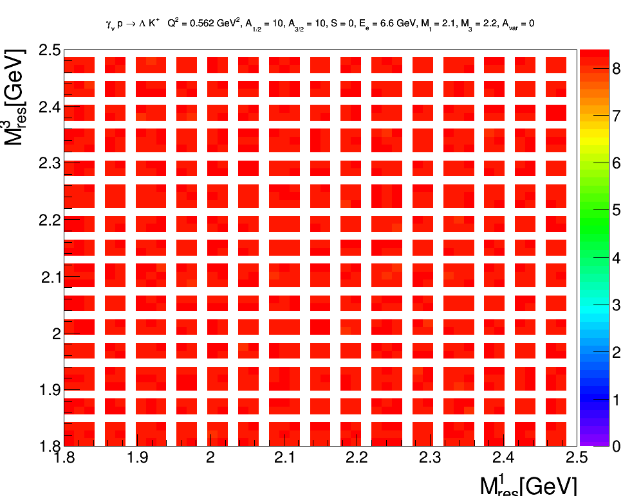
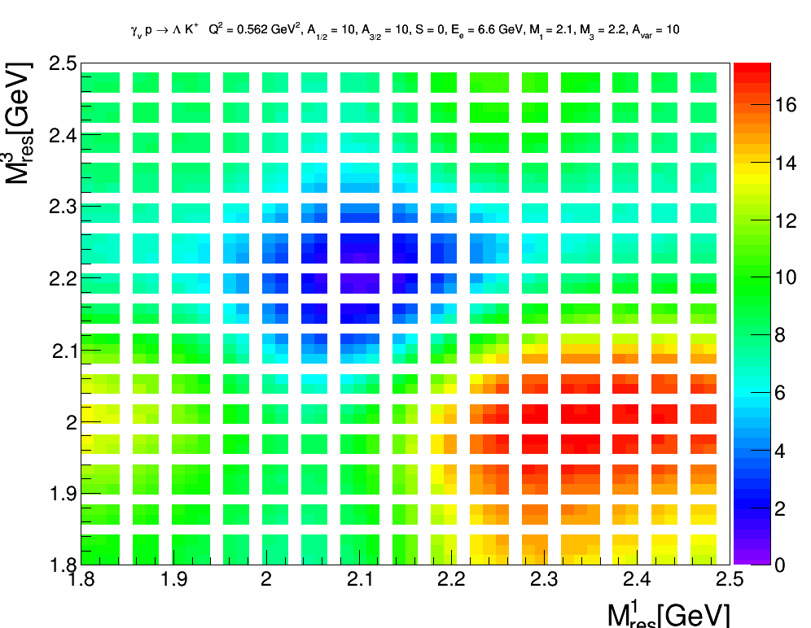
Blind Extraction: J^{P}=1/2⁺ + J^{P}=3/2⁺
Two hybrid baryon resonances with J^{p} = 1/2⁺ and J^{p} = 3/2⁺ were inserted in the ep e K⁺Λ Gent RPR2011 reaction amplitude and quasi-data were generated dσ_{q.d.}
Typical 3-dim map of χ² as a function of the two resonance masses, evolving in time for increasing A_{1/2} (A_{3/2}) strength.
χ ² minimum

Slide 33
Blind Extraction: J^{P}=1/2⁺ + J^{P}=3/2⁺
Two hybrid baryon resonances with J^{p} = 1/2⁺ and J^{p} = 3/2⁺ were inserted in the ep e K⁺Λ Gent RPR2011 reaction amplitude and quasi-data were generated dσ_{q.d.}
A blind analysis has been then attempted trying to extract the resonances J^{P} spin-parities and
7 unknown parameters: M_{res}¹ Γ_{res}¹ A_{1/2}¹
M_{res}² Γ_{res}² A_{1/2}² A_{3/2}²
Hybrid Baryons parameters are well reconstructed.
Blind Resonance Parameters | Extracted Resonance Parameters
M_{res}¹ = 2.30 GeV | M_{res}¹ = 2.32 GeV
Γ_{res} ¹ = 0.30 GeV | Γ_{res} ¹ = 0.30 GeV
A_{1/2} ¹ = 0.020 GeV^{-1/2} | A_{1/2} ¹ = 0.019 GeV^{-1/2}
M_{res}² = 2.45 GeV | M_{res}² = 2.45 GeV
Γ_{res} ² = 0.35 GeV | Γ_{res} ² = 0.31 GeV
A_{1/2} ² = - 0.015 GeV^{-1/2} | A_{1/2} ² = - 0.014 GeV^{-1/2}
A_{3/2} ² = 0.04 GeV^{-1/2} | A_{3/2} ² = 0.038 GeV^{-1/2}

Slide 34
Baryon Spectroscopy Status Today
Major progress made in the last ~ 5 years in the search for N* and Δ states.
All states can be accommodated in CQM and LQCD schemes.
Naïve (non-dynamical) di-quark models are ruled out.
Knowledge of Q²-dependence of electrocouplings is absolutely necessary to understand the nature ( the internal structure) of the excited states.
Roper IS the first radial excitation of the q³ core, obscured at large distances by meson-cloud effects.
Leading electrocoupling amplitudes of prominent low-mass states (e.g. N(1535)1/2⁻ ) is well modeled by DSE/QCD, LC SR and LF RQM for Q²> 2 GeV.
Search for hybrid baryons with explicit gluonic degrees of freedom would be possible investigating the low Q² evolution of high-mass resonance (2-3 GeV) electrocoupligs:
Looking for suppressed A^{1/2}, A^{3/2}, S^{1/2} at low Q^{2.}

Slide 35
Backup Slides

Slide 36
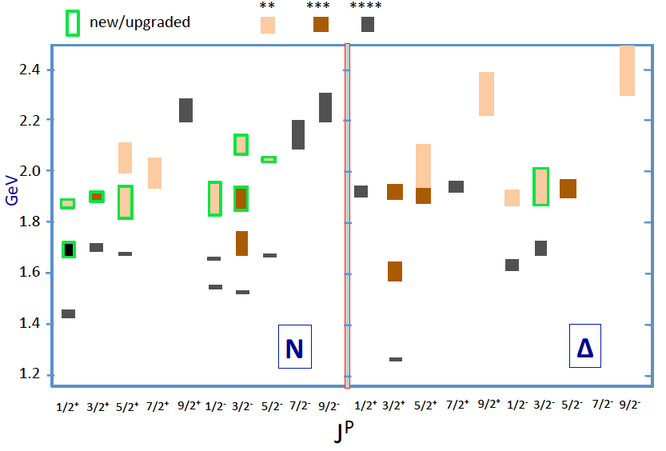
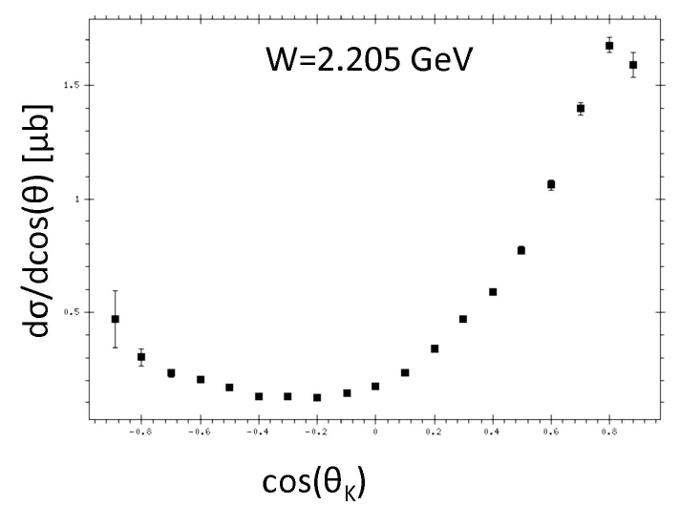
Statistics and Binning Requirements
Samples of γp -> K⁺Λ cross section used in BnGa analysis that discovered new baryon states in the W range 1.85 – 2.2 GeV mass region.
Statistical precision ranges from 2% - 7%.
ΔW=10 MeV, Δcos θ* = 0.1
Similar statistics needed to:
Separate structure functions in φ
Find new excited baryon states
Map Q² dependence of amplitudes
Total KΛ data in 50+50 days: 518.4x10⁶ events
Number of bins: 960x10³
<N> = 540 evts/bin
σ_{N}/N = 4.3%
 | Range | Bin | #bins
W (GeV) | 1.8-3.0 | 0.01 | 120
cos θ* | -1 to +1 | 0.1 | 20
φ [º] | 0 - 360 | 18 | 20
Q²(GeV²) | 0.05 - 2 | 0.02/0.1 | 5/15

Slide 37
Statistical Sensitivity of Resonance Electrocouplings
e p e p π⁺ π⁻
e p e K⁺Y
JLab - Moskow (JM) model
Regge + Resonance (RPR-2011) Gent model
Fixing the resonance parameters: M_{res} = 2.2 GeV, Γ_{res} = 0.25 GeV, S_{1/2} = 0
and varying A_{1/2, 3/2} Minimum values for hybrid baryons electrocouplings
pπ ⁺π ⁻
K⁺Λ
Q² (GeV²) | 0. | 0.65 | 1.3
A_{1/3} x 10⁻³(GeV^{-1/2}) | 22 | 20 | 11
Q² (GeV²) | J_{R} = 1/2 |  | J_{R} = 3/2
X 10⁻³ (GeV^{-1/2}) | A_{1/2} | S_{1/2} | A_{1/2} | A_{3/2} | S_{1/2}
0.1 | 9.5 | 9.5 | 13 | 8.5 | 8.5
0.5 | 14 | 16 | 15 | 15 | 10
1.0 | 13 | 19 | 14 | 14 | 7.5
To be compared with N(1440)1/2⁺
Q² (GeV²) | 0. | 0.65 | 1.3
A_{1/3} x 10⁻³(GeV^{-1/2}) | -70 | 10 | 30

