Slide 1
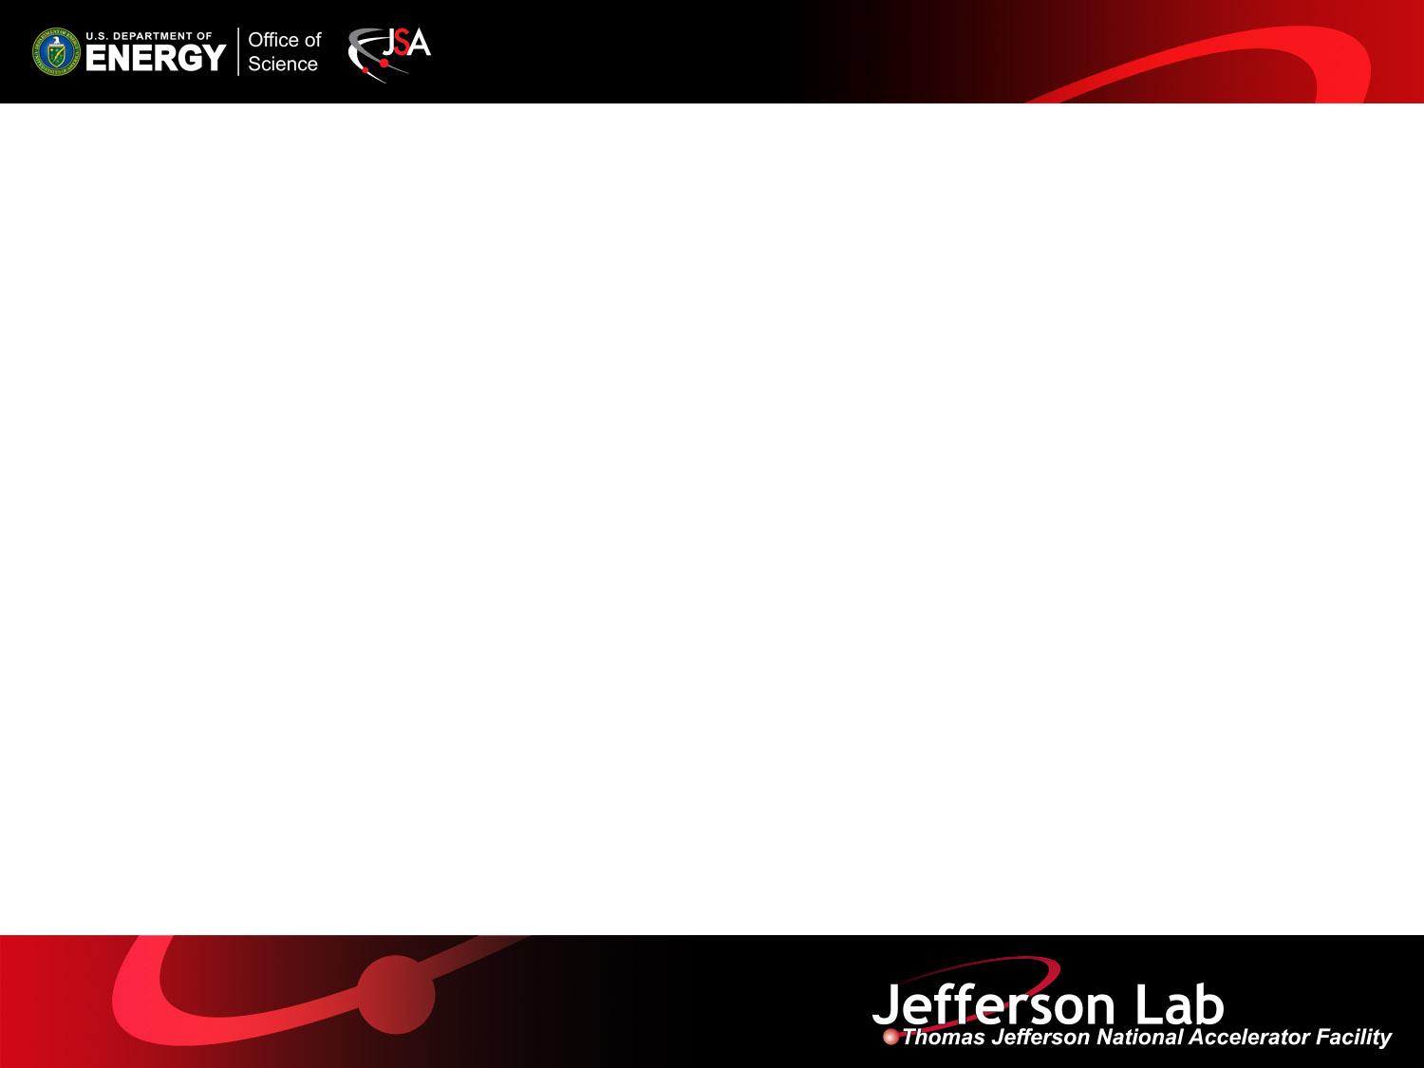
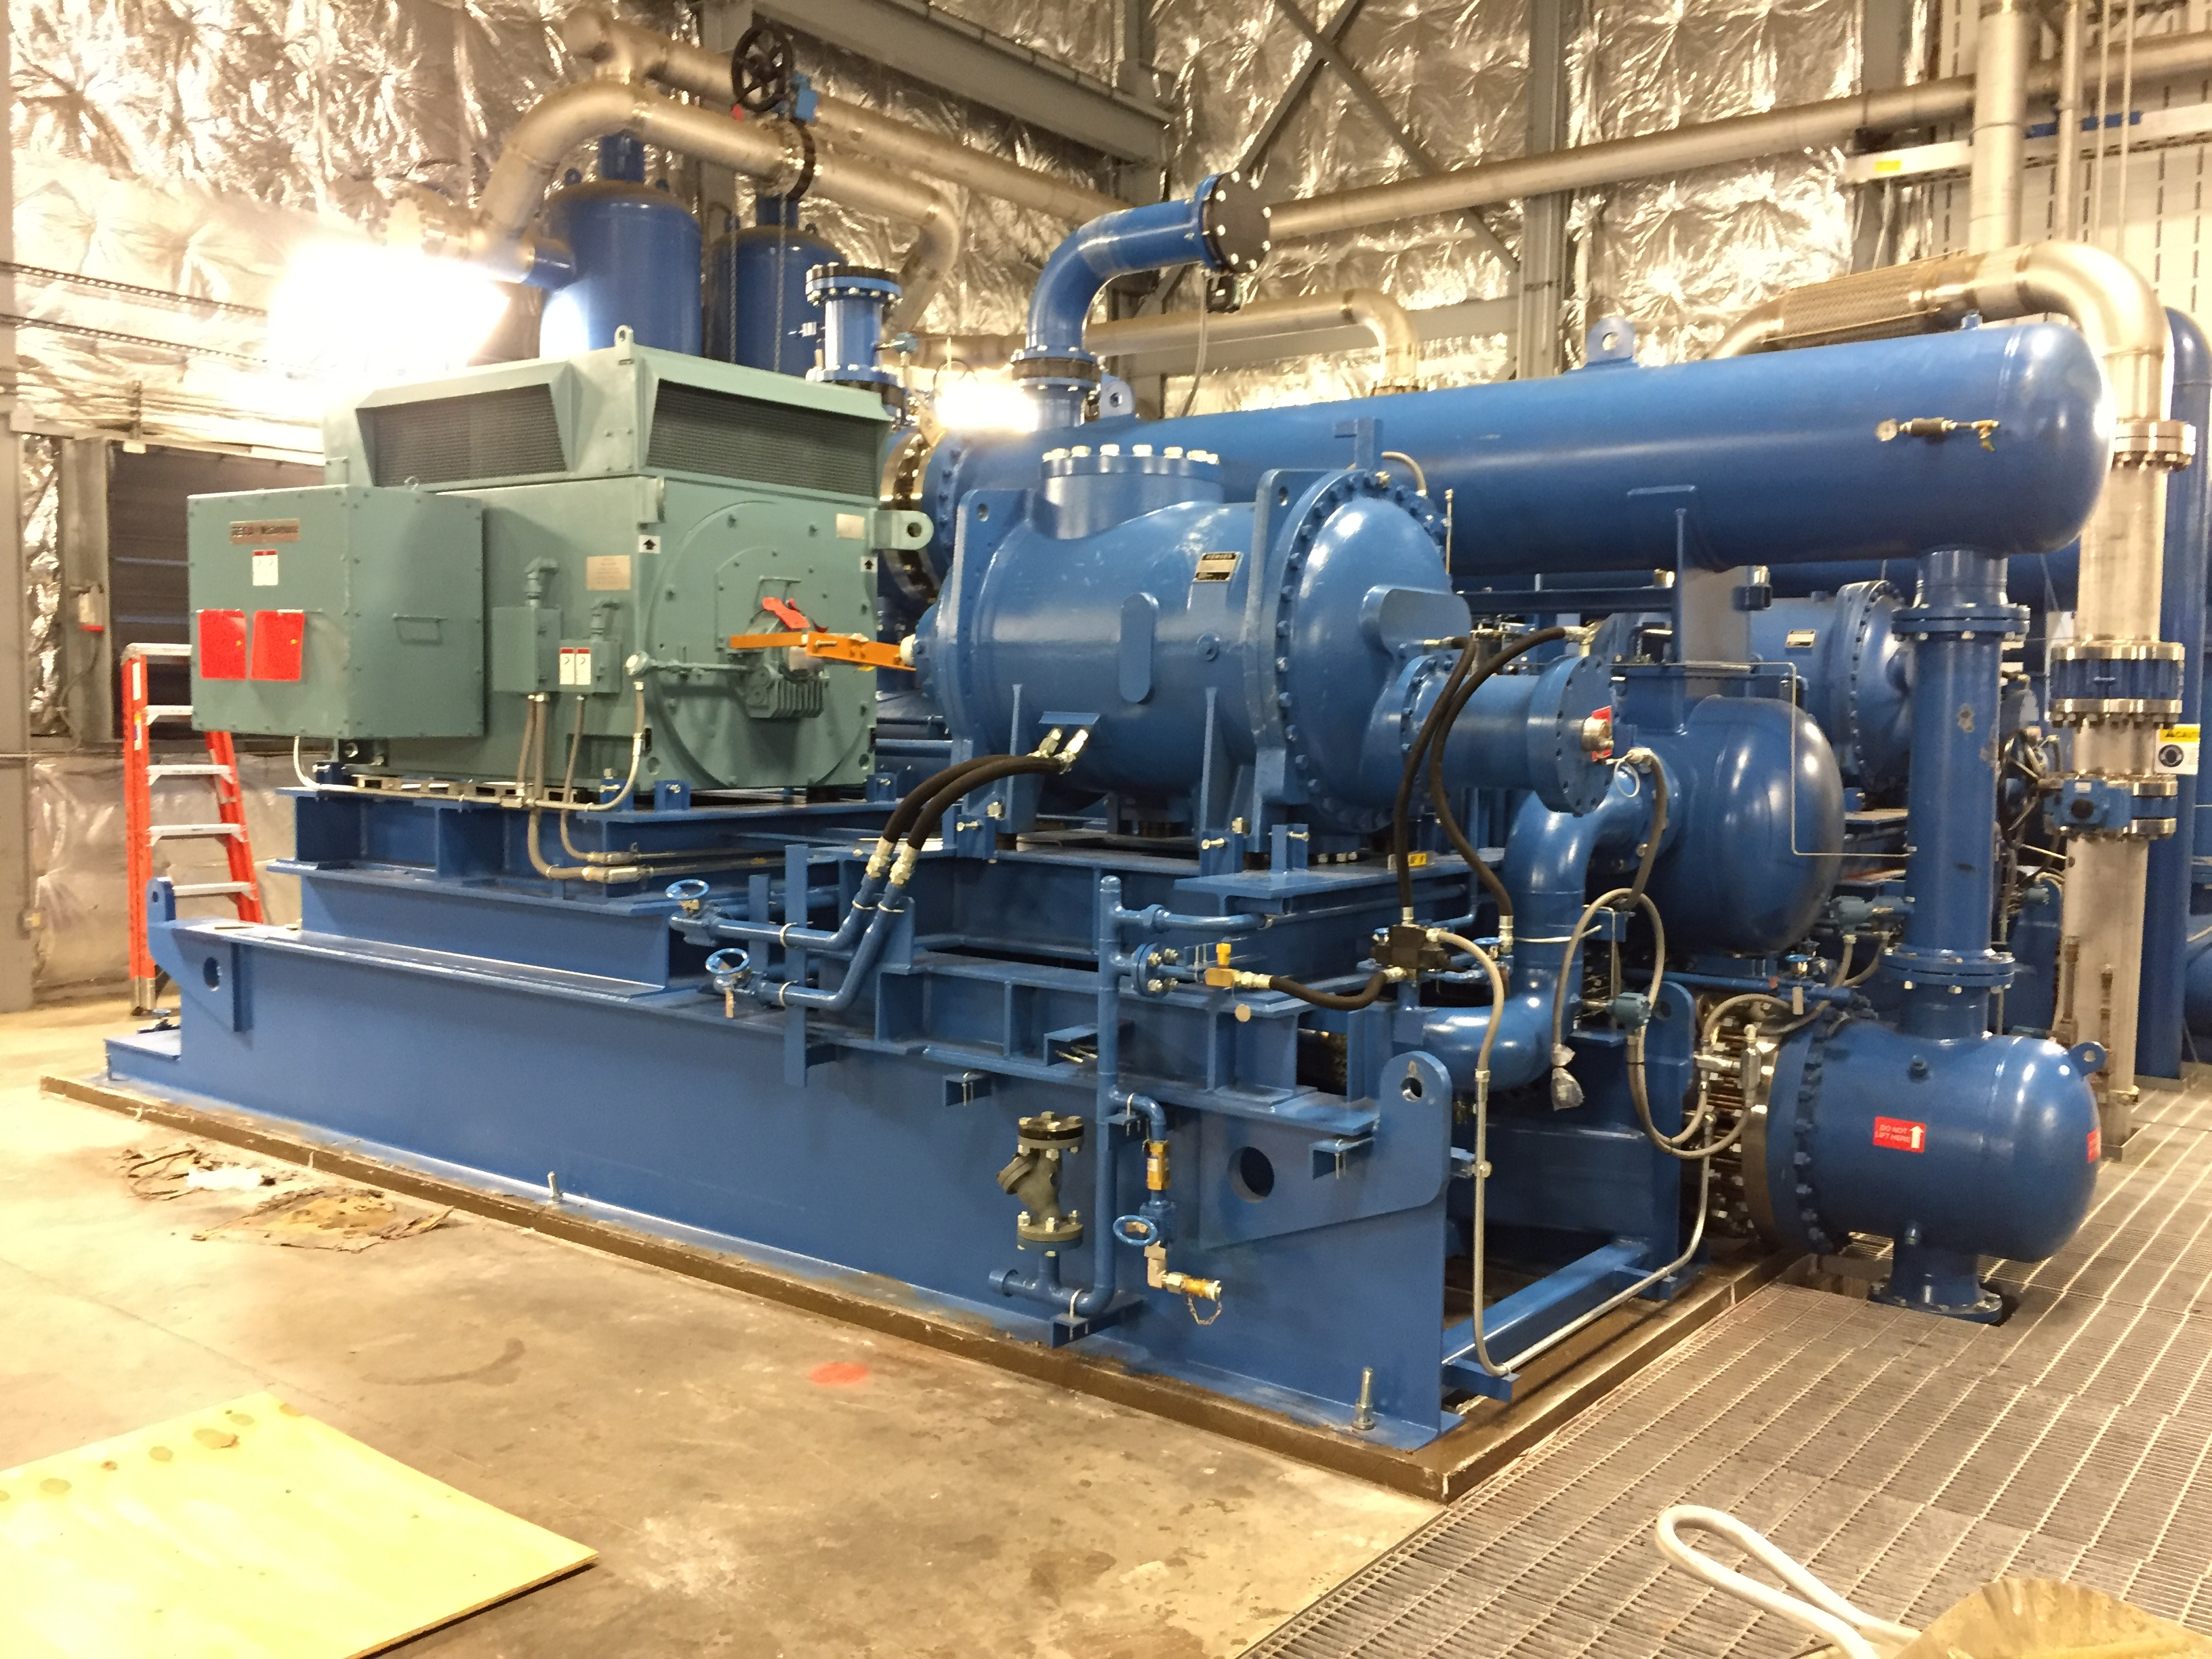
An Overview of Cryogenics at Jefferson Lab
Jonathan Creel
Cryogenics Department
Engineering Division
JLab Users Group Meeting
June 21, 2017

Slide 2
Outline
Cryogenic Plants and Transferlines
  Central Helium Liquefier's (CHL1 & CHL2)
  End Station Refrigerator (ESR)
  Hall D Refrigerator (HDR)
  Cryogenic Test Facility (CTF)
Maintenance
Recent Upgrades
Recent Issues
Path Forward

Slide 3
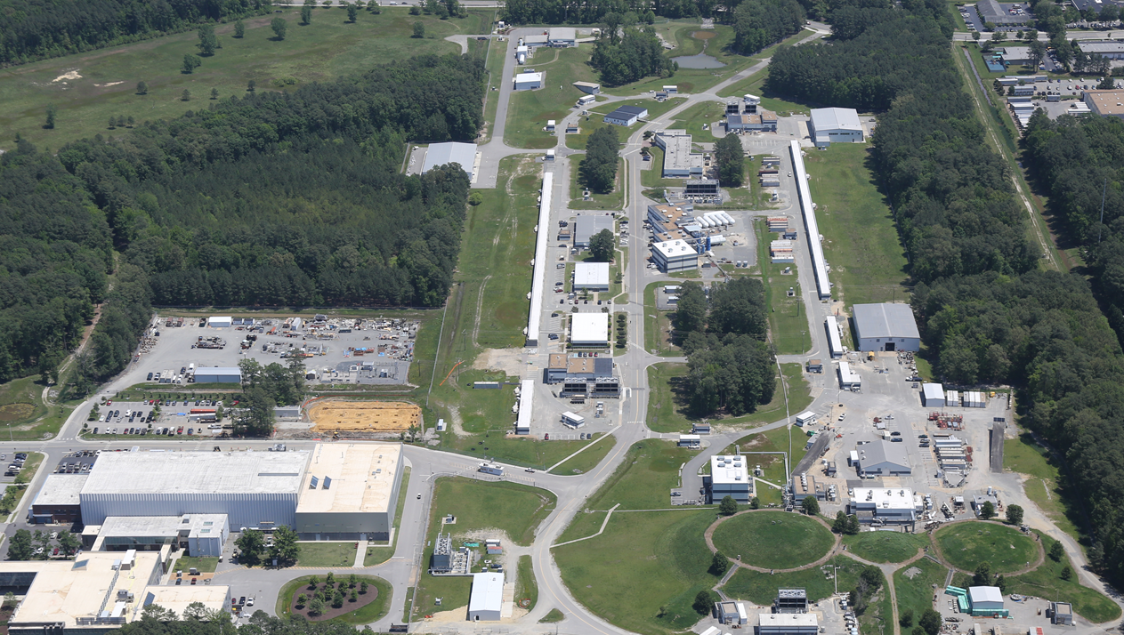
Cryogenic Plants
Plants
Loads
N
HDR, 4K
Hall D
LERF
CHL1 + CHL2, 2K/4K/35K
Linacs
CTF, 2K/4K/35K
CHL/ESR Transferline
ESR, 4K/15K
TestLab
Halls A, B, C
Notes:
Be brief

Slide 4
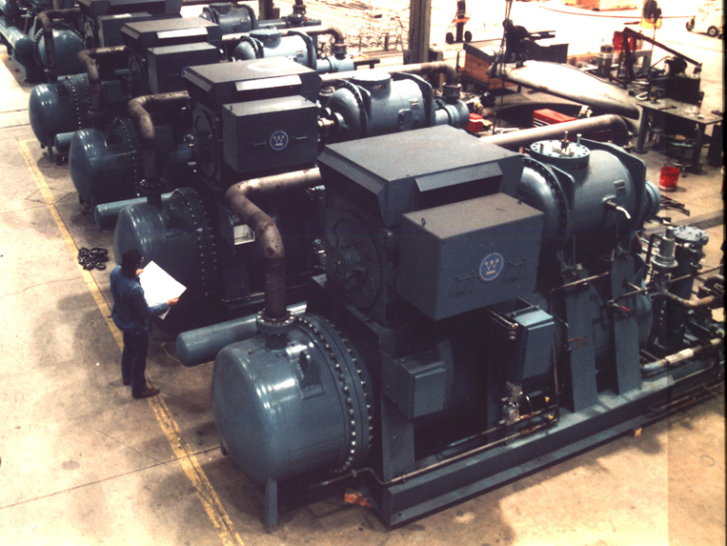
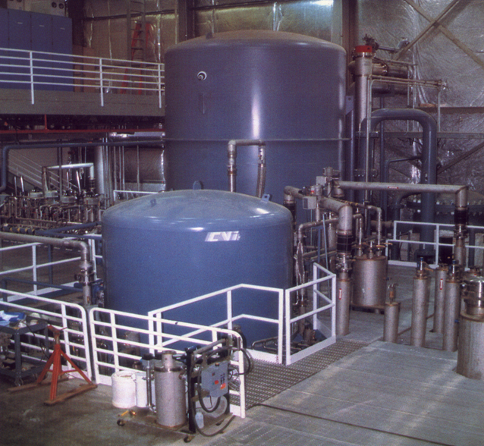
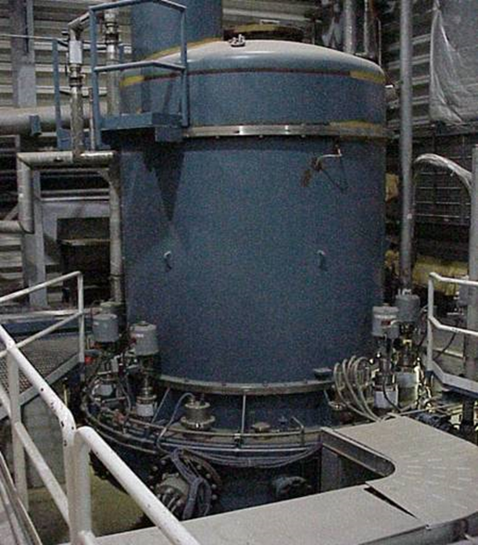
Central Helium Liquefier (CHL1)
Warm Compressors
4.5K Cold Box
2.1K Cold Box
Capacity: 12KW at 35K shield, 4.6KW at 2.1K primary, 10 g/s Liquefaction
Service: Maintains South Linac & LERF super-conducting cryomodules at 2.1K (39,000 liquid liter inventory)
Provides shield circuit for linac cryomodules and transfer lines at 35K
Commission Date: 1991 (4K), 1994 (2K) Service Duty: 24/7/365 Continuous Unattended,
Operation Hours to Date: > 215,000 Main Compressors: 3-600HP 1st stage, 3-2250HP 2nd stage
Cold Compressors: 2.1K Cold Box 250 g/s 5 stage 0.039 atm to 1.1 atm
Cooling Water: 4400 gal/min Electric Power: 5.5 MW, 4160V LN2 Precooling: 330 gal/hour

Slide 5
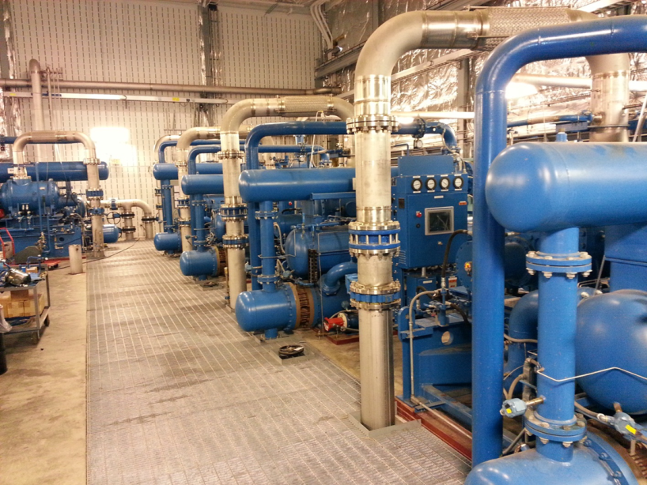
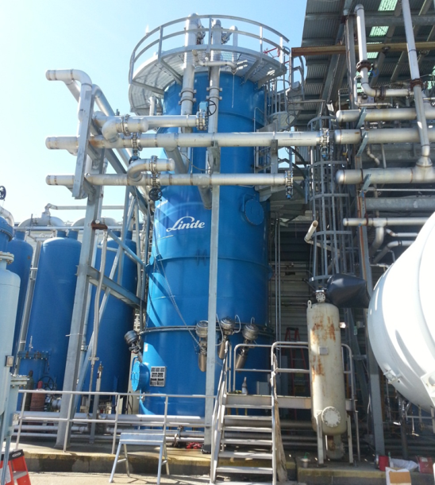
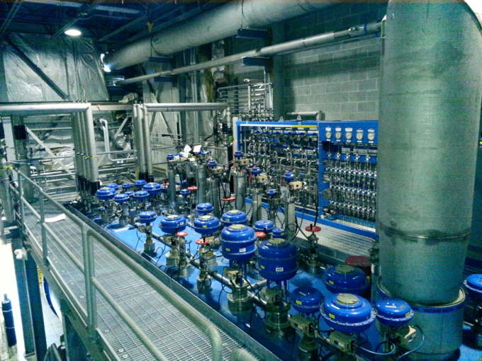
Central Helium Liquefier (CHL2)
Warm Compressors
300-65K Cold Box
65-4.5K Cold Box
Capacity: 12.6KW 35K shield, 4.8KW 2.1K primary, 20 g/s Liquefaction
Service: Maintains North Linac & Injector super-conducting cryomodules at 2.1K (31,000 liquid liter inventory)
Provides shield circuit for linac cryomodules and transfer lines at 35K
Commission Date: 2013 Service Duty: 24/7/365 Continuous Unattended,
Operation Hours to Date: >33,000 Main Compressors: 4-800HP 1st stage, 2-2500HP 2nd stage
Cold Compressors: 2.1K Cold Box 250 g/s 5 stage 0.039 atm to 1.1 atm
Cooling Water: 3100 gal/min Electric Power: 3.8 MW, 4160V LN2 Precooling: 100 gal/hour

Slide 6
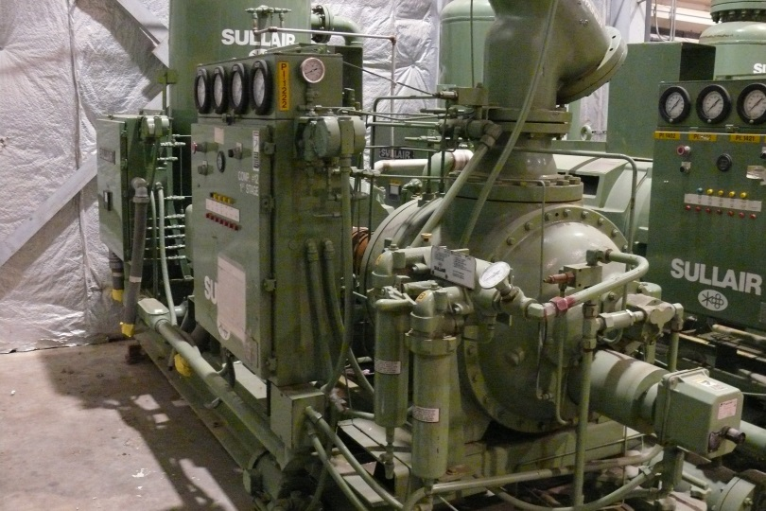
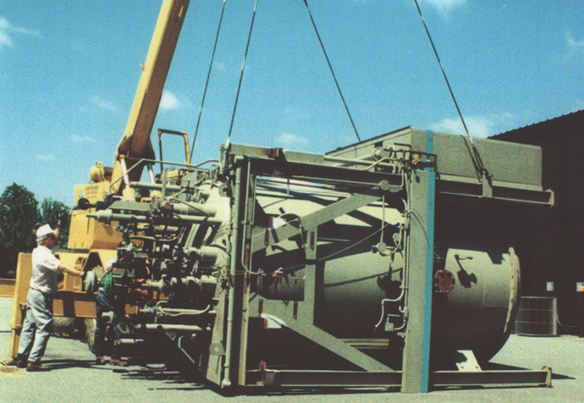
End Station Refrigerator (ESR)
Warm Compressors
4.5K Cold Box
Capacity: 1.5kW 4.5K or 800W 4.5K plus 1.2kW 15K
Service: Maintains Hall’s A, B, and C 4.5K spectrometer magnets and 4.5K/15K targets
Commission Date: 1978 LBL Escar Service Duty: 24/7/365 Continuous Unattended
1994 JLab
Operation Hours to Date: < 900 Escar Main Compressors: 1 x 200HP 1st stage, 2 x 1000HP 2nd stage
> 175,000 JLab
Cooling Water: 450 gal/min Electric Power: 1.2 MW, 480/4160V LN2 Precooling: 40 gal/hour
CHL/ESR transferline allows supplemental flow up to 20 g/s 4.5K to support loads in Hall’s A, B, and C above the capability of the ESR plant

Slide 7
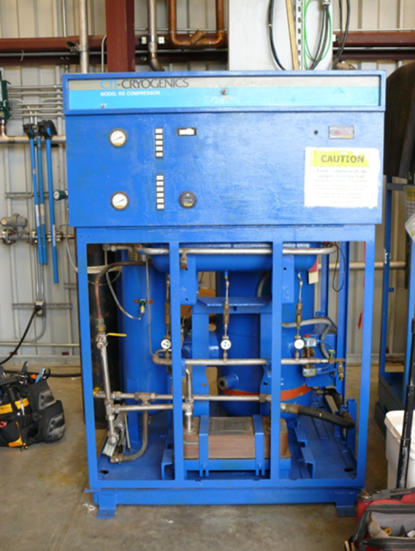
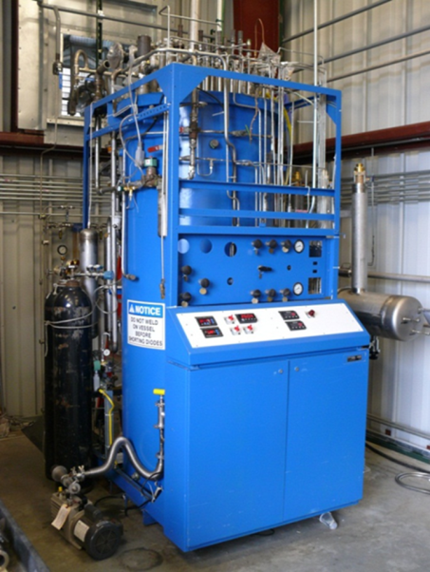
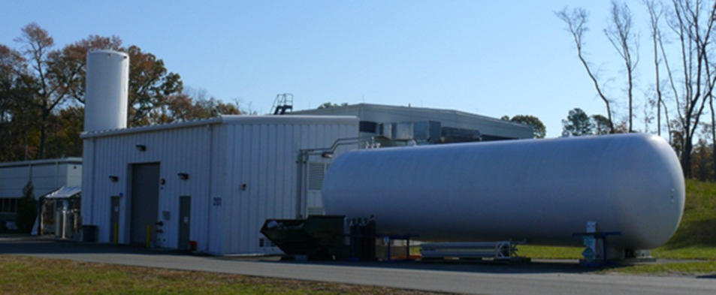
Hall D Refrigerator (HDR)
Warm Compressors
M2800 Cold Box
Helium Gas and Liquid Storage
HDR is independent of End Station Refrigerator and Hall’s A, B, and C
Capacity: 170W 4.5K twin turbine
Service: Hall D Solenoid
Commission Date: 1980 Princeton Plasma Lab Service Duty: 24/7/365 Continuous Unattended
1988 JLab Cryogenic Test Facility
2013 JLab Hall D
Operation Hours to Date: >30,000 PPL/CTF Main Compressors: 3 x 150HP single stage
>25,000 HDR
Cooling Water: 75 gal/min Electric Power: 0.3 MW, 480V LN2 Precooling: 15 gal/hour

Slide 8
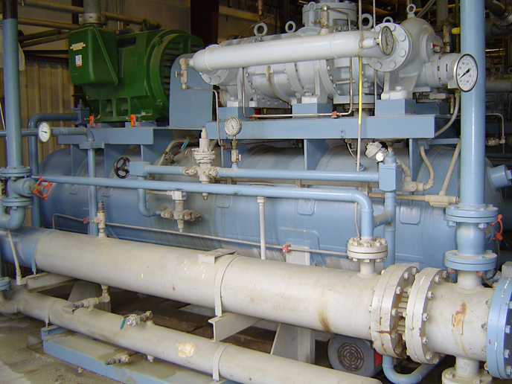
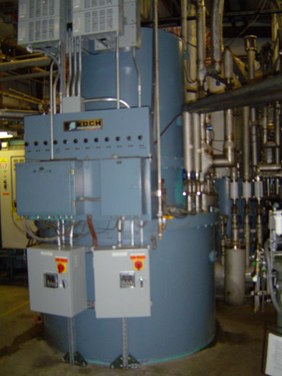
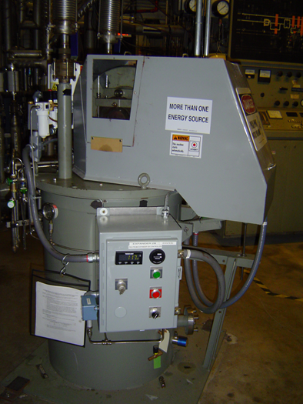
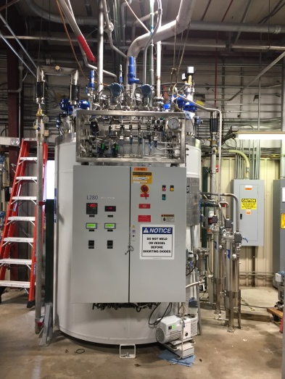
Cryogenic Test Facility (CTF)
Warm Compressors
L280 Cold Box
M2200 Cold Box
Reciprocating Expander
Capacity: 700W 4.5K OR > 8 g/s Liquefaction twin turbine (back up 750W 4.5K w/reciprocating expanders)
800W 35K w/reciprocating expander
Service: Vertical Test Area, Cryomodule Test Cave, Injector Test Facility (in construction)
Commission Date: 1988 M2200 Service Duty: 24/7/365 Continuous Unattended
2017 L280
Operation Hours to Date: >1,400 L280 Main Compressors: 3 x 400HP Compound 1st/2nd stage
>225,000 M2200
Cooling Water: 600 gal/min Electric Power: 0.8 MW, 480V LN2 Precooling: 30 gal/hour

Slide 9
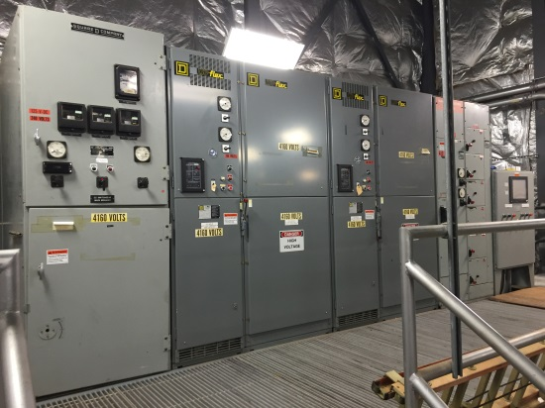
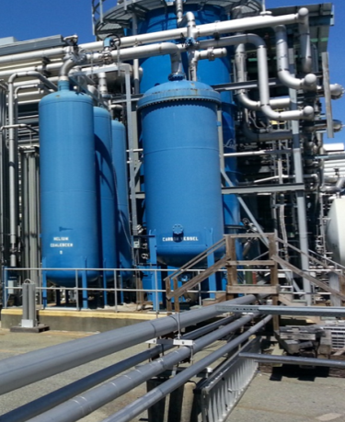
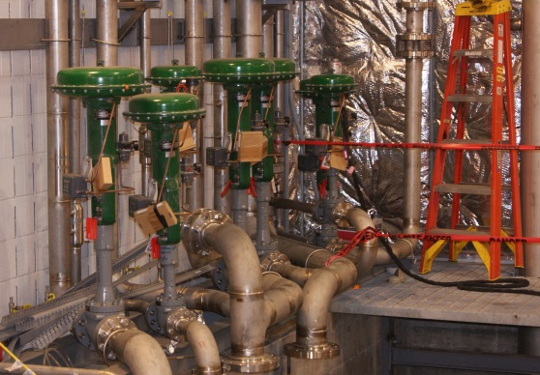
Major Maintenance Drivers
Availability comes with maintenance
  Many rotating parts, seals, connections, sensors, control valves, terminations, etc.
Some maintenance requires no plant shutdowns
  Spare compressors, pumps, etc.
  Switch to spare and work on primary
Some maintenance requires plant shutdowns
  Maintain electrical systems (2 year cycle)
    Tighten and clean wiring, terminations, breakers, fuses, etc.
  Contamination removal (varies)
    Everything that is not helium freezes solid at 2-4K
    Contamination infiltrates the systems during utube operations, transients, equipment failures, etc.
  Replace oil removal carbon systems (7 year cycle)
    Keeps residual compressor oil from reaching cold boxes
  Maintain control valves (7-10 year cycle)
    Seats/stems, soft seals and pneumatic positioners deteriorate over time

Slide 10
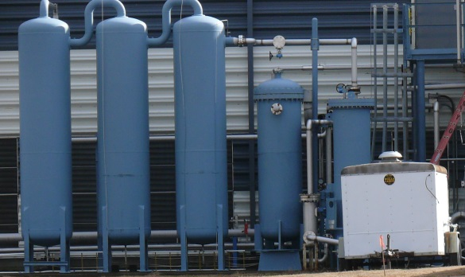
Typical Maintenance Cycles
CHL1 & CHL2
  Alternating plants shutdown each summer
  Allows maintenance and saves utilities like power, nitrogen, etc.
  Off summer FY17 to allow installation of new C6 compressor
ESR
  Shutdown planned FY18 where it best fits lab operations
  Delayed from FY17 to support 12GeV magnets
    Oil removal carbon replacement
    Control valve maintenance
    Control system replacement (CAMAC to PLC)
HDR
  Off summer FY17
    Flush contamination accumulated over time from cold box and magnet
    Repair cold box turbine inlet valve
CTF
  Off spring FY17 to support new L280 cold box installation

Slide 11
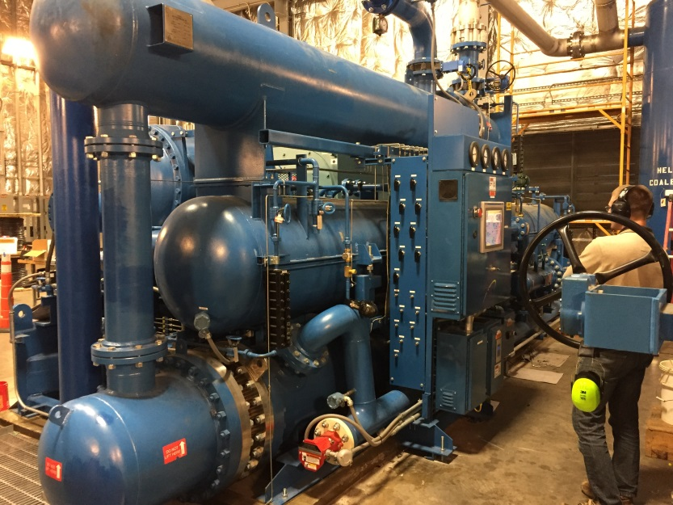
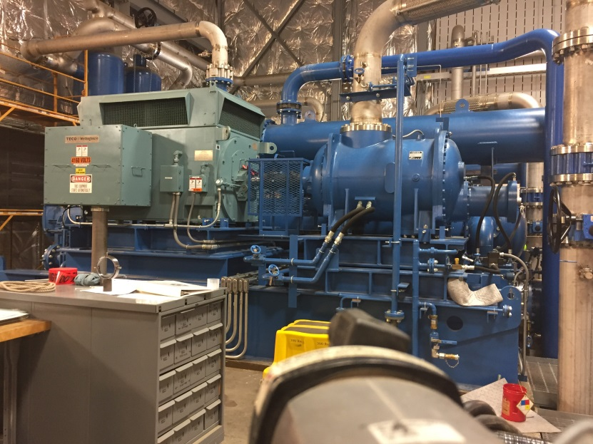
CHL2 Recent Upgrades
Funded through DOE SLI (strategic lab infrastructure) funding program separate from normal lab budget
New warm helium compressor C6 (2,500HP)
Jlab 12GeV design
Provides required redundancy to other five compressors allowing maintenance and repairs during plant operation to increase availability reduce downtime
Versatile spare compressor can be valved in as low pressure, medium pressure, or high pressure stage as needed because of engineered piping features installed during 12GeV buildup

Slide 12
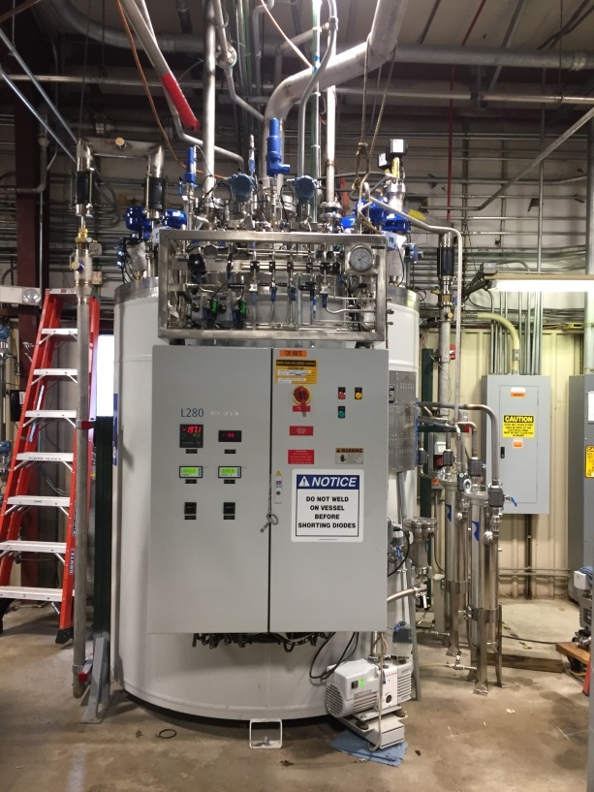
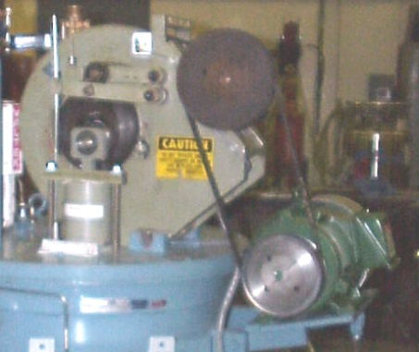
CTF Recent Upgrades
Funded through DOE SLI (strategic lab infrastructure) funding program separate from normal lab budget
New Linde L280 4.5K plant installed
Plant commissioned May/June 2017
Increased liquefaction capacity
  8 g/s verses 4 g/s
  Increases potential testing capabilities
Reduces maintenance
  Twin turbines (low maintenance) instead of twin reciprocating expanders (high maintenance)
Increased support for projects like Upgraded Injector Test Facility (UITF)

Slide 13
2.1K Cold Box and Cold Compressors
Cold Compressor
Liquid nitrogen cooled motors mounted inside vacuum space
Multi-axis actively controlled magnetic bearings with rotor position sensors
Rotational speeds up to 38,400 RPM

Slide 14
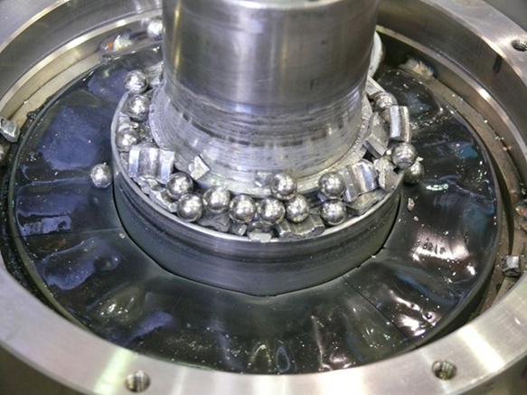
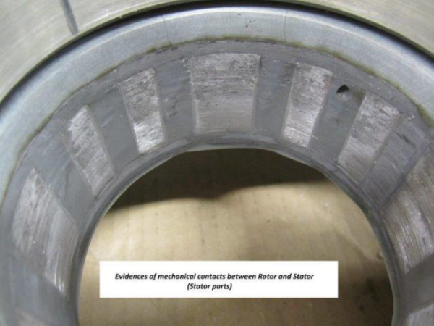
CHL1 SC1 Cold Compressor 4 Failure
Compressor 4 failed 3-25-15
Cold box warmed and compressor removed
Magnetic bearing cabinet control problem resulted in hard rotor landing at high speed that damaged back up ball bearings, rotor, etc.
  Modified manufacturers checkout procedures
Lab decided to reconfigure to one CHL to run lower energy program while repairs were undertaken
Reconfiguration took two weeks to move large utubes to align both linacs to single CHL for 6GeV
Spare compressor borrowed from SNS and modifications performed to install it to be ready for fall FY15 run
Failed compressor sent to France
  Manufacturer repairing using spare parts
  Unit recently returned after two years
  Designing test program to verify health

Slide 15
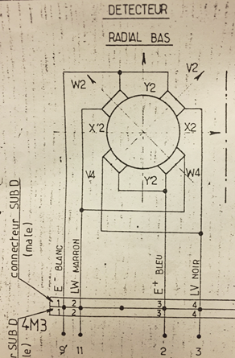
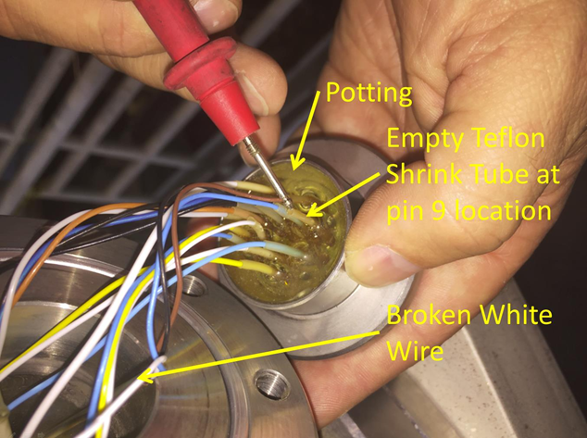
CHL1 SC1 Cold Compressor 5 Problem
Cold compressor 5 problem 3-9-17
Problem occurred close to end of program so lab decided to terminate run early
Cold box warmed and compressor removed
Problem traced to internal broken wire for bottom rotor radial position sensor
  Least operating hours (infant mortality?)
Wire repaired and others checked
Compressor tested warm
  Bearings energized
  Properly levitated
  Rotor spun at high speed
Compressor being reinstalled

Slide 16
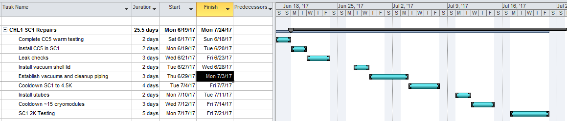
2.1K Cryogenics Path Forward
Future Efforts
  Lab recently received funding through DOE SLI program to design and build a new 2.1K cold box to replace the SC1 cold box
    Design will be based on new cold compressor technology JLab using in FRIB and LCLS2 projects
    SC1 would be decommissioned
    SC1 parts would be used as spares for SC2 cold box

Slide 17
End Station Cryogenics Path Forward
Hall loads have increased in the 12GeV era
  Additional superconducting magnets were added
  Loads are above ESR base capacity and require supplemental flow from the CHL’s via transferline
  Limited capacity also increases recovery time following transients
Recently performed ESR load tests for Hall’s A, B, and C for fall run
  Hall A: 720W at 4K, 500W at 15K
  Hall B: 230W at 4K
    Hall B solenoid not present
  Hall C: 500W at 4K, 600W at 15K
  ESR at full capacity plus supplemental flow from CHL transferline able to support simulated loads
Lab requesting additional money to complete design, installation, and commissioning of additional capacity at End Station

Slide 18
Questions ?

