Slide 1
JLEIC Concept
Speaker: V.S. Morozov (JLab)
on behalf of JLEIC Collaboration

Slide 2


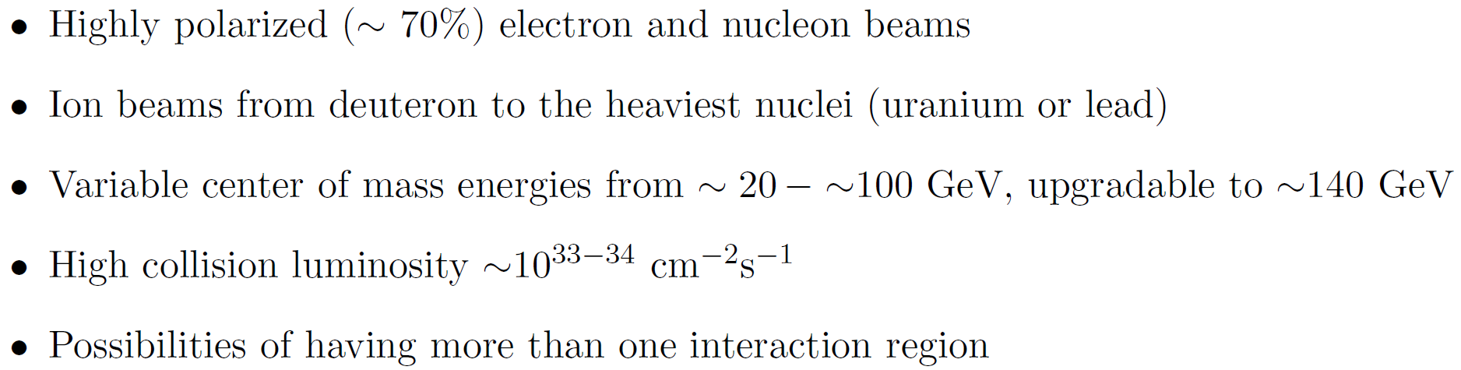
Electron Ion Collider
Recommendations in NSAC LRP 2015:
Continue existing projects: CEBAF, FRIB, RHIC.
“…a U.S.-led ton-scale neutrinoless double beta decay experiment”
“…a high-energy high-luminosity polarized EIC as the highest priority for new facility construction following the completion of FRIB”
“…small-scale and mid-scale projects and initiatives that enable forefront research at universities and laboratories”
EIC Community White Paper arXiv:1212.1701

Slide 3
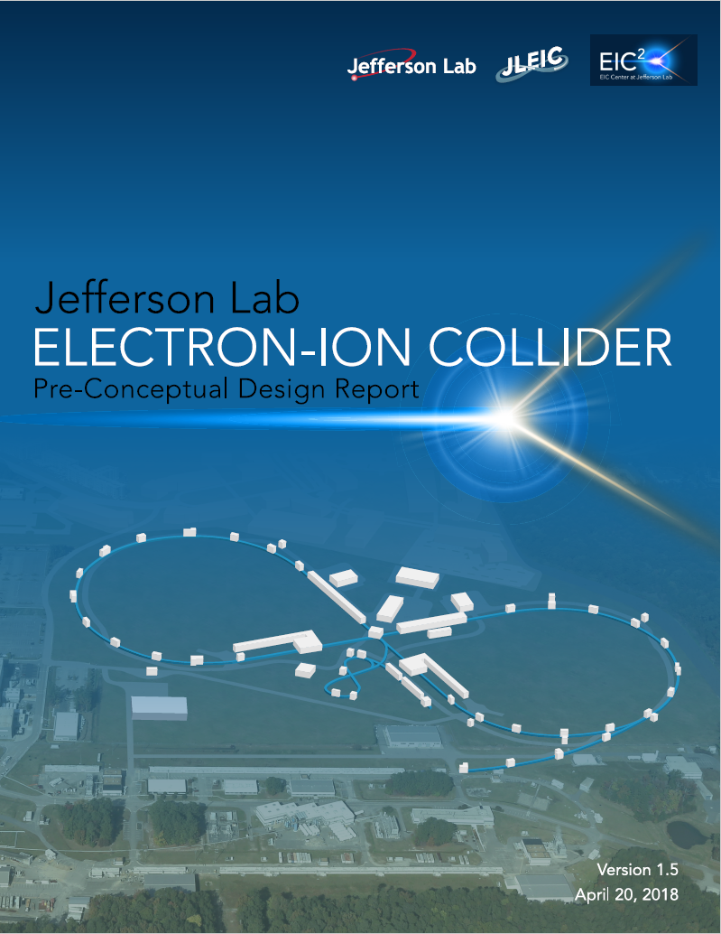
JLEIC Status
JLEIC conceptual design is nearly complete
Key features:
  Modern technology
  High luminosity
  High polarization
  Full-acceptance detection
Current work
  Key R&D
    High-energy electron cooling
    IR magnet prototyping
    Crabbing experiment
    Spin dynamics experiment
    Simulation software development
  Completion of consistent design
  Performance and cost optimization
  Evaluation of engineering challenges
  Completion of a pre-CDR

Slide 4
JLEIC Collaboration
S. Benson, A. Bogacz, P. Brindza, A. Camsonne, E. Daly, Ya.S. Derbenev, M. Diefenthaler, D. Douglas,
R. Ent, Y. Furletova, D. Gaskell, R. Geng, J. Grames, J. Guo, F. Hanna, L. Harwood, T. Hiatt, Y. Huang,
A. Hutton, K. Jordan, G. Kalicy, A. Kimber, G. Krafft, R. Li, F. Lin, F. Marhauser, R. McKeown, T. Michalski,
V.S. Morozov, P. Nadel-Turonski, E. Nissen, H.K. Park, F. Pilat, M. Poelker, R. Rajput-Ghoshal, R. Rimmer,
Y. Roblin, T. Satogata, M. Spata, R. Suleiman, A. Sy, C. Tennant, H. Wang, S. Wang, G.H. Wei, C. Weiss,
M. Wiseman, R. Yoshida, H. Zhang, Y. Zhang - JLab, VA
D.P. Barber - DESY, Germany
Y. Cai, Y.M. Nosochkov, M. Sullivan - SLAC, CA
S. Manikonda, B. Mustapha, U. Wienands - Argonne National Laboratory, IL
P.N. Ostroumov, R.C. York - Michigan State University, MI
S. Abeyratne, B. Erdelyi - Northern Illinois University, IL
J. Delayen, H. Huang, C. Hyde, K. Park, S. De Silva, S. Sosa, B. Terzic - Old Dominion University, VA
P. Nadel-Turonski, SUNY, NY
Z. Zhao - Duke University, NC
A.M. Kondratenko, M. Kondratenko - Sci. & Tech. Laboratory Zaryad, Russia
Yu. Filatov - Moscow Institute of Physics and Technology, Russia
J. Gerity, T. Mann, P. McIntyre, N.J. Pogue, A. Sattarov - Texas A&M University, TX
V. Dudnikov, R.P. Johnson - Muons, Inc., IL
I. Pogorelov, G. Bell, J. Cary - Tech-X Corp., CO
D. Bruhwiler - Radiasoft, CO

Slide 5

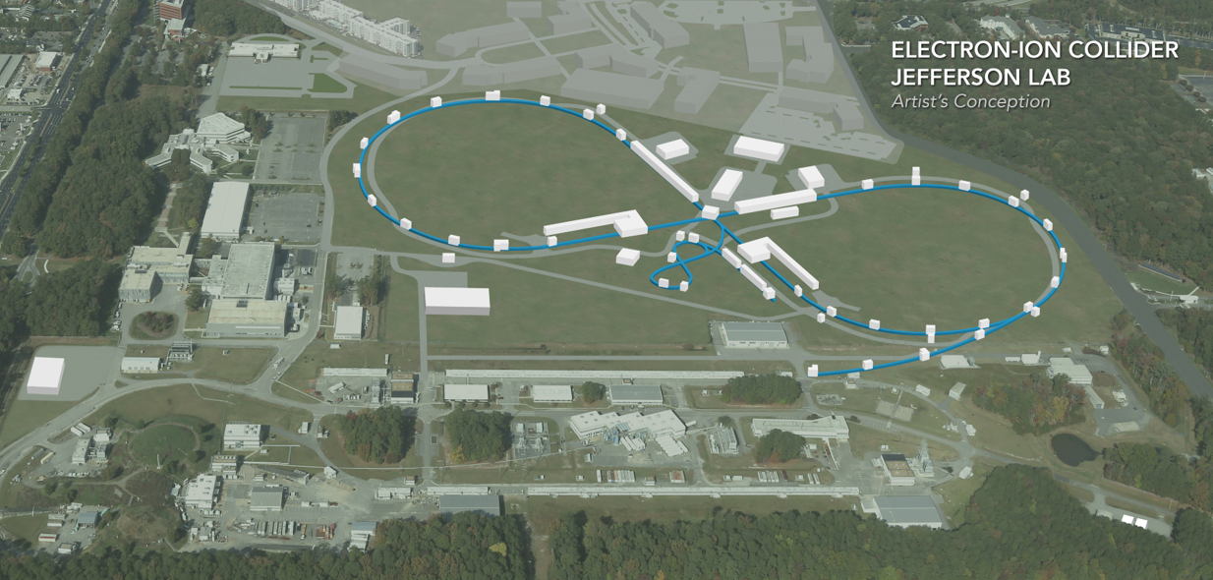
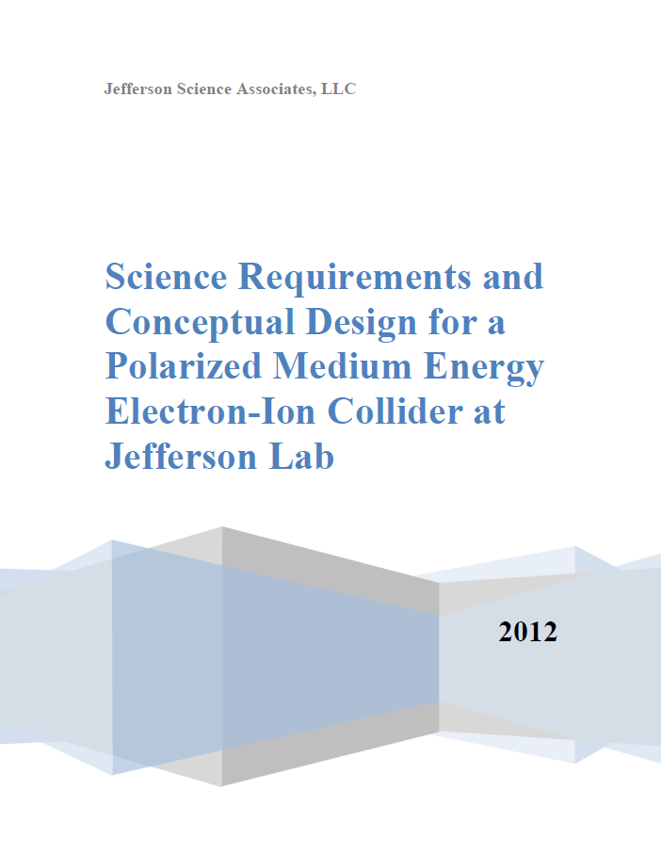
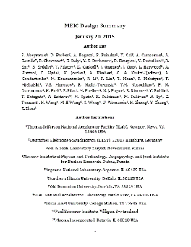
JLEIC Layout
Electron complex
  CEBAF
  Electron collider ring
Ion complex
  Ion source
  SRF linac
  (285 MeV/u for protons)
  Booster
  Ion collider ring
Up to two detectors at
minimum background
locations
8-100 GeV
3-12 GeV
8 GeV
SRF Linac &
2012
2015
arXiv:1209.0757
arXiv:1504.07961
Completed by
October 2018
May 17 parameter update:
https://eic.jlab.org/wiki/index.php/Main_Page

Slide 6
Why EIC Should be Built at JLab
Large established user community in the field
CEBAF, the world highest energy SRF linac, as a full energy injector
  Maintains highly-polarized high-current electron beam in the electron collider ring using demonstrated top-up injection technique
Green Field collider complex
  Modern design and technology
  No constraints imposed by existing infrastructure
  Design driven by experimental requirements
    Novel high luminosity concept
    Luminosity optimized around the CM range of physics interest
    Novel figure 8 design for high polarization of any particles including deuterons
    Deeply integrated detector and machine design for full acceptance
  Balance of good performance and low technical risk

Slide 7

Key Design Concepts
High luminosity: high collision rate of
short modest-charge low-emittance bunches
  Small beam size
    Small β* ⇒ Short bunch length ⇒
    Low bunch charge, high repetition rate
    Small emittance ⇒ Cooling
  Similar to lepton colliders such as
  KEK-B with L > 2×10³⁴ cm⁻²s⁻¹
$$L=f\frac{n_{1}n_{2}}{4πσ_{x}^{∗}σ_{y}^{∗}}\sim f\frac{n_{1}n_{2}}{εβ_{y}^{∗}}$$
High polarization: figure-8 ring design
  Net spin precession zero
  Spin easily controlled by small
  magnetic fields for any particle
  species
Full acceptance primary detector including far-forward acceptance
Beam Design
High repetition rate
Low bunch charge
Short bunch length
Small emittance
Damping
Synchrotron radiation
Electron cooling
IR Design
Small β*
Crab crossing

Slide 8
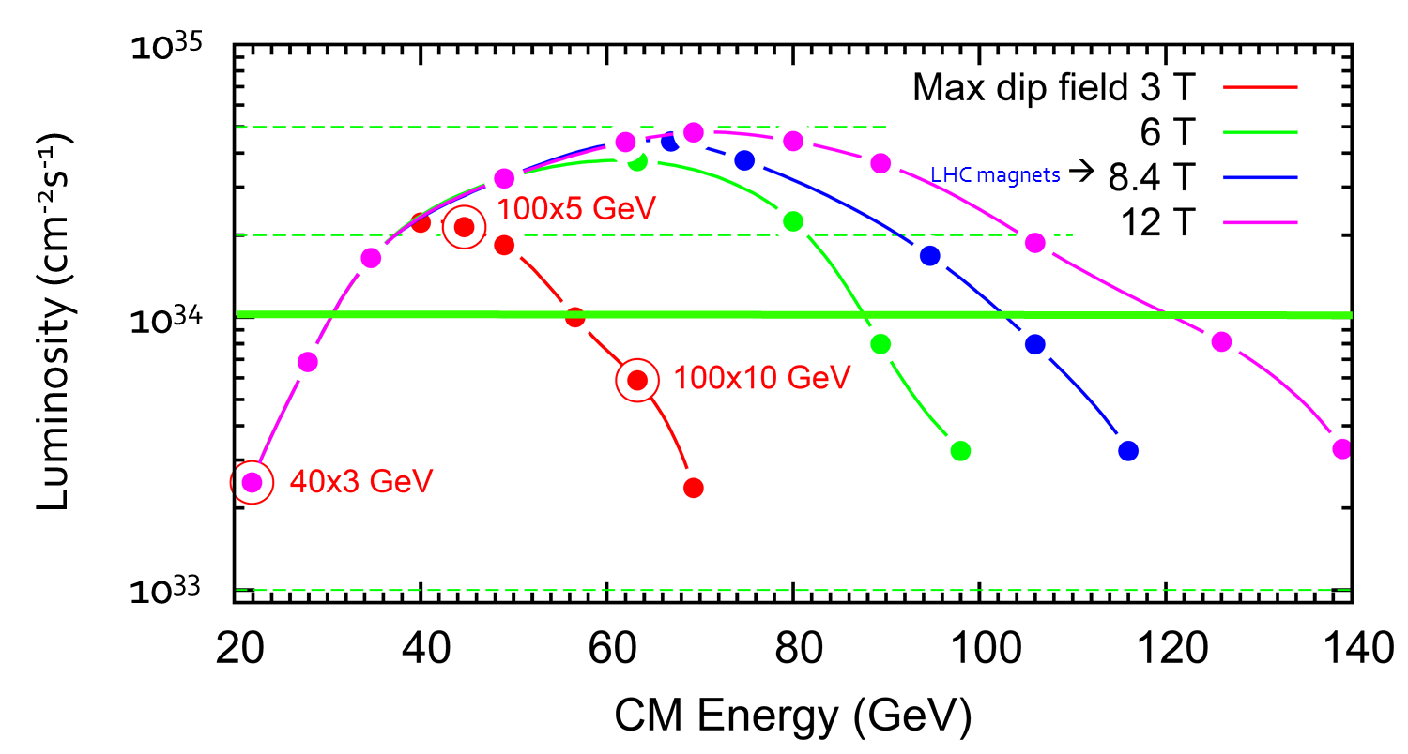
JLEIC Energy Reach and Luminosity
Current baseline
Alternative/
upgrade
options
CM Energy (in each scenario) | Main luminosity limitation
low | space charge
medium | beam-beam
high | synchrotron radiation

Slide 9
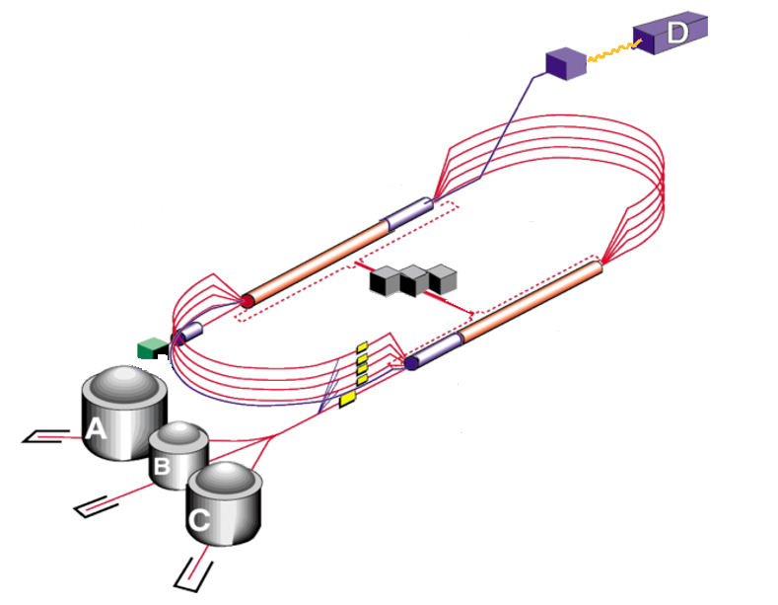
12 GeV CEBAF as Injector
Extensive fixed-target science program
  Fixed-target program compatible
  with concurrent JLEIC operations
JLEIC injector
  Fast fill of collider ring
  Full energy
  ~85% polarization
  Enables top-off
New operation mode
but no hardware
modifications
Up to 12 GeV
to JLEIC

Slide 10
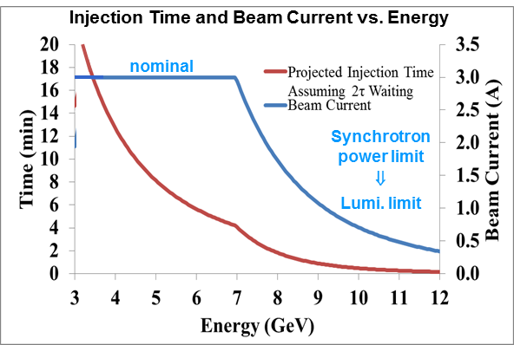
Electron Beam
Electron beam
  3 A at up to 7 GeV
  Normalized emittance
  54 µm @ 5 GeV
  Synchrotron power
  density < 10 kW/m
  Total power
  up to 10 MW

Slide 11
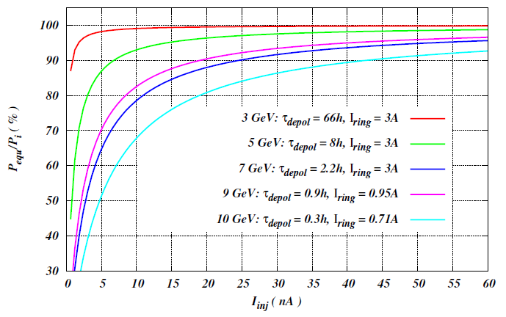
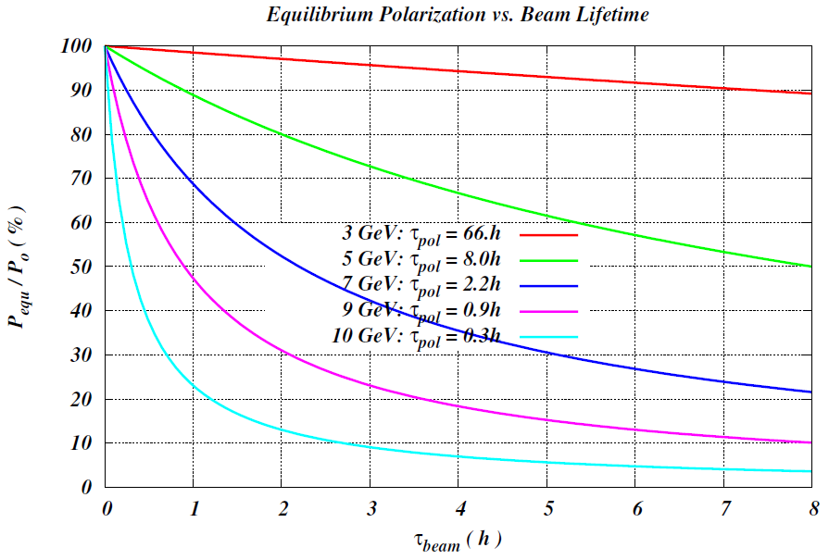

Electron Polarization
Estimated polarization lifetime
At high energies (> ~5 GeV), constant polarization is maintained by continuous injection of highly polarized (~85%) electron beam from CEBAF
A relatively low average injected beam current of tens-of-nA level can maintain a high equilibrium polarization in the whole energy range
Beam lifetime must be balanced with the beam injection rate and $τ_{beam}≪τ_{pol}$
Energy (GeV) | 3 | 5 | 7 | 9 | 10
Lifetime (hours) | 66 | 8 | 2.2 | 0.9 | 0.3

Slide 12
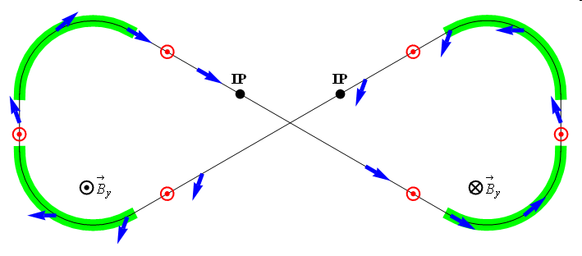
Polarization
Figure-8 concept: Spin precession in one arc is exactly cancelled in the other
Spin stabilization by small fields: ~3 Tm vs. < 400 Tm for deuterons at 100 GeV
  Criterion: induced spin rotation >> spin rotation due to orbit errors
3D spin rotator: combination of small rotations about different axes provides
any polarization orientation at any point in the collider ring
No effect on the orbit
Polarized deuterons
Frequent adiabatic spin flips
ν = 0

Slide 13
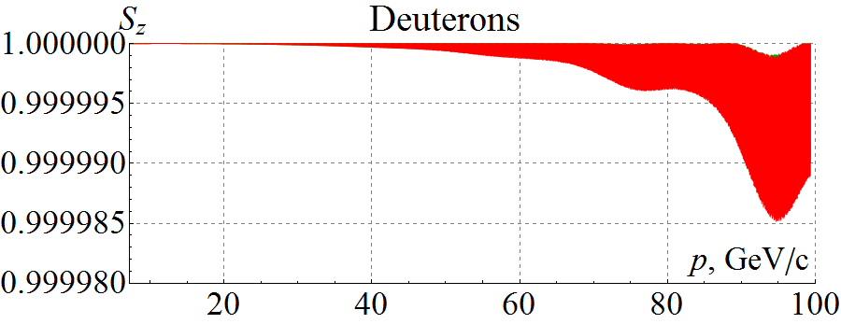
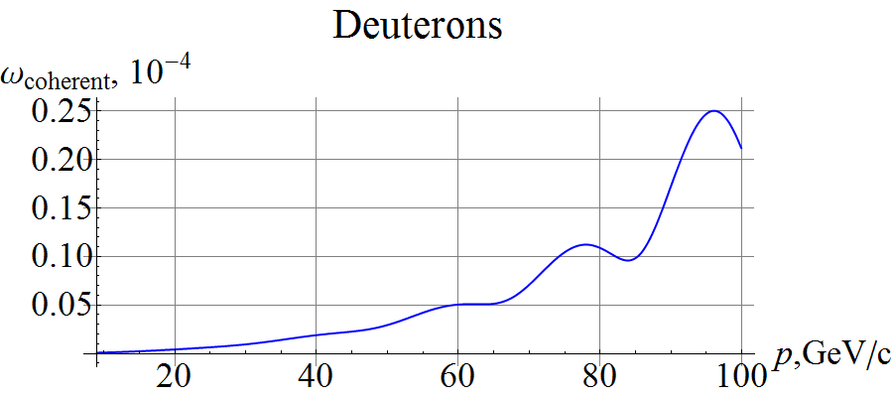
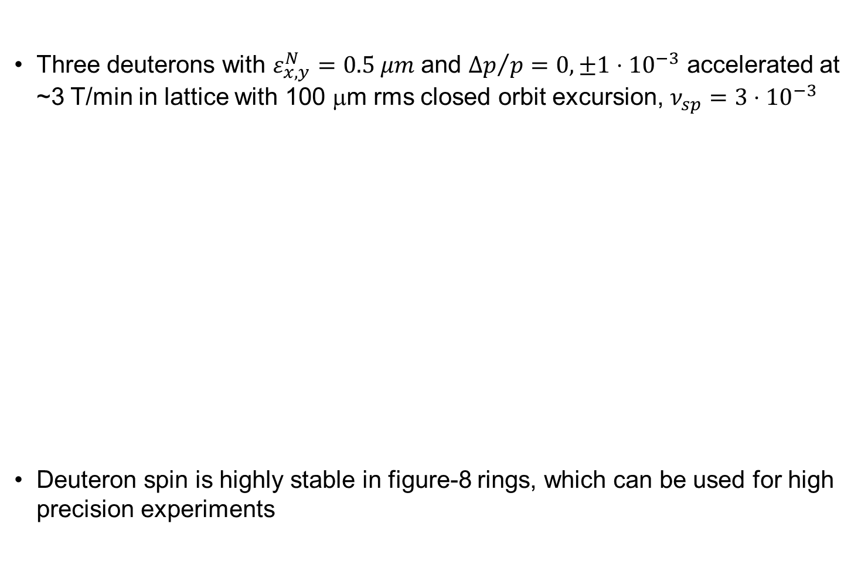

Start-to-End Deuteron Acceleration in Ion Collider Ring
Three deuterons with $ε_{x,y}^{N}=0.5 μm$ and ${Δp}/p=0, ±1⋅{10}^{−3}$ accelerated at ~3 T/min in lattice with 100 μm rms closed orbit excursion, $ν_{sp}=3⋅{10}^{−3}$
Deuteron spin is highly stable in figure-8 rings, which can be used for high precision experiments
(Zgoubi simulation)
Analytic prediction
$$2×{10}^{−5}$$

Slide 14
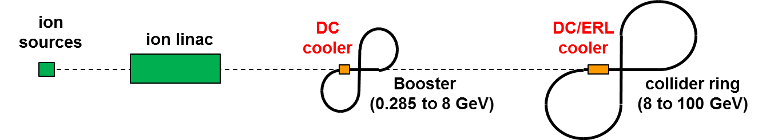
Multi-Stage Cooling Scheme
Cooling of JLEIC proton/ion beams for
  Achieving small emittance (~10x reduction)
  Reaching short bunch length ~1 cm (with SRF)
  Suppressing IBS induced emittance degradation
Pre-cool when energy is low
Cool when emittance is small
(after pre-cool at low energy)
Ring | Functions | Kinetic energy (GeV / MeV) |  |  | Cooler type
 |  | Proton | Lead ion | Electron
booster ring | Accumulation of positive ions |  | 0.1 (injection) | 0.054 | DC
collider ring | Maintain emitt. during stacking | 7.9 (injection) | 2 (injection) | 4.3 (proton) 1.1 (lead) | DC
 | Pre-cooling for emitt. reduction | 7.9 (injection) | 7.9 (ramp to) | 4.3 | DC
 | Maintain emitt. during collision | Up to 100 | Up to 40 | Up to 54.5 | ERL
Can’t reduce emittance due to space charge limit
Pre-cooling both protons and lead ions
ERL cooler can’t reach energy below 20 MeV

Slide 15
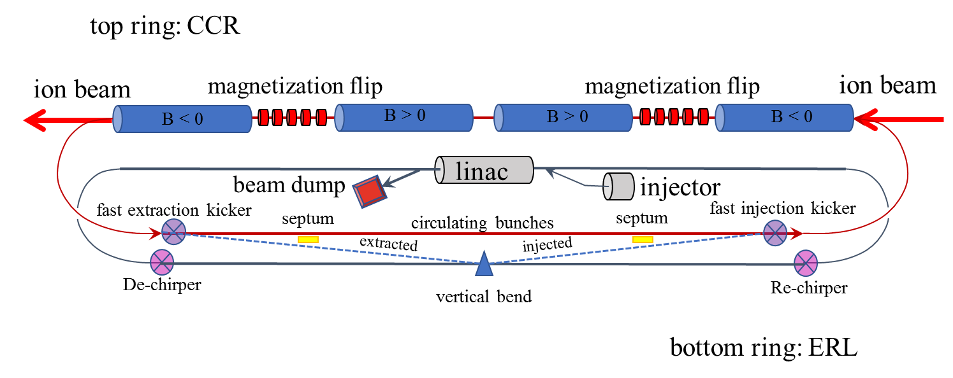
High-Energy Electron Cooling
Magnetized electron beam for higher cooling efficiency
Cooling electron beam is energy-recovered to minimize power consumption
Circulator ring to relax electron source requirements
  Ultra-fast harmonic kicker to kick electrons in and out of the circulator ring

Slide 16
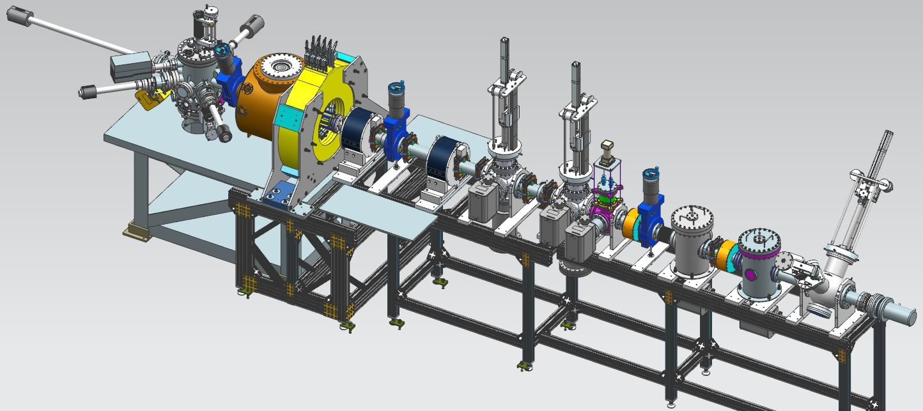
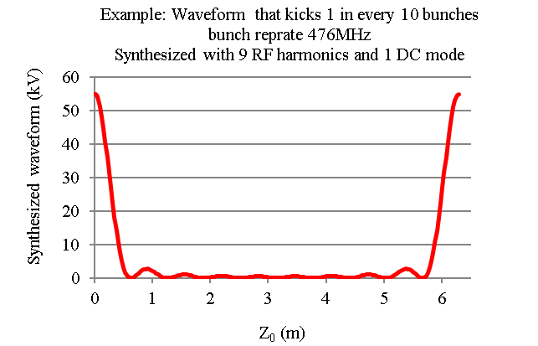
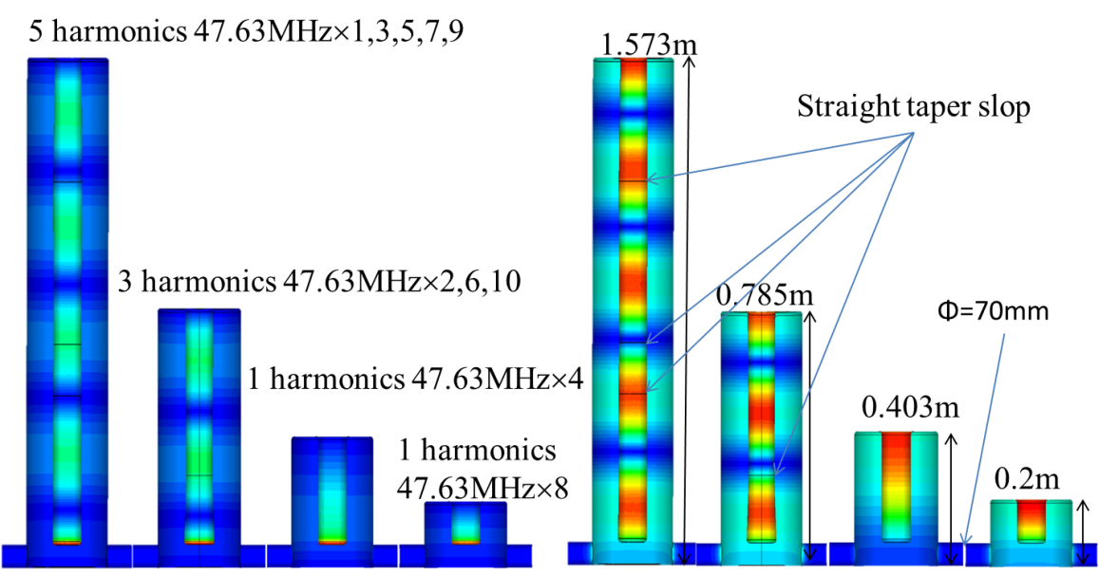
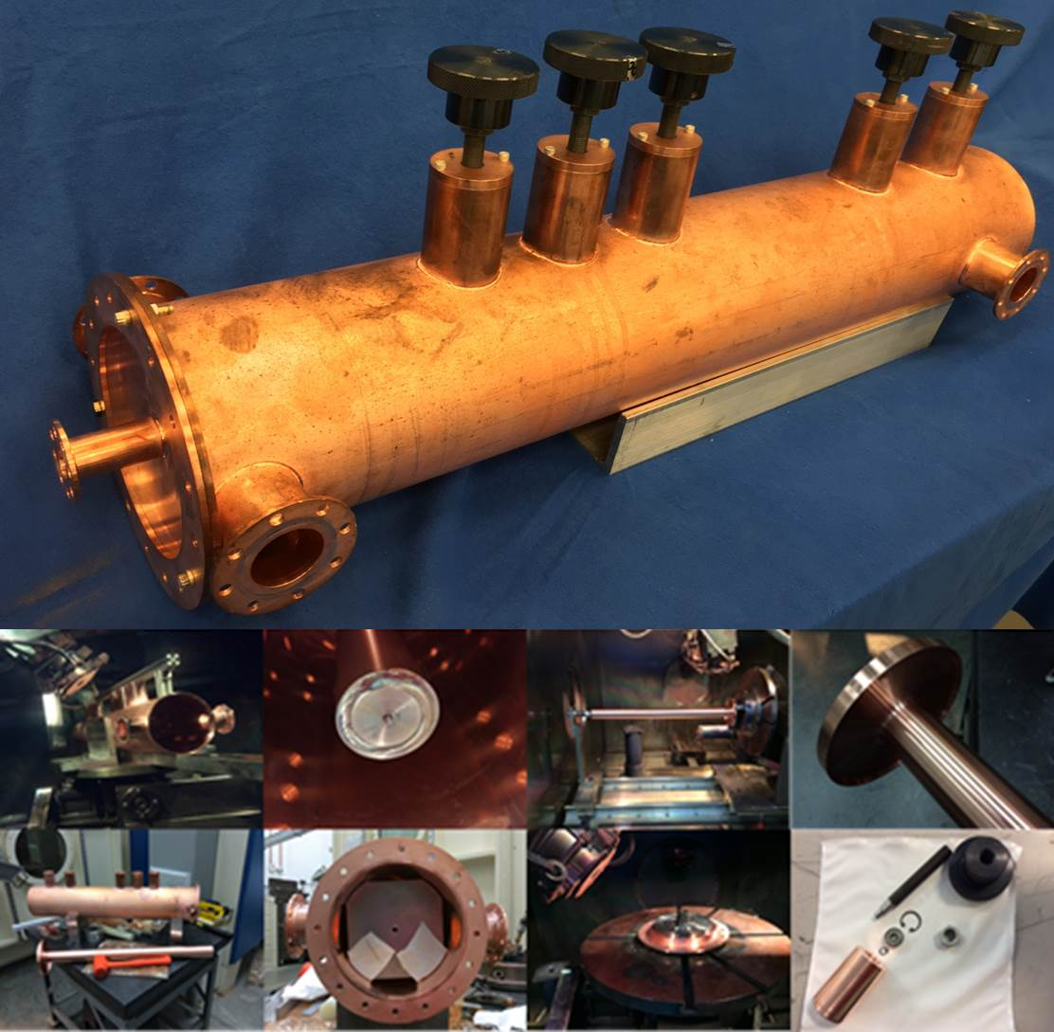
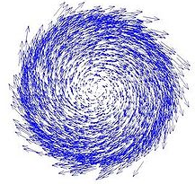
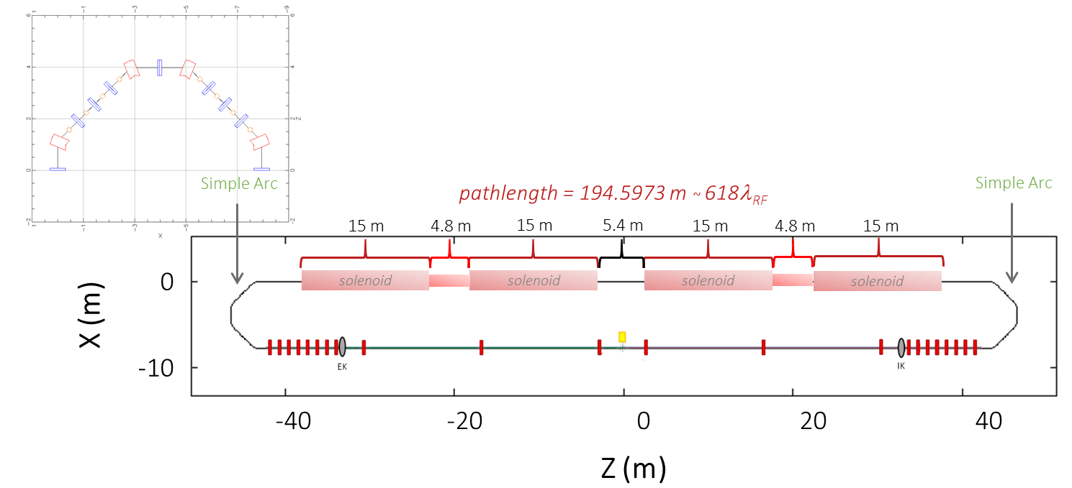
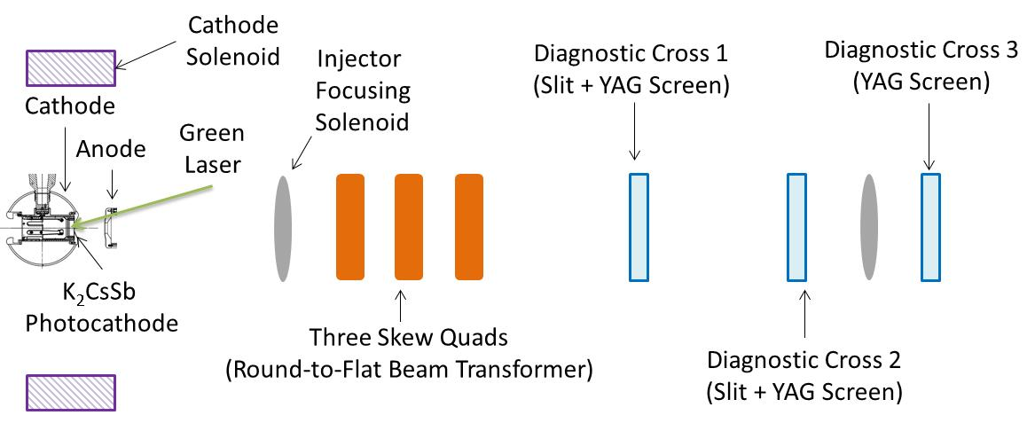
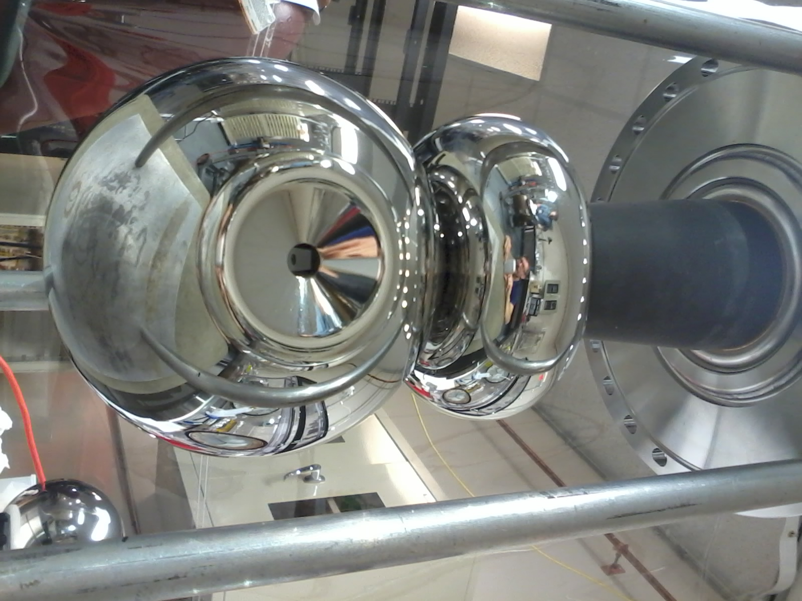
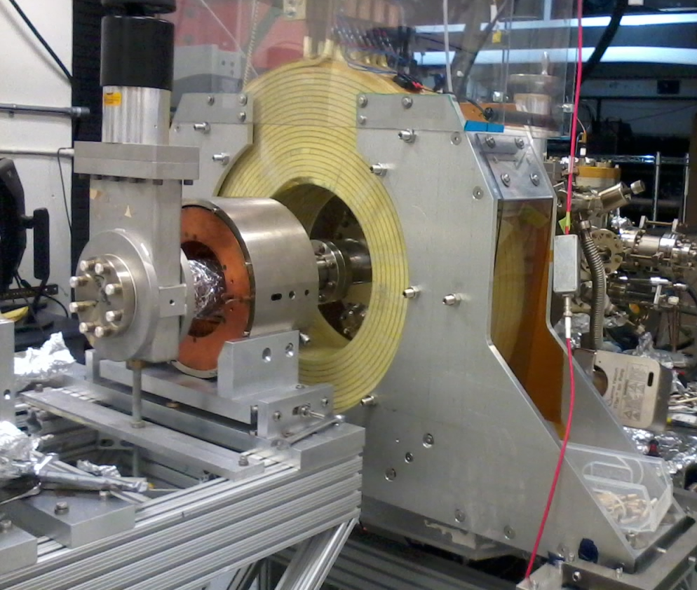
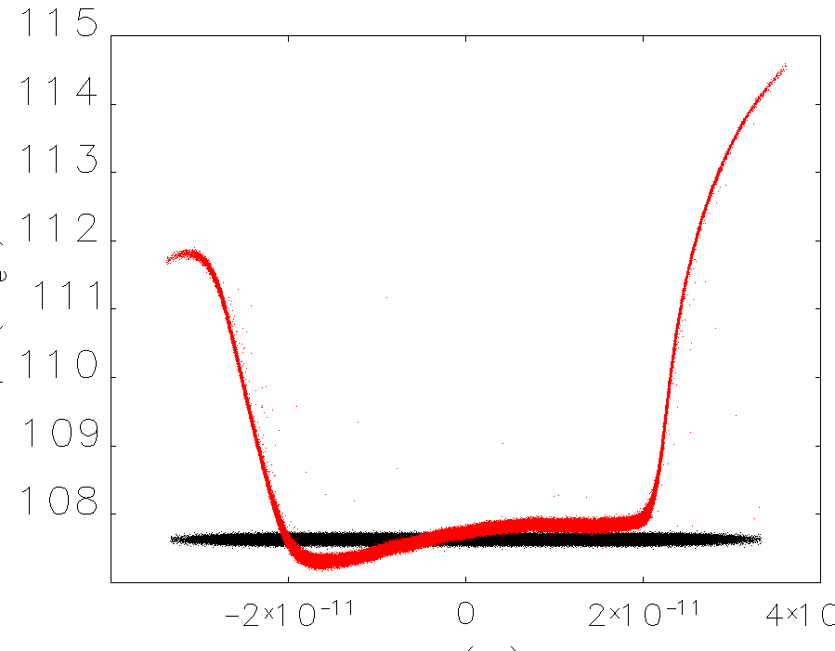
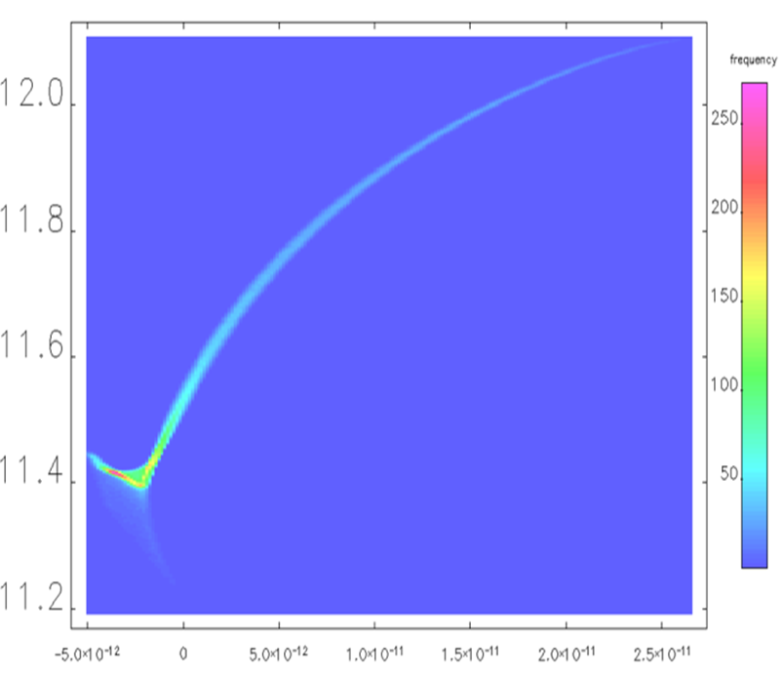
ERL-Circulator Cooler Design and R&D
Magnetized source
Harmonic RF Fast kicker
Gun HV Chamber
10 harmonics
Beamline
Gun Solenoid
magnetized beam
5 harmonic prototype
beamline
Design and BD &
Future Beam Tests at IOTA
Gun HV chamber
Gun solenoid
Long. phase space@200 kV
S2E simulation after booster

Slide 17



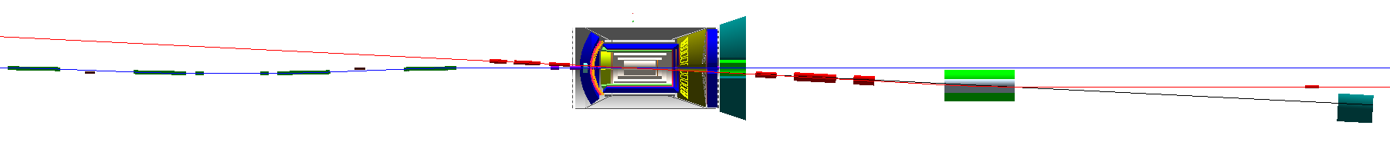
Detector Region
Integrated detector region design developed satisfying requirements of detection, beam dynamics and geometric match
GEANT4 detector model developed, simulations in progress
IP
e
Compton polarimetry
forward ion detection
ions
forward e detection
spectrometers
dispersion suppressor/
geometric match
p
(top view in GEANT4)
e
low-Q² electron detection
and Compton polarimeter
Forward hadron spectrometer
ZDC

Slide 18
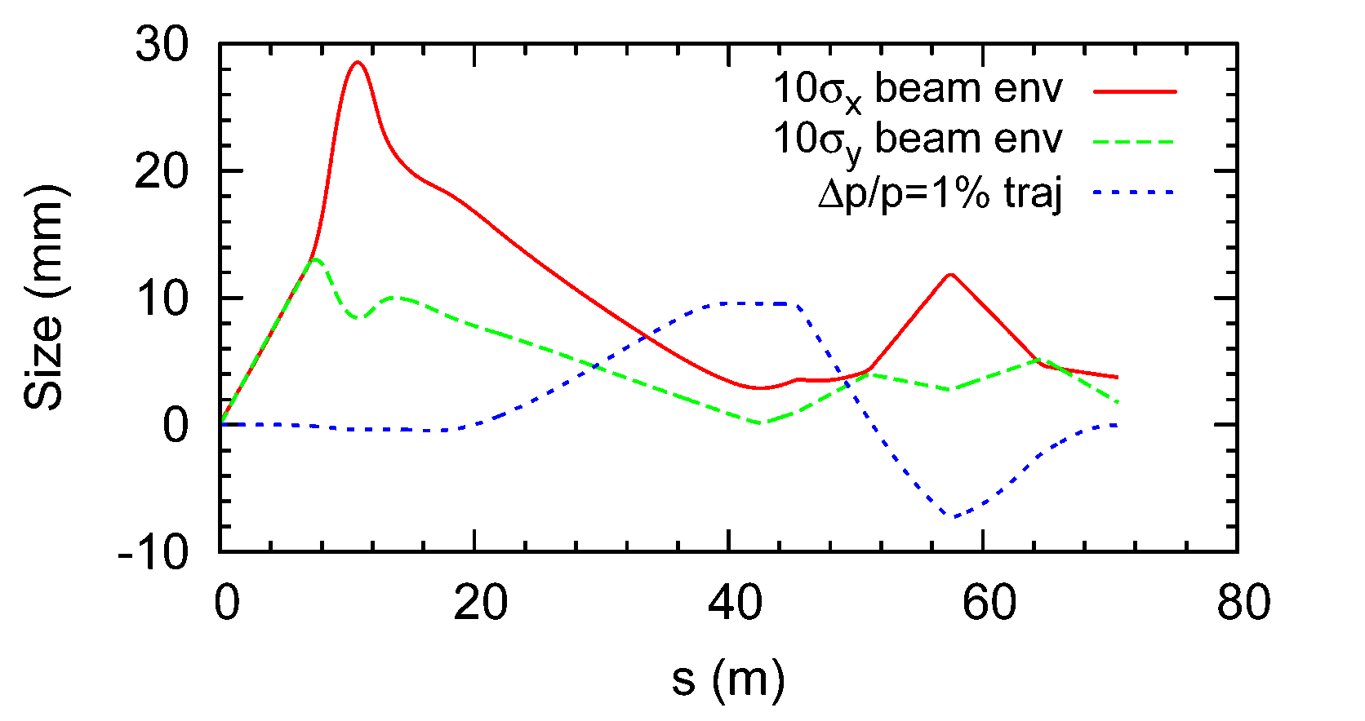

Ion Beam Envelope & 99%p Trajectory
Assuming beam momentum of 100 GeV/c, ultimate normalized x/y emittances $xN/yN$ of 0.35/0.07 μm, and ultimate momentum spread $p/p$ of 3×10⁻⁴
The horizontal size includes both betatron and dispersive components
2nd focus
IP

Slide 19
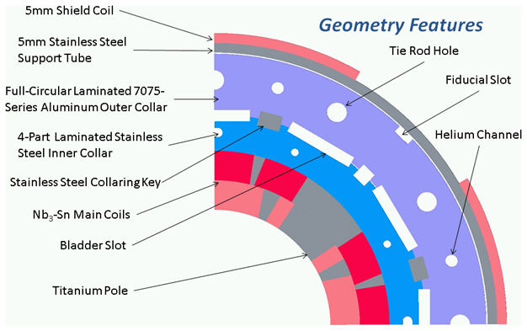
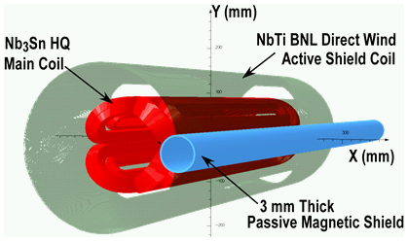
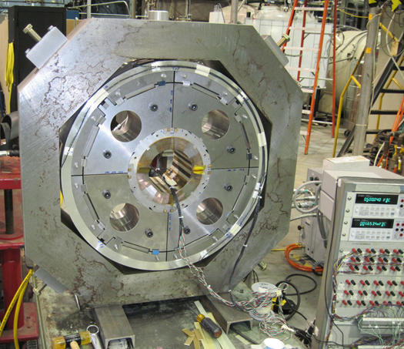
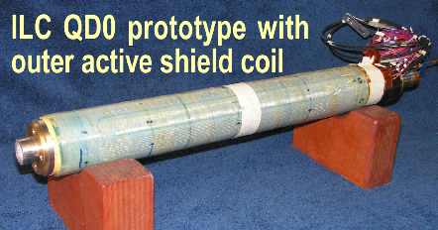
IR Quadrupole Prototype
Collaborative project by BNL, JLab, and LBNL supported by DoE EIC R&D funds
One superconducting magnet will be built and tested – will be similar to the magnet needed for the EIC
The superconducting coils to be used in the magnet will be coils that were built as part of another program
Design of the magnet will incorporate results from detailed computer models and from tests of similar
magnets
Test results - compared
with the predictions of
the models

Slide 20
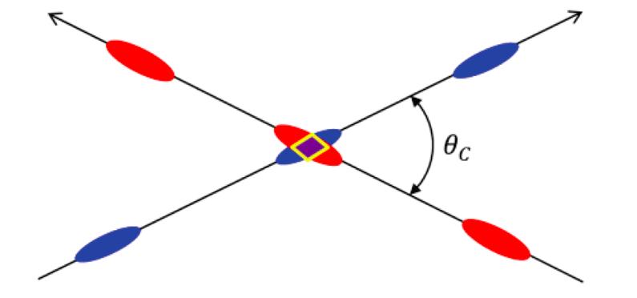
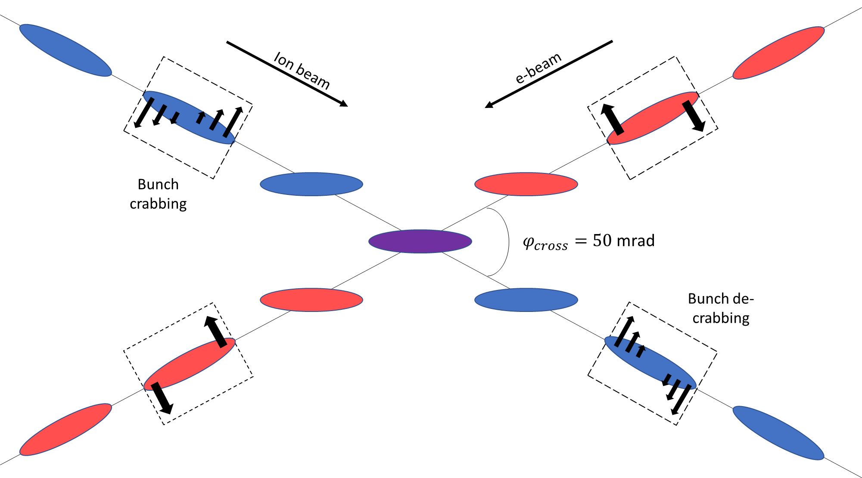
Beam Crabbing
Beam crossing angle is necessary to avoid parasitic collisions due to short bunch spacing, make space for machine elements, improve detection and reduce detector background
Low luminosity
Beam dynamics issues
Bob Palmer’s Solution
Effective head-on collision
restored
Factor of 10 luminosity increase
compared to uncorrected case

Slide 21


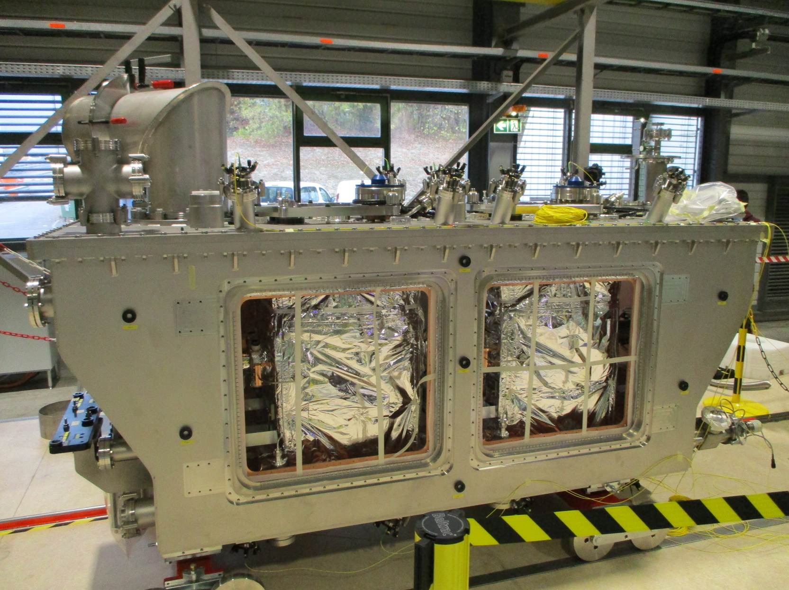
Crabbing Test at CERN’s SPS
First SPS ion crabbing test completed: crab cavity turned on
and bunch tilt observed
ODU, JLab and BNL plan to participate in future tests

Slide 22
FY 18-19 JLab EIC R&D Projects Supported by DoE
Crab cavity operation in a hadron ring (Lead: ODU, collaborators: JLab, BNL)
Development of innovative high-energy magnetized electron cooling for an EIC (Lead: JLab, collaborators: BNL, FNAL, ODU)
Strong hadron cooling with micro-bunched electron beams (Lead: BNL, collaborators: JLab, SLAC, ANL)
High Gradient Actively Shielded Quadrupole (Lead: BNL, collaborators: JLab, LBNL)
Validation of EIC IR magnet parameters and requirements using existing magnet results (Lead: JLAB, collaborators: SLAC, LBNL)
Development & test of simulation tools for EIC beam-beam Interaction (Lead: BNL, collaborators: JLab, MSU, LBNL)
Experimental verification of spin transparency mode in an EIC (Lead: JLab, collaborator: BNL)
High Bandwidth Beam Feedback Systems for a High Luminosity EIC (Lead: ANL, collaborator: JLab)

Slide 23
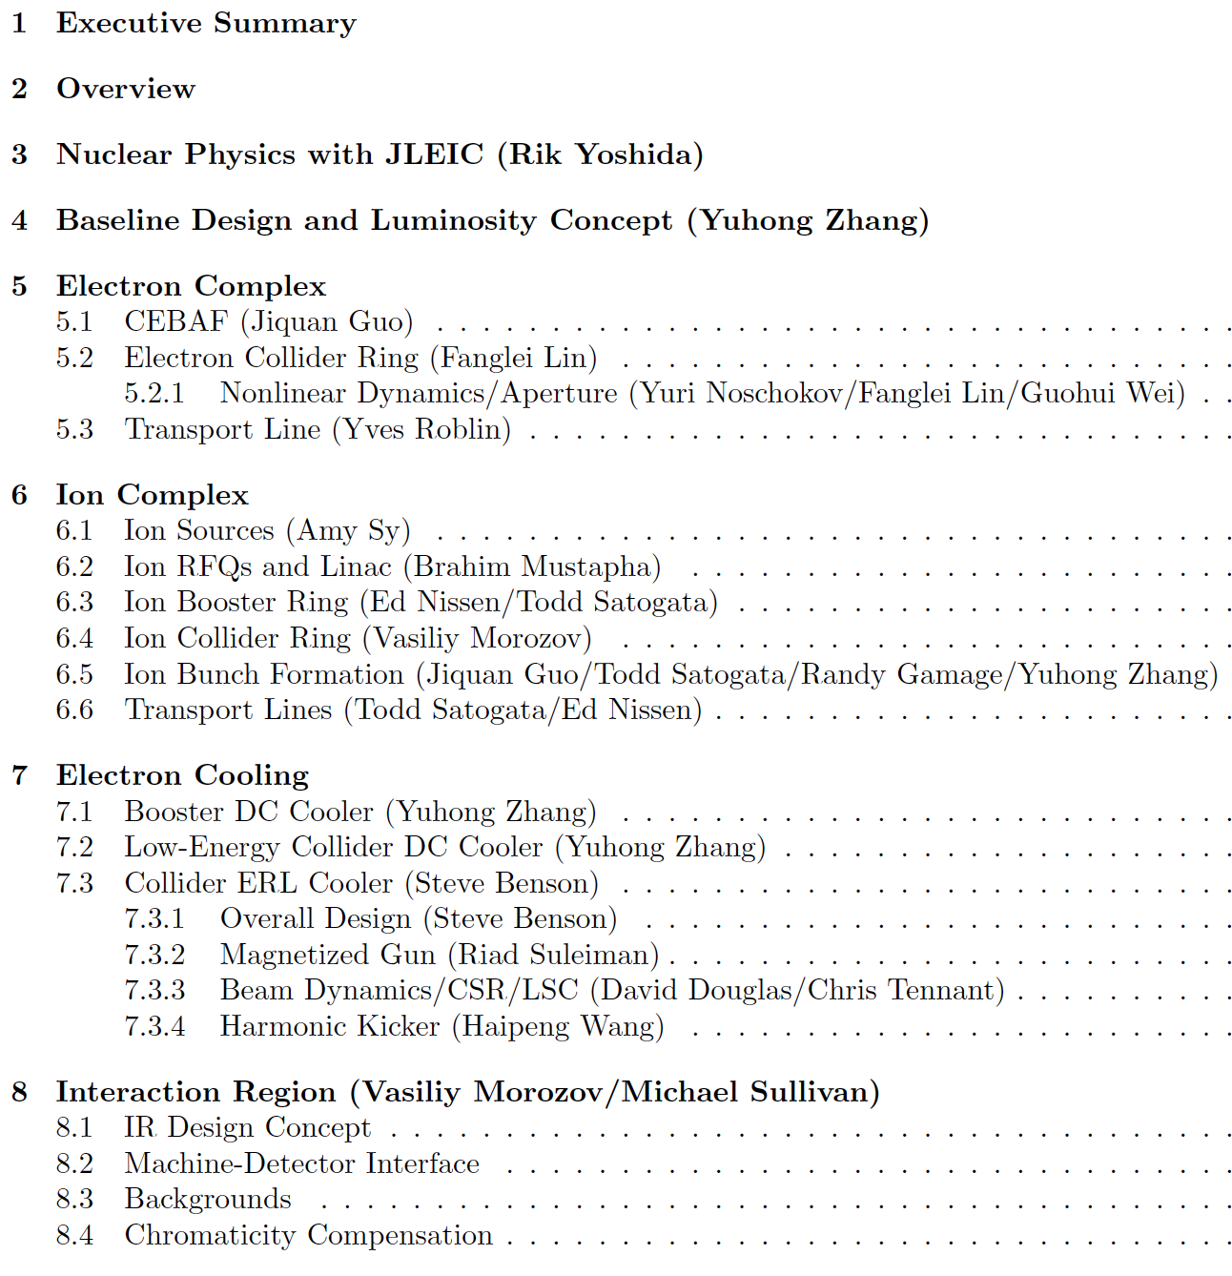
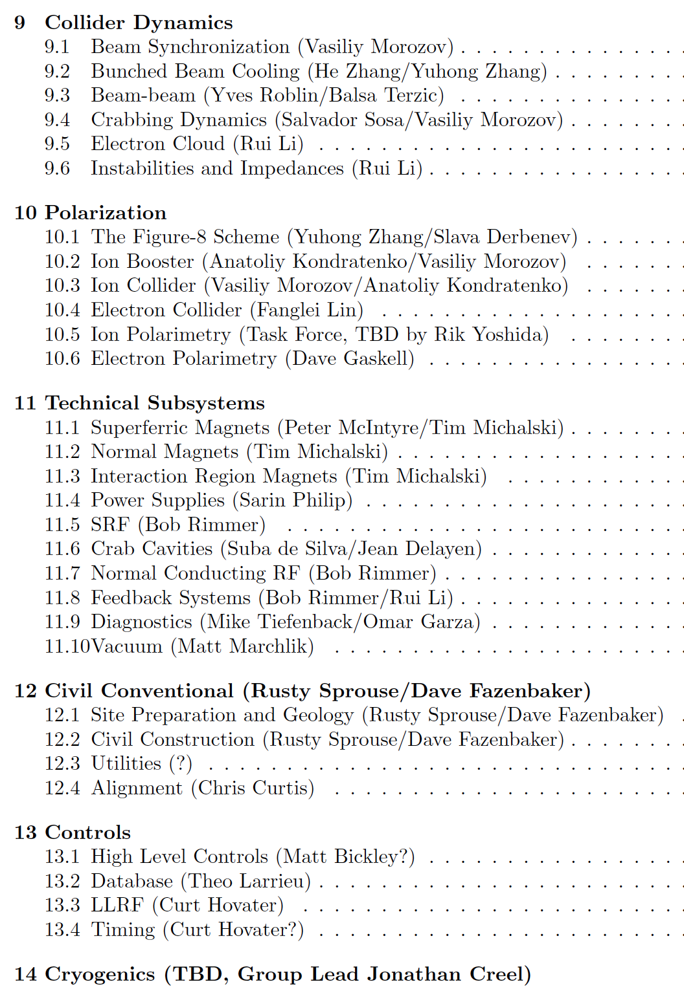
pCDR Planning and Status
Keep in mind pCDR milestones:
  Early section drafts: June 1 2018
  Early draft full document: June 18 2018 (JLab Users Group)
  Solid draft full document: July 30 2018 (EIC Users Group)
  Deliver full document: Sep 28 2018 (End of FY18)

Slide 24
Backup

Slide 25
JLEIC Parameters (3T option)
CM energy | GeV | 21.9 (low) |  | 44.7 (medium) |  | 63.3 (high)
 |  | p | e | p | e | p | e
Beam energy | GeV | 40 | 3 | 100 | 5 | 100 | 10
Collision frequency | MHz | 476 |  | 476 |  | 476/4=119
Particles per bunch | 10¹⁰ | 0.98 | 3.7 | 0.98 | 3.7 | 3.9 | 3.7
Beam current | A | 0.75 | 2.8 | 0.75 | 2.8 | 0.75 | 0.71
Polarization | % | 80% | 80% | 80% | 80% | 80% | 75%
Bunch length, RMS | cm | 3 | 1 | 1 | 1 | 2.2 | 1
Norm. emittance, hor / ver | μm | 0.3/0.3 | 24/24 | 0.5/0.1 | 54/10.8 | 0.9/0.18 | 432/86.4
Horizontal & vertical β* | cm | 8/8 | 13.5/13.5 | 6/1.2 | 5.1/1.0 | 10.5/2.1 | 4/0.8
Ver. beam-beam parameter |  | 0.015 | 0.092 | 0.015 | 0.068 | 0.008 | 0.034
Laslett tune-shift |  | 0.06 | 7x10⁻⁴ | 0.055 | 6x10⁻⁴ | 0.056 | 7x10⁻⁵
Detector space, up/down | m | 3.6/7 | 3.2/3 | 3.6/7 | 3.2/3 | 3.6/7 | 3.2/3
Hourglass(HG) reduction |  | 1 |  | 0.87 |  | 0.75
Luminosity/IP, w/HG, 10³³ | cm⁻²s⁻¹ | 2.5 |  | 21.4 |  | 5.9

