Slide 1
JSA Awards Presentation
Jerry P. Draayer
SURA President & CEO
JSA Board Vice Chair & CEO
-1-

Slide 2
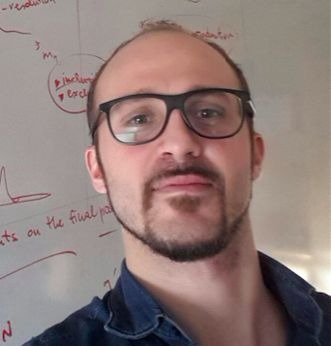
JSA Post Doctoral Research Prize
Established in 2008 by the Users Group as a way to recognize, reward, and honor the finest postdocs and support the Lab’s scientific mission
Over the years, the prize has helped to encourage students to see that excellence is recognized at every level of their careers, including their post graduation, career building phase
Award to:
* Cristiano Fanelli, Post Doc, Massachusetts Institute of Technology
Proposal: A Deep Learning Approach to Particle Identification and Alignment of the GlueX DIRC
* Cristiano was awarded the JSA Thesis Prize in 2015.
-2-

Slide 3
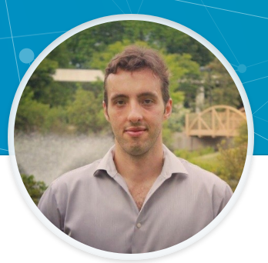
JSA Thesis Prize
Established in 1999 by SURA for the Users Group, an opportunity to recognize some of the best theses on JLab science and research by graduate students
Prize continued since 2007 under the JSA Initiatives Fund Program
Award to:
* Alessandro Baroni, Post Doc, University of South Carolina
Thesis, Old Dominion University: Nuclear Chiral Axial Currents and Applications to Few-Nucleon Systems
* Alessandro was awarded the JSA Distinguished Theory Student Fellowship in 2012.
-3-

Slide 4
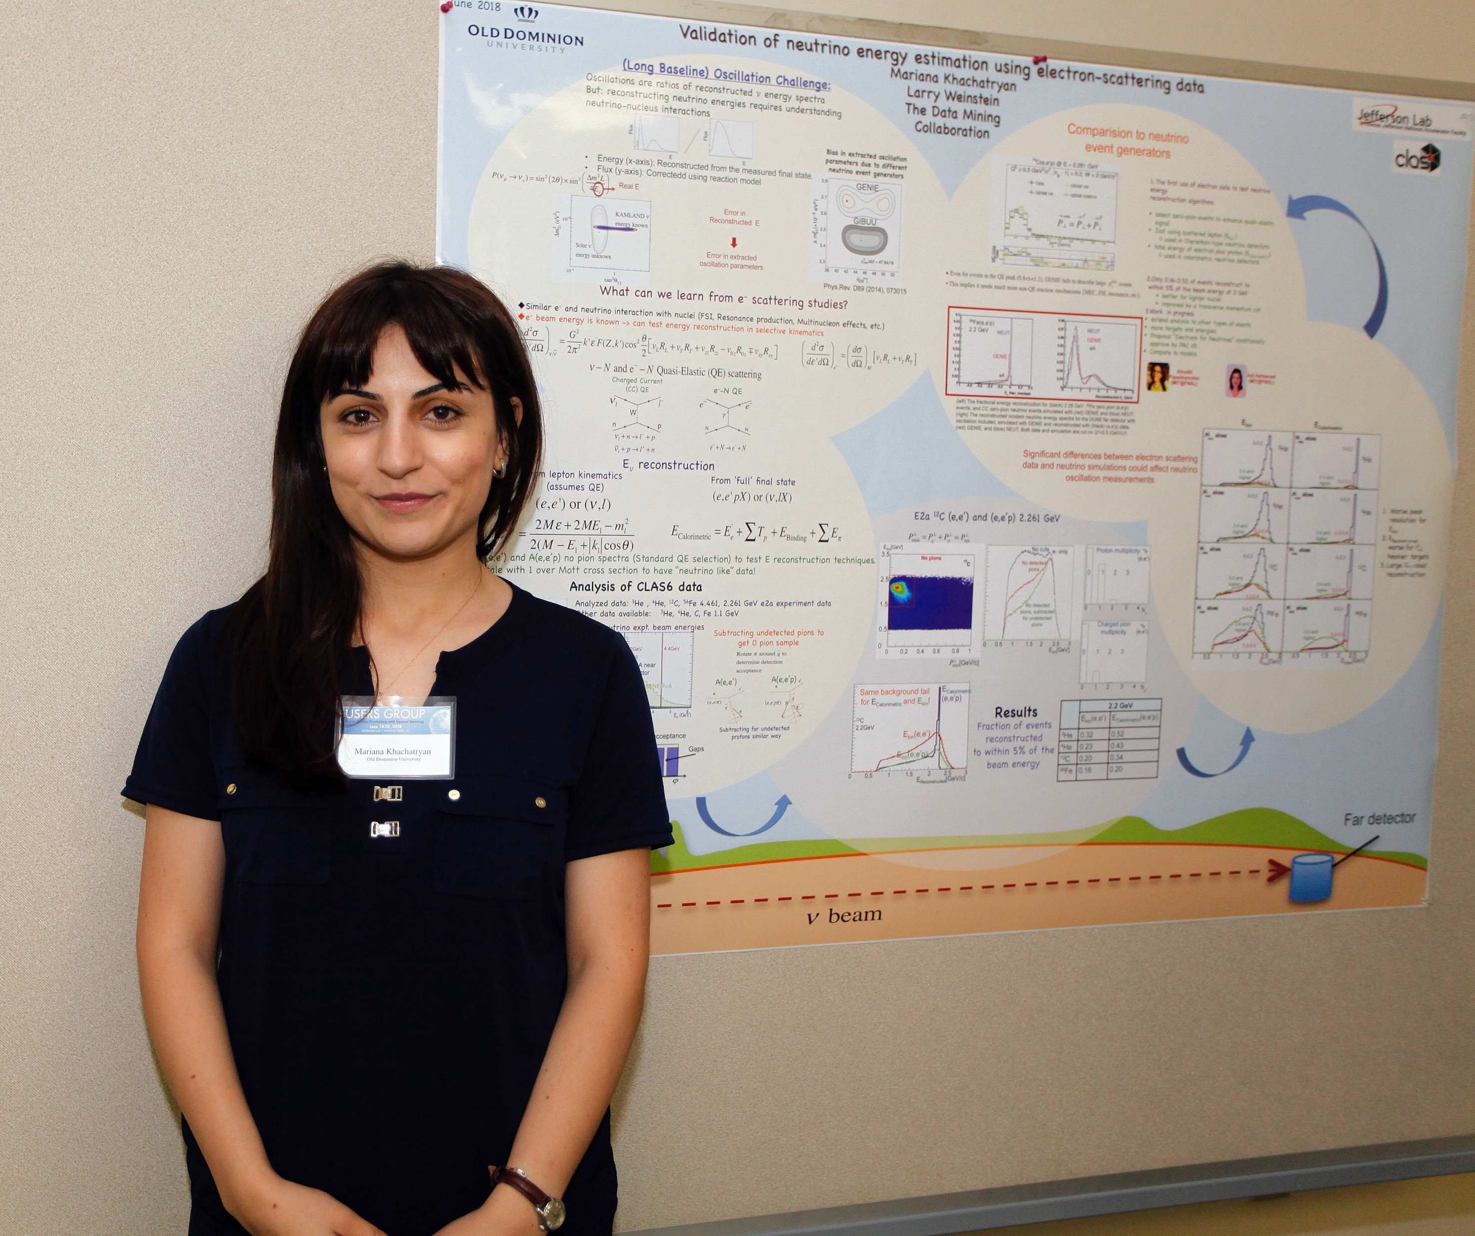
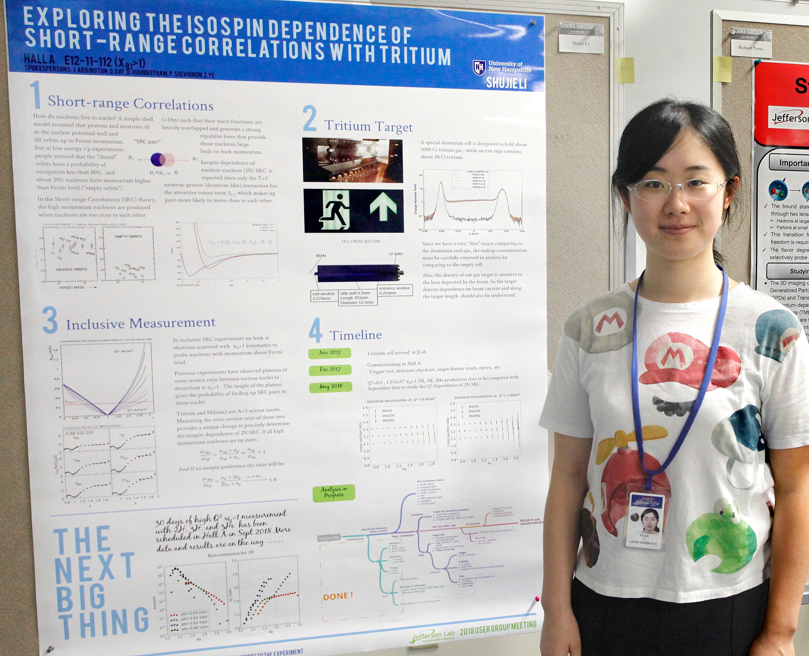
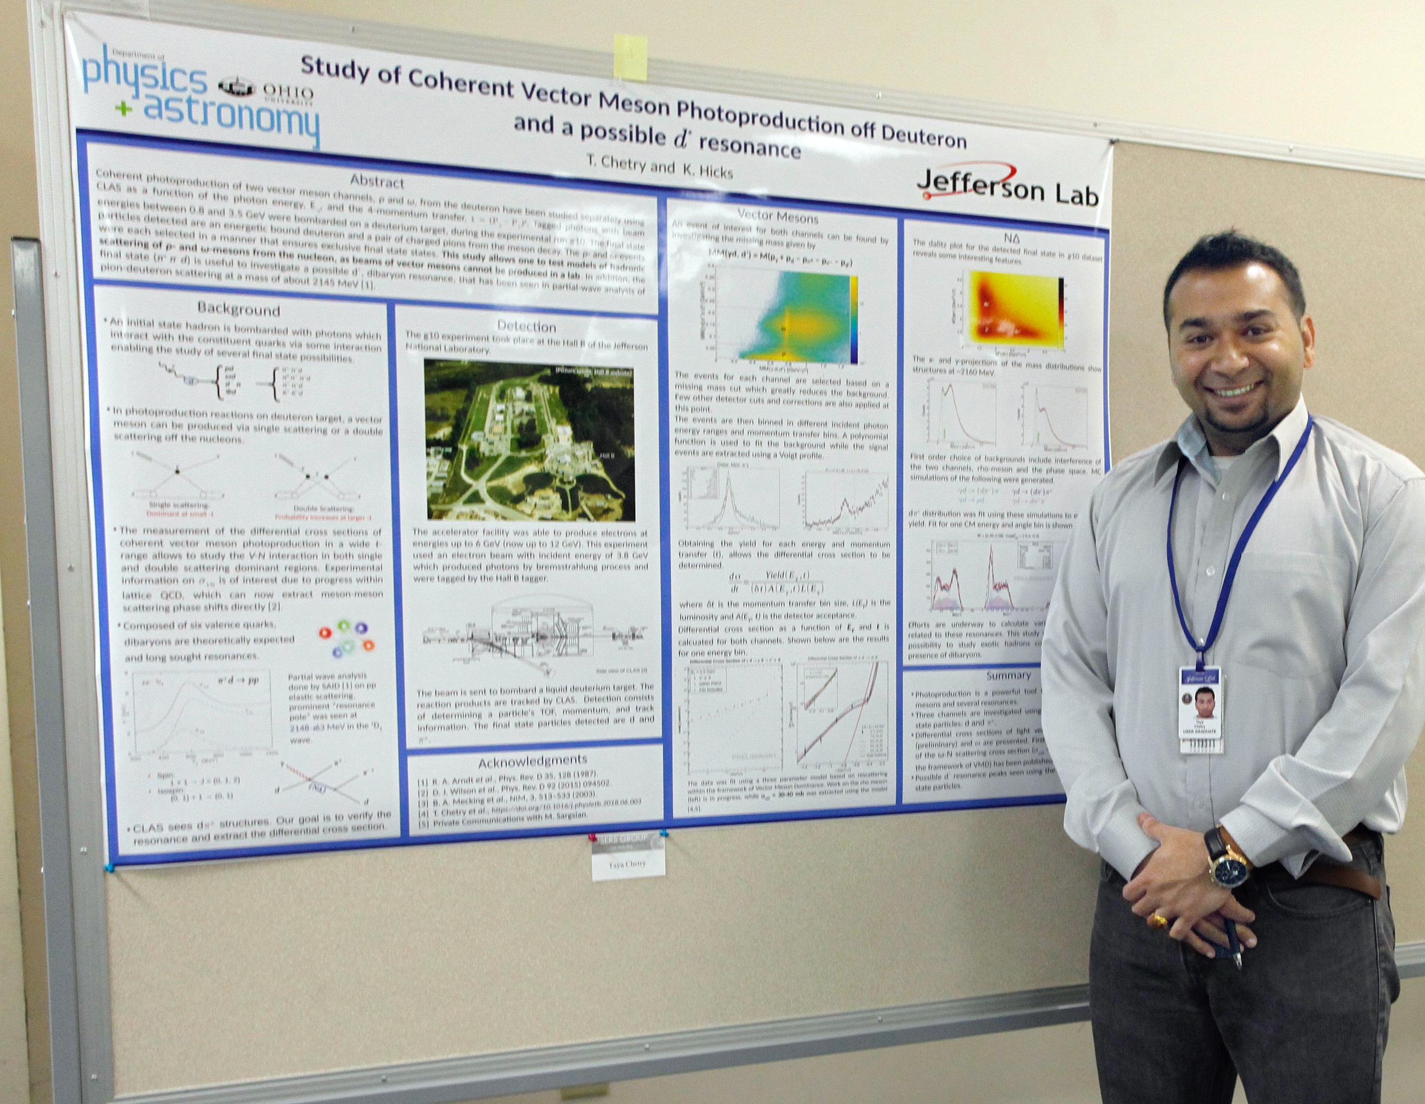
Users Group Poster Prizes
Rewards and recognizes students; encourages attendance at User Group Meeting; encourages students to develop their communication abilities
Awardees receive travel support for attendance at a meeting of their choice to present their poster
Poster Prizes awarded to:
1st Place
Mariana Khachatryan
Old Dominion University
2nd Place
Shujie Li
University of New Hampshire
3rd Place
Taya Chetry
Ohio University
Validation of neutrino energy estimation using electron scattering data
Inclusive Short-range Correlation Measurement with 3H and 3He at Jefferson Lab
Study of Coherent Vector Meson Photoproduction and a Possible d Resonance using CLAS
Honorable Mentions to: Burcu Duran (Temple University) and Victoria Owen (College of William & Mary)
-4-

