Slide 1
Jefferson Lab Users Organization
Krishna Kumar
Stony Brook University
Chair,
JLab User Group
Board of Directors
NEED new JLUO logo

Slide 2
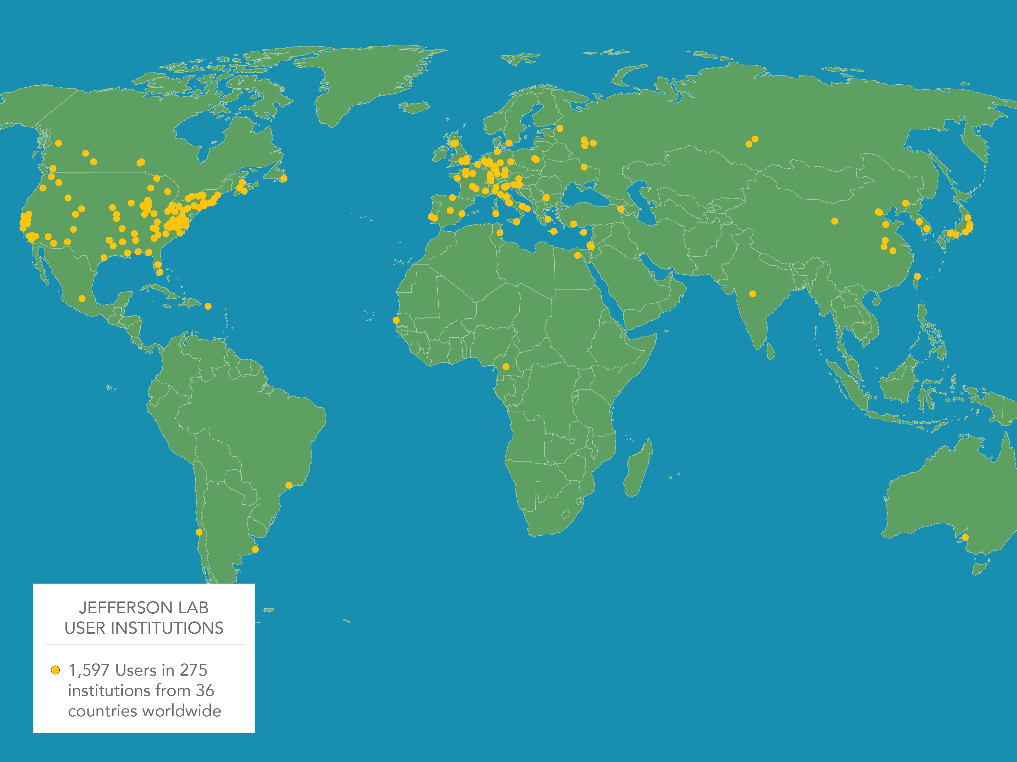
2
JLab Serves a Vibrant and Enthusiastic User Community
1,597 Active Users
(swapped badge at least once last year, authored a proposal, or maintain an active JLab computer account)
425 Physics Letters and Physical Review Letters publications; 1,459 in other refereed journals
608 PhDs granted; 211 more in-progress
JLab produces ~1/3 of US PhDs in Nuclear Physics

Slide 3
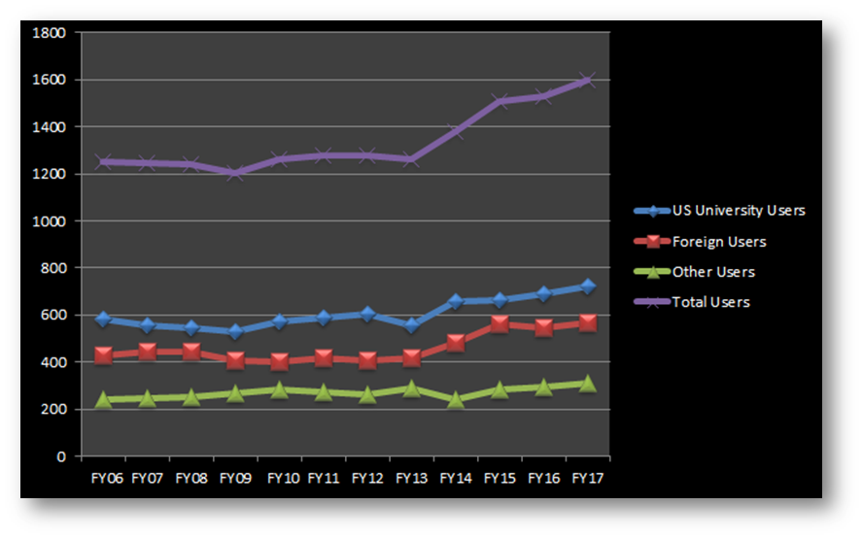
Keen Anticipation Worldwide for the Start of 12 GeV Science
The User Group has grown significantly in recent years
Reflection of the increasing breadth of nuclear science topics and the powerful new capabilities of the upgraded CEBAF

Slide 4
4
JLab User Organization’s purpose
Encourage and assist scientists and engineers in the use of the Continuous Electron Beam Accelerator Facility, (Community building)
Create and maintain effective channels for the exchange of information between the staff of JLab and other scientists and engineers interested in using CEBAF,
Create and maintain effective methods of offering advice and counsel to the JLab management on matters of policy affecting the development and utilization of the facility, and (Representation of users within JLab)
Support, encourage, and assist in the advancement of basic scientific knowledge, and to promote the most effective utilization of CEBAF for the common good and welfare of society. (Outreach)
https://wiki.jlab.org/cugwiki/

Slide 5
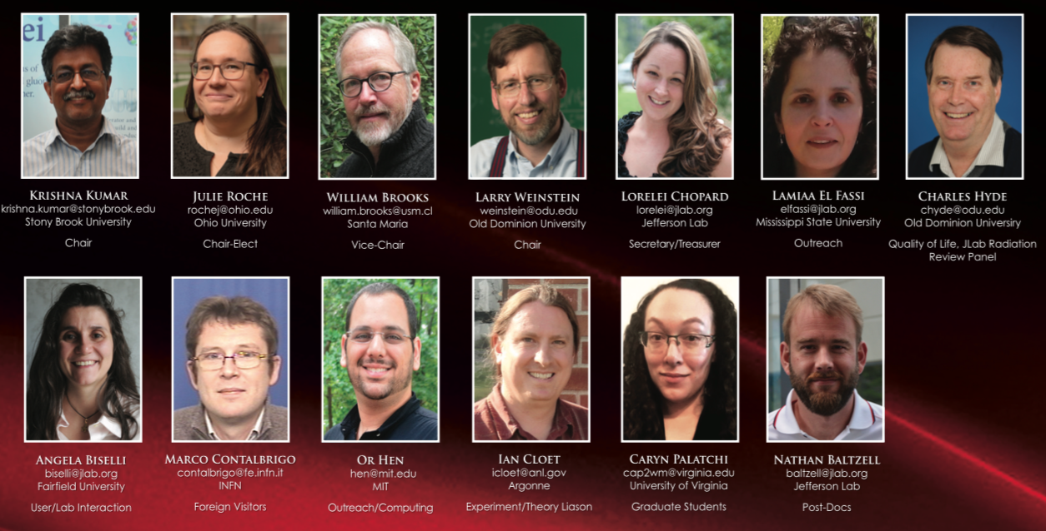
Users Group Board of Directors (UGBoD)
Soon to be Past Chair: Krishna Kumar [Stony Brook]
Soon to be Chair: Julie Roche [Ohio U]
Soon to be Chair-Elect: Will Brooks [UTFSM, Chile]
Incoming Vice-Chair: Kent Paschke [U. Virginia]
Retiring Past Chair: Larry Weinstein [ODU]
Secretary/Treasurer: Lorelei Chopard [Jefferson Lab] (staff)

Slide 6
Users Group Board of Directors (UGBoD)
Lamiaa El Fassi (Mississippi State U): Outreach
Charles Hyde (Old Dominion U): Quality of Life
Angela Biselli (Fairfield U): User/JLab interaction
Marco Contalbrigo (INFN Ferrara): Foreign Visitors
Or Hen (MIT): Outreach and Computing
Ian Cloet (Argonne): Experiment/Theory Liaison
Caryn Palatchi (UVa): Graduate Students *
Nathan Baltzell (Jefferson Lab): Postdocs
New Board Members:
Carlos Munoz Comacho
Yordanka Ilieva
Brad Sawatzky
Eric Pooser
* Torri Roark
Congratulations!
*
*
*
*

Slide 7
7
Examples of Community building activities
Annual Users Meeting (Committee: Julie Roche, Angela Biselli, Will Brooks, Ian Cloet, Or Hen, Charles Hyde, Justin Stevens)
2 satellite meetings (APS April and DNP Fall meetings)
Manage JSA awards (Thesis Prize, Postdoc Prize, Poster Prize…)
Submit several continuing Initiatives Fund (IF) proposals
Most of the JLUO activities are supported by JSA: thanks, continued support is vital; good support for 2018; look forward to support at the same level in 2019
Help with Software Carpentry Workshop
Examples of User Representation at JLab activites
Representation on Director’s Safety Council (E. Brash), JLab radiation review committee (C. Hyde) , Director’s Inclusion and Diversity Council (A. Biselli)
Worked with B. McKeown on PAC-related issues
Suggestions for new PAC members
Role of User Chair on PAC: Julie Roche will serve on 2018 PAC,
guidelines for engagement developed with PAC Chair Jim Napolitano
Meet with JLab management twice a year (Jan, Jun) and with JSA

Slide 8
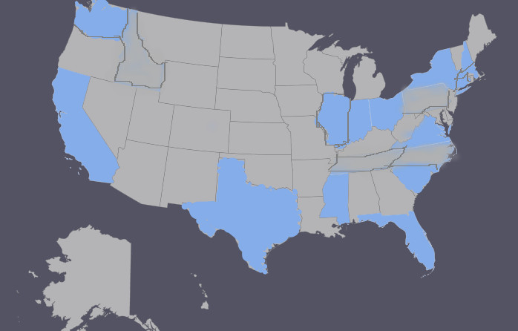
Flagship Outreach example: Nuclear Physics day on the Hill
JLab, RHIC, FRIB and Fundamental Symmetries user communities meet with the offices of senators and representatives
JLab participants (6th year)
2013: 7 persons
2017: 23 from 13 states
2018: 27 from 13 states
In 2018:
Coordinated by L. El Fassi
Meeting was on April 9
https://wiki.jlab.org/cugwiki/index.php/Nuclear_Physics_Day_on_the_Hill
Must participate each year!

Slide 9
9
Examples of Outreach activities
Select and nominate users for APS Fellowships (raise JLab User profiles)
Expanded purview of Nominating Committee beyond UGBOD membership:
John Arrington serves as Chair for 2017-19
UGBOD Engagement with Congress on Office of Science 2018 Budget
Urged Users to write to elected officials
Sent letters to Congressional subcommittees; coordinated with other national user organizations
Strengthening User Group communication with DoE NP Office
Germantown visit May 2017 (another visit is being planned for this year in July)
Conveyed excitement and breadth of 12 GeV Physics
Communicated User concerns
JLab operations budget affects accelerator availability and performance
Timely thesis topics for graduate students and research output for postdocs and junior faculty
With JLab, produced a “broader impacts” slide show with profiles of former users.
We need your non-JLab email address to communicate with you about this topic:
Working with JSA to construct a non-Jlab/gov email list: please to our call when this is ready!

Slide 10
2018 Thesis and Postdoc Prizes
(supported by JSA Initiatives Fund)
Organized by Will Brooks and myself
Thesis prize
Three board members read all entries
The top two theses were chosen and then two outside reviewer opinions were solicited
No conflicts of interest allowed
Postdoc prize
Four board members read all entries (except for COI)
Due to a tie at the top and also because of COI, two other board member opinions were solicited before a final decision was made
Awarded this afternoon by Jerry Draayer
Winner: Alessandro Baroni
Winner: Cristiano Fanelli
Very high quality entries!
Reflects vibrant young scientists pursuing 12 GeV science!

Slide 11
DNP Executive Committee Nominees
Thanks to John Arrington and the rest of the Nominating Committee: David Armstrong, Jose Goity, Maria Niculescu and Elton Smith
We are suggesting two “at-large” candidates, you are allowed up to 3
Chair line: Kawtar Hafidi
Board members:
Douglas Higinbotham
Kent Paschke
Go to http://www.aps.org/units/dnp/ and click on “DNP EC Nomination Form”
Deadline July 2

Slide 12
https://wiki.jlab.org/cugwiki/
cuga@jlab.org
The User Group Board helps
Bring the users together
Represent the users to the lab and the lab to the users
Represent the lab+users to Congress and the DOE
JSA Initiatives Fund support is critically needed for UG Board activities
User group board of directors recent concerns:
MOUs with foreign institutions,
Accelerator performance ,
Lab operating budget and available running time (recent progress but we must continue to contact our congressional representatives!)
Help foster user contributions to the development of the EIC and,
Your issues here: tell us your concerns

