Slide 1

Jefferson Lab Science Program
Robert McKeown
User Meeting
June 19, 2018

Slide 2
Outline
Recent Highlights
Future Projects
PAC
Near term schedule
EIC Developments
Summary

Slide 3

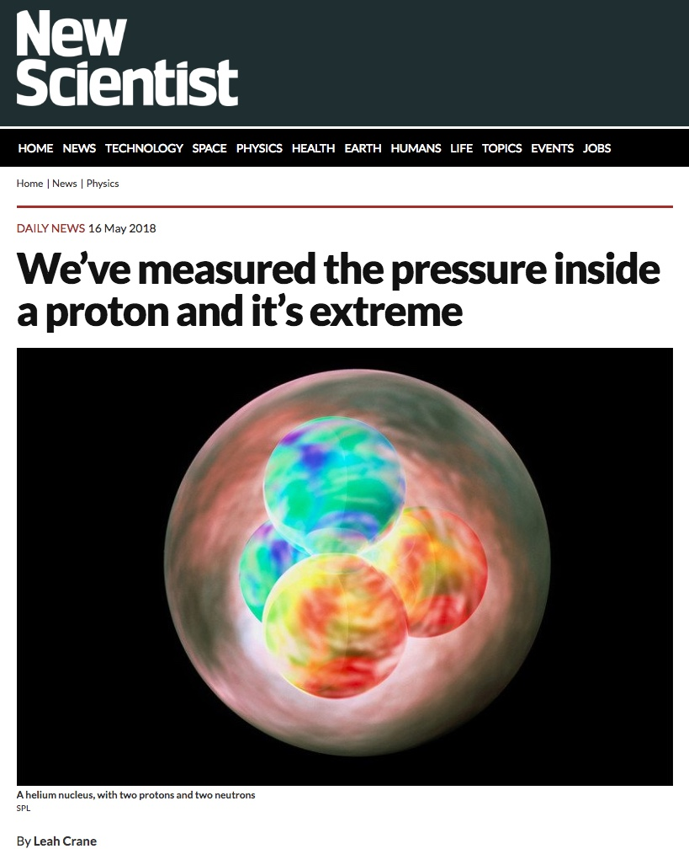
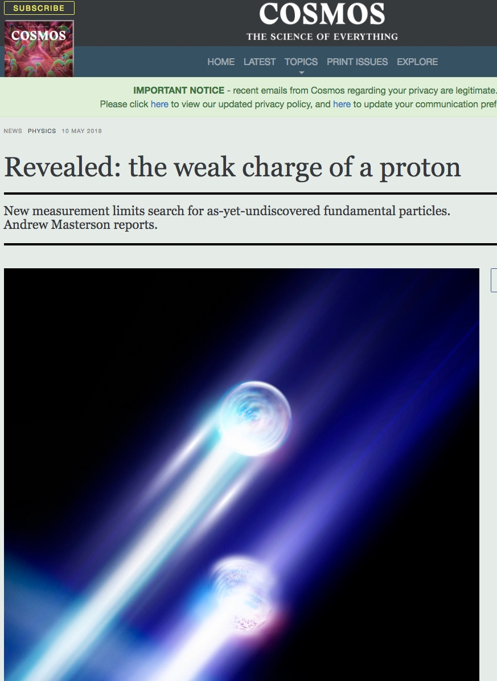
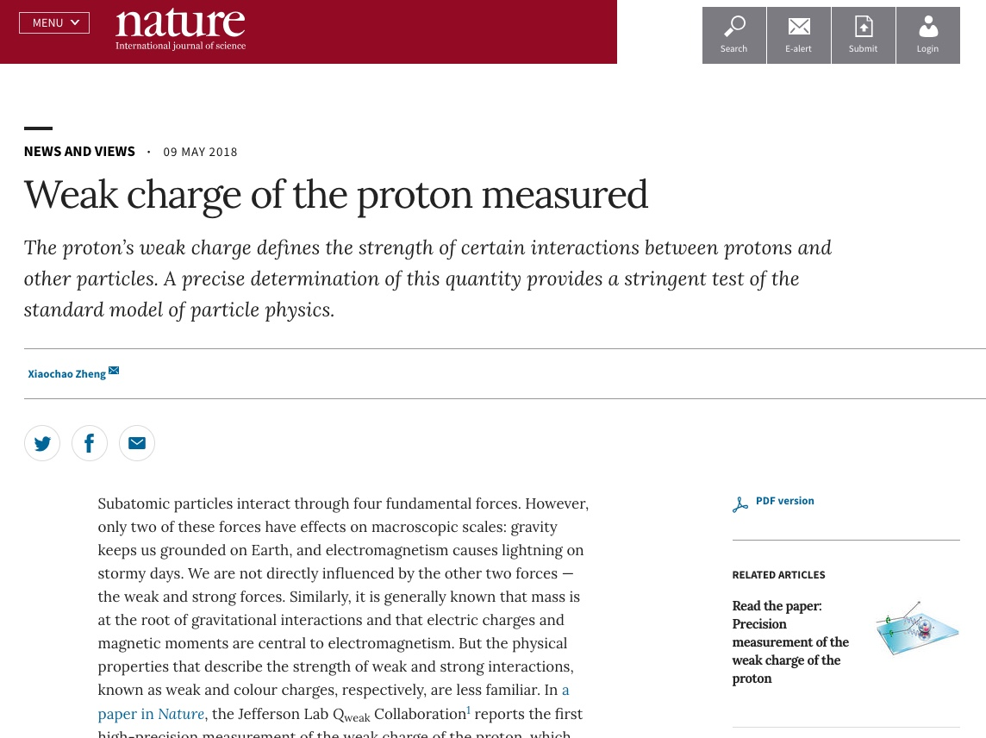

Results Accepted and/or Published in Nature
Precision measurement of the weak charge of the proton, Qweak collaboration,
Published: Nature 557, 207–211 (2018)
The pressure distribution inside the proton, Burkert, Elouadrhiri, Girod, Published: Nature 557 (2018) no.7705, 396-399
A per-cent-level determination of the nucleon axial coupling for quantum chromodynamics, Berkowitz et. al., Published: Nature 558, 91-94 (2018)
Ultrafast Nucleons in Asymmetric Nuclei, M. Duer et. al., CLAS Collaboration, accepted for publication
A glimpse of gluons through deeply virtual compton scattering on the proton, Dufurne et. al., Published: Nature Communications 8, 1408 (2017)
3

Slide 4
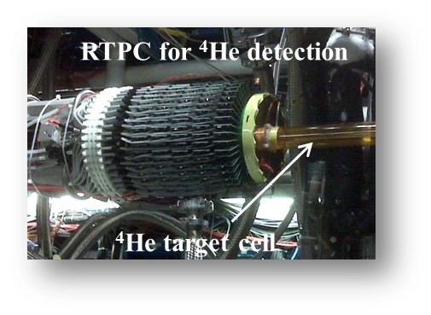

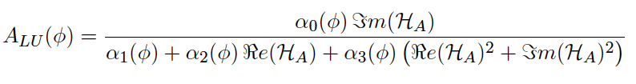
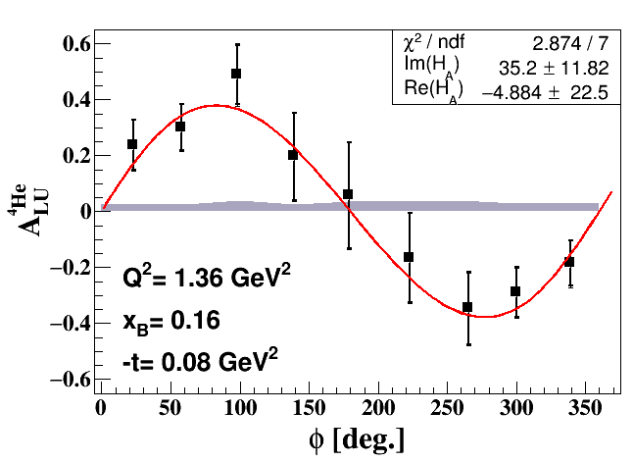
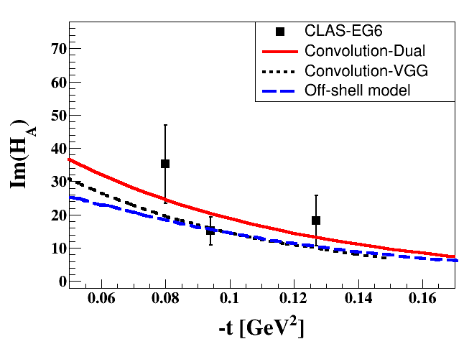
Other Recent 6 GeV Results
DVCS on ⁴He with CLAS; published in PRL: Phys. Rev. Lett. 119, 202004
Multiple nucleon resonances now confirmed; highlighted in Particle Data Group (PDG) tables.
Study the nuclear medium modifications in ⁴He:
one GPD (H_{A}(x,ξ,t)).
State N(mass)J^{P} | PDG pre 2012 | PDG 2018*
N(1710)1/2⁺ | *** | ****
N(1880)1/2⁺ |  | ***
N(1895)1/2⁻ |  | ****
N(1900)3/2⁺ | ** | ****
N(1875)3/2⁻ |  | ***
N(2120)3/2⁻ |  | **
N(2000)5/2⁺ | * | **
N(2060)5/2⁻ |  | **
Δ(2200)7/2⁻ | * | ***
Beam
Asymmetry
**** Existence is certain
*** Existence is very likely
** Evidence of existence is fair
* Evidence of existence is poor
First study of Nuclear GPD  3D Imaging

Slide 5
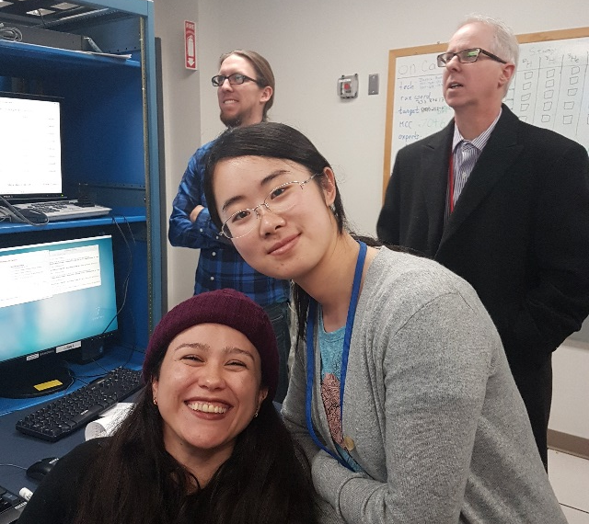
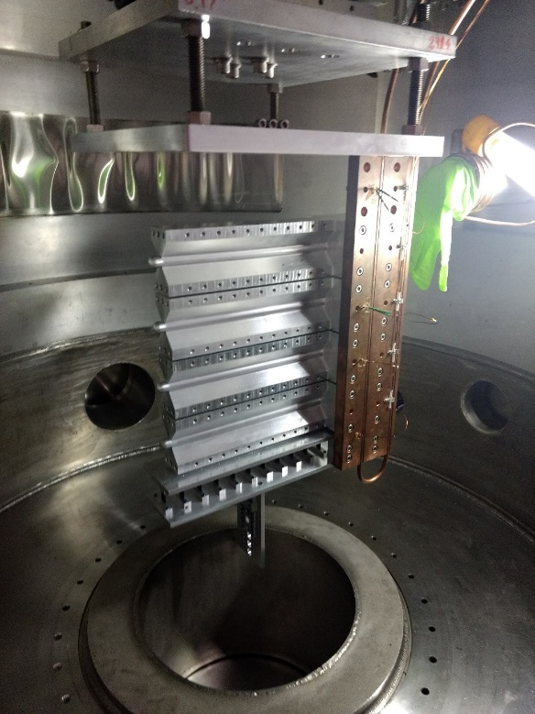
Hall A
First Beam On Tritium Target Cell
On 12/15/17 Hall A put first beam on a tritium target cell – facilitates 4 (3 high impact) experiments!
LEFT Image: Waiting for first beam on the Hall A tritium target: UNH Ph.D. students Nathaly Santiesteban and Shujie Li along with Jefferson Lab postdoc Evan McClellan and lab Director Stuart Henderson.
CENTER Image: Shown are the tritium, He, D target data as compared to running on an empty cell (black). The tritium and other gas targets are clearly visible between the aluminum entrance and exit windows of the target cell.
RIGHT Image: The target cell stack during installation in the Hall A scattering chamber.
MARATHON d/u ratio experiment complete!

Slide 6
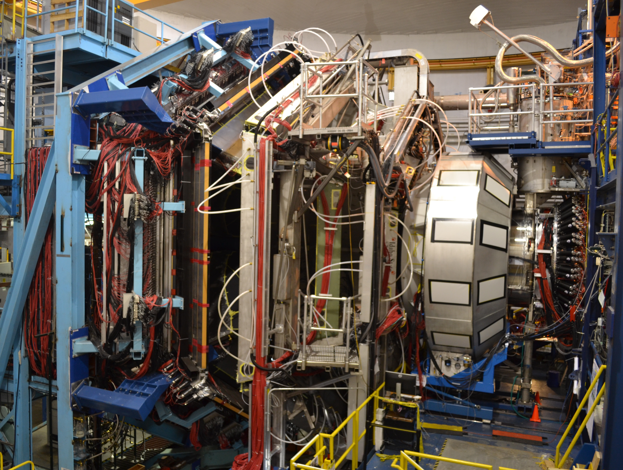
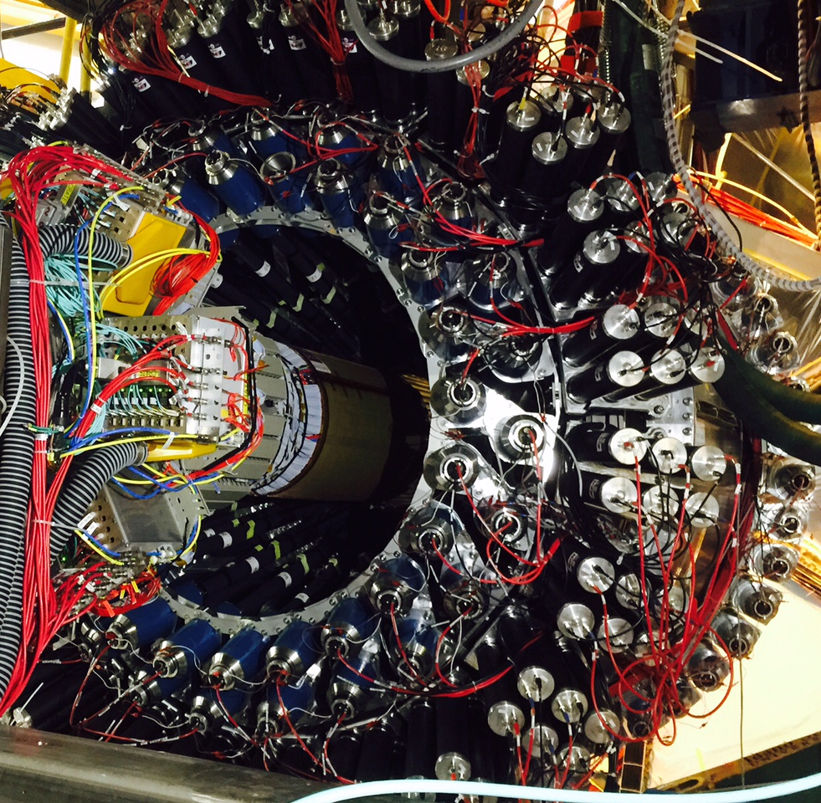
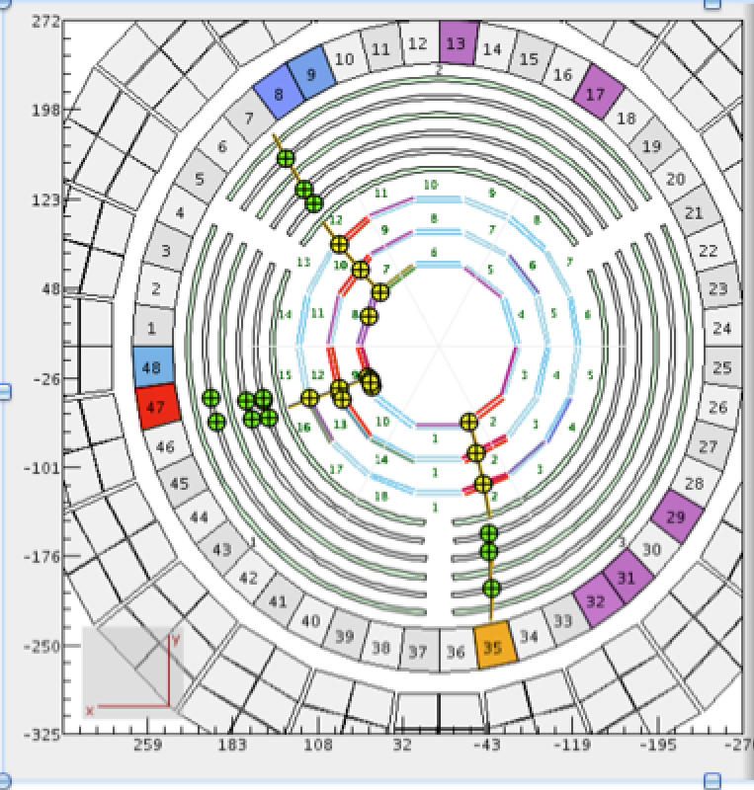
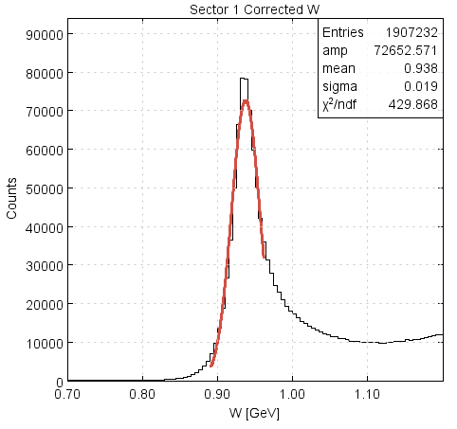
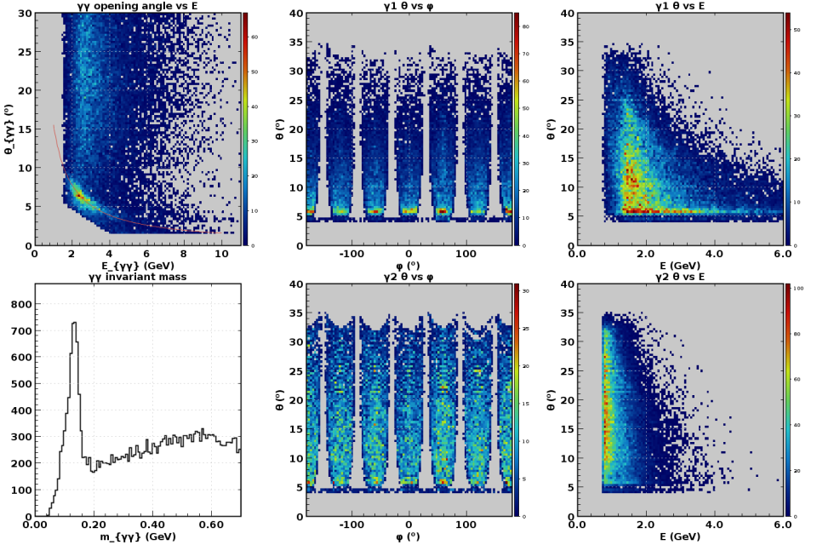
Hall B
CLAS12 Forward Detector
CLAS12 Central Detector with 3 charged particles
p(e,e’)p @ 2.2 GeV
π⁰ @ 10.6 GeV
Detectors were operated during engineering run at luminosities from 0.75 x 10³⁴ to 1.75 x 10³⁵
The latter is nearly twice the design luminosity!
Physics production run started at a luminosity of 3-7 x 10³⁴ – run group A (11 experiments)
π⁰
W (GeV)
m_{γγ}

Slide 7
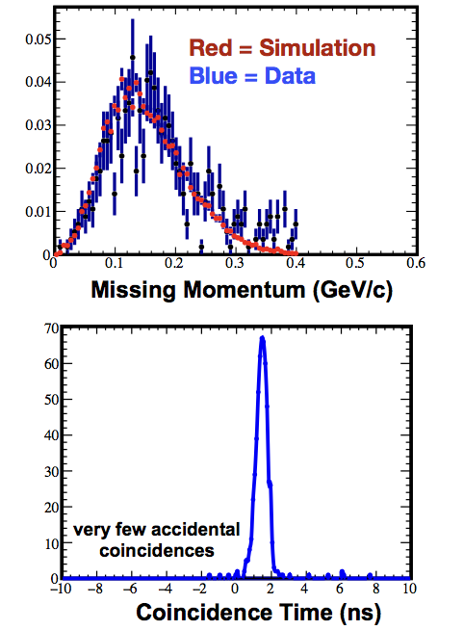
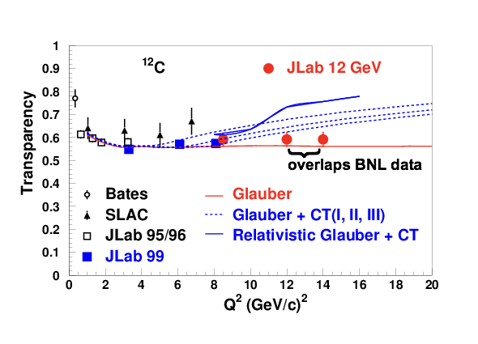
Hall C
SHMS calibration data acquired
Physics Program started:
  F₂^{H,D} structure functions
  D(e,e’p) at high missing momentum
  Color Transparency – ¹²C(e,e’p)
    Data for 2 of 3 points acquired.
    Highest Q² is where BNL A(p,2p) saw rise in transparency
  TMD studies (SIDIS) underway
Online data quality excellent!

Slide 8

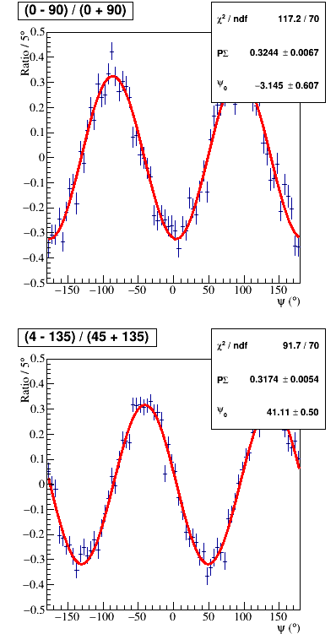
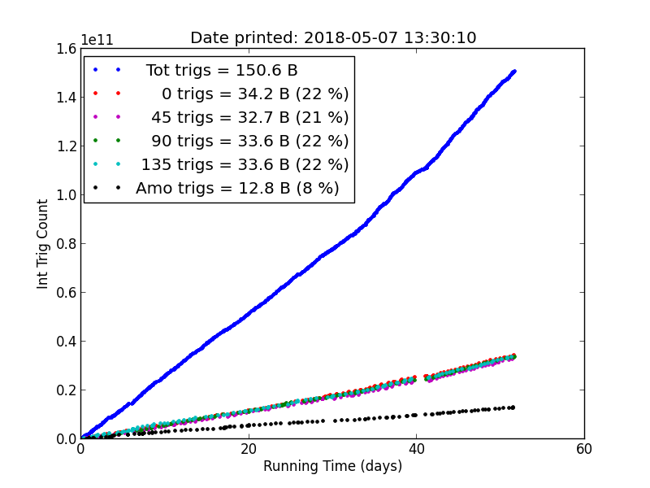

Hall D
Hall D is running GlueX-I (90 PAC days approved)
Spring 2017: 20 PAC days accumulated, ~50B events collected.
Spring 2018: ~150B events collected.
Present estimate: GlueX-I is 80% complete.
Decay asymmetry = ΣP_{beam}, Σ≈1
Data quality monitoring
Beam polarization P_{beam}~35%, similar to 2017
Yields of known resonances are similar to 2017

Slide 9
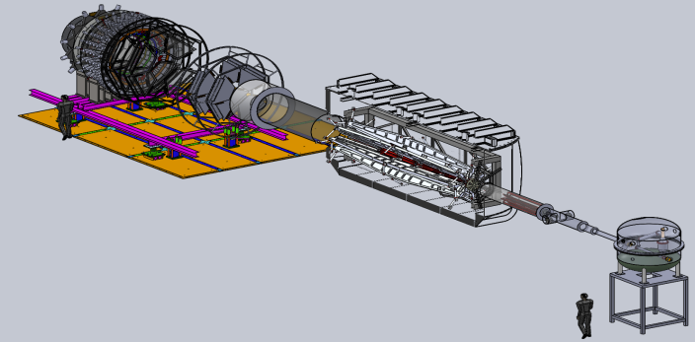

Future Projects
MOLLER experiment
(Possible MIE – FY19-23)
– Precision Standard Model Test
– DOE science review (Sept. 2014) – strong endorsement
– Director’s Cost, Schedule and Technical review held Dec. 2016
– CD-0 approved, Dec. 2016
(project paused due to budget)
– Awaiting green light to proceed
SoLID
– Large acceptance, high lumi
– SIDIS and PVDIS
– CLEO Solenoid 
– International collaboration
– Director’s review (Feb. 2015)
 new pre-CDR complete
– Awaiting science review from ONP

Slide 10
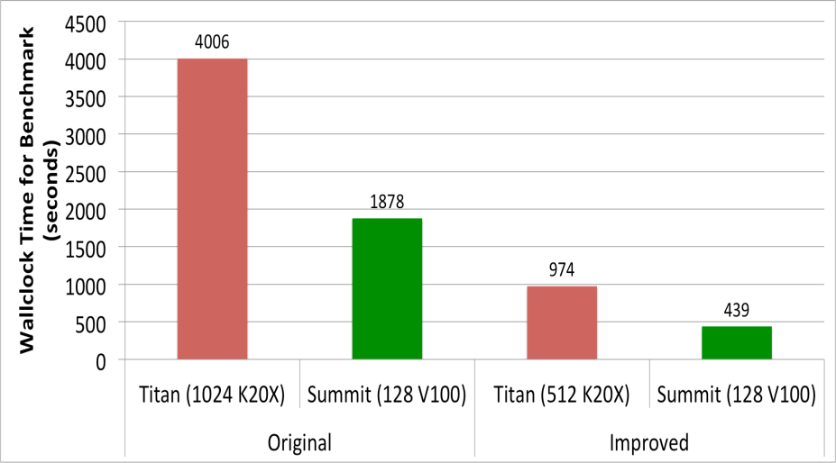
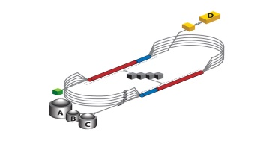

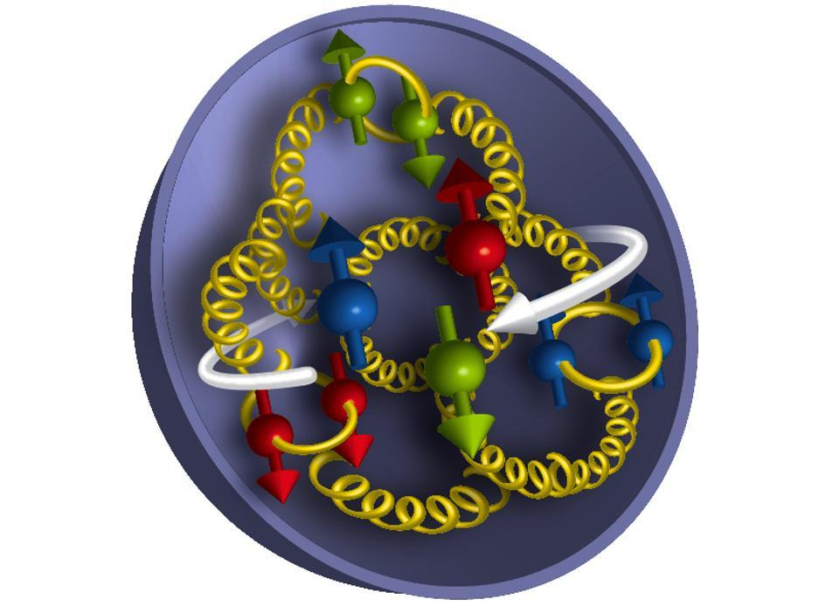

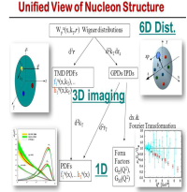
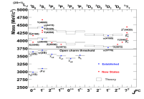
Computation: progress and plans
Strong LQCD Program
- SCIDAC, Exascale Application
- JLab LQCD cluster expansion:
70% increase this year
JLab Data Analysis Cluster
- upgrade from 37 to 72M core-hours/year in FY18
- priority support for production analysis
- increased use of off-site computing for simulations
- LDRD project to explore using NERSC for GLueX analysis
Integration of Experiment and Theory
- explore “Super-Facility” concept
- Center for Nuclear Femtography
4.1x faster
on 2x fewer
GPUs
~8x gain
9.1x faster
on 8x fewer
GPUs
~73x gain

Slide 11
Approved experiments
Topic | Hall A | Hall B | Hall C | Hall D | Other | Total
The Hadron spectra as probes of QCD | 0 | 3 | 1 | 3 | 0 | 7
The transverse structure of the hadrons | 6 | 4 | 3 | 1 | 0 | 14
The longitudinal structure of the hadrons | 2 | 3 | 6 | 0 | 0 | 11
The 3D structure of the hadrons | 5 | 9 | 6 | 0 | 0 | 20
Hadrons and cold nuclear matter | 8 | 4 | 7 | 0 | 1 | 20
Low-energy tests of the Standard Model and Fundamental Symmetries | 3 | 1 | 0 | 1 | 1 | 6
Total | 24 | 24 | 23 | 5 | 2 | 78
Total Experiments Completed | 4.6 | 2.7 | 2.1 | 0.8 | 0 | 10.2
Total Experiments Remaining | 19.4 | 21.3 | 20.9 | 4.2 | 2.0 | 67.8

Slide 12
Approved Experiments – PAC Days
Topic | Hall A | Hall B | Hall C | Hall D | Other | Total
The Hadron spectra as probes of QCD | 0 | 319 | 11 | 540 | 0 | 870
The transverse structure of the hadrons | 150.5 | 185 | 110 | 25 | 0 | 470.5
The longitudinal structure of the hadrons | 65 | 230 | 165 | 0 | 0 | 460
The 3D structure of the hadrons | 409 | 872 | 197 | 0 | 0 | 1478
Hadrons and cold nuclear matter | 220 | 230 | 205 | 0 | 14 | 669
Low-energy tests of the Standard Model and Fundamental Symmetries | 547 | 180 | 0 | 79 | 60 | 866
Total Days | 1392 | 2016 | 688 | 644 | 74 | 4813.5
Total Days - Without SoLID | 917.5 | 2016 | 688 | 644 | 28 | 4294
Total Approved Run Group Days (includes MIE) | 1392 | 981 | 645 | 444 | 74 | 3536
Total Approved Run Group Days (without SoLID) | 917.5 | 981 | 645 | 444 | 28 | 3016
Total Days Completed | 138.4 | 52 | 44.5 | 93 | 0 | 327.9
Total Days Remaining | 779 | 929 | 600.5 | 351 | 28 | 2688

Slide 13
PAC Meetings
PAC45 Changes:
Better communication on previously approved related proposals.
Stricter procedures on conflicts of interest
New user chair role as observer/watchdog on above issues and others to ensure fairness and QA
Seems to have worked well
PAC46:
Scheduled for week of July 16, 2018
New members: A. Bacchetta, S. Paul, C. Elster
5 new proposals, 1 new run group, 2 returning C2, 2 run group additions, 5 LOIs

Slide 14
Jeopardy
Policy
Finalized after discussion with UGBOD in September 2016
Rationale
Use normal yearly PAC for ~4 years to address all presently approved proposals that have not been scheduled, plus new proposals in the next few years. Estimate ~5-10 proposals per meeting
Will start in 2019 to reach steady state in 2024 - proposals that have been approved for 4 years or more but are not scheduled will be considered in Jeopardy.

Slide 15
Jeopardy (cont’d)
PAC meetings after the start of the Jeopardy process will be considering both new proposals and resubmitted Jeopardy proposals. Resubmitted proposals in Jeopardy will be requested to submit updates to their original proposals and give a presentation before the PAC. The PAC will review the updated proposals and reconsider their approval status, grade and number of approved PAC days. The spokespersons of these experiments will be notified directly that their experiments will be reviewed under jeopardy along with specific instructions for resubmission.
The process of Jeopardy will begin with the PAC meeting in 2019. We will consider proposals in Halls A and C that received approval in 2006 and 2007 and that have not been (fully) run or scheduled yet. While these were graded more recently in 2010-11, their approval status has not been addressed since 2006-7. Proposals that remain approved after consideration at this meeting will be granted 4 more years to be scheduled before returning for Jeopardy in 2023.

Slide 16
2019 Jeopardy (proposed)
Proposal | Hall | Title | Contact Person | PAC days | Rating |  | 2019Jeopardy Status
E12-06-101 | C | Measurement of the Charged Pion Form Factor to High Q2 | G. Huber* | 52 | A | Could be on schedule Fall 2020 (with E12-07-105) | No (Hi impact)
E12-06-104 | C | Measurement of the Ratio R=sigmaL/sigmaT in Semi-Inclusive Deep-Inelastic Scattering | R. Ent* | 40 | A- |  | Yes
E12-06-105 | C | Inclusive Scattering from Nuclei at $x > 1$ in the quasielastic and deeply inelastic regimes | D. Day* | 32 | A- | Could be on schedule Fall 2020 | No (Hi impact)
E12-06-107 | C | The Search for Color Transparency at 12 GeV | D. Dutta* | 26 | B+ | 31% completed, 18 days remaining | Yes
E12-06-110 | C | Measurement of Neutron Spin Asymmetry A1n in the Valence Quark Region Using an 11 GeV Beam and a Polarized 3He Target in Hall C | X. Zheng* | 36 | A | On schedule for Fall 2019 | No
E12-06-114 | A | Measurements of Electron-Helicity Dependent Cross Sections of Deeply Virtual Compton Scattering with CEBAF at 12 GeV | C. Hyde* | 100 | A | 50% completed, 50 days remaining | Yes
E12-06-121 | C | A Path to 'Color Polarizabilities' in the Neutron: A Precision Measurement of the Neutron $g_2$ and $d_2$ at High $Q^2$ in Hall C | B. Sawatzky* | 29 | A- | Not on schedule yet, may run adjacent to E12-06-110 in Spring 2020 | No?
E12-06-122 | A | Measurement of neutron asymmetry A1n in the valence quark region using 8.8 GeV and 6.6 GeV beam energies and Bigbite spectrometer in Hall A | B. Wojtsekhowski* | 23 | A- |  | Yes
E12-07-105 | C | Scaling Study of the L-T Separated Pion Electroproduction Cross Section at 11 GeV | T. Horn* | 36 | A- | Could be on schedule Fall 2020 (with E12-06-101) | No?
E12-07-109 | A | Large Acceptance Proton Form Factor Ratio Measurements at 13 and 15 (GeV/c)2 Using REcoil Polarization Method | B. Wojtsekhowski* | 45 | A- |  | No (Hi impact)

Slide 17
Jeopardy (Beyond 2019)
In 2020, we propose that the Jeopardy process will be applied to the presently approved Hall B program. Each run group that has not been scheduled to complete yet (in 2020) will be considered for Jeopardy. We might expect this will include the current Run Groups A, B, C, D, E, G, H, I (note: includes HPS as run group I), but of course it depends on the actual run schedule in the next 5 years. We would also consider currently approved Hall D experiments and non-CEBAF experiments that are not yet scheduled for Jeopardy at this PAC meeting.
In 2021, we would return to Halls A/C. The likely scenario is that proposals that have been approved during 2009-2011 but have not been scheduled will be considered in Jeopardy.
In 2022 we could address A/C again for the years 2012-2016. There are about 10 proposals currently, and again at least half should have run so this seems manageable.
In 2023 we would consider all proposals approved during the 2016-2019 time frame, plus any proposals still in Jeopardy from the 2019 meeting.
This is only a tentative outline to provide an impression of what is to come, and the details may change as the program develops.

Slide 18
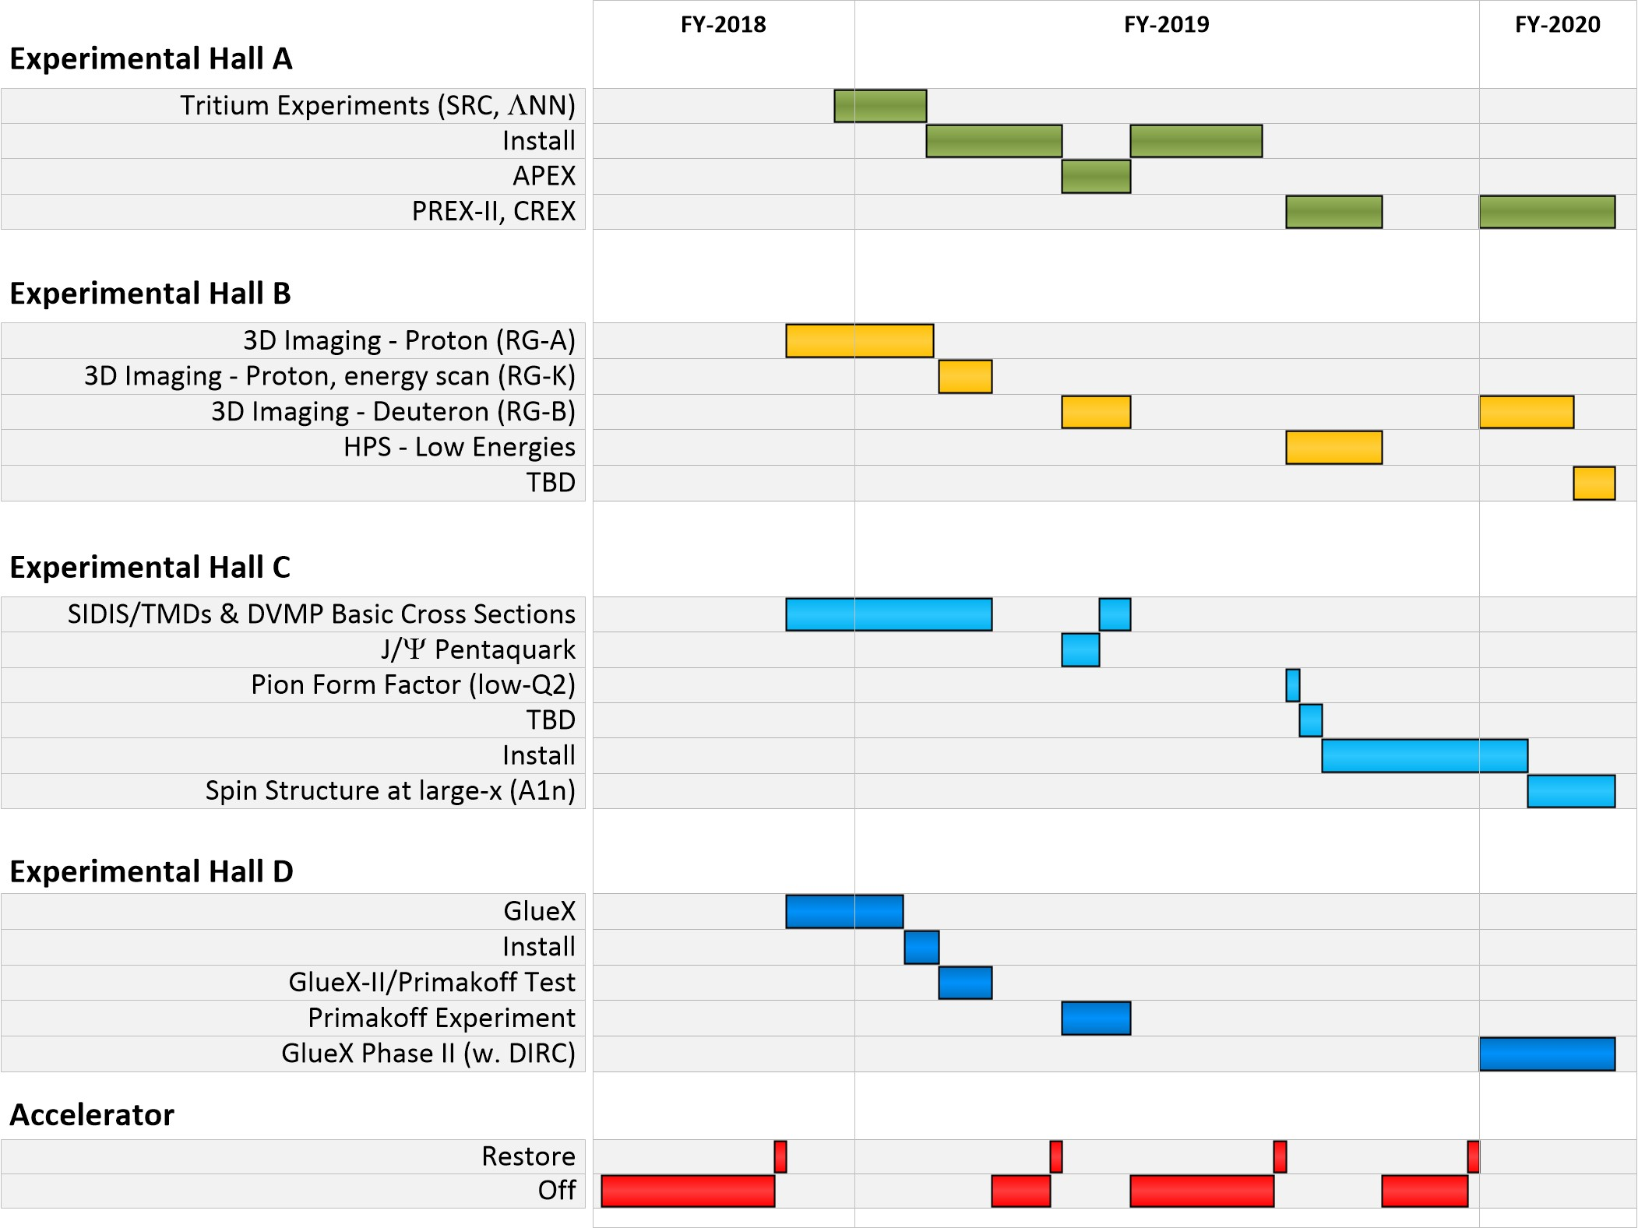
Near Term CEBAF Schedule
Note: 7 “High Impact” Experiments!

Slide 19

EIC Developments
National Academies Study underway
  – Co-Chairs: Gordon Baym (UIUC), Ani Aprahamian (Notre Dame)
– First meeting February 1-2, 2017
– Second meeting April 19-20, 2017
– Third meeting September 11-12, 2017
– Expect report in mid-2018
EIC User Group
  Website: http://www.eicug.org/web/
  Steering Committee established
  Bernd Surrow (Temple, Chair), Charles Hyde (ODU, vice Chair)
  Christine Aidala (U. Mich, IB Chair), John Arrington (ANL),
  E. Sichtermann (LBNL), Marco Radici (U Pavia),
  Rik Yoshida (JLab), Thomas Ullrich (BNL), ex-officio
  Daniel Boer (Groningen), European representative
  Yuji Goto (RIKEN), Int’l non-US, non-EU
  2017 EIC UG Meeting in Trieste, Italy – July 18-22
  2018 EIC UG Meeing at CUA in DC, Jul. 30 – Aug. 2
EIC Center at Jlab

Slide 20
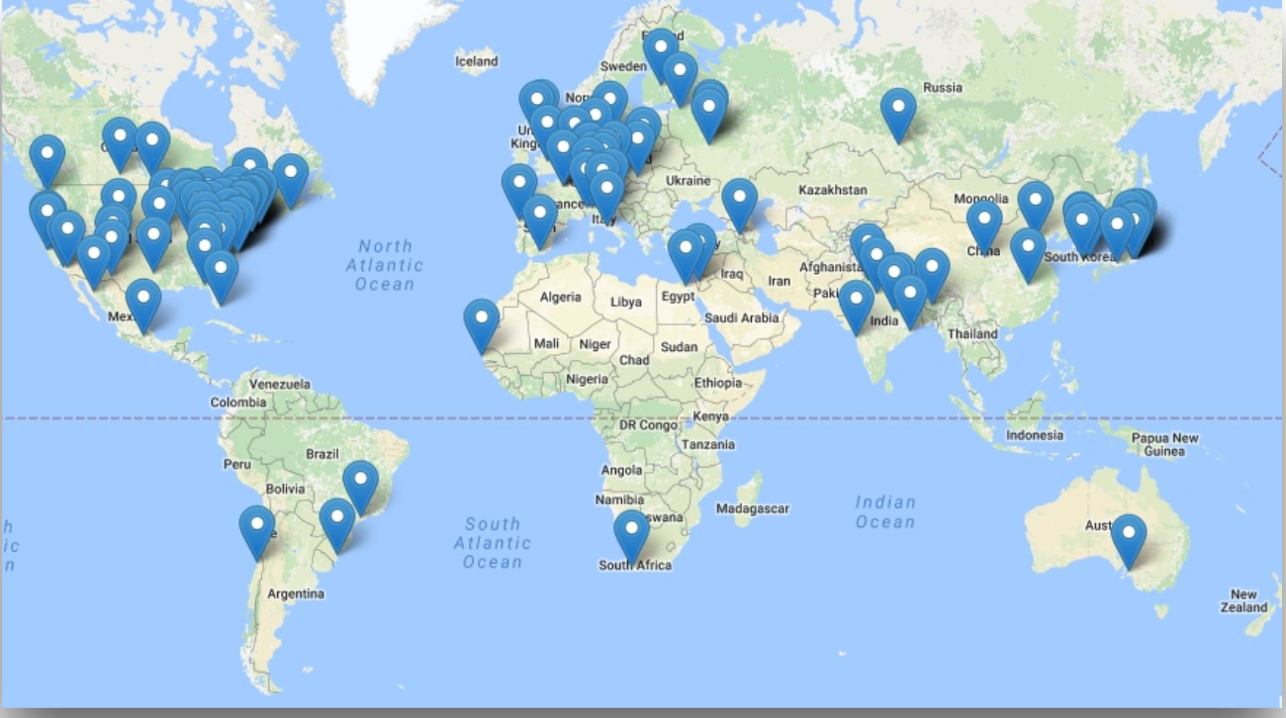
EIC Users Group and International Interest
Formed in fall 2015, currently: 788 members
169 institutions, 29 countries

Slide 21
Recent and Upcoming EIC Events
INT Workshop series:
  Spatial and Momentum Tomography of Hadrons and Nuclei (INT-17-3), August 28, 2017 - September 29, 2017 (I. Cloet, K. Hafidi, Z.-E. Meziani, B. Pasquini)
  The Flavor Structure of Nucleon Sea (INT-17-68W), October 2-13, 2017 (C. Aidala, W. Detmold, J. Qiu, W. Vogelsang)
  Probing Nucleons and Nuclei in High Energy Collisions (INT-18-3), October 1, 2018 - November 18, 2018 (Y. Hatta, Y. Kovchegov, C. Marquet, A. Prokudin)
6th International Workshop on Deep-Inelastic Scattering and Related Topics (DIS 2018), Kobe, Japan, April 16-20, 2018
Physics Opportunities at an ElecTron-Ion Collider (POETIC 2018) conference, Regensburg, Germany, March 19-22, 2018
EICUG meeting 2018 - July 30 – August 4, 2018 / The Catholic University of America hosted by Professor Tanja Horn - Major focus will be on steps after NAS report leading to anticipated CD0 EIC project award!

Slide 22

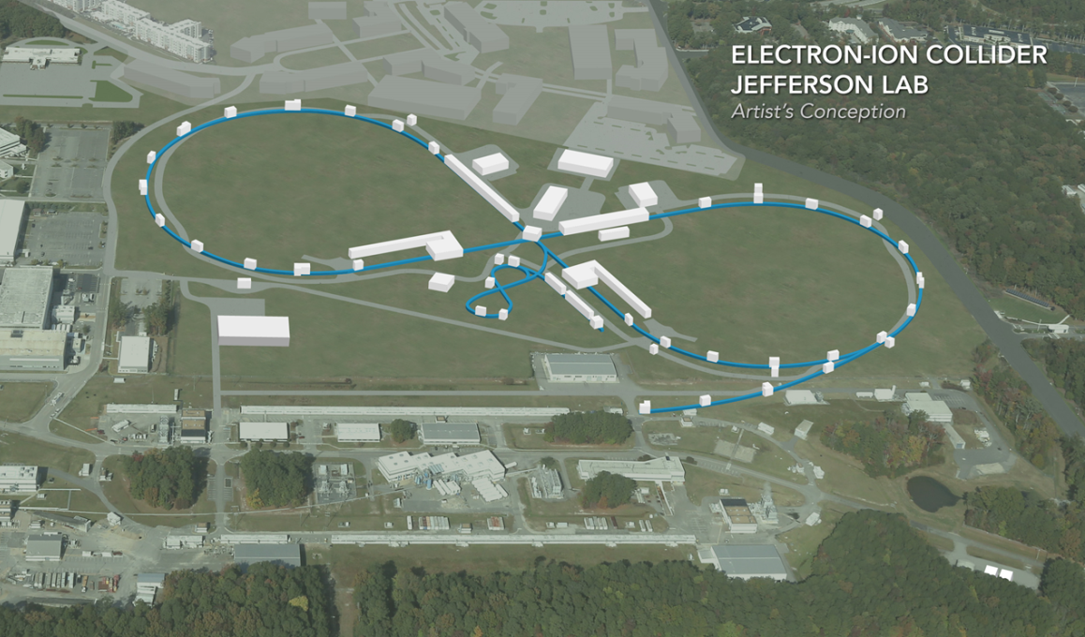
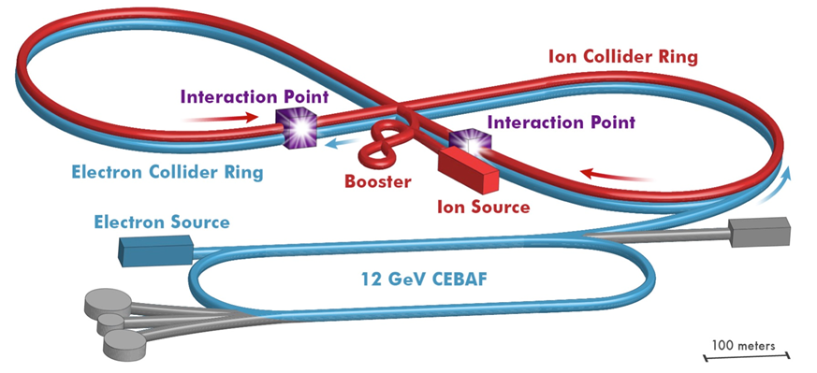
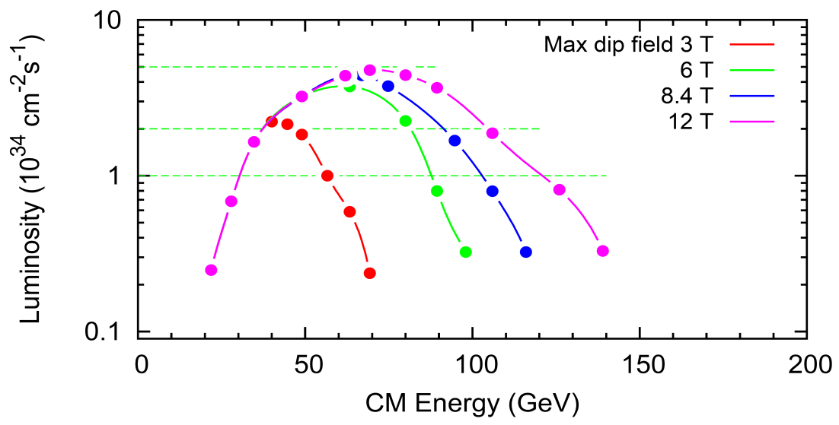
Electron Ion Collider at Jefferson Lab
JLab EIC Figure 8 Concept
    High Polarization
    High Luminosity
    Energy Range: √s : 20 to 65-140 GeV (magnet technology choice)
    Low technical risk
    Flexible timeframe for construction
    consistent w/running 12 GeV CEBAF
    High performance, low-risk, well-reviewed
    Cost effective operations
    Fulfills White Paper Requirements
10³⁵
LHC
(
10³⁴
Strong multi-institutional effort including:
ANL, BNL, FNAL, LBNL, SLAC
10³³

Slide 23

JLEIC Developments
DOE-NP plans to increase EIC accelerator R&D to ~$7M/year
– Through ‘tax’ on Jlab ($1.5M) and BNL ($3.5M)
– Peer review held for November 29-December 2, 2016,
Report released in February (2017)
14 accelerator R&D proposals submitted to DOE Jan. 19, 2018. ($13.6M total FY18 requested by JLab collaborations)
- Eight will receive at least partial funding, total $6.4M ($2.43 to Jlab)
Pre-CDR development in progress, to be completed before October 2018. Status report at JLab user meeting.
Magnetized beam for e-cooler making good progress (LDRD)
$1.4M state funding received for e-ring and crab cavity prototype fabrication and test, and for beam dynamics studies. $1M to continue next year.

Slide 24
Summary
12 GeV science program at Jlab is underway
  4 Hall operation
  A broad program of 76 approved experiments with many opportunities for discovery is planned
  Schedule released through CY19
  Initial science results are already being reported
Future Equipment projects
  MOLLER: CD0 – hope for FY20 start
  SoLID: Prepare for DOE science review
PAC
  PAC46 week of July 16
  Jeopardy on the horizon
Future EIC project taking shape, much activity

