Slide 1
DSG NPS Status Update
Aaron Brown and the
Detector Support Group
June 30, 2022

Slide 2
Contents
EPICS Phoebus Screen Development
Configuration File Control VI Development
Ansys Thermal Analysis (Heat Flux)
NPS Detector Video
Conclusion

Slide 3
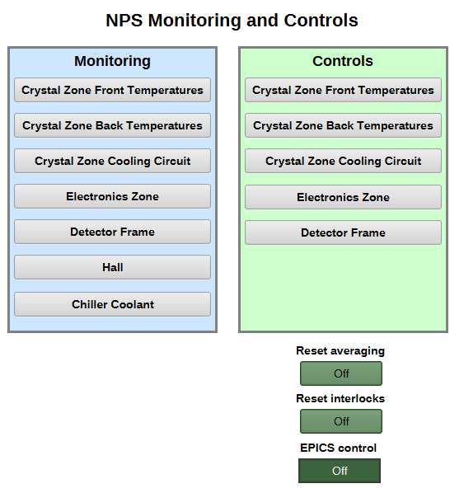
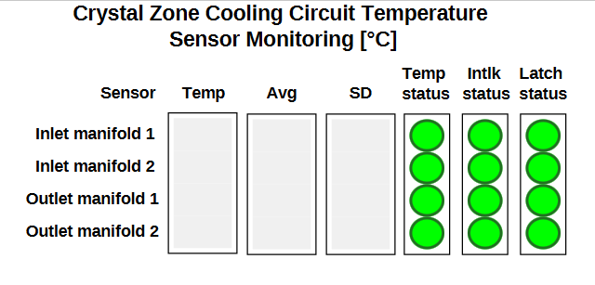
EPICS Phoebus Screen Development
Main menu broken up into monitoring screens and control screens
Adding sensor, averaging, interlock, and trip delay enables for each individual sensor
Adding temp, interlock, and latch status for each individual sensor

Slide 4
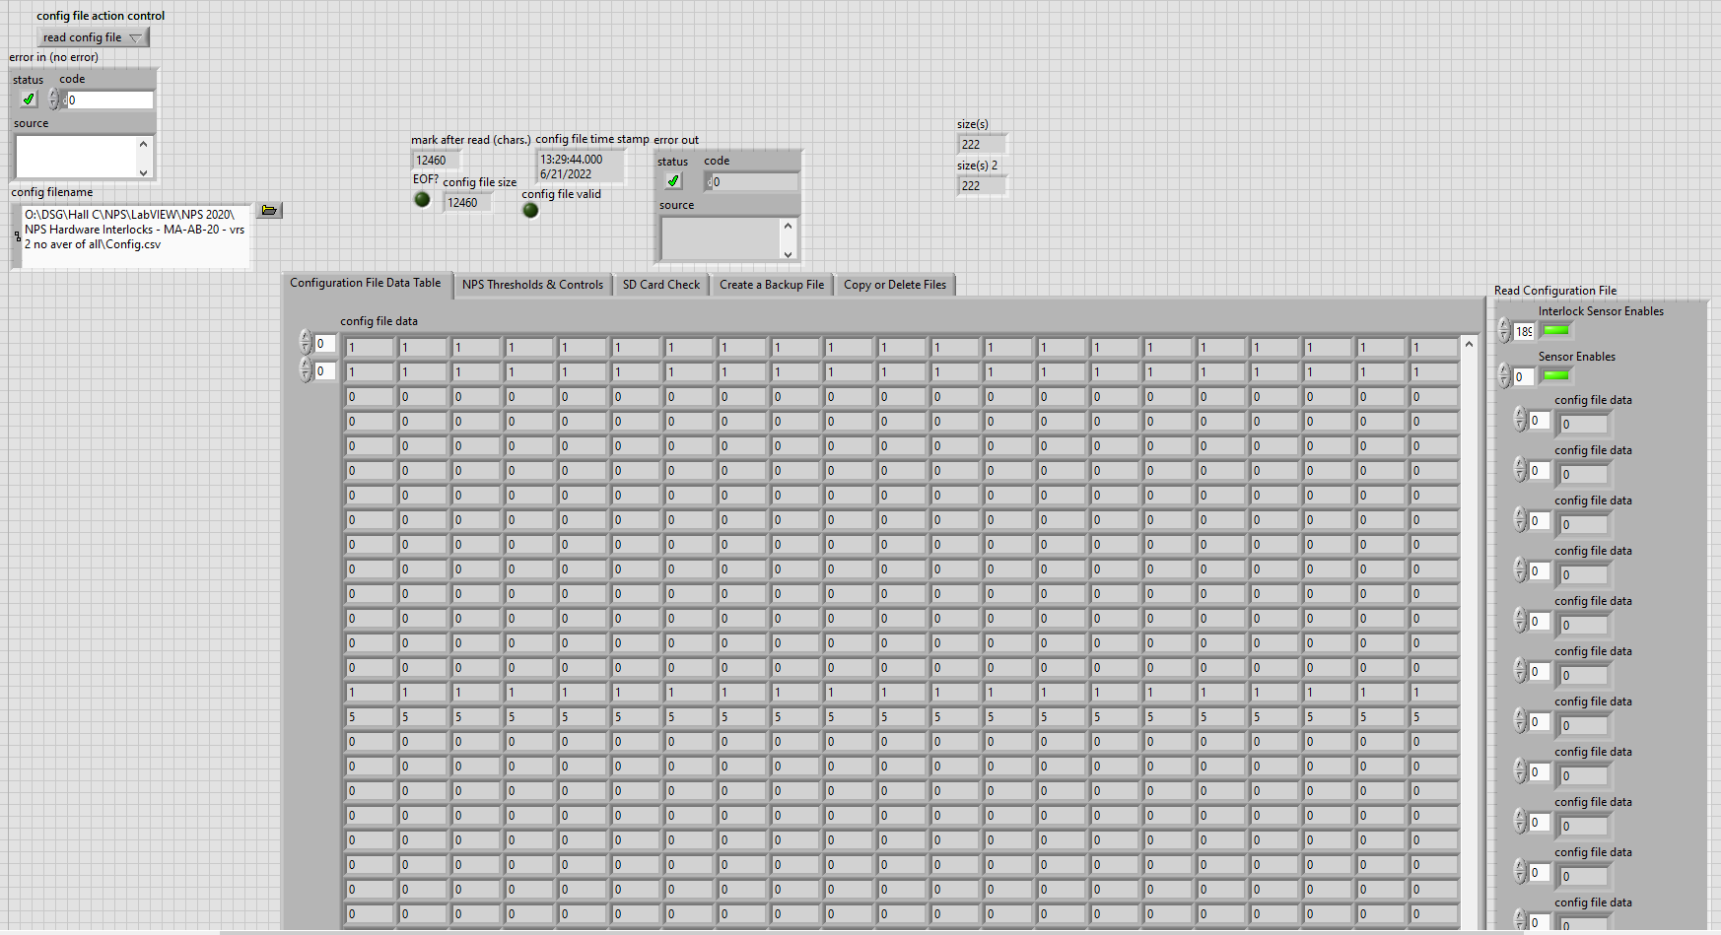
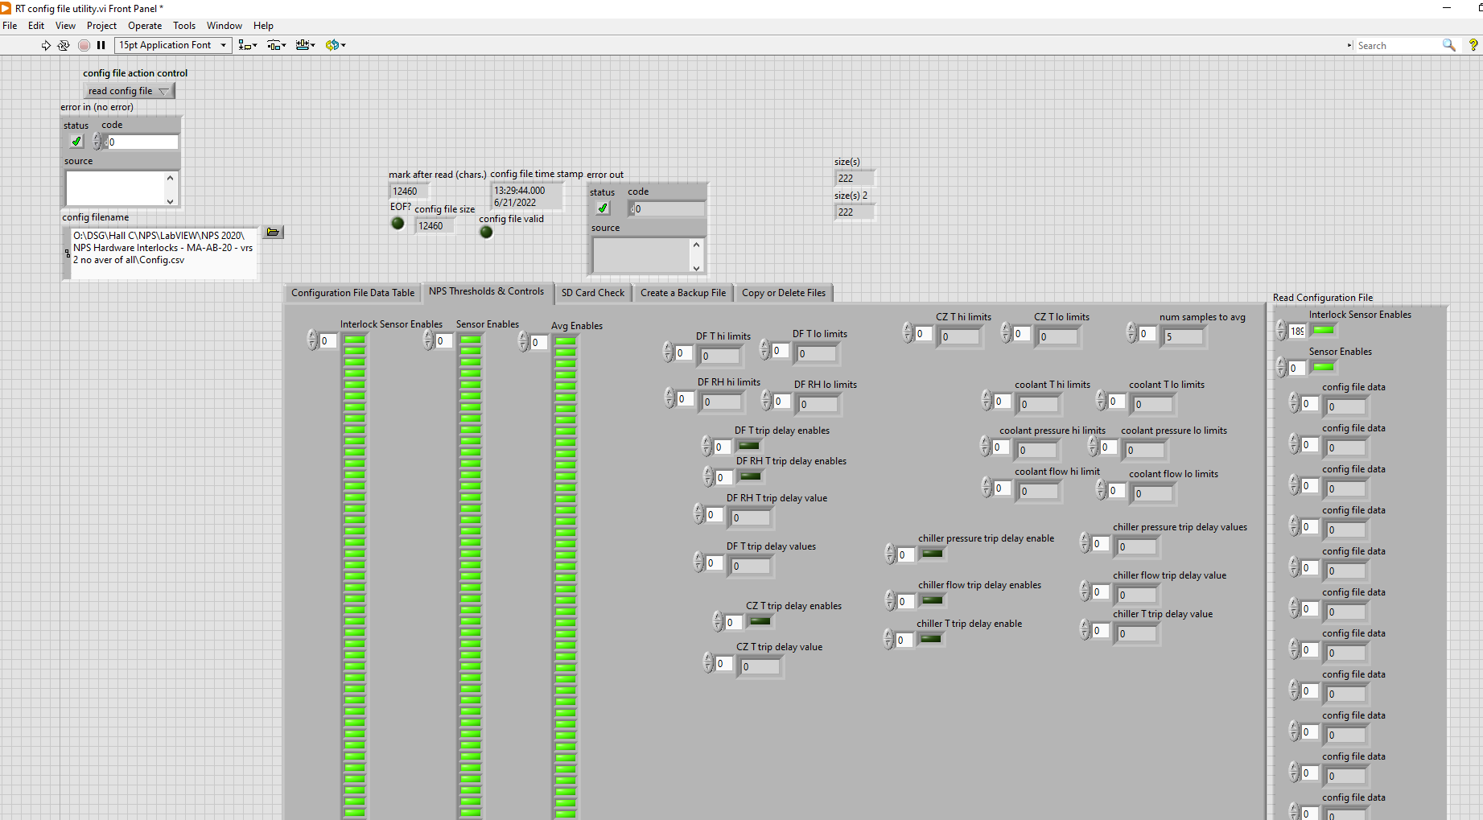
Configuration File Control VI Development
Configuration file control VIs in progress
Read configuration file VI complete

Slide 5
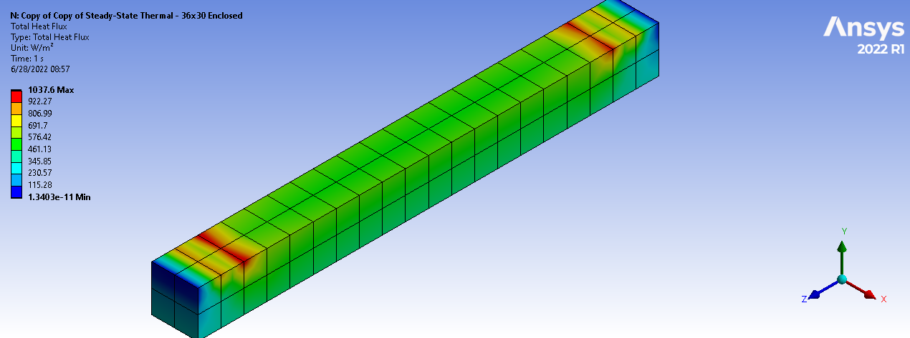
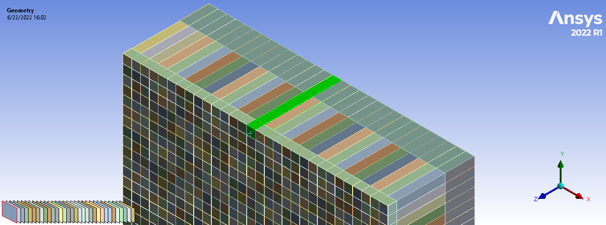
Ansys Thermal Analysis (Heat Flux)
Total heat flux for a single peripheral crystal
Q = 0.3 W per crystal
Simulation analysis in progress

Slide 6
NPS Detector Video
Video taken on 2022-06-16

Slide 7
Conclusion
EPICS Phoebus screens are in development
Configuration file control VIs for LabVIEW in development
Ansys thermal analysis of total heat flux in progress

