Slide 1
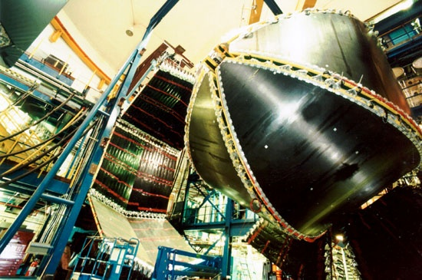
Experimental studies of N* structure from meson electroproduction data
V.I. Mokeev
Cake Seminar at JLAB Theory Center,
November 28 2012

Slide 2
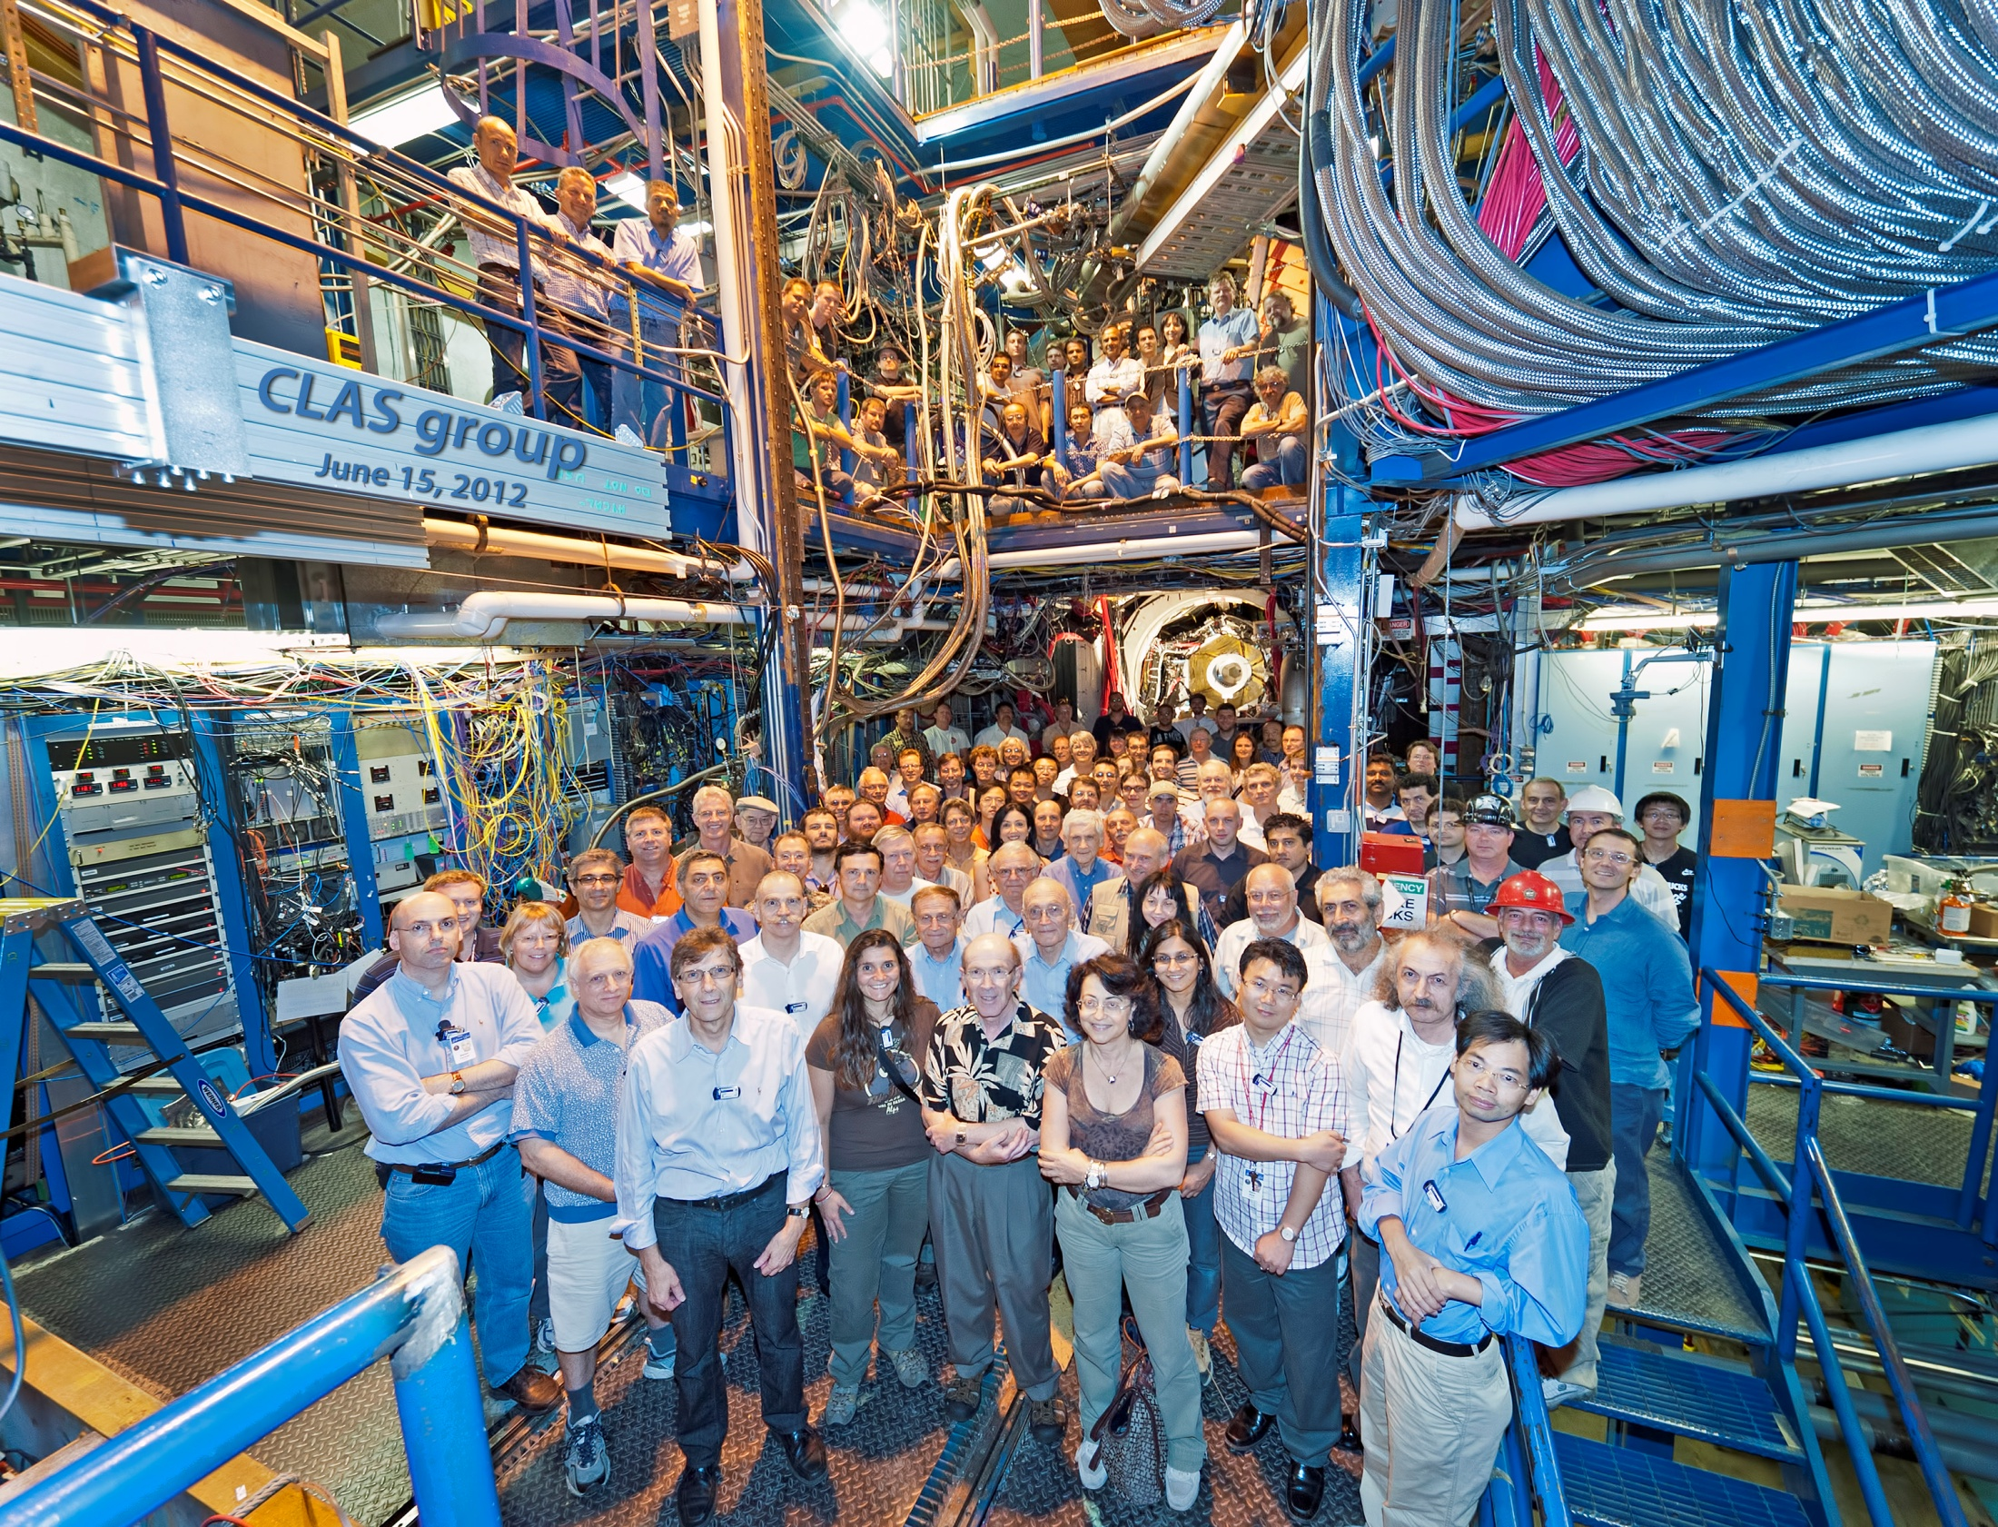
The 6 GeV era came to successful close in May 12’after fifteen years of running many productive world-class experiments. We are poised to continue our very successful experimental program with CLAS12.
CLAS12 will be a unique worldwide facility for exploring strong interaction in the non-perturbative regime.

Slide 3
N* Program with CLAS
Studies of N* spectrum with a focus in the search for new baryon states
strong support from recent LQCD studies, J.J.Dudek, R.G.Edwards, Phys. Rev.
D85, 054016 (2012).
- baryon state spectrum as rich as it was expected in quark models;
employing SU(6) spin-flavor symmetry;
-presence of hybrid baryons with masses above 1.9 GeV.
bare N* masses were evaluated within the framework of DSEQCD: H.L.L. Roberts, et al.,
Few Body Syst. 51, 1 (2011):
-incorporates dynamical chiral symmetry breaking;
-reproduces N* state ordering.
Experimental prospects , V.D.Burkert, arXiv:1209.2402 [nucl-ex] :
-evaluation of pseudo scalar meson photoproduction amplitudes from combined
studies of unpolarized cross sections and polarization asymmetries;
-almost model independent information on N* spectrum, photo and hadronic
couplings from singularities of analytical continuation of produiction amplitudes
into a complex energy plane.
N* structure from exclusive meson electroproduction data
Extraction of resonance electroexcitation amplitudes (γ_{v}NN* electrocouplings) at
different photon virtualities Q².
Recent review papers:
I.G.Aznauryan and V.D. Burkert, Progr. Part. Nucl. Phys. 67, 1 (2012).
I.G.Aznauryan et al., J.Phys. Conf. Ser. 299, 012008 (2011).

Slide 4
The studies of nucleon resonance (N*) structure: motivation and objectives
Our experimental program seeks to determine
  γ_{v}NN* transition helicity amplitudes (electrocouplings) at photon virtualities 0.2< Q²<6.0 GeV² with CLAS and at 4.0< Q²<12.0 GeV² with CLAS12 detectors for most of the excited proton states through analyzing major meson electroproduction channels independently and in global multi- channel analyses.
This information needed to study the non-perturbative strong interaction which generates N* states as bound systems of quarks and gluons
The non-perturbative strong interaction represents the most important part of the Standard Model that we have yet to explore. The non-perturbative strong interaction is far more complex than the electromagnetic and weak interactions and very different in nature.

Slide 5
Theory support for the studies of N* structure with the CLAS12 detector

Slide 6
The Nature of Strong (non-perturbative) QCD regime
quark-gluon running coupling
α_{s} increases with distance
anti- screening (b) takes over screening (a)
α_{s} ~ 1 as Q² → few GeV²
(a)
(b)
QED coupling
QCD coupling
JLAB12
momentum transfer
to lepton
momentum transfer
to single quark
On the same momentum domain, the QCD coupling changes 500,000-times more that the QED coupling and run in the opposite direction.

Slide 7
Particular features of strong interaction in non-perturbative regime
Generation of dressed quarks
and gluons
Dressed quarks and gluons acquire
dynamical, momentum (distance)
dependent masses, structure, and
quark-gluon interaction amplitudes
dressed quark
bare quark
dressing kernel
dressed gluon
bare gluon
Quark/Gluon Confinement
Dynamical Chiral
Symmetry Breaking
Can not be described within
the framework of pQCD!
dressing kernel
Dressing contribution ~ (α_{s})^{N /2} (N stands for
the number of interaction vertices) .
Becomes dominant for the light
u and d quarks and gluons as α_{s} ~ 1

Slide 8
Dynamical mass and structure of dressed quarks and gluons
quark/gluon confinement
L.Chang et al, PRL 106, 072001 (2011)
Gluon dynamical mass
S-x Quin etal., PR C84, 042202(R) (2011)
AEM
almost.
pQCD
ACM
M_{E}=0.4 GeV
> 98% of dressed quark/gluon and N* masses and their dynamical structure are generated non-perturtbatively through dynamical chiral symmetry breaking (DCSB). The Higgs mechanism accounts for less than 2% of the nucleon & N* mass.
the data from CLAS/CLAS12 will allow us to explore the nature of the dominant part of hadron mass, and will provide access to dressed quark dynamical structure.
the momentum dependence of the dressed quark mass reflects the transition from quark/gluon confinement to pQCD .

Slide 9
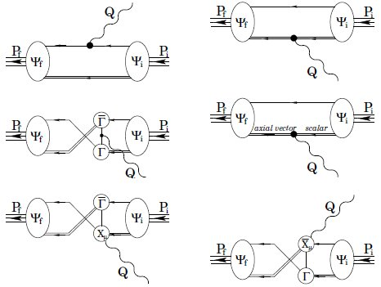
γ_{v}NN* electrocouplings as a window to strong interactions in non-perturbative region
Quark core contribution to γ_{v}NN* electrocouplings
quark propagators are sensitive to the quark running mass M(p);
dressed quark e.m. current is sensitive to the quark dynamical structure;
quark interaction vertices
Γ and X are sensitive to the quark non-perturbative interactions.
Data on γ_{v}NN* electrocouplings at different Q² probe momentum dependence of dynamical quark mass, structure, and non-perturbative qq-interactions.
A key direction in exploration of quark/gluon confinement and DCSB in baryons.

Slide 10
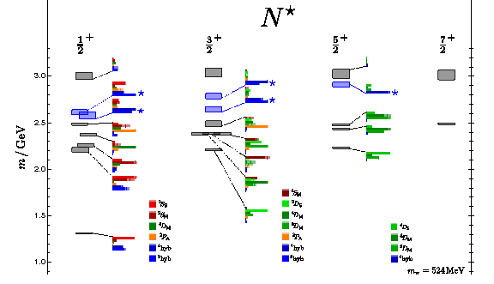
Why studies of ground and excited nucleon states combined are needed?
Di-quark J^{π} | Ground state | P₁₁ ½⁺(1440) | S₁₁ ½⁻(1535) | S₁₁ ½⁻(1650)
0⁺ | 77%
1⁺ | 23% | 100%
0⁻ |  |  | 51% | 43%
1⁻ |  |  | 49% | 57%
Di-quark content of ground and N* states from DSEQCD with vector x vector interaction, C.D.Roberts et al.,
AIP Conf. Proc. 1432, 309 (2012).
N* spectrum and structure from LQCD, J.J.Dudek, R.G.Edwards, Phys. Rev. D85, 054016 (2012).
N* states of different quantum numbers offer complementary information on mechanisms of baryon generation from quarks and gluons.
N* electrocouplings allow us to explore strong regime of QCD at
larger transverse distances with larger α_{QCD} than the ground state form factors.

Slide 11
Extraction of γ_{v}NN* electrocouplings from the data on exclusive
meson electroproduction off protons
Resonant amplitudes
Non-resonant amplitudes
π, η, ππ,..
π, η, ππ,..
γ_{v}
*
N*,△
+
N
N’
N’
N
A_{3/2}, A_{1/2}, S_{1/2}
N*’s photo-/electrocouplings γ_{v}NN* are defined
at W=M_{N*} through the N* electromagnetic
decay width Γγ :
  Separation of resonant/non-resonant contributions within the framework of reaction models; Breit Wigner ansatz for parameterization of resonant amplitudes; fit of γ_{v}NN* electrocouplings and hadronic parameters to the data.
  Consistent results on γ_{v}NN* electrocouplings from different meson electroproduction channels demonstrate reliable extraction of N* parameters.

Slide 12
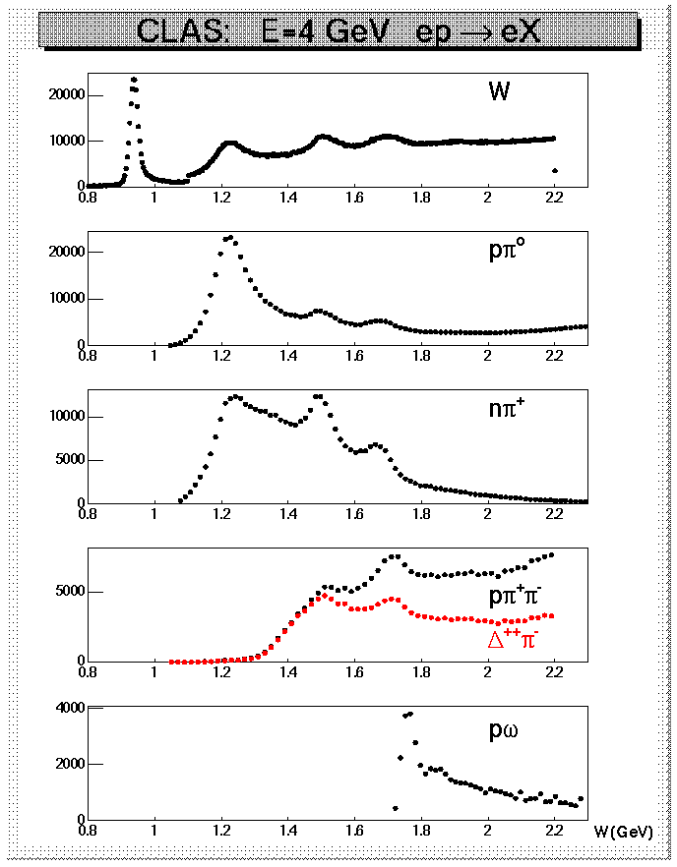

N* electroexcitation in meson electroproduction off protons
Hadronic decays of prominent N*s for W<1.8 GeV.
CLAS data on yields of meson
electroproduction reactions at
Q²<4 GeV²
State | Branch. Fract. to Nπ. | Branch. Fract. to Nη | Branch.Frac.to Nππ
Δ(1232) P₃₃ | 0.995
N(1440) P₁₁ | 0.55-0.75 |  | 0.3-0.4
N(1520) D₁₃ | 0.55-0.65 |  | 0.4-0.5
N(1535) S₁₁ | 0.48±0.03 | 0.46±0.02
Δ(1620) S₃₁ | 0.20-0.30 |  | 0.70-0.80
N(1650) S₁₁ | 0.60-0.95 | 0.03-0.11 | 0.1-0.2
N(1685) F₁₅ | 0.65-0.70 |  | 0.30-0.40
Δ(1700) D₃₃ | 0.1-0.2 |  | 0.8-0.9
N(1720) P₁₃ | 0.1-0.2 |  | > 0.7

Slide 13
Approaches for extraction of γ_{v}NN* electrocouplings from the CLAS data on exclusive meson electroproduction
Analyses of different meson electroproduction channels independently:
π⁺n and π⁰p channels:
Unitary Isobar Model (UIM) and Fixed-t Dispresion Relations (DR)
I.G.Aznauryan, Phys. Rev. C67, 015209 (2003).
I.G.Aznauryan et al., CLAS Coll., Phys Rev. C80, 055203 (2009).
ηp channel:
Extension of UIM and DR
I.G.Aznauryan, Phys. Rev. C68, 065204 (2003).
Data fit at W<1.6 GeV, assuming S₁₁(1535) dominance
H.Denizli et al., CLAS Coll., Phys.Rev. C76, 015204 (2007).
π⁺π⁻p channel:
Data driven JLAB-MSU meson-baryon model (JM)
V.I.Mokeev, V.D.Burkert et al., Phys. Rev. C80, 045212 (2009).
V.I.Mokeev et al., CLAS Coll., Phys. Rev. C86, 035203 (2012).
Global coupled-channel analyses of the CLAS/world data of πN, γ_{v}N → πN, ηN,ππN, KΛ, KΣ exclusive channels:
N.Suzuki, T.Sato , and T-S. H.Lee, Phys, Rev. C82, 045206 (2010).
Further developments by Argonne-Osaka Collaboration are in progress: www.jlab.org/conferences/EmNN2012/

Slide 14
Summary of the CLAS data on single-pion electroproduction off protons
Number of data points >125,000, W<1.7 GeV, 0.15<Q²<6.0 GeV² , almost complete coverage of the final state phase space.
Observables | area, GeV² | Number of data points
dσ/dΩ(π⁰) | 0.16-1.45 3.0-6.0 | 39830 9000
dσ/dΩ(π⁺) | 0.25-0.60 1.7-4.3 | 25588 30 849
A_{e}(π⁰) , A_{t}(π⁰) | 0.25-0.65 | 3981
A_{e}(π⁺) , A_{t}(π⁺) | 0.40-065 1.7 - 3.5 | 1730 3 535
A_{et}(π⁰) | 0.25-0.61 | 1521
Electrocoupling extraction:
  I.G.Aznauryan,
  V.D.Burkert et al.
  (CLAS Collaboration), PR C80, 055203 (2009).
Recent data extension:
π⁺n
1.6< W<2.04 GeV, 1.5<Q²<4.5 GeV²
K.Park private comm.
π⁰n
1.1< W<1.8 GeV, 0.5<Q²<1.0 GeV²
N.Markov private comm.

Slide 15
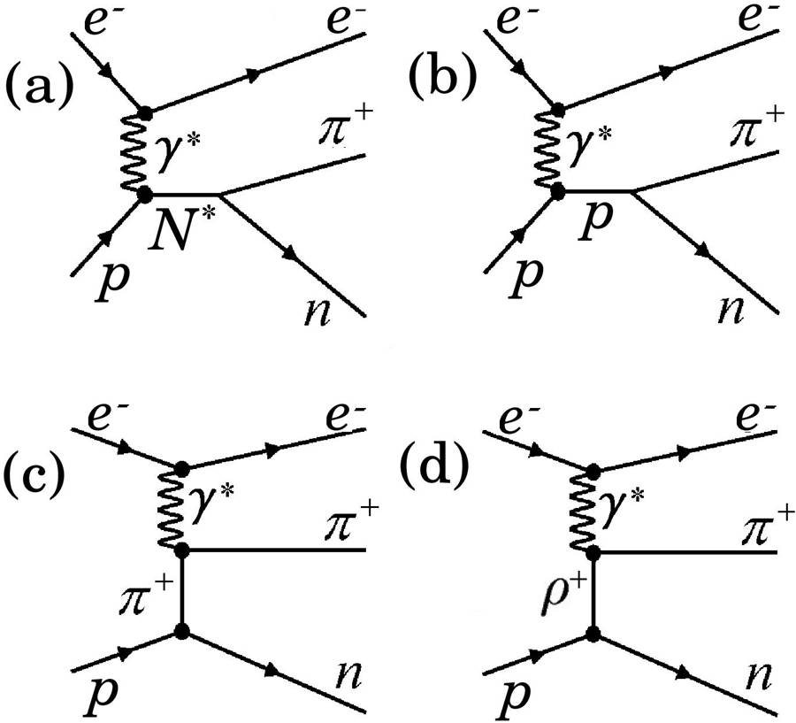
The approaches for extraction of γ_{v}NN* electrocouplings from Nπ exclusive electroproduction off protons
The Model based on fixed-t Dispersion Relations (DR)
Unitary Isobar Model (UIM)
π
π
the real parts of 18 invariant Ball Nπ electroproduction amplitudes are computed from their imaginary parts employing model independent fixed-t dispersion relations;
the imaginary parts of the Ball Nπ electroproduction amplitudes at W>1.3 GeV are dominated by resonant parts and were computed from N* parameters fit to the data.
N
N
π
π
p
N
ω,ρ,π
N
π
N
π⁺
  I. G. Aznauryan, Phys. Rev. C67, 015209 (2003), I.G.Aznauryan,
  V.D.Burkert, et al. (CLAS Collaboration), PRC 80 055203 (2009).

Slide 16
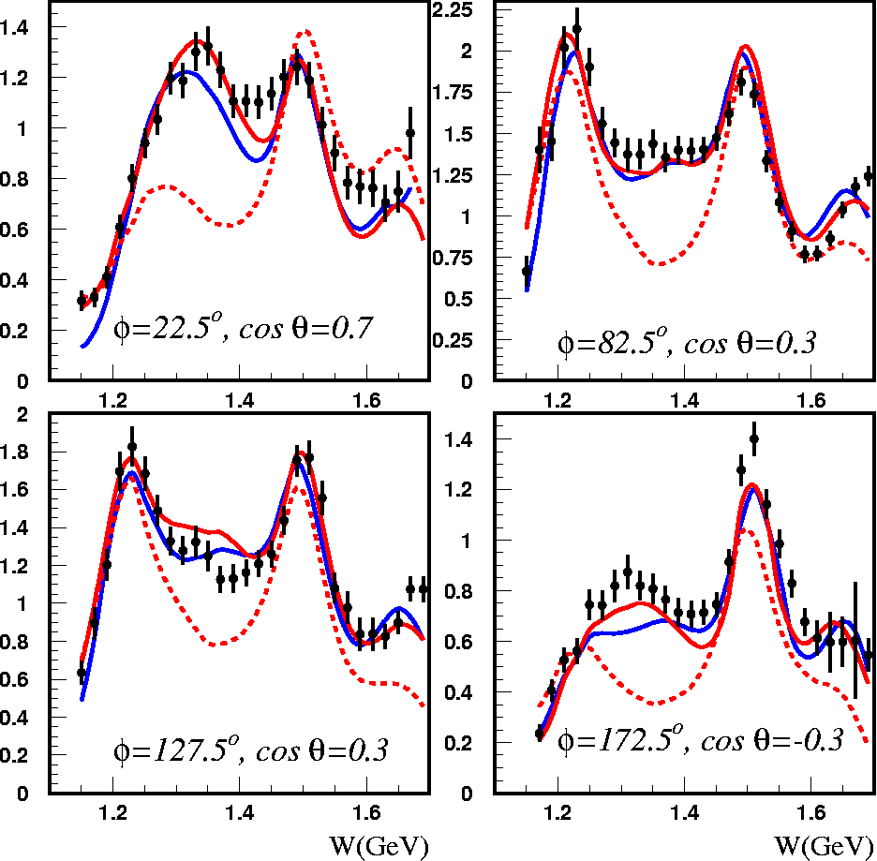
Fits to γp→π⁺n differential cross sections and structure functions
DR
DR
Q²=2.44 GeV²
Q²=2.05 GeV²
DR w/o P11
UIM
UIM
dσ/dΩ_{π}
L=0 Legendre moments from various structure functions

Slide 17
The CLAS data on π⁺π⁻p differential cross sections and their fit within the framework of meson-baryon reaction model JM
G.V.Fedotov et al, PRC 79 (2009), 015204
1.30<W<1.56 GeV; 0.2<Q²<0.6 GeV²
M.Ripani et al, PRL 91 (2003), 022002
1.40<W<2.30 GeV; 0.5<Q²<1.5 GeV²
full JM calc.
π⁺Δ⁰
ρp
π⁺F⁰₁₅(1685)
π⁻Δ⁺⁺
2π direct
π⁺D⁰₁₃(1520)

Slide 18
JM Model Analysis of the π⁺π⁻p Electroproduction
Major objectives: extraction of γ_{v}NN* electrocouplings and πΔ, ρp decay widths.
π
Δ(1232)P₃₃, N(1520)D₁₃,
Δ(1600)P₃₃, N(1680)F₁₅
π
N* contribute to πΔ and ρp channels only
Notes:
Last diagram 1&2) meson meson 3) meson baryon exchange bubbles, more generally 2q and 3q exchange.

Slide 19
Unitarized Breit-Wigner ansatz for resonant amplitudes
Developed based on approach: I.J.R.Aitchison, Nuclear Physics , A189 (1972), 417.
Inverse of the JM unitarized N* propagator:
N*_{α}
N*_{α}
diagonal
N*_{α}
N*_{β}
Off-diagonal transitions incorporated into the full resonant amplitudes of the JM model:
off-diagonal
S₁₁(1535) ↔ S₁₁(1650)
D₁₃(1520) ↔ D₁₃(1700)
3/2⁺(1720) ↔ P₁₃(1700)
Full resonant amplitude of unitarized Breit-Wigner ansatz is consistent with restrictions imposed by a general unitarity condition, as well as with the resonant Argonne-Osaka ansatz in on-shell approximation.

Slide 20
Resonant /non-resonant contributions from the fit of π⁺π⁻p electroproduction cross sections within the JM model
W=1.51 GeV, Q²=0.38 GeV²
W=1.51 GeV, Q²=0.43 GeV²
Reliable isolation of the resonant cross sections is achieved
full cross sections
within the JM model
resonant part
non-resonant part

Slide 21
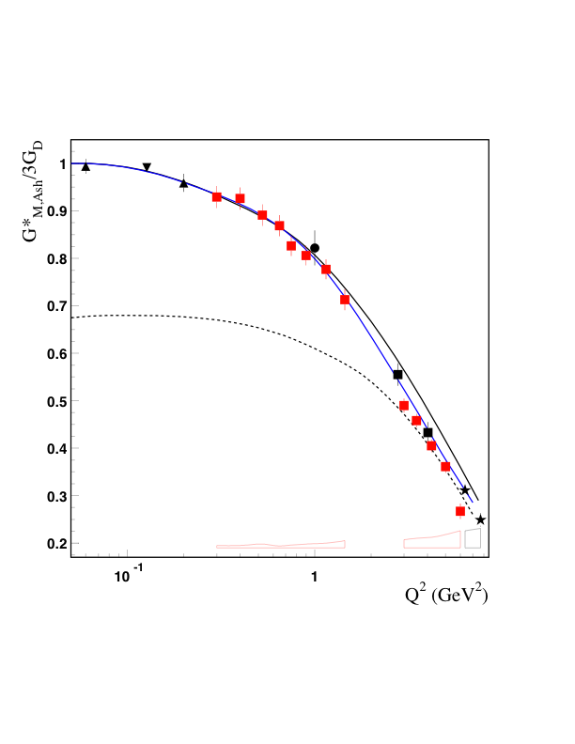
NΔ Transition Form Factor – G_{M.} Meson-baryon dressing vs Quark core contribution from EBAC-DCC/Argonne-Osaka analysis.
One third of G*_{M} at low Q² is due to contributions from meson–baryon (MB) dressing:
Meson-
Baryon
cloud
CLAS
Hall A
Hall C
MAMI
Bates
Within the framework of relativistic QM [B.Julia-Diaz et al., PRC 69, 035212 (2004)], the bare-core contribution is very well described by the three-quark component of wave function
bare quark core
Q²=5GeV²
Whether MB-dressing helps us to
understand local/global parton-
hadron duality?
Could we observe the transition to pQCD
in Q² –range up to 14 GeV² ?

Slide 22
The P₁₁(1440) Electrocouplings from the CLAS Data
LF quark models:
I.G.Aznauryan,
Phys. Rev . C76, 025212
(2007).
S_{1/2}
S. Capstick and
B.D.Keister, Phys.Rev.
D51, 3598 (1995).
A_{1/2}
EBAC-DCC
MB dressing
(absolute values).
B,Julia-Diaz et al., Phys. Rev. C77, 045205 (2008)
π⁺π⁻p
2012
π⁺π⁻p
2010
Nπ
2009
  Consistent values of P₁₁(1440) electrocouplings
  determined in independent analyses of Nπ and π⁺π⁻p
  exclusive channels strongly support reliable
  electrocoupling extraction.
  The physics analyses of these results revealed the P₁₁(1440) structure as a combined contribution of: a) quark core as a first radial excitation of the nucleon 3-quark ground state and b) meson-baryon dressing.

Slide 23
Evaluation of P₁₁(1440) electrocouplings within Dyson-Schwinger Equation of QCD (DSEQCD)
DSEQCD.
parameterization of the EBAC-DCC bare electrocouplings.
A_{1/2}
meson-baryon dressing
EBAC-DCC (abs. values).
Poincare-covariant, symmetry preserving DSEQCD evaluation.
Account for quark mass/structure formation in dressing of bare quark by gluon cloud.
Simplified contact interaction generates momentum independent quark mass.
D.J.Wilson, et al, Phys. Rev. C85, 025205 (2012).
First evaluation from QCD of quark core contribution to P₁₁(1440) electrocouplings.
Evidence for substantial contributions
from meson-baryon cloud in particular at
Q²<1.0 GeV².
Evaluation with vector x vector interaction and momentum dependent quark mass function are in progress.

Slide 24
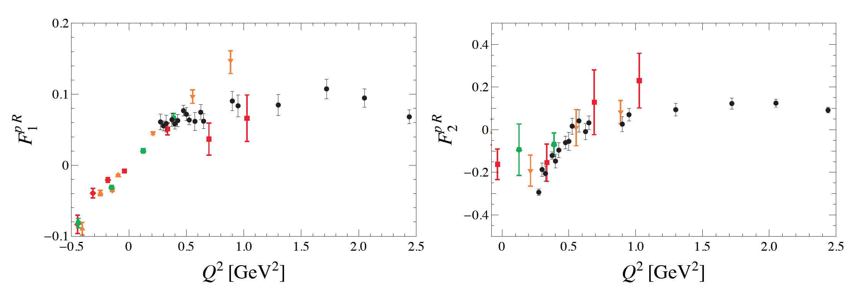
Transition N-P₁₁(1440) form factors in LQCD
Includes the quark loops in the sea , which are
critical in order to reproduce the CLAS data at Q²<1.0 GeV²
A_{1/2}, S_{1/2} => F₁*, F₂*
M_{π} = 390, 450, 875 MeV
L box =3.0, 2.5, 2.5 f
H.W. Lin and S.D. Cohen, arXiv:1108.2528
CLAS data
Exploratory LQCD results provide reasonable description of the CLAS data from the QCD
Lagrangian.
Prospects for LQCD evaluation with improved projection operators, approaching physical mp in the box of appropriate size.

Slide 25
The D₁₃(1520) electrocouplings from the CLAS data
A_{3/2}
S_{1/2}
A_{1/2}
MB dressing abs val. (EBAC)
M.Giannini/E.Santopinto
hCQM, Eur. Phys. J. A1,
307 (1998).
a reasonable agreement between the results from Nπ and π⁺π⁻p exclusive channels.
contributions from 3 dressed quarks in the first orbital excitation and MB cloud combined.
direct access from experimental data on A_{1/2} electrocoupling at Q²>2.0 GeV² to quark
core with negligible contribution from MB cloud.

Slide 26
Evidence for chiral symmetry breaking from Q²-evolution of the ground state and S₁₁(1535) parity partner form factors
In chiral symmetry limit:
-F₁, F₁*
M,m are S₁₁(1535) and proton masses, k= 1.79
F₁*, F₂* p→S₁₁(1535) form factors from
the CLAS data
F₂, F₂*
parameterization of elastic Dirac F₁ and
Pauli F₂ form factors
Evaluation of F₁* and F₂* starting
from QCD within the framework of
Light Cone Sum Rule & LQCD.
V.Braun et al., Phys. Rev. Lett., 103,
072001 (2009) .
Update: LCSR at NLO is in progress
J.Rohrwild, priv. com.

Slide 27
High lying resonance electrocouplings from the π⁺π⁻p CLAS data analysis
Nπ world
V.D.Burkert,
et al., PRC 67,
035204 (2003).
Preliminary
Preliminary
A_{3/2}
S_{1/2}
A_{1/2}
Δ(1700)D₃₃
Nππ CLAS from independent fits
of 3 W-intervals
A_{3/2}
N(1720)P₁₃
A_{1/2}
S_{1/2}
Nπ Q²=0, CLAS
Preliminary
M.Dugger, et al.,
PRC 79,065206
(2009).
the π⁺π⁻p electroproduction channel provided first preliminary results on S₃₁(1620), S₁₁(1650), F₁₅(1685), D₃₃(1700) , and P₁₃(1720) electrocouplings of a good accuracy.
information on electrocouplings of most N* with M_{N}*<1.8 GeV is available and will be extended in few years up to Q²=5.0 GeV².

Slide 28
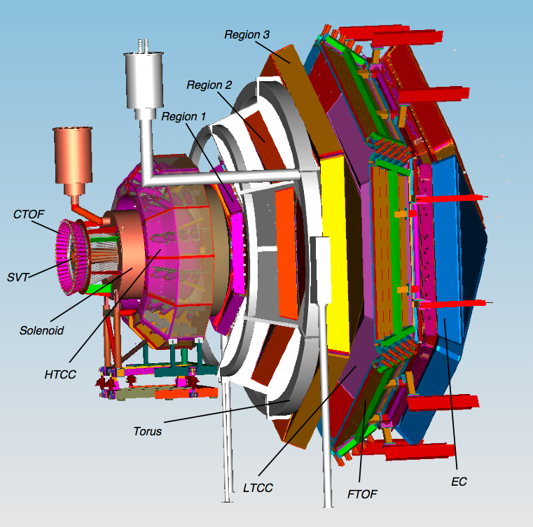
CLAS12
Central
Detector
CLAS12 supports a broad program in hadronic physics.
Plans to study excited baryons and mesons:
Search for hybrid mesons and baryons
Spectroscopy of Ξ* , Ω⁻
N* Transition form
factors at high Q².
Forward
Detector

Slide 29
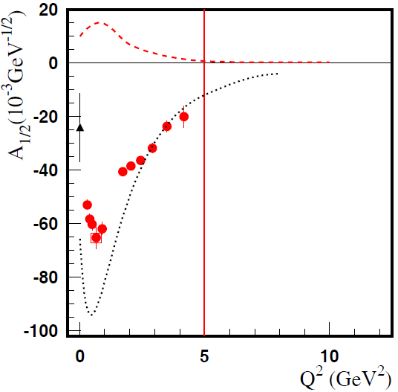
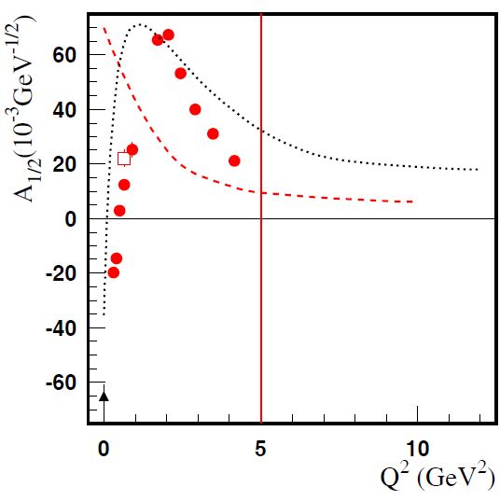
γ_{v}NN* Electrocouplings: A Unique Window into the Quark Structure
Meson-Baryon Dressing
D₁₃(1520)
P₁₁(1440)
absolute meson-baryon cloud amplitudes (EBAC)
quark core contributions (constituent quark models)
CLAS: Nπ and Nπ/Nππ combined
Data on γ_{v}NN* electrocouplings from E12-09-003 experiment (Q² > 5 GeV²) will afford for the first time direct access to the non-perturbative strong interaction among dressed quarks, their emergence from QCD, and the subsequent N* formation.
Notes:
Pink: combined, but double pion is only based on four not nine observables
29

Slide 30
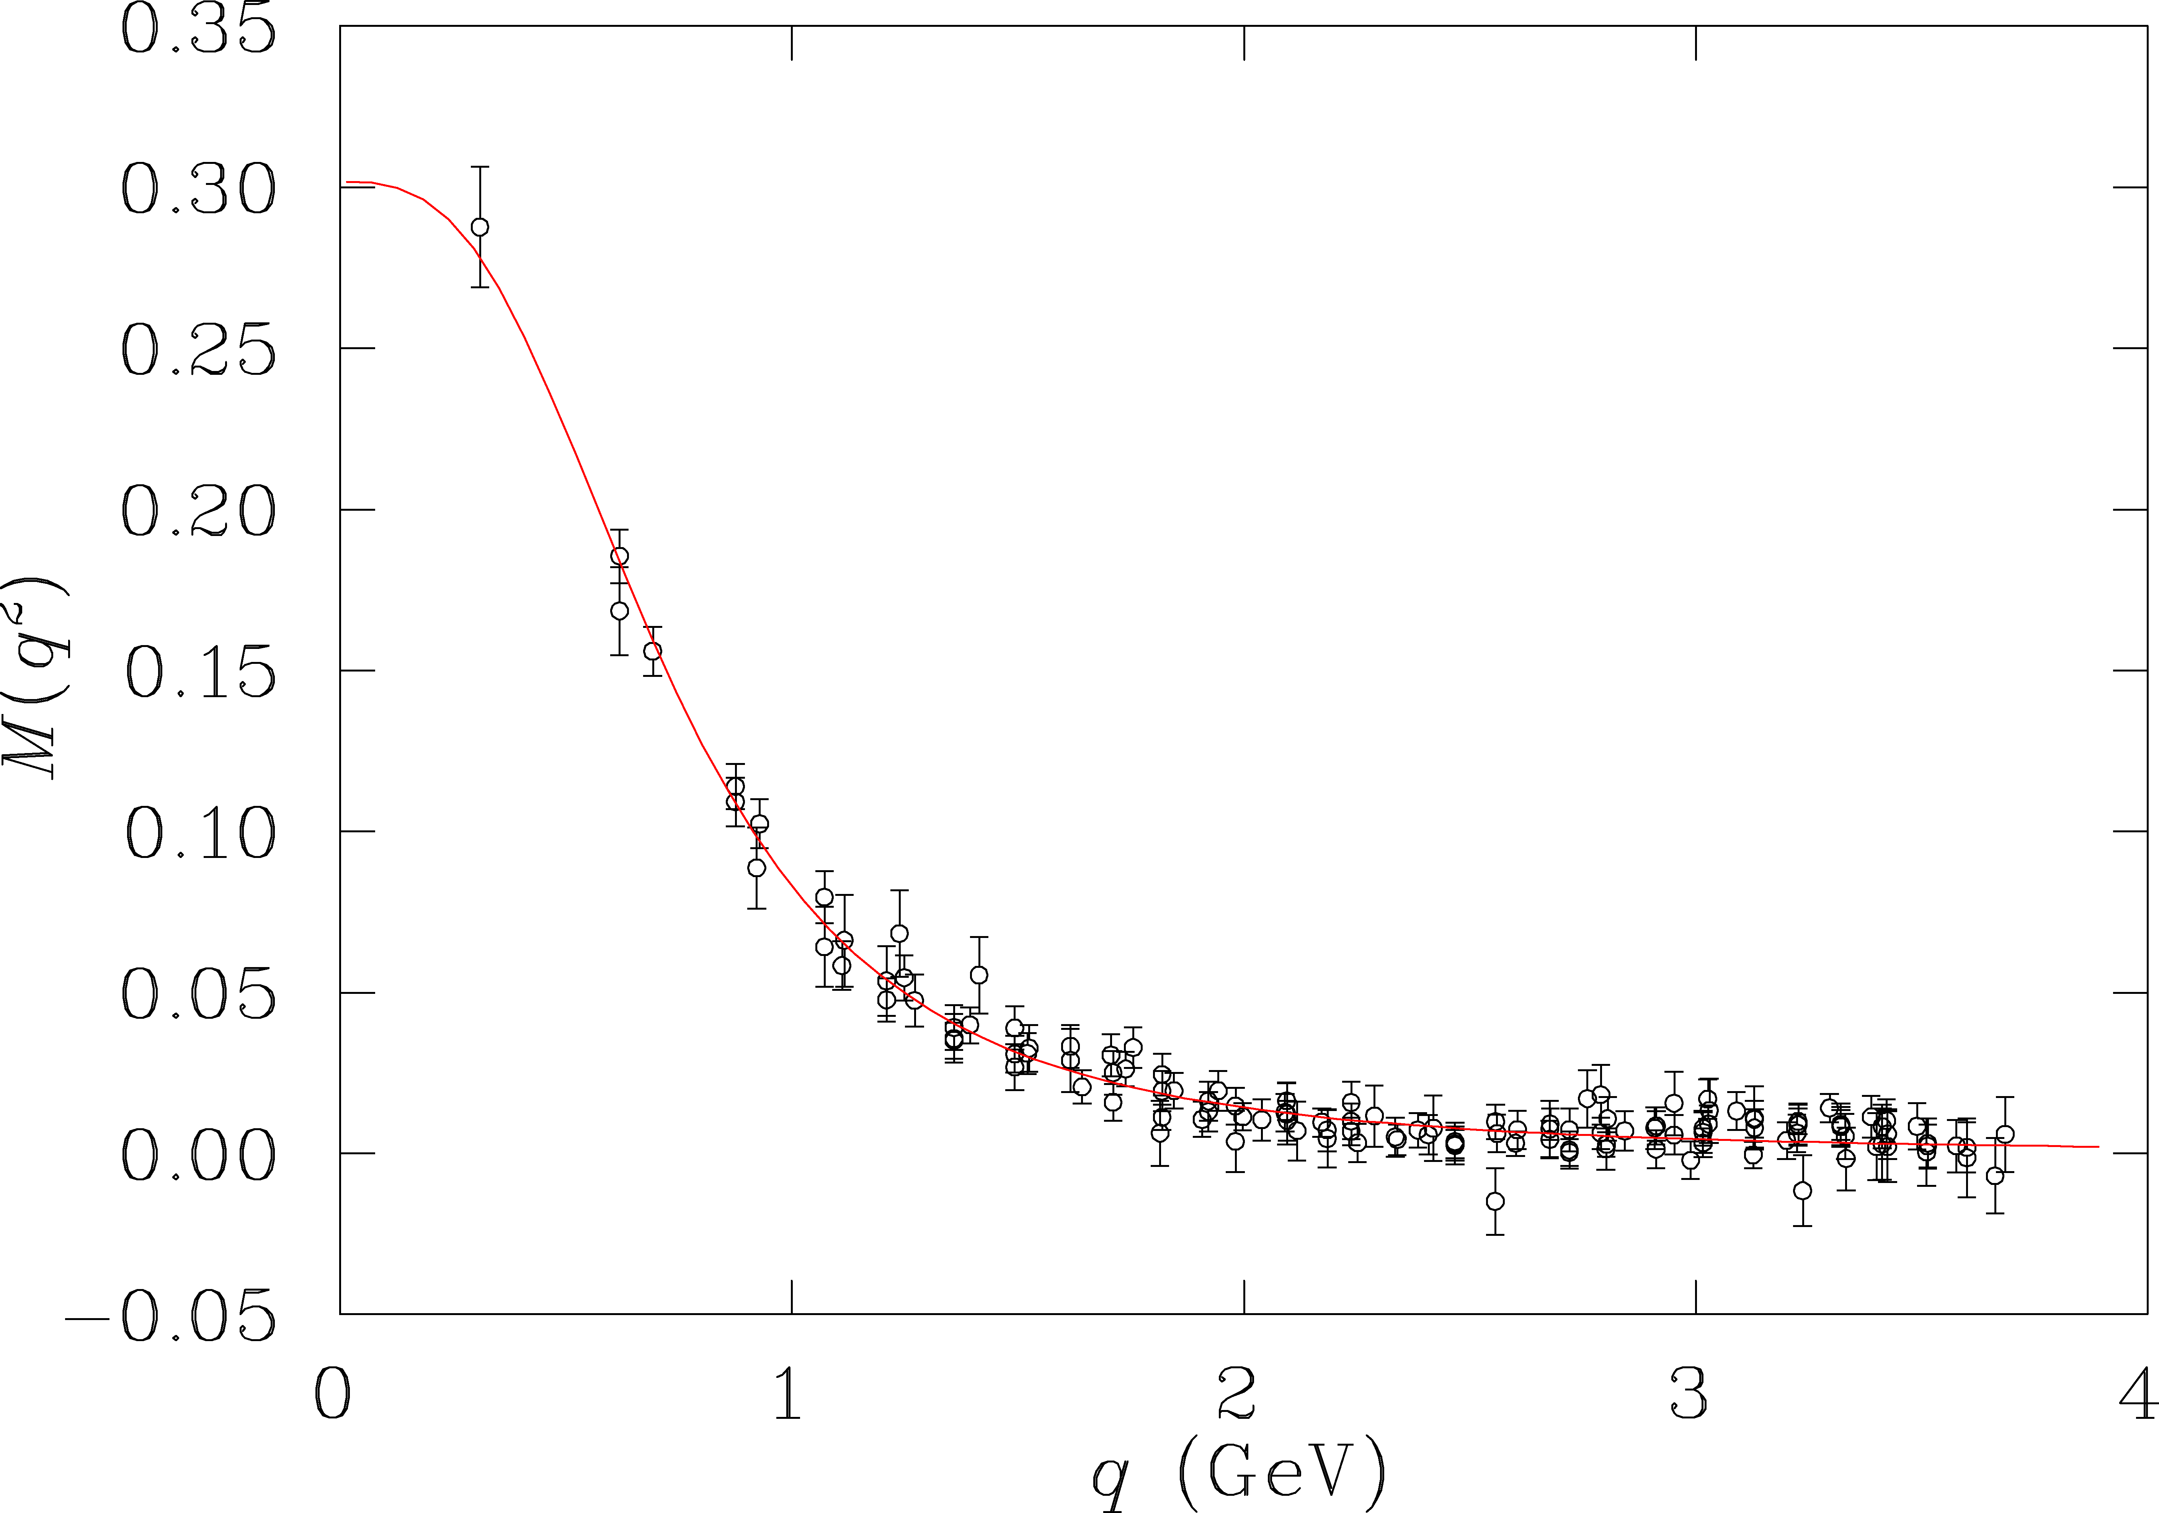
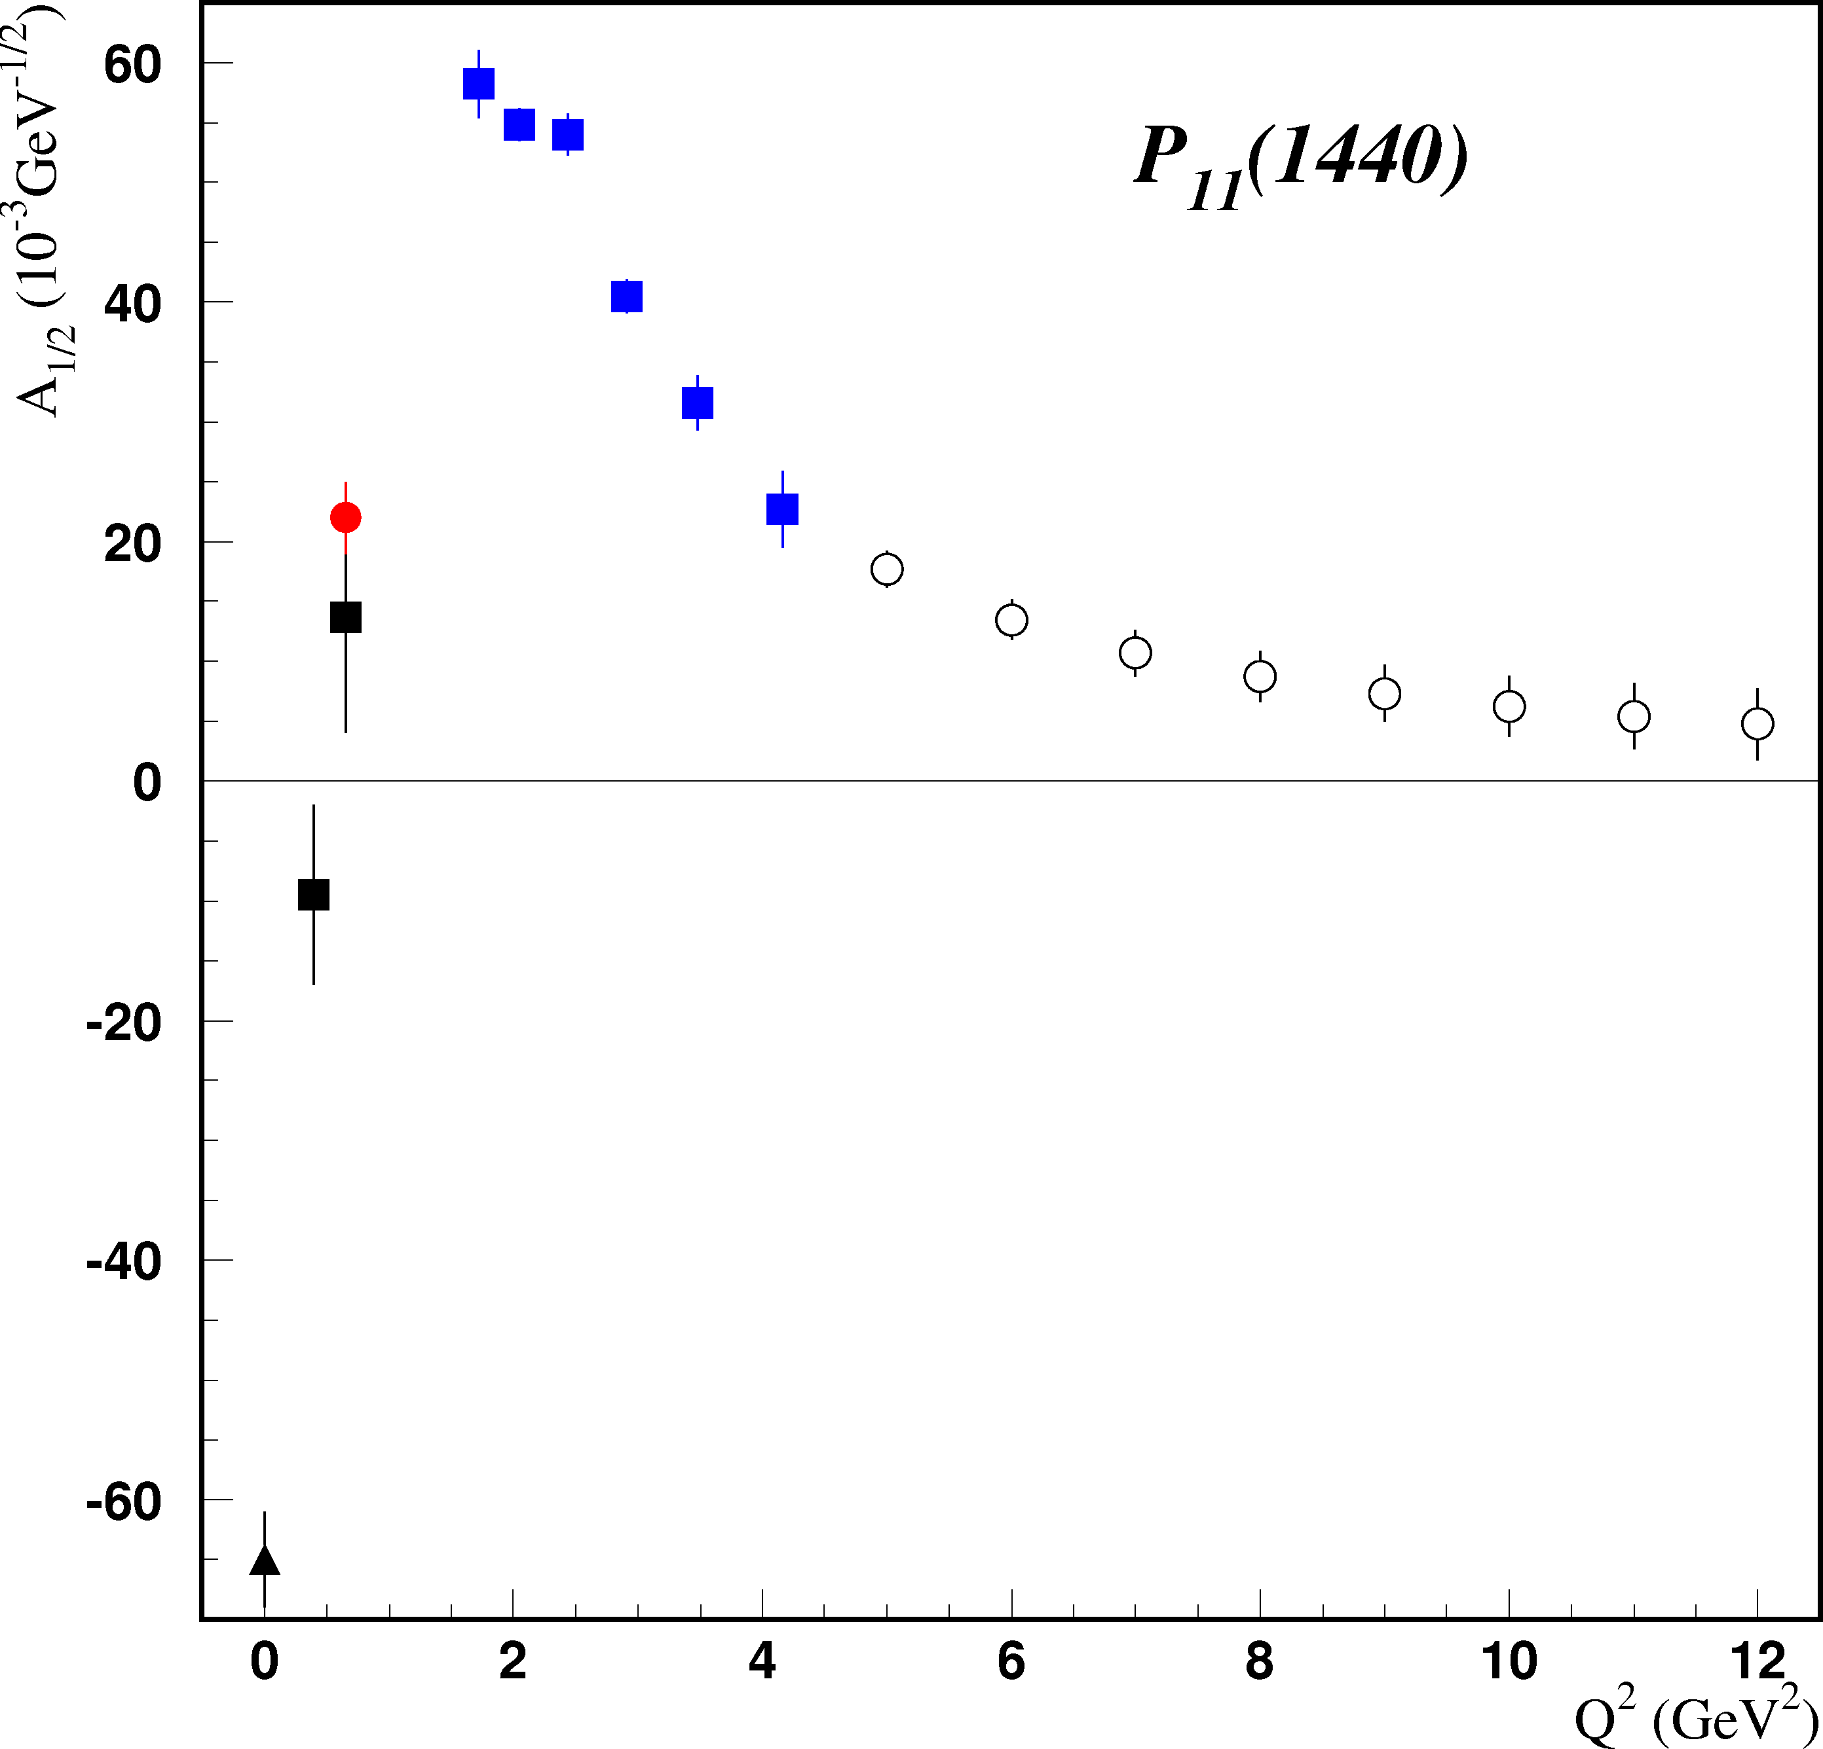
Resonance Transitions at 12 GeV
CLAS12
12 GeV experiment E12-09-003 will extend access to transition FF for all prominent N* states in the range up to Q²=12GeV².
Electromagnetic form factors are sensitive to the running quark
masses and their dynamical structure .
accessible
at 6 GeV
LQCD
DSE
quark mass (GeV)
accessible
at 12 GeV
CLAS12 projected
Probe the transition from confinement to pQCD regimes, allowing us to explore how confinement in baryons emerge from QCD and how >98 % of baryon masses are generated non-perturbatively via dynamical chiral symmetry breaking.

Slide 31
γ_{v}NN* Electrocoupling Sensitivity to Momentum Dependent Quark Mass & Structure
colored point with error bars:
available CLAS results on A_{1/2}
electrocoupling of P₁₁(1440)
P₁₁(1440)
A_{1/2}
π⁺π⁻p
2012
π⁺π⁻p
2010
Nπ
2009
CLAS12 projected
quark core contribution estimated within:
LF quark model which employs
momentum dependent mass of
pointlike quark (F₁=1, F₂=0)
I.G. Aznauryan and V.D.Burkert
Phys. Rev. C85, 055202 (2012).
DSE with contact qq-interaction and momentum independent mass function
DSE expectation for QCD qq-interaction and momentum dependent mass function
γ_{v}NN* electrocouplings measured at the Q²> 5.0GeV² are sensitive to momentum
dependence of dressed quark mass and structure.

Slide 32
Conclusions and outlook
Data on γ_{v}NN* electrocpouplings of most excited proton states in mass range
M_{N*} <1.8 GeV are available from analyses of the CLAS meson electroproduction data at photon virtualitues Q² <5.0 GeV² from single meson and at Q²<1.5 GeV² from double pion electroproduction channels. The files with numerical results can be requested from V.Mokeev (mokeev@jlab.org).
The CLAS results on γ_{v}NN* electrocpouplings offer new opportunity for hadron structure theory to explore how non-perturbative strong interaction generate excited proton states of different quantum numbers
In the future (few years time scale):
- γ_{v}NN* electrocpoupling of N* states with M>1.6 GeV will become available from Nπ channels;
- γ_{v}NN* electrocpoupling of most excited proton states in mass range up to
2.0 GeV and at photon virtualities up to 5.0 GeV² will become available from analysis of π⁺π⁻p electroproduction ;

Slide 33
Conclusions and outlook
- contributions of π⁻Δ⁺⁺, π⁺Δ⁰, π⁺D₁₃(1520), π⁺F₁₅(1685) and ρp channels to nine 1-fold π⁺π⁻p cross sections can be obtained from the CLAS data in DIS area (2.0<W<3.0 GeV, 2.0<Q²<5.0 GeV²), if they can be used for extraction of transition p→N* GPD’s and/or for extending our knowledge on diagonal GPD’s from ρp exclusive electroproduction;
-two-body π⁻Δ⁺⁺, π⁺Δ⁰, π⁺D₁₃(1520), π⁺F₁₅(1685) and ρp cross sections in terms of CM angular distributions at different masses of unstable hadron can be obtained from π⁺π⁻p cross sections for subsequent extraction of these channel amplitudes, employing amplitude analysis methods;
-resonant contributions to meson electroproduction amplitudes can be provided for the studies of global and local duality.
The CLAS12 detector is the only foreseen worldwide facility, which will be capable to explore N* electrocouplings at largest photon virtualities ever achieved 5.0<Q²<12 GeV². For the first time, we will be able to explore regime of quark core dominance, probe momentum dependence of dressed quark mass function in the transition from confinement to pQCD regime and to explore how >98 % of hadron mass in the Universe are generated via dynamical chiral symmetry breaking and how confinement in baryons emerges from QCD.

Slide 34
Back -up

Slide 35
Impact of the Recent LQCD studies of N* Spectrum and Structure on
the N* Program with CLAS/CLAS12
J.J.Dudek, R.G.Edwards, Phys. Rev. D85, 054016 (2012).
each N* state with M_{N*} <1.8 GeV
has partner in computed LQCD
spectrum, but level ordering is
not always consistent to the data
wave functions of the low-lying
N* states dominate by 1-2 SU(6)
configurations, while the wave
function of high lying N*’s may
contain many SU(6) configurations
presence of hybrid-N*s with
dominant contribution of hybrid
components at M_{N*}>1.9 GeV marked by
Should be verified by experiment !
New direction in N* studies proposed in V.D.Burkert, arXiv:1203.2373 [nucl-ex]:
Search for hybrid N*-states looking for:
overpopulation of SU(6)-multiplet;
particular behavior of γ_{v}NN* electrocouplings, which reflects presence of the hybrid
component.

Slide 36
Fixed-t Dispersion Relations for invariant Ball amplitudes (Devenish &Lyth)
γ*p→Nπ
Dispersion relations for 6 invariant Ball amplitudes:
17 UnsubtractedDispersion Relations
(i=1,2,4,5,6)
1 Subtracted Dispersion Relation

Slide 37
Evidence for new N* states and couplings
State N((mass)J^{P} | PDG 2010 | PDG 2012 | KΛ | KΣ | Nγ
N(1710)1/2⁺ | *** (not seen in GW analysis) | *** | *** | ** | ***
N(1880)1/2⁺ |  | ** | ** | * | **
N(1895)1/2⁻ |  | ** | ** | * | ***
N(1900)3/2⁺ | ** | *** | *** | ** | ***
N(1875)3/2⁻ |  | *** | *** | ** | ***
N(2150)3/2⁻ |  | ** | ** |  | **
N(2000)5/2⁺ | * | *** | ** | * | **
N(2060)5/2⁻ |  | *** |  | ** | ***
Bonn-Gatchina Analysis – A.V. Anisovich et al., EPJ A48, 15 (2012)
Strong impact from the CLAS KY photoproduction data on the signala from new states
New states still need to be confirmed

Slide 38
Summary of the CLAS/Hall-C data on ηp electroproduction off protons
Observables | Coverage over Q², GeV² | Coverage over W, GeV | References
dσ/dΩ | 2.4, 3.6 | 1.48-1.62 | [1]
dσ/dΩ | 0.38-2.5 | 1.50-1.86 | [2]
dσ/dΩ | 0.13-3.3 | 1.50-2.30 | [3]
dσ/dΩ | 5.7,7.0 | 1.50-2.30 | [4]
1. C.S. Armstrong et al., Phys. Rev D60, 052004 (1999).
2. R. Thompson et al., (CLAS Collaboration), Phys. Rev. Lett. 86, 1702 (2001).
H. Denizli et al., (CLAS Collaboration), Phys. Rev. C76, 015204 (2007).
M.Dalton et al., Phys. Rev. C80, 015205 (2009).

Slide 39
Summary of the CLAS data on KY electroproduction off protons
Observables | Channel | Coverage over Q², GeV² | Coverage over W, GeV | References
P_{x,y,z} | KΛ,ΚΣ⁰ | 0.7-5.4 | 1.60-2.60 | [1]
A_{e} | KΛ | 0.65-1.0 | 1.60-2.05 | [2]
dσ/dΩ | KΛ,ΚΣ⁰ | 0.5-2.8 | 1.60-2.40 | [3]
P_{x,y,z} | KΛ | 0.3-1.5 | 1.60-2.15 | [4]
1. D.S. Carman et al.,(CLAS Collaboration), Phys. Rev. C79, 065205 (2009).
2. R. Nasseripour et al., (CLAS Collaboration), Phys. Rev. C77, 065208 (2008).
3. P. Ambrozewicz et al., (CLAS Collaboration), Phys. Rev. C75, 045203 (2007).
4. D.S. Carman et al., (CLAS Collaboration), Phys. Rev. Lett. 90, 131804 (2003).
More than 85% of meson electroproduction data worldwide were obtained
in experiments with the CLAS detector and available in the CLAS Physics
Data Base:
http://clasweb.jlab.org/physicsdb/

Slide 40
S₁₁ (1535) electrocouplings and their interpretation
CLAS pη
CLAS nπ+
HallC pη
LC SR
LCQM
CLAS pη
Analysis of pη channel assumes S_{1/2}=0
Branching ratios: β_{Nπ} = β_{Nη} = 0.45
A_{1/2} (Q²) from Nπ and pη are consistent
First extraction of S_{1/2}(Q²) amplitude
LQCD & LCSR calculations (black solid lines) by Regensburg Univ. Group reproduces
data trend at 2.0<Q²<11.0 GeV². V.Braun et al., Phys. Rev. Lett., 103, 072001 (2009) .
Subject for our Workshop:
Prospects for evaluation of γ_{v}NN*electrocouplings for other pairs of N* parity partners;
access to quark distribution amplitudes in N* states of different quantum numbers.

Slide 41
Signals from N* states in the CLAS KY electroproduction data
D.Carman, private communication
Q²=1.8 GeV²
Q²=2.6 GeV²
Q²=3.45 GeV²
3/2 ⁻ 5/2⁻
(1950)
KΛ
the structures in W-dependencies of C_{l} –moments at the same W-values in all Q²-bins are consistent with the contributions from resonances of spin-parities listed in the plots
1/2 ⁺3/2⁺
(1850)
1/2⁺3/2⁺
(2000)
KΣ
reaction model(s) are needed
for extraction of N* parameters
from KY electroproduction
KΣ
3/2⁻5/2⁻
(2050)
W GeV

Slide 42
Anticipated N* Electrocouplings from data on Nπ & Nππ electroproduction
P₁₁(1440)
D₁₃(1520)
S₁₁(1535)
CLAS
Hall C
CLAS
CLAS
Open circles represent projections and all other markers the available results with the 6-GeV electron beam
Examples of published and projected results obtained within 60d for three prominent excited proton states from analyses of Nπ and Nππ electroproduction channels. Similar results are expected for many other resonances at higher masses, e.g. S₁₁(1650), F₁₅(1685), D₃₃(1700), P₁₃(1720), …
This experiment will – for the foreseeable future – be the only experiment that can provide data on γ_{v}NN* electrocouplings for almost all well established excited proton states at the highest photon virtualities ever achieved in N* studies up to Q² of 12 GeV².
Notes:
Errors: projections and D13 data stat^2+syst^2, P11 and S11 data only stat
Blue overlap with and red limit of current data

Slide 43
Reaction Models for Extraction of γ_{v}NN* Electrocoupling at Q²>5.0 GeV²
All currentl reaction models for extraction of γ_{v}NN* electrocouplings employ meson-baryon
degrees of freedom . They can be applied at Q²<5.0 GeV², where meson-baryon mechanisms
are most relevant.
The models explicitly account for the transition from meson-baryon to quark degrees of
freedom are needed for extracting of γ_{v}NN* electrocouplings from Nπ and Nππ electroproduction
data at 5.0<Q²<12.0 GeV² and W<2.0 GeV.
The starting point:
Description of non-resonant mechanisms in π⁺n, π⁰p, πΔ, and ρp electroproduction channels
with the full coverage of reaction phase, including:
hand-bag diagrams with GPD’s structure function from DIS studies;
reggeized meson-baryon amplitudes;
color dipole
others……….
Most urgent need for γ_{v}NN* electrocpoupling studies with the CLAS12 !
Time scale:
Should be ready by 2015, when E-12-09-003 experiment is scheduled
to start the collection of Nπ and Nππ electroproduction data

Slide 44
For discussion
The contribution of π⁻Δ⁺⁺, π⁺Δ⁰, π⁺D₁₃(1520), π⁺F₁₅(1685) and ρp channels to nine 1-fold π⁺π⁻p cross sections (kind of shown in the slide #16) can be obtained in the future at 2.0<W<3.0 GeV and 2.0<Q²<5.0 GeV²
Would it be possible to use these results for extraction of transition π→Δ, p→D₁₃,(1520) p→F₁₅ (1685) GPD’s and diagonal p→p GPD from ρp exclusive channel?
Two-body π⁻Δ⁺⁺, π⁺Δ⁰, π⁺D₁₃(1520), π⁺F₁₅(1685) and ρp cross section at different fixed running masses of unstable hadron can be determined from available π⁺π⁻p cross sections. Is it possible to use “data” on these two body angular distribution for reconstruction of these channel amplitudes?

