Slide 1
Analytic Solutions for Compton Scattering in the High Energy Regime
Todd Hodges
Arizona State University
Old Dominion University 2014 REU Participant
Mentors: Dr. Wally Melnitchouk, Dr. Balša Terzić, & Dr. Geoffrey Krafft

Slide 2
Overview
Definitions
Compton scattering and Thomson scattering
Background
Thomson scattering with relativistic electrons (Thomson source)
Applications
Limitations of Thomson sources
Current corrections
Differential cross section for Compton scattering
Differential cross section in different reference frames
Truncated series representation
Comparison of expressions at fixed scattering angles
Accommodation of a polarized photon beam
Work in progress
Contribution of multi-photon emitting processes

Slide 3
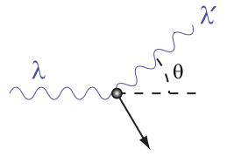
Compton Scattering
Compton scattering
Scattering of real photons from electrons
Thomson scattering in electron rest frame
Low-energy limit (ω << m)
Recoil of electron negligible
Differential cross section is a function of scattering angle only
α = Fine structure constant for QED
m = Mass of electron

Slide 4
Thomson Scattering with Relativistic Electrons
Advantages of Thomson sources
Range of scattered photon energies is small (small bandwidth)
Scattered photons are at greater energies than incident photons
Applications of Thomson source photons
Probes for nuclear physics (E > 1MeV)
Medicine
Higher resolution scanning
Detection of nuclear materials

Slide 5
Limitations of Thomson Sources
As total incident photon intensity increases, bandwidth of scattered photons increases
Krafft 2004, PRL 92, 204802
Solution to bandwidth problem
Frequency modulation of the laser pulse
Terzić, Deitrick, Hofler & Krafft 2014, PRL 112, 074801
Relies on cross section
Currently, limited to individual photon energies within the Thomson limit
Desire to maintain low bandwidth at high intensities with photons outside of Thomson limit
Generalization of cross section to higher energies is needed

Slide 6
Compton Scattering Cross Section
General differential cross section needed
Derive with Quantum Electrodynamics (QED)
Begin with one photon emitting processes
Differential cross section in electron rest frame
ω = Photon energy
E = Electron energy
ϴ = Scattering angle
p = Electron 4-vector
k = Photon 4-vector
Primed ( ʹ ) = Final State

Slide 7
Compton Scattering Cross Section
Differential cross section in “lab” frame
Electron beam and photon beam are collinear
Initial electron four-vector
Differential cross section in lab frame
ω = Photon energy
E = Electron energy
p_{z} = Electron momentum (ẑ)
ϴ = Scattering angle
Primed ( ʹ ) = Final state

Slide 8
Compton Scattering Expansion
Maclaurin series expansion in powers of ω (incident photon energy)
Electron rest frame
Lab frame

Slide 9
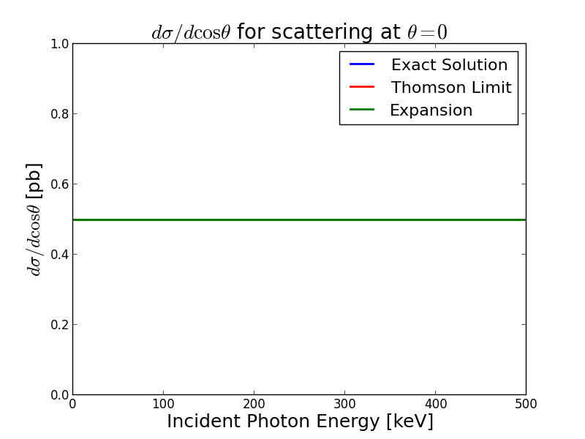
Differential Cross Section

Slide 10
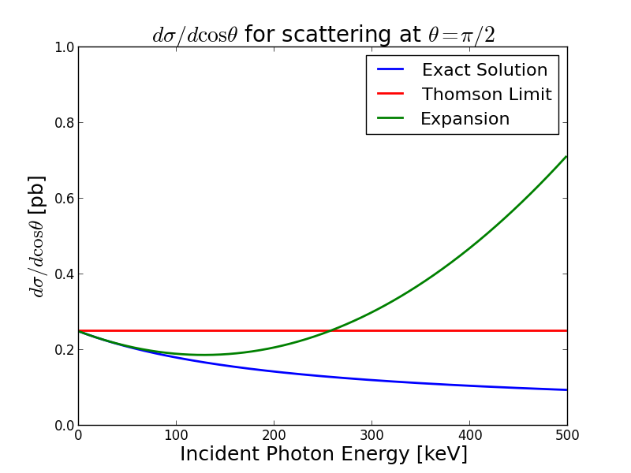
Differential Cross Section

Slide 11
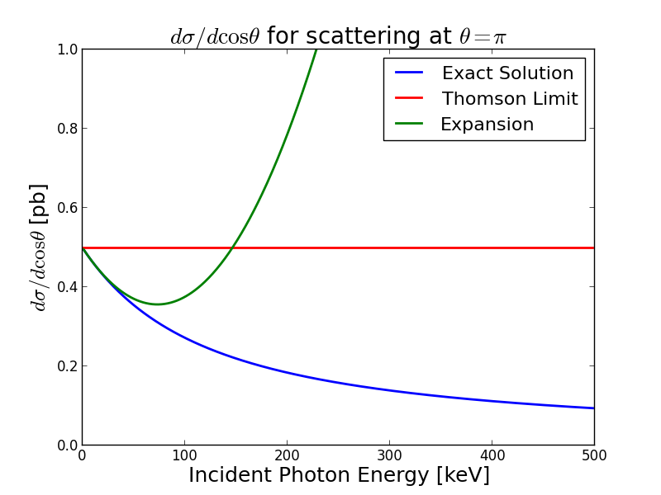
Differential Cross Section

Slide 12
Polarized Photon Beam
For unpolarized scattering
Average over initial electron and photon polarizations
Sum over final electron and photon polarizations
Klein-Nishina formula
For polarized incident and scattered photons
Do not average over initial photons polarizations
Do not sum over scattered photon polarizations

Slide 13
Polarized Photon Beam
Evaluate trace of polarized expression and impose conditions
Final polarized squared amplitude (Note: Averaged and summed electron spins)

Slide 14
Multi-Photon Processes
At photon energies outside Thomson limit, the contribution of multi-photon emitting processes may be significant

Slide 15
Summary
Completed work
Derivation of differential cross section in electron rest frame
Derivation of differential cross section in “lab” frame
Expansion of differential cross section in both frames with corrections
In powers of ω
Calculation of squared amplitude without incident or scattered photon polarizations
In progress
Summation over scattered photon polarizations
Contribution of multi-photon emitting processes

Slide 16
Acknowledgements
Special Thanks
Dr. Wally Melnitchouk
Dr. Balša Terzić
Dr. Geoffrey Krafft
Funding
Old Dominion University
National Science Foundation
Thomas Jefferson National Accelerator Facility
U.S. Department of Energy

