Slide 1
Large Momentum
Effective Field Theory (LaMET) and Parton Physics
P
Xiangdong Ji
University of Maryland/Shanghai Jiao TONG U
Jefferson Lab, Nov. 20, 2017

Slide 2
Outline
Parton physics as fixed point of the momentum RG evolution
Calculating parton physics at the fixed point
Large-momentum effective field theory (LaMET)
Practical considerations & applications
Summary

Slide 3
Parton physics as fixed point of the momentum RG evolution
X. Ji, Sci.China Phys.Mech.Astron. 57 (2014) 1407-1412

Slide 4
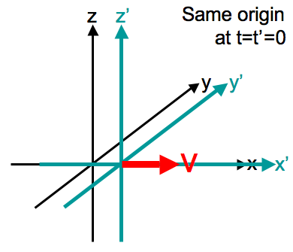
Center-of-Mass and Internal Motions : non-relativistic case
In non-relativistic systems, the COM motion is decoupled from the internal motion in the sense that the internal dynamics is independent of the COM momentum.
H = H_{com} + H_{int}
H_{int} is independent of P (COM momentum) and R (COM position)
Wave function of the H-atom is independent of its speed.
Galilei transformation

Slide 5
Center-of-Mass and Internal Motions : Relativistic case
In relativistic theory, the internal dynamics DOES depend on the total momentum of the system.
The internal wave function of a system is frame-dependent.
Wave functions in the different frame is related by Lorentz boost
|p˃ = U(Λ(p)) |p=0>, Λ is related to the boost K_{i}
Bound state properties do depend on the COM momentum p.

Slide 6
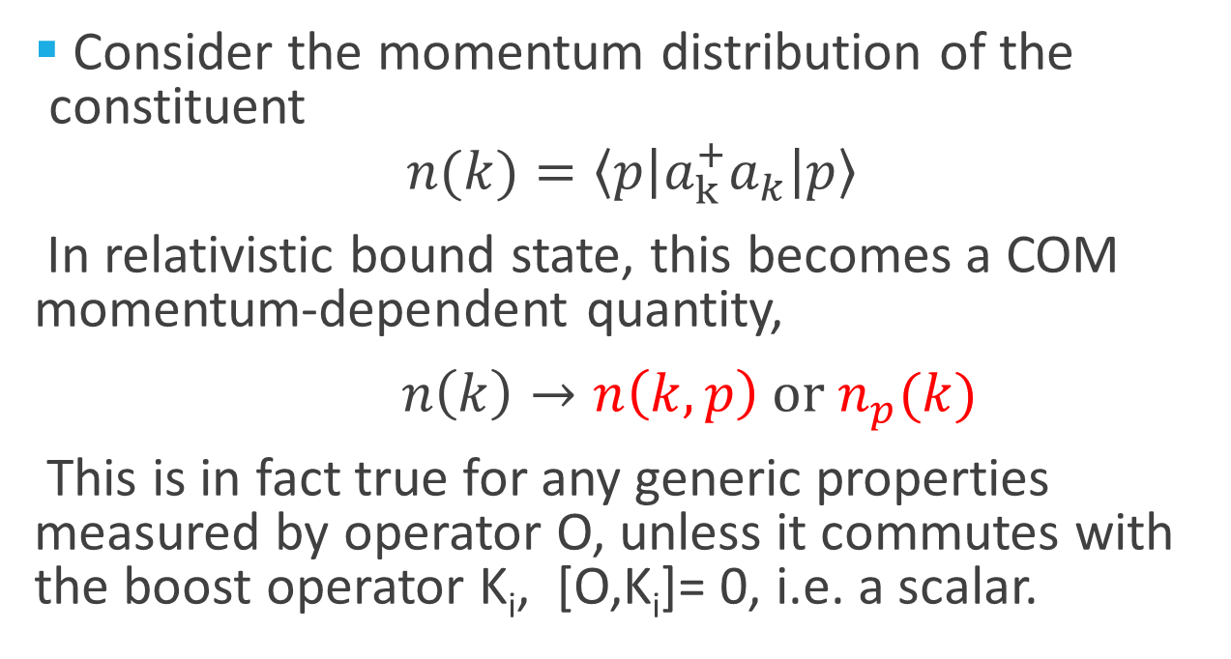
Momentum distribution of constituents
Consider the momentum distribution of the constituent
$$n(k)=〈p\left|a_{k}^{+}a_{k}\right|p〉$$
In relativistic bound state, this becomes a COM momentum-dependent quantity,
$n\left(k\right)→n\left(k,p\right) or n_{p}(k)$
This is in fact true for any generic properties measured by operator O, unless it commutes with the boost operator K_{i}, [O,K_{i}]= 0, i.e. a scalar.

Slide 7
Computing the momentum dependence
computing the momentum dependence of an observable O(p) is in principle possible through commutation relation,
[O, Ki] = ...
However, in relativistic theories, the boost operator K is highly non-trivial, it is interaction-dependent, just like the Hamiltonian.
Thus, computing the p-dependence of an observable is just as difficult as studying the dynamical evolution.

Slide 8
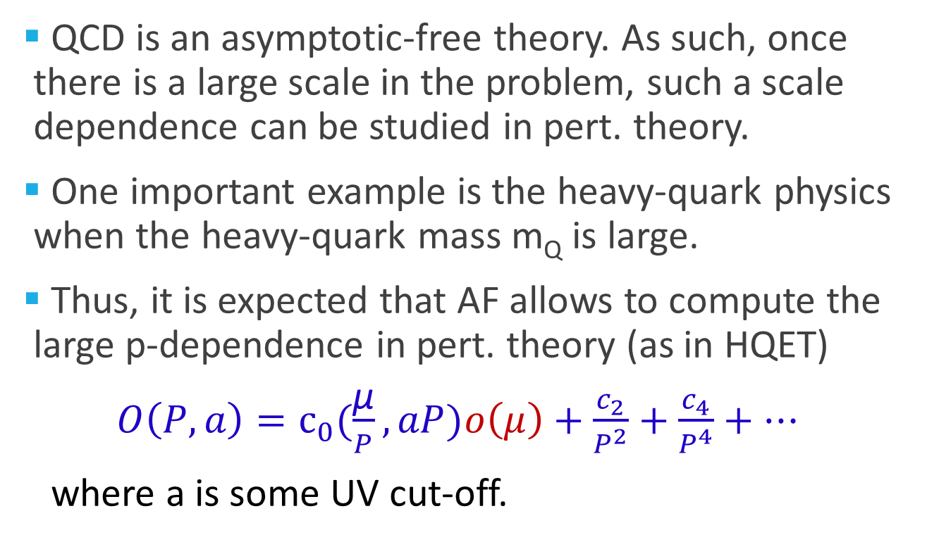
Asymptotic freedom (AF) and large momentum case
QCD is an asymptotic-free theory. As such, once there is a large scale in the problem, such a scale dependence can be studied in pert. theory.
One important example is the heavy-quark physics when the heavy-quark mass m_{Q} is large.
Thus, it is expected that AF allows to compute the large p-dependence in pert. theory (as in HQET)
$O\left(P,a\right)=c_{0}(\frac{\text{μ}}{P}, aP)o\left(μ\right)+\frac{c_{2}}{P^{2}}+\frac{c_{4}}{P^{4}}+…$
where a is some UV cut-off.

Slide 9
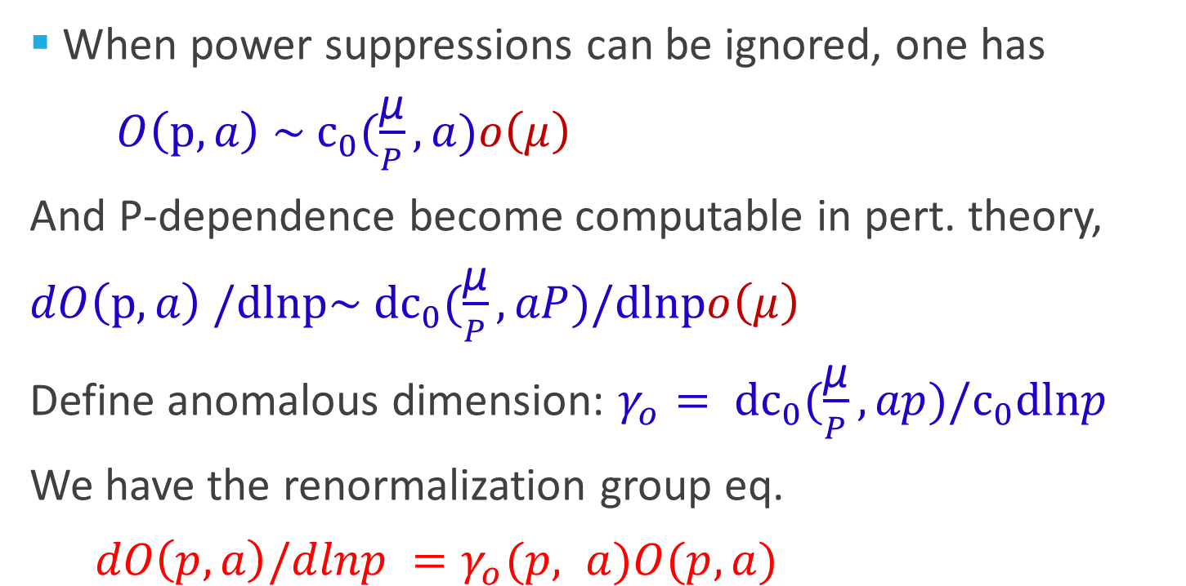
Renormalization group equation
When power suppressions can be ignored, one has
$O\left(p,a\right) \sim c_{0}(\frac{\text{μ}}{P}, a)o\left(μ\right)$
And P-dependence become computable in pert. theory,
$dO\left(p,a\right) /dlnp\sim dc_{0}(\frac{\text{μ}}{P}, aP)/dlnpo\left(μ\right)$
Define anomalous dimension: $γ_{o}= dc_{0}(\frac{\text{μ}}{P}, ap)/c_{0}dlnp$
We have the renormalization group eq.
$dO\left(p,a\right)/dlnp =γ_{o}(p, a)O(p, a)$

Slide 10
Fixed point and parton physics
The RG equation has a fixed point at P=∞
This is the infinite momentum limit in which the partons were first introduced by Feynman. Thus the parton physics corresponds to frame-dependent physical obervables at the fixed point of the frame transformations.
In principle, there is nothing new here. However, as far as I know, this is the first time when this notation has been expressed in QCD equations. More importantly, this teaches one how to calculate the parton physics in QCD！

Slide 11
Parton physics: a unique way to describe the hadron structure
The hadron structure is better represented by partons: parton amplitudes, parton correlations, parton distributions, etc
The great advantage is that partons separate the structure of hadrons from that of the vacuum in which all partons have + momentum zero.
All high-energy scattering data can be used to learn about parton physics

Slide 12
Calculating parton physics at the fixed point (p=∞)

Slide 13
Traditional approache to parton physics
Usually the parton physics is uncovered in perturbation theory by taking the infinite moment limit of Feynman diagrams
The rules can be simplified into the so-called light-front perturbation theory.
These rules can also be generated from light-front quantization of Dirac (1949).

Slide 14
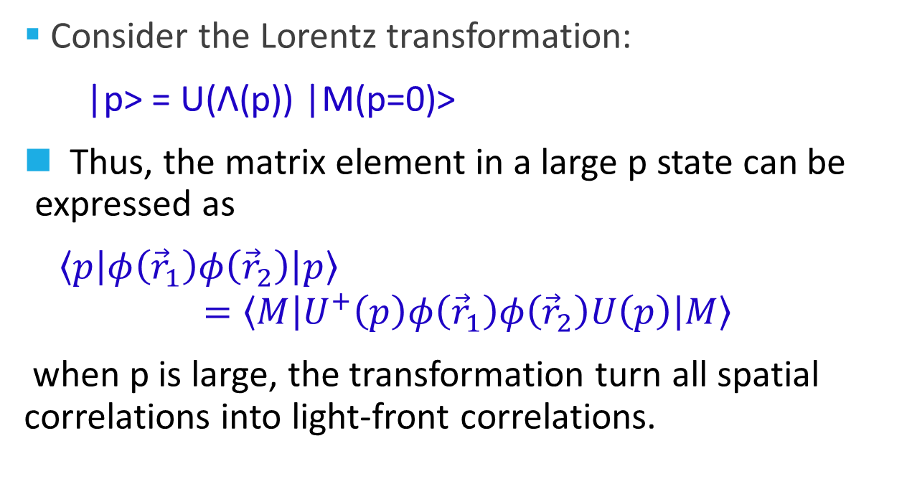
Parton as light-front correlations
Consider the Lorentz transformation:
|p˃ = U(Λ(p)) |M(p=0)>
Thus, the matrix element in a large p state can be expressed as
$〈p\left|φ\left({\vec{r}}_{1}\right)φ\left({\vec{r}}_{2}\right)\right|p〉$
$$=〈M\left|U^{+}\left(p\right)φ\left({\vec{r}}_{1}\right)φ\left({\vec{r}}_{2}\right)U\left(p\right)\right|M〉$$
when p is large, the transformation turn all spatial correlations into light-front correlations.

Slide 15
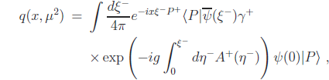
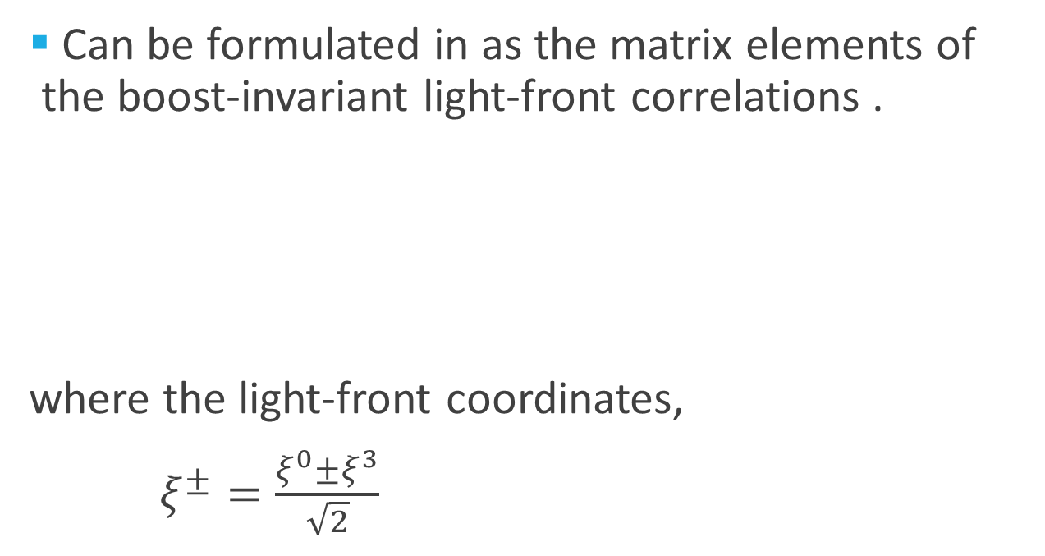
Parton distribution
Can be formulated in as the matrix elements of the boost-invariant light-front correlations .
where the light-front coordinates,
$ξ^{±}=\frac{ξ^{0}±ξ^{3}}{\sqrt{2}}$

Slide 16
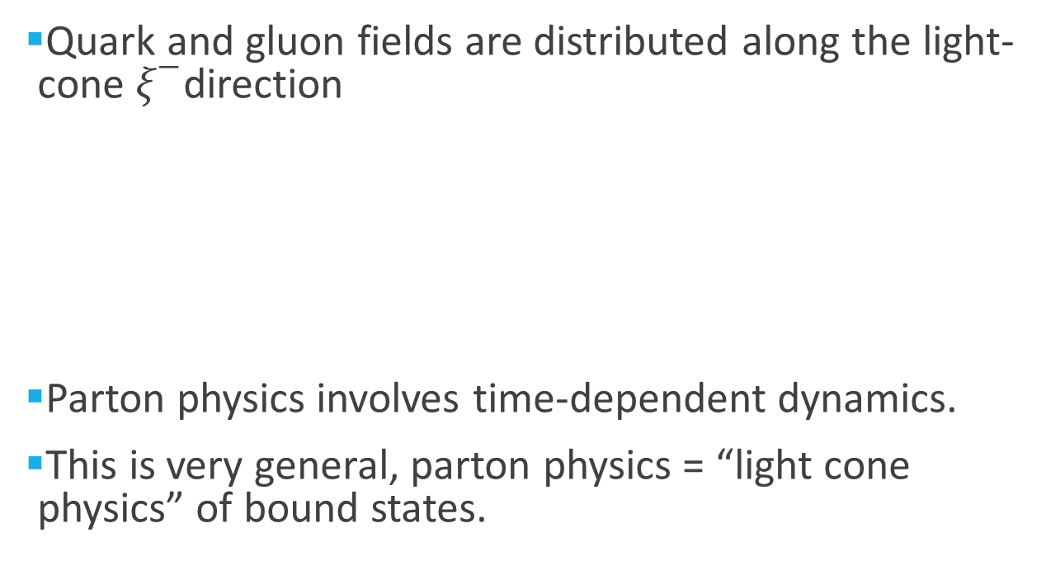
Partons as light-front correlations
Quark and gluon fields are distributed along the light-cone $ξ^{−}$direction
Parton physics involves time-dependent dynamics.
This is very general, parton physics = “light cone physics” of bound states.
𝜉⁰
𝜉⁻
𝜉⁺
𝜉³

Slide 17
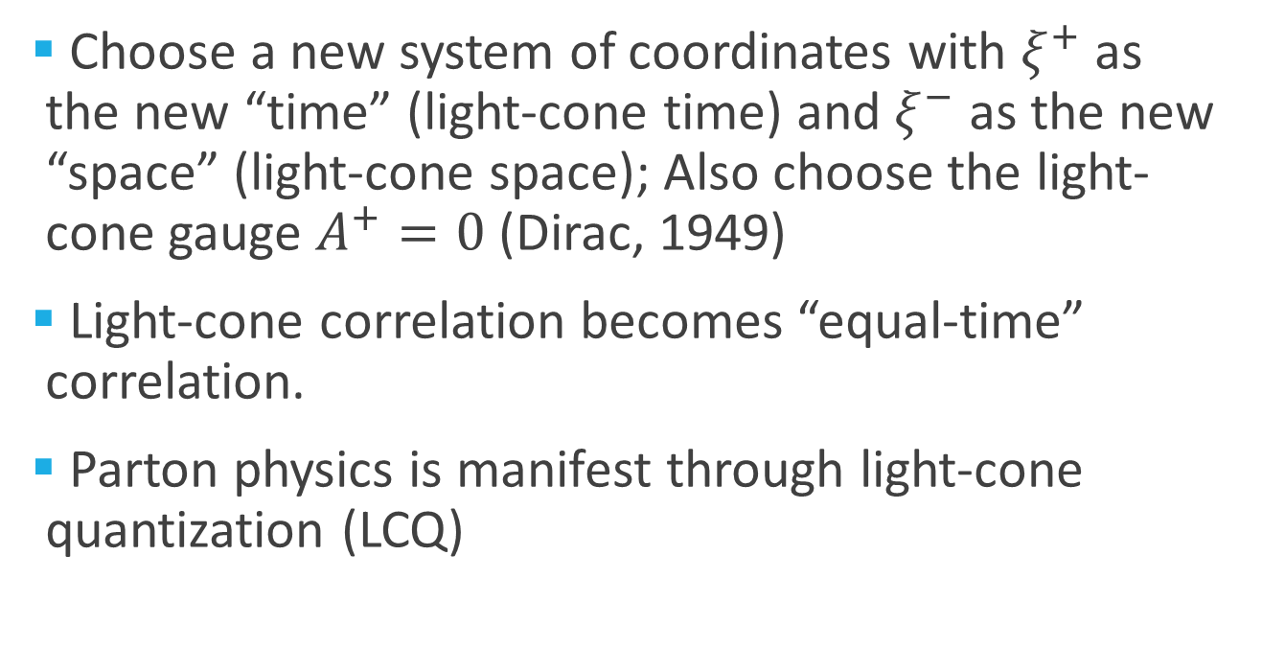
Light-front quantization
Choose a new system of coordinates with $ξ^{+}$ as the new “time” (light-cone time) and $ξ^{−}$ as the new “space” (light-cone space); Also choose the light-cone gauge $A^{+}=0$ (Dirac, 1949)
Light-cone correlation becomes “equal-time” correlation.
Parton physics is manifest through light-cone quantization (LCQ)

Slide 18
Status of Hamiltonian approach
In early 1990’s, Ken Wilson and Stan Brodsky among others became strong proponents for LCQ as a non-perturbative approach to solve QCD, and thus a way to calculate parton physics.
Despite many years of efforts, light-front quantization has not yielded a systematic approach to calculating non-perturbative parton physics.
Not approximate calculations of parton distributions using QCD LF Hamiltonian have appeared.

Slide 19
Monte carlo simulations
Real-time correlations in a dynamical system are usually NPC problem, and cannot be solved using known numerical approaches.
However, there are spatial classes of problems which can be reduced to P problem when conditions are appropriate.
It is not know how to do this directly with light-front quantization.

Slide 20
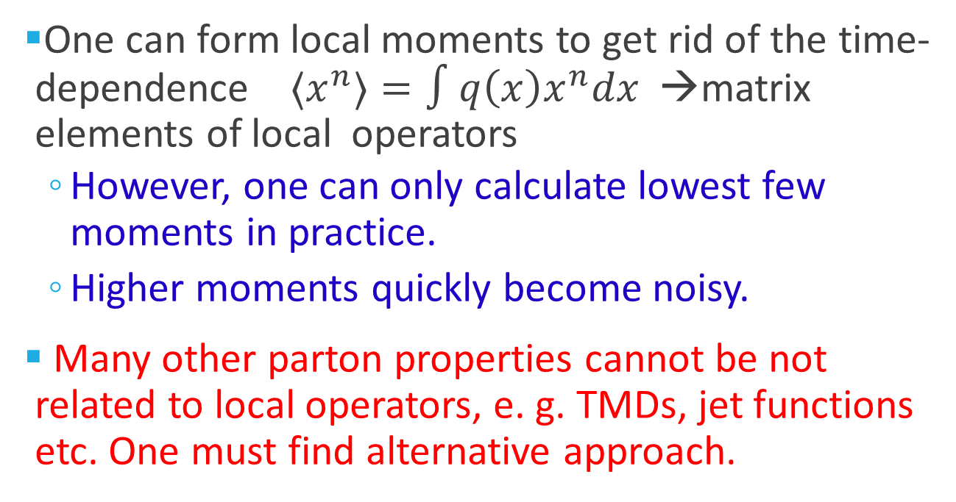
Parton physics on lattice?
One can form local moments to get rid of the time-dependence ${〈x}^{n}〉=∫q\left(x\right)x^{n}dx$ →matrix elements of local operators
  However, one can only calculate lowest few moments in practice.
  Higher moments quickly become noisy.
Many other parton properties cannot be not related to local operators, e. g. TMDs, jet functions etc. One must find alternative approach.

Slide 21
Large-momentum effective theory (LaMET)

Slide 22
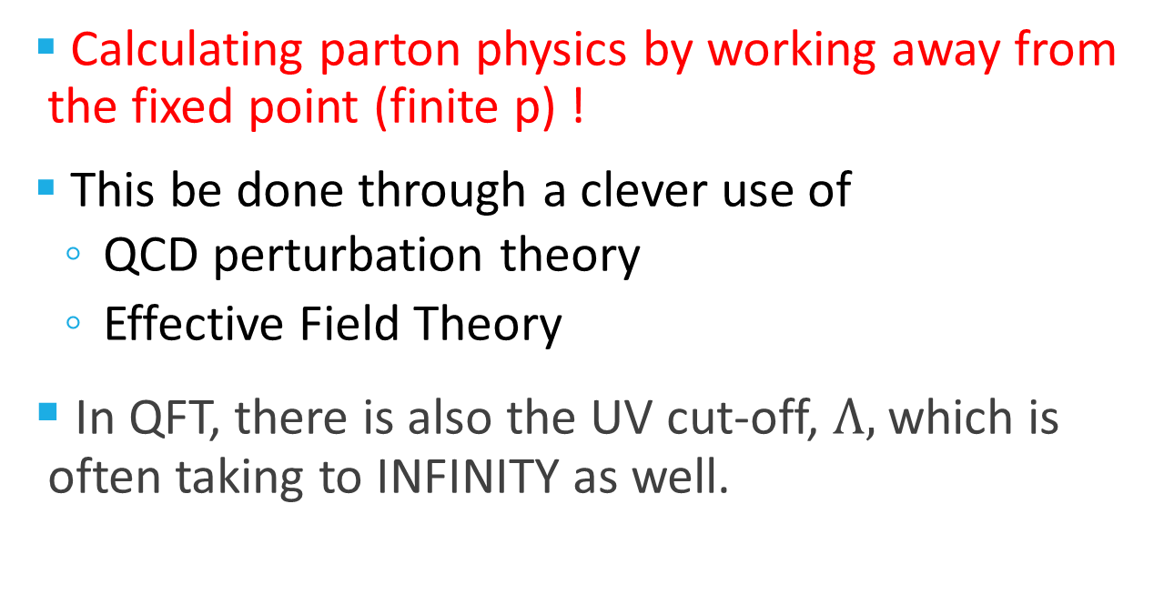
Main goal
Calculating parton physics by working away from the fixed point (finite p) !
This be done through a clever use of
  QCD perturbation theory
  Effective Field Theory
In QFT, there is also the UV cut-off, $Λ,$ which is often taking to INFINITY as well.

Slide 23
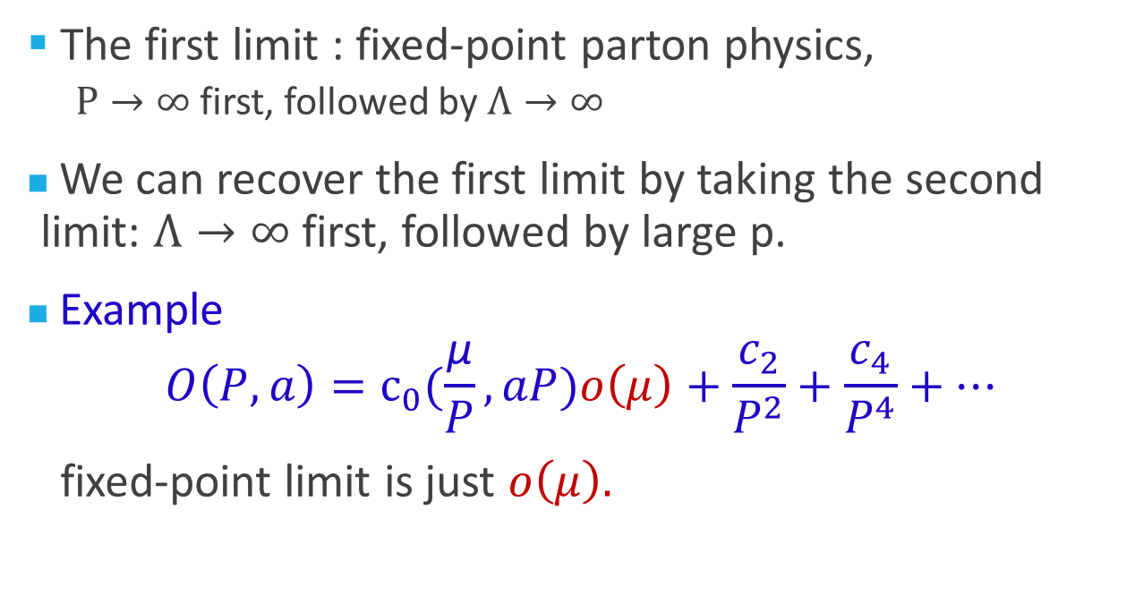
Two different limits
The first limit : fixed-point parton physics,
  $P→∞$first, followed by $Λ→∞$
We can recover the first limit by taking the second limit: $Λ→∞$first, followed by large p.
Example
$$O\left(P,a\right)=c_{0}(\frac{\text{μ}}{P}, aP)o\left(μ\right)+\frac{c_{2}}{P^{2}}+\frac{c_{4}}{P^{4}}+…$$
fixed-point limit is just $o\left(μ\right).$

Slide 24
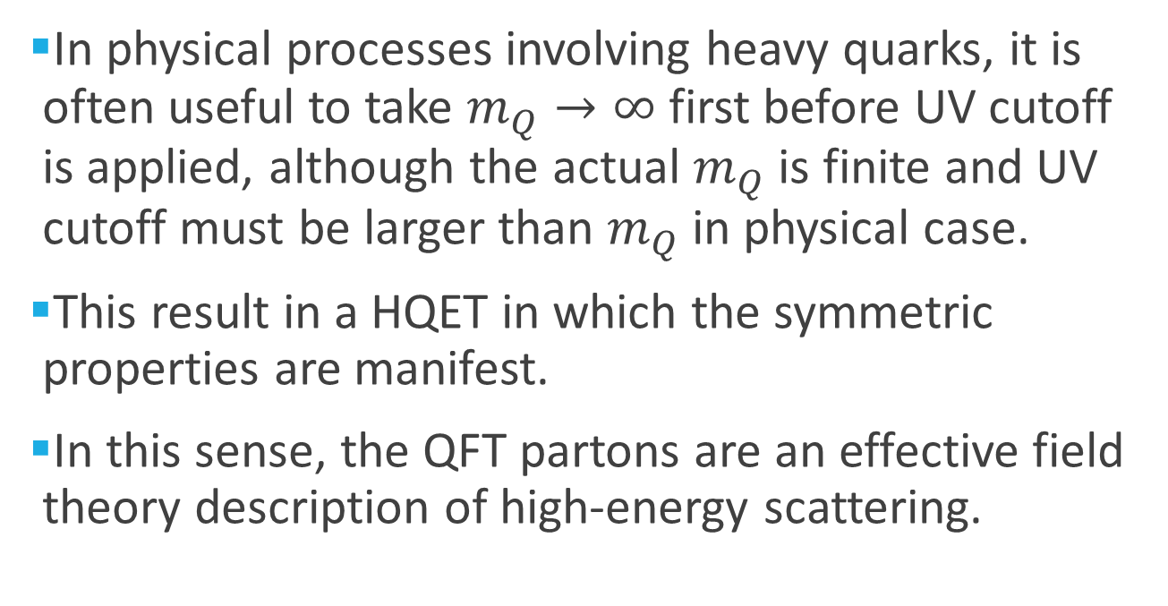
Anatoly with HQET
In physical processes involving heavy quarks, it is often useful to take $m_{Q}→∞$ first before UV cutoff is applied, although the actual $m_{Q}$ is finite and UV cutoff must be larger than $m_{Q}$ in physical case.
This result in a HQET in which the symmetric properties are manifest.
In this sense, the QFT partons are an effective field theory description of high-energy scattering.

Slide 25
A Euclidean quasi-distribution
Consider space correlation in a large momentum P in the z-direction.
  Quark fields separated along the z-direction
  The gauge-link along the z-direction
  The matrix element depends on the momentum P.
𝜉⁰
⁰
^{Z}
𝜉³

Slide 26
The second limit
In taking the second limit, the Q-PDFs will have log dependence on the momentum of the nucleon.
Meanwhile, the parton density has support outside of 0<x<1.
However, it is closer to the physical reality because in high-energy scattering, the hadron does have FINITE momentum.

Slide 27
Taking the limit P-> ∞ first
After renormalizing all the UV divergences, one has the standard quark distribution!
  One can prove this using the standard OPE
  One can also see this by writing
  |P˃ = U(Λ(p)) |p=0>
  and applying the boost operator on the gauge link.
𝜉⁻
𝜉⁰
𝜉⁺
𝜉³

Slide 28
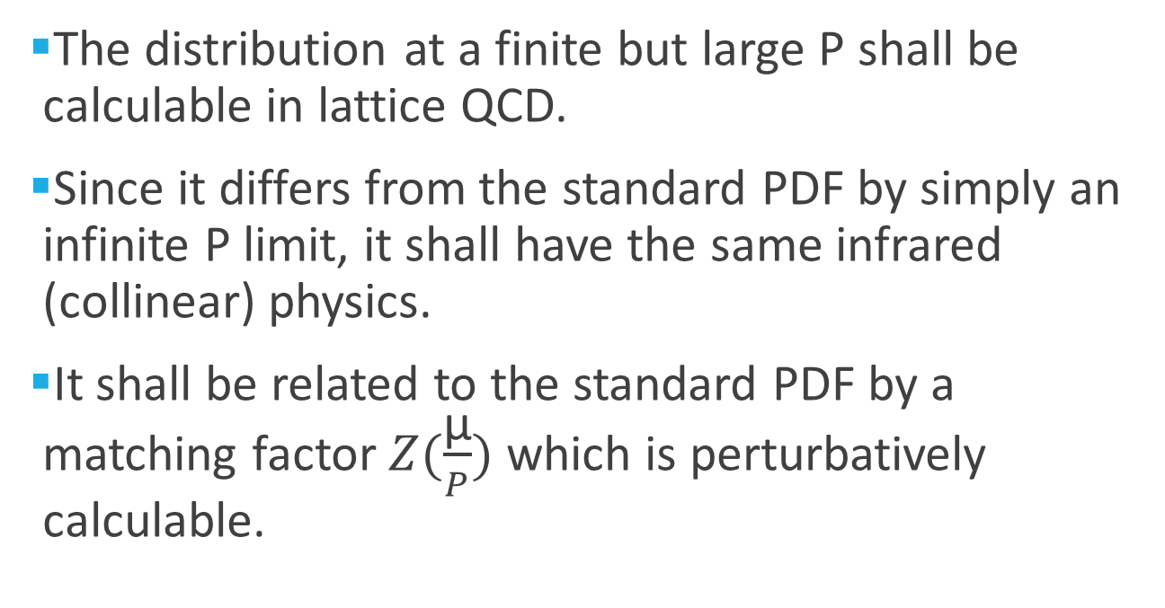
Finite but large P
The distribution at a finite but large P shall be calculable in lattice QCD.
Since it differs from the standard PDF by simply an infinite P limit, it shall have the same infrared (collinear) physics.
It shall be related to the standard PDF by a matching factor $Z(\frac{\text{μ}}{P})$ which is perturbatively calculable.

Slide 29
One-loop matching

Slide 30
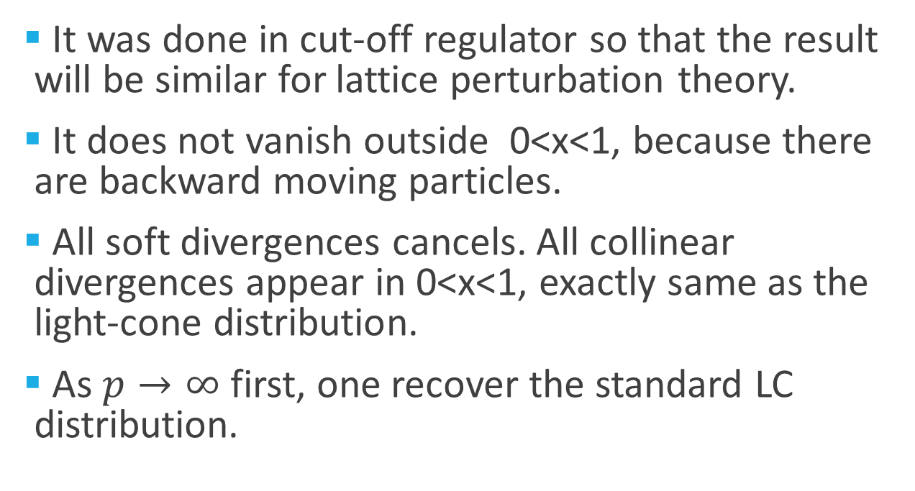
Properties
It was done in cut-off regulator so that the result will be similar for lattice perturbation theory.
It does not vanish outside 0<x<1, because there are backward moving particles.
All soft divergences cancels. All collinear divergences appear in 0<x<1, exactly same as the light-cone distribution.
As $p→∞$ first, one recover the standard LC distribution.

Slide 31

Factorization or matching at one-loop
Since the IR behavior of the quasi-distribution is the same as the LC one, one can write down easily a factorization to one-loop order.
Where the matching factor is perturbative.

Slide 32
All order proof (Qiu and Ma)
Consider A³= 0 gauge (no subtle spurious singularity in this case).
There are no soft-singularities in the quasi-distribution.
All collinear singularities are in ladder diagrams, happen when P large and gluons are collinear with the P. This singularity is the same as that of the light-distribution.

Slide 33
General recipe
LaMET is a theory designed to make ab initio computation of light-cone (light-front, parton) physics on a Euclidean lattice!
The recipe:
  Deconstructing (unboosting) the light-cone operator
  Lattice computation with large momentum
  Effective field theory interpretation

Slide 34
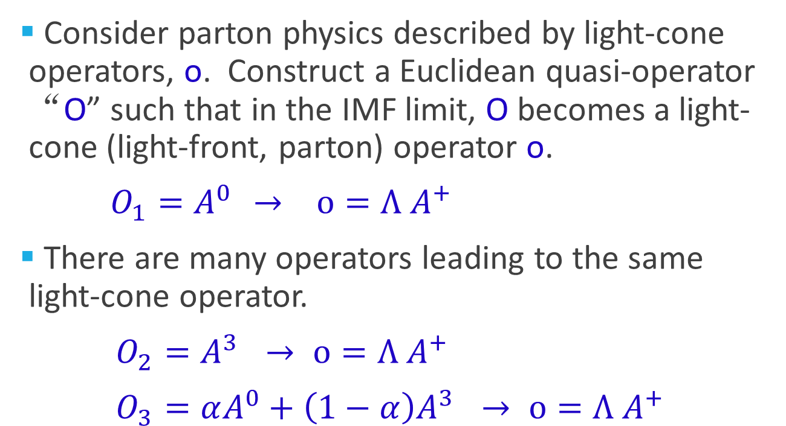
Step 1: Deconstructing the light-cone operators
Consider parton physics described by light-cone operators, o. Construct a Euclidean quasi-operator “O” such that in the IMF limit, O becomes a light-cone (light-front, parton) operator o.
${O_{1}=A}^{0 }→ o=Λ A^{+}$
There are many operators leading to the same light-cone operator.
${O_{2}=A}^{3 }→ o=Λ A^{+}$
${O_{3}=αA^{0}+\left(1−α\right)A}^{3 }→ o=Λ A^{+}$

Slide 35
Step 2: Lattice calculations
Compute the matrix element of Euclidean operator O on a lattice in a nucleon state with large momentum P.
The matrix element may depend on the momentum of the hadron P, O(P,a), and also on the details of the lattice actions (UV specifics).

Slide 36
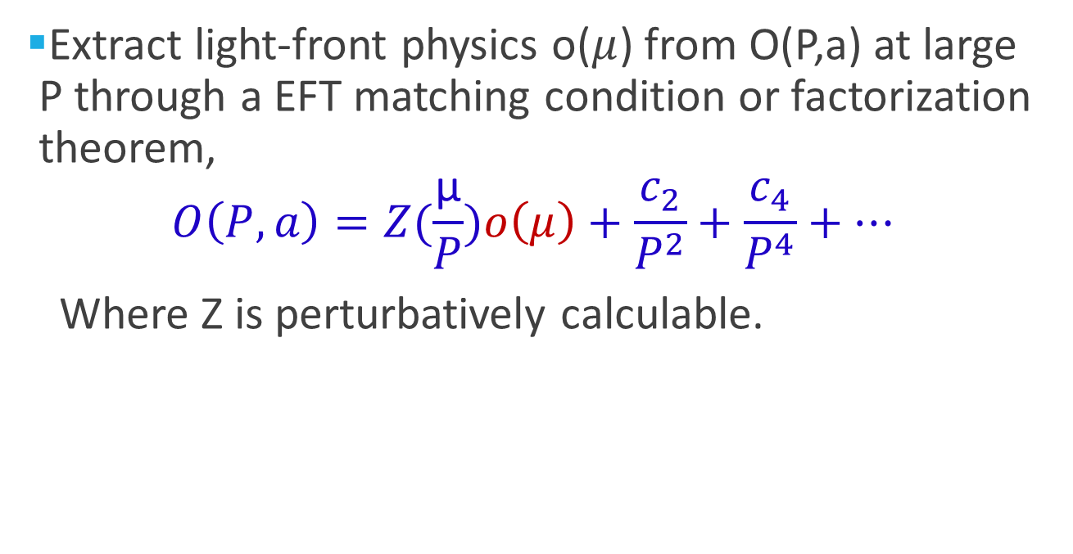
Step 3: Extracting the light-cone physics from the lattice ME
Extract light-front physics o($μ$) from O(P,a) at large P through a EFT matching condition or factorization theorem,
$$O\left(P,a\right)=Z(\frac{\text{μ}}{P})o\left(μ\right)+\frac{c_{2}}{P^{2}}+\frac{c_{4}}{P^{4}}+…$$
Where Z is perturbatively calculable.

Slide 37
Infrared factorization
Infrared physics of O(P,a) is entirely captured by the parton physics o(µ). In particular, it contains all the collinear divergence when P gets large.
Z contains all the lattice artifact (scheme dependence), but only depends on the UV physics, can be calculated in perturbation theory

Slide 38
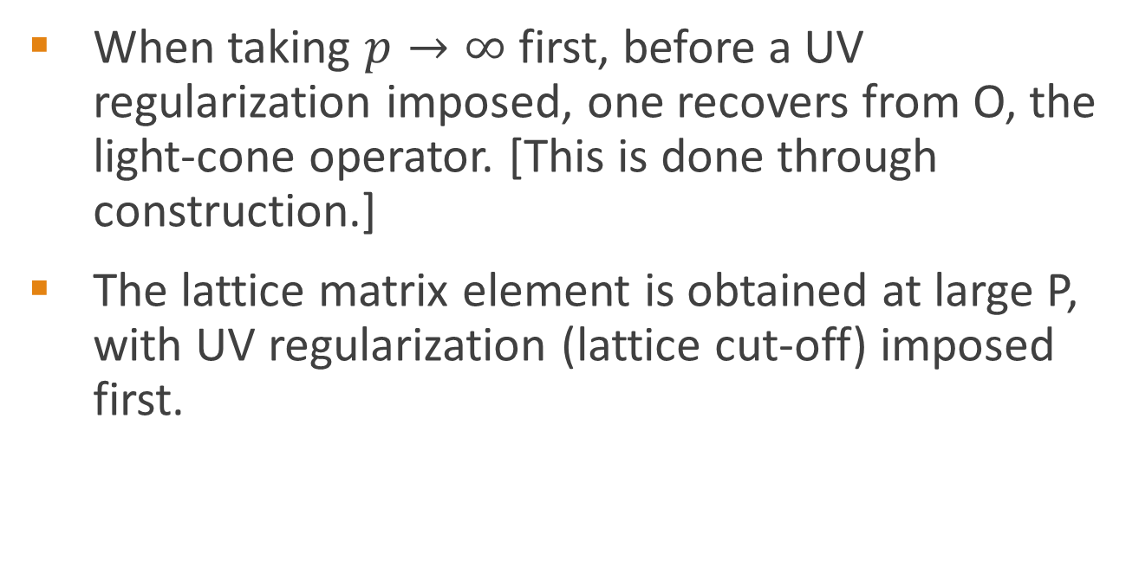
Why factorization exists?
When taking $p→∞$ first, before a UV regularization imposed, one recovers from O, the light-cone operator. [This is done through construction.]
The lattice matrix element is obtained at large P, with UV regularization (lattice cut-off) imposed first.

Slide 39
Universality class
Just like the same parton distribution can be extracted from different hard scattering processes, the same light-cone physics can be extracted from different lattice operators.
All operators that yield the same light-cone physics form a universality class.
Universality class allows one exploring different operator O so that a result at finite P can be as close to that at large P as possible.

Slide 40
Some remarks

Slide 41
Parton physics on lattice
Gluon helicity distribution and total gluon spin
Generalized parton distributions
Transverse-momentum dependent parton distributions
Light-cone wave functions
Higher twist observables

Slide 42
Practical considerations
For a fixed x, large Pz means large kz, thus, as Pz gets larger, the valence quark distribution in the z-direction get Lorentz contracted, z ~1/kz.
Thus one needs increasing resolution in the z-direction for a large-momentum nucleon. Roughly speaking: aL/aT ~ γ

Slide 43
γ=4
x,y
Large P
z

Slide 44
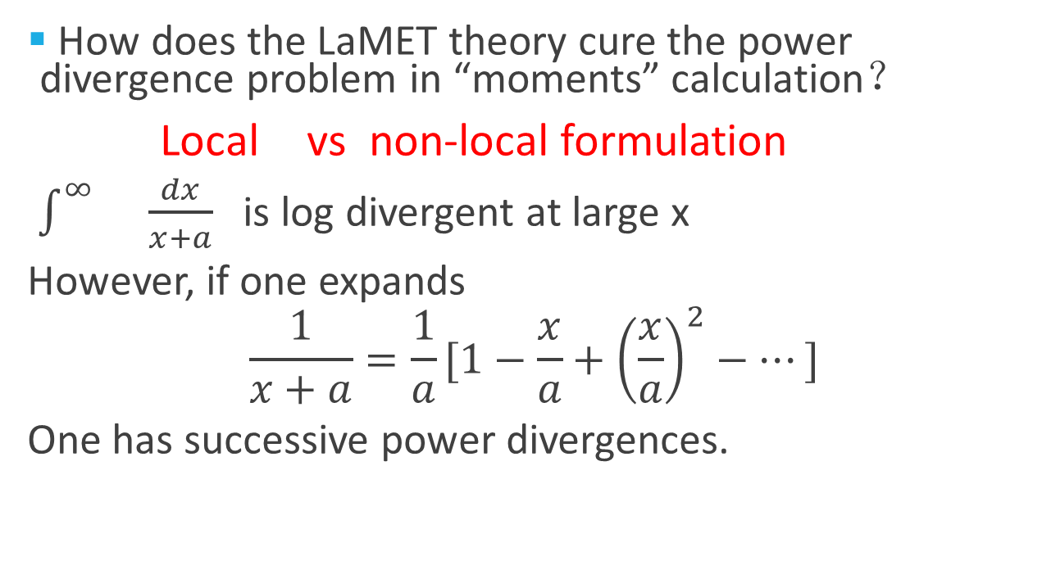
Power divergence problem I
How does the LaMET theory cure the power divergence problem in “moments” calculation？
Local vs non-local formulation
$\int^{∞}{}\frac{dx}{x+a}$ is log divergent at large x
However, if one expands
$$\frac{1}{x+a}=\frac{1}{a}[1−\frac{x}{a}+{\left(\frac{x}{a}\right)}^{2}−…]$$
One has successive power divergences.

Slide 45
Power divergence problem II
There are power divergences in qpdf formulation.
It can be shown all power divergences in quark sector can be absorbed into self-energy renormalization
In the case of gluon, proof is a bit involved because one needs to find a gauge-invariant regularization scheme that preserves power divergence. Could be done on lattice.

Slide 46
Gluon spin
laMET formulation provides the first practical calculation of the gluon helicity contribution to the spin of the proton.

Slide 47
Relation to other formulations
There are other attempts to relate parton physics to lattice calculations. But either has not been proven successful, or more or less equivalent.
large momentum is essential
Ioffe-time formalism (A. Radyushkin), part that rigorous is entirely equivalent.

Slide 48
Summary
Parton physics demands new ideas to solve non-perturbative QCD
New progress recently allows one calculate parton physics using Euclidean lattice. Thus interesting properties like GPDs and TMDs can now be calculated.
With 12 GeV upgrade at Jlab and future EIC, there is an exciting era of precision comparison of parton physics between experimental data and lattice QCD calculations.

Slide 49
Papers
X. Ji, Parton Physics on a Euclidean Lattice, Phys. Rev. Lett. 110, 262002 (2013).
X. Ji, Sci.China Phys.Mech.Astron. 57 (2014) 1407-1412
X. Ji, J. Zhang, and Y. Zhao, Physics of Gluon Helicity Contribution to Proton Spin, Phys. Rev. Lett. 111, 112002 (2013).
Y. Hatta, X. Ji, and Y. Zhao, Gluon Helicity ∆G from a Universality Class of Operators on a Lattice, arXiv:1310.4263v1
H. W. Lin, Chen, Cohen and Ji, arXiv:1402.1462
X. Ji, J. Zhang, X. Xiong, Y. Zhao, submitted to JHEP

Slide 50
Collaborators
Yong Zhao, postdoc at MIT
Xiaonu Xiong, postdoc in Bonn
Jianhui Zhang, postdoc at Regensburg
Huey-wen Lin, Assistant prof at MSU
Jiunn-Wei Chen, Prof. at National Taiwan U.
Feng Yuan, Senior research scientist at LBL
Y. Hatta, Prof. at Kyoto University

