Slide 1
Nuclear Effects in the Proton-Deuteron Drell-Yan Reaction.
Peter Ehlers
University of Minnesota, Morris
Mentor: Wally Melnitchouk
Alberto Accardi

Slide 2
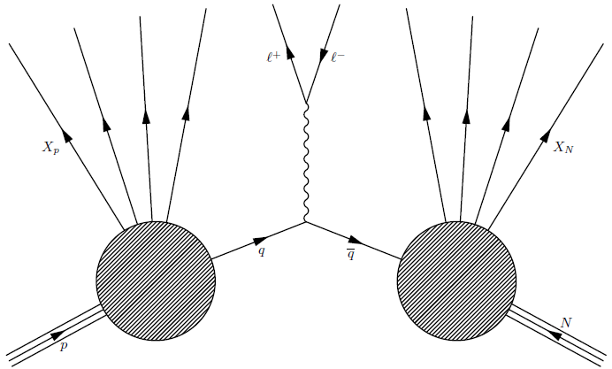
Drell-Yan Process
Two hadrons: proton (p) and nucleon (N).
Quark ($q$) from one and antiquark ($\overline{q}$) from the other annihilate.
Virtual photon becomes lepton-antilepton pair ($ℓ^{−}$, $ℓ^{+}$).
Other hadrons ($X_{p}$, $X_{N}$) produced are not observed.
N is either another proton (p) or a neutron (n)

Slide 3
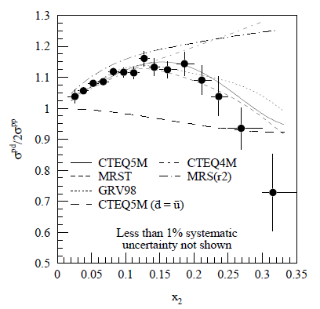
Drell-Yan Process
Individual quark flavor distributions can be probed at high energies.
Deep inelastic scattering (DIS) measures sums of quark and antiquark distributions.
$\frac{{dσ}^{pN}}{dx_{p}dx_{N}}=\frac{4πα^{2}}{9M_{ℓℓ}^{2}}\sum_{q}{e_{q}^{2}}\left(q\left(x_{p}\right)\overline{q}\left(x_{N}\right)+\overline{q}\left(x_{p}\right)q\left(x_{N}\right)\right)$, where $x_{p}=p_{q_{p}+}/p_{p+}$ and $x_{N}=p_{q_{N}+}/p_{N+}$
Ratio of pD to pp cross sections
$≈1+\frac{\overline{d}\left(x_{N}\right)}{\overline{u}\left(x_{N}\right)} (x_{p}≫x_{N})$
R. S. Towell et al., Phys. Rev. D 64, 052002

Slide 4
Motivation for using Deuterons
Uncover the internal structure of the neutron.
Free neutrons are unstable.
Deuteron is composed of one proton & one neutron.
Weak nuclear binding.
Easy place to start examining nuclear effects.

Slide 5
Goals
Compute the nuclear effects on the proton-deuteron cross section (${dσ}^{pD}).$
Earlier analyses use ${dσ}^{pD} ≈{dσ}^{pp}+{dσ}^{pn}$
Examined in DIS, very little attention in DY.
Derive a relation between ${dσ}^{pD}$ and ${dσ}^{pN}$ that accounts for:
Nuclear binding
Fermi motion (internal nucleon motion)
Nucleon off-shell corrections

Slide 6
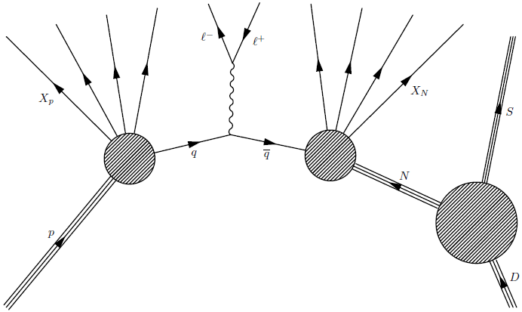
Proton-Deuteron DY Process
One scattered nucleon (N), one spectator nucleon (S).
p & N are involved in the Drell-Yan process.
N is now an internal line; not observable.

Slide 7
Energy of the Struck Nucleon
Because N is not observable, it does not obey the on-mass shell relation $p_{N}^{2}=p_{N0}^{2}−{\vec{p}}_{N}^{2}=m_{N}^{2}$.
However, the spectator nucleon S is on-shell.
$p_{N}+p_{S}=p_{D}={(m}_{D},0, 0, 0)$ in D rest frame.
${\vec{p}}_{S}=−{\vec{p}}_{N}$
$p_{S0}=\sqrt{{\vec{p}}_{S}^{2}+m_{S}^{2}}=\sqrt{{\vec{p}}_{N}^{2}+m_{S}^{2}}$
$p_{N0}=m_{D}−p_{S0}=m_{D}−\sqrt{{\vec{p}}_{N}^{2}+m_{S}^{2}}$
A previous analysis¹ used time-ordered perturbation theory, where N is on-shell but energy is not conserved.
¹H. Kamano and T.-S. H. Lee, Phys. Rev. D 86, 094037

Slide 8
Derivation of the pD Cross Section
$${dσ}^{pD}=\frac{{\left(2π\right)}^{4}}{4\sqrt{{\left(p_{p}∙p_{D}\right)}^{2}+m_{p}^{2}m_{D}^{2}}}\frac{1}{{\left(2π\right)}^{6}}\frac{d{\vec{k}}_{1}}{2E_{1}}\frac{d{\vec{k}}_{2}}{2E_{2}}\frac{1}{q^{4}}f^{μυ}\left(k_{1}, k_{2}\right)F_{μν}^{pD}\left(p_{p},p_{D},q\right)$$
Definition of a scattering cross section for the Drell-Yan Process
$$F_{μν}^{pD}\left(p_{p},p_{D},q\right)=\int{d{\vec{p}}_{N}}{\left|Ψ_{D}\left({\vec{p}}_{N}\right)\right|}^{2}\frac{p_{D0}}{p_{N0}}F_{μν}^{pN}(p_{p},p_{N},q)$$
Deuteron hadron tensor in terms of the nucleon hadron tensor.
$F_{μν}^{pN}$has no transverse momentum or off-shell dependence.
No final state interactions between the spectator nucleon S and hadronic debris X_{N}.

Slide 9
Results
$$\frac{{dσ}^{pD}}{dx_{p}dx_{N}}(x_{p}, x_{N})=\sum_{N=p,n}{\int{dy}f\left(y\right)\frac{{dσ}^{pN}}{dx_{p}dx_{N}}(x_{p},\frac{x_{N}}{y})}$$
pD cross section in terms of the light-cone convolution formula.
$f\left(y\right)=\frac{πm_{N}}{m_{D}−m_{N}y}\int{d{\vec{p}}_{N⊥}^{2}}{\left|Ψ_{D}\left({\vec{p}}_{N}\right)\right|}^{2}\frac{p_{S0}\sqrt{{\left(p_{p}∙p_{N}\right)}^{2}−m_{p}^{2}p_{N}^{2}}}{p_{N0}\left|{\vec{p}}_{p}^{}\right|}$
where $y=\frac{p_{N+}}{p_{D+}}\frac{m_{D}}{m_{N}}=\frac{p_{N0}+p_{Nz}}{m_{N}}$ is the fraction of nucleon light-cone momentum in the deuteron.

Slide 10
Results
Steeply peaked near $y=1$, or $p_{N+}≈\frac{1}{2}p_{D+}$
Quickly approaches zero as y deviates from 1
DIS smearing function is very similar.
Both have factors that approach $1+\frac{p_{Nz}}{p_{N0}}$ in their high energy limits. $\left(\left|{\vec{p}}_{p}^{}\right| , Q^{2}→∞\right)$

Slide 11
Results
Ratio is $\frac{{dσ}^{pD}}{2{dσ}^{pN}}$ using a test function for ${dσ}^{pN}$.
Sharp increase near 1 is because ${dσ}^{pN}=0$ at $x=1$.
Only about 1% correction from $x=0.4$ to $x=0.5$

Slide 12
Results
Ratio is $\frac{{dσ}^{pD}}{2{dσ}^{pp}}$
$\left|{\vec{p}}_{p}^{}\right|=800 GeV$
$x_{p}=0.35$
$Q^{2}=54 {GeV}^{2}$
CTEQ5m PDFs
Experimental data use similar parameters.
Off-shell corrections make a large contribution.
R. S. Towell et al., Phys. Rev. D 64, 052002

Slide 13
Results
Ratio is $\frac{{dσ}^{pD}}{2{dσ}^{pp}}$
$\left|{\vec{p}}_{p}^{}\right|=120 GeV$
$x_{p}=0.6$
$Q^{2}=54 {GeV}^{2}$
CTEQ5m PDFs
Kinematics for the Fermilab E-906/ SeaQuest experiment.
Smearing function contributes primarily at large x.

Slide 14
Conclusion
Nuclear and off-shell corrections will be integrated into the CJ global PDF analysis.
http://www.jlab.org/CJ

Slide 16
DIS Comparison
$\left|{\vec{p}}_{p}^{}\right|$ = 20 MeV for Drell-Yan.
$γ=1.6$ in DIS, where $γ= \sqrt{1+\frac{4x_{N}^{2}m_{N}^{2}}{Q^{2}}}$

