Slide 1
ERGONOMIC INJURIES
Often associated with lifting bulk loads (e.g., large, heavy, awkward shape).
But other hazards activities can cause injury as well:
prolonged repetitive motion forceful or prolonged exertion of the hands Pushing, pulling, or carrying heavy objects awkward postures overhead work | twisting and carrying loads awkward shoulder and wrist position hand/arm vibration whole body vibration distant reach
Notes:
The key to ergonomics is designing the job to fit the worker, not forcing the worker’s body to fit the job.
It’s pretty well understood that a reasonably healthy person can lift 40lbs without getting injured as long as the lift is done correctly.
But there are many other situations, some of which we may encounter here, that could also lead to injury.
Like any hazard the key is taking a step back, recognizing when you might be forcing your body to fit a job, and re-planning the job to eliminate the hazard.
GROUP DISCUSSION – are there any tasks in our area that include these hazards?

Slide 2
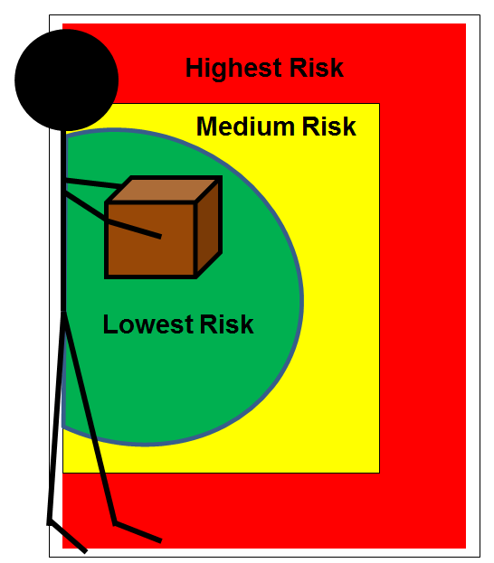
Hazard Reduction
Force: | Reduce the amount of force exerted by the body part in question.
Angle: | Decrease the amount that a joint bends from its neutral position.
Frequency: | Decrease the amount of repetition.
Notes:
Engineered Controls – sometimes engineered controls such as reaching tools and lifting-assistive devices can be used to further reduce risk associated with routine lifts.
Work Practice Controls – these are often the only options available to minimize risk. Can you change your body position, change the set-up, or get a second person involved?
Administrative Controls – consider employee rotation or employee selection, but only do this with advice from Occupational Medicine.
GROUP DISCUSSION – so lets talk a little more about the tasks we identified earlier. Any of these types of solutions appropriate?

Slide 3
Support
Occupational Medicine | Workplace evaluations and presentations by: Dr. Chandler
Program Description | ES&H Manual Chapter 6106 Ergonomics Safety Program
Training | MED 05 – Safe Lifting Training Video* – Proper Lifting Techniques Presentation* – Preventing Hand Injuries: Trends, Causes, Prevention
*Video and presentations can be found at (https://www.jlab.org/ehs/toolbox.html)
Notes:
For more help………….

