Slide 1
Parity-violating electron scattering experiments @ JLAB
Juliette Mammei

Slide 2
Outline
Introduction
Theory
Standard Model
Madam Wu
Z’eldovich
Emmy Noether
Experimental Considerations
Beam quality
Target stability
Backgrounds
Apparatus symmetry
Detector linearity
Collimator precision
Magnet stability
Raster synchronization
Past Experiments
SLAC E158
SAMPLE
Mainz A4
G0
HappEx I-IV
Qweak
PREX
PVDIS
Future Experiments
PREX II
CREX
MOLLER
Qweak (Mainz)
PVDIS
SOLID
Summary

Slide 3
Introduction

Slide 4
PVES
Historical view

Slide 5
Why Parity-Violating Electron Scattering (PVES)?
Search for physics Beyond the Standard Model (BSM) with low energy (Q² <<M²) precision tests complementary to high energy measurements
Neutrino mass and their role in the early universe 0νββ decay, θ₁₃, β decay,…
Matter-antimatter asymmetry in the present universe EDM, DM, LFV, 0νββ, θ₁₃
Unseen Forces of the Early Universe Weak decays, PVES, g_{μ}-2,…
LHC new physics signals likely will need additional indirect evidence
Neutrons: Lifetime, P- & T-Violating Asymmetries (LANSCE, NIST, SNS...)
Muons: Lifetime, Michel parameters, g-2, Mu2e (PSI, TRIUMF, FNAL, J-PARC...)
PVES: Low energy weak neutral current couplings, precision weak mixing angle (SLAC, Jefferson Lab, Mainz)
Study nuclear and nucleon properties
Strange quark content of nucleon
Neutron radii of heavy nuclei

Slide 6
Standard Model of Particles and Interactions
http://www.cpepweb.org/cpep_sm_large.html

Slide 7
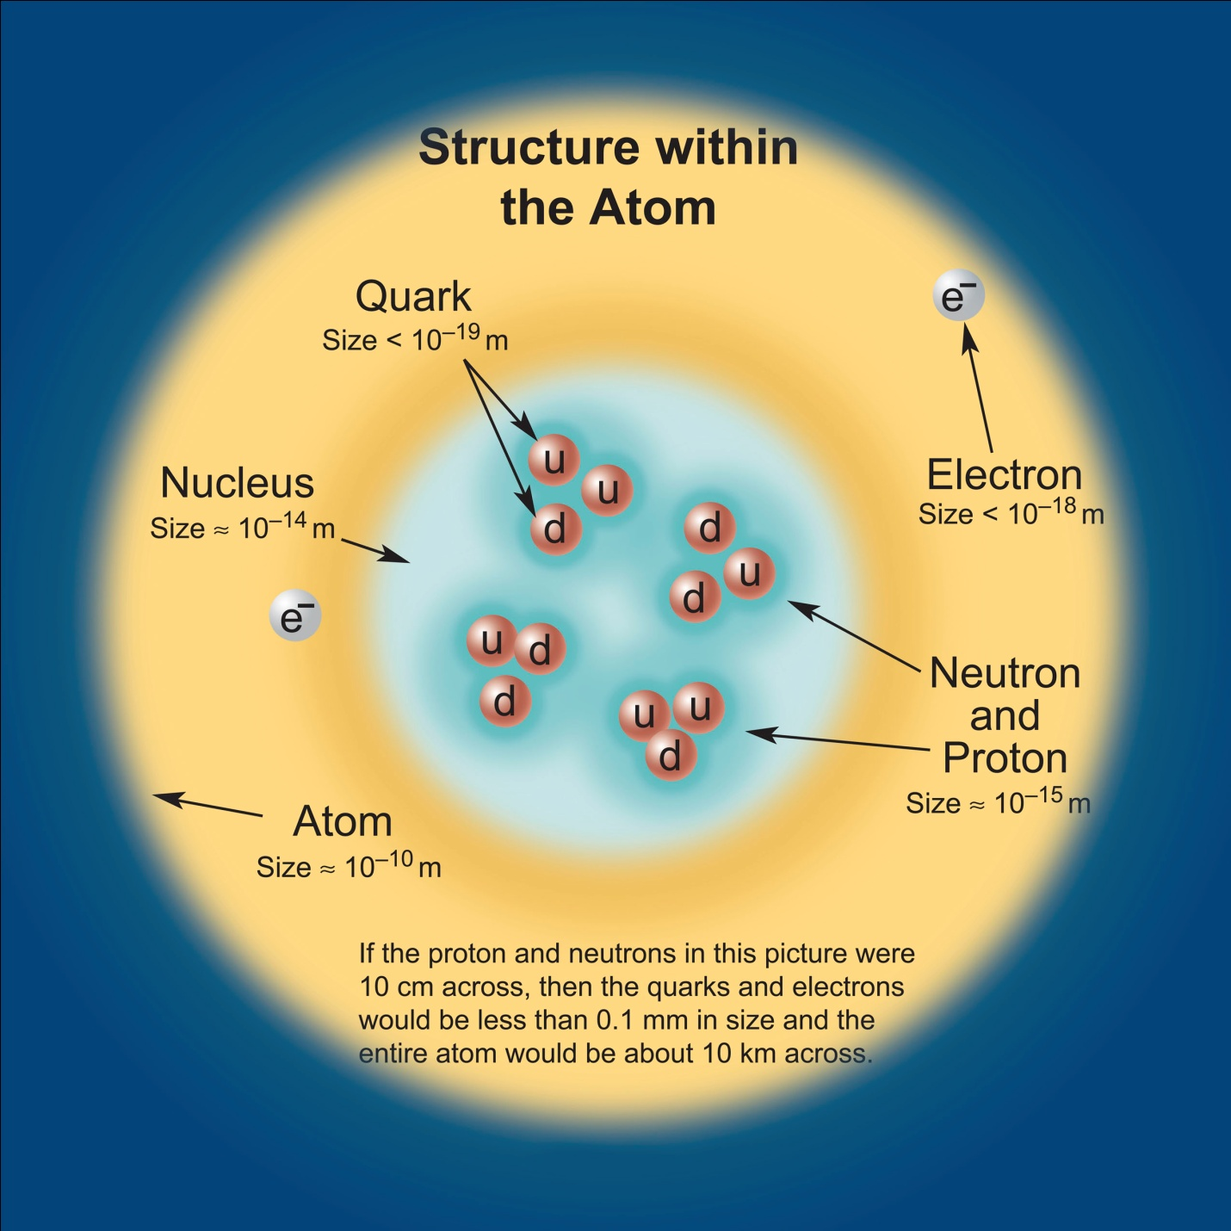
Particles
Interactions

Slide 8
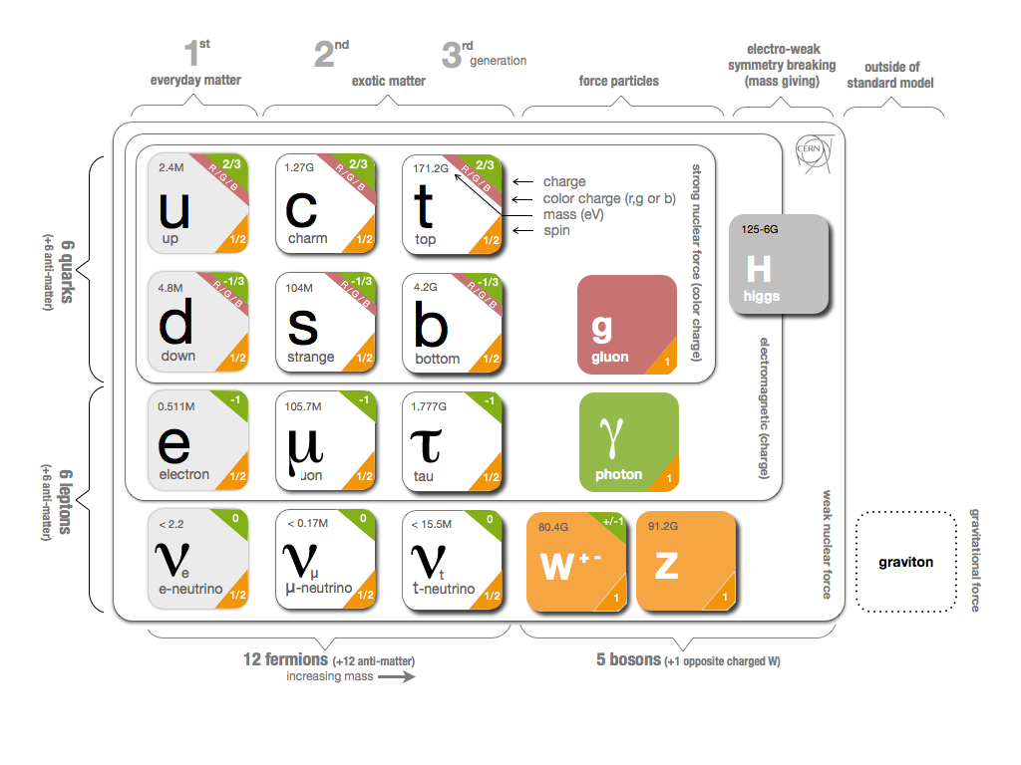

Slide 9
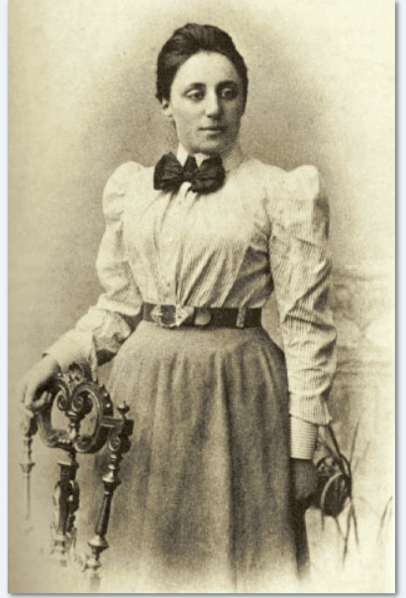
Symmetries
Emmy Noether
(18??-19??)
Conservation laws imply symmetries
Conservation of:
Implies:
Energy
Time invariance
Linear momentum
Translational invariance
Angular momentum
Rotational invariance

Slide 10
What is unitarity and why is it required?
$$\left\langle φ | ψ\right\rangle =\left\langle φ^{′} | ψ^{′}\right\rangle =\left\langle φ | U^{†}U | ψ\right\rangle$$
The adjoint times the operator must be 1:
$$U^{†}U=1$$
CKM matrix
$$\left(\begin{matrix}d^{′} \\ s^{′} \\ b^{′}\end{matrix}\right)=\left(\begin{matrix}V_{ud} & V_{us} & V_{ub} \\ V_{cd} & V_{cs} & V_{cb} \\ V_{td} & V_{ts} & V_{tb}\end{matrix}\right)\left(\begin{matrix}d \\ s \\ b\end{matrix}\right)$$
$$\left(\begin{matrix}ν_{e} \\ ν_{μ} \\ ν_{τ}\end{matrix}\right)=\left(\begin{matrix}U_{e1} & U_{e2} & U_{e3} \\ U_{μ1} & U_{μ2} & U_{μ3} \\ U_{τ1} & U_{τ2} & U_{τ3}\end{matrix}\right)\left(\begin{matrix}ν_{1} \\ ν_{2} \\ ν_{3}\end{matrix}\right)$$

Slide 11
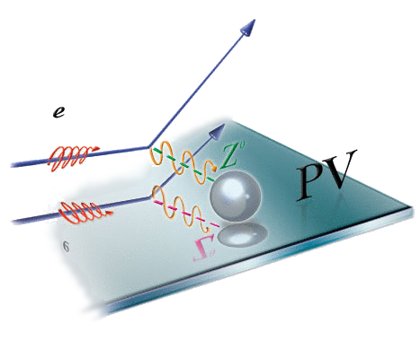
Parity
quantum mechanical operator that
reverses the spatial sign ( P: x -> -x )
We describe physical processes as interacting currents by constructing the most general form which is consistent with Lorentz invariance
Parity
Charge Conjugation
Time Reversal
$$h=\frac{\overset{⃑}{s}∙\overset{⃑}{p}}{\left|\overset{⃑}{s}∙\overset{⃑}{p}\right|}$$
Note: P (V*V) = +1 P (A*A) = + 1 P (A*V) = -1

Slide 12
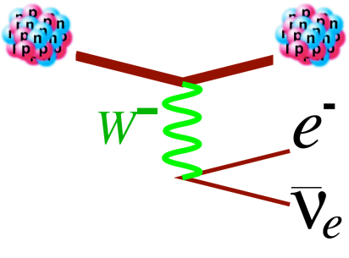
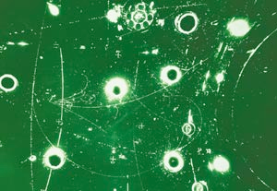
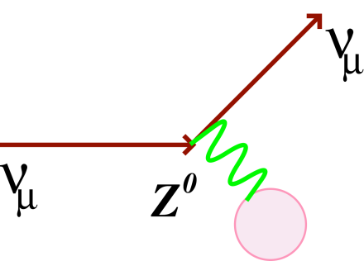
A brief history of parity violation
1930s – weak interaction needed to explain nuclear β decay
1950s – parity violation in weak interaction;
V-A theory to describe ⁶⁰Co decay
R
L
L
R
1970s – neutral weak current events at
Gargamelle
late 1970s – parity violation observed in electron scattering - SLAC E122
Notes:
Add atomic parity violation

Slide 13
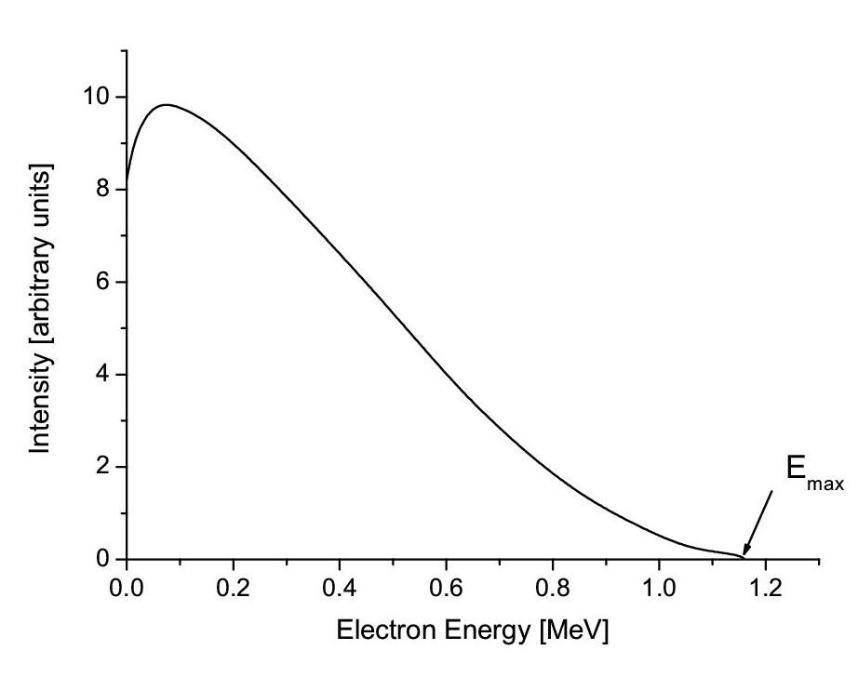
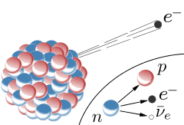
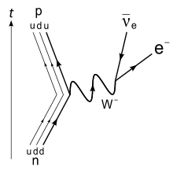
Nuclear beta decay
e-
$${\overline{ν}}_{e}$$
"Beta spectrum of RaE" by HPaul - Own work. Licensed under CC BY-SA 4.0 via Wikimedia Commons
$$G_{F}$$
p
n
Notes:
What does it have to do with PVES?
Fermi’s model – contact interaction between two coupled vector currents
Conserved vector current hypothesis

Slide 14
EM and Weak Interactions : Historical View
EM: e + p → e + p elastic scattering
e-
p
$$J_{μ}^{EM, e}$$
$$J_{μ}^{EM, p}$$
V x V
e-
p
e-
Weak: n → e⁻ + p + ${\overline{ν}}_{e}$ neutron beta decay
Fermi (1932) : contact interaction, form inspired by EM
p
$$J_{μ}^{weak, e}$$
$$J_{μ}^{weak, N}$$
$$G_{F}$$
$$ν_{e}$$
n
V x V
Parity Violation (1956, Lee, Yang; 1957, Wu)
required modification to form of current - need axial vector as well as vector to get a parity-violating interaction
(V - A) x (V - A)
Note: weak interaction process here is charged current (CC)

Slide 15
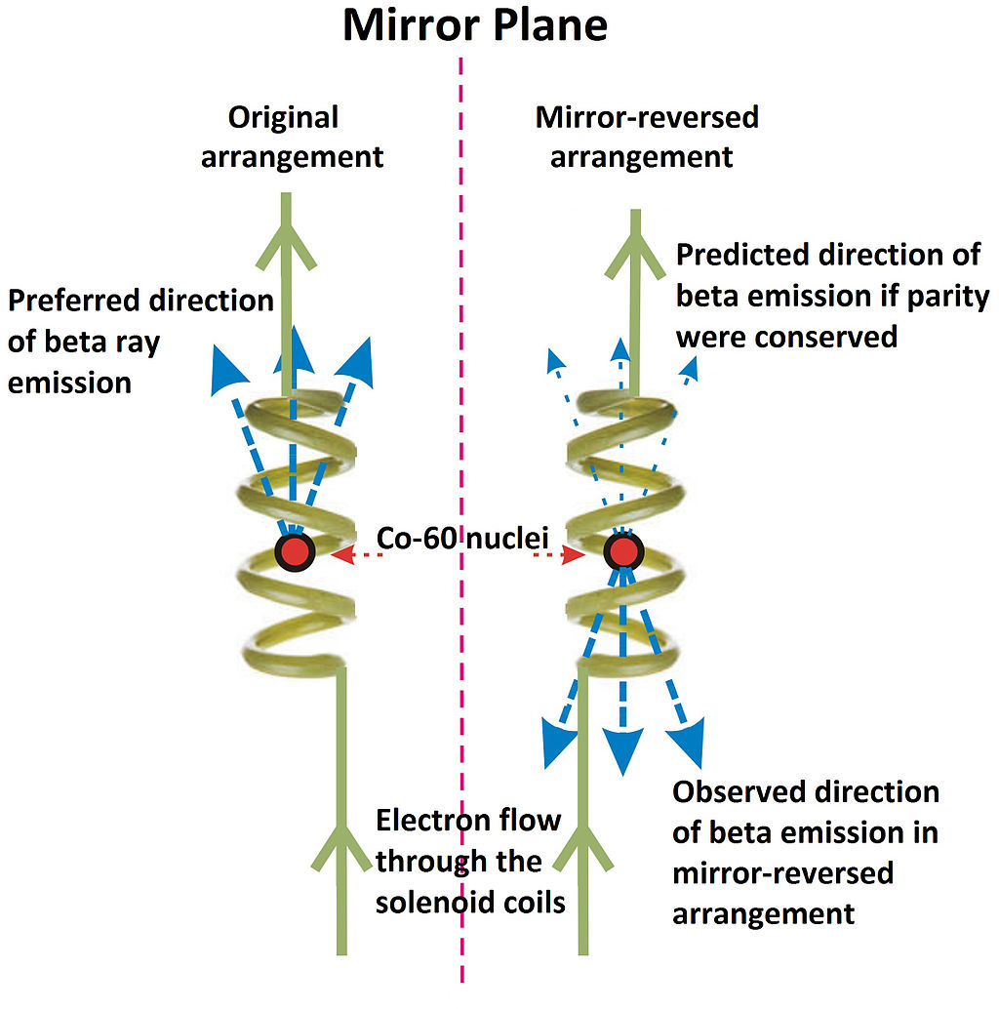
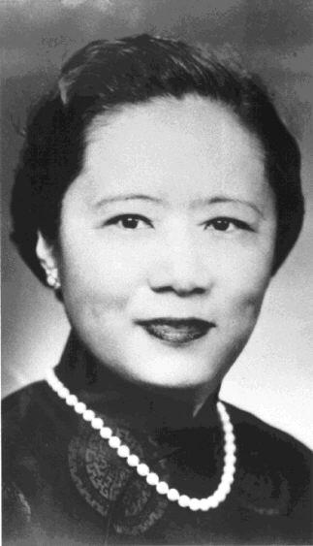
Parity-violation in charge current maximal
electrons favored the direction opposite to that of the nuclear spin
Madam Wu
Bleckneuhaus, with English language captions by Stigmatella aurantiaca
Notes:
Gamma rays are photons, and their release from the nickel-60 nuclei is an electromagnetic (EM) process. This is important because EM was known to respect P-conservation. Hence, the distribution of the emitted gamma rays acted as a control for the polarization of the emitted electrons via the weak interaction, as well as an indicator of the uniformity of the cobalt-60 atoms. Wu's experiment compared the distribution of gamma and electron emissions with the nuclear spins in opposite orientations. If the electrons were always found to be emitted in the same direction and in the same proportion as the gamma rays, P-conservation would be true. If there were a bias in the direction of decays, that is, if the distribution of electrons did not follow the distribution of the gamma rays, then P-violation would be established.

Slide 16
What about a neutral weak current?
Zel’dovich – 1959
Is there a neutral analog to $β$ decay?
Would determine the sign of $G_{F}$
e-
p
e-
p
?
$$G_{F}$$
$$G_{F}$$
$$ν_{e}$$
n
e-
p

Slide 17
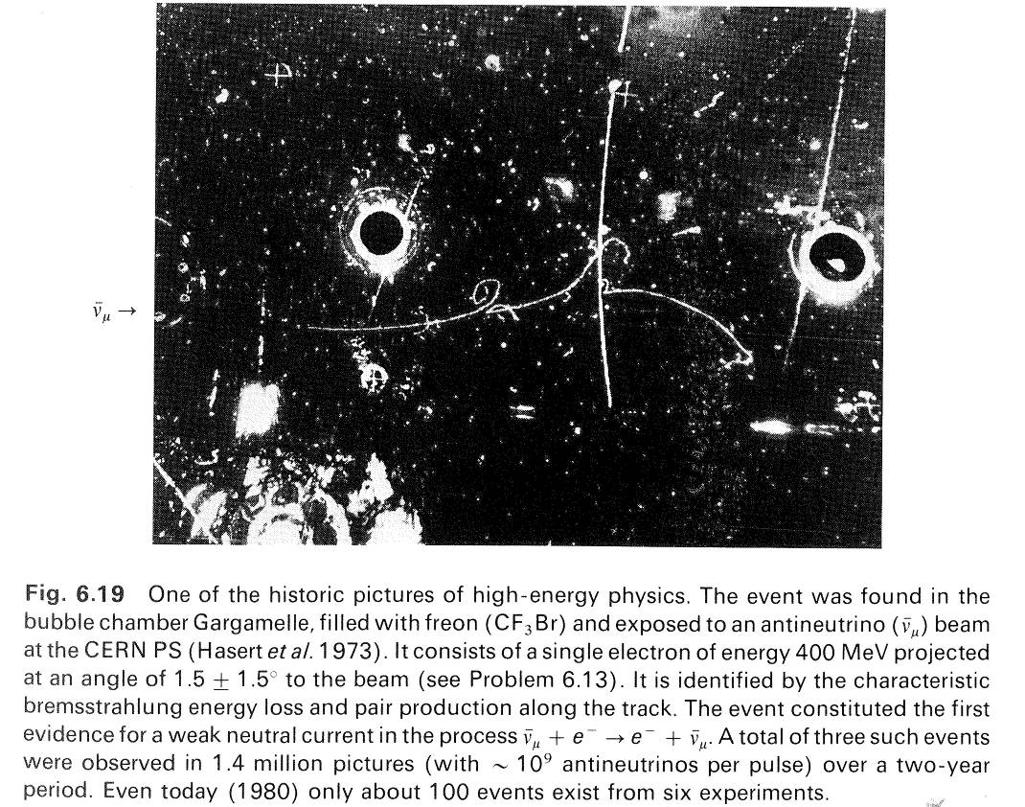
Neutral weak currents observed
The prediction of the Z⁰ implied the existence of previously unobserved neutral current processes like:
These processes were first discovered in 1973:
ν_{μ} + e⁻ → ν_{μ} + e⁻
ν_{μ}
ν_{μ}
Z⁰
e⁻
e⁻
What about parity violation?

Slide 18
The neutral weak current, Zel’Dovich
e-
longitudinally polarized e-
e-
parity non-conservation via weak – EM interference
$$A_{PV}=\frac{σ_{+}−σ_{−}}{σ_{+}+σ_{−}}≈\frac{M_{weak}}{M_{γ}}$$
$$≈\frac{G_{F}Q^{2}}{4πα}$$
parity-violating asymmetry
$$Q^{2}\sim 0.1−1 {GeV}^{2}$$
Four drops of ink in a 55-gallon barrel of water would produce an "ink concentration" of 1 ppm!!!
$$A_{PV}≤{10}^{−6}{ − 10}^{−4}$$

Slide 19
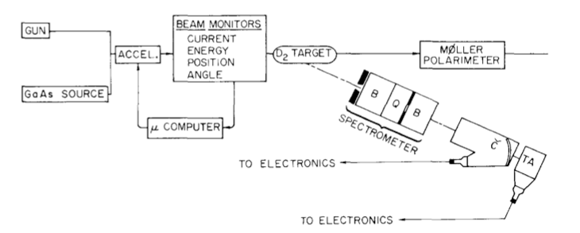
SLAC Experiment E122
Polarimetry
• High luminosity from
photoemission from NEA
GaAs cathode
• Rapid helicity-flip (sign of
e- polarization)
Integrating detectors
Magnetic spectrometer
Background and kinematic separation
Huge achievement!
Highest P²I ever, by far. Developed for this experiment at SLAC and used ever since

Slide 20
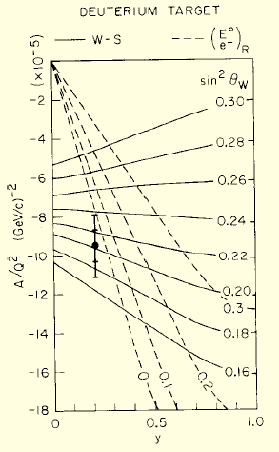
SLAC Experiment E122
Parity Non-Conservation in Inelastic Electron Scattering, C.Y. Prescott et. al, 1978
A_{PV} ~ 100 ± 10 ppm
sin²θ_{W}=0.20±0.03
 | Left | Right
γ Charge | 0, ±1, ±1/3, ±2/3 | 0, ±1, ±1/3, ±2/3
W Charge | T=±1/2 | 0
Z Charge | T-qsin²θ_{W} | -qsin²θ_{W}
GWS --‐ Nobel Prize 1979
Deep inelastic scattering:
Y dependence reflects quark axial/electron vector coupling strength
At high x

Slide 21
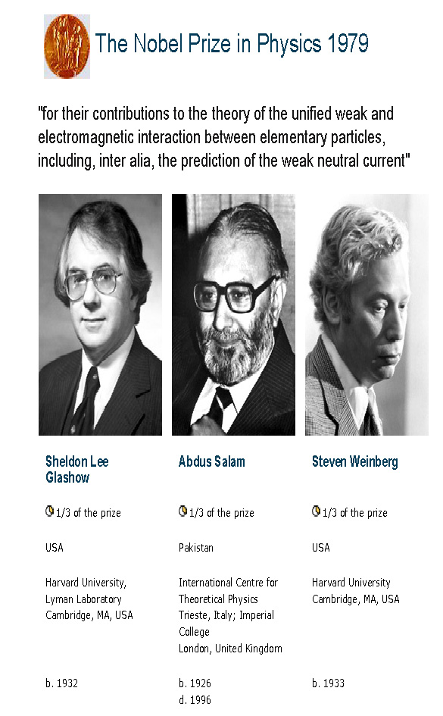
Standard Model of Electroweak Interactions
Glashow-Weinberg-Salam Model (1967): unified EM and weak forces as an electroweak force
→ SU(2)_{L} x U(1) gauge theory with spontaneous symmetry breaking
fermions:
Interaction of fermions with gauge bosons:
γ
W^{+,-}
Z⁰
sin²θ_{W} – “weak mixing angle”, parameterizes the mixing between the two neutral currents

Slide 22
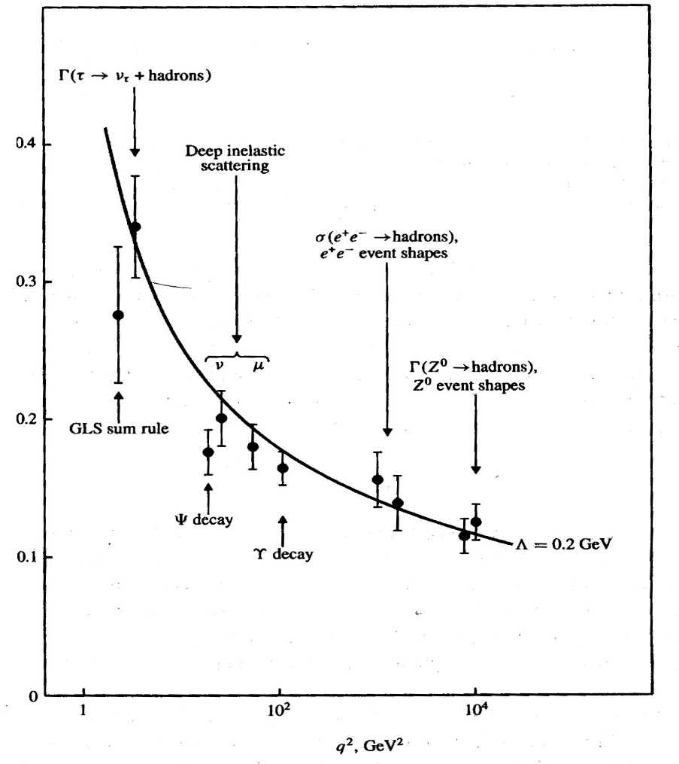
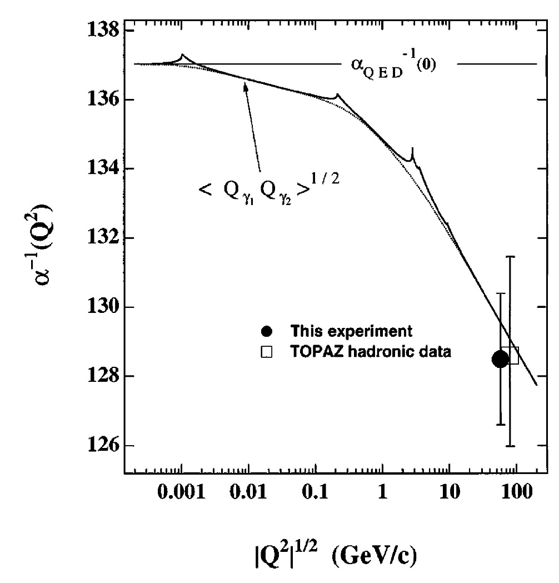
Running of coupling constants
What about sin²θ_{W}?

Slide 23
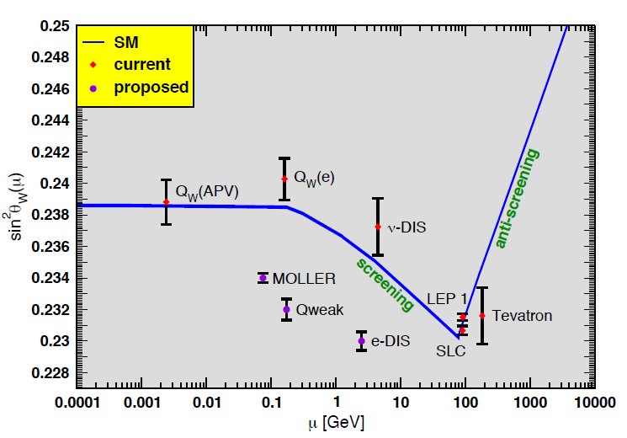
Running of sin²θ_{W}
+
+ •••
Present:
“d-quark dominated” : Cesium APV (Q^{A}_{W}): SM running verified at ~ 4σ level
“pure lepton”: SLAC E158 (Q^{e}_{W} ): SM running verified at ~ 6σ level
Future:
“u-quark dominated” : Q_{weak} (Q^{p}_{W}): projected to test SM running at ~ 10σ level
“pure lepton”: MOLLER (Q^{e}_{W} ): projected to test SM running at ~ 25 σ level

Slide 24
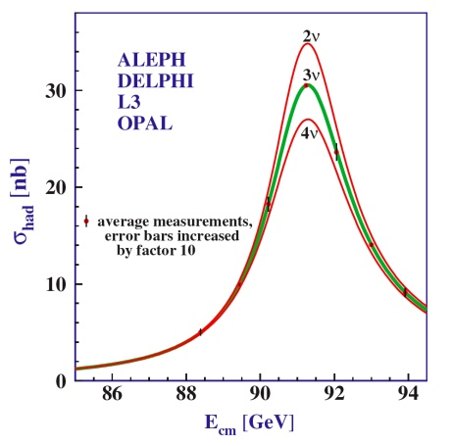
Width of the Z⁰
Production of real Z⁰ bosons in e⁺e⁻ annihilation
$$Γ_{tot}\left(Z^{0}\right)=\sum_{all fermions f}{Γ\left(Z^{0}→f\overline{f}\right)}$$
Measure a variety of electroweak processes with couplings to all possible fermions
Extract values of (sin²θ_{W} )_{eff} in a consistent renormalization scheme from all processes
Notes:
p. 157 Pvh-Rith

Slide 25
Spontaneous symmetry breaking
Why do the weak bosons have mass?
Higgs mechanism
Higgs field – scalar (not a vector) field that permeates all of space
As universe cooled, symmetry was broken and 3 of the electroweak bosons absorbed 3 of the Higgs bosons, gaining mass
$$\left(\begin{matrix}W^{+} \\ W^{−} \\ Z^{0}\end{matrix}\right), γ$$
but leaving the photon massless
and one Higgs boson to be discovered at CERN
Notes:
Ferromagnetism above Curie temp, iron is paramagnetic and spin iostropically oriented. No fore required to alter spin directions (massless to magnetic force). As it cools, Becomes ferromagnetic – spins spontaneously point in common direction. Force must be used to change direction of spins.
Higgs fields like gound state of correlated Cooper pairs in superconductivity
At sufficiently high temps, the weak bosons are also massless

Slide 26
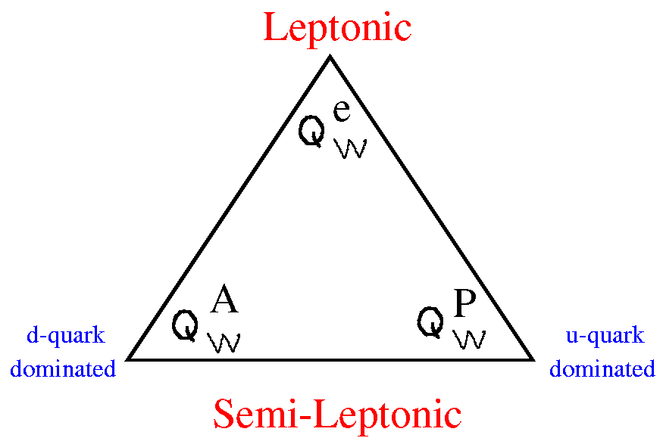
Low Energy Weak Neutral Current
Standard Model Tests
Low energy weak charge “triad” (M. Ramsey-Musolf) probed in weak neutral current experiments
parity-violating Moller scattering e + e → e + e
Cesium Atomic Parity Violation primarily sensitive to neutron weak charge
JLAB Q^{p}_{weak}: parity-violating e-p elastic scattering e + p → e + p
These three types of experiments are a complementary set for exploring new
physics possibilities well below the Z pole
Notes:
Most of what we know about the weak neutral current comes from decays

Slide 27
Some PVES Experiments

Slide 28
PVES Experiments at JLAB
JLAB has a rich program of PVES experiments to measure nuclear and nucleon properties and to perform precision tests of the Standard Model to search for new physics
Nuclear properties
Nucleon properties
SM Tests
PREX
CREX
G0
Happex
Qweak
MOLLER
SOLID
PVDIS

Slide 29
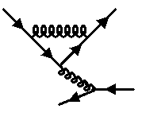
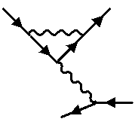
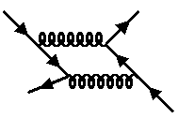
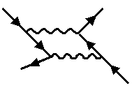
Feynman Diagrams
Further reading: Looking for consistency in the construction and use of Feynman diagrams
Peter Dunne , Phys. Educ. 36 No 5 (September 2001) 366-374

Slide 30
The Dirac Equation
Dirac equation for free electron:
where:
with:
leads to electron four-vector current density:
where the adjoint is:
satisfies the continuity equation:

Slide 31
Cross section
All the physics is in the matrix element
The incident flux times the differential cross section is proportional to the product of the square of the matrix element and the Lorentz invariant phase space

Slide 32
the matrix element
external lines
vertex factors
propagator

Slide 33
the matrix element
external lines
vertex factors
propagator

Slide 34
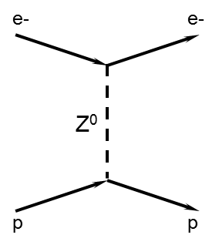
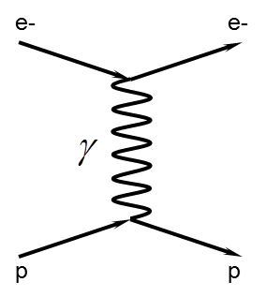
How do we measure ?
2
+
2
2
=
+
+
$$A_{PV}=\frac{σ_{+}−σ_{−}}{σ_{+}+σ_{−}}≈$$
2
Notes:
Mention EM coupling constant…

Slide 35
Hand-waving derivation of the parity-violating asymmetry in electron-proton scattering

Slide 36
Asymmetry
$$σ_{±}∝{\left[M_{EM}±M_{NC}\right]}^{2}$$
$$={\left|M_{EM}\right|}^{2}±2Re\left({M_{EM}^{∗}M}_{NC}\right)+{\left|M_{NC}\right|}^{2}$$
$$A_{PV}=\frac{σ_{+}−σ_{−}}{σ_{+}+σ_{−}}≈\frac{2Re\left({M_{EM}^{∗}M}_{NC}\right)}{{\left|M_{EM}\right|}^{2}+⋯}$$

