Slide 1
PVES
Experimental Considerations

Slide 2
Outline
Beam
Polarization
Beam quality
Raster sync
Target
Density stability
Finite length effects
Backgrounds (rates and asymmetries)
Apparatus symmetry
Detector linearity
Spectrometer
resolution
Collimator precision
Magnet stability

Slide 3
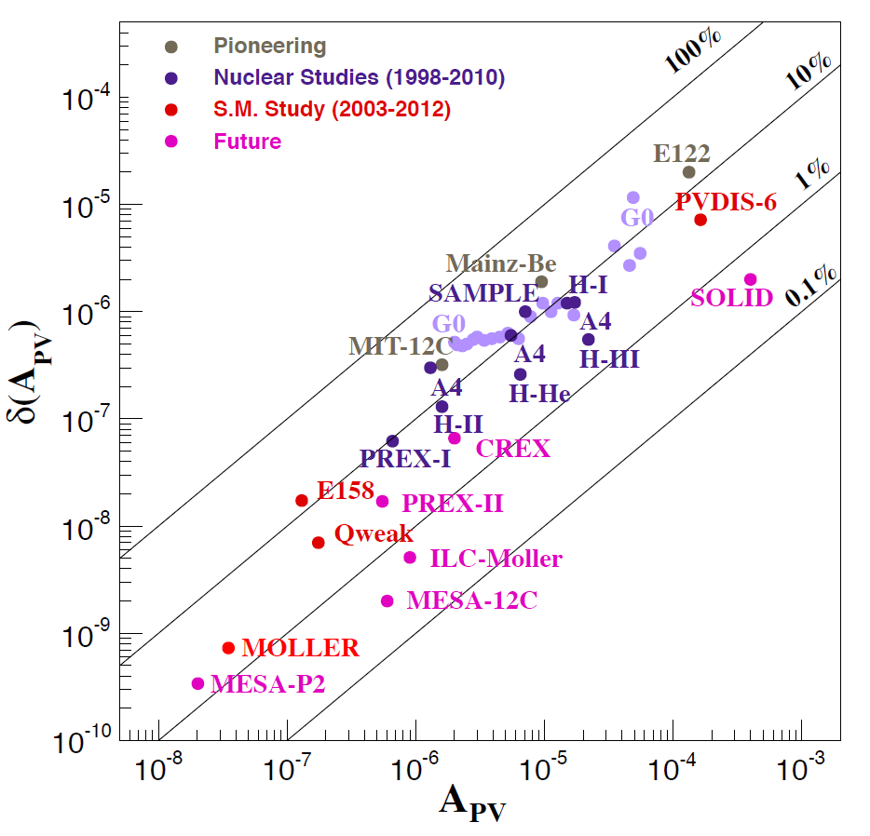
PVES Experiment Summary
size of the uncertainty
relative uncertainty
(log scale)
size of the asymmetry

Slide 4
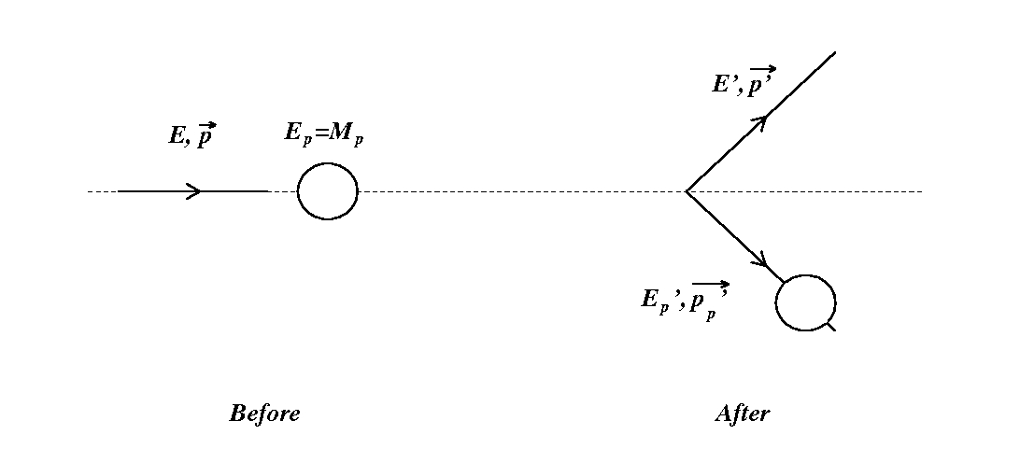
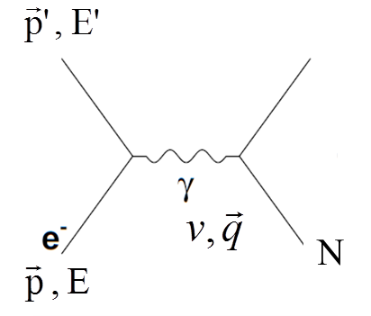
Elastic Scattering
from ²⁰⁸Pb or ⁴⁸Ca
or
from p or d or He
or
from e
e + N → e + N
^{N}
^{N}
^{N}
^{N}
Q² is related to the wavelength of the virtual photon probe -
Notes:
All of the measurements in this talk use elastic (or quasi-elastic) electron proton scattering. An electron is incident on a proton in the target and scatters with some reduced energy. The interaction is mediated by an exchange particle, for example, a photon, which carries the energy and momentum to the proton.
The Lorentz invariant four momentum transfer, Q2 is in general a function of the scattered electron energy and angle, but in elastic scattering can be expressed as a function of the scattering angle only. Q2 is related to the wavelength of the virtual photon probe; the higher the Q2 the smaller the structure that can be “seen”.

Slide 5
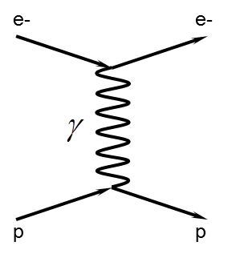
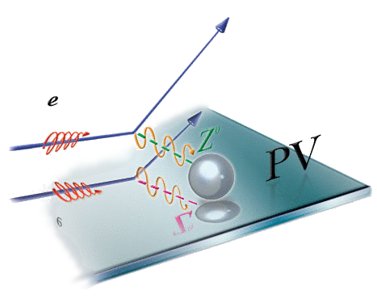
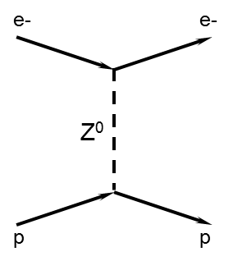
Parity
Quantum mechanical operator that
reverses the spatial sign ( P: x -> -x )
parity conserving
parity violating
Notes:
Parity is a quantum mechanical operator which reverses the spatial coordinates (all of them, at once). Because spin is the product of two spatial operators, it doesn’t reverse sign under parity. What we actually do in the lab is change the polarization of the beam, that is, reverse the relative direction of the electron spin to the momentum vector. The EM interaction conserves parity. The weak interaction does NOT! Now we have a difference between the two interactions that we can exploit to measure the weak form factor.

Slide 6
Cartoon Experiment
accelerator
detectors
Energy measurements
Charge monitors
Position monitors
Halo monitors
detectors
main detector
Photo-cathode
Raster
Pockells cell
Wien filters
tracking detectors
polarized beam
polarized beam
spectrometer
spectrometer
beam
beam
target
Collimators
target
Magnets
background determination
position
cooling
luminosity monitors
Polarimetry
Polarimetry
continuous
At injector
invasive
electronics

Slide 7
Blinding
Factors
Analysis Overview
Raw Asymmetries
A_{meas}
Other Measurements
Typical Corrections:
Helicity Correlated Corrections
Background Asymmetry
Beam Polarization
EM Radiative corrections
Quantity of interest
Physics Asymmetries
A_{phys}
Unblind
Q²

Slide 8
Measuring A_{PV} with ES
unpolarized target
high current
highly polarized beam
polarimetry
elastic electrons from target
(resolution of the spectrometers)
beam property monitoring
active feedback to minimize helicity correlations
rapid helicity reversal
slow helicity reversal as a cross check
Notes:
The general requirements for any parity violating experiment are a high power unpolarized target and a large solid angle acceptance in order to minimize the statistical error. In addition you need a highly polarized beam in order to measure the asymmetry, and you need to measure the polarization. Since we are interested in elastic scattering from the proton, we need not only kinematic separation of the elastics from the inelastics, but also particle identification and background measurements. We also need to have stable beam, and to understand the effects of beam properties on the measured yields. Ideally we would minimize the helicity correlated effects. We have rapid helicity reversal, with a slow helicity reversal as a way to change the polarization without changing the electronics.
In order to go from the measured asymmetry to the physics asymmetry, we need to correct for false asymmetries due to beam properties, background asymmetries and the polarization of the beam. There is also a radiative correction that needs to be performed.

Slide 9
Statistical Uncertainty on A_{PV}
The statistical uncertainty in a counting experiment is given by
$$\frac{δN}{N}=\frac{\sqrt{N}}{N}=\frac{1}{\sqrt{N}}$$
$$σ_{N}=\sqrt{N}$$
$$A_{meas}=\frac{N_{1}−N_{2}}{N_{1}+N_{2}}$$
$$σ_{A}^{2}=\sum{σ_{N_{i}}^{2}}{\left(\frac{∂A}{∂N_{i}}\right)}^{2}$$
The expected width, $σ_{A},$ is calculated from
$$σ_{N_{i}}=\sqrt{N_{i}}$$
$$\frac{∂A}{∂N_{1}}=\frac{{2N}_{2}}{{\left(N_{1}+N_{2}\right)}^{2}}$$
$$\frac{∂A}{∂N_{2}}=\frac{{−2N}_{1}}{{\left(N_{1}+N_{2}\right)}^{2}}$$
$$σ_{A}^{2}=N_{1}{\left(\frac{{2N}_{2}}{{\left(N_{1}+N_{2}\right)}^{2}}\right)}^{2}+N_{2}{\left(\frac{−{2N}_{1}}{{\left(N_{1}+N_{2}\right)}^{2}}\right)}^{2}=\frac{4N_{1}N_{2}\left(N_{1}+N_{2}\right)}{{\left(N_{1}+N_{2}\right)}^{2}}$$

Slide 10
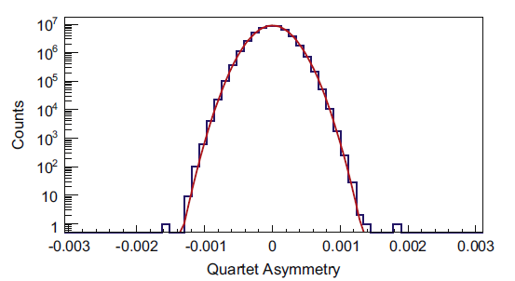
Statistical Uncertainty
$$σ_{A}^{2}=\frac{4N_{1}N_{2}\left(N_{1}+N_{2}\right)}{{\left(N_{1}+N_{2}\right)}^{4}}$$
$$N_{1}\sim N_{2}=\frac{N}{2}$$
$${N=N}_{1}+N_{2}$$
Gaussian
$$σ_{A}^{2}=\frac{4\frac{N^{2}}{4}N}{N^{4}}=\frac{1}{N}$$
$$σ_{A}=\frac{1}{\sqrt{N}}$$
The expected width, $σ_{A},$ is:
$$σ_{A}=\frac{1}{\sqrt{\frac{1}{flip rate}×beam current(μA)×Rate \left({Hz}/{μA}\right)×\#flips ×\# dets }}$$
$$=\frac{1}{\sqrt{\left(\frac{1}{960Hz}\right)\left(150μA\right)\left(4.5MHz/μA×\frac{1e^{6}Hz}{1MHz}\right) \left(4\right)\left(8\right) }}=211ppm$$

Slide 11
Design and simulation
What can we design with the simulations?
Target cell
All apertures
Beamline
Collimator
Spectrometer
Detectors
Detector responses
What are we trying to do?
Minimize systematics
Optimize the acceptance/focus
Minimize backgrounds
Elastic ep vs. moller
Inelastic asymmetry
Target structure/beamline scattering
Neutrons
Make corrections

Slide 12
Monte Carlo Technique
$$\frac{A_{circle}}{A_{square}}=\frac{N_{in}}{N_{total}}$$
$$A_{square}=L^{2}$$
L
$$A_{circle}=\frac{N_{in}}{N_{total}}L^{2}$$
$$=\frac{16}{20}L^{2}=\frac{8}{10}{\left(2R\right)}^{2}=3.2R^{2}$$
L
$$A_{circle}={πR}^{2}\sim 3R^{2}$$
$$\frac{δN}{N}\sim \frac{1}{\sqrt{N_{in}}}=0.25$$
N_{total}=20

Slide 13
Monte Carlo Technique
L
$$A_{square}=L^{2}$$
L
$$\frac{A_{circle}}{A_{square}}=\frac{N_{in}}{N_{total}}×distribution weight factor$$
N_{total}=20

Slide 14
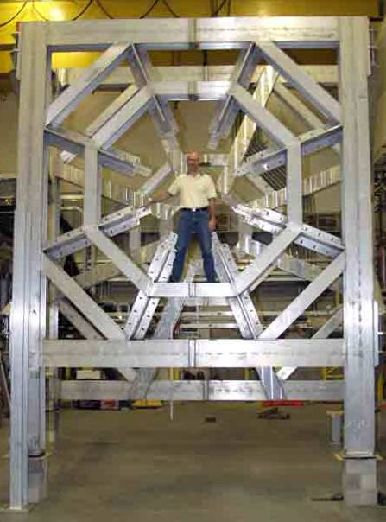
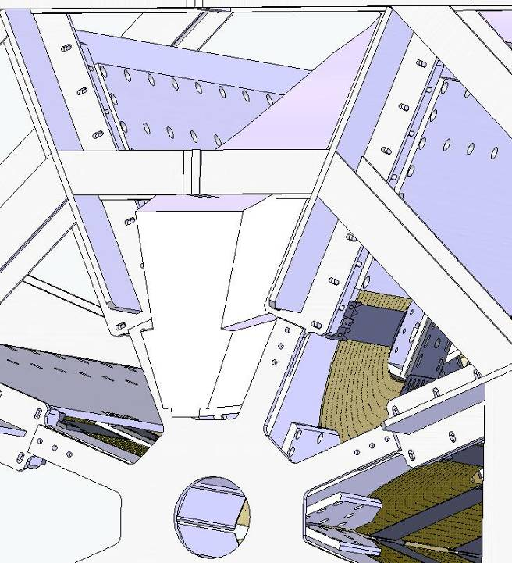
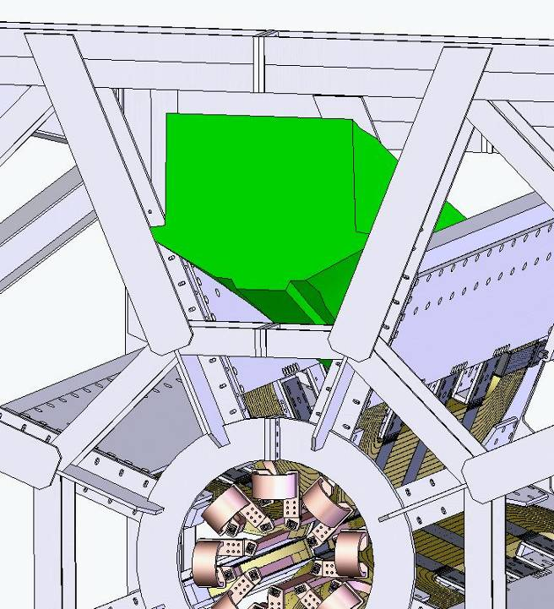
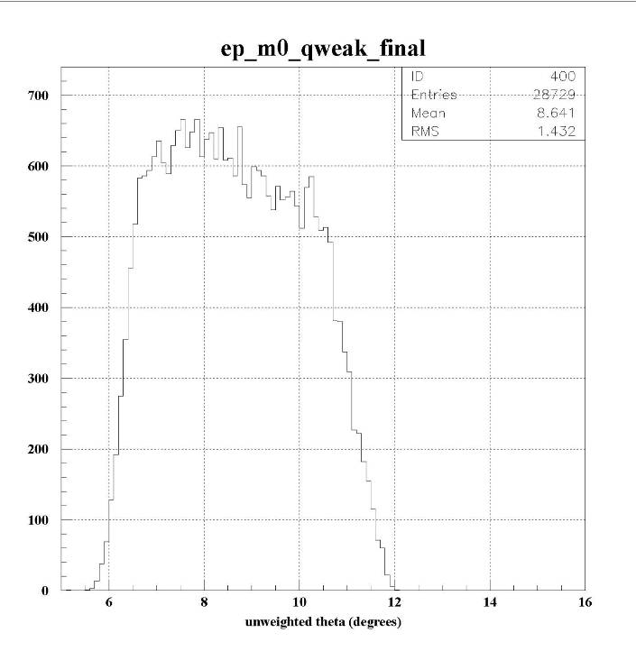
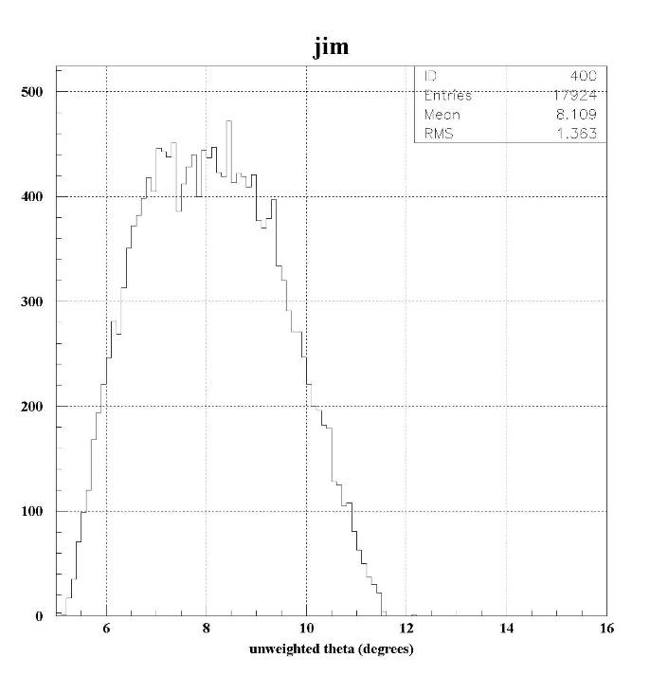
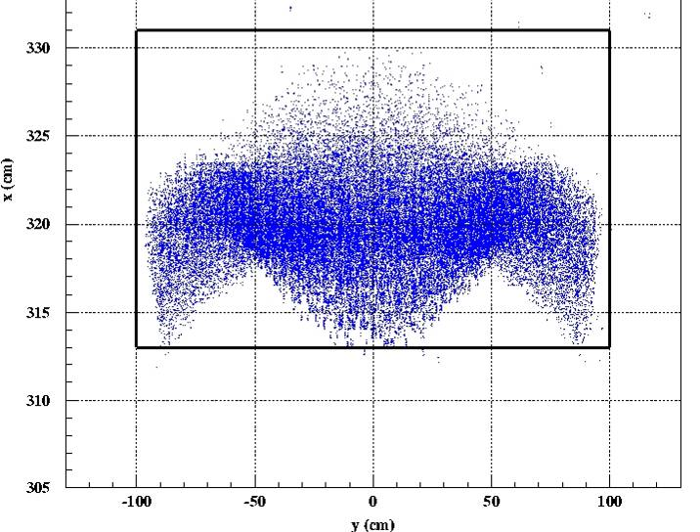
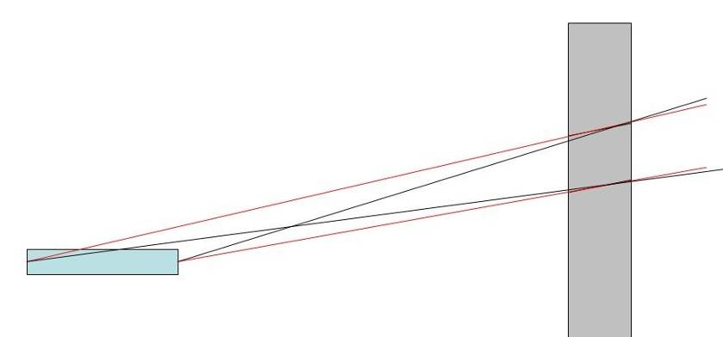
(re-)Design of Q_{weak} collimators
move acceptance defining collimator further from the target
make the acceptance as large as possible (through fixed elements)
check that the profile will fit on a reasonably sized detector
find a shape that will be reasonable to machine

Slide 15
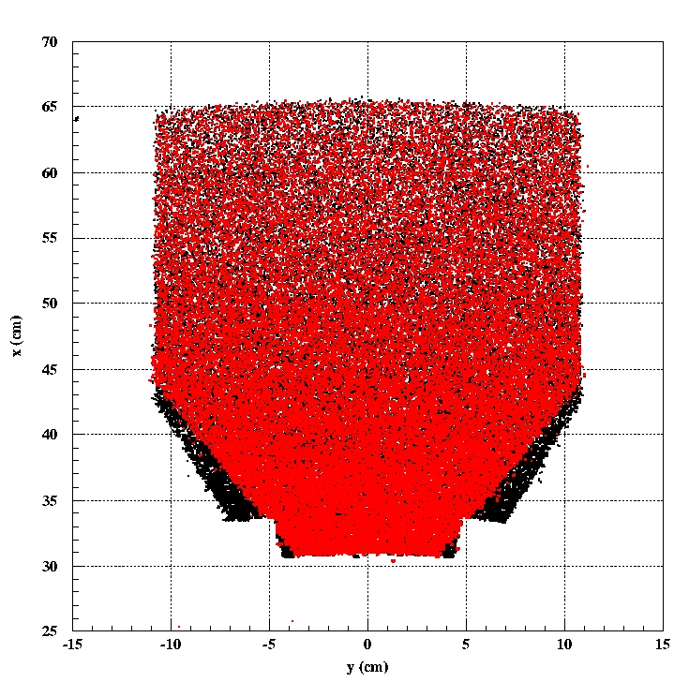
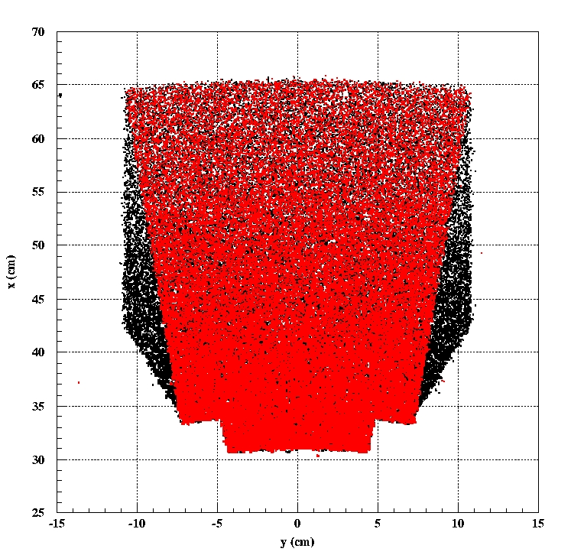
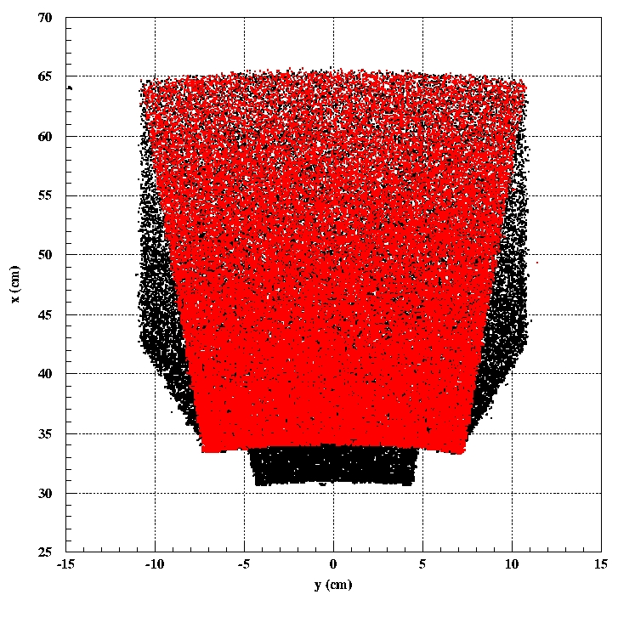
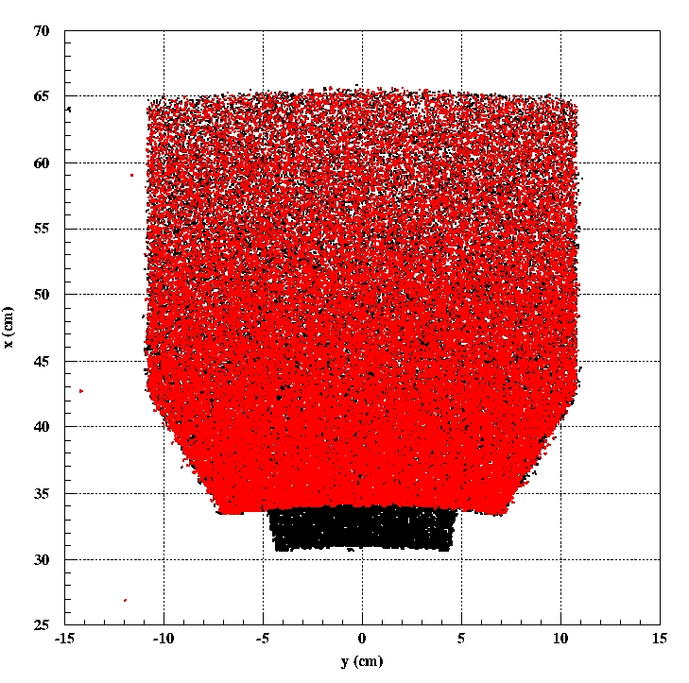
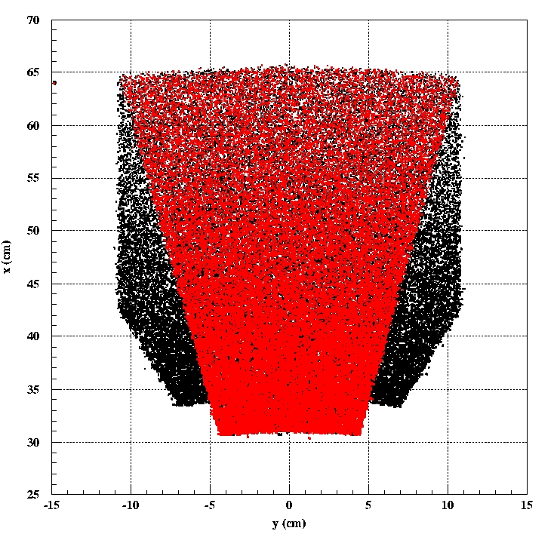
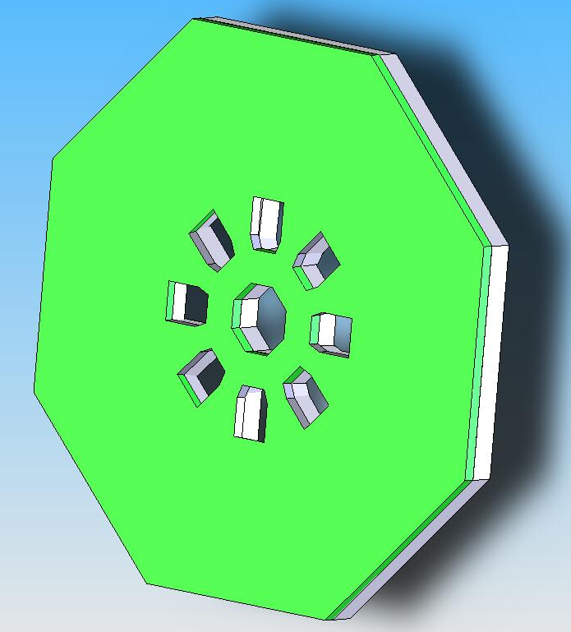
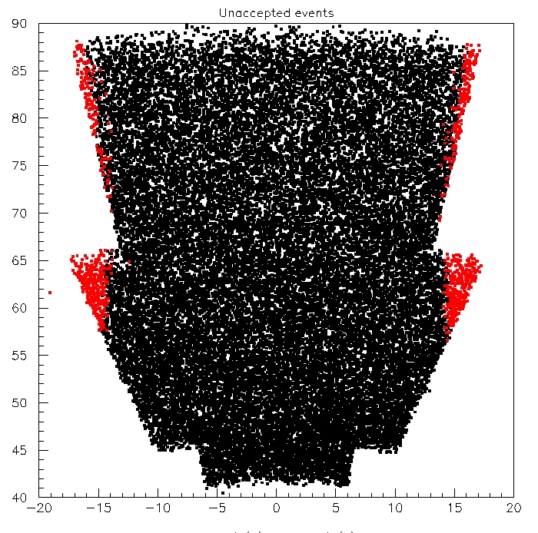
Choosing collimator shape
Originally quoted:
Rate/octant = 763 MHz
<θ> = 9º
<Q²> = .030 (GeV/c)²
Error on Q_{weak}= 4%
After redesign:
Rate/octant = 875 MHz
<θ> = 8º
<Q²> = .026 (GeV/c)²
Error on Q_{weak}= 4.18%

