Slide 1
PVES
Strange Quark Contribution to the Charge and Magnetization of the Nucleon

Slide 2
What can we measure?
Nucleon structure
Nuclear structure
Electron weak charge
Proton weak charge
  Weak coupling constants
SM Tests

Slide 3
Program
Expt/Lab | Target/ Angle | Q² (GeV²) | A_{phys} (ppm) | Sensitivity | Status
SAMPLE/Bates
SAMPLE I | LH₂/145 | 0.1 | -6 | m_{s} + 0.4G_{A} | 2000
SAMPLE II | LD₂/145 | 0.1 | -8 | m_{s} + 2G_{A} | 2004
SAMPLE III | LD₂/145 | 0.04 | -4 | m_{s} + 3G_{A} | 2004
HAPPEx/JLab
HAPPEx | LH₂/12.5 | 0.47 | -15 | G_{E} + 0.39G_{M} | 2001
HAPPEx II | LH₂/6 | 0.11 | -1.6 | G_{E} + 0.1G_{M} | 2006, 2007
HAPPEx He | ⁴He/6 | 0.11 | +6 | G_{E} | 2006, 2007
HAPPEx | LH₂/14 | 0.63 | -24 | G_{E} + 0.5G_{M} | 2009
A4/Mainz
 | LH₂/35 | 0.23 | -5 | G_{E} + 0.2G_{M} | 2004
 | LH₂/35 | 0.11 | -1.4 | G_{E} + 0.1G_{M} | 2005
 | LH₂/145 | 0.23 | -17 | G_{E} + ηG_{M} + η’G_{A} | 2009
 | LH₂/35 | 0.63 | -28 | G_{E} + 0.64G_{M} | 2009
G0/JLab
Forward | LH₂/35 | 0.1 to 1 | -1 to -40 | G_{E} + ηG_{M} | 2005
Backward | LH₂/LD₂/110 | 0.23, 0.63 | -12 to -45 | G_{E} + ηG_{M} + η’G_{A} | 2009

Slide 4
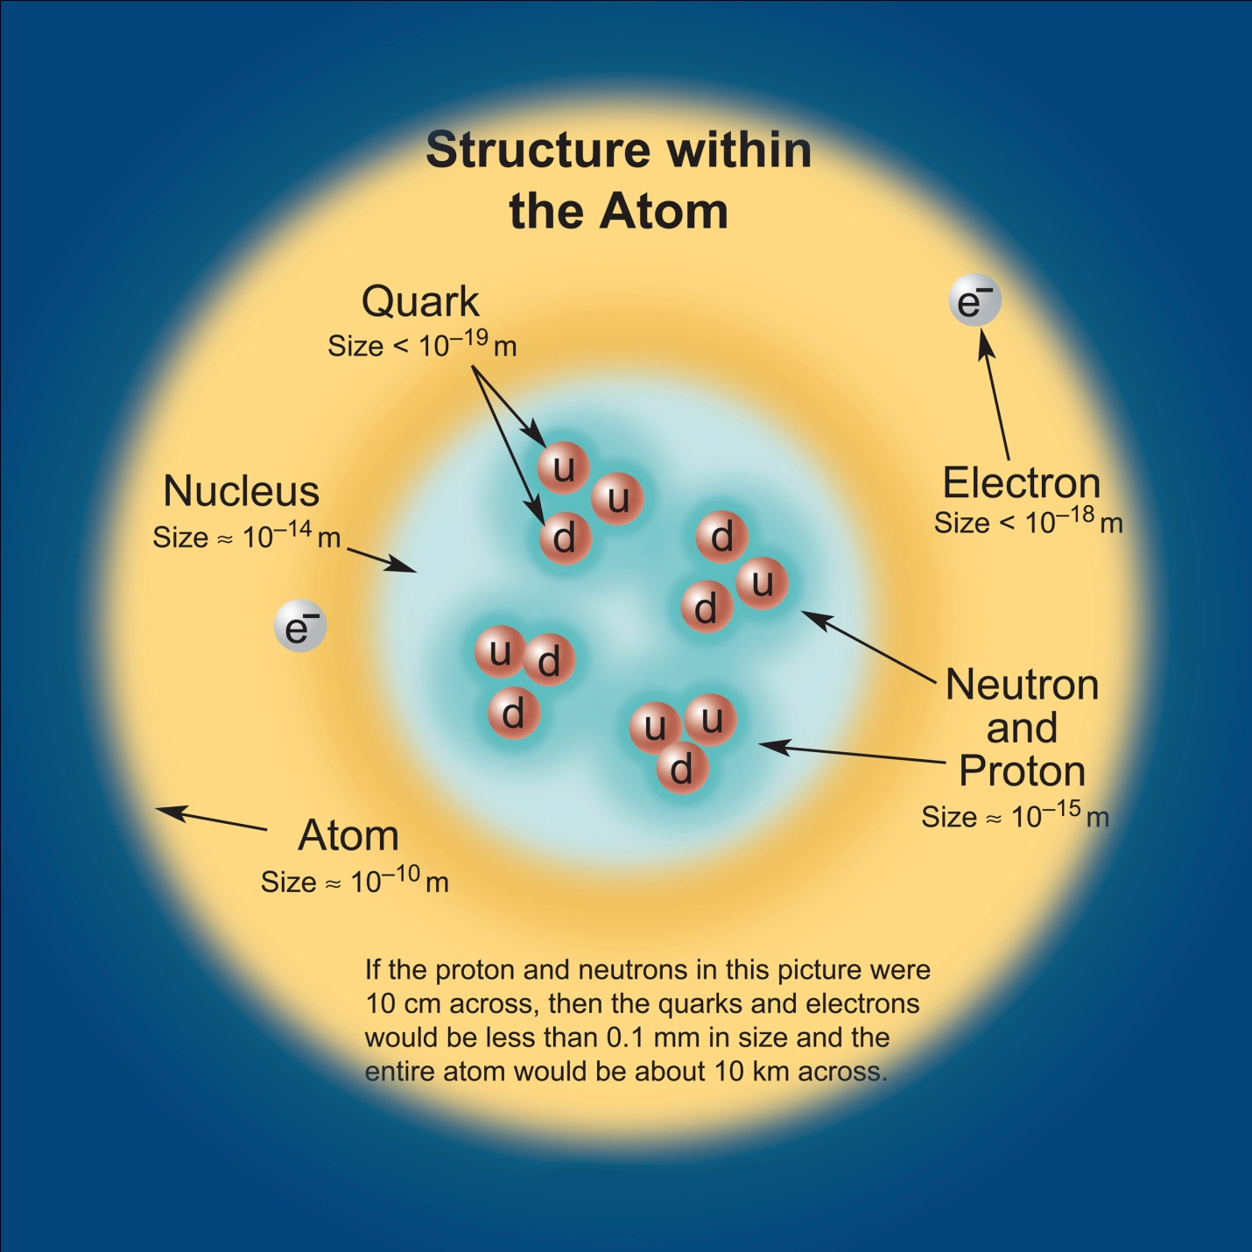
Nucleon Structure
Proton is both ordinary and extraordinary object
  50% of mass of visible universe
  masses of constituents ~ 1% of its total mass
What is it made of?
  valence quarks carry baryon number
q
q
  sea of gluons
  and associated quark-antiquark pairs
    analog of Lamb shift
  very complicated because
    strong coupling ●
    gluons interact with each other
  many-body physics with virtual particles

Slide 5
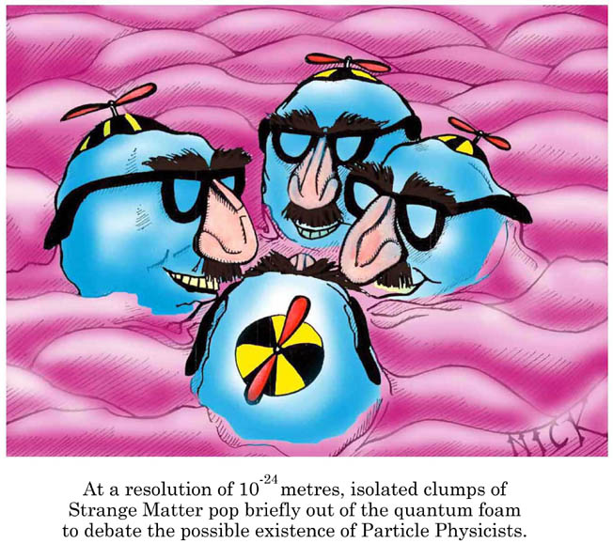

Slide 6
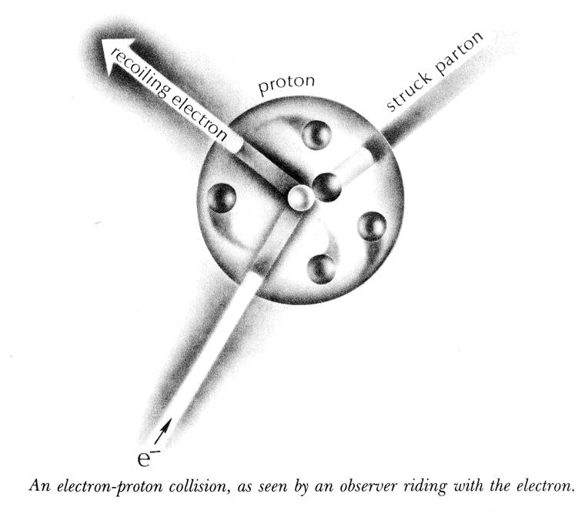
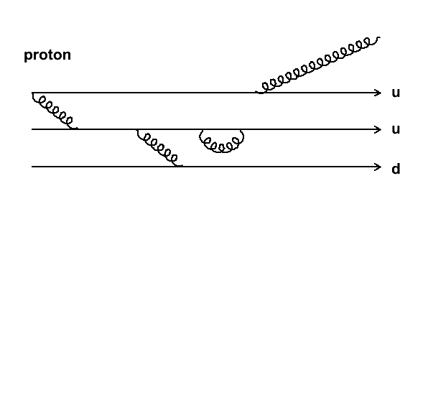
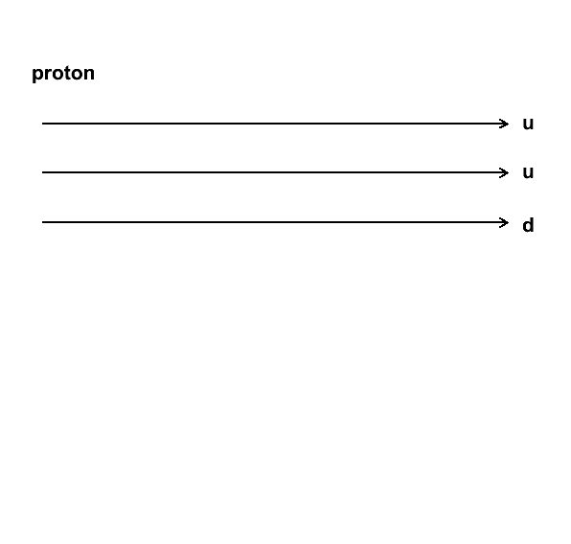
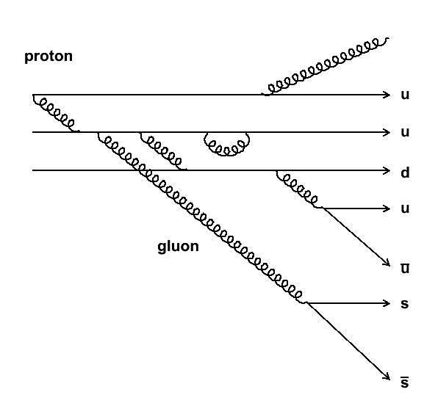
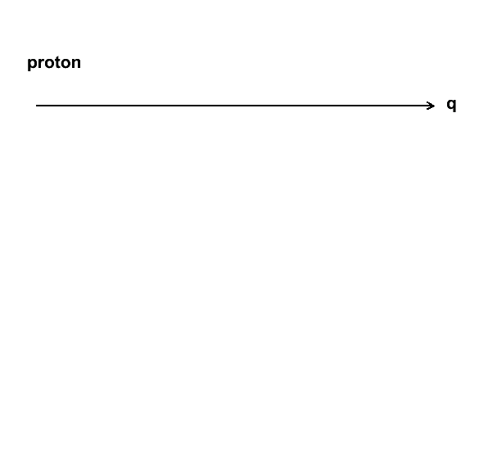
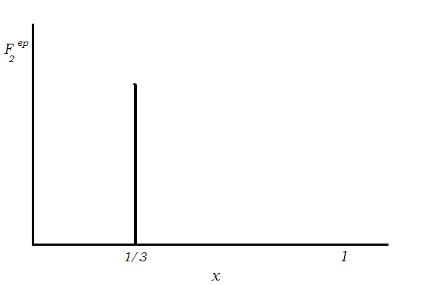
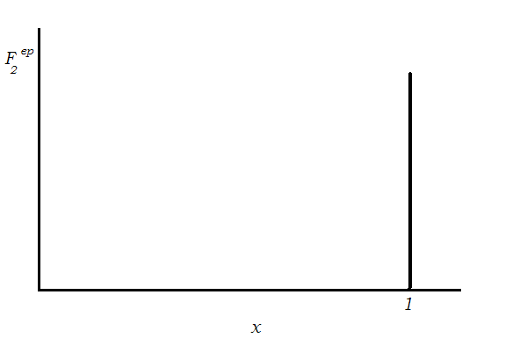
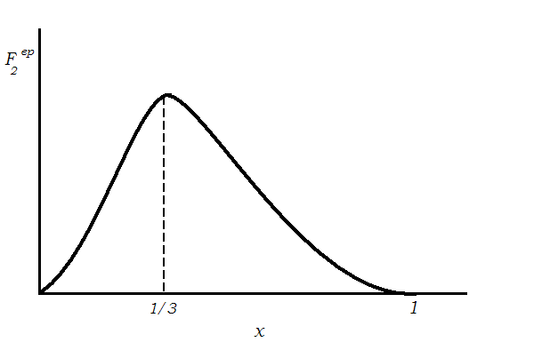
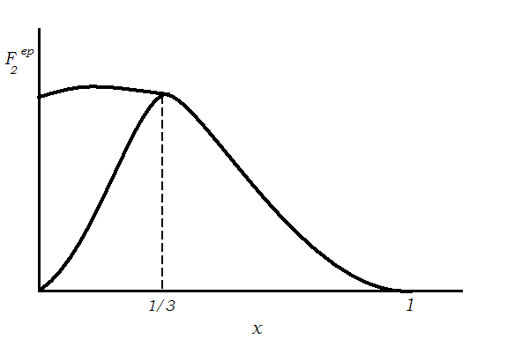
Structure Functions
Deep Inelastic Scattering
x - fraction of momentum carried
by the struck quark

Slide 7
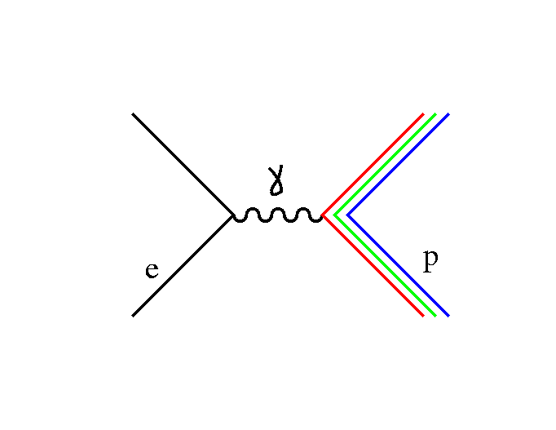
EM Structure of the Nucleon
Elastic Scattering
Electric and magnetic form factors
N
Way of parameterizing this blob
↑
Dirac
↑
Pauli

Slide 8
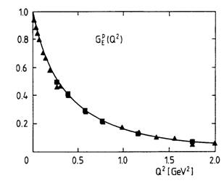
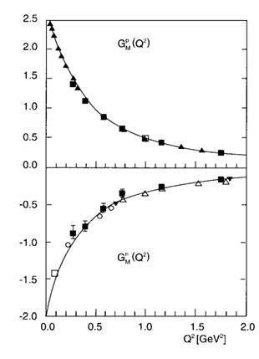
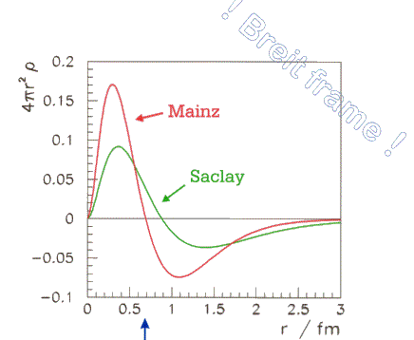
EM Structure of the Nucleon
Related to the charge and magnetization distributions within the nucleon
Fourier transform
Neutron Electric Charge Distribution
“pion cloud”

Slide 9
EM Structure of the Nucleon
N
(Electric and magnetic
form factors)
↑
Dirac
↑
Pauli
↑
Dirac
↑
Pauli

Slide 10
Weak Structure of the Nucleon
Z
N
↑
Dirac
↑
Pauli
parity violation b/c of this

Slide 11
Strangeness in the Nucleon
Nucleon in QCD
¯
How much do virtual ss pairs contribute to the structure of the nucleon?
Momentum:
Spin:
Mass:
Charge and current:

Slide 12
Quarks in the Nucleon
q
q

Slide 13
StRanGe quark contribution
Assume isospin symmetry and we have
this
and this
are well known
what about this?
(Assume neutral weak charges are known)

Slide 14
Isolating form factors
For a proton:
~ few parts per million
Forward angle
Backward angle
For ⁴He: G_{E}^{s} alone
For deuteron:
enhanced G_{A}^{e} sensitivity

Slide 15
The Axial Current Contribution
Z
γ
e
p
  “unknown form factor” G^{e}_{A} (Q²)
  related to form factor measured in neutrino scattering
  also contains “anapole” form factor
  determine isovector (T=1) piece by combining proton and neutron (deuteron) measurements
“box”
γ
Z
e
p
“mixing”
Classical analog: torque on a toroidal magnetic field in an external current field
γ
e
p
“quark pair”

Slide 16
What is the Anapole Moment?
As first noted by Zel’dovich (Sov. Phys. JETP 6 (58) 1184), a parity-violating coupling of the photon can occur
  where F_{A} and F_{E} are the anapole (parity-violating, time-reversal conserving) and electric dipole (parity- and time-reversal- violating) moments, respectively
At low Q² the corresponding interaction energy is (Musolf and Holstein, Phys. Rev. D 43 (91) 2956)
The classical analog of the anapole moment is that property of a toroidal magnetic field that leads to a torque in an external current field

Slide 17
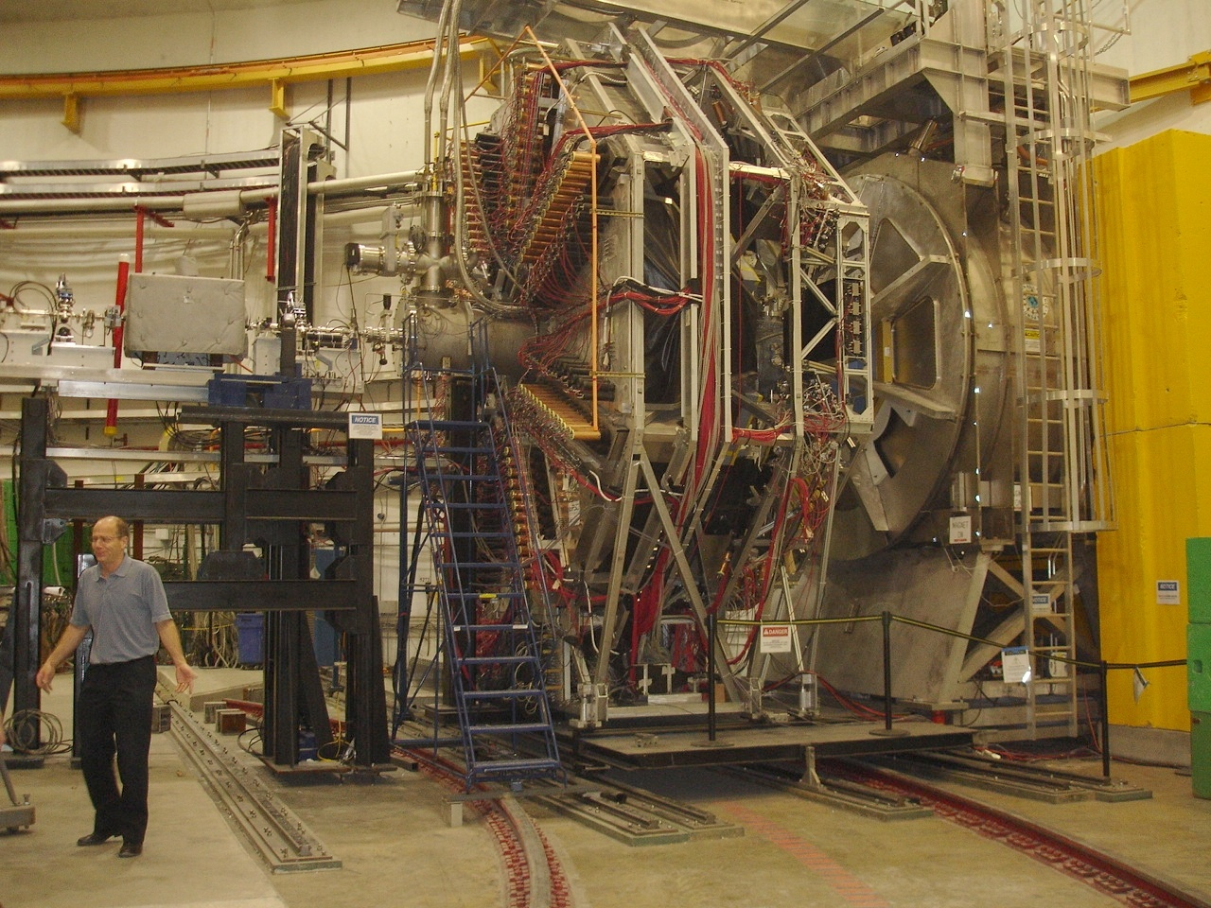
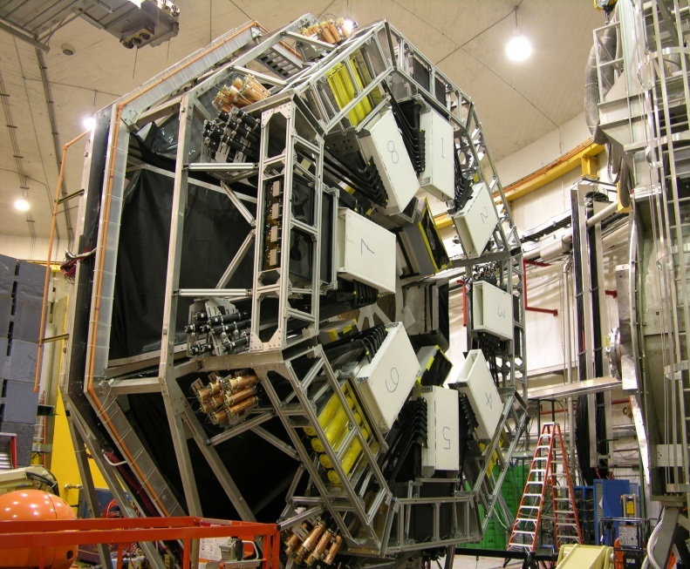
G0 Experiment
Super-conducting magnet (SMS)
Target service
module
G0 Beam monitors
LUMIs
Ferris wheel
FPD
Mini-ferris wheel
CED+ Cerenkov
View from ~upstream
View from downstream

Slide 18
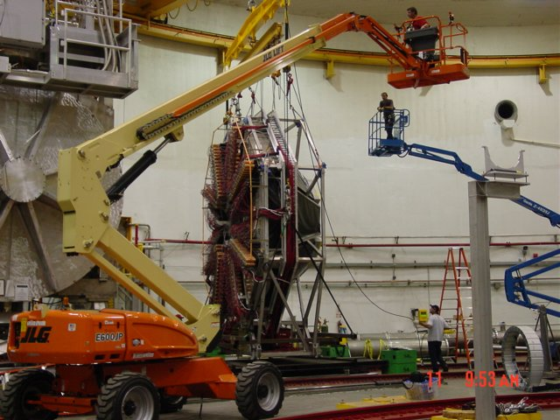
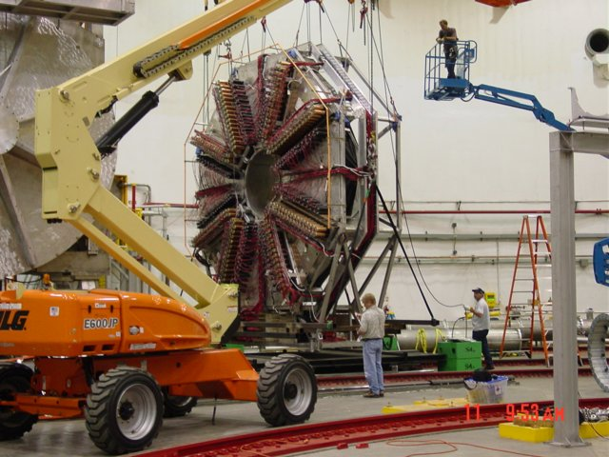
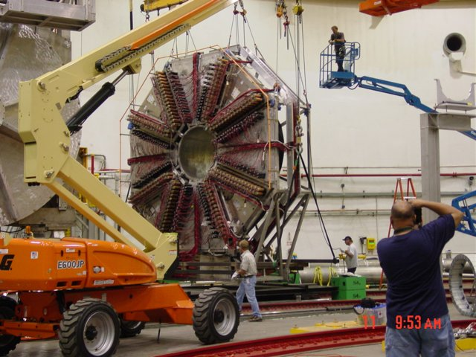
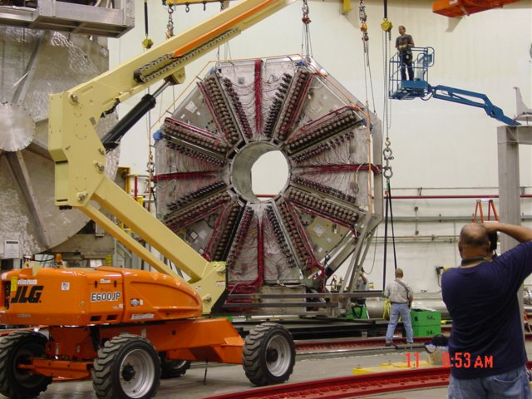
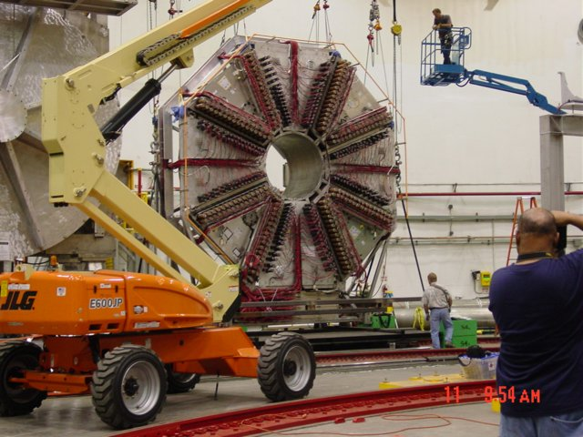
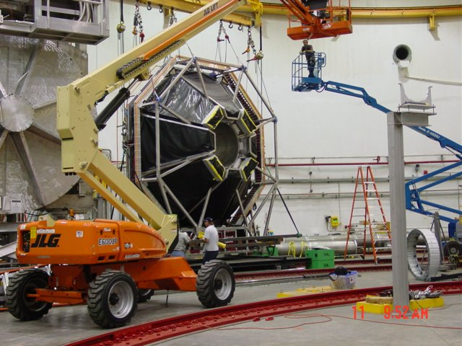
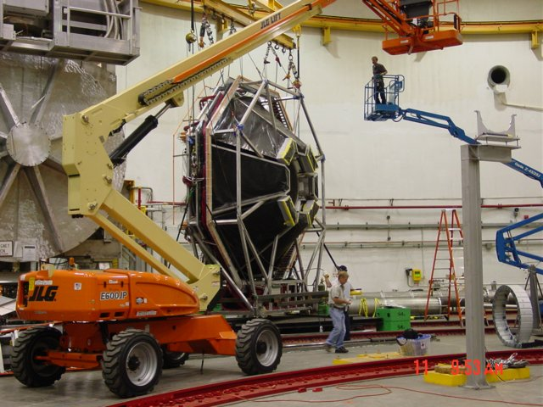
Turn-around of G⁰ Detector – Aug. 11, 2005

Slide 19
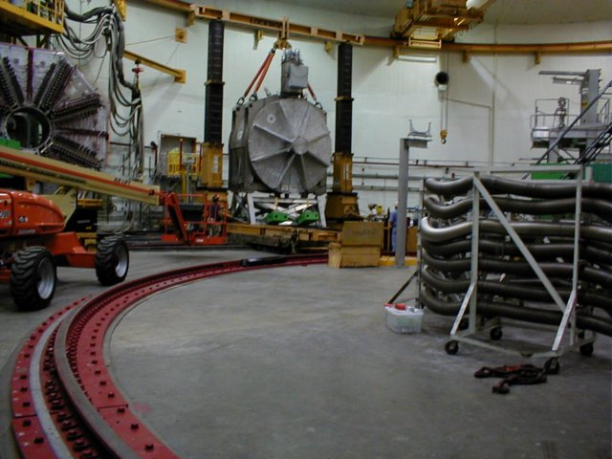
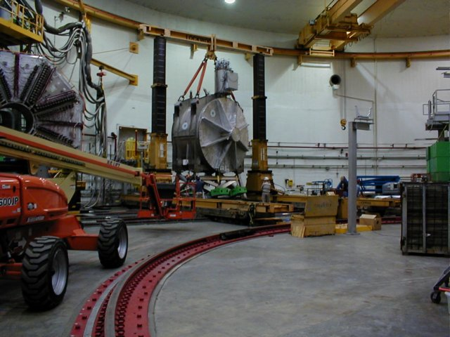
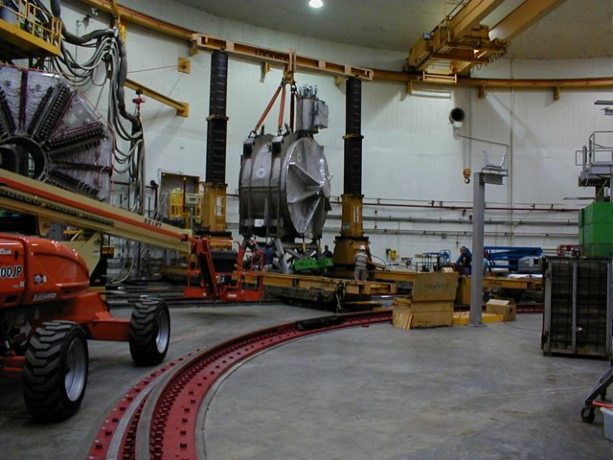
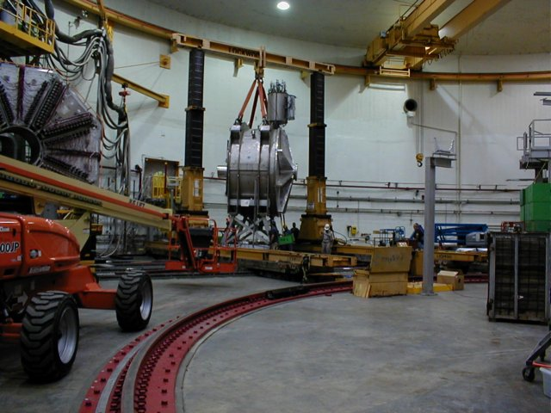
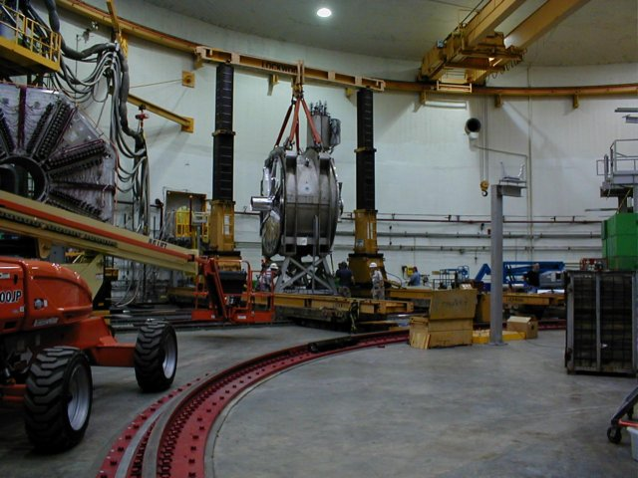
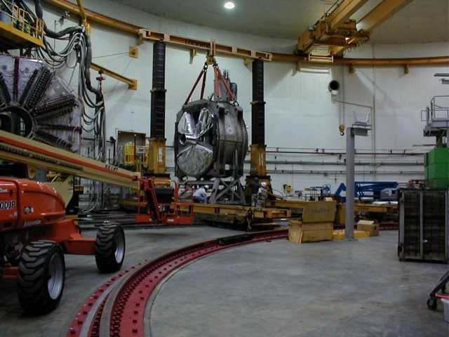
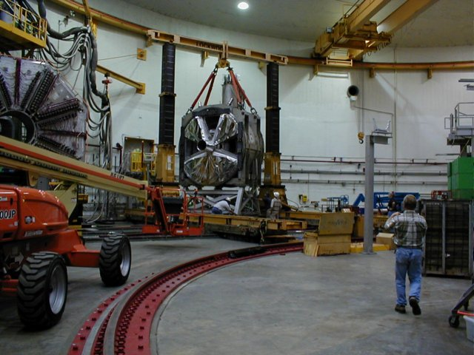
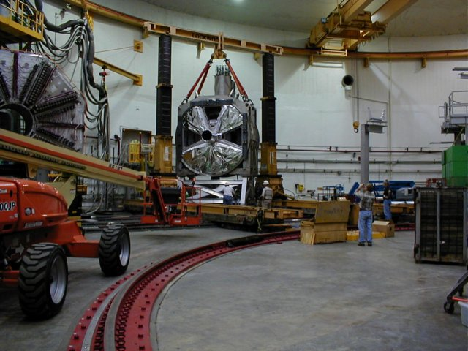
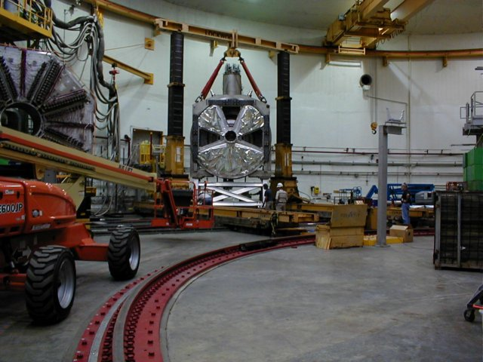
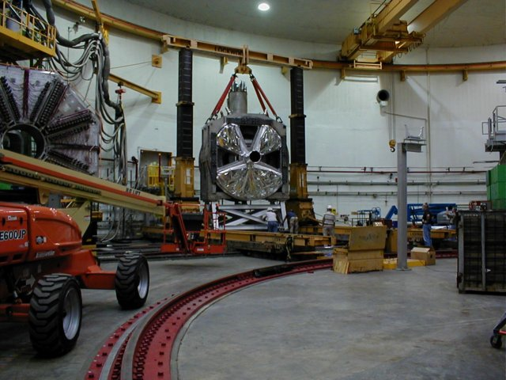
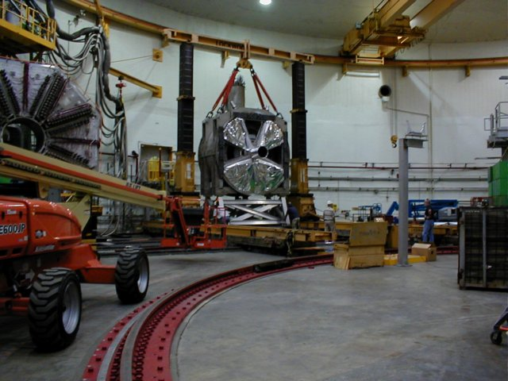
Turn-around of G⁰ Magnet – Aug. 23, 2005

Slide 20
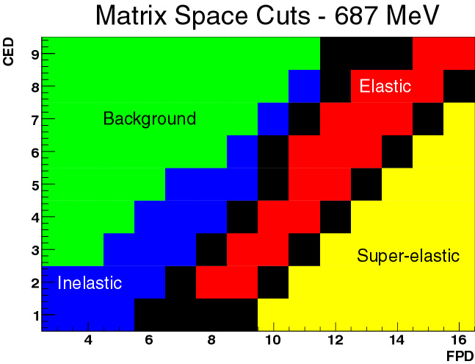
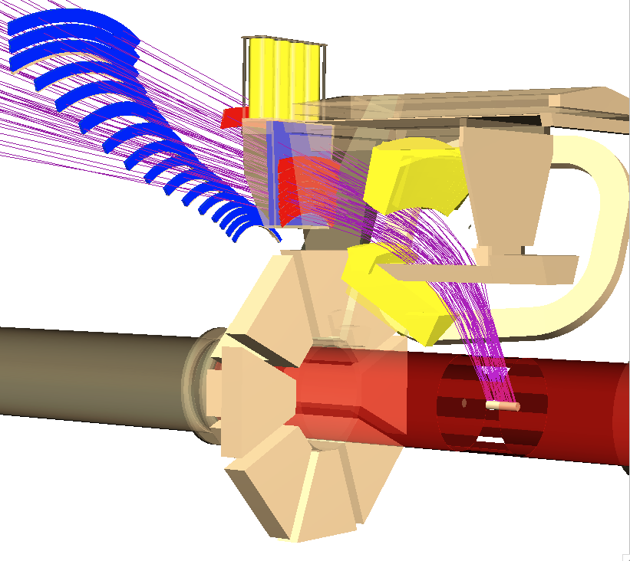
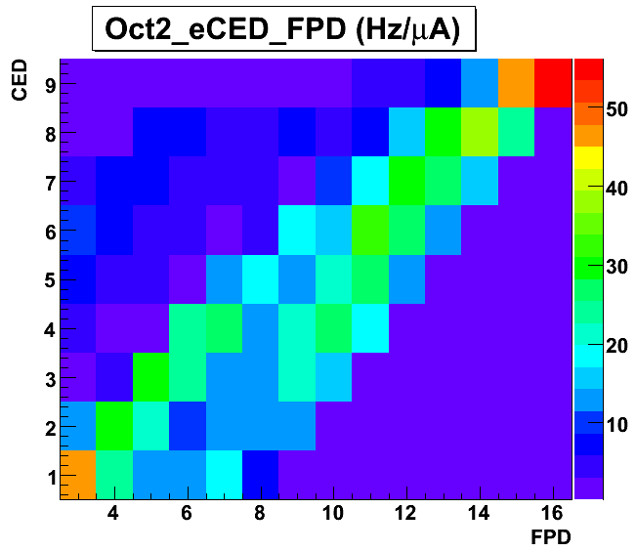
G0 Experiment
CED + Cerenkov
FPD
e⁻ beam
target
LUMIs
(not shown)

Slide 21
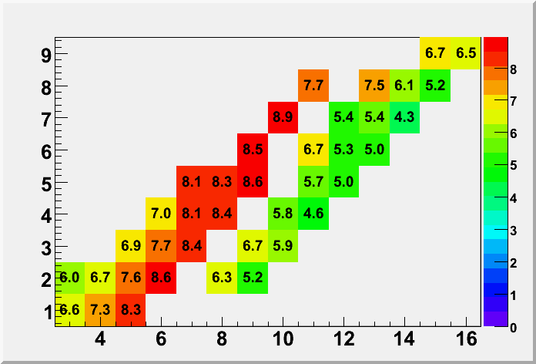
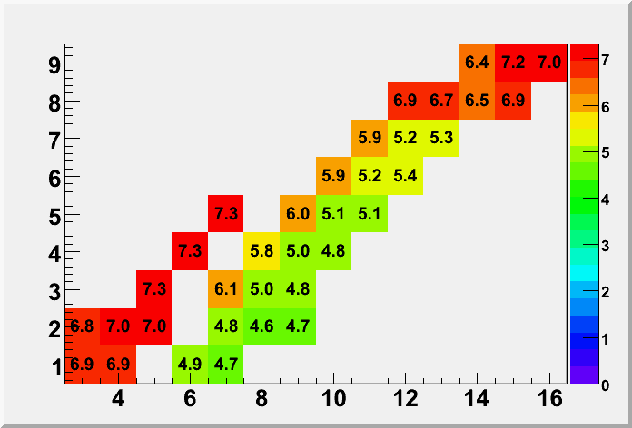
Rate Corrections
Correct the yields for random coincidences and electronic deadtime prior to asymmetry calculation
randoms small except for D-687 (due to higher pion rate)
Direct (out-of-time) randoms measured
- Validated with simulation of the
complete electronics chain
Deadtimes (%)
H 687 MeV
Data set | Correction to Yield (%) | Asymmetry Correction (ppm) | systematic error (ppm)
H 362 | 6 | 0.3 | 0.06
H 687 | 7 | 1.4 | 0.17
D 362 | 13 | 0.7 | 0.2
D 687 | 9 | 6 | 1.8
H 362 MeV

Slide 22
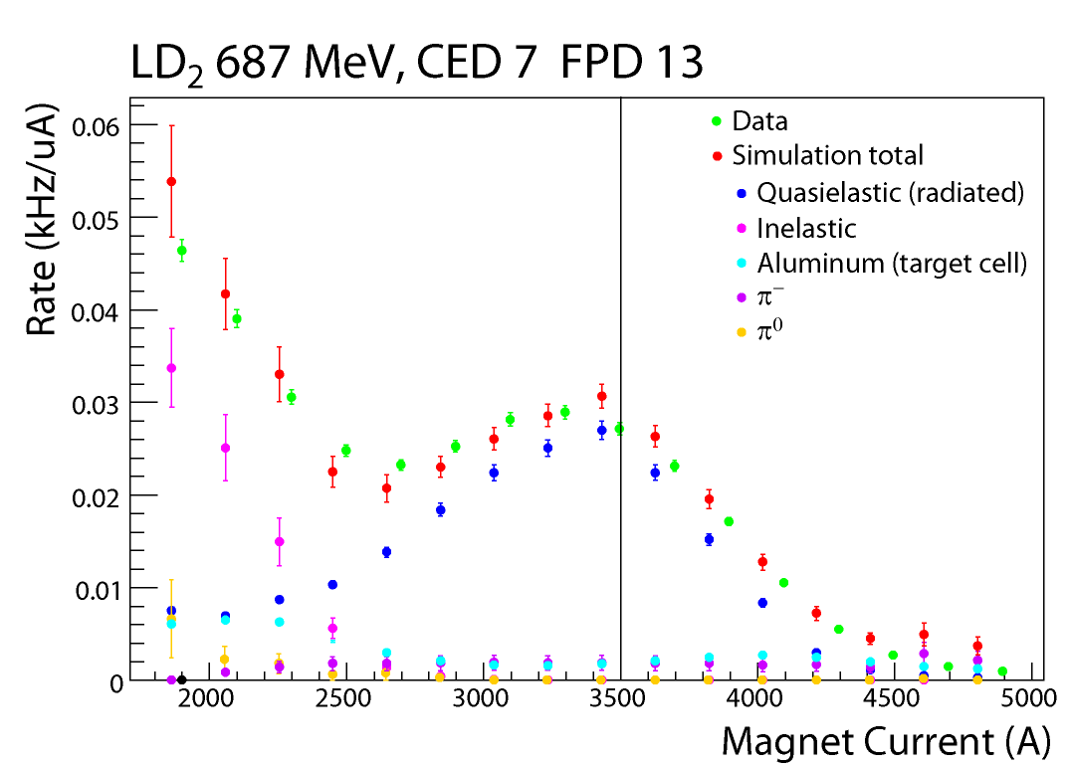
Background Corrections
Data set | ΔA (ppm) | Δσ_{A} (ppm)
H 362 | 0.5 | 0.4
H 687 | 0.1 | 1.1
D 362 | 0.07 | 0.08
D 687 | 2.0 | 0.5

Slide 23
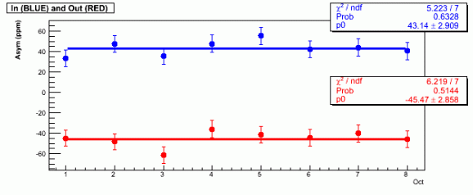
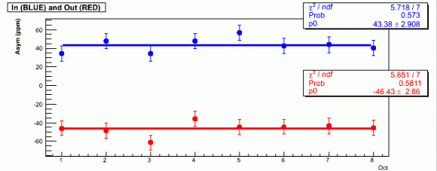
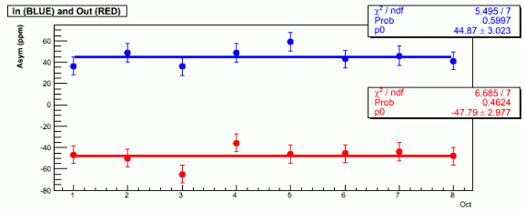
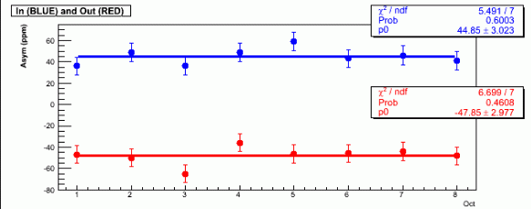
Elastic Asymmetries
Hydrogen, 687 MeV, BLINDED
Including rate, helicity-correlated corrections
Asymmetry (ppm)
Pass 1-Raw asymmetries
Asymmetry (ppm)
2-Scaler counting correction
3-Rate correction
Asymmetry (ppm)
Asymmetry (ppm)
4-Linear regression correction
Octant
Octant

Slide 24
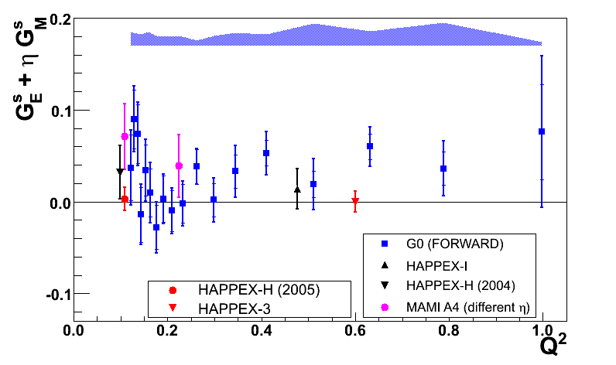
Asymmetries --> FFs
Unblinded, corrected asymmetries and Q²
Combine with forward angle data
and nucleon EM form factors
Data Set | Q² (GeV²) | A_{phys} (Value in ppm ± σ_{stat} ± σ_{pt-pt} ± σ_{global})
H362 | 0.221 | -11.416 | ± 0.872 | ± 0.268 | ± 0.385
D362 | 0.221 | -17.018 | ± 0.813 | ± 0.411 | ± 0.197
H687 | 0.628 | -46.14 | ± 2.43 | ± 0.84 | ± 0.75
D687 | 0.628 | -55.87 | ± 3.34 | ± 1.98 | ± 0.64
Preliminary results, not for quotation
D.S. Armstrong et al., PRL 95 (2005) 092001

Slide 25
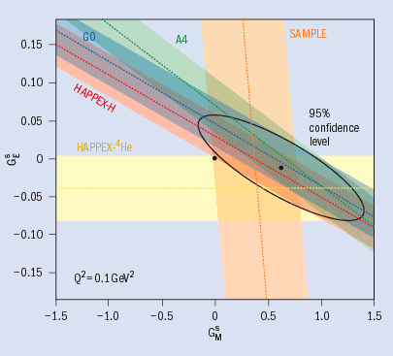
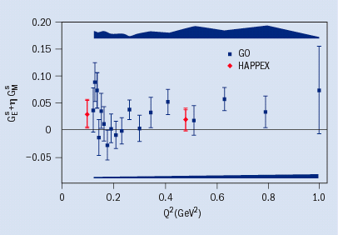
Summary of other experimental results
Q² variation from G⁰ and HAPPEx at JLAB
Measurements at Q² = 0.1 GeV²
MIT-Bates (SAMPLE)
JLAB (HAPPEx)
Mainz (A4)
G⁰ (forward)
→ 10 ± 5% contribution to G^{p}_{M}(Q²)

Slide 26
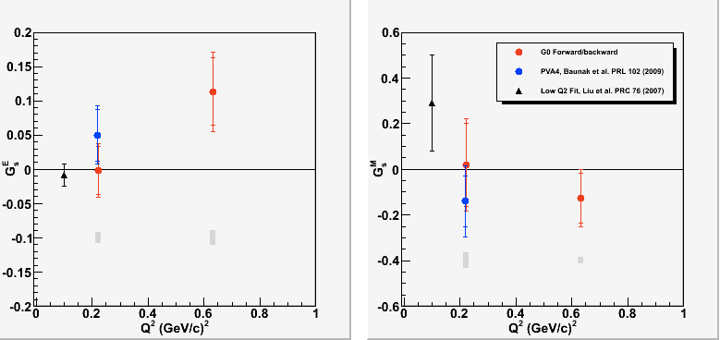
Results
What we see:
G^{s}_{E} has a small positive component Q²=0.63 GeV²
G^{s}_{M} is consistent with zero
Comparison with theory predictions:
Lattice QCD – close to zero
some models predict small G^{s}_{E} and “large” G^{s}_{M}
First Q² dependence of G^{e}_{A}(T=1)

Slide 27
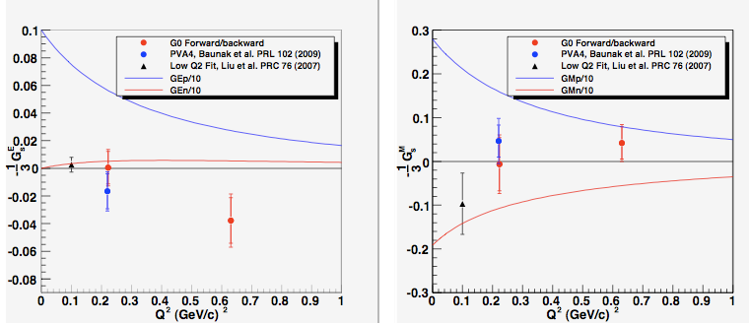
Comparison to Nucleon Form Factors
Recall:

Slide 28

The G⁰ Collaboration
G⁰ Spokesperson: Doug Beck (UIUC)
California Institute of Technology, Carnegie-Mellon University, College of William and Mary, Hendrix College, IPN Orsay, JLab, LPSC Grenoble, Louisiana Tech, New Mexico State University, Ohio University, TRIUMF, University of Illinois, University of Kentucky, University of Manitoba, University of Maryland, University of Winnipeg, Virginia Tech, Yerevan Physics Institute, University of Zagreb
Analysis Coordinator: Fatiha Benmokhtar (Carnegie-Mellon,Maryland)
Thesis Students:
Stephanie Bailey (Ph.D. W&M, Jan ’07, not shown)
From left to right: Colleen Ellis (Maryland) , Alexandre Coppens (Manitoba),
Juliette Mammei (VA Tech), Carissa Capuano (W&M),
Mathew Muether (Illinois), Maud Versteegen (LPSC) , John Schaub (NMSU)

Slide 29

parity violating asymmetries
elastic electron-proton scattering
strange quark
nucleon
momentum transfer
form factors

Slide 30

G⁰ Results featured in Physical Review Focus
http://focus.aps.org

Slide 31

G⁰ Results “published” in the Economist magazine

