Slide 1
PVES
Qweak

Slide 2
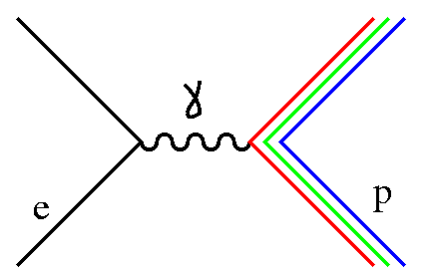
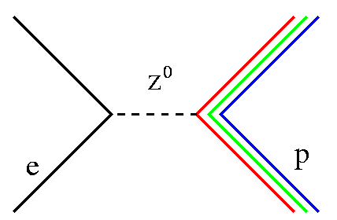
Weak Charges of the Nucleons
As Q² → 0
M_{EM}
M_{NC}
measures Q^{p} – proton’s electric charge
measures Q^{p}_{weak} – proton’s weak charge

Slide 3
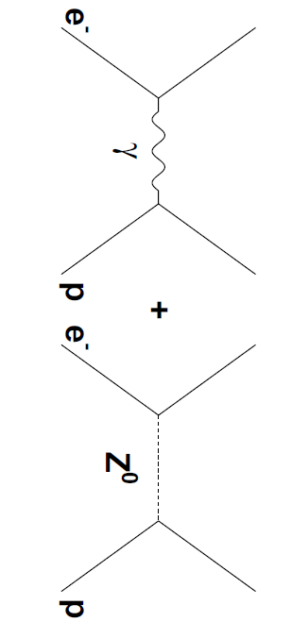
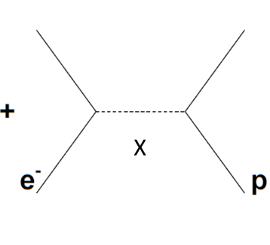
Neutral Weak Coupling
e + p → e + p
E_{beam} = 1.165 GeV
θ ~ 7.9°
Q² ~ 0.025 GeV²/c²
Standard Model processes
Standard Model Test
possible new exchange particle X
Q² → 0
measure charge of proton
Q² → 0
measure weak
charge of proton
Q² → 0
measure coupling of new physics to proton
Notes:
Define Q^2
The neutral weak interaction is parity violating, and in order to access it we can make measurements using polarized electrons. The helicity of the electron is the projection of its spin onto its momentum. An interaction which violates parity will depend on the sign of the helicity, so by polarizing the electron’s spin longitudinally we can access the coupling of the Z boson, which violates parity, while the electromagnetic interaction does not.
Qweak and G0 exploit the parity violation in the weak interaction at different Q2 to measure different properties of the nucleon. Qweak uses a very low Q2 and effectively sees the whole proton – so it can measure the proton’s weak charge. Because of its precision it can serve as a test of the standard model, with sensitivities to various new kinds of exchange particles.
G0 is at relatively larger Q2 (smaller wavelength) and able to see effects of nucleon structure. Its goal is to separate the contribution of the strange quarks to the nucleon sea.

Slide 4
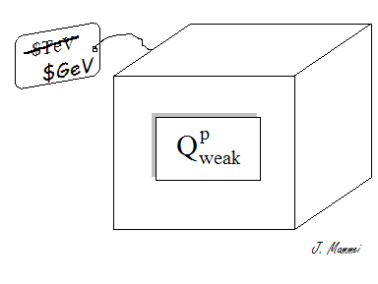
Sensitivity to New Physics
Precision measurements well below the Z-pole have more sensitivity (for a given experimental precision) to new types of tree level physics, such as additional heavier Z’ bosons.
Z’

Slide 5
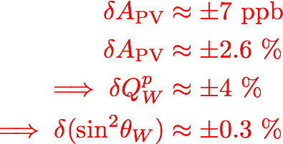
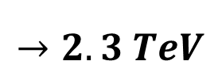

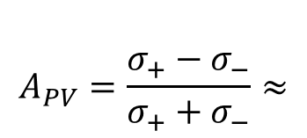
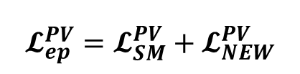

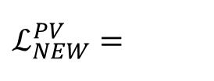
The Physics
$$A_{PV}=\frac{σ_{+}−σ_{−}}{σ_{+}+σ_{−}}≈$$
$$≈280±7 ppb$$
2
nucleon structure, ~30% of asymmetry
Coupling constants
$$𝓛_{ep}^{PV}=𝓛_{SM}^{PV}+𝓛_{NEW}^{PV}$$
$$ℒ_{NEW}^{PV}=$$
e-
p
$$Q_{W}^{p}G_{F}$$
Mass scale
e-
p
4% Qweak uncertainty
$$→2.3 TeV$$

Slide 6
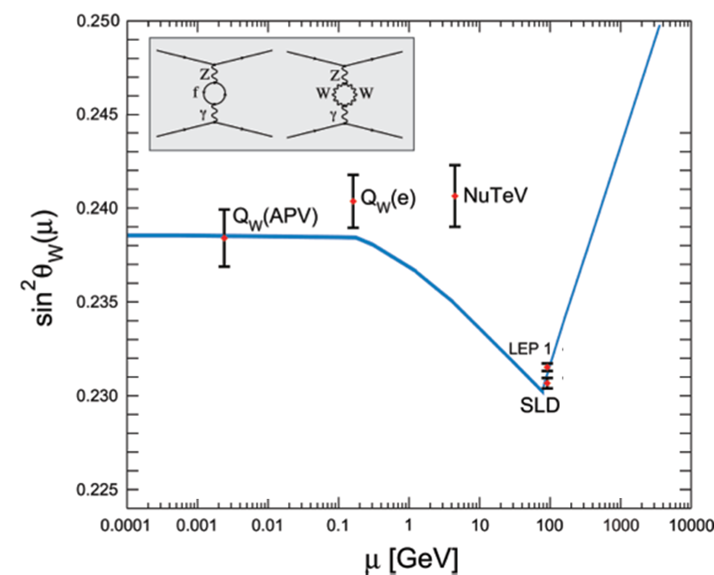
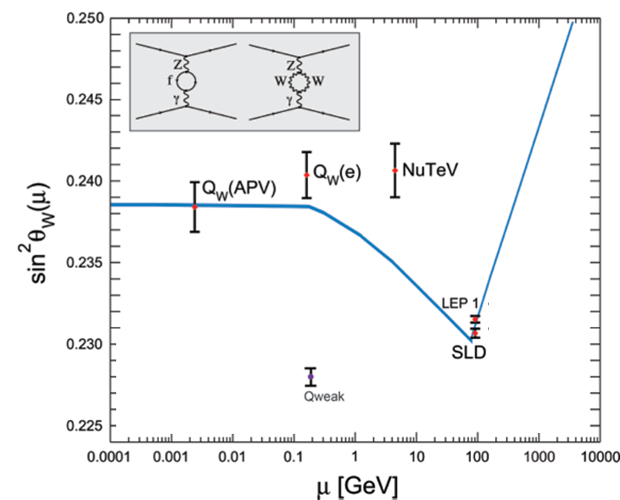
Weak mixing angle
Each experiment is differently sensitive to potential new physics
neutrino deep-inelastic scattering cross-sections
(controversial hadronic corrections not included)
6S → 7S ¹³³Cs atomic transition
Standard Model electroweak fit with uncertainty
Parity violating moller scattering
Colliders
Qweak will test a new set of couplings to new physics
Qweak projected final uncertainty (arbitrary position)

Slide 7
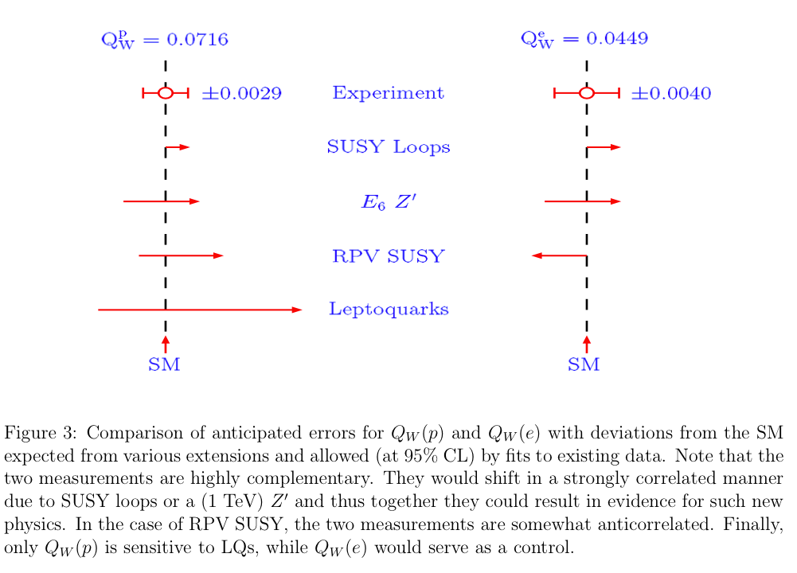
Complementary Diagnostics
JLab Qweak
SLAC E158
-
(proposed)
Erler, Kurylov, Ramsey-Musolf, PRD 68, 016006 (2003)
Qweak measurement will provide a stringent stand alone constraint
on Lepto-quark based extensions to the SM
Q^{p}_{weak} (semi-leptonic) and E158 (pure leptonic) together make a
powerful program to search for and identify new physics

Slide 8
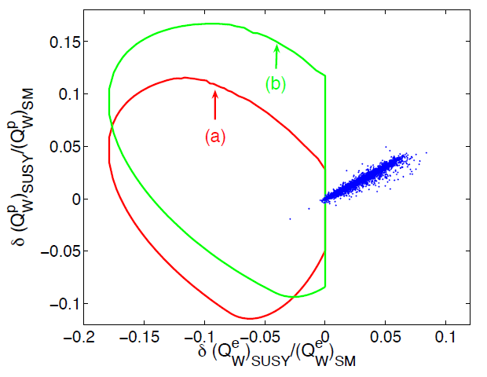
Shifts due to SUSY Effects
R parity (B-L conservation)
RPC SUSY occurs only
at loop level
RPV SUSY occurs at
tree level
Future 2.5% Qweak
4% Qweak
Ramsey-Musolf, Su
Erler, Ramsey-Musolf, Su hep-ph/0303026

Slide 9
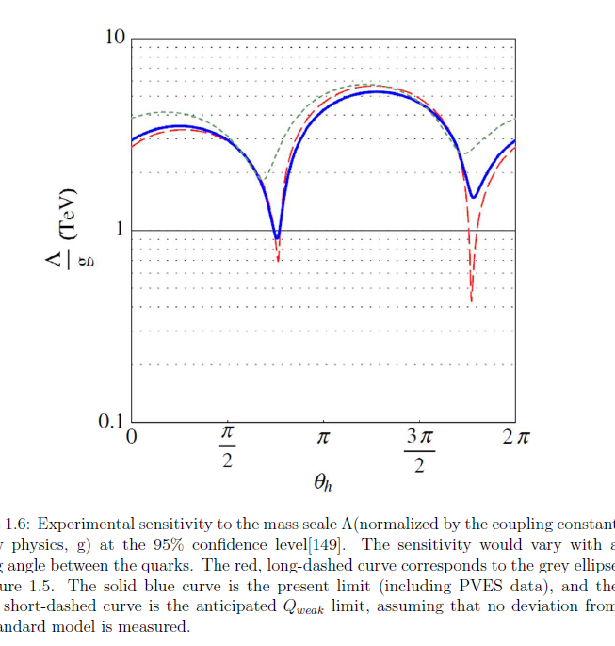

Slide 10
General Requirements
high power unpolarized
target, 35cm, 2.5 kW
large solid angle acceptance
(high rates)
High current, highly polarized beam, 180 μA and ~87%
polarimetry
elastic electrons from proton
(kinematic separation)
beam property monitoring
active feedback to minimize helicity correlations
rapid helicity reversal
slow helicity reversal as a cross check
Notes:
The general requirements for any parity violating experiment are a high power unpolarized target and a large solid angle acceptance in order to minimize the statistical error. In addition you need a highly polarized beam in order to measure the asymmetry, and you need to measure the polarization. Since we are interested in elastic scattering from the proton, we need not only kinematic separation of the elastics from the inelastics, but also particle identification and background measurements. We also need to have stable beam, and to understand the effects of beam properties on the measured yields. Ideally we would minimize the helicity correlated effects. We have rapid helicity reversal, with a slow helicity reversal as a way to change the polarization without changing the electronics.
In order to go from the measured asymmetry to the physics asymmetry, we need to correct for false asymmetries due to beam properties, background asymmetries and the polarization of the beam. There is also a radiative correction that needs to be performed.

Slide 11
Proposed Uncertainties
Uncertainty | ΔA_{PV}/A_{PV} | ΔQ_{W}/Q_{W}
Statistical (2.5k hours at 150 μA) | 2.1% | 3.2%
Systematic |  | 2.7%
Hadronic structure uncertainties | — | 1.5%
Beam polarimetry | 1.0% | 1.5%
Absolute Q² determination | 0.5% | 1.0%
Backgrounds | 0.5% | 0.7%
Helicity correlated beam properties | 0.5% | 0.8%
Total | 2.5% | 4.2%

Slide 12
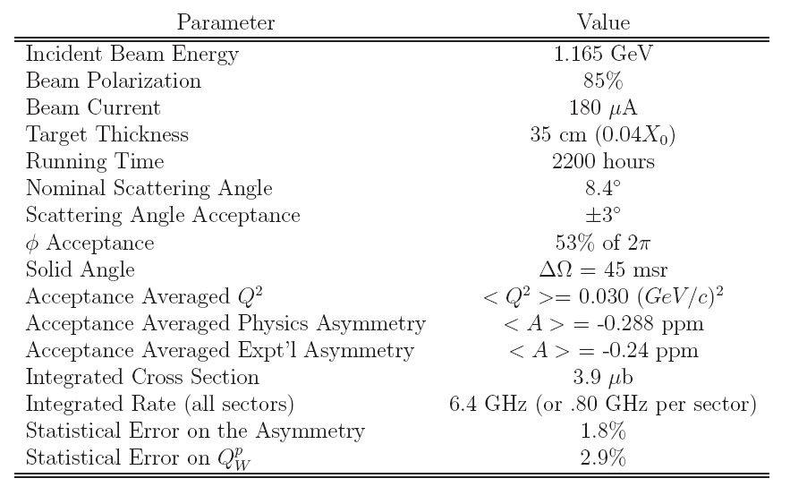
Qweak Requirements

Slide 13
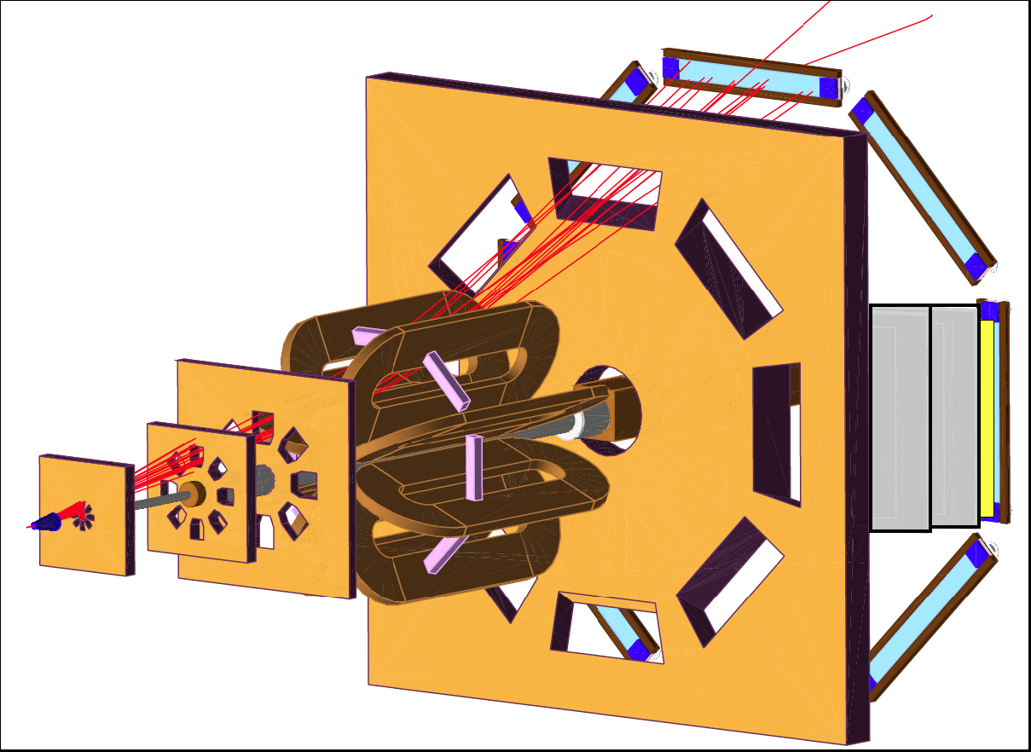
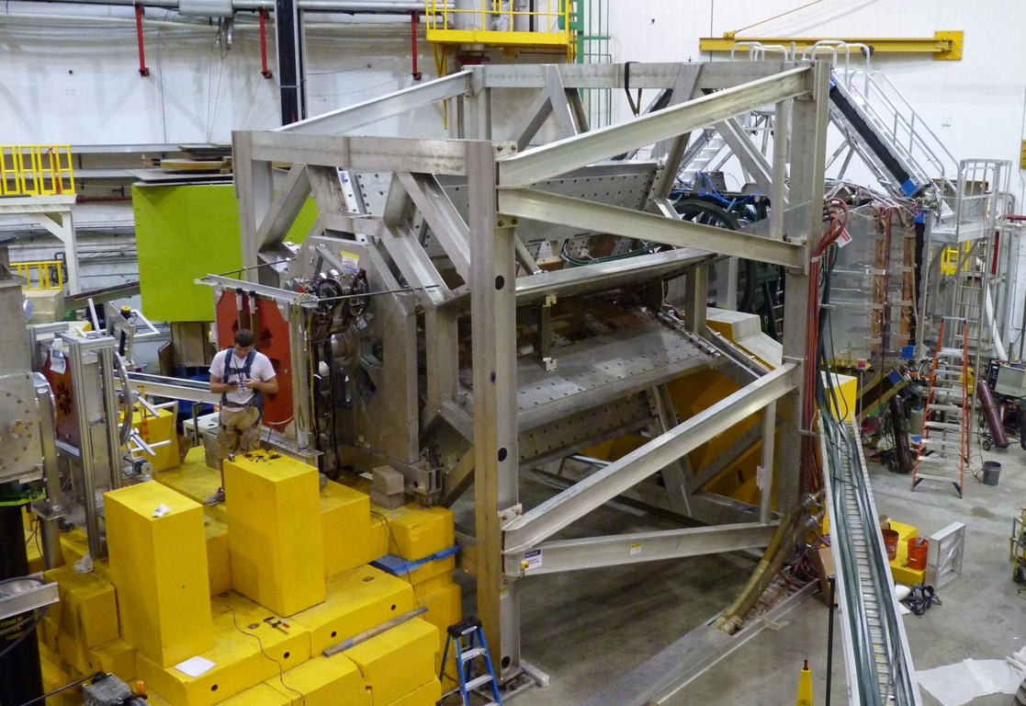
The Qweak Apparatus
QTOR
Main detectors
8-fold symmetry
Cleanup collimators
QTOR
Shield wall
Acceptance defining collimator
Trigger scintillator
Lead collar
Vertical drift chambers (VDC)
(rotate)
e⁻ beam
e⁻ beam
Target
Tungsten plug
Horizontal drift chambers (HDC)
(rotate)
Lintels

Slide 14
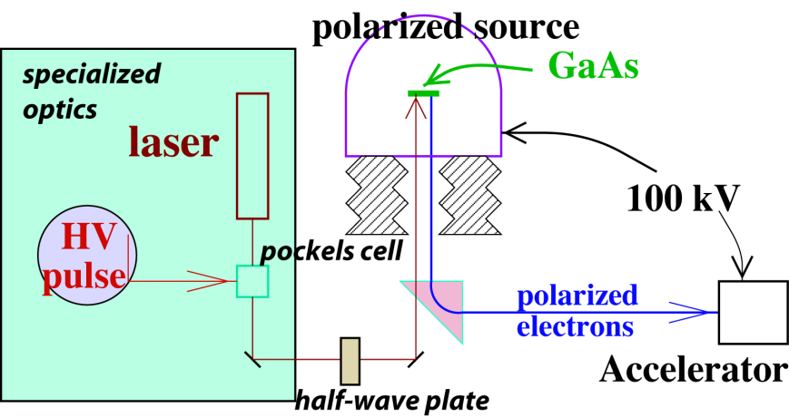
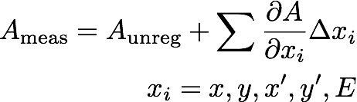
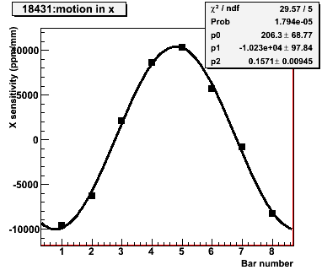
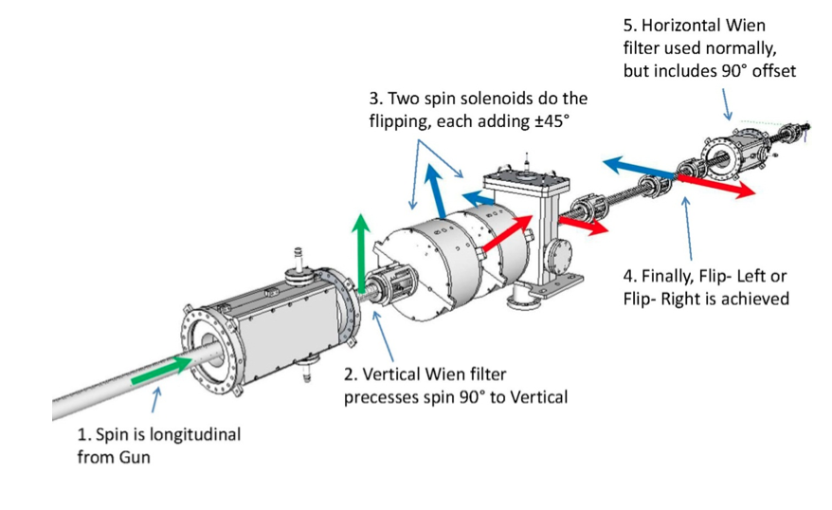
Beam asymmetries
Averaging over the detectors reduces sensitivities by an order of magnitude
IHWP
Double-wien

Slide 15
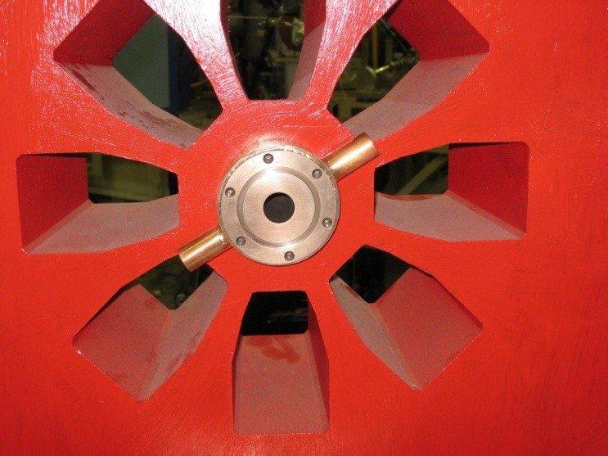
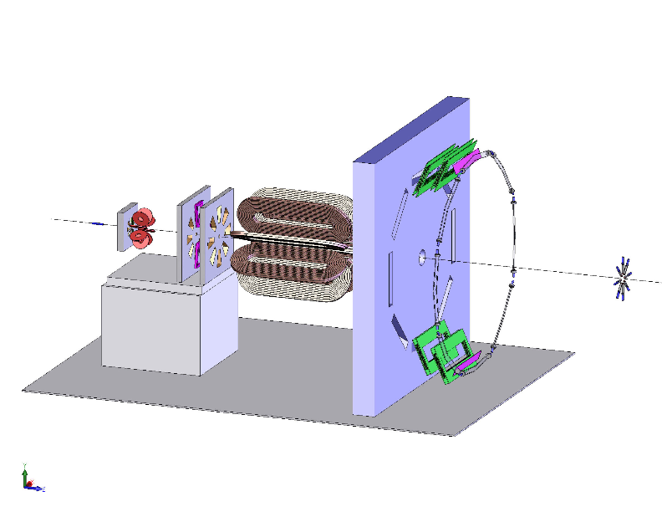
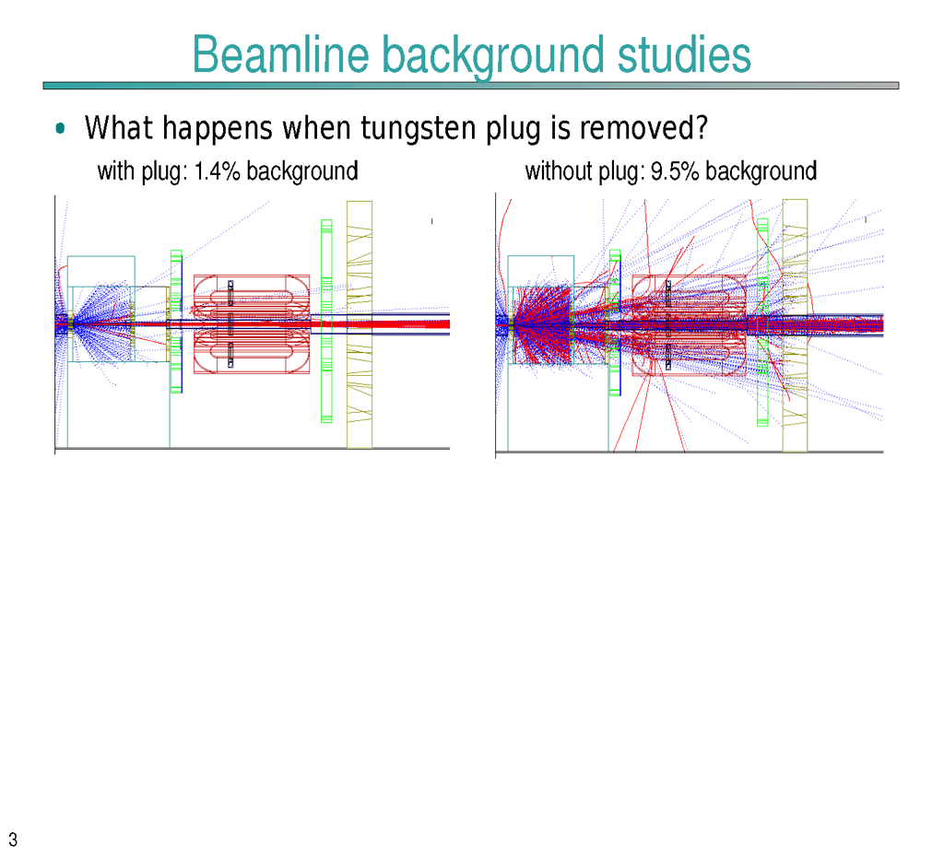
Collimation and shielding
Three layers of lead collimation, lintels and concrete shield wall to control background.
Shutters to study beam background
Small aperture Tungsten collimator “plug” placed in collimator 1 in order to block low angle scattered e- from interacting with the downstream beam pipe
Without “plug”
Reduced background
Notes:
We’re often asked why use the plug because it is a source of background that we have to overcome; didn’t completely eliminate

Slide 16
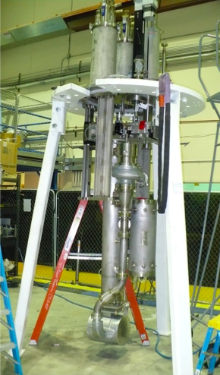
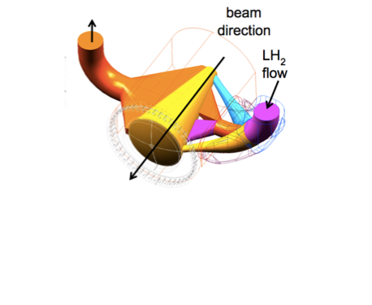
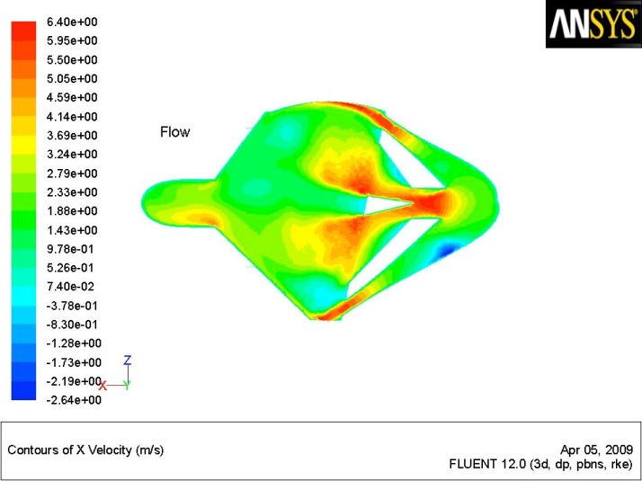
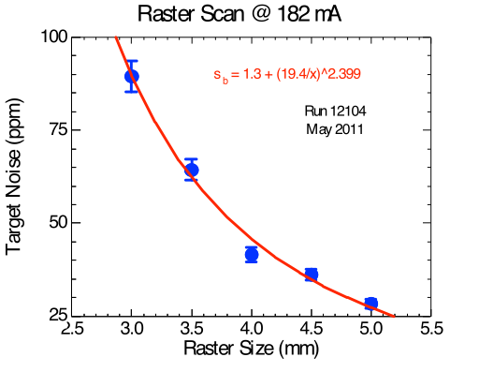
Target
World’s highest power cryogenic target ~2.5 kW!
Designed with computational fluid dynamics (CFD) to reduce density fluctuations
Fluid velocity
46 ppm at 182 µA, 4x4 mm² raster!
Notes:
beam current 180 uA 35cm long

Slide 17
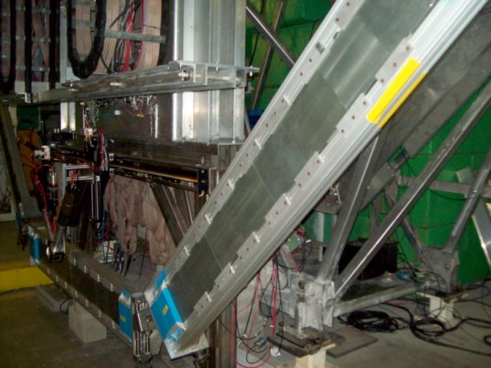
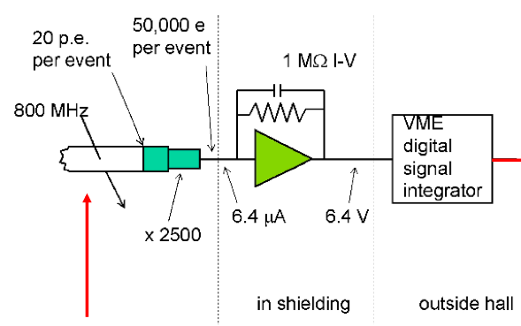
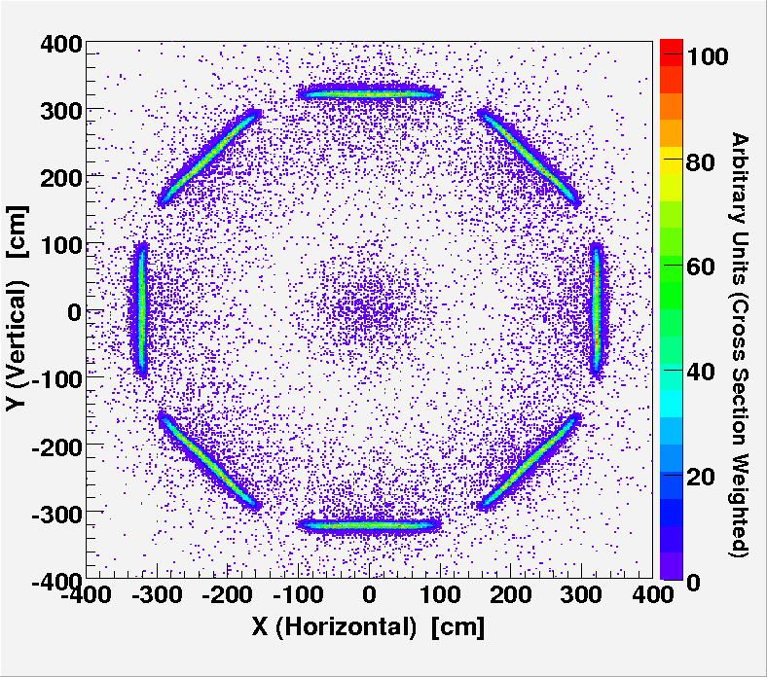
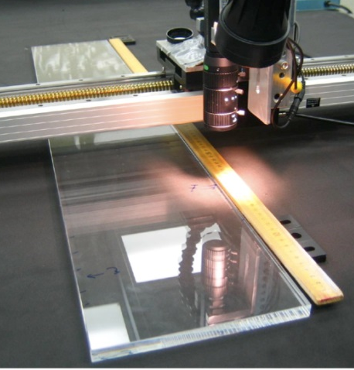
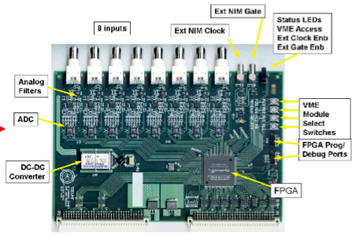
Detector and electronics
100 pe’s/track with 2cm Pb pre-radiators; resolution limited by shower fluctuations
Low noise electronics from PMT base through TRIUMF custom 18 bit ADC, sampling at 500 kHz, summed in FPGA
Spectrosil 2000: Rad-hard, non-scintillating, low-luminescence, optical grade, 25 Å RMS polish
Notes:
Azimuthal symmetry decreases sensitivity to HC beam motion, transverse asymmetry

Slide 18

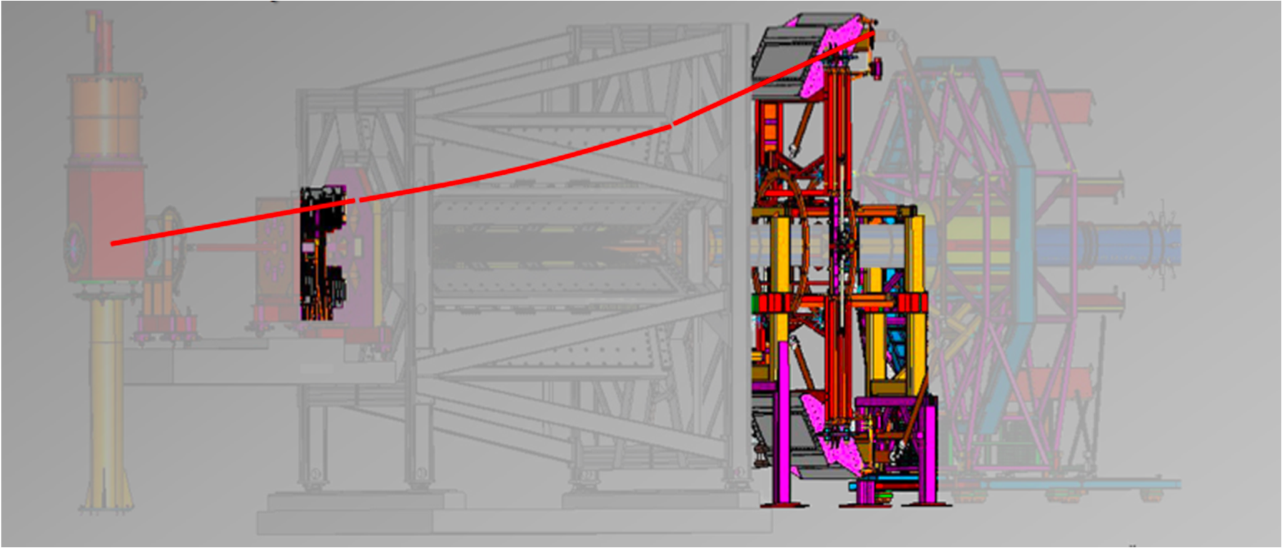
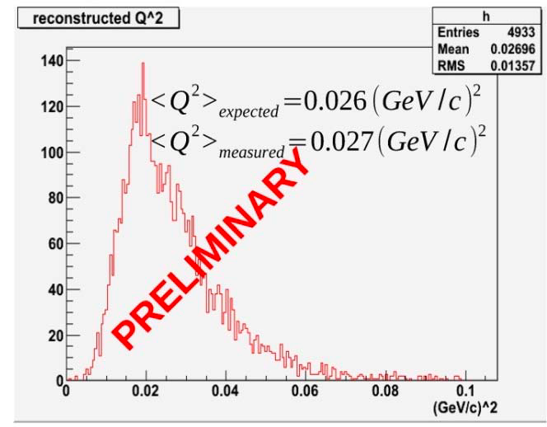
Determining the Kinematics
Required uncertainty on Q² is 0.5%; combination of tracking and simulation
Need momentum and scattering angle + energy loss to vertex:
Region 2 HDCs → scattering angle and vertex in target
Region 3 VDCs → partial track from QTOR exit to detector
“Swim” electrons through the QTOR magnetic field to match partial tracks and find p
Map out main detector light response for single track to determine light-weighted <Q²>
Data to benchmark simulation (confirm treatment of energy loss, radiative corrections, etc.)

Slide 19
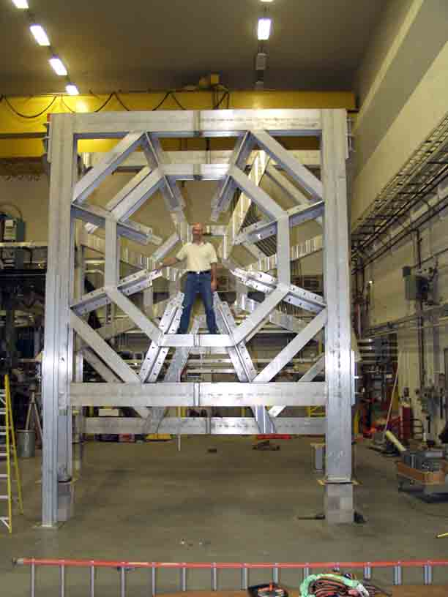
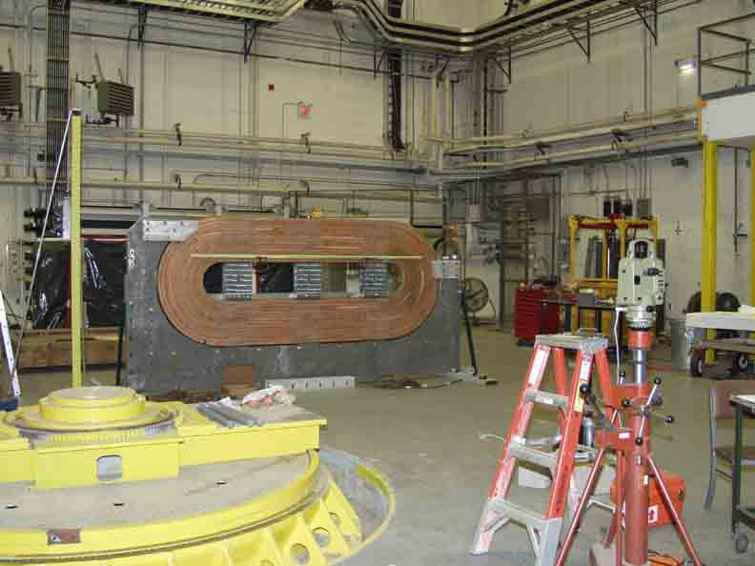
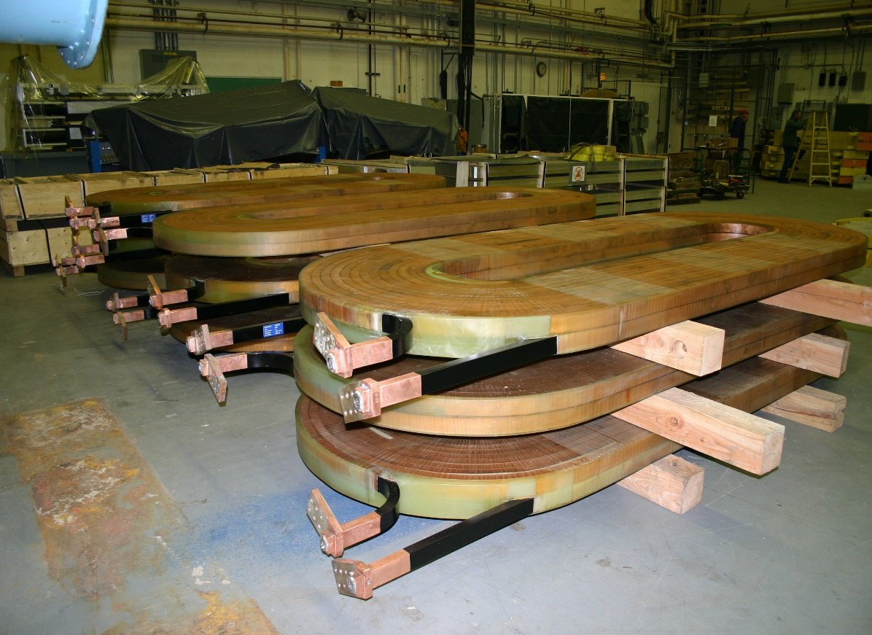
Q^{p}_{Weak} Toroidal Magnet - QTOR
8 toroidal coils, 4.5m long along beam
Resistive, similar to BLAST magnet
Pb shielding between coils
Coil holders & frame all Al
∫B⋅dl ~ 0.7 T-m
bends elastic electrons ~ 10º
current ~ 9500 A
Status: • Being assembled at MIT-Bates
magnet coils at MIT

Slide 20
Looking downstream
φ=-360°/14
φ=+360°/14
͢
B
B_{x}
B_{y}
B_{y}
B_{x}
x
r
In this septant:
B_{y} ~ B_{φ}
B_{x} ~ B_{r}
φ
y

Slide 21
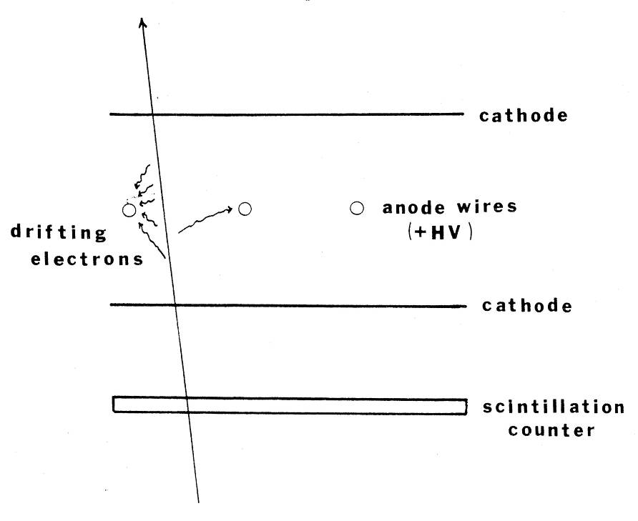
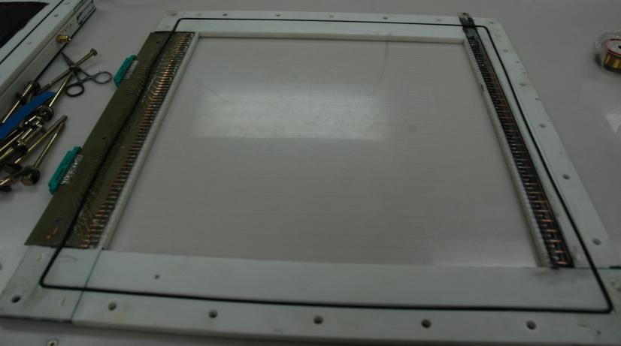
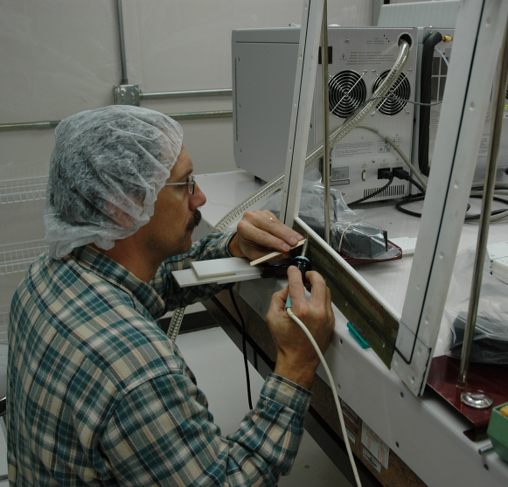
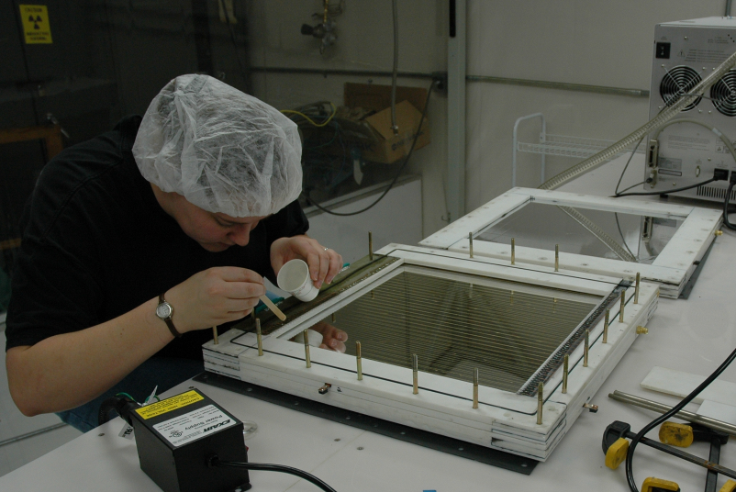
Drift Chambers: Used to precisely locate charged particles

Slide 22
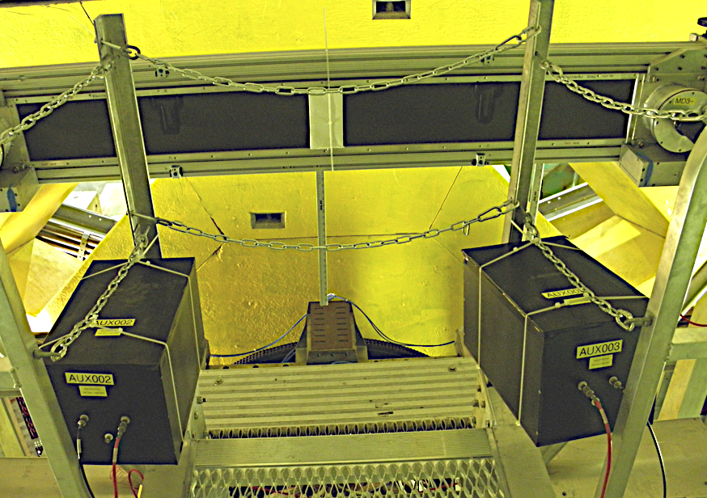
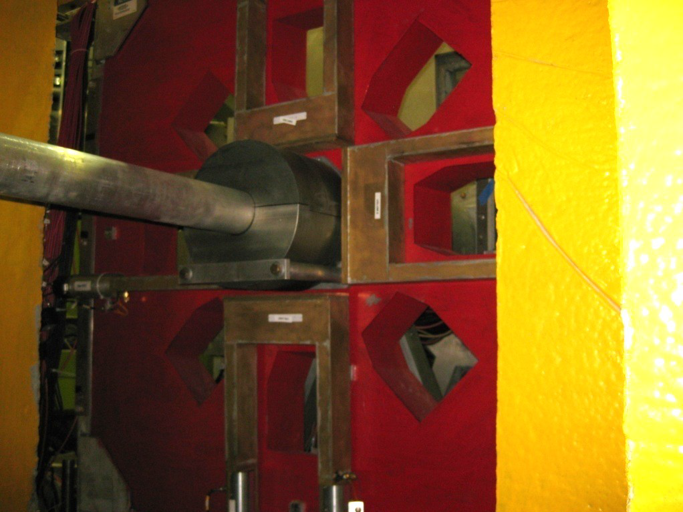
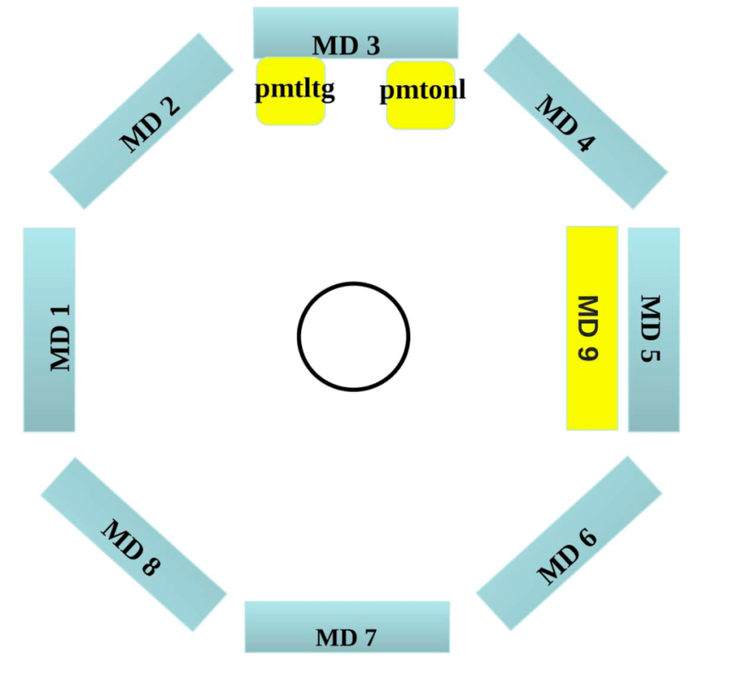
Background Detectors
upstream luminosity monitors (US lumi):
4 detectors at ~5 degrees 100 GHz / detector
50-60% of signal from Tungsten “plug” scattering (i.e. functions like a
background detector)
MD3
PMTs in detector region
“Lead donut” added for additional shielding.

Slide 23
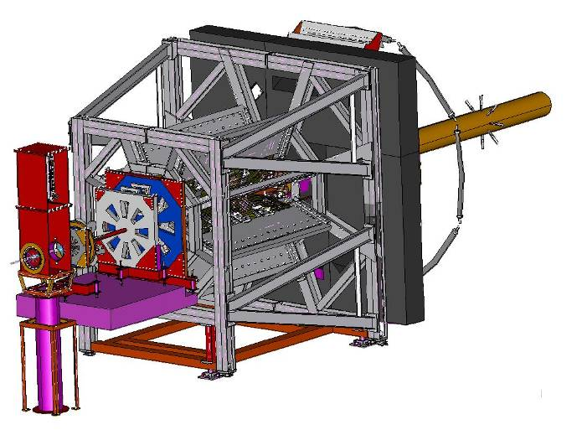
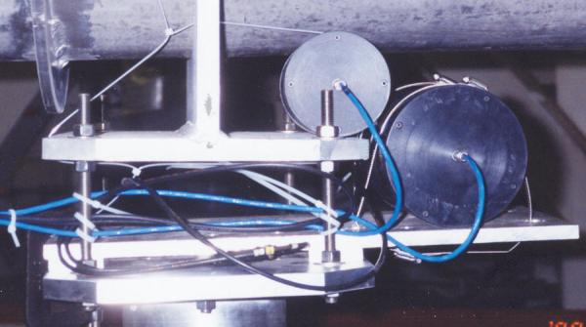
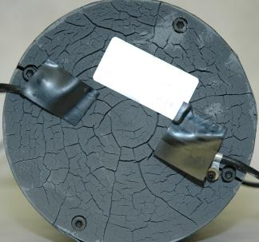
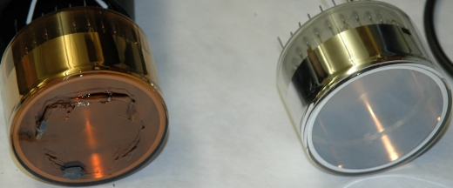

The Q^{p}_{Weak} Luminosity Monitor
Luminosity monitor → Symmetric array of 8 quartz Cerenkov detectors
Placed in location where physics asymmetry is expected to be VERY small; useful as a
“null” asymmetry monitor
Some prototyping:
Before beam:
After beam (radiation damage!):

Slide 24
Run periods
Q-weak ran from Fall 2010 – May 2012 in four distinct running periods
Commissioning (Fall 2010-January 2011)
Run 0 (January 2011 – February 2011) ~44 C*
Run 1 (February 2011 – May 2011) ~360 C
Run 2 (November 2011 – May 2012) ~680 C
*Raw data recorded
These slides focuse only on the Run 0 period (about 1/25th of our total dataset).
This small bit already enables us to constrain possible “new” physics and is competitive with previous experiments.
Separate blinding factor (allows early unblinding)
Some equipment for highest precision was still being commissioned: Compton polarimeter, beam modulation, and injector spin manipulation will be used only for the full data set

Slide 25




Asymmetry Extraction
Hydrogen Elastic Asymmetry Effective Corrections
(14.9 % rel)
Polarization
Beamline background
Beam asymmetries
Aluminum target windows
(2% rel)
4% of total data
(16.3 % rel)

Slide 26



Ex. Aluminum Window Background
Large asymmetry and high fraction make this a big effect; correction driven by measurement
Rate from windows measured with empty target (actual windows)
Corrected for effect of hydrogen using simulation and data driven models of elastic and QE scattering
Asymmetry measured from thick Al target
Measured asymmetry agrees with expectation from scaling

Slide 27





Reduced Asymmetry
4% of total data
in the forward-angle limit (θ=0)
data rotated to the forward-angle limit
SAMPLE
G0
Hadronic part can be extracted through global fit of PVES data.
QWEAK
PVA4
HAPPEX
Qweak point:
4% of total data
Standard Model
Young et al. PRL99 122003(2007)
Notes:
Fit a given Q^2 vs theta. To plot on same point here, use results of fit to rotate to forward angle limit.

Slide 28


Electroweak Corrections
Uncertainty on this calculation only important at final precision
~7% correction
Rapid progress in data driven theoretical work is decreasing uncertainties:
Estimates of γZ contribution at Qweak kinematics
(calculation constrained by PVDIS data)
Calculations are primarily dispersion theory type - error estimates can be firmed up with data! Inelastic parity-violating asymmetries:
• PVDIS at 6 GeV (JLAB E08-011); resonance region asymmetries
• Qweak: inelastic asymmetry data taken at W ~ 2.3 GeV, Q² = 0.09 GeV²
Notes:
Originally thought to contribute 0.65% to error, WW and ZZ evaluated perturbatively (25% correction, but small uncertainty)

Slide 29







Contact Interaction Models
Use four-fermion contact interaction to parameterize the effective PV electron-quark couplings (mass scale and coupling)
For electron-quark scattering:
Qweak is particularly sensitive to C1q
Small θ
Large θ
New physics interaction:
A 4% measurement of the proton weak charge would probe TeV scale new physics
new Z', leptoquarks, SUSY ...
Erler, Kurylov, and Ramsey-Musolf, PRD 68, 016006 2003

Slide 30





Impact on C1q
Standard Model Value
Combined fit of Atomic Parity Violation (APV) data.
Combined fit of Parity Violating Electron Scattering (PVES) data.
PVES and APV combined
Qweak Commissioning Run
(4% of data)
QWEAK
QWEAK
Final projected uncertainty
Qweak and PVES combined
without APV
PVES, APV and Qweak
QWEAK
+ PVES
Potential impact of uncertainty from total expected Qweak data set is shown at arbitrary location.
RDY et al., PRL99,122003(2007)

Slide 31

Weak mixing angle result
4% of total data
* Uses electroweak radiative corrections from
Erler, Kurylov, Ramsey-Musolf, PRD 68, 016006 (2003)

Slide 32
Conclusions
Qweak has produced the first direct measurement of the weak charge of the proton, with ~4% of the total data set
The result is a 16% measurement of the PV asymmetry
at the effective kinematics
This is a 22% measurement of the weak charge of the proton
The result is ~1.1 sigma higher than the SM
~25 times more statistics and additional calibration data in hand for high precision with low systematic error
Demonstrated the technological base for future high precision Standard Model tests using PVES at an upgraded 12 GeV Jefferson Lab
Notes:
Paper submitted to PRL for 25% measurement
Analysis ongoing for remaining data
Expect to present final result early next year
Auxiliary measurements will also be published

Slide 33






Qweak

Slide 34

~100 collaborators, 25 Students, many postdocs and young faculty
Qweak Collaboration Meeting: William & Mary, 2011
D. Androic, D.S. Armstrong, A. Asaturyan, T. Averett, J. Balewski, J. Beaufait, R.S. Beminiwattha, J. Benesch, F. Benmokhtar, J. Birchall, R.D. Carlini¹ (Principal Investigator), J.C. Cornejo, S. Covrig, M.M. Dalton, C.A. Davis, W. Deconinck, J. Diefenbach, K. Dow, J.F. Dowd, J.A. Dunne, D. Dutta, W.S. Duvall, M. Elaasar, W.R. Falk, J.M. Finn^{1*}, T. Forest, D. Gaskell, M.T.W. Gericke, J. Grames, V.M. Gray, K. Grimm, F. Guo, J.R. Hoskins, K. Johnston, D. Jones, M. Jones, R. Jones, M. Kargiantoulakis, P.M. King, E. Korkmaz, S. Kowalski¹, J. Leacock, J. Leckey, A.R. Lee, J.H. Lee, L. Lee, S. MacEwan, D. Mack, J.A. Magee, R. Mahurin, J. Mammei, J. Martin, M. McHugh, D. Meekins, J. Mei, R. Michaels, A. Micherdzinska, K.E. Myers, A. Mkrtchyan, H. Mkrtchyan, A. Narayan, L.Z. Ndukum, V. Nelyubin, Nuruzzaman, W.T.H van Oers, A.K. Opper, S.A. Page¹, J. Pan, K. Paschke, S.K. Phillips, M.L. Pitt, M. Poelker, J.F. Rajotte, W.D. Ramsay, J. Roche, B. Sawatzky, T. Seva, M.H. Shabestari, R. Silwal, N. Simicevic, G. Smith², P. Solvignon, D.T. Spayde, A. Subedi, R. Subedi, R. Suleiman, V. Tadevosyan, W.A. Tobias, V. Tvaskis, B. Waidyawansa, P. Wang, S.P. Wells, S.A. Wood, S. Yang, R.D. Young, S. Zhamkochyan, D. Zou
¹Spokespersons *deceased ²Project Manager

Slide 35
Students
25 students received at least some of their doctoral thesis training on Qweak
Including
Peiqing Wang - University of Manitoba Distinguished Dissertation Award
Jie Pan
Scott MacEwan
8 students have graduated with theses topics on Qweak
JLAB Users Group Meeting
1st Place Poster – Buddhini Waidyawansa (Ohio U.)
3rd Place Poster – Josh Magee (College of William and Mary)
JSA Thesis Prize – Katherine Myers (George Washington U.)

Slide 36







The Pb Radius Experiment and the
Ca Radius Experiment
Juliette Mammei
²⁰⁸Pb

Slide 37
Neutron Rich Matter
At the heart of many fundamental questions in nuclear physics and astrophysics:
  What are the high density phases of QCD?
  Where did the chemical elements come from?
  Structure and properties of celestial bodies
  Neutron distribution effect on spectroscopy, dark matter measurements
Can be studied with astrophysical observations (X-rays, neutrinos, gravity waves)
and in new facilities like the Facility for Rare Isotope Beams (FRIB)
Many of these methods have complications
from strong interaction dependencies
Measurement of the mean radius of the neutron density distribution in a heavy nucleus,
R_{n,} could provide key insight

Slide 38

Neutron Stars
A typical neutron star is 1.5 solar masses, M_{ʘ}, has a radius of 12 km, and a density as high as 5-10 times that of lab nuclei
Crust is 10 billion times stronger than steel
The interface between the crust and the outer core consist of regions with different void structures (spaghetti, lasagna, ziti) called pasta!
What we don’t know is:
maximum mass of a neutron star
radius of 1.4 M_{ʘ} neutron star
Does the direct URCA process (emission of a pair) occur in neutron stars?
Fig from: D. Page. J.M. Lattimer & M. Prakash, Science 304 (2004) 536.
Notes:
Brief overview of a neutron star – mountain - LIGO

Slide 39



Neutron Stars
Equation of State
The equation of state (EOS) is the pressure as a function of density
URCA cooling
Resulting in the emission of a pair, cooling the star
Crab Nebula (X-ray, infrared, radio, visible)
Using hydrostatics in general relativity, and astrophysics observations of:
Luminosity, L
Temperature, T
Mass M (from pulsar timing)
(with corrections)
If R_{n} ↑ and r_{NS} ↓ - quark matter?
If R_{n}↑, then ↓ - affects solid crust
r_{NS} from combined observations predicts R_{n}-R_{p} ~0.15 +/- .02 fm
Steiner, Lattimer and Brown arXiv:1005.0811
Notes:
Can’t decouple mass and radius because spacetime curved around large mass <- Steiner, Lattimer and Brown – r_{NS} from combined observations; predict Rn-Rp ~0.15 +/- .02 fm (using X-ray measurements, neutron stars in globular clusters and nearby isolated star RXJ 1856)
If R_{n} large, EOS is stiff at low densities. If r_{NS} small, then high density EOS is soft with low pressure and could indicate a phase transition to quark matter, strange matter or color superconductor
If R_{n} large, energy rises rapidly with density, favors a quick transition to liquid phase; many observables depend on properties of solid crust
The symmetry energy S, determines the proton fraction; if higher than 12% then n near surface can undergo direct URCA process… if Rn large, large neutron stars likely to cool rapidly by direct URCA.
URCA - Cassino da Urca in Rio de Janeiro. Schoenberg is reported to have said to Gamow that "the energy disappears in the nucleus of the supernova as quickly as the money disappeared at that roulette table." In Gamow's South Russian dialect, urca can also mean a robber or gangster.^{[1][2]}

Slide 40


CREX Workshop Summary
BE and charge radii well described (isoscalar)
Isovector sector unconstrained by data
Slope of asymmetry energy with density, L, is primarily isovector
The things we know the best are unaffected by wildly different values of L
You need neutron-rich matter (isovector)
  ²⁰⁸Pb is uniform nuclear matter – addresses L (but do we know everything we need from this?)
  ⁴⁸Ca interpolate to intermediate A (big lever arm)
F. Fattoyev
Need ⁴⁸Ca to address in ab initio and DFT (bridge!)
  ab initio calculations can’t be done in ²⁰⁸Pb
  3N forces

Slide 41

How on Earth can we learn about neutron stars?
Same forces.
Same particles.
Same equation of state.
18 orders of magnitude in size!
(10 km to 5.5 fm)
55 orders of magnitude in mass!
A whole lot closer to home.
Notes:
How lead could be used to get at some of these answers….

Slide 42
Other ways to get R_{n}
Proton-Nucleus Elastic scattering
Pion, alpha, d Scattering
Pion Photoproduction
Heavy ion collisions
Rare Isotopes (dripline)
Magnetic scattering
PREX/CREX
Theory
Involve strong probes
Most spins couple to zero.
Weak interaction
MFT fit mostly by data other than neutron densities

Slide 43
Form Factors
Example
pointlike
constant
Mott scattering describes electron scattering, including the spin of the electrons
electron
exponential
dipole
proton
The Fourier transform of the “form factor” F(Q²) gives the density as a function of radius
oscillating
most nuclei
sphere with diffuse surface
Adapted from Particles and Nuclei, Povh, Rith, Scholz, Zetsche

Slide 44





The “radius” of Pb
At low Q² there is a tight correlation between R_{n} and F_{n}(Q²)
A single measurement of F_{n}(Q²) translates to a measurement of R_{n} via mean-field nuclear models.

Slide 45

Physics Output
Measured A_{PV}
Correct for Coulomb Distortions
Weak density at one Q²
Small corrections for
MEC
Mean Field and Other Models
Atomic Parity Violation
Neutron density at one Q²
Neutron Stars
Assume surface thickness good to 25% (MFT)
R_{n}
Notes:
Q value chosen in a place where the correlation with the symmetry energy and the skin is the highest (plateau)

Slide 46


Which nuclei?
First excited state far from elastic peak
Target that won’t melt
Neutron excess
Doubly-magic
Stable
²⁰⁸Pb
¹⁰⁰Sn
¹³²Sn
⁵⁶Ni
⁷⁸Ni
⁴⁰Ca
⁴⁸Ca
¹⁶O
energy cost for unequal #p & #n
Notes:
Because they are doubly-magic, various nuclear corrections cancel

Slide 47


Neutron skin of Pb
C.J. Horowitz
There is a tight correlation between the neutron skin of Pb, actually
and the symmetry energy
and
the EOS of neutron matter
Density dependence of symmetry energy L
Notes:
We want to know the neutron skin so we can learn about the EOS of neutron rich matter, so we can understand neutron stars.

Slide 48
How do we measure ?
N
2
N
N
2
2
N
N
N
N

Slide 49
PV Asymmetry
N
N
2
N
Notes:
Not only dramatically improves access to weak interaction, cancels a lot of things by taking the ratio

Slide 50
Measuring A_{PV} with ES
unpolarized target
high current
highly polarized beam
polarimetry
elastic electrons from target
(resolution of the spectrometers)
beam property monitoring
active feedback to minimize helicity correlations
rapid helicity reversal
slow helicity reversal as a cross check
Notes:
The general requirements for any parity violating experiment are a high power unpolarized target and a large solid angle acceptance in order to minimize the statistical error. In addition you need a highly polarized beam in order to measure the asymmetry, and you need to measure the polarization. Since we are interested in elastic scattering from the proton, we need not only kinematic separation of the elastics from the inelastics, but also particle identification and background measurements. We also need to have stable beam, and to understand the effects of beam properties on the measured yields. Ideally we would minimize the helicity correlated effects. We have rapid helicity reversal, with a slow helicity reversal as a way to change the polarization without changing the electronics.
In order to go from the measured asymmetry to the physics asymmetry, we need to correct for false asymmetries due to beam properties, background asymmetries and the polarization of the beam. There is also a radiative correction that needs to be performed.

Slide 51


PREx
(CREx)
1 GeV electron beam, 50-70 µA
high polarization, ~89%
helicity reversal at 120 Hz
D
1 (2.2) GeV electron beam, 50-70 µA
high polarization, ~89%
helicity reversal at 120 Hz
A
B
C
0.5 mm thick Pb target
5° scattered electrons
Q² =0.0088 GeV²/c²
thick and thin quartz detectors
0.5 (5) mm thick Pb (Ca) target
5° (4°) scattered electrons
Q² =0.0088 (0.022) GeV²/c²
thick and thin quartz detectors

Slide 52



Hall A High Resolution Spectrometers
detector
elastic
inelastic
pure, thin ²⁰⁸Pb target
(2.6 MeV)
target
dipole
quads
Momentum (GeV/c)

Slide 53






PREx (CREX) Apparatus
Notes:
Digress to talk about how close the spectrometers were. Relevant because we need the septum, which cause problems with vacuum, etc.

Slide 54




Target Performance
Normalized Rate vs. Time
Thick
Medium
Thin
Targets with thin diamond backing (4.5% bkgd) degraded fastest.
Thick diamond (8% bkgd) ran well and did not melt at 70 uA.
Solution: Run with 10 targets.

Slide 55
Region Near the Septum
New Collimator
& Shielding
HRS-L
Q1
target
septum magnet
HRS-R
Q1
Former O-Ring location
Collimators

Slide 56

Simulations
Ongoing simulations to refine:
Hall geometry
Shielding placement
Collimator design
Magnetic shielding
Target design (CREX)
Hall geometry by Lorenzo Zana

Slide 57
PREx I Results
Systematic Error | Absolute (ppm) | Relative ( %)
Polarization (1) | 0.0071 | 1.1
Beam Asymmetries (2) | 0.0072 | 1.1
Detector Linearity | 0.0071 | 1.1
Beam current normalization | 0.0010 | 0.2
Rescattering | 0.0001 | 0
Transverse Polarization | 0.0012 | 0.2
Q² ⁽¹⁾ | 0.0028 | 0.4
Target Thickness | 0.0005 | 0.1
¹²C Asymmetry ⁽²⁾ | 0.0025 | 0.4
Inelastic States | 0 | 0
TOTAL | 0.0130 | 2.0
Statistics limited (9%)
Systematic error goal achieved !
(1) Normalization Correction applied
(2) Nonzero correction (the rest assumed zero)

Slide 58
PREx I Results
PREx II/CREX
Statistics limited (9%)
Systematic error goal achieved !

Slide 59


3 nucleon forces
$J^{π}=2^{+}$excited states
Ab-initio coupled-cluster calculations
3N forces needed for ⁴⁸Ca to be doubly-magic
G. Hagen, et. Al, arXiv:1312.7872v1 [nucl-th] 30 Dec 2013
Can do microscopic calculations for ⁴⁸Ca that we can’t do for lead (yet?)
Binding energies

Slide 60

Neutron Stars
Using models, one can relate the neutron star radius to the neutron skin of heavy nuclei
Gandolfi et al. PRC85, 032801 (2012)
Including 3N forces can change the model predictions; CREX and PREX will help constrain the models
PREX I
PREX II
Notes:
P0 is saturation density

Slide 61


PREX and CREX
²⁰⁸Pb more closely approximates infinite nuclear matter
The ⁴⁸Ca nucleus is smaller, so can be measured at a Q² where the figure of merit is higher
and are expected to be correlated, but the correlation depends on the correctness of the models
The structure of ⁴⁸Ca can be addressed in detailed microscopic models
Theory from P. Ring et al. Nucl. Phys. A 624 (1997) 349
Measure both and - test nuclear structure models over a large range of A
Notes:
PREX could provide an electroweak complement to Rn predictions from a wide range of physical situations and model dependencies

Slide 62
Conclusions
The systematic error goals of PREX I were met! (2% total)
  Only achieved 9% statistical error on the asymmetry
Future program could make it possible to:
  Distinguish between models
  Learn about the shape dependence
PREx II approved - run in 2016 (1% uncertainty on R_{n}, or 0.06 fm)
  Metal o-rings
  Radiation-hard electronics
  Modified collimator and shielding
CREX approved – run in 2016 (0.6% uncertainty on R_{n}, or 0.02 fm)

Slide 63
PVES
Future experiments

Slide 64


The Physics
$$A_{PV}=\frac{σ_{+}−σ_{−}}{σ_{+}+σ_{−}}≈$$
$${∝m}_{e}E_{lab}\left(1−4\sin^{2}θ_{W}\right)$$
$$=35.6 ± 0.73 ppb$$
$$2$$
$$\frac{δ\sin^{2}{θ_{W}}}{\sin^{2}{θ_{W}}}≃.05\frac{{δA}_{PV}}{A_{PV}}$$
$$δQ_{W}^{e}=2.3\%, \sim 5×smaller$$
$than E158 ({δQ}_{W}^{e}=10.9\%)$
$$𝓛_{e_{1}e_{2}}^{PV}=𝓛_{SM}^{PV}+𝓛_{NEW}^{PV}$$
$$ℒ_{NEW}^{PV}=\sum_{i,j=L,R}{\frac{g_{ij}^{2}}{2Λ_{ij}^{2}}\overline{e_{i}}{γ_{i}e}_{i}\overline{e_{j}}{γ_{}^{j}e}_{j}}$$
Coupling constants
e-
e-
$$Q_{W}^{e}G_{F}$$
Mass scale
$$=\frac{Λ}{\sqrt{{\sqrt{2}G}_{F}\left|ΔQ_{W}^{e}\right|}}$$
$$\frac{Λ}{\sqrt{\left|g_{LL}^{2}−g_{RR}^{2}\right|}}$$
e-
e-
$$g_{ij}=g_{ij}^{∗}$$
2.3% MOLLER uncertainty
$$e_{L,R}=\frac{1}{2}\left(1∓γ_{5}\right)ψ_{e}$$
$$→7.5 TeV$$

Slide 65


Measurement of sin²θ_{W}
MOLLER
Z-pole
MOLLER
Erler, Kurylov, Ramsey-Musolf
$$∆α_{had}^{(5)}=0.02758±0.00035$$
$$m_{t}=172.7±2.9 GeV$$
Erler

Slide 66

Higgs Mass
MOLLER would dominate this ellipse
All precision EW data
Direct Searches (Excluded)
Tevatron
LEP2
Erler

Slide 67
Other Models
2.3% MOLLER
SUSY and RPV SUSY
If RPC, possible dark matter candidate
4% Qweak
Ramsey-Musolf, Su
Doubly-charged scalars
(reach of 5.3 TeV compared
to 3 TeV at LEP2)

Slide 68


Complementary to the LHC - Z΄
Assume LHC discovers a new spin 1 gauge boson with M =1.2 TeV
Half-way between SM and E158 central value
If the SM value is measured
MOLLER can distinguish between models
Erler and Rojas
$$α=0→E6 models, α≠0 describes kinetic mixing$$
$$β=0→SO\left(10\right)\left(including those based on LR symmetry\right)$$

Slide 69

The Experiment
SOLIDWORKS STUDENT EDITION
Picture thanks to Patrick Rogan, UMass undergrad
Parity quality beam >85% using strained GaAs photocathodes
After upgrade to 12 GeV beam energy, addition of a new Hall D
MOLLER will run in Hall A with an 11 GeV, 75 μA beam
150 cm high power (5kW) liquid hydrogen target
detectors located 28 m downstream (~150 GHz rate, <10% bkgd)
two-toroid spectrometer (focus Møller electrons from 5.5-19 mrads, 2.5 to 8.5 GeV)

Slide 70




Polarized Beam
Compton polarimeter (non-invasive, continuous)
Moller polarimeter (invasive, noncontinuous)
Atomic hydrogen moller target also being studied
at Mainz

Slide 71



Target
Qweak Target Performance
MDAllbar Detector widths ~250ppm
E158 Target Cell
Silviu Covrig doing CFD calculations to design the target cell

Slide 72


The Experiment
Detector Array
28 m
Hybrid Torus
Main detectors:
224 quartz bars with air light guides
Additional detectors (systematics and background):
2nd moller ring
pion detectors
tracking GEMs
Upstream Torus
Scattering Chamber
Target
Collimators

Slide 73



Detector Array
(Rate weighted 1x1cm² bins)

Slide 74



Detector Array
Moller envelope
Elastic ep envelope

Slide 75



Detector Electronics
Electronics chain
Qweak-style electronics with few or no modifications will be suitable
TRIUMF Amplifier

Slide 76

Mainz Beam Tests
University of Manitoba and Umass Amherst
(Slides thanks to Peiqing Wang)
Notes:
Umass quartz in Umanitoba light guide

Slide 77


Comparison of Sim and Test Results

Slide 78
Spectrometer Design
Ideal current distribution
Conductor layout
Optics tweaks
Fill azimuth at low radius, far downstream
Half azimuth at upstream end
No interferences
Minimum bends 5x OD of wire
Minimum 5x ms radius
Double-pancake design
Clearance for insulation, supports
Return to proposal optics or better
Optimize Moller peak
Minimize ep backgrounds
Symmetric front/back scattered mollers (transverse cancellation)
Different W distributions in different sectors (inelastics, w/ simulation)
Optimize Moller peak
Eliminate 1-bounce photons
Minimize ep backgrounds
Symmetric front/back scattered mollers (transverse cancellation)
Different W distributions in different sectors (inelastics, w/ simulation)
Force calculations
Symmetric coils
asymmetric placement of coils
Sensitivity studies
Materials
Coils in vacuum or not
Add’l input from us
Water-cooling connections
Support structure
Electrical connections
Power supplies
Optimize collimators
Engineering design

Slide 79



Proposal Model to TOSCA model
Home built code using a Biot-Savart calculation
Optimized the amount of current in various segments (final design had 4 current returns)
Integrated along lines of current, without taking into account finite conductor size
“Coils-only” Biot-Savart calculation
Verified proposal model
Created a first version with actual coil layout
Created second version with larger water cooling hole and nicer profile; obeyed keep-out zones

Slide 80

Tracks in TOSCA
Not using the mesh
- “coils only” calculation fast enough on my machine
- Actual layout much slower – use blocky version or improve mesh
up (z0 =-75 cm) 5.5 to 15 mrads
middle (z0 =0 cm) 6.0 to 17 mrads
down (z0 =75 cm) 6.5 to 19 mrads
Tracks colored by theta from purple to red (low to high)
All phi values

Slide 81


Spectrometer
Property | Upstream | Hybrid | Qweak
Field Integral (T·m) | 0.15 | 1.1 | 0.89
Total Power (kW) | 40 | 765 | 1340
Current per wire (A) | 298 | 384 | 9500
Voltage per coil (V) | 19 | 285 | 18
Current Density (A/cm²) | 1200 | 1550 | 500
Wire cross section (ID: water hole, in) | 0.229x0.229 (0.128) | 0.229x0.229 (0.128) | 2.3x1.5 (0.8)
Weight of a coil (lbs) | 44 | 555 | 7600
Magnetic Forces (lbs) | 100 | 3000 | 27000

Slide 82



100% Azimuthal Acceptance
e-
e-
Forward
Backward
e-
e-
COM Frame
100% Azimuthal Acceptance
Any odd number of coils will work
e-
e-
e-
e-
Lab Frame
Backward
Forward
Notes:
There is a strong energy dependence on scattering angle, with forward scattered electrons having lower lab scattering angles and higher energies.
I have drawn electrons after a Moller scattering event in the COM frame on the top, and the lab frame on the bottom. Now consider an event where the forward electron scatters into the opposite sector in the COM frame, in this case in the plane of the page, and in the lab frame. Now I’ll block the electrons going into the bottom sector. In fact, looking downstream, I am going to block every other sector. Now I will put a detector in the open sector. For the forward scattered electrons that I don’t detect in this sector, I will actually measure the event because I measure the backward scattered electron in the open sector.
Which conveniently leaves room for the coils – any odd number of coils will work.
To put it another way – if I were to count these electrons, and these electrons, I would be double-counting, because they are describing the same event.
The result is that in an open sector we have to accept a large range of scattered electron angles and energies.

Slide 83



Sector Orientation

Slide 84



Sensitivity Studies
For example,
Results for all offsets give a ~3 mm tolerance to shifts in position of a
$${δA}_{raw}{\left(\frac{∂A_{raw}}{∂R}\right)}^{−1}=δR$$
single coil translated or rotated about its center of mass
Assume asymmetry uncertainty of 0.1ppb

Slide 85


Coil Package
Detailed CAD drawings have been made and electrical and water-cooling connections are being designed
FEA done to design the coil package and the support structure
Engineers from MIT are consulting manufacturers for budgetary quotes and feasibility

Slide 86

Conductor Layout Options

Slide 87


Support Structure
Coils within vacuum box so scattered electrons remain in vacuum through drift region
Coils supported by roof of vacuum box

Slide 88



Collimators

Slide 89

Run Plan
Assume 80% polarization
Run I – commissioning
Run II – 25% statistical measurement
Run III – Full statistical measurement
Experience has taught us:
The breaks are useful!

Slide 90
Status
Approved by JLAB PAC with an A rating for 334 days
  International collaboration from over 40 institutions and 100 collaborators
Simulation and Design
  Ongoing work on collimator design and supports
  optics optimization (minimize photon, elastic ep backgrounds)
  Detector region background simulations begun
  Improvements to Hall A polarimeters
  Target CFD
Engineering Design
  Magnet review meetings (2 held)
  MIT engineers FEA on structural forces for coils and vacuum box
  Design of water cooling and electrical connections

Slide 91
Collaboration
J. Benesch, P. Brindza, R.D. Carlini, J-P. Chen, E. Chudakov, S. Covrig, C.W. de Jager, A. Deur, D. Gaskell, J. Gomez, D.W. Higinbotham, J. LeRose, D. Mack, R. Michaels, B. Moffit, S. Nanda, G.R. Smith, P. Solvignon, R. Suleiman, B. Wojtsekhowski (Jefferson Lab) , H. Baghdasaryan, G. Cates, D. Crabb, D. Day, M.M. Dalton, C. Hanretty, N. Kalantarians, N. Liyanage, V.V. Nelyubin, B. Norum, K. Paschke, M. Shabestari, J. Singh, A. Tobias, K. Wang, X. Zheng (University of Virginia), J. Birchall, M.T.W. Gericke, W.R. Falk, L. Lee, R. Mahurin, S.A. Page, W.T.H. van Oers, V. Tvaskis (University of Manitoba), S. Johnston, K.S. Kumar, J. Mammei, L. Mercado, R. Miskimen, S. Riordan, J. Wexler (University of Massachusetts, Amherst),
V. Bellini, A. Giusa, F. Mammoliti, G. Russo, M.L. Sperduto, C.M. Sutera (INFN Sezione di Catania and Universita' di Catania), D.S. Armstrong, T.D. Averett, W. Deconinck, J. Katich, J.P. Leckey (College of William & Mary), K. Grimm, K. Johnston, N. Simicevic, S. Wells (Louisiana Tech University), L. El Fassi, R. Gilman, G. Kumbartzki, R. Ransome (Rutgers University), J. Arrington, K. Hafidi, P.E. Reimer, J. Singh (Argonne National Lab), P. Cole, D. Dale, T.A. Forest, D. McNulty (Idhao State University), E. Fuchey, F. Itard, C. Muñoz Camacho (LPC Clermont, Universitè Blaise Pascal), J.H. Lee, P.M. King, J. Roche (Ohio University), E. Cisbani, S. Frullani, F. Garibaldi (INFN Gruppo Collegato Sanita' and Istituto Superiore di Sanitá), R. De Leo, L. Lagamba, S. Marrone (INFN, Sezione di Bari and University di Bari), F. Meddi, G.M. Urciuoli (Dipartimento di Fisica dell'Universita' la Sapienza and INFN Sezione di Roma), R. Holmes, P. Souder (Syracuse University), G. Franklin, B. Quinn (Carnegie Mellon University), W. Duvall, A. Lee, M. Pitt (Virginia Polytechnic Institute and State University), J.A. Dunne, D. Dutta (Mississippi State University), A.T. Katramatou, G. G. Petratos (Kent State University), A. Ahmidouch, S. Danagoulian (North Carolina A&T State University), S. Kowalski, V. Sulkosky (MIT) , P. Decowski (Smith College), J. Erler (Universidad Autónoma de México) , M.J. Ramsey-Musolf (University of Wisconsin, Madison), Yu.G. Kolomensky (University of California, Berkeley), K. A. Aniol (California State U.(Los Angeles)) , C.A. Davis, W.D. Ramsay (TRIUMF) , J.W. Martin (University of Winnipeg), E. Korkmaz (University of Northern British Columbia) ,T. Holmstrom (Longwood University), S.F. Pate (New Mexico State University), G. Ron (Hebrew University of Jerusalem), D.T. Spayde (Hendrix College), P. Markowitz (Florida International University), F.R. Wesselmann ( Xavier University of Louisiana), F. Maas(Johannes Gutenberg Universitaet Mainz), C. Hyde(Old Dominion University), F. Benmokhtar (Christopher Newport University), E. Schulte (Temple University), M. Capogni (Istituto Nazionale di Metrologia delle Radiazioni Ionizzanti ENEA and INFN Gruppo Collegato Sanitá), R. Perrino (INFN Sezione di Lecce)
*Spokeperson

Slide 92

PVES Experiment Summary

Slide 93

SOLID

Slide 94

SOLID – Large Acceptance Device

Slide 95
Contact Interaction Models
Use four-fermion contact interaction to parameterize the effective PV electron-quark couplings (mass scale and coupling)
For electron-quark scattering:
Qweak is particularly sensitive to C1q
Small θ
Large θ
New physics interaction:
A 4% measurement of the proton weak charge would probe TeV scale new physics
new Z', leptoquarks, SUSY ...
Erler, Kurylov, and Ramsey-Musolf, PRD 68, 016006 2003

Slide 96


Red ellipses are PDG fits
Blue bands represent expected data: Qweak (left) and PVDIS-­6GeV (right)
Green bands are proposed SOLID PVDIS
Small θ
Large θ

Slide 97







SOLID
e-
e-
Z* γ*
N
X
Cahn and Gilman, PRD 17 1313 (1978) polarized electrons on deuterium

Slide 98

PVES Experiment Summary
size of the uncertainty
relative uncertainty
(log scale)
size of the asymmetry

