Slide 1
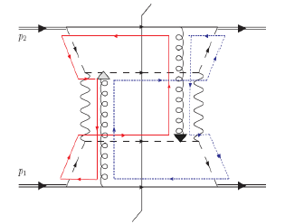
Transverse-Momentum-Dependent Distributions and
Color Entanglement in QCD
Lecture 1 - Introduction
Christine A. Aidala
University of Michigan
left
right
Hampton University Graduate Studies Program
Jefferson Lab
June 2016

Slide 2
How do we understand the visible matter in our universe in terms of the quark and gluon degrees of freedom of quantum chromodynamics?
How can studying QCD systems teach us more about fundamental aspects of QCD as a theory?
Notes:
Goals of all of QCD research

Slide 3
Mapping out the partonic structure of the proton
What does the proton look like in terms of the quarks and gluons inside it?
Position
Momentum
Spin
Flavor
Color
Theoretical and experimental concepts to describe and access position only born in mid-1990s. Pioneering measurements over past decade.
Vast majority of past four decades focused on
1-dimensional momentum structure! Since 1990s starting to consider transverse components . . .
Polarized protons first studied in 1980s. How angular momentum of quarks and gluons add up still not well understood!
Early measurements of flavor distributions in valence region. Flavor structure at lower momentum fractions still yielding surprises!
Accounted for theoretically from beginning of QCD, but more detailed, potentially observable effects of color have come to forefront in last few years . . .

Slide 4
Outline of lectures
Introduction; collinear and TMD proton structure and hadronization; some history
TMDs and proton structure; measurements; collinear twist-3 and multiparton correlations; sea quarks
Processes and experimental facilities
TMD factorization, Aharonov-Bohm, and color entanglement I
TMD factorization, Aharonov-Bohm, and color entanglement II
Connections to other subfields of QCD; summary and outlook

Slide 5
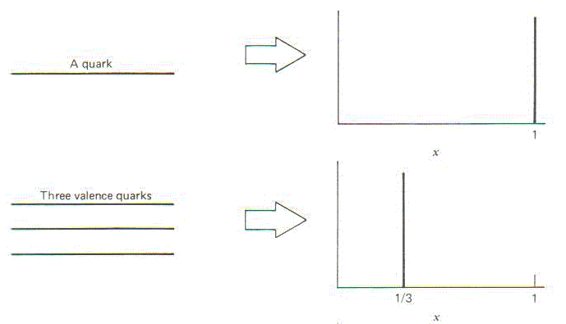
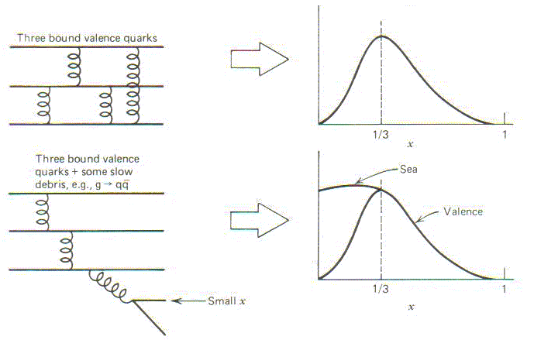
Ways to describe proton structure:
Review of unpolarized, collinear pdfs
What momentum fraction would the scattering particle carry
if the proton were made of …
3 bound valence quarks
A point particle
Halzen and Martin, “Quarks and Leptons”, p. 201
x
1
3 bound valence quarks + some
low-momentum sea quarks
1/3
x
1
Sea
3 valence quarks
Valence
Small x
1/3
x
1
1/3
x
1
Don’t take into account polarization of proton or parton
Integrate over partonic transverse momentum within proton

Slide 6
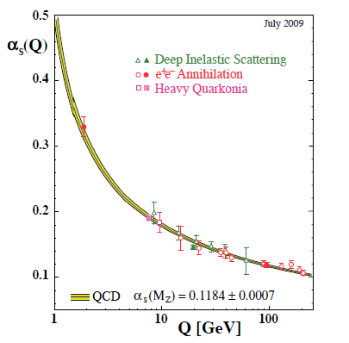
Review: Perturbative QCD
Take advantage of running of the strong coupling constant with energy (asymptotic freedom)—weak coupling at high energies (short distances)
Perturbative expansion as in quantum electrodynamics (but many more diagrams due to gluon self-coupling!!)
Importantly: Perturbative QCD provides a rigorous way of relating the fundamental field theory—in terms of quarks and gluons—to a variety of physical observables—in terms of hadrons
Notes:
Scattering energy

Slide 7
Review: Factorization and universality in perturbative QCD
Systematically factorize short- and long-distance physics—observable physical QCD processes always involve at least one long-distance scale (confinement)
  Short-distance (high-energy) scale required to apply perturbative techniques
Long-distance (i.e. nonperturbative) functions need to be universal in order to be portable across calculations for many processes
Measure nonperturbative pdfs and fragmentation functions (FFs) in many scattering systems over a wide kinematic range → constrain by performing simultaneous fits to world data.
See lectures by Amanda Cooper-Sarkar

Slide 8
Pdfs and FFs in pQCD calculations of observables
q(x₁)
Hard Scattering Process
X
g(x₂)
High-energy processes have predictable rates given:
    Partonic hard scattering rates (calculable in pQCD)
    Parton distribution functions (experiment )
    Fragmentation functions (experiment )
Universal non-perturbative factors

Slide 9
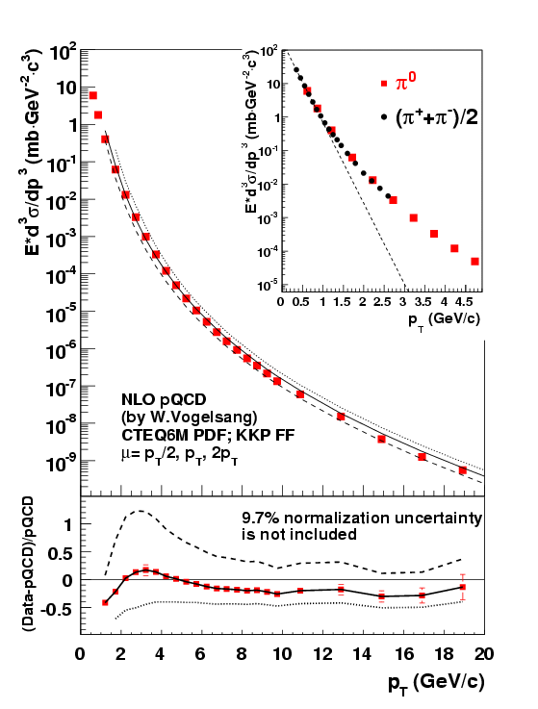

pQCD in action at √s=200 GeV
p+p◊π⁰+X
Fraction of pions produced
Midrapidity
√s=200 GeV
Systematic uncertainty on calculation due to factorization, renormalization, and fragmentation scale dependence. All three scales taken as equal and varied from p_{T}/2 to 2p_{T}. See lectures by Markus Diehl.
Cross section prediction varies by tens of percent here.

Slide 10
Complementary scattering systems
Learn from p+p results in conjunction with information from simpler systems
  Many subprocesses contribute to (e.g.) inclusive hadron production in p+p collisions—couldn’t disentangle them with p+p data alone
  (A few processes are simpler, e.g. Drell-Yan)
Most knowledge of pdfs from DIS
Most knowledge of FFs from e+e-
Note that Drell-Yan, DIS, and e+e- are all QED processes involving hadrons
Once you have reasonably constrained pdfs and/or FFs, can use p+p data to further refine those constraints
  Hadronic collisions have been important in constraining gluons—interact at leading order. E.g. pion production results on previous page have improved constraints on gluon → pion FFs
  Hadronic collisions also open up opportunities to explore unique aspects of QCD! More in Lectures 4 and 5 . . .
More on complementary processes and experimental facilities in Lecture 3 . . .

Slide 11
Beyond unpolarized, collinear pdfs:
Spin-spin and spin-momentum correlations in QCD bound states
Unpolarized
Spin-spin correlations
Spin-momentum correlations

Slide 12
Twist-2 transverse-momentum-dependent pdfs
Can keep transverse momentum dependence (more info than collinear),
but survive if you do integrate over k_{T}
Unpolarized
Spin-spin correlations
Spin-momentum correlations
Vanish if integrate over k_{T}, no collinear counterparts

Slide 13



Twist-2 transverse-momentum-dependent pdfs
Worm-gear
(Kotzinian-Mulders)
Unpolarized
Spin-spin correlations
Helicity
Transversity
Spin-momentum correlations
Sivers
Boer-Mulders
Pretzelosity
Worm-gear

Slide 14
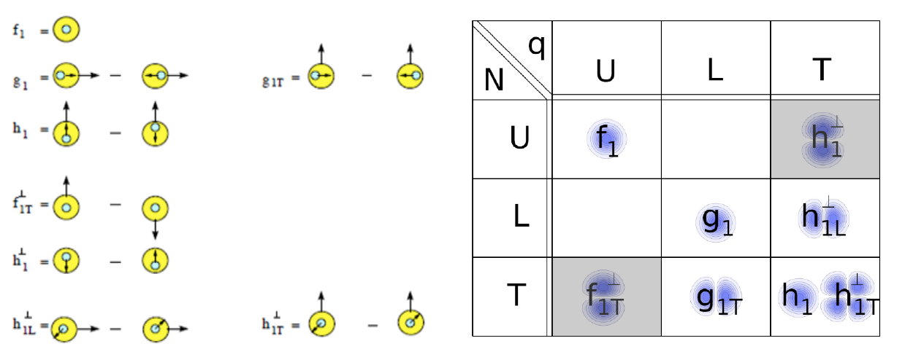
Twist-2 transverse-momentum-dependent pdfs
U = unpolarized L = longitudinally polarized T = transversely polarized
N = nucleon q = quark

Slide 15
Spin-spin correlations in terms of helicity
Elastic proton-quark scattering
(related to inelastic scattering through optical theorem)
Three independent pdfs corresponding to following helicity states in scattering:
Helicity basis not “natural” for transversity
Corresponds to difference in probability of scattering off of transversely polarized quark within transversely polarized proton with quark spin parallel vs. antiparallel to proton’s
Take linear combinations to form familiar collinear pdfs:
Helicity average
(unpolarized pdf)
Helicity difference
(helicity pdf)
Helicity flip
(transversity pdf)

Slide 16
Spin-spin correlations (collinear or TMD):
Helicity vs. transverse spin structure
Transverse spin structure of the proton cannot be deduced from helicity structure
  Spatial rotations and Lorentz boosts don’t commute
  Relationship between longitudinal and transverse structure provides information on the relativistic nature of partons in the proton
  Even collinear transverse spin structure (transversity) should thus be linked to parton k_{T}
    I haven’t dug into this yet myself to try to understand it better . . .

Slide 17
TMD pdfs: Some properties
Pdfs involving transversely polarized quarks are chiral-odd—can only be observed experimentally in conjunction with a second chiral-odd function
  Another pdf or a FF
  Transversity, Boer-Mulders, pretzelosity, one of the worm gears (all the ‘h’ TMD pdfs)
TMD pdfs involving a single spin vector are “naïve-time-reversal-odd,” i.e. PT-odd
  Sivers and Boer-Mulders
What about TMD pdfs for gluons?
  Gluons massless—can’t have helicity-flip states, i.e. transversely polarized gluons
  However, can have TMDs for linearly polarized gluons, similar to linearly polarized photons—not extensively explored yet
  Unpolarized and longitudinally polarized TMD pdfs no problem for gluons

Slide 18
Transverse single-spin asymmetries
General form for transverse single-spin asymmetries:
  Collinear momenta would produce no effect
  Thus importance of transverse momentum dependence
Spin could be of initial proton, struck quark, fragmenting quark, produced hadron
Possible momenta include initial proton momentum, final-state particle or jet momentum, k_{T} of parton within proton, j_{T} of final-state particle with respect to jet axis
Lots of combinations possible!

Slide 19
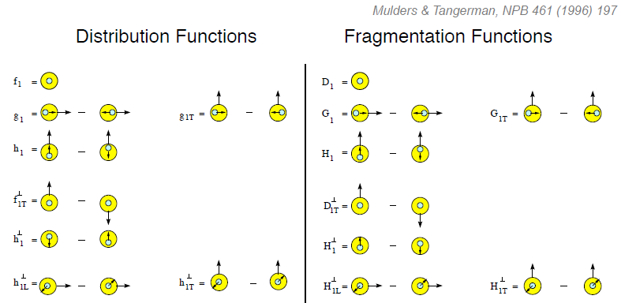
Twist-2 transverse-momentum-dependent FFs
Unpolarized
Spin-spin correlations
Polarizing FF
Spin-momentum correlations
Collins
(only one extensively studied)

Slide 20
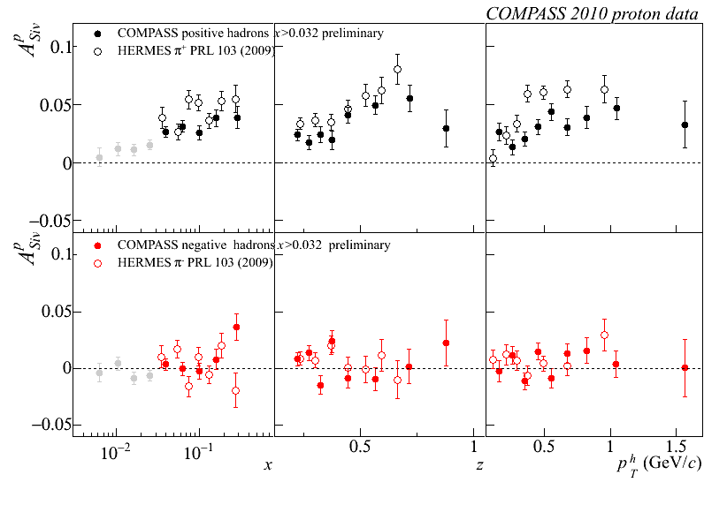
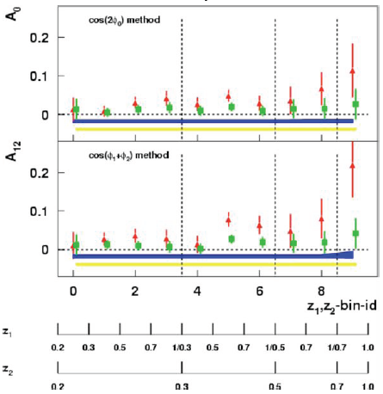
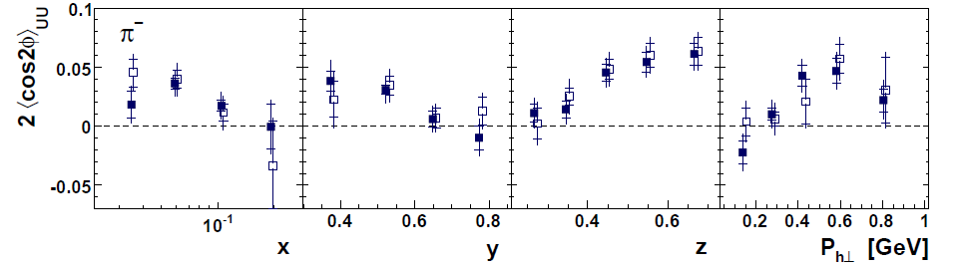
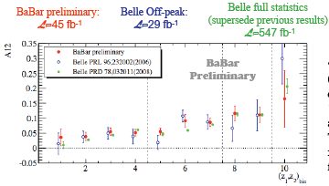
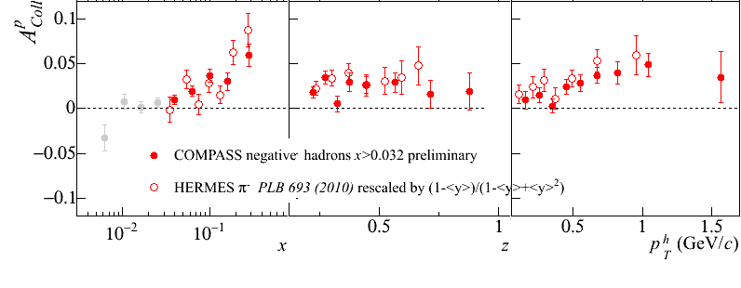
Lots of mix-and-match combinations theoretically possible, but are these correlations nonzero in nature? Experimental evidence for many of them over last decade!
Sivers
e+p
μ+p
BELLE PRL96, 232002 (2006)
Collins x Collins
e⁺e⁻
Boer-Mulders x Collins
e+p
HERMES, PRD 87, 012010 (2013)
BaBar published ref. PRD90, 052003 (2014)
Collins x Collins
e⁺e⁻
e+p
μ+p
Transversity x Collins

Slide 21
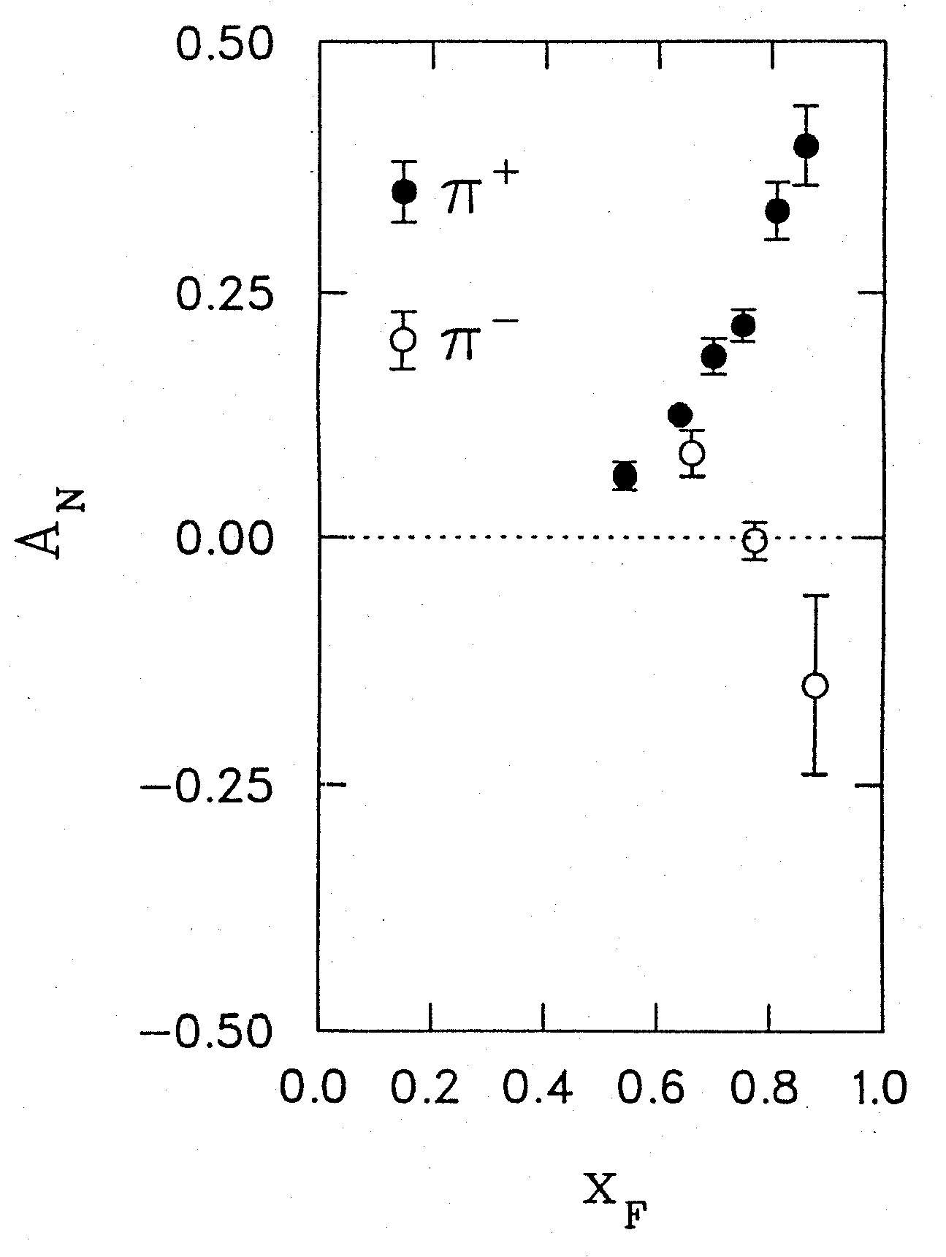
Some history of spin-momentum correlations and TMD functions:
1976 discovery in p+p collisions
Argonne √s=4.9 GeV
Charged pions produced preferentially on one or the other side with respect to the transversely polarized beam direction—by up to 40%!!
Had to wait more than a decade for the birth of a new subfield in order to explore the possibilities . . .
left
right
W.H. Dragoset et al., PRL36, 929 (1976)

Slide 22
Transverse-momentum-dependent distributions and single-spin asymmetries
1990: “Sivers mechanism” proposed in attempt to understand observed asymmetries
Departed from traditional collinear factorization assumption in pQCD and proposed correlation between the intrinsic transverse motion of the quarks and gluons and the proton’s spin
Sivers distribution: first transverse-momentum-dependent parton distribution function describing a spin-momentum correlation
New frontier! Parton dynamics inside hadrons, and in the hadronization process
D.W. Sivers
PRD41, 83 (1990)
Spin and momenta of partons and/or hadrons
Notes:
Dennis Sivers motivated by forthcoming E704 data

Slide 23
“Naïve-T-odd” (PT-odd) spin-momentum correlations require phase interference
Some spin-momentum correlation functions odd under “naïve-time-reversal” (actually a PT transformation)
1990 – Proposed by D.W. Sivers
1993 – Claimed forbidden by J.C. Collins
2002 – Demonstrated nonvanishing by Brodsky, Hwang, Schmidt if phase interference effects due to color interactions present
2002 – J.C. Collins realizes that this implies a relative sign difference between PT-odd TMD pdfs with color interactions in the initial vs. the final state
  Sparked dramatic increase in interest in the field
2004 – Measurement of nonzero Sivers asymmetry in SIDIS by HERMES

Slide 24
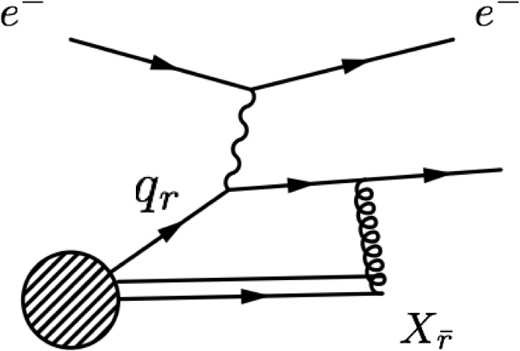
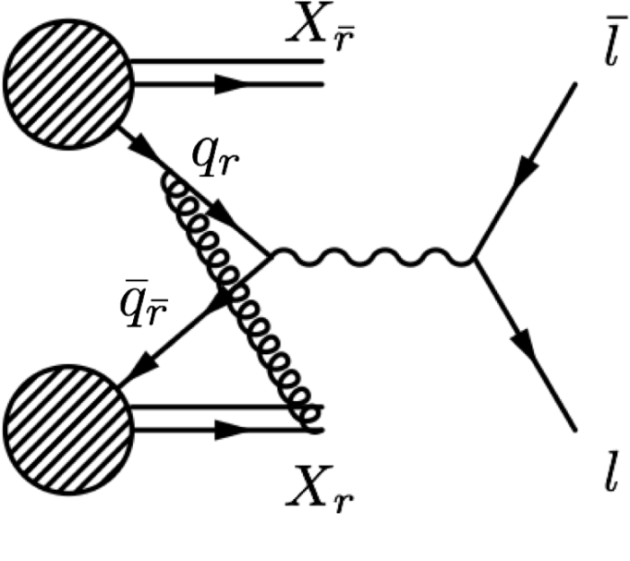
Modified universality of certain transverse-momentum-dependent distributions:
Color in action!
Deep-inelastic lepton-nucleon scattering:
Attractive final-state interactions
Quark-antiquark annihilation to leptons:
Repulsive initial-state interactions
As a result, get opposite sign for the Sivers transverse-momentum-dependent pdf when measure in semi-inclusive DIS versus Drell-Yan: process-dependent pdf! (Collins 2002)
Figures by J.D. Osborn

Slide 25
Modified universality of
PT-odd TMD pdfs
Gluon exchange between a parton involved in the hard scattering and a remnant can (and presumably does) always take place
What’s special about processes involving PT-odd TMD pdfs: Can’t get rid of such gluon exchanges via a gauge transformation
Experimental evidence from SIDIS for a nonzero Sivers pdf already confirms that such gluon exchanges are taking place
Still waiting for a definitive polarized Drell-Yan measurement to compare to SIDIS. More in Lectures 2 and 3 . . .

Slide 26
Hadronization, collinear and TMD:
Recent advances
Not as far along as nucleon structure—less of a focus in earlier years
Recent advances via
  Spin-momentum (and spin-spin) correlations in FFs
  Multiparton correlations in hadronization—interference effects between hadronization from (q+g) and only a quark, or (g+g) and only a gluon. See Lecture 2
  Looking at interference effects of multiple hadrons coming from a single parton
  Hadronization in nuclear environment

Slide 27
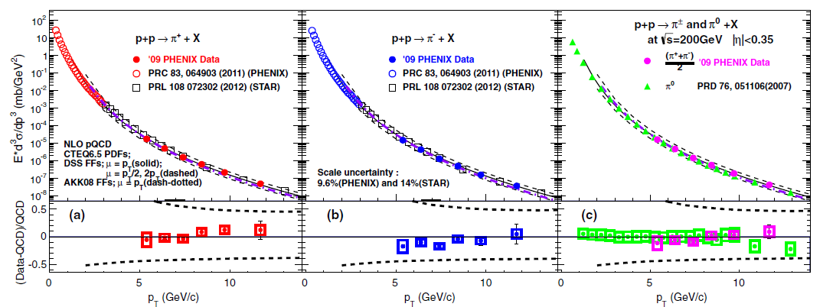
Inclusive pion production in
200 GeV p+p
PRD91, 032001 (2015)
Easiest hadron to produce—lots of data. Where are we?
Data points themselves 10-14% normalization uncertainty.
NLO pQCD calculations within ~+-20% for scale choice of p_{T}, p_{T} ~5-15 GeV/c.
Scale uncertainties ~+-50% for scale choice from p_{T}/2 to 2p_{T}. “Good” agreement.

Slide 28
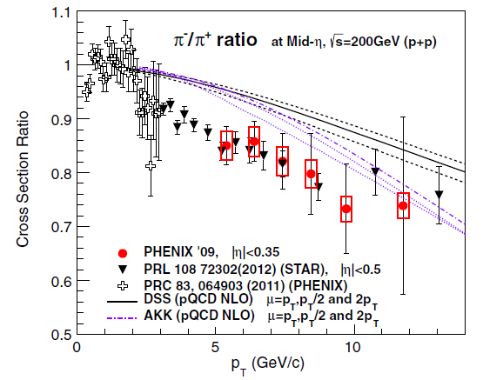
Charged pion ratio, 200 GeV p+p
Measured π-/π+ ratio significantly below NLO calculations for p_{T} ~3-10 GeV/c
  Data: Normalization uncertainties on cross sections cancel completely
  Calculation: Scale uncertainty greatly reduced
More powerful constraint to fit ratio directly—just starting to be done
PRD91, 032001 (2015)

Slide 29
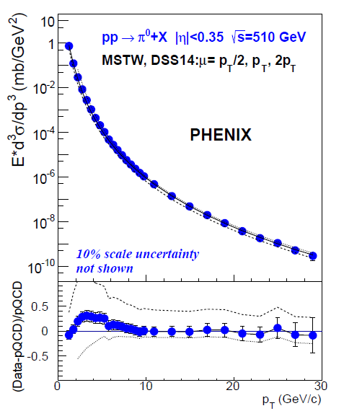
Scale uncertainty remains large for single-particle p+p cross sections even for
√s =510 GeV and p_{T} up to 30 GeV
Good agreement with NLO, but variation up to ~10-20% for scale choice p_{T}
Scale uncertainty ~+50%, -20%
Measured π-/π+ ratio at 200 GeV within ~15% of NLO calculation, but less “good” because of greatly reduced scale uncertainties
  Evidently other uncertainties relevant
What are most appropriate uncertainties to use in each case?
arXiv:1510.02317
Notes:
I’ve heard statements that the pT/2 to 2pT range of scale choices is unrealistically large for single-particle cross section calculations, but the measured ratio compared to the calculation indicates that there are significant uncertainties other than the scale uncertainty.

Slide 30
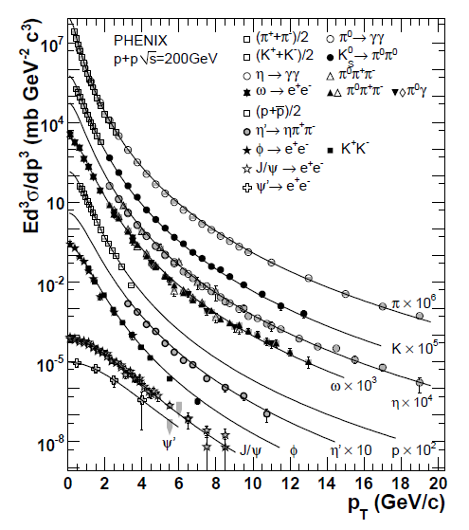

Eventually even more global global fits?
(for “traditional” FFs in “vacuum”)
Perform FF parameterizations for even more particles simultaneously?
  Will constrain relative normalizations well!
  Eventually simultaneous pdf and FF extractions
Can we learn by comparing similar mass states? E.g. about gluon FFs?
  Is a gluon any more or less likely to fragment into a kaon vs. an eta? Eta’ vs. phi vs. proton?
PRD83, 052004 (2011)

Slide 31
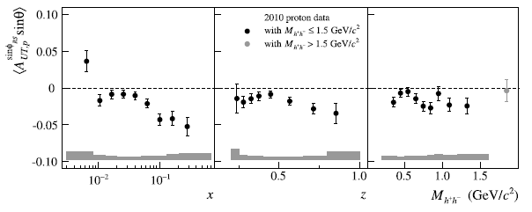
Looking at multiple hadrons from the same parton: Dihadron interference FF
COMPASS, PLB736, 124 (2014)
Pion pair hadronizes from same quark; correlation between quark transverse spin and angular distribution of pair
  collinear
  chiral-odd—can measure in conjunction with another chiral-odd function
  Clear nonzero effects in e+e- and semi-inclusive DIS
  Transversity x IFF in SIDIS shown here

Slide 32
Twist-2 transverse-momentum-dependent FFs
Unpolarized
Spin-spin correlations
Polarizing FF
Spin-momentum correlations
Collins
(only one extensively studied)

Slide 33
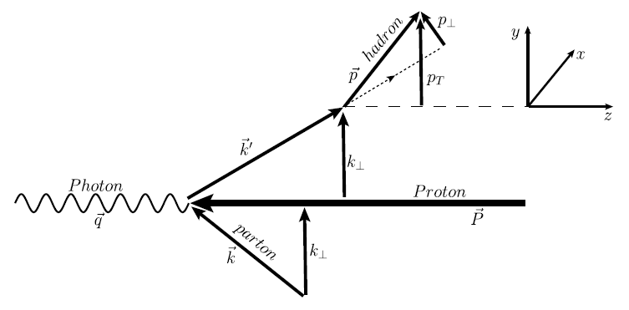
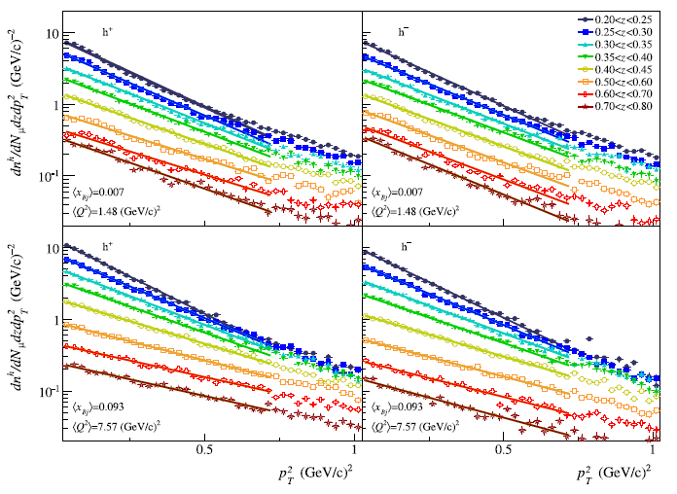
Semi-inclusive DIS TMD multiplicities
COMPASS, EPJ C73, 2531 (2013)
Nonidentified h+, h-multidifferential in p_{T}², x, z, Q²

Slide 34
TMD spin-momentum correlation in hadronization: Collins FF
BaBar published ref. PRD90, 052003 (2014)
Collins x Collins
e⁺e⁻
Measured for pions in e+e- by BELLE and BaBar: 5-20% effect

Slide 35
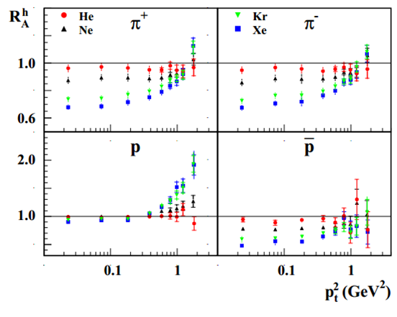
Hadronization in higher-density partonic environments: Nuclear SIDIS
Nuclear modification of particle production
Enhancement of protons compared to pions in e+A with respect to scaled e+p
HERMES, NPB780, 1 (2007)

Slide 36
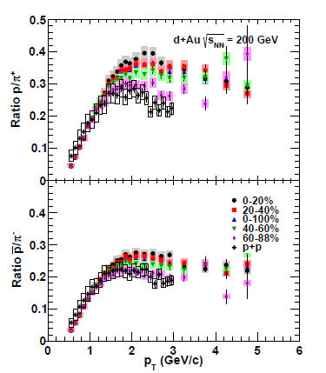
Hadronization in higher-density partonic environments: d+Au compared to p+p
d+Au data for identified charged hadrons in bins of centrality (degree of overlap of colliding nuclei—smaller percentiles are more overlapping)
Ratio of protons to pions increases with greater overlap
New hadron production mechanism enabled by presence of additional partons/nucleons
  Parton recombination?
PRC88, 024906 (2013)

Slide 37
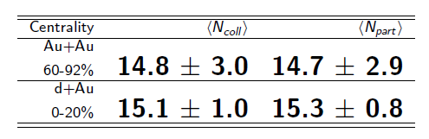
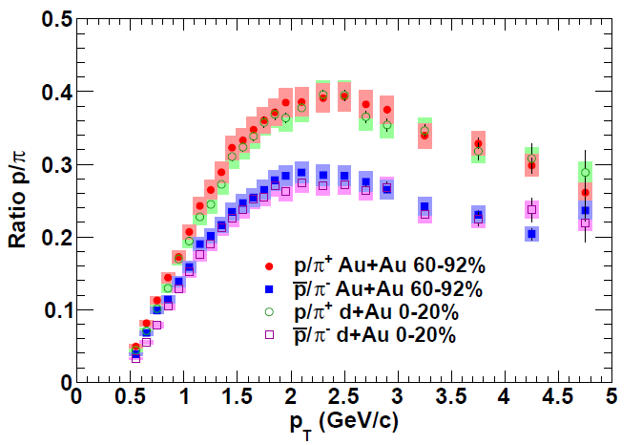
Comparing proton-to-pion ratio in central d+Au with peripheral Au+Au
N_{coll} - # of binary nucleon-nucleon collisions
N_{part} - # of participating nucleons
Both shape and magnitude identical for ~same number of nucleons involved!
Suggests common mechanism(s) for baryon production in the two systems
PRC88, 024906 (2013)

Slide 38
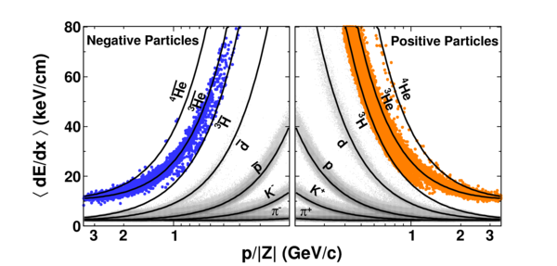
Bound states of hadronic bound states:
Creating nuclei!
STAR
Nature 473, 353 (2011)

Slide 39

Back to spin-momentum correlations:
What about the original p+p → hadrons?
ANL
√s=4.9 GeV
BNL
√s=6.6 GeV
FNAL
√s=19.4 GeV
RHIC
√s=62.4 GeV
left
Experimentally confirmed numerous times, with strikingly similar effects across energies!
right

Slide 40
p+p → hadron + X:
Challenging to interpret
Always huge effects!
But in p+p → pion +X don’t have enough information to separate initial-state (proton structure) from final-state (hadronization) effects
Inclusive measurement—don’t measure the combination of a hard plus a nonperturbative momentum scale required to (directly) apply TMD framework in pQCD calculations
More in later lectures . . .

Slide 41
Summary: Lecture 1
Transverse-momentum-dependent distributions have extended our knowledge of partons within QCD bound states and the process of hadronization, highlighting parton dynamics
Working with TMD functions has furthermore brought to light fundamental aspects of QCD related to color interactions
While nucleon structure has been a focus over the past ~40 years, increasing attention is starting to be paid to hadronization

Slide 42
Extra

Slide 43
[More history]
[Early work by Ralston and Soper, or was this transversity?]

Slide 44
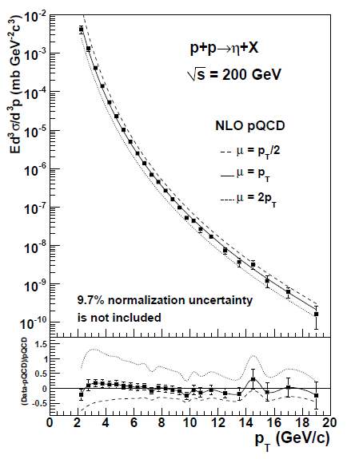
Eta mesons in 200 GeV p+p
Cross section data used in FF fit
NLO calculation for η/π⁰ ratio ~15% too low (no uncertainties shown)
PHENIX eta data and (earlier but consistent) π⁰ data were used in respective FF fits, but in π⁰ fit, PHENIX data normalization scaled within uncertainty in one direction, and in eta fit, scaled in other direction
Again, fitting ratio directly would provide stronger constraint
PRD83, 032001 (2011)

Slide 45
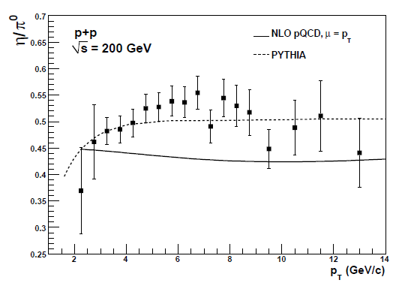
Eta mesons in 200 GeV p+p
Cross section data used in FF fit
NLO calculation for η/π⁰ ratio ~15% too low (no uncertainties shown)
PHENIX eta data and (earlier but consistent) π⁰ data were used in respective FF fits, but in π⁰ fit, PHENIX data normalization scaled within uncertainty in one direction, and in eta fit, scaled in other direction
Again, fitting ratio directly would provide stronger constraint
PRD83, 032001 (2011)

Slide 46
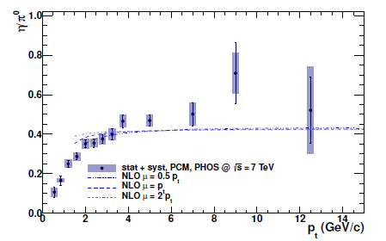

ALICE η/π⁰ ratio, p+p at 7 TeV
Same p_{T} range as PHENIX data
Calculated ratio again below data
Scale uncertainty on NLO calculation shown (nearly cancels!)
PLB717, 152 (2012)

Slide 47
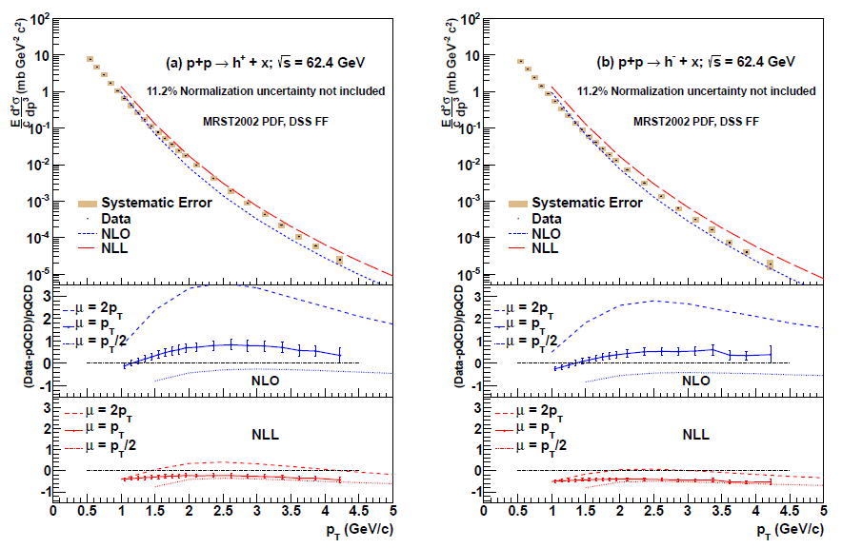
Midrapidity charge-separated hadrons in 62.4 GeV p+p: Reining in scale uncertainties with NLL resummation
Useful when appropriate…
PRD86, 092006 (2012)

Slide 48
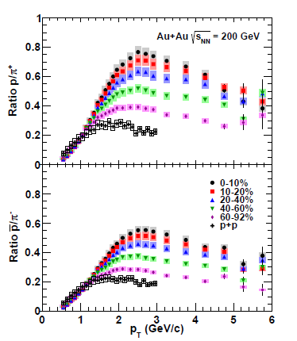
Centrality-dependent baryon enhancement in d+Au compared to p+p
Precision d+Au data for identified charged hadrons in bins of centrality
New hadron production mechanism enabled by presence of additional partons/ nucleons
  Parton recombination?
Strong centrality dependence despite small range of N_{part} and N_{coll} values in d+Au
Well-known centrality-dependent baryon enhancement in Au+Au
PRC88, 024906 (2013)

Slide 49
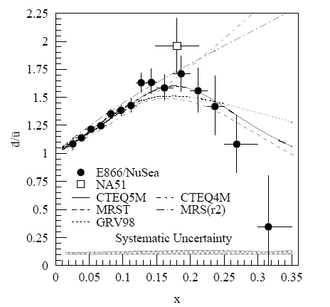
And a (relatively) recent surprise from p+hydrogen, p+deuterium collisions
Fermilab Experiment 866 used proton-hydrogen and proton-deuterium collisions to probe nucleon structure via the Drell-Yan process
Would expect anti-up/anti-down ratio of 1 if sea quarks are only generated dynamically by gluon splitting into quark-antiquark pairs
Measured flavor asymmetry in the quark sea, with striking x behavior
Indicates some kind of “primordial” sea quarks!
Hadronic collisions play a complementary role to electron-nucleon scattering and have let us continue to find surprises in the rich linear momentum structure of the proton, even after > 40 years!
PRD64, 052002 (2001)

Slide 50
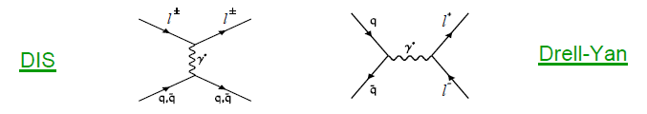
Complementarity of Drell-Yan and DIS
Both deep-inelastic lepton-nucleon scattering (DIS) and quark-antiquark annihilation to leptons (Drell-Yan process) are tools to probe the quark and antiquark structure of hadrons

