Slide 1
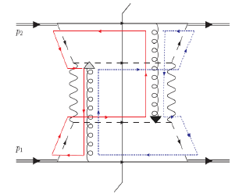
Transverse-Momentum-Dependent Distributions and
Color Entanglement in QCD
Lecture 2 – TMDs and Collinear Twist-3 Correlation Functions
Christine A. Aidala
University of Michigan
left
right
Hampton University Graduate Studies Program
Jefferson Lab
June 2016

Slide 2
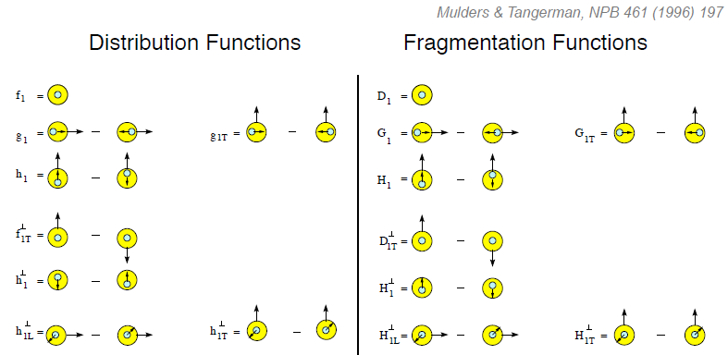
Lots of TMD pdfs and FFs: What do we know from experiment?
Unpolarized
Spin-spin correlations
Spin-momentum correlations
Unpolarized
Spin-spin correlations
Spin-momentum correlations

Slide 3
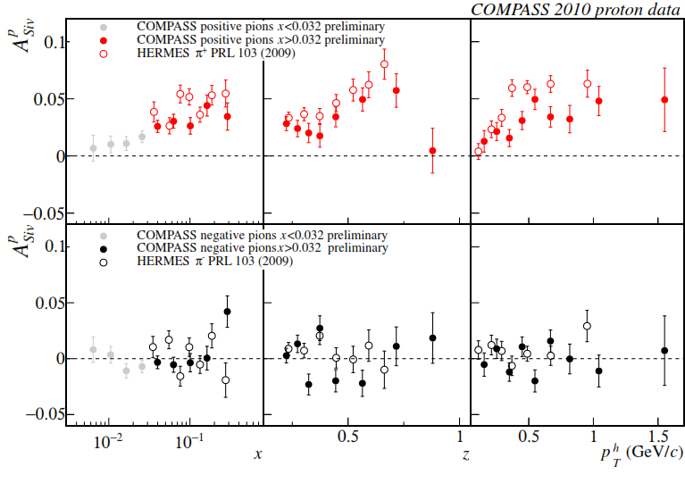
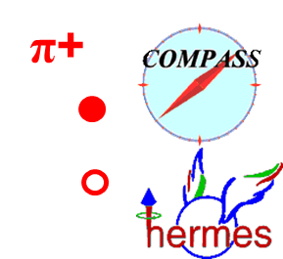
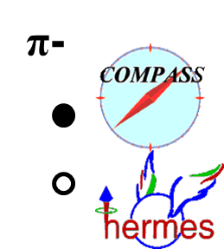
Sivers asymmetry in SIDIS
Charged pions (and kaons), HERMES and COMPASS
Sivers TMD pdf – correlation between proton transverse spin and quark transverse momentum. PT-odd
Clearly nonzero for positive pions. Cancellations between up and down quarks lead to smaller negative pion asymmetries?

Slide 4
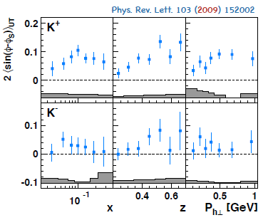
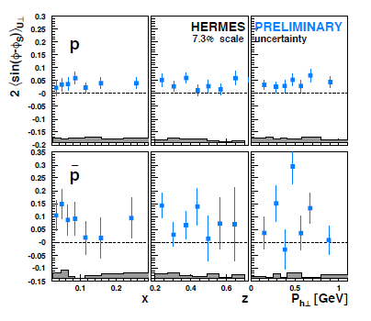
Sivers asymmetry in SIDIS for kaons and protons
Nonzero for positive kaons and protons, hints for negative kaons and antiprotons. Identified particles help give flavor separation for Sivers TMD pdf

Slide 5
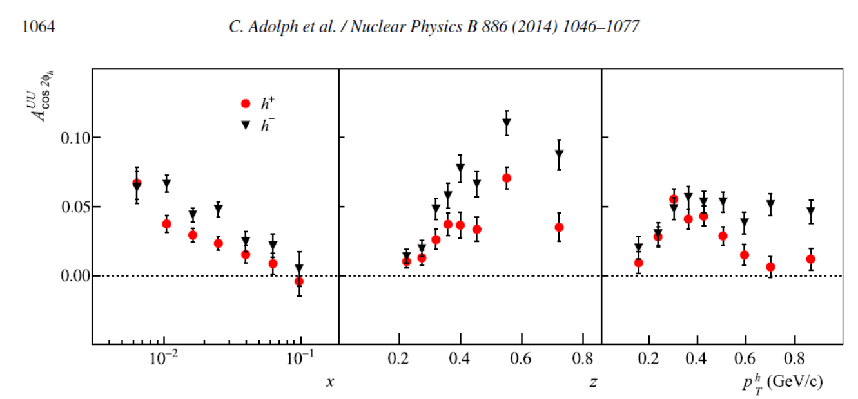
Boer-Mulders ×Collins asymmetry from SIDIS
COMPASS
Boer-Mulders TMD pdf – correlation between quark transverse spin and its own transverse momentum. PT-odd, chiral-odd
Chiral-odd → need another chiral-odd function to measure it. Here the Collins TMD FF
Clearly nonzero for positive and negative hadrons
Also measured by HERMES – PRD87, 012010 (2013)

Slide 6
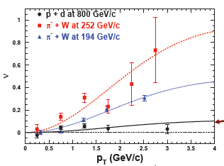

Boer-Mulders ×Boer-Mulders asymmetry from Drell-Yan
E866, PRL 99, 082301 (2007);
PRL 102, 182001 (2009)
Huge cos2φ dependence in pion-induced Drell-Yan
Significantly reduced in proton-induced Drell-Yan
Suggests sea quark transverse spin-momentum correlations small?
E866, p+d

Slide 7
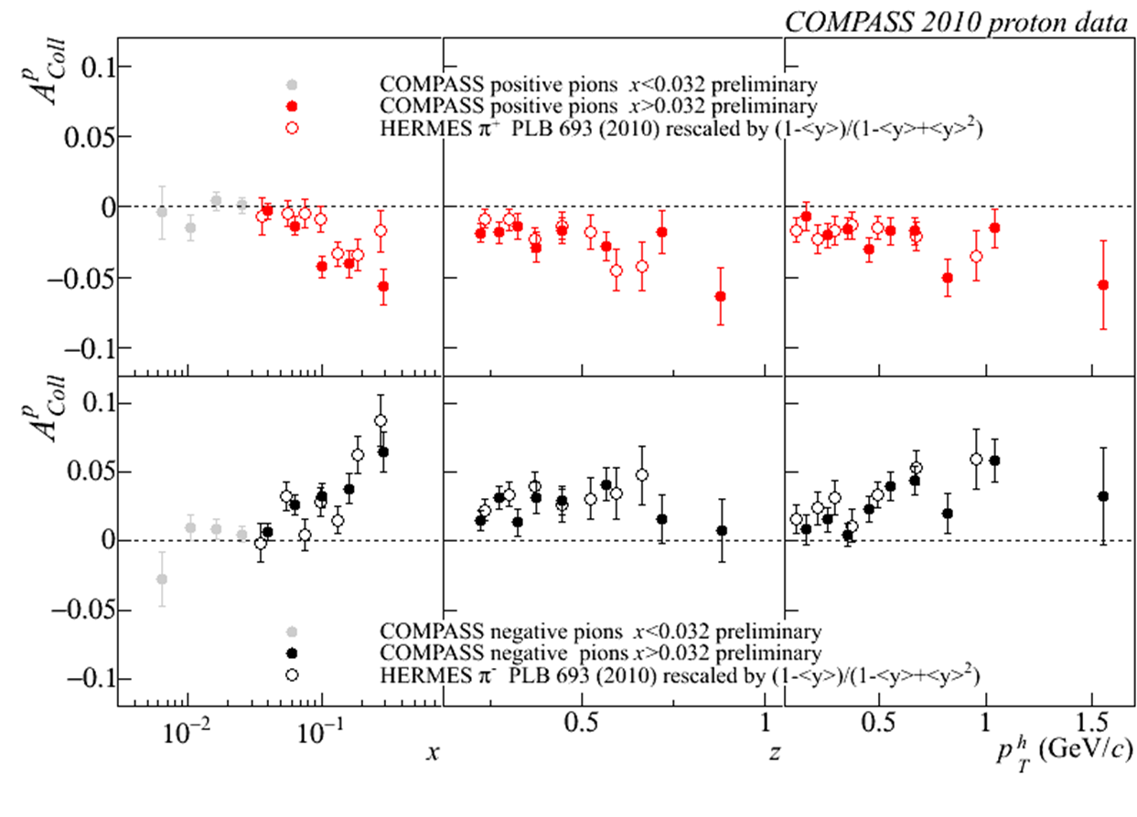
Transversity ×Collins asymmetry from SIDIS
Transversity pdf – correlation between proton transverse spin and quark transverse spin. Survives integration over k_{T}, chiral-odd
Collins TMD FF – correlation between quark transverse spin and hadron transverse momentum. Chiral-odd
Clearly nonzero for positive and negative pions
Notes:
7

Slide 8
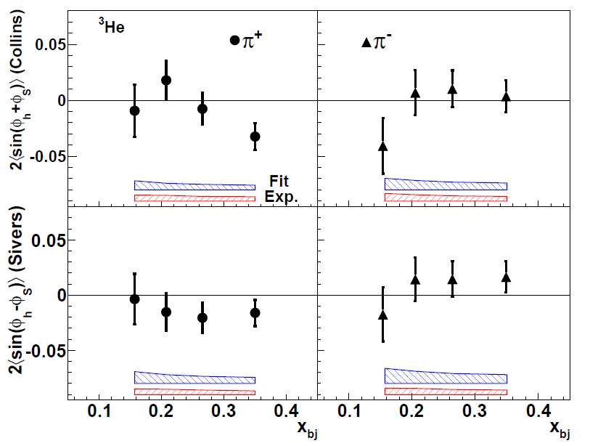
Hints from SIDIS on polarized ³He
JLab Hall A
Measurements on polarized neutrons help provide flavor information
12 GeV program will bring a lot more data!
Transversity x Collins
e+³He
PRL 107, 072003 (2011)
Sivers

Slide 9
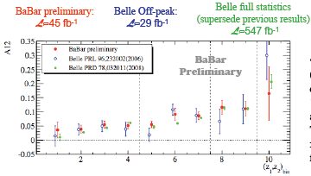
Collins ×Collins asymmetry from e+e-
BaBar published ref. PRD90, 052003 (2014)
Collins x Collins
e⁺e⁻
Collins TMD FF – correlation between quark transverse spin and hadron transverse momentum. Chiral-odd
Clearly nonzero for charged pions
Notes:
9

Slide 10
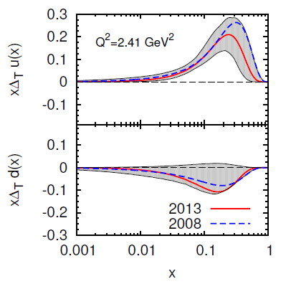
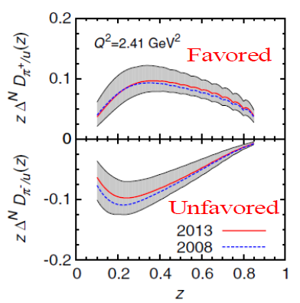
Simultaneous extraction of transversity pdf and Collins FF
Anselmino et al. ,
PRD87, 094019 (2013)
Extracted from simultaneous fit to HERMES, COMPASS, and BELLE data

Slide 11
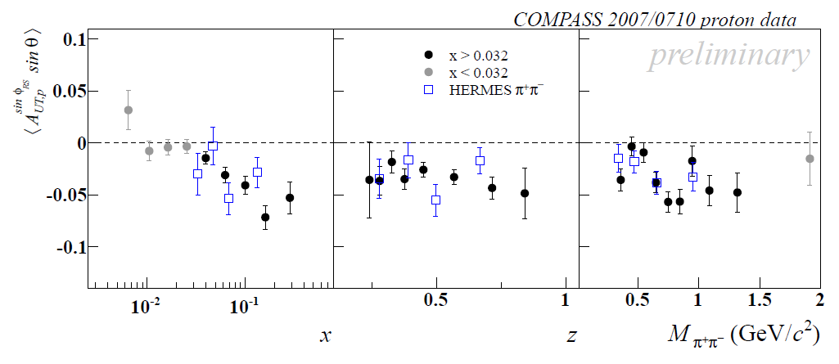

Transversity ×dihadron interference FF asymmetries in SIDIS
Transversity pdf – correlation between proton transverse spin and quark transverse spin. Survives integration over k_{T}, chiral-odd
Dihadron interference FF – correlation between quark transverse spin and angular distribution of two-particle production. Collinear, chiral-odd
Clearly nonzero for charged pion pairs

Slide 12
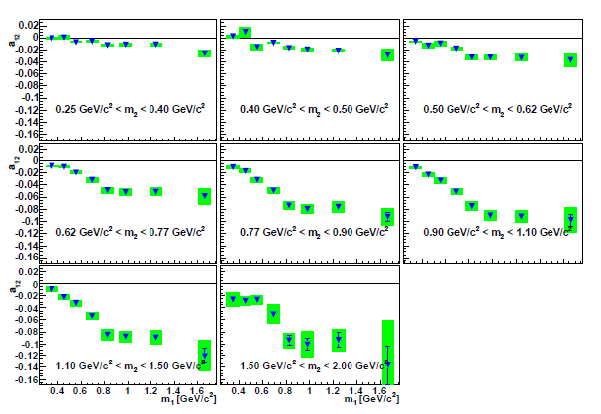
Dihadron interference FF × Dihadron interference FF asymmetry from e+e-
BELLE
PRL107, 072004 (2011)
Dihadron interference FF – correlation between quark transverse spin and angular distribution of two-particle production. Collinear, chiral-odd
Clearly nonzero for charged pion pairs
Notes:
12

Slide 13
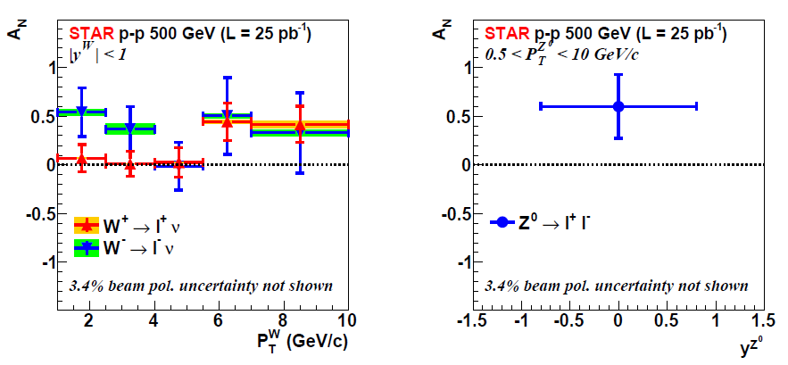
Probing modified universality of the Sivers TMD pdf via W and Z production in p+p
PRL 116, 132301 (2016)
Early measurement hints at nonzero asymmetries, but inconclusive for testing modified universality. Expect more data in 2017

Slide 14
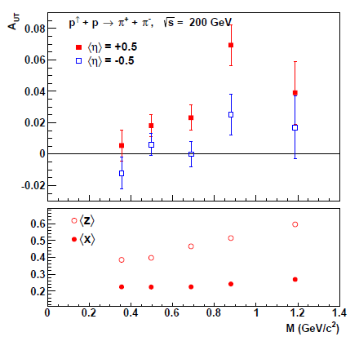
Transversity ×dihadron interference FF asymmetries in p+p
Purely collinear measurement
- No issues of TMD-factorization breaking. More in Lectures 4+5 . . .
Transversity pdf – correlation between proton transverse spin and quark transverse spin. Survives integration over k_{T}, chiral-odd
Dihadron interference FF – correlation between quark transverse spin and angular distribution of two-particle production. Collinear, chiral-odd
Clearly nonzero for charged pion pairs

Slide 15
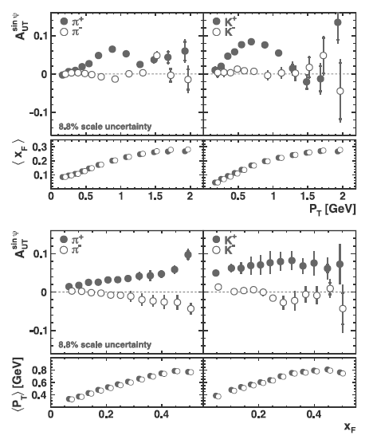
Inclusive hadron transverse single-spin asymmetries in e+p
No scattered electron measured
Shown here as function of p_{T} and x_{F}
Also measured doubly differentially
Clear nonzero asymmetries with interesting dependencies
Not as easy to interpret . . .
HERMES, PLB728, 183 (2014)

Slide 16
Summary of spin-momentum correlation results
Clear empirical evidence for nonzero
  Sivers TMD pdf – correlation between proton transverse spin and quark transverse momentum
    SIDIS
  Collins TMD FF – correlation between quark transverse spin and transverse momentum of produced hadron
    e+e-, SIDIS
  Boer-Mulders TMD pdf – correlation between quark transverse spin and quark transverse momentum
    Drell-Yan, SIDIS
Hints from SIDIS measurements (in backup) of nonzero
  Worm gear TMD pdf – correlation between proton transverse spin, quark longitudinal spin, quark transverse momentum
  Pretzelosity TMD pdf – correlation between proton transverse spin, perpendicular quark transverse spin, quark transverse momentum
Also clear evidence for nonzero helicity and transversity collinear pdfs from SIDIS and p+p, collinear dihadron interference FF from e+e-, SIDIS, p+p

Slide 17
What about unpolarized TMD functions?
Unpolarized TMD pdfs
Can access via transverse-momentum-dependent Drell-Yan, Z, and W boson production
  Isolate initial state, i.e. access pdfs without FFs
  Transverse momentum of the final-state Drell-Yan lepton pair, Z, or W for small (nonperturbative) transverse momentum values due to initial-state k_{T} of the interacting quark and antiquark
    Larger final-state transverse momenta generated perturbatively via gluon radiation

Slide 18
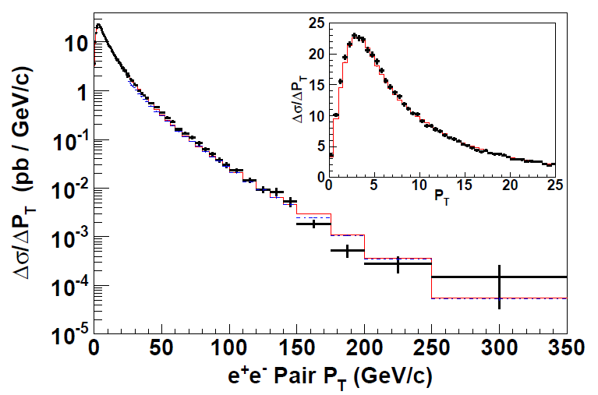
Unpolarized quark TMD pdfs
p_{T} of Z in this region due to k_{T} vectors of annihilating quark and antiquark
Perturbatively generated tail out to 350 GeV
CDF Z production
PRD86, 052010 (2012)

Slide 19
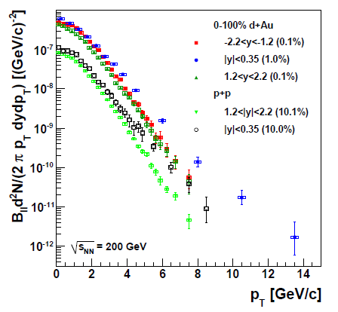
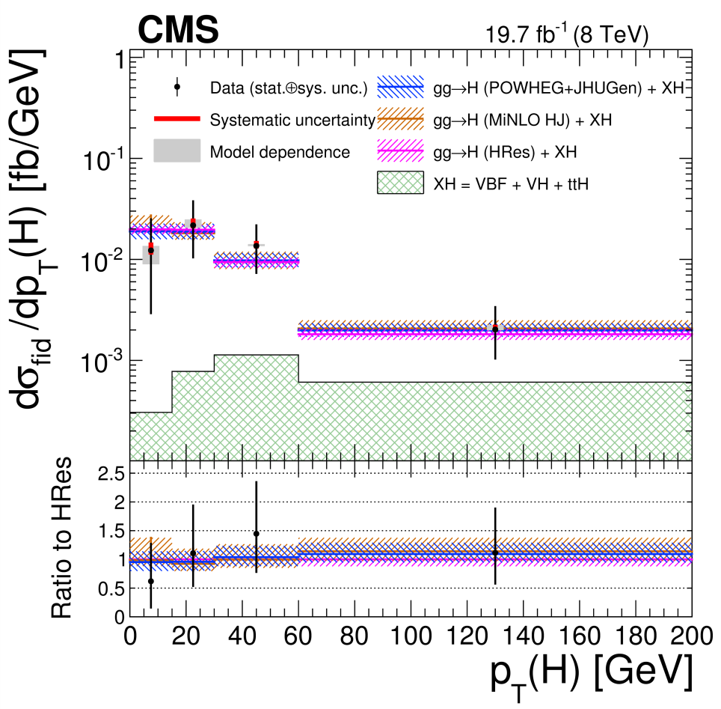
Unpolarized gluon TMD pdfs
CMS
gg→Higgs
PRC87, 034904 (2013)
PHENIX
gg→J/Psi
JHEP04, 005 (2016)
Need more data, but same idea as for Drell-Yan and Z boson production
k_{T} vectors of fusing gluons lead to nonperturbative p_{T} of J/Psi or Higgs; then long perturbative tail

Slide 20
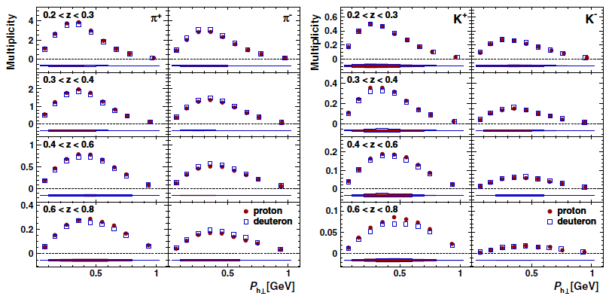
Unpolarized TMD FFs:
Semi-inclusive DIS TMD multiplicities
HERMES, PRD87, 074029 (2013)
π+-, K+-, multidifferential in p_{T}, z
Convolution of TMD pdfs and FFs

Slide 21
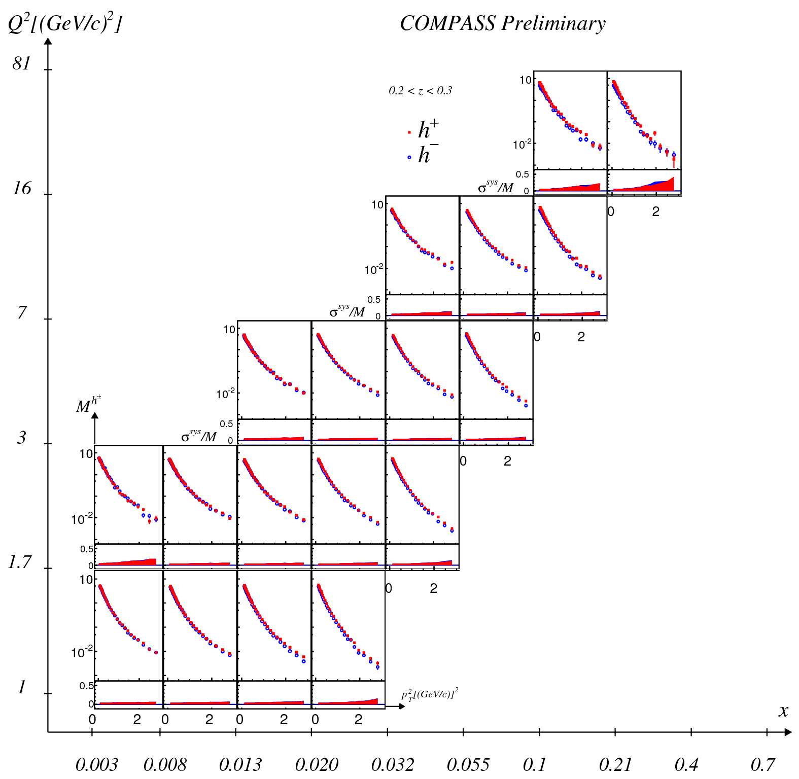
Unpolarized TMD FFs:
Semi-inclusive DIS TMD multiplicities
Positive and negative hadron production, multidifferential in x, Q², p_{T}²
Recent availability of multidifferential measurements should greatly improve constraints on TMD functions
Awaiting unpolarized TMD measurements from e+e- . . .
x-axis of each panel is p_{T}², ranging from ~0-3 GeV²

Slide 22
High-energy QCD: Thinking in terms of individual partons
Pdfs are single-parton functions in single nucleons
  Or in nuclei, but typically still think of partons in individual nucleons within nucleus
Can we go beyond this single-parton picture while staying in the hard (short-distance) limit of perturbative QCD?

Slide 23
An alternative approach to describing the large single-spin asymmetries:
Higher-twist multiparton correlations
Extend our ideas about (single-parton) pdfs to correlation functions that can’t be associated with a single parton
Non-perturbative structure → matrix elements involving the quantum mechanical interference between scattering off of a (quark+gluon) and scattering off of a single quark (of the same flavor and at the same x)
  Can also have interference between (gluon+gluon) and single gluon
  No explicit dependence on partonic transverse momentum
  Efremov+Teryaev 1981, 84; Qiu+Sterman 1991, 98

Slide 24
Beware: Two common usages of the term “twist”
Formal definition of twist: “mass dimension minus spin” of the operator in a matrix element within the Operator Product Expansion
  “Leading twist” is twist-2
  Twist-n matrix element carries a factor of 1/Q^{(n-2)}
But – observables with measurable contributions from terms suppressed by a factor of 1/Q^{(n-2)} often referred to as sensitive to “twist-n” contributions
  Never measure a matrix element, only matrix elements squared!
  To get 1/Q term describing an observable, need interference term in the square modulus:
    A = order 1 + order 1/Q + order 1/Q² + …
    |A|² = |order 1|² + |order 1/Q|² + (order 1)(order 1/Q)* + (order 1)*(order 1/Q) + …
  So twist-3 term in matrix element times twist-2 term gives 1/Q
  Square modulus of twist-3 term gives 1/Q², sometimes referred to as “twist-4”

Slide 25
Transverse single-spin asymmetries provide new information on hadron structure
Leading contribution to transverse single-spin asymmetries comes from either:
  Convolution of two twist-2 transverse-momentum-dependent parton distribution functions and/or fragmentation functions, or . . .
  Convolution of one twist-2 collinear pdf or fragmentation function and one twist-3 (collinear) multiparton correlation matrix element

Slide 26
Multiparton correlations in hadronization
Traditional fragmentation functions describe probability of single parton to hadronize into particular hadron, as function of momentum fraction (z) of parton carried by the final hadron
Can have matrix elements describing multiparton correlations in hadronization
  Interference between a (quark+gluon) hadronizing and only a quark
  Similarly, interference between (gluon+gluon) and only a single gluon
  Kanazawa+Koike, 1991

Slide 27
Transverse-momentum-dependent functions and twist-3 multiparton correlators
Twist-3 (collinear) multiparton correlators believed to be related to k_{T}-moments of (twist-2)TMD pdfs and fragmentation functions
  NPB667, 201 (2003); PRL97, 082002 (2006)
To directly constrain TMD functions with experimental data, need two scales
  Hard momentum
  Observable sensitive to parton intrinsic momentum
  Recall: Original p+p→pion+X asymmetries only measured a single scale

Slide 28
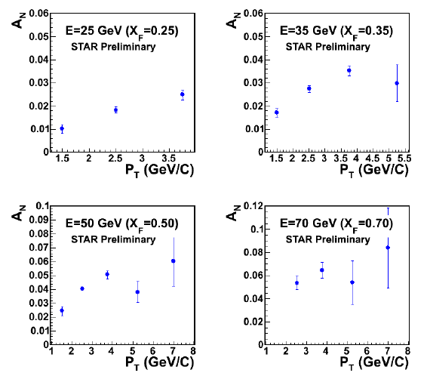
Transverse single-spin asymmetry in p+p → hadron + X:
Only measure one momentum scale
For high enough p_{T} of produced hadron (>1-2 GeV) have hard scale, so can apply perturbative calculations
  Clear nonzero asymmetries out to 8 GeV → Q² ~ 64 GeV²
Can have contributions from initial-state and final-state effects
Inclusive measurement—don’t measure the combination of a hard plus a nonperturbative momentum scale required to (directly) apply TMD framework in pQCD calculations
√s=200 GeV
π⁰

Slide 29
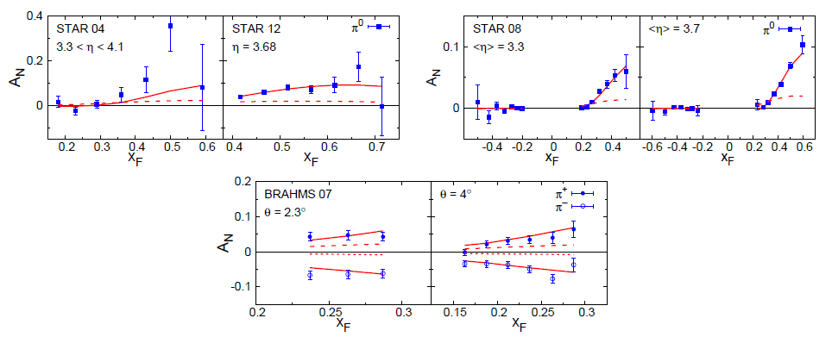
Twist-3 multiparton correlations to try to interpret inclusive A_{N} data from RHIC
Kanazawa, Metz, Koike,
Pitonyak
arXiv:1509.07554
Find dominant contribution from twist-3 correlation in hadronization

Slide 30
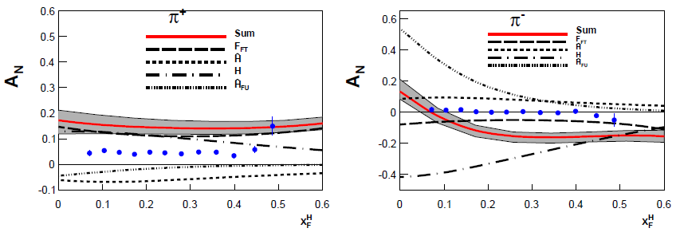
Twist-3 correlations to interpret inclusive hadron A_{N} in e+p
Gamberg et al., PRD90, 074012 (2014)
Data from HERMES
Twist-3 phenomenology still in early stages!

Slide 31
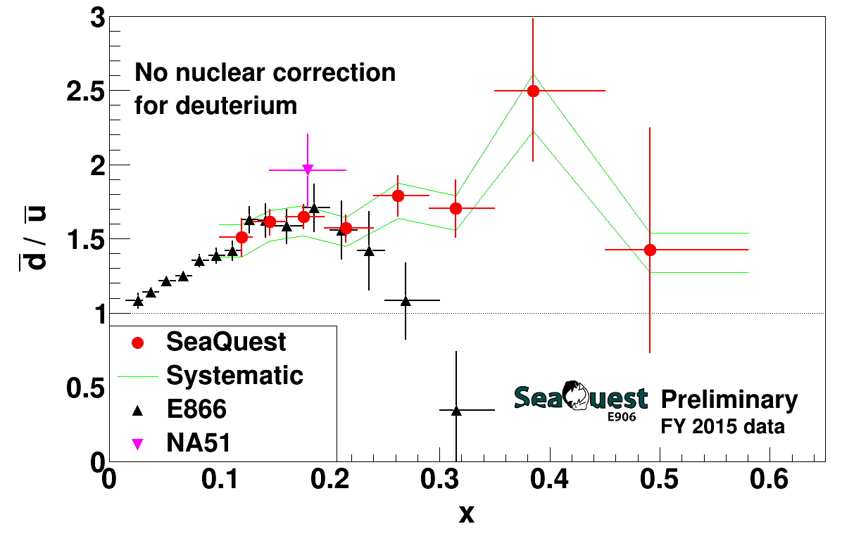
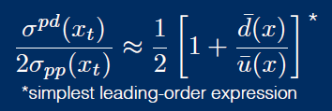
Sea quarks and sea quark dynamics
Proton-hydrogen and proton-deuterium collisions
Expect anti-down/anti-up ratio of 1 if sea quarks only generated by gluon splitting
Indicates additional mechanism to generate sea quarks—still not well understood
  Recent review: Chang and Peng, Prog. Part. Nucl. Phys. 79, 95 (2014)
Fermilab E866 data: PRD64, 052002 (2001)
CERN NA51 data: PLB332, 244 (1994)

Slide 32
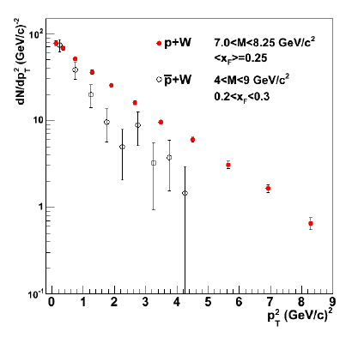
Sea quarks—other hints of interesting behavior
p+W: (Valence) quark from p, (sea) antiquark from W
pbar+W: (Valence) quark from W, (valence) antiquark from pbar
(Valence × sea) spectrum harder → Larger mean k_{T} for sea than valence quarks?
  Agrees with chiral soliton model predictions (e.g. Schweitzer, Strikman, Weiss 2013)
  Consistent with work by Bacchetta et al.
Plot from CAA, Field, Gamberg, Rogers, PRD89, 094002 (2014)
Data from E537 (pbar+W): PRD38, 1377 (1988)
E439: (p+W): AIP Conf. Proc. 45, 93 (1978)

Slide 33
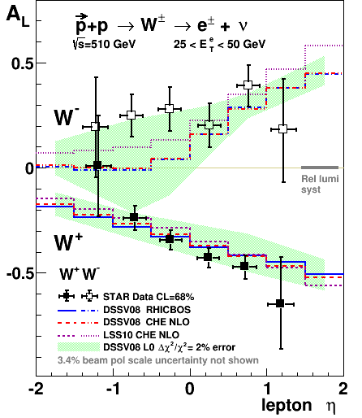
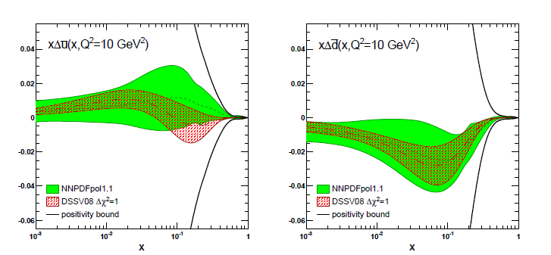
Flavor asymmetry in the sea helicity distributions
STAR, PRL 113, 72301 (2014)
(DSSV08 before RHIC W data)
NNPDF, NPB 887.276 (2014)
STAR

Slide 34
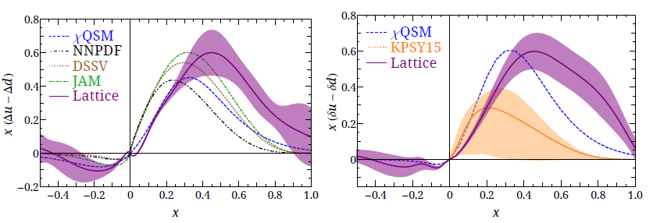
Helicity and transversity distributions for sea quarks from lattice(!)
Chen et al., arXiv:1603.06664
Lattice calculations of x-dependent pdfs, rather than moments, just starting to be published!
Lattice confirms experimental evidence for flavor asymmetry in sea helicity distributions
Lattice calculation finds transversity for sea nonzero and flavor-asymmetric . . .
x-dependent unpolarized sea distributions: PRD91, 054510 (2015)

Slide 35
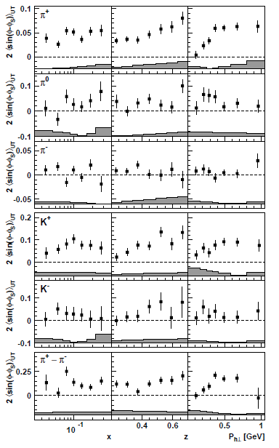
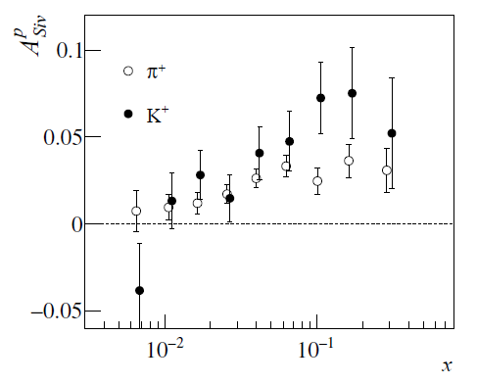
SIDIS Sivers asymmetries larger for K⁺ than π⁺
COMPASS, PLB744, 250 (2015)
HERMES, PRL103, 152002 (2009)

Slide 36
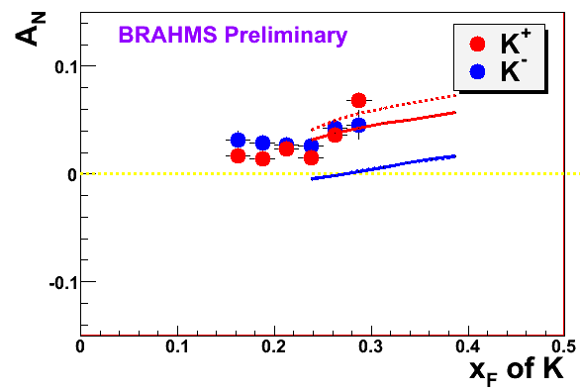
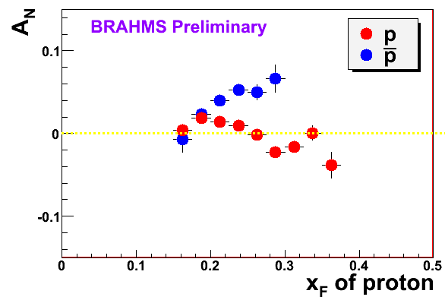

Large K⁻ and antiproton(!) transverse single-spin asymmetries in p+p
K
p
200 GeV
200 GeV

Slide 37
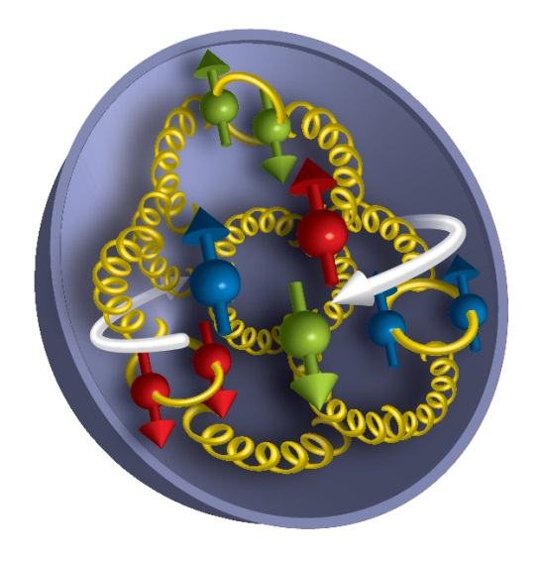
Need more data for sea quarks!
And with more measurements to provide meaningful constraints, will need consistent treatment of sea quarks in theory/phenomenology
Understanding the dynamics of sea quarks, which probe beyond static pictures of antiquarks in the nucleon, will be crucial to understanding how the nucleon sea is generated (and what in fact it is!)

Slide 38
Summary: Lecture 2
Have experimental evidence from SIDIS, Drell-Yan, e+e-, and p+p that numerous spin-momentum correlations described by TMD pdfs and FFs are nonzero in nature
  Others remain to be measured
  Important probes of parton dynamics, along with unpolarized TMD measurements
Collinear twist-3 multiparton correlation functions can also generate single-spin asymmetries
  Can be related to moments of TMD functions
  Go beyond traditional thinking in terms of single-parton scattering or hadronization
Increasing interest in sea quarks—probing spin-spin and spin-momentum correlations for sea quarks will be important in understanding what’s really going on in the sea

Slide 39
Extra

Slide 40
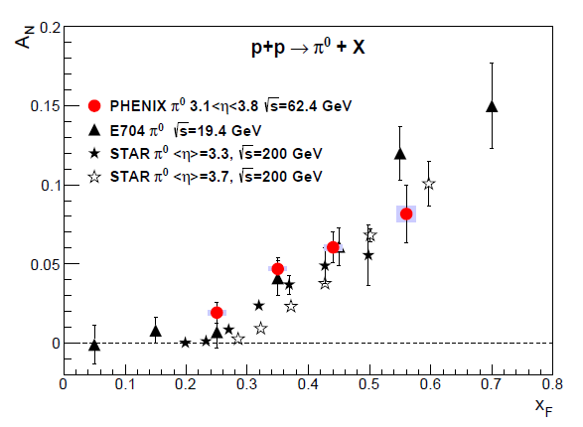

Transverse single-spin asymmetries:
From low to high energies!
ANL
√s=4.9 GeV
BNL
√s=6.6 GeV
FNAL
√s=19.4 GeV
RHIC
√s=62.4 GeV
π⁰
PRD90, 012006
(2014)
left
right

Slide 41
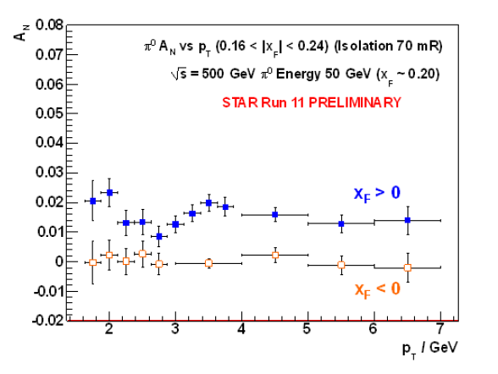
Effects persist up to transverse momenta of 7(!) GeV/c at √s=500 GeV
Can try to interpret these non-perturbative effects within the framework of perturbative QCD.
Haven’t yet disentangled all the possible contributing effects to the (messy) process of p+p to pions
π⁰

Slide 42
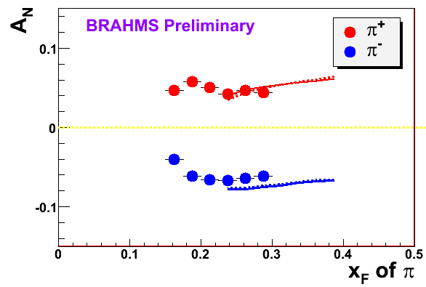
π
π
π, K, p
at 200 and 62.4 GeV
200 GeV
62.4 GeV
Note different scales
K
K
K- asymmetries
underpredicted
Pions suggest valence quark effect.
Kaons and (anti)protons don’t!
200 GeV
62.4 GeV
p
p
PRL 101, 042001 (2008)
Large antiproton asymmetry?? Unfortunately no 62.4
GeV measurement
200 GeV
62.4 GeV

Slide 43
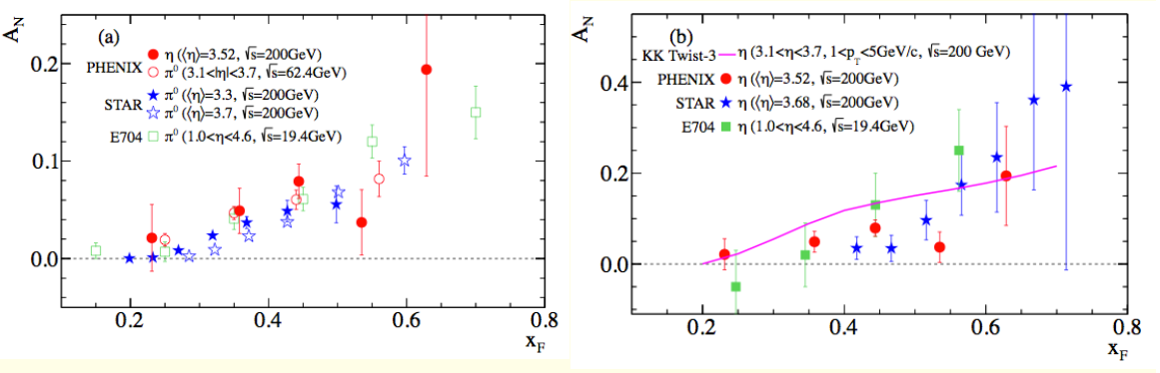
Transverse single-spin asymmetry in p+p → η+X
PRD90, 072008 (2014)
Large η A_{N} observed by STAR and PHENIX (and Fermilab E704), similar in magnitude to π⁰

Slide 44
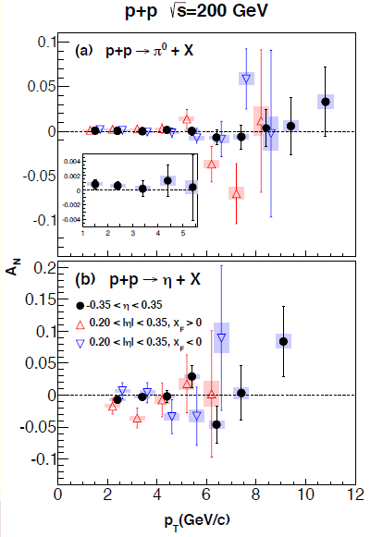
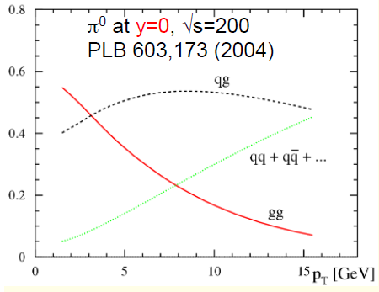
η and π⁰ A_{N} at midrapidity
Sensitive to gg, qg scattering
Consistent with zero

Slide 45
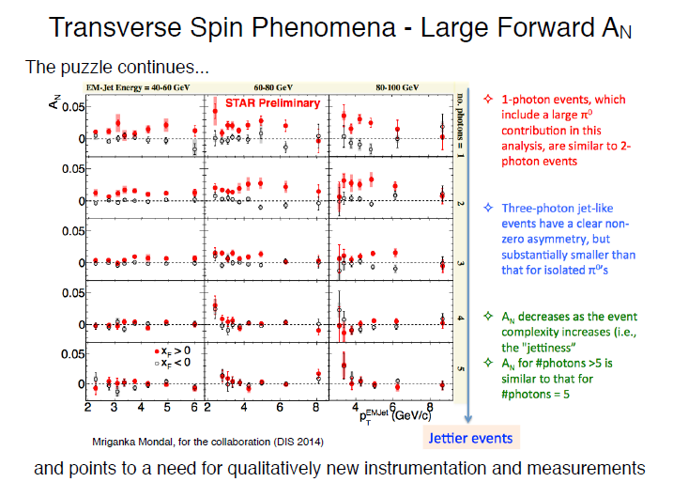
Enhanced A_{N} for isolated forward neutral pions

Slide 46
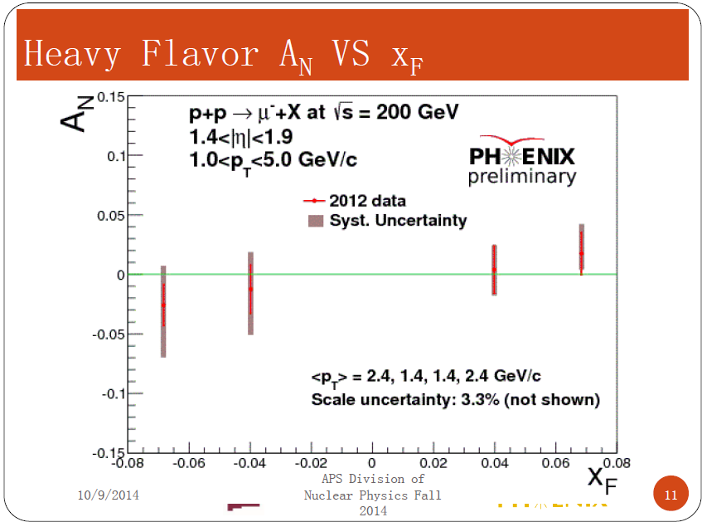
Open heavy flavor A_{N} to probe twist-3 trigluon correlations
Expect measurement with ~0.01 accuracy from 2015 data, with displaced vertex heavy flavor tagging

Slide 47
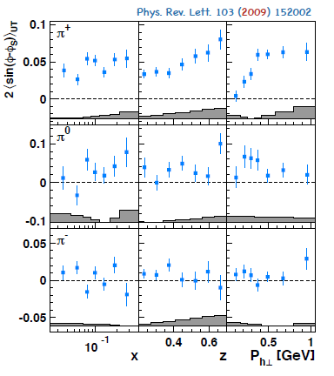
HERMES Sivers for pions

Slide 48
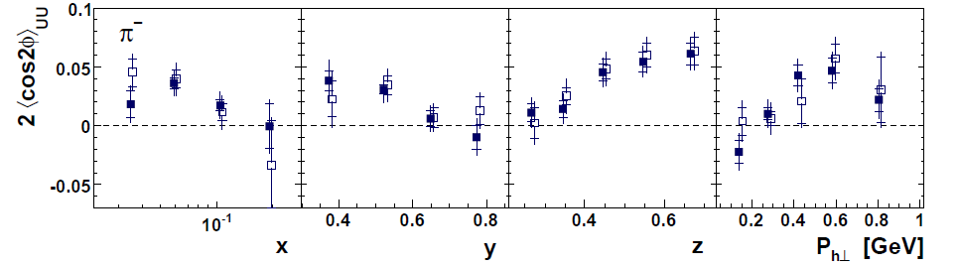
Boer-Mulders ×Collins asymmetry from SIDIS
Boer-Mulders x Collins
e+p
HERMES, PRD 87, 012010 (2013)

Slide 49
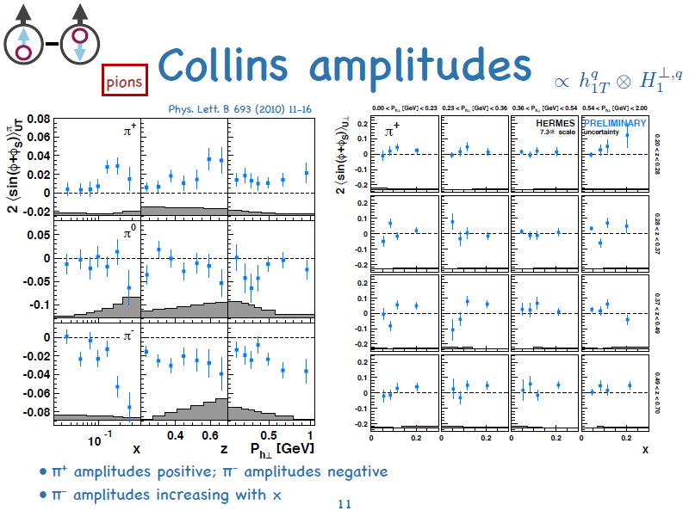
From C. van Hulse, DIS 2016

Slide 50
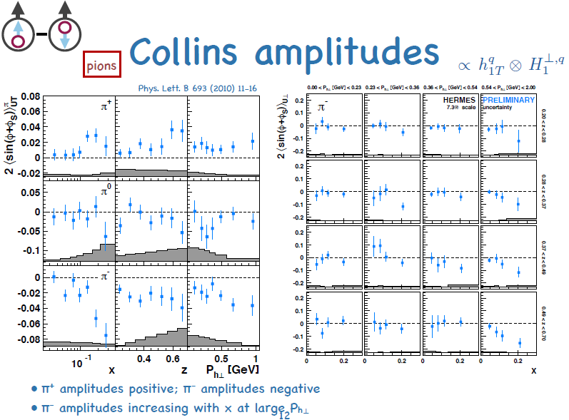
From C. van Hulse, DIS 2016

Slide 51

Transversity ×Collins asymmetry from SIDIS for protons and antiprotons

Slide 52

Collins ×Collins from e+e-
BELLE PRL96, 232002 (2006)
Collins x Collins
e⁺e⁻

Slide 53


Other TMD pdf measurements in SIDIS
Pretzelosity x Collins
COMPASS
Worm gear g_{1T}┴

Slide 54

Other TMD pdf measurements in SIDIS
HERMES

Slide 55

Similarity of Collins and dihadron interference FF asymmetry
COMPASS, PLB736, 124 (2014)
Common hadron sample for Collins and interference FF analysis

Slide 56

Inclusive hadron transverse single-spin asymmetries in e+p
Striking enhancement if measure scattered electron
HERMES, PLB728, 183 (2014)

