Slide 1
Parton distributions in QED
HUGS 2016
Luca Mantovani
WHERE ??
1

Slide 2
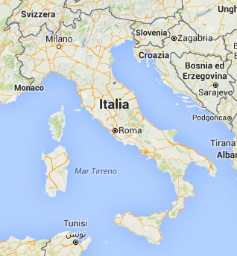
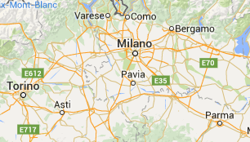
2

Slide 3
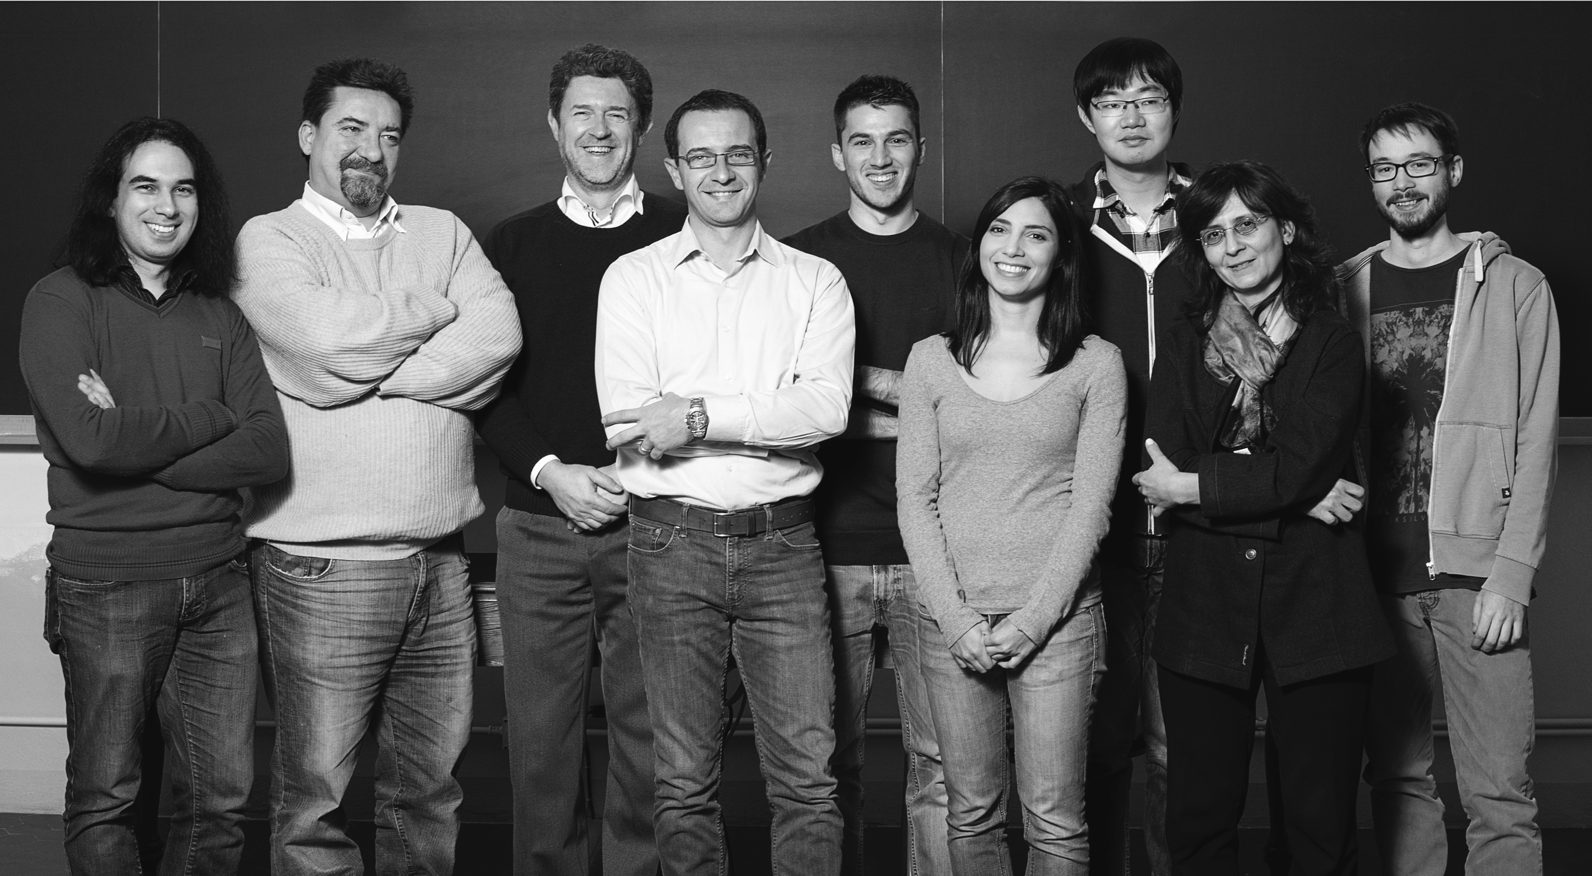
Our group
www.hadronicphysics.it
3

Slide 4
WHY QED?
4

Slide 5
Outline
Distributions functions for the electron
Light-cone Quantization
Results and Summary
???
5

Slide 6
Bare electron
6

Slide 7
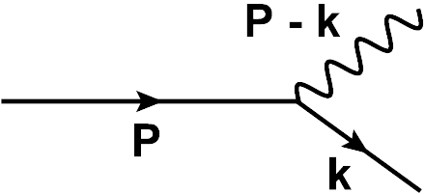
Dressed electron
6

Slide 8
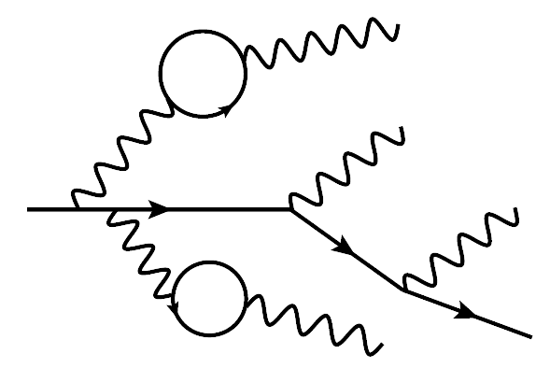
Dressed electron (3D structure!)
Brodsky, Hwang, Ma, Scmidth (2000)
Hoyer, Kurki (2009)
Miller (2014)
Bacchetta, LM, Pasquini (2015)
6

Slide 9
Dressed electron
Electron in the dressed electron
6

Slide 10
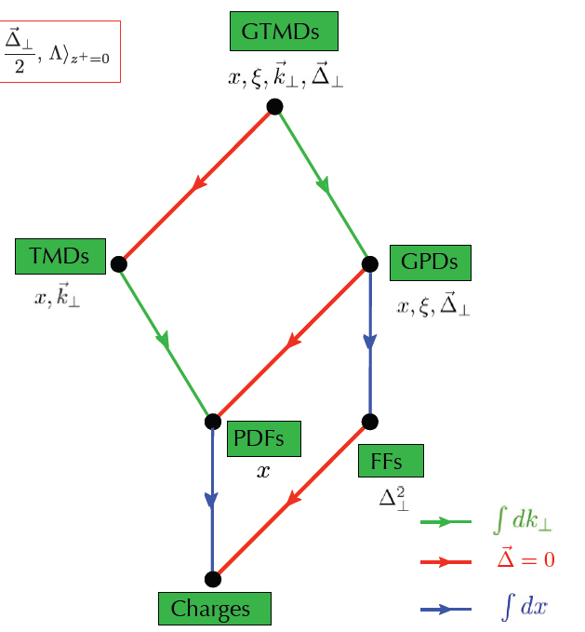
Lorcè, Pasquini, Vanderhaeghen (2011)
See M. Diehl lectures
7

Slide 11
Lorcè, Pasquini, Vanderhaeghen (2011)
See M. Diehl lectures
7

Slide 12
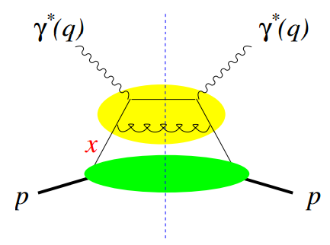
QCD case
$$Φ$$
TMD correlator
See M. Diehl lectures
?
8

Slide 13
QED case
TMD correlator
We know how to rewrite initial and final electron states!
9

Slide 14
Light-cone quantization
10

Slide 15
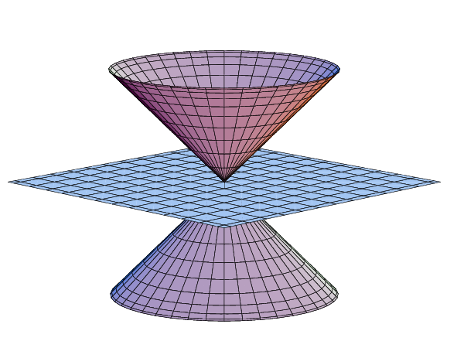
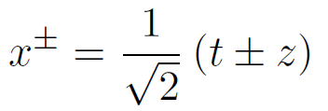
Forms of dynamics
Instant form
Front form
$$t$$
$$x^{+}=0$$
$$x^{+}$$
$$Ψ(t=0)$$
$$t=0$$
11

Slide 16
Forms of dynamics
Instant form
Front form
$$t$$
$$x^{+}=0$$
$$x^{+}$$
$$Ψ(t=0)$$
$$t=0$$
11

Slide 17
Fock state expansion of the dressed electron
12

Slide 18
Fock state expansion of the dressed electron
P,S
12

Slide 19
Fock state expansion of the dressed electron
P,S
Model dependent in QCD, exact in QED!
12

Slide 20
Results and applications
13

Slide 21
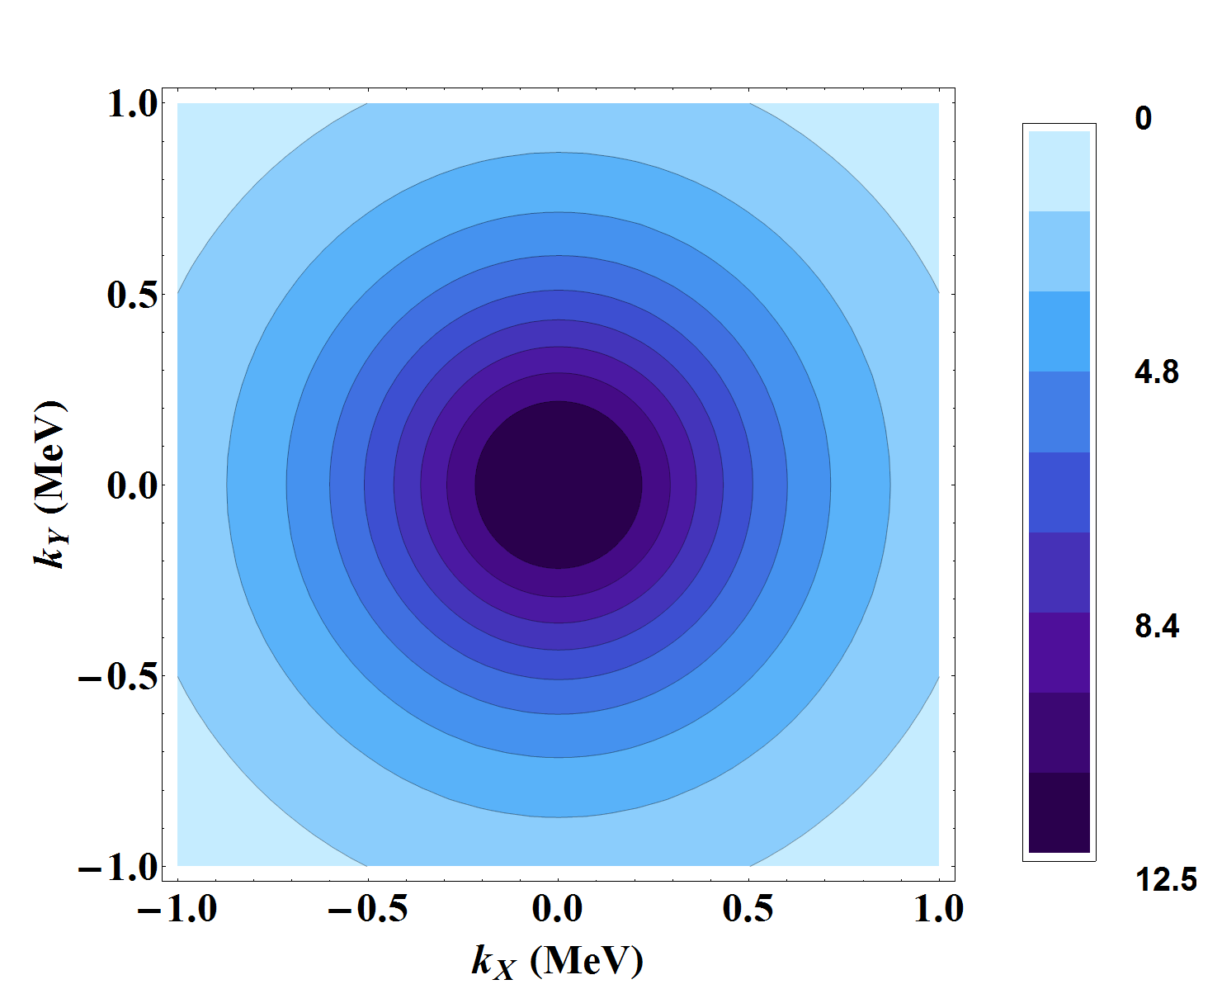
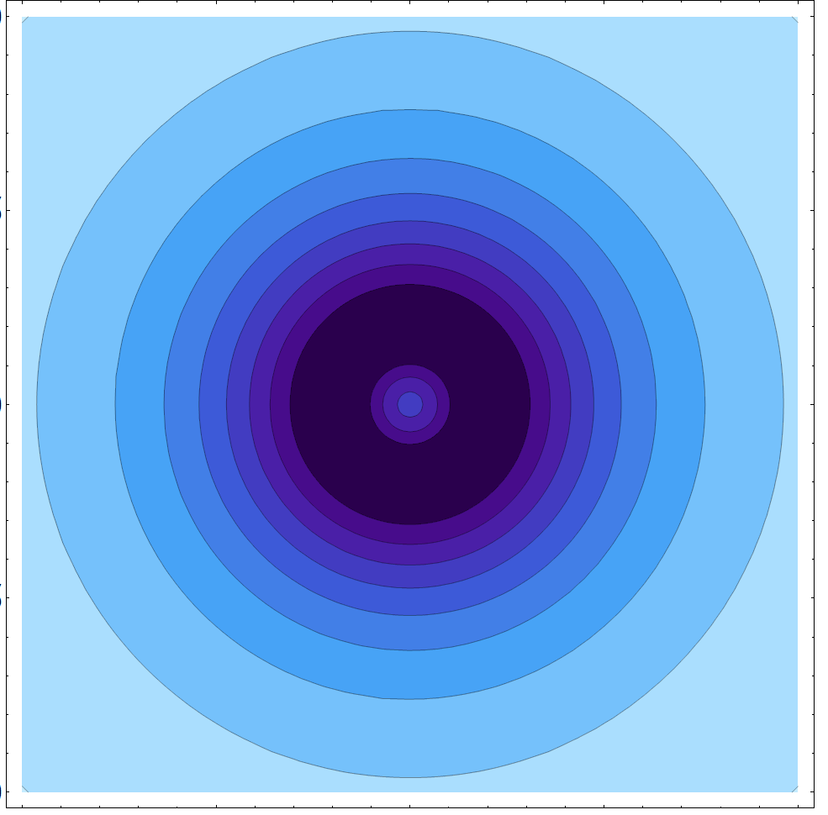
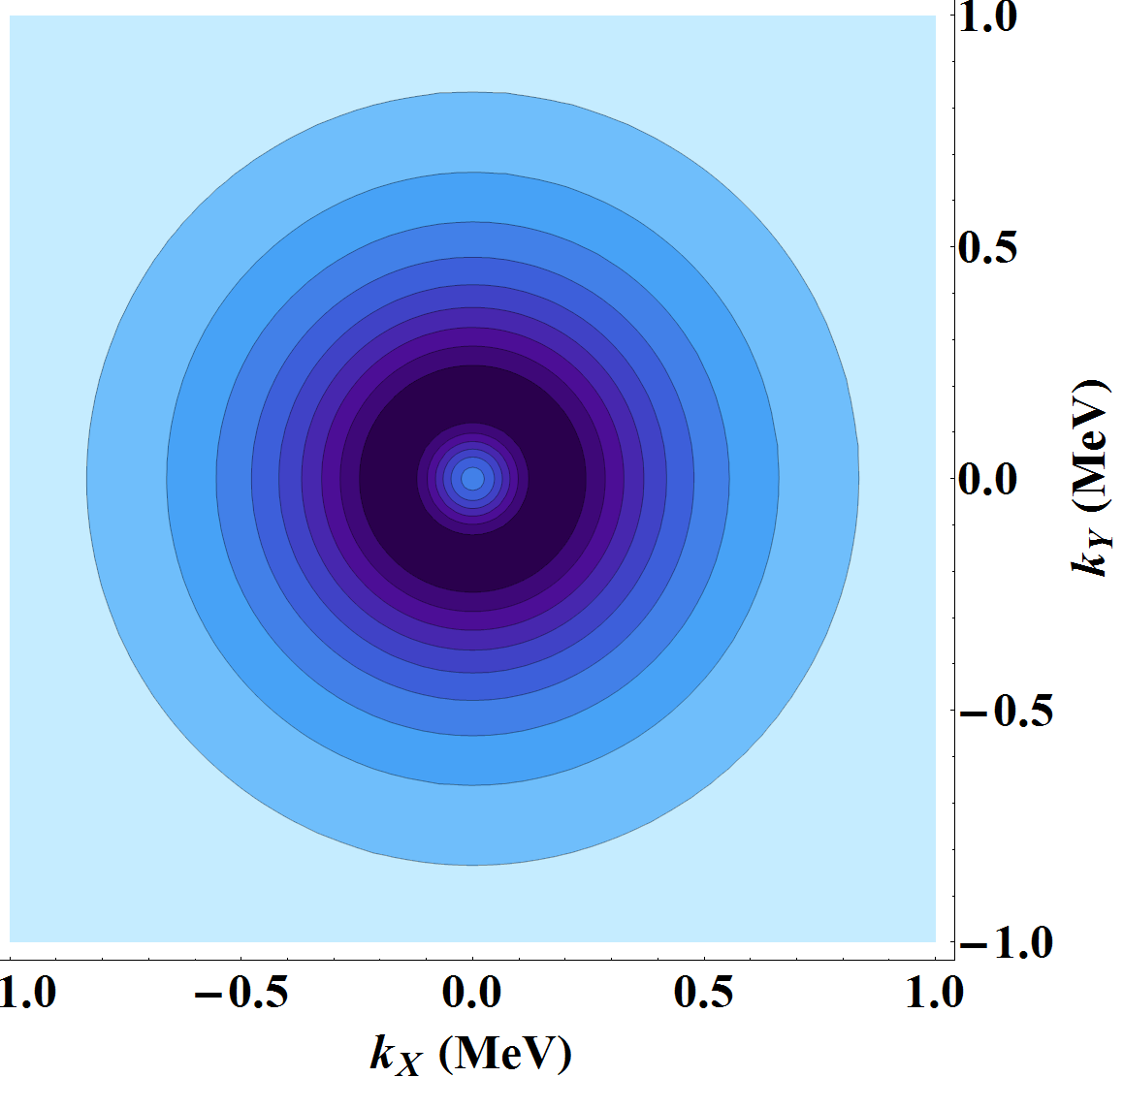
Unpolarized electron in unpolarized electron
$$0.2$$
$$x$$
$$0.5$$
$$0.6$$
14

Slide 22
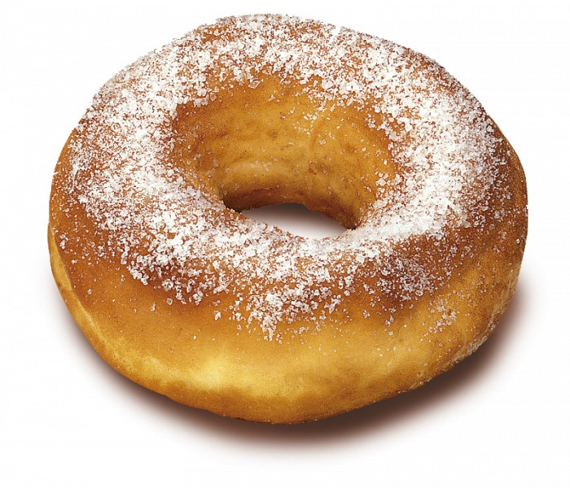
Electron is ring-shaped!
(in momentum space..)
15

Slide 23
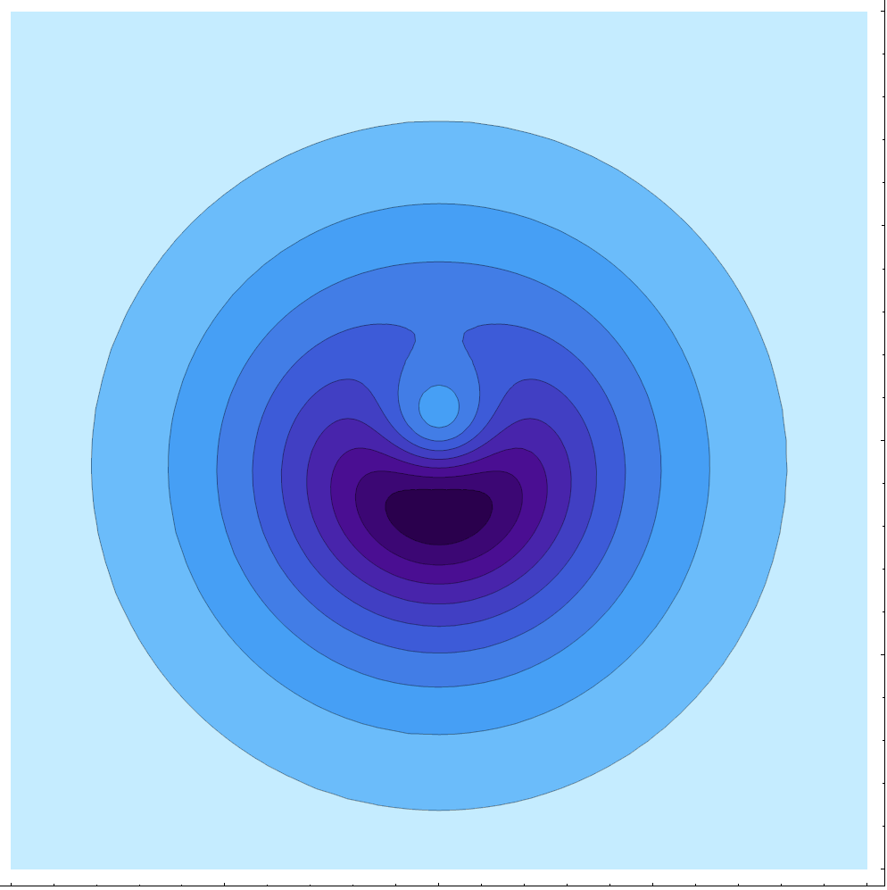
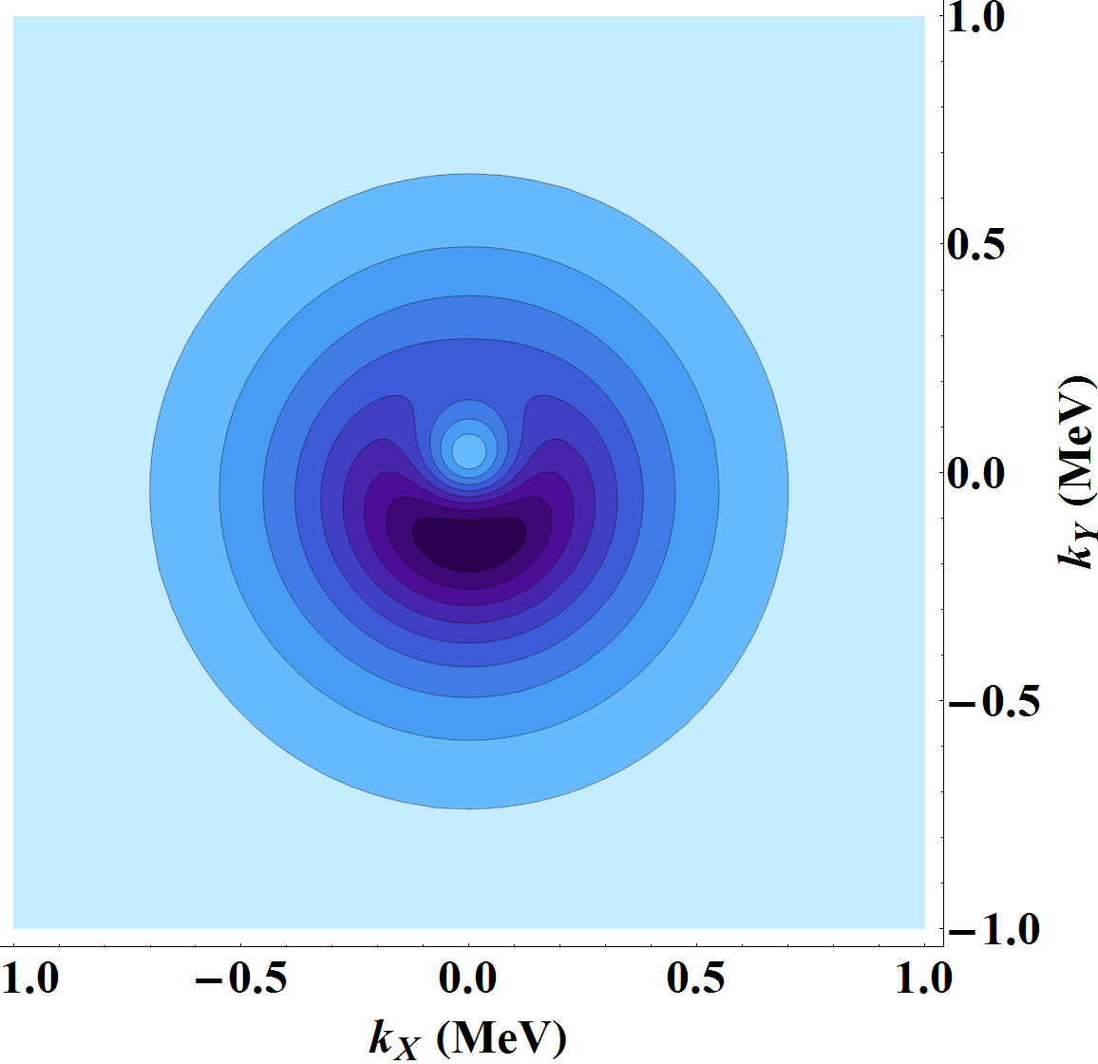
Long. pol. electron in Transv. pol. electron
$$0.2$$
$$x$$
$$0.5$$
$$0.6$$
16

Slide 24
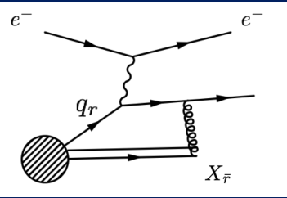
What about PT-odd TMDs?
QCD
Nonzero Sivers asymmetry
See C. Aidala lectures
17

Slide 25
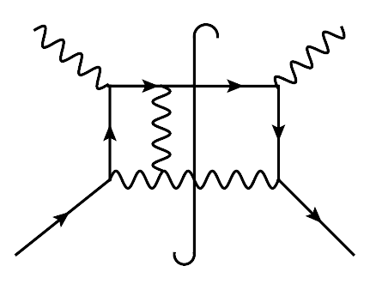
What about PT-odd TMDs?
QCD
QED
Nonzero Sivers asymmetry
$$α^{2}$$
order…probably not at higher order!
See C. Aidala lectures
18

Slide 26
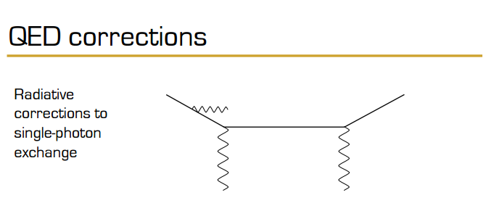
Slides by A. Bacchetta
"Radiative corrections 2016"
Jefferson Lab
Relevant for
12 GeV program!
19

Slide 27
Summary
Parton distributions are meaningful also in QED
They can be studied using light-cone quantization without model assumptions
Applications from a theoretical point of view
20

