Slide 1
Deeply Virtual Compton Scattering on the neutron (n-DVCS)
Hall A
Meriem BENALI
LPC de Clermont Ferrand, France
Faculté des sciences de Monastir, Tunsia
HUGS 2016
May 16

Slide 2
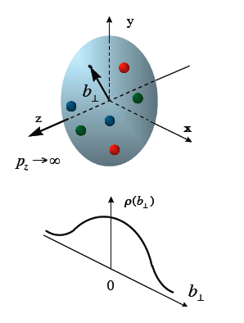
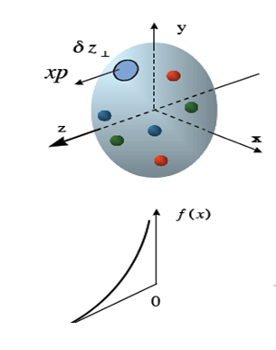
Introduction
Deeply (Q²>>M²) Inelastic (W²>>M²) Scattering (DIS)
Parton Distribution Function ( PDFs)
(Longitudinal momentum distribution of the partons in the nucleon)
Elastic Scattering (W²=M²)
Form Factors
(Transverse position of partons)
Two separate and non-correlated informations about the nucleon structure and they do not allow multi-dimensional description
Some exclusive reactions of deep inelastic scattering (like the DVCS) can measure new quantities: (Generalized Parton Distribution GPDs)
Notes:
Deeply (Q2>>M2) Inelastic (W2>>M2) Scattering
For an elastic process we have (W2=M2)

Slide 3
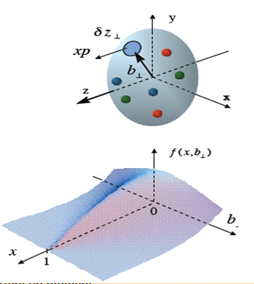
Introduction
Deeply (Q²>>M²) Inelastic (W²>>M²) Scattering (DIS)
Parton Distribution Function ( PDFs)
(Longitudinal momentum distribution of the partons in the nucleon)
Elastic Scattering (W²=M²)
Form Factors
(Transverse position of partons)
GPDs relate :
Spatial parton distribution in the transverse plane (2d)
+
Their longitudinal momentum fraction (1d)
Three-dimensional picture of the nucleon
Notes:
Deeply (Q2>>M2) Inelastic (W2>>M2) Scattering
For an elastic process we have (W2=M2)

Slide 4
Generalized Parton Distribution GPDs
At leading order, 4 GPDs : , , ,
Link to Parton distribution functions (ξ=t=0)
Link to Form Factors ( Ɐ ξ)
= q(x) ; x>0
= - ̅q(x) x<0
= ∆q(x) ; x>0
= ∆̅q(-x) ; x<0
Access to quark angular momentum, via Ji sum rule [X. Ji 1997]:
Solve the problem of the "spin crisis"
??
spin quarks contribution
Spin gluons contribution
Quarks and gluons orbital momentum contributions

Slide 5
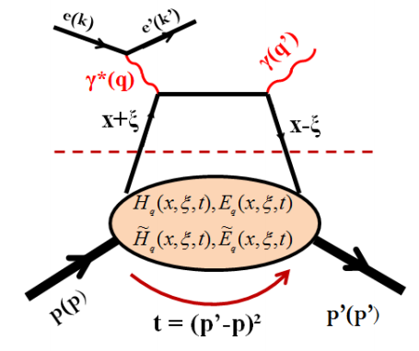
How to measure GPDs ?
Deeply Virtual Compton Scattering (DVCS )
The simplest exclusive process that can be described in terms of GPDs by measuring its
cross section
At Bjorken regime ( )
Bjorken Variable
Perturbative part
(calculable)
: longitudinal momentum fraction
: GPDs skewness invariant
t : squared momentum transfer
Non perturbative
part parameterized by GPDs
The dominant process
(The Handbag diagram)
5
Notes:
Je dois commencer:
In this process the virtual photon interact with a quark of a nucleon having a fraction momentum x+xi, this quark emit a real photon before reintegrating in the nucleon with different momentum fraction, At the bjorken limit difined by …..

Slide 6
Total cross section
Known term
Real part
Imaginary part
The unpolarized cross section accesses the real part of DVCS and the |T^{DVCS}|² term which are sensitive to an integral of GPDs over x
The polarized cross-section difference accesses the imaginary part of DVCS and therefore GPDs at x=±ξ
6
Notes:
experimentally the DVCS process is contaminated by BH process where the real photed emetted by the incident electron the scattered electron. Since the BH term is known. The total cross section …..

Slide 7
Total cross section→GPDs
The unpolarized cross section (using the Belitsky and Mueller formalism)
Interference
A.V. Belitsky, D. Mueller Phys. Rev., D82:074010, 2010
The observable is a linear combination of form factors and Compton form factors :
Compton form factors(CFFs)
Since F2> F1 for the neutron:
GPD

Slide 8
Motivation (DVCS on the neutron)
Measure cross section at different kinematics (2 beam energies)
Separates theI(T^{BH}T^{DVCS}) of DVCS and the |T^{DVCS}|²
Better constrain theoretical models of GPDs
Measure n-DVCS cross section is important
Neutron has different flavors from the proton
Sensitive to GPD E ( The less constrained GPD and which is important to access quarks orbital momentum via Ji’s sum rule)
The E08-025 (n-DVCS) experiment (DVCS on the neutron)
Q² (GeV²) | 1.75
x_{B} | 0.36
E_{beam}(GeV) | 4.45 (Kin2Low) and 5.54 (kin2high)
Target | LH2 and LD2
Notes:
In order to separate the real part of DVCS and DVCS2 and better constrain theoretical models of GPDs we can measure cross section at two different beam energies………..but……… and that is the goal of…

Slide 9
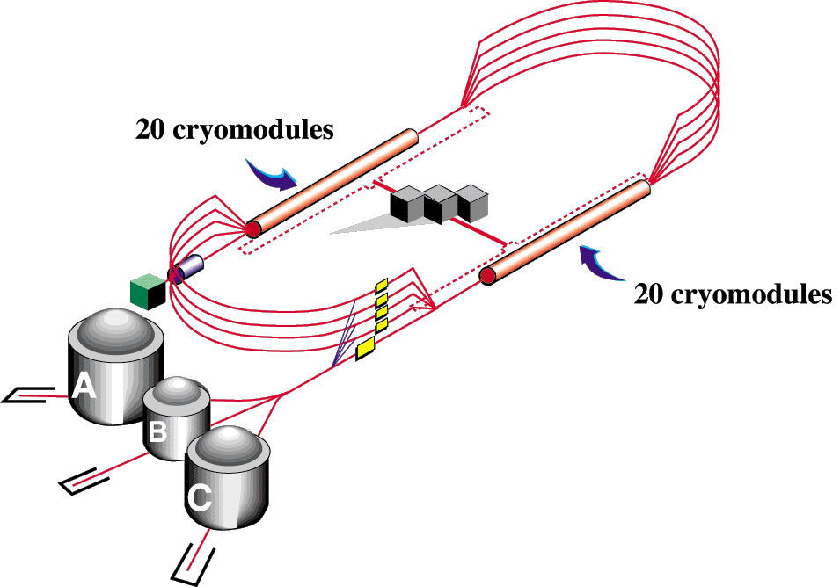
CEBAF
The E08-025 (n-DVCS) experiment was performed at JLab Hall A in 2010.
Goal : Measure the n-DVCS total cross-sections
6 GeV
Hall A at Jefferson Lab
(Newport, Virginia, USA)
E_{beam} = 4.45 GeV and
E_{beam}=5.54 GeV
beam intensity I= 3 µA
Polarisation du faisceau
72% et 76%
Résolution en énergie du faisceau
~10⁻⁴ (expériences de haute précision)

Slide 10
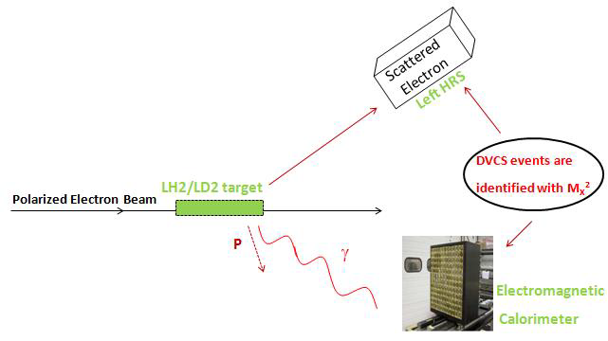
Experimental apparatus
High Resolution Spectrometers
Maximal momentum 4 GeV/c
Momentum acceptance ± 5%
Momentum Resolution ~10⁻⁴
Solid angle ∆Ω 7 msr
Recoil nucleon not detected
Electromagnetic Calorimeter
13x16 PbF₂ blocks (Čerenkov light detection)
Block size: 3x3 cm² x 20 X₀
Each block is connected to (PMT + base + ARS)
The energy deposit determination is based on a wave form analysis of the ARS signals.
The data were taken at two kinematics:
Beam energy = 4.45 GeV & 5.54 GeV
Q² = 1.75 GeV²
x_{Bj} = 0.36
t ~ [-0.5 , -0.1] GeV²
Maximal luminosity = 3. 10³⁷cm⁻²s⁻¹
Blocks blacken under the radiation effect:
→the gains of the blocks decreases
→ Calibrate the response of the EM calorimeter
Notes:
* We used two target In order to extract the nDVCS via difference etween D2-H2.
Th HRS having the following carateritics.
* since the recoil nucleon not detected, the DVCS events are identified with Mx2 technique . It has to be noticed that data were taken at 2 different energie but the same Q2 and XB.
* the blocks darken under the radiation effect so we should calibrate the response electromagnetic calorimetre

Slide 11
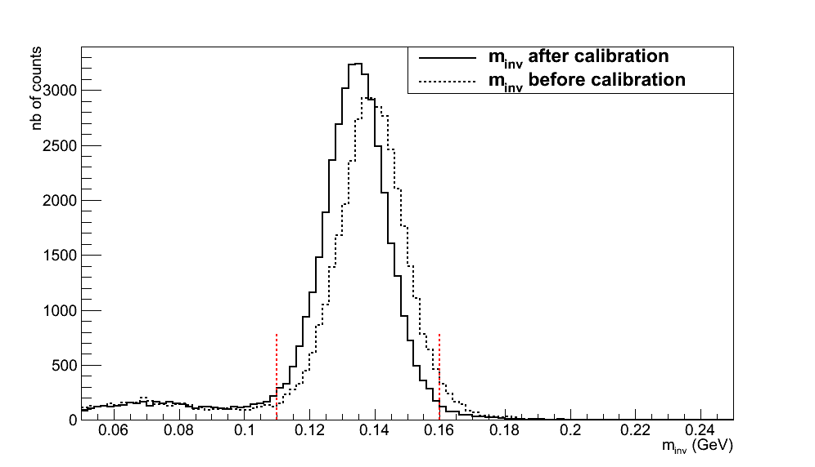
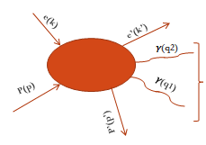
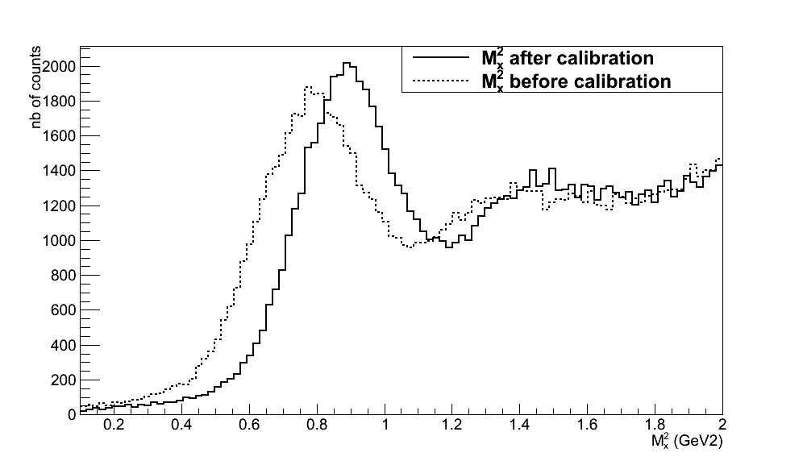
Calorimeter energy calibration
Method: the calibration method is based on the comparison between the measured energy of a
detected π⁰ from H(e,e’ π⁰)p events and its expected energy calculated with its scattering angle.
e N e’ π⁰ N
γ γ
After the minimization we get the calibration coefficients for each block i
Sum over
all events
Calculated energy
of pion
measured energy in one block
Sum over all blocks
Calibration coefficients
To select the H(e,e’ π⁰)p events
Mπ⁰
(Missing mass)² =( k + p - k’ - q1 - q2 )²
Mp²
(invariant mass of two detected photons )²=(q1+q2)²
11
Notes:
** Dire ici; the calorimeter calbraton use the pi0 electroprodution events where the 2 photons coming from the pi0 decays are detected in the calorimeter. The calibration method based on ….
** In order to seelect….
** the chi2 minimazition between the expected pi0 energy and the maseared energy in the block gives these calibration coeffecients.

Slide 12
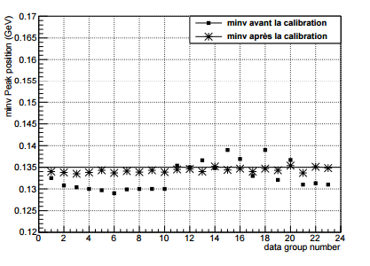
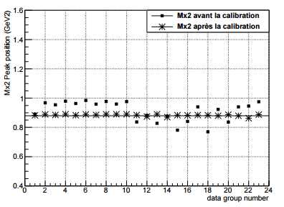
Calorimeter energy calibration
Calibration result
Invariant mass peak position
(Missing mass)² peak position
M_{inv} before calibration
* M_{inv} after calibrationc
M²_{X} before calibration
* M²_{X} after calibration
Kin2_low
Kin2_high
Kin2_low
Kin2_high
M(π⁰)≈ 0.135 GeV
M²p≈ 0.88 GeV²
After the π⁰ calibration we reproduce: the π⁰ mass & the proton mass
Each group number correspond to 1 or 2 days of data taking
This method allows a daily calibration of the calorimeter energy

Slide 13
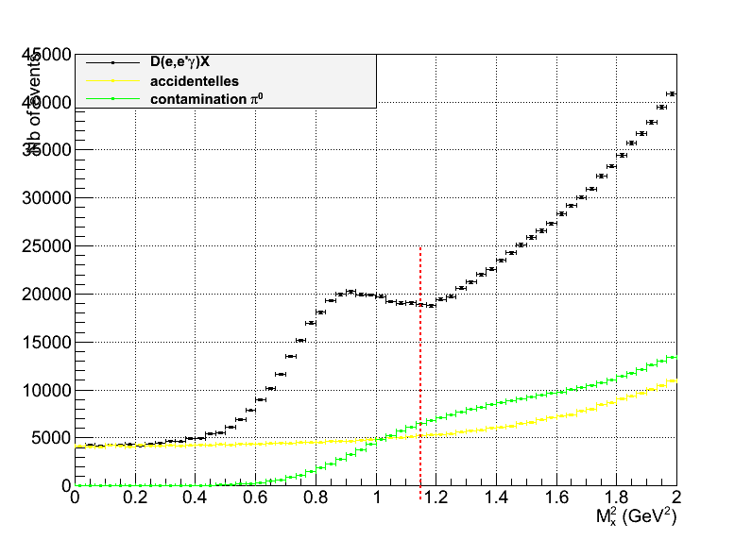
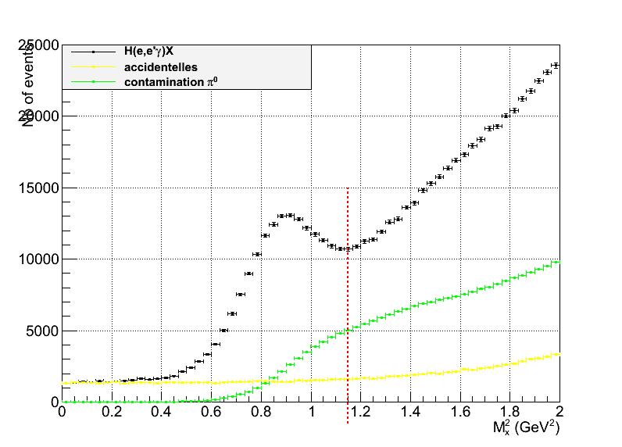
Selection of the n-DVCS events
In order to select the DVCS events:
(Missing mass)²= (e + N - e’ - γ)²
Subtraction of the accidentals
(When the detected photon is fortuitous coincidence with the scattered electron
D(e, e’ γ)X
H(e, e’ γ)X
Subtraction of the π⁰ contamination
(When the detected photon come from the decay of π0 and resemble kinematically to a photon DVCS)
threshold pion production
threshold pion
production
Subtracting the π0 contamination from eN→e π0 X events detected
To ensure the reaction exclusivity
To subtract the channels associated with the DVCS:
eN→e’N’π⁰ γ (M_{X}² ⁼1.15 GeV²)
eN→e’∆γ (M_{X}² ⁼1.50 GeV²)
…
cut at M_{X}² < (M_{N} +M_{π0})²
=1.15 GeV²
Notes:
Il faut parler un peu de la contamination pi0 (lui consacrer un demi slide ou un slide entier s’il le faut sans trop rentrer dans les details : 1 phrase pour dire ce que c’est et pourquoi il faut l’enlever et 1 ou 2 phrases pour dire comment on le determine). Enlever les “+…” dans la derniere equation (mais prepare une reponse sur la contamination par les evts inclusifs si jamais on te pose la question : dire que c’est negligeable sur le deuton (isospin) et qu’on peut la reduire sur le neutron avec une coupure mx2 plus severe)

Slide 14
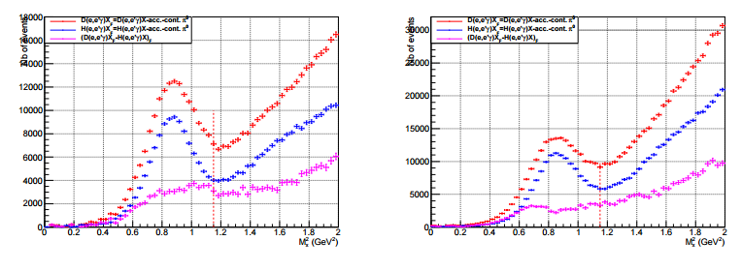
Selection of the n-DVCS events
After
subtracting the accidentals,
subtracting single photons coming from π⁰ decay (π⁰ contamination),
adding Fermi momentum to H2 data,
normalizing H2 and D2 data to the same luminosity,
we obtain the difference (D(e,e' γ)X- H(e,e' γ)X )
__.__ D(e,e’γ)X - acc - π⁰ cont
__.__ H(e,e’γ)X – acc - π⁰ cont
__.__ D(e,e’γ)X-H(e,e’γ)X
Ebeam=4.45GeV
Ebeam=5.54GeV
D(e,e’ γ)X-H(e,e’ γ)X
D(e,e’ γ)X-H(e,e’ γ)X
1.15 GeV²
M_{X}² = 0.95 GeV²
1.15 GeV²
M_{X}² = 0.95 GeV²
M_{X}² (GeV²)
M_{X}² (GeV²)
M_{X}² (GeV²)
14
M_{X}² (GeV²)
Notes:
Dire: af, ter substraction pi0 and accidentals, we add the fermi momentum to H2 data and we normalize the D2 and H2 to the same luminosity

Slide 15
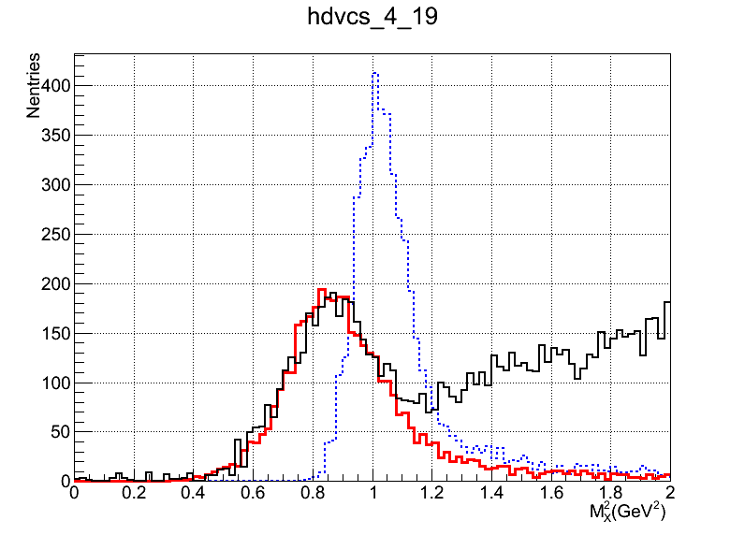
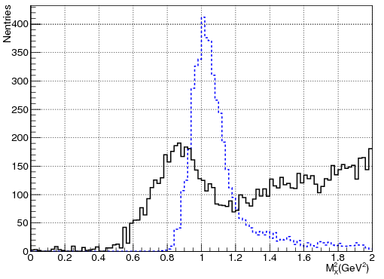
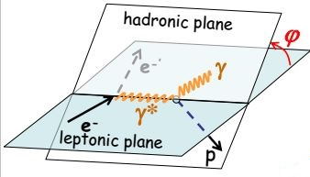
Adjusting the simulation to the experimental data
Experimental data obtained
+
Simulated data:
1- have the same cuts applied to the experimental data
2- have the same resolution and the same calibration that experimental data
Simulation
before smearing
Adjustment :
Simulation
after smearing
Experimental
data
Cross Section
Result of smearing for one bin in (t, φ)
Notes:
In order to extract our cross section we fitted the experimental data by the simulated data, on the simulated events we applied the same cuts than the experimental events and we applied a smearing step in order to obtain the same resolution and the same calibration than the experimental data. I will not explain here the steps of smearing because they are very long and complicated and I haven’t much time. But I show you the result for one exemple bin.

Slide 16
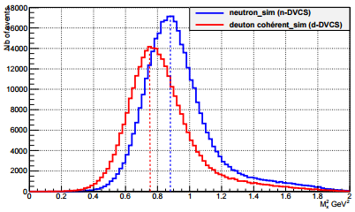
Extraction of the cross section
Binning : 4 bins on t (squared momentum transfer)× 20 bins on φ
Events number in the simulation in one bin at the vertex
luminosity
solid angle
differential cross section
kinematic variables
The unpolarized (nDVCS + coherent dDVCS) total cross section (simplified expression) :
kinematical factor
(DVCS²+I) neutron
Contribution
(DVCS²+I) Coherent deuteron
Contribution
BH _neutron
contribution
BH_coherent deuteron
contribution
___ n-DVCS simulation
___d-DVCS simulation
Calculated with
elastic form factors
Dependence in φ ➔ Separate the different neutron contributions Xin (neutron) (or Xid (coherent deuton))
The observables we want
to extract: these are linear
combinations of CFFS
which contains GPDs (unknown)
t/2
Binning in Mx2 Separate contributions Xin des Xid:
Mx²d ≈ Mx²n+t/2
≈Mn² + t/2
≈Mn²_neutron
A.V. Belitsky, D. Mueller Phys. Rev., D82:074010, 2010
Notes:
The event number in the simulation is function of luminosity, differentiel cross section and solid angle .I remind you that in our expérimental data we have two contribution so our cross section according to the BKM formalism has the following expression, where we have 2 BH contribution …..

Slide 17
Extraction of the cross section
A χ² minimization between the smeared simulation and experimental data:
Binning : 4 bins on t (squared momentum transfer)× 20 bins on φ
Number of experimental events in one bin k
The statistical
errors in one bin k
Events Number in the simulation in one experimental bin e
migration probability of an event at the vertex “v” to an experimental bin “e”
Events Number in the simulation in one
Vertex bin v
The cross section :
Values of the
Notes:
** The smeared simulation reproduce the calibration and the resolution of experimental data.
** The chi2 is between Nsim and Nexp in experimetal bin k
** In order to deduce the cross section

Slide 18
(n-DVCS +d-DVCS) cross section
Experimental cross section and (BH_{neutron}+BH_{deuton})
(D(e,e’γ)X - H(e,e’ γ)X) = (n-DVCS+d-DVCS+BH_{neutron}+BH_{deuton})
< t >=-0.25GeV² , M_{X}²<0.95 GeV²
Ebeam=5.54 GeV
Ebeam=4.45 GeV
PRELIMINARY
Experimental cross section > (n-BH + d-BH)
These results show for the first time the existence of a positive contribution
of n-DVCS (+ d-DVCS) at both beam energies

Slide 19
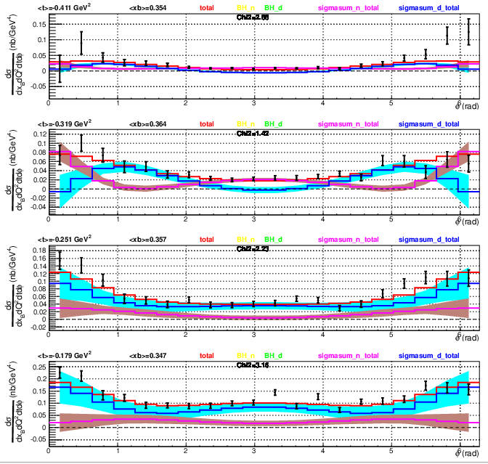
(n-DVCS +d-DVCS) cross section
σ(exp)
σ(fitted)
total neutron contribution
total coherent-deuton
contribution
<t_n>=-0.41 GeV², <t_d>=-0.33 GeV²
<t_n>=-0.31 GeV², <t_d>=-0.26 GeV²
PRELIMINARY
<t_n>=-0.25 GeV², <t_d>=-0.20 GeV²
<t_n>=-0.18 GeV², <t_d>=-0.14 GeV²
Total cross section is small at large | t |
The coherent-deuteron contribution is dominant at small | t |

Slide 20
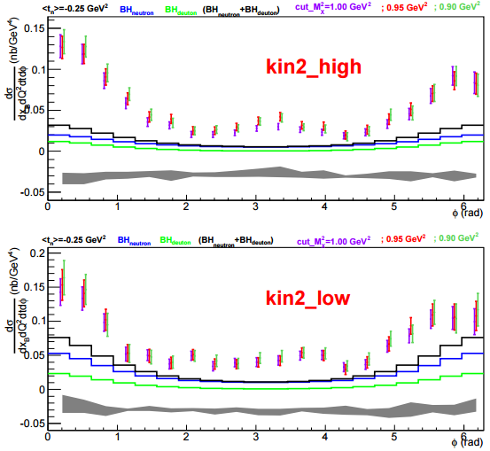
(n-DVCS +d-DVCS) cross section
Stability and systematic errors
PRELIMINARY
results are stable as a function of M_{X}² cut and binning on M_{X}² :
1.00 GeV²
0.95 GeV²
0.90 GeV²
Systematic errors :
* Systematic errors on the normalization (2.7%)
+
* Systematic errors related to the cut on M_{X}²
PRELIMINARY

Slide 21
Conclusion
Extraction of the preliminary experimental cross section (neutron + deuton Coherent)
for two energy beam
These results show for the first time the existence of a positive contribution of
n-DVCS (+ d-DVCS) {Expérimental cross section > (n-BH+d-BH)}:
For two beam energy (Low and High)
For 4 bins in t
For different MX² cuts
For different binning in Mx²
Preliminary estimate for systematic errors
Stability and correlation studies to estimate separately the contributions of n-DVCS and d-DVCS still to be done.
Using these experimental results and theoretical models to constrain GPDs

Slide 22
Thank you for your attention

Slide 23
Back-up

Slide 24
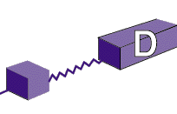
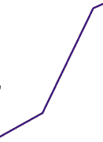
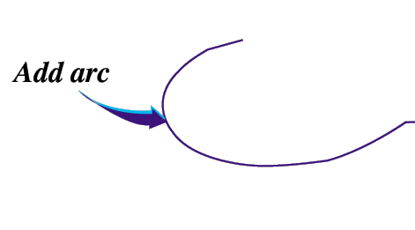
CEBAF
6 GeV Upgrade
12
Increasing beam energy
new experience on the DVCS proton(Q²>2 GeV², xB est variable) running
Unfortunately No n-DVCS experience in Hall A,
DVCS on the neutron in Hall B (using central detector of the neutron in CLAS12)
Hall A at Jefferson Lab
(Newport, Virginia, USA)
E_{beam} = 4.45 GeV and
E_{beam}=5.54 GeV
I= 3 µA
Polarisation du faisceau
72% et 76%
Résolution d’énergie du faisceau
~10⁻⁴ (High precision experiments)
CHL-2

Slide 25
Calorimeter energy calibration
Calibration method
eN → e’ π⁰ N
γ1 γ2
(Detected)
The calibration method is based on the comparison between the measured energy of a
detected π⁰ from H(e,e’ π⁰)p events and its expected energy calculated with its scattering angle:
??
After the minimization we get the coefficients
for each block i
Sum over all events
Sum over
all blocks
Calculated energy of pion
measured energy in one block
(elastically calibrated)
Calibration coefficients
The momentum of π⁰ reconstructed using
Many iterations to get the final coefficients for each block i

Slide 26
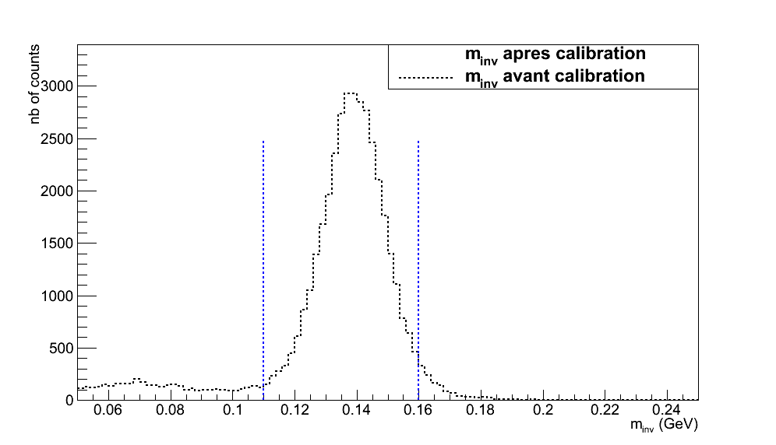
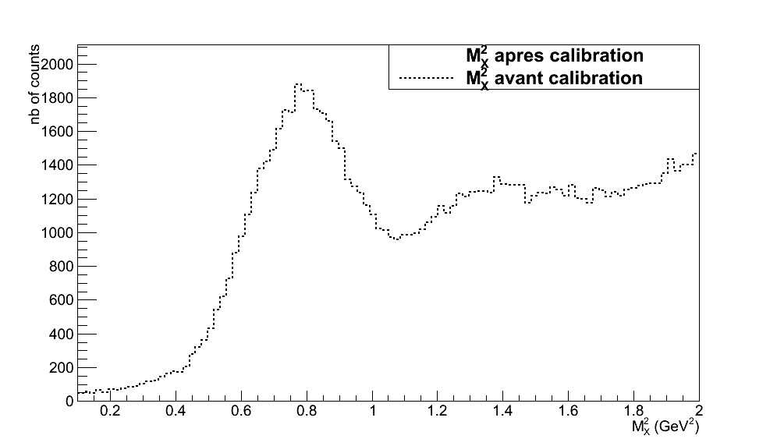
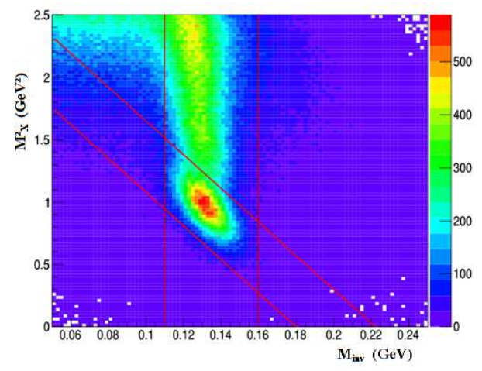
Calorimeter energy calibration
Select the H(e, e’ π⁰)p events
(invariant mass of the tow detected photons )²
M_{inv}²=(q1+q2)²
(missing masse squared)
M_{X}²=( k + p - k’ - q1 - q2 )²
Mp²
Mπ⁰
Correlation between M_{inv} et M_{X}²
Two dimensional cut for select
H(e,e’ π⁰)p events

Slide 27
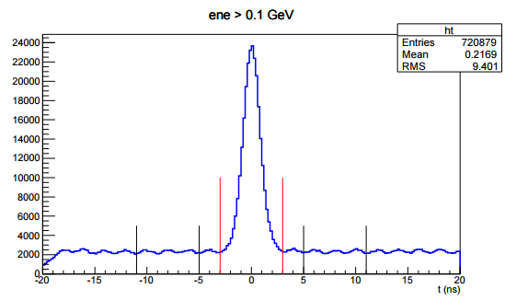
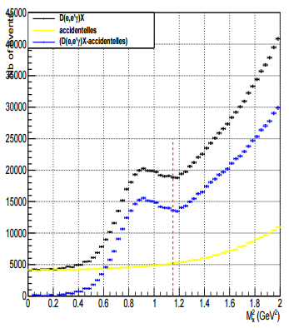
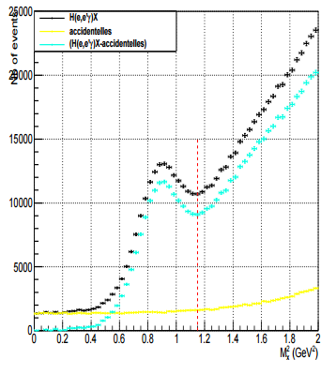
Selection of the n-DVCS events 1- Accidental subtraction
The raw data: e 'and γ are coincident ( eN→e’ γ X)
1 track in the HRS and 1 cluster in the calorimeter (energy> 1 GeV)
→The detected photon may be in fortuitous coincidence with the scattered electron
)
Arrival time spectrum of photons in the calorimeter (ns)
true coincidences
1- selection of accidentals
accidentals
[-3,3]ns: coincidence events(DVCS+ accidentals)
[-11,-5]ns and [5,11]ns : accidentals
2- Accidental subtraction
Spectrum : M_{X}²= (e + N - e’ - γ)²
raw D(e,e’γ)X
raw H(e,e’γ)X
Accidentals
Accidentals
D(e,e’γ)X-accidentals
H(e,e’γ)X-accidentals
41.5%
24.5%

Slide 28
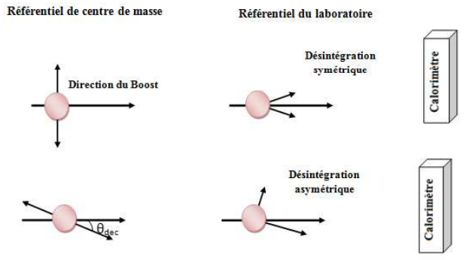
Selection of the n-DVCS events 2- π⁰ contamination subtraction
The photon detected in the calorimeter may come from the decay of π0 and resembles kinematically to a DVCS photon : eN→e’π⁰ X→e’ γ₁ γ₂X
π⁰ decay in γ₁ γ₂
Two clusters events:
eN→e’π⁰ X→e’ γ₁ γ₂X
CM frame Laboratory frame
γ₂
Symmetric decay
Simulation
Direction of Lorentz Boost
γ₂
N_{T} = N_{0γ} + N_{1γ} + N_{2 γ}
γ₁
0 detected
photon
1 detected
photon
2 detected
photons
γ₁
γ₂
Asymmetric decay
γ₂
1 detected photon
=
π0 contamination
γ₁
γ₁

Slide 29
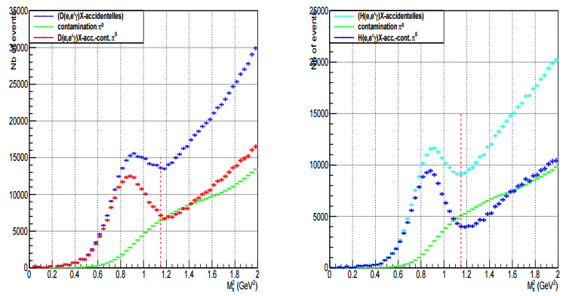
Selection of the n-DVCS events 2- π⁰ contamination subtraction
D(e,e’γ)X-accidentals
H(e,e’γ)X-accidentals
D(e,e’γ)X-accidentals- π⁰ cont.
H(e,e’γ)X-accidentals-cont π⁰
π⁰ contamination 19%
π⁰ contamination
13.27%
M_{X}² = 0.95 GeV²
M_{X}² = 0.95 GeV²
Pion production threshold
Pion production threshold
cut at M_{X}² < (M_{N} +M_{π0})²=1.15 GeV²
To ensure the reaction exclusivity
To subtract the channels associated with the DVCS:
eN→e’N’π⁰ γ (M_{X}² ⁼1.15 GeV²)
eN→e’∆γ (M_{X}² ⁼1.50 GeV²)
…

Slide 30
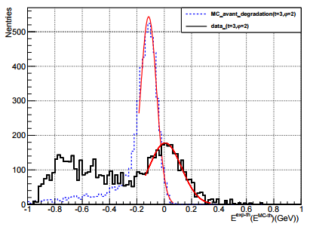
Smearing of the simulation data
Method:
To reproduce the resolution of experimental data, we chose to smear the photon energy
for each event in the simulation by bin on t and φ.
for 1 bin in (t, φ)
fit of the simulation data
by a Gaussian
fit of the experimental data
by a Gaussian
E^{(Exp-th)} (E^{(MC-th)} )
The photon energy in the simulation is smeared by:

Slide 31
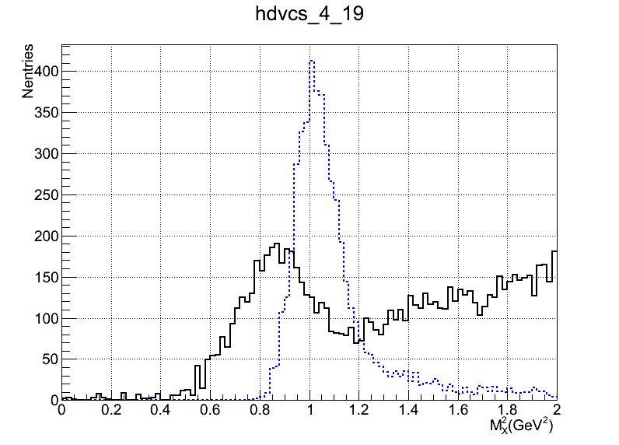
Smearing of the simulation data
Smearing Result
for 1 bin in (t, φ )
Simulation before simulation
Simulation after simulation
Experimental data

Slide 32
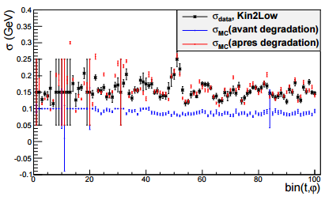
Smearing of the simulation data
Smearing Result
For 5 in t and 20 in φ
Good agreement between the resolution of the data and the simulation for each bin (t and φ)
Good agreement between the calibration of the data and the simulation for each bin (t and φ)
The first 20 bins are rejected (blocks on board of the calorimeter)
The coefficients of the smearing determined with LH2_data and the p_DVCS simulation are then applied to d_DVCS and n_DVCS simulation.
Résolution (largeur du pic)

Slide 33
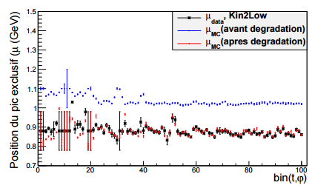
Smearing of the simulation data
Smearing Result
For 5 in t and 20 in φ
Good agreement between the resolution of the data and the simulation for each bin (t and φ)
Good agreement between the calibration of the data and the simulation for each bin (t and φ)
The first 20 bins are rejected (blocks on board of the calorimeter)
The coefficients of the smearing determined with LH2_data and the p_DVCS simulation are then applied to d_DVCS and n_DVCS simulation.
Calibration (position du pic)

Slide 34
Smearing of the simulation data
Smearing Result
For 5 in t and 20 in φ
Good agreement between the resolution of the data and the simulation for each bin (t and φ)
Good agreement between the calibration of the data and the simulation for each bin (t and φ)
The first 20 bins are rejected (blocks on board of the calorimeter)
The coefficients of the smearing determined with LH2_data and the p_DVCS simulation are then applied to d_DVCS and n_DVCS simulation.
Calibration (position du pic)
The first 20 bins are rejected

Slide 35
Smearing of the simulation data
Smearing Result
For 5 in t and 20 in φ
Good agreement between the resolution of the data and the simulation for each bin (t and φ)
Good agreement between the calibration of the data and the simulation for each bin (t and φ)
The first 20 bins are rejected (blocks on board of the calorimeter)
The coefficients of the smearing determined with LH2_data and the p_DVCS simulation are then applied to d_DVCS and n_DVCS simulation.
Calibration (position du pic)
The first 20 bins are rejected

Slide 36
Extraction of the cross section
Binning : 4 bins on t (squared momentum transfer)× 20 bins on φ
Events number in the simulation in one bin at the vertex
luminosity
solid angle
differential cross section
kinematic variables
The unpolarized (nDVCS + dDVCS) total cross section (simplified expression) :
Facteurs cinématiques
(DVCS²+I) neutron
Contribution
(DVCS²+I) Coherent deuteron
Contribution
BH _neutron
contribution
BH_coherent deuteron
contribution
___ n-DVCS simulation
___d-DVCS simulation
Calculated with
elastic form factors
Dependence in φ ➔ Separate the different neutron contributions Xin (neutron) (or Xid (coherent deuton))
The observables we want
to extract: these are linear
combinations of CFFS
which contains GPDs (unknown)
t/2
Binning in Mx2 Separate contributions Xin des Xid:
Mx²d ≈ Mx²n+t/2
≈Mn² + t/2
≈Mn²_neutron

Slide 37
Extraction of the cross section
According to the formalism of Muller Belitsky and the differential cross section is:
Terme connu
1
2
9 Contributions !! ( we can’t fit everything)
3
A.V. Belitsky, D. Mueller Phys. Rev., D82:074010, 2010
Notes:
Nous ne pouvons pas fitter tout avec nos condition cinématiques, 1 bin en Q², xB fixe ..

Slide 38
A.V. Belitsky, D. Muller Phys. Rev., D82:074010, 2010
9 CFFs for the neutron
9 CFFs for the coherent deuton
18 Contributions !!
( we can’t fit everything)
In the new BKM Formalism we have:
3 X_{in} = Re(C^{I})_{n} , Re(C^{I}_{Feff})_{n} , C_{n}^{DVCS}
We chose to fit only 6 CFFs:
AND
3 X_{id} = Re(C^{I})_{d} , Re(C^{I}_{Feff})_{d} , C_{d}^{DVCS}
BUT:
These coefficients X_{in} and X_{id} are effective coefficients
AND
These coefficients are not stable (event if the χ² of the fit is good) as a function of:
Cut on Mx²
the binning on Mx²
The number of contributions to fit
Only the BH_contributions and the total experimental cross section will be shown
Notes:
For all the reasons, I will not show you these extracted coefficients, I will show you just the BH_contributions and the total experimental cross section wich are , of course, stable and independing of the cut.

Slide 39
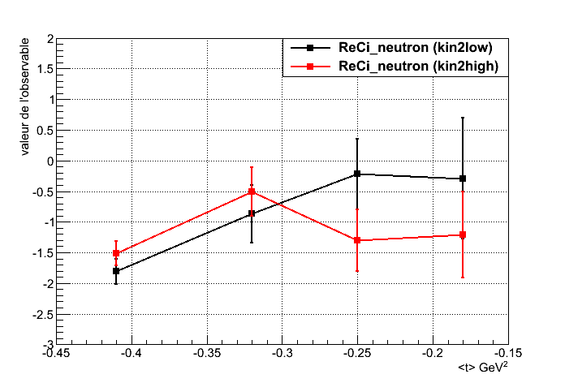
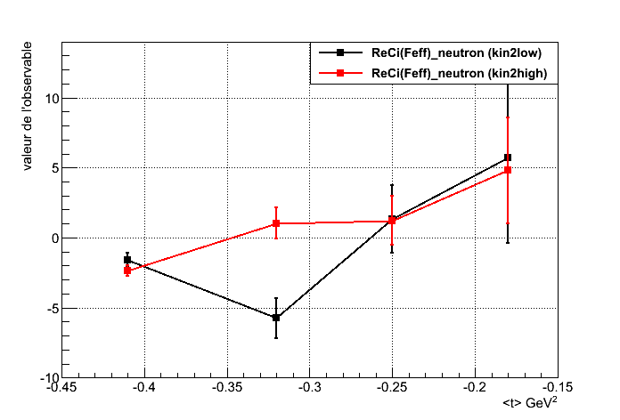
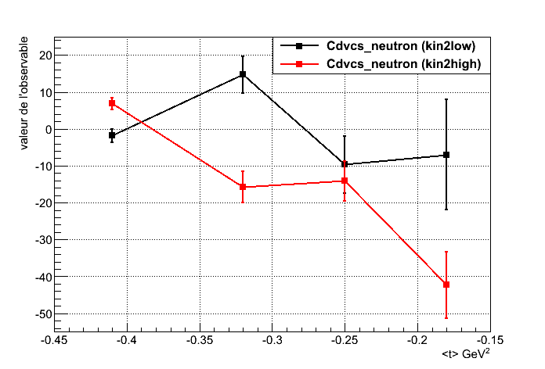
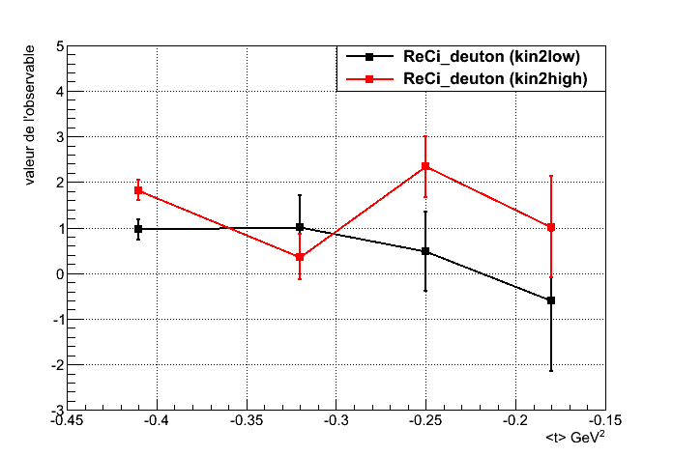
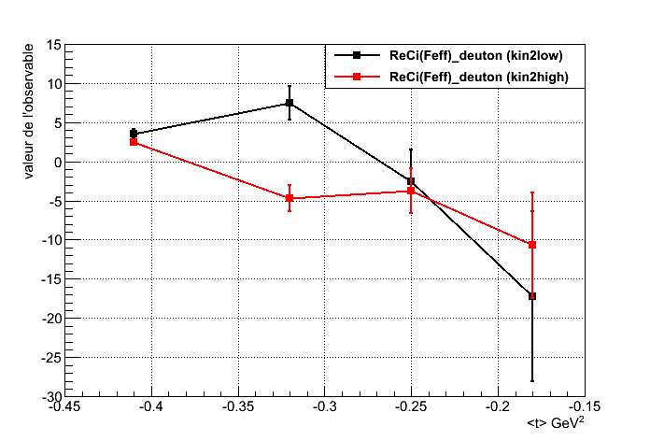
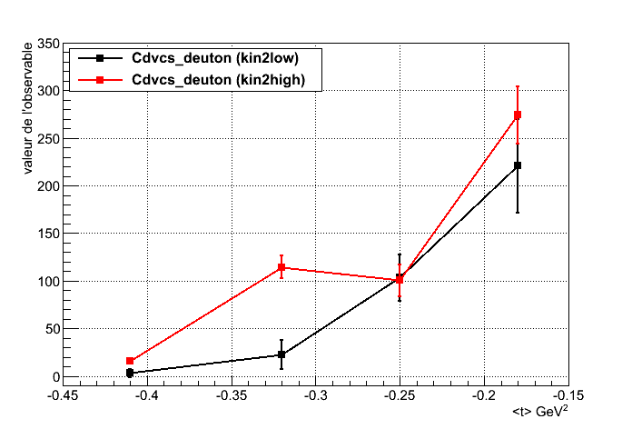
Observables: 3 X_{in} = Re(C^{I})_{n} , Re(C^{I}_{Feff})_{n} , C_{n}^{DVCS}/// Re(C^{I})_{d} , Re(C^{I}_{Feff})_{d} , C_{d}^{DVCS}
----- Kin2low ---- Kin2hign,
Re(C^{I})_{neutron}
C^{DVCS}_{neutron}
Re(C^{I}_{Feff})_{neutron}
Valeur de l’observable
<t> GeV²
<t> GeV²
<t> GeV²
Re(C^{I})_{deuton}
C^{DVCS}_{deuton}
Re(C^{I}_{Feff})_{deuton}
<t> GeV²
<t> GeV²
<t> GeV²

