Slide 1
GEANT4 and Pion Photo-production in the intermediate energy regime at Jefferson Lab
Sokhna Bineta Lo Amar
Advisor: Prof. Oumar Ka, UCAD
Co-Advisor: Dr. Paul Guèye, Hampton Univ./JLab/FRIB
Cheikh Anta Diop University, Dakar (Sénégal)
HUGS_2016

Slide 2
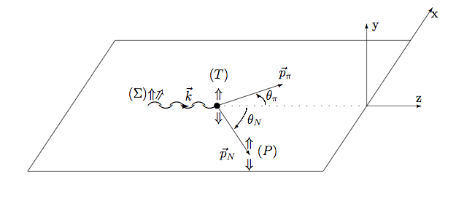
Introduction
Pion photo-production : alternative method for probing the matter
Electromagnetic and hadronic Interactions combined
⬅
In the intermediate energy regime
GEANT4,
tool for simulation and data analysis
Validate G4 physics using Jlab data in the GeV range
Resonances identified
Notes:
Pourquoi as-tu enlevé la mention “(1 ~ 30 GeV)”?

Slide 3
Outline
GEANT4 Overview
Cross section comparison
Data comparison analysis
Results
Total cross sections simulation
Differential cross sections simulation
Angular distribution
Total cross section integrated
Energetic distribution
Conclusion & perspectives

Slide 4
GEANT4 Overview (1/4)
GEANT4 : GEometry ANd Tracking 4
Developed and maintained by an international collaboration
Purpose: simulate the interaction between particle and matter
Application: high-energy, nuclear, space and material sciences to medical physics
Ingredients
Large flexible set of models for physical interactions of leptons and hadrons
Electromagnetic and hadronic processes (both elastic and inelastic)
Range : eV to TeV
Extensive support of geometry and visualization tools + advanced scoring and tracking options

Slide 5
GEANT4 Overview (2/4)
Interactions in GEANT4 as a physical process and its associated model(s);
Two distinct packages: electromagnetic physics and hadronic physics;
Photo-and lepto-nuclear interactions in a hybrid process;
Hadro-nuclear interaction in a hadronic process
electromagnetic
hadronic
e+/-, γ, ions
fragmentation

Slide 6
GEANT4 Overview (3/4)
Tens of categories of hadronic models (Geant4 .9.6.p02)

Slide 7
GEANT4 Overview (4/4)
Different models considering incidents particles

Slide 8
Cross sections comparison (1/3)
Jefferson Lab: Pion photo-production experimental data from Hall B
Comparison: PDG and GEANT4 (CHIPS & BERT)
PDG: Particle Data Group
Large collaboration aimed at summarizing data for particle physics and related fields
Database that includes various compilations and evaluations of elementary particles properties
Comparison: GEANT4 and SAID+Jefferson Lab experimental data
SAID: Scattering Analysis Interactive Dial-in
(Phenomenological model driven from world-wide experimental data and maintained by GWU)
Notes:
Voir avec Paul : “Large collaboration aimed at summarizing data for particle physics and related field”

Slide 9
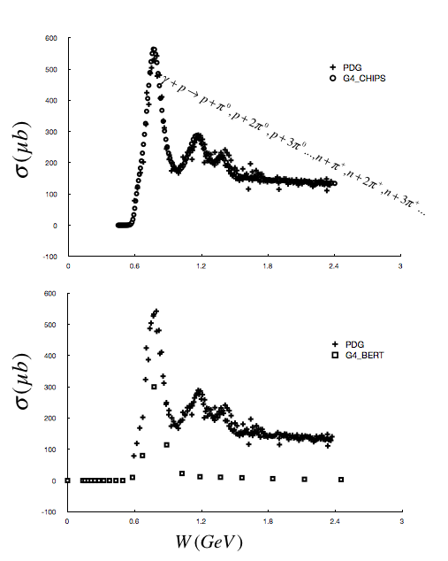
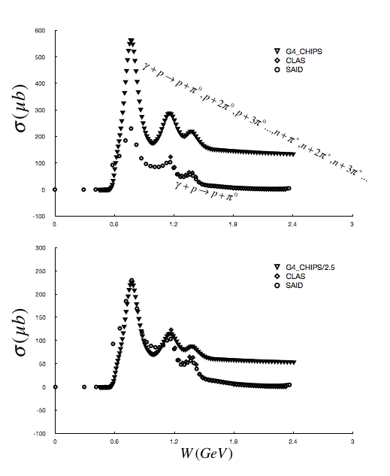
Cross sections comparison (2/3)
Total Cross Sections
PDG/CHIPS
CLAS/SAID/CHIPS
PDG/BERT
CLAS/SAID/CHIPS
Δ
N*
G4_CHIPS
fits perfectly with PDG;
reproduce correctly the experimental resonances (G4_CHIPS/2.5)

Slide 10
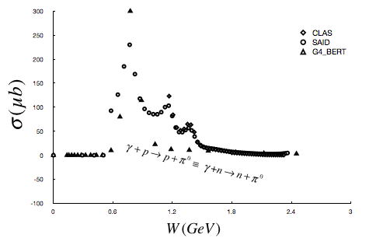
Cross sections comparison (3/3)
G4_BERT
Describes relatively well Δ resonances but few data in this range
Limitation: same results for photo-production of γ(p,p)π⁰ and γ(n,n)π⁰
More simulation and comparison with data using this model is highly desirable

Slide 11
Data comparison analysis(1/2)
Generate 2 histograms with same binning
Perform χ² minimization
Follow the prescription from Gagunashvili
N. D. Gagunashvili, Chi square goodness of fit tests for weighted histograms, Journal of Instrumentation 10 (2015) P0500
Check normalized residuals for low statistics issue
Notes
Example: total cross section CHIPS vs. PDG
Similar approach for all work:
Geant4 vs. SAID
Angular & energy distributions

Slide 12
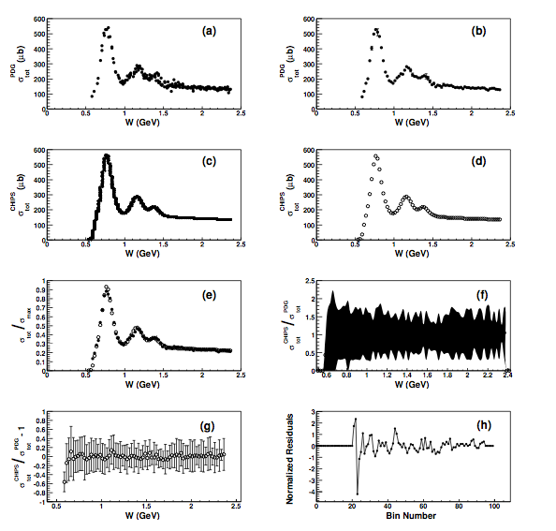
Data comparison analysis(2/2)
Original
Rebin
PDG
•
Original
Rebin
CHIPS
○
PDG & CHIPS
Normalized

Slide 13
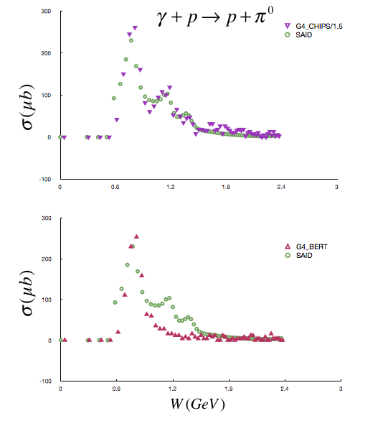
Results Total Cross section simulation
G4_CHIPS
Confirmation that CHIPS describes very well the fitting model, hence the experimental data
Simulation is improved but over estimation with a smaller coefficient
Lots of fluctuations after the second resonance
(see differential cross section simulation)
G4_BERT
Tabulated data fit with simulation results
Geant4 database only for protons
Recommendation: do not use for neutrons

Slide 14
Results Differential Cross section simulation (1/4)
JLab experiments total cross sections : obtained from Σdσ/dΩ
Differential cross section : generated both angular and energetic distributions
Objective : detailed comparison between Geant4 and Jlab/SAID data for σ_{Tot} and dσ/dΩ
→ simulate number of events under scattering angle theta in the lab frame
From the kinematics data, we calculate theta in the center of mass frame following the relation
Differential cross section calculated for :
a given energy and variable angle: angular distribution
a given angle and variable energy: energetic distribution
Notes:
“to perform the preview results of total cross section simulated” je ne suis pas sûr de savoir ce que tu veux dire…
Formule à reformater

Slide 15
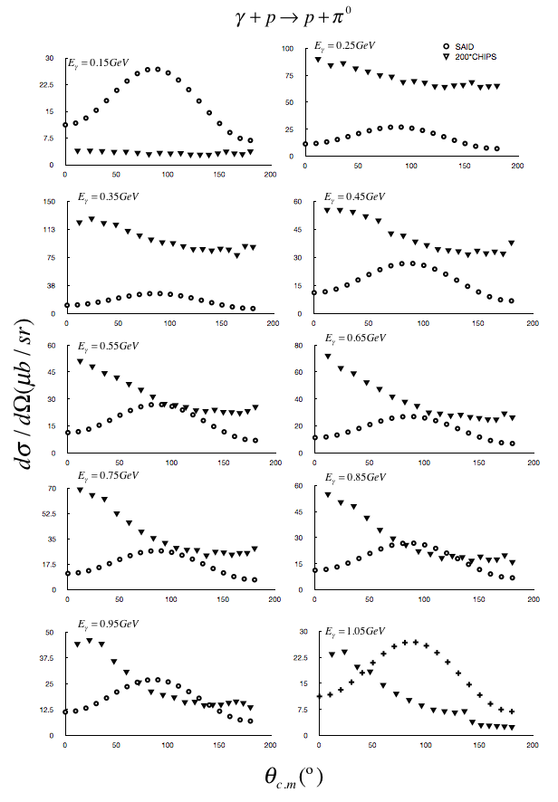
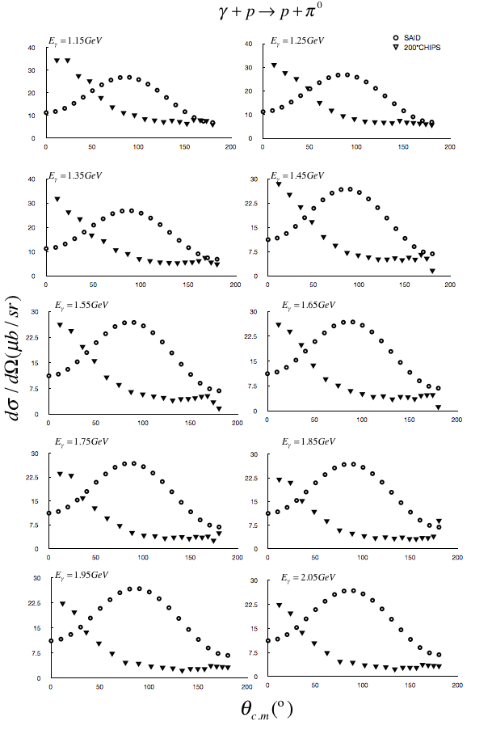
Differential Cross section simulation (2/4) Angular Distributions
“Low Energy”
“High Energy”
Very different distributions!!

Slide 16
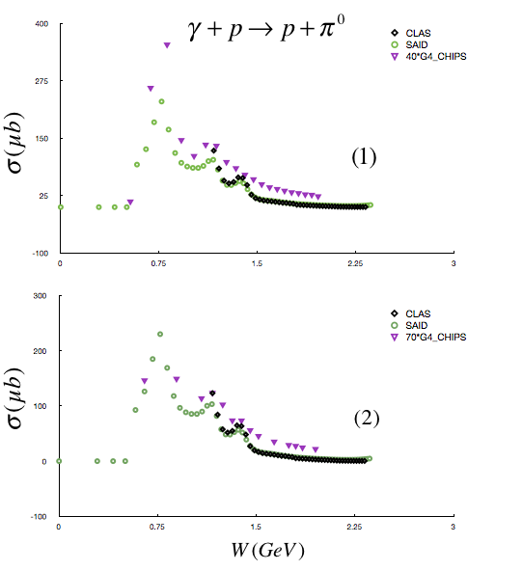
Differential Cross section simulation (3/4)
(1)
Different binning
Differential cross section integrated over scattering angles
(1): Third resonance not well-described
Energy step used is not the same as Jlab
(2): Rebinning shows good agreement
In process …
(2)
Same binning
Notes:
Je ne suis pas sûr de comprendre ce que tu veux dire par “ that is why we simulate back in the experimental conditions”

Slide 17
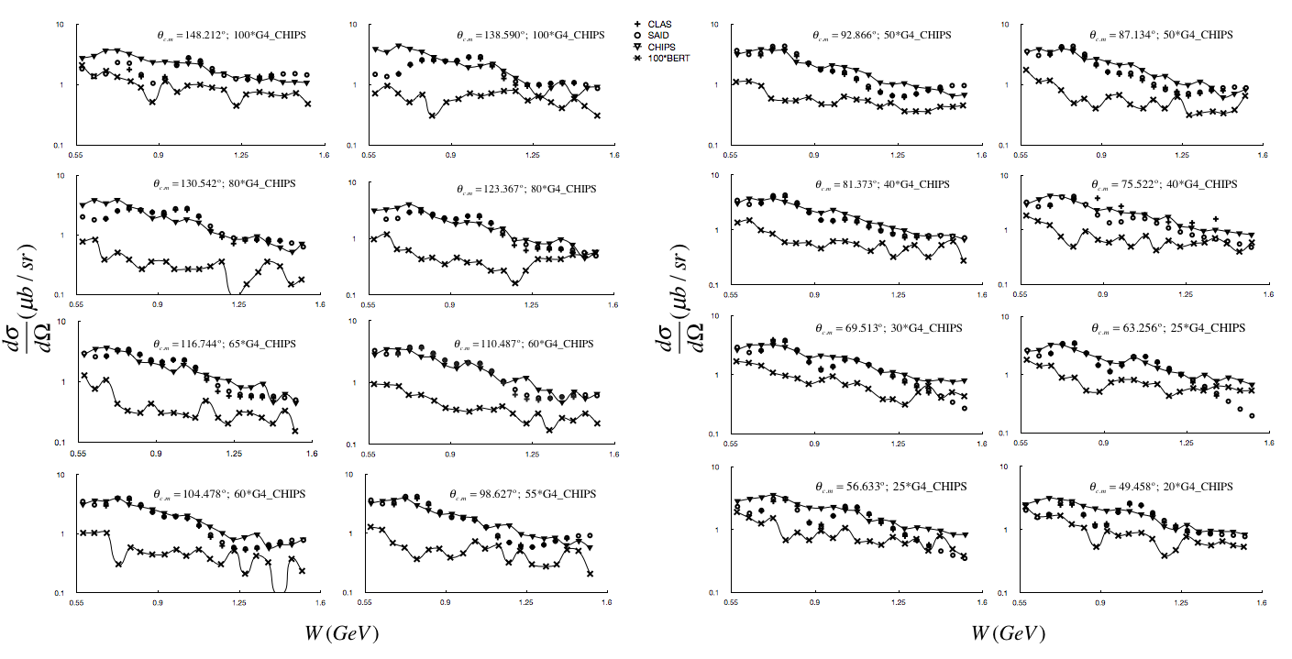
Differential Cross section simulation (4/4) Energy Distributions
Backward Angle
Forward Angle
Preliminary

Slide 18
Conclusion & Perspectives
Conclusion
Study of pion photo-production off hydrogen in Geant4 using JLab/SAID data
Comprehensive comparison of differential and total cross sections
Qualitative analysis: seems OK – Quantitative: with chi-square (next step)
CHIPS model: reasonable in the intermediate energy range
BERT model: necessary to perform more comparison/improvement
Perspectives
Finish the simulation for the proton target (in progress)
Same exercises for the neutron target (very near future)
Applications to heavier targets (if time allows it)
Provide recommendation for the use of Geant4 models in mesons photo-production within the intermediate energy regime
Thesis defense: December 2016!!

